Slide 1
To-do list for IDRC review – Performance related
Impact of Beam Induced Background
  Simulation of Incoherent Pairs Creation
  Map for magnetic field: non-uniform B field, anti-solenoid
Impact of Material Budget Change
  Beampipe, VTX, supporting tube
Muon Requirement and Performance
  Standalone muon efficiency
Evaluate photon mis-ID (from pi0) in Z->ττ
W mass – motivation for WW threshold scan
Mingshui Chen, August 15th, 2025, CEPC Day

Slide 2
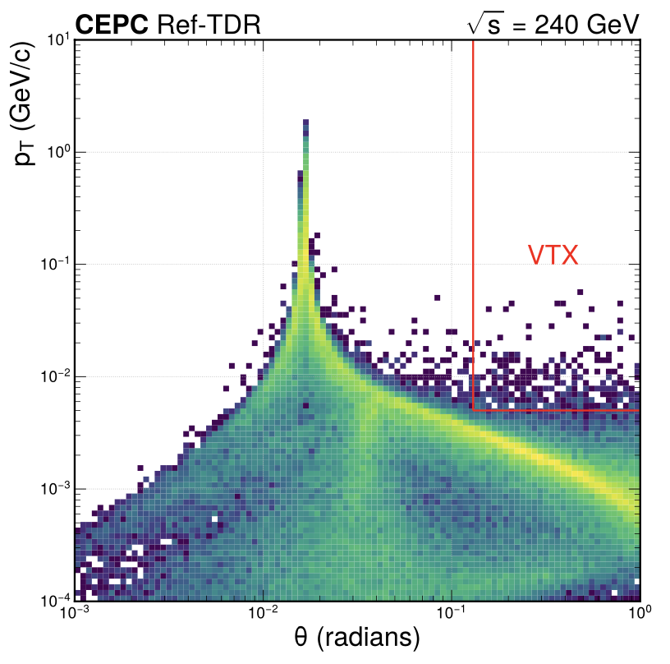
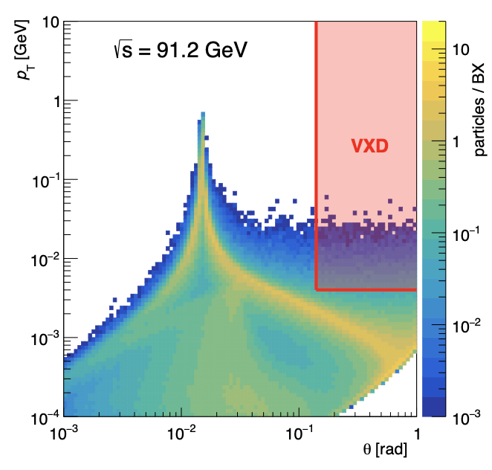
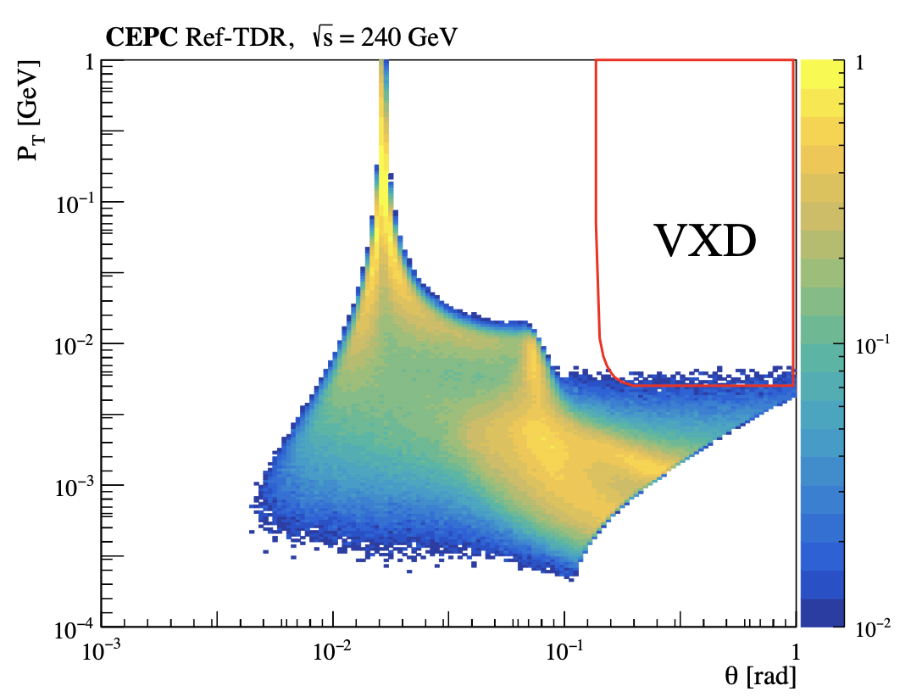
BIBs: incoherent pair creations
ESPP, 2025
Old version with bugs
Latest version
FCC-ee
Checks done by Chenguang Zhang, Xiaotian Ma, and MDI team
  Bug fix in the beam crossing angle, and electron energy threshold reduced to 0.511 MeV
  Speed improved by two orders of magnitude (5 minutes vs. 10 hours for one bx simulation)
    New framework, and no slicing on the time dimension
More statistics needed, also tests being performed with various magnetic fields

Slide 3
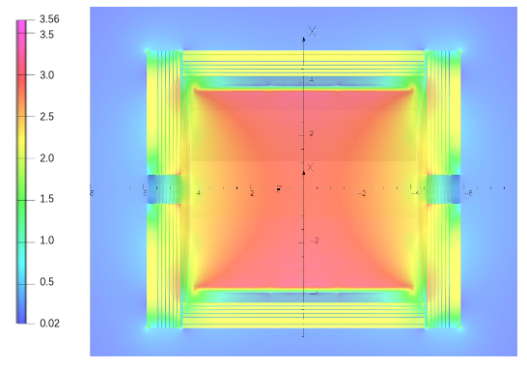
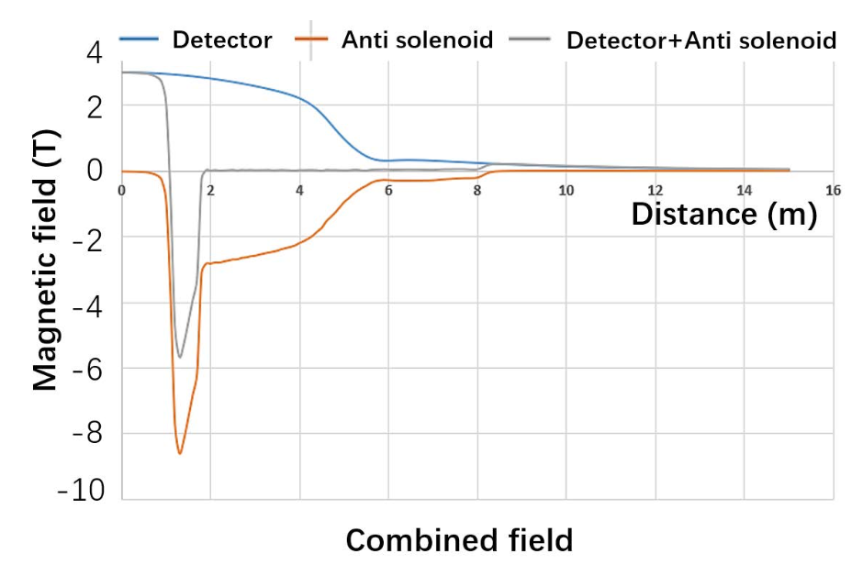
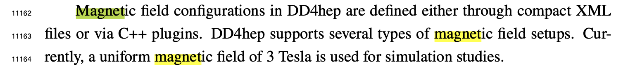
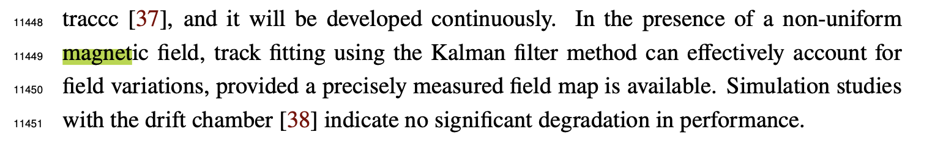
Magnetic Field
Current CEPCSW: 3 T uniform B-Field assumed inside coil only
  Different from actual map
  Also no anti-solenoid
Definitely need correct map for beam induced background studies
Not clear if full map is needed for physics studies
  No significant degradation for tracking mentioned in software chapter currently
Simulation and reconstruction with full map probably takes much more resources
Plan to have tracking performance re-evaluated if possible
Figure 10.14
Figure 10.22
Actual map in magnet chapter

Slide 4
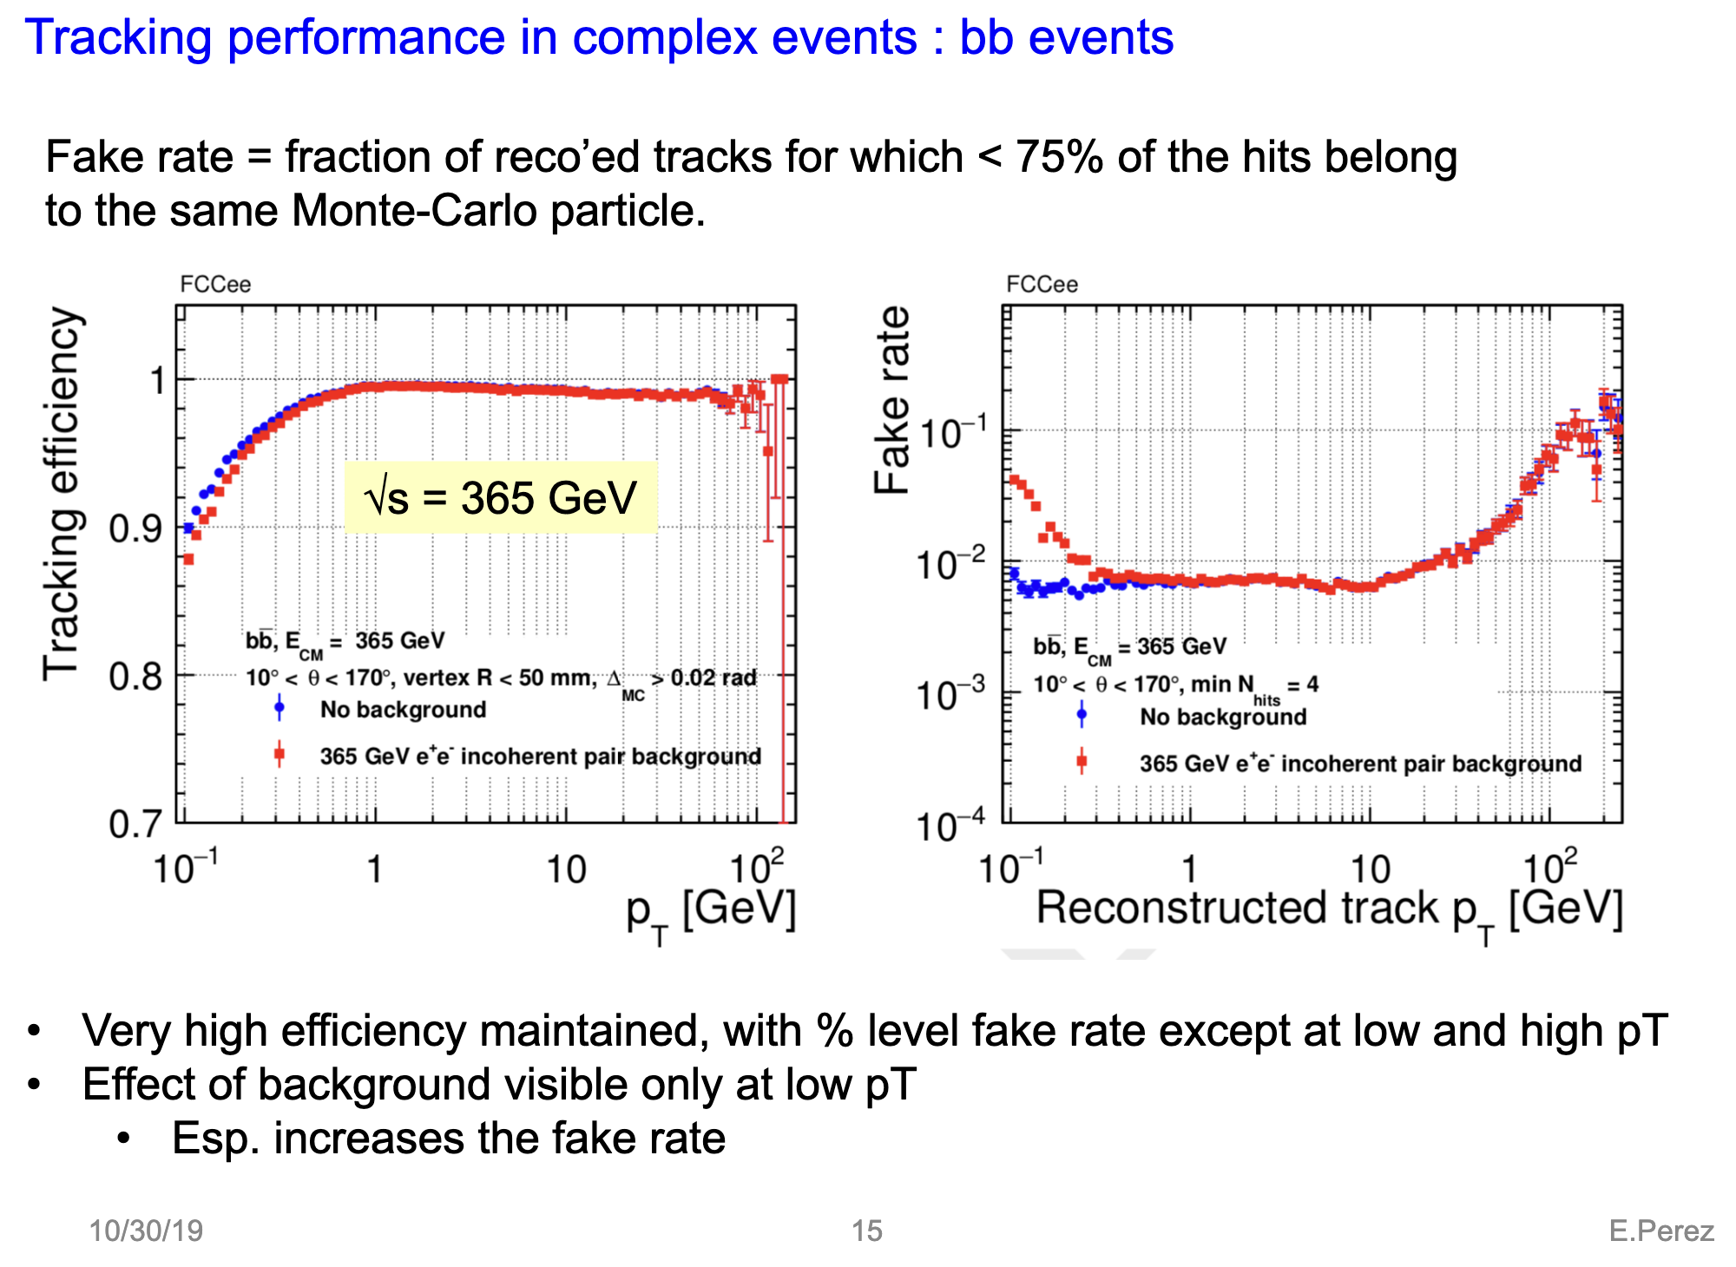
Impact on tracking from BIBs @ FCC-ee
https://agenda.linearcollider.org/event/8217/contributions/44773/attachments/35054/54232/LCWS2019_Perez.pdf
Currently, we see negligible effect on tracking efficiency in CEPC simulation.
Need double check with next proper CEPCSW release

Slide 5
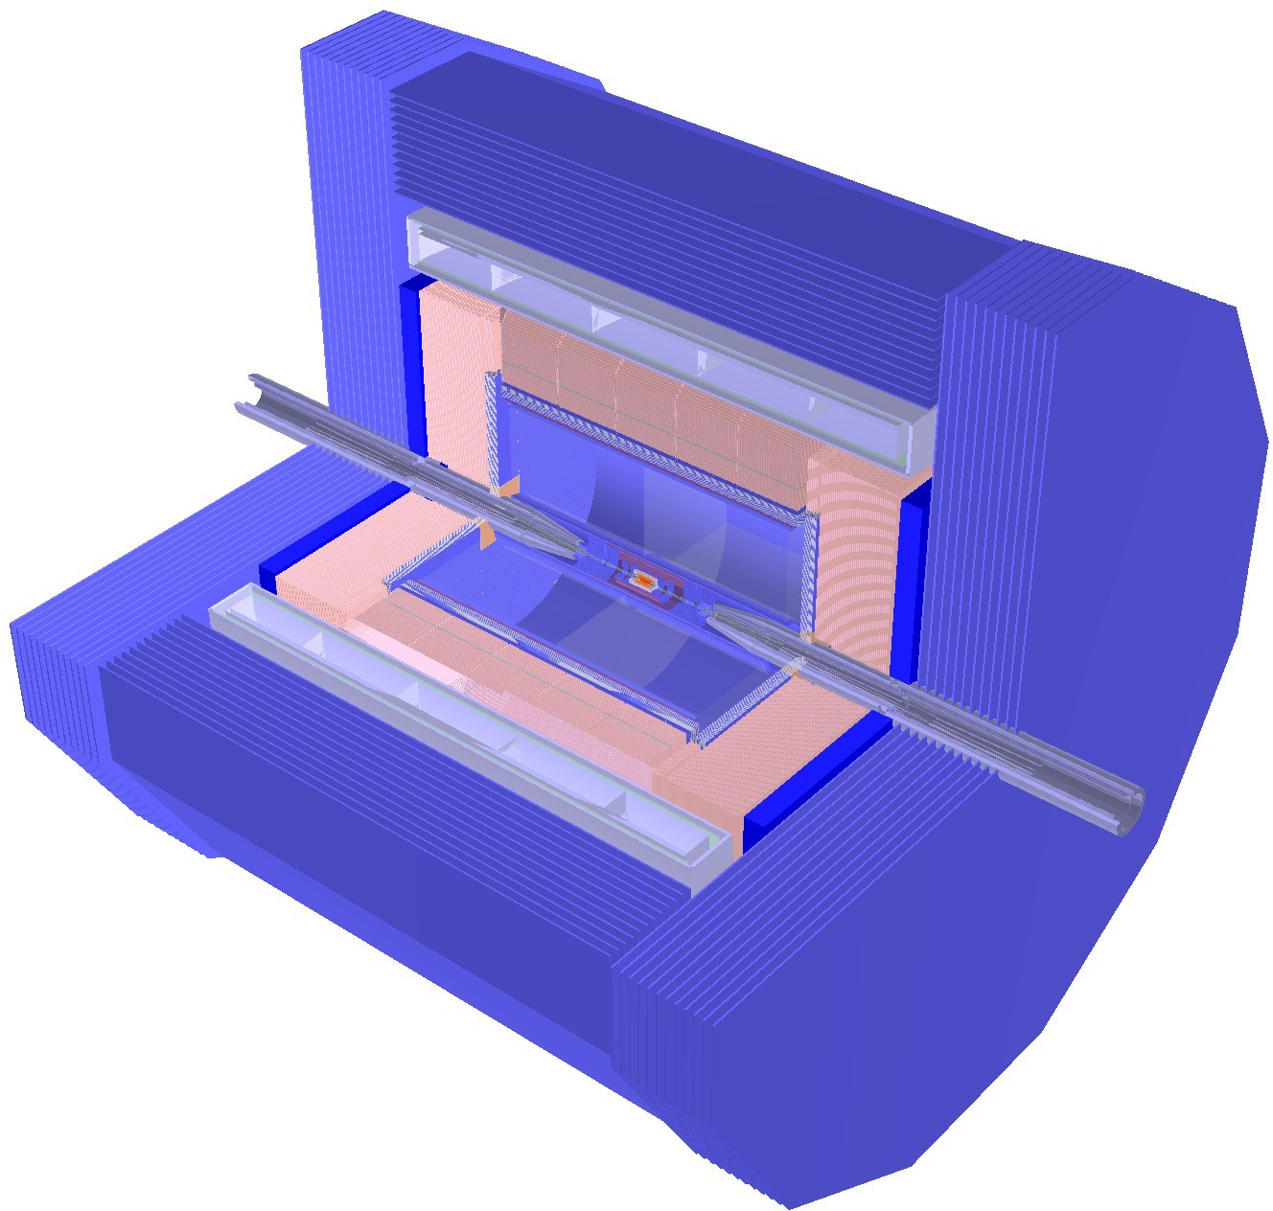
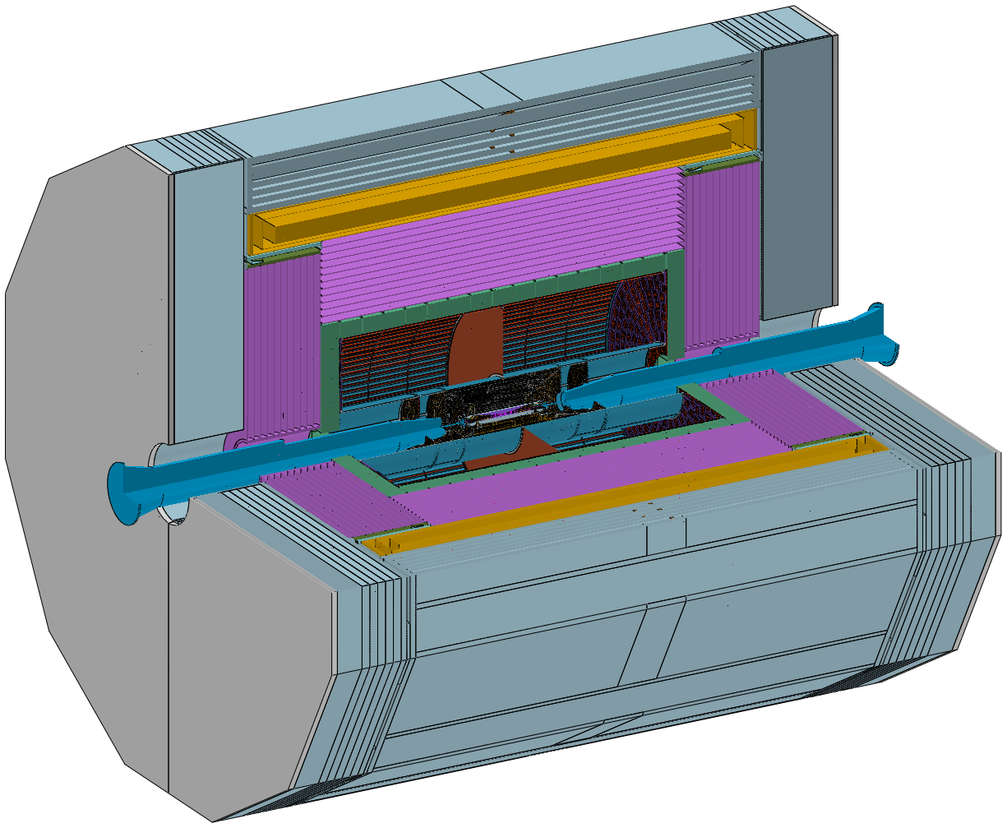
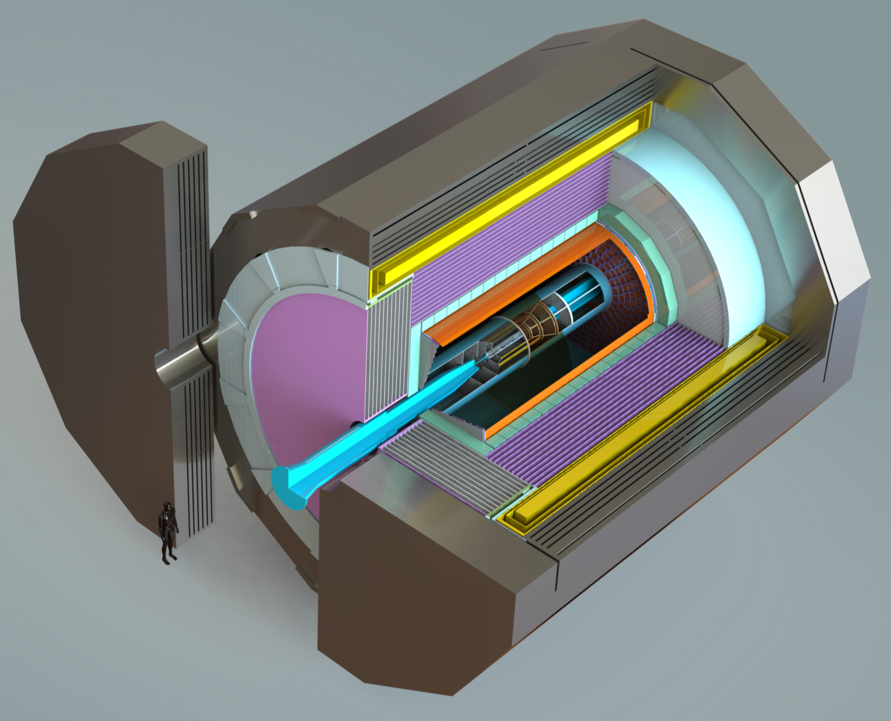
Material Budget from CDR to RefTDR
 | CDR | RefTDR @ April presentation
VTX | Inner radius of 16 mm | Inner radius of 11 mm
VTX | Material Budget: 0.15%*6+0.14%(beampipe)= 1.05% X0 | Material Budget: 0.06%*4(inner)+0.165%*2(outer)+0.2%(beampipe)= 0.77% X0
 | CEPCSW March | CEPCSW June
VTX | Inner radius of 11 mm | Inner radius of 11 mm
VTX | Material Budget: 1.0%+0.3%(beampipe)= 1.3% X0 | Material Budget: 0.061%*4(inner)+0.28%*2(outer)+0.45%(beampipe)=1.3% X0
Coincidently identical for “VTX+Beampipe”

Slide 6
Material Budget in SW
March Version
June Version
Beampipe changes from 0.3% to 0.45%
VTX changes from ~1.0% to ~0.85%
Supporting Tube from ~0.8% to ~0.2%
TPC from 2.2% to 2.3%
No change on ITK, OTK
No change in Barrel ECAL
Small change in Endcap ECAL
Will check the performance in the new CEPCSW release, do not expect significant change
Also ECAL group is working on optimizing its supporting structure 28mm (in paper) -> 5mm (in SW)

Slide 7
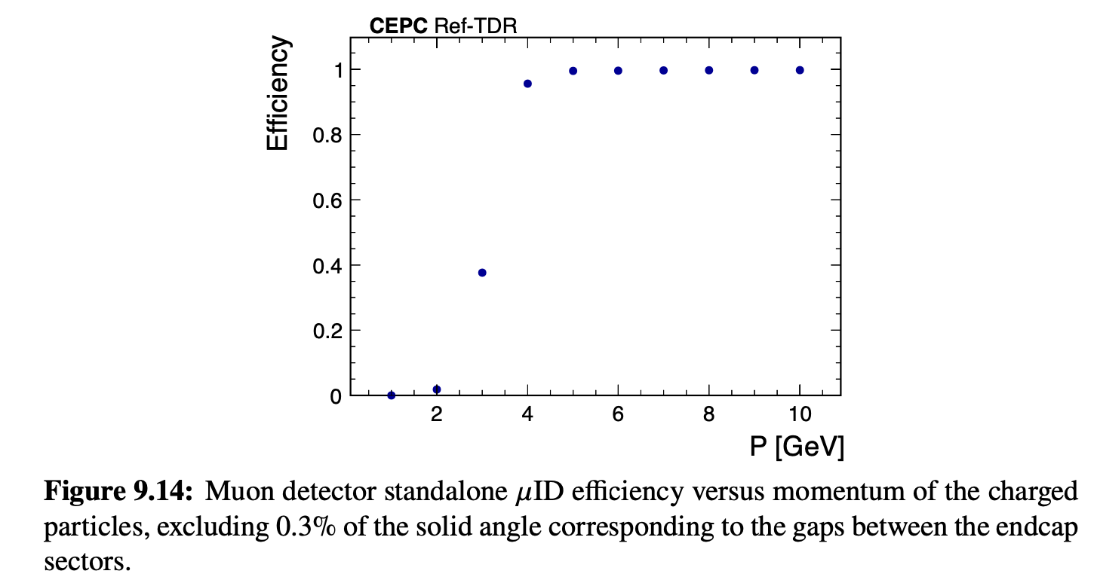
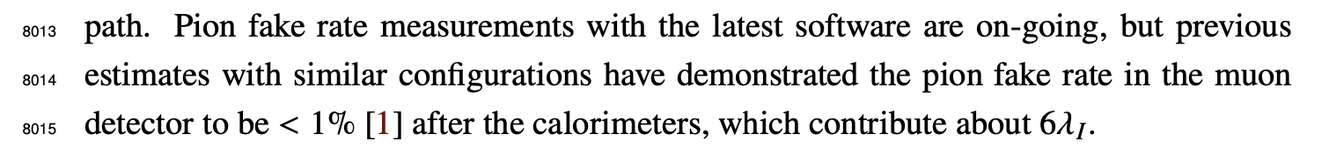
Standalone Muons
Requirements in TDR-0.6.1: per-layer efficiency >95% and a time resolution of 1 ns; This design allows muon tracks to traverse multiple scintillator layers embedded within the yoke, enhancing the identification efficiency to more than 99%.
(1) Study standalone muon performance: reconstruction efficiency, standalone ID vs fake rate
(2) Evaluate improvement on global muon ID by including muon detector – to motivate the muon detector

Slide 8
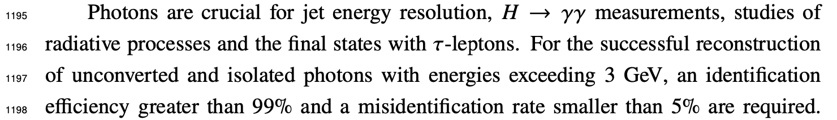
Photon Mis-ID
Current requirement in TDR
From CDR: To identify the τ-leptons in the different decay modes, the photons should be distinguishable from π⁰’s with an efficiency and purity higher than 95% measured in the Z->ττ event sample at the CEPC Z factory operation.
Ongoing study with Z->ττ sample

Slide 9
W mass
Not benchmark requested by IDRC
But major motivation for WW threshold scan
– one year data taking planned
We have a subsection on the major challenge related to W mass
15.3.2 Application of the resonant depolarization method for the 𝑊/𝑍 boson mass determination
  Plan to rephrase it in performance chapter to make it more clear
  ( the CEPC potential to W mass sensitivity )

Slide 10
Backup

Slide 11
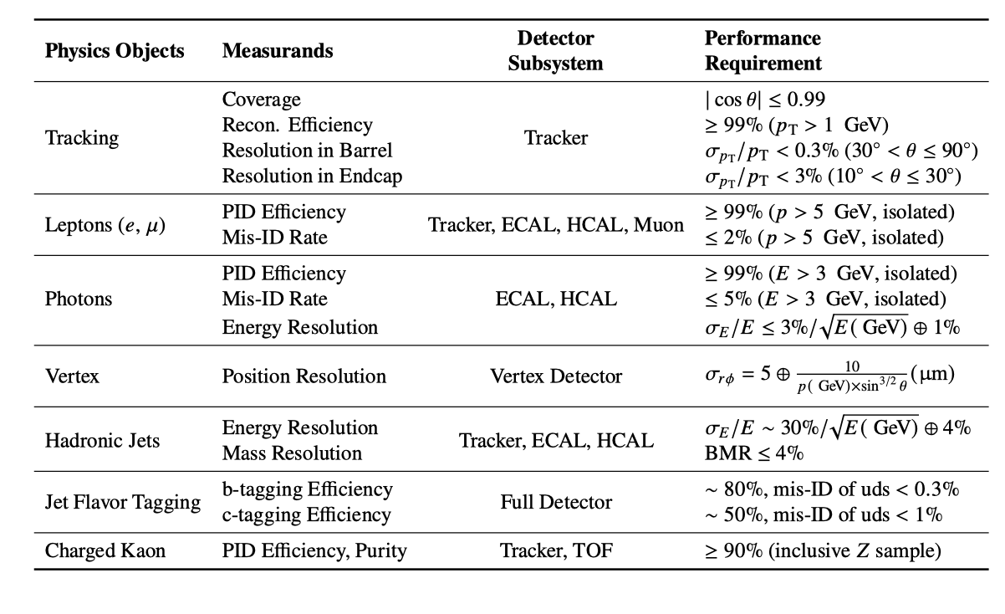
Performance Requirements

Slide 12
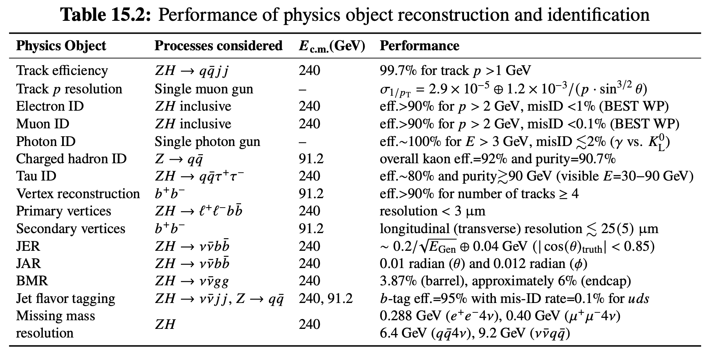
Performance achieved
The reference detector provides excellent performance and achieves all the requirements for physics objects, and enables a rich physics program to be conducted at CEPC.

Slide 13
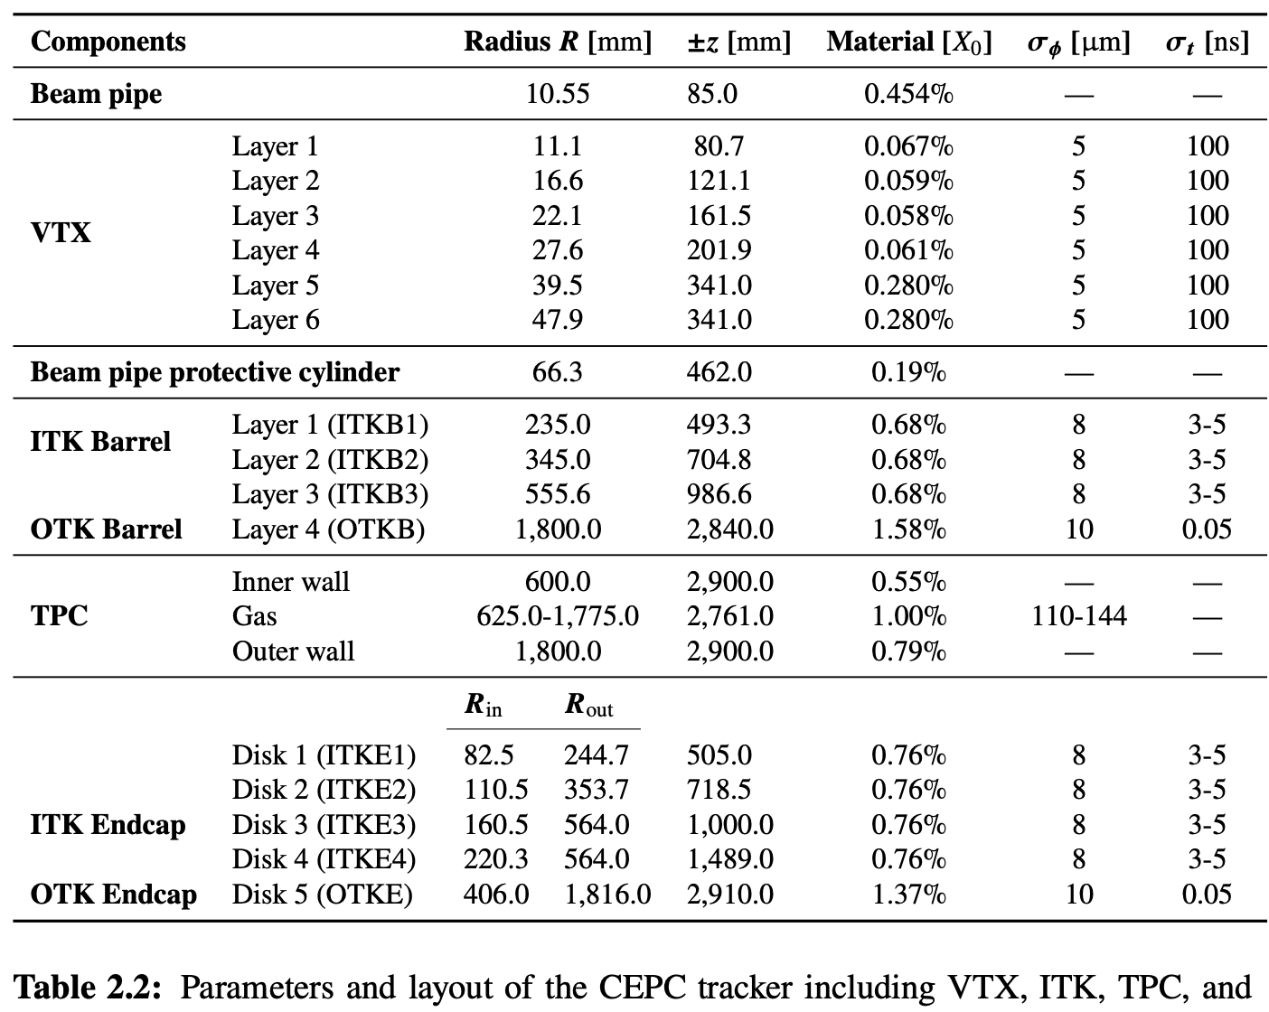
Latest Material Budget

Slide 14
ECAL material budget

Slide 15
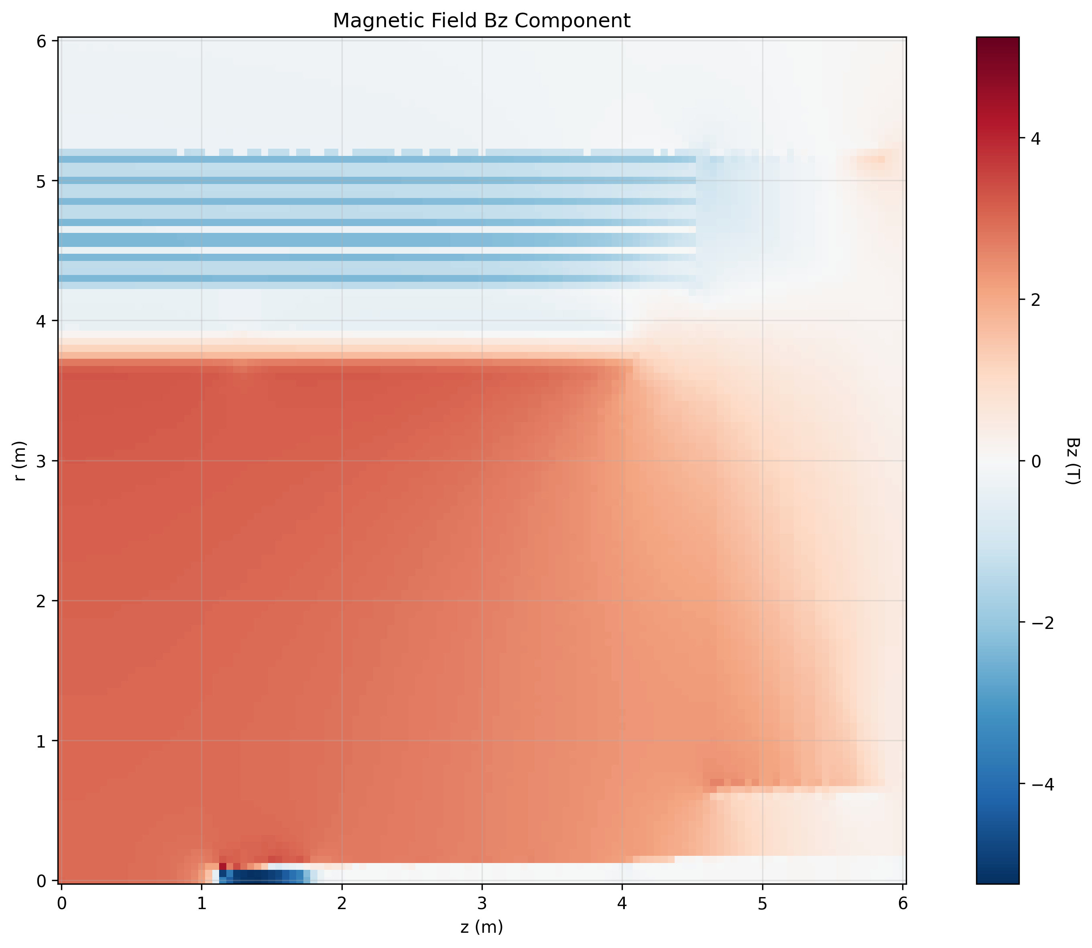
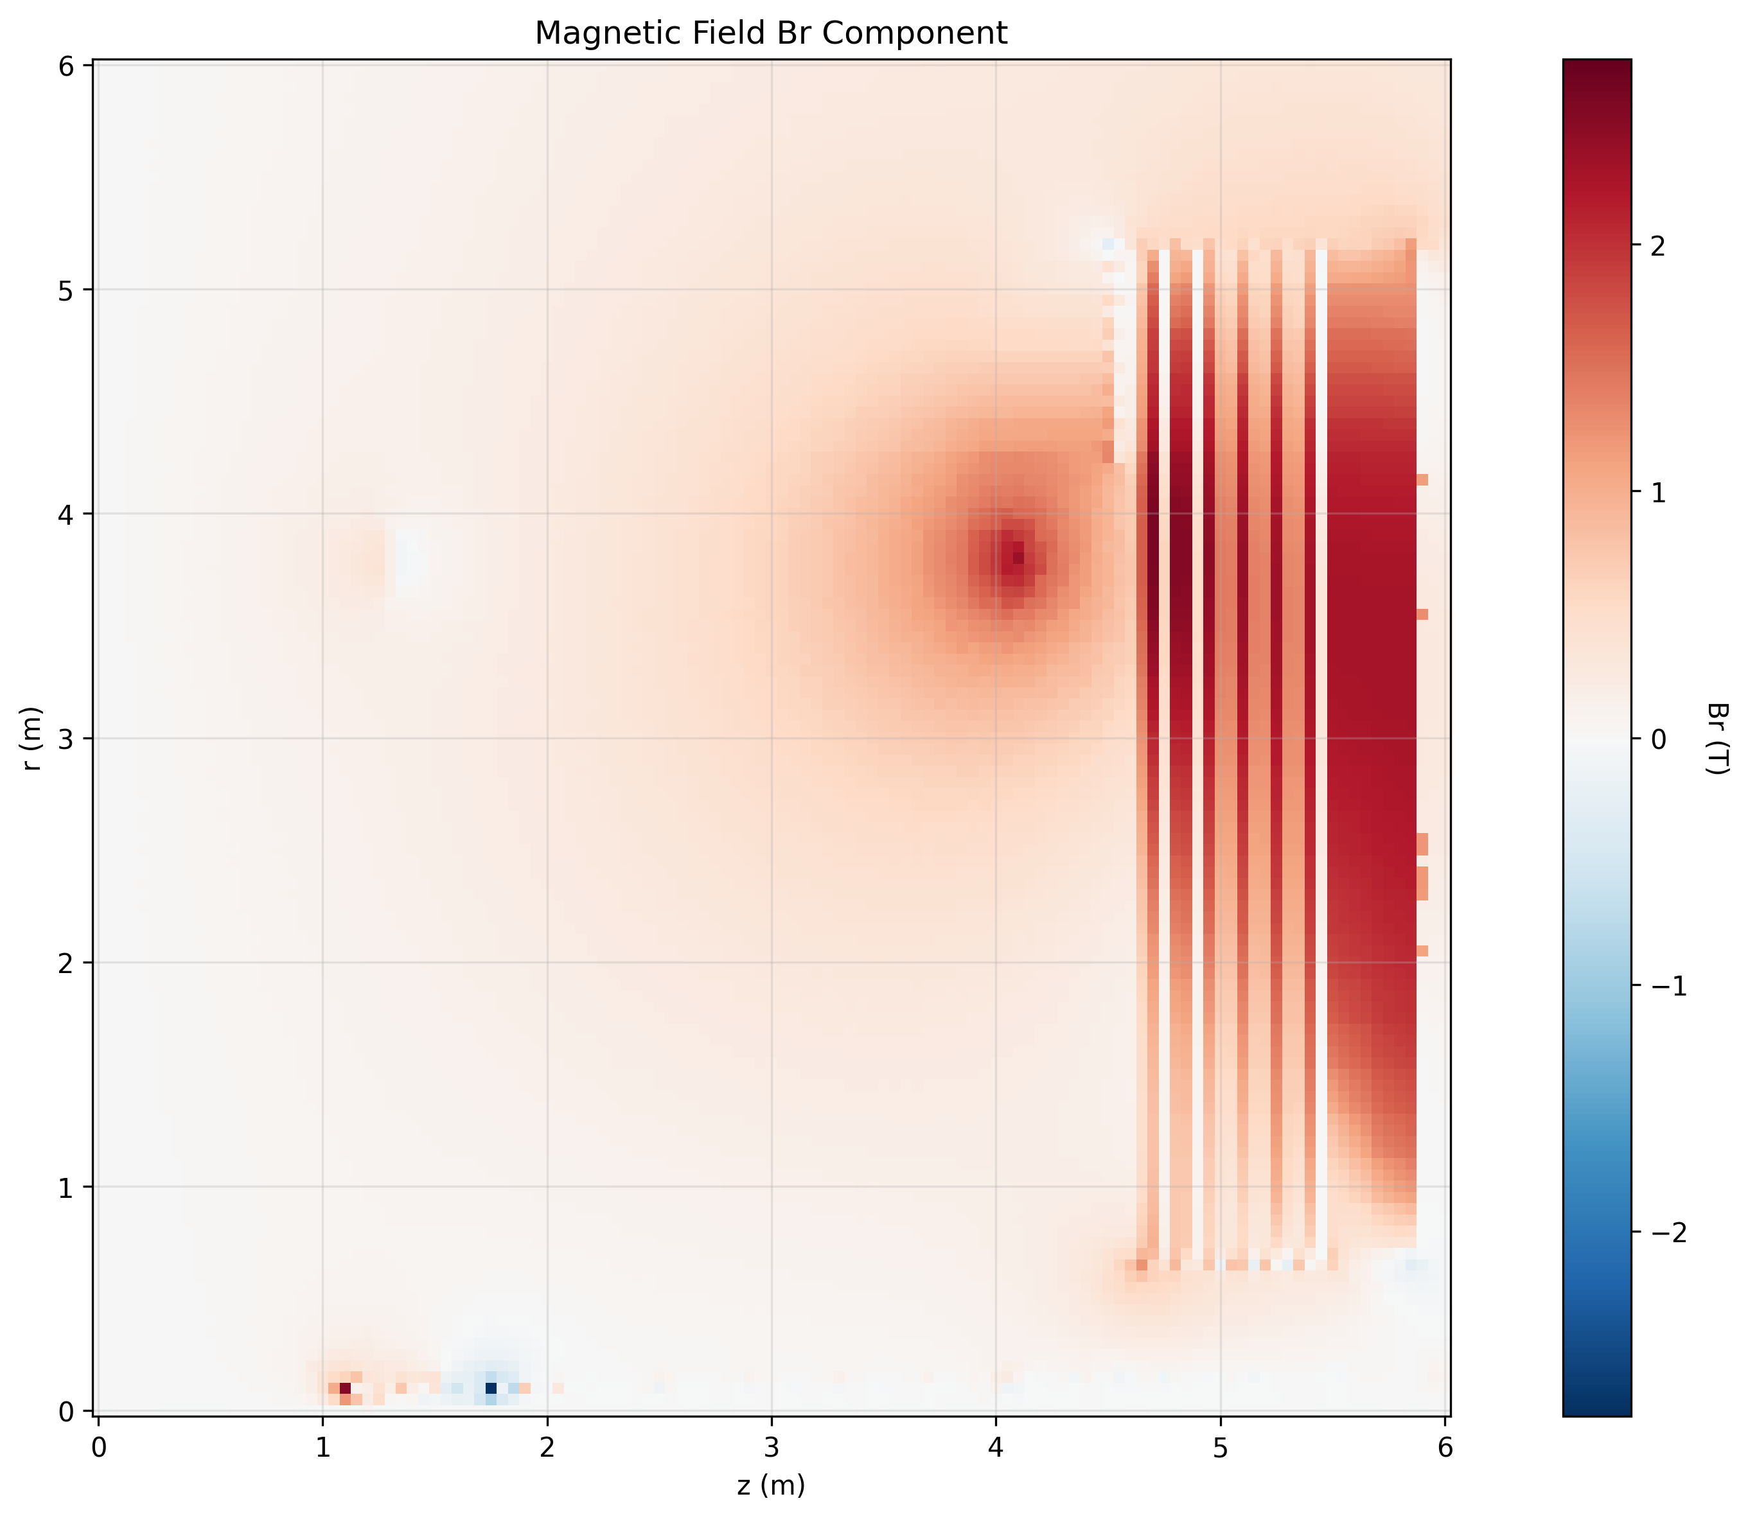
Magnetic Field Maps scanned by SW

Slide 16
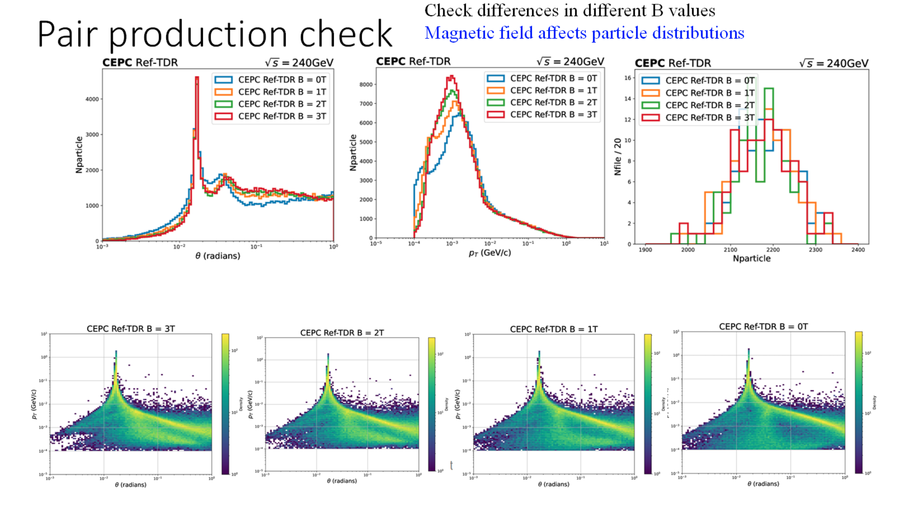
BIBs in various magnetic fields

