Slide 1

Confront Perturbative QCD to Hard Exclusive Processes
Based on:
Phys.Rev.Lett. 135,131903(2025)
Phys.Lett.B. 870,139116(2025)
With: Wen Chen, Feng Feng,Yu Jia
陈龙斌
Long-Bin Chen
2026/4/12

Slide 2
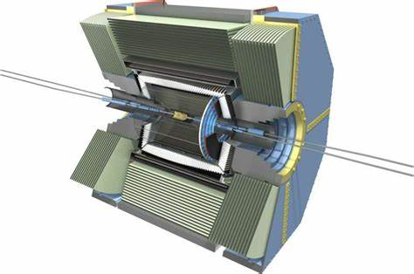

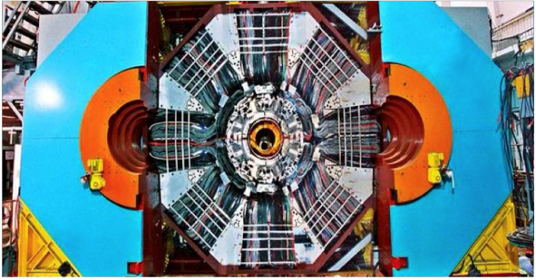
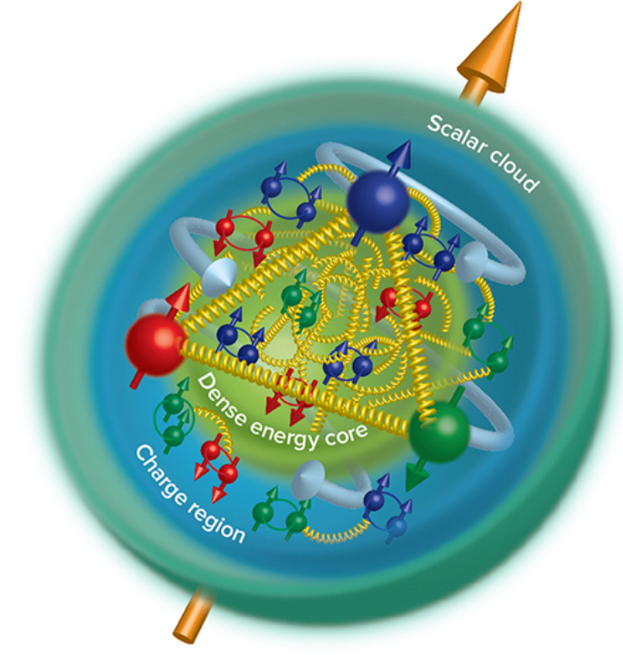
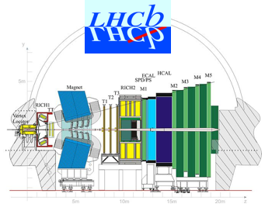
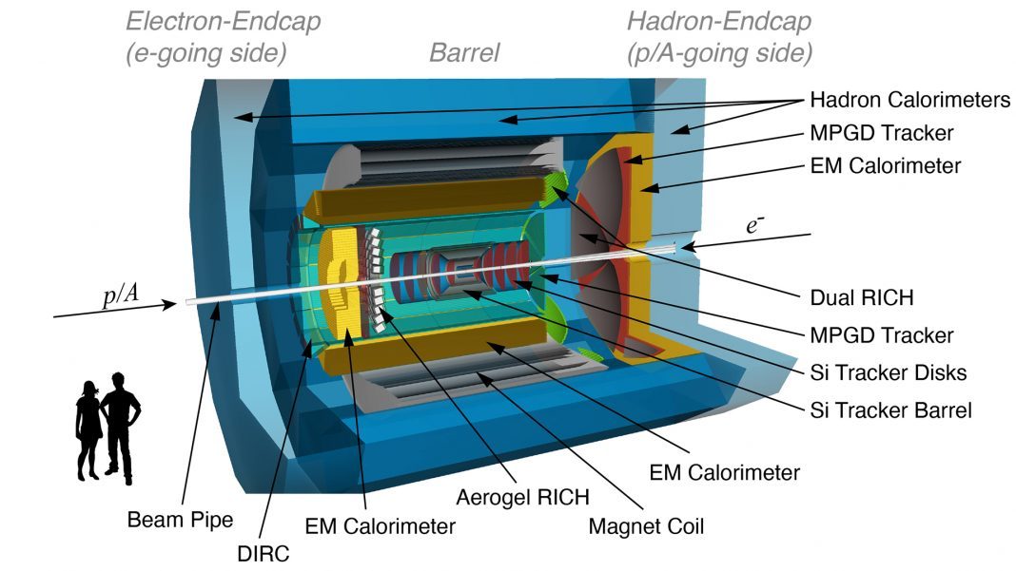
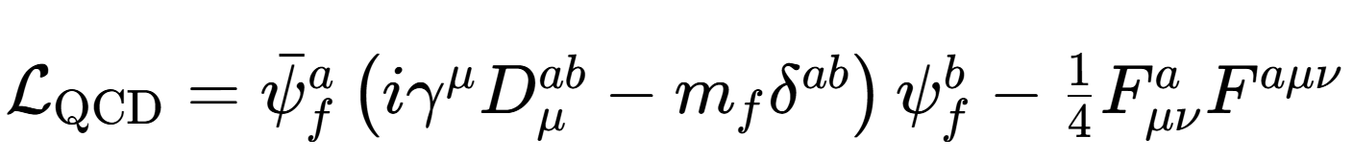

Unveiling the inner structure of hadron
Understanding the internal structure of nucleons from quantum chromodynamics (QCD), the underlying theory of strong interaction, is the fundamental challenge faced by the contemporary hadron and nuclear physics.--Eur. Phys. J. C83, 1125 (2023 )

Slide 3
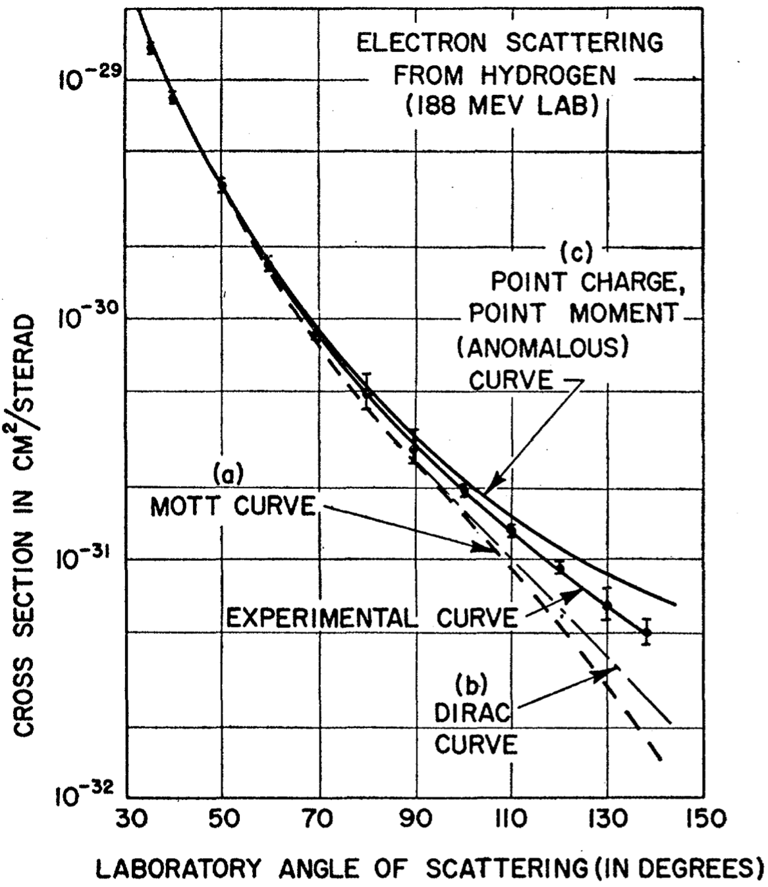
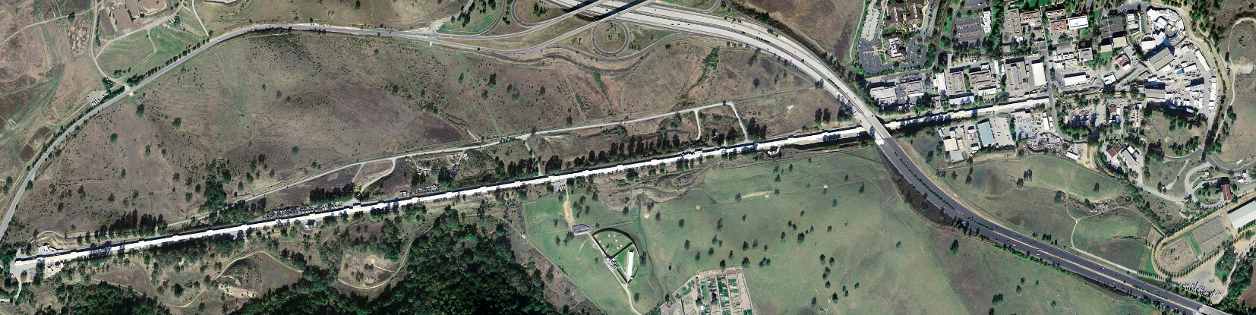
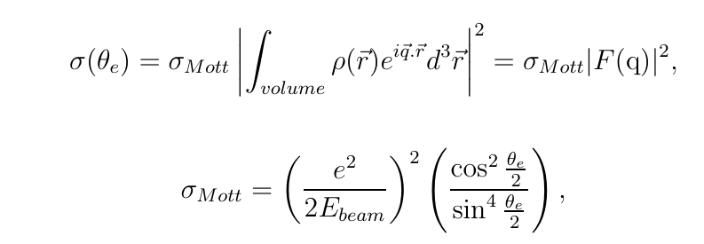


Historic Milestones
From Hu Jifeng’s talk
Electron Scattering (1950s)
Hofstadter R. etc., “electron scattering and nuclear structure”
Rev. Mod. Phys. 28, 214–254 (1956)
Developments of the definition
Sachs formula
$$G_{E}=F_{1}+{τF}_{2}, G_{M}=F_{1}+F_{2}$$
Electric FF
Magnetic FF

Slide 4
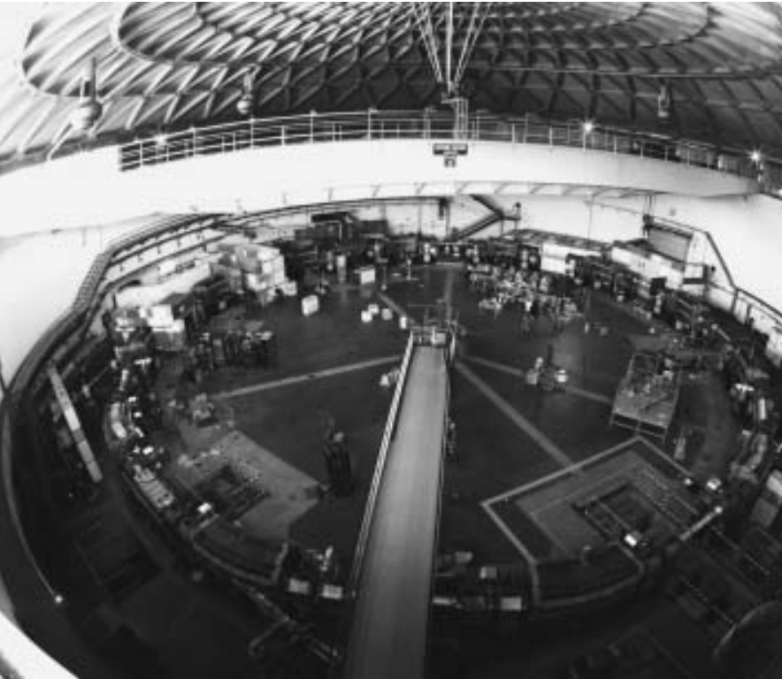
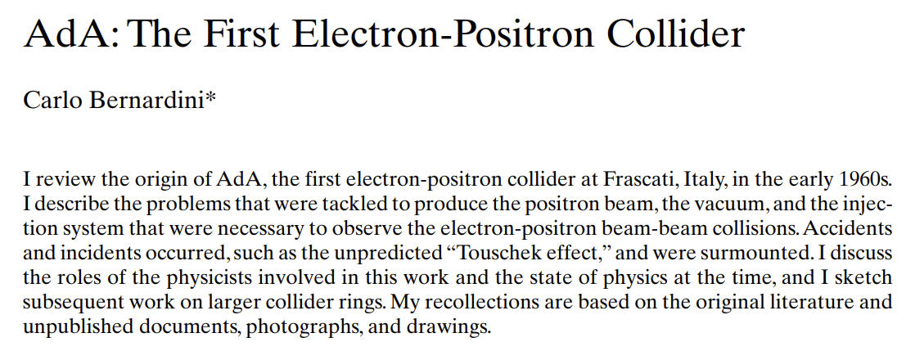

Historic Milestones
From Hu Jifeng’s talk
https://cas.web.cern.ch/sites/default/files/lectures/baden-2004/bernardini.pdf
Electron Scattering (1950s)
$e^{+}e^{−}$ → $p\overline{p}$ (1972)
Hofstadter R. etc., “electron scattering and nuclear structure”
Rev. Mod. Phys. 28, 214–254 (1956)

Slide 5
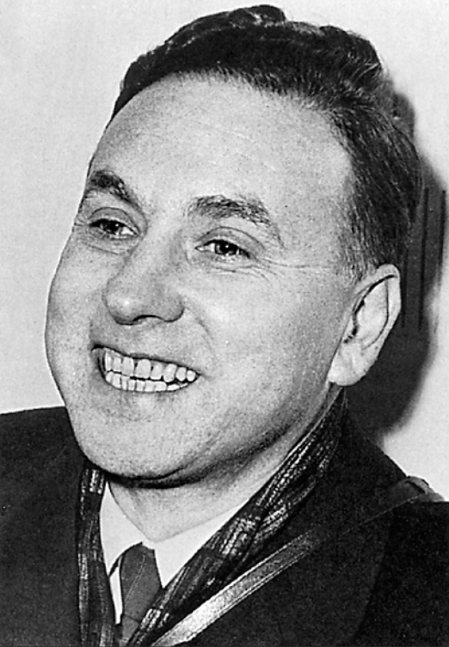
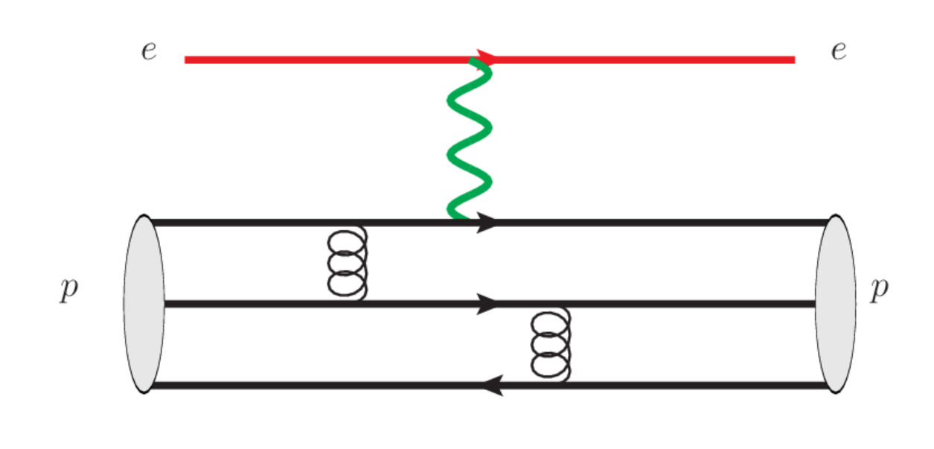
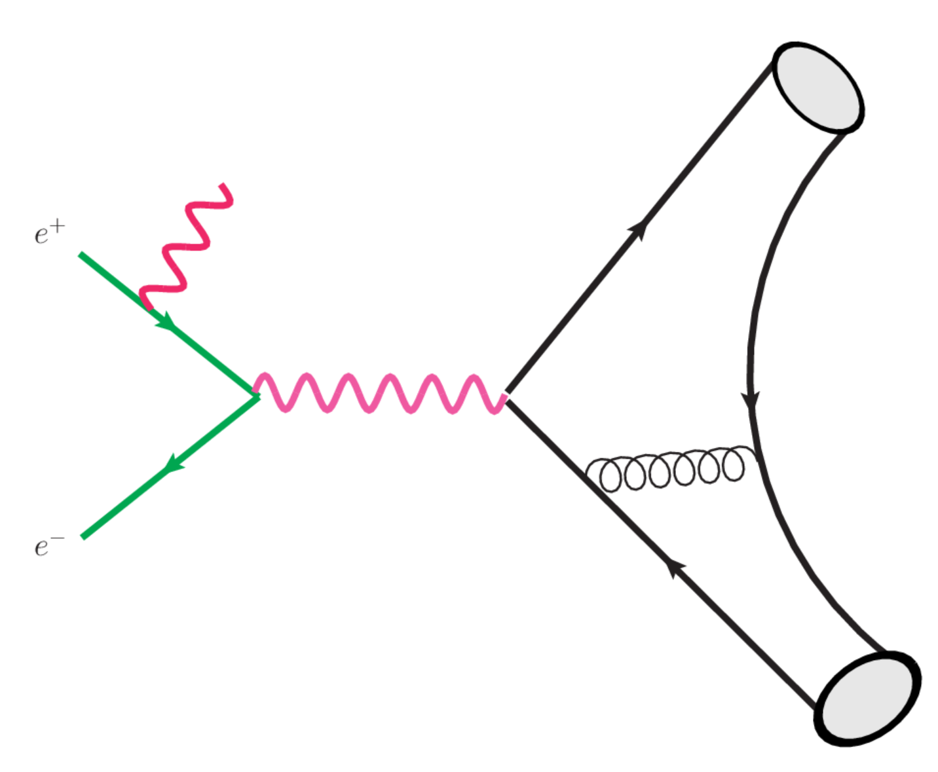

Probing baryon and meson EM Form Factors
1961
Space Like
R. Hofstaders’ pioneering work in mid-50s
SLAC, Q^2 up to 30GeV^2 in early 90
Phys. Rev. D 48 , 29 (1993)
EIC：Q^2 up to 40-50 GeV^2
arXiv:2208.14575
Time Like
BESIII, BarBar, Belle II, STCF
Babar, Q^2 up to 40GeV^2 in 2013
Phys. Rev. D88 , 072009 (2013)
Notes:
这类给出质子和介子电磁形状因子相关测量过程的费曼图，在高Q^2情况下，我们可以通过微扰论来计算。

Slide 6
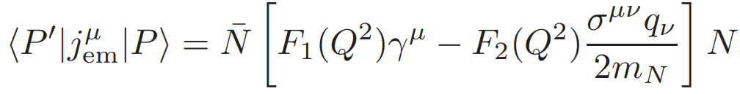
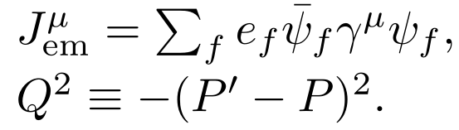
EM FFs: Probing the internal structure of hadrons
EM Form Factors for mesons and baryons:
Dirac FF
Pauli FF
EM FFs describe the distributions of electric charge and magnetization inside the hadron, key roles to probes the internal structure of hadron.

Slide 7
Theoretical side on EMFFs
Vector meson dominance model
  PLB43,191 (1973); PRD69,054022 (2004); NCA109, 241 (1996); CPL41, 021302 (2024); ……
Constitute quark model
  PRD44, 229 (1991); PRD73, 114021 (2006); PLB671, 153 (2009); ……
Cloudy bag model
  PRD24, 216 (1981); PRD28, 2848 (1983); PRC46, 1077 (1992); ……
Dyson-Schwinger equation
  CTP58, 79 (2012); PRL111, 101803 (2013); FBS55, 1185(2014); ……
Light-front Hamiltonian
  PRD102, 016008 (2020); ……
Chiral perturbation theory
  EPJA26, 1 (2005); PRC86, 065206 (2012); ……
Light-cone sum rule
  PRD65, 074011 (2002); PRD78, 033009 (2008); PRD111,L071902……
Lattice QCD
  PRD84, 074507 (2011); PRD83, 094502 (2011); PRD96, 114509 (2017);
  PRD92, 054511 (2015); PRD100, 014509 (2019); PRD101, 014507 (2020); ……
Dispersive analysis
  NPA596, 367 (1996); PRC75, 035202 (2007); ……

Slide 8
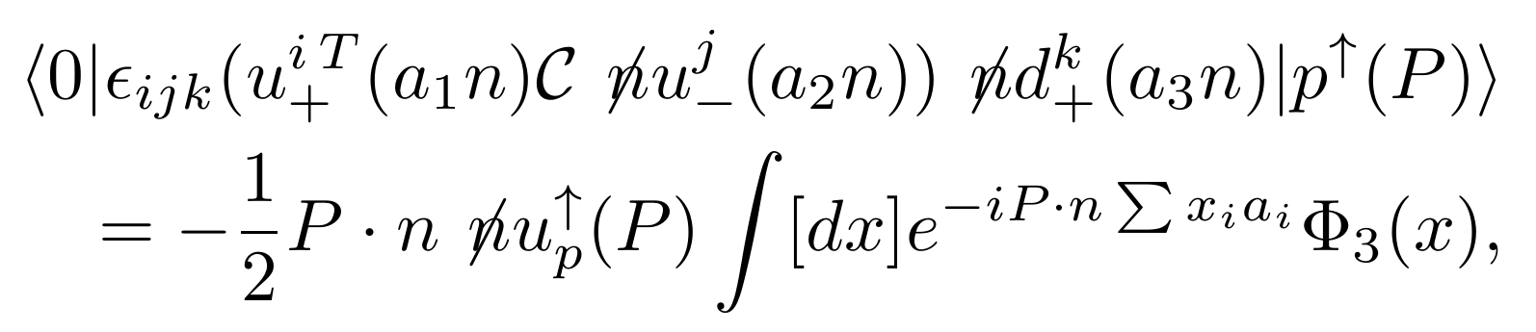
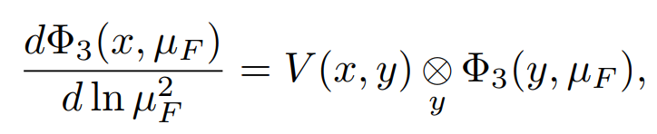

Large $Q^{2}$, Collinear Factorization
(Brodsky, Lepage, Efremov, Radyushkin, Duncan, Mueller)
Meson
Baryon
Operator definition of Tiwst-3 LCDA for baryon
ERBL evolution equations
Phys. Rev. D22 , 2157 (1980)
Phys. Rev. D78 , 033009 (2008)

Slide 9
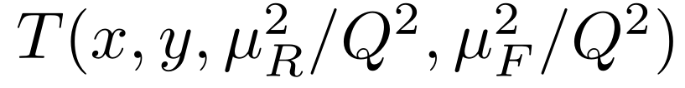
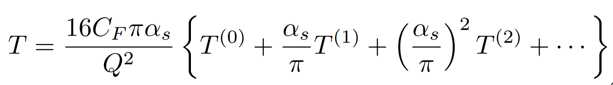
Hard Kernel
Perturbative Expansion
Leading Order EMFFs
G. P. Lepage and S. J. Brodsky, Phys. Rev. Lett. 43, 545 - 549 (1979)
G. P. Lepage and S. J. Brodsky, Phys. Rev. D22, 2157 (1980)
V. L. Chernyak, A. R. Zhitnitsky and V. G. Serbo, JETP Lett. 26, 594 (1977)
V. L. Chernyak and A. R. Zhitnitsky, Phys. Rept. 112, 173 (1984)

Slide 10
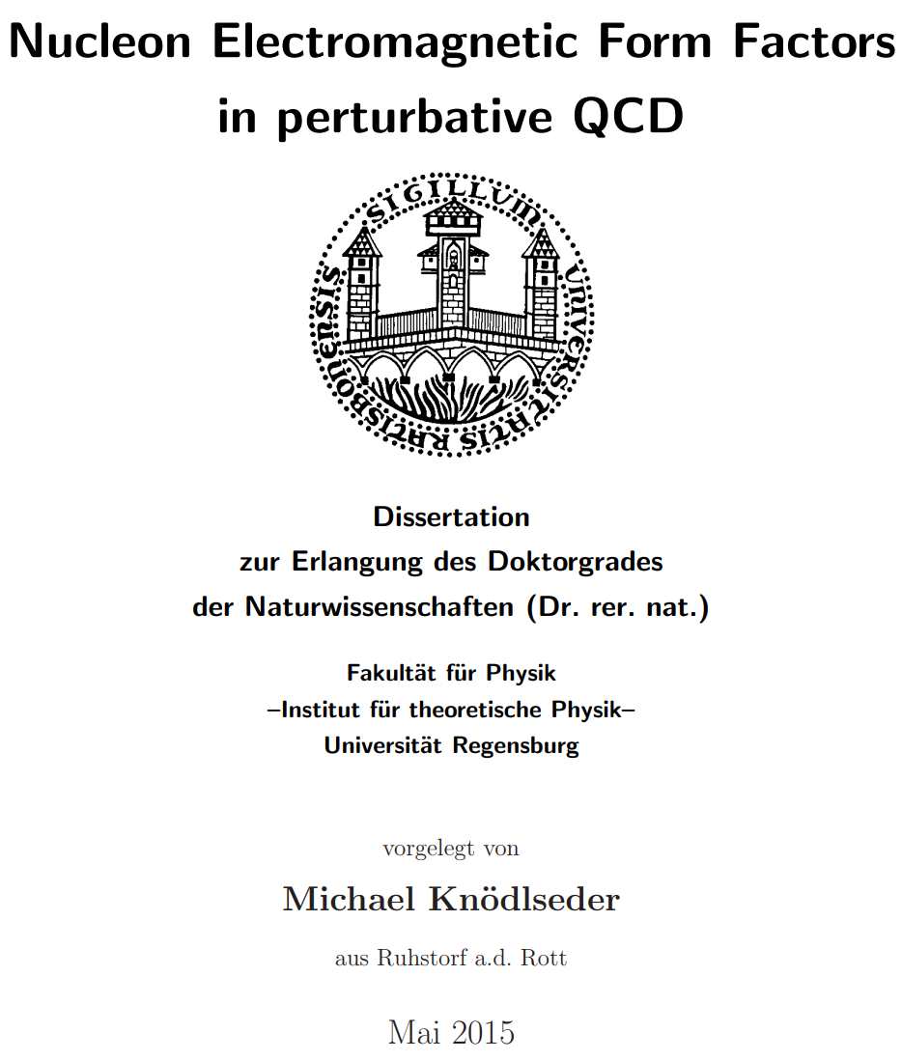
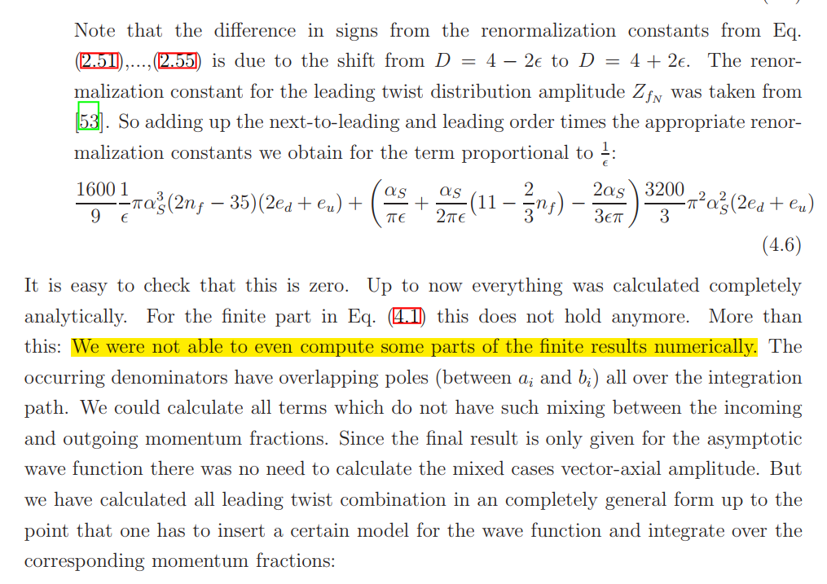
Status of EMFF in pQCD for baryon FFs
Promotionsgesuch eingereicht am: 18.06.2014
Die Arbeit wurde angeleitet von: Prof. Dr. V. Braun

Slide 11
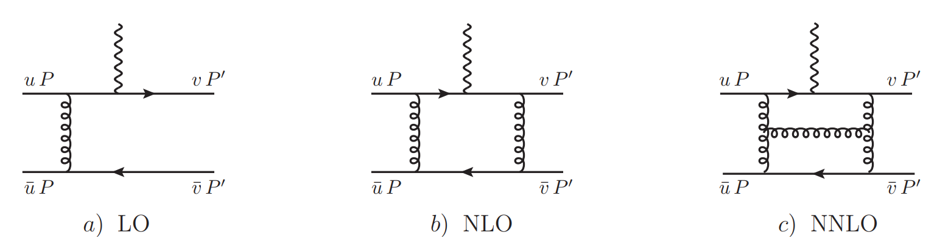
Feynman Diagrams(about 1600)
Partonic Process

Slide 12
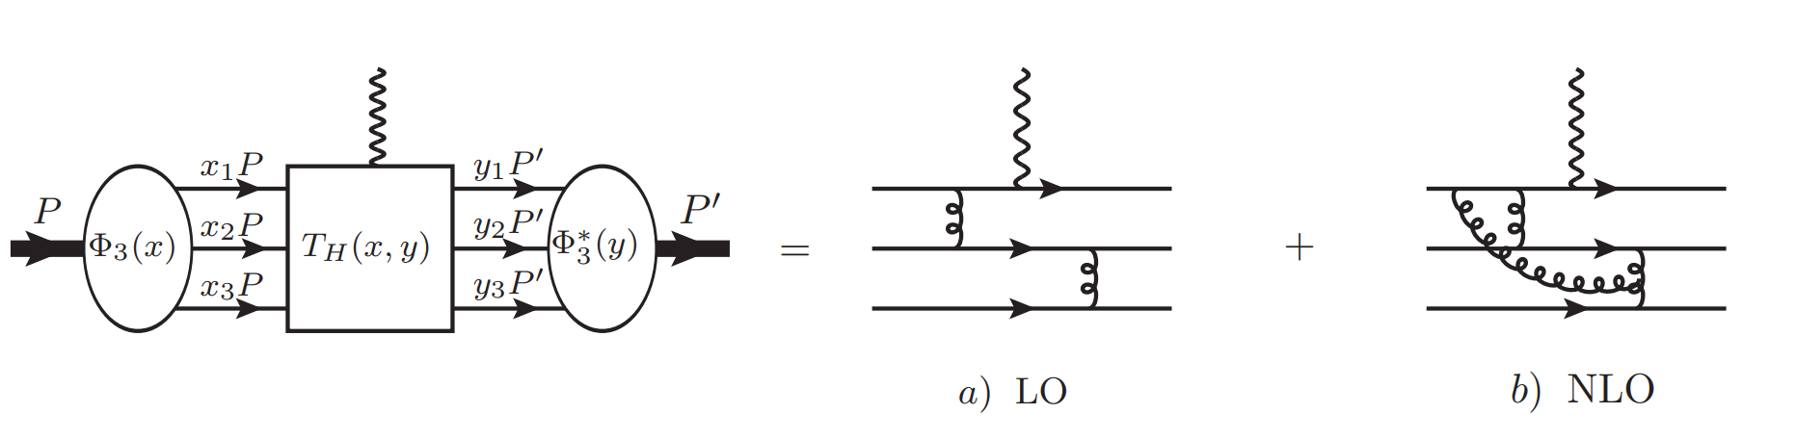
Feynman Diagrams(about 2000)

Slide 13
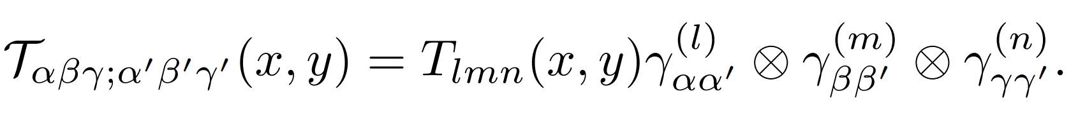
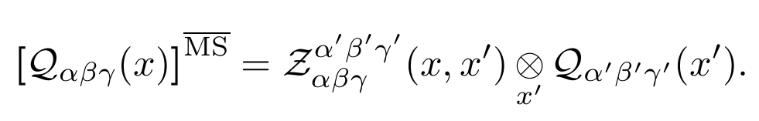
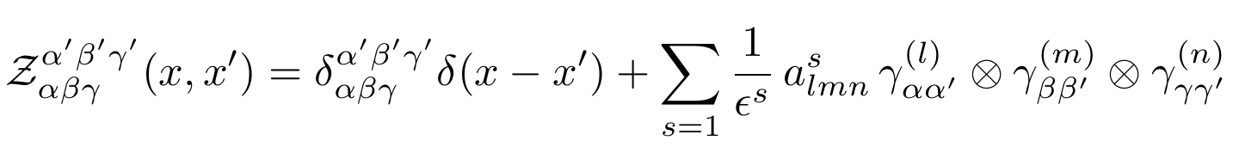
Perturbative matching in KM scheme
S. Krankl and A. Manashov, Phys. Lett. B. 703,519-523 (2011)
Renormalization of DA
Notes:
为了更加自洽的处理红外发散，我们后来在KM框架下开展计算，保留所有的旋量指标，并重新计算了DA的重整化因子。

Slide 14
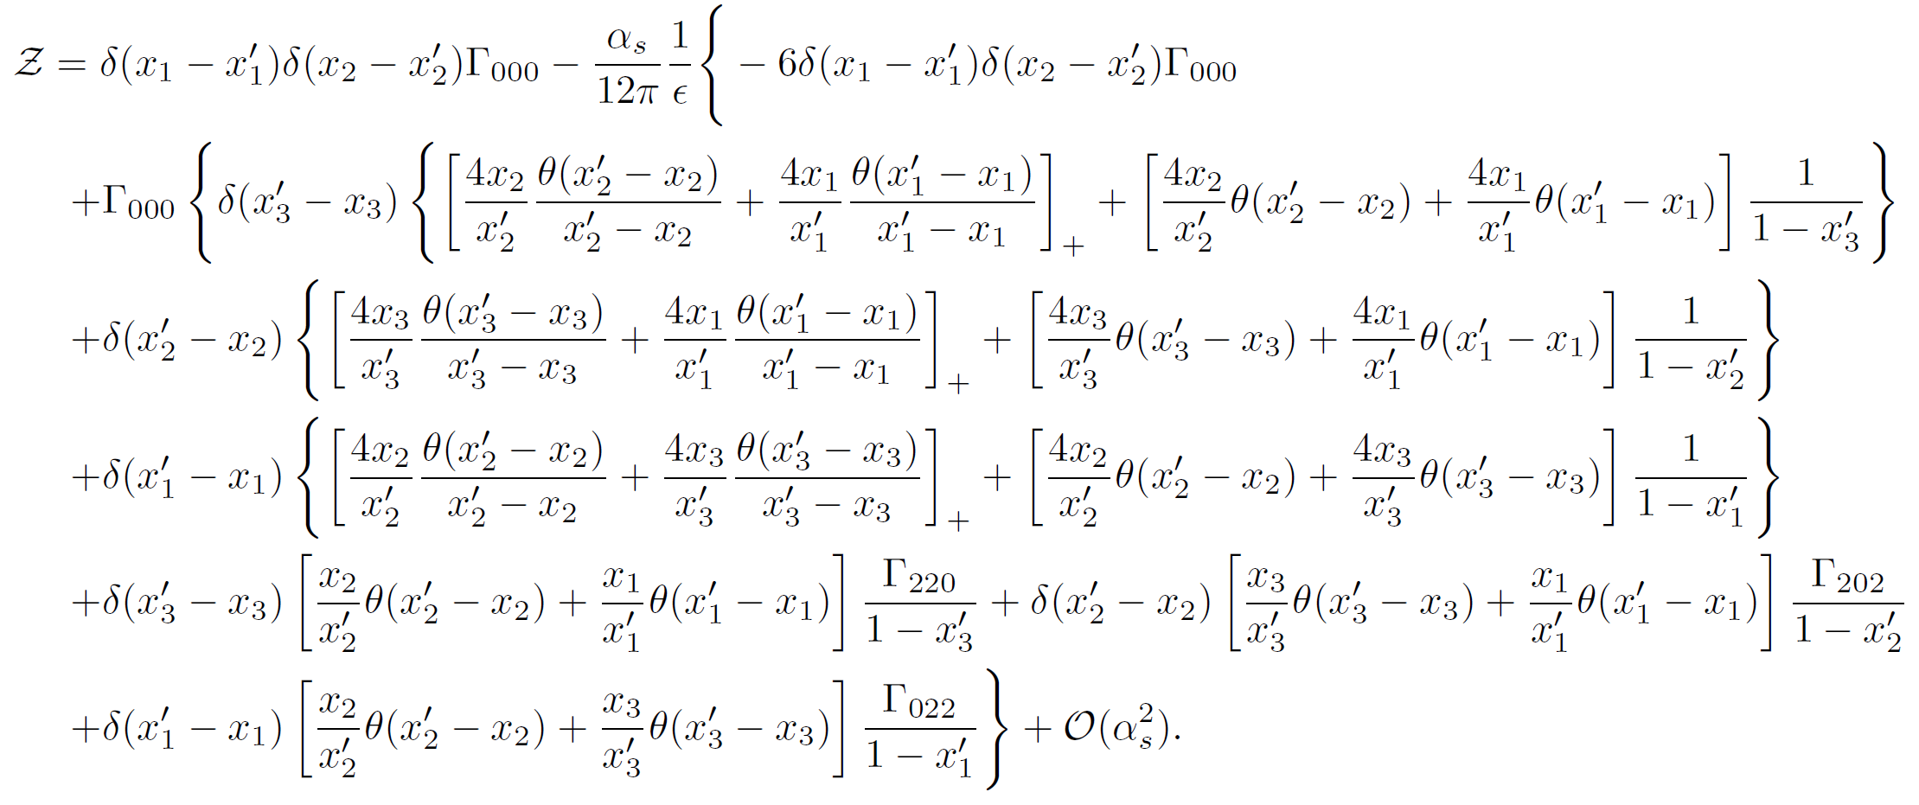
Renormalization Factor in KM scheme

Slide 15
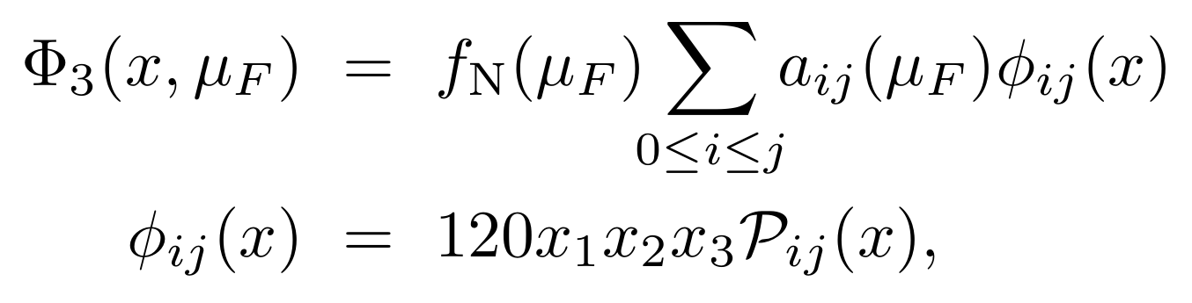
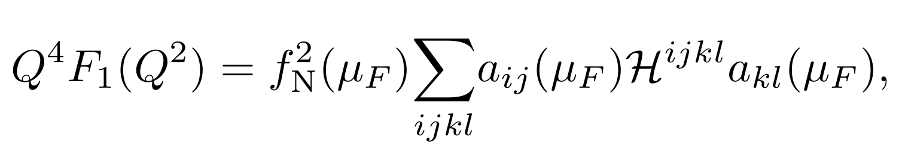
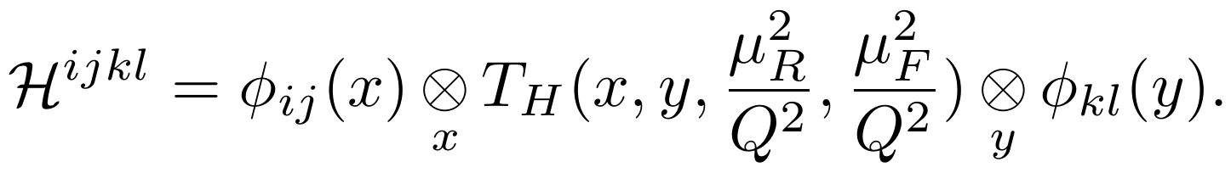
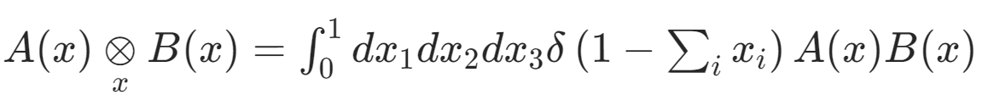
Distribution Amplitudes(DA)
Expressed in terms of GPLs.

Slide 16
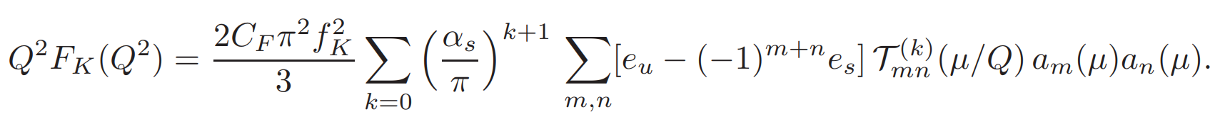
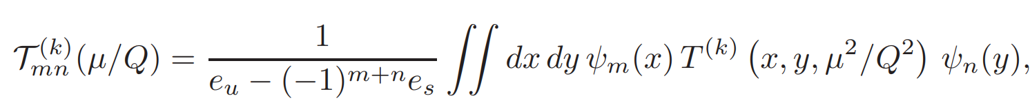
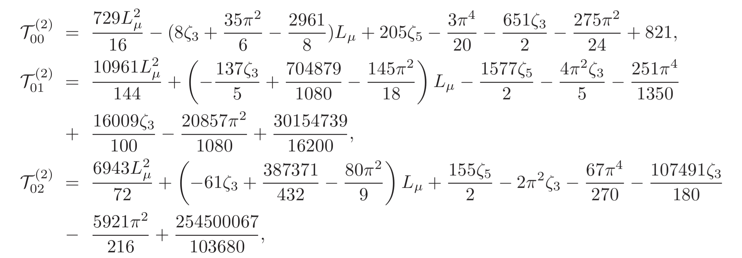
Kaon FFs
The short distance coefficients:

Slide 17
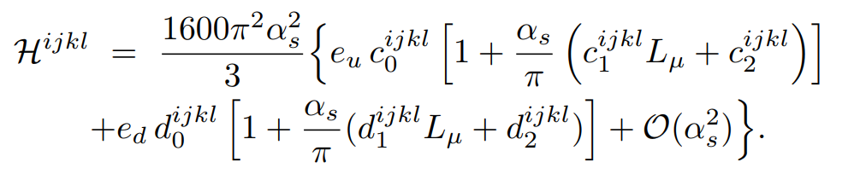
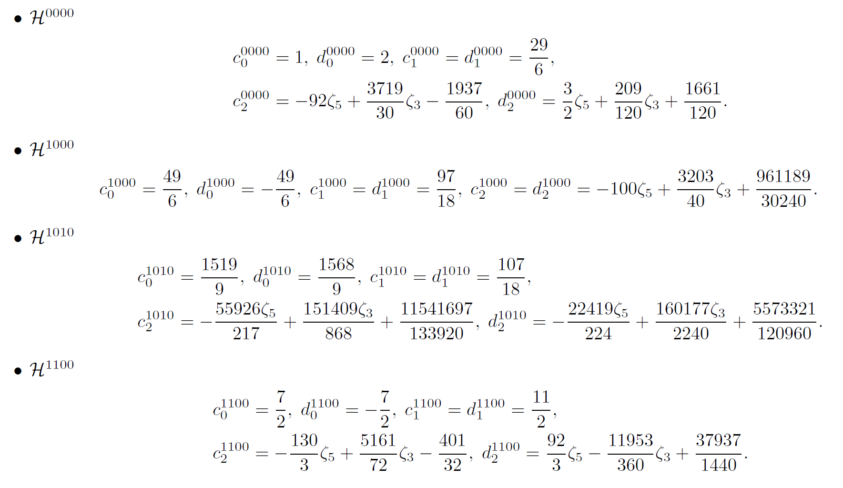
Baryon FFs
Short-distance coefficients
Only Zeta function and rational number appear.
Validated numerically by Cubature

Slide 18
Phenomenological Exploration

Slide 19
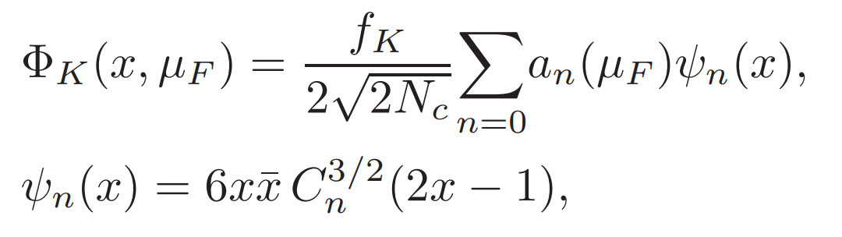
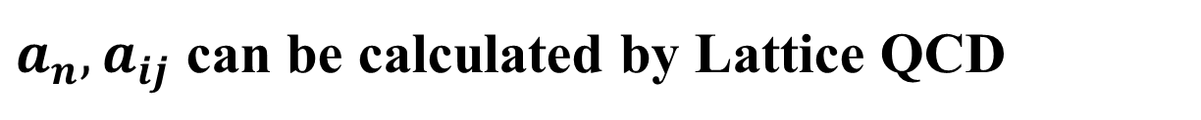
Leading-twist LCDA
Kaon
Twist-2
Nucleon
Twist-3
$a_{n},a_{ij}$ can be calculated by Lattice QCD

Slide 20
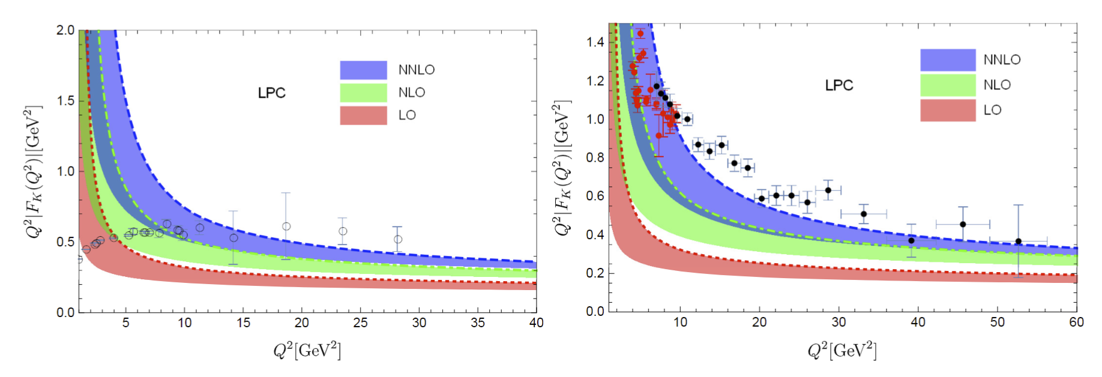
Charge Kaon FFs
Space like FFs, data taken form
Ding et.al. Phys. Rev. Lett. 18, 181902 (2024)
Time like FFs, data taken from BESIII and BarBar

Slide 21
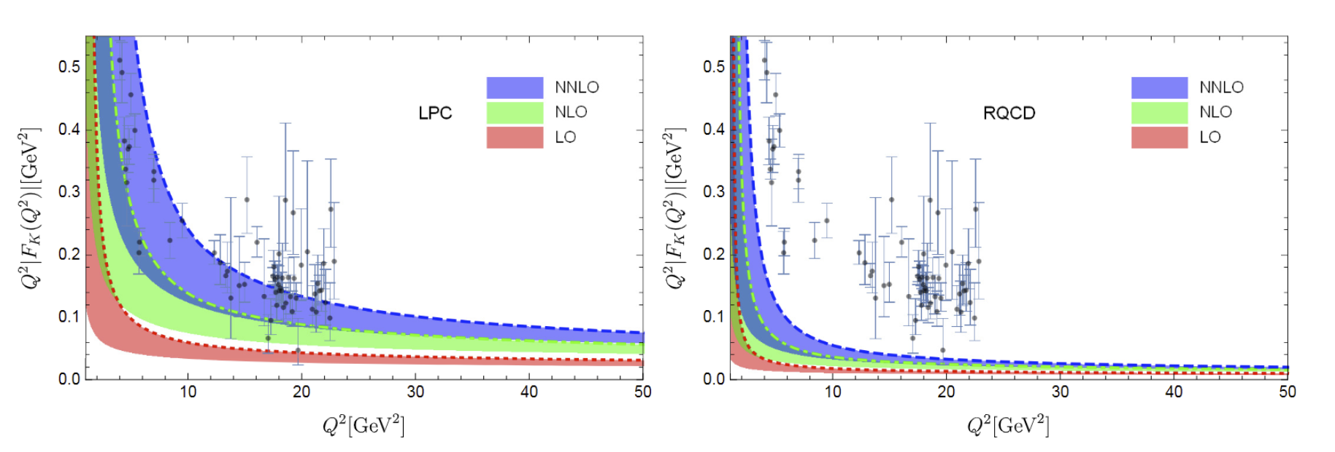
Neutral Kaon FFs
Time like FFs for neutral Kaon,
data take from BESIII[Phys. Rev. Lett. 132,131901 (2024)]

Slide 22
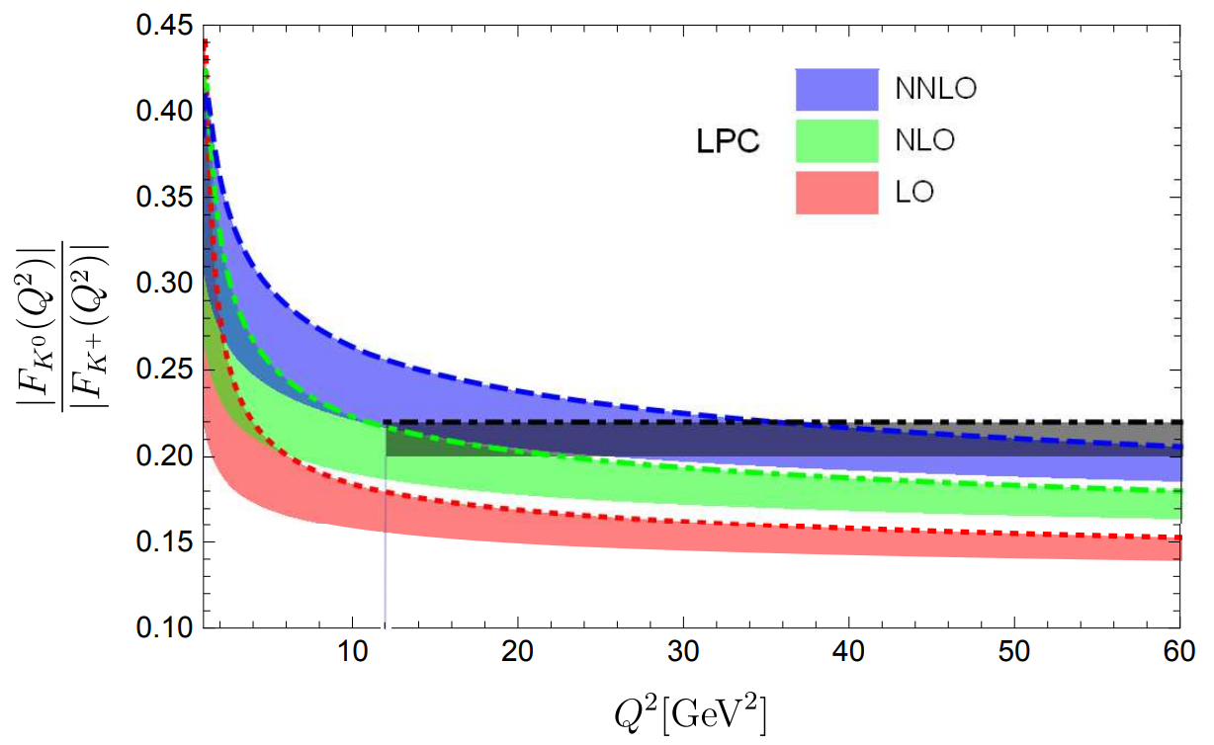
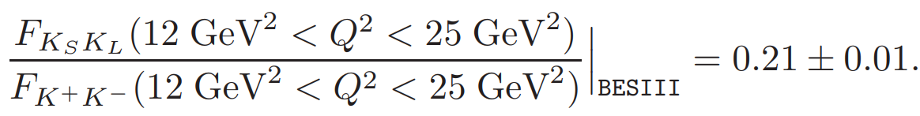
SU(3) Flavor Breaking Effects
Kaon FFs
Data take from BESIII [Phys. Rev. Lett. 132,131901 (2024)]

Slide 23
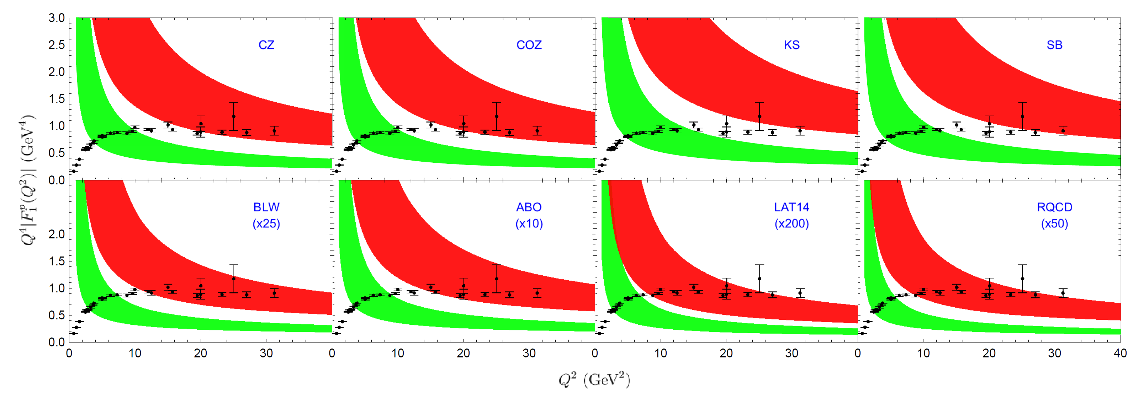
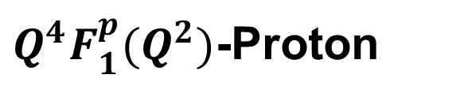
Space like FFs
$Q^{4}F_{1}^{p}(Q^{2})$-Proton

Slide 24
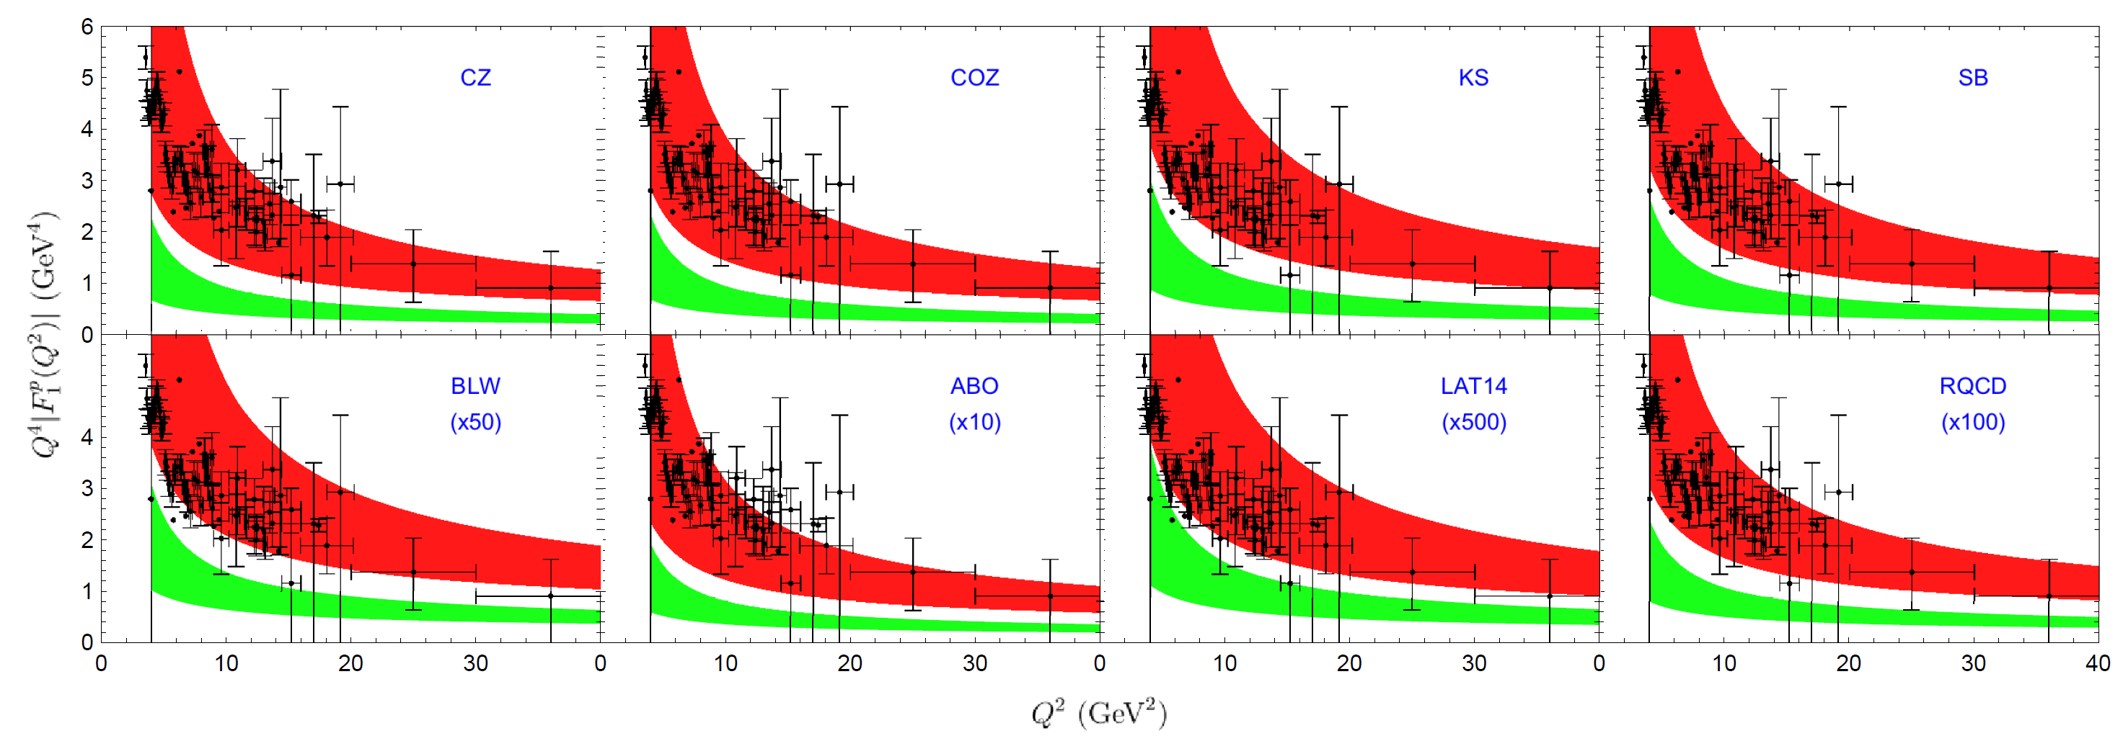
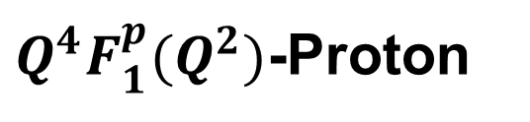
$Q^{4}F_{1}^{p}(Q^{2})$-Proton
Time like FFs

Slide 25
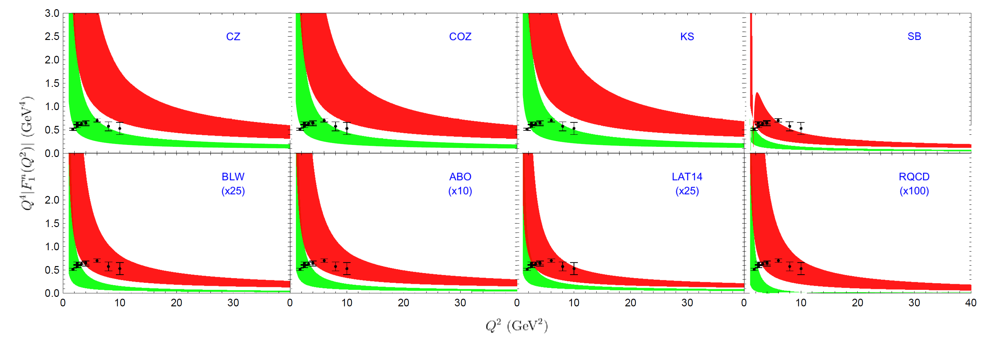
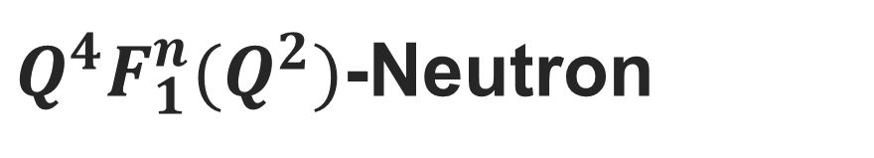
$Q^{4}F_{1}^{n}(Q^{2})$-Neutron
Space like FFs

Slide 26
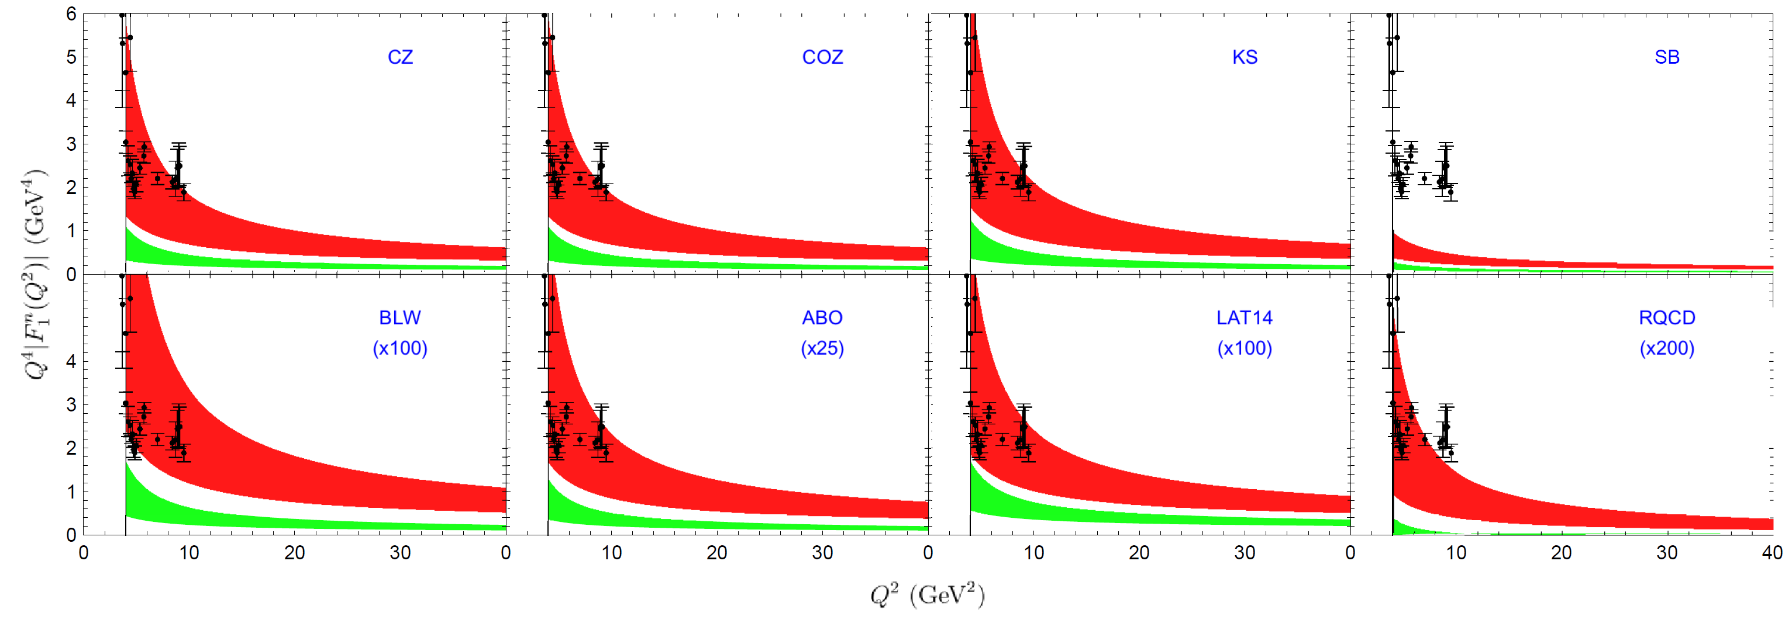

$Q^{4}F_{1}^{n}(Q^{2})$-Neutron
Time like FFs

Slide 27
Conclusion
The EM form factors for kaon have been calculated up to NNLO QCD corrections.
The EM form factors for baryon have been calculated up to NLO QCD corrections after 50 years.
The matching kernel have been obtained analytically, how to understand the concise analytic results?
The QCD corrections turn out to be positive and significant.
Extend to more exclusive processes…
Combined with PMC [ Rep. Prog. Phys. 78 (2015) 126201] …

Slide 28
Thanks！
陈龙斌

