Slide 1
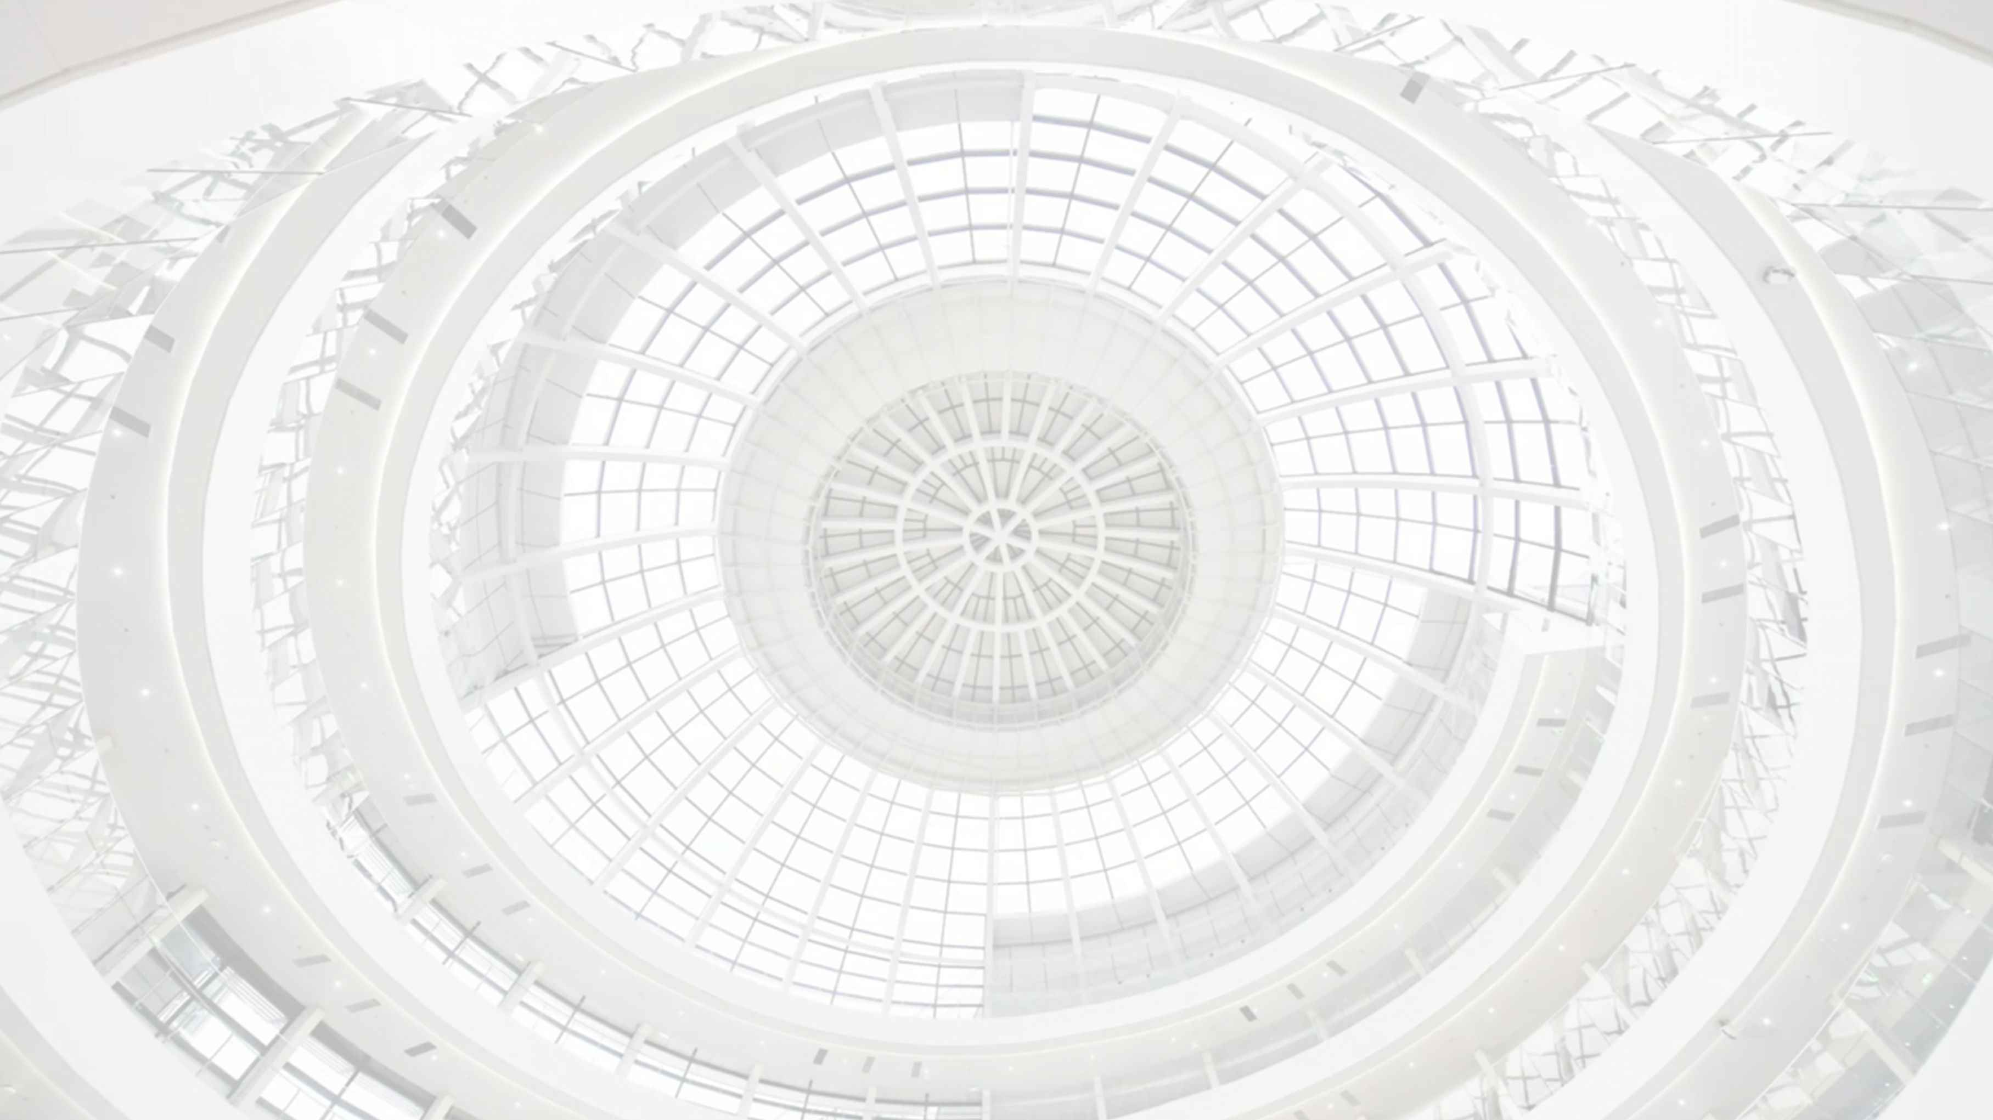

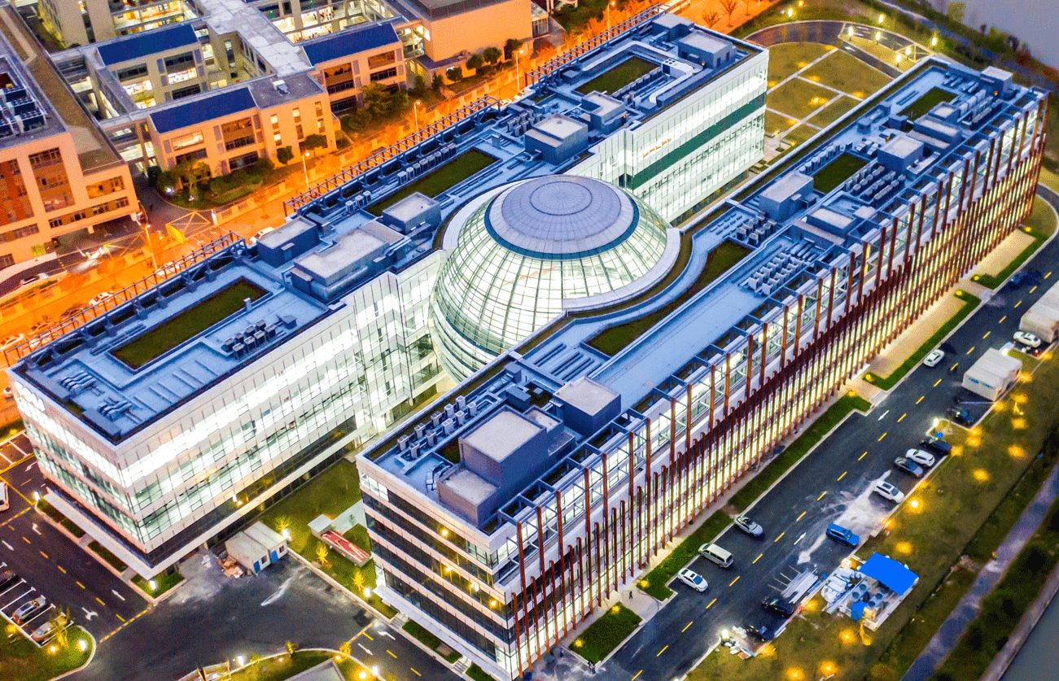


$SU{\left(3\right)}_{F}$ flavor analysis for charmed baryons
Chang Yang
April 12, 2026
Collaborators： X. G. He, C. W. Liu
JHEP 09 193 (2025)

Slide 2

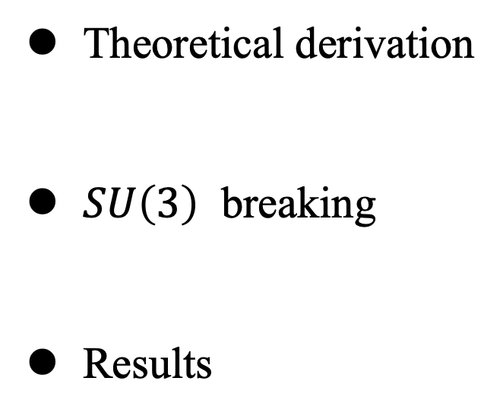
Theoretical derivation
$SU\left(3\right)$ breaking
Results
SU(3) flavor symmetry

Slide 3
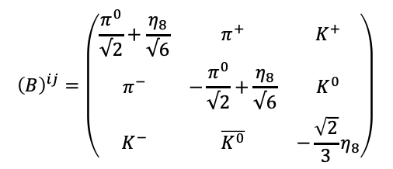
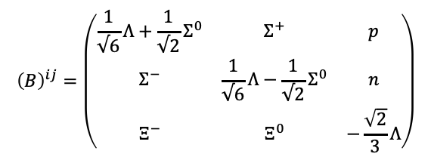
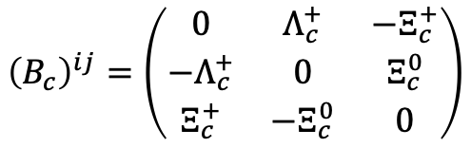
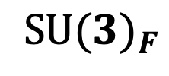

Theoretical derivation
The $SU(3)_F$ flavor symmetry arises from the approximate symmetry among the light quarks：up, down, and strange.
SU(3)_{F}
relations
C-parameters
$${SU(3)}_{F}$$
Fit
Predictions
$$B_{c\overline{3}} →B P$$
data inputs
Data
$${\left(B\right)}^{ij}=\left(\begin{matrix}\frac{1}{√6}Λ+\frac{1}{√2}Σ^{0} & Σ^{+} & p \\ Σ^{−} & \frac{1}{√6}Λ−\frac{1}{√2}Σ^{0} & n \\ Ξ^{−} & Ξ^{0} & −\frac{\sqrt{2}}{3}Λ\end{matrix}\right)$$
$${\left(B\right)}^{ij}=\left(\begin{matrix}\frac{π^{0}}{√2}+\frac{η_{8}}{√6} & π^{+} & K^{+} \\ π^{−} & −\frac{π^{0}}{√2}+\frac{η_{8}}{√6} & K^{0} \\ K^{−} & \overline{K^{0}} & −\frac{\sqrt{2}}{3}η_{8}\end{matrix}\right)$$
$${\left(B_{c}\right)}^{ij}=\left(\begin{matrix}0 & Λ_{c}^{+} & −Ξ_{c}^{+} \\ −Λ_{c}^{+} & 0 & Ξ_{c}^{0} \\ Ξ_{c}^{+} & −Ξ_{c}^{0} & 0\end{matrix}\right)$$

Slide 4
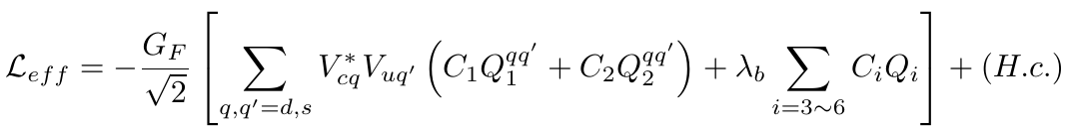


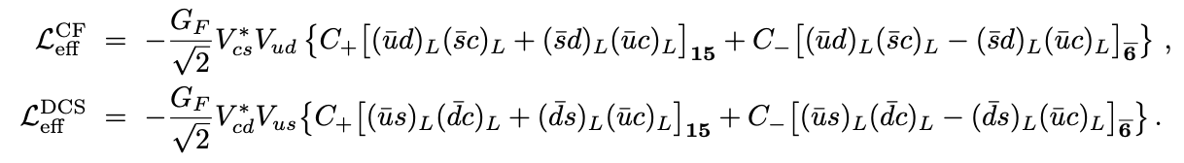
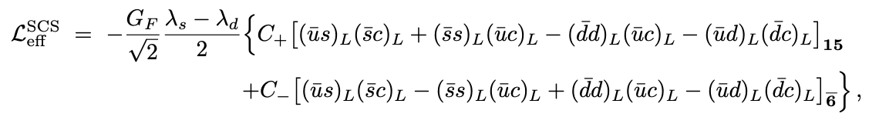
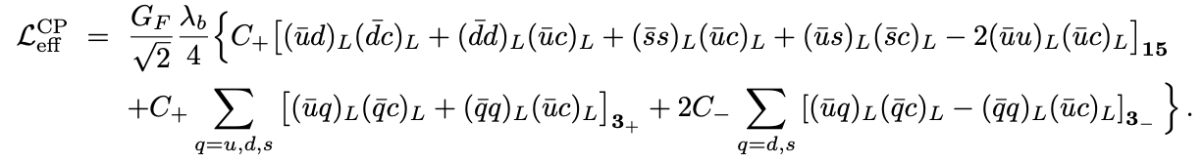

CKM matrix element relation: $λ_{d}+λ_{s}+λ_{b}=0; (λ_{q}={ V}_{cq}^{∗}V_{uq})$
$3⊗\overline{3}⊗3=3 ⨁ 3 ⨁\overline{ 6} ⨁15$

Slide 5





$M=f^{a}{(P)}_{l}^{l}{\overline{B}}_{k}^{j}{H(\overline{6})}_{ij}{(B_{c})}^{ij}$ + …… $f^{e}{(P)}_{k}^{l}{\overline{B}}_{j}^{i}{H(15)}_{l}^{jk}{(B_{c})}_{i}$ + …… + $f_{3}^{a}{(P)}_{k}^{k}{\overline{B}}_{i}^{j}{H(3)}^{i}{(B_{c})}_{j}$ + ……
4-terms
5-terms
4-terms
k
l
$$P$$
c
j
$$f^{e}{(P)}_{k}^{l}{\overline{B}}_{j}^{i}{H(15)}_{l}^{jk}{(B_{c})}_{i}$$
a
m
b
n
$$f^{e}{(P)}_{k}^{l}ε^{mni}{(\overline{B})}_{mnj}{H(15)}_{l}^{jk}ε_{abi}{(B_{c})}^{ab}$$
$$B_{c}$$
$$\overline{B}$$
The specific process is derived by expanding these amplitudes.

Slide 6

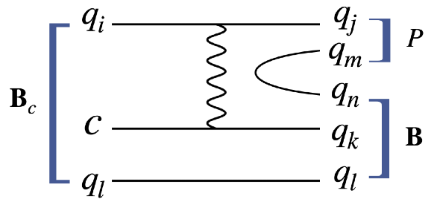


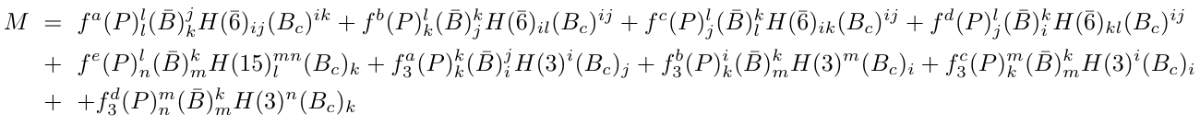
First Measurement of the Decay Asymmetry of pure W-exchange Decay $Λ_{c}^{+}→Ξ^{0}K^{+}$
Phys. Rev. Lett. 132, 031801
Indicate the phase shift between S- and P-wave is $δ_{p}−δ_{s}=−1.55±0.25±0.05$
Korner-Pati-Woo theorem:
Indicate the amplitudes should be complex.
51-parameters, 50 data
Fierz Transformation
Color symmetry
Reduce the number of amplitudes
35-parameters

Slide 7
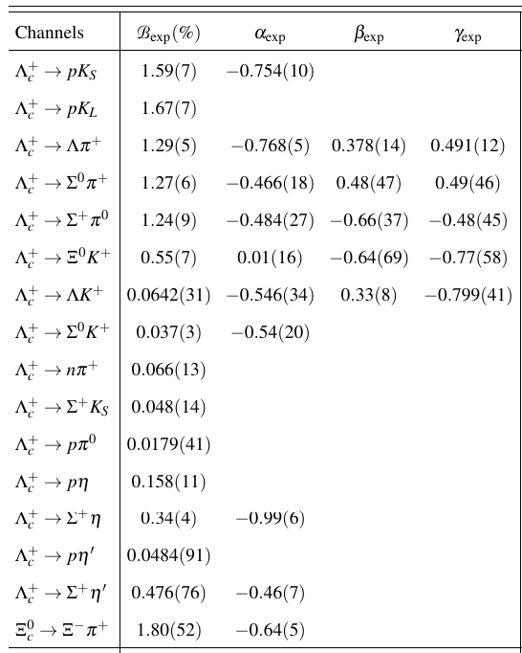


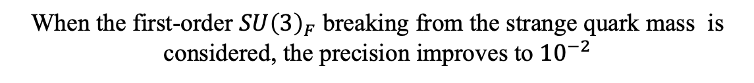

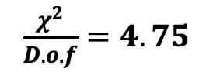
$$λ_{d}+λ_{s}+λ_{b}=0, (λ_{q}={ V}_{cq}^{∗}V_{uq})$$
$$λ_{b}≪1$$
👉
Drop $f_{3}^{a,b,c,d}$
👉
19-parameters
👉
$\frac{χ^{2}}{D.o.f}=4.75$
The leading-order $SU{\left(3\right)}_{F}$ results have a precision of ${10}^{−1}.$
CP-even experimental data
When the first-order $SU{\left(3\right)}_{F}$ breaking from the strange quark mass is considered, the precision improves to ${10}^{−2}$

Slide 8
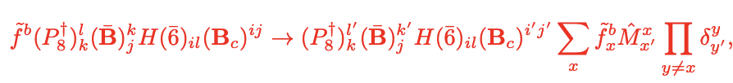

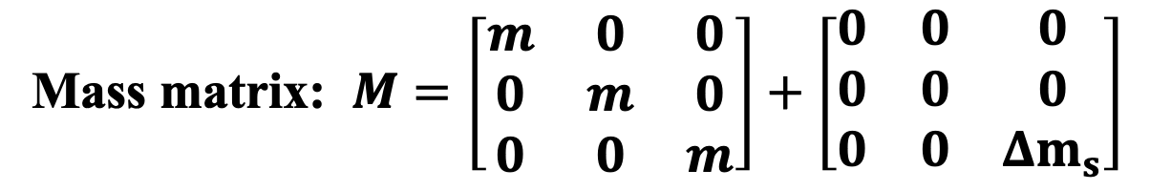
$SU\left(3\right)$ breaking
Mass matrix: $M=\left[\begin{matrix}m & 0 & 0 \\ 0 & m & 0 \\ 0 & 0 & m\end{matrix}\right]+\left[\begin{matrix}0 & 0 & 0 \\ 0 & 0 & 0 \\ 0 & 0 & {Δm}_{s}\end{matrix}\right]$
Insert the mass matrix into the amplitudes to reflect the first-order breaking effects .
Full Consideration will bring 15 complex parameters with $H\left(\overline{6}\right)$ and 22 with $H\left(15\right)$.
Scenario: According to the topological diagrams, the main SU(3) breaking is considered

Slide 9
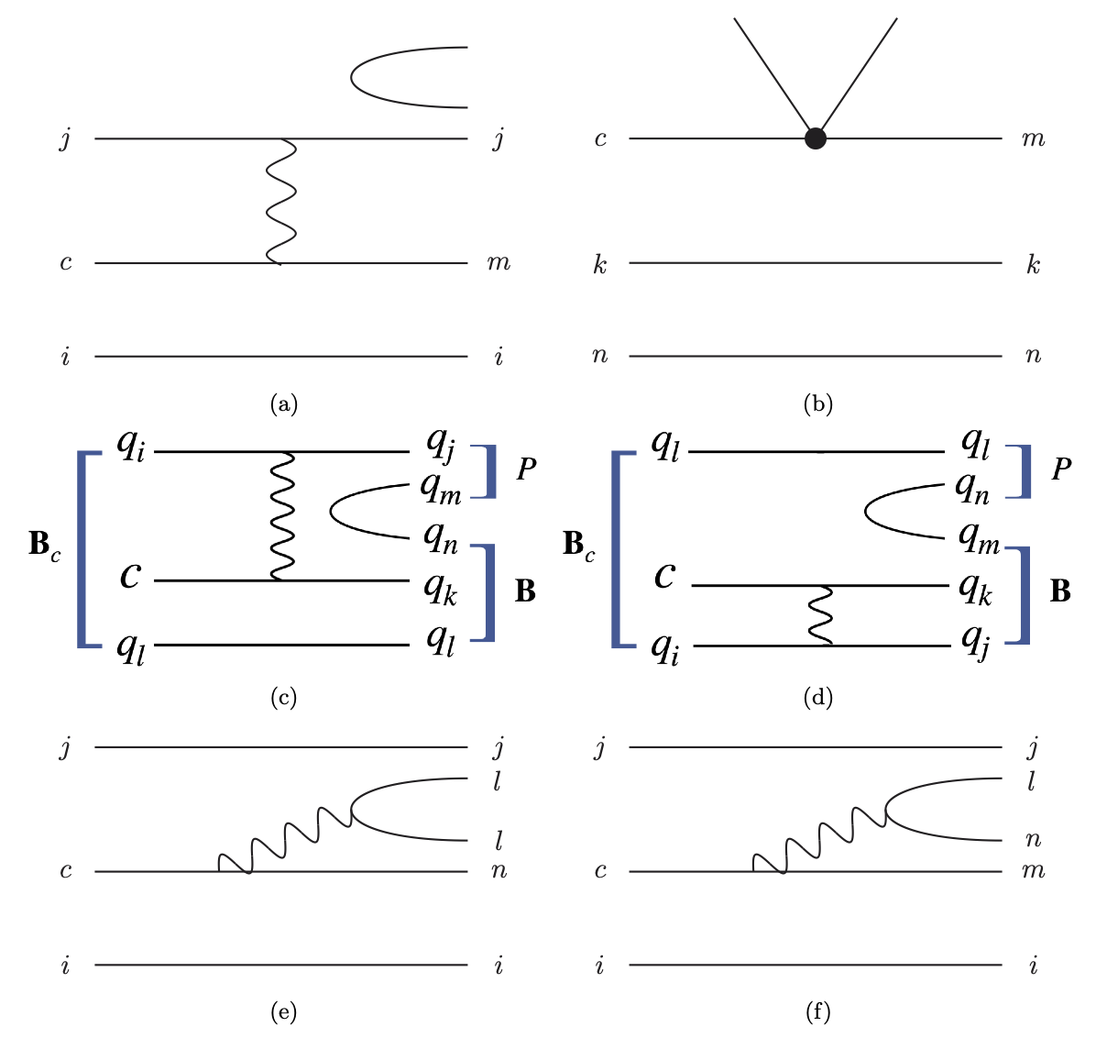
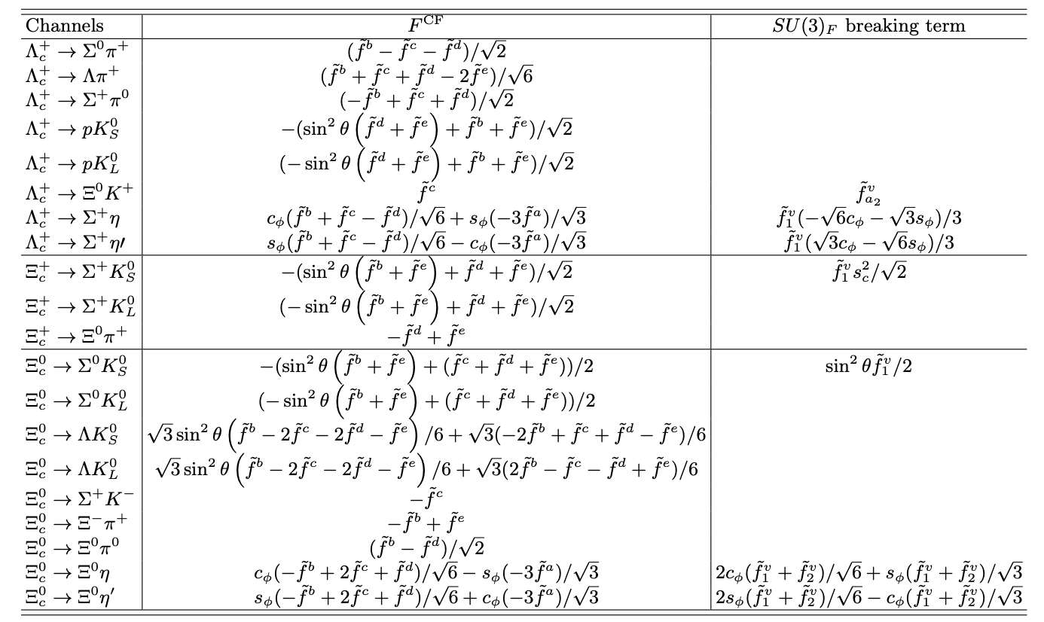

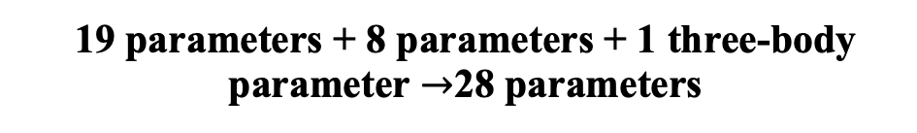
19 parameters + 8 parameters + 1 three-body parameter $→$28 parameters
$\frac{χ^{2}}{D.o.f}=2.36$

Slide 10
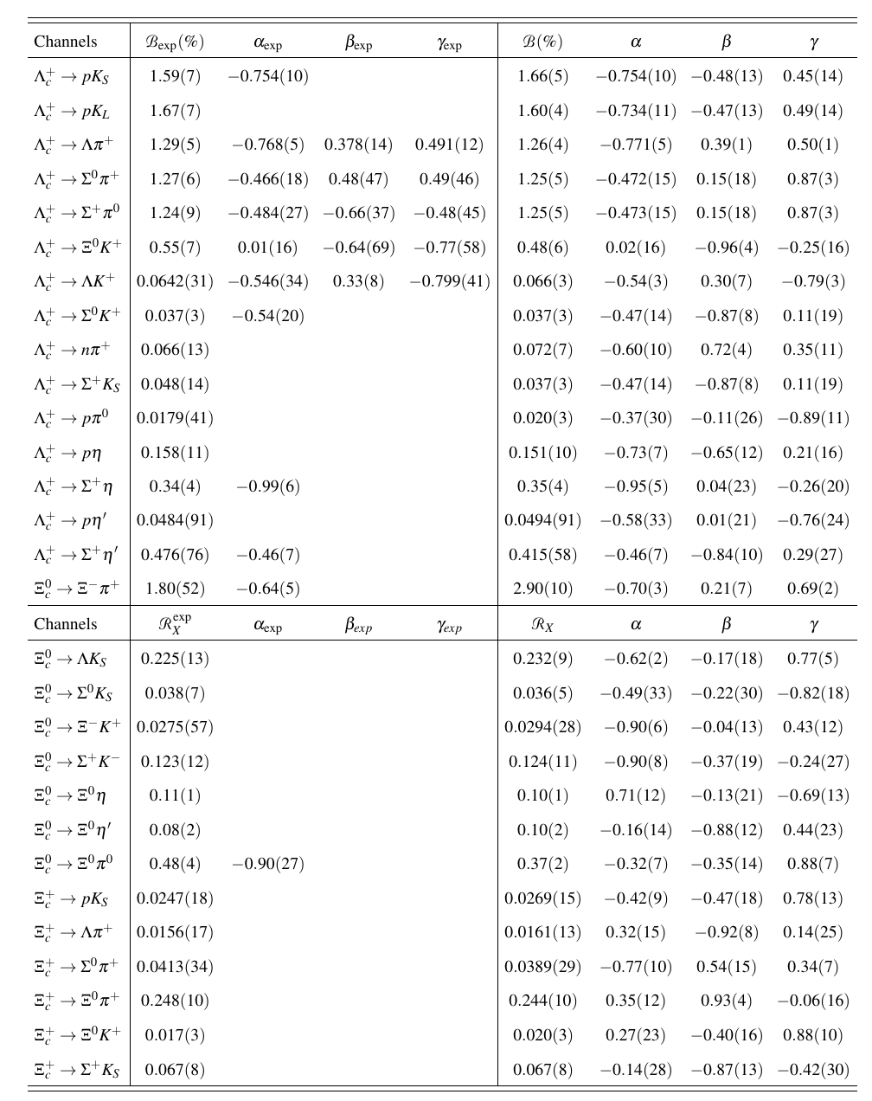
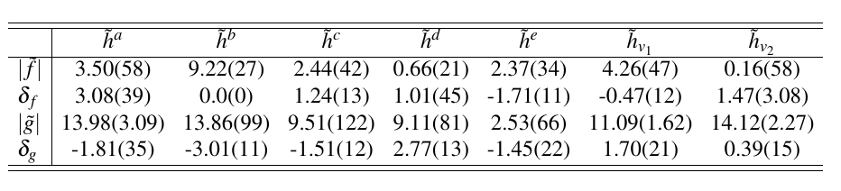
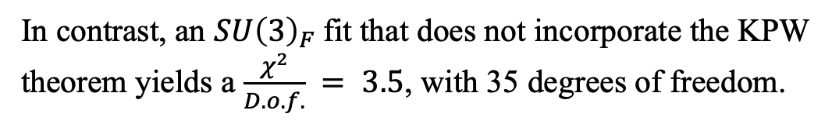
In contrast, an $SU{\left(3\right)}_{F}$fit that does not incorporate the KPW theorem yields a $\frac{χ^{2}}{D.o.f.} = 3.5$, with 35 degrees of freedom.

Slide 11
Theoretical derivation
Numerical results
Final state scattering

Slide 12



Theoretical derivation
$$V_{cs}V_{us}^{∗}+V_{cd}V_{ud}^{∗}+V_{cb}V_{ub}^{∗}=0$$
$λ_{b}=V_{cb}V_{ub}^{∗}$ $≪1$
$${−V}_{cs}V_{us}^{∗}≈V_{cd}V_{ud}^{∗}$$
Singly Cabibbo-suppressed process:
$$V_{cd}V_{ud}^{∗}{M_{1}+V}_{cs}V_{us}^{∗}M_{2} → V_{cd}^{∗}V_{ud}{M_{1}+V}_{cs}^{∗}V_{us}M_{2}$$
$$V_{cd}V_{ud}^{∗}{M_{1}+V}_{cs}V_{us}^{∗}M_{2} = V_{cd}^{∗}V_{ud}\left(M_{1}−M_{2}\right)$$

Slide 13
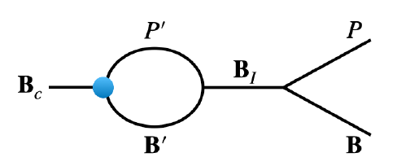
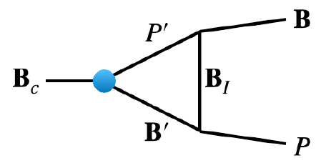
The contribution of the 3 terms are non-negligible, determining its value is not straightforward. At present, there is insufficient data to support a fully model-independent analysis to obtain it.
The semi–data-driven approach, Final state scattering (FRS)
The main of FRS is to determine the relationship between 15, $\overline{6}$and 3. Analyzing the $SU{\left(3\right)}_{F}$flavor structure of the FSR in elastic scattering in one loop.

Slide 14

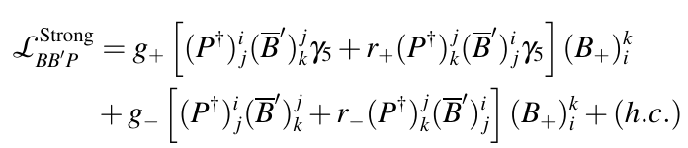
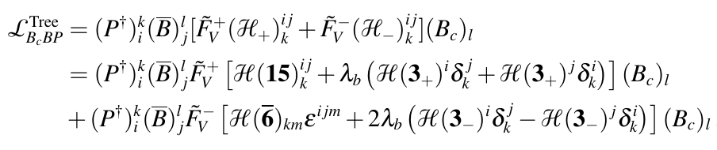
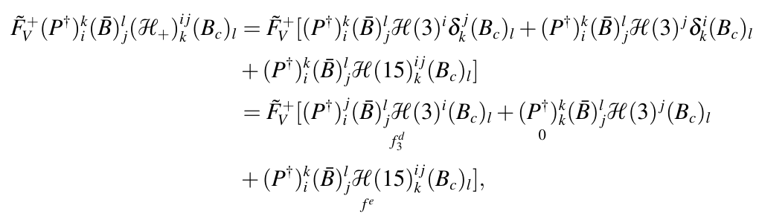
The full effective Lagrangian at hadron level：

Slide 15
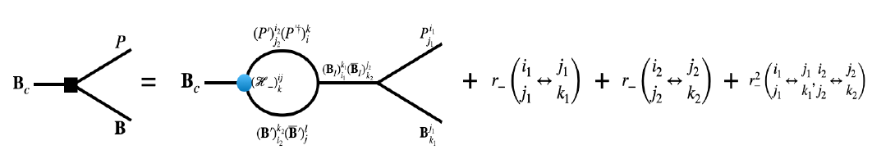
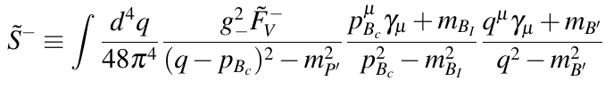
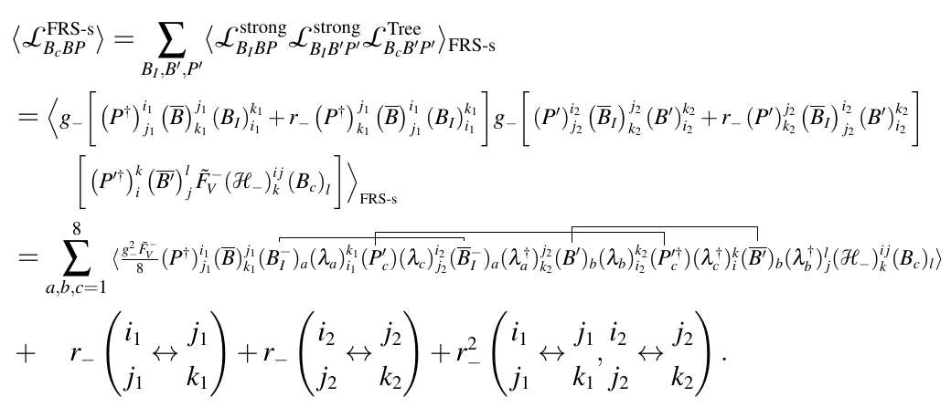
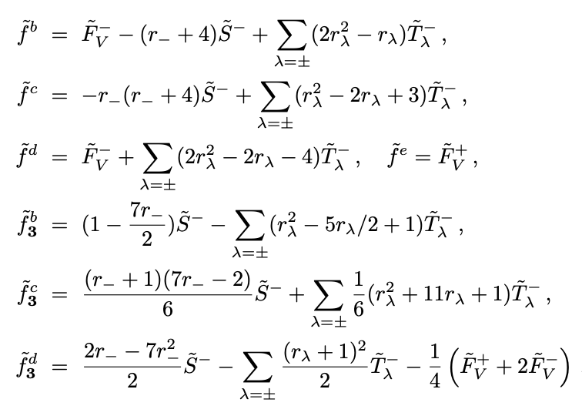
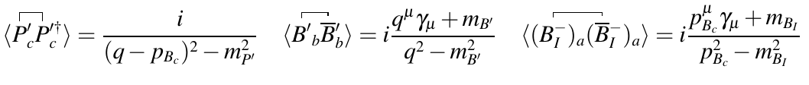
S - Channel

Slide 16
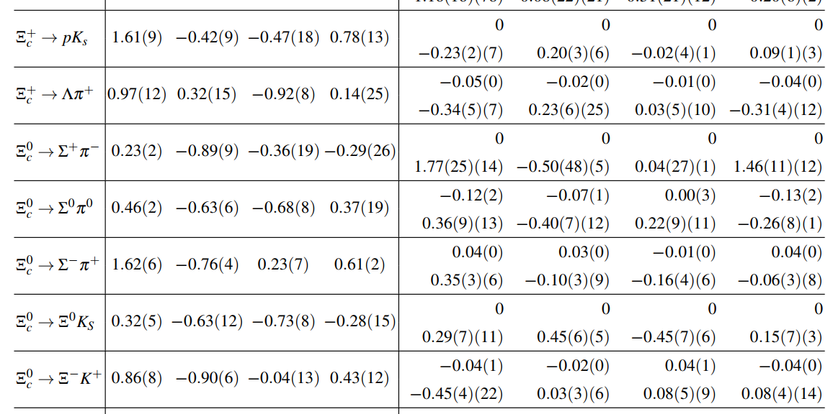
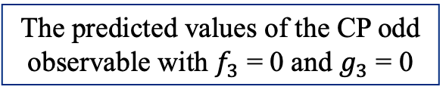
Numerical results
The predicted values of the CP odd observable with $f_{3}$ = 0 and $g_{3}$ = 0
The predicted values of the CP odd observable from the re-scattering mechanism
Improve CP violation at least by an order

