Slide 1
Weekly Report
Minghao Li 2025.08.26

Slide 2
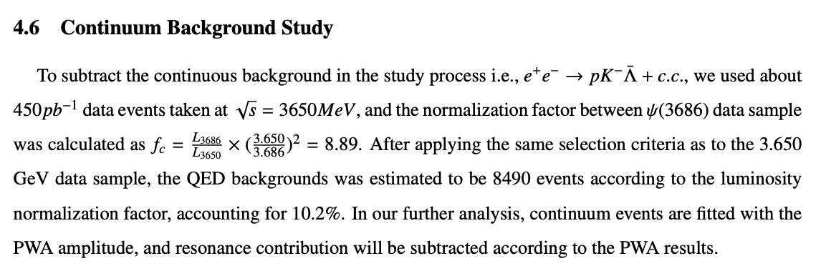
$$ψ\left(3686\right)→pK^{−}\overline{Λ}+c.c.$$
p12, L4: we can see your factor is 8.89, so the subtraction may introduce larger statistical error. so what about using the 3.77 GeV data?
We need to run the data at 3.773 GeV.

Slide 3
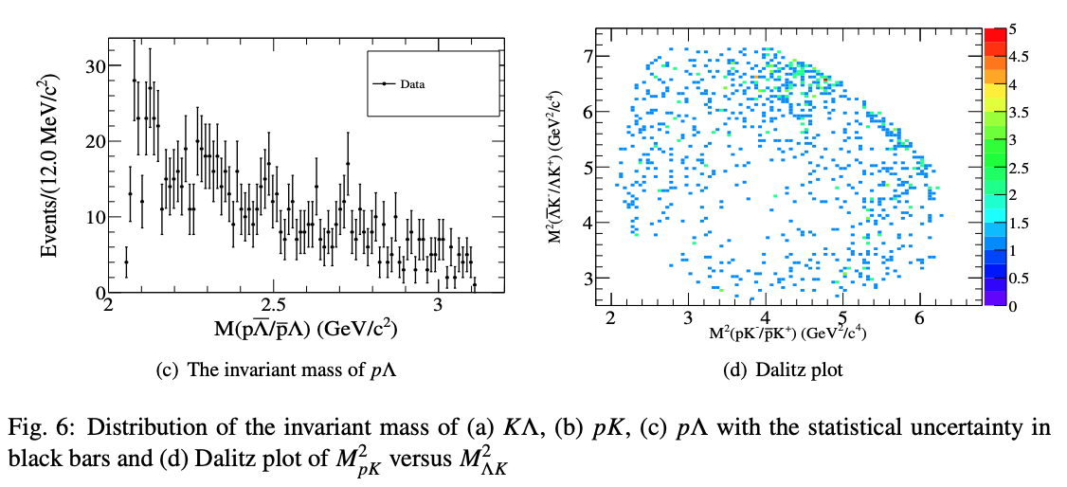
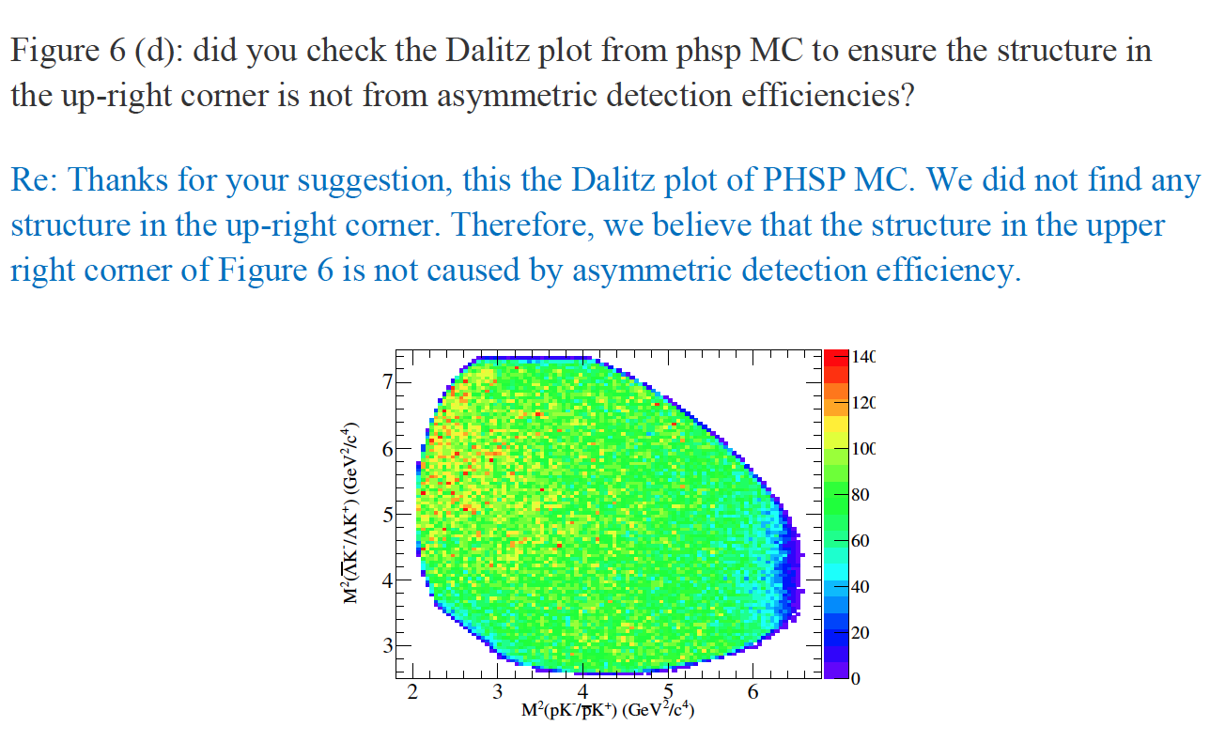
$$ψ\left(3686\right)→pK^{−}\overline{Λ}+c.c.$$

Slide 4
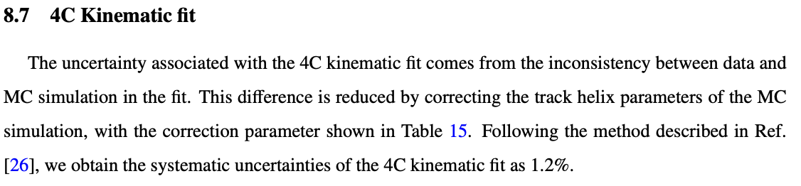
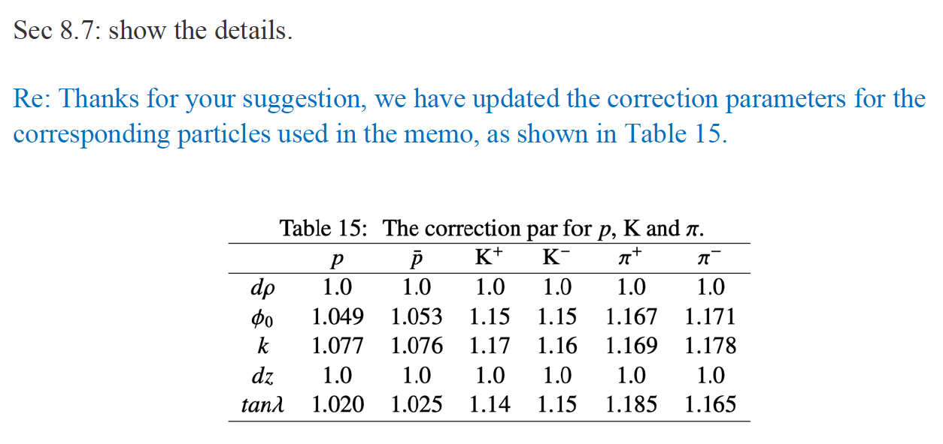
$$ψ\left(3686\right)→pK^{−}\overline{Λ}+c.c.$$

Slide 5
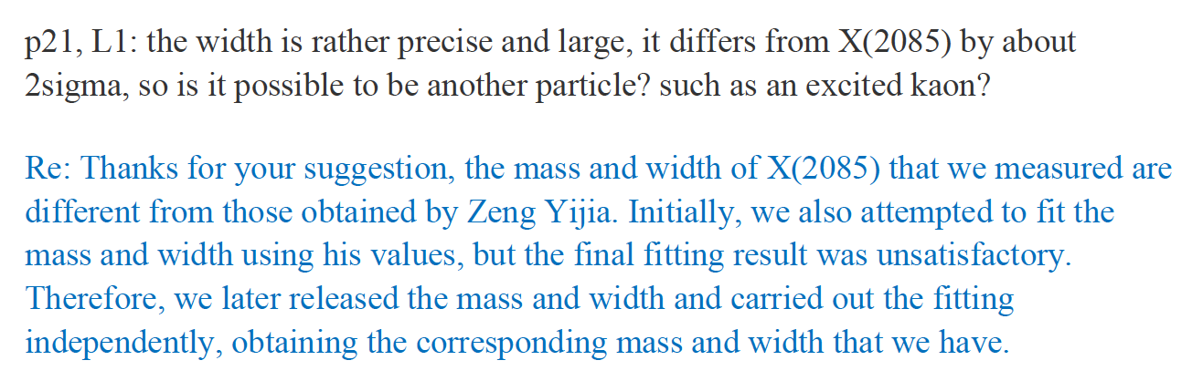
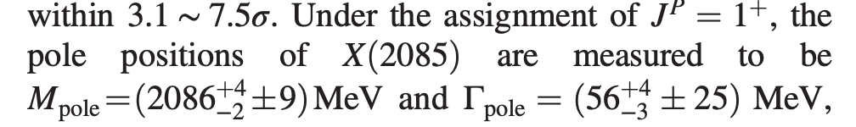
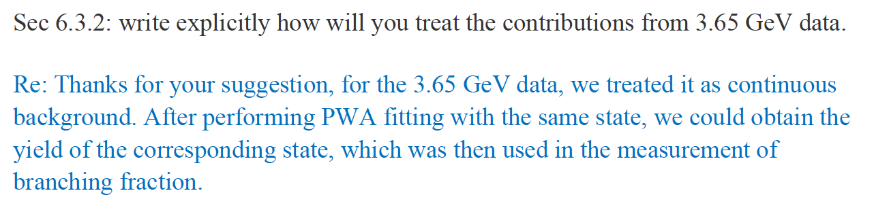
$$ψ\left(3686\right)→pK^{−}\overline{Λ}+c.c.$$

Slide 6
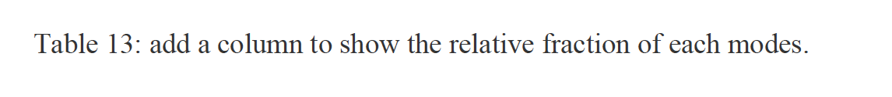
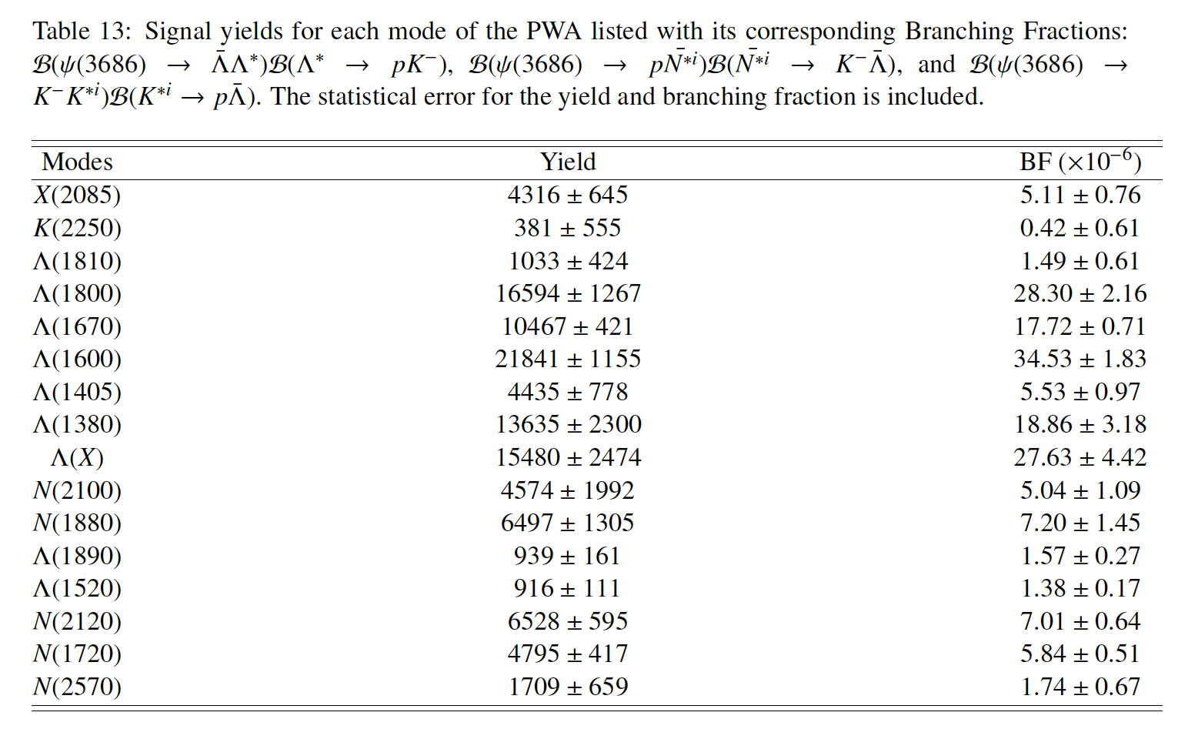
$$ψ\left(3686\right)→pK^{−}\overline{Λ}+c.c.$$

Slide 7
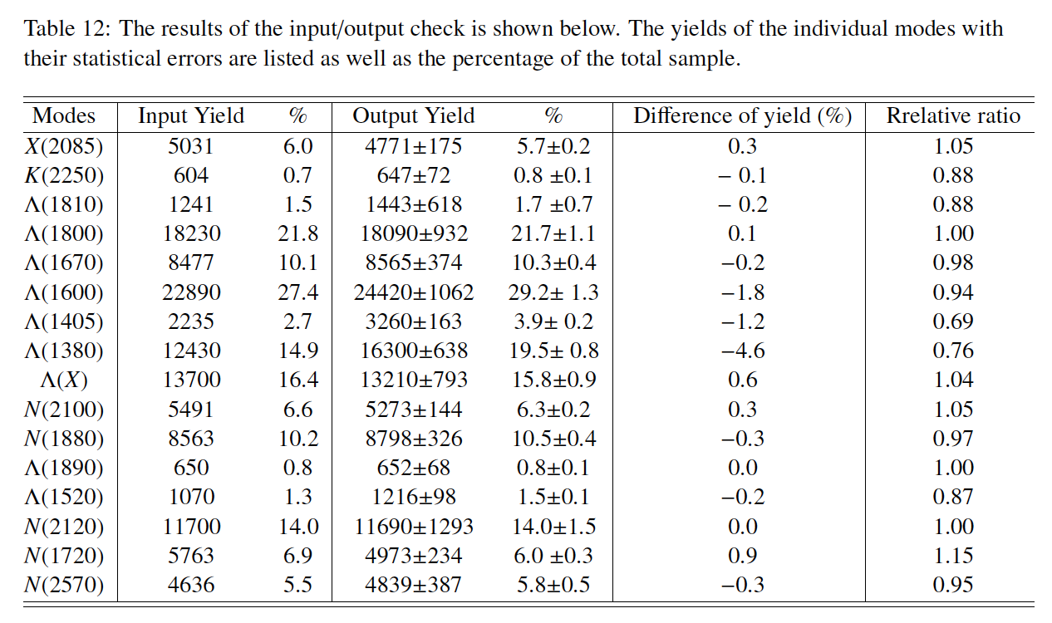
$$ψ\left(3686\right)→pK^{−}\overline{Λ}+c.c.$$
Table 12: how did you calculate the `Difference of yield'? my calculation does not meet yours.
Re: Thanks for your suggestion, regarding the discrepancies in the calculations, we are not clear about your calculation method at present and thus cannot draw a conclusion. If it is convenient for you, please tell us your calculation method so that we can compare and study it.

