Slide 1


P(muon) question
Remove ${\text{P}}_{\text{μ}} \text{>}{ \text{P}}_{\text{π}}$

Slide 2
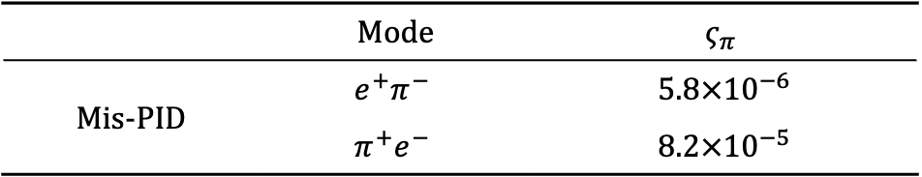
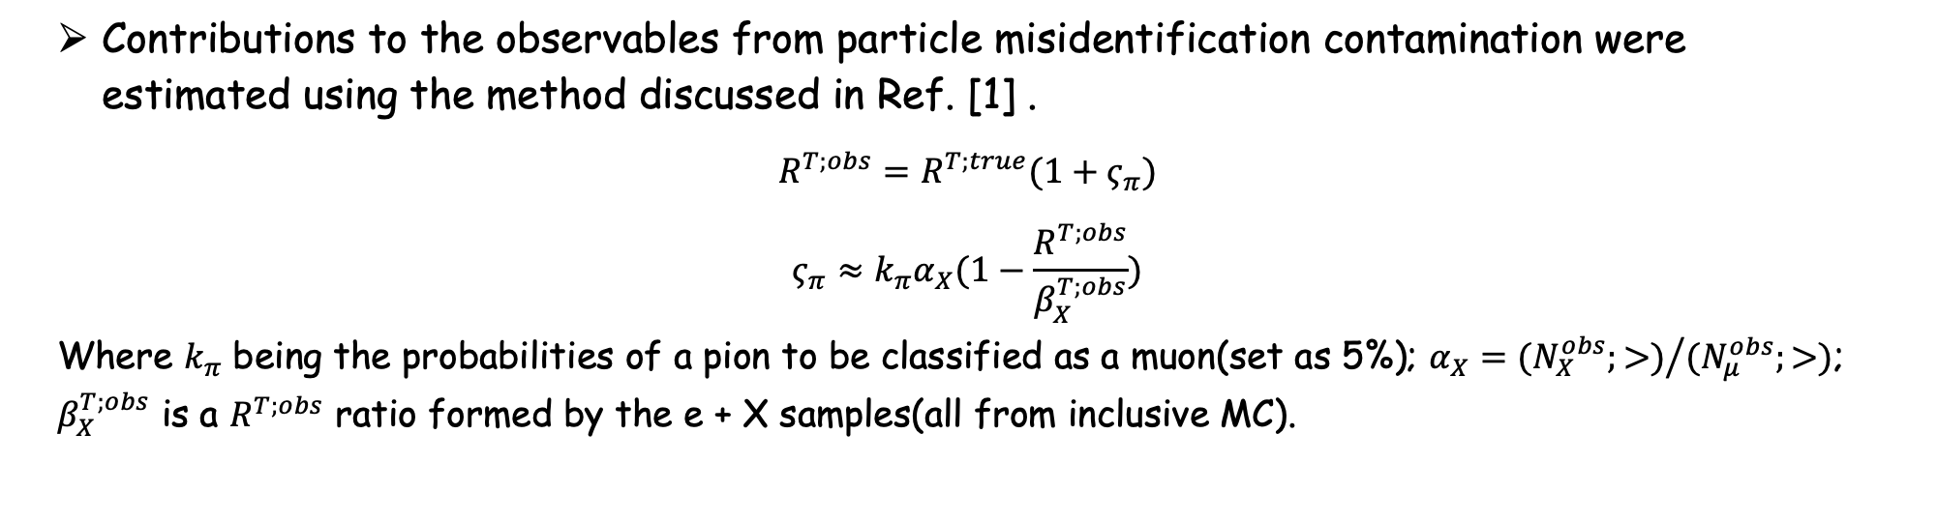
Sensitivity vs. Background
Contributions to the observables from particle misidentification contamination were estimated using the method discussed in Ref. [1] .
$$R^{T;obs}=R^{T;true}(1+ς_{π})$$
$$ς_{π}≈k_{π}α_{X}(1−\frac{R^{T;obs}}{β_{X}^{T;obs}})$$
Where $k_{π}$ being the probabilities of a pion to be classified as a muon(set as 5%); $α_{X}={(N_{X}^{obs};>)}/{(N_{μ}^{obs};>)}$; $β_{X}^{T;obs}$ is a $R^{T;obs}$ ratio formed by the e + X samples(all from inclusive MC).
 | Mode | $$ς_{π}$$
Mis-PID | $$e^{+}π^{−}$$ | $5.8×{10}^{−6}$
 | $${π^{+}e}^{−}$$ | $8.2×{10}^{−5}$
[1] T.Ohshima et al., Prog. Theor. Phys., 99(1998) 413.

Slide 3
Cut flow
改统计误差，加入背景的统计敏感性

Slide 4
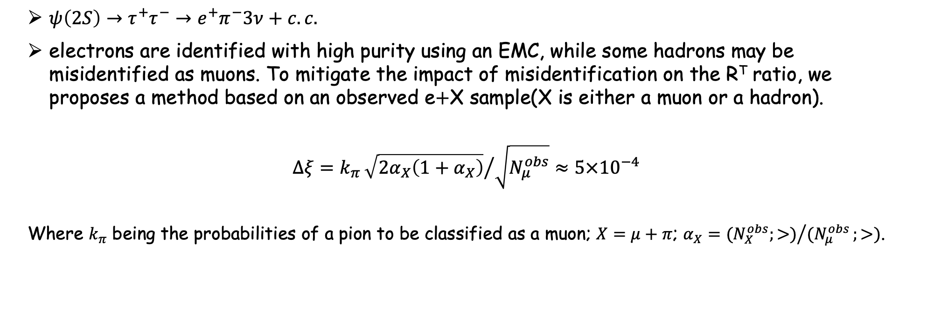
Sensitivity vs. Background
$ψ\left(2S\right)→τ^{+}τ^{−}→e^{+}π^{−}3ν+c.c.$
electrons are identified with high purity using an EMC, while some hadrons may be misidentified as muons. To mitigate the impact of misidentification on the R^{T} ratio, we proposes a method based on an observed e$+$X sample(X is either a muon or a hadron).
$$Δξ=k_{π}{\sqrt{2α_{X}\left(1+α_{X}\right)}}/{\sqrt{N_{μ}^{obs}}}≈5×{10}^{−4}$$
Where $k_{π}$ being the probabilities of a pion to be classified as a muon; $X=μ+π$; $α_{X}={{(N}_{X}^{obs};>)}/{(N_{μ}^{obs}};>)$.

