Slide 1




Gravitational waves from
the early universe:
My personal historic view
Department of Physics
Jun’ichi Yokoyama

Slide 2

Gravitational wave Physics and Astronomy
New Eyes to Observe the Universe

Slide 3

Gravitational wave Physics and Astronomy
Science Goals
Fundamental Physics
Is GR the correct theory of gravity?
Do black holes really have “no hair” ?
What is the neutron star equation of state?
Astrophysics
What is the black hole mass distribution?
How did supermassive BHs grow?
What are the progenitors of GRBs?
Cosmology
Can we directly see before the CMB era?

Slide 4
Gravitational
waves provide
new eyes to
see the earliest
Universe.
Today 13.8Gyr
dark energy
Gravitational
waves can probe
up to inflation era.
galaxy formation
We can probe
another tiny dark
age between
inflation and
Big Bang
Nucleosynthesis
Shedding new
“lignt” on this
epoch
first star
Electromagnetic waves can
probe only up to decoupling era.
dark age
decoupling 380kyr
reheating=Big Bang
inflation
multiproduction of universes
m

Slide 5
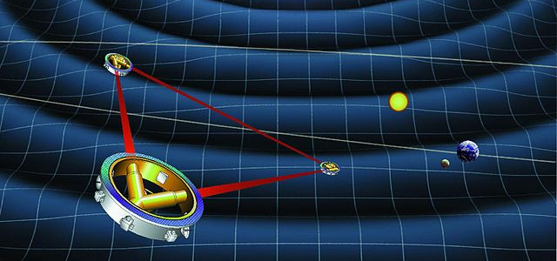
Direct detection of cosmological
Gravitational waves can be achieved
by space-based laser interferometers
Such as LISA, Taiji, TianQin, DECIGO,...

Slide 6
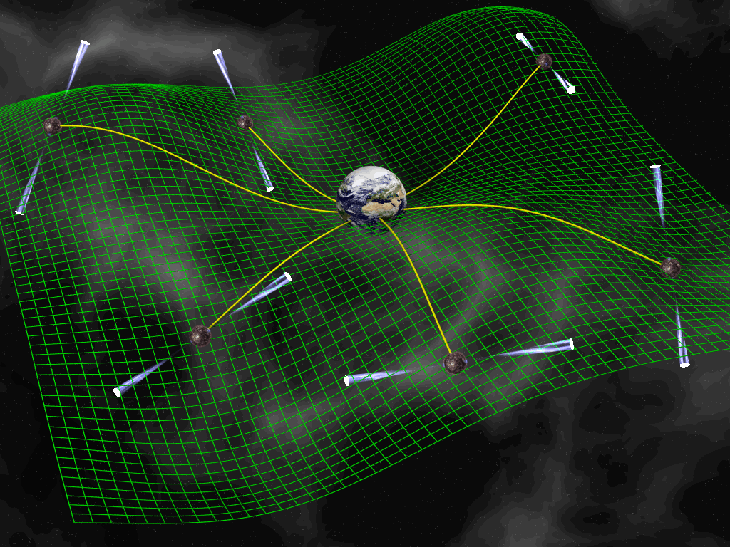
Other means of detection of
Cosmological gravitational waves
B-mode polarization
of Cosmic Microwave
Background (CMB)
Pulsar Timing
Arrays (PTAs)
LiteBIRD: approved by
JAXA in May 2019, but…
©David J. Champion

Slide 7
Sources of gravitational waves
from the early universe
Quantum tensor perturbations from inflation
GWs from second-order scalar perturbations
GWs from bubble collisions after phase transition
GWs from self-ordering scalar fields
GWs from topological defects esp. cosmic strings
Gravitational particle production of gravitons
。。。

Slide 8
Sources of gravitational waves
from the early universe
Quantum tensor perturbations from inflation

Slide 9
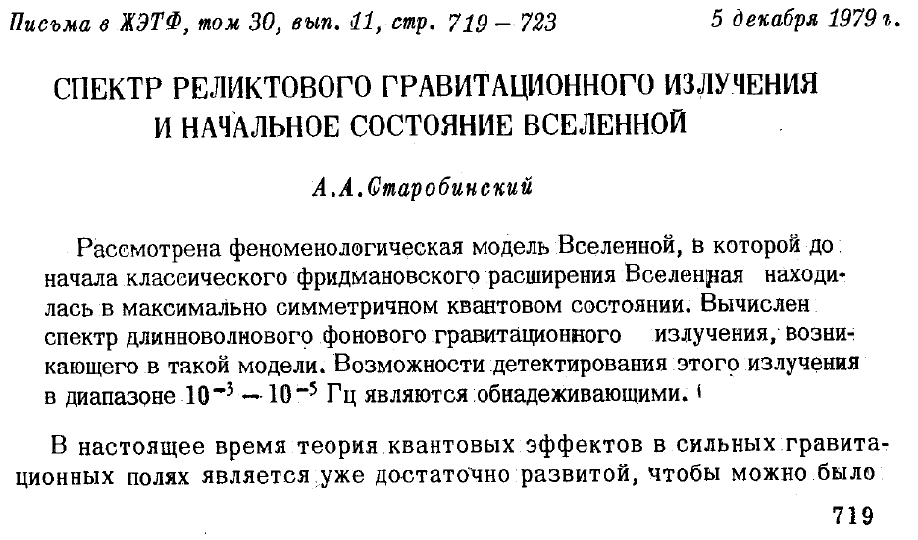
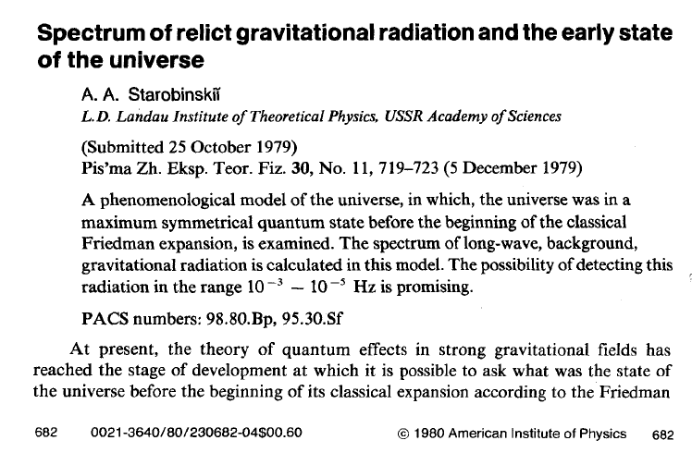
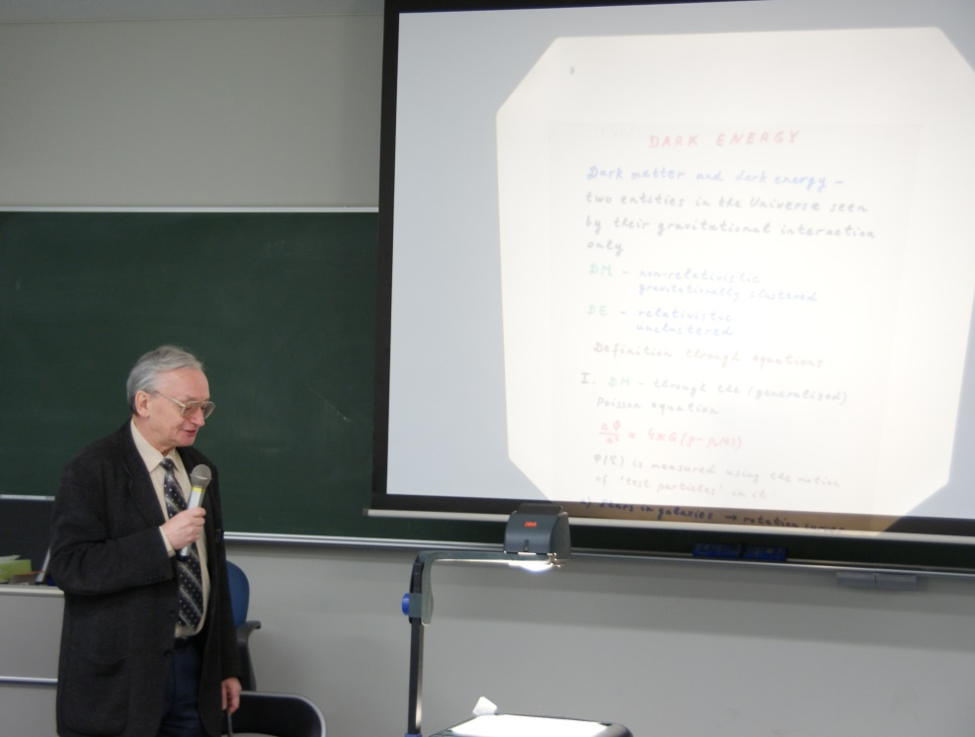
Quantum creation of gravitational waves in exponentially
expanding universe i.e. de Sitter space was discussed by
Alexei A. Starobinsky (1948-2023) in 1979, even before
the idea of cosmic inflation!
cf L. P. Grishchuk
Amplification of gravitational waves
in an isotropic universe
Soviet Physics JETP, Vol. 40, No. 3, p. 409-415
(1975年2月)

Slide 10
Why did Starobinsky work out this?
Because
he wanted to know the universe before the big bang,
said he.
Hot Fireball Universe: (Nearly) Thermal Equilibrium State
Only particles with extremely weak interactions
retain memory of the initial state.
This is why he focused on the graviton.
He postulated that the universe before the Friedmann era
must have been in a highly symmetric state based on
quantum consideration (Herald of quantum cosmology)
De Sitter space!
This ultimately led to considering the quantum generation of tensor fluctuations in an inflationary universe.

Slide 11
Tensor Perturbations (Quantum Gravitational Waves)
transverse
-traceless
They are equivalent with two massless scalar fields.
satisfies massless
Klein-Gordon eqn
Quantization in De Sitter background yields nearly
scale-invariant long-wave perturbations during inflation.
Starobinsky (1979)

Slide 12
Evolution of gravitational waves in the standard inflationary Universe
scale
Field oscillation
dominant
Radiation
H⁻¹
Hubble horizon
Amplitude of GW is constant
when its wavelength is longer
than the Hubble radius
between and .
Radiation
dominant
a(t)λ
inflation
After entering the Hubble
radius, the amplitude
decreases as
and the energy density as
.
Matter
dominant
H⁻¹
Matter
dominant
time
Reheating
When , the tensor perturbation evolves as

Slide 13
Density parameter in GW per logarithmic frequency interval
When the mode reentered the Hubble horizon at ,
the angular frequency is equal to , so we find
at horizon reentry

Slide 14
After entering the Hubble horizon at ,
: equation of state parameter
Radiation dominated era:
Matter dominated era:

Slide 15
as a function of frequency
We may determine the equation of state in the early Universe.
We may determine thermal history of the early Universe.
N. Seto & JY (03), Boyle & Steinhardt (08), Nakayama, Saito, Suwa, JY (08), Kuroyanagi et al (11)…

Slide 16
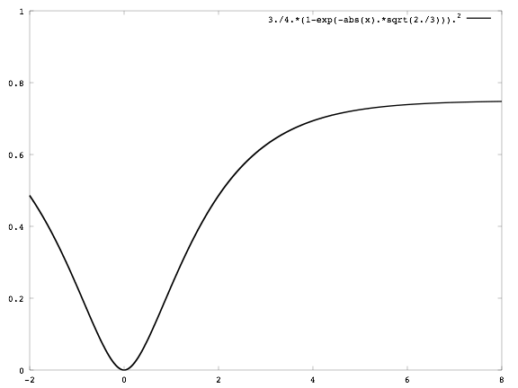

Standard potential-driven inflation models
effective potential
inflation
reheating
M
Inflation is followed by a coherent oscillation of the inflaton which behaves like non-relativistic matter
with EOS parameter if the mass term dominates the potential.
in high frequency region

Slide 17
Thermal History is inprinted on the spectrum of GWs.
Sensitivity curves of various
specifications of DECIGO
We can determine
the reheating
temperature T_{R}
(Nakayama, Saito, Suwa & JY 08)
characteristic
frequency at
reheating time

Slide 18
If inflation is followed by a kination regime with w=1,
high frequency gravitational waves are enhanced.
Current amplitude in
this high frequency
region is independent
of the scale of inflation.
This continues to the
frequency corresponding
to the comoving horizon
scale at the end of
inflation.
k-& G-inflation
CMB B-mode
(Chiba, Tashiro & Sasaki 04)
Standard inflation

Slide 19
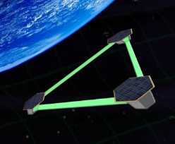
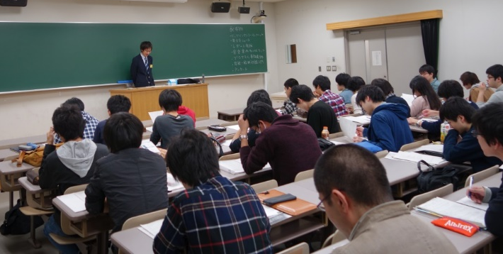
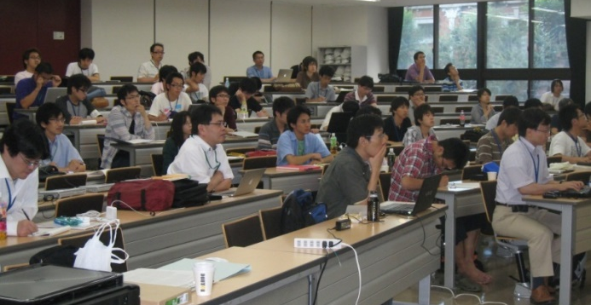
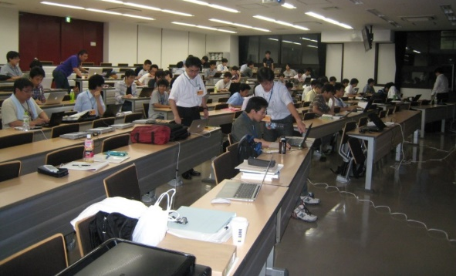
LiteBIRD can measure the tensor-to-scalar ratio,
to determine the energy scale of inflation, or
When inflation happened.
DECIGO can measure the reheating temperature, or
When big bang happened.
This is my ultimate goal.
DECIGO cannot be realized without the success of
KAGRA, so I started working on KAGRA first, organizing
a number of activities including data analysis schools,
and finally succeeded in funding a for computer cluster
for data analysis at RESCEU.

Slide 20
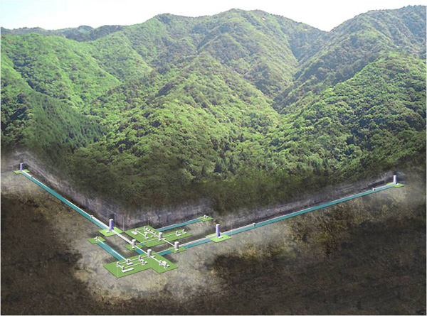
KAGRA
World’s first 2.5 generation GW detector
Cryogenic to reduce
thermal noises
(T=20K @mirrors)
Underground to reduce
seismic noises
3km
3km
Fabry-Perot Michelson type Laser interferometer

Slide 21
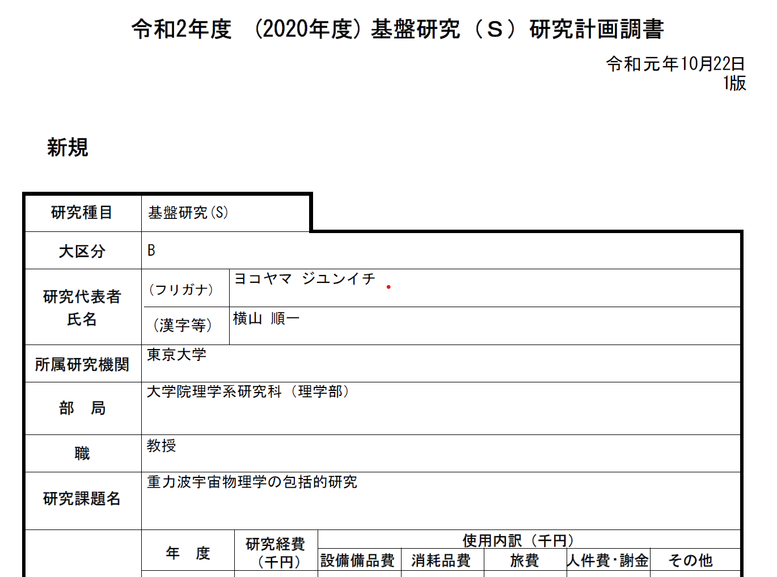
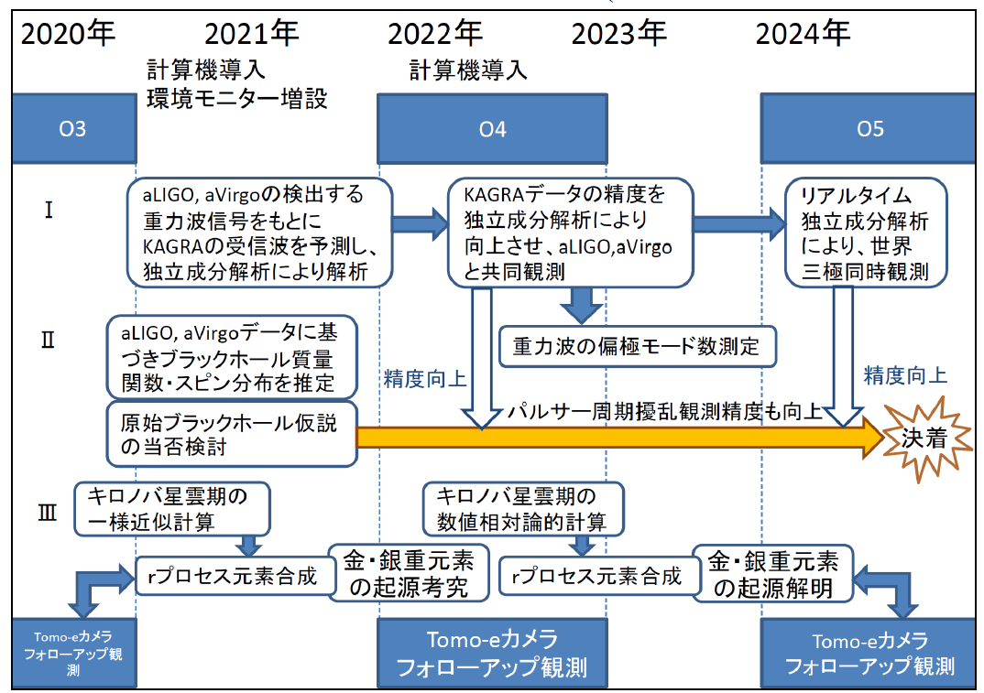
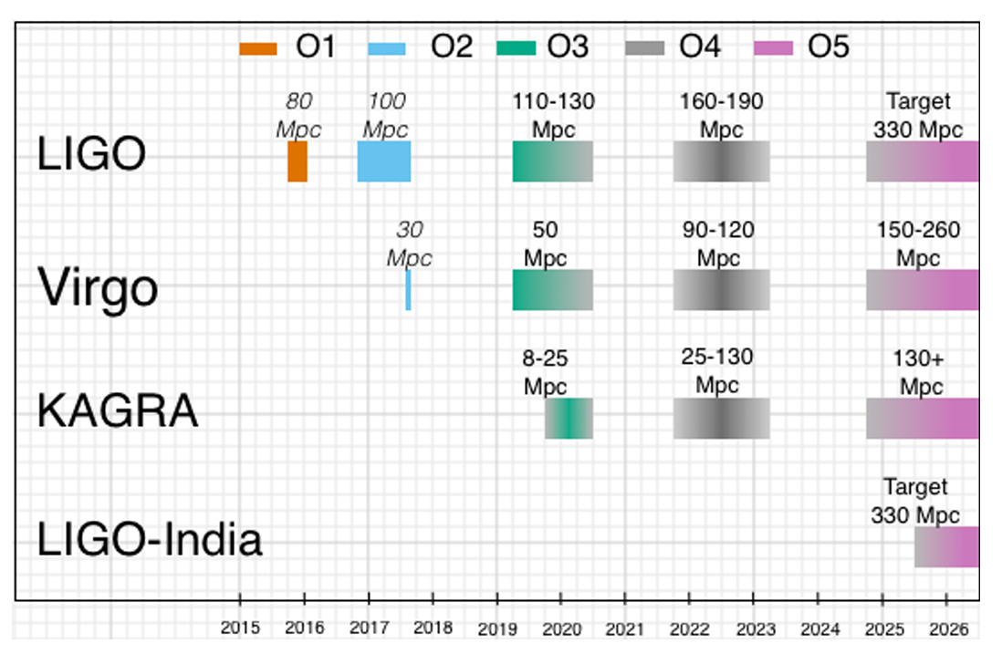
October 2019
Expected time line
as of 2019
Comprehensive study of gravitational-wave astrophysics

Slide 22
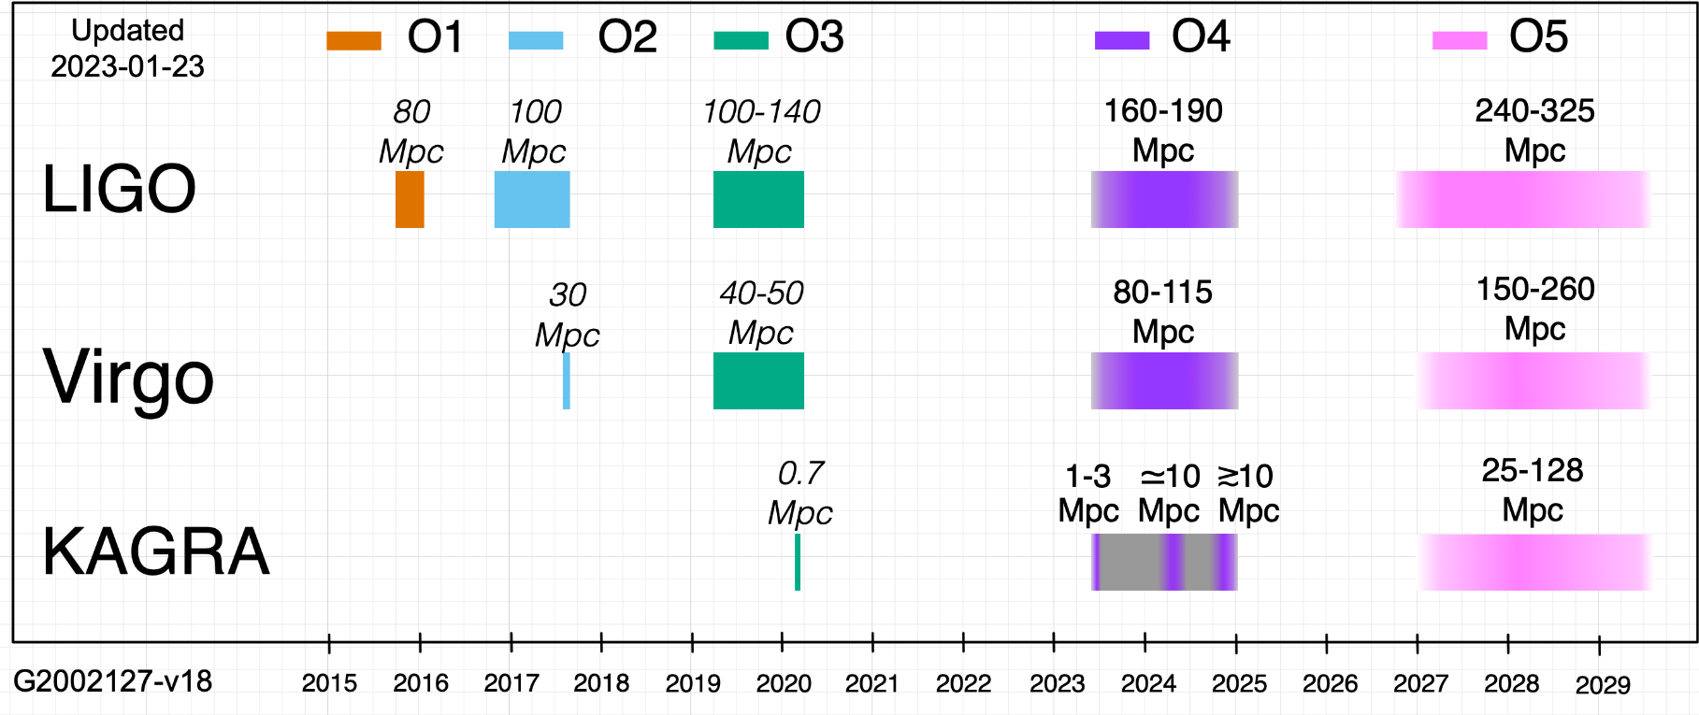
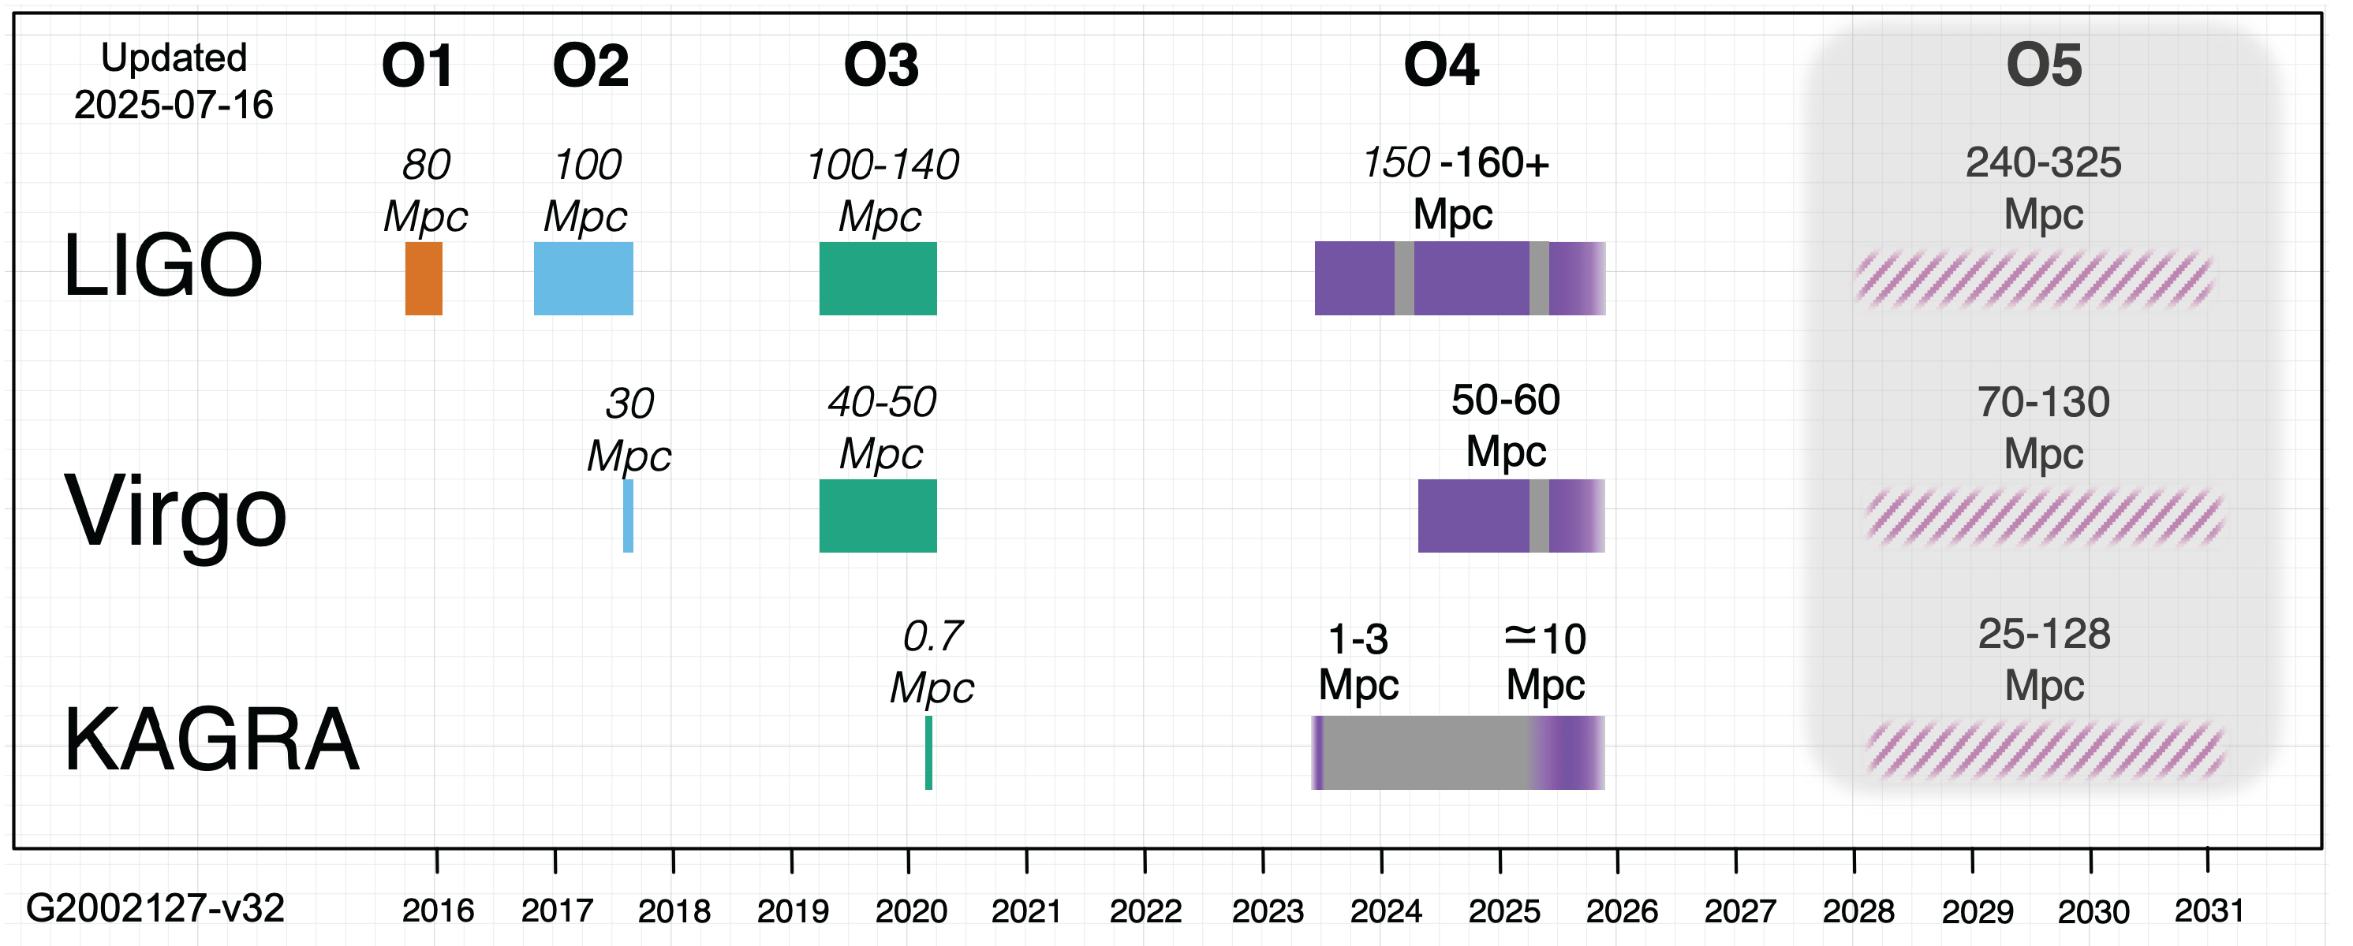
In reality, the original plans were never realized.

Slide 23
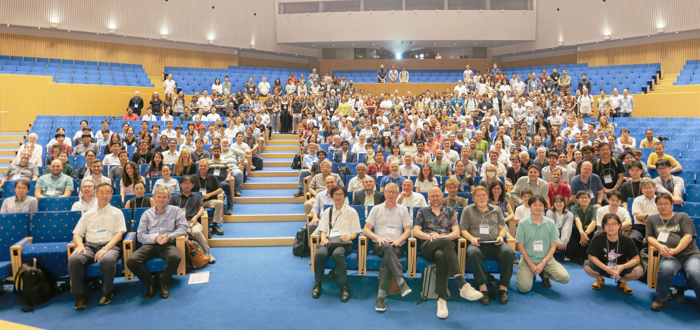
In reality, the original plans were never realized.
I felt uneasy for obtaining a big funding based on
an unrealistic research situation.
So I decided to take a position of KAGRA Science
Congress chair, which is regarded as the spokesperson
of KAGRA project for two years from August 2021 until
September 2023 when we hosted an LVK meeting.

Slide 24
In reality, the original plans were never realized.
I felt uneasy for obtaining a big funding based on
an unrealistic research situation.
So I decided to take a position of KAGRA Science
Congress chair, which is regarded as the spokesperson
of KAGRA project for two years from August 2021.
By the way, my research plan included the study of the origin of BHs discovered by LIGO and Virgo, too.

Slide 25
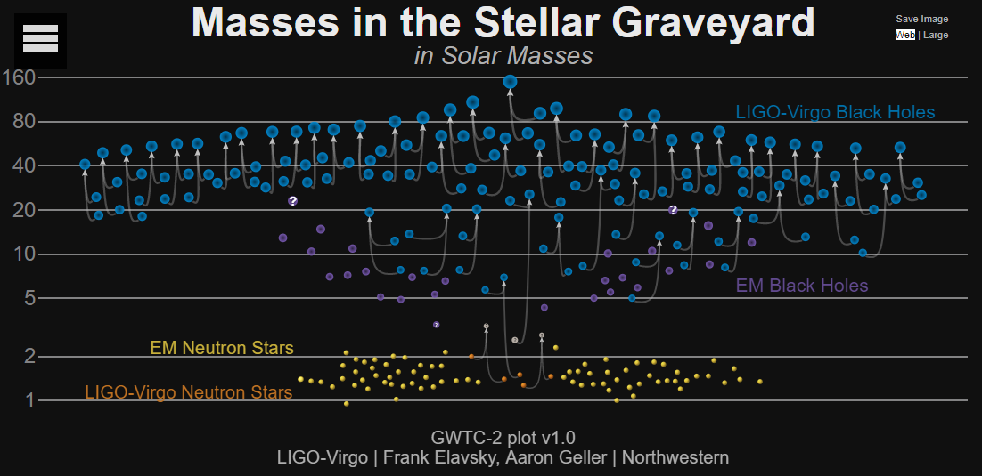
Big new mystery revealed by aLIGO/aVirgo
solar mass
So many black holes much heavier than the sun,
which are difficult to explain by normal stars as
they lose masses by stellar wind before collapsing.

Slide 26
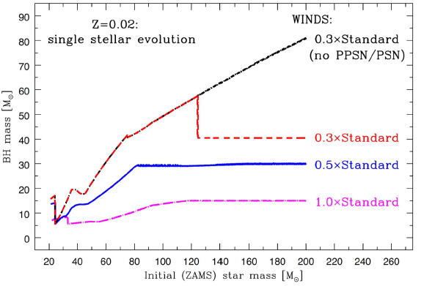

Slide 27
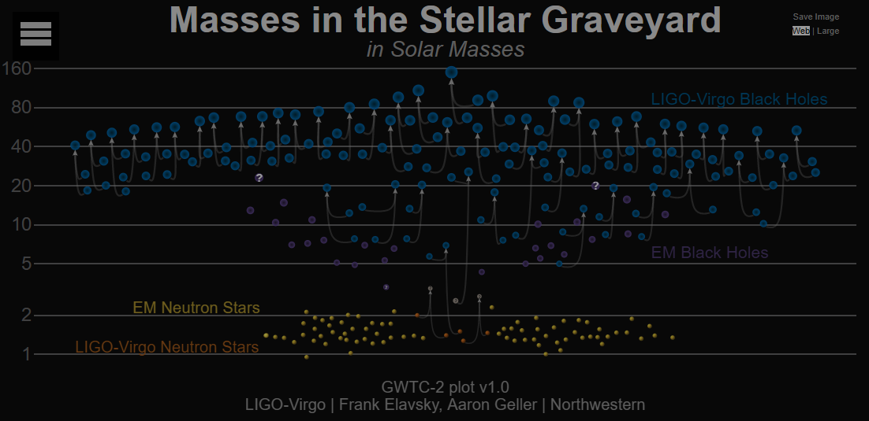
Big new mystery revealed by aLIGO/aVirgo
So many black holes much heavier than the sun,
which are difficult to explain by normal stars as
they lose masses by stellar wind before collapsing.
●First generation stars with low metallicity or
●Primordial black holes (PBHs) created just after
the Big Bang.

Slide 28


This question may be answered by
RESCEU
Research Center for the Early Universe
School of Science, The University of To
Tokyo, 113-0033, Japan
INVITATION
TO
Multi-frequency
Gravitational-Wave
Astrophysics
RESCEU
Research Center for the Early Universe
School of Science, The University of Tokyo
Tokyo, 113-0033, Japan

Slide 29
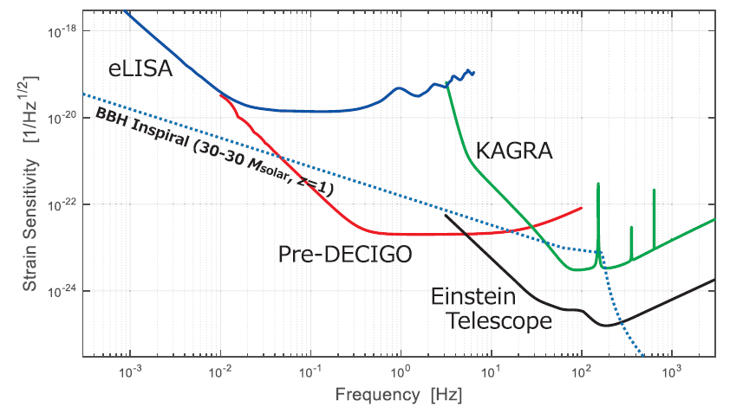
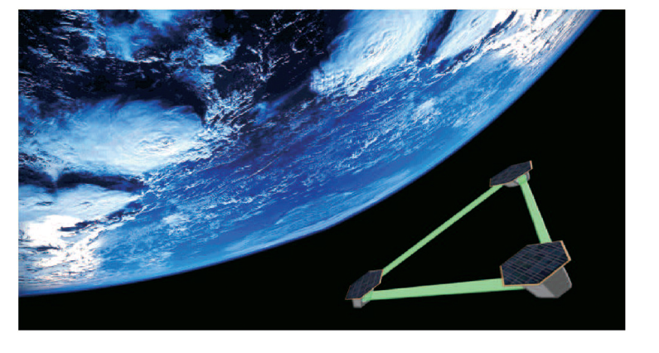
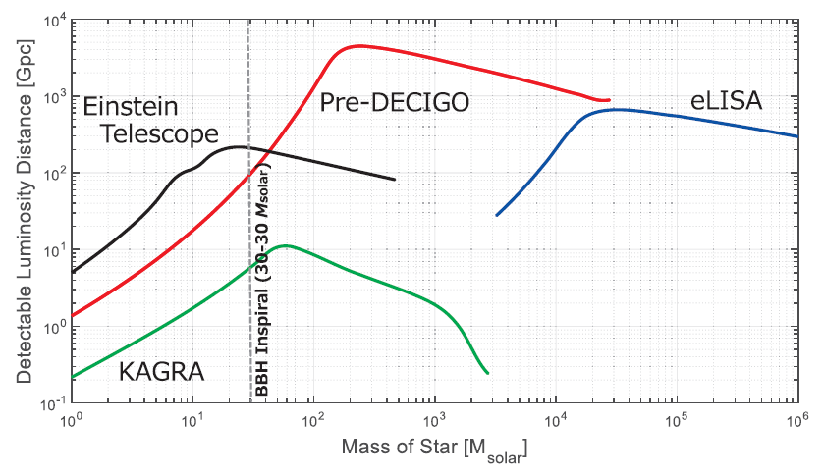
Space-based laser interferometer B-DECIGO can probe…
B-DECIGO
30 solar mass BHs’
merger up to redshift
ｚ～30, while first stars do
not exist beyond ｚ～10.
If B-DECIGO finds a distant
event, it would be from
primordial black holes!
B-DECIGO

Slide 30
We want to know the answer
without launching satellites!
Quantum tensor perturbations from inflation
GWs from second-order scalar perturbations

Slide 31
Generation of gravitational waves from density fluctuations
Formation of Primordial
Black Holes (PBHs) on
a specific mass scale.
Density/curvature fluctuations have
a large amplitude on a specific scale.
horizon mass when the peak entered
the Hubble radius
Gravitational waves
(tensor perturbations)
generated from second-
order density/curvature
fluctuations are significant.
Kawaguchi,Kawasaki,Takayama,
Yamaguchi,&JY 08
Large curvature
fluctuation resulting
in PBH formation
CMB & LSS
(Mollerach,Harari,& Matarrese 04,
Ananda,Clarkson,& Wands 07,
Baumann,Steinhardt,Takahashi,& Ichiki 07)
Large 2nd order
tensor fluctuations

Slide 32
What I am going to discuss is NOT GWs associated with PBH
formation which are created only at high σpeaks.
density fluctuation
PBH
position
but those created by (density fluctuations)×(density fluctuations)
as a second order effect in cosmological perturbation theory.
×
This effect is much more universal than GWs associated with
PBH formation.

Slide 33

Saito & JY calculated it in the Newtonian gauge
Perturbed metric: Scalar modes: and ; Tensor modes .
in the radiation dominated regime.
Equation of motion for the transverse-traceless ( ) tensor mode
sourced by the second-order linear scalar perturbations :
These equations are obtained by writing the Einstein tensor
up to second order in and and first order in and apply
the projection operator to the transverse-traceless components.

Slide 34
Linear evolution equation suffices for in wavenumber space.
which is easily solved as
Evolution equation for is also easily solved by the Green function method.
to obtain

Slide 35
Contribution of GWs with wavenumber to the density parameter
with
where
We take a spiky initial scalar power spectrum peaked at .

Slide 36

Formation of PBHs with mass horizon mass when mode
reentered the Hubble radius with the fractional energy density
we take for the threshold.
corresponding to the current density parameter
Gravitational Waves has a peak at the frequency corresponding to
namely, at .

Slide 37
We calculated the spectral energy density of the
gravitational wave background from second-order
scalar perturbation in the Newtonian gauge.
Later on, several groups in Japan studied its gauge
dependence and concluded that what we calculated
was actually the right quantity independent of the
gauge choice.
That is, although the definition of gravitational waves
depends on the gauge choice, the averaged spectral
energy density does not.
Tomikawa and Kobayashi PRD101(2020)08359
Inomata and Terada PRD101(2020)023523
Domenech and Sasaki PRD103(2021)063531

Slide 38
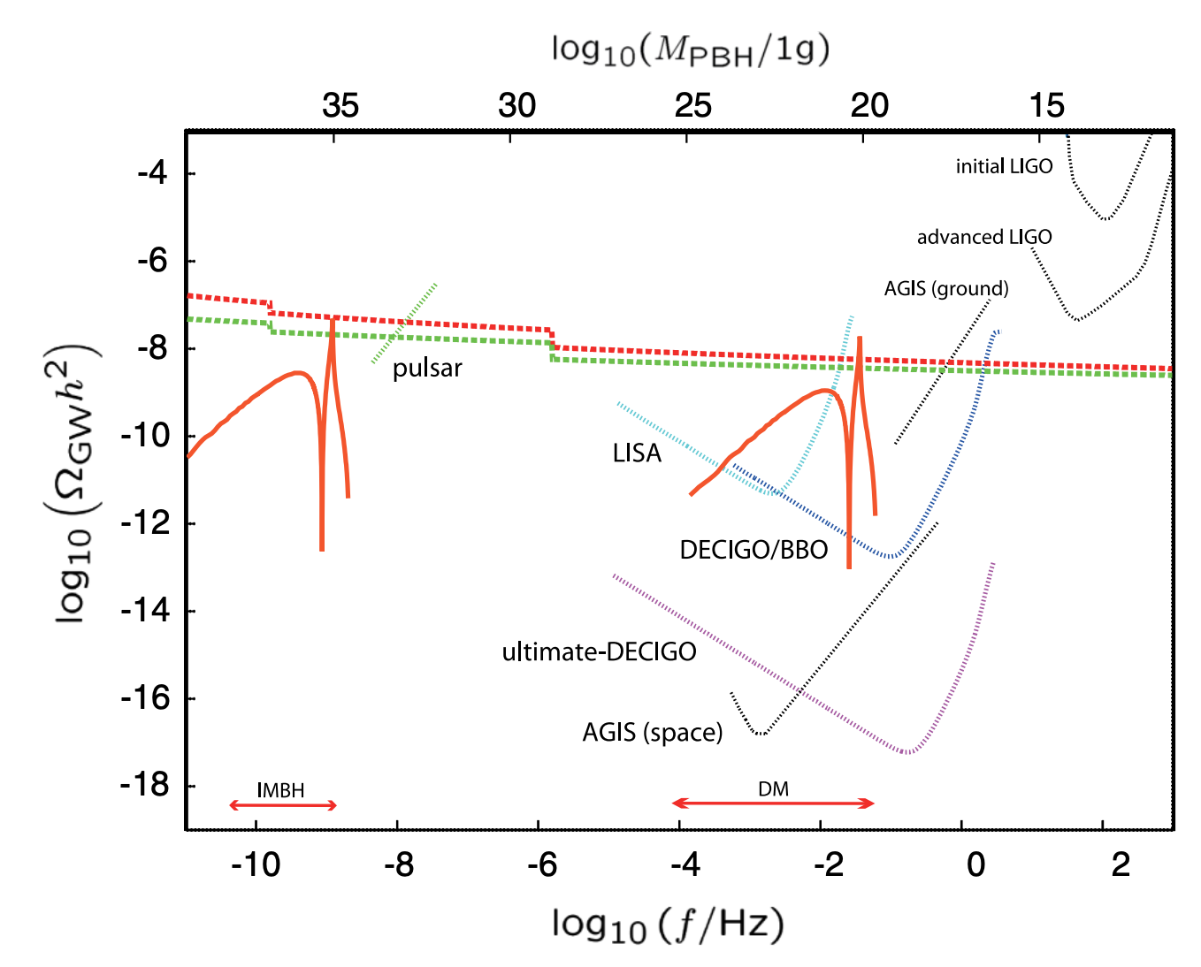
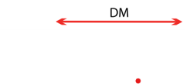
PBH DM scenario can be tested by 太極、天琴、LISA,
DECIGO, and TOBA (torsion bar antenna).
Envelope curves for
One-to-one
correspondence
between
PBH mass and
peak frequency
TOBA
(1996)
天琴
太極
DECIGO
Saito & JY PRL107(2011)069901

Slide 39
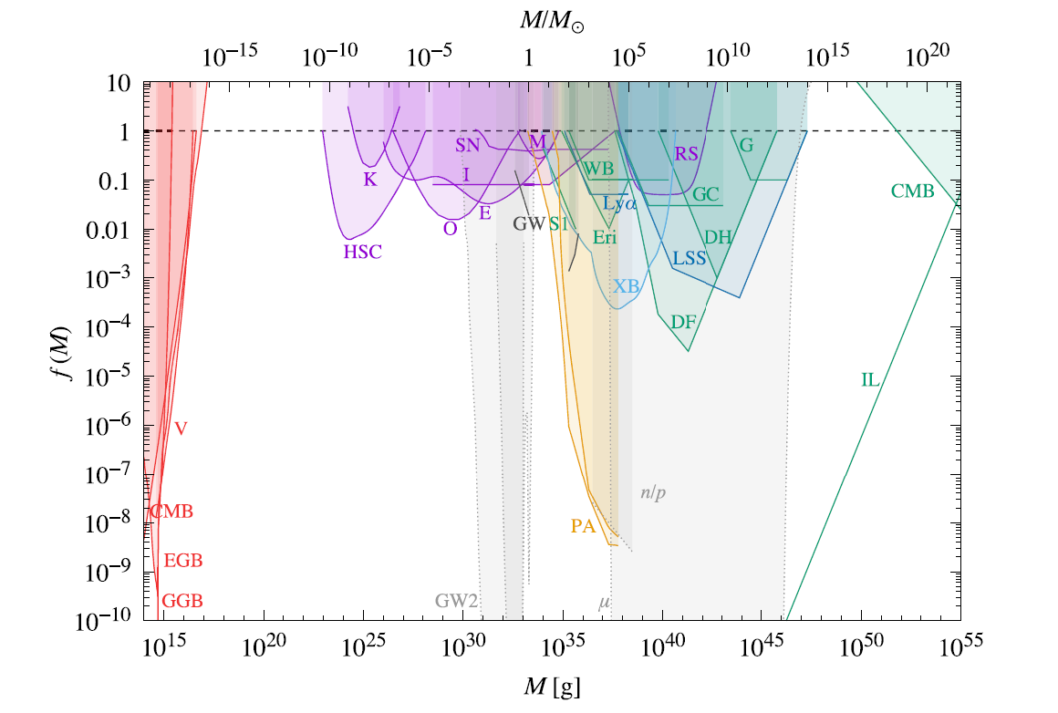
Constraints on the abundance of PBHs in terms of the
fraction of cold dark matter.
can be
DM
Carr, Kohri, Sendouda & JY RoPP 84(2021)11

Slide 40
Timing residual noises of millisecond pulsars
can probe long-wave gravitational waves with
their period ～observation time (about 10+years).

Slide 41
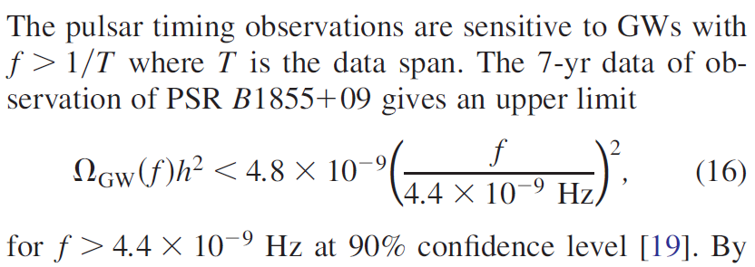
When I first studied gravitational waves from second-
order scalar perturbations, the pulsar timing constraint
was
I expected this constraint would become more and more
stringent as time passes, so I made a funding proposal
to FALSIFY PBHs as the origin of BH coalescence detected
by ground-based laser interferometers.

Slide 42
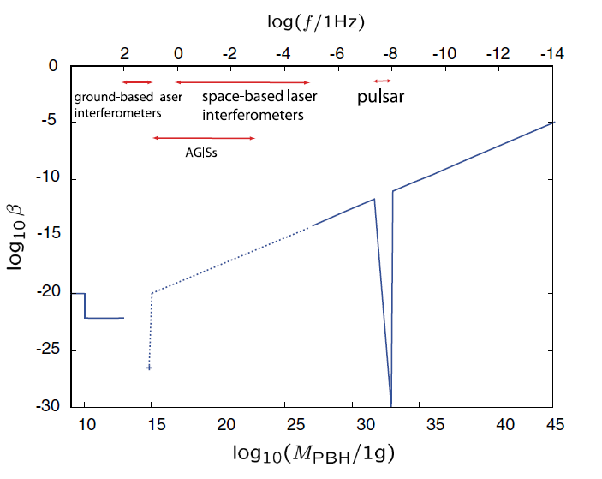
Energy fraction of PBHs at formation
As observation
time gets longer,
larger mass can
be constrained.
1solar mass =2x10³³ g

Slide 43
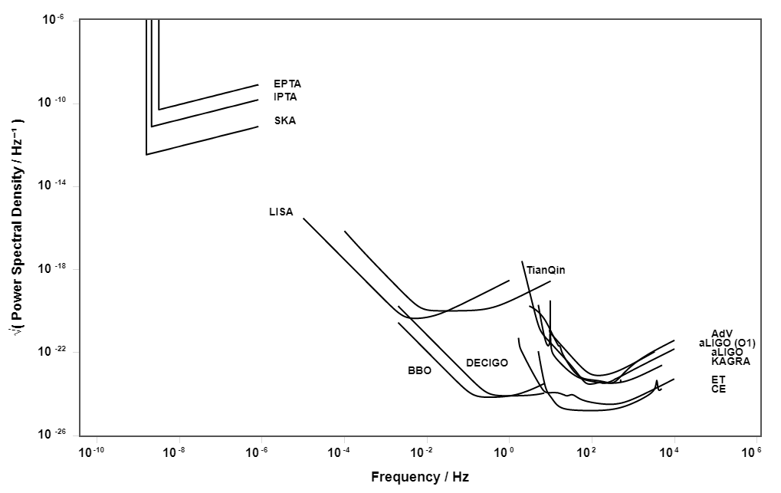
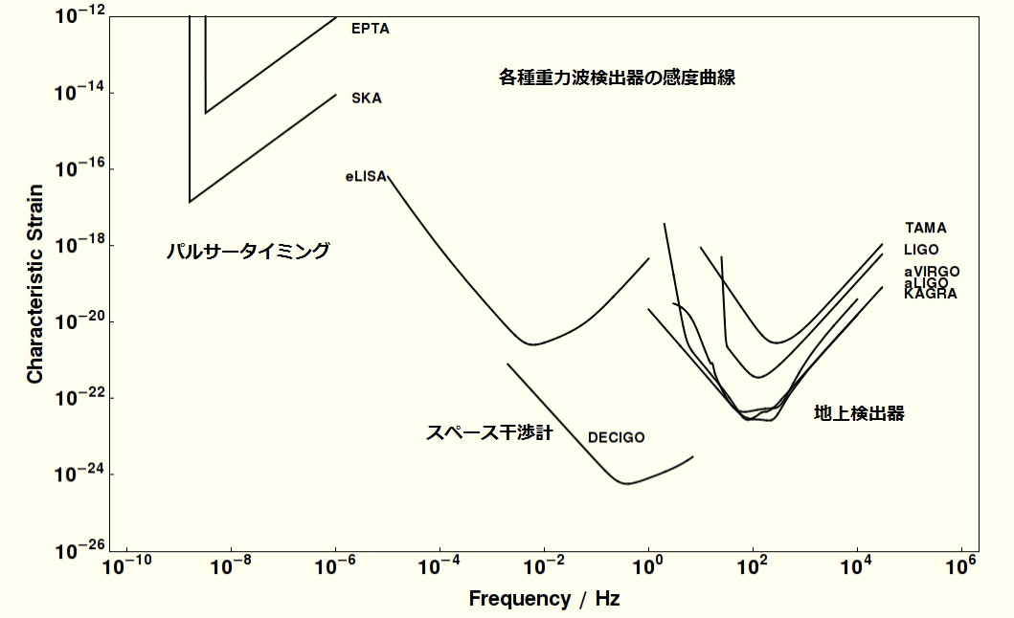
Multi-frequency Gravitational Wave Astrophysics
LVK-BHのPBH hypothesis
Pulsar Timing
Space based
Taiji
aLIGO
aVirgo
KAGRA

Slide 44

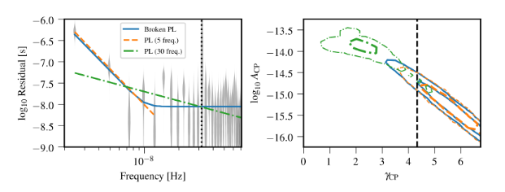
However, some time after my funding started, NANOGrav
collaboration reported possible positive detection(!) in
their 12.5yr data, (which is actually above their 11year
constraints(!!))
2009.04496
corresponding to

Slide 45
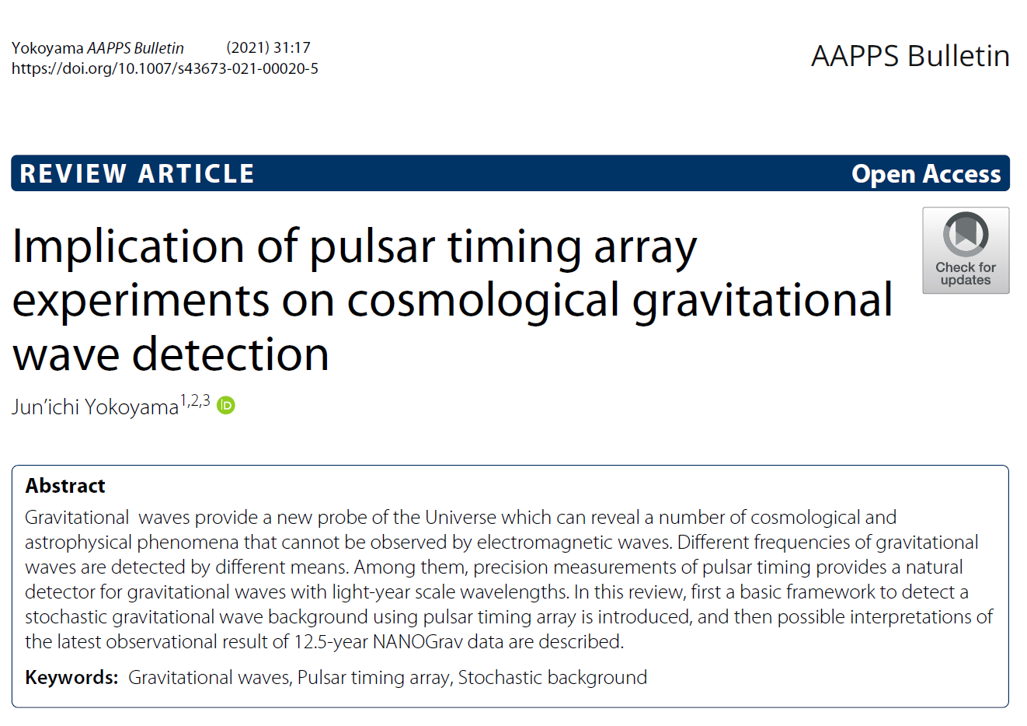
AAPPS bulletin

Slide 46
Prospects: The way to detect stochastic gravitational
wave background
Stagnation of improvement in upper limits.
Emergence of spatially uncorrelated common-
spectrum red process to all the pulsars.
3. Quadrupolar signature is seen in the spatial
correlation obtained by Hellings & Downs.
We have reached 2?
As of 2020

Slide 47
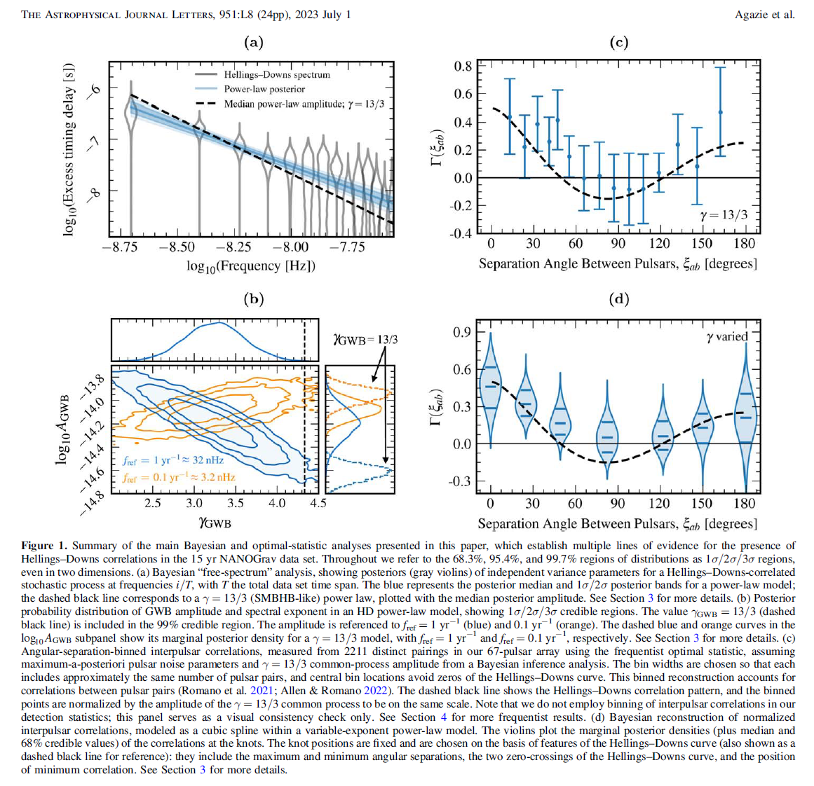
15 yr data is observing the Hellings & Downs curve!

Slide 48
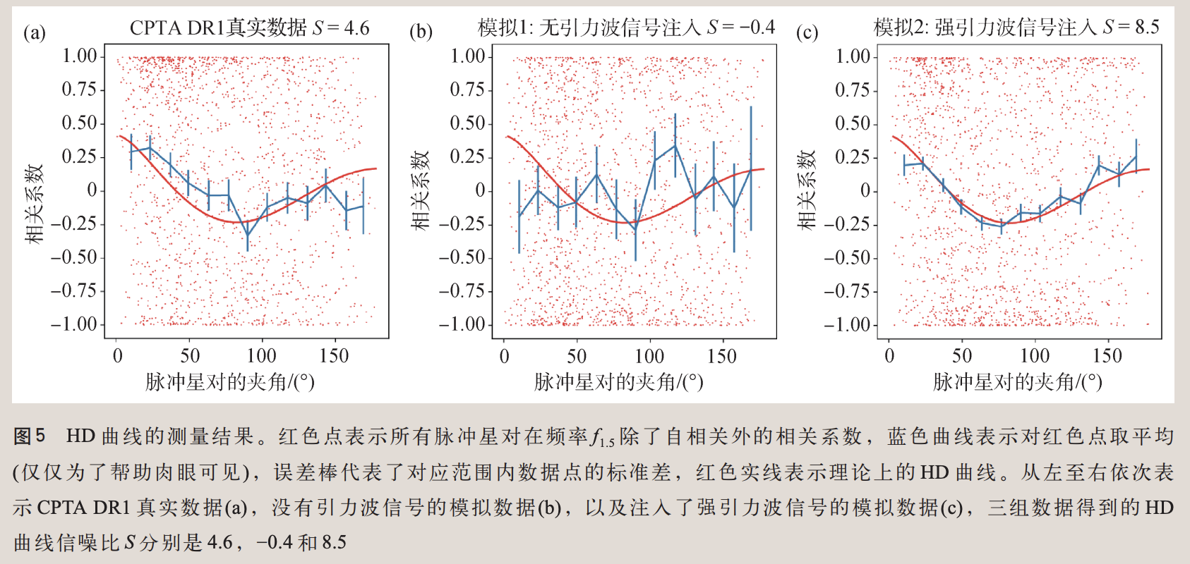
The Hellings & Downs curve measured by Chinese Pulsar Timing Array

Slide 49
Prospects: The way to detect stochastic gravitational
wave background
Stagnation of improvement in upper limits.
Emergence of spatially uncorrelated common-
spectrum red process to all the pulsars.
3. Quadrupolar signature is seen in the spatial
correlation obtained by Hellings & Downs.
We have reached 3?
As of 2023

Slide 50
While the most plausible source of the stochastic
gravitational wave background is the radiation from
binary supermassive black holes (SMBH), the possibility
that they originate from cosmological gravitational
waves remains, and is actively debated.
Quantum tensor perturbations from inflation
GWs from second-order scalar perturbations
GWs from bubble collisions after phase transition
GWs from self-ordering scalar fields
GWs from topological defects esp. cosmic strings
Gravitational particle production of gravitons
。。。

Slide 51
In particular, a number of researchers have worked
out possible connection to PBH formation through
consideration of generation of gravitational waves from
second-order scalar perturbations.
Quantum tensor perturbations from inflation
GWs from second-order scalar perturbations
GWs from bubble collisions after phase transition
GWs from self-ordering scalar fields
GWs from topological defects esp. cosmic strings
Gravitational particle production of gravitons
。。。

Slide 52

October 2019
I was in trouble.
Comprehensive study of gravitational-wave astrophysics
My plan as of October 2019 was to rule out the PBH
scenario of black holes observed by LIGO and Virgo
making use of the ABSENCE of stochastic gravitational
wave background. However, it was actually discovered!

Slide 53
Proposition
PBHs are formed.
GW background is induced.
Inverse
GW background is induced.
PBHs are formed.
Converse
PBHs are not formed.
GW background is not induced.
Contrapositive
GW background is not induced.
PBHs are not formed.

Slide 54
Proposition
TRUE
Saito & JY PRL107(2011)069901
PBHs are formed.
GW background is induced.
Inverse
FALSE
GW background is induced.
PBHs are formed.
Converse
FALSE
PBHs are not formed.
GW background is not induced.
Contrapositive
TRUE
GW background is not induced.
PBHs are not formed.

Slide 55
We cannot conclude whether
PBHs are responsible for
the LVK Black Holes from the gravitational wave background.
So we decided to take a different path
by considering loop effects in single-
field inflation models with ultra slow-
roll behaviors to enhance the spectrum.

Slide 56
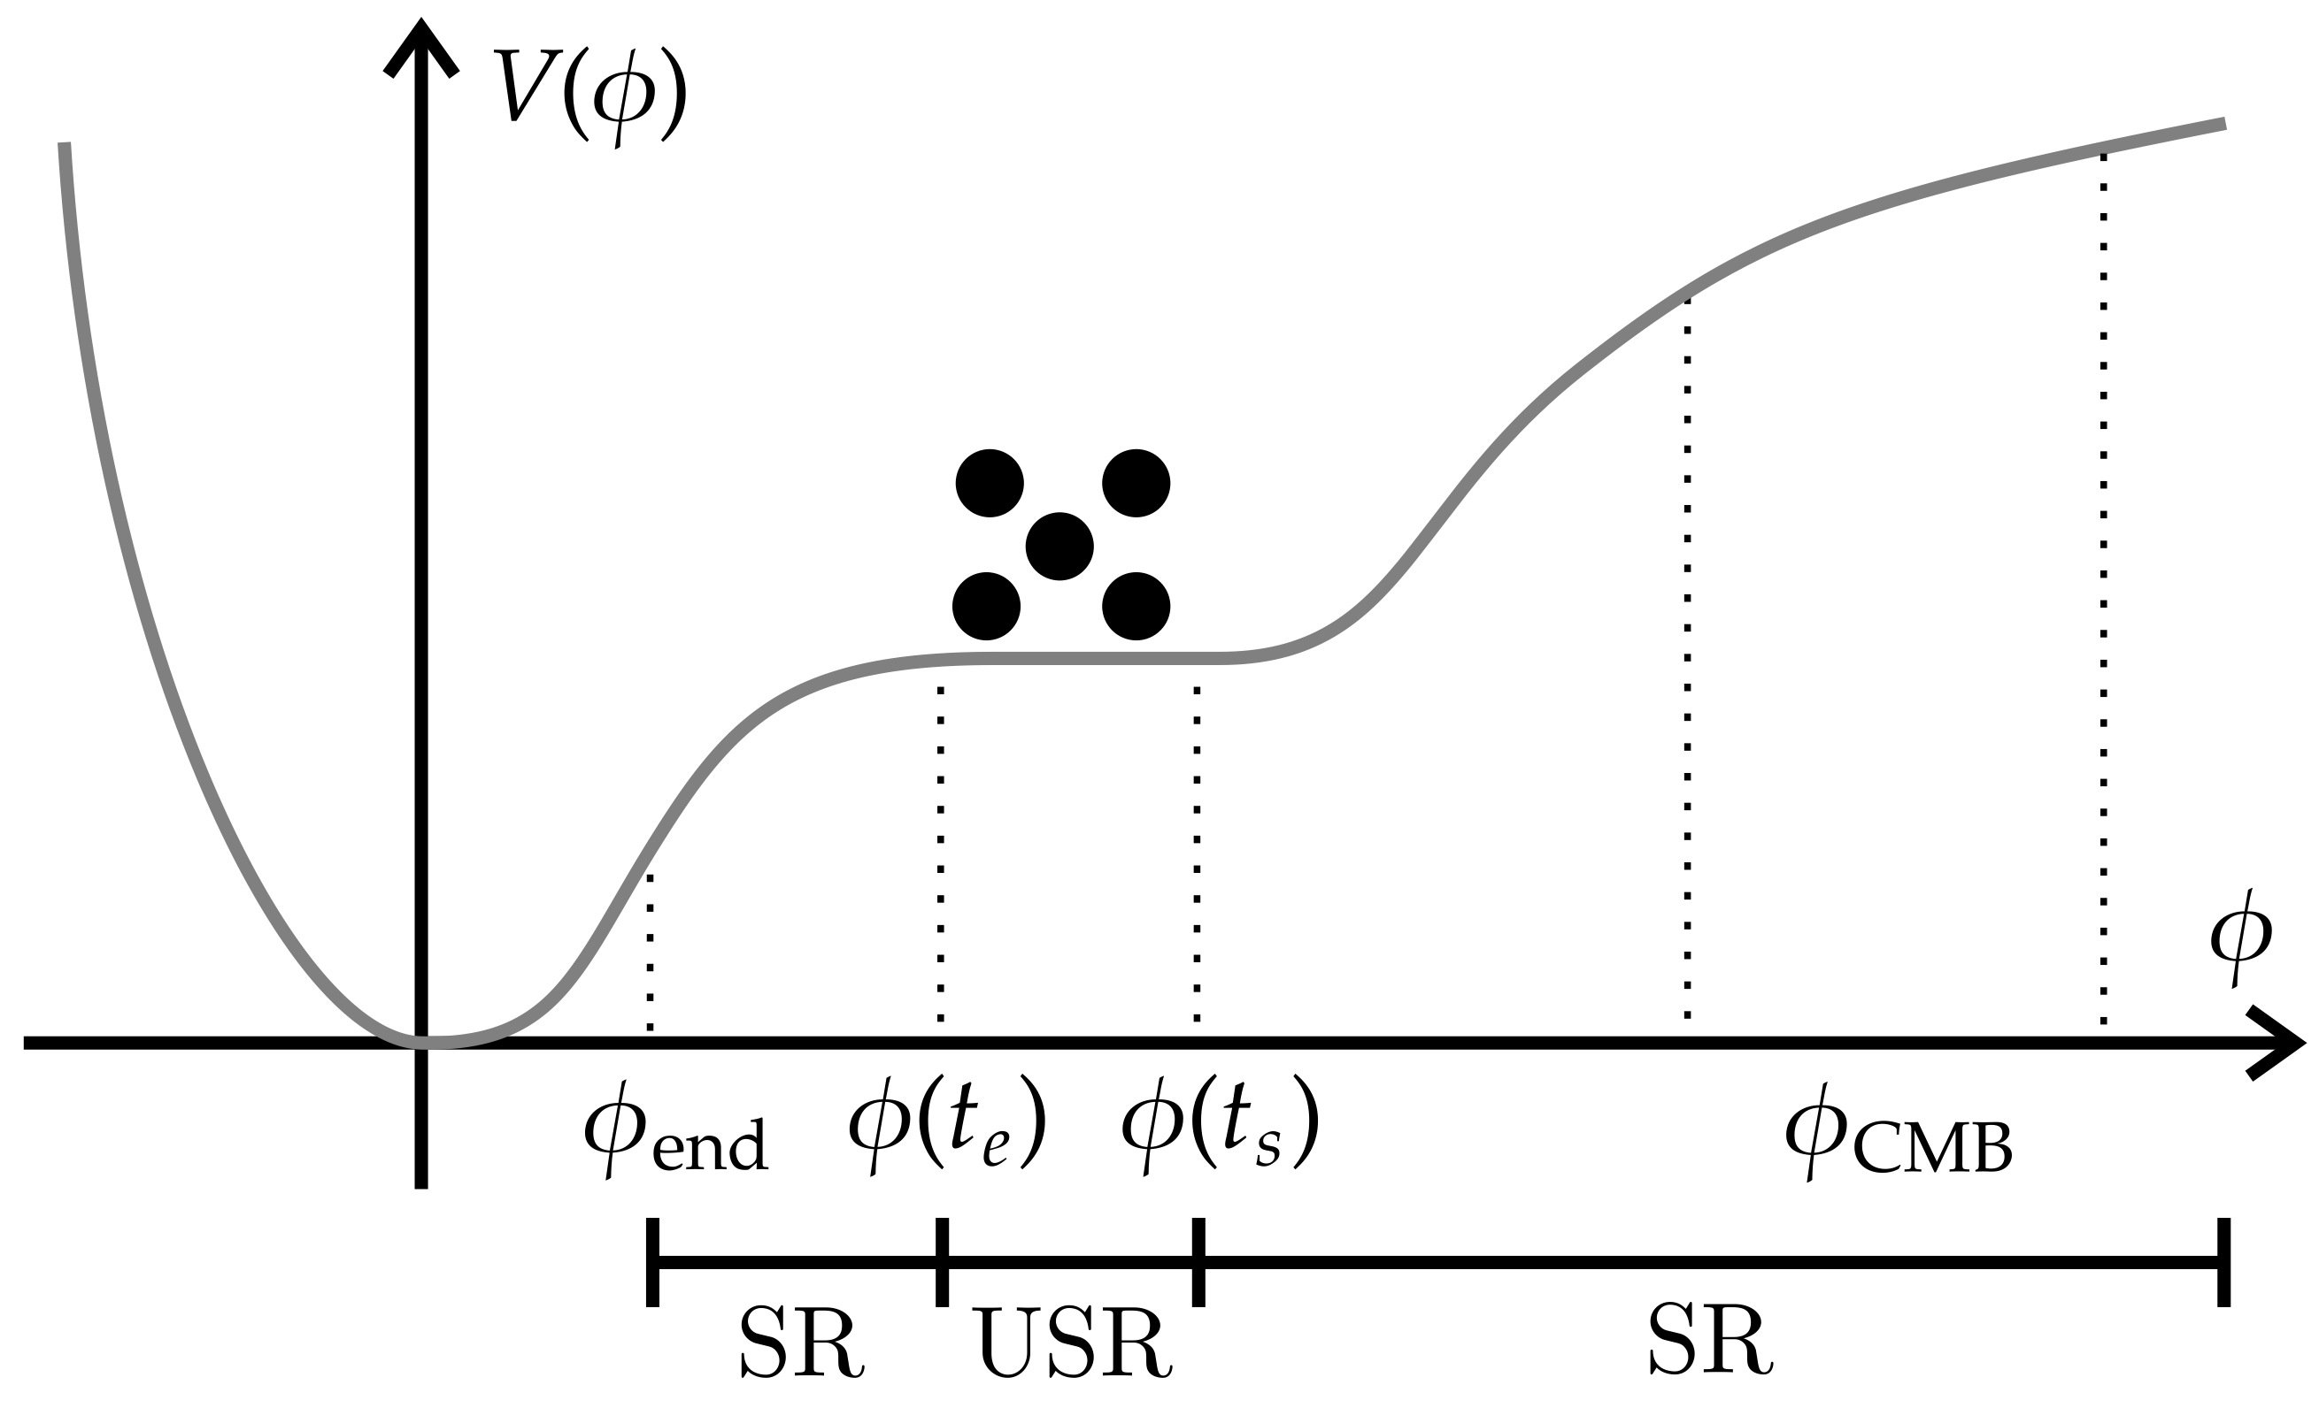
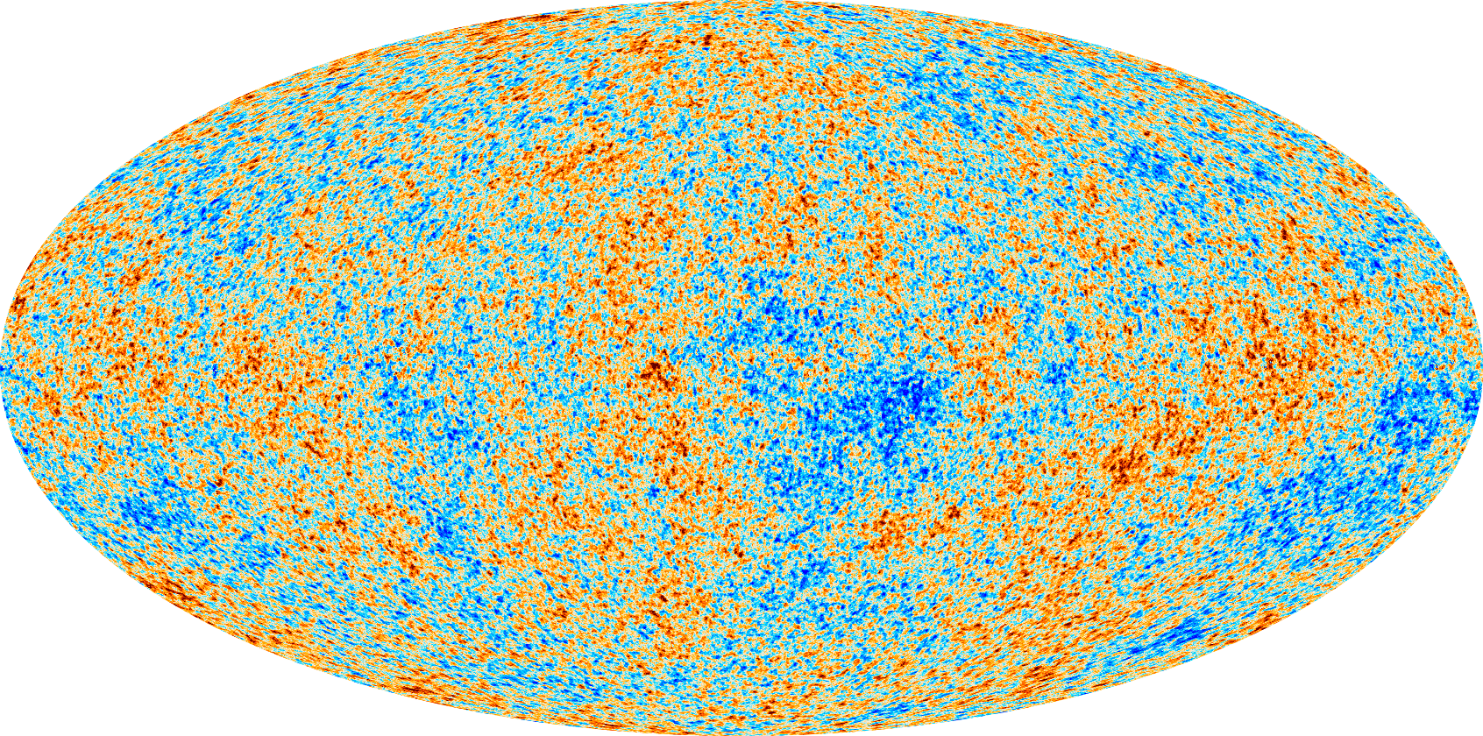

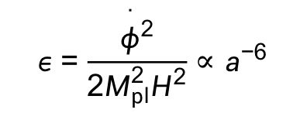
In order to realize temporal enhancement of curvature perturbation,
one is tempted to adopt a model in which ε decreases temporarily.
$$c_{s}=1 withP\left(X,φ\right)=X−V[φ]$$
Ivanov, Naselsky, & Novikov (1994)
CMB scale
SR: slow roll periods
PBH scale
USR: ultra-slow roll period (flat potential)
$$ε=\frac{{\overset{·}{φ}}^{2}}{2M_{pl}^{2}H^{2}}∝a^{−6}$$

Slide 57
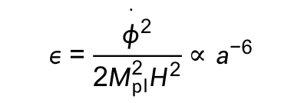
Ultra slow-roll (USR) inflation
Kinney (1998,2005), JY & Inoue (2002)
Martin, Motohashi, & Suyama (2013)
$$ε=\frac{{\overset{·}{φ}}^{2}}{2M_{pl}^{2}H^{2}}∝a^{−6}$$
Second slow-roll parameter:
In such a regime, contrary to the standard slow-roll inflation,
curvature perturbation grows even on superhorizon scale, as it
satisfies
In the standard inflation with , on superhorizon,
constant mode
decaying mode
“classical” perturbation
In ultra slow-roll inflation with , on superhorizon
constant mode
growing mode
quantum nature?

Slide 58
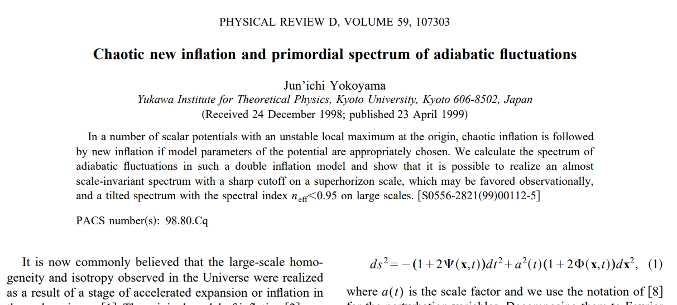
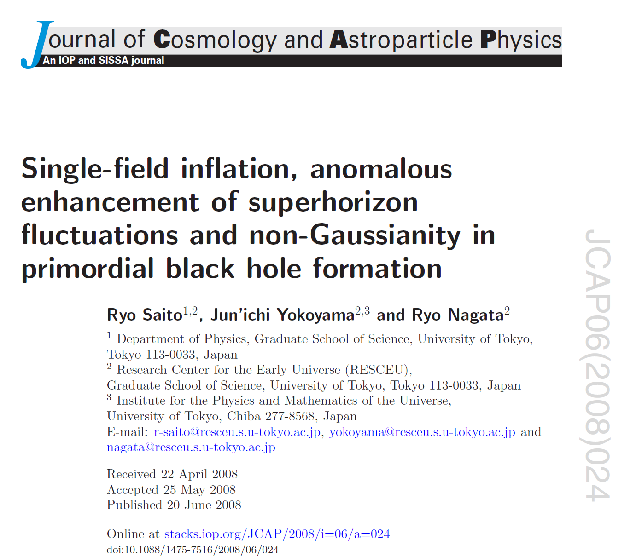
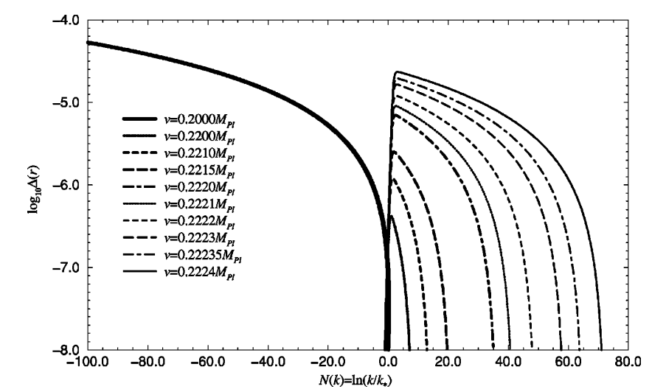
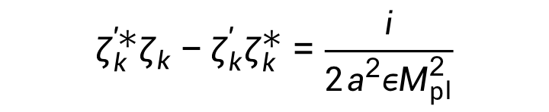
Indeed we find
$$ζ_{k}^{′∗}ζ_{k}−ζ_{k}^{′}ζ_{k}^{∗}=\frac{i}{{2a}^{2}εM_{pl}^{2}}$$
which induces significant correction as we will see shortly.
In USR, the standard wisdom does not apply!
NB Such superhorizon growth of perturbation was also found in the chaotic
new inflation model (JY 1999) and its analytic interpretation was given in
(Saito, JY, Nagata 2008).

Slide 59
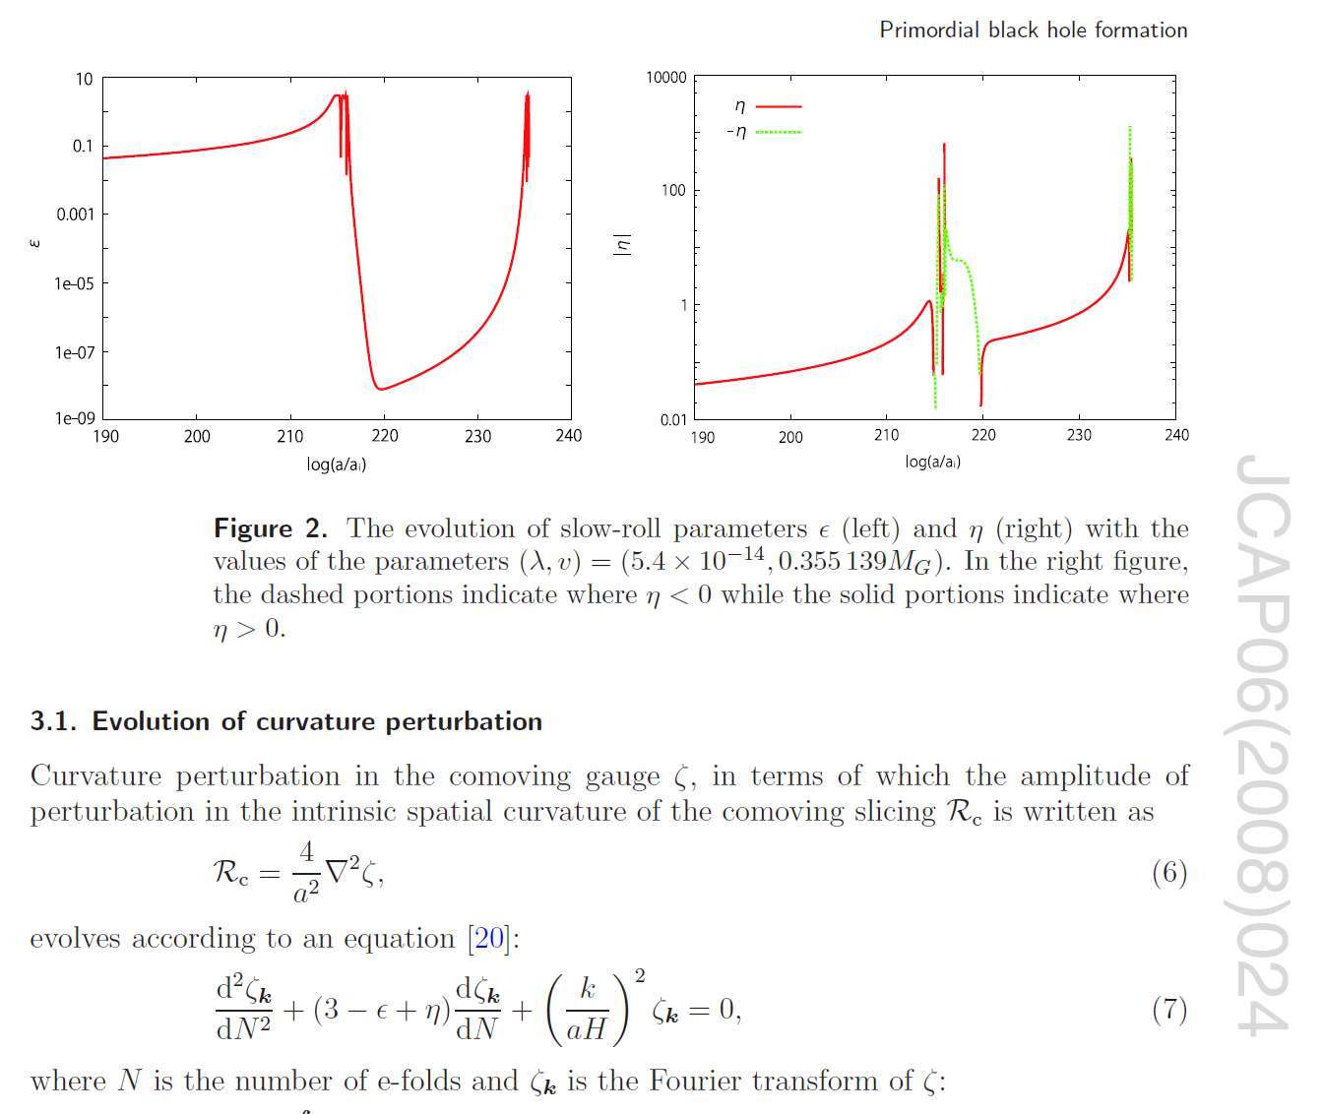
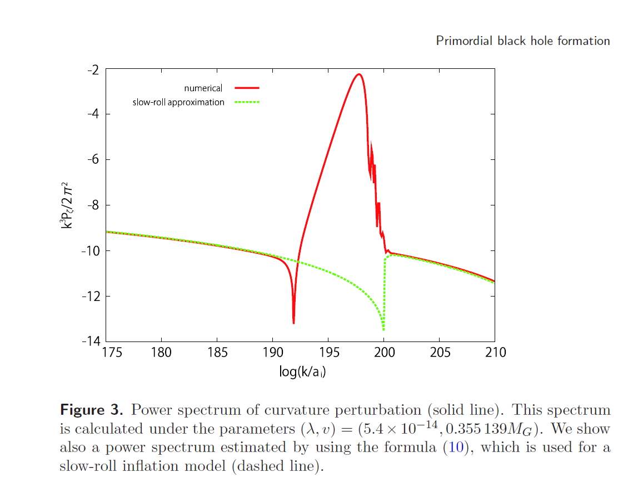
Indeed we find
$$ζ_{k}^{′∗}ζ_{k}−ζ_{k}^{′}ζ_{k}^{∗}=\frac{i}{{2a}^{2}εM_{pl}^{2}}$$
which induces significant correction as we will see shortly.
In USR, the standard wisdom does not apply!
NB To the best of my knowledge, such superhorizon growth of perturbation
was first found in the chaotic new inflation model (JY 1999) and its analytic
interpretation was given in (Saito, JY, Nagata 2008)

Slide 60
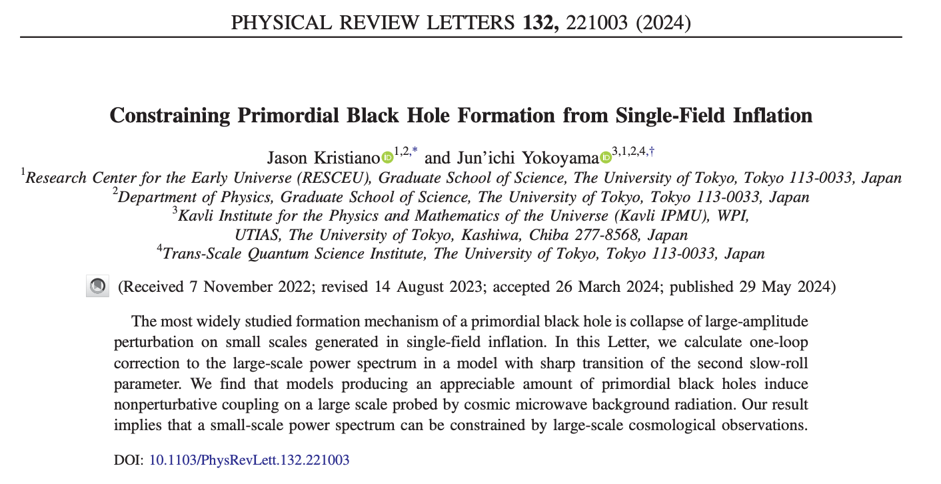
This feature induces a large quantum
corrections to the power spectrum
even on small wavenumber region
observable by CMB, essentially ruling
out PBH formation.
After we have published it, many people tried to refute our argument,
saying that superhorizon perturbation must be conserved (which is
actually incorrect already at the tree level in ultra slow-roll inflation.)
To show that the loop corrections really vanish on large scales with
small wavenumbers, one has to show this is the case independent of the regularization scheme and renormalization condition.
If that were demonstrated, it would not be about a petty topic like PBH formation; rather, it would show that the physics in the infrared is completely unaffected by the ultraviolet. Such a result would have profound implications for fundamental physics!!

Slide 61
Conclusion: I hope to witness
detection of any of below
within my lifetime!
Quantum tensor perturbations from inflation
GWs from second-order scalar perturbations
GWs from bubble collisions after phase transition
GWs from self-ordering scalar fields
GWs from topological defects esp. cosmic strings
Gravitational particle production of gravitons
。。。
I hope Taiji will achieve it!!

