Slide 1


Observation of a family of all-charm tetraquarks at CMS
Yufei Chen
Nanjing Normal University
LHC理论与实验联合研讨会
Sep.13, 2025
1

Slide 2
Outline
Motivation
  Tetraquark candidates
Updated Analysis of 𝐽/𝜓𝐽/𝜓 Channel
  Data sample and event selections
  𝐽/𝜓𝐽/𝜓 pairs signal in Run II+III data
  Fit model
  Run III && Run II+III result
Summary and Outlook

Slide 3
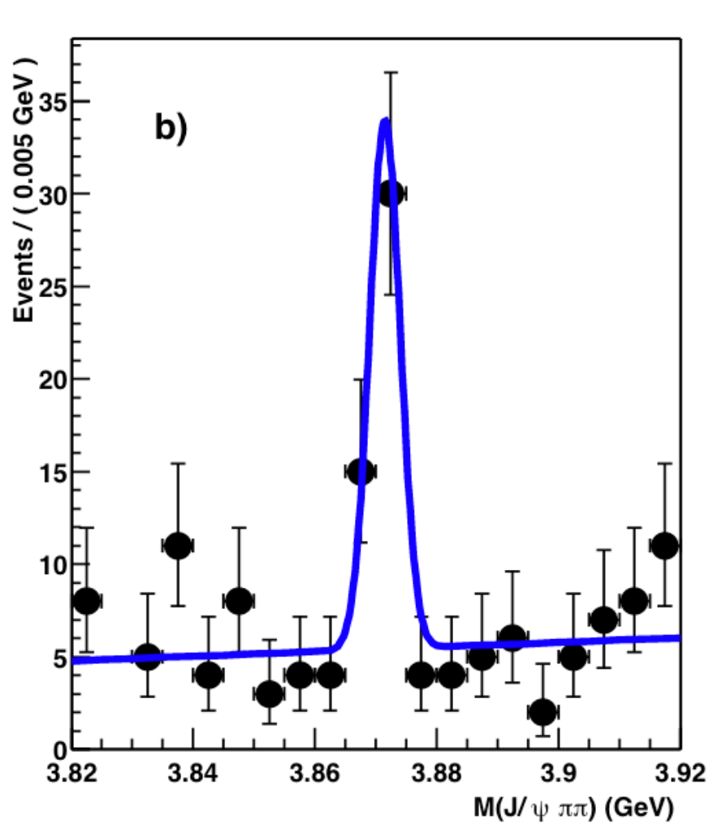
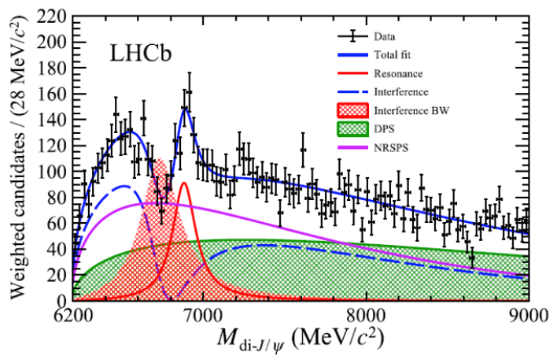
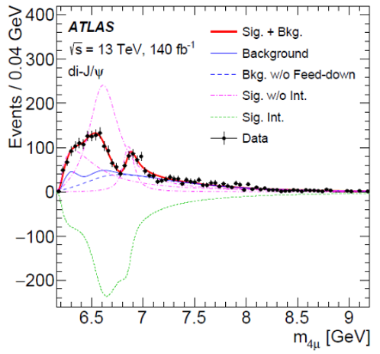
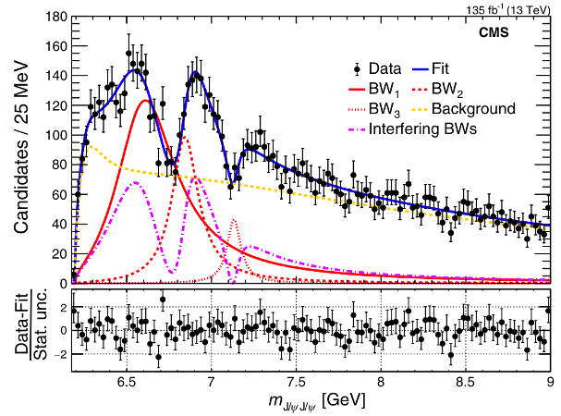
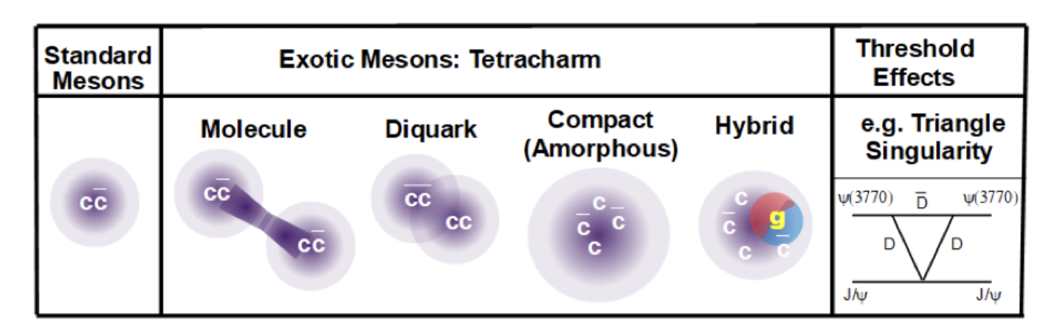


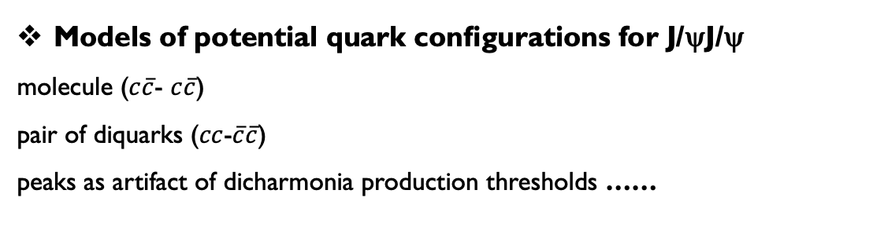
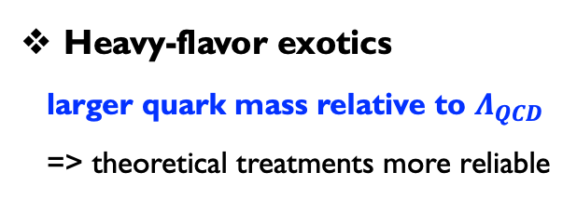
Tetraquark candidates with heavy-flavor
Heavy-flavor exotics
larger quark mass relative to $Λ_{QCD}$
=> theoretical treatments more reliable
All-charm Tetraquark on LHC
Three experiments observed X(6900) in J/ψJ/ψ channel
all-charm tetraquark candidates
X(3872) [$uc\overline{u}\overline{c}$]
X(6900) [c$c\overline{c}\overline{c}$]
Sci. Bull., 65(23):1983, 2020
Phys. Rev. Lett., 131(15):151902, 2023
Phys. Rev. Lett., 132(11):111901, 2024
Belle
Models of potential quark conﬁgurations for J/ψJ/ψ
molecule ($c\overline{c}$- $c\overline{c}$)
pair of diquarks ($cc$-$\overline{c}\overline{c}$)
peaks as artifact of dicharmonia production thresholds ……
3

Slide 4
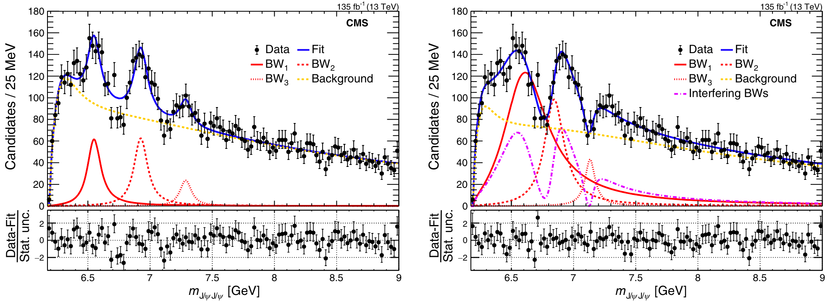

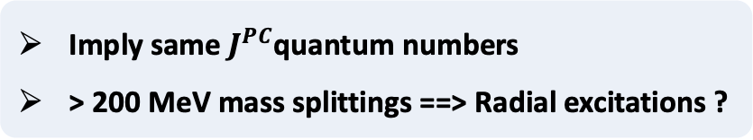
Prospects: A family of all-charm tetraquarks?
CMS report 3 tetracharm candidates (Run II)
  X(6900) [all 3 experiments]
  X(6600) is observed with 7σ
  Evidence of X(7100) [4.7σ in Interf.]
With 3.6X 𝐽/𝜓𝐽/𝜓 statistics (Run II + III):
  Significance of ALL states over 5σ ?
  Significance of interference over 5σ ?
Imply same $J^{PC}$quantum numbers
> 200 MeV mass splittings ==> Radial excitations ?
CMS adopt “3-way” interference model:
    Threshold BW (non-interfering) + three interfering BWs
    Interference for each individual dip < 4σ
A family of all-charm tetraquarks with same $J^{PC}$ ?
4

Slide 5
Outline
Motivation
  Tetraquark candidates
Updated Analysis of 𝐽/𝜓𝐽/𝜓 Channel
  Data sample and event selections
  𝐽/𝜓𝐽/𝜓 pairs signal in Run II+III data
  Fit model
  Run III && Run II+III result
Summary and Outlook
5

Slide 6
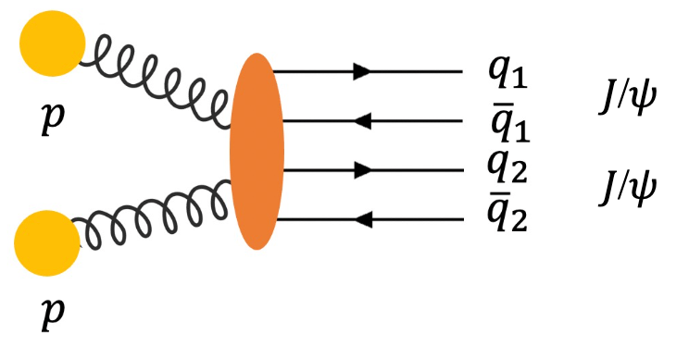
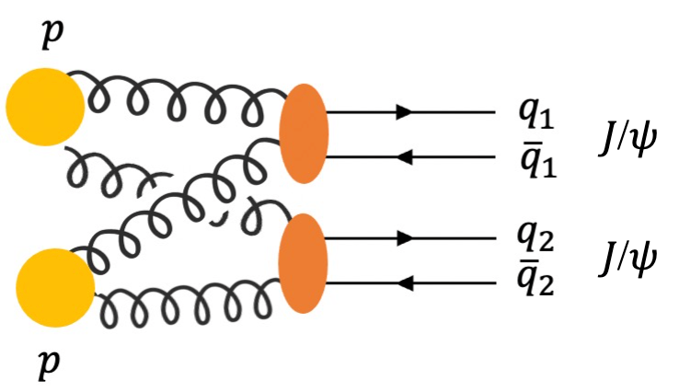




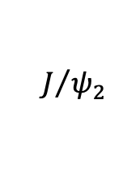
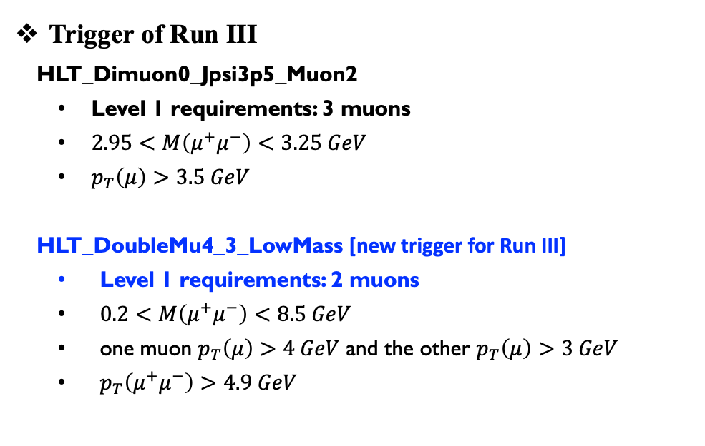

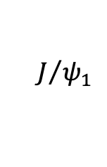


Datasets, MC, and trigger
Data samples [315 fb⁻¹]
  Run II: 135 fb⁻¹ data taken in 2016, 2017 and 2018.
  Run III: 180 fb⁻¹ data taken in 2022, 2023 and 2024.
Trigger of Run III
  HLT_Dimuon0_Jpsi3p5_Muon2
  Level 1 requirements: 3 muons
  $2.95<M\left(μ^{+}μ^{−}\right)<3.25 GeV$
  $p_{T}\left(μ\right)>3.5 GeV$
  HLT_DoubleMu4_3_LowMass [new trigger for Run III]
  Level 1 requirements: 2 muons
  $0.2<M\left(μ^{+}μ^{−}\right)<8.5 GeV$
  one muon $p_{T}\left(μ\right)>4 GeV$ and the other $p_{T}\left(μ\right)>3 GeV$
  $p_{T}\left(μ^{+}μ^{−}\right)>4.9 GeV$
Signal and Background simulated events:
  Signal $X→J/ψJ/ψ→μ^{+}μ^{−}μ^{+}μ^{−}$by JHUGen
  NRSPS, DPS, and Feeddown by Pythia8 or event-mixing
$$μ_{1}^{+}$$
$$J/{ψ_{1}}$$
$$X$$
$$μ_{2}^{−}$$
$$μ_{3}^{+}$$
$$J/{ψ_{2}}$$
Compared to only Dimuon trigger, LowMass trigger increase 30% $J/ψJ/ψ$ statistics
$$μ_{4}^{−}$$
SPS
DPS
6

Slide 7
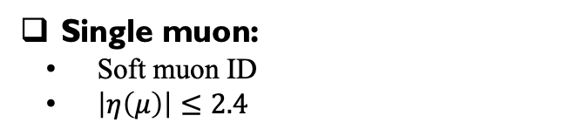
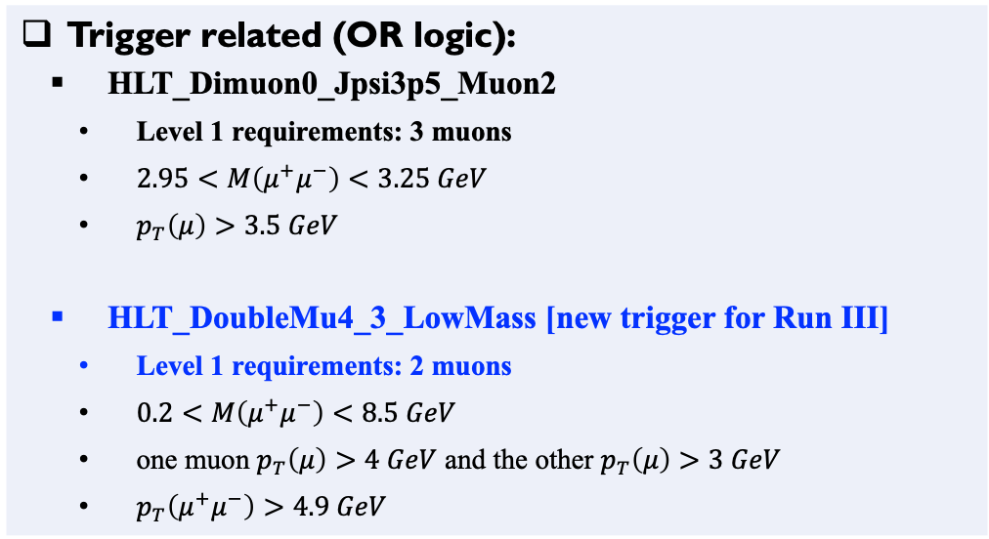
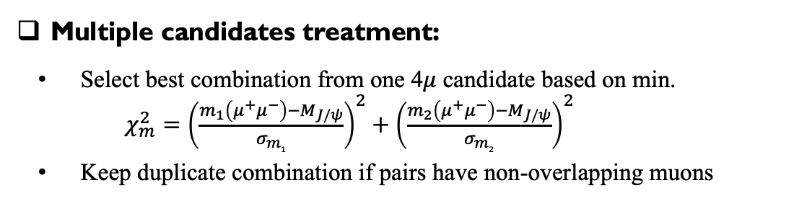
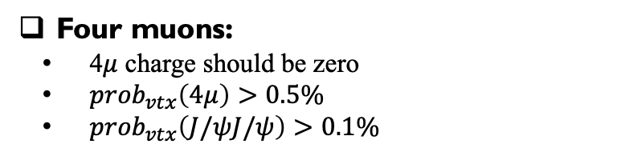
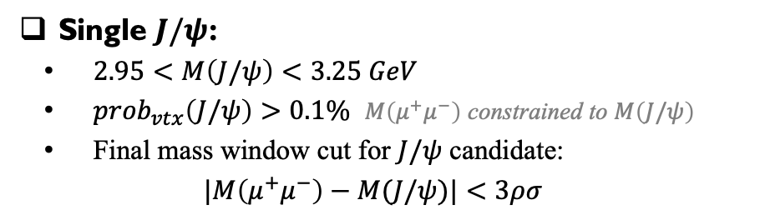
Event selection for Run III data
Follow PRL cuts + A new trigger for Run III
Single muon:
Soft muon ID
$\left|η\left(μ\right)\right|≤2.4$
Trigger related (OR logic):
  HLT_Dimuon0_Jpsi3p5_Muon2
  Level 1 requirements: 3 muons
  $2.95<M\left(μ^{+}μ^{−}\right)<3.25 GeV$
  $p_{T}\left(μ\right)>3.5 GeV$
  HLT_DoubleMu4_3_LowMass [new trigger for Run III]
  Level 1 requirements: 2 muons
  $0.2<M\left(μ^{+}μ^{−}\right)<8.5 GeV$
  one muon $p_{T}\left(μ\right)>4 GeV$ and the other $p_{T}\left(μ\right)>3 GeV$
  $p_{T}\left(μ^{+}μ^{−}\right)>4.9 GeV$
Single $J/ψ$:
$2.95<M\left(J/ψ\right)<3.25 GeV$
${prob}_{vtx}\left(J/ψ\right)>0.1\%$ $M\left(μ^{+}μ^{−}\right)$ constrained to $M\left(J/ψ\right)$
Final mass window cut for $J/ψ$ candidate:
$$|M\left(μ^{+}μ^{−}\right)−M(J/ψ)|<3ρσ$$
Four muons:
4$μ$ charge should be zero
${prob}_{vtx}\left(4μ\right)>0.5\%$
${prob}_{vtx}\left(J/ψJ/ψ\right)>0.1\%$
Baseline mass variable
– invariant mass of two constrained J/ψ candidates
Multiple candidates treatment:
Select best combination from one 4$μ$ candidate based on min.
$χ_{m}^{2}={\left(\frac{m_{1}\left(μ^{+}μ^{−}\right)−M_{J/ψ}}{σ_{m1}}\right)}^{2}+{\left(\frac{m_{2}\left(μ^{+}μ^{−}\right)−M_{J/ψ}}{σ_{m2}}\right)}^{2}$
Keep duplicate combination if pairs have non-overlapping muons
7

Slide 8
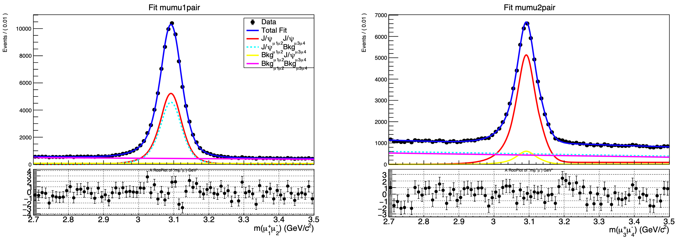
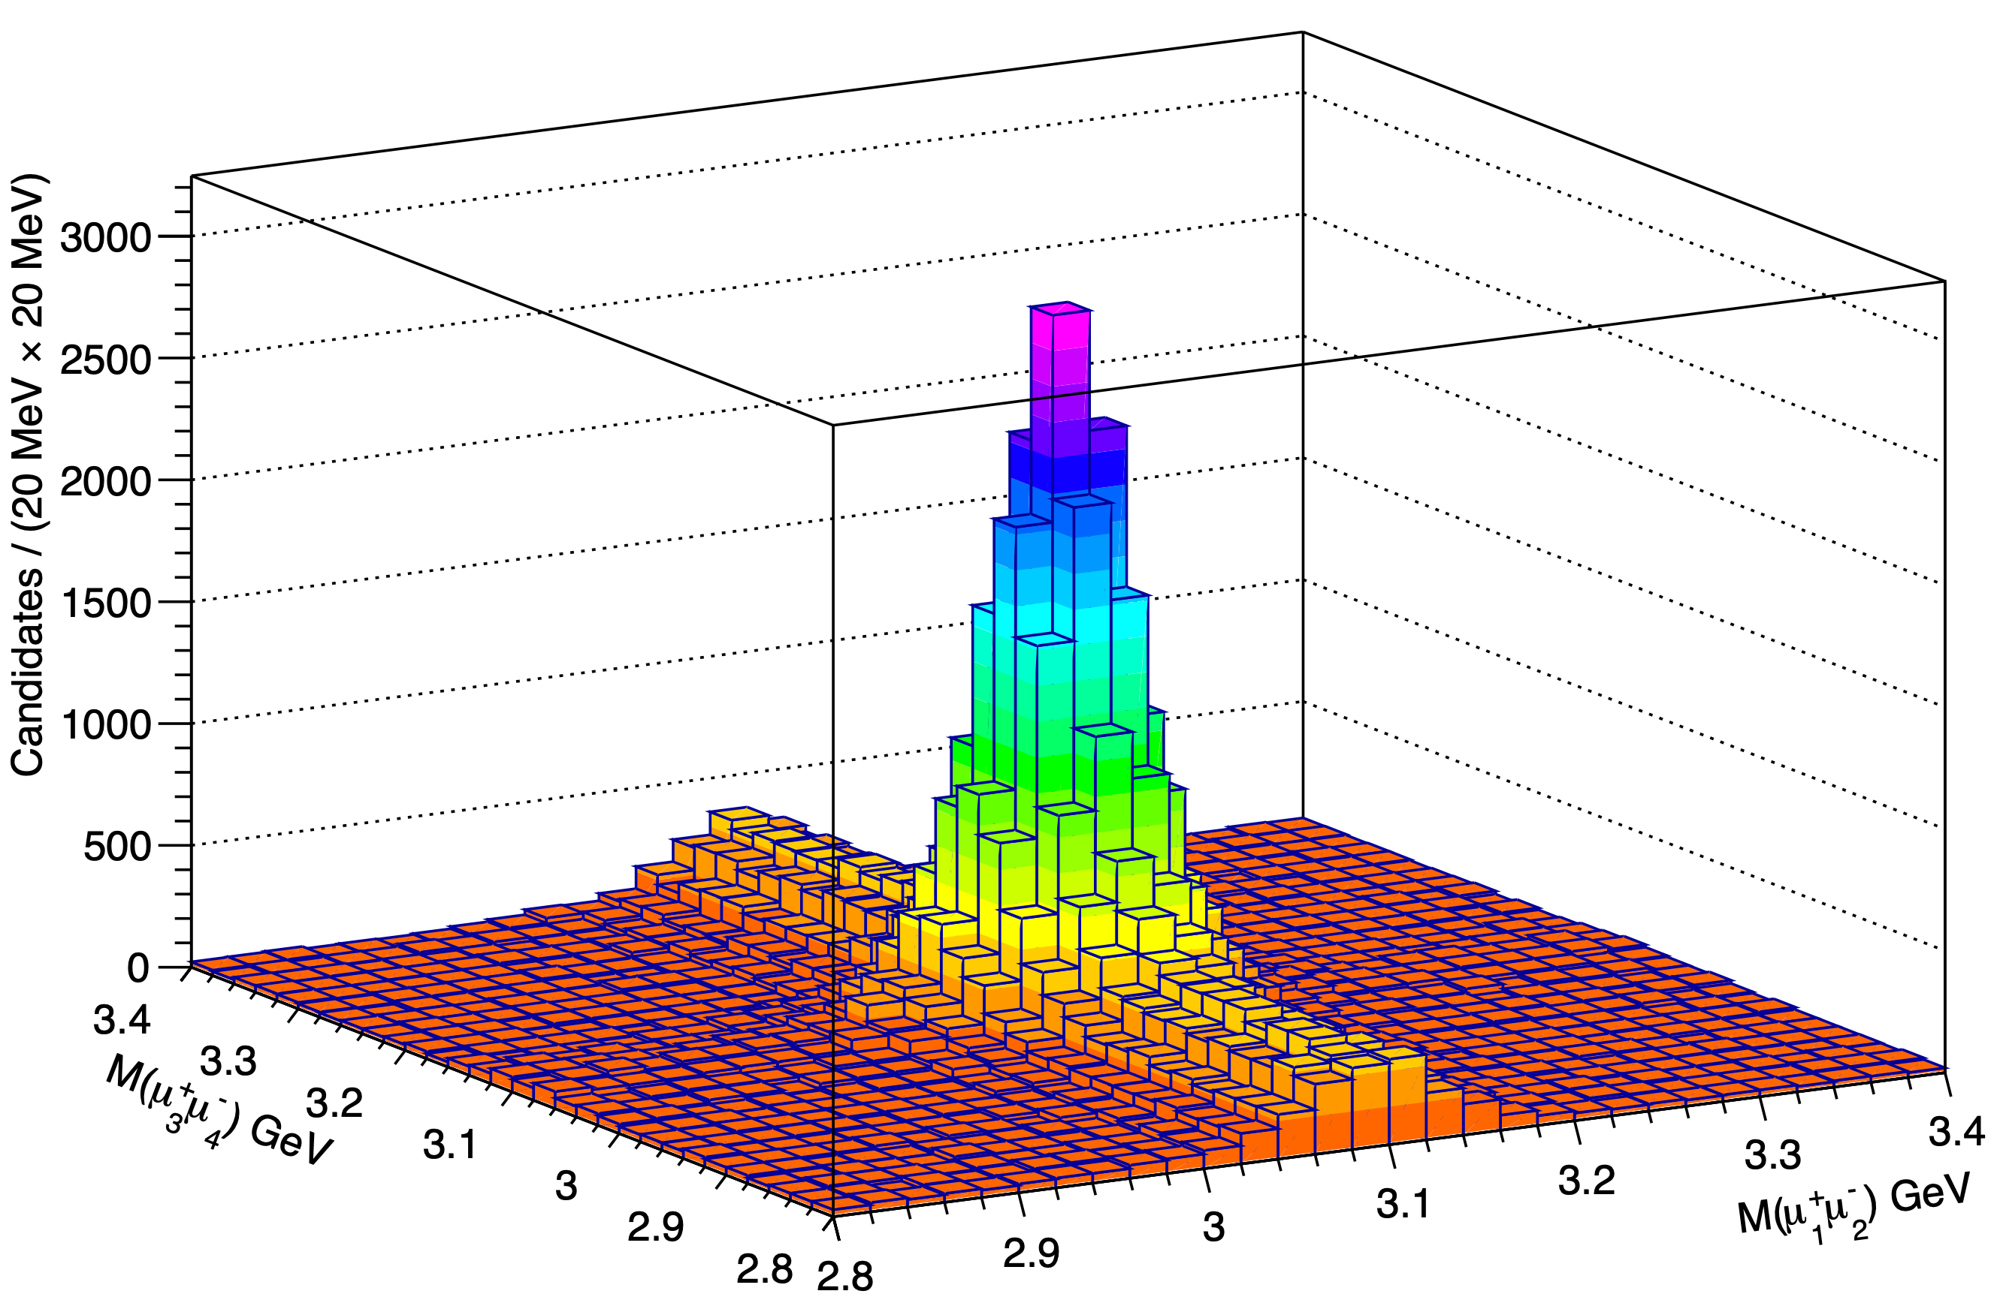
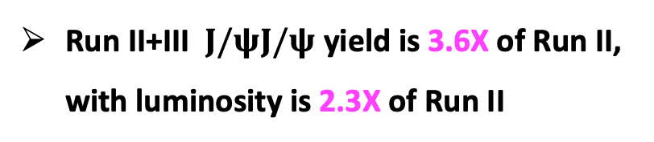
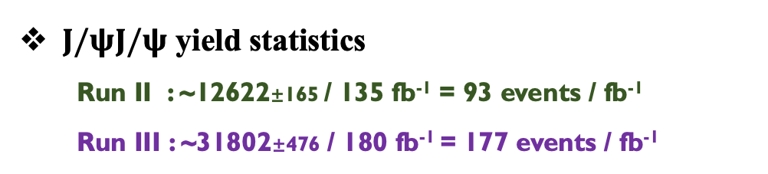
𝐽/𝜓𝐽/𝜓 yield: Two-dimensional fit
Two-dimensional fit
  𝐽/𝜓 signal: Double Crystal Ball
  non-resonant: First-order Chebyshev polynomial
$J/ψJ/ψ$ yield statistics
  Run II : ~12622±165 / 135 fb⁻¹ = 93 events / fb⁻¹
  Run III : ~31802±476 / 180 fb⁻¹ = 177 events / fb⁻¹
Run II+III $J/ψJ/ψ$ yield is 3.6X of Run II, with luminosity is 2.3X of Run II
8

Slide 9
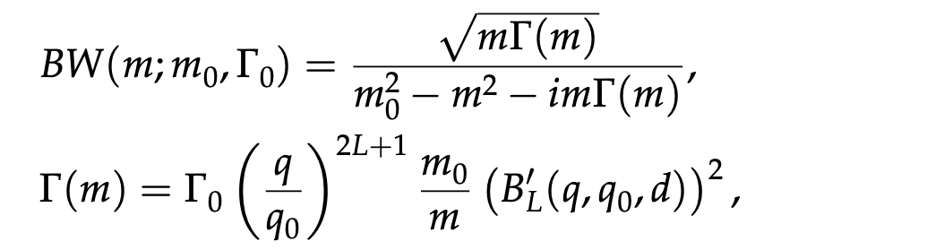
Signal and Background models
Signal shape: Relativistic Breit-Wigner
Background component: NRSPS+NRDPS+Comb+Feeddown+BW0
NRSPS
Non-Resonant Single Parton Scattering
NRDPS
Non-Resonant Double Parton Scattering
Combinatorial background
J/ψμμ, μμJ/ψ, and μμμμ
a Gaussian constraint of its yield
BW0
A significant structure at the threshold treated as background
  Inadequacy of NRSPS model at threshold.
  Parameters sensitive to model assumption;
  A region populated by feed-down;
Feed-down
From possible heavier mass states
Here we consider: [BPH-22-004]
  X(6900) → J/ψψ(2S) → J/ψJ/ψ + anything
9

Slide 10
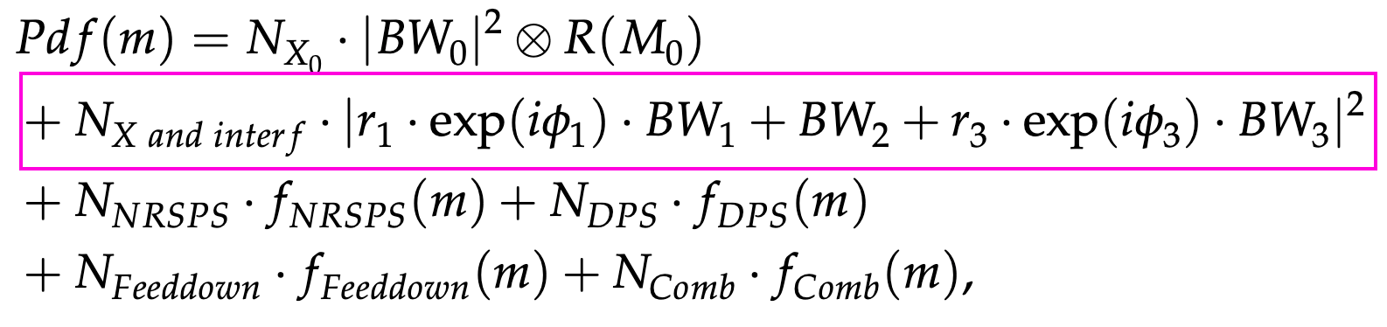
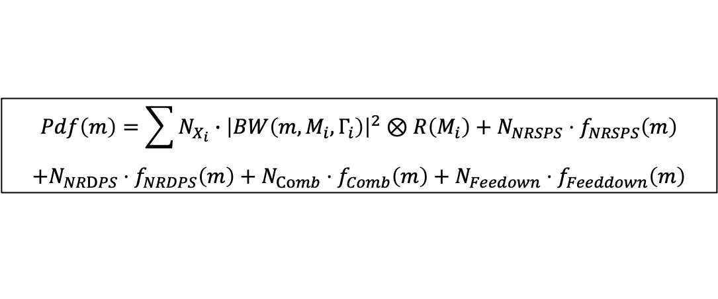
Signal and Background models
Signal shape: Relativistic Breit-Wigner
Background component: NRSPS+NRDPS+Comb+Feeddown+BW0
Non-interference model:
  Signal-hypothesis: NRSPS+NRDPS+Comb+Feeddown+BW0+BW1+BW2+BW3
$$Pdf\left(m\right)=\sum{N_{X_{i}}∙{\left|BW\left(m,M_{i},Γ_{i}\right)\right|}^{2}⊗R\left(M_{i}\right)}+N_{NRSPS}⋅f_{NRSPS}\left(m\right)$$
$$+N_{NRDPS}⋅f_{NRDPS}\left(m\right)+N_{Comb}⋅f_{Comb}\left(m\right)+N_{Feedown}⋅f_{Feeddown}\left(m\right)$$
Interference model:
  Signal-hypothesis: NRSPS+NRDPS+Comb+Feeddown+BW0+BW123 Interf. Term
10

Slide 11
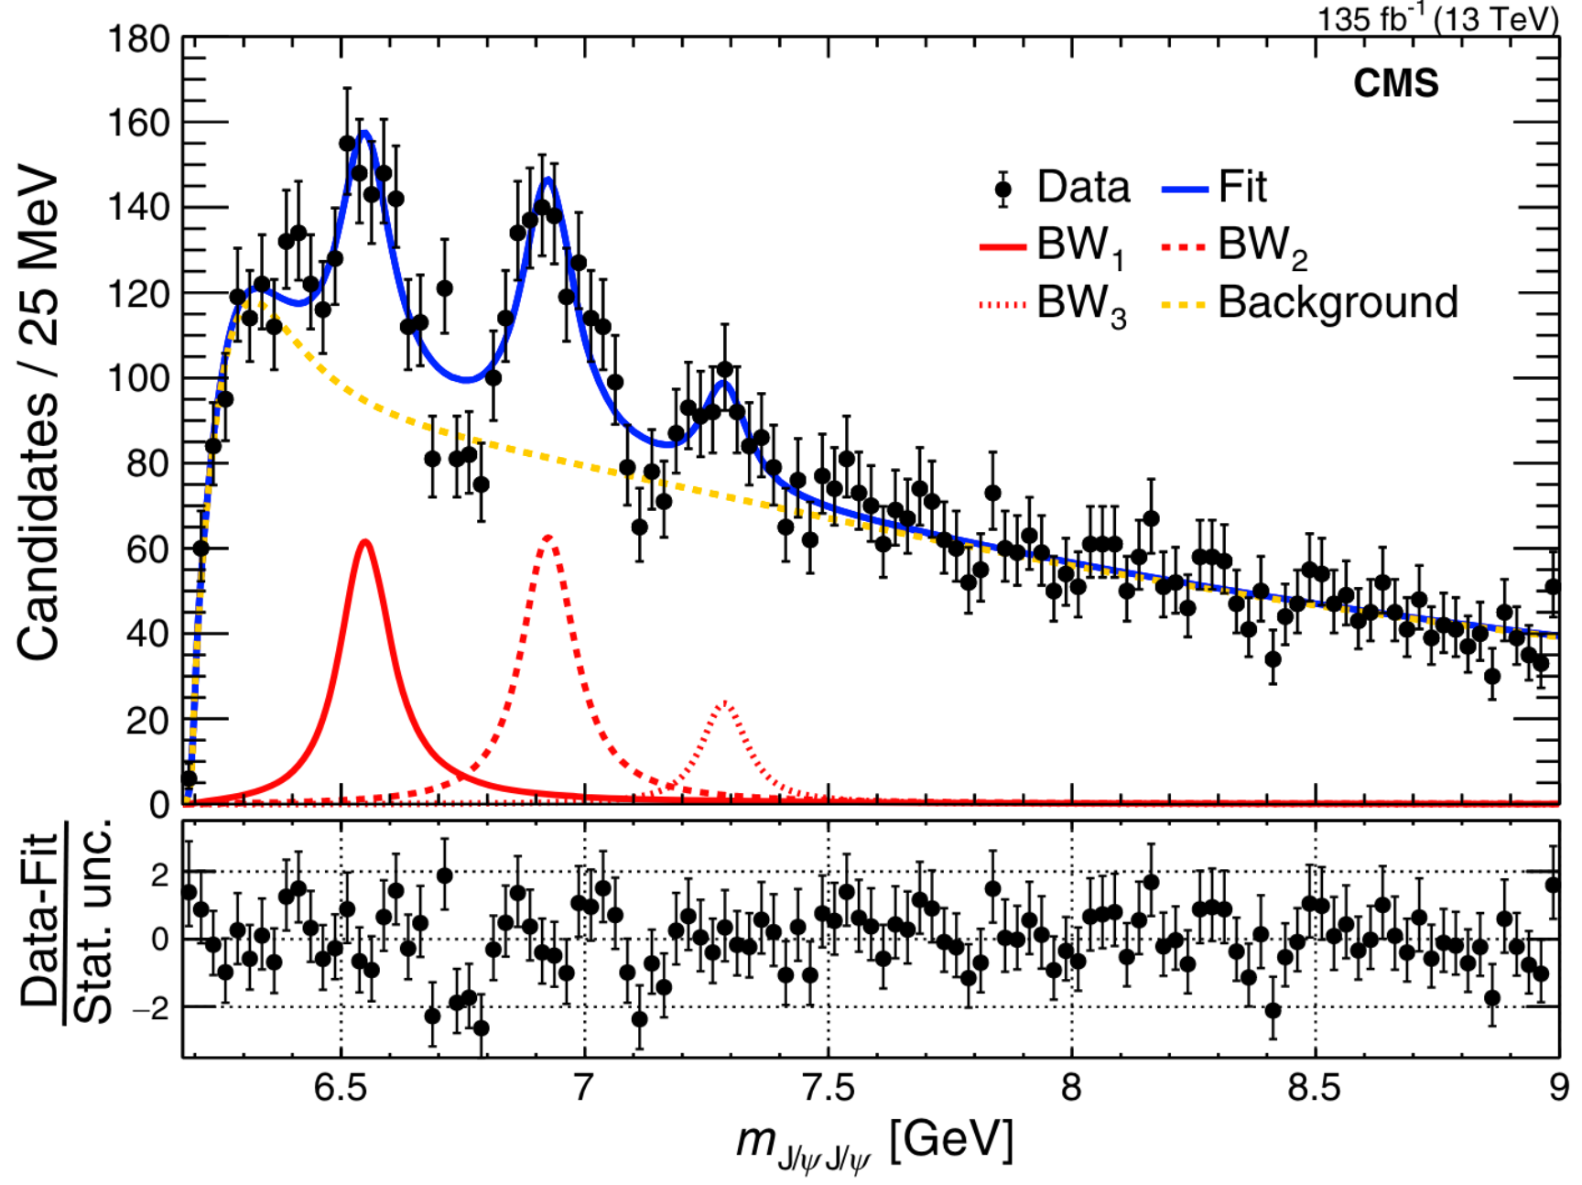
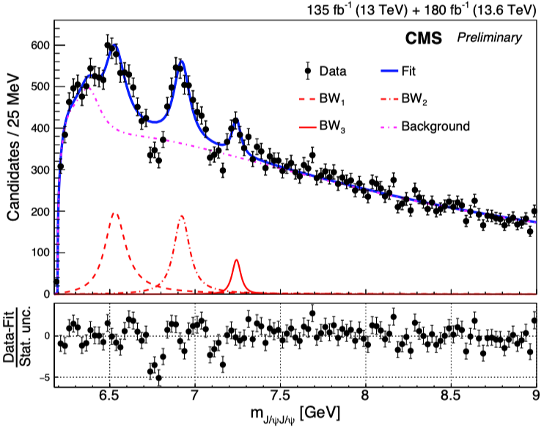
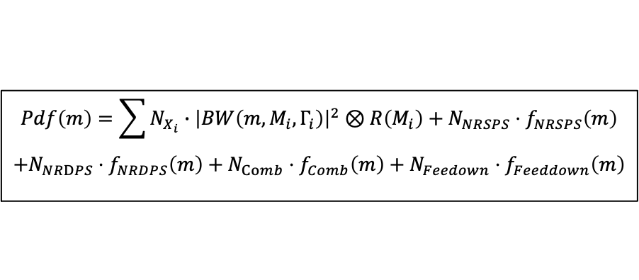
Run II & III No-interference fit result
No-interference model:
  Signal-hypothesis: NRSPS+NRDPS+Comb+Feeddown+BW0+BW1+BW2+BW3
$$Pdf\left(m\right)=\sum{N_{X_{i}}∙{\left|BW\left(m,M_{i},Γ_{i}\right)\right|}^{2}⊗R\left(M_{i}\right)}+N_{NRSPS}⋅f_{NRSPS}\left(m\right)$$
$$+N_{NRDPS}⋅f_{NRDPS}\left(m\right)+N_{Comb}⋅f_{Comb}\left(m\right)+N_{Feedown}⋅f_{Feeddown}\left(m\right)$$
Run 2 No-Interf
Run 2+3 No-Interf
Dips poorly described — no-Interf. model no longer sufficient !
11

Slide 12
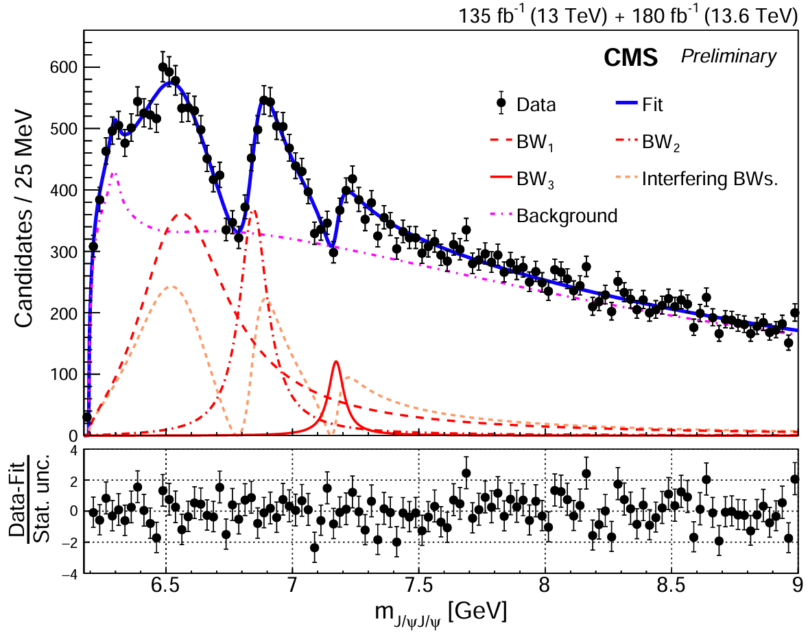
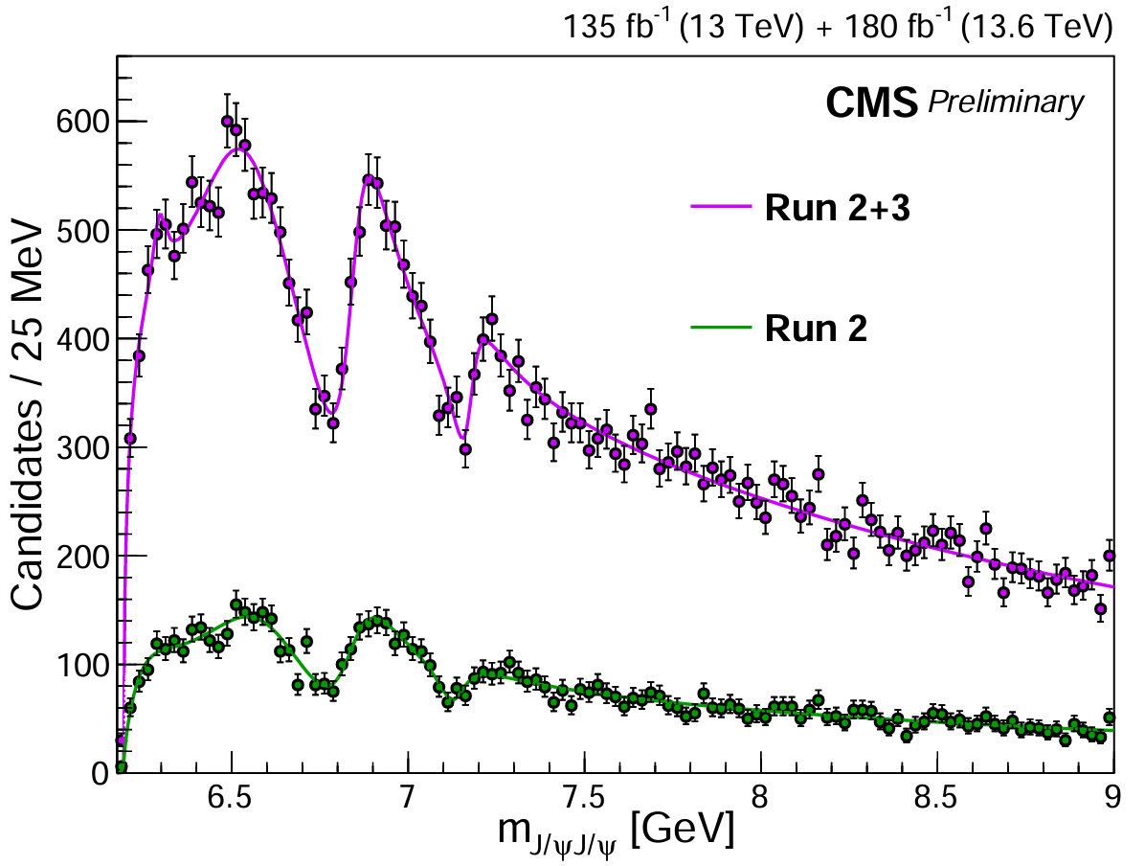

Run II & III interference fit result
Interference model with Run II + III:
15σ
17σ
X(7100)
8σ
Dip1: 10σ
Dip2: 7σ
All states and dips well above 5σ !
Quantum interference among structures validated!
Strongly imply that they have same $J^{PC}$
12

Slide 13
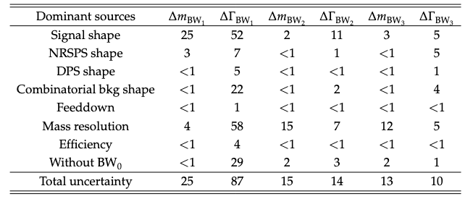
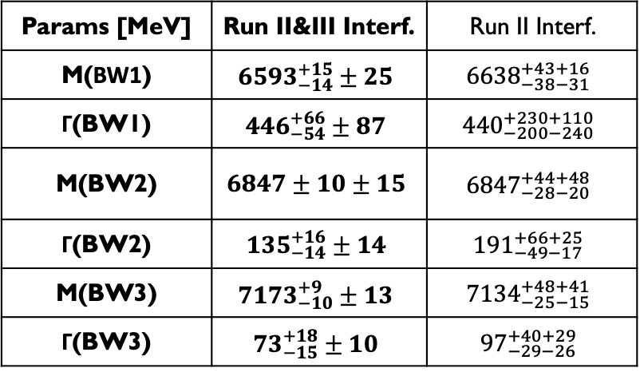
Run II & III interference fit result
Interference model:
Params [MeV] | Run II&III Interf. | Run II Interf.
M(BW1) | $${6593}_{−14}^{+15}±25$$ | $${6638}_{−38−31}^{+43+16}$$
Γ(BW1) | $${446}_{−54}^{+66}±87$$ | $${440}_{−200−240}^{+230+110}$$
M(BW2) | $$6847±10±15$$ | $${6847}_{−28−20}^{+44+48}$$
Γ(BW2) | $${135}_{−14}^{+16}±14$$ | $${191}_{−49−17}^{+66+25}$$
M(BW3) | $${7173}_{−10}^{+9}±13$$ | $${7134}_{−25−15}^{+48+41}$$
Γ(BW3) | $${73}_{−15}^{+18}±10$$ | $${97}_{−29−26}^{+40+29}$$
VS. Run II result:
  Statistical uncertainty reduced by a factor of 3
  Systematic uncertainty reduced by about a factor of 2
  Large mass splittings (> 250MeV) still exist, with improved precision
13

Slide 14
Outline
Motivation
  Tetraquark candidates
Updated Analysis of 𝐽/𝜓𝐽/𝜓 Channel
  Data sample and event selections
  𝐽/𝜓𝐽/𝜓 pairs signal in Run II+III data
  Fit model
  Run III && Run II+III result
Summary and Outlook
14

Slide 15
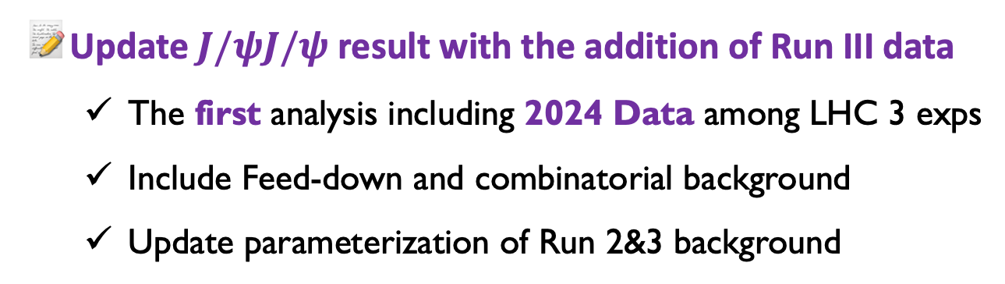
Summary and Outlook
Update $J/ψJ/ψ$ result with the addition of Run III data
  The first analysis including 2024 Data among LHC 3 exps
  Include Feed-down and combinatorial background
  Update parameterization of Run 2&3 background
A family of all-charm tetraquarks !!!
  X(6600), X(6900), and X(7100) well above 5σ
  Quantum interference among structures validated well above 5σ
  Large mass splittings, more precisely
==> Comparisons possible
==> States have common J^{PC}
==> radial family of states
Missing piece of puzzle ---- What’s cross section? What’s J^{PC} ?
THANKS!
15

Slide 16
BACKUP
BACKUP
16

Slide 17
BACKUP
17

Slide 18
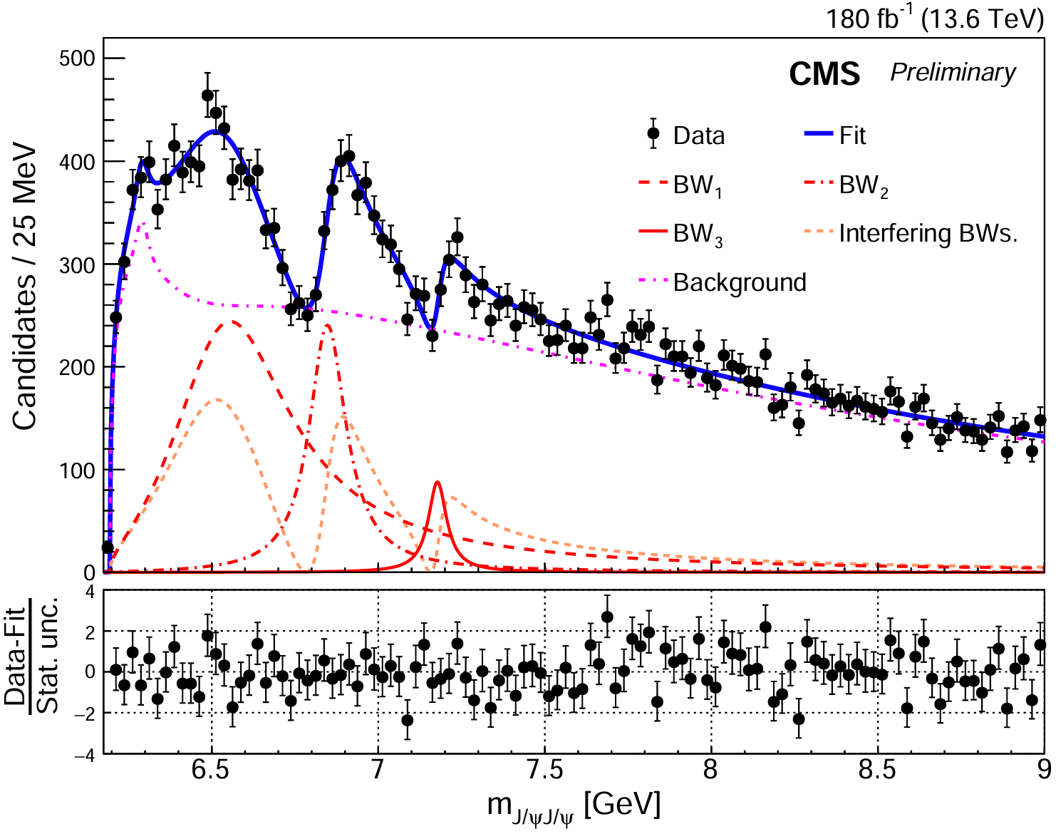
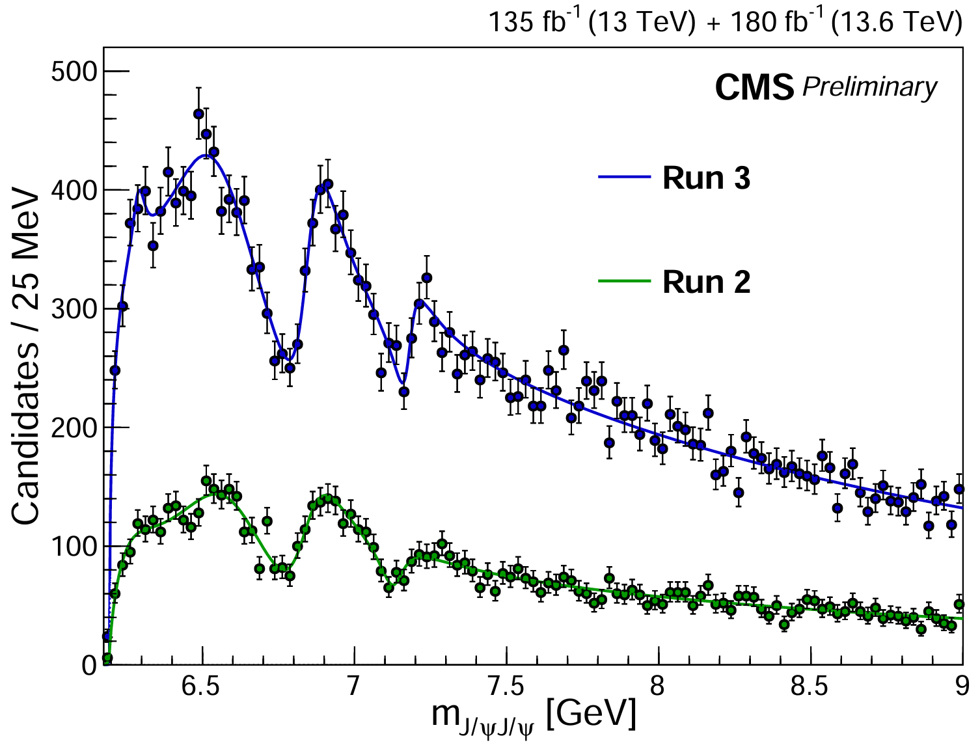
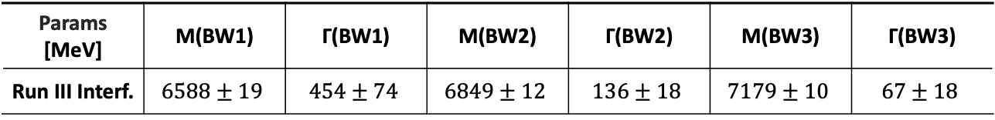
Run III interference fit result
12.7σ
12.9σ
6.3σ
Dip1: 8.4σ
Dip2: 5.1σ
Params [MeV] | M(BW1) | Γ(BW1) | M(BW2) | Γ(BW2) | M(BW3) | Γ(BW3)
Run III Interf. | $$6588±19$$ | $$454±74$$ | $$6849±12$$ | $$136±18$$ | $$7179±10$$ | $$67±18$$
Confirm Run II results with Run III data only
All states and dips above 5σ !
---with better precision!
---already achieve our goals!
18

