Slide 1
Introduction: vertex detector
International review IDRC review
  Possible date: Sep 10th ? (tbd)
Next CEPC day in September:
  We are asked for a report about the vertex detector
  Development plan (merging Taichu and Jadepix) ,
    Review Taichu and Jadepix development (重要指标，异同），各自研发历程
      空间分辨
      高本底
    Plan for the future （MOST3, stitching )，提一下华力
    MOST3 (3微米, 指标，下周1~3）
      第一步，双面PCB的束流测试（一面Taichu，一面Jadepix）
      第二步，流片工程批（一半面积是Taichu，一半是Jadepix）
      第三步：65/55nm流片
    CEPC 最终指标是不是要3微米？
      目前ref-TDR， 25*25微米
      d0~3微米, z0 变差 , （16*40微米）
      D0, Z0 ， 3微米 （16*16微米），功耗，散热
      不同半径 11mm, 12mm, 13mm
    define new name of the chip

Slide 2
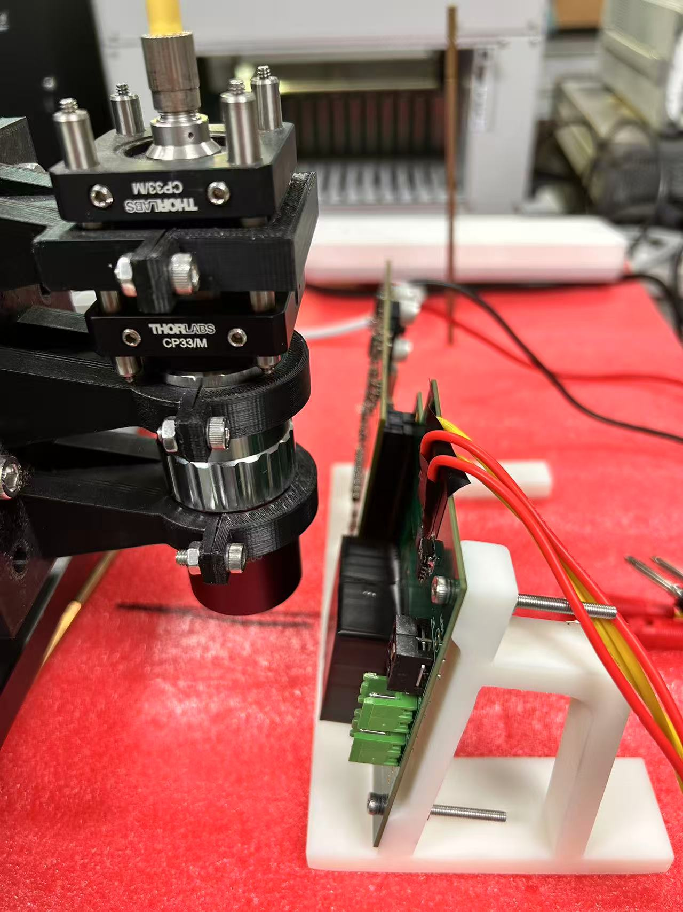
Issue can be addressed before review
Comment about Vertex design : Study readout frequency vs power consumption
About laser alignment: more study with illuminations at shallow angles on prototype sensors will be performance in a short time scale. ( Study hit maps in different angle from front side and from back side )
Comments about performance: Study physics performance (eg: Rb) of alternative layout
Study impact parameters performance with some inefficiency sensors scenario
(1% of N_hit =4)

