Slide 1
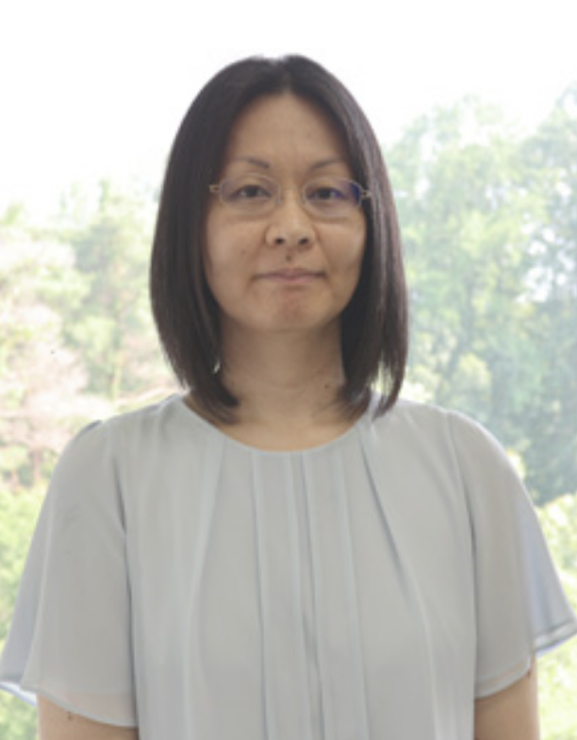

Experimental Physics Division Seminar
Institute of High Energy Physics, CAS
Operation of Belle II drift chamber at B-factory
photo
Speaker: | Prof. Nanae Taniguchi
Host: | Prof. Mingyi Dong
Time: | 09:00 am, 2nd Sep, 2025
Location: | 228 Multidisciplinary Building
Indico: | indico.ihep.ac.cn/event/27111
Zoom ID: | 9827 5121 355
Password: | 250902
Abstract:
In this talk, the Belle II experiment will be discussed, focusing on the Central Drift Chamber (CDC). SuperKEKB, the asymmetric energy accelerator that provides e⁺e⁻ collisions inside Belle II, achieved a new luminosity world record of 4.7x10³⁴ cm⁻²s⁻¹ (2022) and 5.1x10³⁴ cm⁻²s⁻¹ (2024).
The Central Drift Chamber is currently showing good performance. However, with the expected increase in luminosity in future runs, it will be necessary to keep stable operation and good performance even in higher background conditions. We will then look at how beam backgrounds affect the operation and performance of the CDC, and describe possible countermeasures for the future.
About the speaker:
Nanae Taniguchi
Associate Professor, Institute of Particle and Nuclear Studies (IPNS), High Energy Accelerator Research Organization (KEK)
Leader, Central Drift Chamber (CDC) Group, Belle II Experiment

