Slide 1
MVA(3922)
'CMS_pt','psi2S_CMS_pt','m2Recoil','psi2S_m2Recoil','distance','dcosTheta','dphi','psi2S_px','psi2S_py','psi2S_pz','psi2S_p','px','py','pz','pt'

Slide 2
MVA(3922)

Slide 3
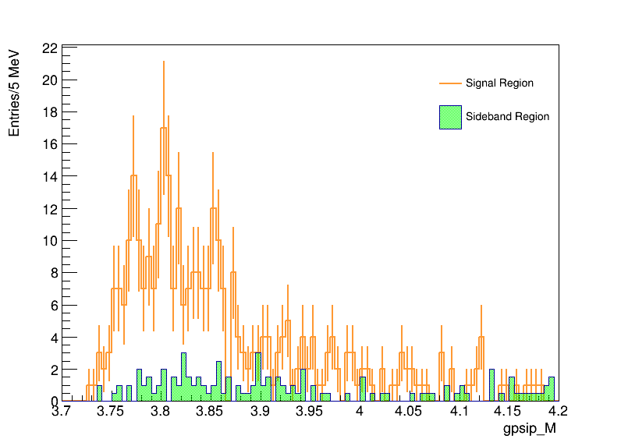
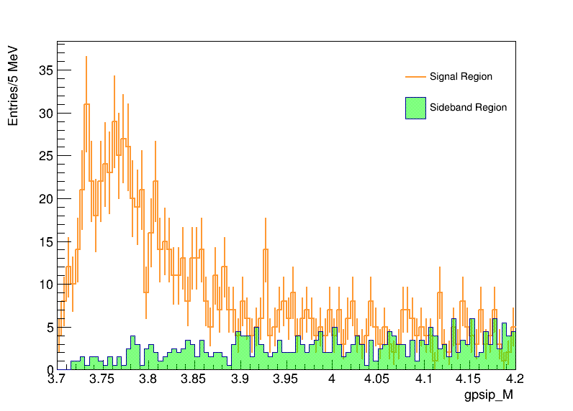
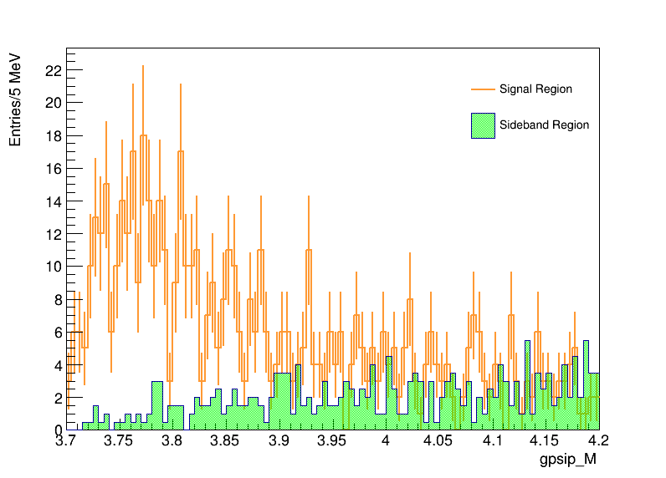
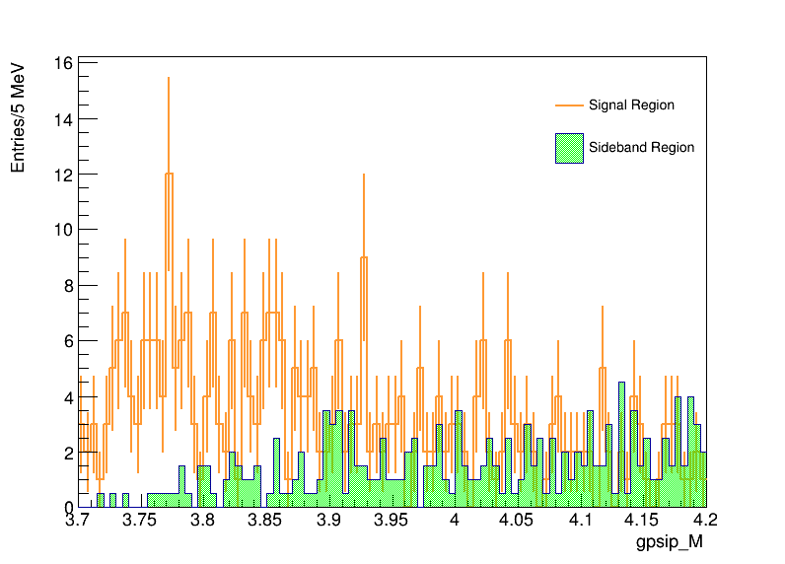
Belle2 Data(365/fb)
传统选择条件
MVA(3930) > 0.90
MVA(3930) > 0.93
MVA(3930) > 0.95

Slide 4
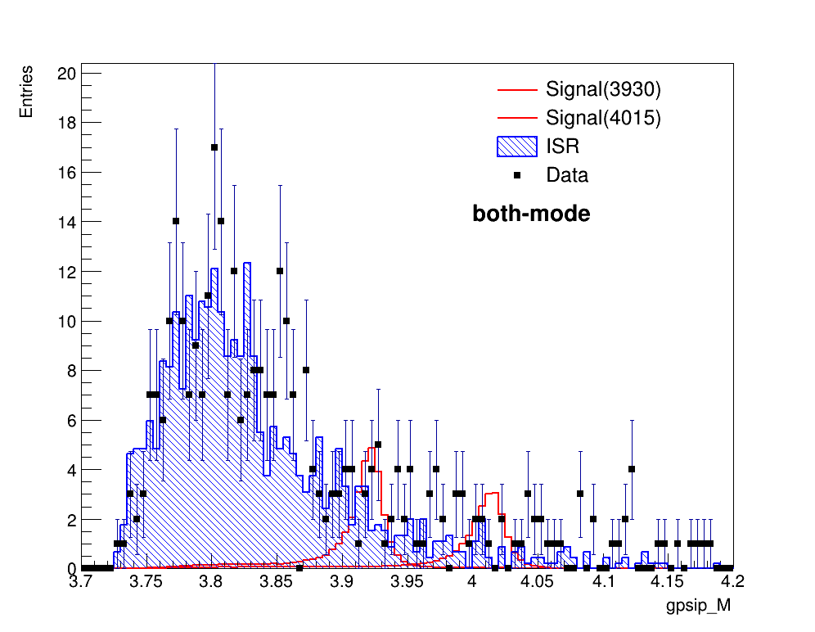
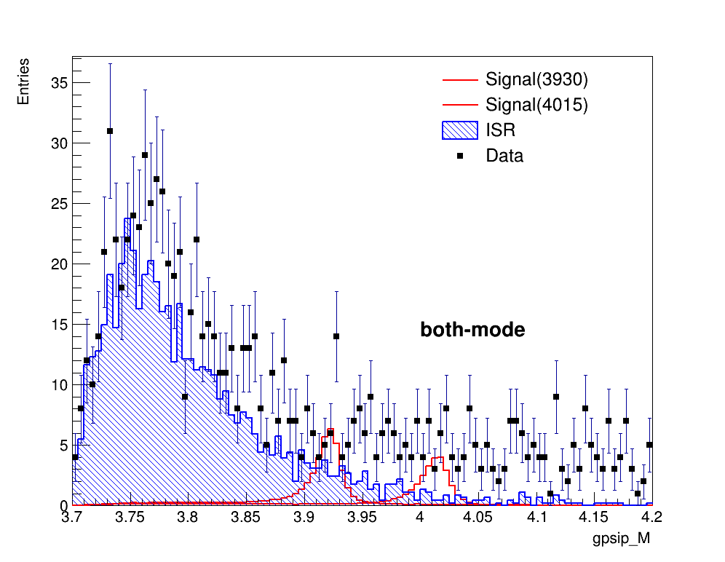
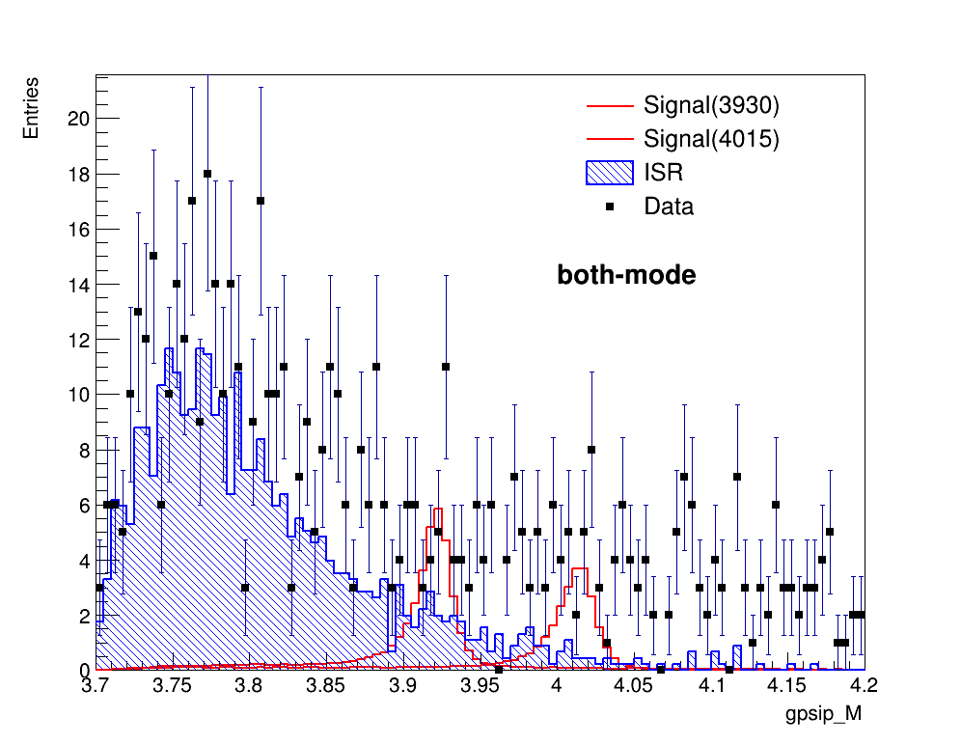
传统选择条件
MVA(3930) > 0.90
MVA(3930) > 0.93

Slide 5
MVA(4015)
'CMS_pt','psi2S_CMS_pt','m2Recoil','psi2S_m2Recoil','distance','dcosTheta','dphi','psi2S_px','psi2S_py','psi2S_pz','psi2S_p','px','py','pz','pt'

Slide 6
MVA(4015)

Slide 7
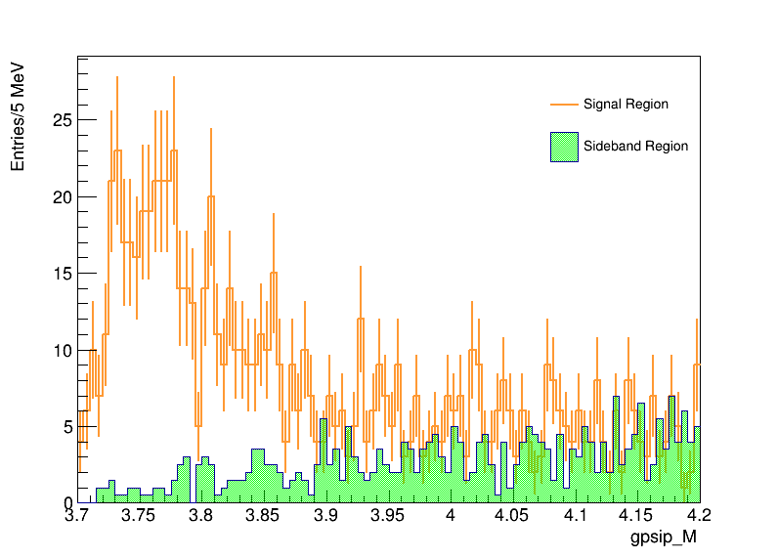
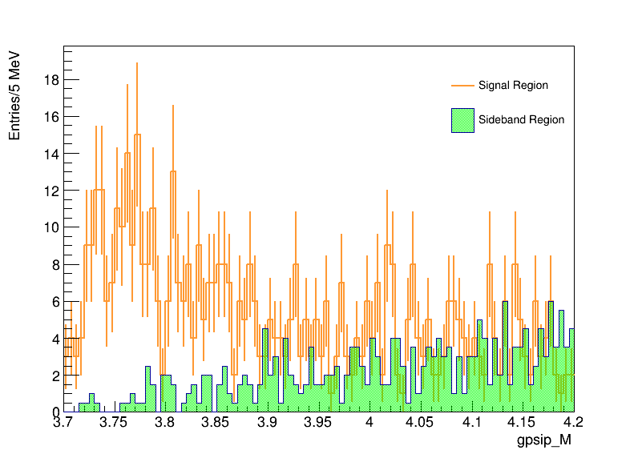
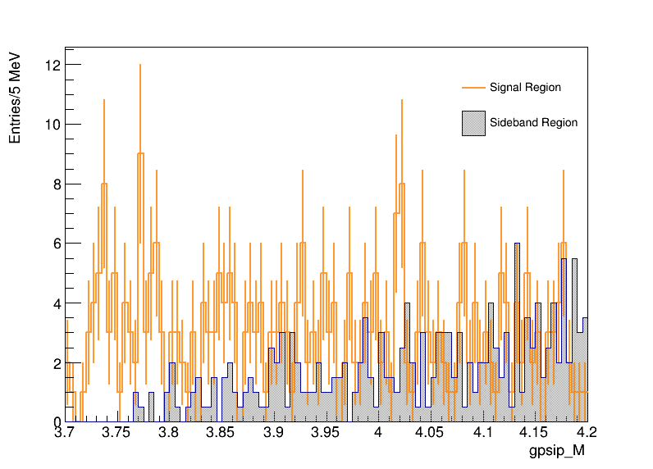
Belle2 Data(365/fb)
传统选择条件
MVA(4015) > 0.90
MVA(4015) > 0.93
MVA(4015) > 0.95

Slide 8
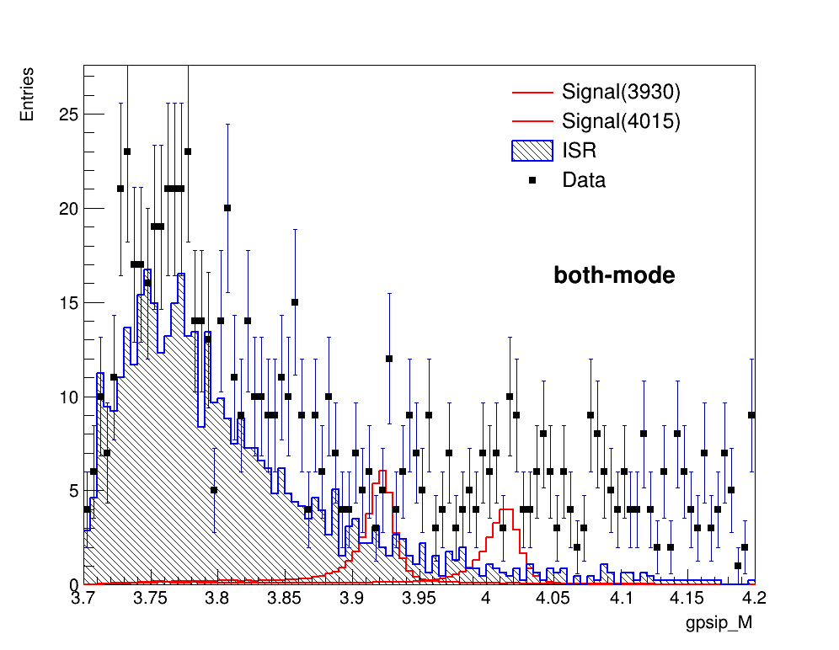
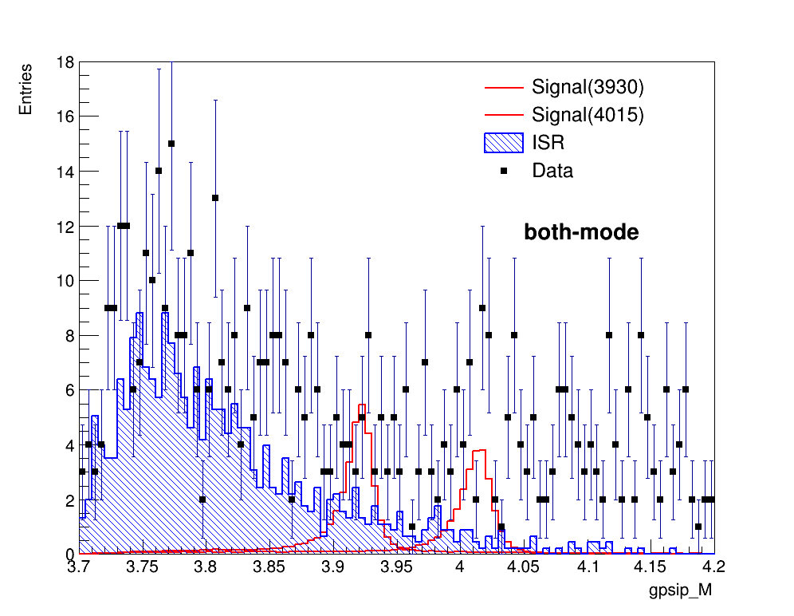
传统选择条件
MVA(4015) > 0.90
MVA(4015) > 0.93

