Slide 1
Weekly Report
Minghao Li 2025.09.02

Slide 2
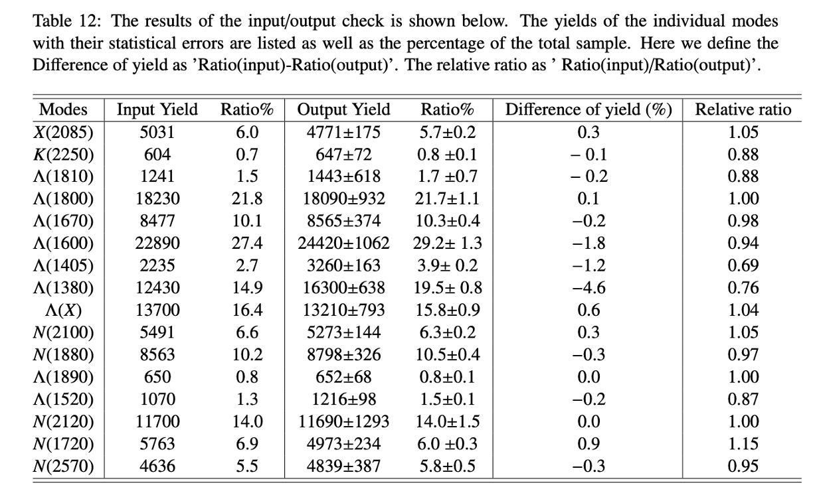
$$ψ\left(3686\right)→pK^{−}\overline{Λ}+c.c.$$
Table 12: how did you calculate the `Difference of yield'? my calculation does not meet yours.
Re: Thanks for your suggestion, here we calculate the value of "Difference of yield". We obtain it by subtracting the ratio of the input of each state from the ratio of the output. Then we defined the "difference of yield" and add the corresponding explanation in Table 12 of the memo.

Slide 3
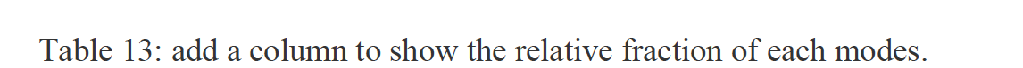
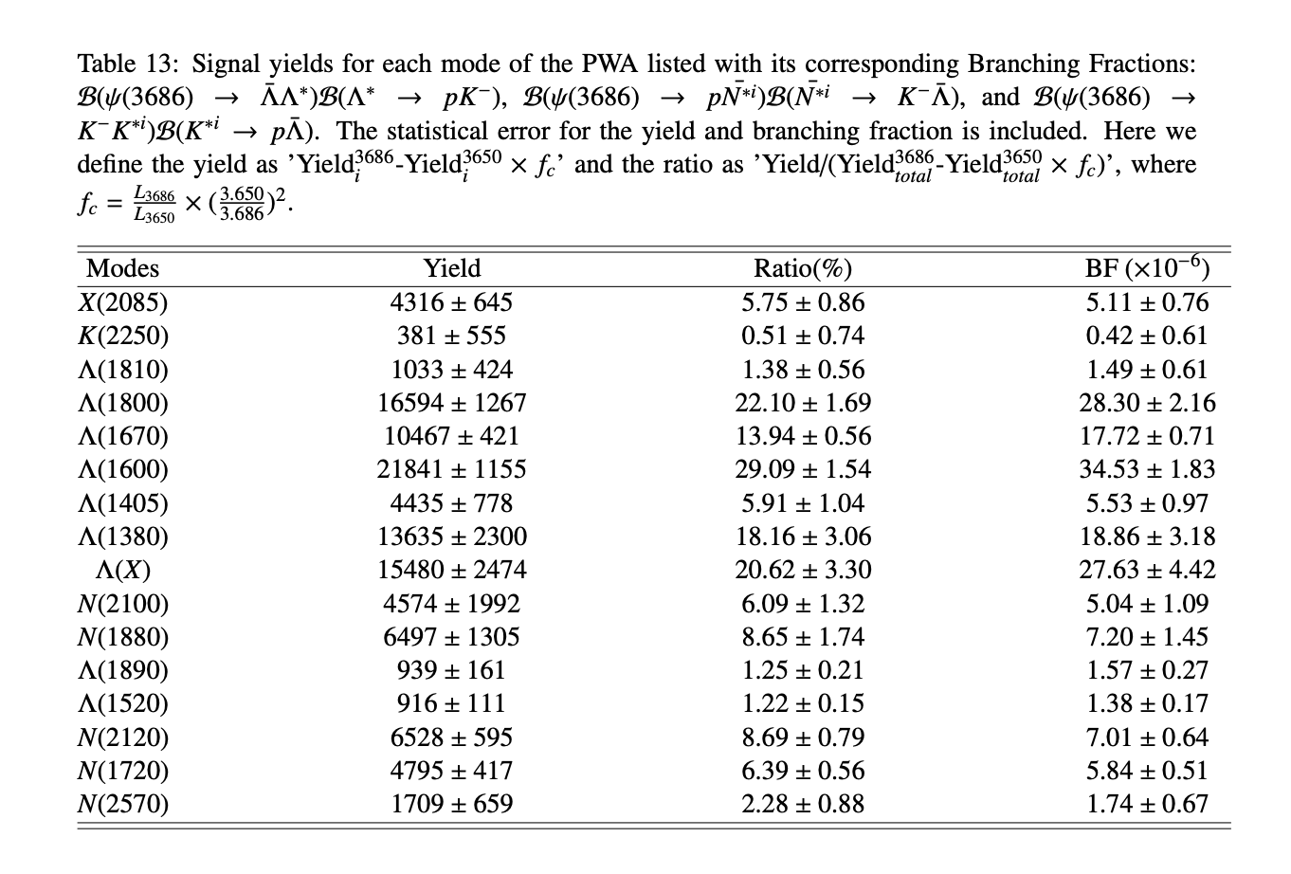

$$ψ\left(3686\right)→pK^{−}\overline{Λ}+c.c.$$
$$f_{c}=8.89$$
Re: Thanks for your suggestion, it has been modified in the updated memo. In order to make it easier to understand, we also defined the calculation methods for yield and ratio, and updated them in Table 13.

Slide 4
$$ψ\left(3686\right)→pK^{−}\overline{Λ}+c.c.$$
Next to do
Preparing Prof. Zhao's question and updated the memo.
Read articles to prepare for writing the draft.
Engaged in the BESIII shift at this week and next week.

