Slide 1
Group Meeting
王仕元
2025.9.2

Slide 2
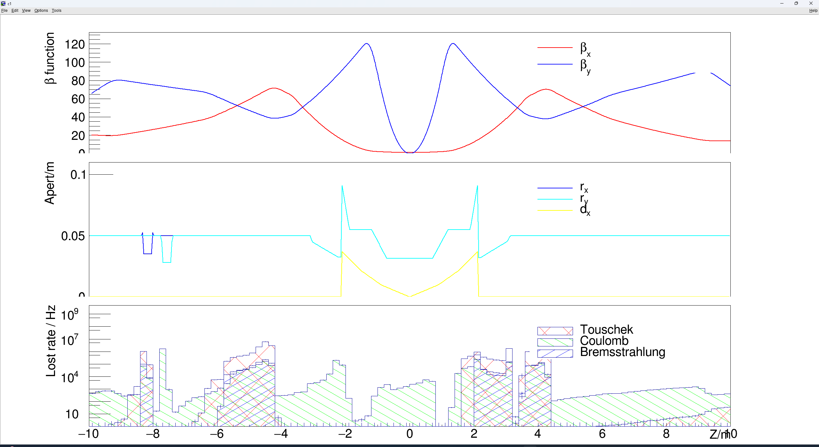
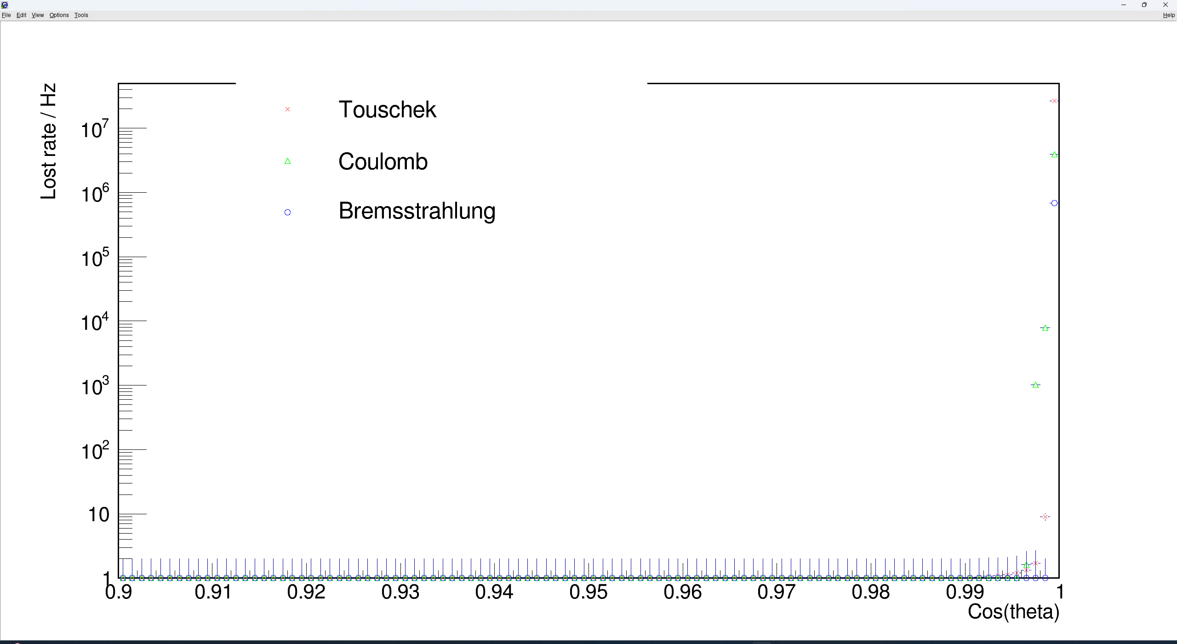
Past Work
Run SADSimulation/Tracking, generated corresponding images.
Analyzed the code's operational logic.
Analysis of physics-related aspects is planned for the near future.
Variation of β-function (Horizontal/Vertical) along the beam direction (Z-axis) (DrawIRZ_Apt_Beta.C).
Distribution of mechanical aperture (Horizontal rx, Vertical ry) and orbit offset (dx).
Logarithmic distribution of beam background loss rates (Touschek, Coulomb scattering, Bremsstrahlung).
Loss angle distribution (DrawCosT.C) of background particles.
第一页

Slide 3
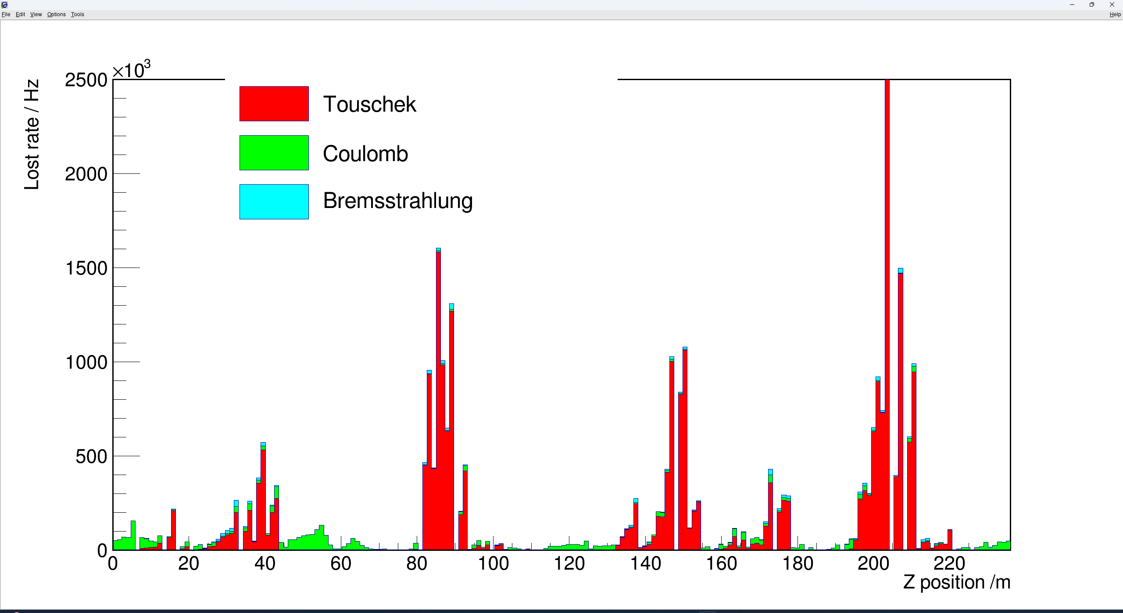

The loss rate distribution of background particles along the $Z_{0}$ direction (DrawIRinitZ.C)

Slide 4
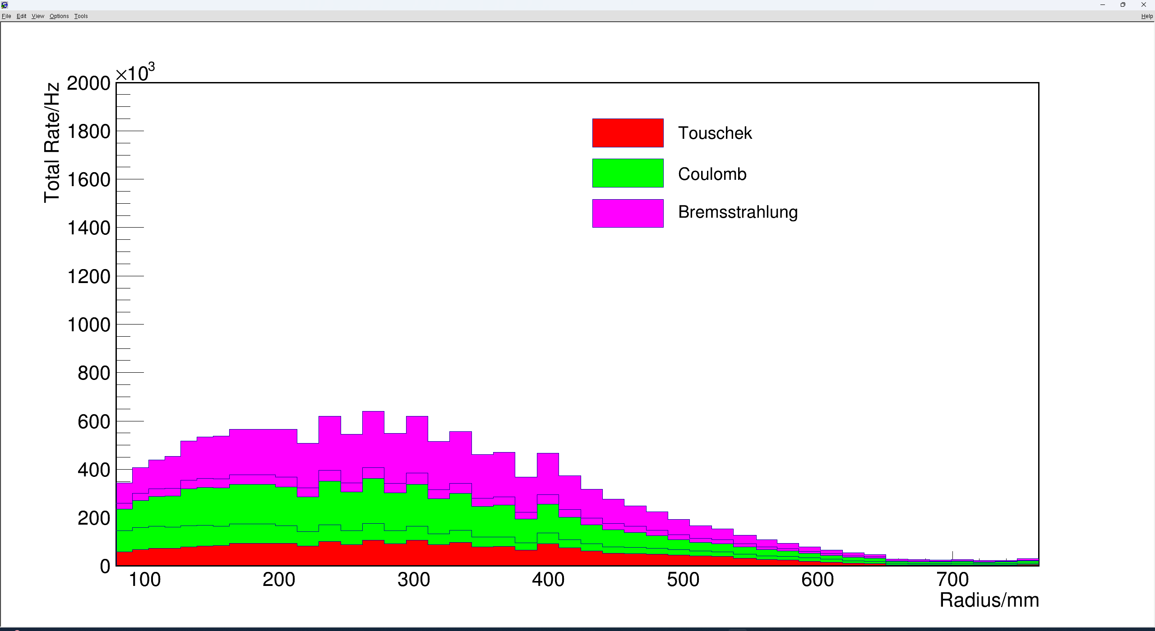
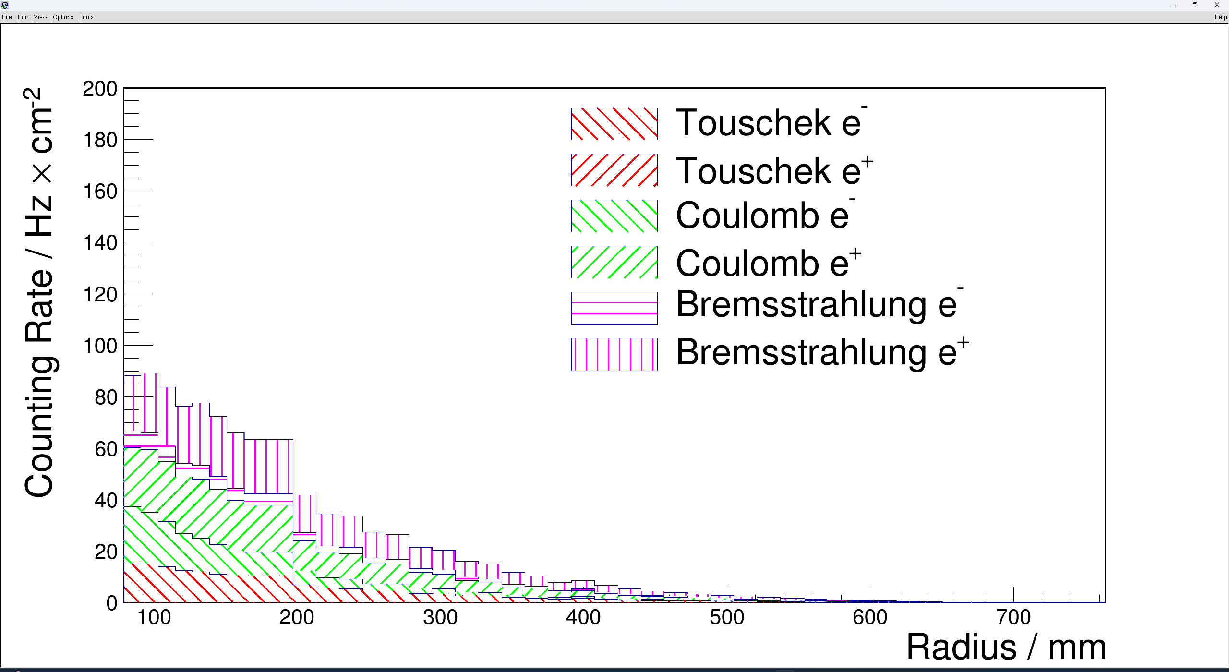
Total hit rate of background particles in different layers (draw_total.C).
Generated Plots (from SAD data via BOSS programs):
Hit rate of background particles per layer (draw_lay.C).

Slide 5
Ongoing Work
1.Preparing to run APES based on the obtained APES package for subsequent tasks.
2.Modifying SAD_RBB to make it compatible with BIIU (Current Tasks).

