Slide 1
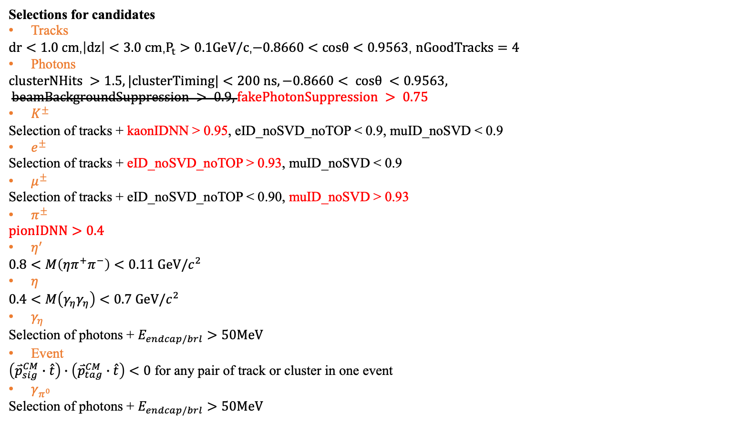
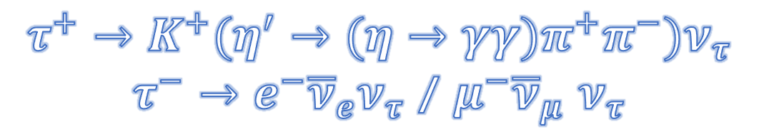
$$τ^{+}→K^{+}(η^{′}→(η→γγ)π^{+}π^{−})ν_{τ}$$
$τ^{−}→e^{−}{\overline{ν}}_{e}ν_{τ}$ / $μ^{−}{\overline{ν}}_{μ}$ $ν_{τ}$
Selections for candidates
Tracks
$dr<1.0 cm$,$\left|dz\right|<3.0 cm$,$P_{t}>0.1GeV/c$,$−0.8660<cosθ<0.9563$, $nGoodTracks=4$
Photons
$$clusterNHits >1.5, |clusterTiming|<200 ns, −0.8660< cosθ <0.9563, beamBackgroundSuppression > 0.9, fakePhotonSuppression > 0.75$$
$K^{±}$
Selection of tracks + kaonIDNN > 0.95, eID_noSVD_noTOP < 0.9, muID_noSVD < 0.9
$e^{±}$
Selection of tracks + eID_noSVD_noTOP > 0.93, muID_noSVD < 0.9
$μ^{±}$
Selection of tracks + eID_noSVD_noTOP < 0.90, muID_noSVD > 0.93
$π^{±}$
$$pionIDNN>0.4$$
$η^{′}$
$$0.8<M\left(ηπ^{+}π^{−}\right)<0.11 GeV/c^{2}$$
$η$
$$0.4<M\left(γ_{η}γ_{η}\right)<0.7 GeV/c^{2}$$
$γ_{η}$
Selection of photons + $E_{endcap/brl}>50MeV$
Event
$\left({\overset{⃑}{p}}_{sig}^{CM}∙\hat{t}\right)∙\left({\overset{⃑}{p}}_{tag}^{CM}∙\hat{t}\right)<0$ for any pair of track or cluster in one event
$γ_{π^{0}}$
Selection $\text{of} \text{photons}\text{ + }E_{endcap/brl}>50MeV$
Signal Reconstruction Efficiency:
e-mode: 9.49%
mu-mode: 9.04%
tot: 18.53%

Slide 2
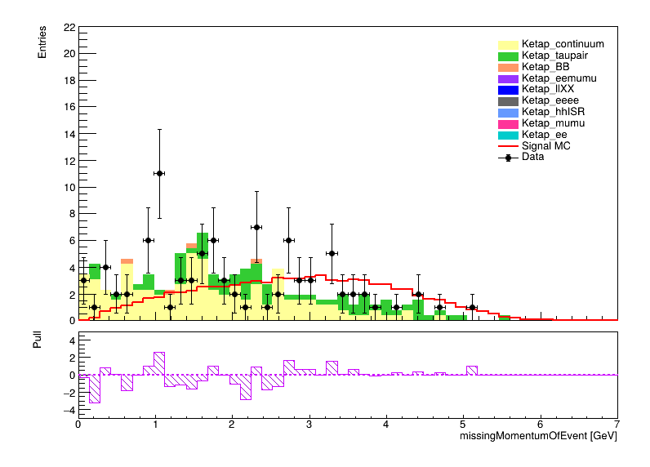
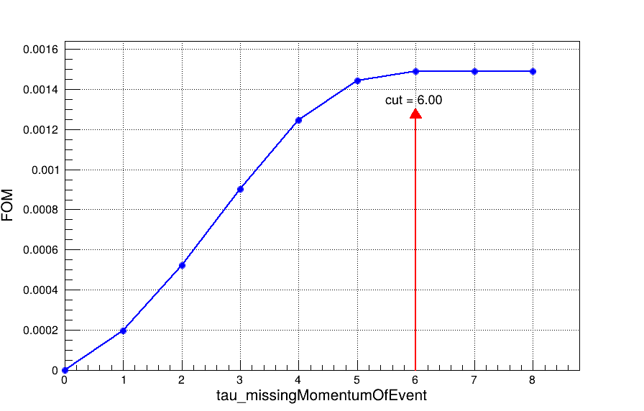
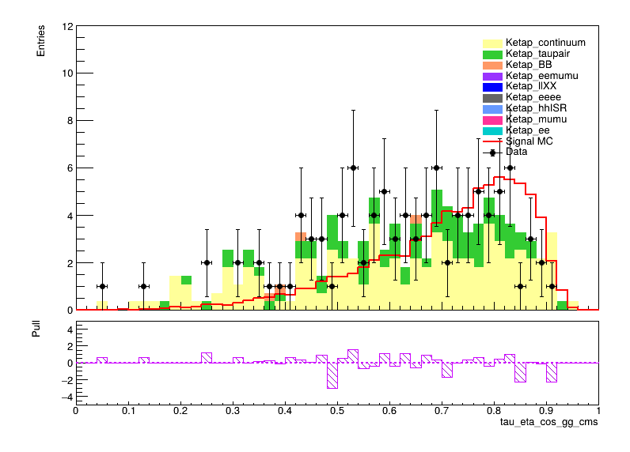
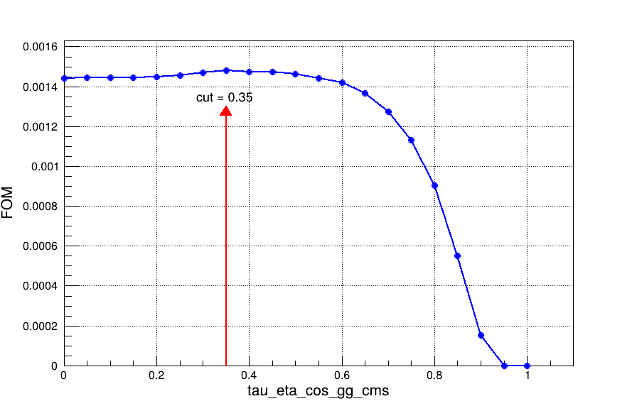
Selection Optimization

Slide 3
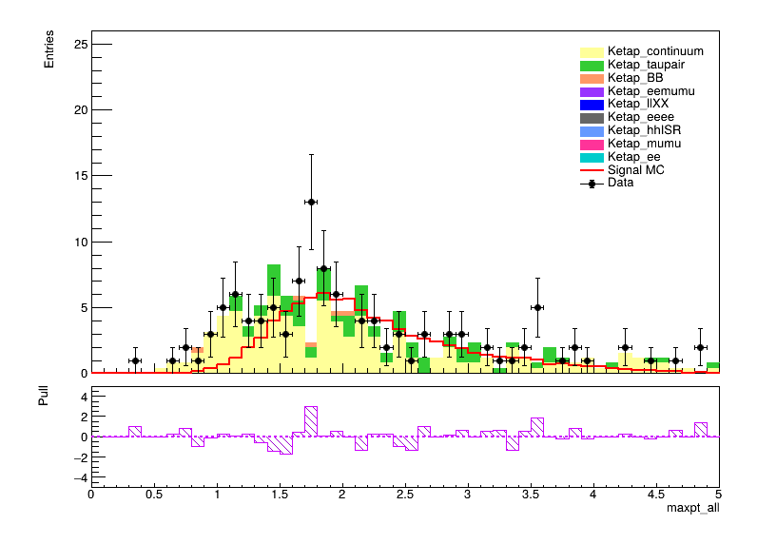
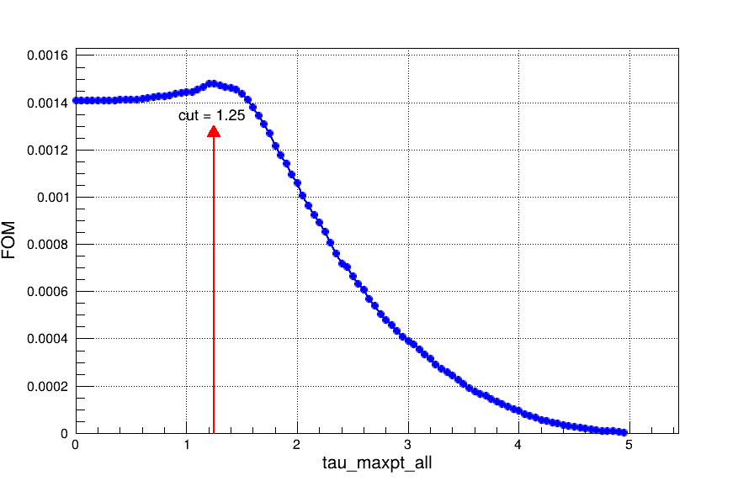
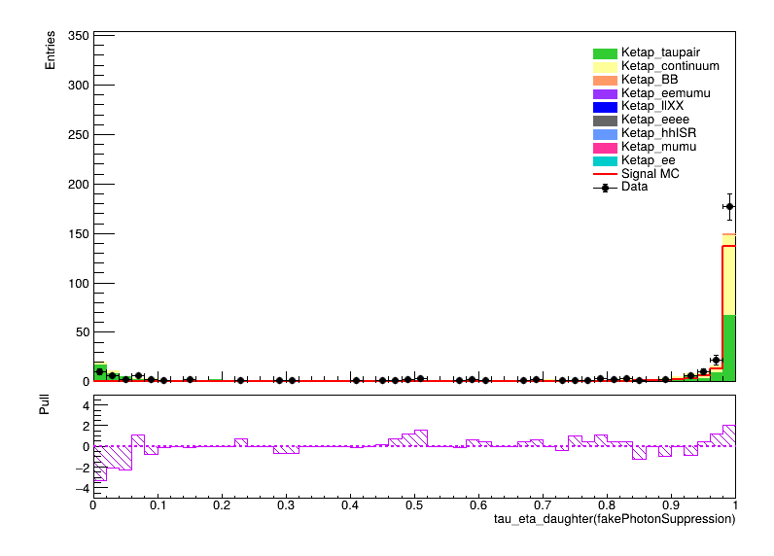
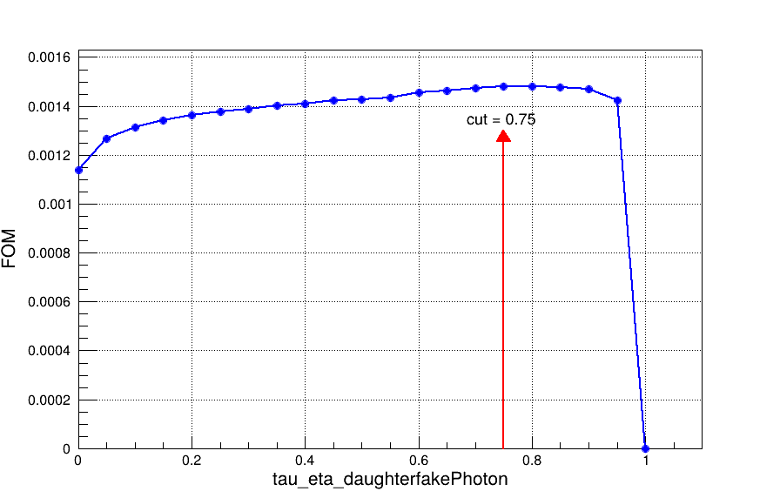
Selection Optimization

Slide 4
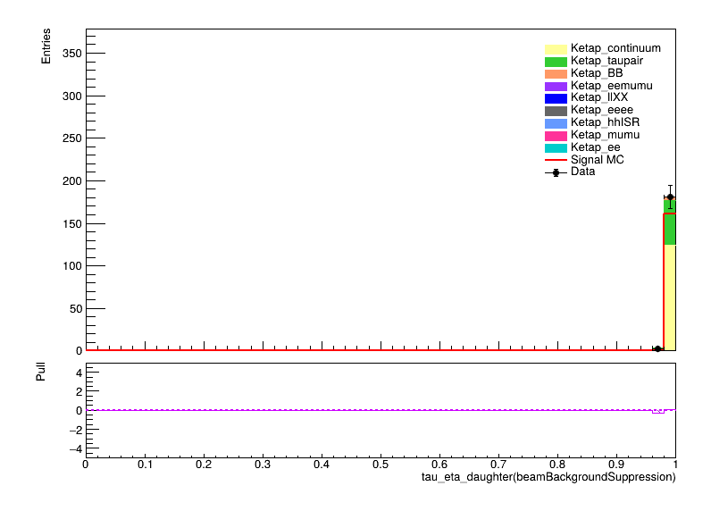
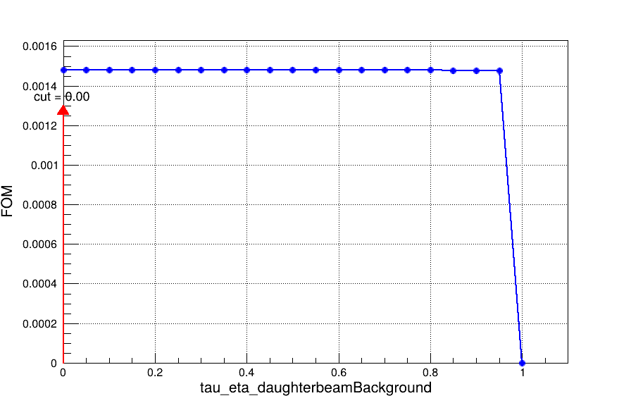
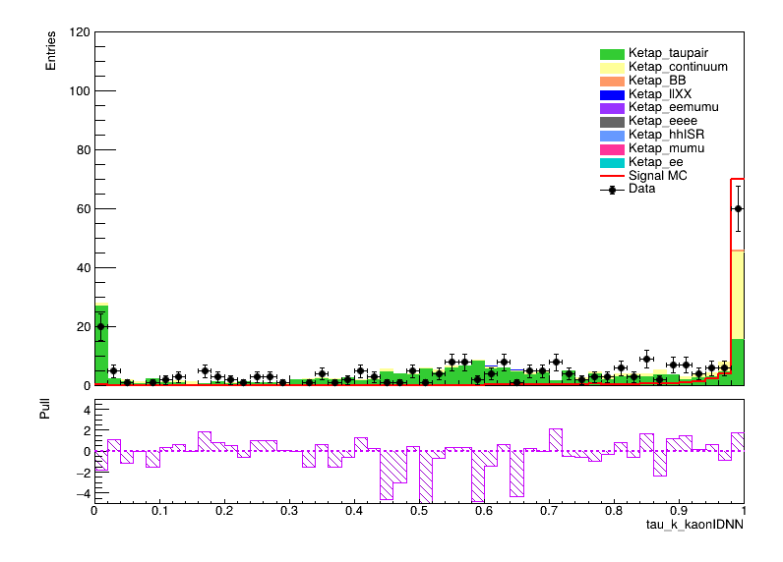
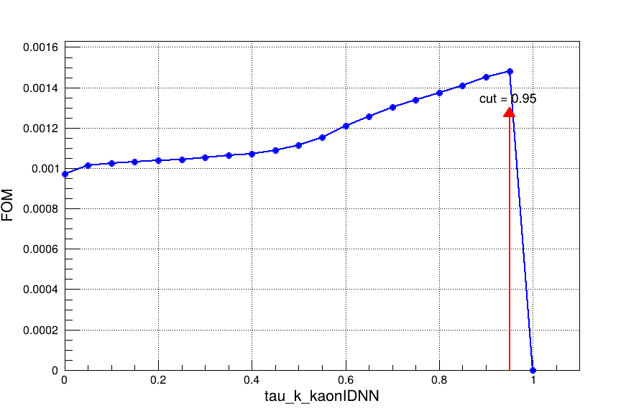
Selection Optimization

Slide 5
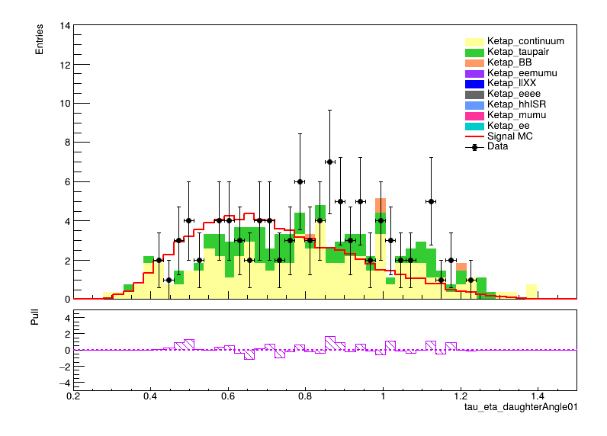
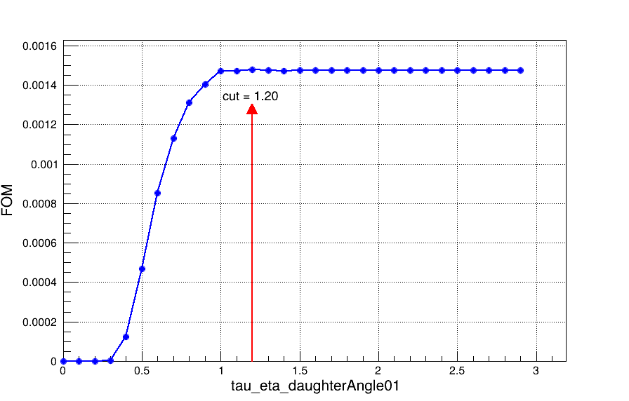
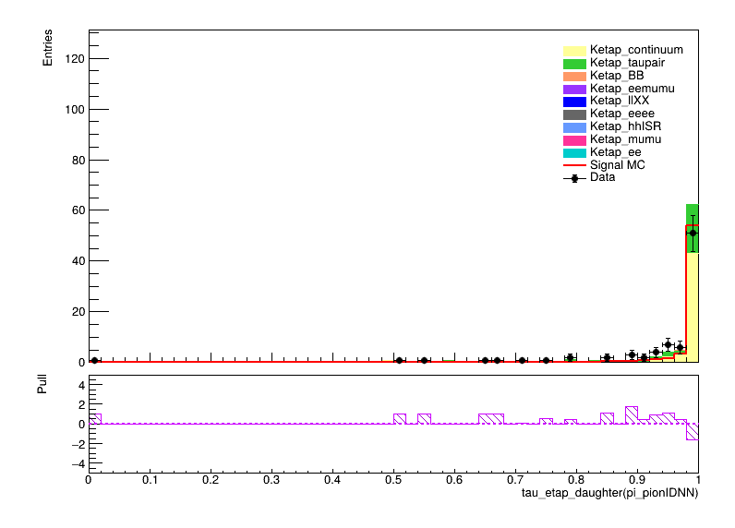
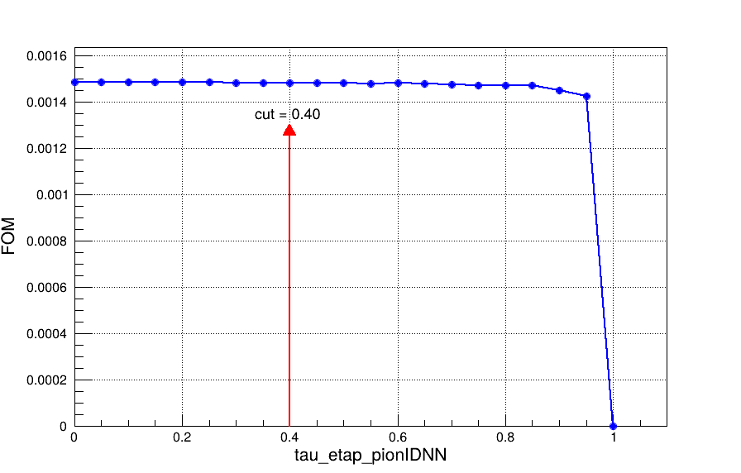
Selection Optimization

Slide 6
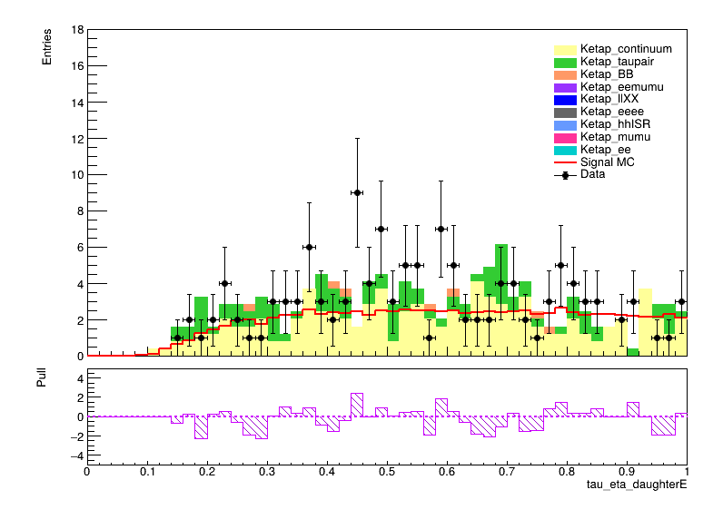
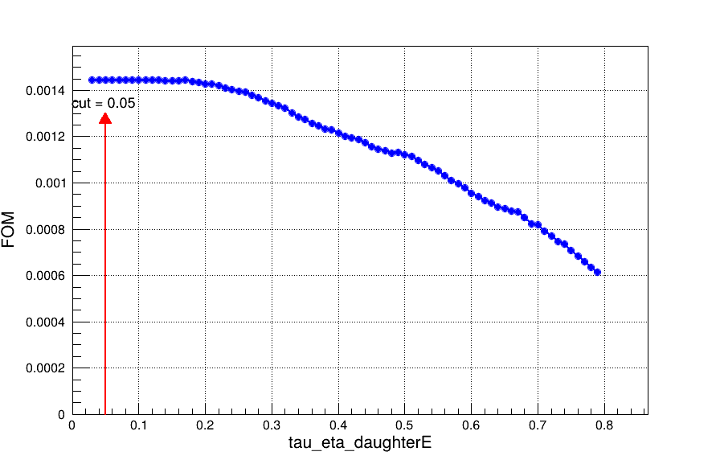
Selection Optimization

Slide 7
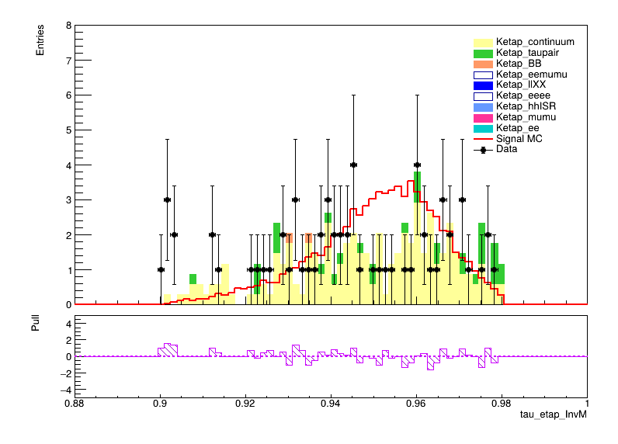
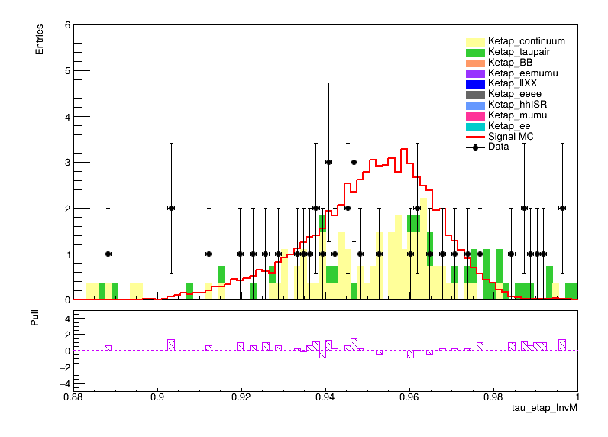
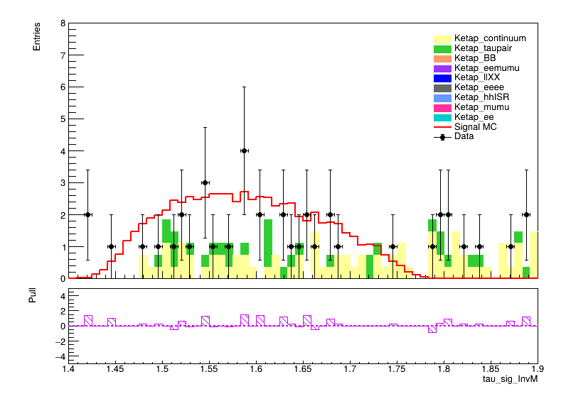
Previous:
Optimization:

Slide 8

Study of $γγ→γψ(2S)$ at BelleII

Slide 9
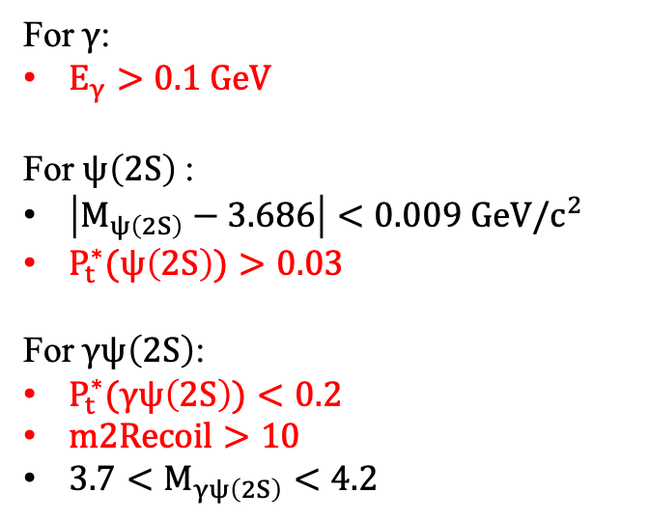
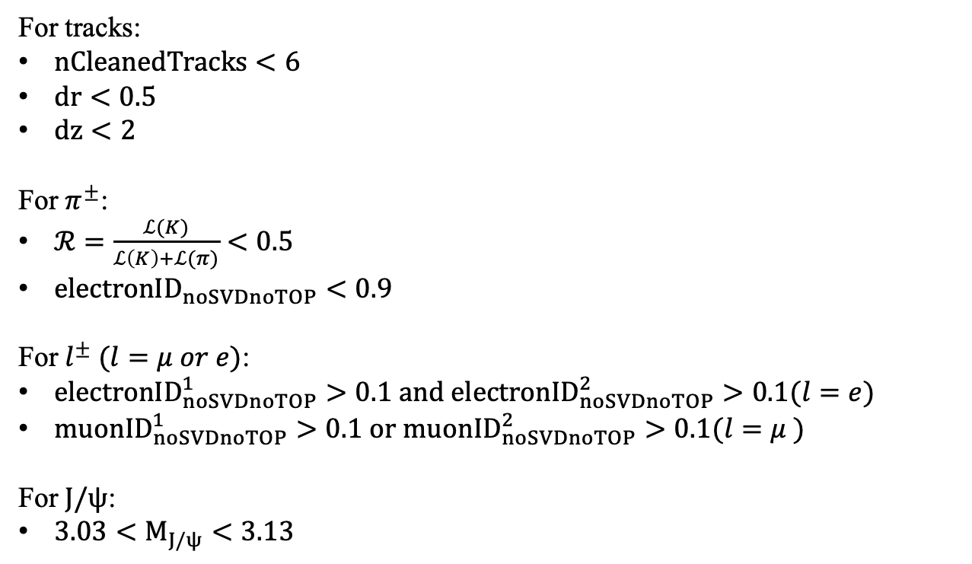
Event Selection
For tracks:
$nCleanedTracks<6$
$dr<0.5$
$dz<2$
For $π^{±}$:
$ℛ=\frac{ℒ(K)}{ℒ\left(K\right)+ℒ(π)}<0.5$
${electronID}_{noSVDnoTOP}<0.9$
For $l^{±} (l=μ or e)$:
${electronID}_{noSVDnoTOP}^{1}>0.1 and {electronID}_{noSVDnoTOP}^{2}>0.1(l=e)$
${muonID}_{noSVDnoTOP}^{1}>0.1 or {muonID}_{noSVDnoTOP}^{2}>0.1(l=μ )$
For $J/ψ$:
$3.03<M_{J/ψ}<3.13$
For $γ$:
$E_{γ}>0.1 GeV$
For $ψ\left(2S\right)$:
$\left|M_{ψ\left(2S\right)}−3.686\right|<0.009 GeV/c^{2}$
$P_{t}^{∗}(ψ\left(2S\right))>0.03$
For $γψ\left(2S\right)$:
$P_{t}^{∗}(γψ\left(2S\right))<0.2$
$m2Recoil>10$
$3.7<M_{γψ\left(2S\right)}<4.2$

Slide 10
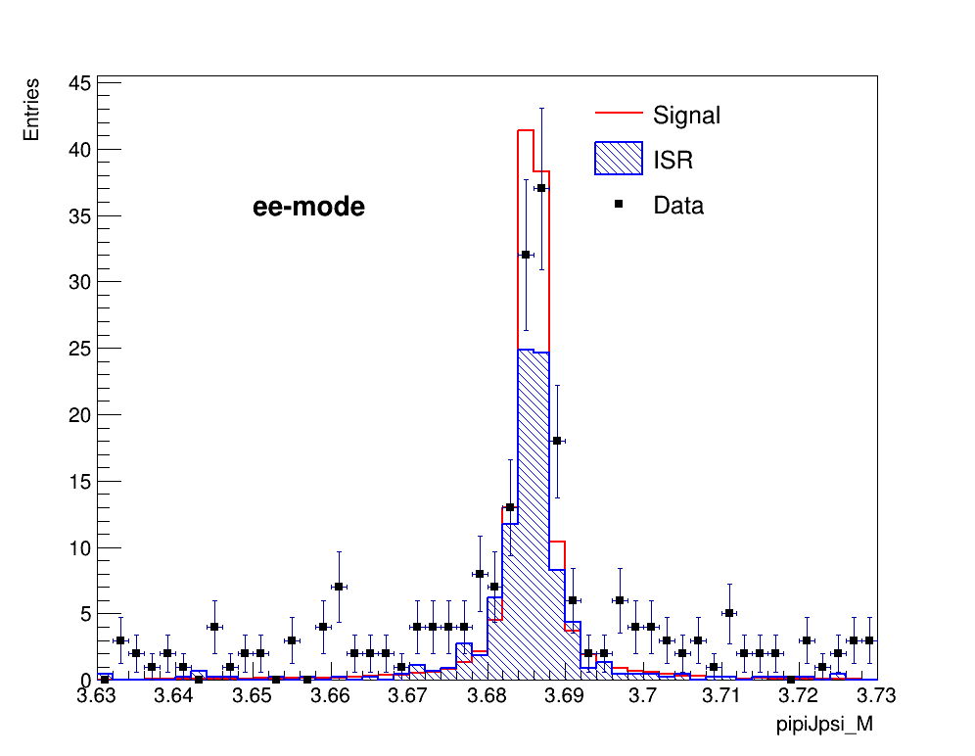
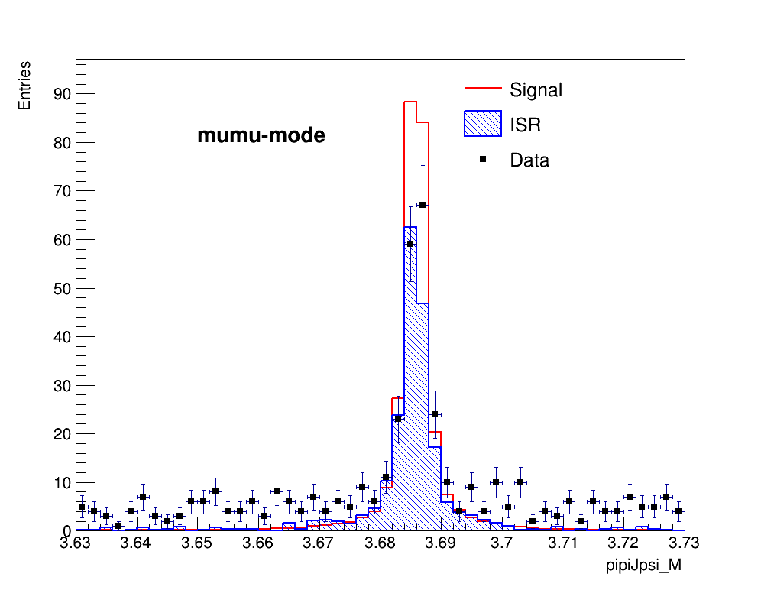
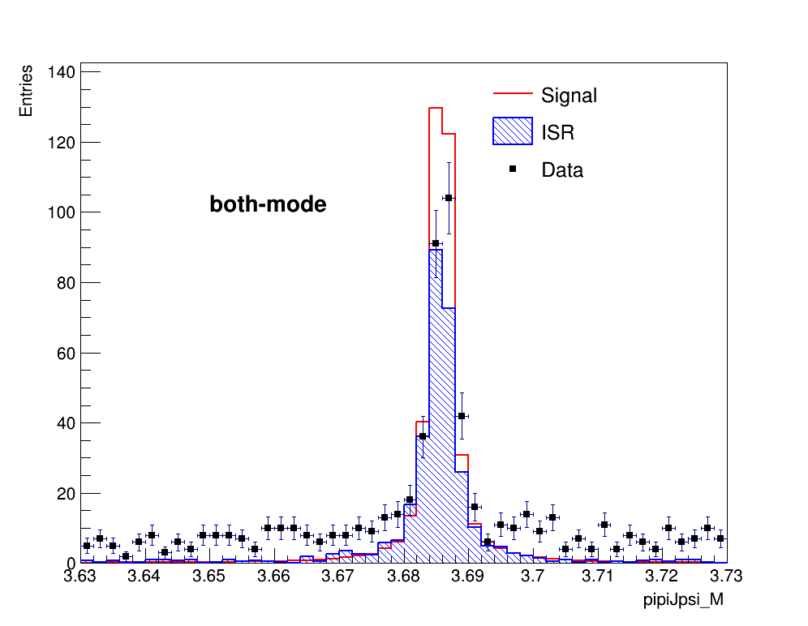
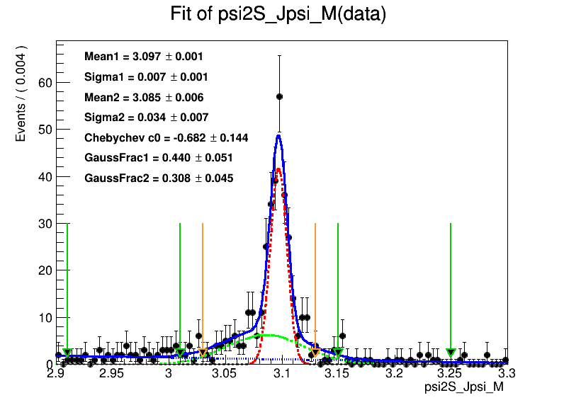
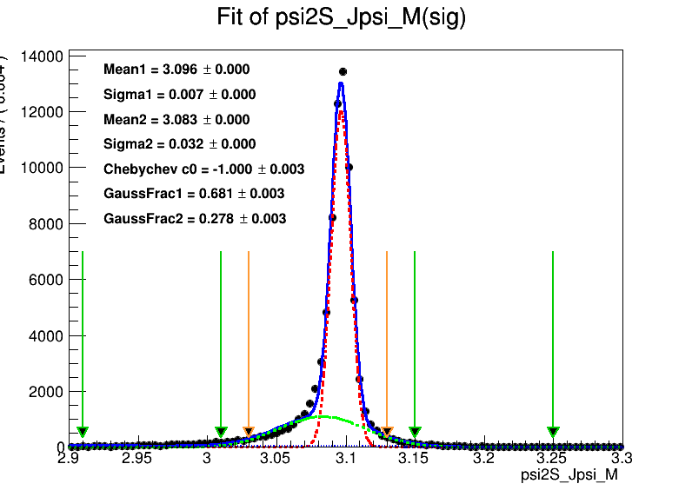
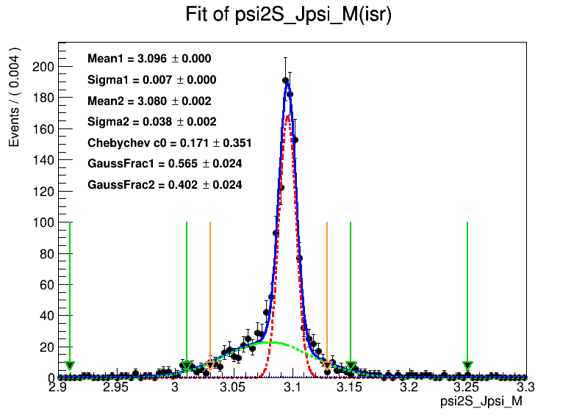

$J/ψ$ $signals$

Slide 11
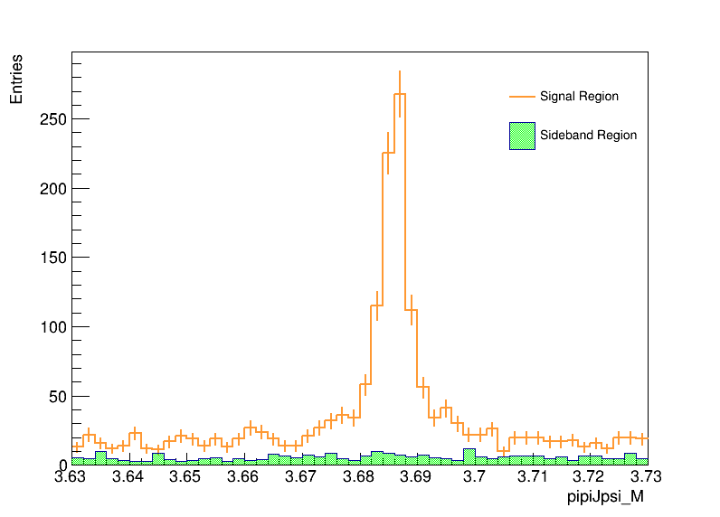
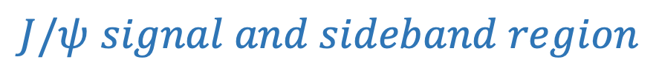
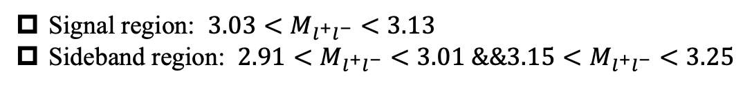
$J/ψ$ $signal and sideband region$
Signal region: $3.03<M_{l^{+}l^{−}}<3.13$
Sideband region: $2.91<M_{l^{+}l^{−}}<3.01 \&\&3.15<M_{l^{+}l^{−}}<3.25$

Slide 12
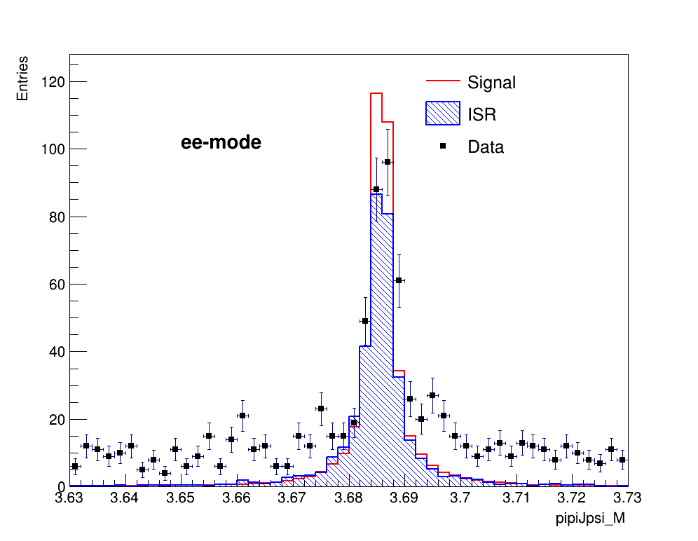
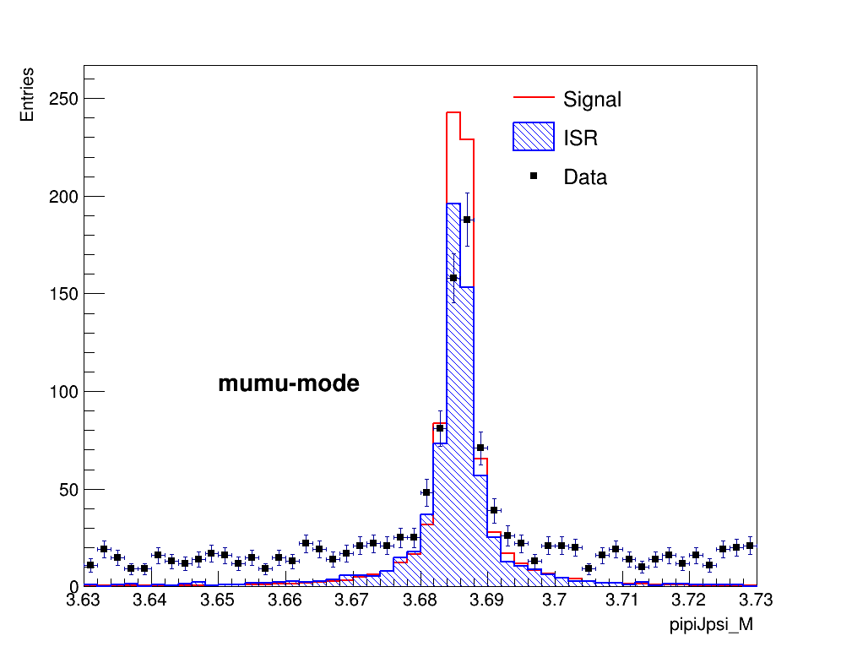
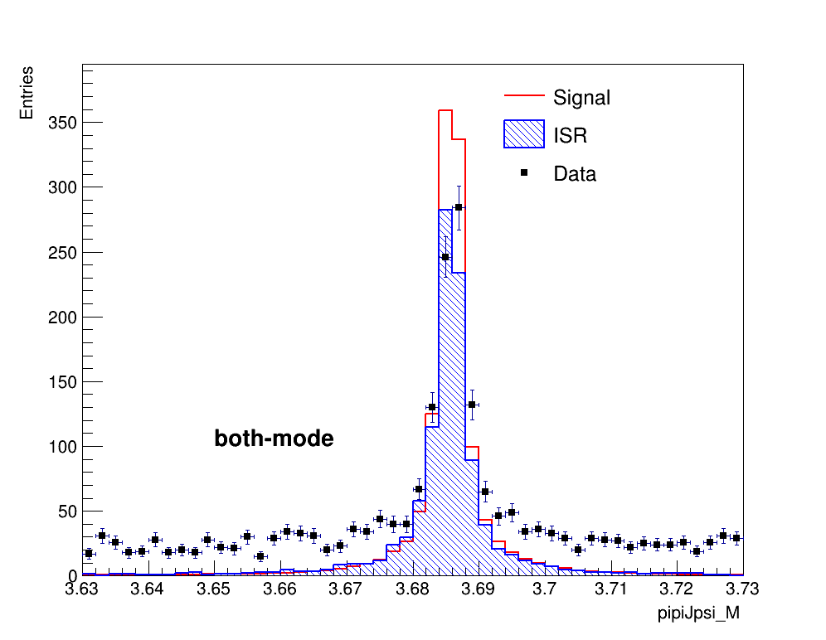
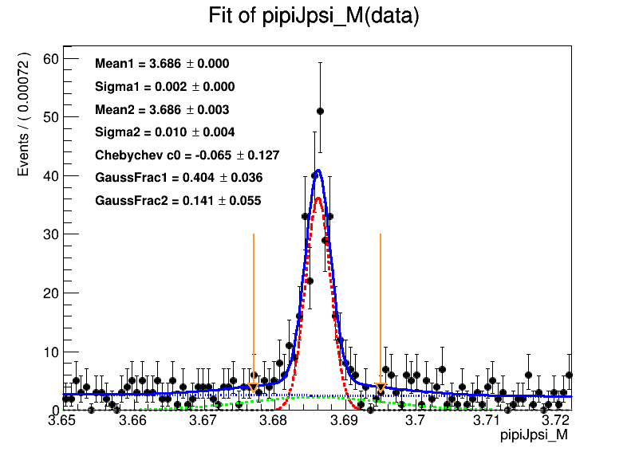
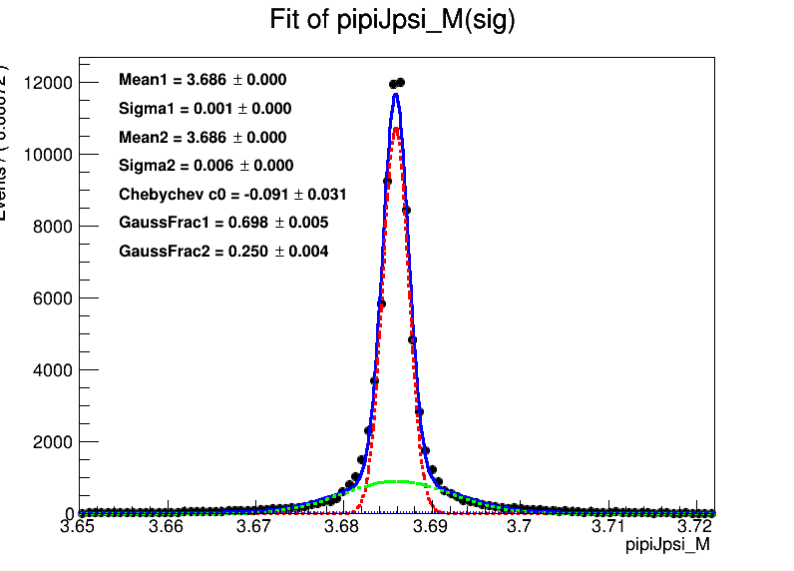
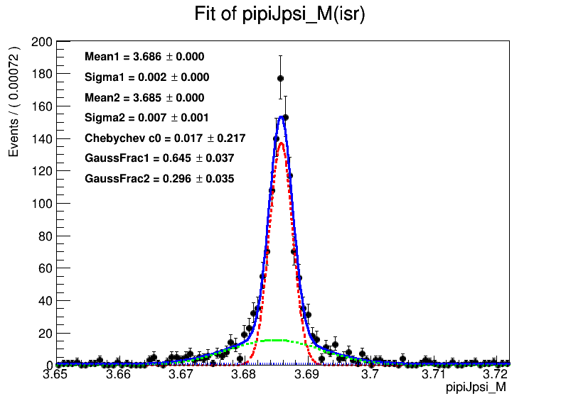
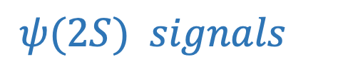
$ψ(2S)$ $signals$

Slide 13
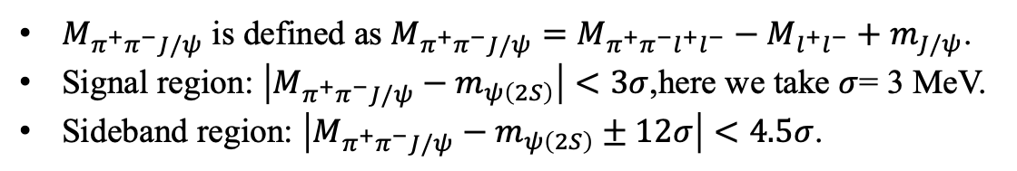
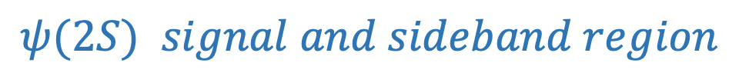
$ψ(2S)$ $signal and sideband region$
$M_{π^{+}π^{−}J/ψ}$ is defined as $M_{π^{+}π^{−}J/ψ}=M_{π^{+}π^{−}l^{+}l^{−}}−M_{l^{+}l^{−}}+m_{J/ψ}$.
Signal region: $\left|M_{π^{+}π^{−}J/ψ}−m_{ψ\left(2S\right)}\right|<3σ$,here we take $σ$= 3 MeV.
Sideband region: $\left|M_{π^{+}π^{−}J/ψ}−m_{ψ\left(2S\right)}±12σ\right|<4.5σ$.

Slide 14
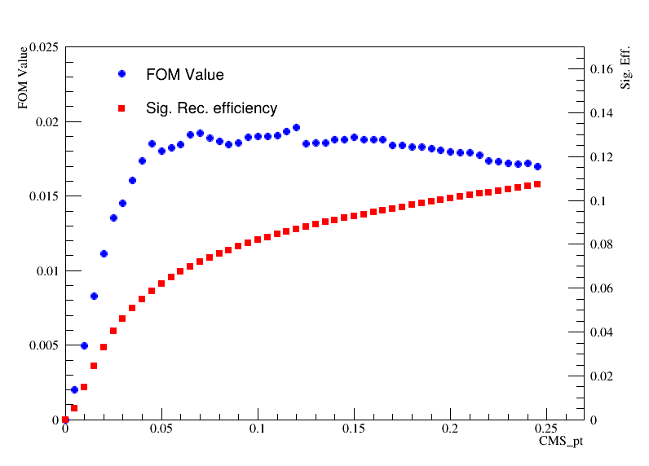
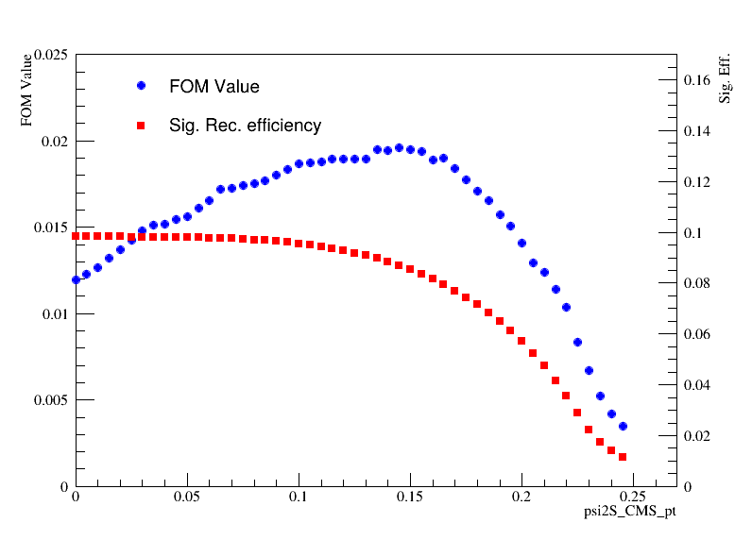
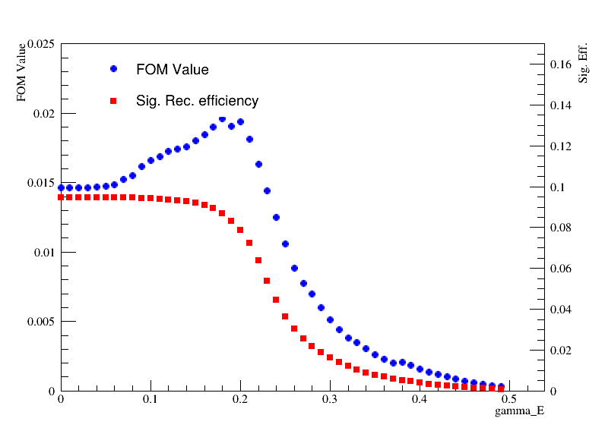
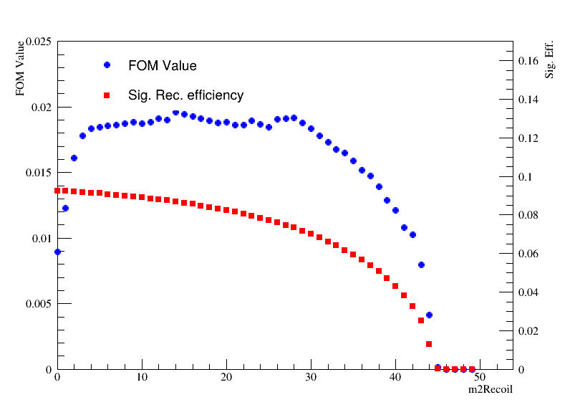
Selection Optimization
CMS_pt<0.25
psi2S_CMS_pt>0.10
Gamma_E>0.15(?)
m2Recoil>8

Slide 15
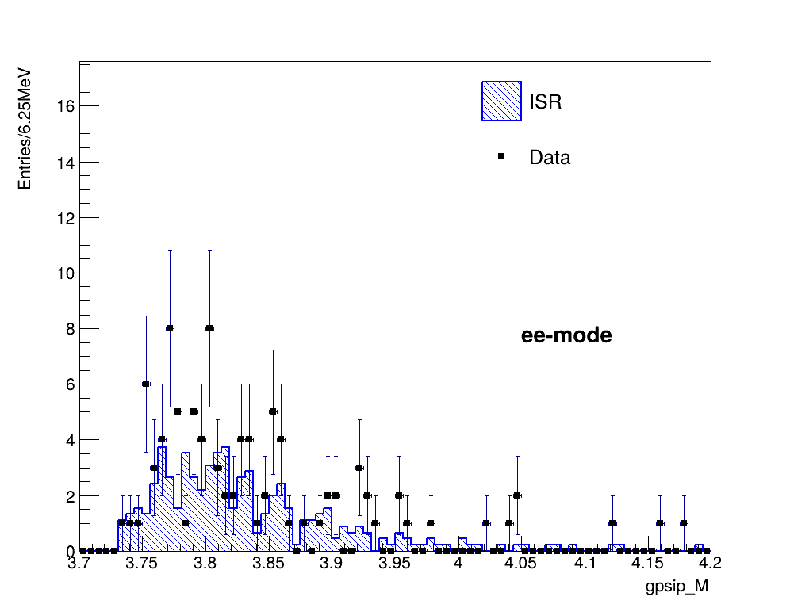
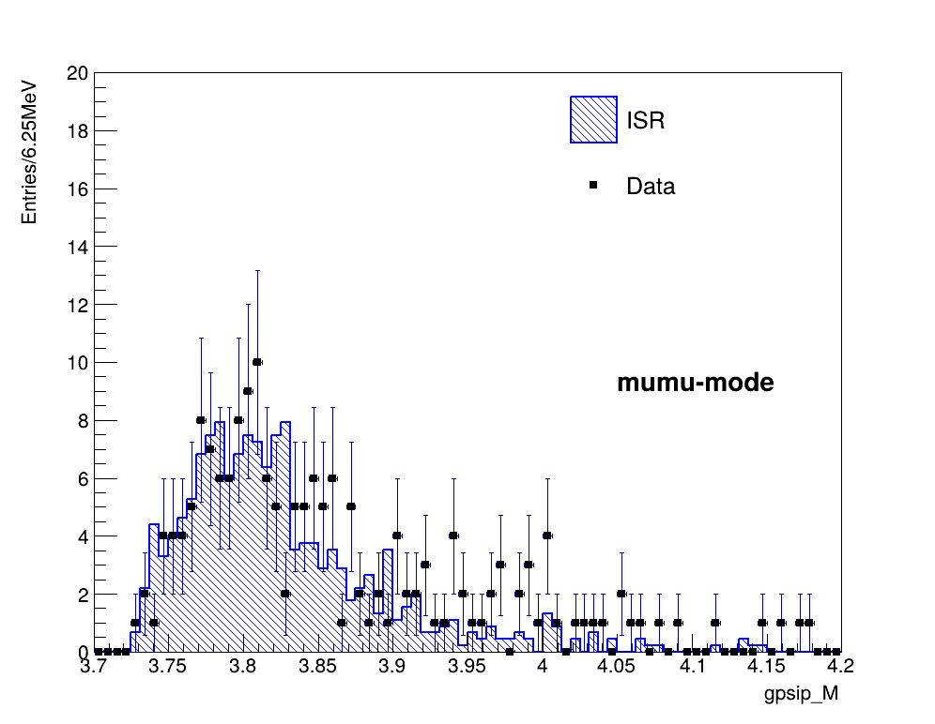
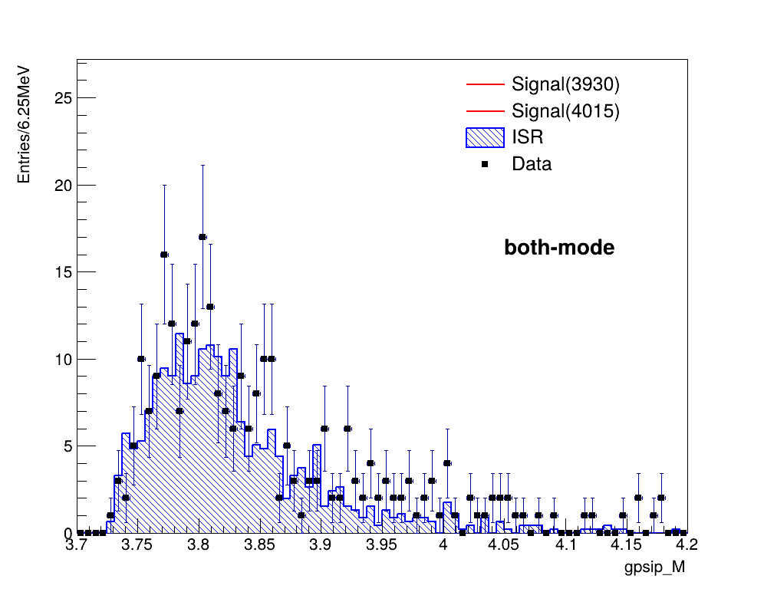

Traditional selection:(loose)

Slide 16



Traditional selection:(Tight)

Slide 17
关联性检查 (MVA input variables VS M(gamma psip) )
Signal(3922)
CMS_pt: 0.038420; psi2S_CMS_pt: 0.062237; m2Recoil: -0.021534; psi2S_m2Recoil: 0.055706; significanceOfDistance: 0.000529; gamma_E: 0.616624; distance: 0.000213; dcosTheta: -0.003363; dphi: 0.001706; psi2S_pRecoilPhi: -0.001613; psi2S_pRecoilTheta: -0.011901; pRecoilPhi: 0.006224; pRecoilTheta: -0.012665; psi2S_pRecoilPhi: -0.001613; psi2S_pRecoilTheta: -0.011901; gamma_clusterTiming: -0.054436; gamma_cosTheta: -0.054155; gamma_theta: 0.061342
Signal(4015)
CMS_pt: -0.107316; psi2S_CMS_pt: 0.131778; m2Recoil: -0.045755; psi2S_m2Recoil: 0.059314; significanceOfDistance: 0.002392; gamma_E: 0.653079; distance: 0.002359; dcosTheta: 0.001004; dphi: -0.001769; psi2S_pRecoilPhi: 0.000582; psi2S_pRecoilTheta: -0.016616; pRecoilPhi: 0.005523; pRecoilTheta: -0.007691; psi2S_pRecoilPhi: 0.000582; psi2S_pRecoilTheta: -0.016616; gamma_clusterTiming: 0.206592; gamma_cosTheta: 0.063792; gamma_theta: -0.054159

Slide 18
关联性检查 (MVA input variables VS M(gamma psip) )
Data(4S)
CMS_pt: 0.224886; psi2S_CMS_pt: 0.203641; m2Recoil: 0.452997; psi2S_m2Recoil: 0.544906; significanceOfDistance: 0.070443; gamma_E: 0.808199; distance: 0.063226; dcosTheta: 0.038252; dphi: 0.004611; psi2S_pRecoilPhi: -0.002198; psi2S_pRecoilTheta: -0.237166; pRecoilPhi: -0.003593; pRecoilTheta: -0.190836; psi2S_pRecoilPhi: -0.002198; psi2S_pRecoilTheta: -0.237166; gamma_clusterTiming: 0.164346; gamma_cosTheta: 0.064758; gamma_theta: -0.050875
Isr
CMS_pt: 0.091089; psi2S_CMS_pt: 0.072540; m2Recoil: -0.090392; psi2S_m2Recoil: -0.050032; significanceOfDistance: 0.000655; gamma_E: 0.544943; distance: 0.004149; dcosTheta: 0.001559; dphi: 0.002316; psi2S_pRecoilPhi: 0.010328; psi2S_pRecoilTheta: 0.070385; pRecoilPhi: 0.005897; pRecoilTheta: 0.069495; psi2S_pRecoilPhi: 0.010328; psi2S_pRecoilTheta: 0.070385; gamma_clusterTiming: -0.184067; gamma_cosTheta: -0.196326; gamma_theta: 0.200816

Slide 19
Training Variables Set1:
'CMS_pt','psi2S_CMS_pt','m2Recoil','psi2S_m2Recoil','significanceOfDistance','distance','dcosTheta','dphi','pRecoilPhi','pRecoilTheta','psi2S_pRecoilPhi','psi2S_pRecoilTheta','gamma_clusterTiming','gamma_cosTheta','gamma_theta’
Traning Variables Set2:
(考虑去除了关联性20%的变量)
'significanceOfDistance','distance','dcosTheta','dphi','pRecoilPhi','pRecoilTheta','psi2S_pRecoilPhi','psi2S_pRecoilTheta','gamma_cosTheta']

Slide 20




SET1:
SET2:

Slide 21




SET1:
SET2:

Slide 22



MVA(3922)

Slide 23



MVA(3922)

Slide 24



MVA(4015)-set1

Slide 25



MVA(4015)-set2

Slide 26





KLM 端盖模拟
Release9 ——> Release 8
升级之前：
前端盖
前端盖
后端盖
后端盖

Slide 27




KLM 桶部模拟
Release9 ——> Release 8
升级之前：

