Slide 1
BEPCII高频系统 2024-2025年度运行总结
戴建枰
代表BII高频运行团队
2025/10/13
加速器联合年会，2025/10/12~10/14，郑州市黄河迎宾馆
jpdai@ihep.ac.cn

Slide 2
目 录
BEPCII-U高频系统简介
设备安装及调试进程
主要问题
运行情况
小结

Slide 3
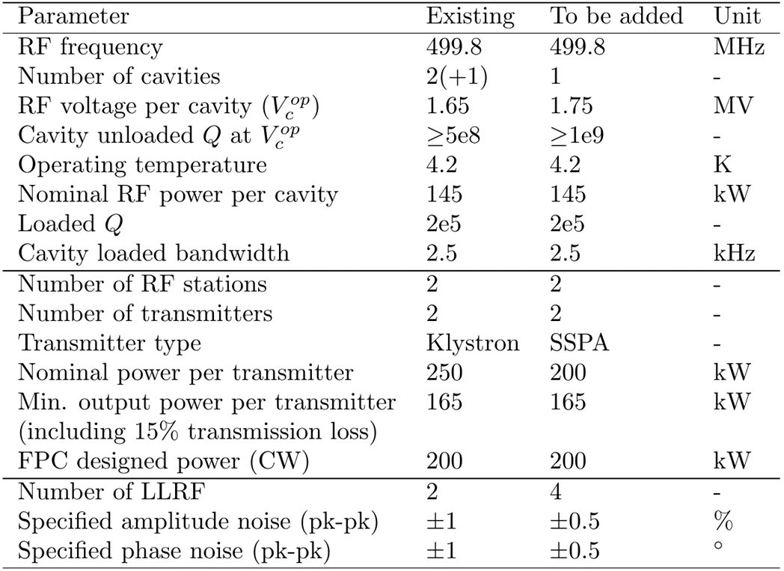
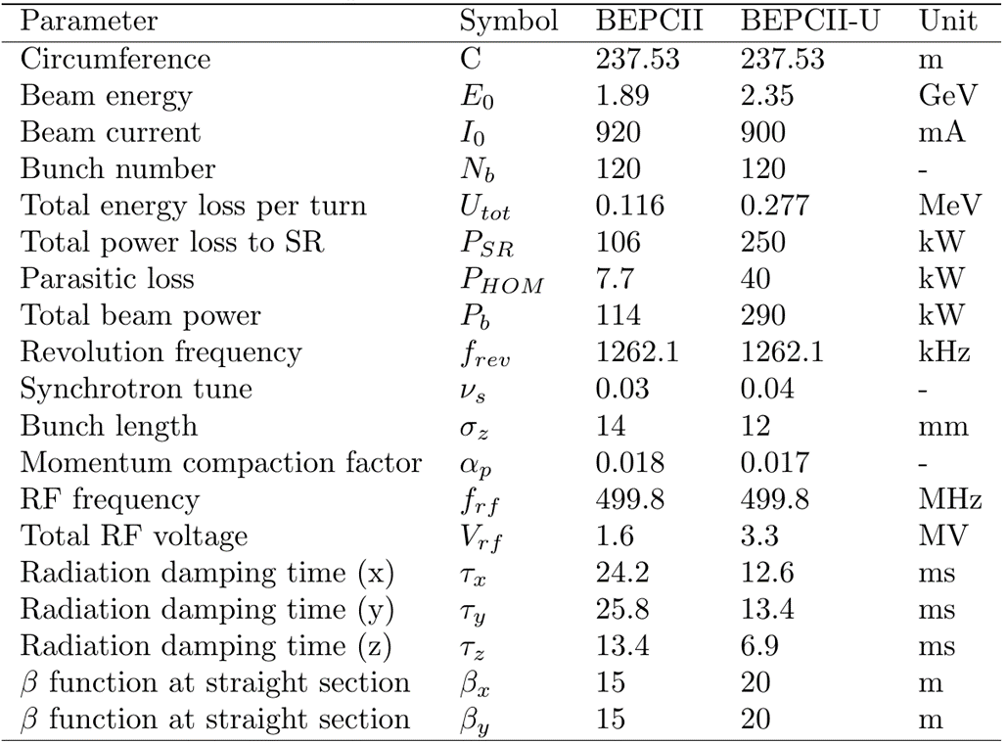
BEPCII-U束流及高频系统主要参数
束流参数
高频参数

Slide 4
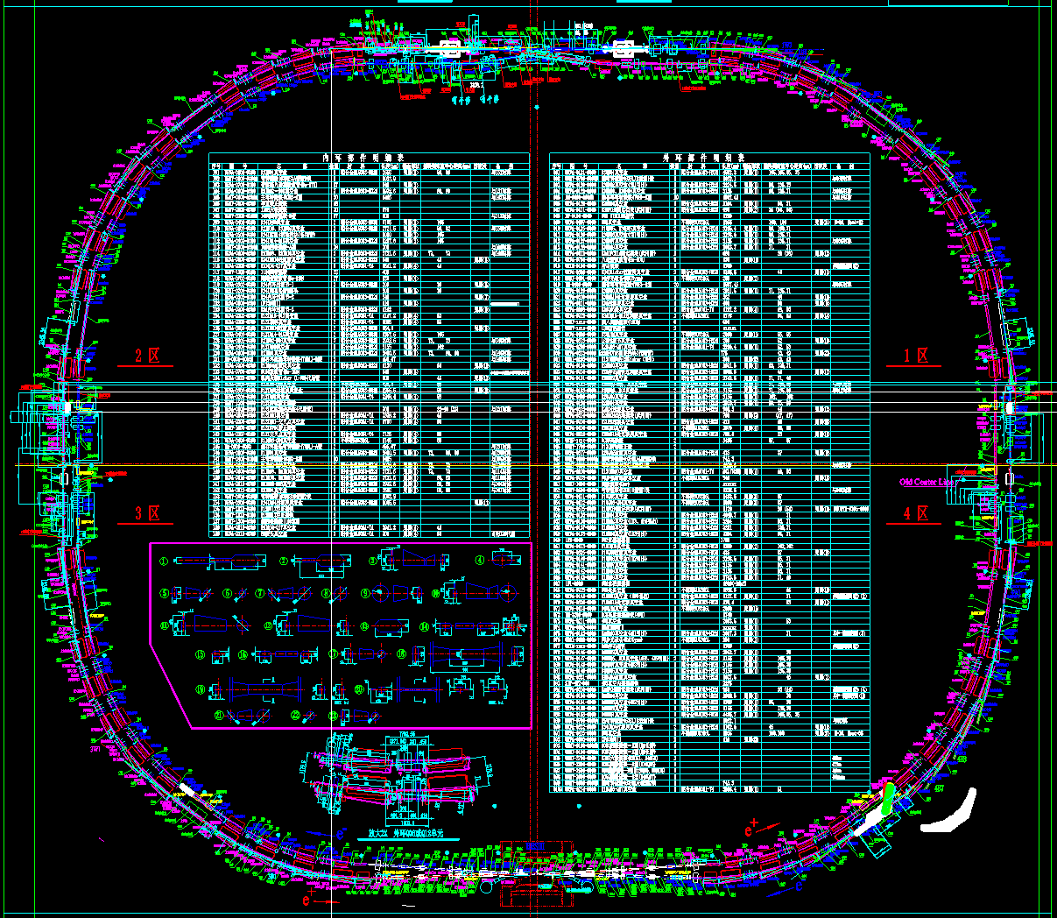
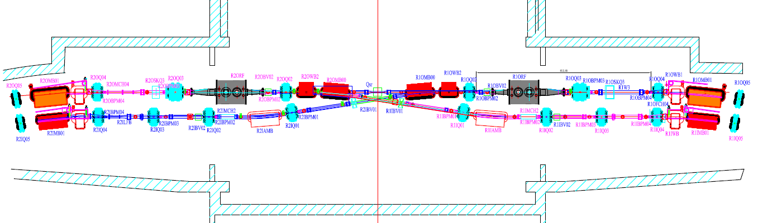
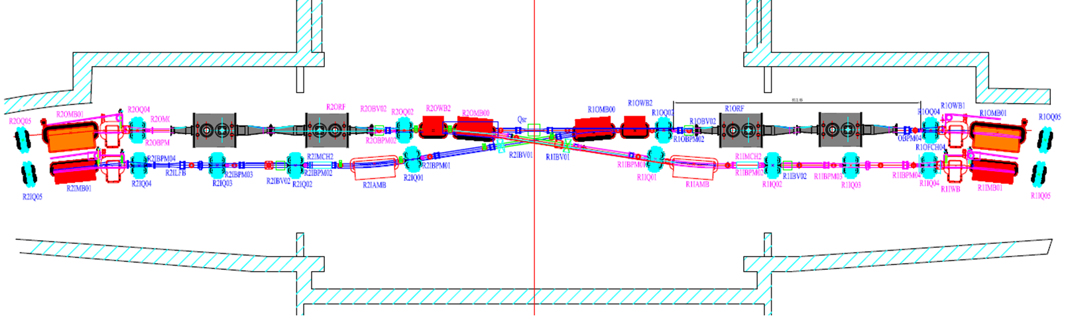
BEPCII-U高频系统超导腔布局
BEPCII RF section
北对撞区
BEPCII-U RF section
备用三菱东腔
三菱西腔
国产新腔
旧国产东腔

Slide 5
BEPCII-U高频系统主要设备
超导腔系统
2套原三菱超导腔模组+1套原国产腔+新研制1套国产腔
高功率系统
固态功率源（1台旧Kly+1台旧SSA+2台新SSA）
环行器（2旧+2新）
水负载（2旧+2新）
功率传输系统（2旧+2新）
低电平控制系统
新研制四套低电平控制系统
水、电、风、空调等

Slide 6
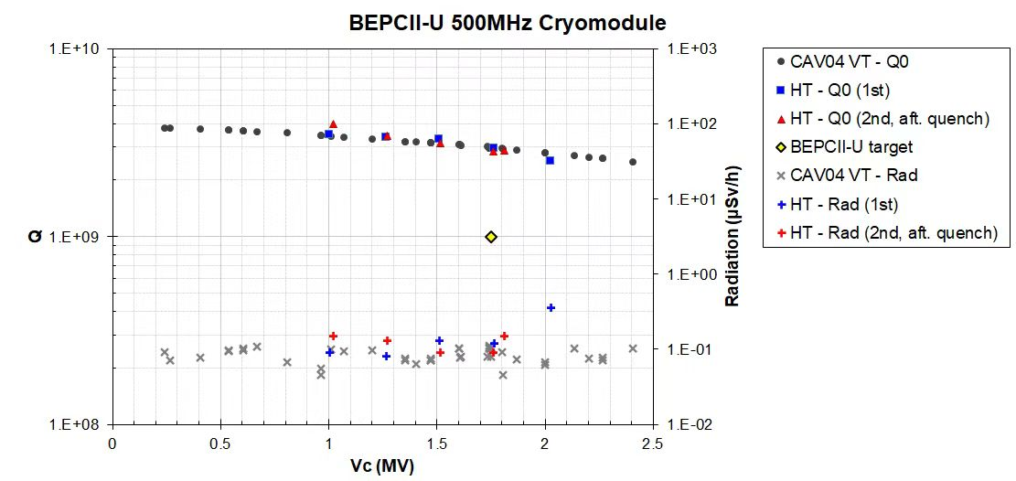
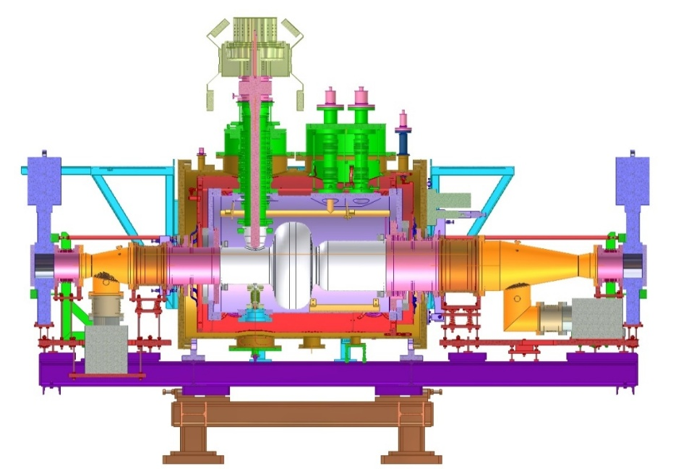
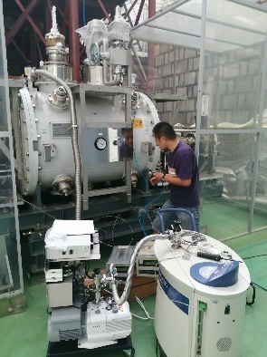
500MHz超导腔模组
BEPCII升级后一共四套超导腔模组：两套三菱模组、一套国产模组、新制造一套模组（采用与HEPS模组相同的设计）
三菱东腔常温氦质谱检漏
2024 年安装之前，
不再进行高功率测试

Slide 7
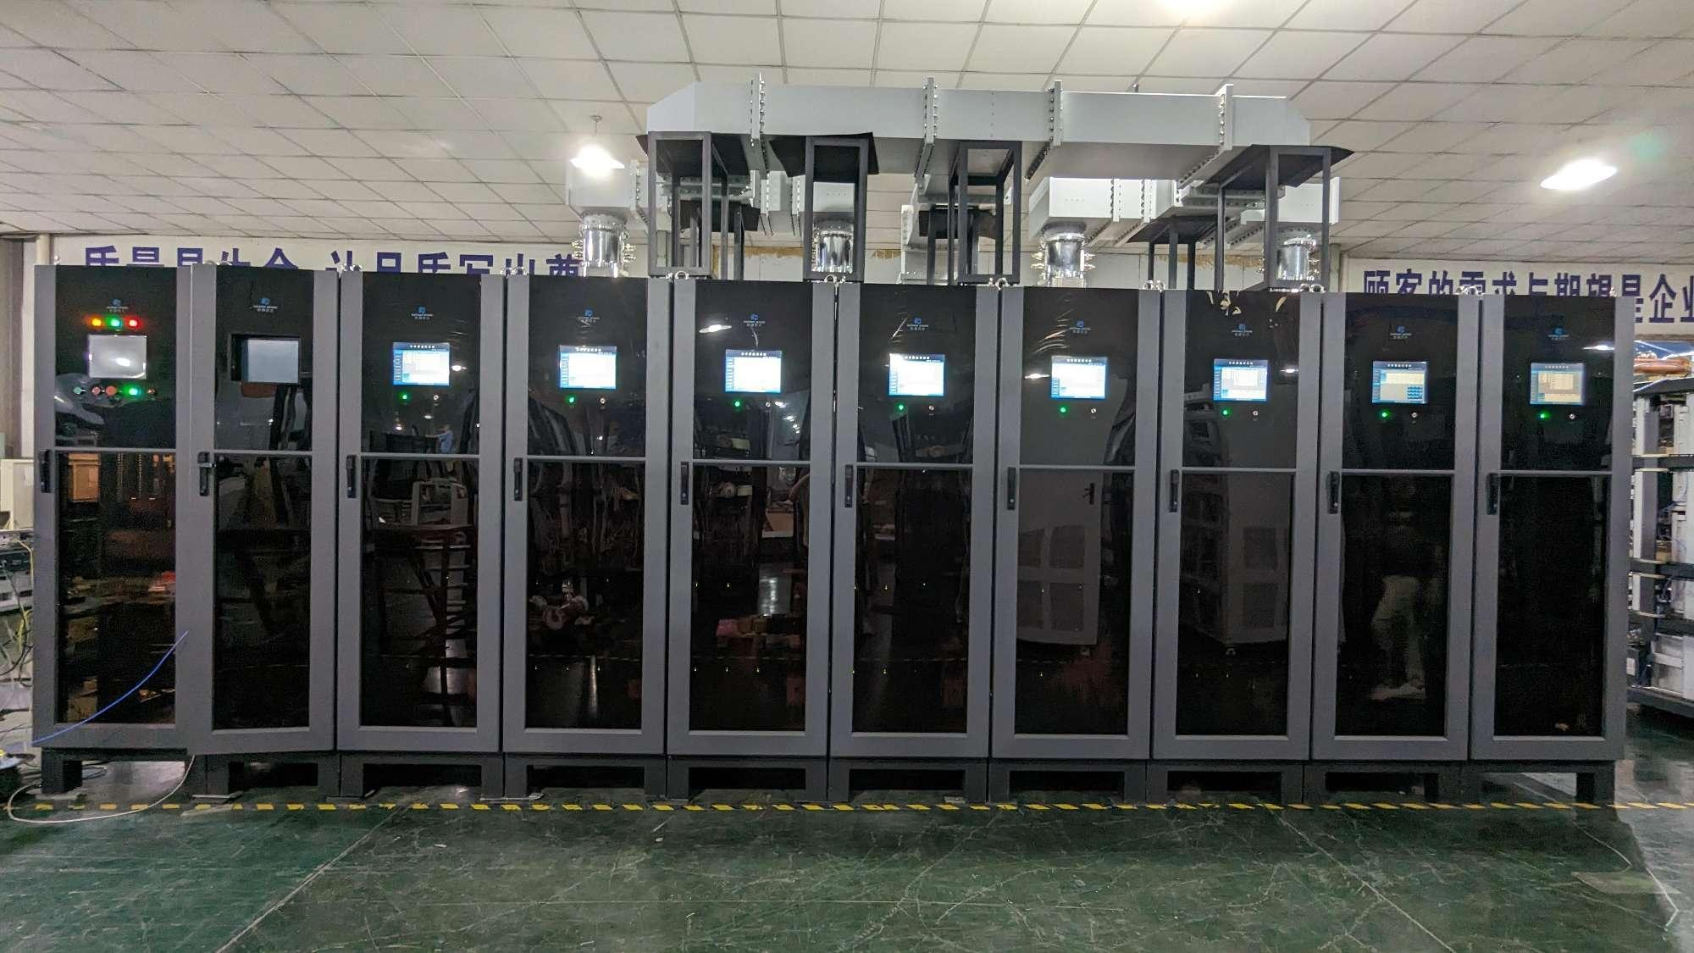
200kW SSA
Parameter (per ring) | Unit | BII existing | BII-U TBA
Total beam power | kW | 290 | 290
Number of RF stations | - | 2 | 2
Number of transmitters | - | 2 | 2
RF power required per cavity | kW | 145 | 145
Min. output power per transmitter (including 15% transmission loss) | kW | 167 | 167
Nominal RF power per transmitter | kW | 250 | 200
Transmitter type | - | Klystron | SSA
Power reservation | % | 33 | 16.5
500 MHz 200 KW 固态功率源。
与高能光源（HEPS）的 500 MHz 260 kW 固态功率源采用相同工艺设计。

Slide 8
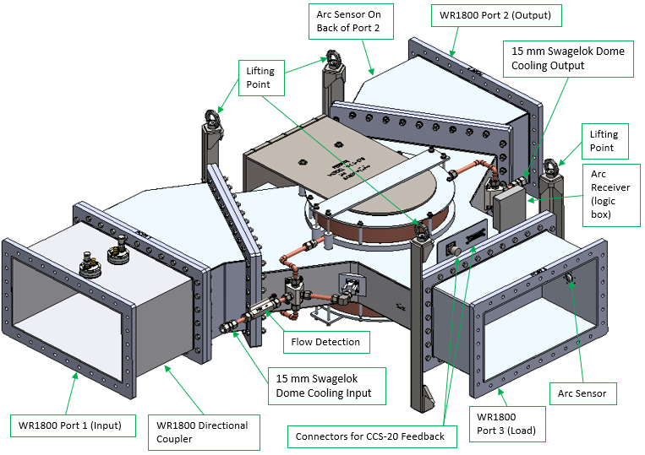
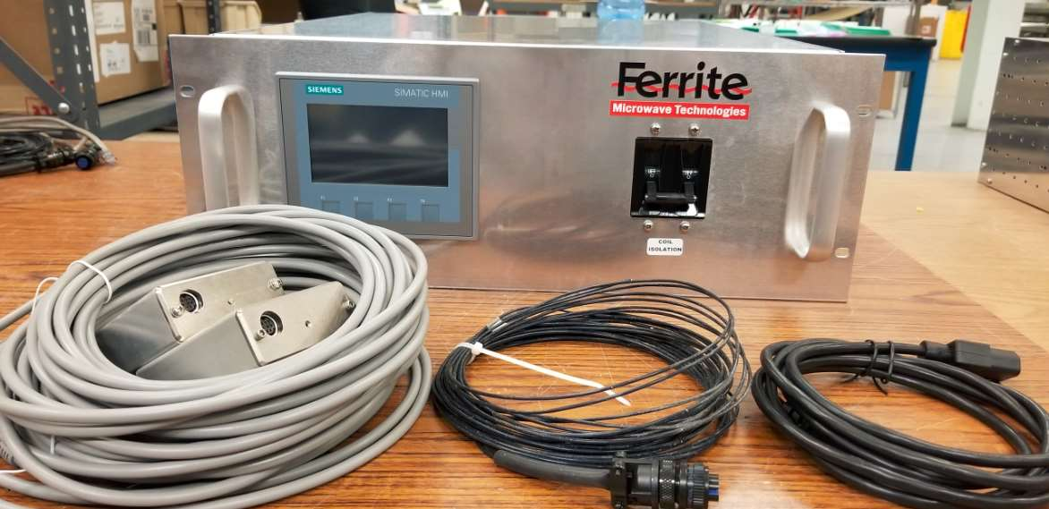
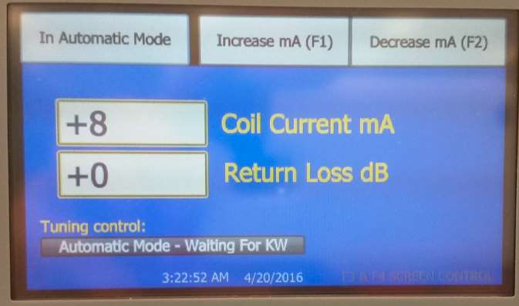
BEPCII-U新环形器
500 MHz 300 kW circulator with arc detectors
Circulator Control System (CCS)
CCS通过调节补偿线圈电流，控制环行器的反射功率。

Slide 9
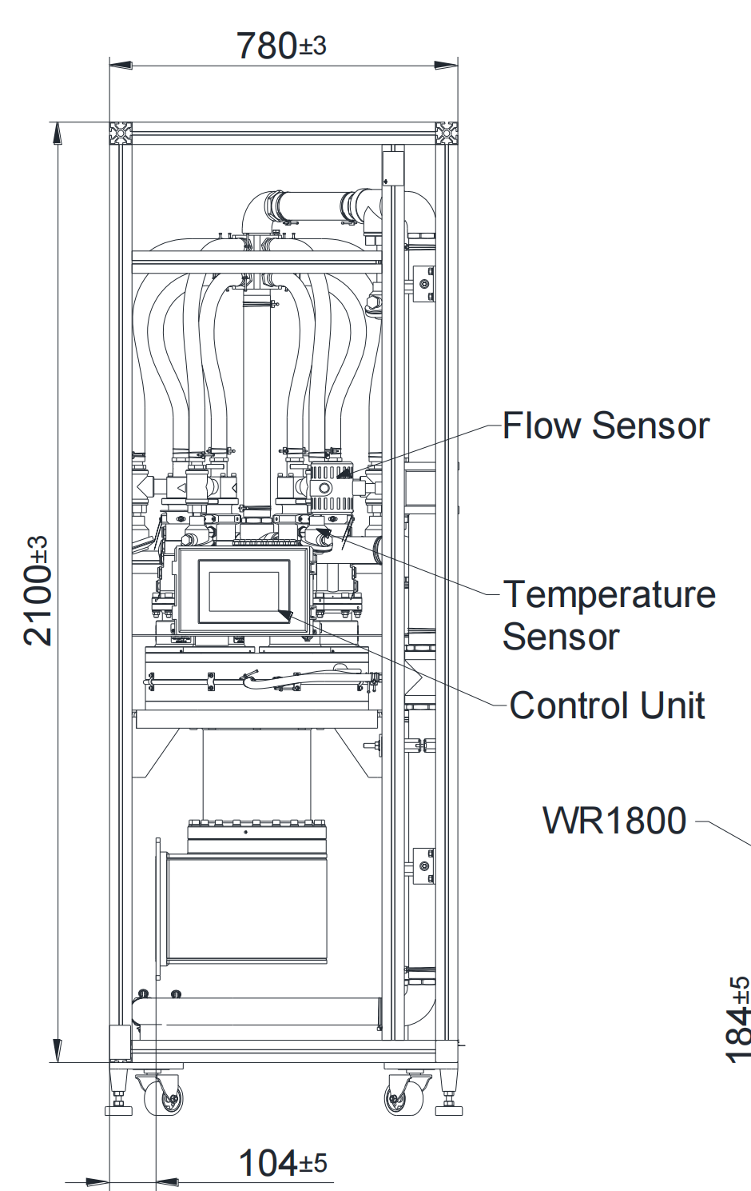
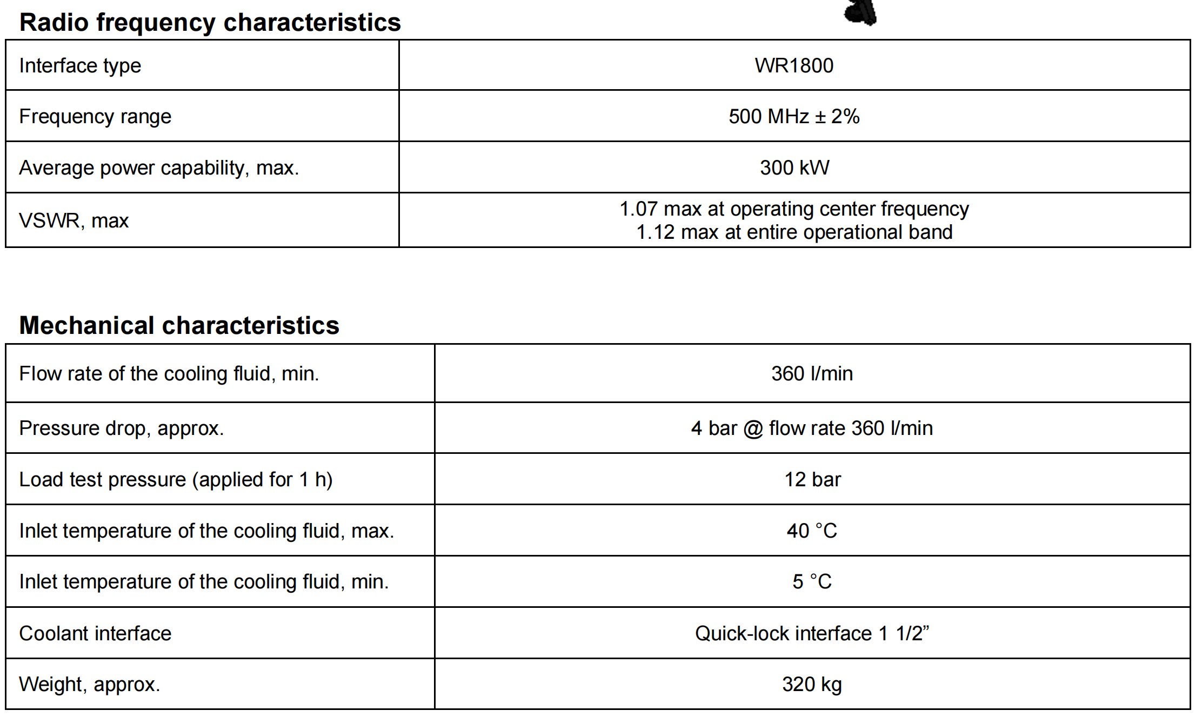
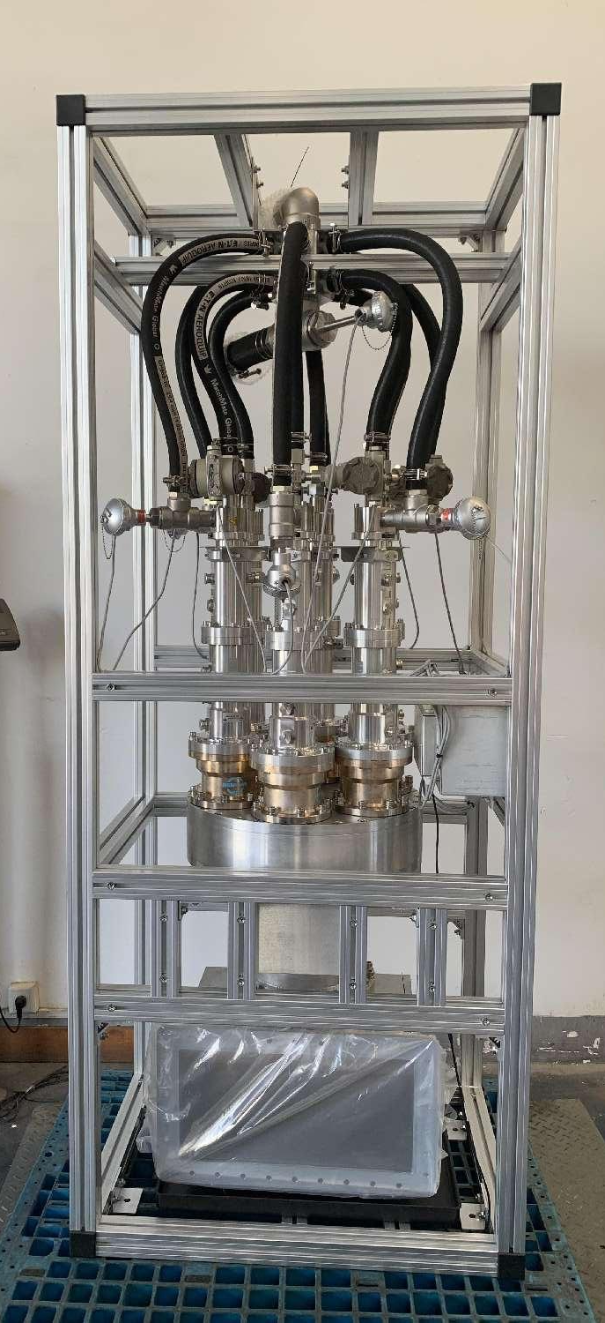
BEPCII-U新水负载（500MHz/300kW）

Slide 10
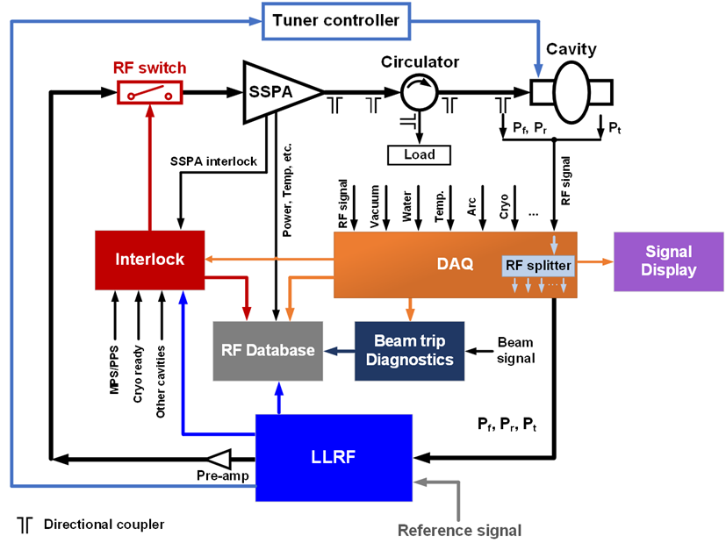
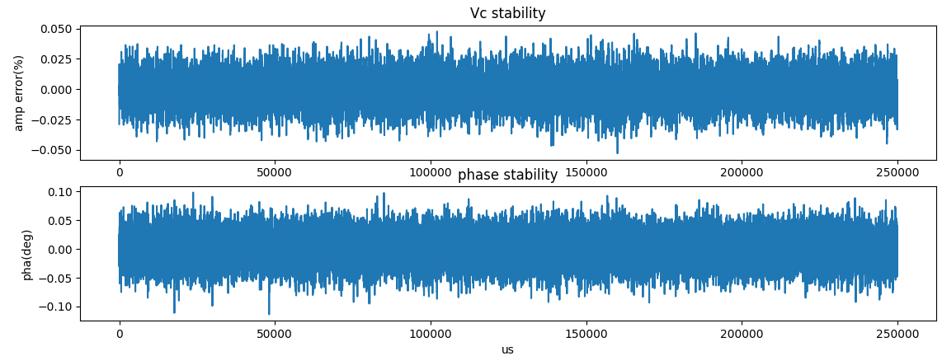
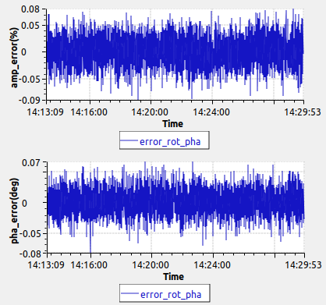
BEPCII-U新低电平系统
短时稳定性测试
长时稳定性测试
参数 | 短时 | 长时 | 设计要求
幅值波动 | ±0.05% | ±0.08% | ±0.1%
 |  |  | ±0.1°
相位波动 | ±0.1° | ±0.08°
低电平系统采用与光源储存环超导腔完全相同的低电平系统设计。

Slide 11
目 录
BEPCII-U高频系统简介
设备安装及调试进程
主要问题
运行情况
小结

Slide 12
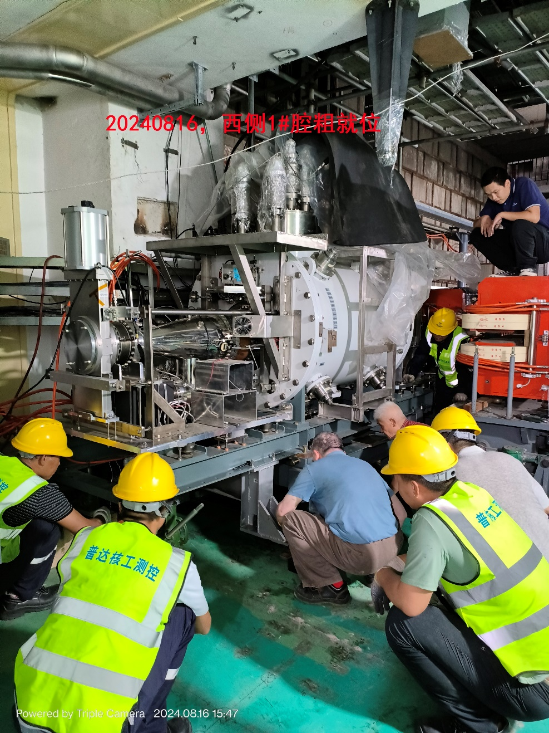
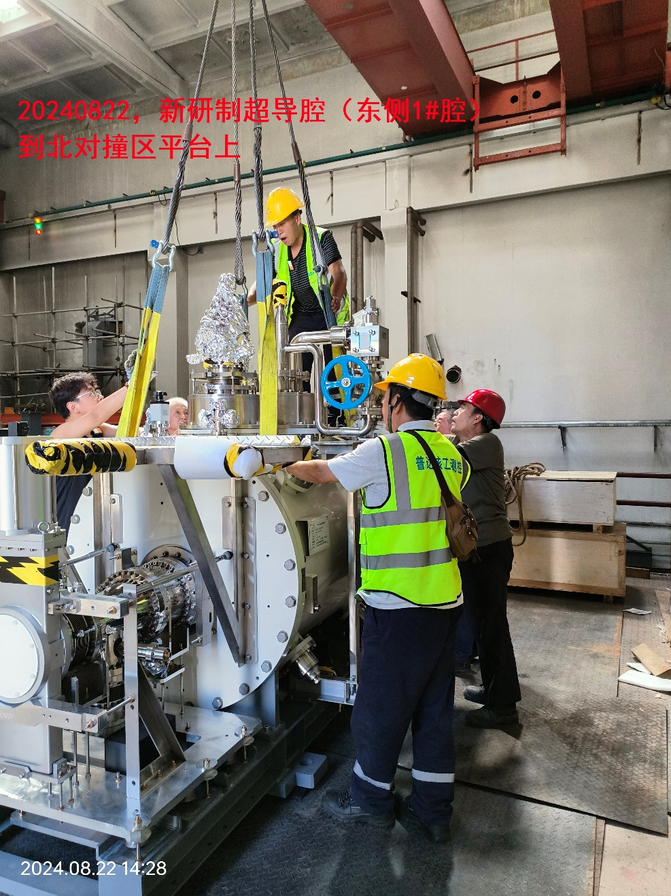
超导腔

Slide 13
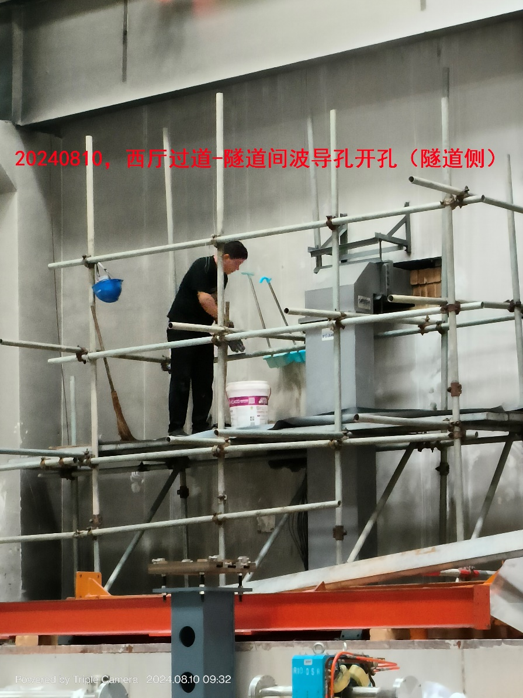
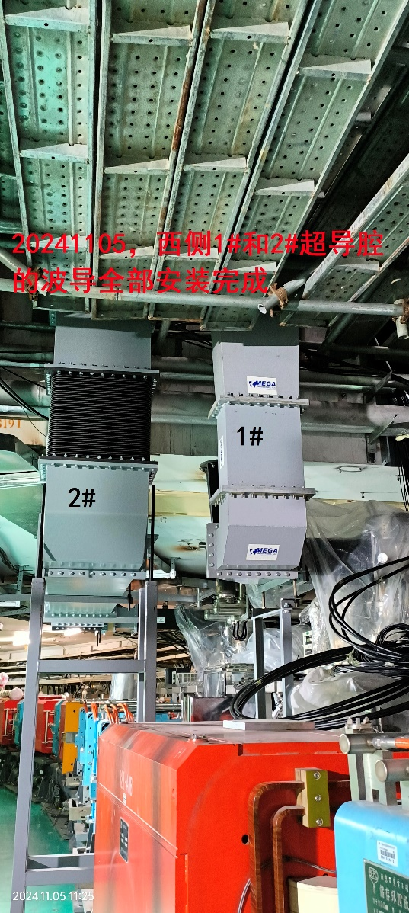
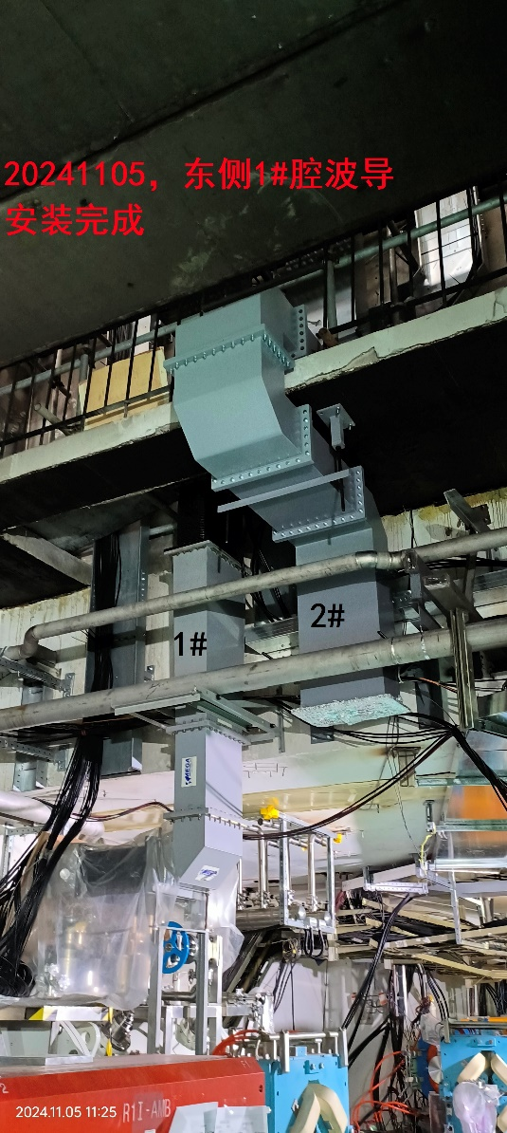
波导安装

Slide 14
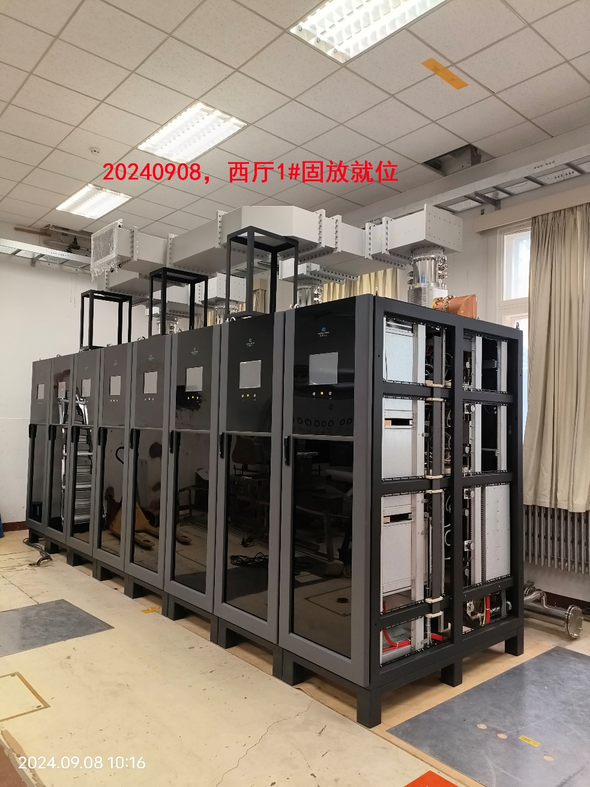
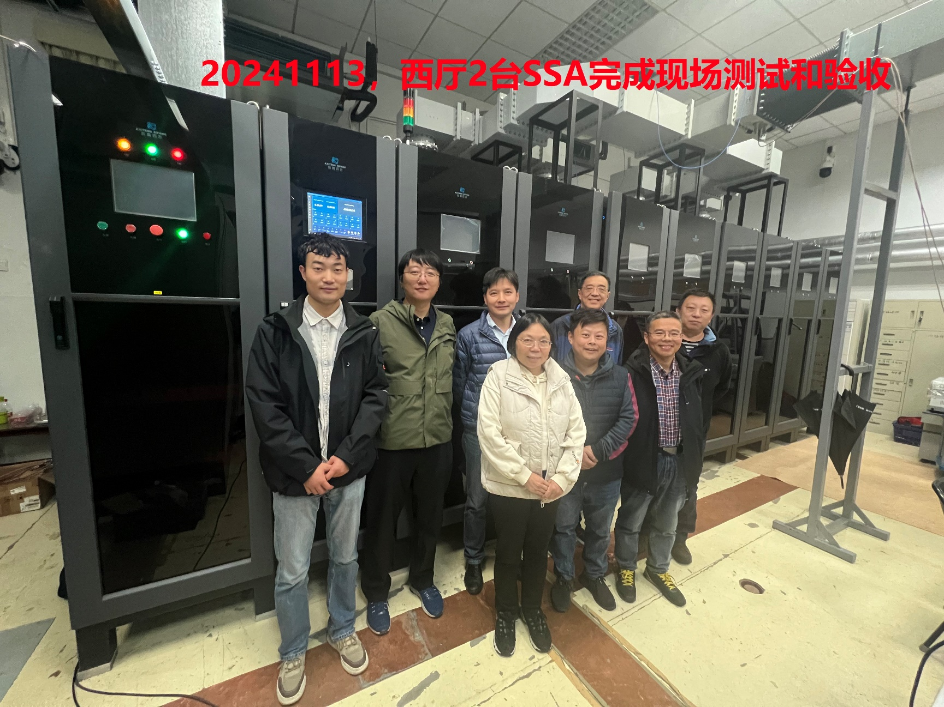
SSA固态功率源

Slide 15
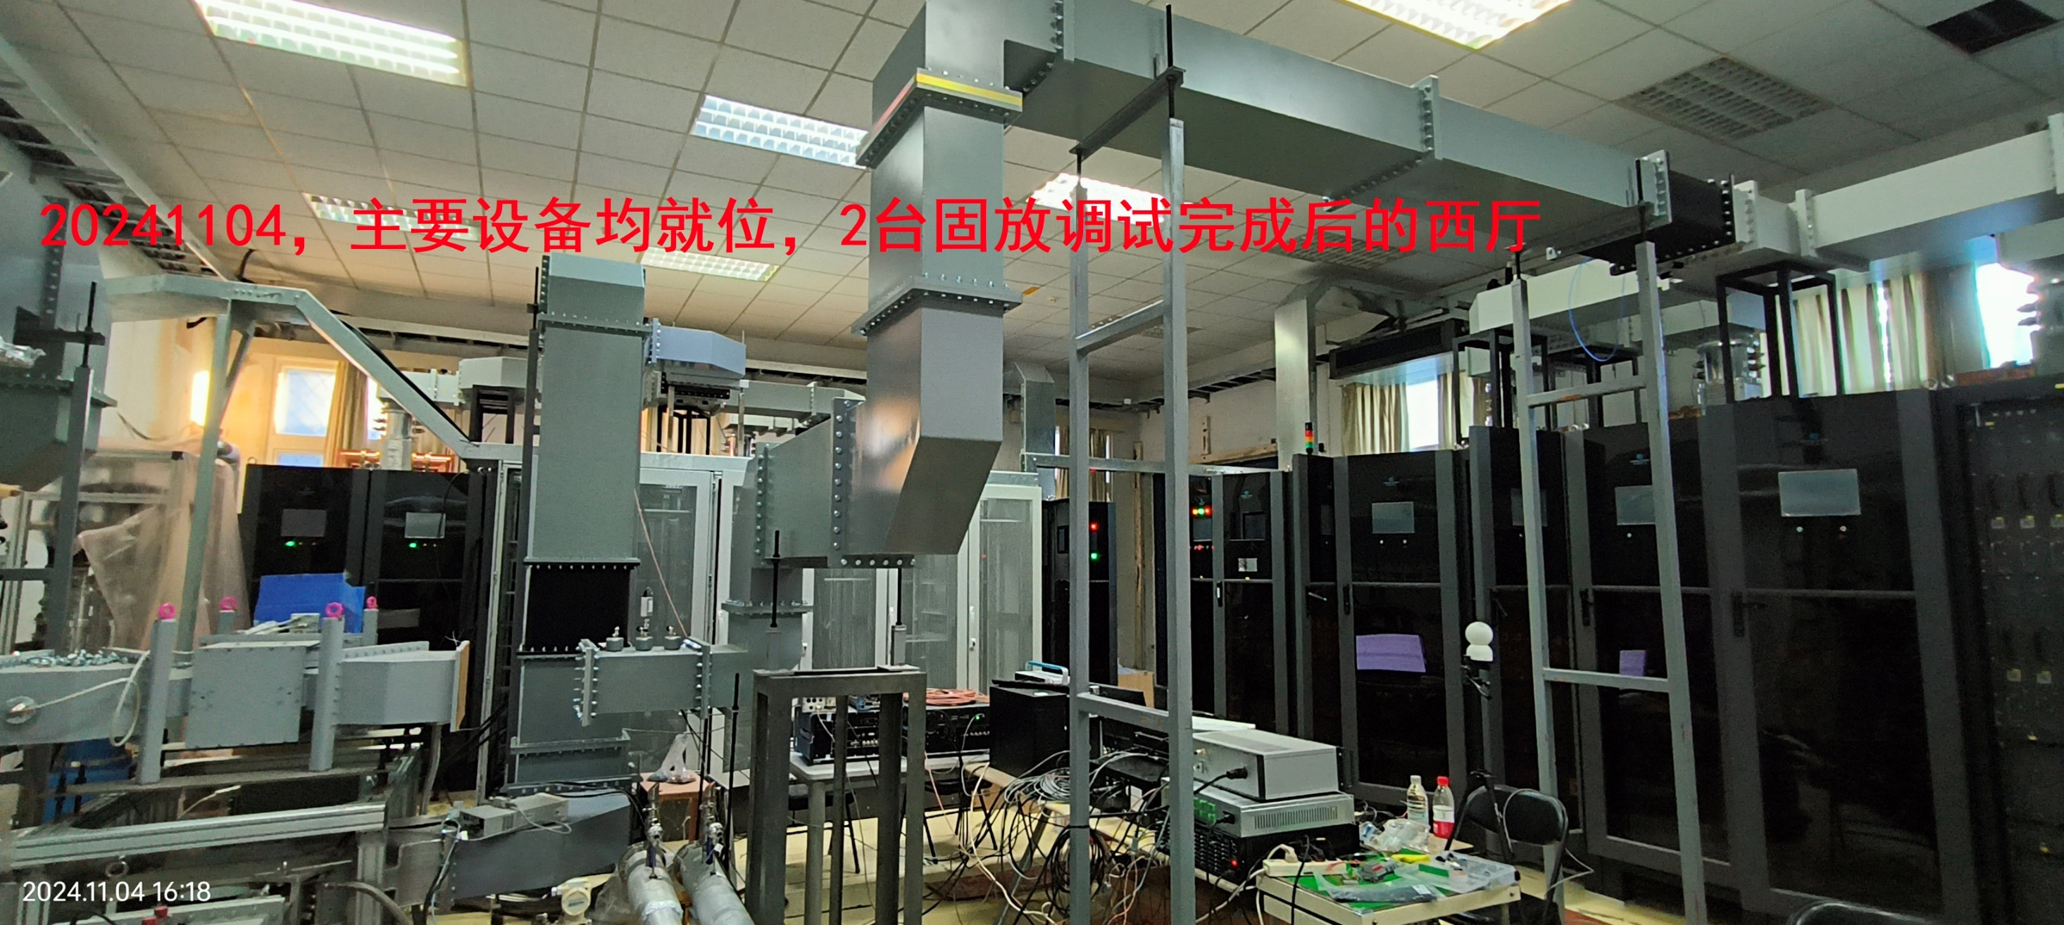
SSA固态功率源

Slide 16
目 录
BEPCII-U高频系统简介
设备安装及调试进程
主要问题
运行情况
小结

Slide 17
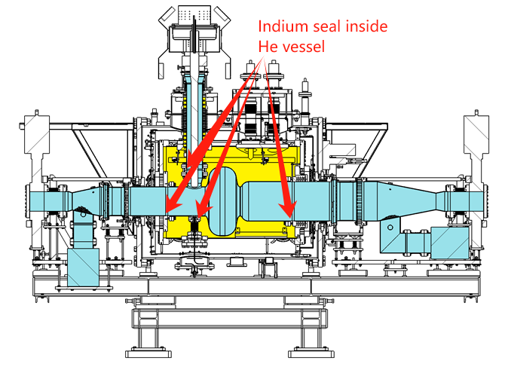
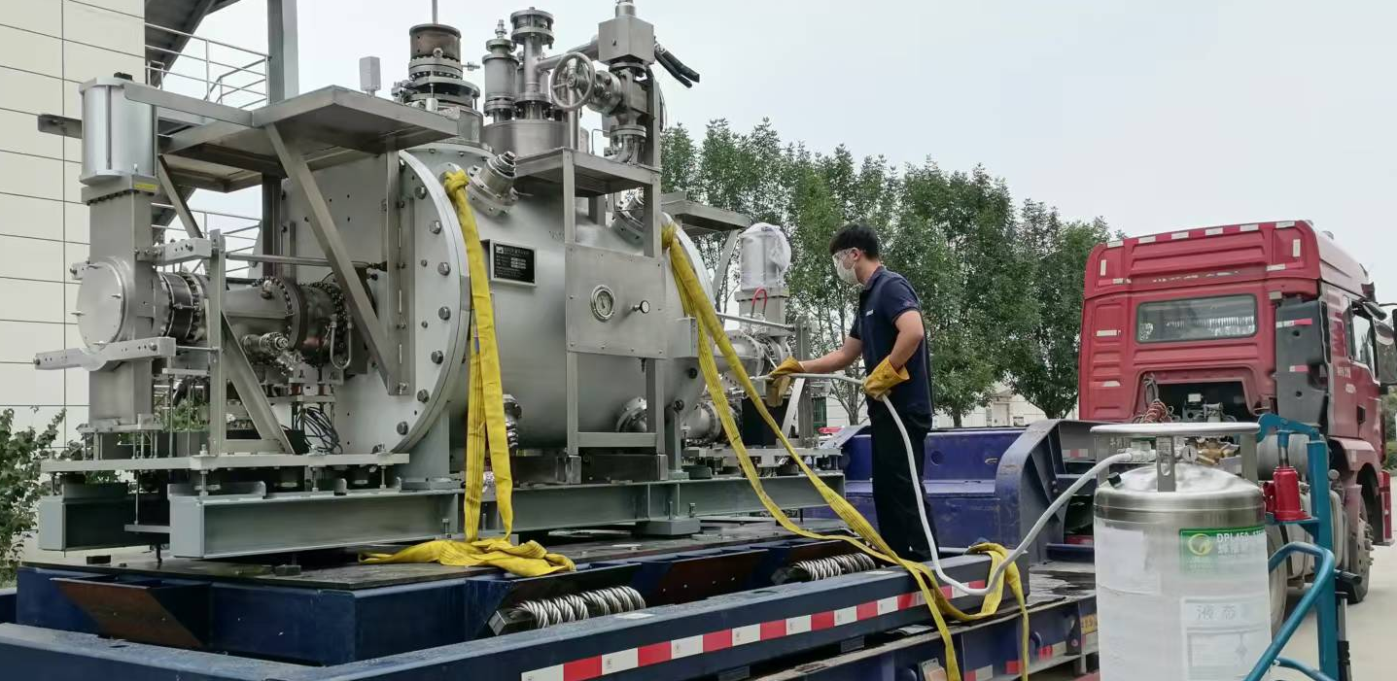
原国产超导腔模组真空泄漏及修复
Leakage of 5e-6mbar.L/s inside the helium vessel was found on maintenance Set.2014, in a home-made 500MHz cryomodule with KEK-B structure, after about 9(?) thermal circles in 7 years of operation
The cryomodule was shipped to PAPS SRF-lab with a shock-absorbing tooling, departing at 2024.9.25 22:08, and arriving at 1:14, with average 26km/h (max 33)
The cryomodule was cleaned before entering PAPS, by wiping with detergent, water-jet rinsing, wiping with ethanol, and blowing with nitrogen gas

Slide 18
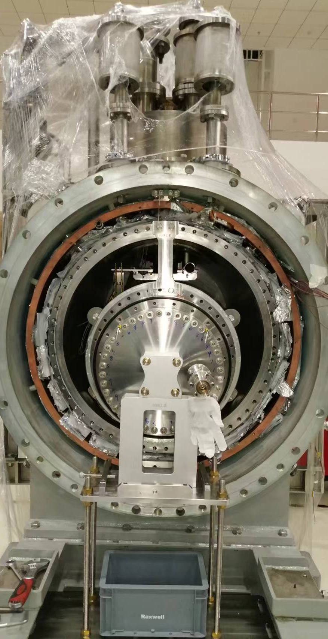
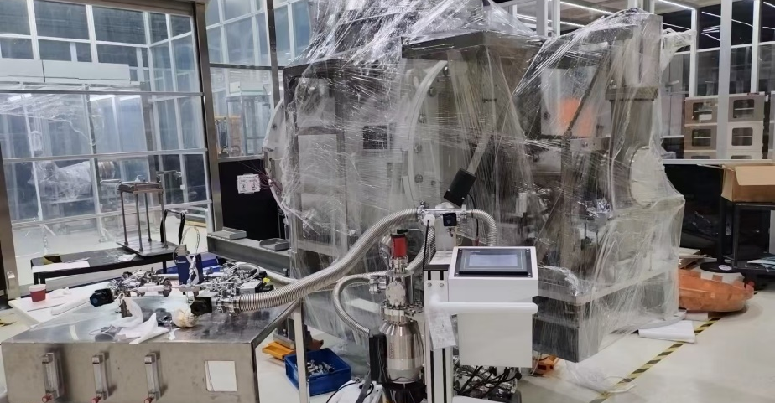
B-II east CM repair
The beam-line (HOM absorber to gate-valve) has to be removed in clean-room, before the end-plate of the CM and the helium vessel could be opened
With large-beam-pipe side open at Sep.28, leak-rate is reduced to ~e-8mbar.L/s, and the leak vanished when both sides are open at Sep.30
Torque for indium-seals were found loose (~8-10 N.m). They were re-tightened to 15N.m

Slide 19
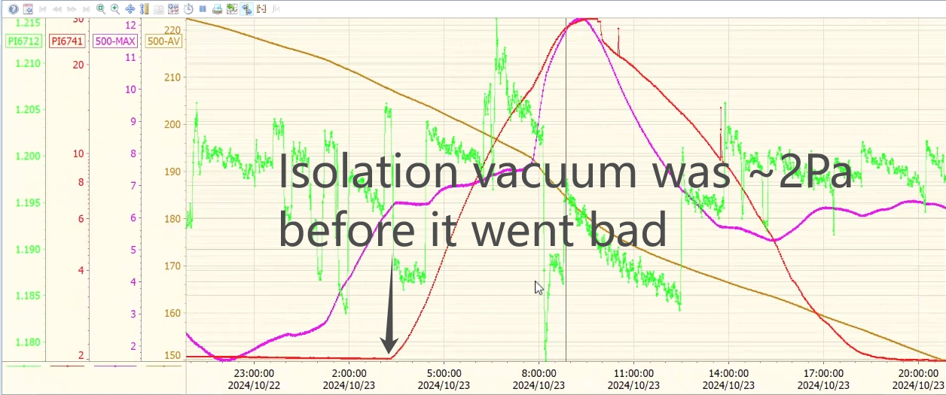
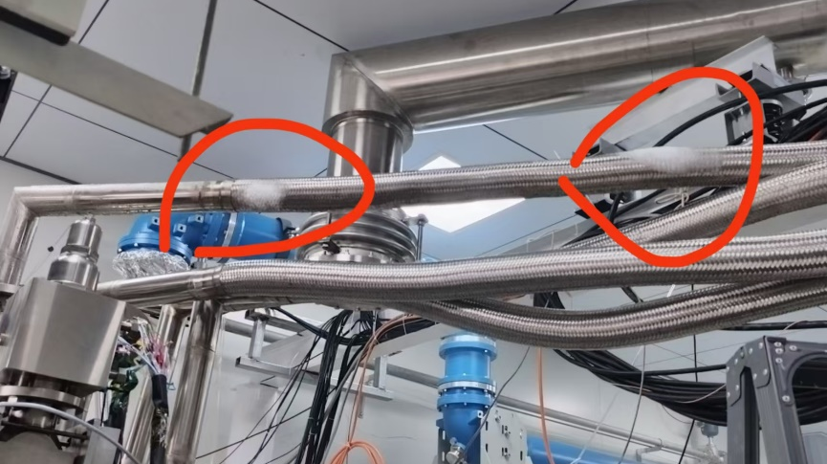
B-II east CM 1st cooling down
After the helium-vessel, LN shielding, MLI, cryomodule, and the beam-pipes were restored at Oct.8-16, leak detector was attached to isolation vacuum, and helium gas from inside the helium vessel and LN pipe showed no leak upto 4e-11mbar.L/s
The CM was installed in the horizontal test stand during Oct.17-20, with 500MHz solid-state amplifier shipped to PAPS and commissioned, and WR1500 waveguides borrowed from HEPS and CEPC-650MHz-CM.
The cooling started at Oct.21, after the coupler was processed at RT. The isolation vacuum went bad since Oct.23 3:20am, and ice on the LHe input pipe was found. It is determined that there is no way for cooling down to continue, and the CM was warmed up during Oct.24-27.

Slide 20
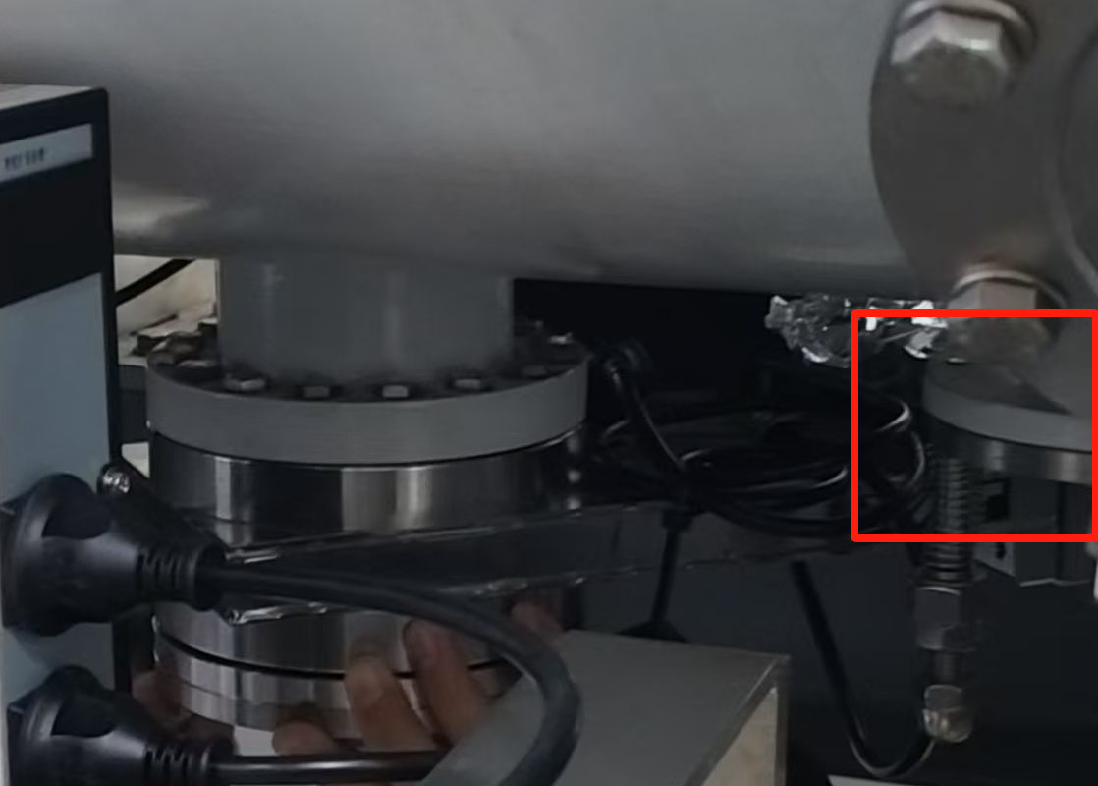
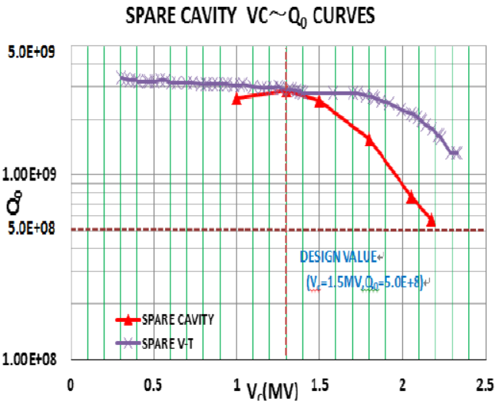
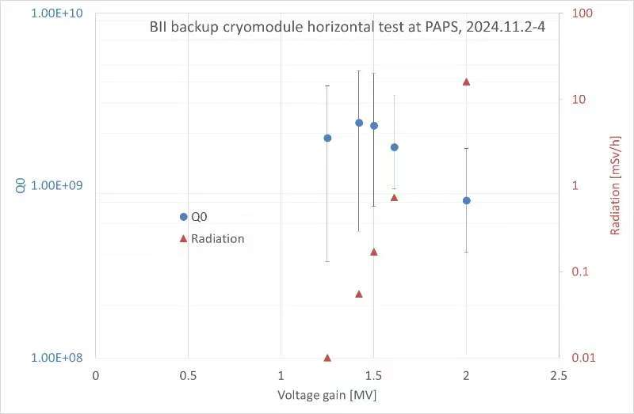
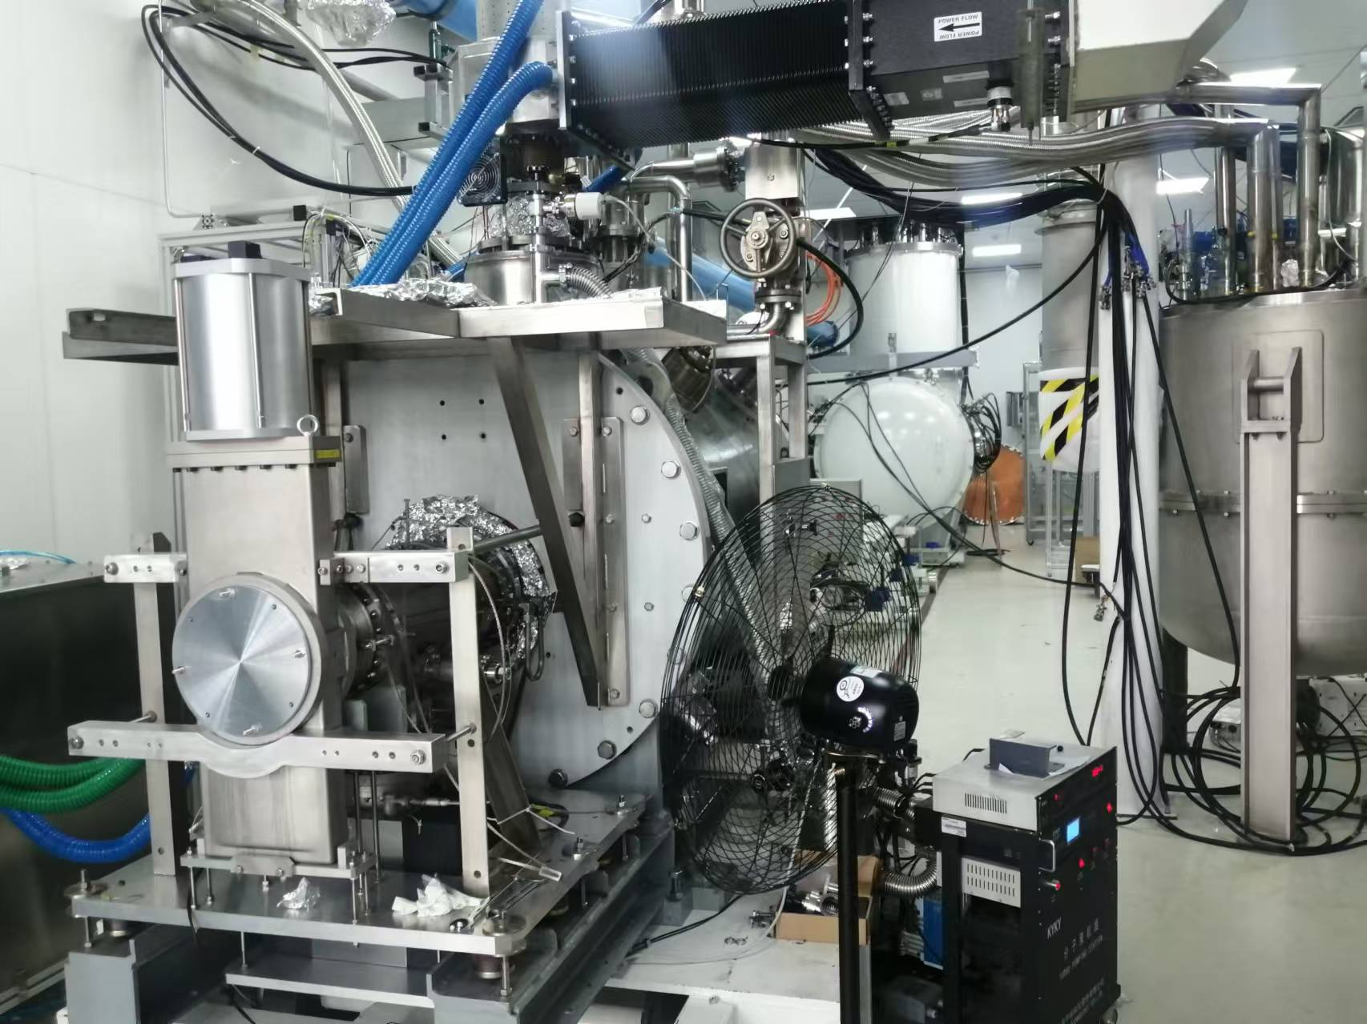
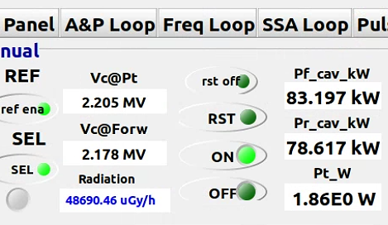
B-II east CM qualification
The damaged LHe input pipe was replaced; a piece of MLI on the O-ring of pressure release flange, which caused a leak of 1e-4 mbar.L/s, was found and removed
2nd cool down started at Oct.29, and CM test was done on Nov 2-4. Volume-change from liquid level was adopted to roughly estimate the heat load.
2.2MV accelerating voltage was recovered; Q0>1e9 at 1.5MV operational voltage was confirmed. Radiation level is similar to that before the leak
Tested at 2011

Slide 21
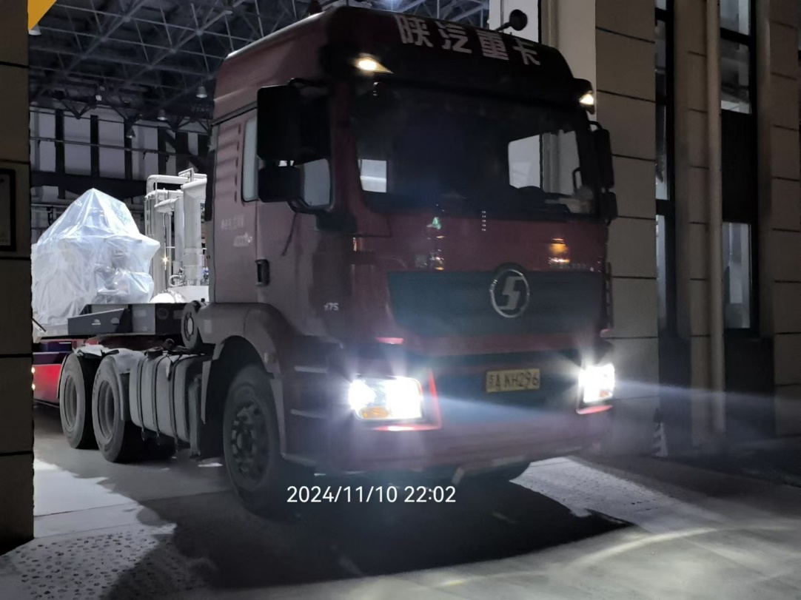
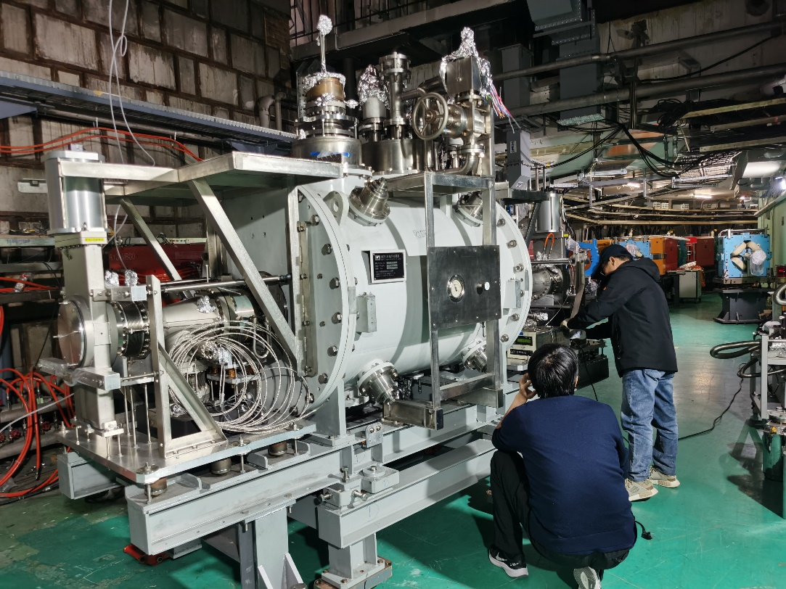
B-II east CM ship-back to B-II tunnel
The cryomodule was warmed up during Nov 5-8.
The cryomodule was shipped back to Yuquanlu with a shock-absorbing tooling, departing at 2024.11.10 22:02, and arriving at 1:16, with average 24.5km/h (max 34km/h). The cavity vacuum was ~7e-7Pa during the shipment.
The cryomodule was installed back to the tunnel on Nov.11.

Slide 22
目 录
BEPCII-U高频系统简介
设备安装及调试进程
主要问题
运行情况
小结

Slide 23
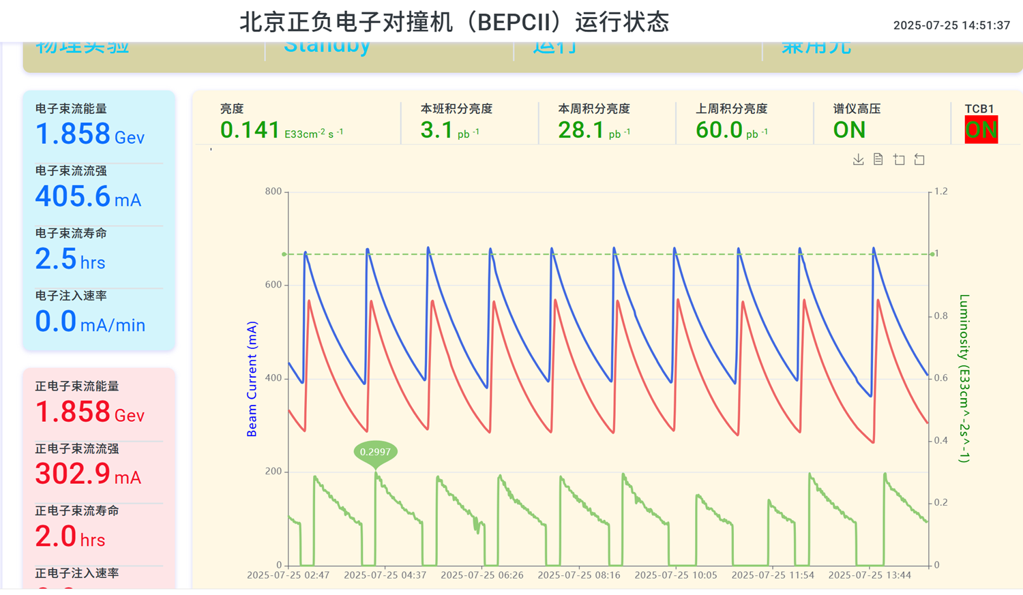
运行概况
20250113-0116，对四个腔进行了常温老练。老练流程：1）不加偏压，CW80kW； 2）加偏压，300V为步长，±1500V， CW80kW
2025年5月2日，8点W1和E2的低温ready，开始调试两腔的低电平，进入运行模式；（最高e-680mA, e+580mA）
2025年7月27日8点停机；

Slide 24
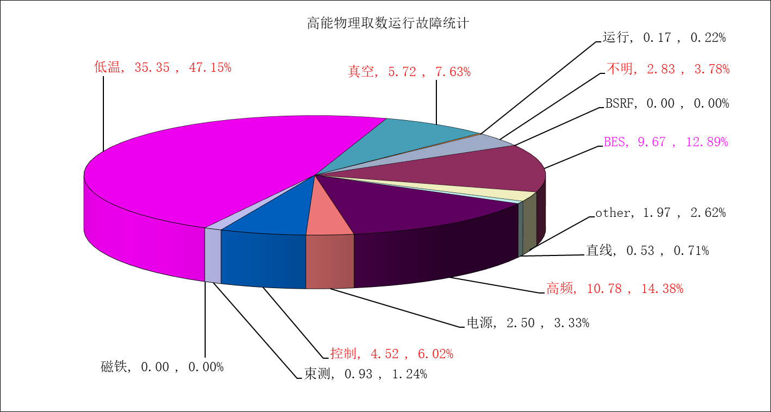
故障时间统计

Slide 25
高频系统故障原因统计（36次，10.78小时）
主要原因：硬件干扰信号（Cpl-arc，SSA-ready，W1隔热真空）；E2频控环路优化不够充分及程序bug

Slide 26
小 结
成功修复了原国产备用腔，高频系统的安装、调试按时完成；
因束流的能量不高（~1.9GeV），流强也较低（<700mA），本轮运行每个环主要还是单腔运行；
高频系统运行基本稳定、可靠，没有成为制约束流性能的瓶颈因素。
本轮正式运行时间较短（约2个月），高频系统故障36次，时长10.78小时，属于正常水平；
接下来的主要工作是提高硬件的抗干扰能力，优化低电平参数，进一步降低高频故障率。

Slide 27
谢 谢！

