Slide 1
Group Meeting
王仕元
2025.9.9

Slide 2
SAD(Strategic Accelerator Design)
Software developed and maintained by the High Energy Accelerator Research Organization (KEK) in Japan
Specifically designed for particle accelerator physics design and simulation
Main functions: Beam optics design, particle tracking, dynamic aperture analysis, orbit and optics correction, error analysis

Slide 3
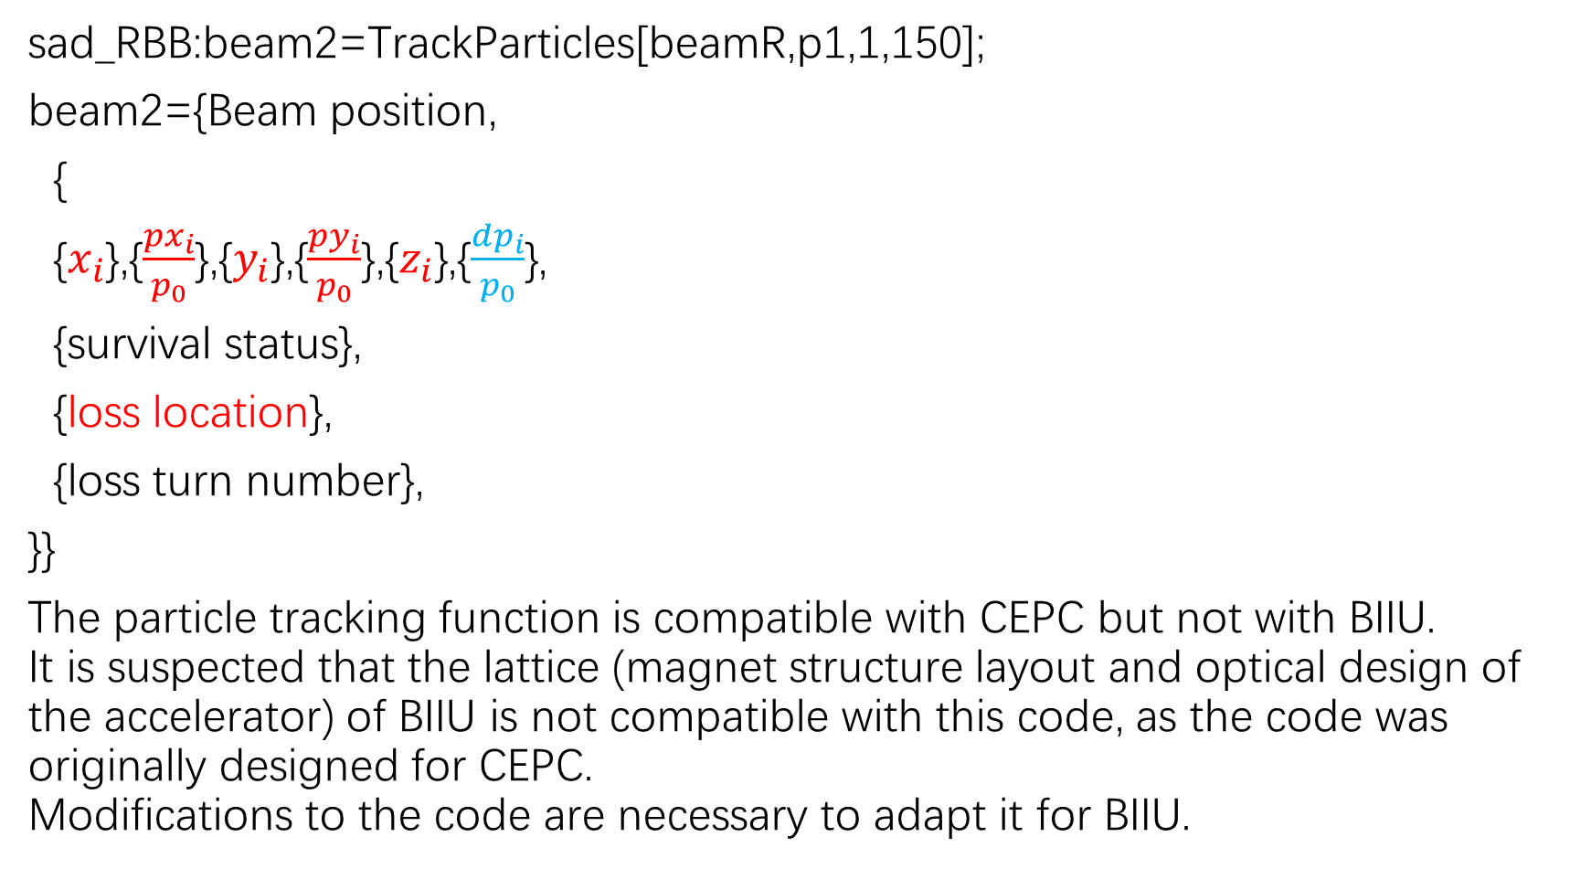
Question：
sad_RBB:beam2=TrackParticles[beamR,p1,1,150];
beam2={Beam position,
{
{$x_{i}$},{$\frac{{px}_{i}}{p_{0}}$},{$y_{i}$},{$\frac{{py}_{i}}{p_{0}}$},{$z_{i}$},{$\frac{{dp}_{i}}{p_{0}}$},
{survival status},
{loss location},
{loss turn number},
}}
The particle tracking function is compatible with CEPC but not with BIIU.
It is suspected that the lattice (magnet structure layout and optical design of the accelerator) of BIIU is not compatible with this code, as the code was originally designed for CEPC.
Modifications to the code are necessary to adapt it for BIIU.

Slide 4
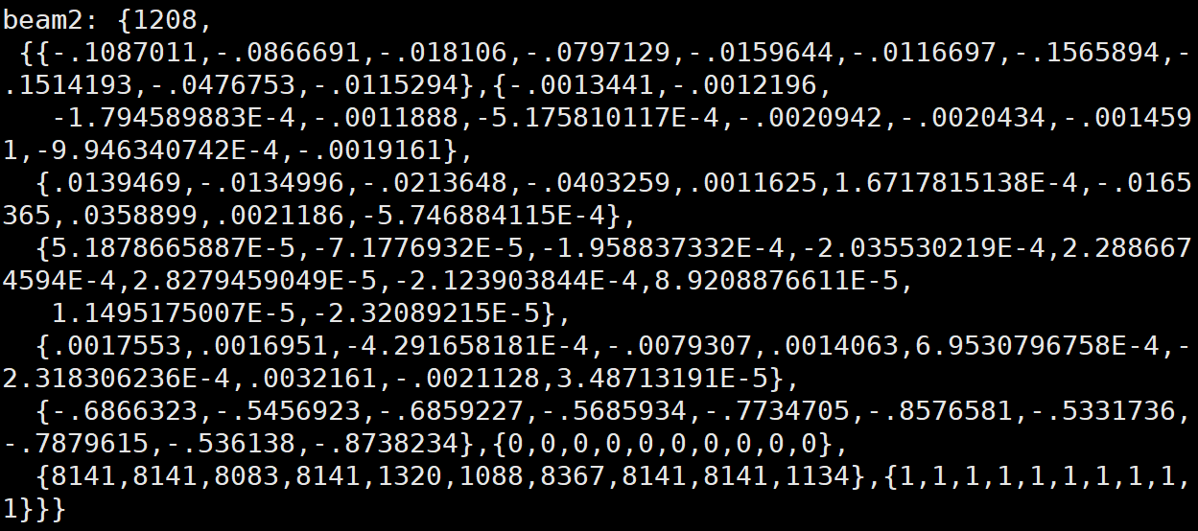
cepc:Nparticles=10

Slide 5
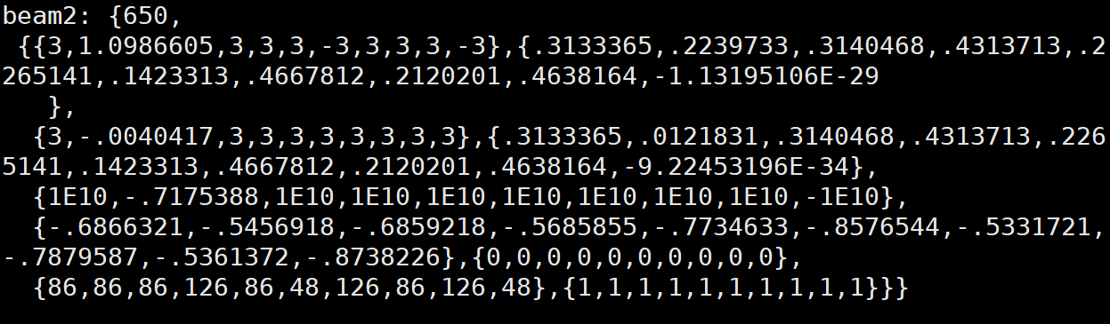
biiu:Nparticles=10

