Slide 1
CDT(Causal Dynamical Triangulation)
Hong-An Zeng
2025.9.4
[1]H. W. Hamber, Quantum gravitation: the Feynman path integral approach. Berlin: Springer, 2009.
[2]J. Z. Zhang, 《Causal Dynamical Triangulation of Quantum Gravity in Three Dimensions》.
[3]J. Ambjorn, A. Goerlich, J. Jurkiewicz和R. Loll, 《Nonperturbative Quantum Gravity》, 2012

Slide 2
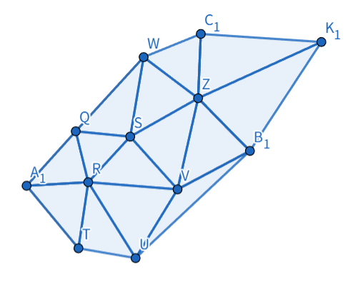
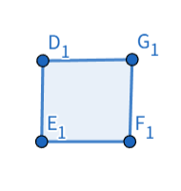
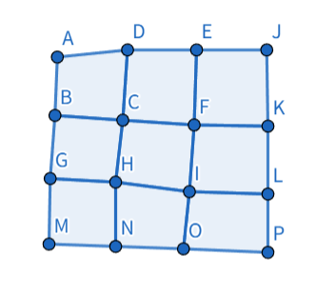
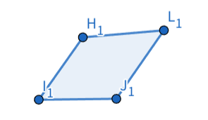


motivation
How to sample gravity?
$$lij$$
Triangular lattice
Square lattice
$$lij$$
Not sufficient to fully determine the geometry

Slide 3
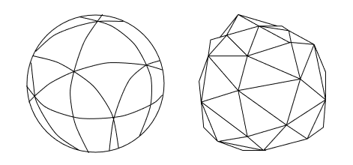
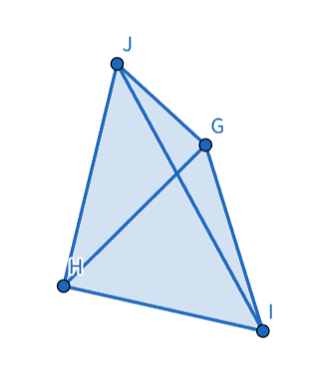
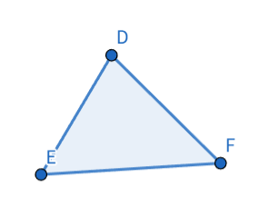
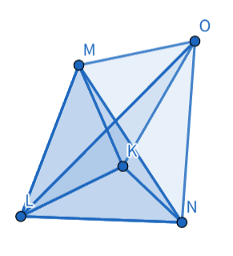
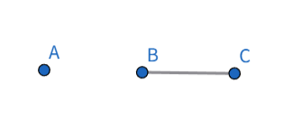
For any manifold
Complex（复形）
Its discretized form is composed of a collection of simplices.
  D-Simplex（单形）: edge lengths uniquely determine its shape. For d-dimension
0-Simplex
1-Simplex
2-Simplex
3-Simplex
tetrahedron
（四面体）
4-Simplex（五胞体）

Slide 4
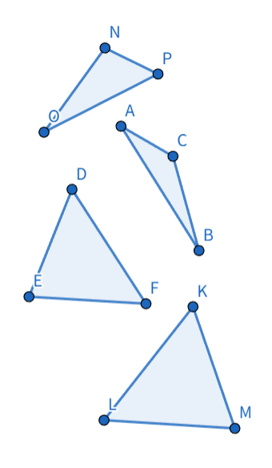
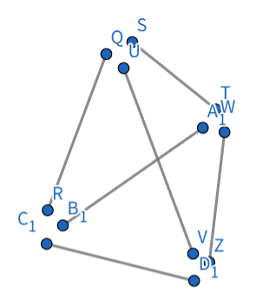
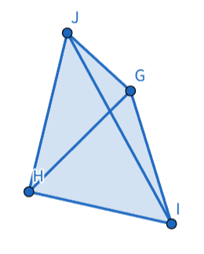
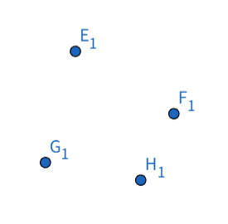
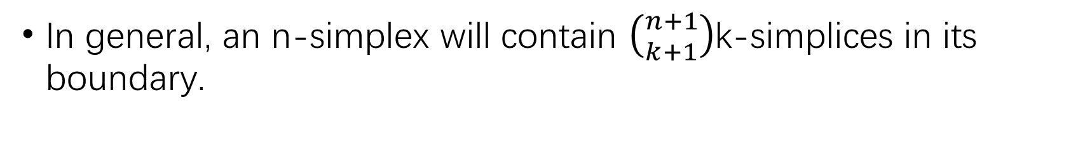
In general, an n-simplex will contain $\left({n+1 \atop k+1}\right)$k-simplices in its boundary.

Slide 5

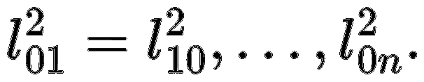
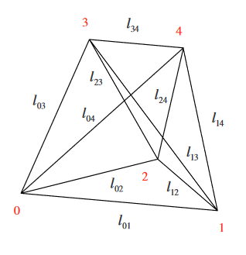
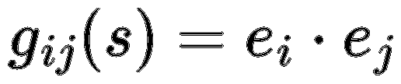
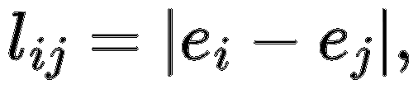
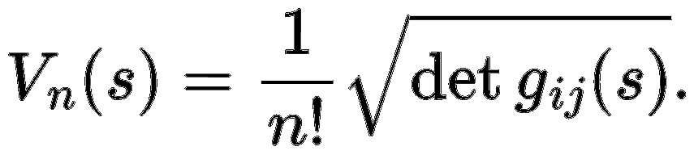
Volumes and Angles
The n-simplex can then be spanned by the set of n vectors
And we can denote the square edge lengths by
s is an n-simplex

Slide 6
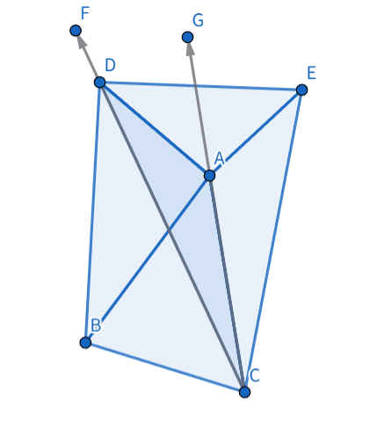
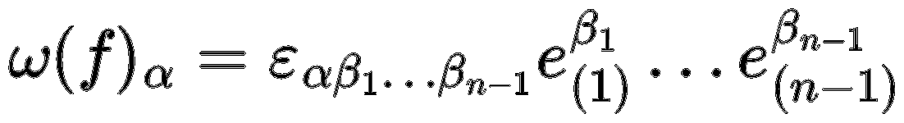
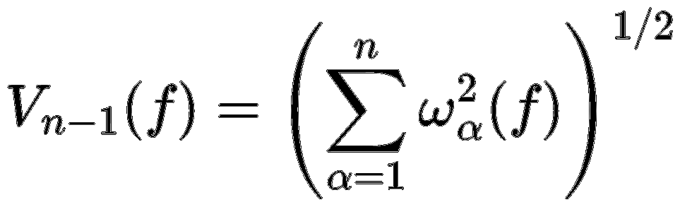


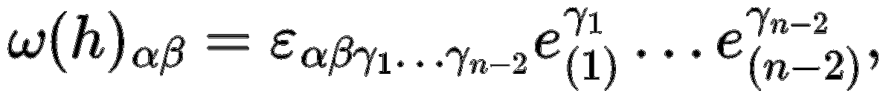
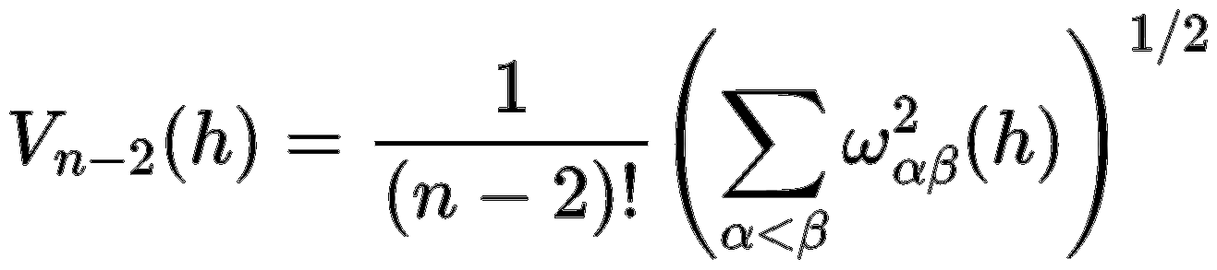
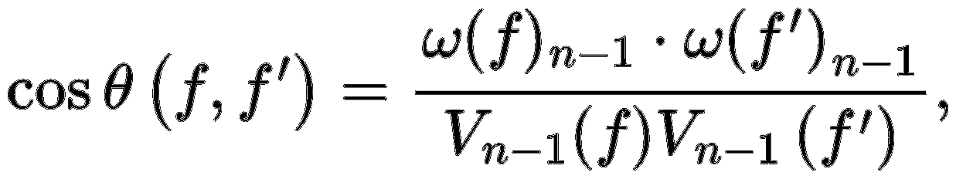
A vector perpendicular(垂直) to face
volume of the face f
Hinge（铰链）
volume of the hinge
dihedral angle(二面角)

Slide 7
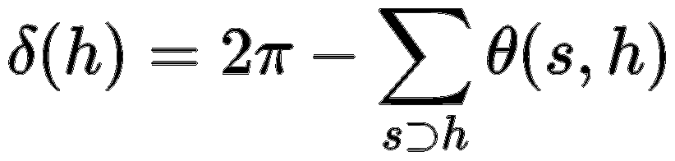
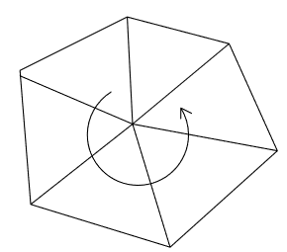
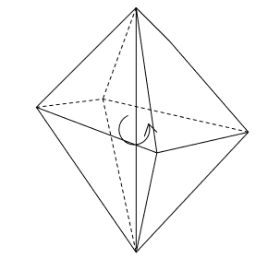
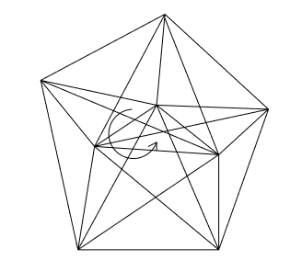
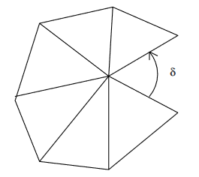
deficit angle

Slide 8
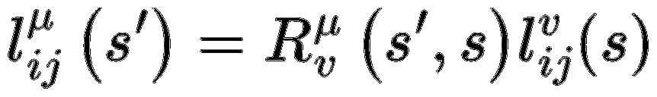
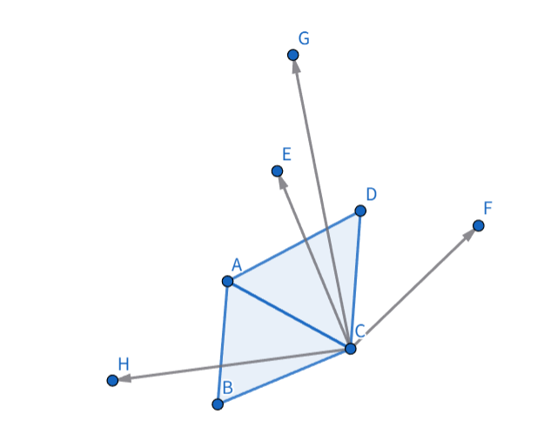
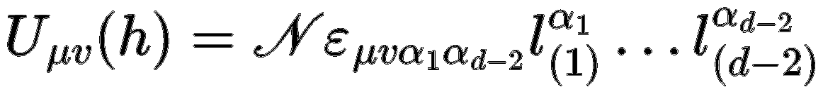

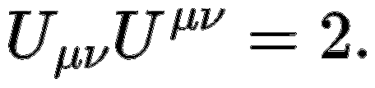


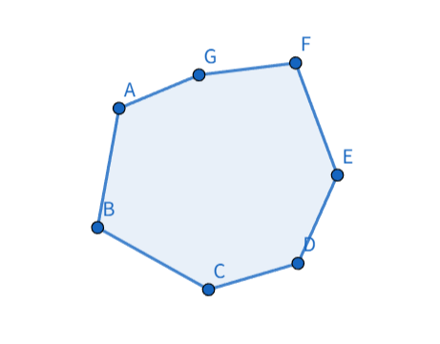
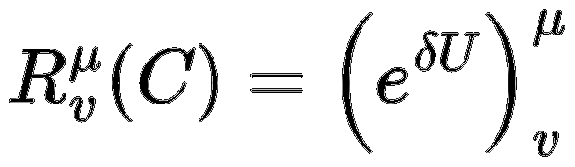

Lorentz rotation
The common edge in two different coordinate systems
Totally antisymmetric tensor – rotation generator

Slide 9
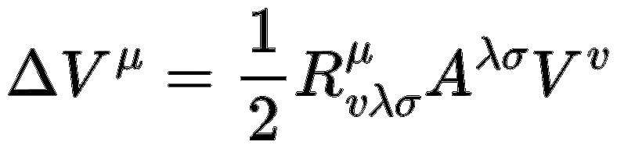
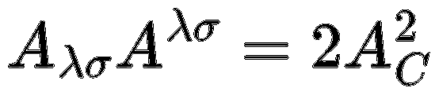
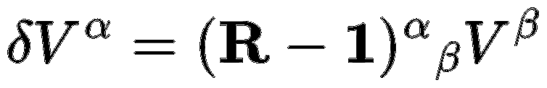
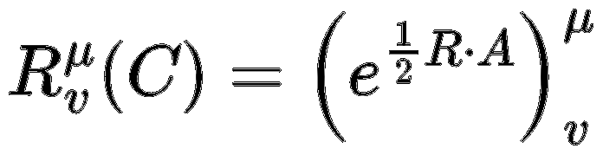
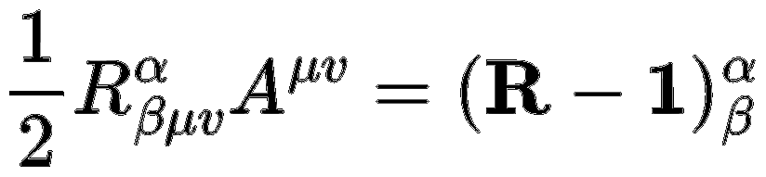
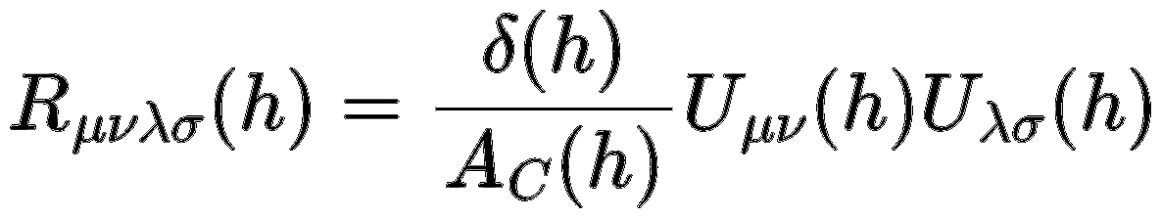
Riemann tensor
The transformation of a vector after being parallel transported around a closed loop
The rotation transformation around a closed loop can be expressed in terms of the Riemann curvature.
The Riemann curvature can be obtained.

Slide 10
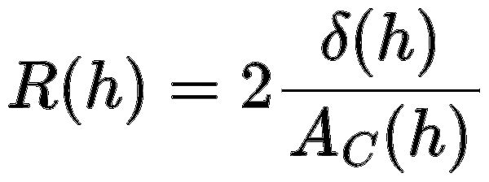
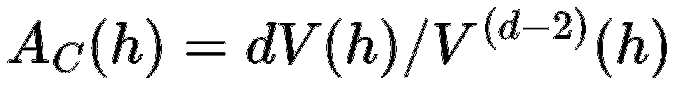
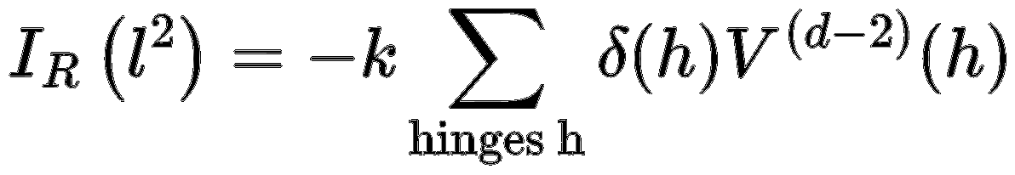
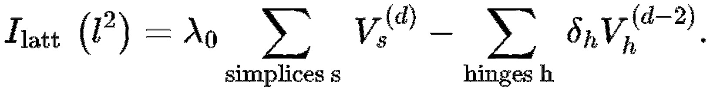
Regge action
Simplify
The gravitational action can be expressed in terms of the hinge volumes and deficit angles.
After including the cosmological constant term, it can be written in the form known as the Regge action.

Slide 11
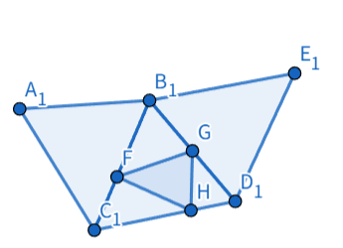
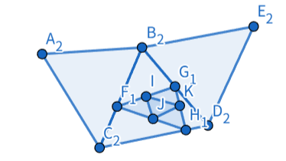
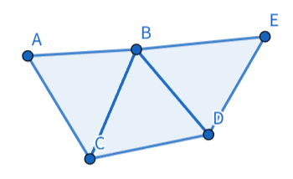
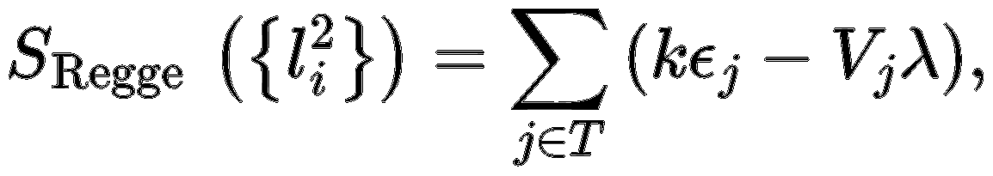
problem
Configurations involving extensive repeated calculations
In three dimensions

Slide 12


CDT
Vertices are required to be on distinct time slices.
Fixed edge lengths
Spacetime is composed of a fixed set of simplices with fixed edge lengths, so the degrees of freedom are entirely determined by their arrangement. This does not reduce the degrees of freedom, as it does not affect the generation of deficit angles. Moreover, it naturally introduces a cutoff.
C corresponds to removing some redundant permutations/combinations.

Slide 13



Move: MCMC
The random walk consists of five basic moves.

Slide 14




Critical cosmological constant
In order to keep the volume $N_{3}$fixed, the cosmological constant term must vary with the Newton constant.

Slide 15





Phase transition
Expanding–contracting universe
The order parameter changes with the Newton constant, indicating a phase transition.
A disconnected universe can be approximated as a combination of lower-dimensional universes.

