Slide 1


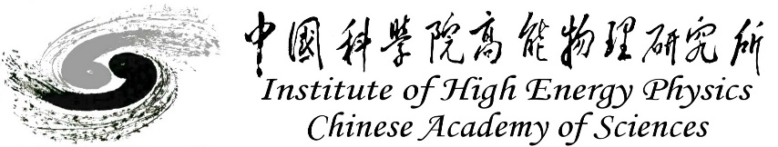
Vertex Detector
Zhijun Liang
(On behalf of the CEPC physics and detector group)
XXX XXX, 2025, CEPC Detector Ref-TDR Review

Slide 2
Content
Overview of IDRC feedback and main changes
Detailed description of the changes
Requirement and overall design
Detailed design including electronics, cooling and mechanics
Performance from simulation or beam test
Research team and working plan
Summary
(in Backup) ALL the answers to Review comments

Slide 3
Overview of IDRC feedback and main changes
Main points from IDRC feedback:
  Design for high-lumi Z is challenging. Relaxing parameters may lead to more robust design
  Study physics performance for backup layout with ladders
  Study impact of beam background, separate ee and synchrotron radiation contribution
  Laser alignment: Understanding reflections and signals at shallow angle
  Verify that sufficient space for service and air cooling
Main changes according to IDRC feedback:
  Update physics performance with beam background
  Update thermal simulation with air cooling
  Make a full-size mockup to verify the space for cable routing and air cooling

Slide 4
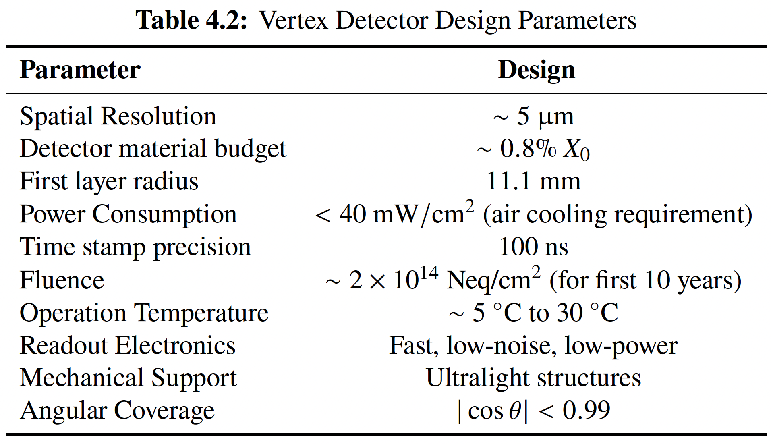
Vertex Requirement
  Inner most layer (b-layer) need to be positioned as close to beam pipe as possible
    Challenges: Radius (11.1mm) is smaller compared with ALICE ITS3 (18mm)

Slide 5
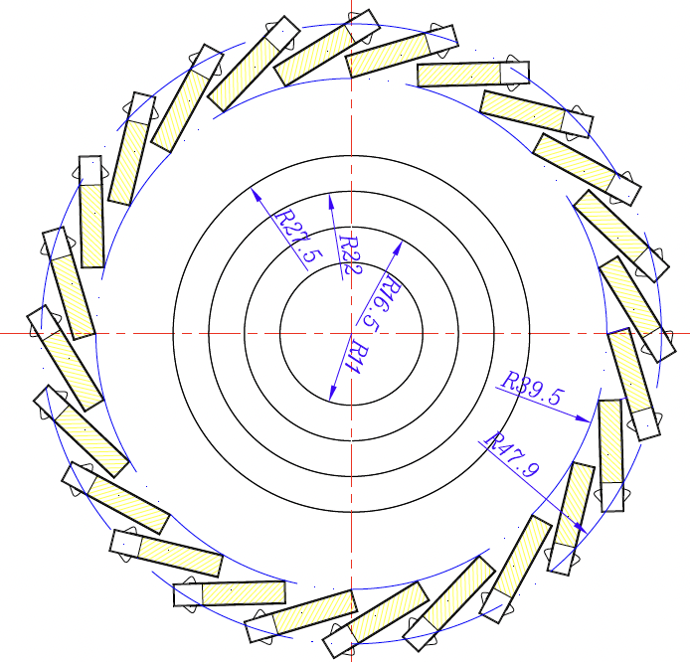
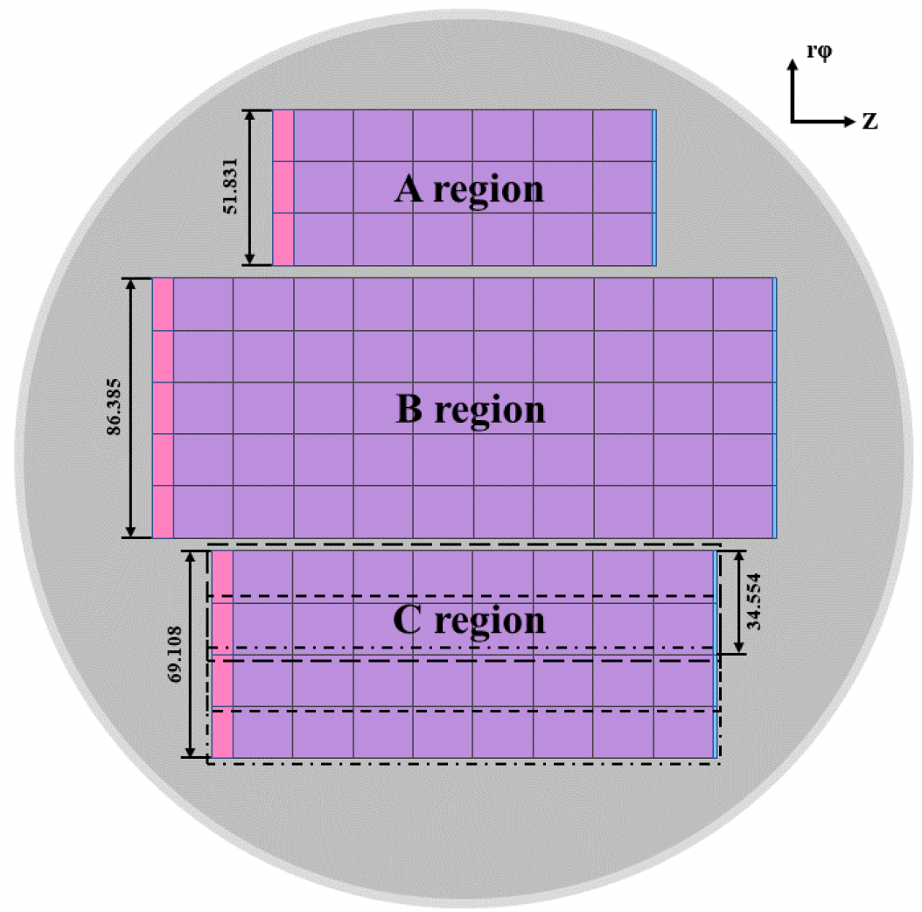
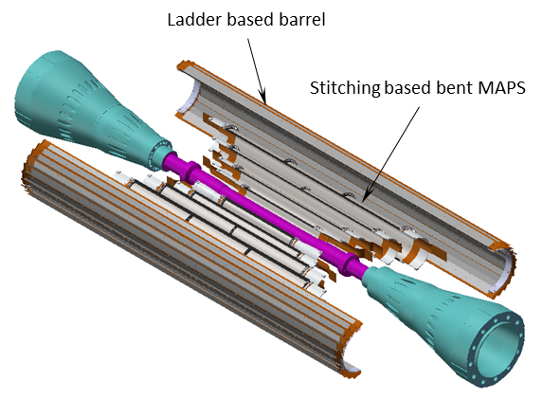
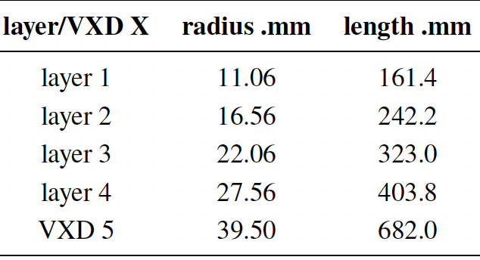
Detailed design：Baseline layout
  Baseline :4 single layer of bent MAPS + 1 double layer ladders
    Alternative option: 3 double layer ladders
  Inner layer: Use single bent MAPS for Inner layer (~0.15m²)
    Low material budget 0.06%X0 per layer
    Different rotation angle in each layer to reduce dead area
  Outer layer: Double layer Ladder (~0.28% X0 per layer)
Figure 4.2
Long barrel layout (no endcap disk)
Figure 4.3
Figure 4.1
Figure 4.3

Slide 6
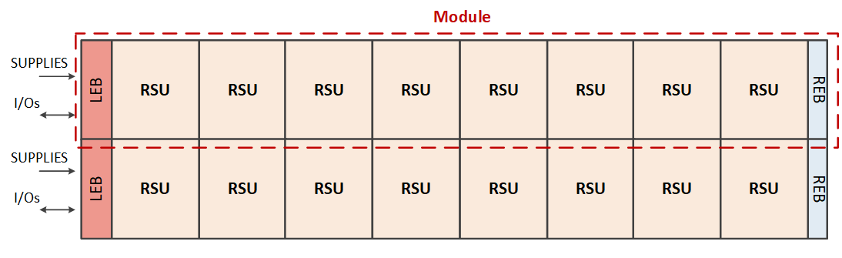
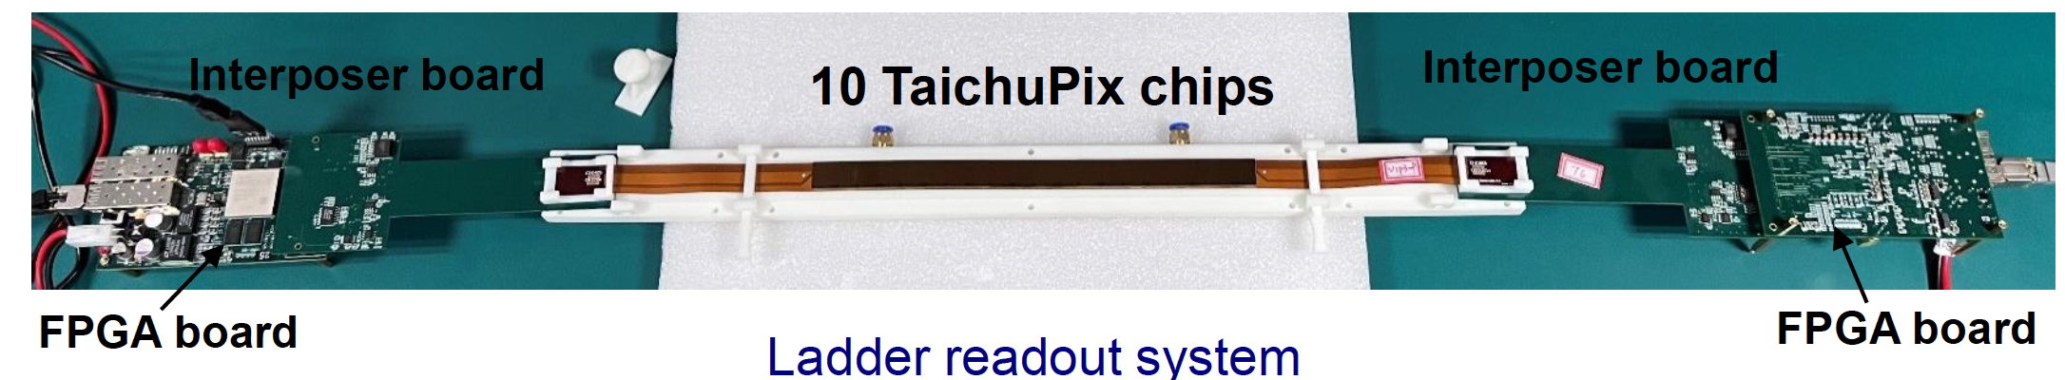
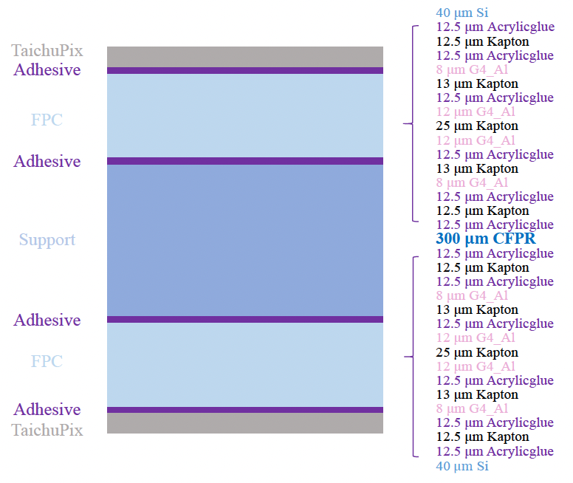
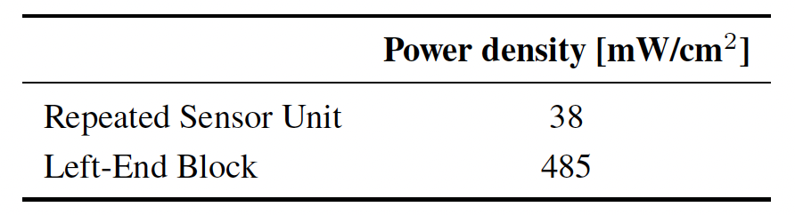
Detailed design： Electronics
  Stitching layer : stitching and RDL metal layer on wafer to replace PCB
  Outer layer (L5/L6) : flexible PCB （also used in alternative layout)
    Signal, clock, control, power, ground will be handled by control board through flexible PCB
Stitching layers : ALICE ITS3 like stitching
Outer layer (layer 5/6, ) ： flexible PCB
Figure 4.15
Table 4.12, Estimates of average power dissipation per unit area
Figure 4.6
[1] ALICE ITS3 TDR: https://cds.cern.ch/record/2890181

Slide 7
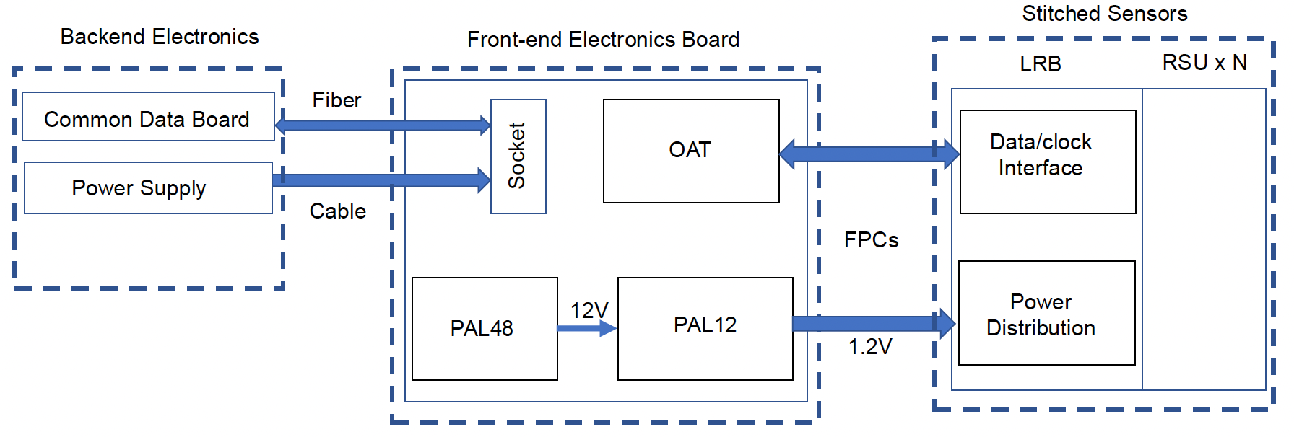
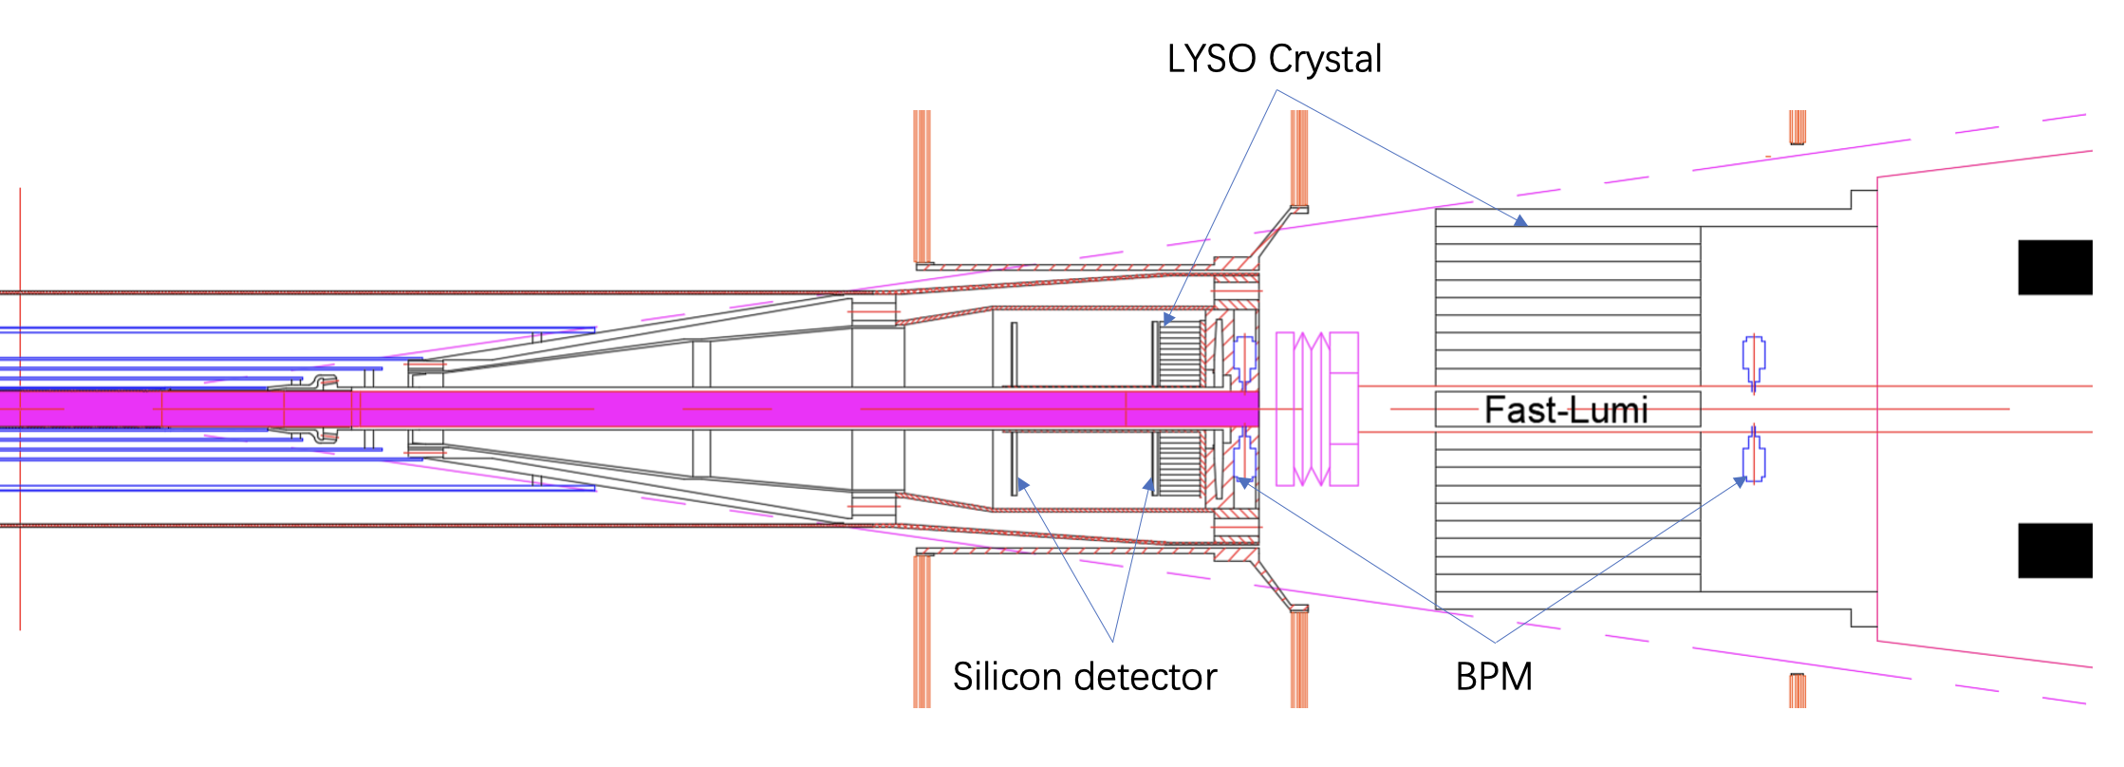
(new) Electronics of stitching layer
  Flexible PCB cable connecting stitched sensors and frontend board
  Frontend board located at fast-LumiCal volume
Frontend electronics board
Figure 4.15
Figure 3.13

Slide 8
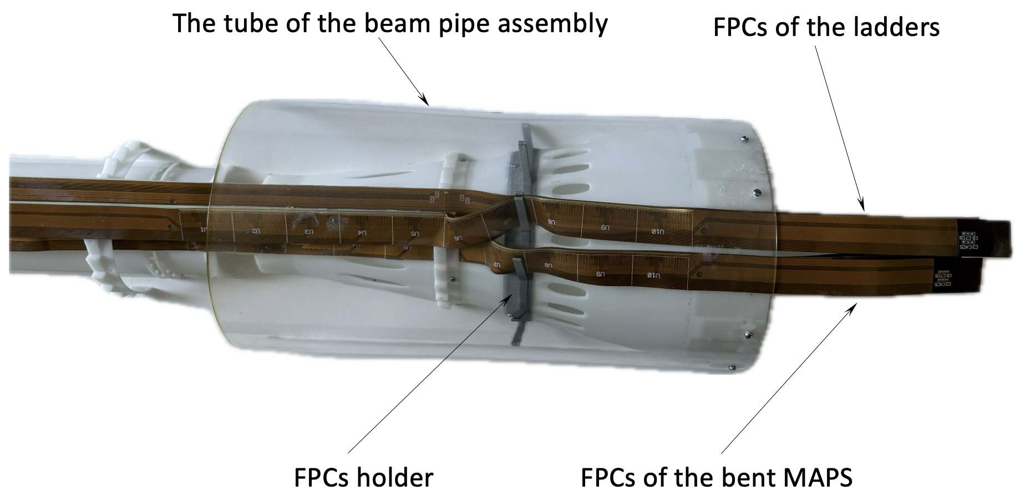
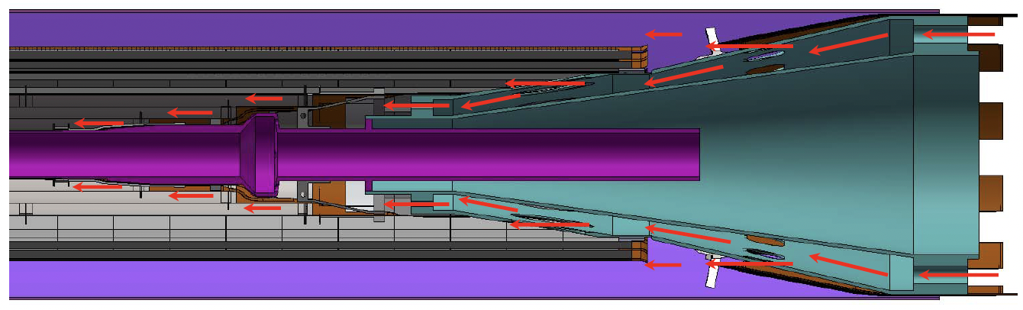
（new) Mockup to validate cable routing
Full-size 3D printed vertex detector and beam-pipe mockup
  Validate there is enough space for cable routing and air cooling channel
  The total cross-sectional area available for air cooling in the inner four layers is 12.6 cm²
This study is to address the IDRC comment:
  C-B-14-1-2: Pay particular attention to the air-cooling and service routing for the vertex detector, where space within the beam-pipe assembly is extremely limited. It is essential to verify that sufficient space is available to ensure the proper functionality of the air-cooling system, without compromising reliability or maintenance access.

Slide 9
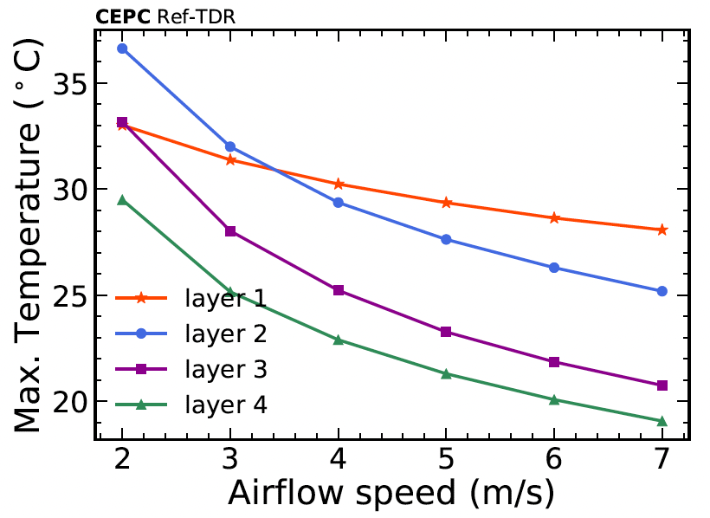
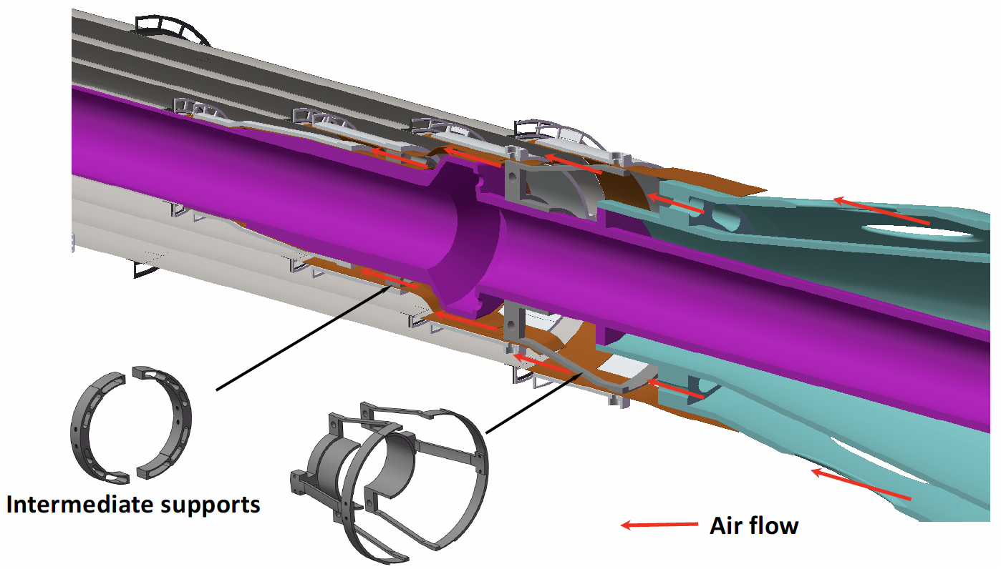
（new) Thermal simulation
New thermal simulation, baseline air speed increased from 3.5m/s to 5m/s
  Obstacles due to support structure and thermal gradients along the flow accounted for
This study is to address the IDRC comment:
  C-B-4-10-17: L2906 – 300 mW/cm2 cooling with airflow needs a reference and also at what conditions. This may lead a reader to a false believe that around an order of magnitude less is trivial to cool. A few more sentences are needed here: what flow was simulated (laminar/turbulent), if all obstacles were correctly accounted for. Have the thermal gradients along the flow been taken into consideration?

Slide 10
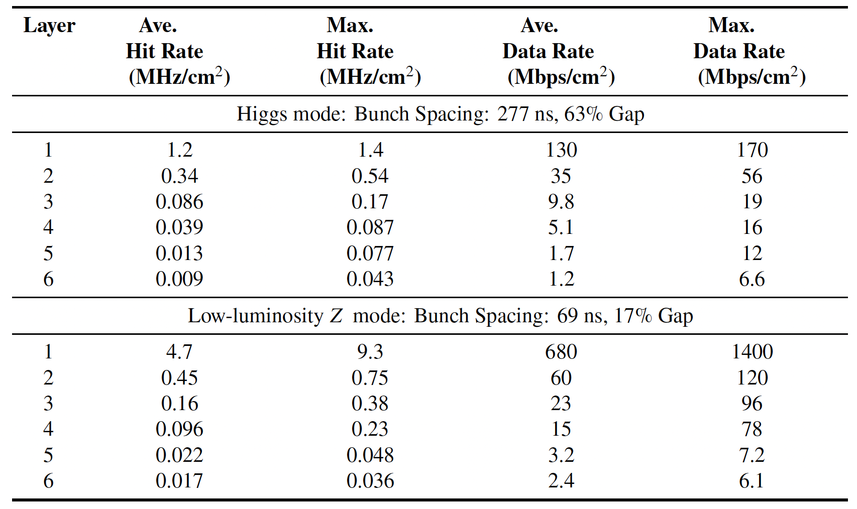
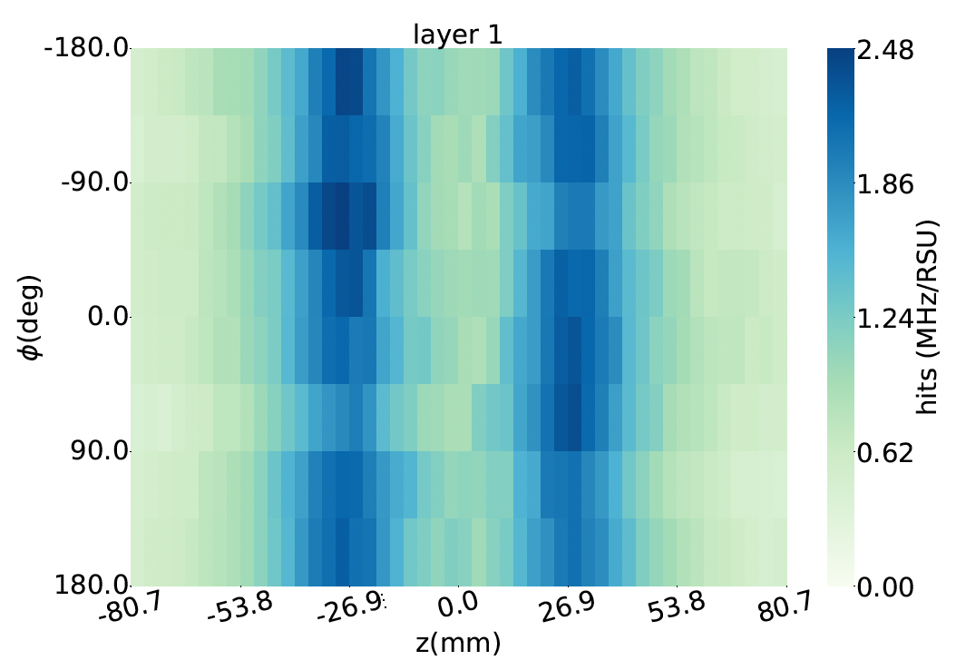
Reply to IDRC comments: Background
C-B-4-8: Background studies from ee and synchrotron radiation are crucial for understanding the background. Mixing the tables and plots with/without different background contributions is difficult to follow and evaluate.
→ We agreed with your comment. The dominant source of beam-induced background for the vertex detector is pair production, which has been included in the current studies. Due to the limited Monte Carlo statistics available at this stage, the contribution from synchrotron radiation has not yet been incorporated in the results shown in Table 4.5, Fig. 4.8, and Fig. 4.9.
→ We are improving the simulation of synchrotron radiation. Updated results, with synchrotron radiation contributions included, are expected to be available for presentation at the next IDRC review.
Table 4.5 Background rate for Higgs and low-lumi Z runs
Fig 4.9 Hit rate map for 1st layer @ low-lumi Z run

Slide 11
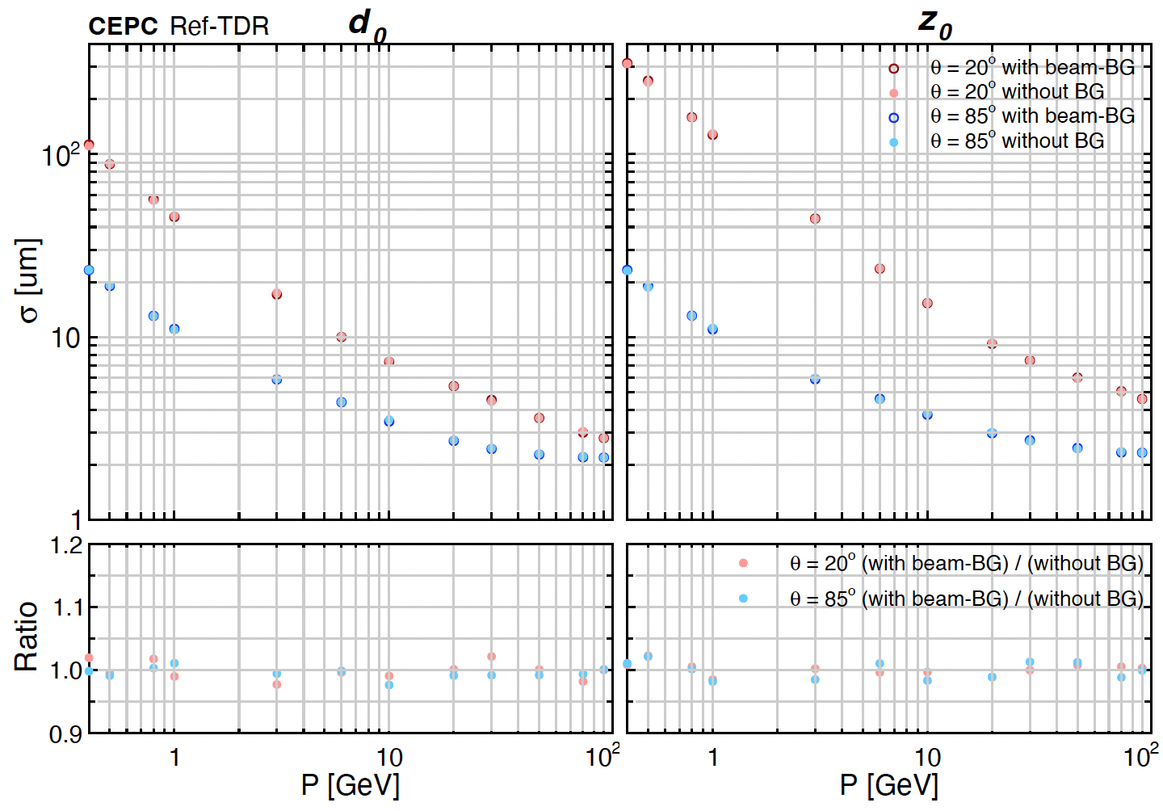
Performance with beam background
The impact of beam background to performance has been updated.
  No visible effect in d0/Z0 resolution
    Add ratio plot in lower canvas
  SR photons are not included yet

Slide 12
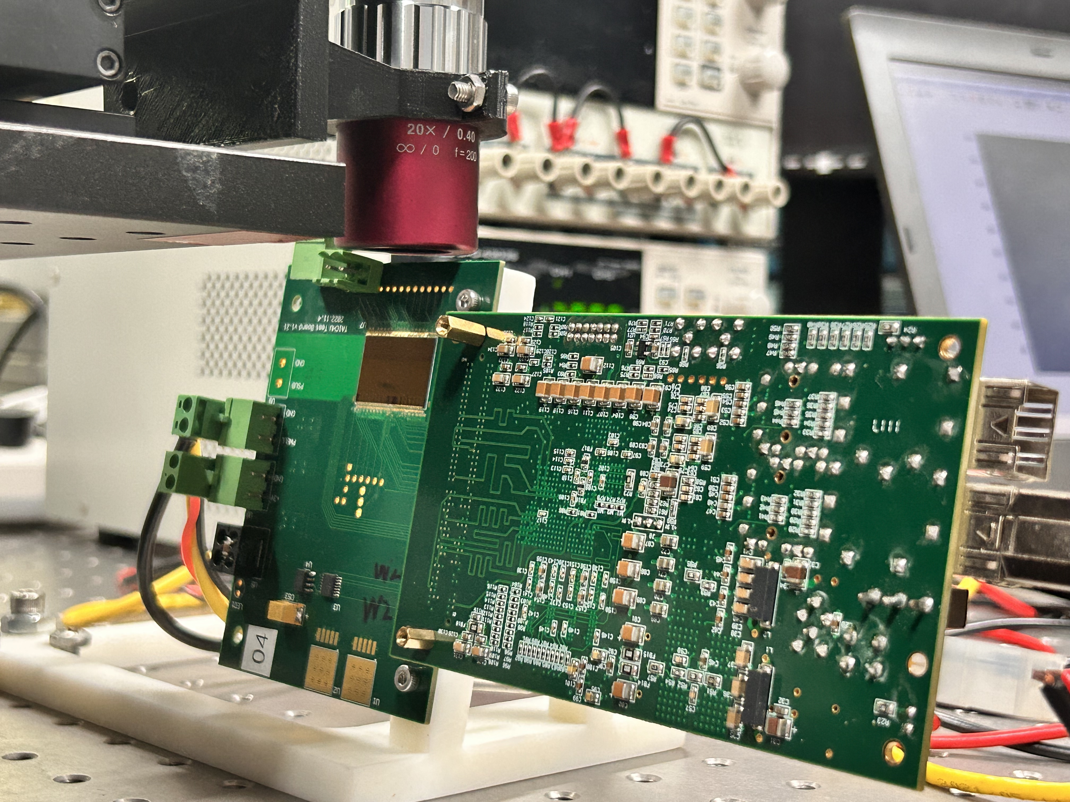
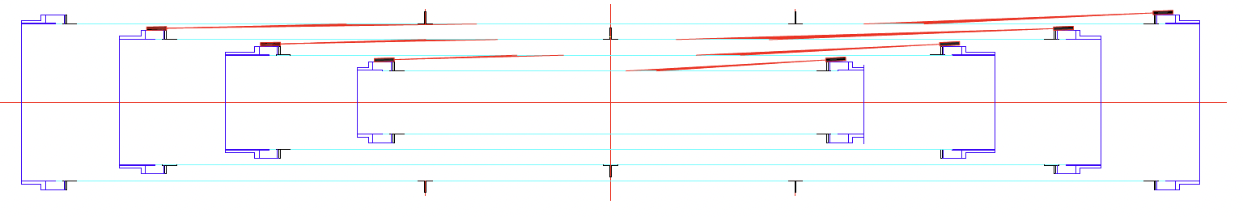
Reply to IDRC comments: Laser alignment
C-B-4-9: Laser alignment is an important tool and if implemented will reveal many unknowns about the mechanical stability of such objects not demonstrated in real experiment before. However, illuminations at shallow angles on almost entirely metalized surfaces are much more complicated that for e.g. strip detectors. Understanding all reflections and ways to induce signals will be a challenge.
→ More recent studies on laser illumination at shallow angles and from the backside have been carried out. Signals from front-side illumination at shallow angles agree with our expectations, while backside illumination shows good results with reduced reflection in laboratory tests.
→ In the current laser alignment scheme, the laser lines on the left use backside illumination (Fig. 4.22). By comparing the beam spots on the left and right, the reflection effect can be reduced.
→ In the longer term, the laser alignment method will be validated using a vertex detector prototype with stitched sensors.
Laser illuminations at shallow angle
Back-side illuminations
Figure 4.22

Slide 13
Reply to IDRC comments: general design
C-B-4-7: VTX design for for high lumi Zmode which only comes after 10 y is super challenging. Relaxing design parameters for longer BX may lead to more robust design. VTX is not very large and a better design for high lumi Zpole running may emerge with time.
Answer: The current design is optimized for low-luminosity Z operation and is not targeted for high-luminosity Z, which is foreseen only after the first 10 years. When the design is relaxed from the low-Z mode to the Higgs mode, the power density decreases from 38 to 33 mW/cm^2 (see the table below and Table 4.8). This result indicates that further relaxation from current design does not lead to significant gains. For high-luminosity Z operation, additional R&D and possibly new design concepts will be required. We agree with your recommendation that more advanced designs should be pursued in the longer term, particularly for a vertex detector replacement before the high-luminosity Z runs.
Estimates of power consumption of one RSU, RSU area = 3.46 cm²
Mode | Pixel Analogue (mW) | Pixel Digital (mW) | Biasing Block (mW) | Matrix Readout (mW) | Data Interface (mW) | RSU Total (mW)
Higgs | 28 | 25 | 8 | 28 | 25 | 114
Low-Z | 36 | 30 | 8 | 32 | 25 | 131

Slide 14
Research team
IHEP: 8 faculty, 2 postdoc, 5 students
CERN: Recent joint R & D collaboration in HLMC 55nm aiming for ALICE3 upgrade
IPHC/CNRS: Christine Hu et al (3 faculty): Collaboration in FCPPL and DRD3
  CEPC Jadepix design, ALICE ITS3 upgrade (especially on MAPS design, stitching)
IFAE: Chip design , Sebastian Grinstein et al (2 faculty)
  CEPC Taichupix chip design, ATLAS ITK pixel and HGTD upgrade
ShanDong U.: Stitching chip design (3 faculty, 1 postdoc, 3 students )
CCNU: chip design, ladder assembly (2 faculty , 3 students )
Northwestern Polytechnical U. : Chip design (5 faculty, 2 students )
Nanchang U. : chip design, (1 faculty, 1 students)
Nanjing U.: irradiation study, chip design : (2 faculty, 4 students)
NanKai U. : physics performance (1 faculty, 1 student)

Slide 15
Working plan
Development of wafer-scale stitching MAPSs
  Develop wafer-scale stitching with 180nm technology
  The second-generation stitching chip will transition to 65 nm/55 nm
    Baseline: TPSCo’s 65 nm technology
    Alternative: HLMC’s 55 nm technology.
Ultra-thin mechanical supports and low-mass integration techniques.
  Start with prototype with dummy silicon wafer
Construction of a full-scale VTX prototype to address challenges in mechanical precision, cooling performance, laser alignment, and system-level integration.

Slide 16
Summary
Following feedback from IDRC review, updated TDR content
  Update physics performance with beam background
  Update thermal simulation with air cooling
  Make a full-size mockup to verify the space for cable routing
Short term plan before TDR:
  Impact of beam background with synchrotron radiation
We active expanding international collaboration and explore synergies with other projects
  Recent collaboration with CERN on ALICE3 tracker upgrade
  We are member of ECFA DRD3 collaboration

Slide 17
Answers to IDRC Feedback
（copy the slides from the long feedback ppt）
Aug. 7th, 2024, CEPC Detector Ref-TDR Review

Slide 18
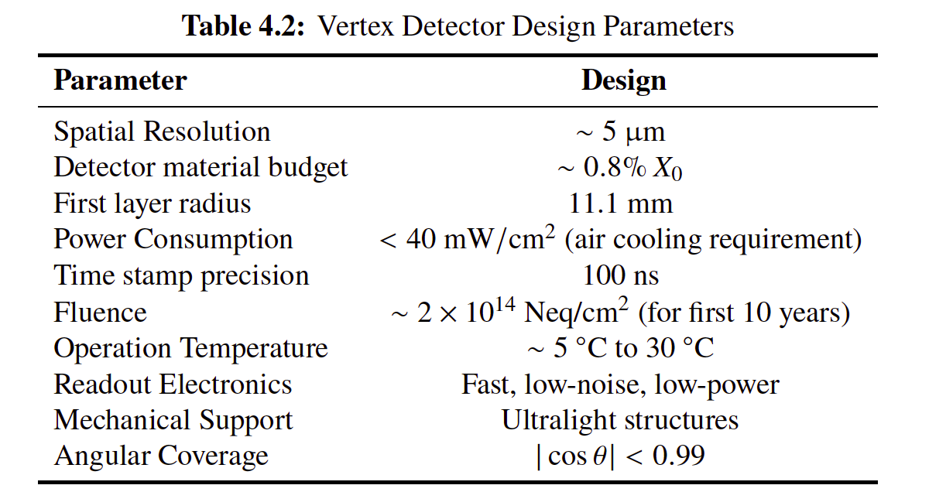
Recommendations
Vertex Detector
R-A-4-1: Re-evaluate the required performance specifications, focusing on operation during ZH and low-luminosity Z runs over the first 10 years.
The baseline vertex detector design has been optimized for low-luminosity Z operation and Higgs runs, consistent with the primary physics goals during the first 10 years. Power consumption and detector performance have been carefully evaluated under these conditions ( As shown in Table 4.2) .

Slide 19
Comments on Draft v0.4.1
Vertex Detector
C-B-4-7: VTX design for for high lumi Zmode which only comes after 10 y is super challenging. Relaxing design parameters for longer BX may lead to more robust design. VTX is not very large and a better design for high lumi Zpole running may emerge with time.
Answer: The current design is optimized for low-luminosity Z operation and is not targeted for high-luminosity Z, which is foreseen only after the first 10 years. When the design is relaxed from the low-Z mode to the Higgs mode, the power density decreases from 38 to 33 mW/cm^2 (see the table below and Table 4.8). This result indicates that further relaxation from current design does not lead to significant gains. For high-luminosity Z operation, additional R&D and possibly new design concepts will be required. We agree with your recommendation that more advanced designs should be pursued in the longer term, particularly for a vertex detector replacement before the high-luminosity Z runs.
Estimates of power consumption of one RSU, RSU area = 3.46 cm²
Mode | Pixel Analogue (mW) | Pixel Digital (mW) | Biasing Block (mW) | Matrix Readout (mW) | Data Interface (mW) | RSU Total (mW)
Higgs | 28 | 25 | 8 | 28 | 25 | 114
Low-Z | 36 | 30 | 8 | 32 | 25 | 131

Slide 20
Recommendations
Vertex Detector
R-A-4-2: We reiterate our previous recommendation to expand the current manpower dedicated to design and R&D efforts. A close collaboration with ALICE-ITS3 on stitched sensor development is strongly encouraged.
Answer: We are starting a collaboration with CERN team in ALICE3 upgrade. Part of us (eg: CCNU) is involved in ALICE ITS3 upgrade. IHEP and CCNU started having meetings with the CERN team on the ALICE3 upgrade at the end of 2024 in China, exploring potential collaboration on HLMC 55 nm. In mid-2025, the CERN team visited HLMC in Shanghai. More detailed discussions are still ongoing, and a close collaboration is expected as you suggested.
R-A-4-3: Explore constructing a mock-up with dummy heaters for thermal performance tests, to be used also for simulation validation.
Answer: We planned to construct a mock-up using a thin silicon wafer with heaters; however, this has not been done yet due to its complexity. We have added this suggestion to the future plan section in the vertex chapter (Sec. 4.8). The plan begins with exploring the construction of a mock-up featuring dummy heaters for thermal performance testing, and the results will also be used to validate thermal simulation models.
R-A-4-4: While pixel functionalities are similar for the ladder and stitched sensor options, significant differences in chip-to-chip (RSU-to-RSU) connectivity could impact performance. Address potential challenges (e.g., power and data distribution across large, stitched sensors) as early as possible through simulation studies
Answer: We will perform simulations on the stitching design when we are about to tape out the next version of the sensor by the end of 2025. Most of these potential challenges can be simulated using the design kits once the stitching design is finalized.

Slide 21
Comments on Draft v0.4.1
Vertex Detector
C-B-4-1:
Daniela’s comment:
I read the tracker section and found that the structure of the reference TDR has improved.
Nonetheless, the Barcelona version still needs substantial editing. In addition, some figure captions — for example, Figure 4.8: “For we could not completely handle high-lumi 𝑍 mode now, as well as the major difference between high-lumi 𝑍 with 𝑍 mode is luminosity which means their hit rate distribution is similar, the hit rate distribution of high-lumi 𝑍 would not be shown here.” — indicate that there is still an unresolved issue with the high-lumi 𝑍 mode.
This should be addressed carefully.
Answer:
We added this statement in Section 4.2 “The readout architecture can accommodate the data rates in both the Higgs factory mode and the low-luminosity 𝑍 boson factory mode during the first ten years of operation. A replacement of the VTX with upgraded technology is foreseen thereafter, with the readout architecture for the high-luminosity 𝑍 boson factory mode discussed in Chapter 11.2.”
“The process involves: buffering detector signals and background data on the front-end chip; the trigger system generating fast trigger arbitration information quickly and sending it to the front-end chip via a dedicated channel; the front-end chip comparing buffered data with the fast trigger information and transmitting preliminarily arbitrated data to the BEE.”

Slide 22
Comments on Draft v0.4.1
C-B-4-6: Is the Layer 5,6 the exactly the same design/concept as L1,2 and L3,4 of the backup design? The stitching concept is very attractive, but also very innovative and unproven which poses a significant risk. Given the development of the backup (baseline for L5,6) will have to go hand in hand with stitched-chip design it may be worth presenting the impact of using conventional design on performance (not only d0,z as in 4.6 but maybe a subset of physics channels) . Also a possible lack of technology access or resources may force you to abandon stitched-MAPS part baseline option. If you are confident in stitched-chip technology wouldn’t it be worth finding the way to use it also in L5,6?
→ Yes, Layer 5,6 in baseline layout the exactly the same design/concept as L1,2 and L3,4 of the backup layout.
→ The d_0 and z_0 resolutions of the conventional design are shown in Fig. 4.30. Its overall physics performance is under evaluation. As an initial benchmark, we assess the precision of R_b (Z→bb branching rate measurement) to evaluate physics sensitivity. From preliminary studies, the baseline design achieves a b-tagging efficiency that is about 2% higher than the conventional design at the same light-jet mis-tag rate. We will present more results at the next IDRC review.
→ Due to wafer size limitation and the yield issue, we still don’t have a good solution for stitched-chip technology in Layer 5/6 yet. We have added the following text in Section 4.1.2.1 “The outer layers (layers 5 and 6) of the VTX do not use stitching technology due to wafer size limitations.”

Slide 23
Comments on Draft v0.4.1
C-B-4-8: Background studies from ee and synchrotron radiation are crucial for understanding the background. Mixing the tables and plots with/without different background contributions is difficult to follow and evaluate.
→ We agreed with your comment. The dominant source of beam-induced background for the vertex detector is pair production, which has been included in the current studies. Due to the limited Monte Carlo statistics available at this stage, the contribution from synchrotron radiation has not yet been incorporated in the results shown in Table 4.5, Fig. 4.8, and Fig. 4.9.
→ We are improving the simulation of synchrotron radiation. Updated results, with synchrotron radiation contributions included, are expected to be available for presentation at the next IDRC review.

Slide 24
Comments on Draft v0.4.1
C-B-4-9: Laser alignment is an important tool and if implemented will reveal many unknowns about the mechanical stability of such objects not demonstrated in real experiment before. However, illuminations at shallow angles on almost entirely metalized surfaces are much more complicated that for e.g. strip detectors. Understanding all reflections and ways to induce signals will be a challenge.
→ More recent studies on laser illumination at shallow angles and from the backside have been carried out. Signals from front-side illumination at shallow angles agree with our expectations, while backside illumination shows good results with reduced reflection in laboratory tests.
→ In the current laser alignment scheme, the laser lines on the left use backside illumination (Fig. 4.22). By comparing the beam spots on the left and right, the reflection effect can be reduced.
→ In the longer term, the laser alignment method will be validated using a vertex detector prototype with stitched sensors.
Laser illuminations at shallow angle
Back-side illuminations
Figure 4.22

Slide 25
Comments on Draft v0.4.1
C-B-4-10: Remarks/questions and editorial comments:
C-B-4-10-1: L2444 - dead zone -> inefficient region (all over the text) ->Done
C-B-4-10-2: L2479 - 65 nm or 55 nm (SMIC) - maybe it would be better not to limit yourself ->Added more info about alternative technology on 65/55nm
C-B-4-10-3: Table 4.1 - time stamp precision should be without +/- ->Removed
C-B-4-10-4: L2505 - using the word chip can be confusing as people use it for reticle size objects -> stitched-chip would make it clearer all over the text
C-B-4-10-5: L2506 - to satisfy the coverage from 8.1-90 deg ->Corrected as |cos (theta)|<0.991
C-B-4-10-6: Figure 4.2 : CMOS, MAPS used here imply as CMOS and MAPS are different detector technologies. Maybe planar CMOS sensors -> “single reticle MAPS” and “stitched MAPS” is a better terminology. → we now unify the wording stitched layer and planar layer
C-B-4-10-7: Figure 4.6 - please put “not to scale” in the caption. ->Done
C-B-4-10-8: Figure 4.7 - Please mention that the cell in this case is a single chip, for easier reading. The legend (Layer 1 and Layer 2 labels should be larger. The colour coding of the plots is not the most convenient. I would advise you to use the same scale on both plots! ->Corrected
C-B-4-10-9: L2626 - remove Tower from the TPSCo ->removed.
C-B-4-10-10: Table 4.7 and also in the text put the fill factor (sensitive area) of the RSU
  →Table 4.7 (the area of each functional block in the MAPS) has been removed, as the design has not yet been completed. We will aim to maintain the highest possible fill factor during the design process. The expected fill factor is slightly above 95%, achieved in part by removing the backup I/O pads, which provides an additional 2–3%.

Slide 26
Comments on Draft v0.4.1
C-B-4-10-11: Figure 4.9 it is unclear to what the data interface part if the middle x~10 mm is stitched to (or "stitched" can be omitted)? For 1D stitching of RSU as I understand reticles are stitched along the z axis.
→ yes, stitching direction is along the z axis, we now indicated the stitching direction in Figure 4.11 and also in the text. Each sensor block connects directly to the LRB (Left-end Readout Block) and data are transmitted via dedicated point-to-point links. We now add the blue lines in Figure 4.11 to represent the point-to-point data transmission lines traverse the stitching boundaries of RSUs.
Figure 4.11

Slide 27
Comments on Draft v0.4.1
C-B-4-10-12: L2699 - What about the n-spray implant (modified process) to find optimum between collection efficiency and position resolution. → we now added some tex to mention n-spray implant
C-B-4-10-13: L2679 - “the leakage current should be controlled in 5 times of TaichuPix” - this doesn‘t read well. ->Removed
C-B-4-10-14: L2840 – although some studies show that that bending of silicon to 11 mm is doable, this is far from certain and surprises may appear. → Thanks, we will keep that in mind.
C-B-4-10-15: L2847-2849 – this needs a rewrite for easier reading. ->Rewrote
C-B-4-10-16: L2876 – with our previous prototyped vertex design -> with an earlier prototype design. -> done

Slide 28
Comments on Draft v0.4.1
C-B-4-10-17: L2906 – 300 mW/cm2 cooling with airflow needs a reference and also at what conditions. This may lead a reader to a false believe that around an order of magnitude less is trivial to cool. A fee more sentences are needed here: what flow was simulated (laminar/turbulent), if all obstacles were correctly accounted for. Have the thermal gradients along the flow been taken into consideration?
  We have removed the previous statement about achieving 300 mW/cm^2 cooling with airflow. There is a reference to support this statement (LENG Xian-chun, A Thermal Design of Forced Air Cooling Solid-State Power Amplifier, Machinery & Electronics, ISSN 1001-2257, (2), pp. 44–47, 2012). As we removed this statement already, this reference was not included.
  The simulation results indicate that the airflow is turbulent. We have updated our thermal simulations so that most of the obstacles, especially those due to the support structure, have been accounted for. The baseline air speed has increased from 3.5 m/s to 5 m/s （Fig 4.18). We have now added more information about the cooling simulations in the text: “To evaluate the performance of the cooling system, simulations were performed under various airflow speeds, as shown in Fig. 4.18. The results indicate a turbulent pattern under the current geometry and flow conditions.”
  The obstacles introduced by the flexible PCB have not yet been included in the thermal simulations. We are working to incorporate this effect, and updated thermal simulation results will be presented at the next IDRC review.
Figure 4.18
Figure 4.16
Obstacles due
To support structure

Slide 29
Comments on Draft v0.4.1
4.4.1 looks a generic wish list. It is clear that presently the level of details known or needed is not large, but a bit more refined information would be welcome. →added more detailed “During the assembly phase of the CVTX layers, the thickness and curvature of the stitched sensors will be inspected. In later stages, the layer-to-layer coaxiality and 𝜙-stagger across layers will also be checked and recorded. “
4.4.2./3 The alignment is critical and level of distortions at 3.5 m/s airflow which may change/oscillate with time is a big challenge for the first 4 layers.
→We fully agree that alignment stability is critical, particularly for the innermost four layers where the required spatial resolution is most stringent. In the current baseline design, mechanical stability is addressed through the use of lightweight yet rigid support structures and by optimizing the airflow channel to minimize turbulence. In the longer term, vertex detector prototype studies incorporating laser alignment measurements are also planned to evaluate potential time-dependent oscillations under realistic airflow conditions.
Figure 4.19: Please use (a), (b) and ( c) so that the figure captions are coherent across the text. → done
L3131 - Better wording would be lateral and more uniform depletion ->Rewrote as suggested
4.5.2.3 Prototype of a stitching CMOS detector - It is not clear what is the state of that prototype or the results from it. It is a very important piece of information of e.g. of LDOs performance … A few sentences summarizing the state of functional tests would be welcome. → added one paragraph in 4.5.2.3 of the function tests results.
4.6.1 - Genantino studies are well described, but it is not clear on how much the physics performance would degrade if e.g. fraction of hits=4 increases to say 1% and hits=5,6,7 are reduced.
→ According to Fig. 4.31, the performance degradation is limited when a fraction of the sensors is turned off. We are carrying out a more quantitative study for the case you mentioned, and will present the results at the next IDRC review meeting.
L3283 - I would replace "domestic" with "Chinese" or omit it, unless you want the TDR to be biased. → we omitted it.

Slide 30
Comments
Vertex Detector
C-A-4-1: The chapter in the TDR is very long and detailed. In sections covering previously published R&D, the level of detail could be reduced. However, we found it very positive that past efforts from various groups were acknowledged, and that valuable experience and knowledge have been incorporated into the current vertex detector design.
  This section has been reduced from ~60 pages to 40 pages
C-A-4-2: Although pursuing the HLMC 55 nm process could dilute focus and resources, it remains a worthwhile avenue, especially if difficulties arise in securing access to TPSCo65.
C-A-4-3: While the mechanical design, simulations, and testing are advanced for this stage, maintaining mechanical stability and achieving efficient cooling remain significant challenges.
C-A-4-4: The foreseen cost of sensors (~4.0 MCHF) appears reasonable. The relatively higher cost per unit area compared to other silicon detectors likely reflects the fact that the baseline sensor producer is not domestic.
C-A-4-5: The estimated costs for mechanics, electronics, and the alignment system are of the correct order of magnitude but constitute only a fraction of the sensor cost

Slide 31
Findings
Vertex Detector
F-A-4-1: The design and technology choice for the vertex detector is highly ambitious and at the forefront of technological innovation. The baseline option—thin, bendable silicon CMOS sensors that can be stitched together to create a large, lightweight vertex detector—is certainly a very challenging yet promising approach. The backup solution, which also employs thin CMOS sensors mounted on ladders, remains technologically advanced. The project has made significant progress since the last review.
F-A-4-2: The vertex detector is expected to operate for 10 years during Higgs and low-luminosity Z running, after which it will need to be replaced for high-luminosity Z, WW, and tt̄ operations. The ability to run at high-luminosity Z mode imposes additional demands on an already extremely challenging design (e.g., larger data rate capabilities, shorter charge collection times, lower noise, and tighter power consumption constraints).
F-A-4-3: There are several major challenges for the vertex detector. Achieving the desired position resolution has been demonstrated with the TaichuPix-3 chip in TJ180 nm technology. However, this process has limitations, particularly its high-power consumption (>100 mW/cm²), which is too high for air cooling. Transitioning to the TPSCo65 process is a way forward, reducing power consumption to approximately 40 mW/cm². The required position resolution and uniform hit efficiency have already been demonstrated in this new process.
F-A-4-4: The real challenge now lies in the development of large-area stitched sensors of ~40 μm thickness that can be bent to radii as small as 11 mm, achieving a material budget of just 0.06% X₀. Successful bending of dummy 40 μm wafers has been demonstrated, but bending fully processed wafers (including metal layers for data and power lines) remains to be achieved. Securing access to TPSCo65 technology, including a modified process optimized for particle detection, is crucial. An alternative approach under early exploration is the HLMC 55 nm technology, although it has yet to be demonstrated.
F-A-4-5: The mechanical design is quite advanced for this stage, with many demonstrators and mock-up parts already tested, including a full ladder demonstrator. The simulations shown for mechanical and thermal performance, efficiency coverage, and background hit rates are detailed and of high quality. The impact of background hit rates on physics performance has been found to be negligible. The planned laser alignment system is a very positive development, but its effective operation must still be demonstrated.
F-A-4-6: The fifth double layer of the vertex detector employs a more conventional ladder design, achieving approximately 0.25% X₀. At the larger radius of the fifth layer, this becomes necessary but also requires parallel development. Importantly, this ladder design offers a reliable fallback option in case insurmountable problems arise with the stitched sensor technology for the inner layers.
However, adopting this backup would come at the cost of a slightly higher material budget, and thus a somewhat degraded pₜ resolution at lower energies.

Slide 32
Thank you for your attention!
Aug. 7th, 2024, CEPC Detector Ref-TDR Review

Slide 33
Extra slides
Put here at least ALL the figures and tables in TDR and any other additional information
Aug. 7th, 2024, CEPC Detector Ref-TDR Review

Slide 34
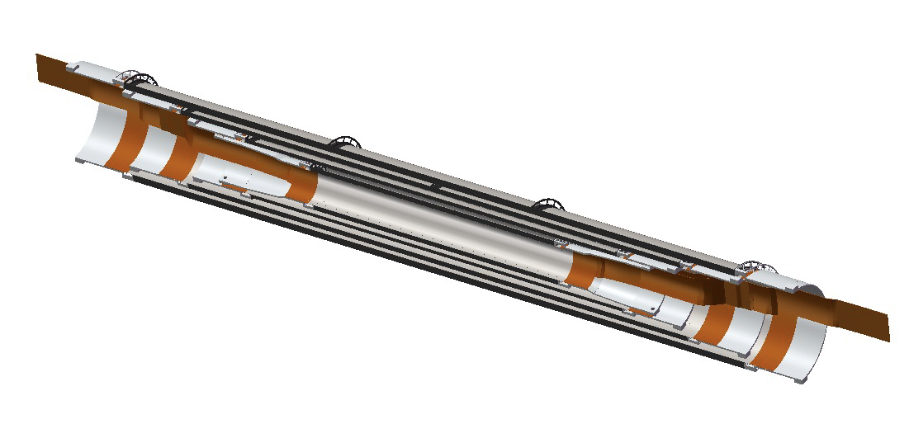
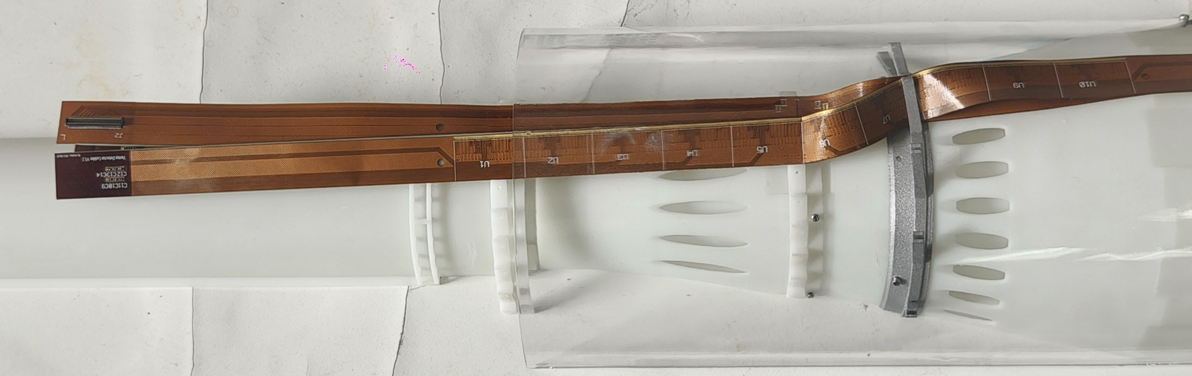
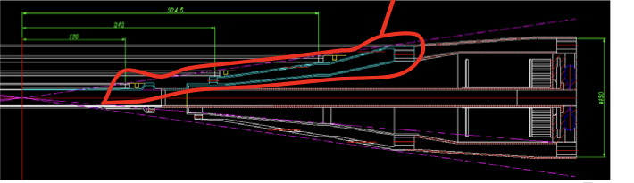
Vertex technologies: Cables and services
Limited space in the MDI region for cables and services
  Signal are transmitted by a flexible PCB then converted to fiber out of MDI region
  Feasibility study with 3D printing mockup
Cables routing using 3D printed model

Slide 35
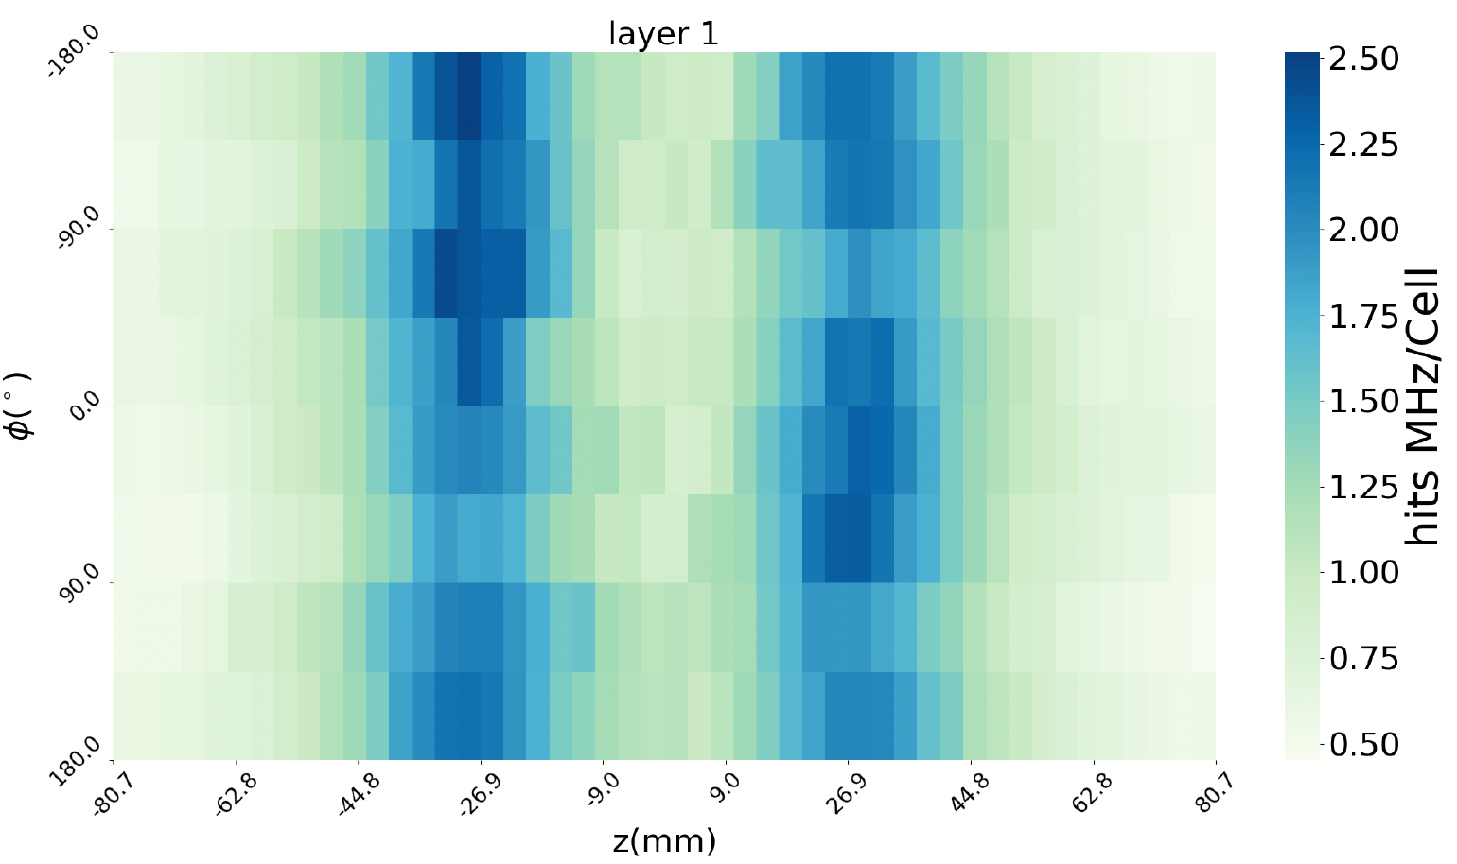
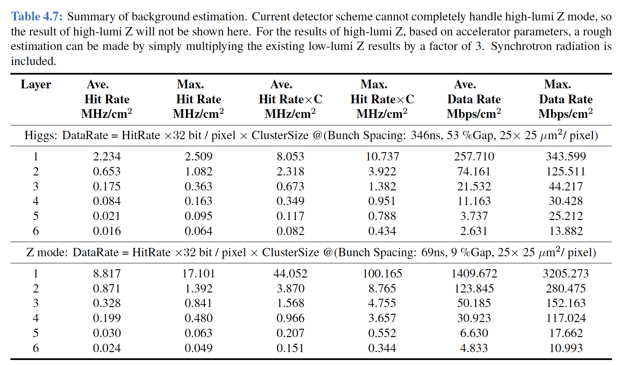
Progress after 2024 IDRC Review: background
Background rate are simulated
  The data rate at low-lumi Z pole is about ~Gbps level.
Hit rate map for 1st layer @ low-lumi Z run
Background rate for Higgs and low-lumi Z runs
This study is to address the IDRC comment:
  Thorough analysis and simulation of the background are essential, as they directly influence key aspects of detector design and operation, such as data rates and power consumption.

