Slide 1
Group Meeting
邹世明
2025/09/12

Slide 2
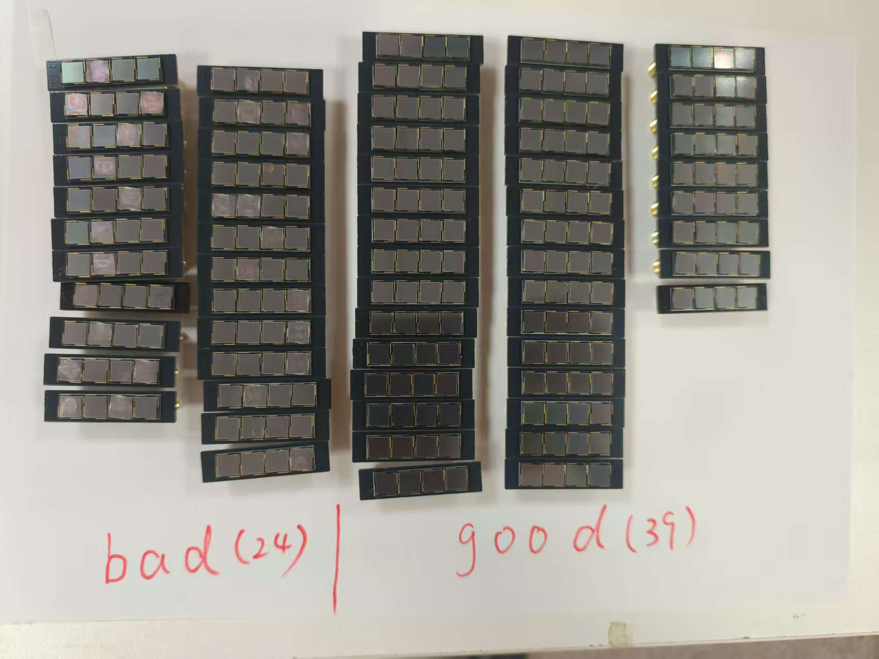
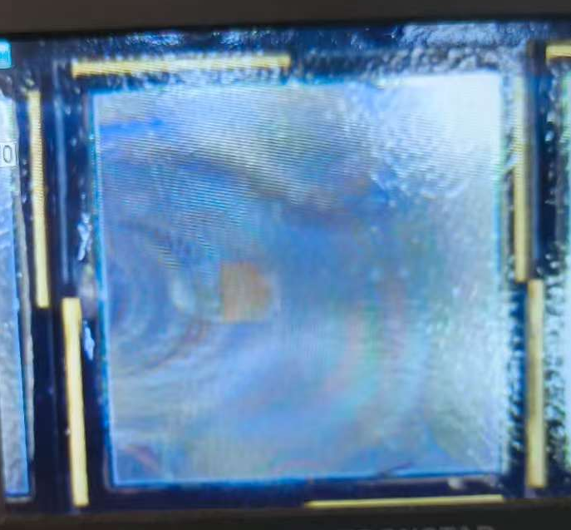
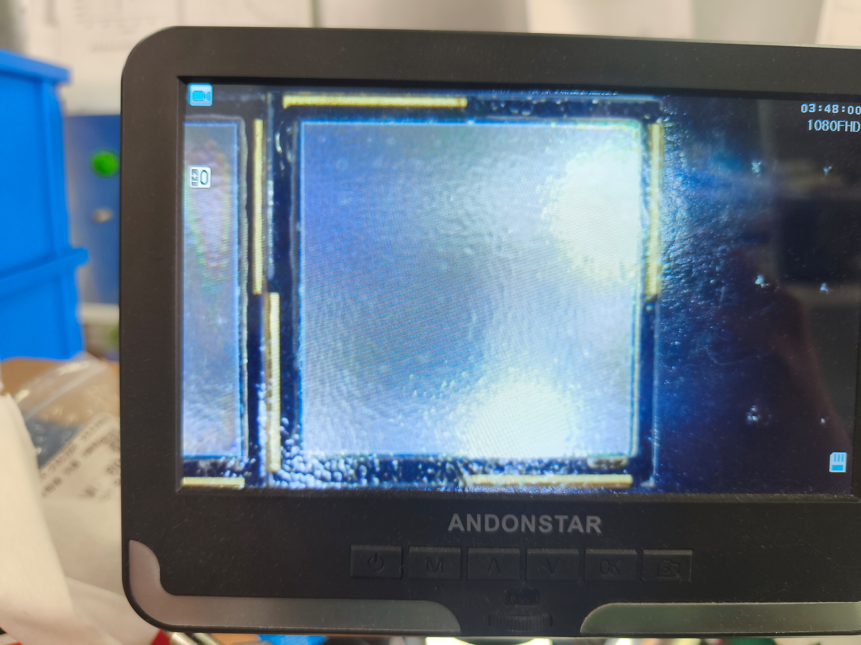
NDL_4S SIPM_ARRAY

Slide 3
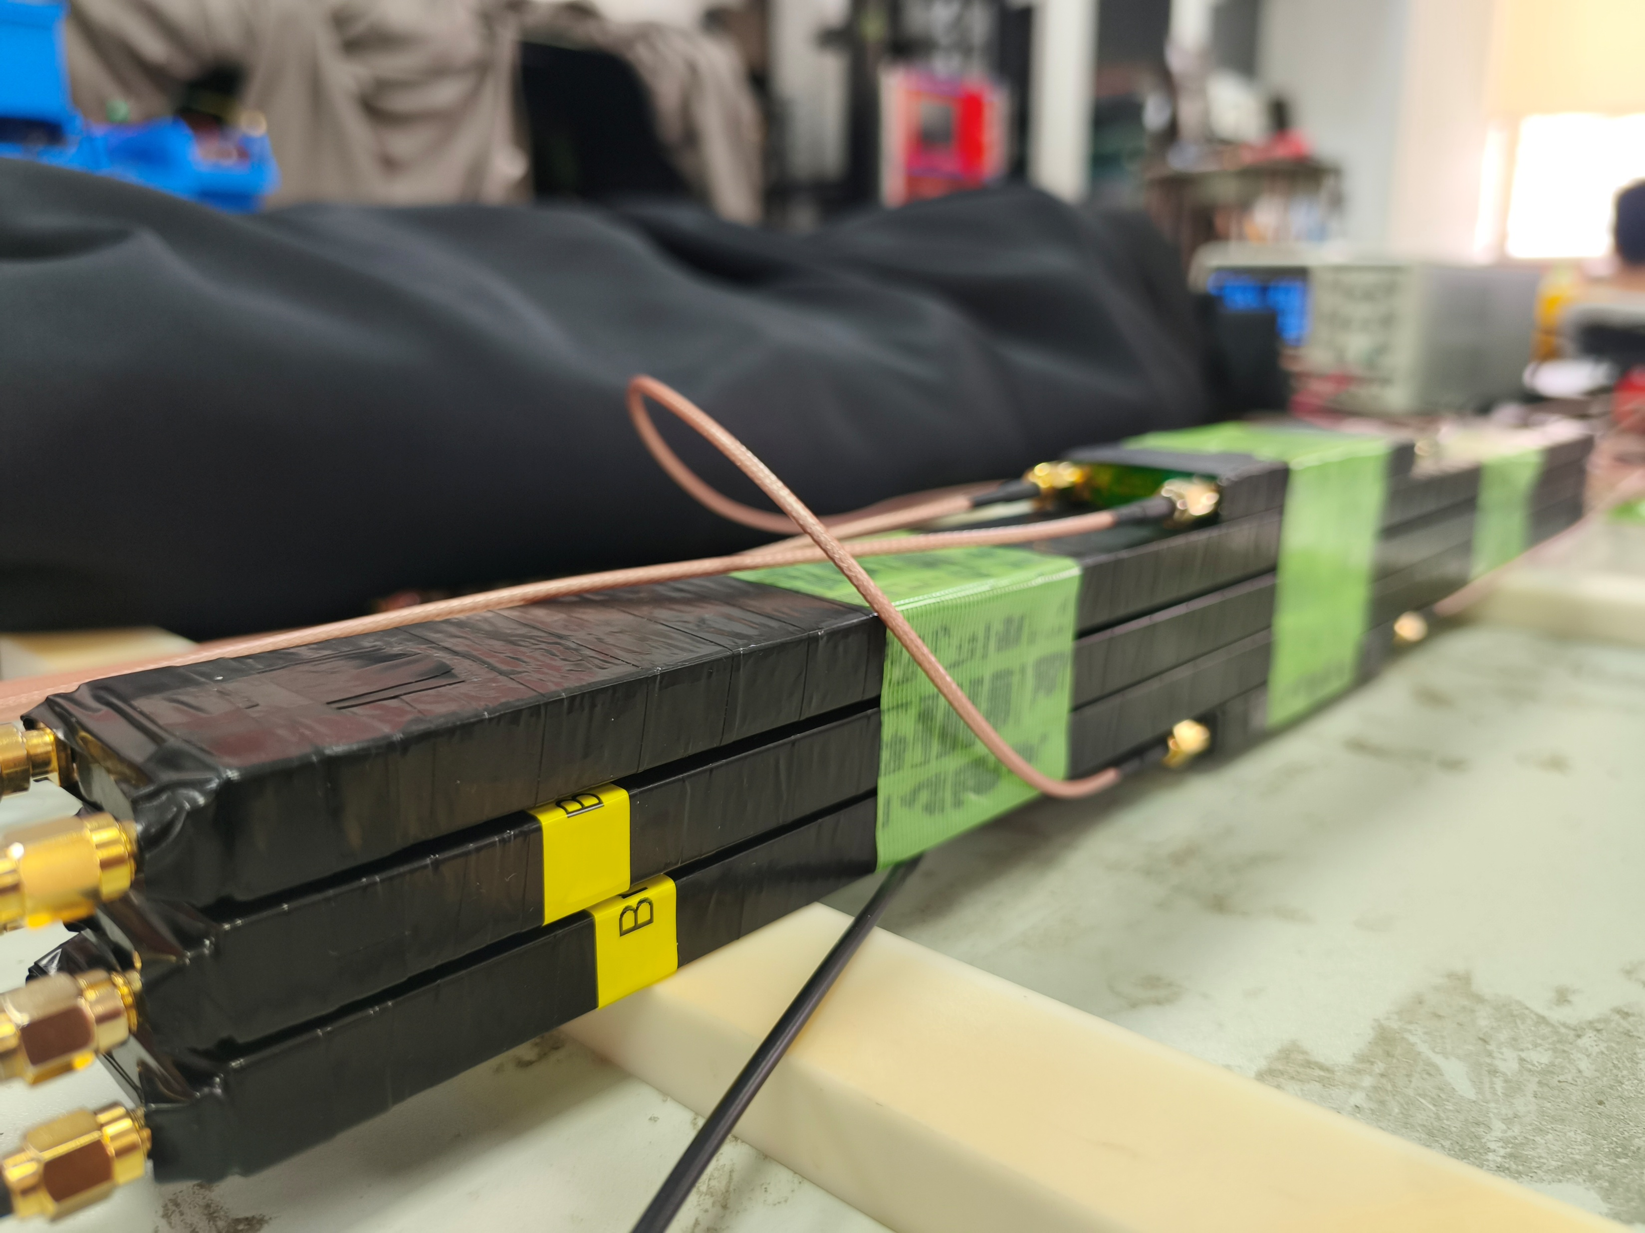
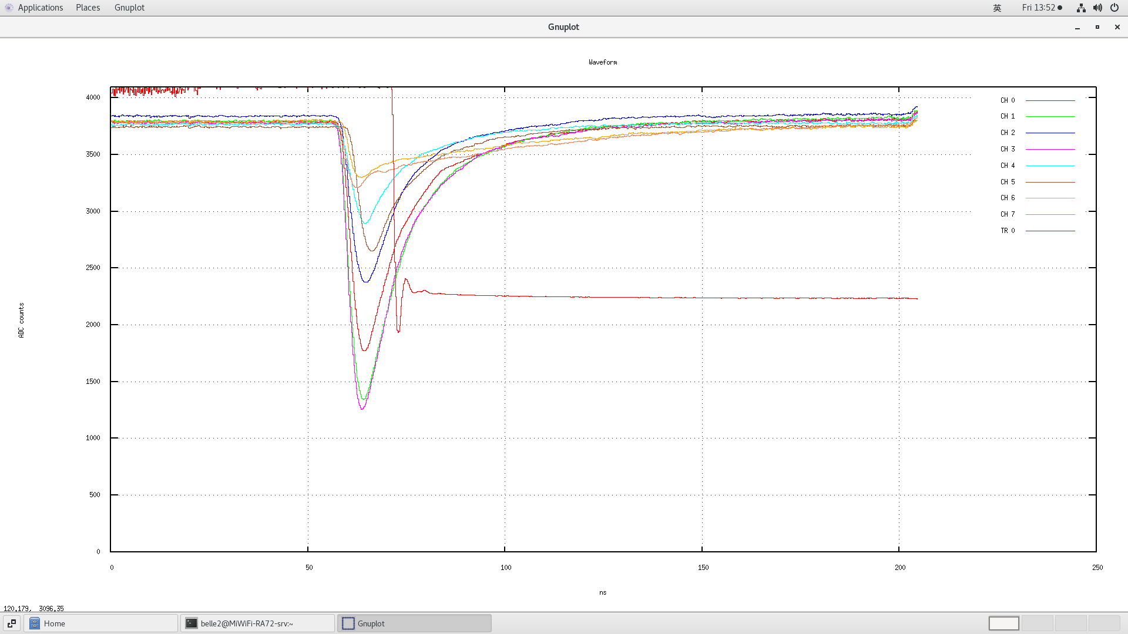
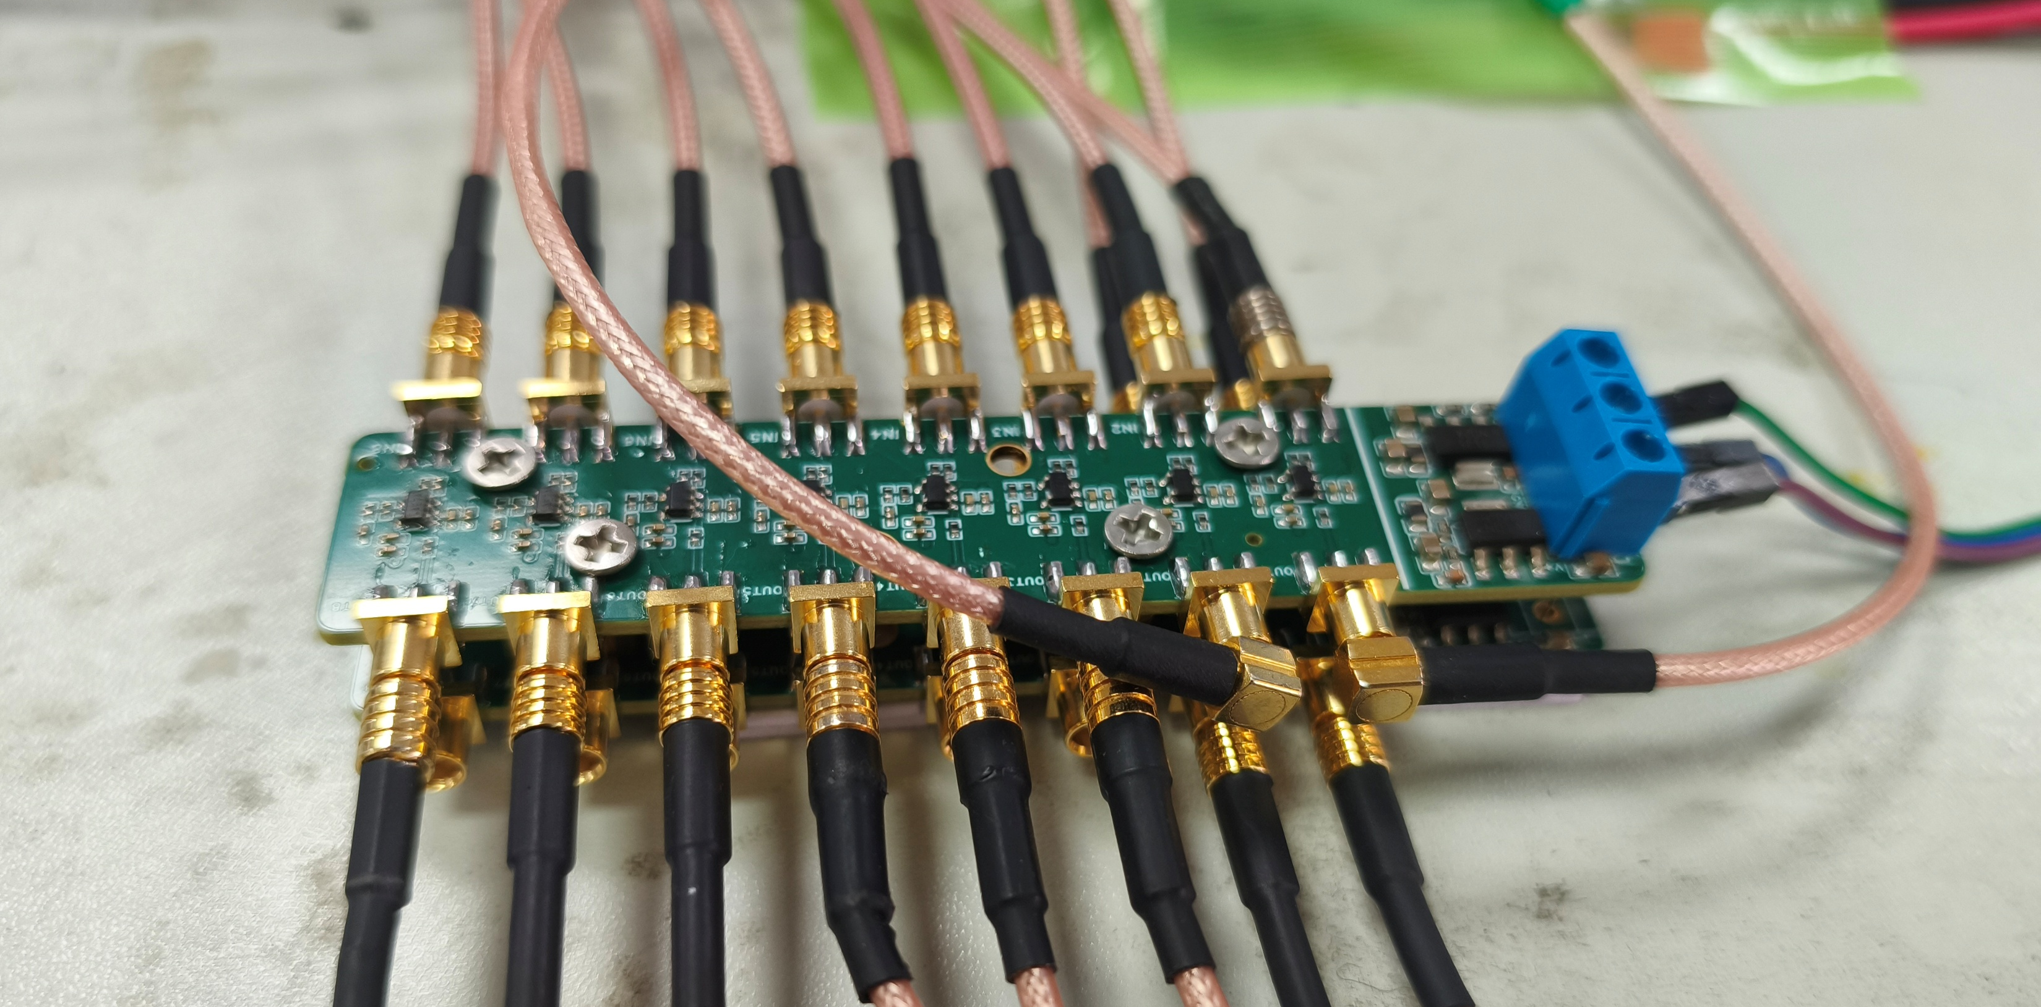
NDL_4S SIPM_ARRAY
Normal Readout
10 cm Triggers
Broken SiPM *1
Broken SiPM *2
New Amplifiers
Waveforms

Slide 4
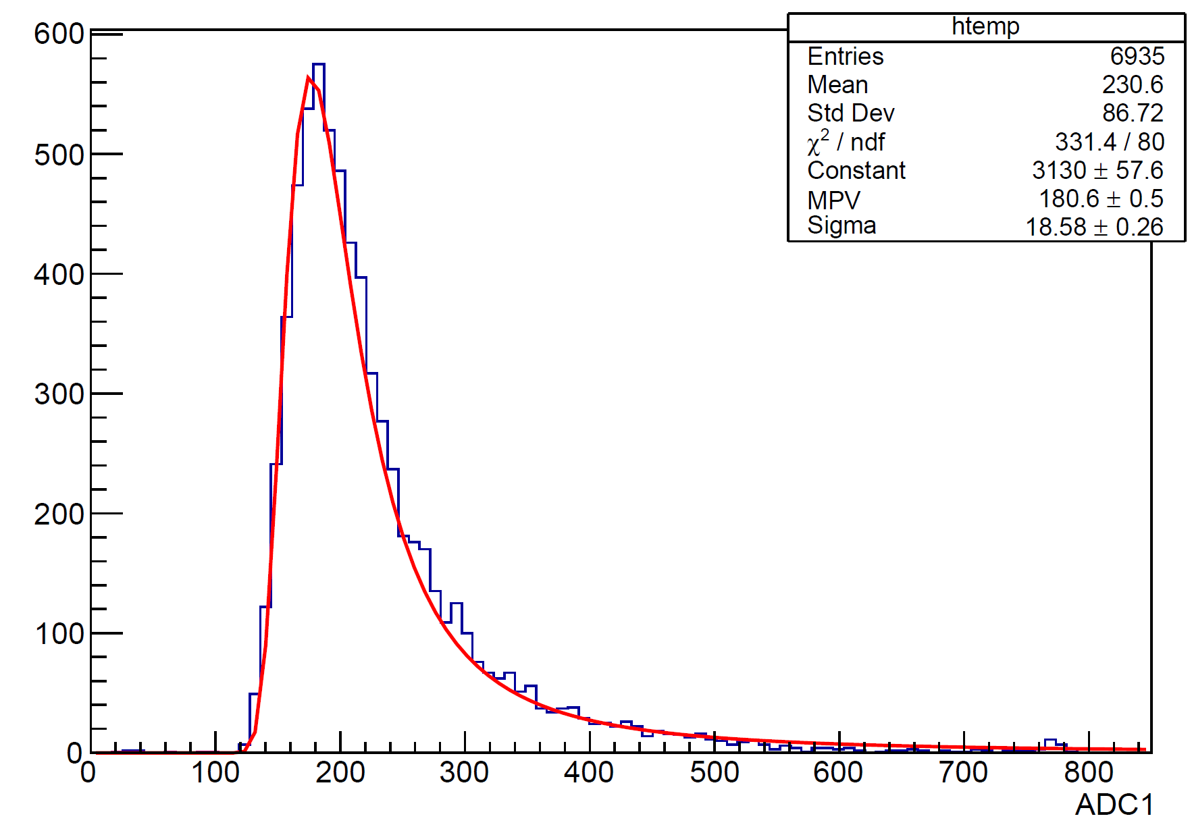
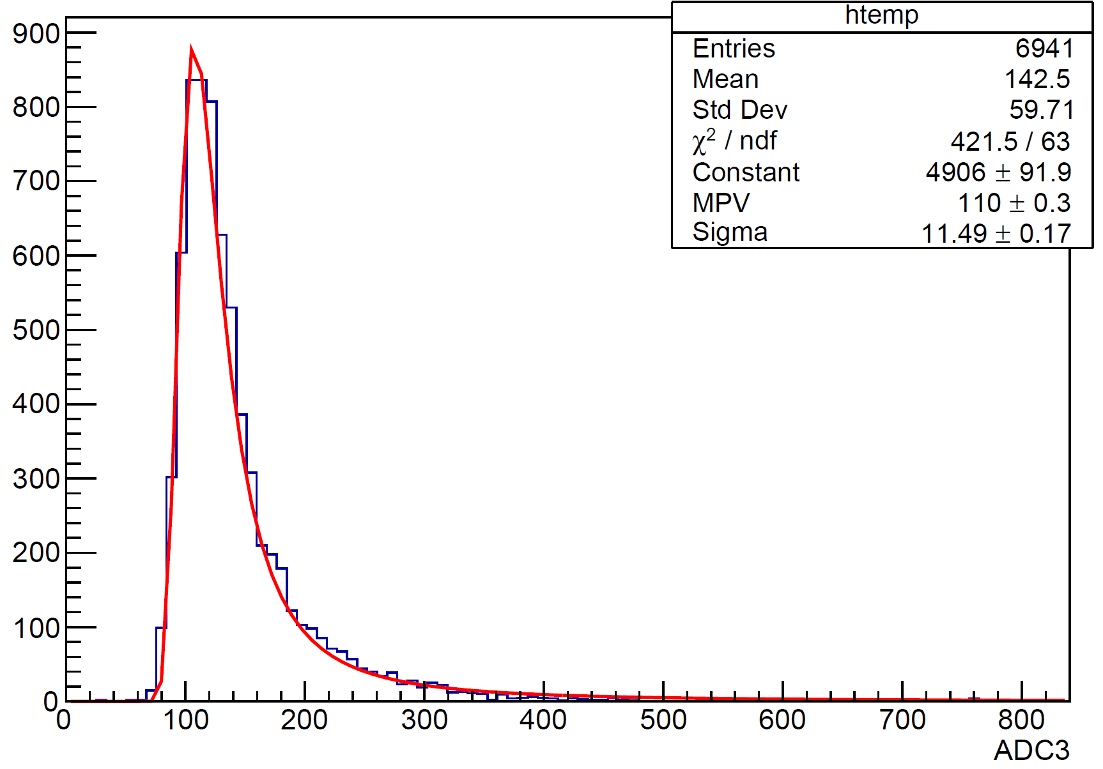
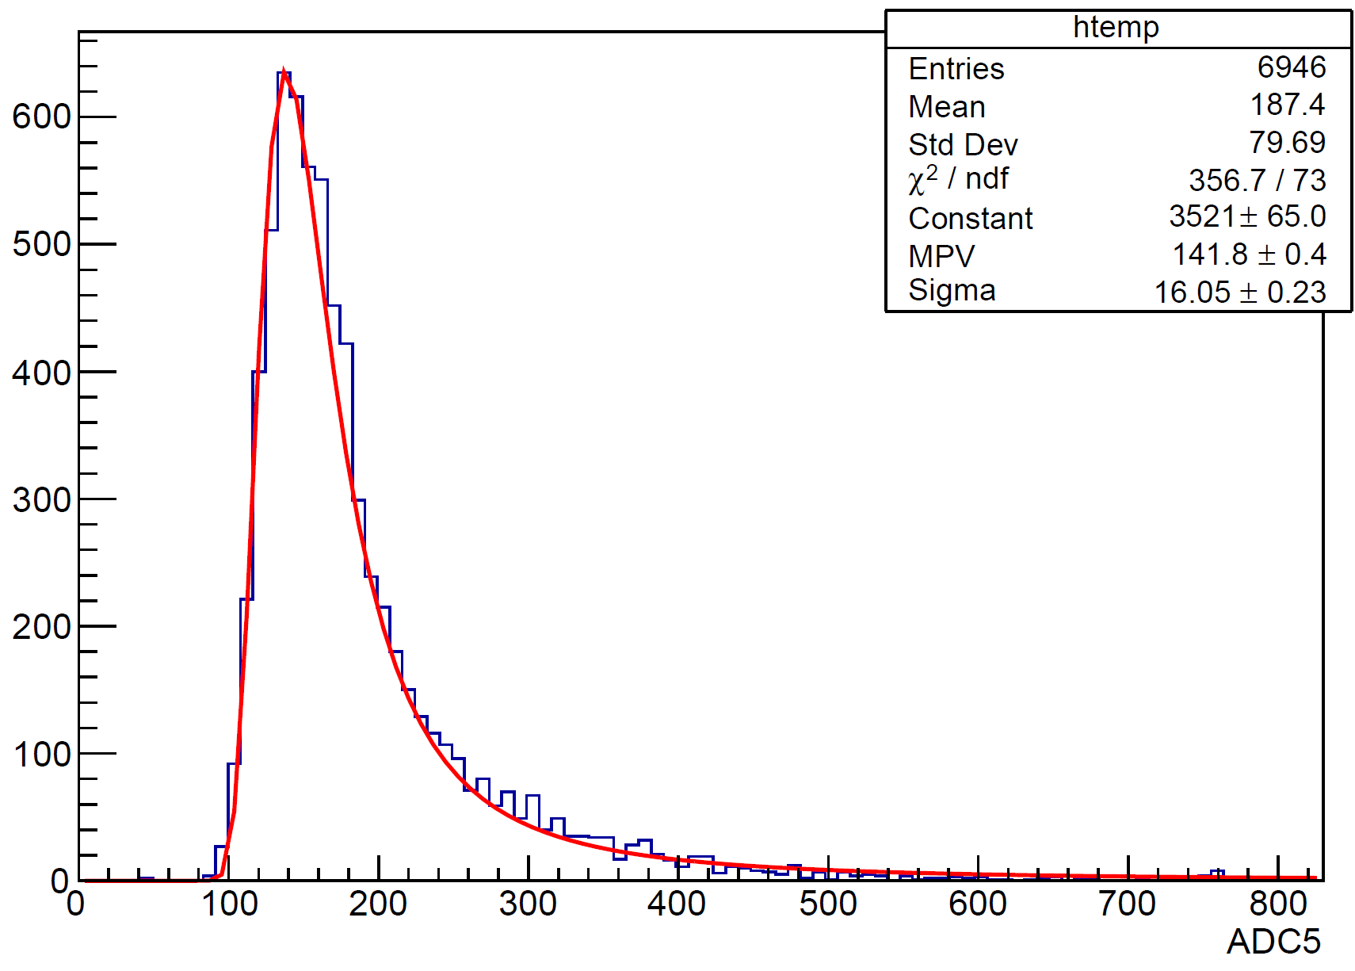
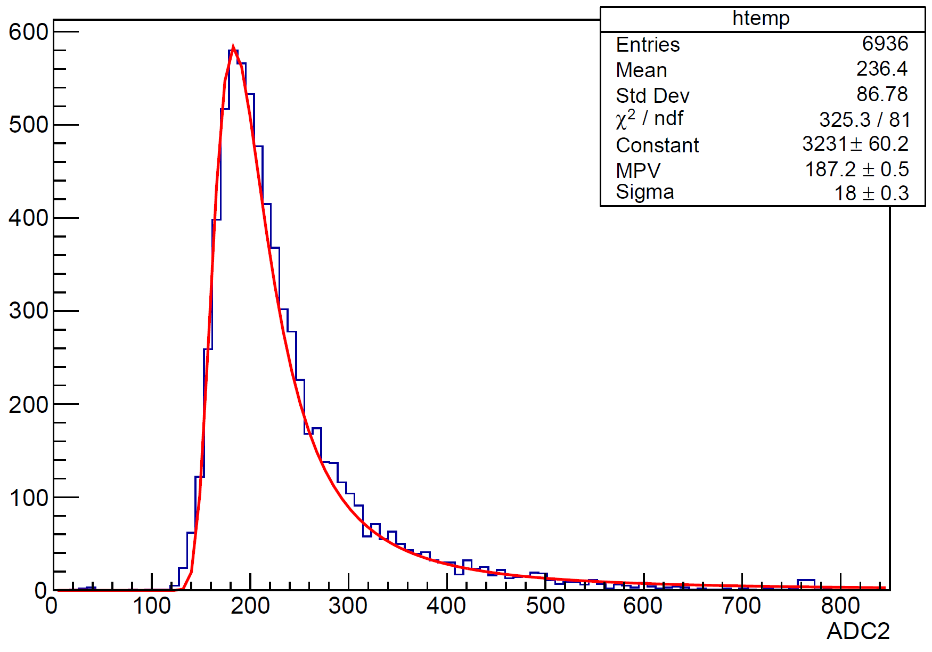
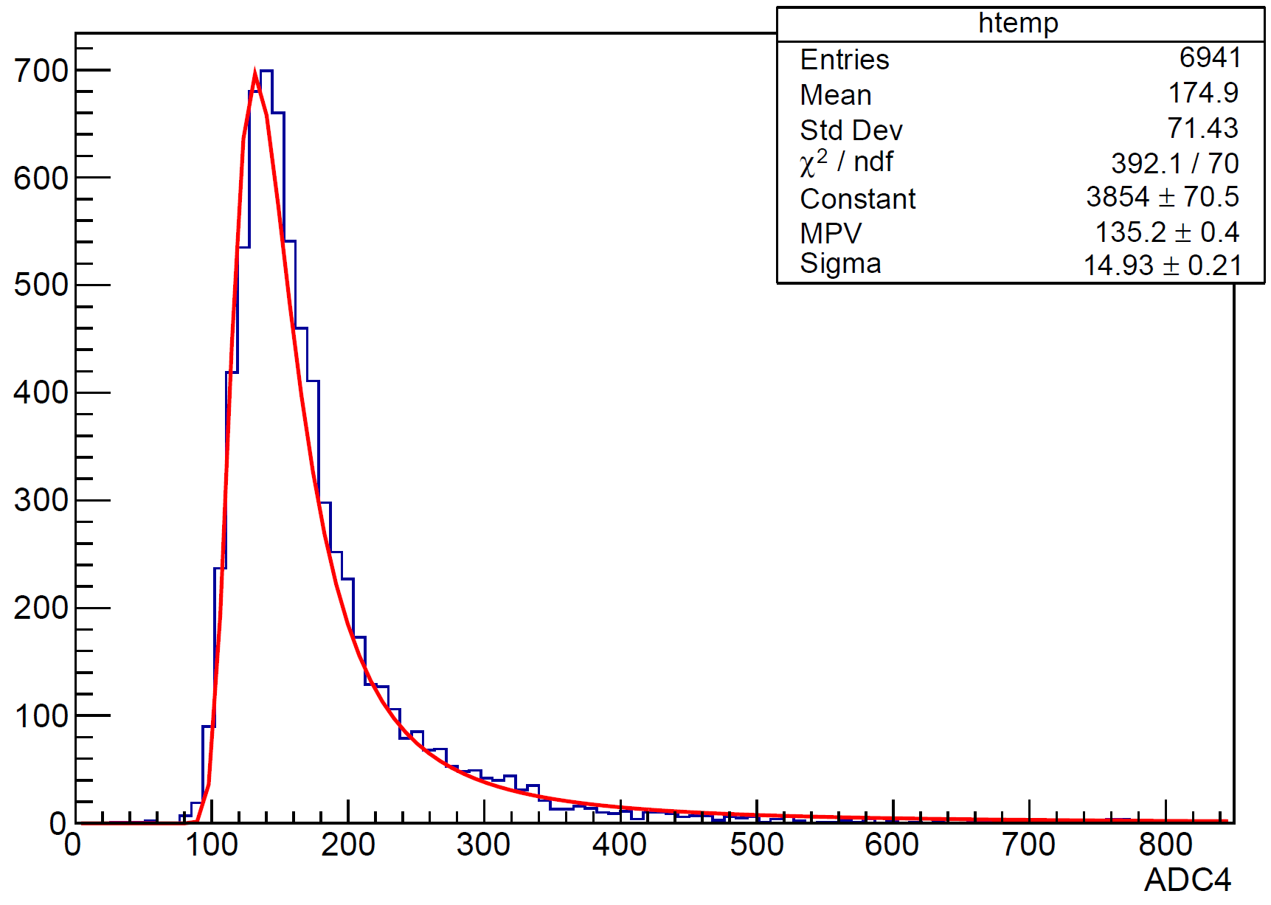
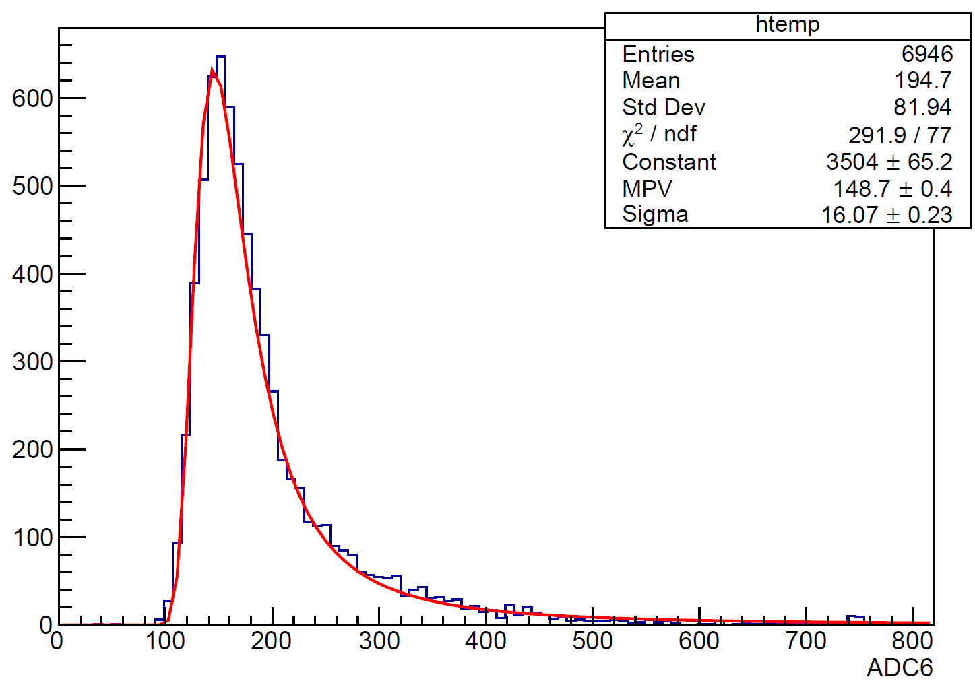
NDL_4S SIPM_ARRAY (Amplitude)
Normal Readouts (MPV~185 mV)
Broken SiPM*2
(MPV<136 mV)
Broken SiPM*1
(MPV~145 mV)

Slide 5
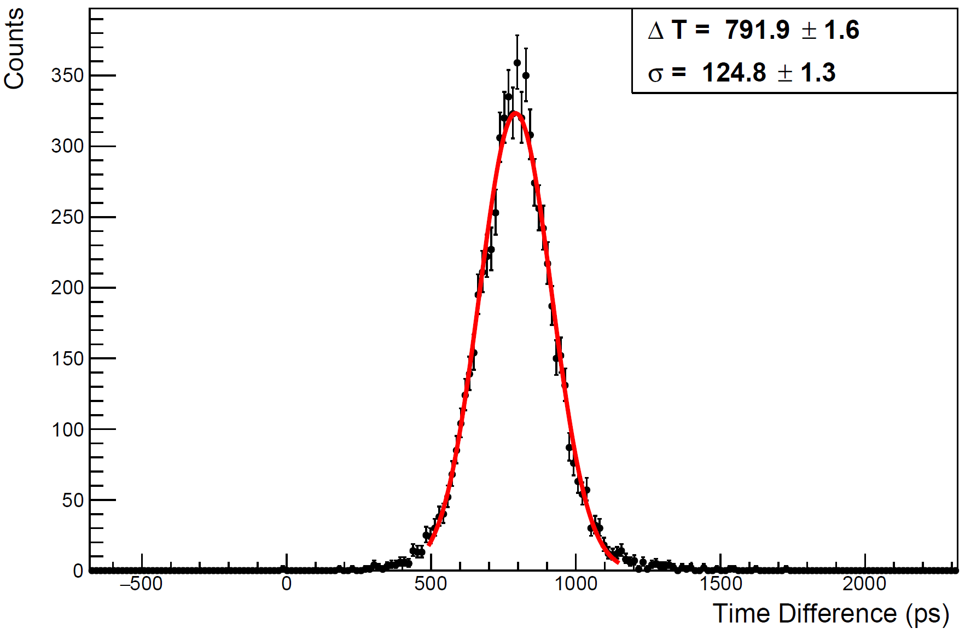
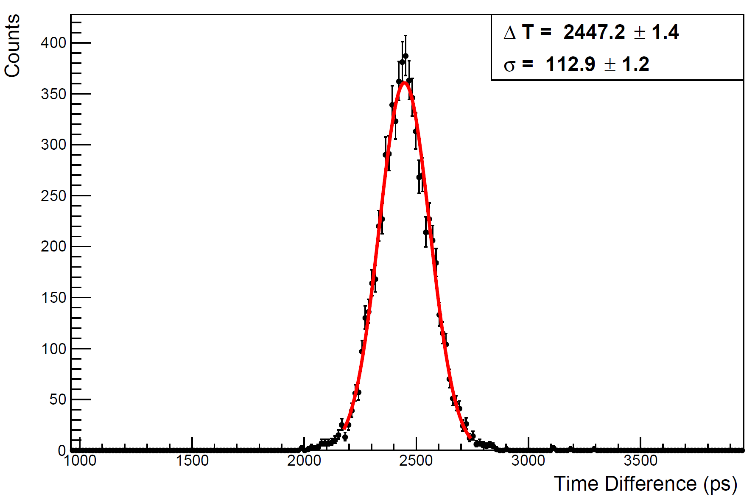
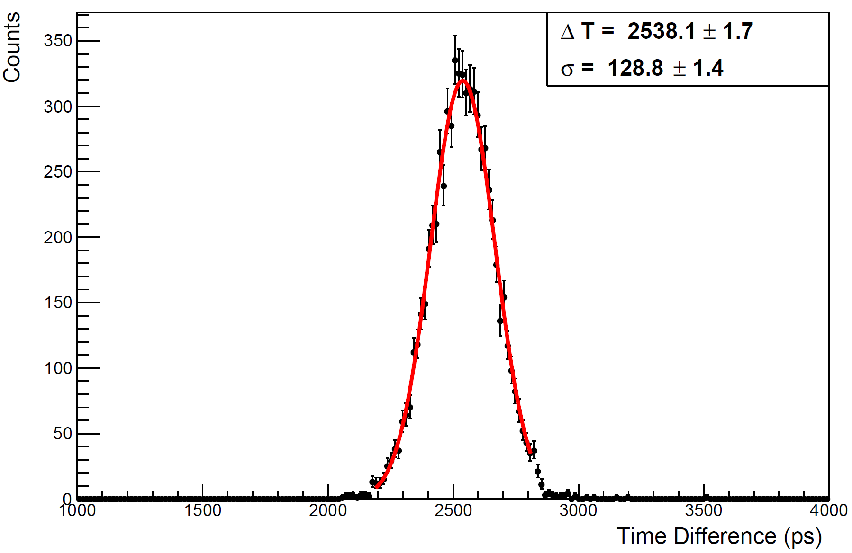
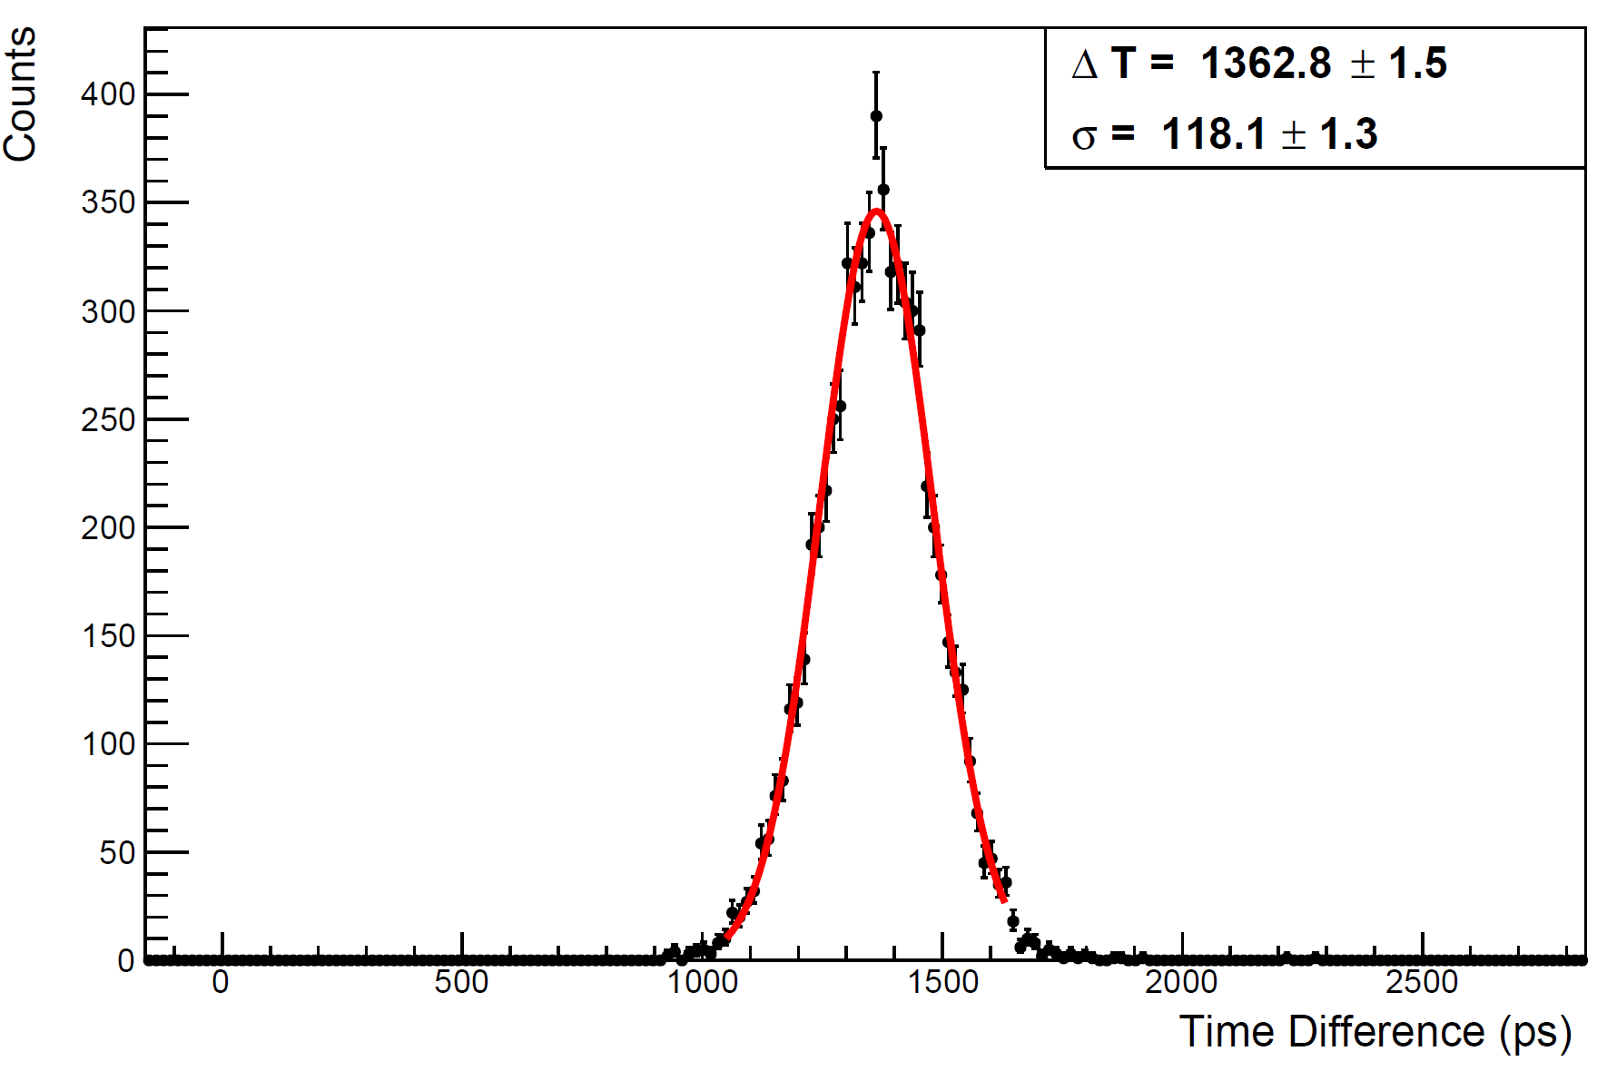


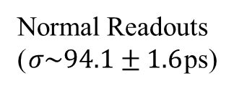
NDL_4S SIPM_ARRAY (Time Resolution)
TRG
Normal Readouts ($σ\sim 94.1±1.6$ps)
Broken SiPM*2
($σ\sim 112.2±1.6$ps)
Broken SiPM*1
($σ\sim 100.3±1.6$ps)

