Slide 1
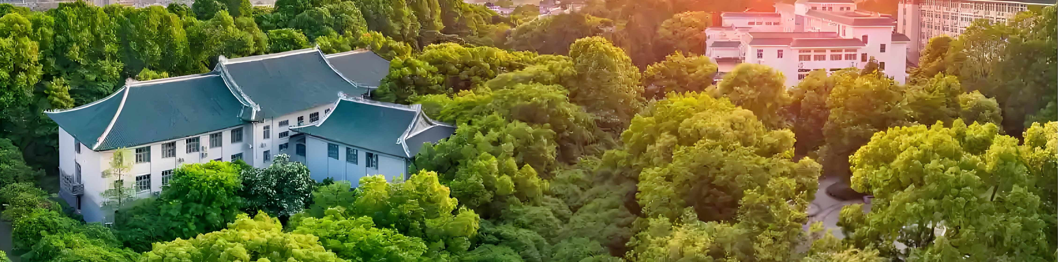

An Introduction to C3NT
Xin-Nian Wang
Central China Normal University

Slide 2

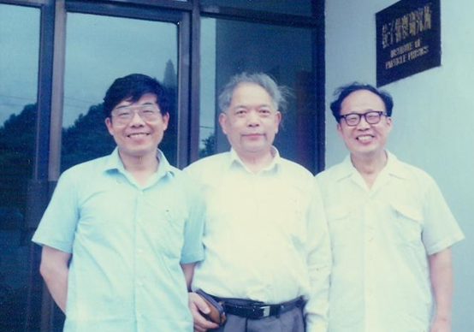
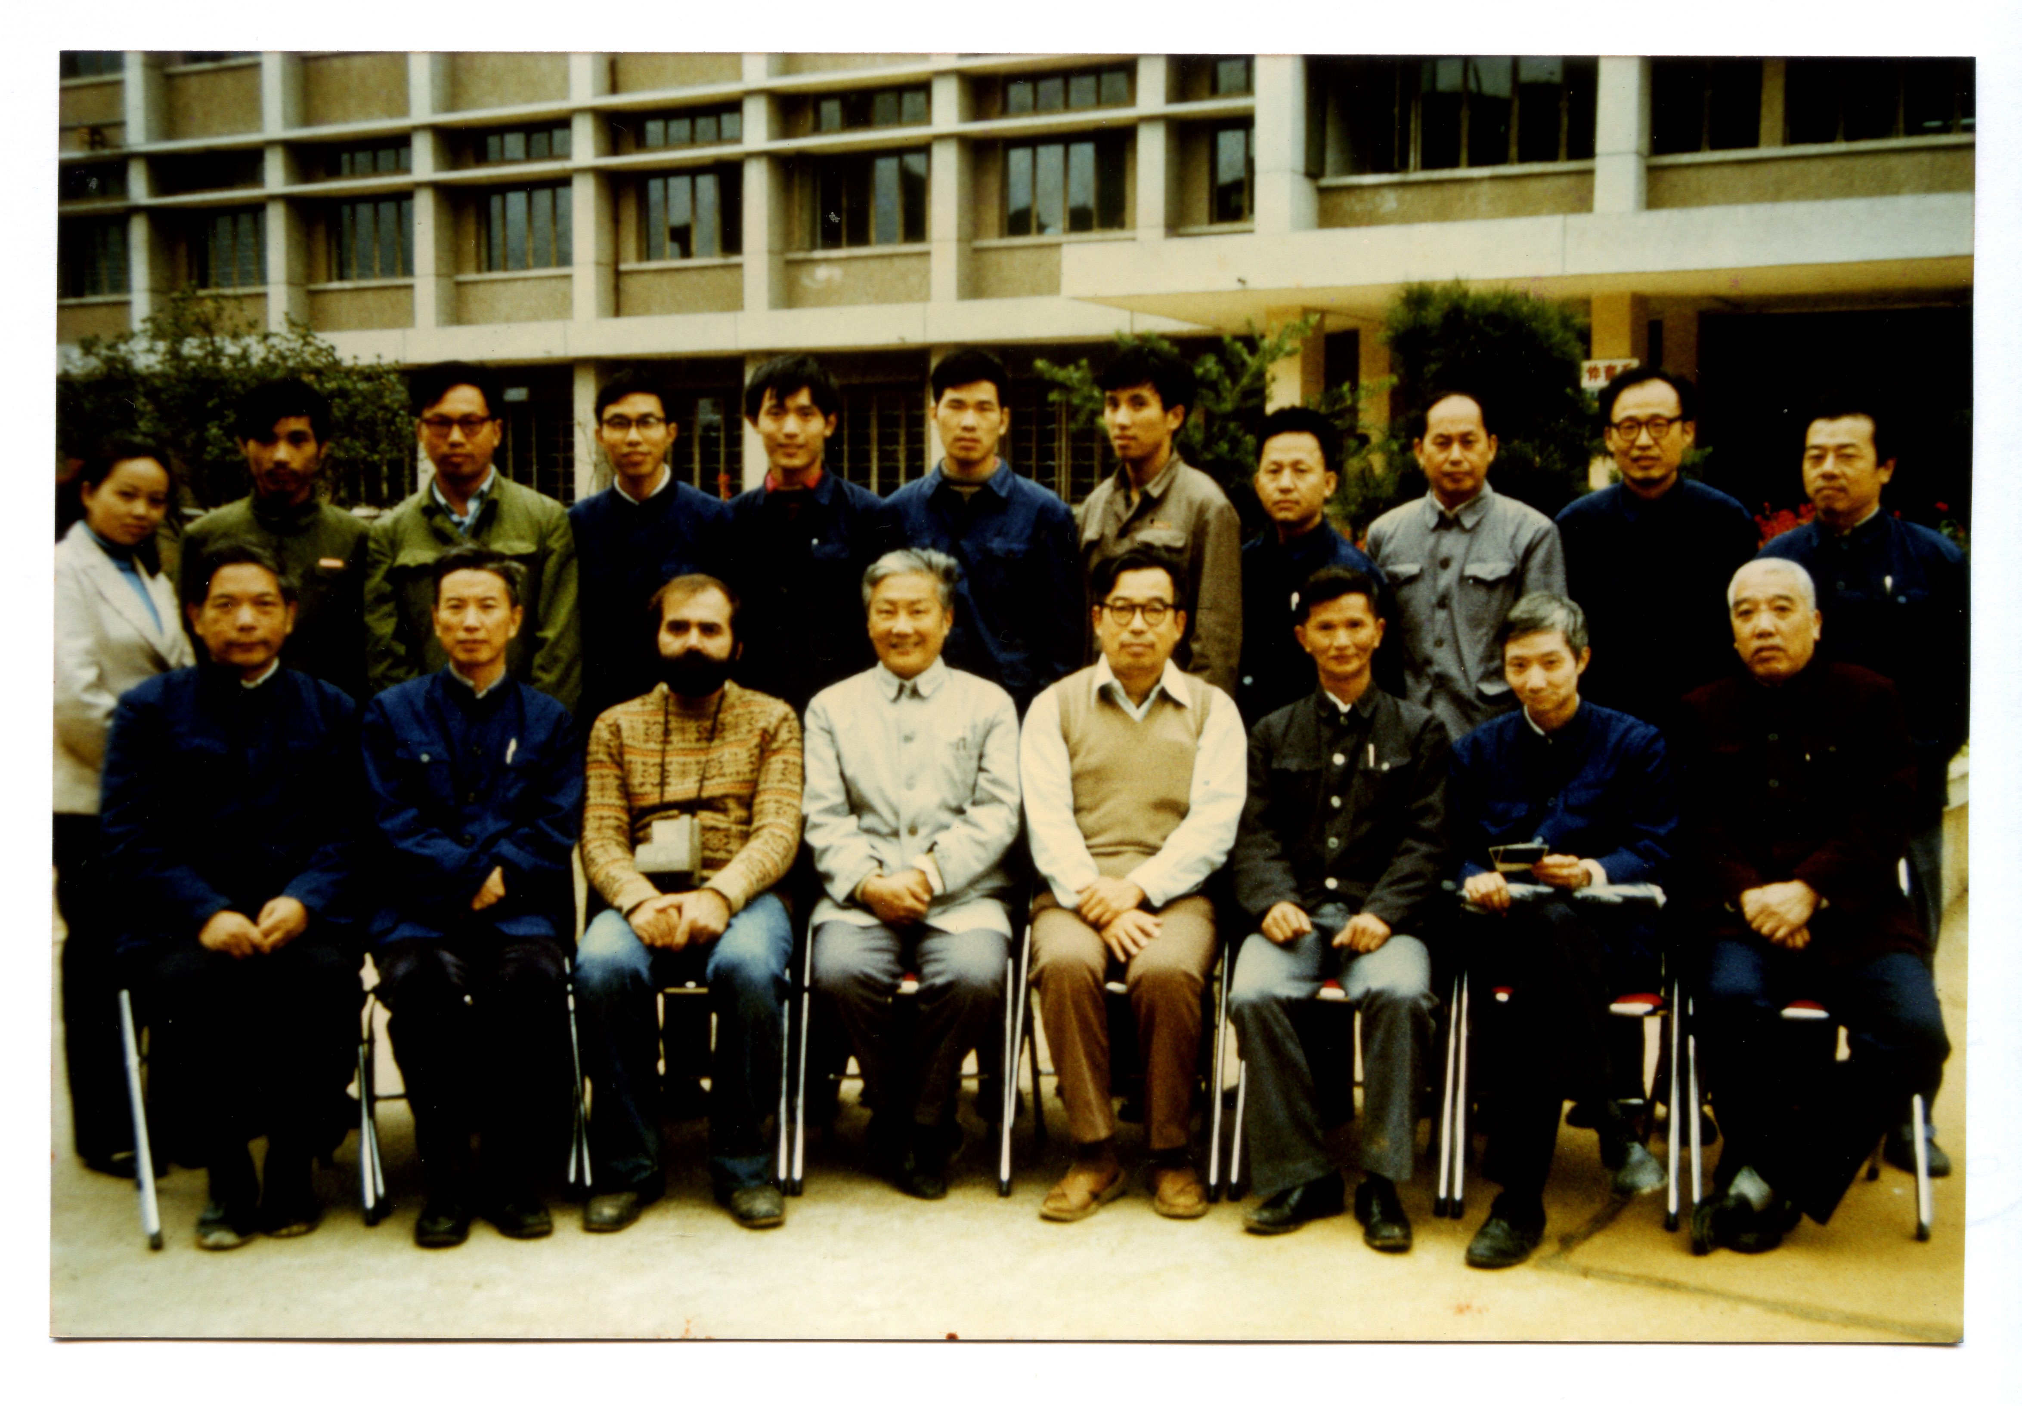
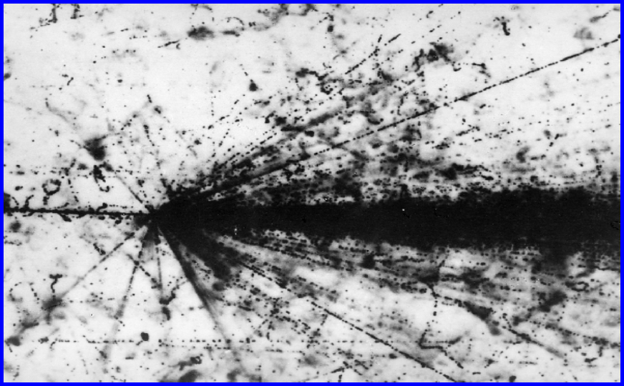
Institute of Particle Physics at CCNU
Established in 1977
X.Cai
J.R. Li
刘峰
李家荣
L.S. Liu
Early involvement in experiments: BNL/E815-E863、CERN/EMU01-EMU12，
CERN/SPS/NA22、CERN/SPS/NA49
刘连寿
L. McLerran
高崇寿
谢去病
Workshop on high-energy heavy-ion collisions, 1983, Wuhan
Notes:
IOPP established in 1977, shortly after the end of the culture revolution and the start of a new era in Chinese modernization
1983 workshop changed the research direction at IOPP,
Like any university research group in particle and nuclear physics, we started by joining the international community

Slide 3
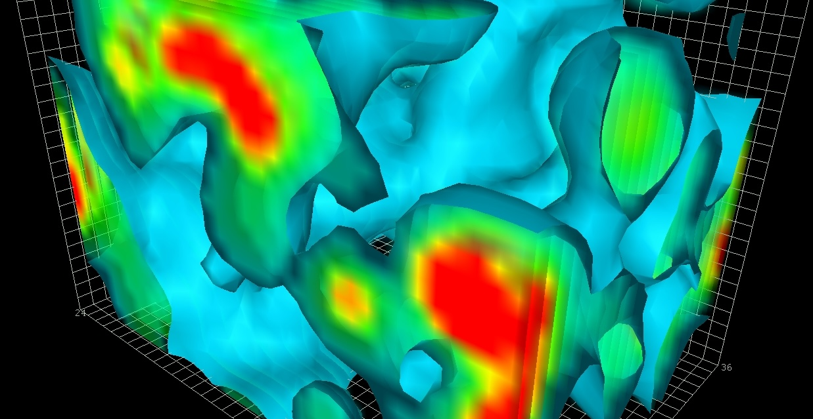
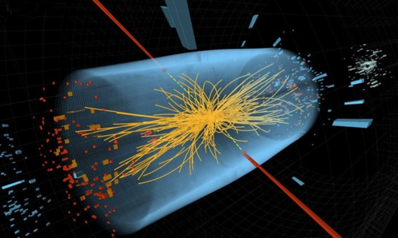
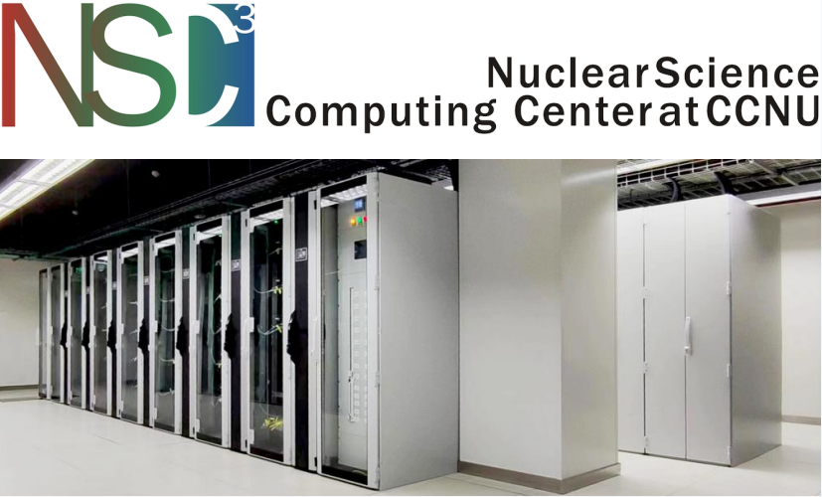
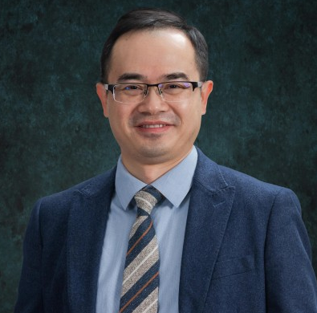
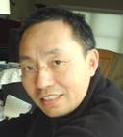

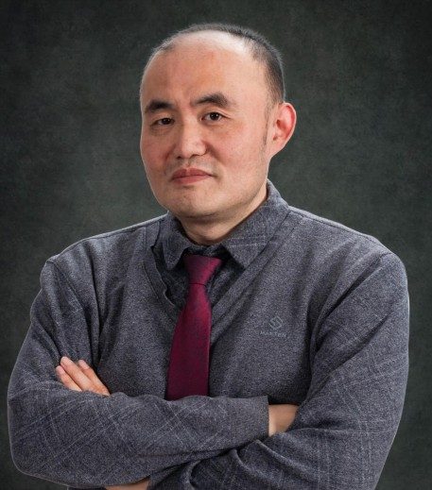
63 faculties & staff, ~150 PhD students, ~120 Master students
Key Laboratory of Quark and Lepton Physics (MOE)
International Center for Quark Matter and Detector Technology
Nu Xu
Hengtong Ding
Xiangming Sun
Notes:
Forward 48 years today, the institute has grown into one of the biggest particle and nuclear physics group in a university
The institute is now the host to ….

Slide 4
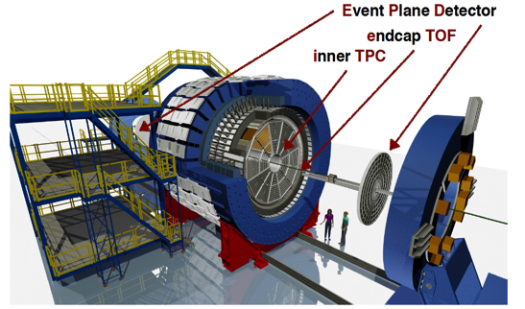
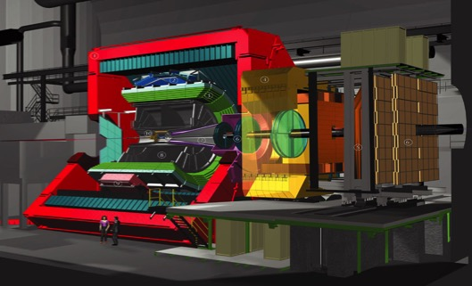
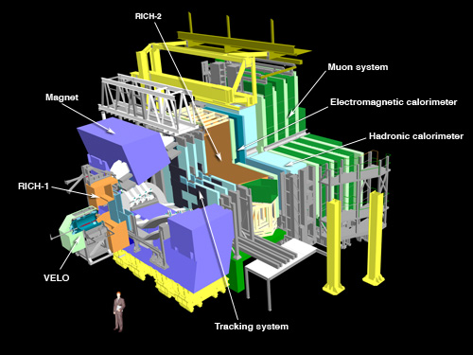
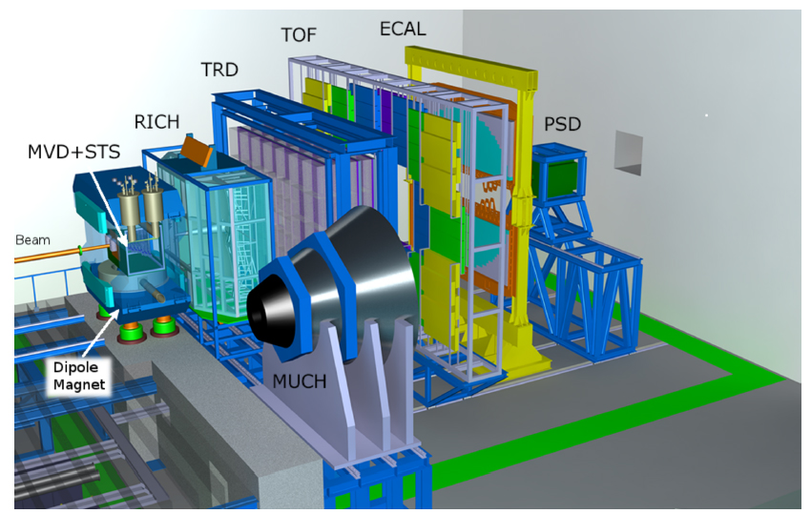




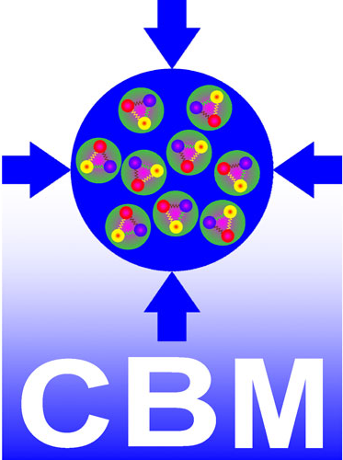
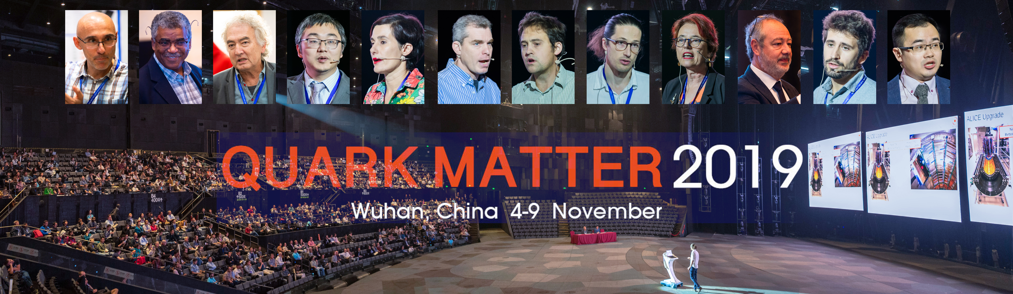
Part of the international community
Notes:
We have done all of these through internation collaboration
Our international collaboration culminated in a climax in 2019 at the memeroable quark matter 2019
Then came the pandemic

Slide 5
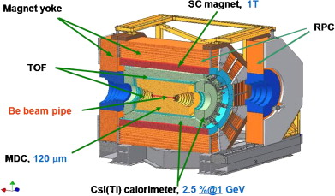

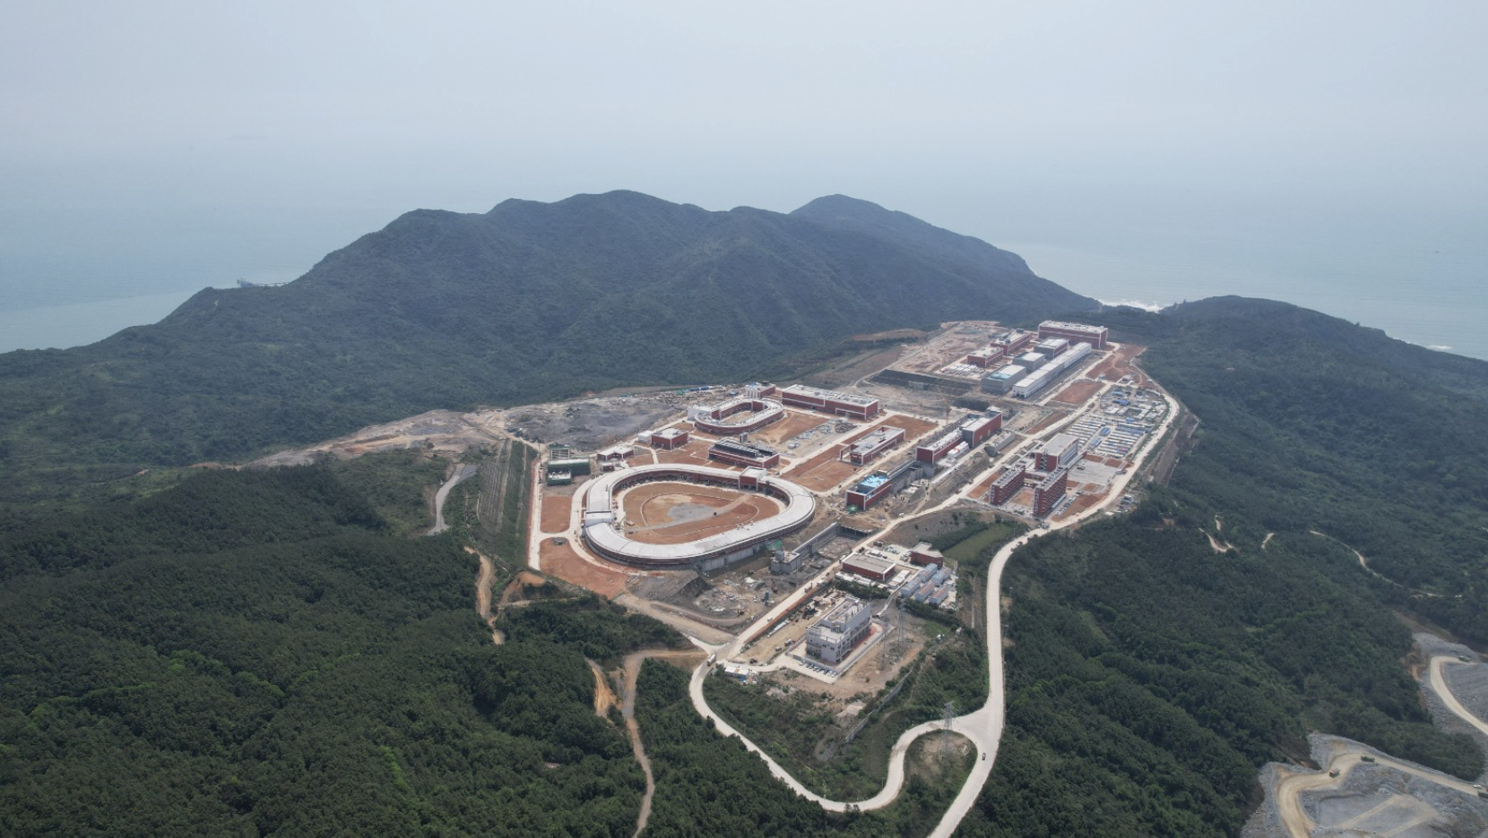
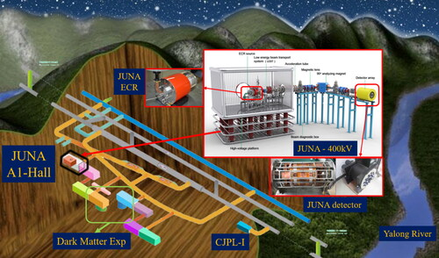
Advances in nuclear physics in China
The world needs to know and engage China to benefit Science
HIAF=High Intensity heavy-ion Accelerator Facility
JUNA=Jinping Underground Nuclear Astrophysics experiment
Notes:
A lot things has happened in the last five years,

Slide 6

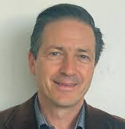
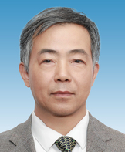
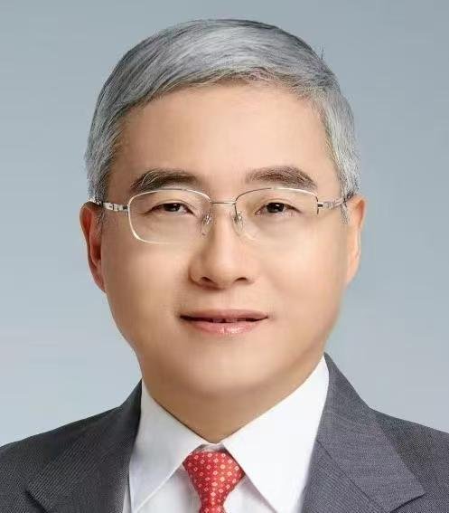
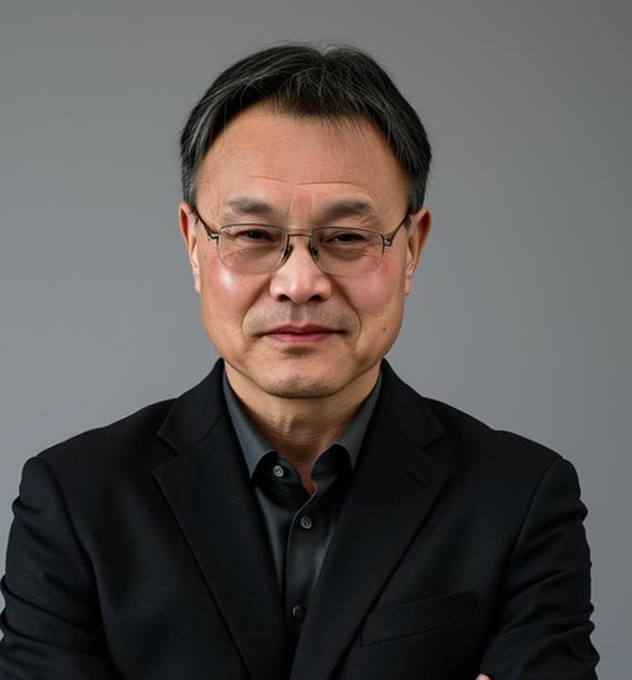
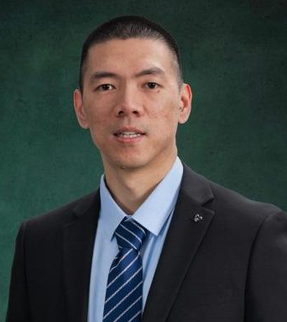
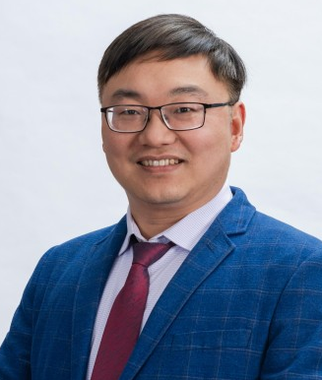
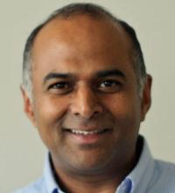
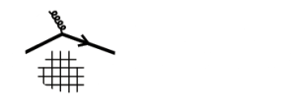

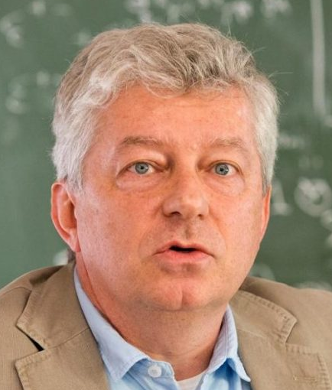
Board of Directors
(Chair: Urs Wiedemann)
Scientific Advisory Committee
(Chairs: Yugang Ma, Qun Wang)
Regional Committee
Director: Xin-Nian Wang
Deputy Directors: Weiyao Ke,
Longgang Pang
Sanjay Reddy
Ubirajara van Kolck
Notes:
This is why we want to establish C3NT

Slide 7
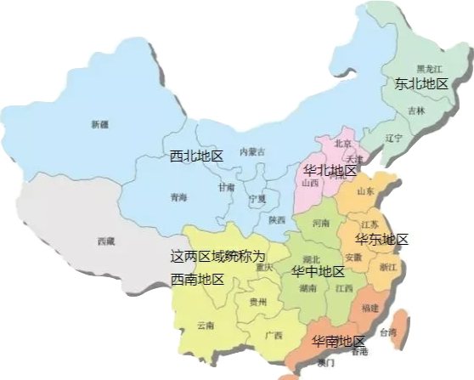
Nuclear Physics Groups in Central China
Univ of Science and Technology of China
Anhui University
Anhui Univ of Science and Technology
Zhengzhou University
Henan Univ of Technology
Central China Normal Univ
Huazhong Univ of Science and Technology
China Univ of Geosciences, Wuhan
Hunan Normal University
Univ of South China
Hunan University
Central South University
…..
5 hrs
Notes:
Wuhan is geologically center of China, with networks of rivers, railroads run through the city and connect to the rest of China and the world

Slide 8
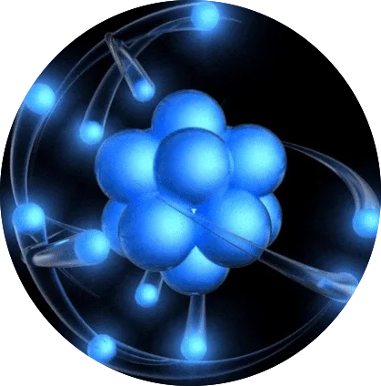
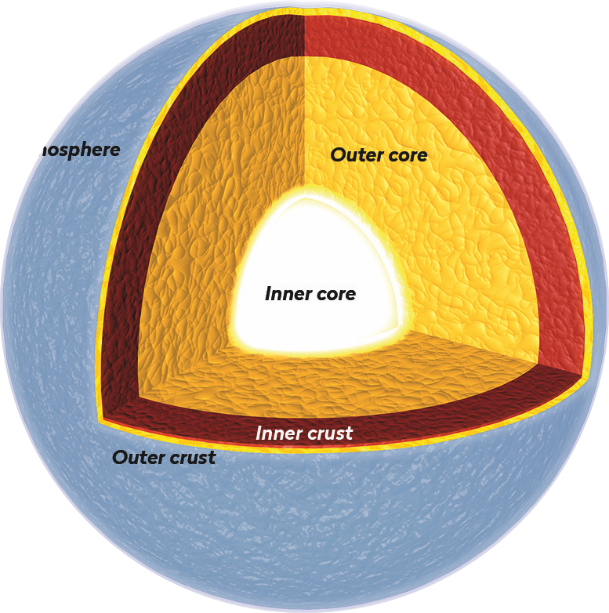
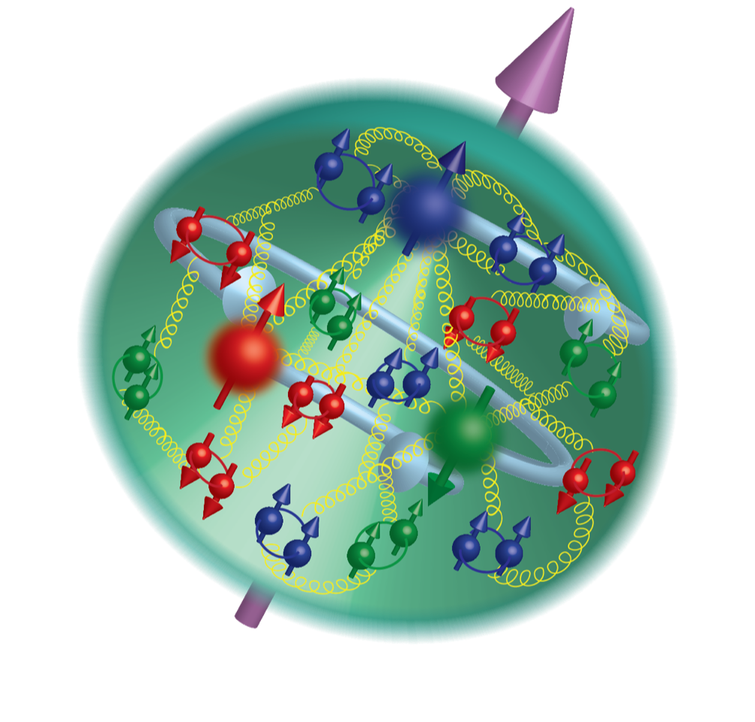
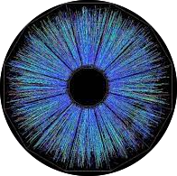
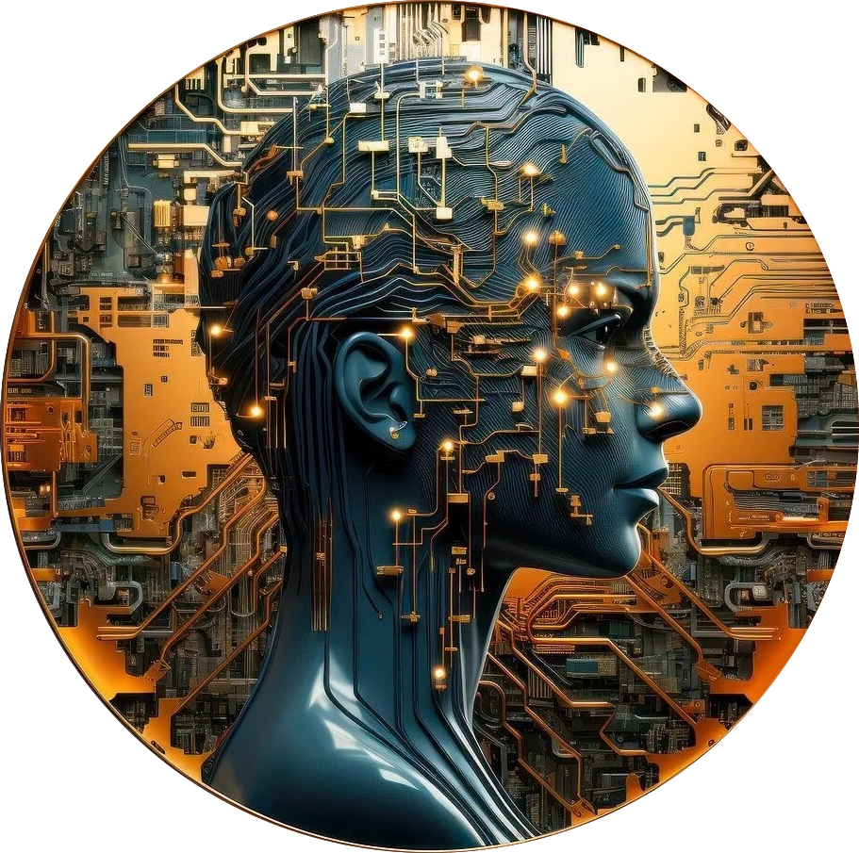
C3NT: Missions & Programs
Nuclear structure
Nuclear matter under extreme conditions
Hadron physics
Nuclear astrophysics and fundamental symmetry
Quantum computing and AI in nuclear physics
Provide an open environment that is conducive to cutting-edge research and collaboration at the forefront of nuclear theory and phenomenology with close contact with experiments.
Long workshops
Collaboration
Short workshops
Info exchange
Regional meetings
Networking
Huada QCD Schools
Training

Slide 9
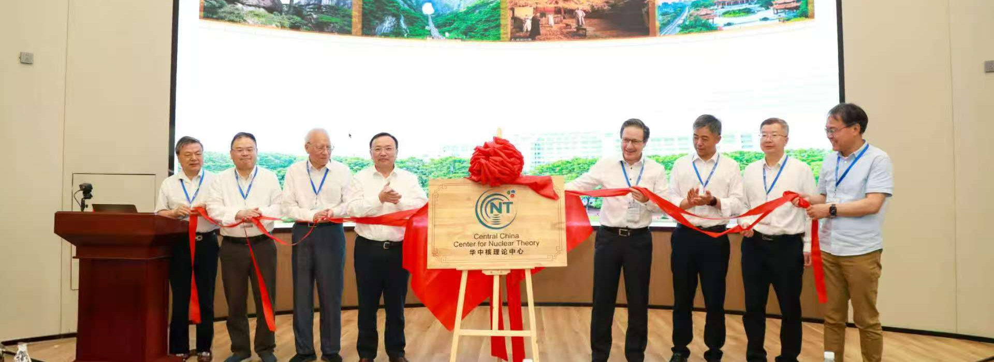
Inaugural Symposium of C3NT, May 17-18,2-25

Slide 10
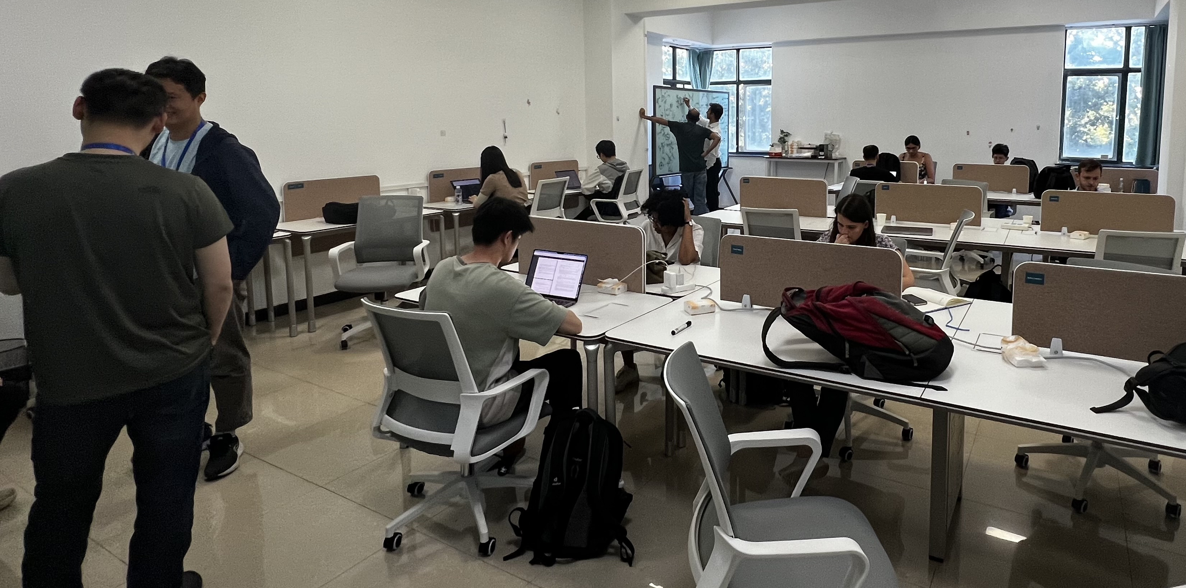
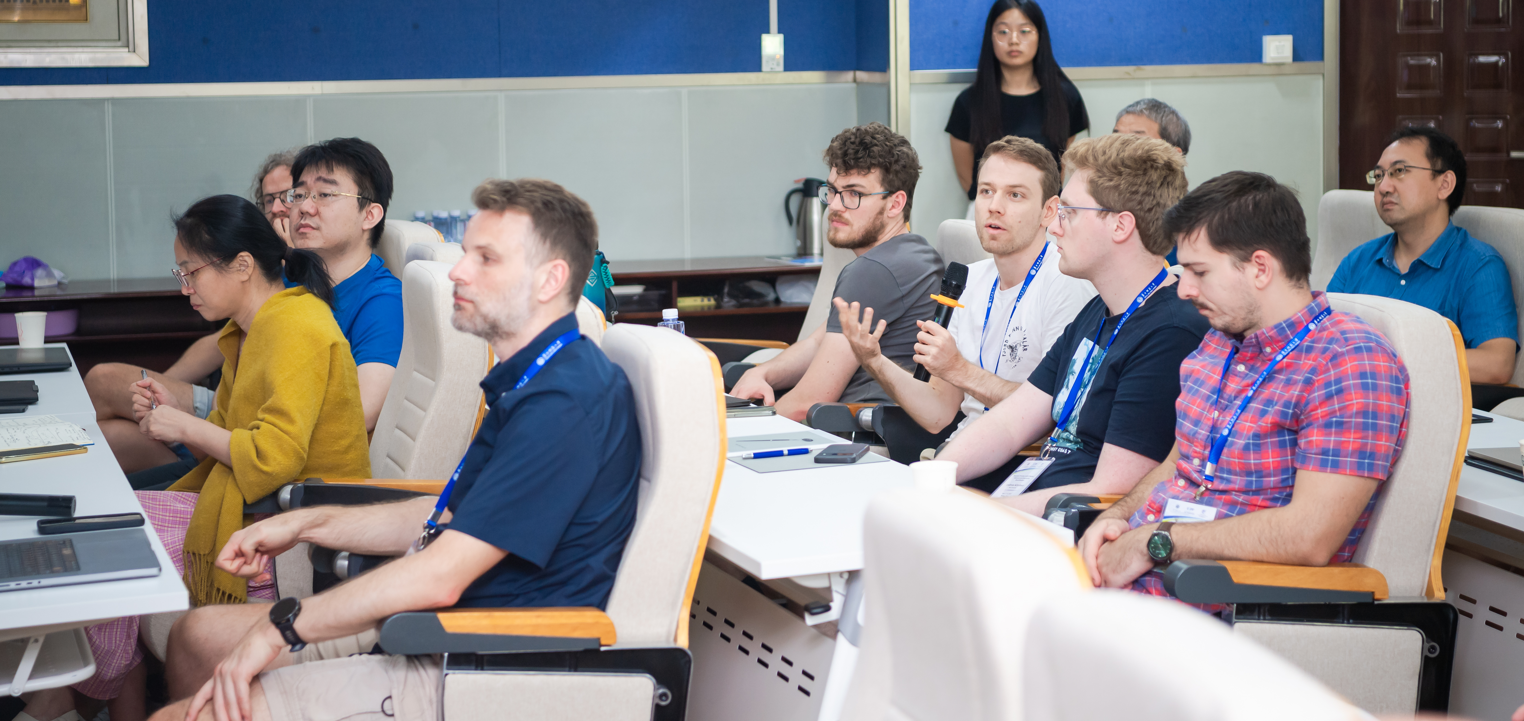
Timeline of C3NT programs during May 2025 – April 2026
New opportunities in particle
and nuclear physics with
energy correlators
13th Huada QCD
School on QCD out
of equilibrium
Workshop on Nuclear physics
across energy scales
2025
May 17-18
September 1-12
May 6-17
August 25-29
September 19-21
Inaugural Symposium on
Frontiers of Nuclear Theory
Precision Frontiers of QCD
Matter: Inference and uncertainty
quantification
1st workshop on Jet and
Heavy Quark Physics (JAQ2026)
Jet-Soft Dynamical Interaction in
High-energy heavy-ion collisions
CEP & EFT
January 6-17
June 15 -19
Sept 20-24
November 22– Dember 5
2026
January 6-17
March 22-April 4
October 19 - 22
Workshop on Global
Constraints of QGP properties
QIS - HENP
14th Huada QCD School on
Spin and polarization in QCD
Frontiers of ab initio
Nuclear Theory

Slide 11
Programs in 2026-2027
Long1: Connecting Theory to Collider Data in the Era of Precision Saturation Physics （2027.1.18-29)
Long2: Nuclear Physics under Extreme Cosmic Conditions (April, May/June, Sept/Oct, 2027)
Long3: Strangeness across Scales: linking QCD, dense matter and fundamental symmetries. (no preferred dates)
Short 1: QCD CEP and EFT (2026.10.19-22)
Short 2: AI for Nuclear Modeling: from ab initio to DFT (2027.11-5-8)
Short 3: Artificial intelligence in nuclear and high-energy physics (2027.9.13-17 or 20-24)

Slide 12
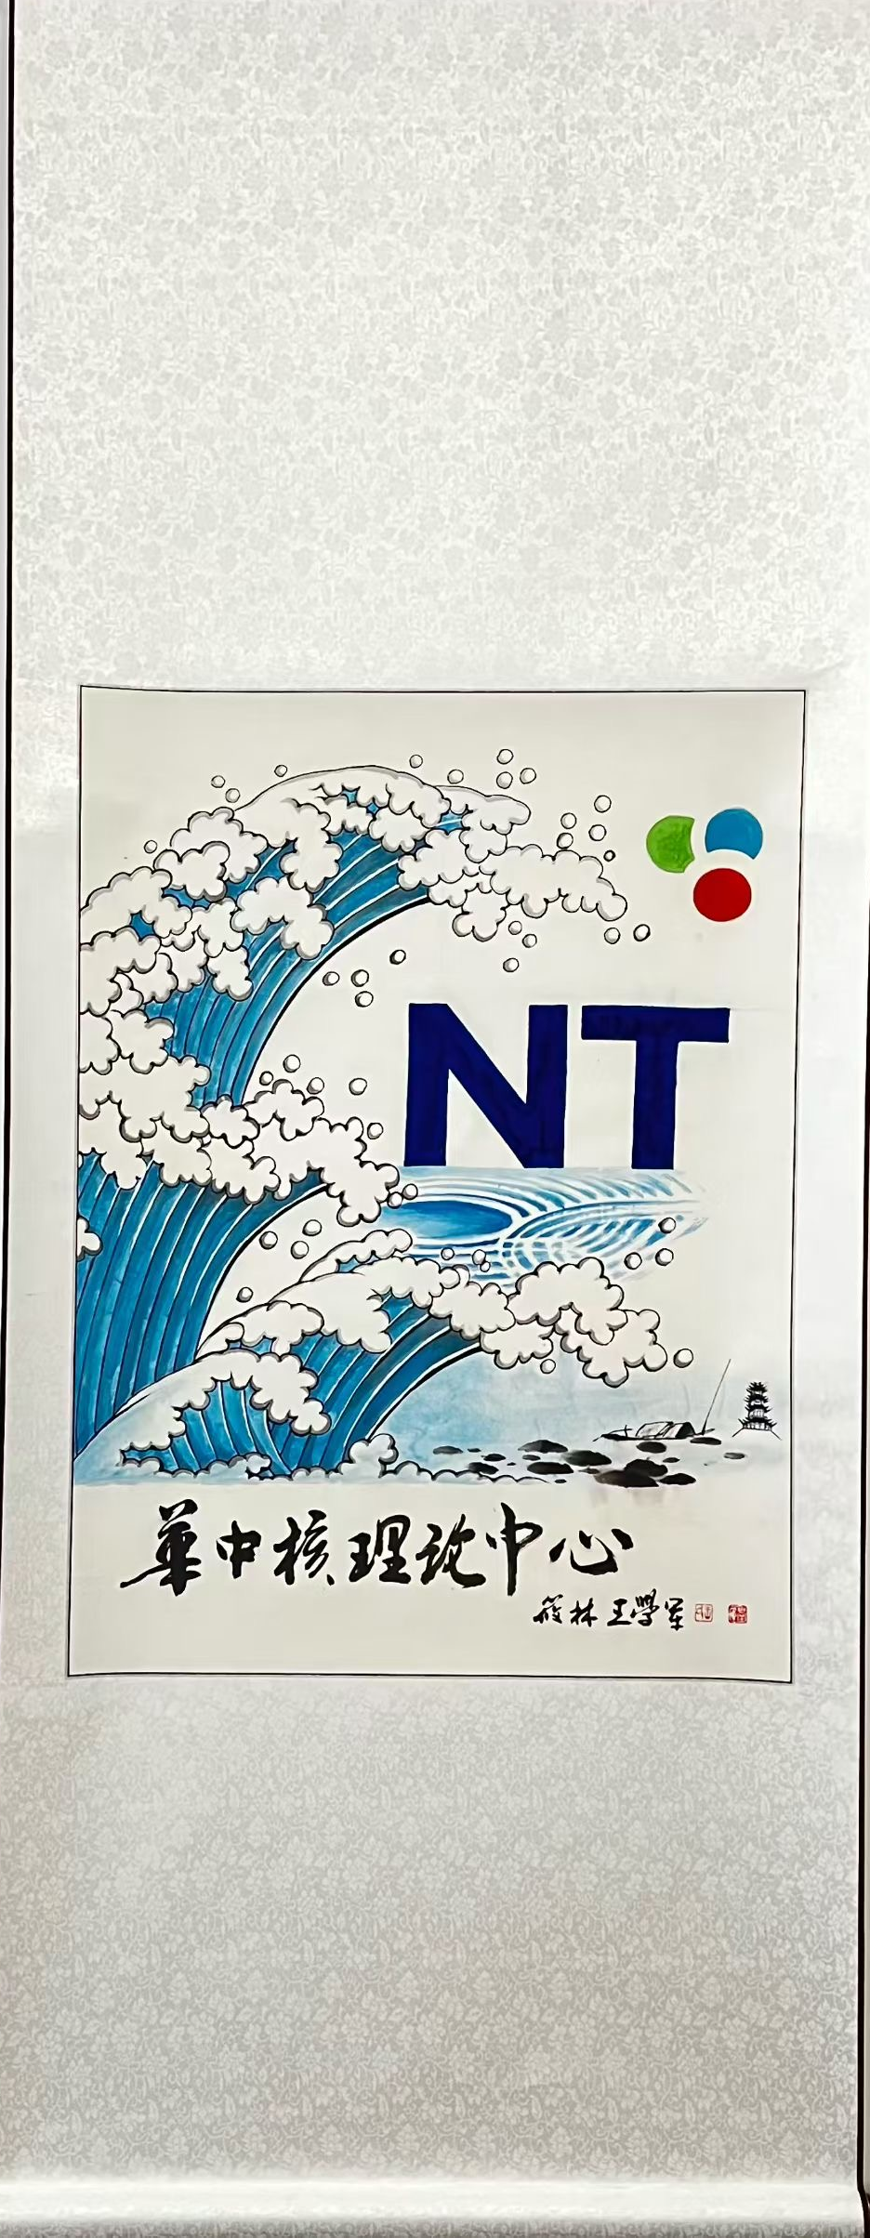
Welcome to C3NT @CCNU

