Slide 1









Probing Confinement with Superconducting Circuits:
From Z₂ String Dynamics to Continuous U(1) Electrodynamics
Enrique Rico Ortega
Mon. June 15, 13:30 — 14:05
based on arXiv:2507.08088 and arXiv:2601.23150

Slide 2









Slide 3
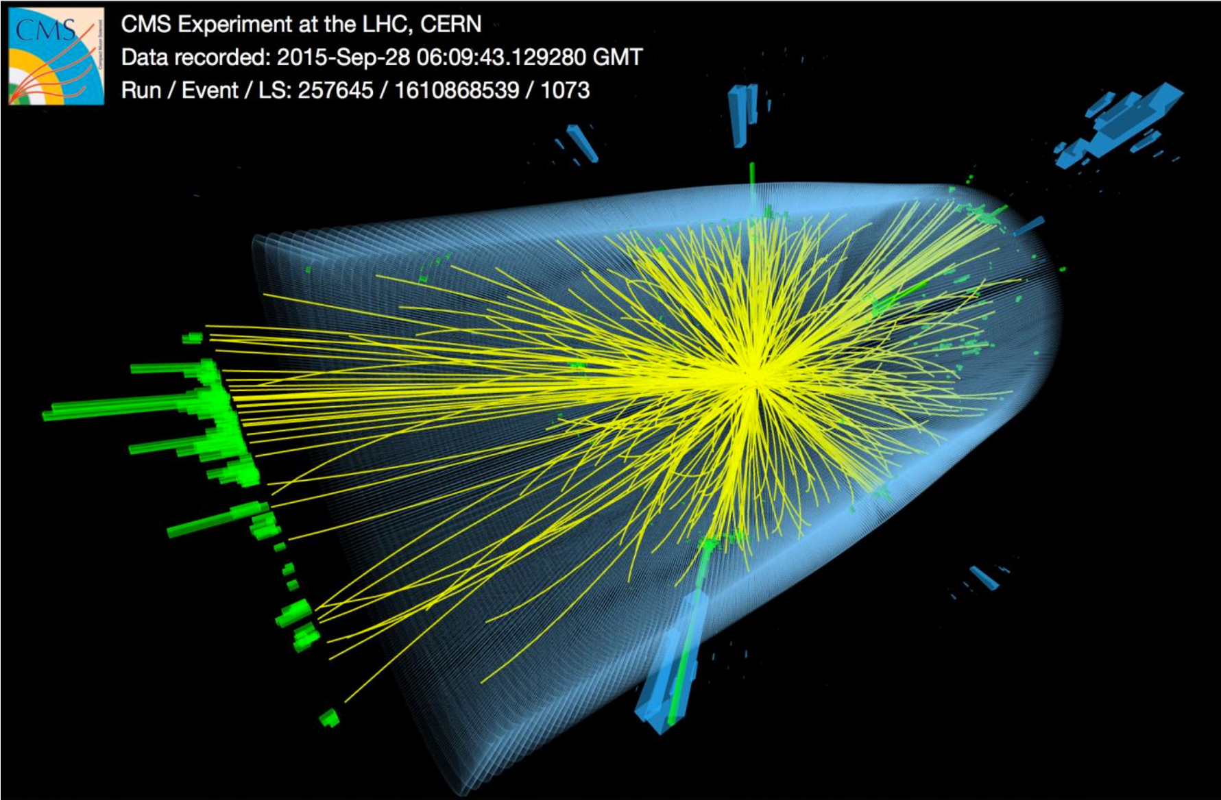
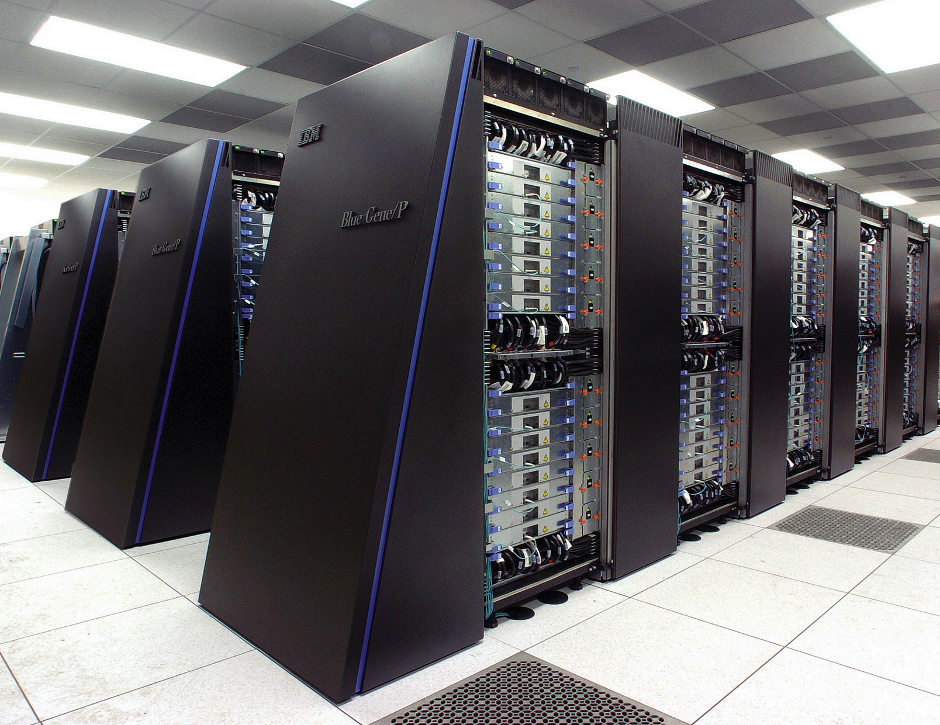
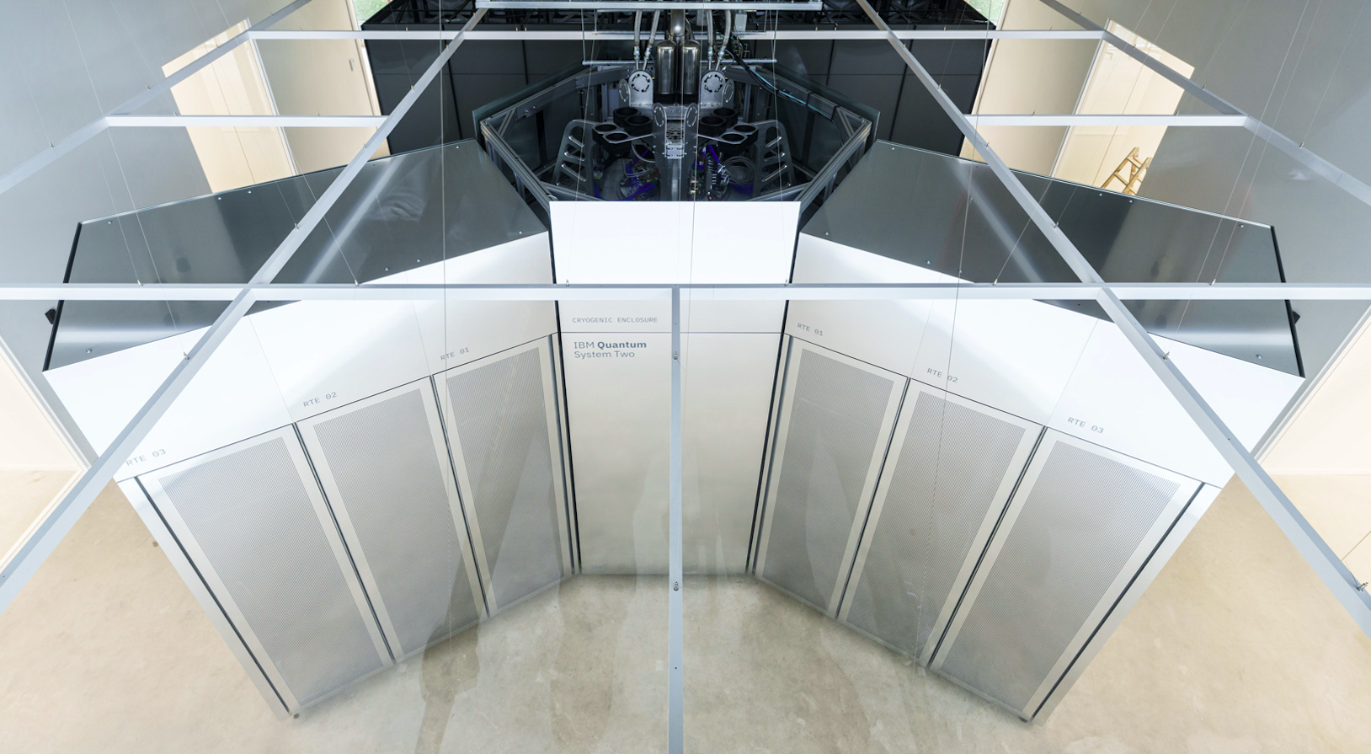

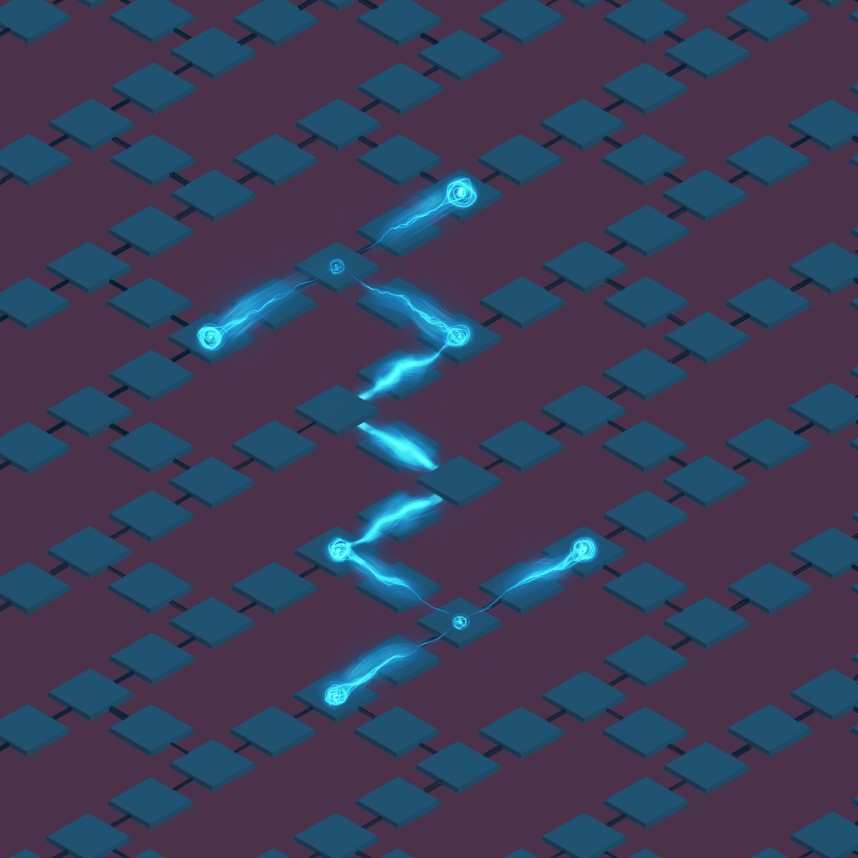
The Grand Challenge:
Simulating the strong force (QCD)
Building purpose-driven hardware to solve fundamental physics
Co-designed hardware as a physics laboratory
“History doesn't repeat itself, but it often rhymes.”
BlueGene & QCDOC
Classical Co-Design for QCD
Solved static properties
(e.g., hadron masses)
Non-efficient for real-time dynamics.
K. G. Wilson,
Phys. Rev. D (1974)
TODAY
Quantum Co-Design for QCD
Solved dynamical properties
(e.g., string dynamics)
R. P. Feynman,
Int. J. Theor. Phys. (1982)
Notes:
The Confinement Puzzle
Beyond Classical Limits
One of the deepest puzzles in fundamental physics is confinement: the phenomenon where quarks are permanently bound together by gauge-field flux tubes.
Calculating the real-time dynamics of these interacting gauge theories is notoriously difficult on classical machines due to the computational sign problem in Monte Carlo methods.
Quantum simulation offers a direct, real-time window into these non-perturbative dynamics, simulating the underlying Hamiltonian directly on quantum hardware.

Slide 4

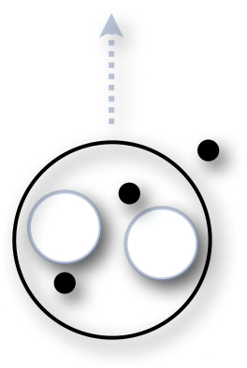
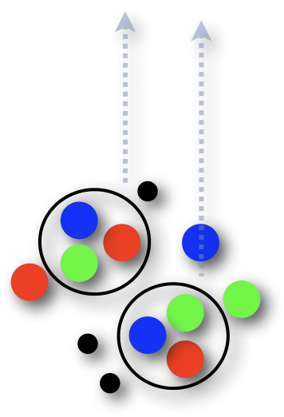
Three ingredients to describe Nature
Energy/length scales
atoms
eV / 10⁻¹⁰ m
Quantum matter as the basic building block
Gauge symmetry as a fundamental principle and at the origin of every force
nucleons
MeV (10⁶ eV) / fm (10⁻¹⁵ m)
Renormalisation group as a tool to study Nature at different scales
Gev (10⁹ eV) / 10⁻¹⁹ m
quarks
Tens of different energy/length scales

Slide 5
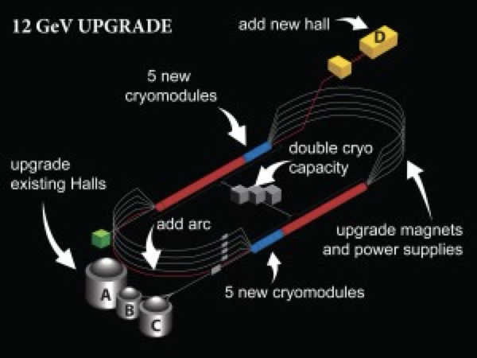
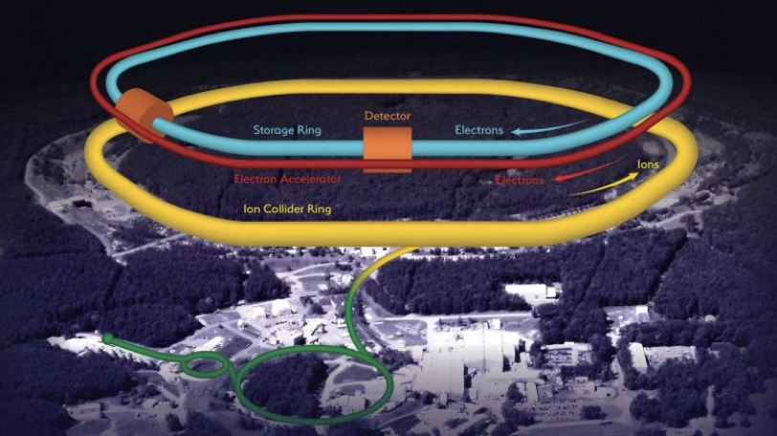
modern microscopes
(semi-inclusive) deep-inelastic lepton scattering
Highly virtual photons resolve inner (partonic) structure
Factorization theorems separate the non-calculable from the calculable parts

Slide 6
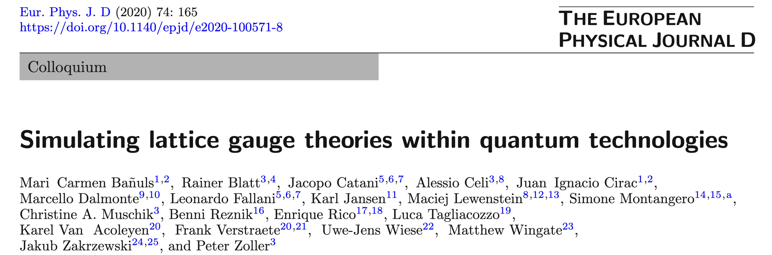
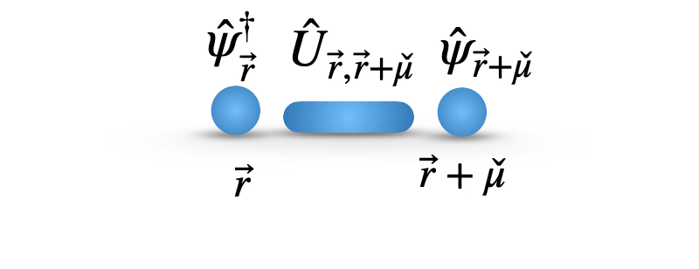
Hamiltonian formulation
Matter degrees of freedom on the vertices of the lattice
Gauge degrees of freedom on the links of the lattice
J. Kogut, L. Susskind
Phys. Rev. D (1975)
Reviews:
Quantum Computer Systems for Scientific Discovery, PRX Quantum (2021)
Cold atoms meet lattice gauge theory, Philos Trans A Math Phys Eng Sci (2022)
Quantum Simulation for High-Energy Physics, PRX Quantum (2023)
Quantum Computing for High-Energy Physics: State of the Art and Challenges, PRX Quantum (2024)
Cold-atom quantum simulators of gauge theories, Nat. Phys. (2025)
…
First experimental realizations:
Real-time dynamics of lattice gauge theories with a few-qubit quantum computer, Nature (2016)
Observation of gauge invariance in a 71-site Bose–Hubbard quantum simulator, Nature (2020)
Realizing topologically ordered states on a quantum processor, Science (2021)
Probing topological spin liquids on a programmable quantum simulator, Science (2021)
Observation of string breaking on a (2+1)D Rydberg quantum simulator, Nature (2025)
Visualizing dynamics of charges and strings in (2+1)D lattice gauge theories, Nature (2025)
…

Slide 7
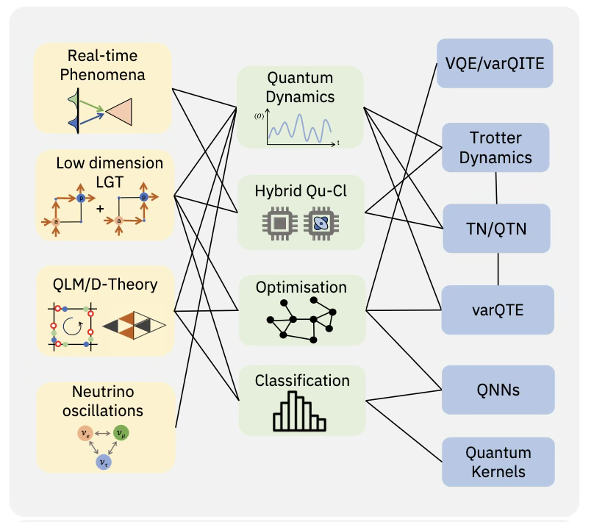
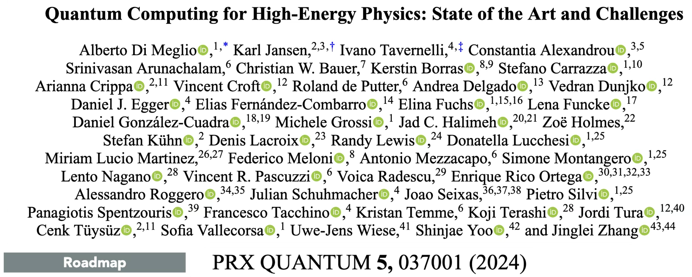
Reviews:
Quantum Computer Systems for Scientific Discovery, PRX Quantum (2021)
Cold atoms meet lattice gauge theory, Philos Trans A Math Phys Eng Sci (2022)
Quantum Simulation for High-Energy Physics, PRX Quantum (2023)
Quantum Computing for High-Energy Physics: State of the Art and Challenges, PRX Quantum (2024)
Cold-atom quantum simulators of gauge theories, Nat. Phys. (2025)
…
First experimental realizations:
Real-time dynamics of lattice gauge theories with a few-qubit quantum computer, Nature (2016)
Observation of gauge invariance in a 71-site Bose–Hubbard quantum simulator, Nature (2020)
Realizing topologically ordered states on a quantum processor, Science (2021)
Probing topological spin liquids on a programmable quantum simulator, Science (2021)
Observation of string breaking on a (2+1)D Rydberg quantum simulator, Nature (2025)
Visualizing dynamics of charges and strings in (2+1)D lattice gauge theories, Nature (2025)
…

Slide 8

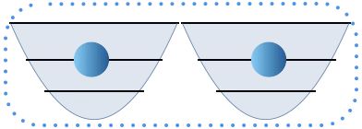
Superconducting circuits implementation
We need:
Tunable (spectrum) device
two-level atom (anharmonic)
cavity (harmonic)
Coherent dynamics (low dissipation)
Non-linear oscillator – anharmonic cavity – Josephson junction
Couple two superconductors via an oxide layer
The oxide layer acts as a tunnelling barrier
Superconducting gap inhibits electron tunnelling
written in terms of:
the charge-flux variables
or
lowest-energy excitations

Slide 9
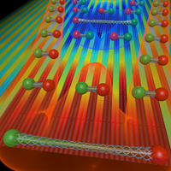
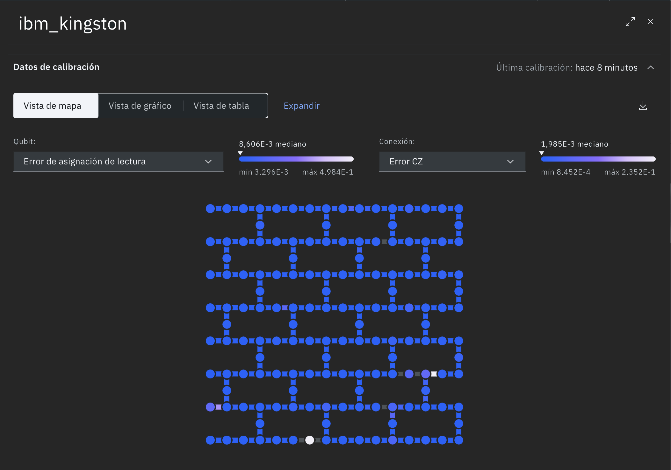
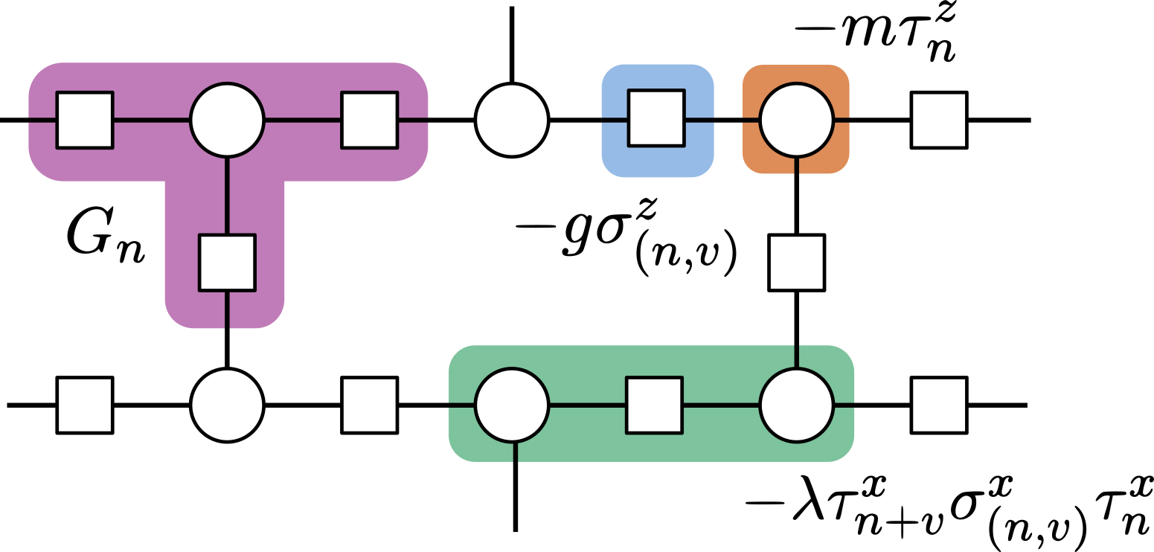
Watching Strings in Real-Time
After a particle collision, pairs of quarks remain confined in color-singlet states through a flux tube (Wilson line) connecting them.
As the flux tube evolves, it stretches, giving rise to the String breaking and String fragmentation
How do Strings of energy form, wobble, and break (hadronization)?
Can we use quantum co-design to solve the dynamics?
PRX 6 011023 (2016)
The 2025 Co-Design: Physics-to-Hardware Mapping
Matter (particles): Vertex Qubits
Gauge fields (strings): Link Qubits

Slide 10
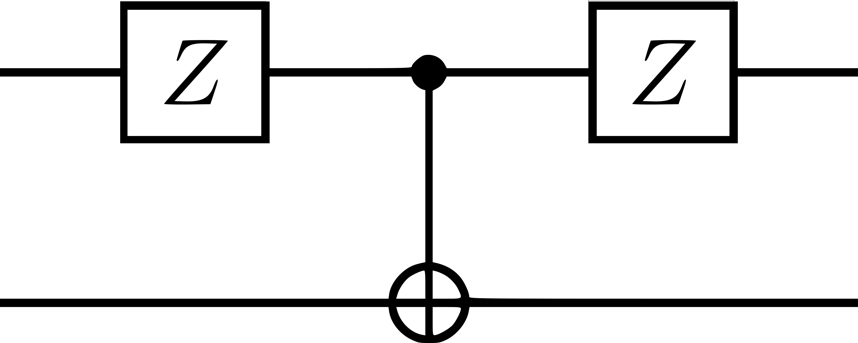

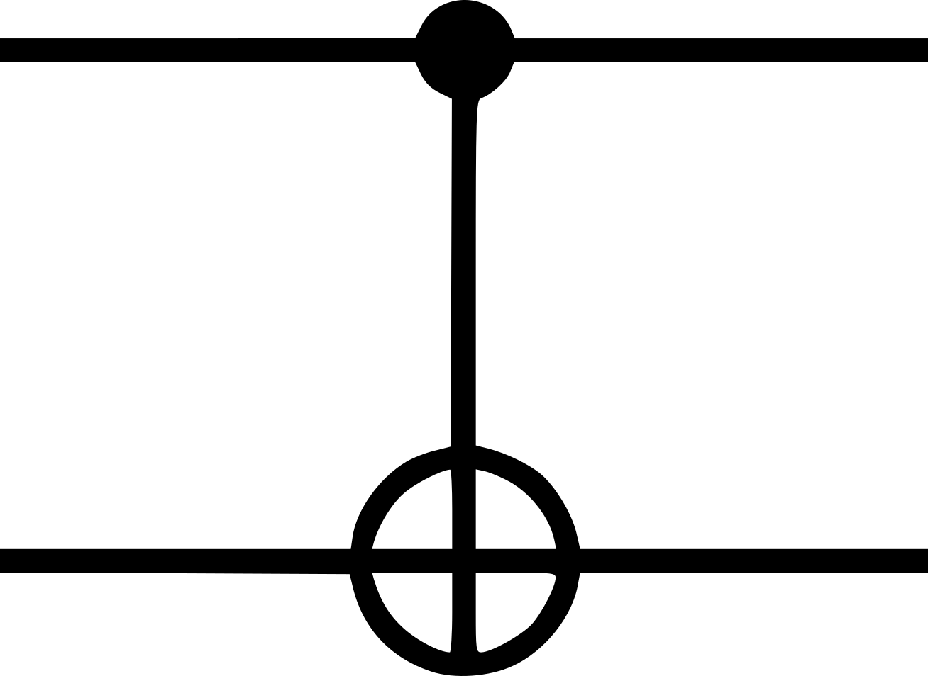


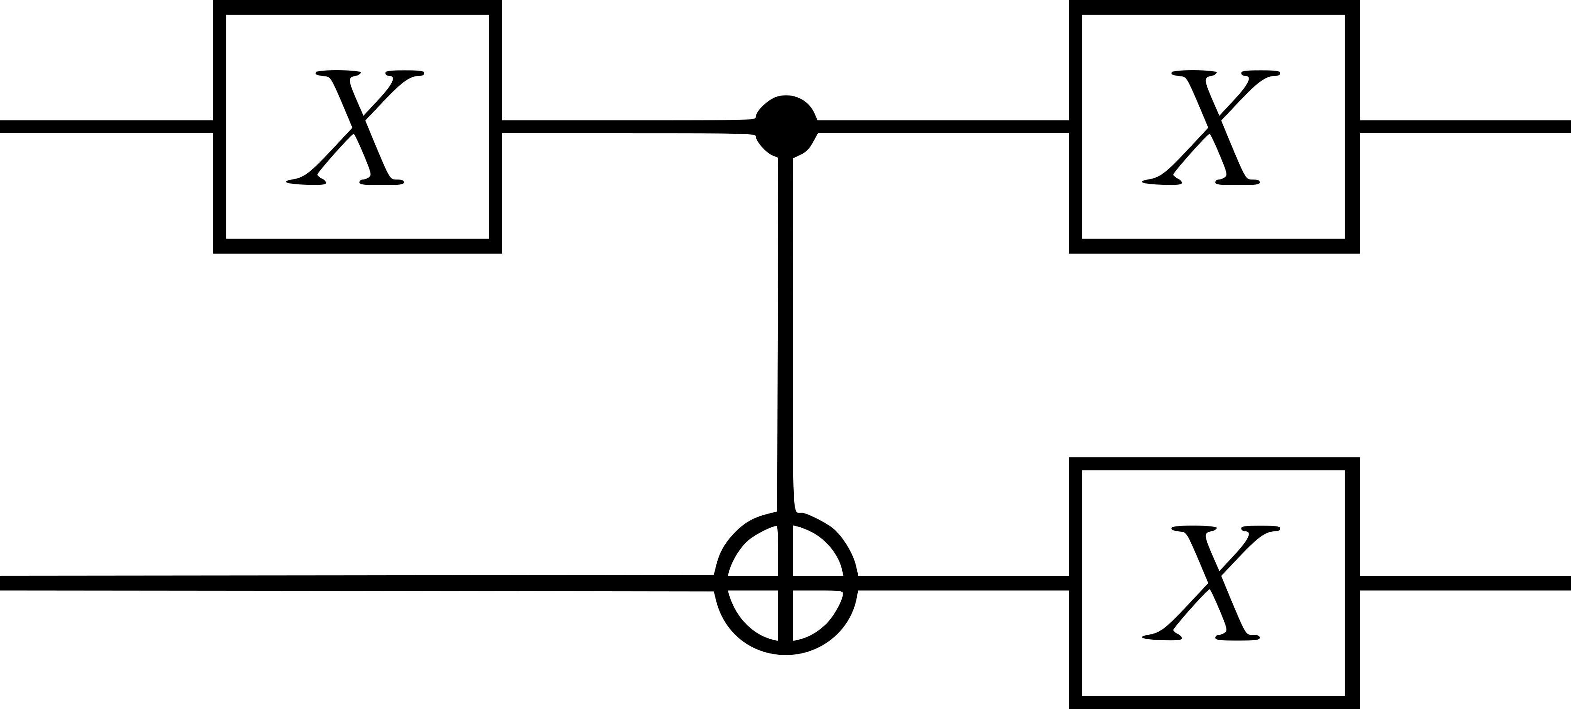
Addressing algorithmic & hardware errors
Gauge Dynamical Decoupling
Pauli Twirling
Gauge Sector Correction
Observable Depolarize Renormalization
Decoder

Slide 11
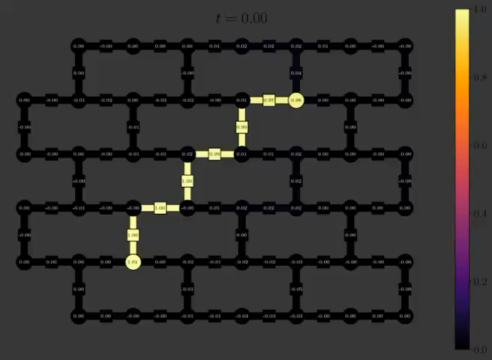
Watching the String "Rhyme" with Theory
String oscillations at m = 0, g = 0 point:
Max. 2Q depth: 192
Num qubits: 144
Total 2Q gates: 7872
300,000 shots/circuit
(600,000 shots/time step)
for statistics
Device: ibm_aachen

Slide 12
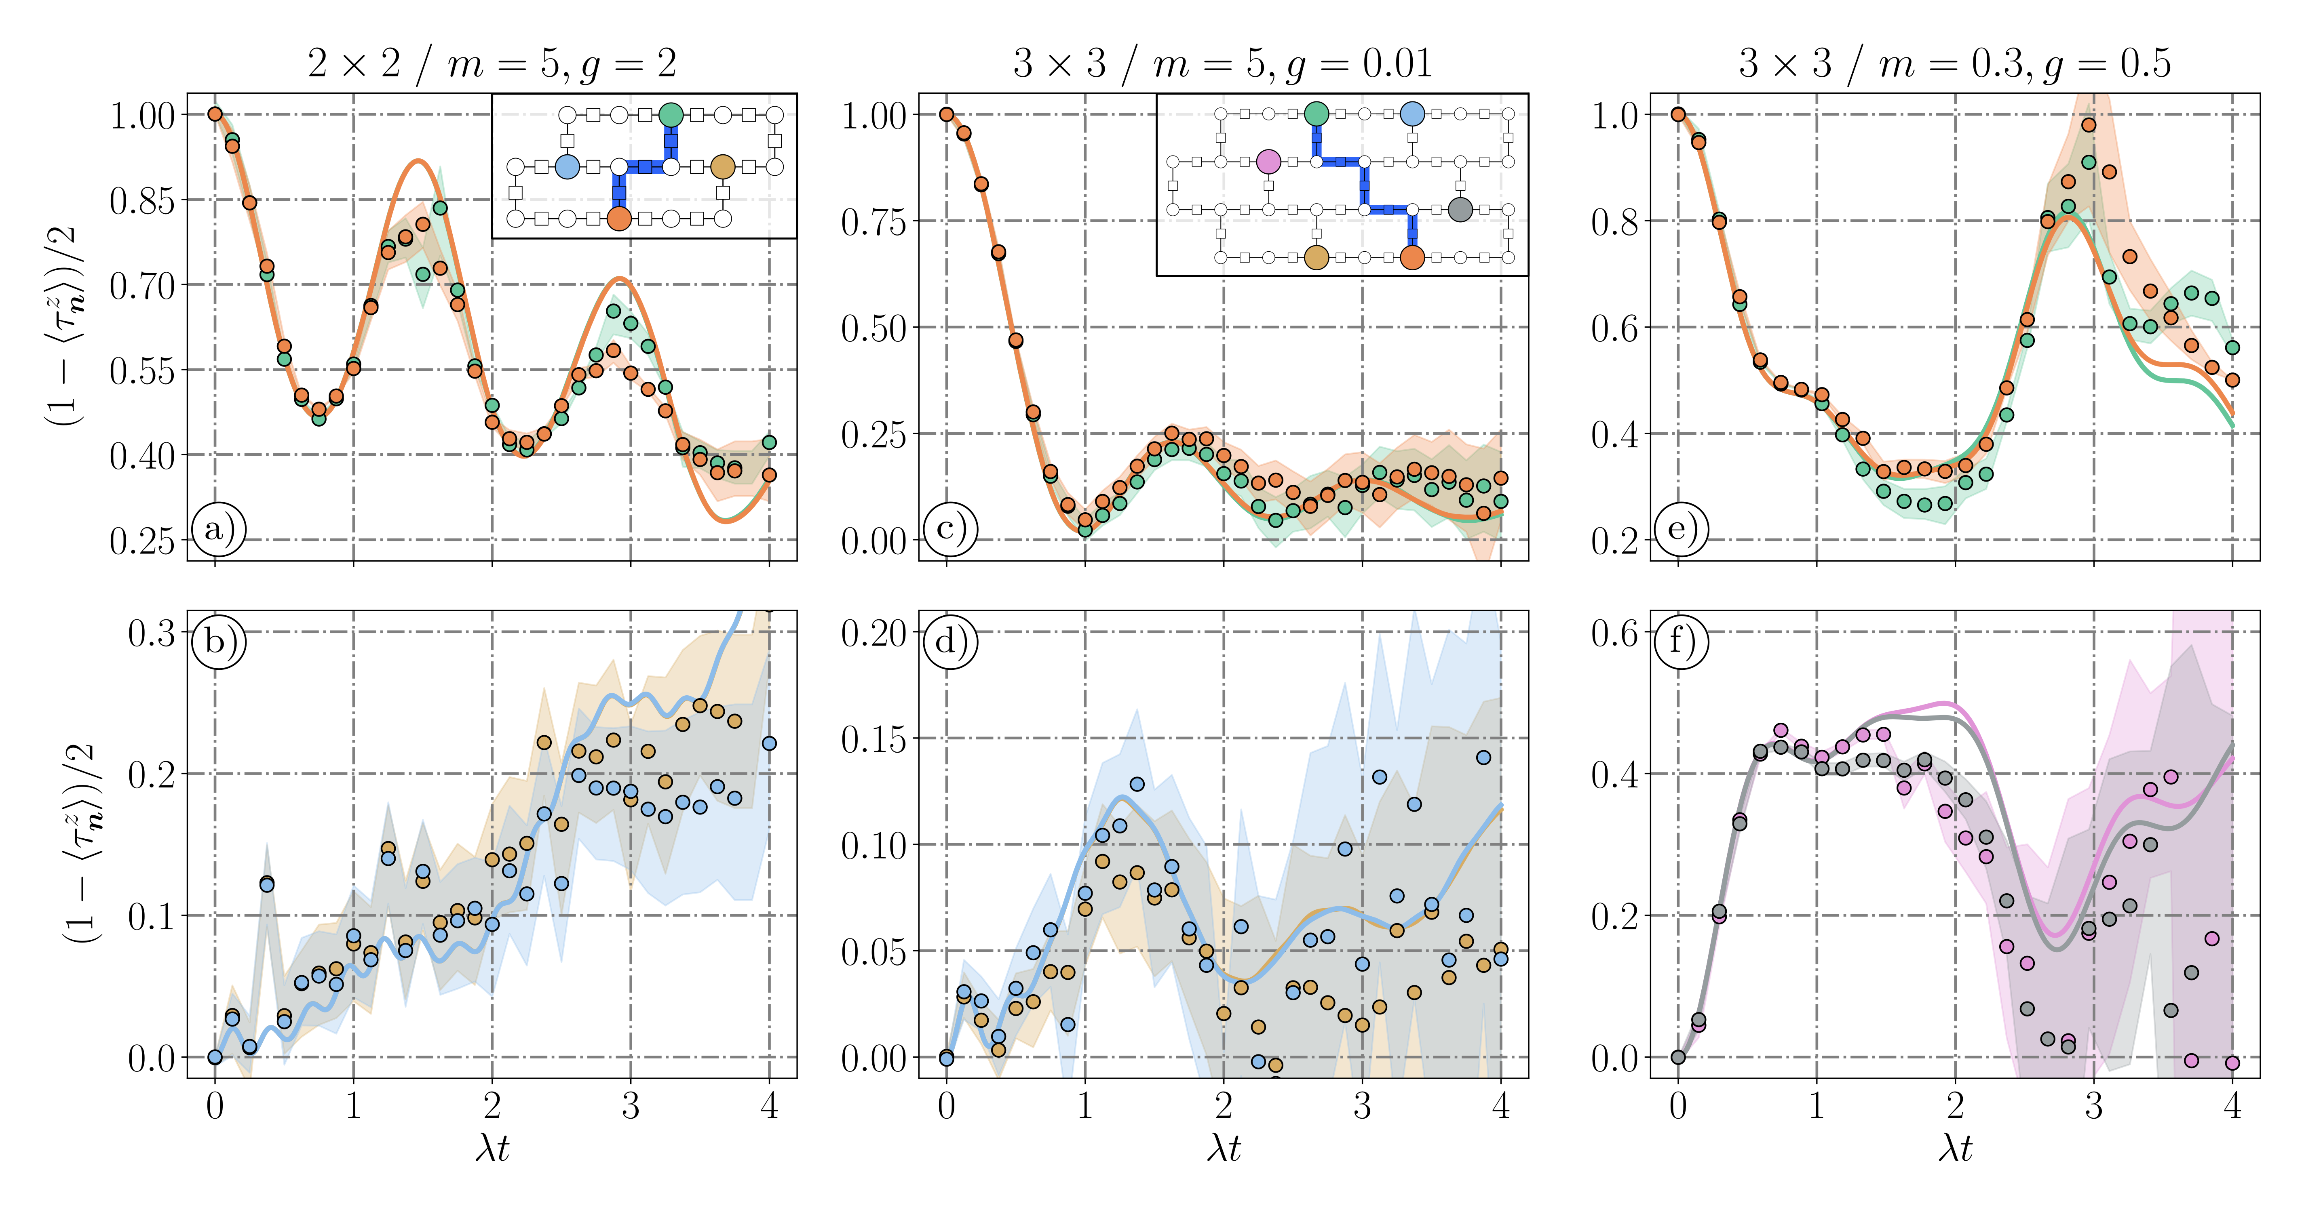
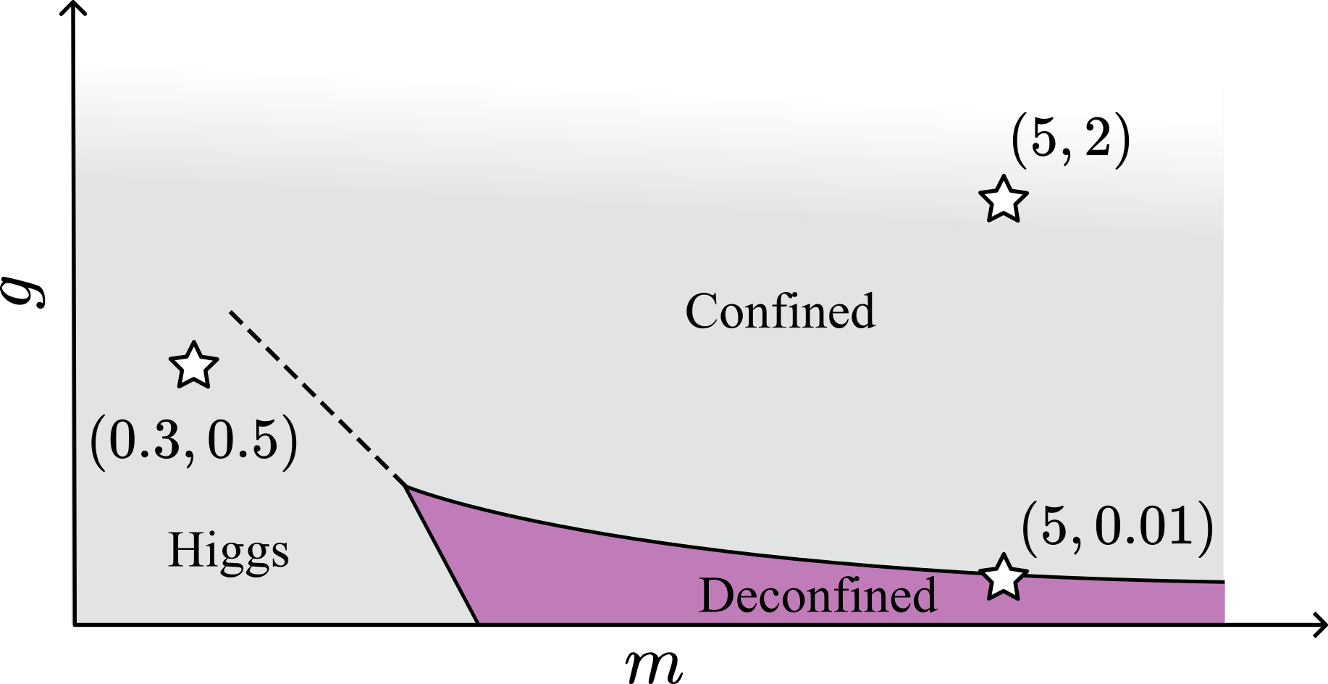
The Z2-Higgs model & results
Confined
Deconfined
Higgs
Yo-yo
Bending
Phase diagram and benchmark calculations with TN methods

Slide 13
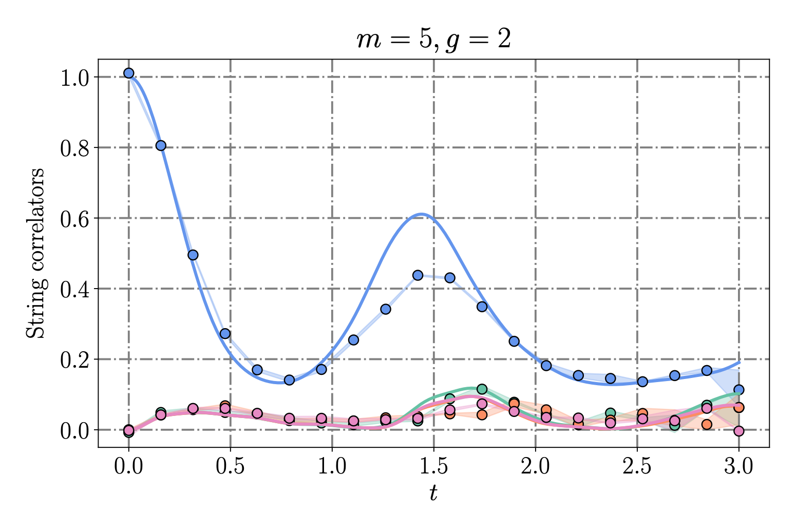
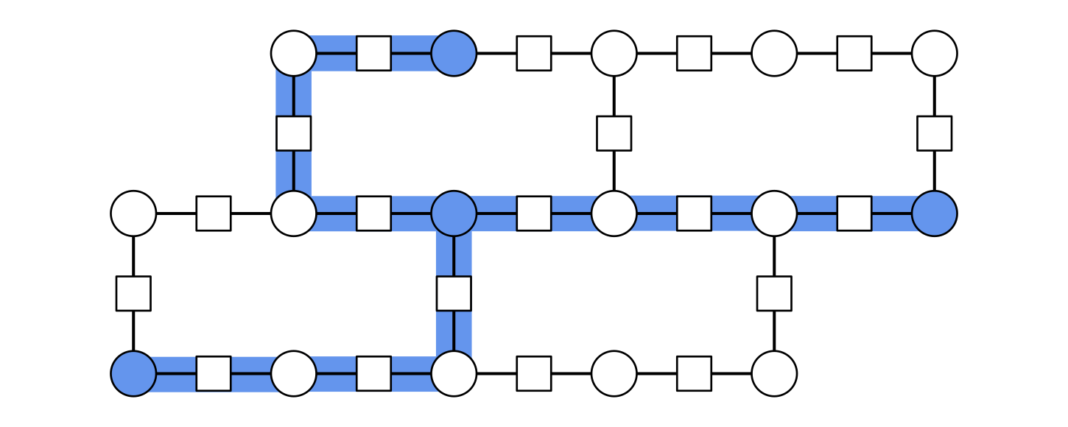
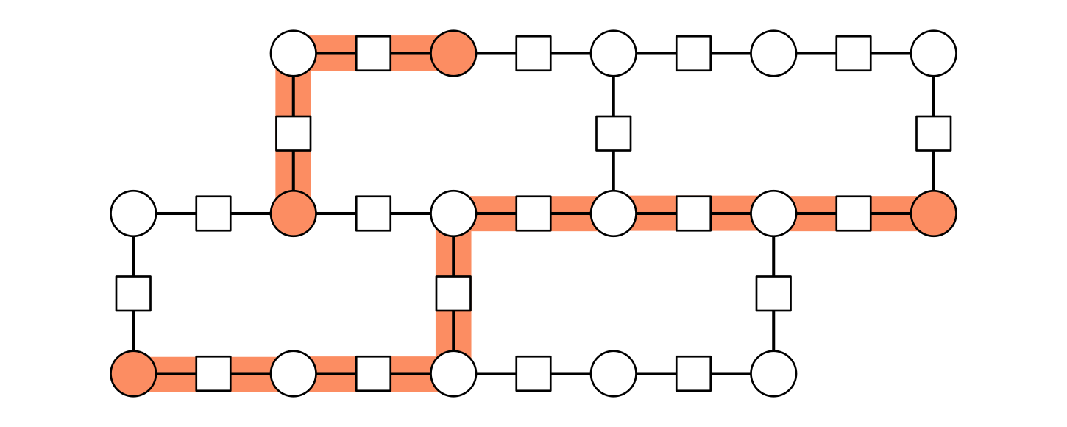
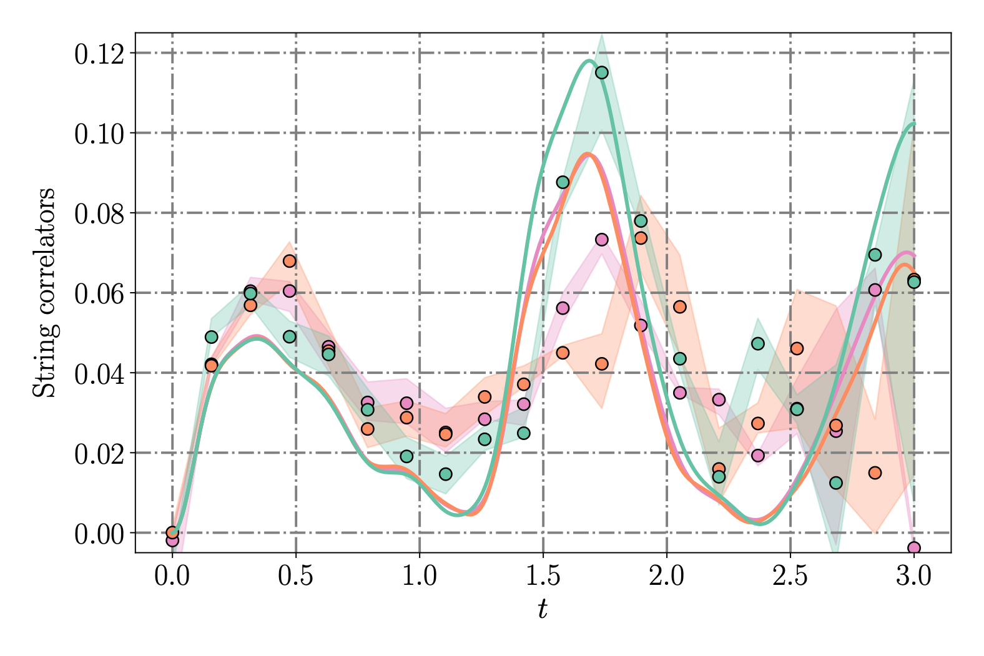
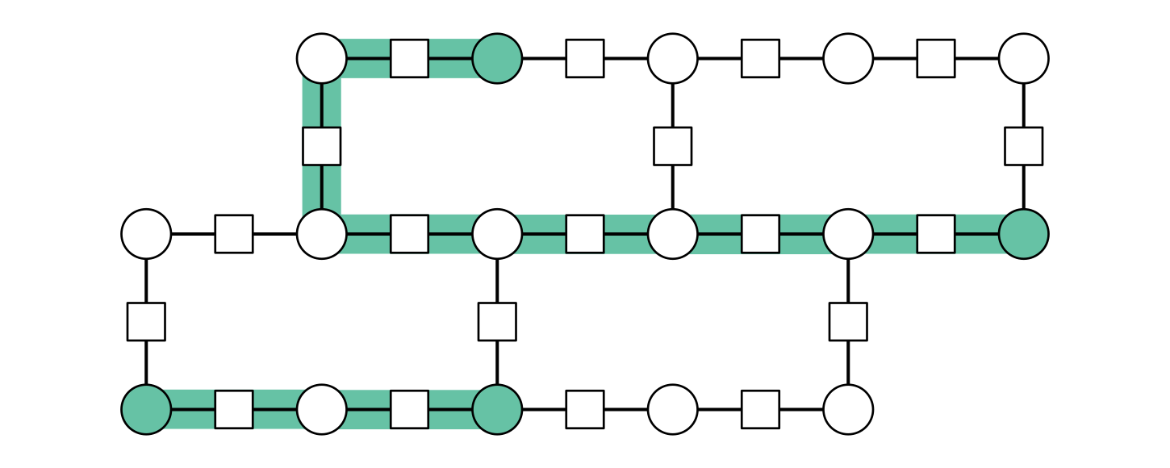
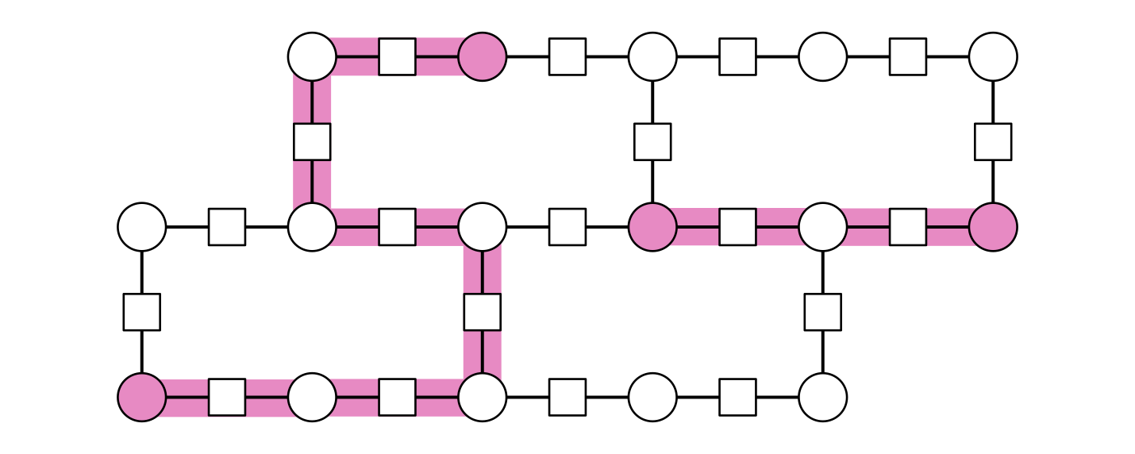
The Z2-Higgs model & results
String breaking of a 3-string at m = 5, g = 2

Slide 14

Hardware-native compact quantum electrodynamics in superconducting circuits:
Exact gauge invariance from circuit topology
A capacitor in parallel with a Josephson Junction
Transmon configuration
A capacitor in series with a Josephson Junction
matter (vertex) degrees of freedom
Quantum Electrodynamics !!!
gauge (link) degrees of freedom

Slide 15



Hardware-native compact quantum electrodynamics in superconducting circuits:
Exact gauge invariance from circuit topology
Native interactions, exactly gauge invariants !!!
No fine-tuning, no approximation, no perturbation
mass
(on-site energy)
Electric term
(on-site energy)
Matter-gauge coupling
(correlated hopping)
lack of native magnetic term (plaquette interaction)
Pure Quantum Electrodynamics:
Electric + magnetic interaction

Slide 16

Hardware-native compact quantum electrodynamics in superconducting circuits:
Exact gauge invariance from circuit topology
Vortex states:
Displacement on the plaquette

Slide 17
Probing Confinement with Superconducting Circuits:
From Z₂ String Dynamics to Continuous U(1) Electrodynamics
Quantum simulation and co-design (Hardware + Physics + Error Handling).
Digital quantum simulators: 144-qubit digital processor to track the real-time evolution/vibrations of electric flux tubes in a (2+1)-D.
Analog quantum simulators: In analog architectures, Gauss's law can appear exactly from fundamental circuit topology.
Continuum limit: Exploiting the intrinsic infinite-dimensional Hilbert space of superconducting circuit variables (phase/charge) to simulate continuous gauge fields naturally.

