Slide 1
Defining quantum advantage
in microscopic nuclear theory
James P. Vary
Iowa State University
Workshop on
Quantum Information Science
in High-Energy Nuclear Physics
(QIS-HENP)
Central China Center for Nuclear Theory
(C3NT)
Institute of Particle Physics (IOPP)
Central China Normal University
Wuhan, China
June 15-19, 2026
Notes:
File: Nucleus-2022_Moscow.pptx
File: IMP_Huizhou_November_2023_final.pptx
JV: Note that the file was revised 12/1/24 with updated slides for the BE2 ratios and the Mn/Mp ratios to reflect the corrections made in the resubmitted version of the manuscript. In the case of the Mn/Mp ratios the only correction was the reference numbers
File: Vary_shell_Model_at_75_2024_final.pptx (revised as indicated above)
File: Vary_CENS_Frontiers_Meeting_final.pptx
File: Vary_CENS_Frontiers_Meeting_final.pptx
File is online at: https://ntse.khb.ru/files/uploads/2026/vary_ntse_2026.pdf
File: NTSE2026_Vary_Full_rev.pptx

Slide 2
Quantum advantage regime for ab initio nuclear structure
A quantum advantage regime is an application which is not solvable with any existing
state-of-the-art classical code running on the largest available leadership-class supercomputer.
We adopt the latest version of MFDn running on Aurora as our candidate code for the classical
calculation with plans to consult Calvin Johnson (Big Stick author) to verify our candidate is indeed
a valid quantum advantage regime case.
The case is defined by an actual classical calculation that saturates classical resources currently available leading to a concrete limit on the lower bound for the quantum advantage regime.
The case so-defined should help solve an important physics problem such as whether the
predictive theory produces a vibrational or a rotational spectrum.
We make the case for ³²Mg solved with the ab-initio no-core shell model at N_{max} = 7 using an NN-only
interaction is above the lower bound of the quantum advantage regime.
We recognize that the case defined for the quantum advantage regime is necessarily time-dependent
since the state-of-the-art of the classical code(s) as well as the available supercomputers are
continuously being updated.
Notes:
From File: NP_vary_v12.pptx
File is online at: https://ntse.khb.ru/files/uploads/2026/vary_ntse_2026.pdf
File: NTSE2026_Vary_Full_rev.pptx

Slide 3
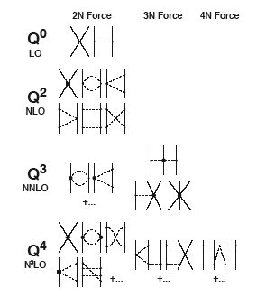
Effective Nucleon Interaction
Chiral Perturbation Theory (χPT)
Weinberg’s χPT allows for controlled power series expansion
Within χPT 2π-NNN Low Energy Constants (LEC) are related to the NN-interaction LECs {c_{i}}
C_{D}
C_{E}
Additional terms from χPT
with LECs specific to NNN systems
Regularization is essential, which is also implicit within the Harmonic Oscillator (HO) wave function basis (see below)
R. Machleidt, D. R. Entem, nucl-th/0503025
Adapted from P. Navratil slide
R. Machleidt and D.R. Entem, Phys. Rep. 503, 1 (2011);
E. Epelbaum, H. Krebs, U.-G Meissner, Eur. Phys. J. A51, 53 (2015); Phys. Rev. Lett. 115, 122301 (2015)
Notes:
Updated for File: IMP_Huizhou_November_2023_full.pptx
From: Vary_C2R2_South_Korea.pptx
Slide from: Topical_Collaboration_Report_Sept_2018_full.pptx
2021 - Adopted from file Heff_Basics.ppt
File: Nucleus-2022_Moscow.pptx
File: IMP_Huizhou_November_2023_final.pptx
File: Vary_Shell_Model_at_75_2024_full.pptx (added the “Adapted from P. Navratil slide)
File: Vary_shell_Model_at_75_2024_final.pptx (revised as indicated above)
File: Vary_CENS_Frontiers_Meeting_final.pptx
File: Vary_CENS_Frontiers_Meeting_final.pptx
File is online at: https://ntse.khb.ru/files/uploads/2026/vary_ntse_2026.pdf
File: NTSE2026_Vary_Full_rev.pptx

Slide 4
No Core Shell Model (NCSM)
A large sparse matrix eigenvalue problem
P. Navratil, J. P. Vary and B.R. Barrett,
Phys. Rev. Lett. 84, 5728 (2000);
Phys. Rev. C 62, 054311 (2000)
Review:
B.R. Barrett, P. Navratil and J.P. Vary,
Prog. Part. Nucl. Phys. 69, 131 (2013)
Adopt realistic NN (and NNN) interaction(s) & renormalize as needed - retain induced many-body interactions: Chiral Effective Field Theory (Chiral EFT) interactions
Adopt the 3-D Harmonic Oscillator (HO) for the single-nucleon basis states, α, β,…
Evaluate the nuclear Hamiltonian, H, in basis space of HO (Slater) determinants (each determinant manages the bookkeeping of anti-symmetrization)
Diagonalize this sparse many-body H in its “m-scheme” basis where [α =(n,l,j,m_{j,}τ_{z})]
Evaluate observables and compare with experiment
HO basis space
(configurations)
Now at ~10¹¹ (see below)
Comments
Computationally demanding => needs new algorithms & high-performance computers
Requires convergence assessments and extrapolation tools to retain predictive power
Achievable for nuclei up to atomic number of about 20 with largest computers available
Notes:
From: Vary_C2R2_South_Korea.pptx
“Original” from file: Vary_Ab_Initio_Nuc_thy_Full
Modified for 15C_SciDAC4_Success
While some might consider this too technical, others need this detail to set up their picture of the physics and computational science aspcts of the quantum many-body problem we are addressing
This quantum many-body problem as a large sparse matrix eigenvalue problem has long been recognized as “computationally hard”
File: Nucleus-2022_Moscow.pptx
File: IMP_Huizhou_November_2023_final.pptx
File_ Vary_Shell_Model_at_75_2024_full.pptx (corrected spelling of “bookkeeping”)
File: Vary_shell_Model_at_75_2024_final.pptx (revised as indicated above)
File: Vary_CENS_Frontiers_Meeting_final.pptx
Updated with PPNP review citation and comment on increasing dimensions for File: NTSE2026_Vary_full.pptx
File is online at: https://ntse.khb.ru/files/uploads/2026/vary_ntse_2026.pdf
File: NTSE2026_Vary_Full_rev.pptx

Slide 5
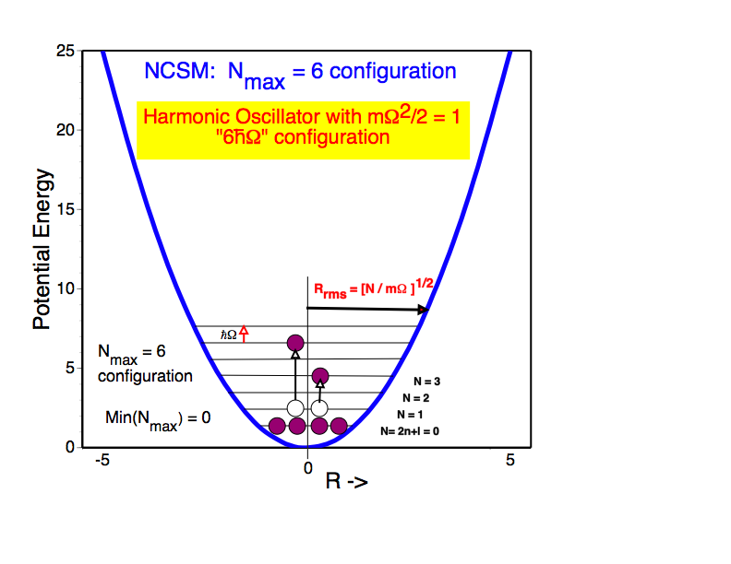
extrapolate: N_{max} -> infinity
N_{max} = 6 configuration
for ⁶Li
3 neutrons + 3 protons
in low-lying HO shells
N_{min} = 2
Notes:
“Original” from Vary_Daejeon_Two_Lectures
Nmin is both the [quanta of the highest 2 nucleons in the lowest configuration (IR/UV notes)=preferred usage] and the [sum of all quanta of the nucleons in the lowest configuration= used here in the text above the figure] in this 6Li example
Be sure to mention that hw controls an estimated size scale of the system and the spacing of the single-particle energies of the HO.
File: Nucleus-2022_v1 added the statement about extrapolation.
File: Nucleus-2022_Moscow.pptx
File: Vary_shell_Model_at_75_2024_final.pptx (revised as indicated above)
File: Vary_CENS_Frontiers_Meeting_final.pptx
File is online at: https://ntse.khb.ru/files/uploads/2026/vary_ntse_2026.pdf
File: NTSE2026_Vary_Full_rev.pptx

Slide 6
Challenge
Exponential increase in Matrix Dimension (D)
Opportunities
Memory/cpu time grows only as D^{3/2}
Algorithm development (SciDAC funding)
Exaflop machines now available (DOE/INCITE competitive awards)
Improved understanding of Chiral EFT
Developing methods for extrapolating D->inf (N_{max}->inf)
Notes:
From Pieter via email on 12/04/24. They were included in his NTSE2024 invited talk.
Adapted and extended by Pieter from:
P. Maris, J.P. Vary and A.M. Shirokov, Phys, Rev. C 79, 014308 (2009); ArXiv:0808.3420;
J.P. Vary, et al., Jnl. of Phys.: Conf. Series 180, 012083 (2009)
File: Vary_CENS_Frontiers_Meeting_final.pptx
File is online at: https://ntse.khb.ru/files/uploads/2026/vary_ntse_2026.pdf
File: NTSE2026_Vary_Full_rev.pptx

Slide 7
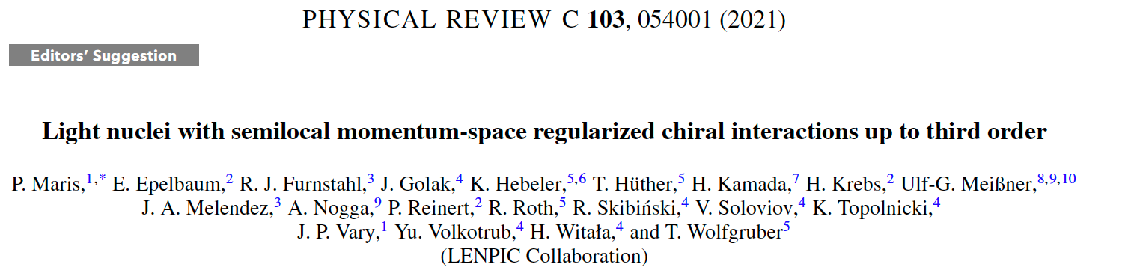
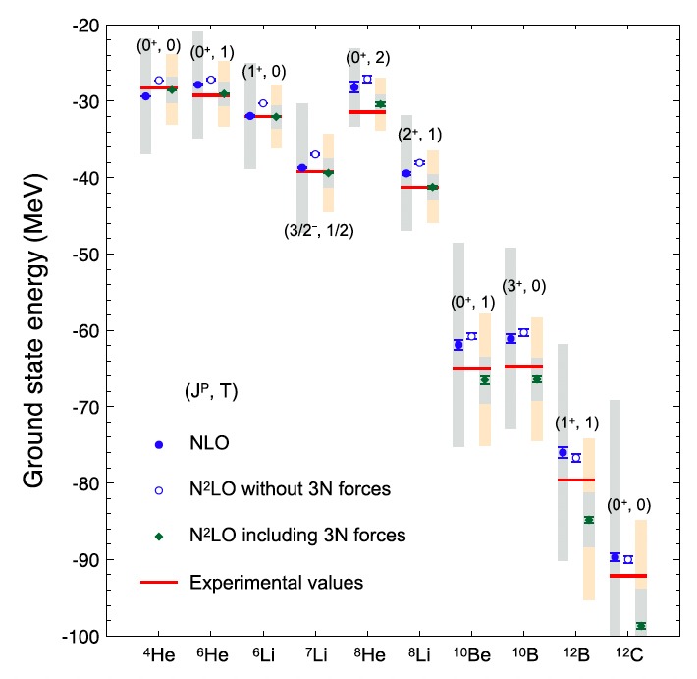
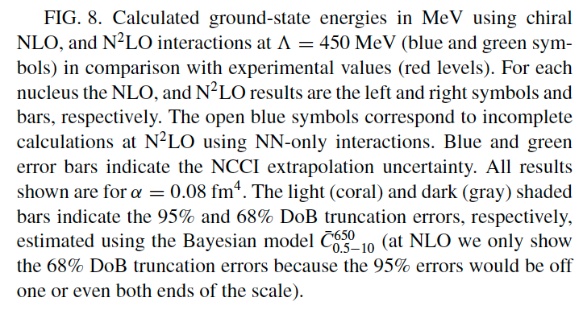
The LENPIC team:
www.lenpic.org
Notes:
JV: New slide prepared for Phys526 lecture #29
File: IMP_Huizhou_November_2023_final.pptx
File: Vary_shell_Model_at_75_2024_final.pptx (revised as indicated above)
File: Vary_CENS_Frontiers_Meeting_final.pptx
File is online at: https://ntse.khb.ru/files/uploads/2026/vary_ntse_2026.pdf
File: NTSE2026_Vary_Full_rev.pptx

Slide 8
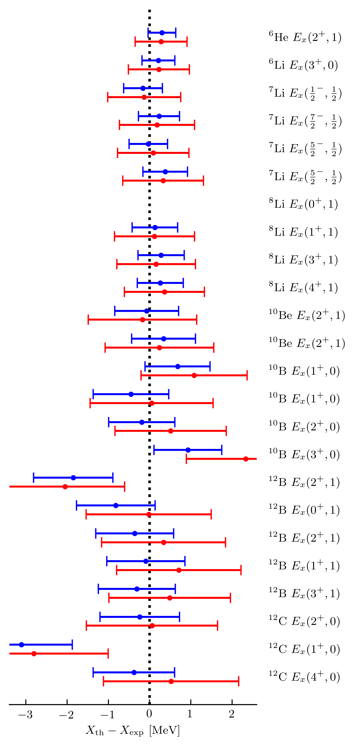
Excitation energies from effective field theory with quantified uncertainties
Objectives
Theory minus experiment for selected excitation energies
Predict properties of ground and excited states of light nuclei with robust theoretical error estimates.
Test consistent LENPIC chiral effective field theory (EFT) interactions with 2- and 3-nucleon forces.
Extend and test a Bayesian statistical model that learns from the order-by-order EFT convergence pattern to account for correlated excitations.
No data
Bayesian 95% intervals for two forces (blue & red)
Impact
First test of novel chiral nucleon-nucleon potentials with consistent three-nucleon forces.
Demonstrates understanding of theoretical uncertainties due to chiral EFT expansion.
Accounting for correlations produces agreement with experimental excitation energies (see figure).
Exceptions in ¹²C and ¹²B indicate different theoretical correlations in the nuclear structure.
Check if ≈95% of bars overlap zero
Accomplishments
P. Maris et al, Phys. Rev. C 103, 054001 (2021); Editors’ Suggestion; arXiv: 2012.12396 [nucl-th]
Notes:
Mention: Current LENPIC goal – fully consistent NN & NNN interactions through N3LO: results anticipated in late 2025
From: Vary_C2R2_South_Korea.pptx
File: LENPIC_SMS_Excitation_v7
Contacts: : Pieter Maris (pmaris@iastate.edu); Dick Furnstahl (furnstahl.1@osu.edu)
Funding sources: DOE Office of Science: Office of Nuclear Physics & ASCR
Resources: Computational resources were provided through an INCITE award and an award at NERSC
Note that these results were discussed in first lecture in the NCSM/NCCI Lecture series by Pieter Maris.
File: Nucleus-2022_Moscow.pptx
Bars represent 95% degree of confidence regions.
Upper (blue) bar is for Lambda = 450 MeV/c while lower (red) bar is for Lambda = 500 MeV/c
File: NTSE-2023
File: IMP_Huizhou_November_2023_final.pptx
File: Vary_shell_Model_at_75_2024_final.pptx (revised as indicated above)
File: Vary_CENS_Frontiers_Meeting_final.pptx
File is online at: https://ntse.khb.ru/files/uploads/2026/vary_ntse_2026.pdf
File: NTSE2026_Vary_Full_rev.pptx

Slide 9
P. Maris, H. Le, A. Nogga, R. Roth, J.P. Vary
Front. Phys. 11, 1098262 (2023)
Adapted from P. Maris, LENPIC Annual Meeting, Bonn, March 11-13, 2024
Notes:
File: Vary_Shell_Model_at_75_2024_full.pptx
Adapted from P. Maris, LENPIC annual meeting, Bonn, March 11-13, 2024
File: Vary_shell_Model_at_75_2024_final.pptx (revised as indicated above)
File: Vary_CENS_Frontiers_Meeting_final.pptx
File is online at: https://ntse.khb.ru/files/uploads/2026/vary_ntse_2026.pdf
File: NTSE2026_Vary_Full_rev.pptx

Slide 10
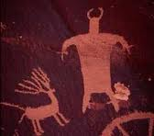
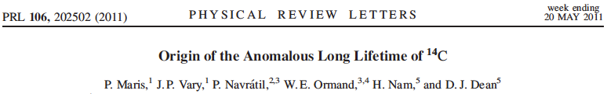
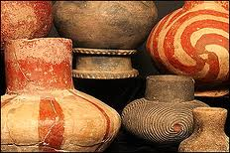
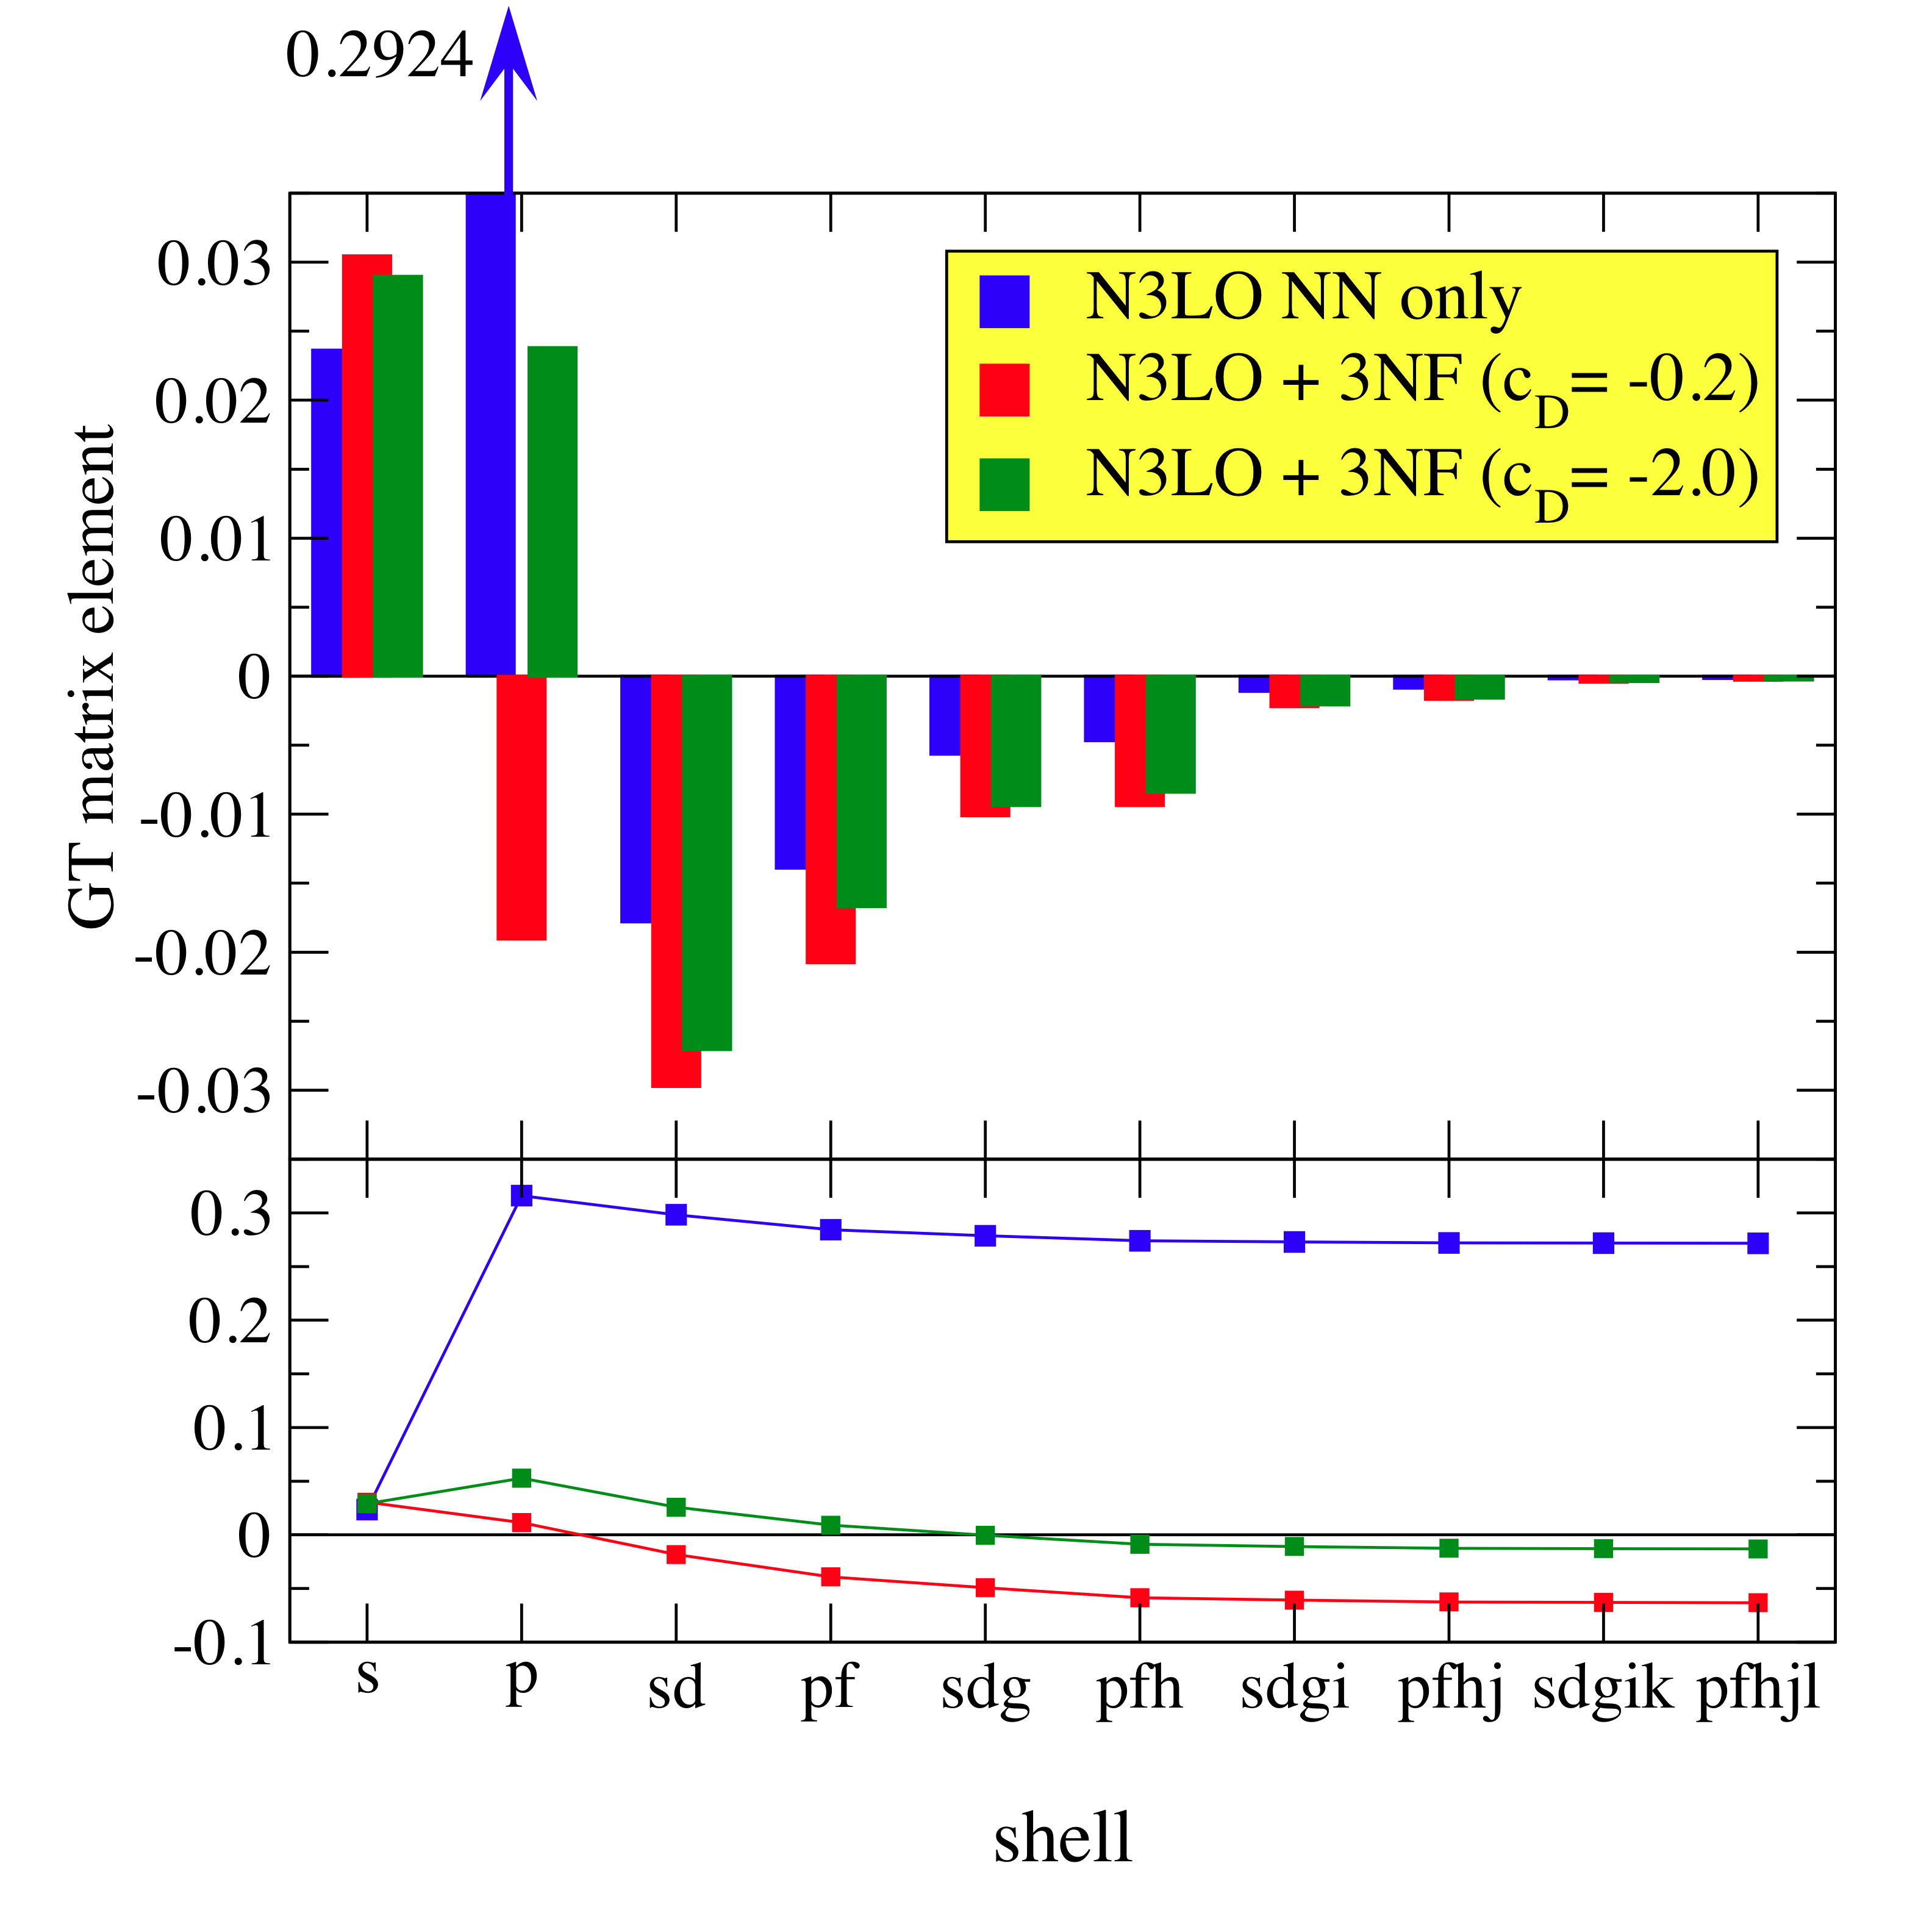
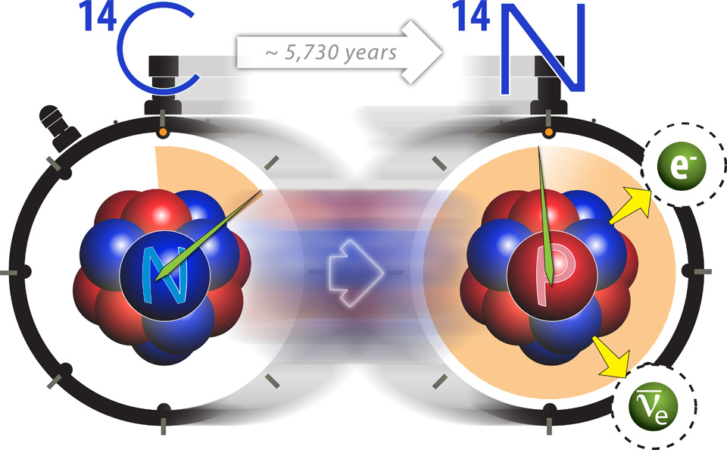


Solves the puzzle of the long but useful lifetime of ¹⁴C
Establishes a major role for strong 3-nucleon forces in nuclei
Strengthens foundation for guiding experiments
3-nucleon forces suppress critical component
Dimension of matrix solved for 8 lowest states ~ 1x10⁹
Each run takes ~ 6 hours on 215,000 cores on Cray XT5 Jaguar at ORNL
“Scaling of ab initio nuclear physics calculations on multicore computer architectures," P. Maris, M. Sosonkina, J. P. Vary, E. G. Ng and C. Yang, 2010 Intern. Conf. on Computer Science, Procedia Computer Science 1, 97 (2010)
net decay rate
Is very small
Notes:
From: Vary_C2R2_South_Korea.pptx
“Original” from file: Vary_Ab_Initio_Nuc_Thy_Full
Modified for 14C_SciDAC2_Success
Modified for C2R2 seminar (South Korea) in 2022
File: Nucleus-2022_Moscow.pptx (not shown)
File: Vary_Shell_Model_at_75_2024_full.pptx (look up and add statement on which interaction employed – e.g. EM500 with SRG?
File: Vary_shell_Model_at_75_2024_final.pptx (revised as indicated above)
File: Vary_CENS_Frontiers_Meeting_final.pptx
File is online at: https://ntse.khb.ru/files/uploads/2026/vary_ntse_2026.pdf
File: NTSE2026_Vary_Full_rev.pptx
10

Slide 11
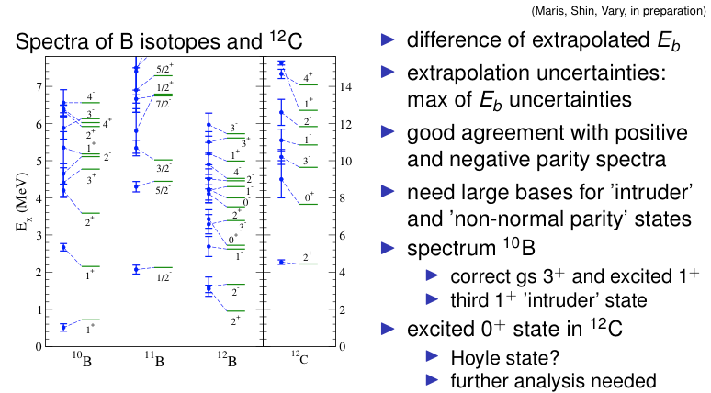
Daejeon16 NN interaction
Based on SRG evolution of Entem-Machleidt “500” chiral N3LO to
followed by Phase-Equivalent Transformations (PETs)
to fit selected properties of light nuclei.
A.M. Shirokov, I.J. Shin, Y. Kim, M. Sosonkina, P. Maris and J.P. Vary,
“N3LO NN interaction adjusted to light nuclei in ab exitu approach,”
Phys. Letts. B 761, 87 (2016); arXiv: 1605.00413
Application to excited states of p-shell nuclei
Hoyle state?
see MCNCSM results below
Notes:
From: Vary_C2R2_South_Korea.pptx
Adapted from: Hirschegg_Full_with_updates
Note the 12C gs radius plot appears in the original Daejeon16 paper showing good convergence towards the experimental result.
File: Lanzhou_Vary_November_2019
New composite slide with major edit for Hoyle state prepared for File: Nucleus-2022_v1
File: Nucleus-2022_Moscow.pptx
File: Vary_shell_Model_at_75_2024_final.pptx (revised as indicated above)
File: Vary_CENS_Frontiers_Meeting_final.pptx
File is online at: https://ntse.khb.ru/files/uploads/2026/vary_ntse_2026.pdf
File: NTSE2026_Vary_Full_rev.pptx

Slide 12


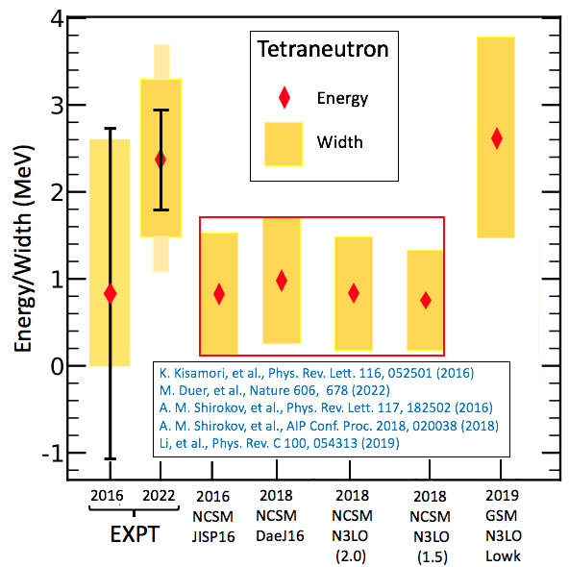
Tetraneutron discovery
confirms prediction
Objectives
Ab initio nuclear theory aims for parameter-free predictions of nuclear properties with controlled uncertainties using supercomputer simulations
Specific goal is to predict if the tetraneutron (4-neutron system) has a bound state, a low-lying resonance or neither
Impact
Discovery in 2022 announced in Nature [1] confirms ab initio theory predictions from 2016 [2] of a short-lived tetraneutron resonance at low energy and the absence of a tetraneutron bound state
Demonstrates the predictive power of ab initio nuclear theory since theory and experiment are within their combined uncertainties
Sets stage for further experimental and theoretical research on new states of matter formed only of neutrons
Shows need to anticipate a long wait time for experimental confirmation of such an exotic phenomena, ~ 6 years in this case
Emphasizes the value of DOE supercomputer allocations (NERSC) and support for multi-disciplinary teamwork (SciDAC/NUCLEI)
Accomplishments
[1] M. Duer, et al., Nature 606, 678 (2022)
[2] A.M. Shirokov, G. Papadimitriou, A.I. Mazur, I.A. Mazur, R. Roth and J.P. Vary, “Prediction for a four-neutron resonance,” Phys. Rev. Lett. 117, 182502 (2016)
Experiment and theory for the tetraneutron’s resonance energy and width. Ab initio No-Core Shell Model (NCSM) and Gamow Shell Model (GSM) predictions use different neutron-neutron interactions and different basis function techniques.
Notes:
File: Nucleus-2022_Moscow.pptx
File: NTSE-2023 (improved the first bullet to make the announcement year explicit)
File: IMP_Huizhou_November_2023_final.pptx
File: Vary_shell_Model_at_75_2024_final.pptx (revised as indicated above)
File: Vary_CENS_Frontiers_Meeting_final.pptx
File is online at: https://ntse.khb.ru/files/uploads/2026/vary_ntse_2026.pdf
File: NTSE2026_Vary_Full_rev.pptx

Slide 13
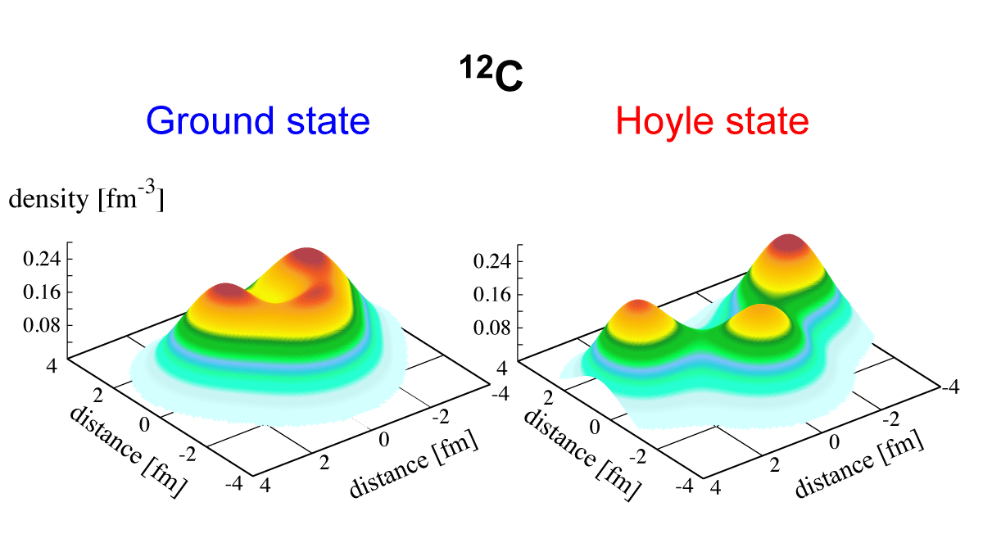
Alpha clusters in Carbon-12 from
ab initio theory & statistical learning
Objectives
Ab initio nuclear theory aims for parameter-free predictions of critical nuclear properties with controlled uncertainties using supercomputer simulations
Specfic goal is to determine extent of alpha clustering in the Ground state and the Hoyle state of Carbon-12 (¹²C)
Impact
Ground state found to have 6% alpha clustering while Hoyle state discovered to be 3-alphas 61% of the time
With this high percentage of 3-alphas, the Hoyle state is confirmed as a natural gateway state for the cosmic formation of ¹²C, the key element for organic life
Statistical learning confirms 3-alpha feature of Hoyle state
Ab initio Monte-Carlo Shell Model results for density contours of 12C Ground state and first excited 0⁺ (Hoyle) state using the Daejeon16 two-nucleon potential. Simulations were performed on Fugaku in Japan, the world’s largest supercomputer at the time.
Accomplishments
T. Otsuka, T. Abe, T. Yoshida, Y. Tsunoda, N. Shimizu, N. Itagaki, Y. Utsuno, J. Vary, P. Maris and H. Ueno, “Alpha-Clustering in Atomic Nuclei from First Principles with Statistical Learning and the Hoyle State Character,” Nature Communications 13:2234 (2022)
Notes:
File: Nucleus-2022_Moscow.pptx
File: IMP_Huizhou_November_2023_final.pptx
File: Vary_shell_Model_at_75_2024_final.pptx (revised as indicated above)
File: Vary_CENS_Frontiers_Meeting_final.pptx
File is online at: https://ntse.khb.ru/files/uploads/2026/vary_ntse_2026.pdf
File: NTSE2026_Vary_Full_rev.pptx

Slide 14
What lies ahead for nuclear theory to reach heavier nuclei?
Need for increased theory effort at deriving, applying and validating Chiral EFT
  Derive improved valence effective interactions from Chiral EFT
Develop direct QCD-based approach valid beyond Chiral EFT limits
Expand multi-disciplinary and multi-national collaborative efforts
Need for enhanced computational power (Quantum Computing and Artifical
Intelligence) to greatly expand basis spaces
Notes:
File: Nucleus-2022_Moscow.pptx
File: IMP_Huizhou_November_2023_final.pptx
File: Vary_shell_Model_at_75_2024_final.pptx (revised as indicated above)
File: Vary_CENS_Frontiers_Meeting_final.pptx
File; NTSE2026_Vary_full.pptx
File is online at: https://ntse.khb.ru/files/uploads/2026/vary_ntse_2026.pdf
File: NTSE2026_Vary_Full_rev.pptx
Extended for C3NT_Wuhan_June_2026_Vary_full.pptx

Slide 15
Pushing NCSM to current
computational limits:
Preludes to ³²Mg
Comparing NCSM (NCSM-4) with
derived Valence Effective SM (DJ16₄-th)
at N_{max} = 4 using Daejeon16 plus Coulomb.
0hw-only states
Dimension at N_{max} = 8 is 12.2 billion
Low-lying “0hw states” well converged
Intruders not yet converged at N_{max} = 8
0hw and 2hw state spacings ~Nmax indep.
Low-lying “0hw-states” well reproduced
Favorable comparison with USDB and
and with EXP
I.J. Shin, I Mazur, N.A. Smirnova, A.M. Shirokov and Y. Kim et al, in preparation
Notes:
Spectroscopy examples from subfolder in folder JPVz117_Shin_etal_sd_calculations_at_Nmax4
File is online at: https://ntse.khb.ru/files/uploads/2026/vary_ntse_2026.pdf
File: NTSE2026_Vary_Full_rev.pptx

Slide 16
Where “Quantum Advantage” appears
Case study: Is ³²Mg Spherical, Deformed or Hybrid?
Notes:
File is online at: https://ntse.khb.ru/files/uploads/2026/vary_ntse_2026.pdf
File: NTSE2026_Vary_Full_rev.pptx

Slide 17
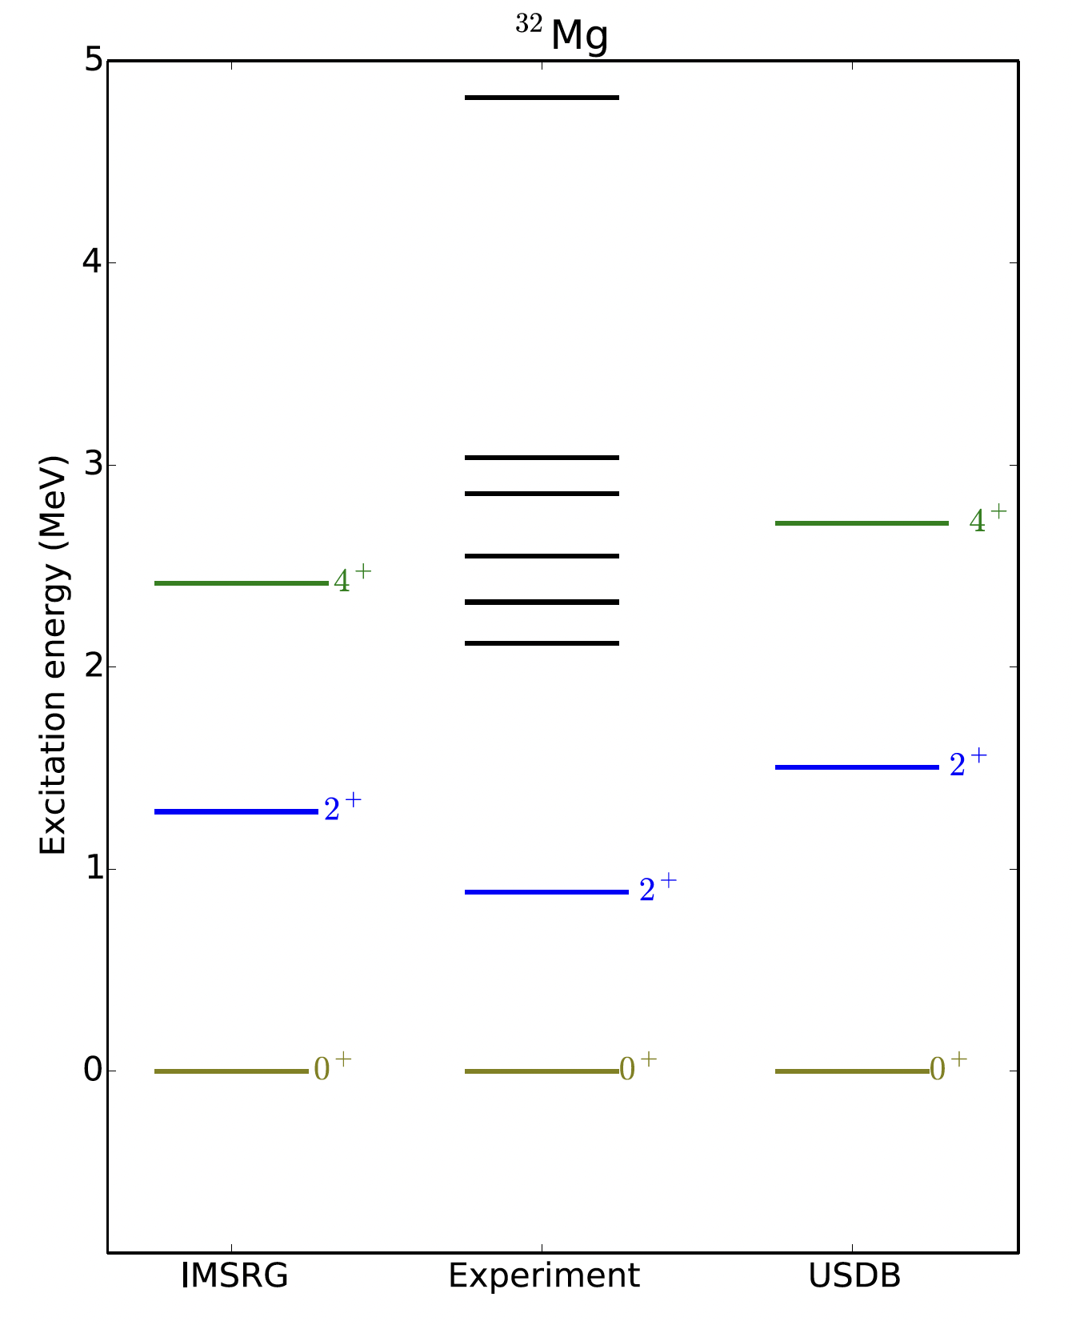
The Science Challenge: Can ab initio theory predict Configuration Inversion?
Note that theory and phenomenology indicate vibrational spectra
more typical of semi-magic (0p-0h) spectra.
Current experiment (not shown) supports rotational spectrum:
E4⁺ / E2⁺
4 / 2 = 2.0 (vibrational)
20 / 6 = 3.3 (rotational)
2.32 / 0.88 ~ 2.6 (Experiment)
Stroberg PRC 2016
Notes:
From file: Stroberg_PRC2016_SupplementSpectra.pdf
Fro
File is online at: https://ntse.khb.ru/files/uploads/2026/vary_ntse_2026.pdf
File: NTSE2026_Vary_Full_rev.pptx
m File: Basili_26.1.16_NTG_Q-Blue.pptx

Slide 18
Coupled Cluster in Hartree-Fock basis
using a hybrid chiral EFT Hamiltonian
Spherical is below deformed though energy gain from projection
suggests actual solution will be a hybrid solution
Z.H. Sun, A. Ekstroem, C. Forssen, G. Hagen, G.R. Jansen and T. Papenbrock,
“Multiscale Physics of Atomic Nuclei from First Principles,”
Phys. Rev. X 15, 011028 (2025)
Notes:
Figure caption from the combined Fig captions of Fig. 4 (30Ne) and Fig. 5 (32Mg)
FIG. 5. (a) shows the Hartree-Fock energy for 32Mg as a function of the quadrupole deformation q20 for the more spherical (left, red
curves) and deformed (right, blue curves) states for increasingly larger model spaces (labeled by Nmax) with an oscillator frequency of
ℏω . 14 MeV. (b) demonstrates the convergence of the ground-state energy from symmetry-breaking coupled cluster with singles and
doubles (CCSD) and triples estimates [CCSD . .T.]. These deformed states are superpositions of states with good angular momentum.
(c) shows the rotational bands obtained from angular-momentum-projected coupled-cluster computations of the deformed states in a
model space Nmax . 8. All calculations are based the interaction 1.8=2.0.EM..
File: Pages from Sun_etal_HF+CC_PhysRevX.15.011028.pdf
File is online at: https://ntse.khb.ru/files/uploads/2026/vary_ntse_2026.pdf
File: NTSE2026_Vary_Full_rev.pptx

Slide 19
³²Mg
10¹¹
³²Mg at N_{max}=7 has D~1trillion & requires ~1.4 quadrillion nonzero matrix elements
Notes:
Adapted from File SciDAC2025_Maris.pdf – presented at the SciDAC Annual Meeting, September 2025
Adaptations by JPV in File: NP_Vary_v12.pptx
File is online at: https://ntse.khb.ru/files/uploads/2026/vary_ntse_2026.pdf
File: NTSE2026_Vary_Full_rev.pptx

Slide 20
Current classical calculations suggest rapidly deceasing ”collective intruder band”
Similar to
G.S. Band
R. Basili, P. Maris and J.P. Vary, in preparation
Notes:
File is online at: https://ntse.khb.ru/files/uploads/2026/vary_ntse_2026.pdf
File: NTSE2026_Vary_Full_rev.pptx

Slide 21
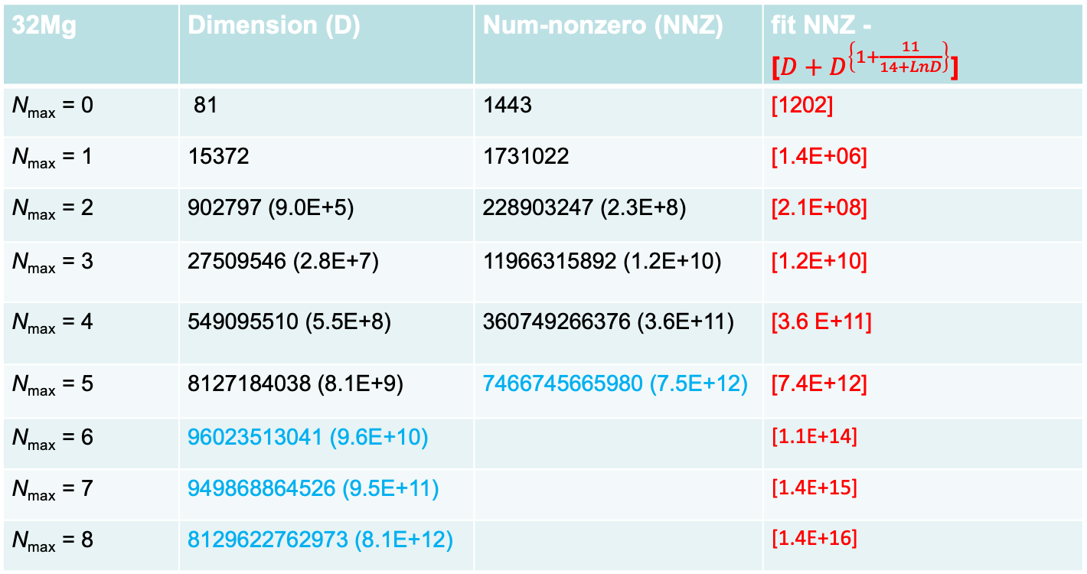
Where is Quantum Advantage for ³²Mg in the NCSM?
32Mg | Dimension (D) | Num-nonzero (NNZ) | fit NNZ - [$D+D^{\left\{1+\frac{11}{14+LnD}\right\}}$]
N_{max} = 0 | 81 | 1443 | [1202]
N_{max} = 1 | 15372 | 1731022 | [1.4E+06]
N_{max} = 2 | 902797 (9.0E+5) | 228903247 (2.3E+8) | [2.1E+08]
N_{max} = 3 | 27509546 (2.8E+7) | 11966315892 (1.2E+10) | [1.2E+10]
N_{max} = 4 | 549095510 (5.5E+8) | 360749266376 (3.6E+11) | [3.6 E+11]
N_{max} = 5 | 8127184038 (8.1E+9) | 7466745665980 (7.5E+12) | [7.4E+12]
N_{max} = 6 | 96023513041 (9.6E+10) |  | [1.1E+14]
N_{max} = 7 | 949868864526 (9.5E+11) |  | [1.4E+15]
N_{max} = 8 | 8129622762973 (8.1E+12) |  | [1.4E+16]
Memory limit on Aurora
Fit function: J.P. Vary et al; J. Phys. Conf. Ser. 180 012083 (2009)
Notes:
Initial slides from He Li, with updates from Pieter (light blue = teal) and with fits from Bo
Based on slides from Bo on 12/20/25 – File: 32Mg_nonzeros_estimations_from_Bo_2025-12-20.pptx
Based also on data from PM on 12/19/25 – File: sparsity_Magnesium32_from_PM.dat
Note that PM views Nmax = 6 as likely doable on Aurora
Updated slide with additional Fit3 results from Bo 01/08/26 (with narrative description in email) = File: 32Mg_26-1-8.pptx
Adapted From File: Basili_26.1.16_NTG_Q-Blue.pptx
Adapted From File: NP_vary_v12.pptx
File is online at: https://ntse.khb.ru/files/uploads/2026/vary_ntse_2026.pdf
File: NTSE2026_Vary_Full_rev.pptx

Slide 22
For each of the two classes (neutrons and protons) the following table applies
# # sps # 32-bit words
Nshel orb’ls m-states numwds (classical sps encoding)
0s 1 1 2 1
0p 2 3 8 1
1s,0d 3 6 20 1
1p,0f 4 10 40 2
2s,1d,0g 5 15 70 3
2p,1f,0h 6 21 112 4
3s,2d,1g,0i 7 28 168 6
3p,2f,1h,0j 8 36 240 8
4s,3d,2g,1i,0k 9 45 330 11 Nmax=6 for 32Mg enclosed
4p,3f,2h,1j,0l 10 55 440 14 Nmax=7 for 32Mg enclosed
5s,4d,3g,2i,1k,0m 11 66 572 18
5p,4f,3h,…,1l,0n 12 78 728 23
6s,5d,4g,…1m,0o 13 91 910 29
6p,5f,4h,….1n,0p 14 105 1120 35
7s,6d,5g,…,10,0q 15 120 1360 43
7p,6f,5h,…,1p,0r 16 136 1632 51
Notes:
Adapted from page 395 of Heff_R&D_plans.doc
File: ECT_July_2025_full.pptx
Nshell 9 plus lagrange mult
From File: Basili_26.1.16_NTG_Q-Blue.pptx
From File: NP_vary_v12.pptx
File is online at: https://ntse.khb.ru/files/uploads/2026/vary_ntse_2026.pdf
File: NTSE2026_Vary_Full_rev.pptx

Slide 23
Many outstanding nuclear physics
discoveries & opportunities remain
Origin of the successful nuclear shell model
Collective motion & Clustering phenomena
Nuclear reactions and breakup
Astrophysical processes & drip lines
New opportunities: AI and Quantum Computing
Predictive Nuclear Theory will provide
a window on Physics beyond the Standard Model
A comprehensive program of theory & experiment
is needed to maximize discovery potential
Notes:
From: Vary_C2R2_South_Korea.pptx
Many more include:
Solve the Ay puzzle, neutrinoless double-beta decay (lepton number violation already mentioned)
updated for: Vary_SINP_Jubilee_full
Expanded for File: Nucleus-2022_v1
File: Nucleus-2022_Moscow.pptx
Modified for NTSE-2023
File: IMP_Huizhou_November_2023_final.pptx
File: Vary_shell_Model_at_75_2024_final.pptx (revised as indicated above)
Extended for File: Vary_CENS_Seminar_final.pptx
File: Vary_CENS_Frontiers_Meeting_final.pptx
File is online at: https://ntse.khb.ru/files/uploads/2026/vary_ntse_2026.pdf
File: NTSE2026_Vary_Full_rev.pptx

Slide 24
Thank you for your attention
I welcome your questions
Notes:
From: Vary_C2R2_South_Korea.pptx
File: IMP_Huizhou_November_2023_final.pptx
File: Vary_shell_Model_at_75_2024_final.pptx (revised as indicated above)
File: Vary_CENS_Frontiers_Meeting_final.pptx
File is online at: https://ntse.khb.ru/files/uploads/2026/vary_ntse_2026.pdf
File: NTSE2026_Vary_Full_rev.pptx

Slide 25
Backup Slides and References
Notes:
From: Vary_C2R2_South_Korea.pptx
File: IMP_Huizhou_November_2023_final.pptx
File: Vary_shell_Model_at_75_2024_final.pptx (revised as indicated above)
File: Vary_CENS_Frontiers_Meeting_final.pptx
File is online at: https://ntse.khb.ru/files/uploads/2026/vary_ntse_2026.pdf
File: NTSE2026_Vary_Full_rev.pptx

Slide 26
Bibliography of ISU Nuclear Theory on Quantum Computers – p1
506. Michael Kreshchuk, Shaoyang Jia, William M. Kirby, Gary Goldstein, James P. Vary and Peter J. Love,
“Simulating Hadronic Physics on NISQ devices using Basis Light-Front Quantization,”
Phys. Rev. A 103, 062601 (2021); arXiv: 2011.13443
507. Michael Kreshchuk, Shaoyang Jia, William M. Kirby, Gary Goldstein, James P. Vary and Peter J. Love,
“Light-Front Field Theory on Current Quantum Computers,” Entropy 23, 597 (2021);
Special Issue Noisy Intermediate-Scale Quantum Technologies (NISQ); arXiv: 2009.07885
510. Weijie Du, James P. Vary, Xingbo Zhao and Wei Zuo, “Quantum Simulation of Nuclear Inelastic Scattering”,
Phys. Rev. A 104, 012611 (2021); arXiv: 2006.01369
Robert A.M. Basili, Wenyang Qian, Shuo Tang, Austin Castellino, Mary Eshaghian-Wilner, Ashfaq Khokhar,
Glenn Luecke and James P. Vary, “Performance Evaluations of Noisy Approximate Quantum Fourier Arithmetic,” 2022
IEEE International Parallel and Distributed Processing Symposium Workshops (IPDPSW), 435 (2022);
arXiv: 2112.09349
Wenyang Qian, Robert Basili, Soham Pal, Glenn Luecke and James P. Vary,
“Solving hadron structures using the basis light-front quantization approach on quantum computers,”
Phys. Rev. Research 4, 043193 (2022); arXiv: 2112.01927
Wenyang Qian, Robert Basili, Mary Eshaghian-Wilner, Ashfaq Khokhar, Glenn Luecke and James P. Vary,
“Comparative study on the variations of quantum approximate optimization algorithms to the Traveling Salesman
Problem,” Entropy 25, 1238 (2023); arXiv: 2307.07243
548. Weijie Du and James P. Vary, “Multi-nucleon structure and dynamics via quantum computing,”
Phys. Rev. A 108, 052614 (2023); arXiv: 2304.04838
556. Shiplu Sarker, Wenyang Qian, Soham Pal, Robert Basili, Mary Eshaghian-Wilner, Ashfaq Khokhar, Glenn Luecke
and James P. Vary, “Quantifying performance of wire-based circuit cutting with entanglements,”; IEEE International Parallel
and Distributed Processing Symposium Workshops (IPDPSW), San Francisco, CA, USA, 1068 (2024).
Notes:
File: Vary_CENS_Frontiers_Meeting_final.pptx
File: Vary_INT_26-1_NCSM_Progress_and_Plans_full.pptx

Slide 27
Bibliography of ISU Nuclear Theory on Quantum Computers – p2
558. Peiyan Wang, Weijie Du, Wei Zuo and James P. Vary, “Nuclear Scattering via Quantum Computing,”
Phys. Rev. C 109, 064623 (2024); arXiv: 2401.17138
569. Sihao Wu, Weijie Du, Xingbo Zhao and James P. Vary, “Efficient and precise quantum simulation of ultra-relativistic
quark-nucleus scattering ,” Phys. Rev. D 110, 056044 (2024); arXiv: 2404.00819
573. Diyi Liu, Weijie Du, Lin Lin, James P. Vary and Chao Yang, “An Efficient Circuit for Block Encoding a Pairing Hamiltonian,”
Journal of Computational Science, 85, 102480 (2025); arXiv: 2402.11205
575.. Weijie Du and James P. Vary, “Systematic input scheme for many-boson Hamiltonians with applications
to the two-dimensional $\phi ^4$ theory,” Phys. Rev. D 111, 016013 (2025); arXiv: 2407.13672
579. Weijie Du and James P. Vary, “Systematic many-fermion Hamiltonian input scheme and spectral calculations
on quantum computers,” Phys. Letts. B 866, 139548 (2025); arXiv: 2402.08969
594. Robert A. M. Basili, Wenyang Qian, Shiplu Sarker, Shuo Tang, Austin Castellino, Mary Eshaghian-Wilner, Ashfaq Khokhar,
Glenn Luecke and James P. Vary, “Performance Evaluations of Signed and Unsigned Noisy Approximate Quantum Fourier Arithmetic,”
The Journal of Supercomputing, 81, 1465 (2025); arXiv: 2112.09349v2
604. Weijie Du, Yangguang Yang, Zixin Liu, Chao Yang and James P. Vary, “Quantum-classical framework for many-fermion
response and structure”; Phys. Letts. B 878, 140538 (2026); arXiv: 2602.08357
605. Weijie Du, Yangguang Yang, Zixin Liu, Chao Yang, and James P. Vary, “Ab initio many-fermion structure calculations
on a quantum computer”; Phys. Rev. C Letters 113, L061302 (2026); arXiv: 2505.19906
z67. Michael Kreshchuk, James P. Vary and Peter J. Love, “Simulating Scattering of Composite Particles”; arXiv: 2310.13742
Notes:
Updated for File: NP_and_HEP_on_Quantum_Computers_IEEE_Q-CASA_2024_v3.pptx
Further updated 12/2/24 and also leave out until further notice even though it has 9 citations to date (InSPIRE):
z19. Weijie Du, James P. Vary, Xingbo Zhao and Wei Zuo, “Ab initio nuclear structure via quantum adiabatic algorithm,”
arXiv: 2105.08910
File: Vary_CENS_Frontiers_Meeting_final.pptx
File: Vary_INT_26-1_NCSM_Progress_and_Plans_full.pptx

