Slide 1




Quantum Simulation of Lattice Gauge Theory
苑震生, Zhen-Sheng Yuan
C3NT QIS-HENP, June 15-19, 2026. Wuhan

Slide 2
Outline
Motivation on simulating LGT
Simulating U(1) LGT with ultracold atoms
Microscopic dynamics of LGT
Conclusion and outlook

Slide 3
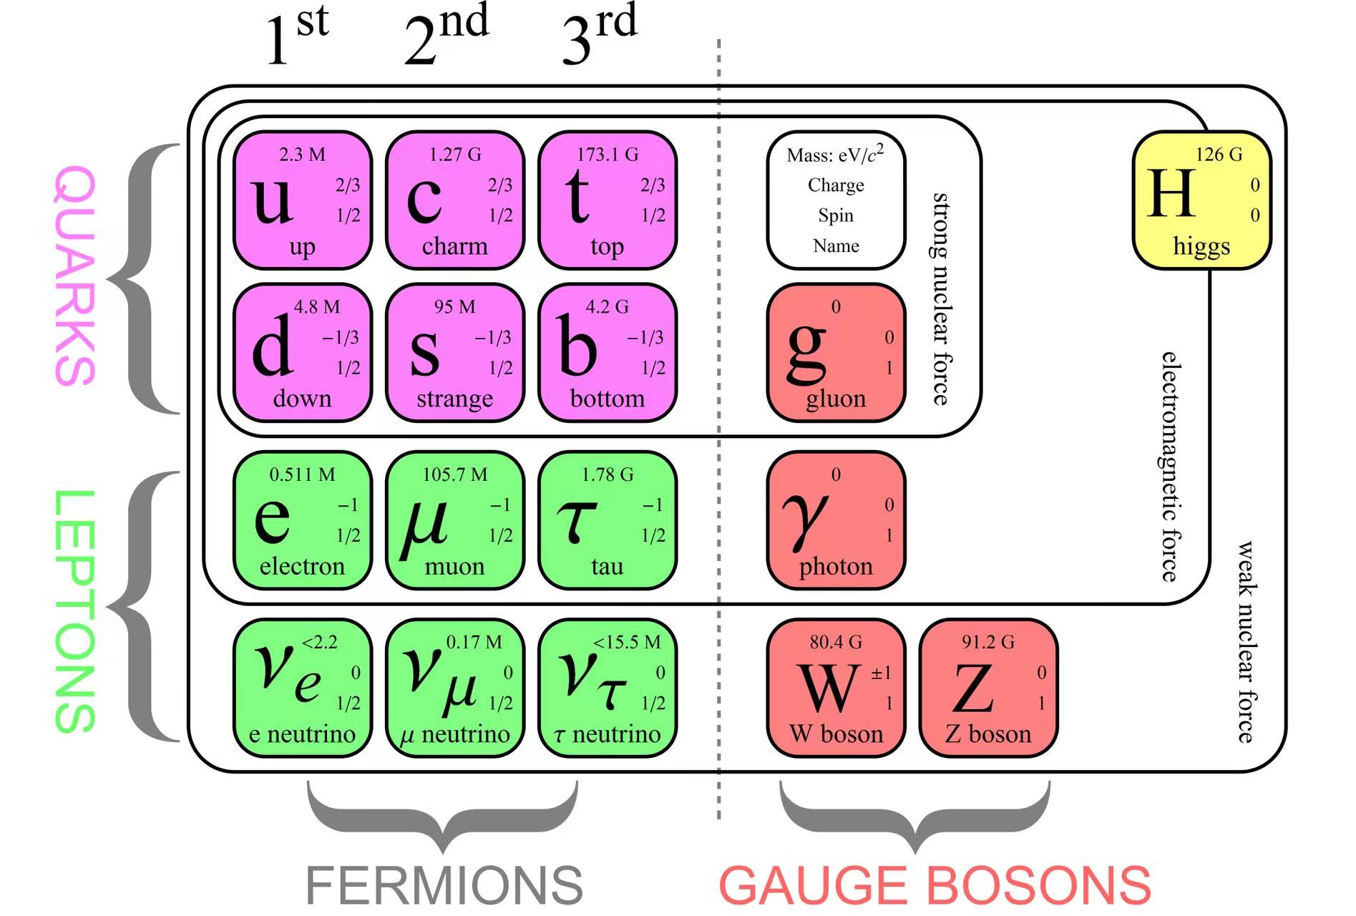
Gauge theory
The Standard Model is a gauge theory with a gauge symmetry, U(1)×SU(2)×SU(3)
Fundamental interactions: electromagnetic, weak, and strong interactions
Elementary particles
• Fermions
matter particles
spin: half integers
Pauli exclusion
• Gauge Bosons
mediate interactions
spin: integers
• Higgs Bosons
gives mass to particles
Notes:
First part:
What is gauge theory; Gauge group, gauge field;
The standard model;
Why Lattice gauge theory;
Why Quantum simulation of Lattice gauge theory; the toolkits of our quantum simulator
Our quantum simulator and
Second part:
The Schwinger model in a quantum link model description;
The ring exchange term;
The coupling between matter and gauge field (Nature);
The thermalization (Science and PRL)
The future:
Confinement and deconfinement
Higher trancations;
Higher dimensions
General comments on quantum simulation with ultracold atoms:
We build a strongly correlated system;
Symmetry; interactions;
Quantumness, the overall measurement. Reach a
Understand the nature of physics,

Slide 4
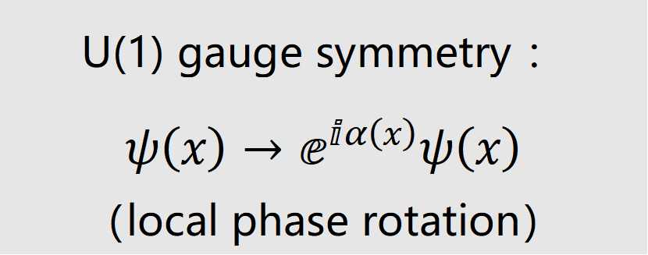
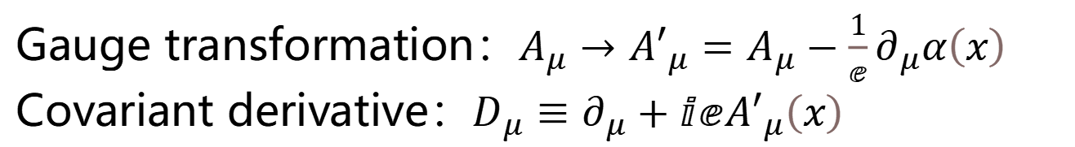
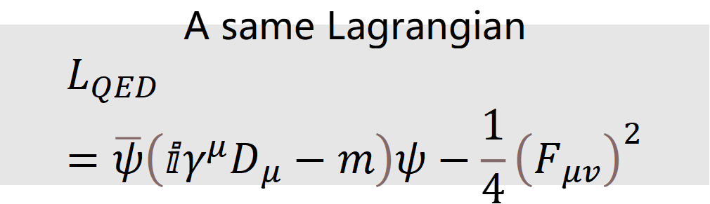
Gauge symmetry is the key of a gauge theory
In QED
U(1) gauge symmetry ：
$$ψ\left(x\right)→ⅇ^{ⅈα\left(x\right)}ψ\left(x\right)$$
（local phase rotation）
A same Lagrangian
$$L_{QED}=\overline{ψ}\left(ⅈγ^{μ}D_{μ}−m\right)ψ−\frac{1}{4}{\left(F_{μv}\right)}^{2}$$
Gauge transformation：$A_{μ}→{A′}_{μ}=A_{μ}−\frac{1}{ⅇ}∂_{μ}α\left(x\right)$
Covariant derivative：$D_{μ}≡∂_{μ}+ⅈⅇ{A′}_{μ}\left(x\right)$

Slide 5
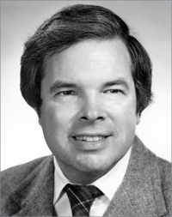
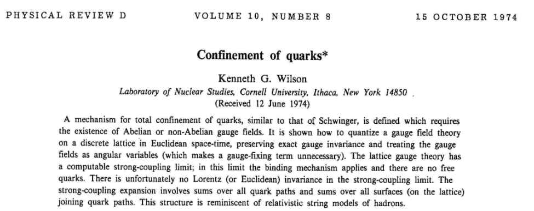
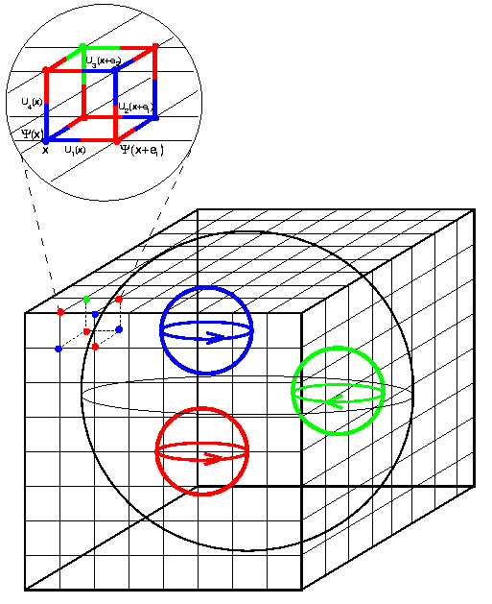
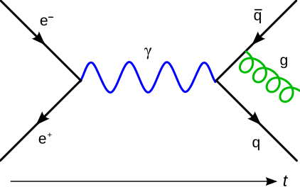
Lattice gauge theory
Lattice gauge theory (LGT) is the space-time discretized form of a gauge theory, for being solved non-perturbatively.
KG Wilson (1936-2013)
Nobel Prize Physics 1982
PRD 10, 2445 (1974)

Slide 6
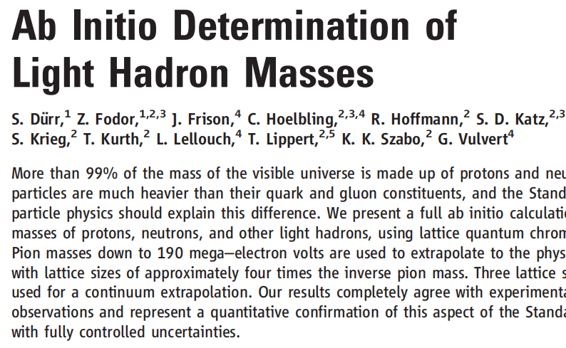
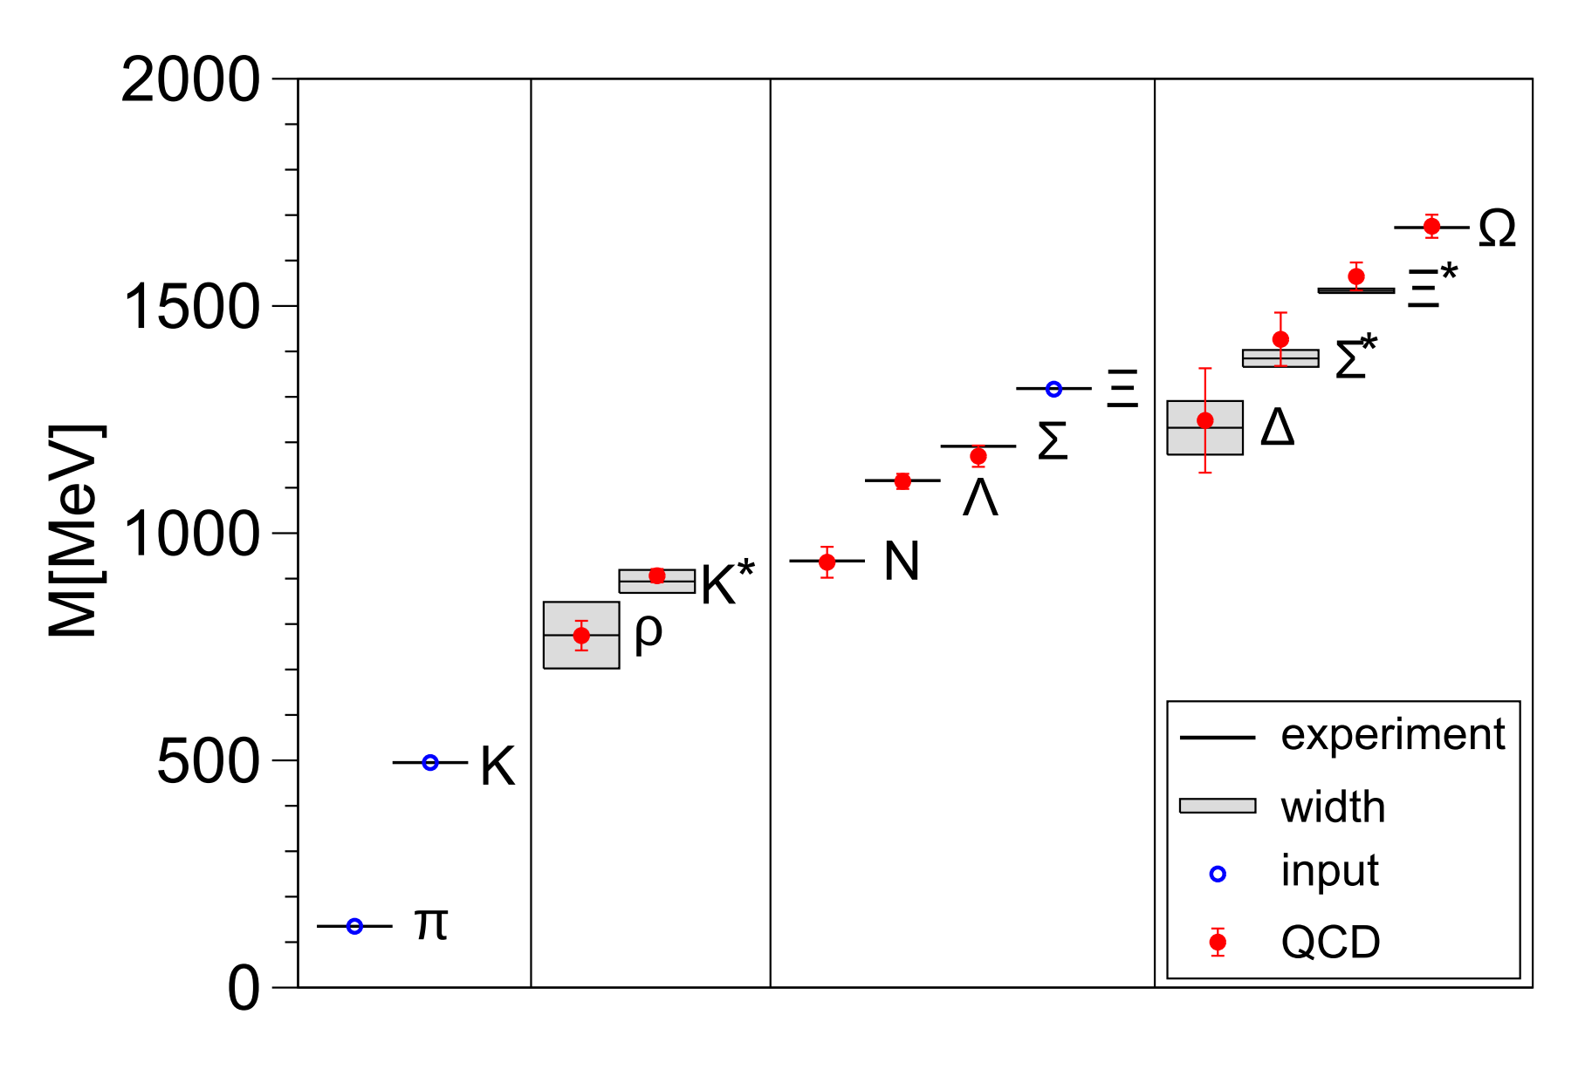
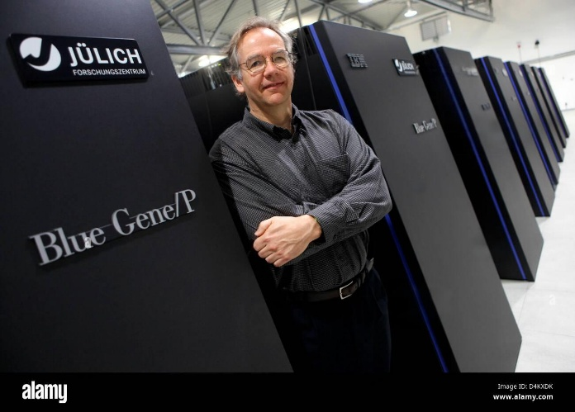

Solving LGT with supercomputers
Hadron spectrum
Science 322, 1224 (2008)
USQCD group Supercomputer clusters@Fermi Lab, Argonne, Oak Ridge…
FZ Jülich Blue Gene
Recent progress in calculating quark-gluon coupling constant, uncertainty 0.6%, Nature 652, 328 (2026),
Notes:
随着超级计算机地发展，人们开展了大规模从头算研究，例如对强子谱的计算，结果与实验测量高度符合。但是，右边这几个问题都是超算数值求解难于胜任的。在量子色动力学相图上，右上是解禁闭的夸克胶子等离子体，左下是禁闭的各种强子，科学家猜测（1）处有一个相变临界端点，这是布鲁克海文实验室RHIC加速器重点关注的问题；（2）中子星是强子低温高密度区域，预期有色超导相；(3)高温低密度区域，预期对应早期宇宙演化问题；(4)是对撞机碰撞点附近的动力学过程，在远场的探测器无法直接探测碰撞点附近的动力学过程。于是，造一台化学势温度可调、可随时间动力学演化的机器来模拟以上问题就有重要科学意义。

Slide 7
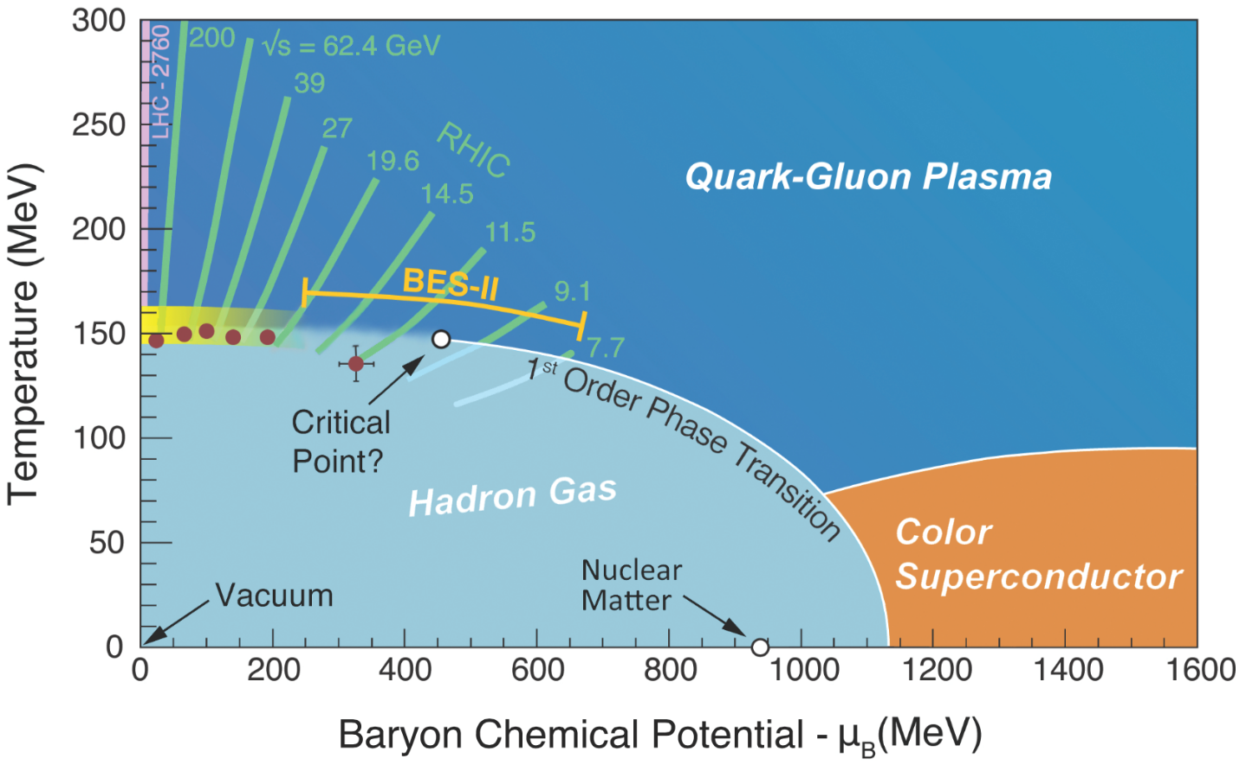
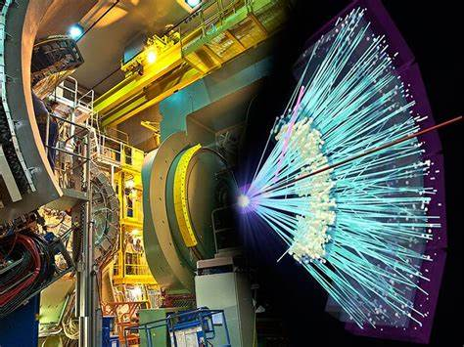
Challenges for solving LGT problems
QCD thermodynamics: Quark-gluon plasma
Collider Experiments
(3)
(1)
(4)
(2)
What’s happening here?
Theory: sign problem in Monte-Carlo simulations
Experiment:
critical point; color superconductor and neutron star physics;
evolution of the early Universe, bubble collisions; dynamics near the collision point in colliders

Slide 8
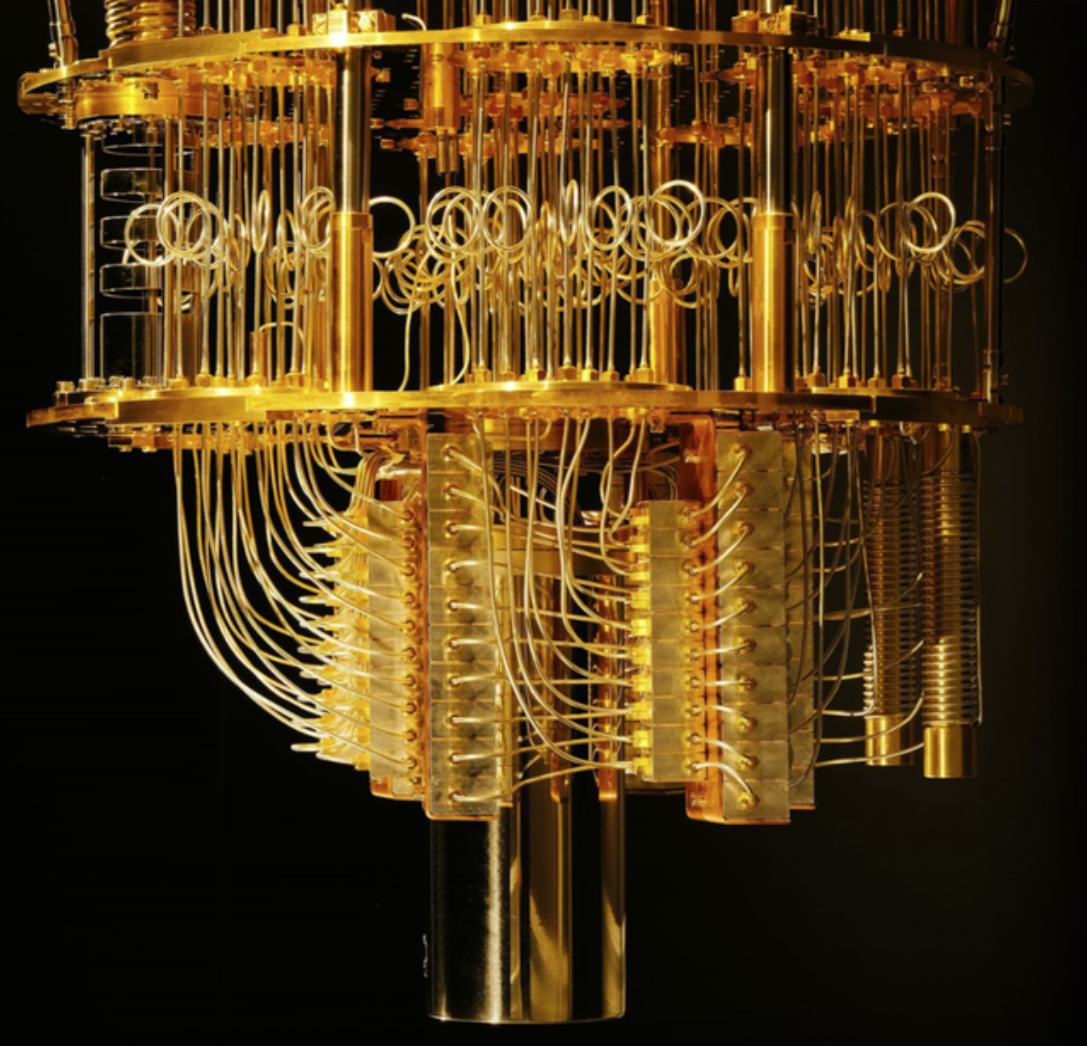
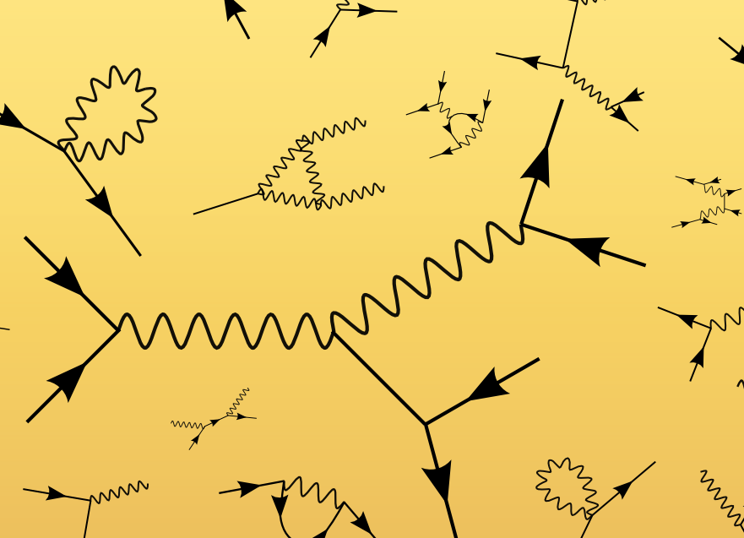
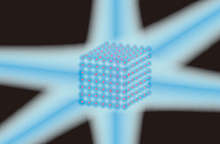

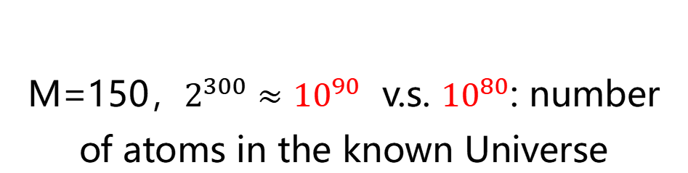





Quantum simulation
Diagonalization of H
Quantum computation
$$H=H_{0}+H_{I}$$
Lattice Gauge Theory
Digital
$$\begin{matrix}H_{11} & H_{12} & H_{13} \\ H_{21} & H_{22} & ∙ \\ H_{31} & ∙ & ∙\end{matrix}$$
$$\begin{matrix}⋯ & ⋯ & H_{1M} \\ ⋯ & ⋯ & ∙ \\ ⋯ & ⋯ & ∙\end{matrix}$$
$$\begin{matrix}⋮ & ⋮ & ⋮ \\ ⋮ & ⋮ & ⋮ \\ H_{M1} & ∙ & ∙\end{matrix}$$
$$\begin{matrix}⋯ & ⋯ & ∙ \\ ⋯ & ⋯ & ∙ \\ ⋯ & ⋯ & H_{MM}\end{matrix}$$
Analog
$$2^{M}×2^{M}$$
M=150，$2^{300}≈{10}^{90}$ v.s. ${10}^{80}$: number of atoms in the known Universe
Quantum Machine (Feynman,1981)
Requirements: manipulation of many particles at single particle level

Slide 9

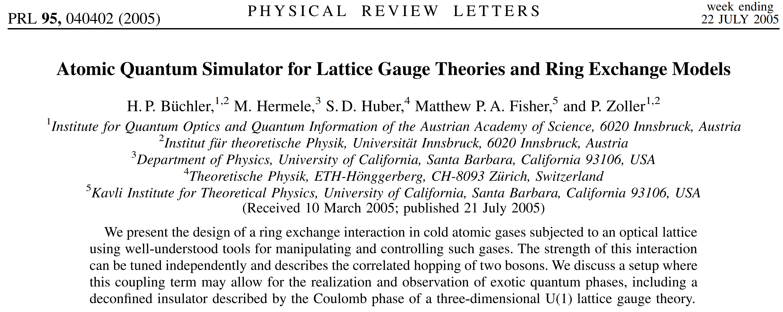
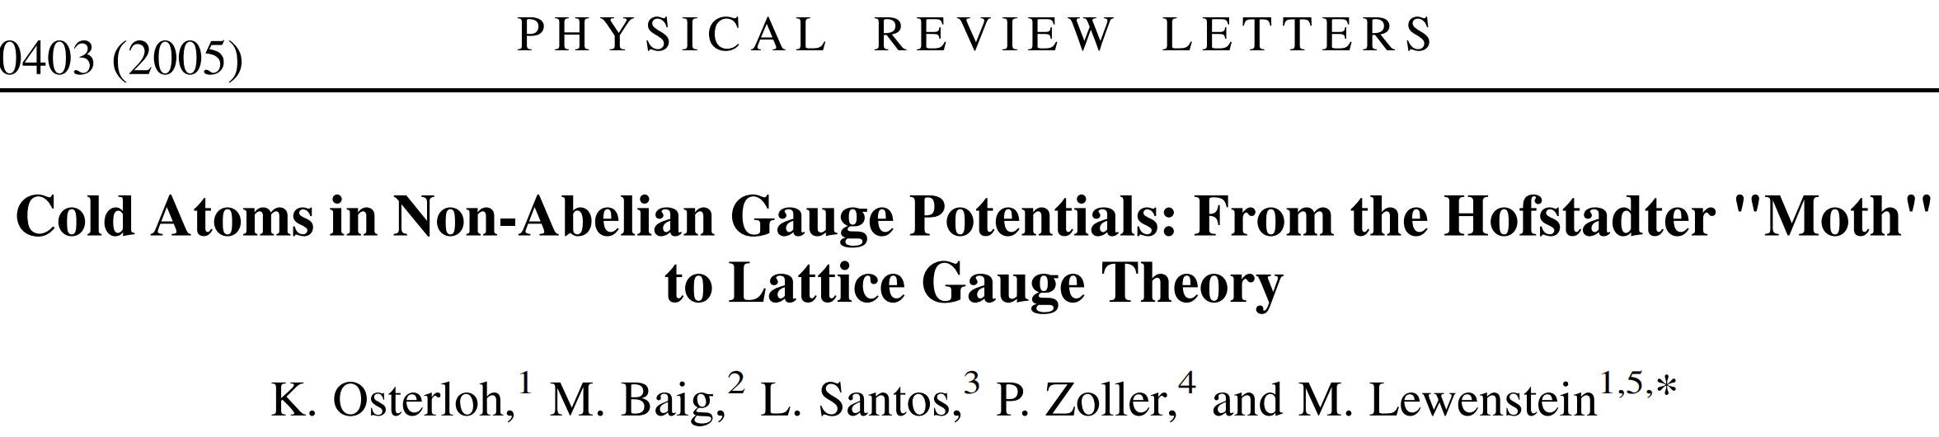

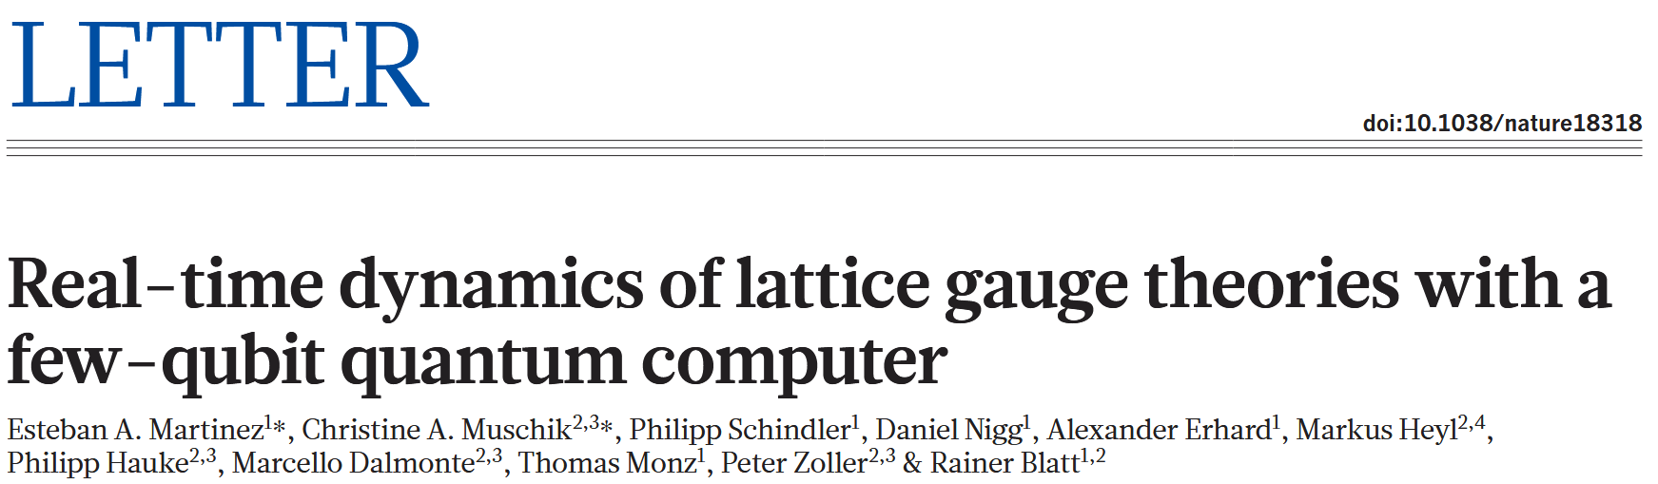
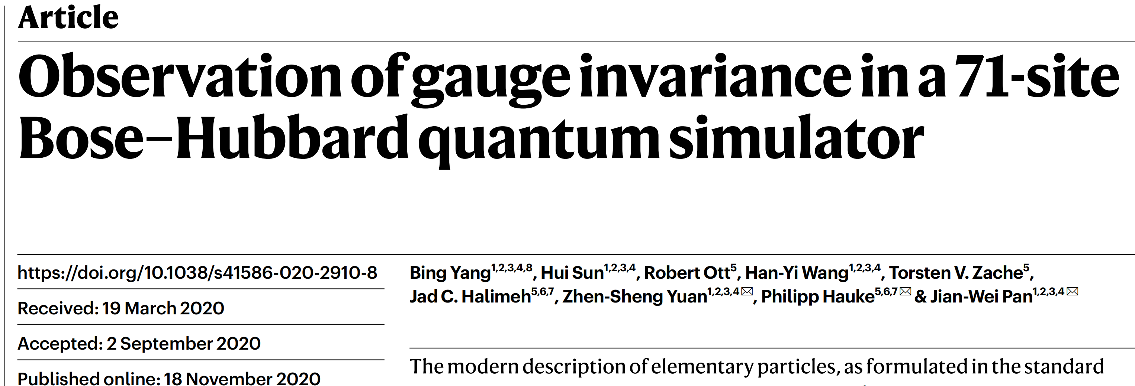
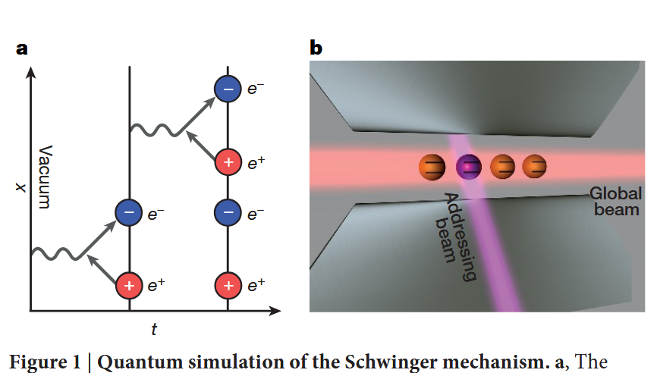
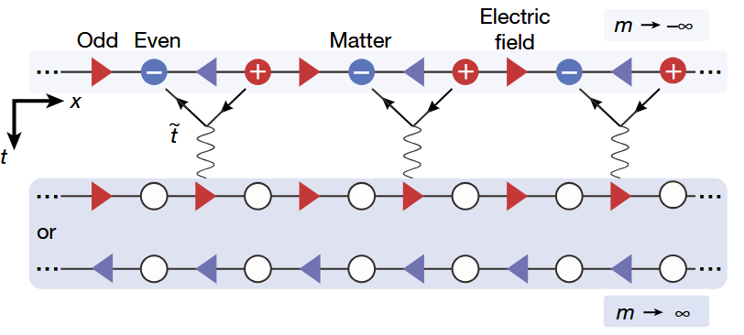
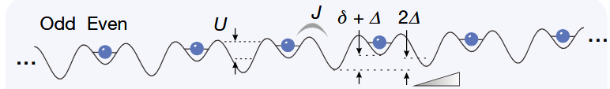
Simulating LGT with ultracold atoms
Theoretical proposals
Pair creation, with 4 trapped ions
2016
U(1) LGT, with 71-site ultracold atoms
White paper, USQCD: Quantum simulation for high-energy physics,
PRX Quantum 4, 027001 (2023)
Notes:
2005年，一周内先后投稿的两篇工作提出了使用超冷原子模拟器研究格点规范理论的方案。2016年，Innsbruck的blatt小组用4个离子模拟了正负粒子对的产生过程，仅模拟了物质场，再由守恒条件推导出规范场；2020年，我们开发了大规模的超冷原子量子模拟器，同时模拟了物质场、规范场自由度，并观测到规范不变性；2023年，美国格点理论合作组发表了量子模拟高能物理白皮书，阐述了量子模拟器、物理问题等方面的发展规划建议。

Slide 10
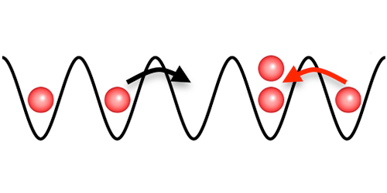
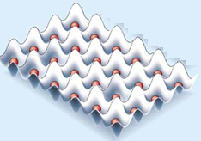
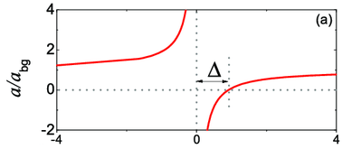

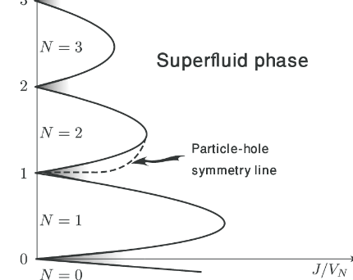
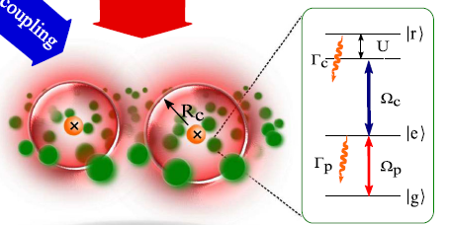
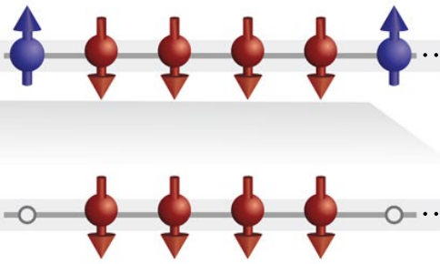
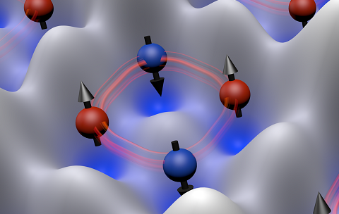
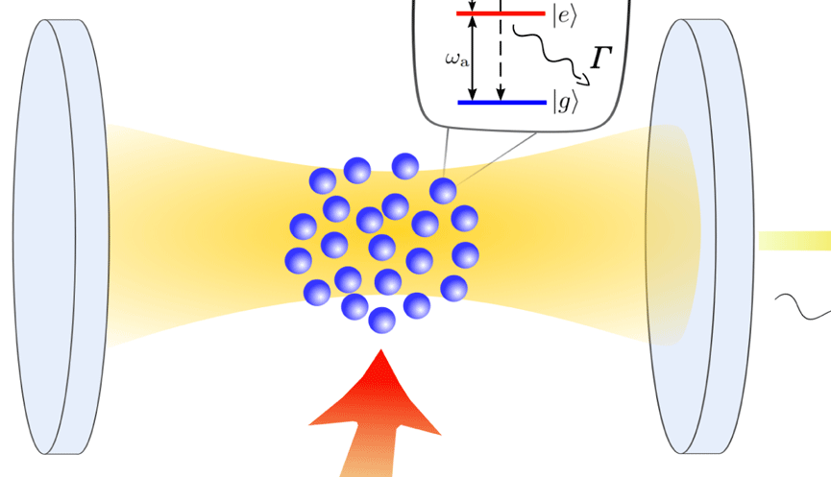

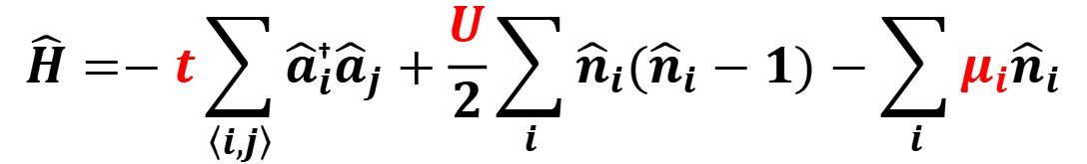



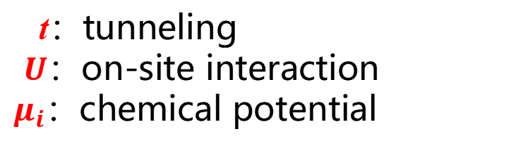

Tool box for quantum simulation
Quantum simulator: Hubbard Model, bosonic spins
Tune interactions
t
$$U$$
$$\hat{H}=−t\sum_{\left\langle i,j\right\rangle }{{\hat{a}}_{i}^{\text{†}}{\hat{a}}_{j}+\frac{U}{2}\sum_{i}{{\hat{n}}_{i}({\hat{n}}_{i}−1)−\sum_{i}{μ_{i}{\hat{n}}_{i}}}}$$
Feshbach resonance
t：tunneling
$U$：on-site interaction
$μ_{i}$：chemical potential
a~600 nm
Rydberg dressing
t/U competition
U>>t
U>>t, spin dependency
$$H\sim J_{ex}{\vec{S}}_{i}∙{\vec{S}}_{j}$$
$$H\sim J_{∎}{\vec{S}}_{1}∙{\vec{S}}_{2}∙{\vec{S}}_{3}∙{\vec{S}}_{4}$$
$$J_{ex}=t^{2}/U$$
$$J_{∎}=t^{4}/U^{3}$$
Cavity enhancement
Superfluid-insulator transition
Spin model
Topological models
Greiner et al., Nature 415, 39 (2002);
Jaksch et al., PRL 81, 3108 (1998);
Fisher et al., PRB 40, 546 (1989).
Dai et al., Nat. Phys. 12, 783 (2016);
Trotzky et al., Science 319, 295 (2008);
Duan et al., PRL 91, 090402 (2003).
Dai et al., Nat.Phys.13, 1195 (2017)
Paredes et al., PRA 77,023603 (2008)
Büchler et al., PRL 95, 040402 (2003)

Slide 11
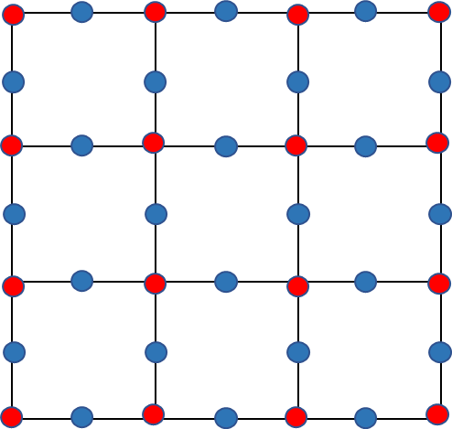

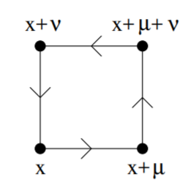

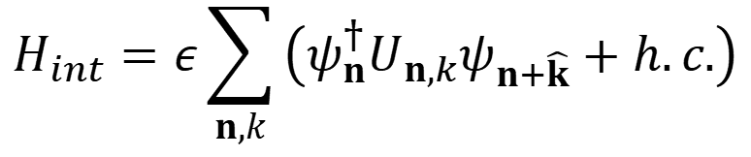
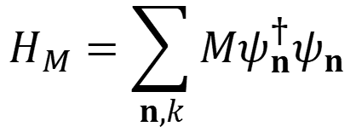
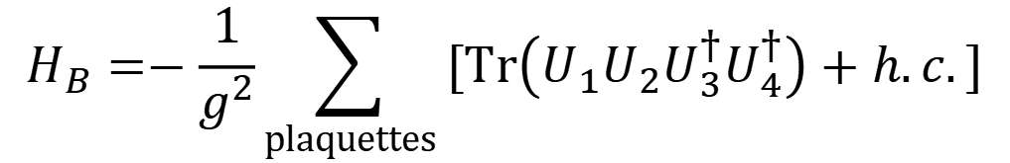
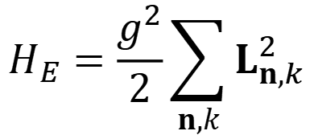
6-2. 哈密顿量组成
The Hamiltonian of 2D LGT
$$H=H_{E}+H_{B}+H_{M}+H_{int}$$
$$H_{E}=\frac{g^{2}}{2}\sum_{n,k}{L_{n,k}^{2}}$$
$$H_{B}=−\frac{1}{g^{2}}\sum_{plaquettes}{[Tr\left(U_{1}U_{2}U_{3}^{†}U_{4}^{†}\right)+h.c.]}$$
$$H_{M}=\sum_{n,k}{Mψ_{n}^{†}ψ_{n}}$$
$$H_{int}=ε\sum_{n,k}{\left(ψ_{n}^{†}U_{n,k}ψ_{n+\hat{k}}+h.c.\right)}$$
Wilson Loop
Strongly correlated many-body system

Slide 12
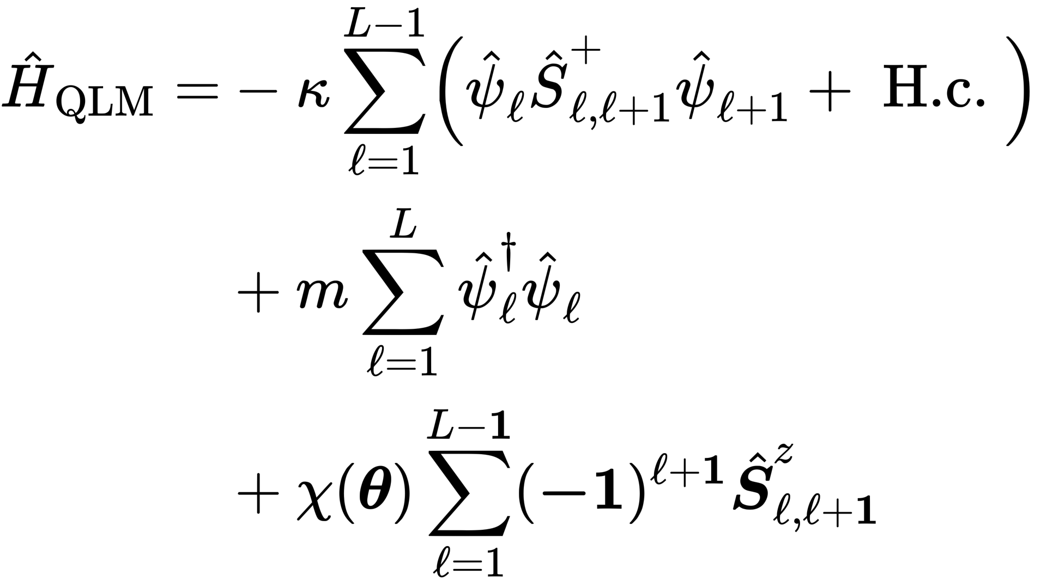
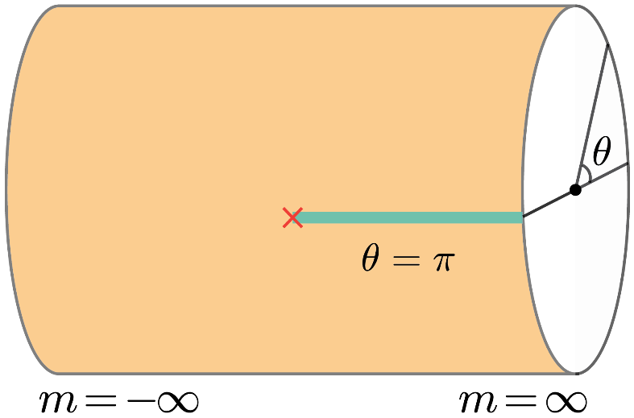
(1+1)d QED, U(1) LGT
Dynamics of particle-antiparticle pair
Matter-gauge interaction
quench
Mass term
ramp
electric field
Coleman’s phase transition at topological angle $θ=π$
Thermalization dynamics of a gauge theory
Yang et al., Nature 587, 392 (2020).
Zhou et al., Science 377, 311 (2022).
Zhang et al., Nat. Phys. 21, 155 (2025).
Liu et al., PRL 135, 101902 (2025).
Zhu et al., arXiv:2411.12565 (2024).
Confinement and deconfinement
String breaking and false vacuum decay

Slide 13
Outline
Motivation on simulating LGT
Simulating U(1) LGT with ultracold atoms
Microscopic dynamics of LGT
Conclusion and outlook

Slide 14
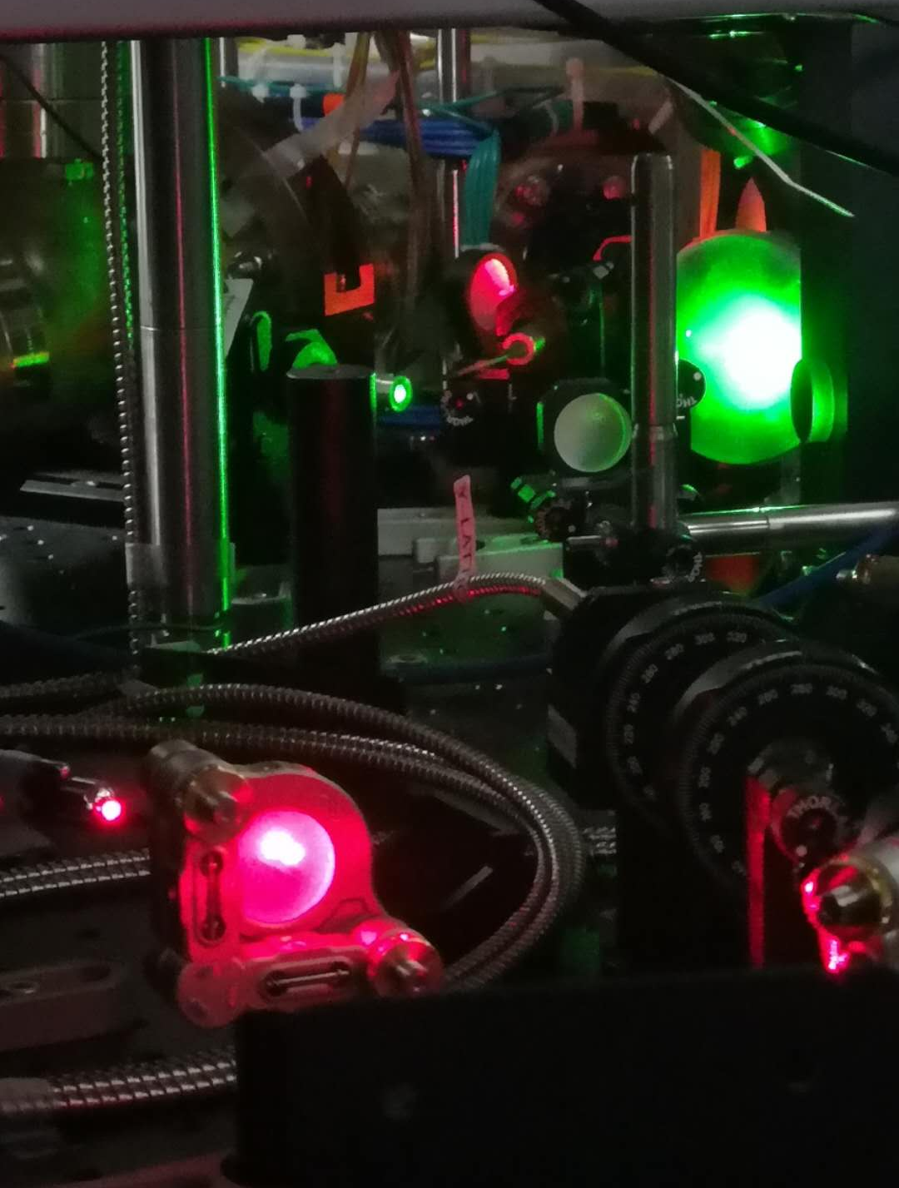
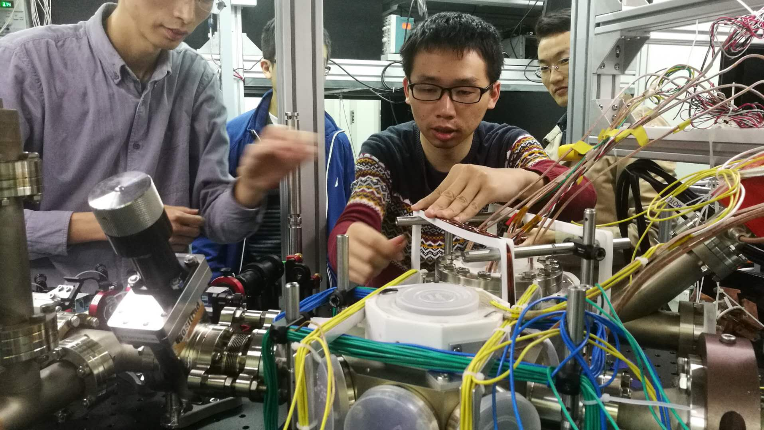
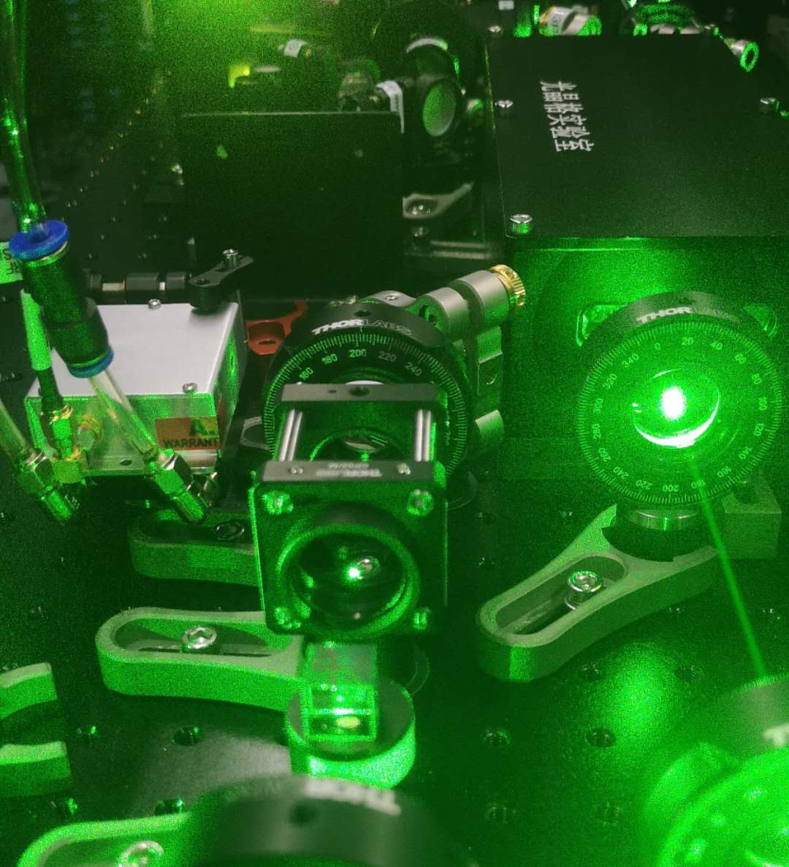
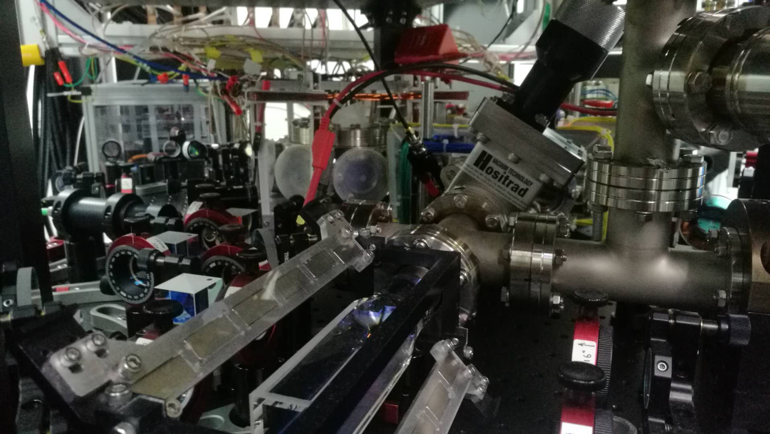
Experimental setup
⁸⁷Rb
Ion Pump
Ion Pump
3D MOT
⁸⁷Rb
2D MOT
Science Chamber

Slide 15
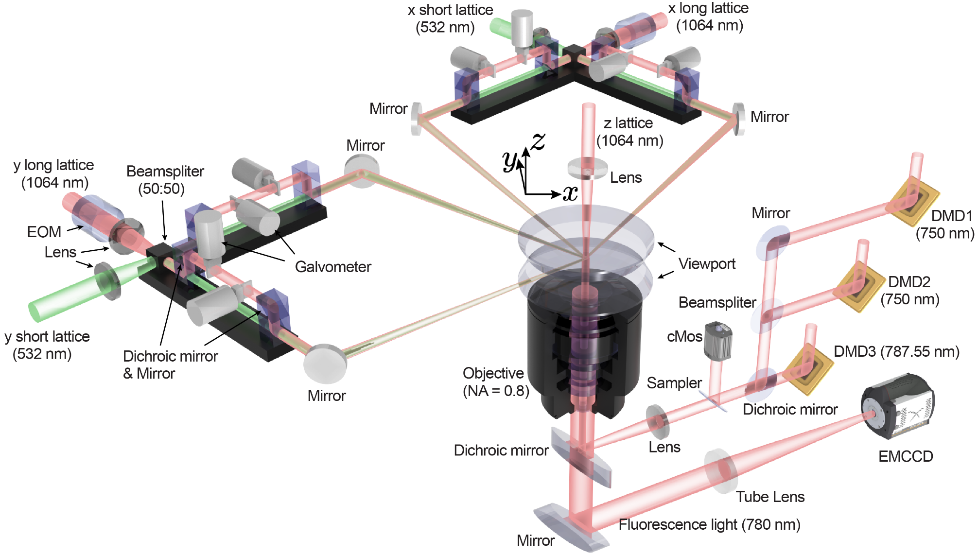
Experimental setup
Optics around the Science Chamber

Slide 16
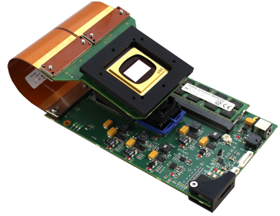
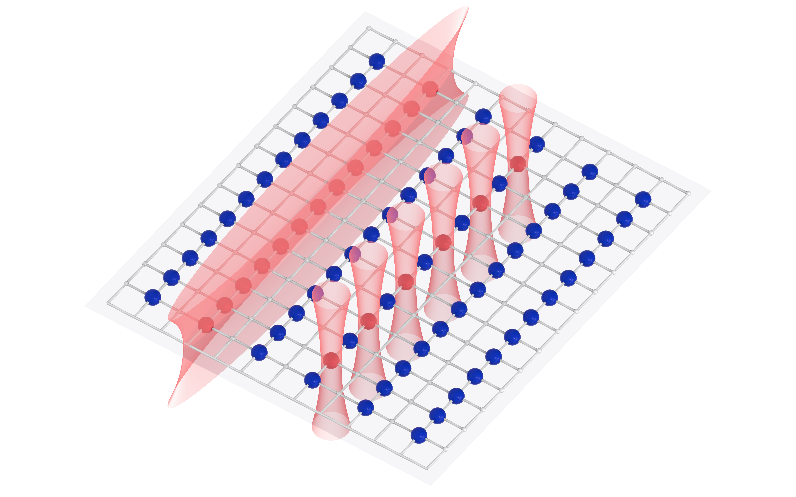
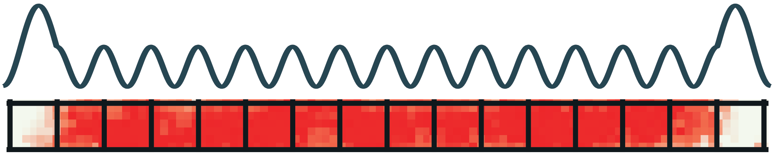


6-2. 哈密顿量组成
Tailoring the pattern of atoms
$$λ=750 nm$$
$λ=787.55 nm, σ^{−}$-polarized
Pattern-programmable site-resolved addressing
Arbitrary potential engineering

Slide 17

6-2. 哈密顿量组成
Number resolved detection
Zheng et al., arXiv:2210.08556 (2022).

Slide 18


Staggered-immersion cooling in the lattice
Challenge: remove defects, cool the atoms in lattices
Entropy $→0.0019 k_{B}/N$, $60$ times reduction
Defects: $10\%→0.1\%$, ~${10}^{4}$ sites
B. Yang et al., Science 369, 550 (2020).
Zhang et al., PRL 131, 073401 (2023).

Slide 19


1D Schwinger Hamiltonian with quantum link model
Electric field
Matter-Gauge interaction
Matter field
$${\hat{H}}_{QED}=\frac{a}{2}\sum_{l}{\left({\hat{E}}_{l,l+1}^{2}\right)−\frac{\text{i}}{2a}\sum_{l}{( {\hat{ψ}}_{l}^{†} {\hat{U}}_{l,l+1} {\hat{ψ}}_{l+1}−\text{H}\text{.}\text{c}\text{.})}+\frac{a}{2}\sum_{l}{m{(−1)}^{l}{\hat{ψ}}_{l}^{†} {\hat{ψ}}_{l}}}$$
considering spin-1/2 truncation
→ A constant electric field!
Along $θ=π$!
Notes:
This is the typical form of the 1D Schwinger model. Discretized matter fields sit on the lattice sites. Electric fields and the affiliated gauge fields are located on the links. The 1D Schwinger model contains the energy of electric field, the interaction between matter and gauge field, the rest energy of matter field. Later we will see that the electric field is modeled by a spin (two-level) system, then the energy of electric field is kept constant and can be neglected.

Slide 20






Simulating 1D LGT with the Hubbard model
Target Hamiltonian
Gauge field
Matter field, fermionic
$${\hat{H}}_{LGT}=\sum_{l}{[−\frac{i\tilde{t}}{2}\left({\hat{ψ}}_{l}{\hat{U}}_{l,l+1}^{†} {\hat{ψ}}_{l+1}−H.c.\right)+m{\hat{ψ}}_{l}^{†}{\hat{ψ}}_{l}] }$$
Matter-Gauge interaction
Map to the Bose-Hubbard model
matter
gauge
matter
gauge
matter
…
…
$$l−1$$
$$l$$
$$l+1$$
${\hat{a}}_{l}$: annihilation operator on matter sites
${\hat{d}}_{l,l+1}$: annihilation operator on gauge links
$${\hat{H}}_{LGT}=\sum_{l}{[\frac{\tilde{t}}{2√2}\left({\hat{a}}_{l}{\left({\hat{d}}_{l,l+1}^{†}\right)}^{2} {\hat{a}}_{l+1}+H.c.\right)+m{\hat{a}}_{l}^{†}{\hat{a}}_{l}] }$$
Notes:
Therefore, the target Hamiltonian is composed by the latter two terms and can be mapped to the Hubbard model. Here ${\hat{a}}_{l}$ is the annihilation operator on matter site l, and ${\hat{d}}_{l,l+1}$is the annihilation operator on gauge links. The interaction term shows that the annihilation of two matter fields on site l and l+1 leads to the creation of two particles on the gauge links.

Slide 21
Theory-Experiment mapping
$m→−∞$, matter field dominates.
One atom on 4n-2 site (n = 1, 2, 3, …)
|0 1 0⟩
One atom on 4n site (n = 1, 2, 3, …)
i : 1 2 3 4 5 6 7 8 9 10 11 12
|0 1 0⟩
$m→∞$, matter field annihilated to gauge field
Two atoms on 4n-3 site (n = 1, 2, 3, …)
|2 0 0⟩
Two atoms on 4n-1 site (n = 1, 2, 3, …)
|0 0 2⟩
Notes:
More concretely, in the low-energy limit (m is minus infinity), the matter field dominates, the net electric field will zero. We have the definition of the two mapping configurations.

Slide 22
Experimental observation within a 71-site lattice chain
Matter field l : 1 2 3 4 5 6
Observed the Coleman phase transition for the first time.
Verification of the Gauss’ law
Yang et al., Nature 587, 392 (2020).
Notes:
We measure the population of particles on the even or odd sites and observe the transition between the two states. The experimental results match well the numerical calculations.

Slide 23

Illustration of the experiment
Yang et al., Nature 587, 392 (2020).
动画：梁琰、石千惠、苑震生等

Slide 24
Outline
Motivation on simulating LGT
Simulating U(1) LGT with ultracold atoms
Microscopic dynamics of LGT
Conclusion and outlook

Slide 25

U(1) LGT, (1+1)D QED
Recall the Phase Diagram and Hamiltonian of U(1) LGT, (1+1)D QED
Matter-gauge interaction
Mass term
Dynamical electric field
Where, $κ=1$;
Horizontal -- $m/κ$;
Radial -- $∝χ/κ$;
J. Halimeh et al., PRX Quantum 3, 040316 (2022).
Y.-T. Cheng et al., PRX Quantum 3, 040317 (2022).

Slide 26





Mapping from BHM to QLM, a U(1) LGT
Implementing a tunable $θ$–angle term in a tilted Bose-Hubbard quantum simulator
BHM
QLM
Su et al., Phys. Rev. Research 5, 023010 (2023).
Zhang et al., Nat. Phys. 21, 155 (2025).

Slide 27


Mapping from BHM to QLM, a U(1) LGT
BHM
QLM
Staggered potential (BHM)
$θ$–angle term (QLM)

Slide 28




Dynamics of particle-antiparticle pair
Target initial state: creating a particle-antiparticle pair
Ground state @ $m→+∞$ -- Vacuum state
BHM
QLM
When $m>0$
Target initial state

Slide 29



Creating a particle-antiparticle pair!

Slide 30



Real time dynamics vs. $θ$-angle ($m=4κ>0$)
Atom density
$$χ/κ$$
2-point correlation
Ballistic propagation @ $θ=π$.

Slide 31
Real time dynamics vs. $θ$-angle ($m=4κ>0$)
Atom density
$$χ/κ$$
2-point correlation
Ballistic propagation @ $θ=π$.

Slide 32

Real time dynamics vs. $θ$-angle ($m=4κ>0$)
Atom density
$$χ/κ$$
2-point correlation
Ballistic propagation @ $θ=π$.
Constrained propagation ($θ≠π$)

Slide 33






More observables ($m>0$)
$θ=π\left(χ=0\right)$:
particle-antiparticle pair
ballistic (free) propagation
→ Deconfined phase
$θ≠π(χ≠0)$:
particle-antiparticle pair constrained propagation
→ Confined phase

Slide 34

In-situ observation of the deconfined dynamics
Zhang et al., Nat. Phys. 21, 155 (2025).

Slide 35





String breaking mechanism
Target Hamiltonian
String breaking
matter-gauge interaction
rest mass
string tension
Adiabatic evolution
QLM
BHM
string state
broken-string state
Liu et al., PRL 135, 101902 (2025).

Slide 36



String breaking mechanism
Mechanism of string breaking and inversion
String breaking
(even-sized systems)
String inversion
(odd-sized systems)

Slide 37





False Vacuum Decay Dynamics
Initial state:
  Dirac vacuum $\left|0^{+}\right\rangle =\left|…2020…\right\rangle$ with uniform $E_{i,i+1}=+1/2$.
Quench dynamics:
  Quantum fluctuations nucleate particle-antiparticle pairs under mass $m$ and external field $h$.
Energy cost of a pair $ΔE≈2m−hℓ$ , $ℓ$ is the pair size
Zhu et al., arXiv:2411.12565 (2024).

Slide 38
Outline
Motivation on simulating LGT
Simulating U(1) LGT with ultracold atoms
Microscopic dynamics of LGT
Conclusion and outlook

Slide 39



Conclusion
Simulating the 1D Schwinger model with 71-site optical lattice
Yang et al., Nature 587, 392 (2020).
Thermal dynamics of a lattice gauge theory
Zhou et al., Science 377, 311 (2022).
Su et al., PR Research 5, 023010 (2023).
Interrelated thermalization and quantum criticality
Wang et al., PRL 131, 050401 (2023).
Confinement physics of a lattice gauge theory, 𝜽 & microscopic
Zhang et al., Nat. Phys. 21, 155 (2025).
String breaking and false vacuum decay
Liu et al., PRL 135, 101902 (2025).
Zhu et al., arXiv:2411.12565 (2024).
Notes:
Based on the plaquette units, by modulating the lattice, we may couple them dynamically to a many-body strongly correlated topological system. This will open an new route to study exotic phases of material and simulating lattice gauge theories. One may refer to the reviews on topological matters with ultracold atoms. The spin-dependent technique developed in our experiment may be extended to fermionic systems where non-Abelian anyons can be studied.

Slide 40

Outlook
Confinement/deconfinement of the Schwinger model
Simulating 2D LGT
Intractable
for classical computers
Accessible with
Classical computers
Non-abelian
SU(2) LGT
1$D Z_{2}$ symmetry
1D 71-site
U(1) LGT
High-order truncations of gauge fields
1D U(1) gauge
1D many-body system
Building blocks
2D ring exchange
Dynamics of 2D LGT
SU(3) LGT quantum simulator ➔ QCD
Now
Future
Notes:
We should think about big pictures?
Quantum simulation with universal quantum computing.
Still have the advantage of parallel operation
Overall measurement.

Slide 41














The experiment team
Co-PI:
Members:
Prof. Jian-Wei Pan (USTC)
Dr. Hui Sun
Dr. Y.-G. Zheng
Dr. W.-Y. Zhang
Z.-Y. Zhou
An Luo
G.-X. Su
Ying Liu
H.-Y. Wang
M.-G. He
Z.-H. Zhu
Y.-C. Shen
P.-Y. Qiu
T.-Y. Wang

Slide 42














Acknowledgement
Collaborators:
Theory teams:
Prof. Bing Yang
(Sustech)
Prof. H.-N Dai (USTC)
Prof. P Hauke
(Trento)
Prof. J Berges
(UHEI)
Dr. J Halimeh
(LMU)
Robert Ott
(UHEI, Innsbruck)
Dr. T Zache
(UHEI, Innsbruck)
Prof. Y. Deng (USTC)
Prof. Y.-A Chen (USTC)
Prof. Zlatko Papic
(U. Leeds)
Prof. Hui Zhai
(Tsinghua)
Dr. Yanting Cheng
(USTB)
Dr. Sid Morampudi
(MIT)
Prof. M. Dalmonte
(ICTP)

Slide 43
Thanks for your attention！
感谢自然科学基金委、新基石基金会、科技部等的支持！
Welcome to visit us at USTC
https://quantum.ustc.edu.cn
Positions (for faculty, postdoc, PhD student) are available

