Slide 1
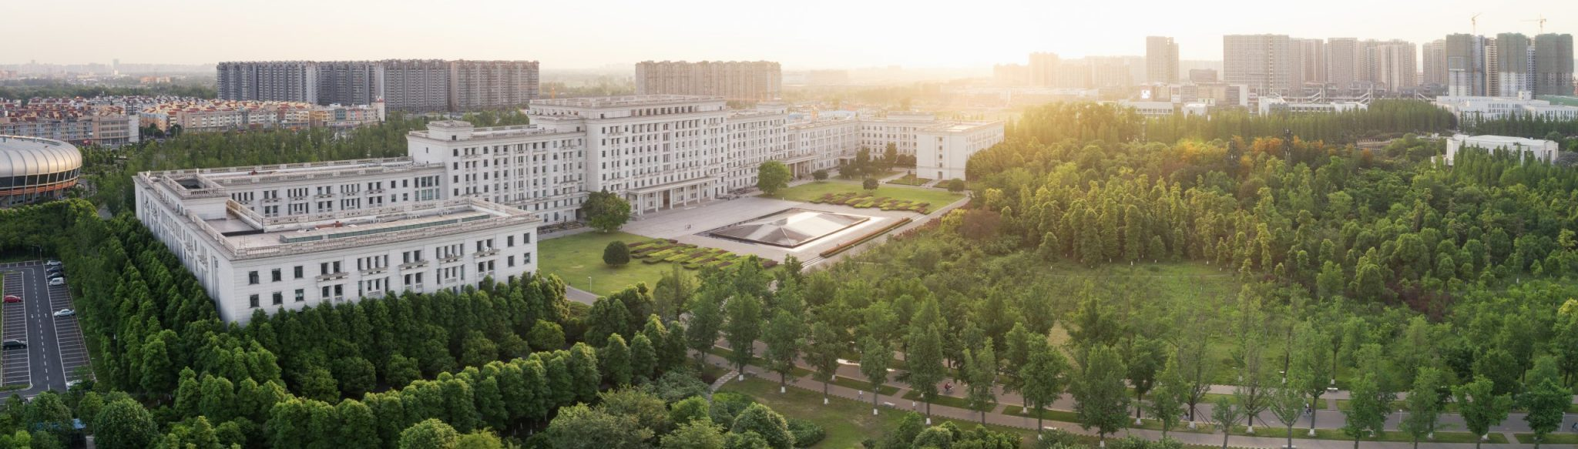
Quantum many-body sensors
Abolfazl Bayat
University of Electronic Science and Technology of China, Chengdu

Slide 2

What can be estimated?
The only way to extract information about the parameter of interest in a physical system is to
perform measurement
If the parameter of interest is a quantum mechanical observable
(e.g. energy) one can directly measure it
If the parameter of interest is not an observable (e.g. temperature) it
has to be estimated
Sometimes even observables should be estimated due to practical
constrains

Slide 3
Sensing procedure
Probe
Measurement
Estimator
Unknown parameter
is estimated
The probe, measurement basis and estimators should be optimal

Slide 4

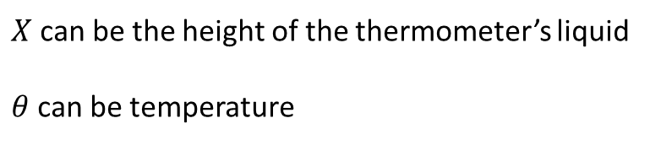
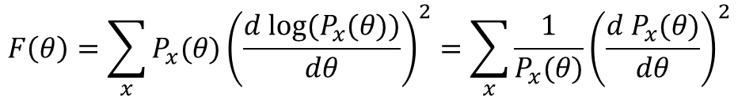

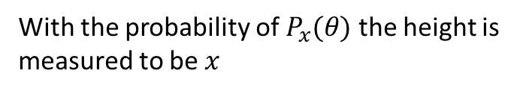
Estimation theory
One can measure a random variable $X$ for measuring an unknown parameter $θ$
$X$ can be the height of the thermometer’s liquid
$θ$ can be temperature
With the probability of $P_{x}(θ)$ the height is
measured to be $x$
Cramer-Rao inequality:
$${δθ}^{2}=\left\langle {\left(θ_{est}−θ_{real}\right)}^{2}\right\rangle ≥ \frac{1}{MF(θ)}$$
M is the number of repetition
$$F\left(θ\right)=\sum_{x}{P_{x}(θ){\left(\frac{d{ log⁡(P}_{x}(θ))}{dθ}\right)}^{2}}=\sum_{x}{\frac{1}{P_{x}(θ)}{\left(\frac{d{ P}_{x}(θ)}{dθ}\right)}^{2}}$$
Fisher information:
Larger Fisher information implies better sensitivity

Slide 5

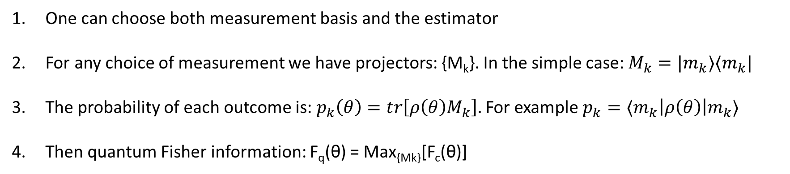


Quantum Fisher information
$$ρ(θ)$$
Estimate $θ$
One can choose both measurement basis and the estimator
For any choice of measurement we have projectors: {M_{k}}. In the simple case: $M_{k}=|m_{k}⟩⟨m_{k}|$
The probability of each outcome is: $p_{k}\left(θ\right)=tr\left[ρ\left(θ\right)M_{k}\right].$For example $p_{k}=⟨m_{k}\left|ρ\left(θ\right)\right|m_{k}⟩$
Then quantum Fisher information: F_{q}(θ) = Max_{{Mk}}[F_{c}(θ)]
$$F_{q}{≥F}_{c}$$
M. G. A. Paris, International Journal of Quantum Information 7, 125 (2009)
J. Liu, H. Yuan, X. M. Lu, X. Wang, J. Phys. A-Math.53, 023001 (2020)
J. J. Meyer, Quantum 5, 539 (2021)

Slide 6

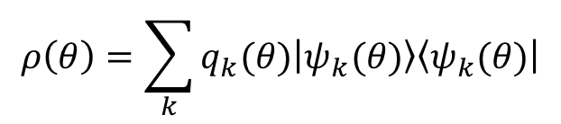

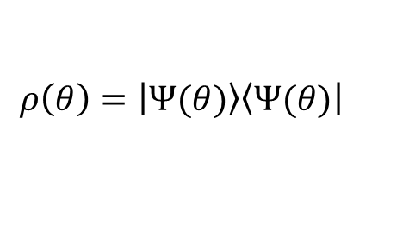
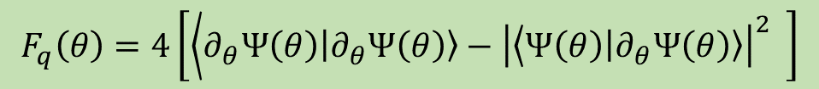
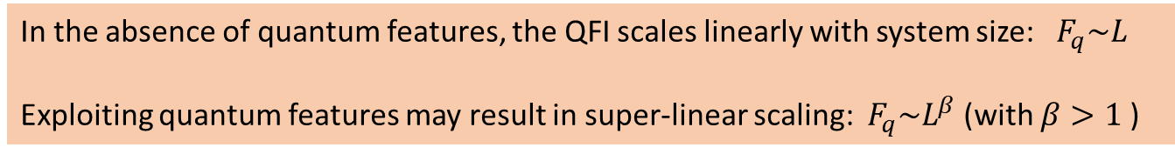
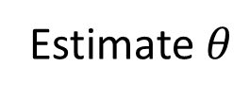

Quantum estimation theory
$$ρ\left(θ\right)=\sum_{k}{q_{k}(θ)\left|\left.ψ_{k}(θ)\right\rangle \right.\left\langle \left.ψ_{k}(θ)\right|\right.}$$
Estimate $θ$
Cramer-Rao inequality:
$${δθ}^{2}=\left\langle {\left(θ_{est}−θ_{real}\right)}^{2}\right\rangle ≥ \frac{1}{MF_{c}\left(θ\right)}≥ \frac{1}{MF_{q}\left(θ\right)}$$
Note that F_{q}(θ) = Max_{{Mk}}[F_{c}(θ)], however, one can get a closed form for quantum Fisher information:
$$\frac{∂ρ\left(θ\right)}{∂θ}=\frac{L\left(θ\right)ρ\left(θ\right)+ρ\left(θ\right)L(θ)}{2}$$
$$F_{q}\left(θ\right)=Tr\left[ρ\left(θ\right)L^{2}(θ)\right]$$
For pure states:
$$ρ\left(θ\right)=\left|\left.Ψ(θ)\right\rangle \right.\left\langle \left.Ψ(θ)\right|\right.$$
$F_{q}\left(θ\right)=4\left[\left\langle ∂_{θ}Ψ\left(θ\right)\left.\left|∂_{θ}Ψ\left(θ\right)\right.\right\rangle −{\left|\left\langle Ψ\left(θ\right)\left|\left.∂_{θ}Ψ\left(θ\right)\right\rangle \right.\right.\right|}^{2}\right. \right]$
In the absence of quantum features, the QFI scales linearly with system size: $F_{q}\sim L$
Exploiting quantum features may result in super-linear scaling: $F_{q}\sim L^{β}$ (with $β>1$)

Slide 7
Many-body quantum sensors

Slide 8

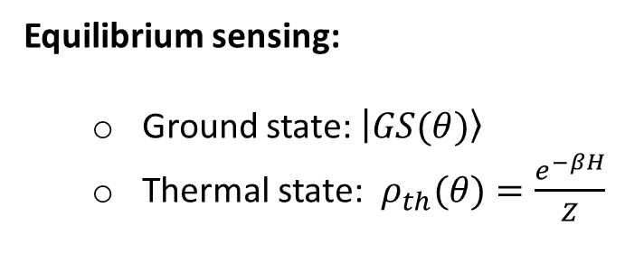
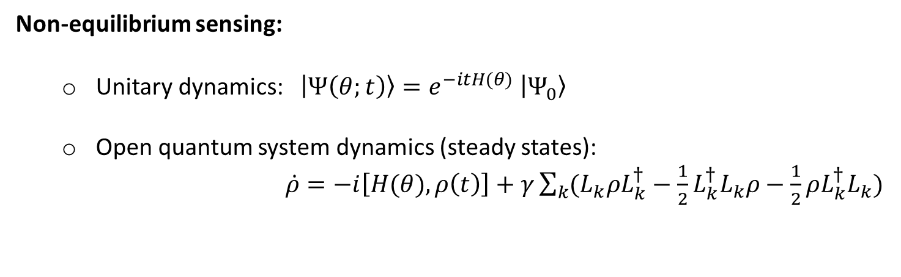
Quantum many-body sensing
$$H(θ)=θH_{1}+H_{2}$$
Equilibrium sensing:
  Ground state: $\left|\left.GS(θ)\right\rangle \right.$
  Thermal state: $ρ_{th}(θ)=\frac{e^{−βH}}{Z}$
Non-equilibrium sensing:
  Unitary dynamics: $\left|Ψ\left(θ;t\right)\right\rangle =e^{−itH(θ)}$ $\left|Ψ_{0}\right\rangle$
  Open quantum system dynamics (steady states):
  $\dot{ρ}=−i\left[H(θ),ρ\left(t\right)\right]+γ\sum_{k}{(L_{k}ρL_{k}^{†}−\frac{1}{2}L_{k}^{†}L_{k}ρ−\frac{1}{2}{ρL}_{k}^{†}L_{k})}$

Slide 9

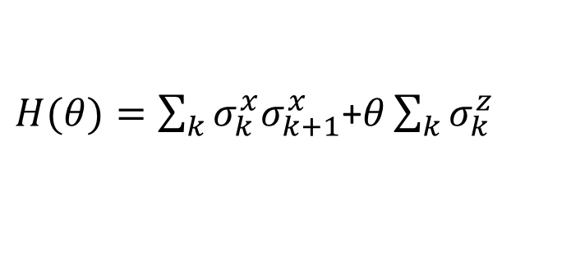
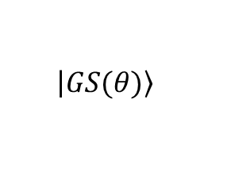









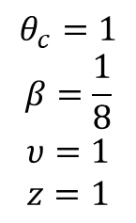
Critical systems
$$H=θH_{1}+H_{2}$$
$$\left|\left.GS(θ)\right\rangle \right.$$
$$m= \left\langle GS(θ) | \hat{M} | GS(θ)\right\rangle$$
m
$$E_{k}$$
$$m\sim {\left|θ−θ_{c}\right|}^{β}$$
$$ΔE\sim \frac{1}{ξ^{z}}$$
$$ξ\sim {\left|θ−θ_{c}\right|}^{−υ}$$
$$θ_{c}$$
$$θ$$
$$θ_{c}$$
$$θ$$
$$θ_{c}=1$$
$$β=\frac{1}{8}$$
$$υ=1$$
$$z=1$$
Ising in transverse field:
$H(θ)=\sum_{k}{σ_{k}^{x}σ_{k+1}^{x}}$+$θ\sum_{k}{σ_{k}^{z}}$

Slide 10



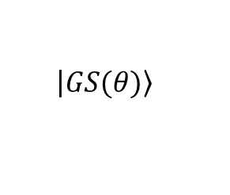




Criticality enhanced sensing
$$H=θH_{1}+H_{2}$$
$$\left|\left.GS(θ)\right\rangle \right.$$
Can one estimate $θ$directly from the ground state?
Near criticality ($θ≈θ_{c}$):
$$F_{q}\left(θ\right)\sim N^{2/dv}$$
Far from criticality:
$$F_{q}\left(θ\right)\sim N{\left|θ−θ_{c}\right|}^{dυ−2}$$
For Ising in transverse field ($d=1, υ=1$) around criticality:
$$F_{q}\left(θ\right)\sim N^{2}$$
Heisenberg limit
P. Zanardi and N. Paunkovic, Phys. Rev. E 74, 031123 (2006).
P. Zanardi, H. T. Quan, X. Wang, and C. P. Sun, Phys. Rev. A 75, 032109 (2007).
P. Zanardi, M. G. A. Paris, and L. Campos Venuti, Phys. Rev. A 78, 042105 (2008).
C. Invernizzi, M. Korbman, L. C. Venuti, and M. G. A. Paris, Phys. Rev. A 78, 042106 (2008).
M. Skotiniotis, P. Sekatski, and W. Dur, New J. Phys. 17, 073032 (2015).
S.-J. Gu, Int. J. Mod. Phys. B 24, 4371 (2010).
S. Gammelmark and K. Mølmer, New J. Phys 13, 053035 (2011).
M. M. Rams, P. Sierant, O. Dutta, P. Horodecki, J. Zakrzewski, Phys. Rev. X 8, 021022 (2018)

Slide 11

Criticality-based sensing
What is responsible for quantum enhanced sensitivity across a phase transition?
    Scale invariance
    Symmetry-breaking
    Long-range entanglement/correlations
    Gap closing
Can other phase transitions also allow for quantum enhanced sensitivity?

Slide 12
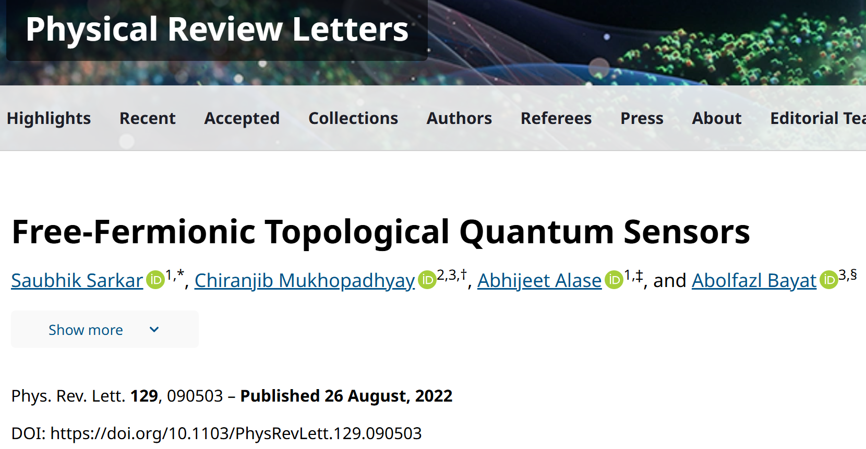
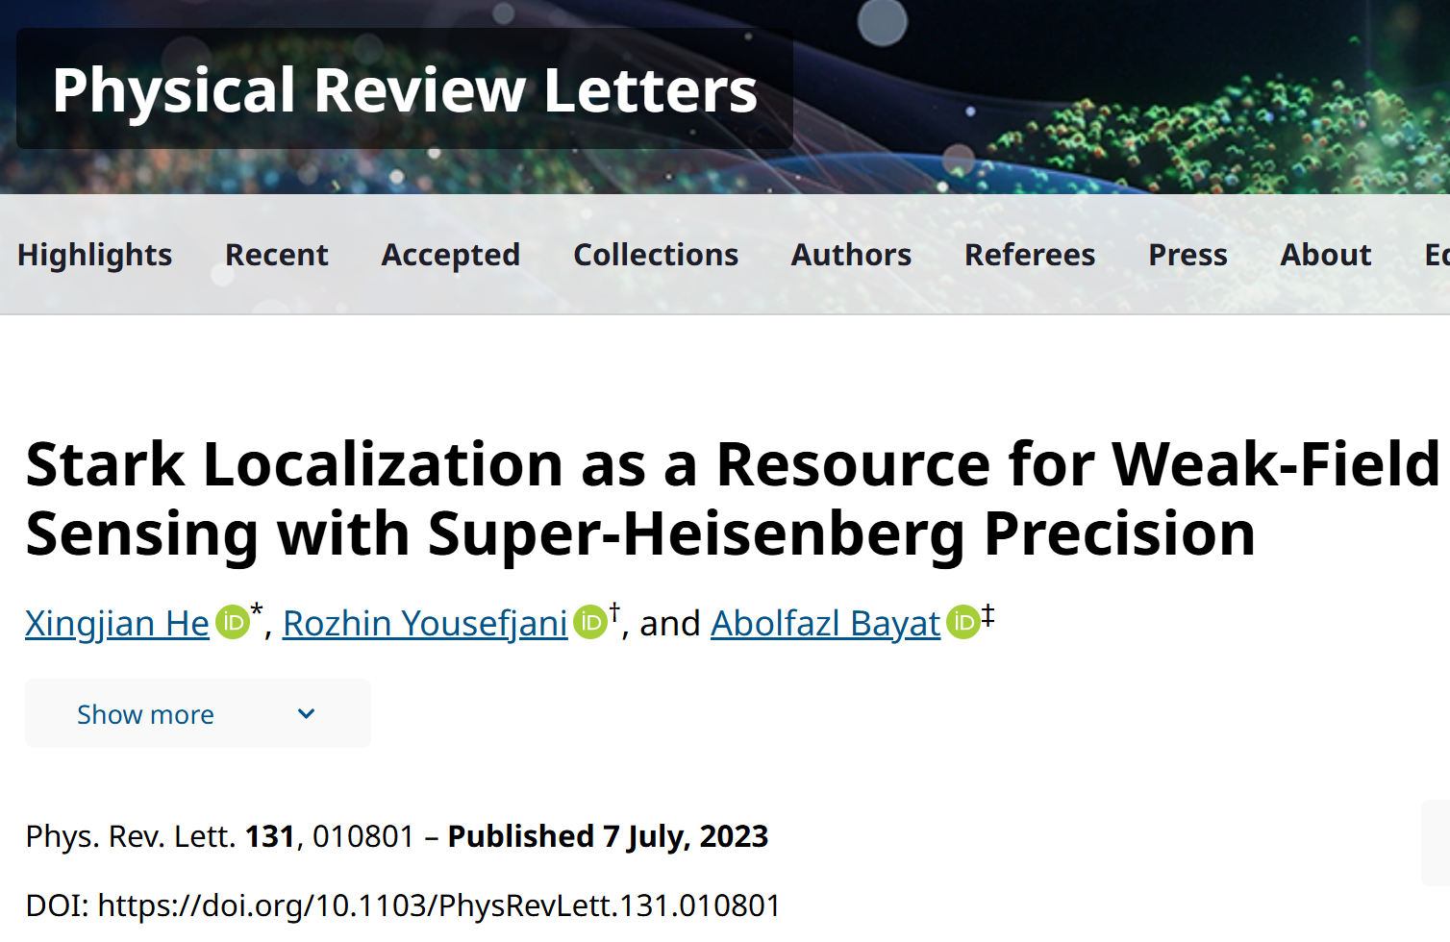
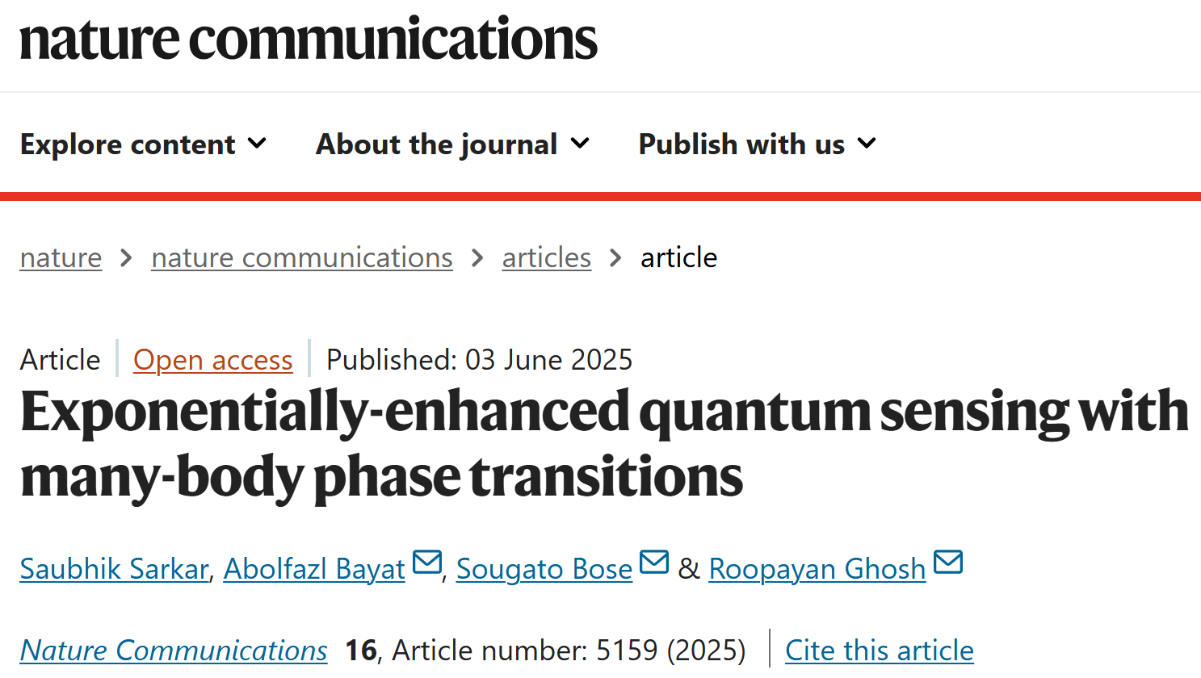
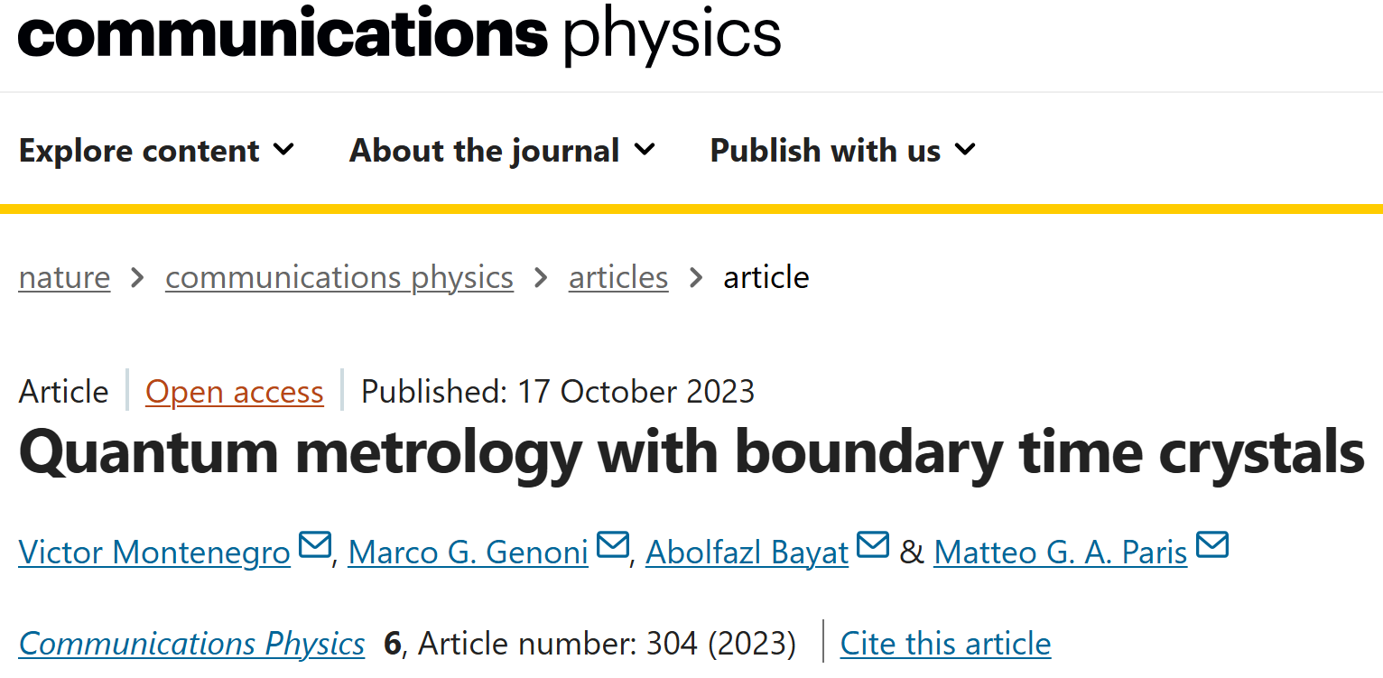
Criticality is a resource for quantum-enhanced sensitivity
Topological phase transitions
Stark localization
phase transitions
First-order phase transitions
Dissipative phase transitions

Slide 13
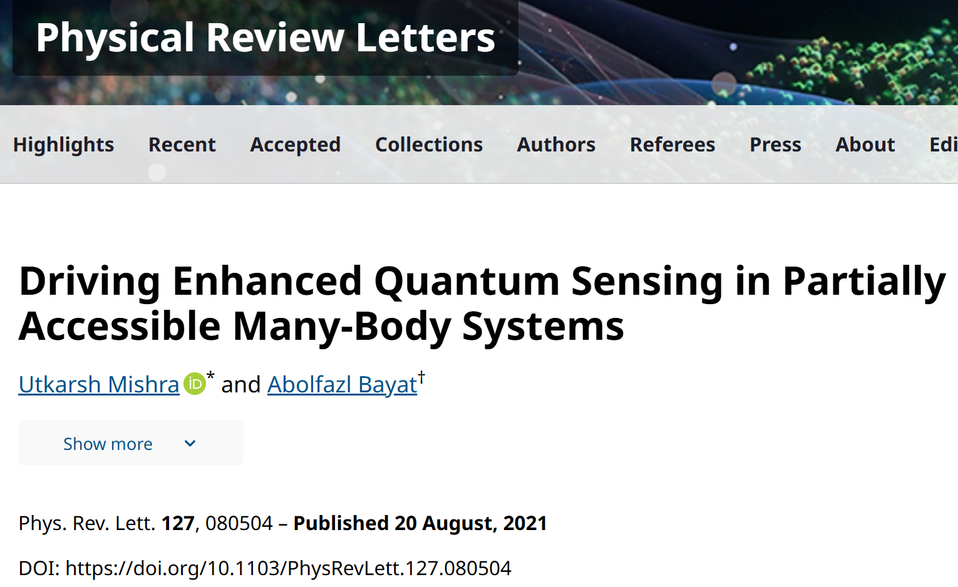
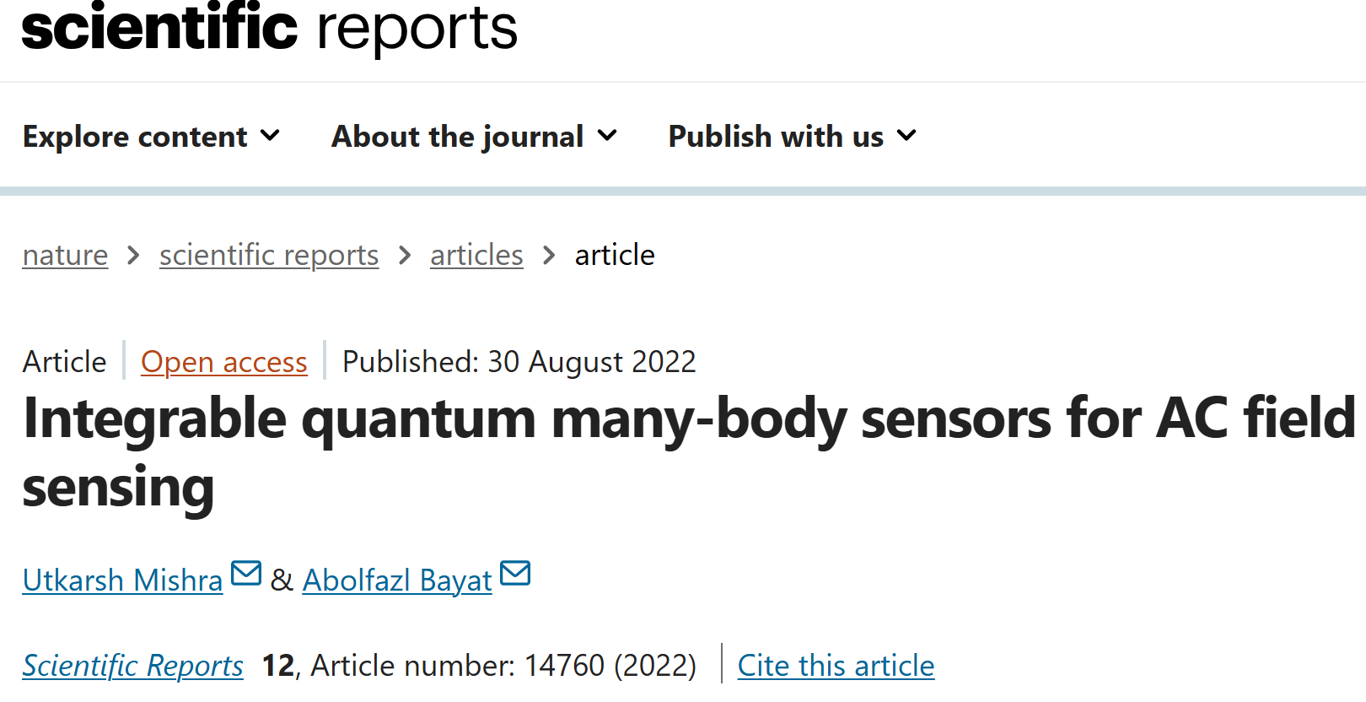
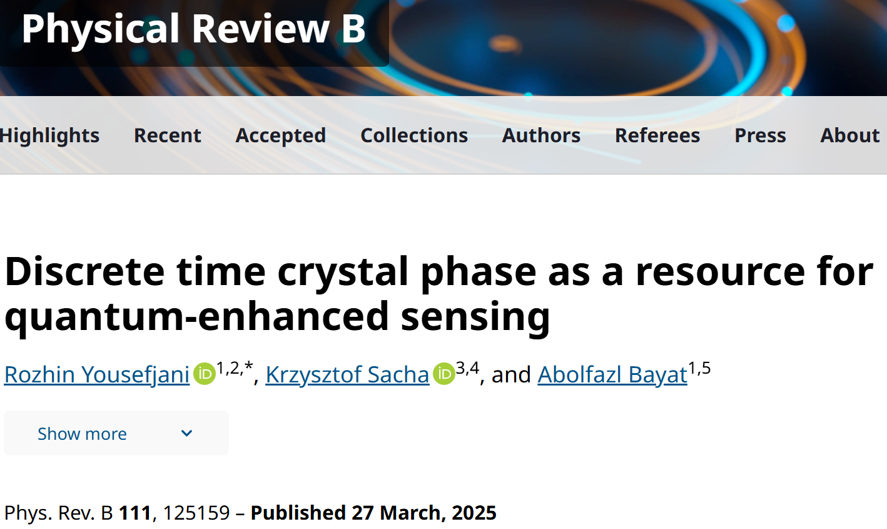
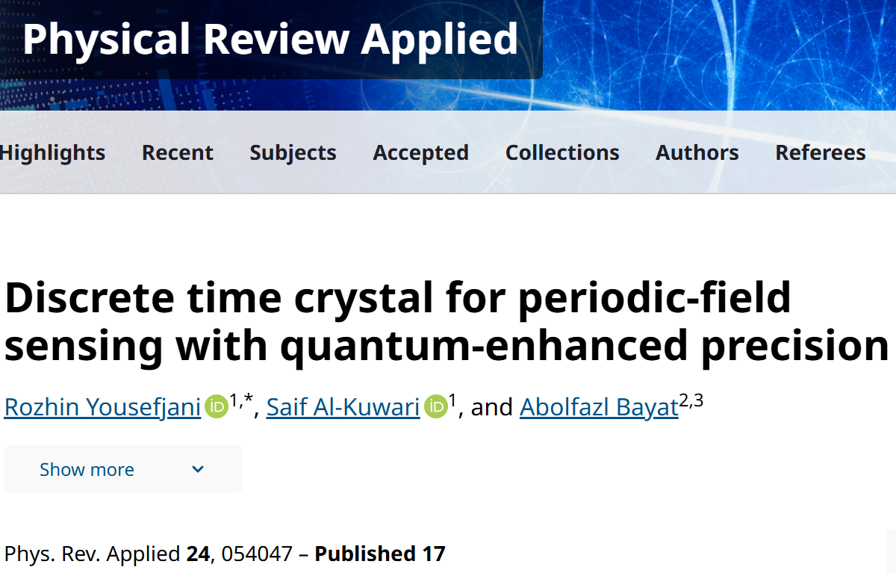
Criticality is a resource for quantum-enhanced sensitivity
Floquet phase transitions
Discrete time crystals

Slide 14

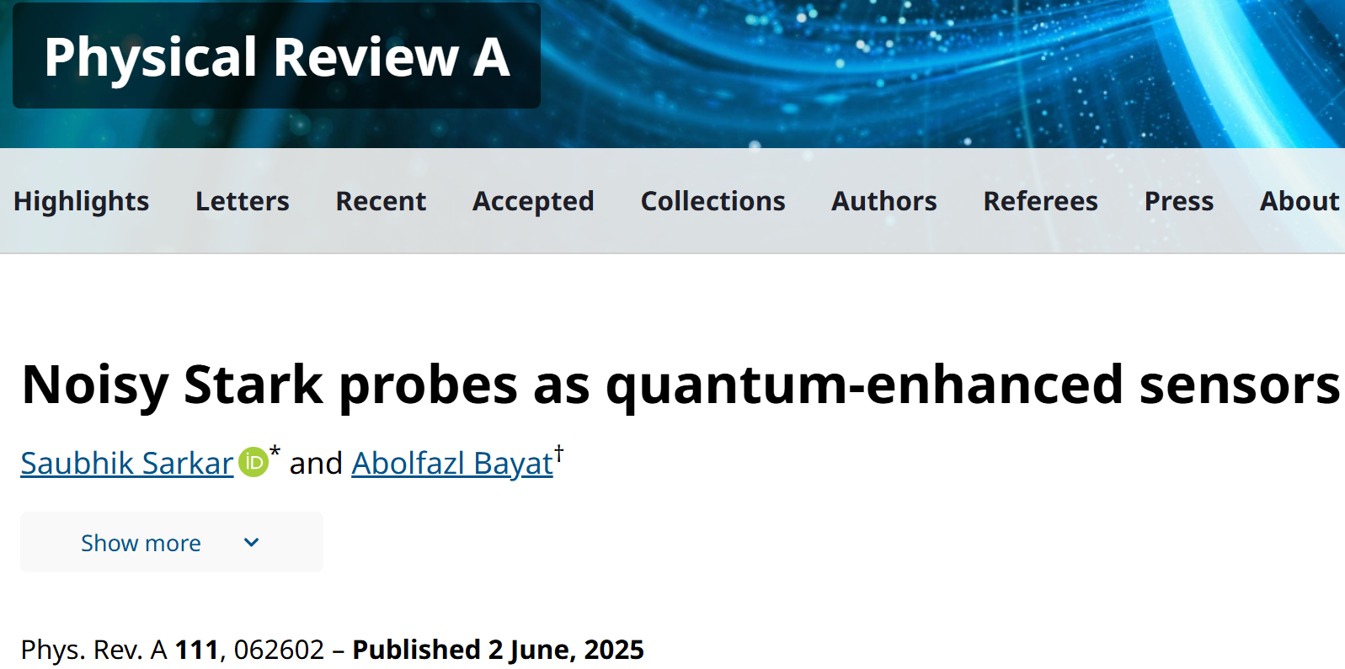
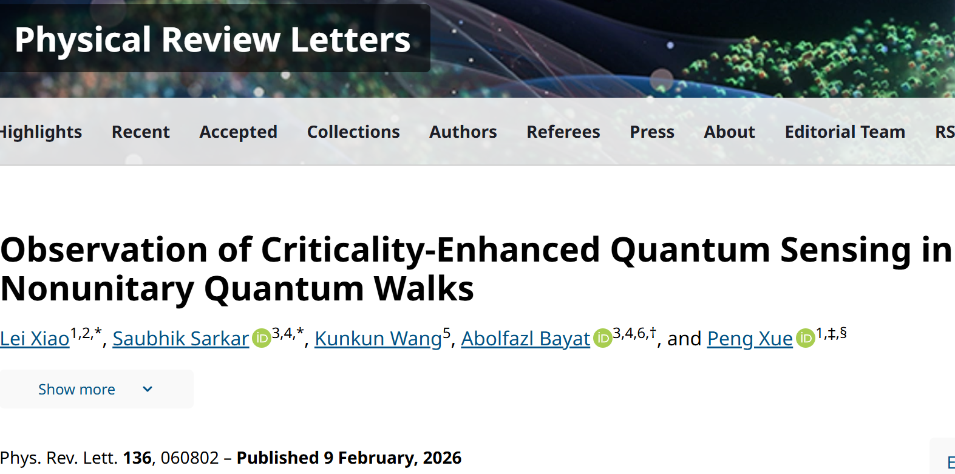
Criticality is a resource for quantum-enhanced sensitivity
Non-Hermitian systems

Slide 15
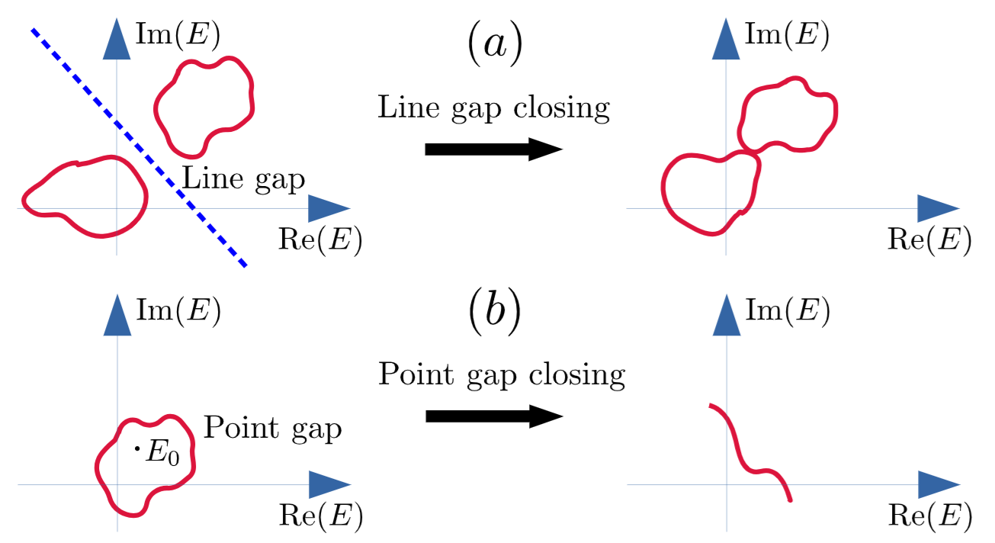

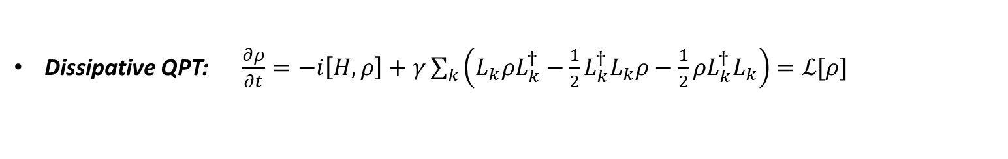

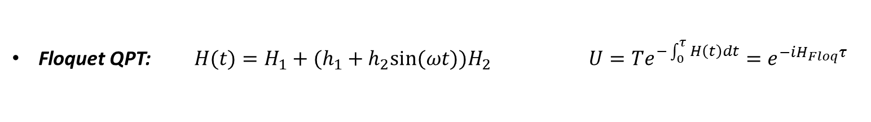



Energy gap closing and quantum-enhanced sensitivity
Discovery: In all these quantum phase transitions, the critical point is accompanied by an energy gap closing
  Second-order QPT: $ΔE\sim L^{−z}$ $F_{Q}\sim L^{β}$
  First-order QPT: $ΔE\sim e^{−βL/2}$ $F_{Q}\sim e^{βL}$
Floquet QPT: $H(t)=H_{1}+(h_{1}+h_{2}{sin⁡(ωt))H}_{2}$ $U=Te^{−\int_{0}^{τ}{H\left(t\right)dt}}=e^{−iH_{Floq}τ}$
For the set of parameters $(h_{1},h_{2})$ that $H_{Floq}$ is gapless
$$F_{Q}\sim L^{β}$$
Dissipative QPT: $\frac{∂ρ}{∂t}=−i\left[H,ρ\right]+γ\sum_{k}{\left(L_{k}ρL_{k}^{†}−\frac{1}{2}{L_{k}^{†}L}_{k}ρ−\frac{1}{2}ρL_{k}^{†}L_{k}\right)}=ℒ[ρ]$
$$ρ\left(t\right)=e^{ℒt}ρ(0)$$
Spectrum of $ℒ=\left\{μ_{k}^{R}+iμ_{k}^{I}\right\}$
For the set of parameters that $\left\{μ_{k}^{R}\right\}$ is gapless
$$F_{Q}\sim L^{β}$$
  Non-Hermitian systems: For non-Hermitian Hamiltonians, where
  energy eigenvalues are complex, both line-gap and point-gap
  closing results in quantum enhanced sensitivity
Energy gap closing implies quantum enhanced sensitivity

Slide 16
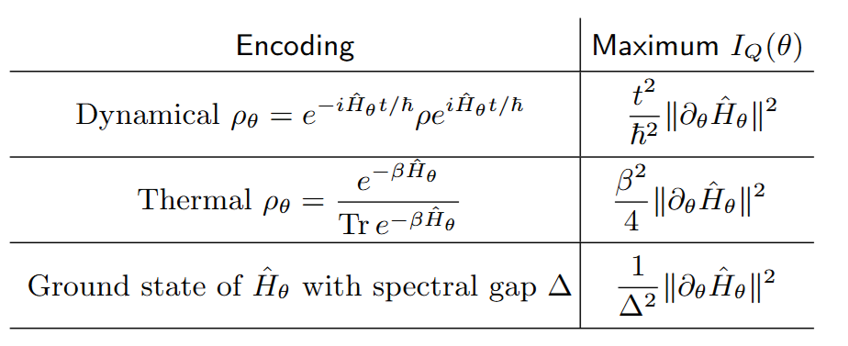
Insight on the origin of quantum enhanced sensitivity
One can find fundamental bounds on the QFI
These bounds may NOT be tight but are insightful
P. Abiuso, P. Sekatski, J. Calsamiglia, M. Perarnau-Llobet, Phys. Rev. Lett. 134, 010801 (2025)

Slide 17
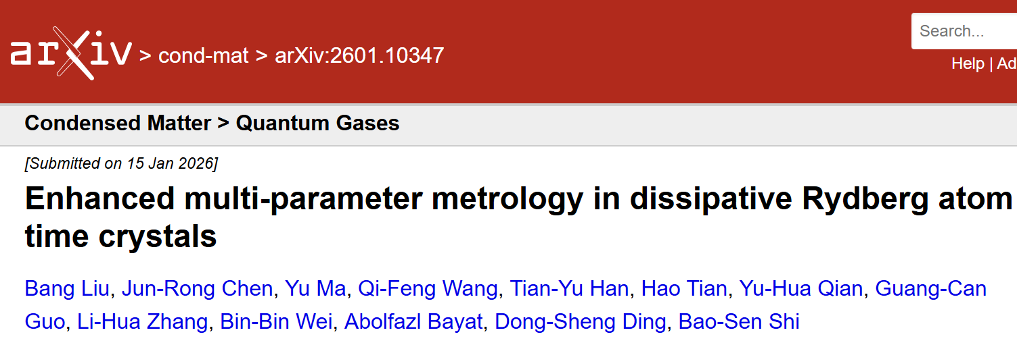
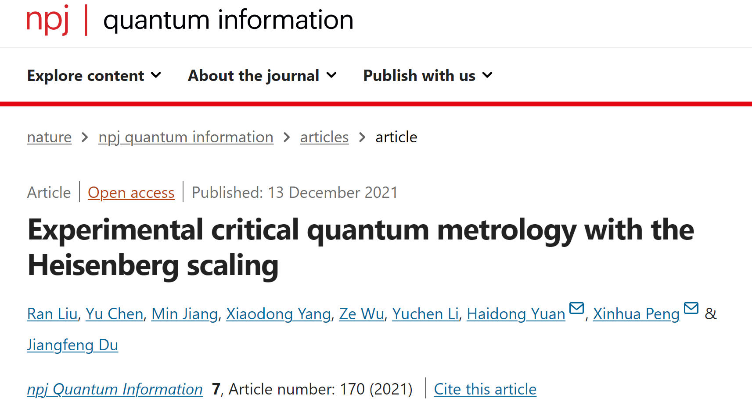
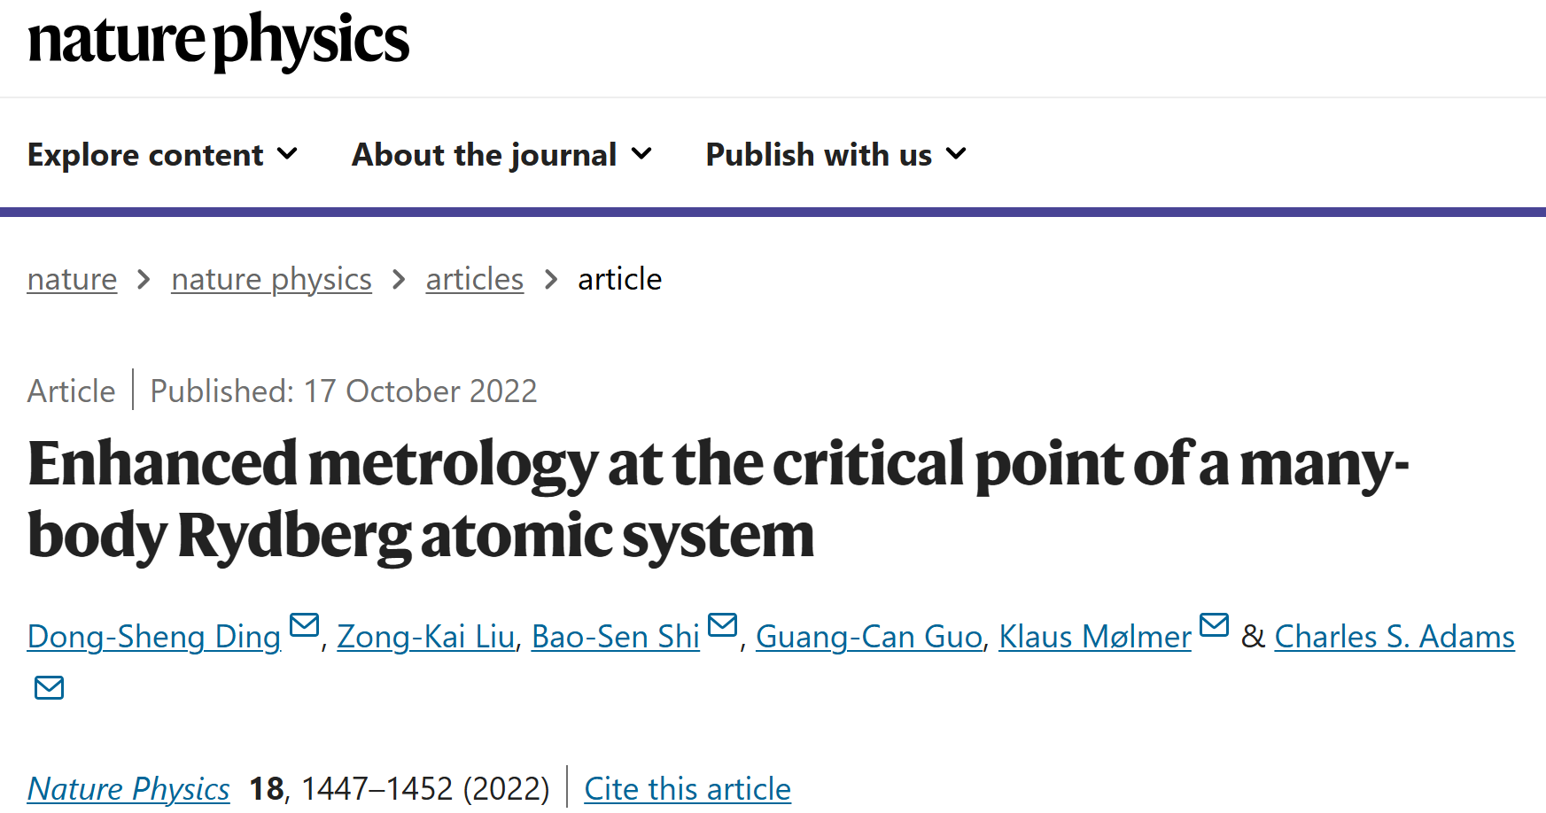
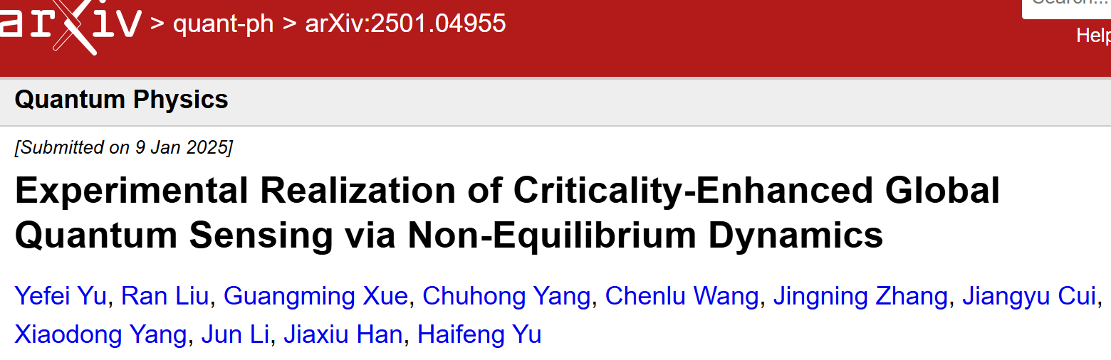
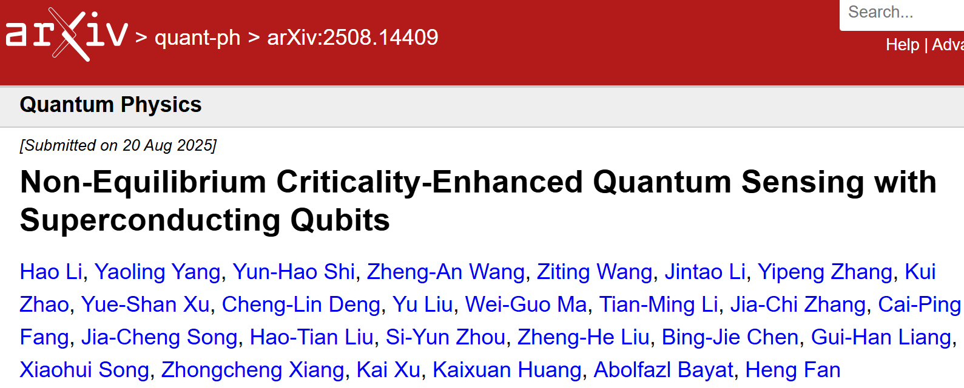
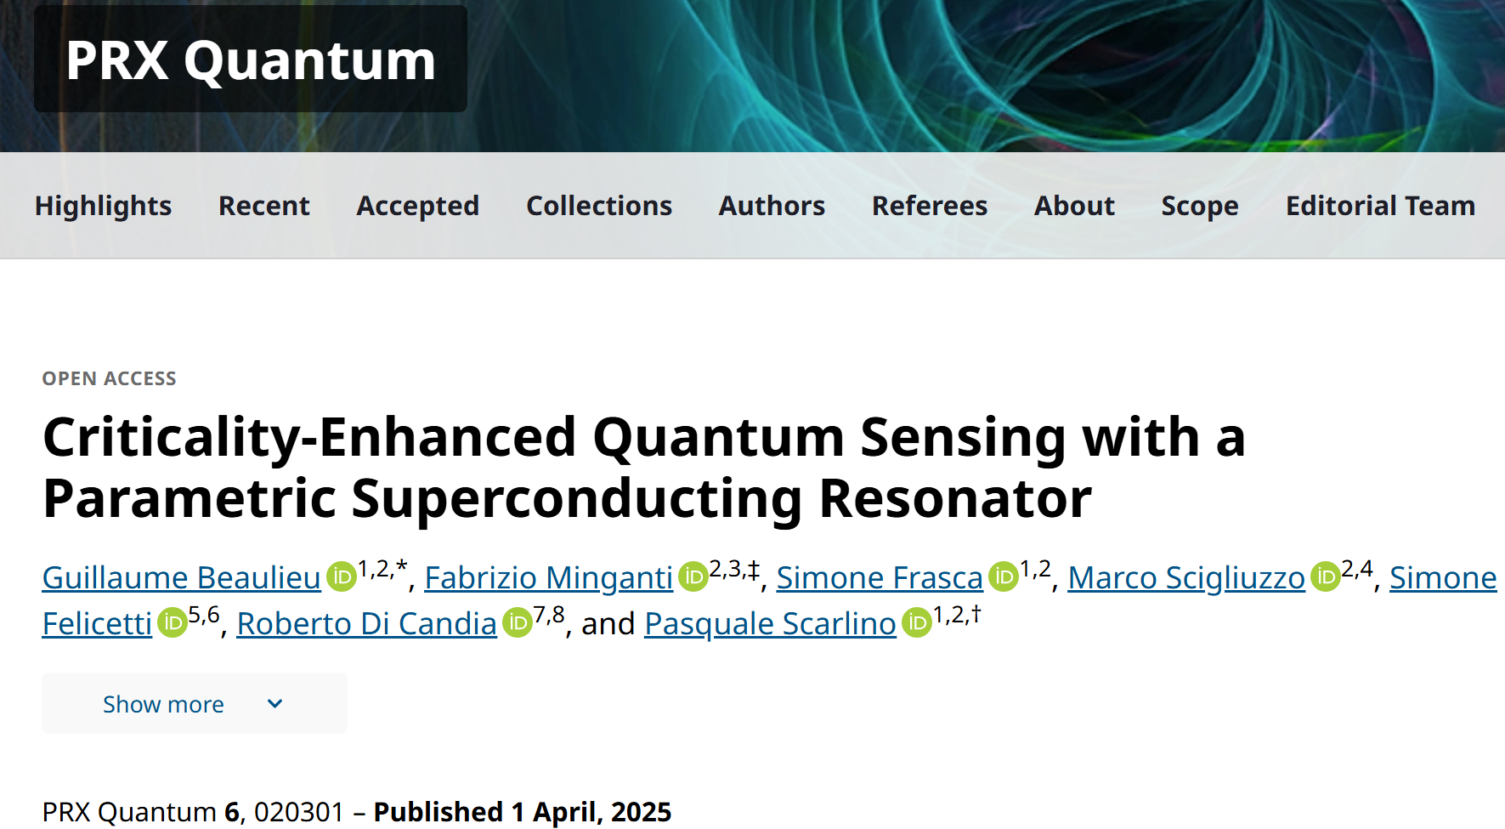
Criticality-based sensing is viable
Rydberg atoms
NMR systems
Superconducting qubits
Superconducting qubits
Superconducting qubits
Optical setups

Slide 18
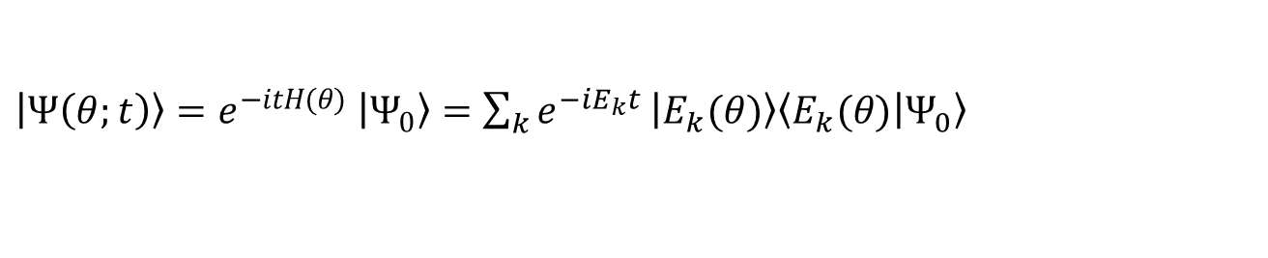





Equilibrium versus non-equilibrium quantum sensing
$$H(θ)=θH_{1}+H_{2}$$
Criticality-based quantum sensing: $\left|GS\left(θ\right)\right\rangle$
$F_{Q}\sim L^{β}$ system size is a resource
Unitary dynamics: $\left|Ψ\left(θ;t\right)\right\rangle =e^{−itH(θ)}$ $\left|Ψ_{0}\right\rangle$
$F_{Q}\sim t^{2}$ time is a resource
Is it possible to combine the both strategies and take advantage of both time and system size?
$\left|Ψ\left(θ;t\right)\right\rangle =e^{−itH(θ)}$ $\left|Ψ_{0}\right\rangle =\sum_{k}{e^{−iE_{k}t}}\left|E_{k}(θ)\right\rangle \left\langle \left.E_{k}(θ)\right|\left.Ψ_{0}\right\rangle \right.$
In order to see the enhancement from quantum criticality in non-equilibrium
dynamics, the phase transition has to happen across the entire spectrum

Slide 19
Stark Localization Phase Transition

Slide 20
Single particle
$$J$$
$$J$$
$$H=J\sum_{i}{(|i⟩⟨i+1|+h.c.)}+h\sum_{i}{i|i⟩⟨i|}$$
$$h$$
$$2h$$
$$3h$$
As $h$ increases system localizes resembling Anderson localization
Localization happens across the whole spectrum and not just the ground state
In 1D systems and at the thermodynamic limit, localization happens for infinitesimal values of $h$

Slide 21
Fisher information
For every eigenstate $\left|E_{n}\left(h\right)\right\rangle$ one can compute the Fisher information
Ground state
Mid spectrum
By increasing L, the peak of the QFI, dramatically enhances showing divergence in the thermodynamic limit.
The position of the peak gradually moves towards zero suggesting that in the thermodynamic limit $h_{max}→h_{c}=0$
In the localized regime, the QFI becomes size-independent showing convergence to the thermodynamic limit

Slide 22
Fisher information scaling
$$F_{Q}^{max}\sim L^{β}$$
Ground state
Mid spectrum

Slide 23
Beyond single-particles (half-filling)
By increasing the filling factor, QFI still shows super-Heisenberg scaling though with lower $β$

Slide 24
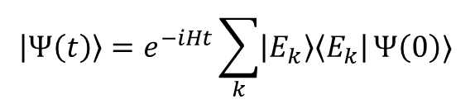

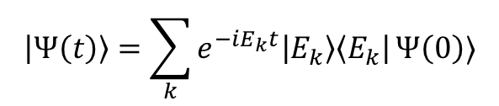
Non-equilibrium Stark probe
The non-equilibrium dynamics of the system is described by
$$\left|Ψ\left(t\right)\right\rangle =e^{−iHt}\sum_{k}{\left|E_{k}\right\rangle \left\langle E_{k}\right|}Ψ\left(0\right)⟩$$
$$\left|Ψ\left(t\right)\right\rangle =e^{−iHt}\left|Ψ\left(0\right)\right\rangle$$
$$\left|Ψ\left(t\right)\right\rangle =\sum_{k}{e^{−iE_{k}t}\left|E_{k}\right\rangle \left\langle E_{k}\right|}Ψ\left(0\right)⟩$$
All spectrum is potentially involved in the dynamics
The Stark localization happens across the entire spectrum
Can one see the finger print of the Stark localization transition in non-equilibrium dynamics?
Can we use the non-equilibrium Stark probe for sensing?

Slide 25
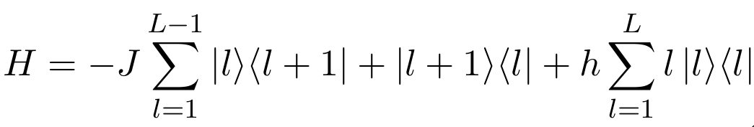
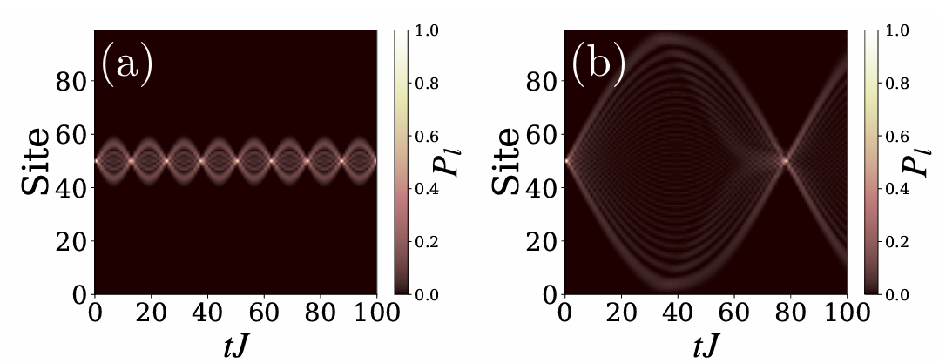
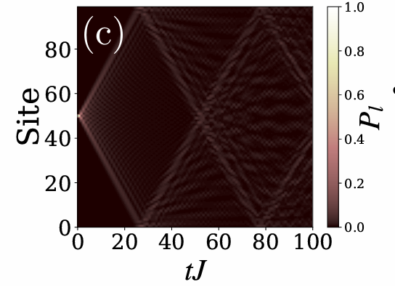

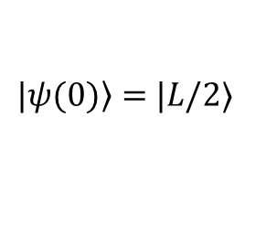

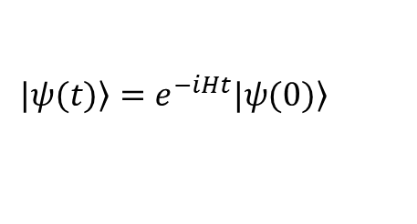

Stark probe
H. Manshouri, M. Zarei, M. Abdi, S. Bose, and A. Bayat, Quantum 9, 1793 (2025)
$\left.|ψ(0)\right\rangle =$ $|L/2$⟩
$$\left.|ψ(t)\right\rangle =e^{−iHt}\left.|ψ(0)\right\rangle$$
$$h/J=0.5$$
$$h/J=0.08$$
$h/J=0.0$1

Slide 26

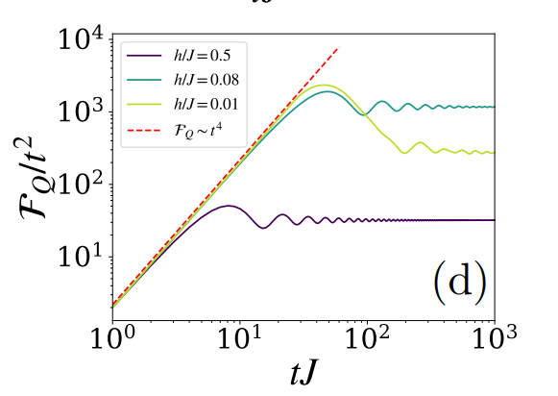
Dynamical Quantum Fisher Information

Slide 27
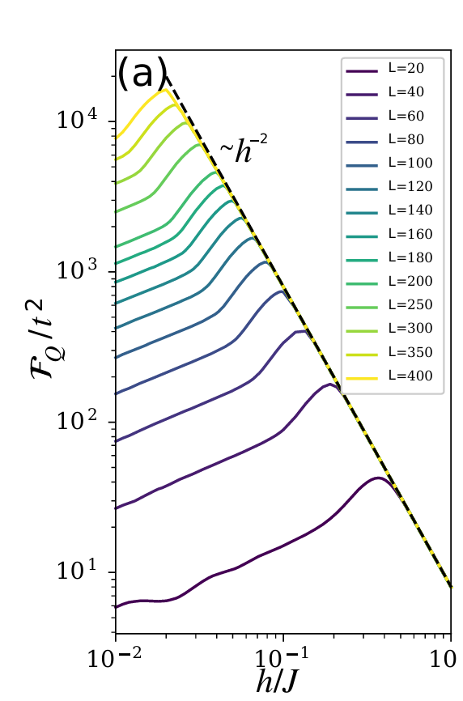
Long-time behavior
QFI scales with length in ergodic phase
QFI becomes size-independent in the localized phase
H. Manshouri, M. Zarei, M. Abdi, S. Bose, and A. Bayat, Quantum 9, 1793 (2025)

Slide 28
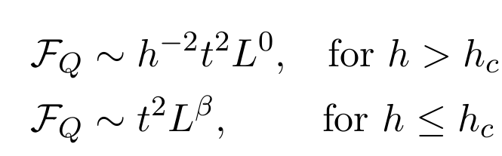
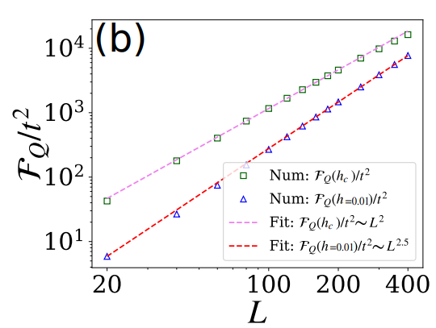
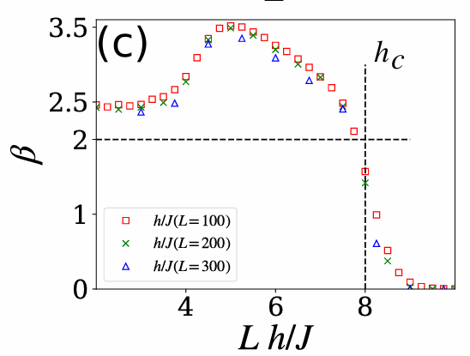
Scaling

Slide 29








Multi-particle probes with N excitations
$$Δ=0, L=17$$
$$Δ=1, L=17$$
$$Δ=0, N=3$$
$$Δ=1, N=3$$

Slide 30

Scaling versus number of excitations

Slide 31











Half filling ($N=L/2$)
$$Δ=0$$
$$Δ=1$$
$$h>h_{c}: F_{Q}\sim h^{−2}t^{2}L^{0}N^{α}$$
N=L/2
$$F_{Q}\sim h^{−2}t^{2}L^{α}$$
$$h≤h_{c}: F_{Q}\sim t^{2}L^{β}N^{α}$$
N=L/2
$$F_{Q}\sim t^{2}L^{β+α}$$
At $h=h_{c}$ we have $β\sim 2$ and $α\sim 1$, so:
$F_{Q}\sim t^{2}L^{β+α}\sim t^{2}L^{3}$
$$Δ=0$$
$$Δ=1$$
H. Manshouri, M. Zarei, M. Abdi, S. Bose, and A. Bayat, Quantum 9, 1793 (2025)

Slide 32




Experiment: Stark probe
Non-Equilibrium Criticality-Enhanced Quantum Sensing with Superconducting Qubits
Hao Li, et. al., arXiv:2508.14409
Professor Heng Fan
CAS & BAQIS
Kai-Xuan Huang
BAQIS
Hao Li
BAQIS
Yaoling Yang
UESTC

Slide 33







Superconducting quantum systems
$$h_{j}=h_{0}+\left(j−1\right)h$$
Initial state of the system:
$\left.|ψ(0)\right\rangle =$ $|(L+1)/2$⟩
$$\left.|ψ(t)\right\rangle =e^{−iHt}\left.|ψ(0)\right\rangle$$
Theory: $P_{j}={\left|\left\langle j | ψ(t)\right\rangle \right|}^{2}$
Experiment: ${\tilde{P}}_{j}=\frac{n_{j}}{n}$ where $n=\sum_{j}{n_{j}}$

Slide 34


Non-equilibrium sensing capacity
Extended phase
Critical point
Localized phase
Computational basis is not always optimal
When the Fisher information is small the
sensing quality can be poor
To compute CFI, we have to sampled
$n=250,000$times

Slide 35





Bayesian estimation
Posterior
Likelihood
Prior
Likelihood:
By using measurement data from different times, the posteriors are independent so:
$n^{\left(t_{1}\right)}=(n_{1}^{\left(t_{1}\right)},n_{2}^{\left(t_{1}\right)},…,n_{L}^{(t_{1})})$, $n^{\left(t_{2}\right)}=(n_{1}^{\left(t_{2}\right)},n_{2}^{\left(t_{2}\right)},…,n_{L}^{(t_{2})})$, $⋯$ , $n^{\left(t_{K}\right)}=(n_{1}^{\left(t_{K}\right)},n_{2}^{\left(t_{K}\right)},…,n_{L}^{(t_{K})})$
$$f\left(h | n^{\left(t_{1}\right)},n^{\left(t_{2}\right)},{…,n}^{\left(t_{K}\right)}\right)=\prod_{j=1}^{K}{f(h|n^{\left(t_{j}\right)})}$$
$$δh^{2}≥\frac{1}{MF_{C}^{av}}$$
$$F_{C}^{av}=\frac{F_{C}\left(t_{1}\right)+F_{C}\left(t_{2}\right)+…F_{C}(t_{K})}{K}$$

Slide 36

Bayesian estimation
Using a single time, sensing precision may not be good
By incorporating different times, the sensing becomes precise
Error bars in extended phase is much smaller than then error bars in the localized phase

Slide 37


Quantum enhanced sensitivity
By incorporating more data points from different times
one recovers the: $F_{C}\sim t^{2}$

Slide 38

Double excitation

Slide 39

Summary
Quantum criticality is a resource for sensing with respect to system size ($F_{Q}\sim L^{β}$)
The key feature in criticality-based sensing is gap-closing:
    2nd-order quantum phase transition (ground state)
    1st order quantum phase transitions (ground state)
    Stark localization (affects the whole spectrum)
    Symmetry protected topological phase transitions (edge and ground state)
    Floquet phase transition (driven systems)
    Boundary time crystal phase transition (open quantum system)
    Discrete time crystals (non-equilibrium)
    Non-Hermitian systems (open quantum system)
Non-equilibrium quantum probes achieve quantum enhanced sensitivity with respect to time
(e.g. in unitary evolutions $F_{Q}\sim t^{2}$)
Non-equilibrium Stark probes combine criticality with non-equilibrium dynamics to harness both system size and time for achieving quantum enhanced sensitivity: $F_{Q}\sim t^{2}L^{β}N^{α}$
Experimentally, one can achieve quantum enhanced sensitivity by incorporating simple measurements at different times

Slide 40




Quantum Metrology and Sensing with Many-Body Systems
Physics Reports 1134, 1-62 (2025)

