Slide 1

Gauge field flow for chiral gauge theories on a slab and a disk boundary
党金龙 Jinlong Dang
Peking University
北京大学理论物理研究所

Slide 2


Publications
发表文章
This talk is based on
  Jinlong Dang, Rohith Karur, Srimoyee Sen. (2026). Gauge field flow for chiral gauge theories on a slab. arXiv:2606.05306.
  Jinlong Dang, Rohith Karur, Srimoyee Sen. (2026). Gauge field flow for chiral gauge theories on a disk boundary. arXiv:2606.05305.
Collaborators:
  Rohith Karur, University of California, Berkeley
  Srimoyee Sen, Iowa State University

Slide 3
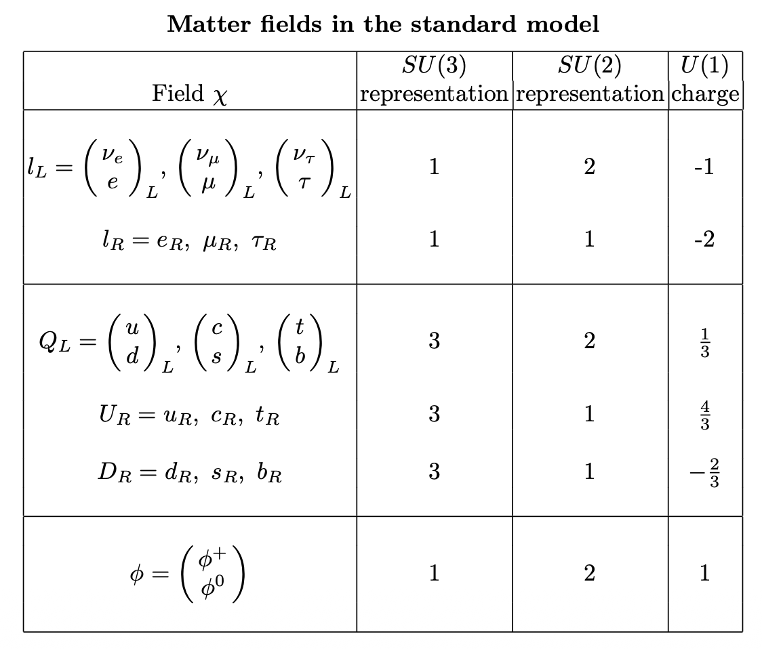
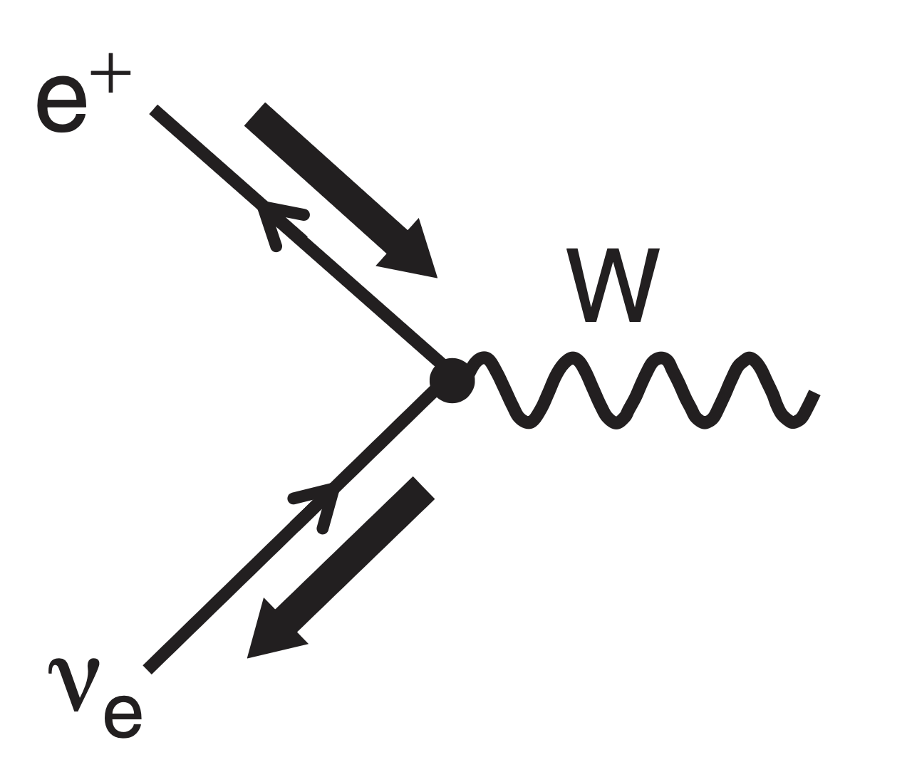
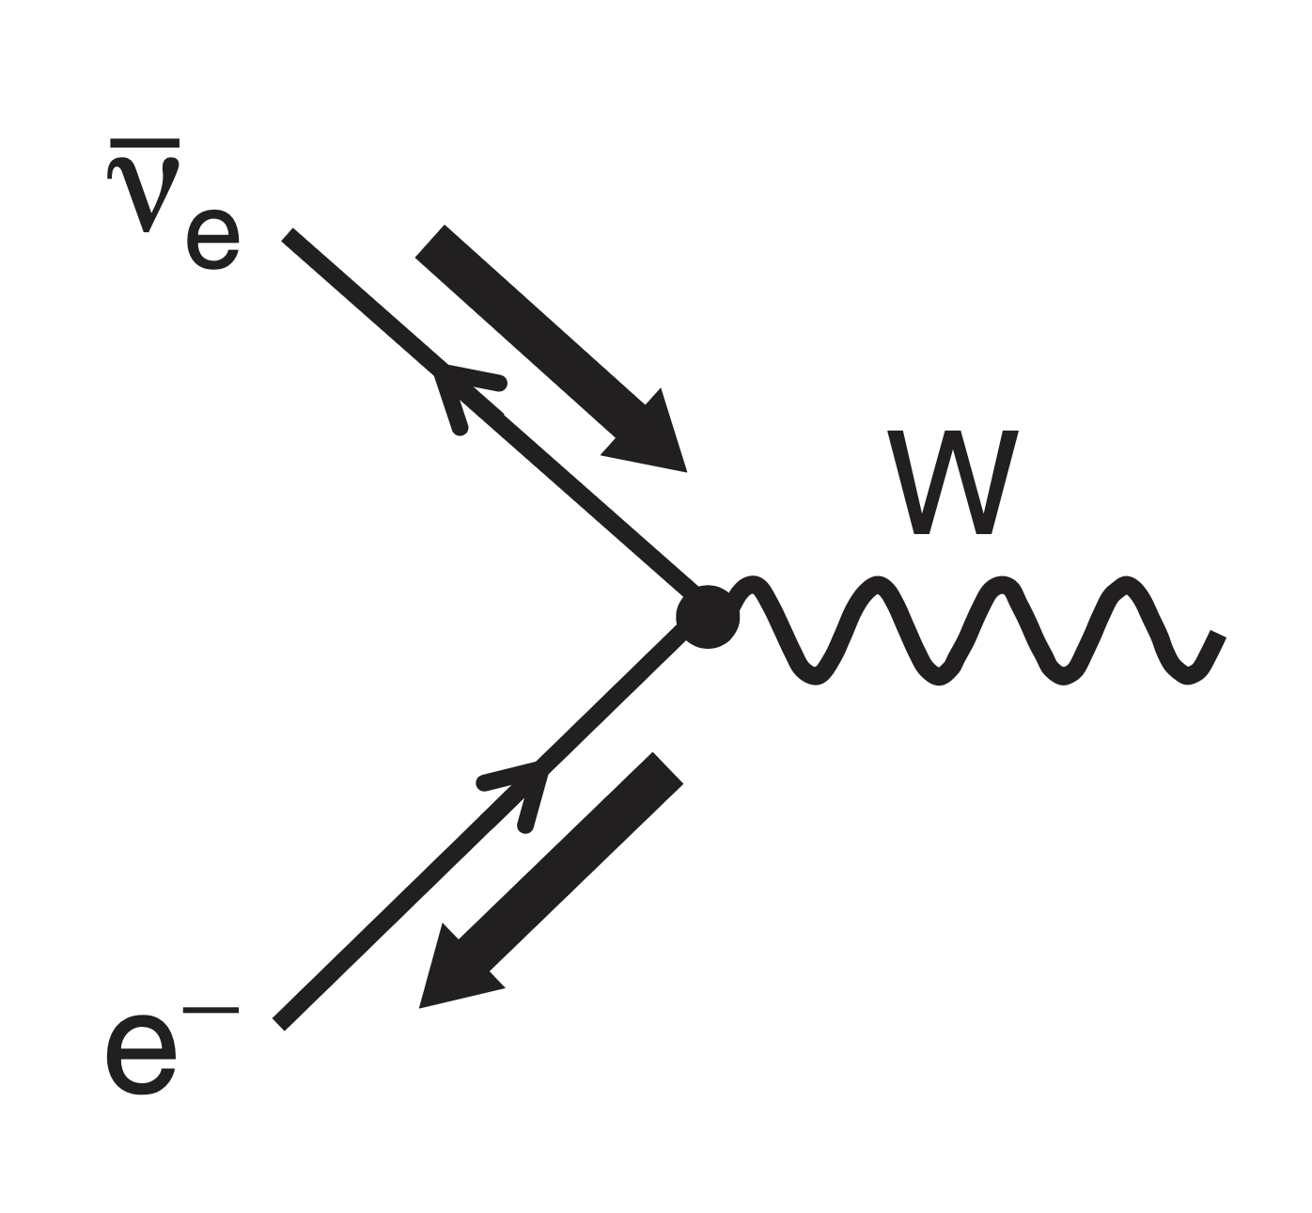
Standard Model
标准模型
Standard model is a chiral gauge theory. Although it is a tremendous achievement in the last century, a non-perturbative definition of a such chiral gauge theory is notorious difficult.
In the Standard model, the gauge group of electroweak interaction has different representation for particles with different chirality.
spin

Slide 4
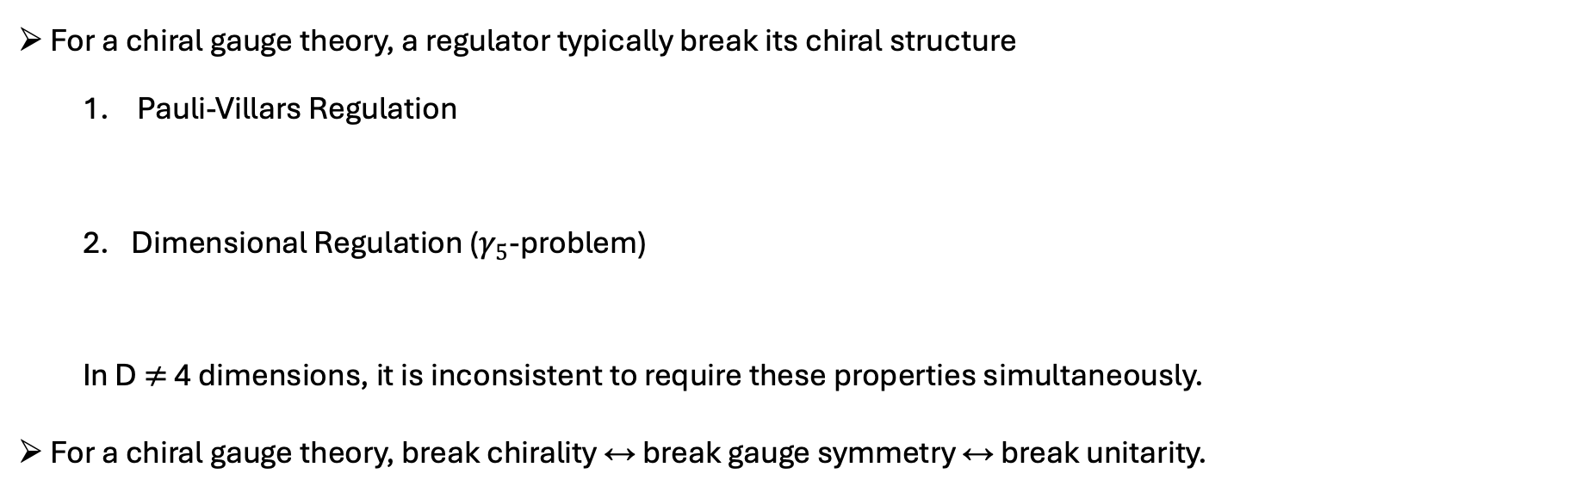

Chiral Guage Theory
手征规范场论
A simple example of a chiral gauge theory Lagrangian:
$$ℒ= ψ_{L_{i}}^{†}i\overline{σ}⋅Dψ_{L_{i}}+ψ_{R_{i}}^{†}iσ⋅∂ψ_{R_{i}}$$
For a chiral gauge theory, a regulator typically break its chiral structure
  Pauli-Villars Regulation
  Dimensional Regulation ($γ_{5}$-problem)
  In D $≠$ 4 dimensions, it is inconsistent to require these properties simultaneously.
For a chiral gauge theory, break chirality $↔$ break gauge symmetry $↔$ break unitarity.
$$M\overline{ψ}ψ= Mψ_{R}^{†}ψ_{L}+Mψ_{L}^{†}ψ_{R}$$
$$\left\{γ_{5},γ^{μ}\right\}=0, \operatorname{Tr}\left(γ_{5}γ^{μ}γ^{ν}γ^{ρ}γ^{σ}\right)=−4iε^{μvρσ}, \operatorname{Tr}\left(Γ_{1}Γ_{2}\right)=\operatorname{Tr}\left(Γ_{2}Γ_{1}\right).$$

Slide 5
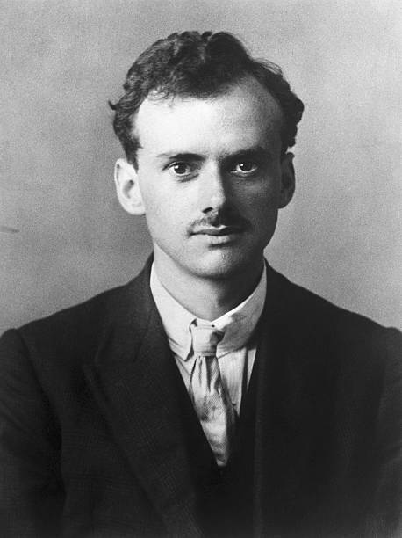
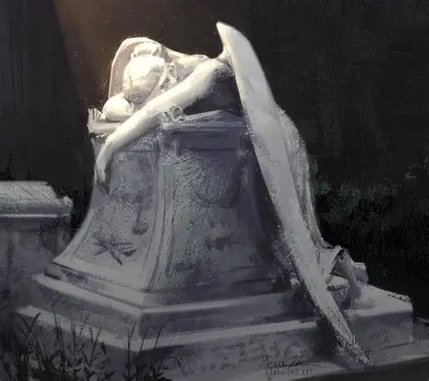
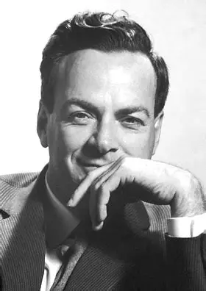

Difficulty in defining UV Physics
定义UV物理的困难
Dirac and Feynman both made huge contribution to Quantum Field Theory, but had very different perspectives about the infinities one encounters from short distance (UV) physics.

Slide 6
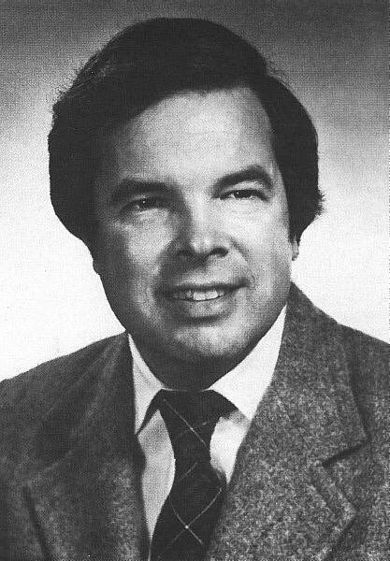
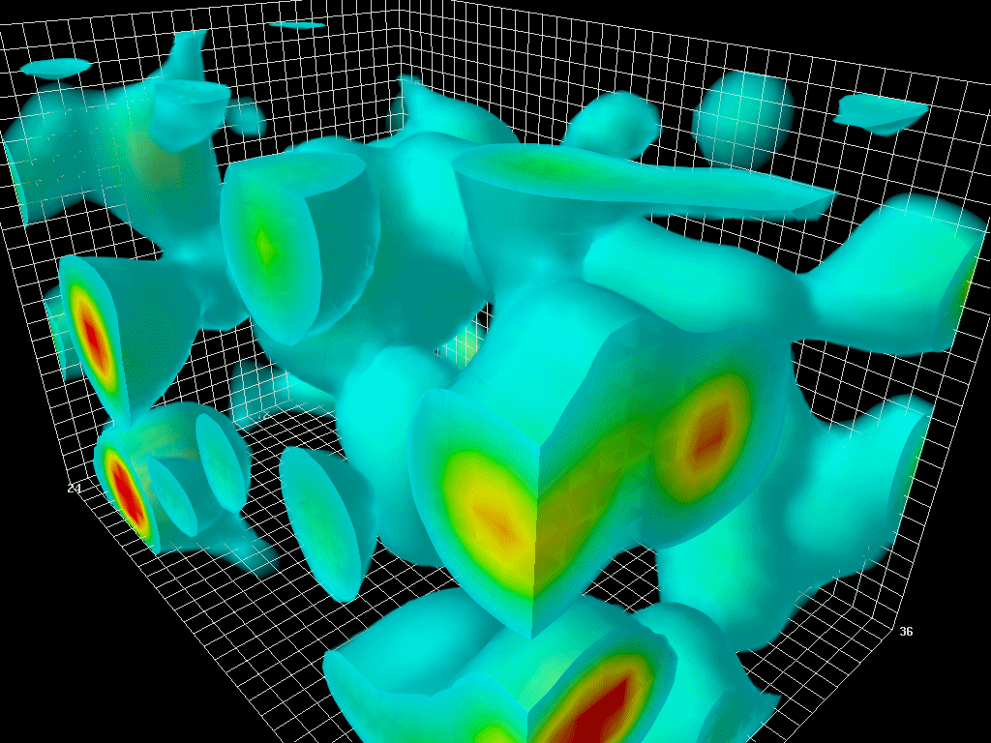
Wilson’s New Perspective
Wilson的新观点
Wilson wanted to understand the strong interactions, where Feynman’s perturbative approach fails. So, he asked: How can on put a quantum field theory on a computer?
Kaplan: Specific computations aside, however, we cannot claim to thoroughly understand the theory without understanding how in principle to compute its implications in a controlled manner to arbitrary precision.
Treat a quantum field theory as a condensed matter system
Work in 4d Euclidian spacetime
Approximate spacetime as a lattice of points and represent fields as interacting degrees of freedom on sites and links

Slide 7



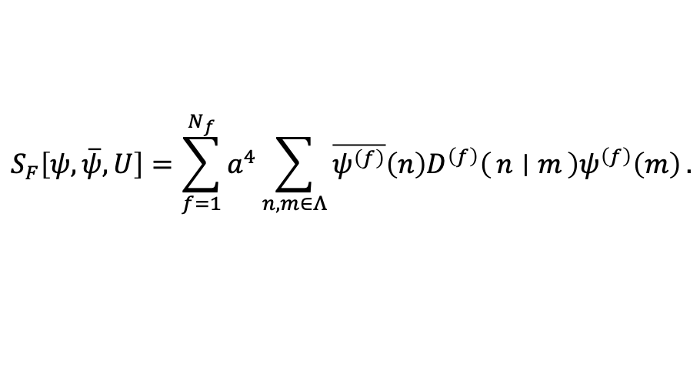


Lattice Gauge Theory
格点规范场论
An example of $N_{f}$ flavor QCD fermion action
where $a$ is the lattice spacing, $D^{\left(f\right)}$ is a Dirac fermion operator on lattice who depends on gauge link $U_{μ}$
$$S_{F}\left[ψ,\overline{ψ},U\right]=\sum_{f=1}^{N_{f}}{a^{4}\sum_{n,m∈Λ}{\overline{ψ^{\left(f\right)}}\left(n\right)D^{\left(f\right)}\left(n ∣ m\right)ψ^{\left(f\right)}\left(m\right)}}.$$
Treat a quantum field theory as a condensed matter system
Work in 4d Euclidian spacetime
Approximate spacetime as a lattice of points and represent fields as interacting degrees of freedom on sites and links
$$U(n,ν)$$
$$Z=\int{DU}e^{−S_{g}}\det{D^{\left(f\right)}}=\sum{\det{D^{\left(f\right)}}}$$
$$ψ\left(n\right)$$
$$U\left(n,μ\right)$$

Slide 8
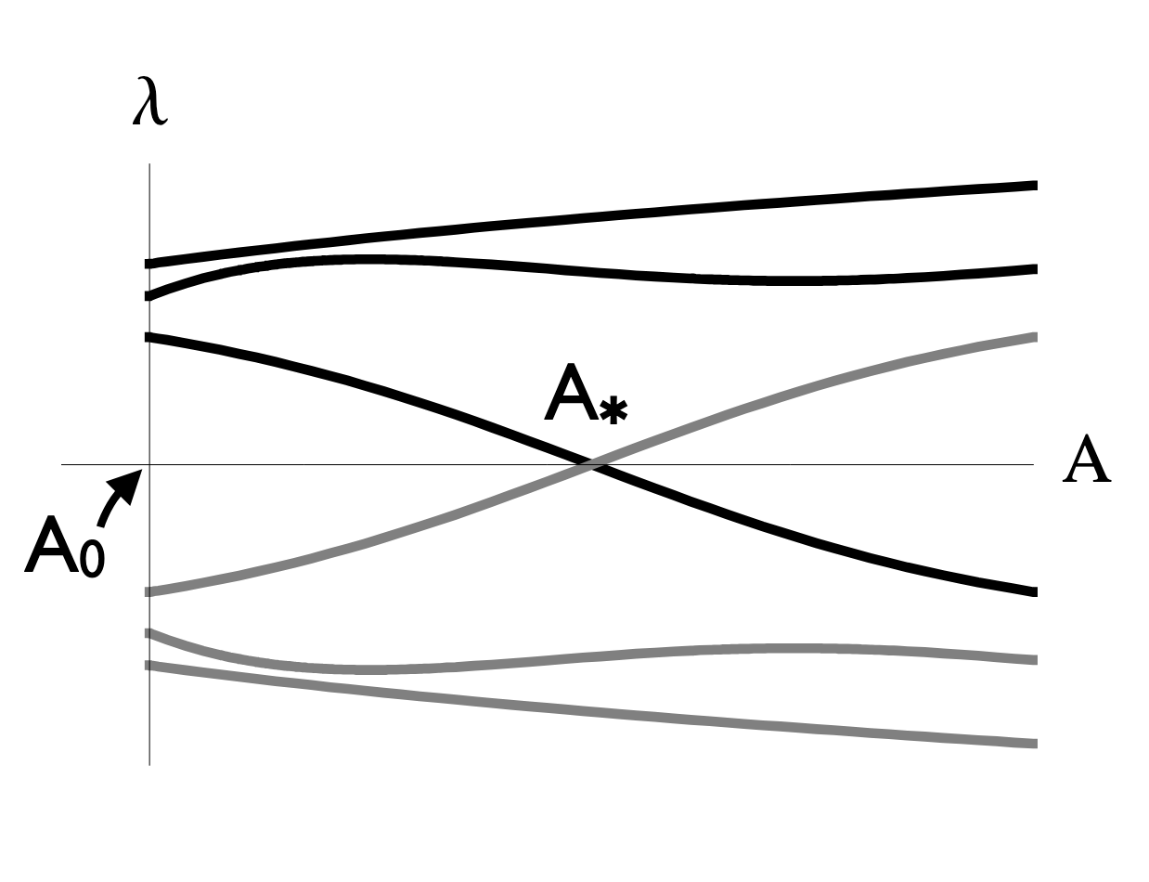


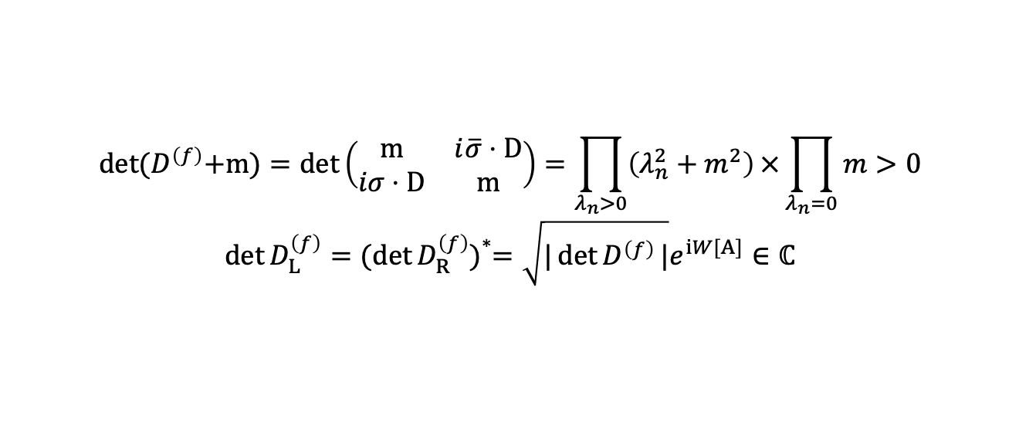
Chiral lattice Gauge Theories?
手征格点规范场论？
A Sign Problem
  Dirac fermion
  Chiral fermion
An ambiguous phase?
$$\det{{(D}^{\left(f\right)}+m)}=\det\left(\begin{matrix}m & i\overline{σ}⋅D \\ iσ⋅D & m\end{matrix}\right)=\prod_{λ_{n}>0}{\left(λ_{n}^{2}+m^{2}\right)}×\prod_{λ_{n}=0}{m}>0$$
$$\det{D_{L}^{\left(f\right)}}={(\det{D_{R}^{\left(f\right)})}}^{*}=\sqrt{|\det{D^{\left(f\right)}}|}e^{iW[A]}∈ℂ$$
Is it well defined?
？
$$W\left[A_{0}\right]=W\left[A_{1}\right]±π$$
$$A=\left(1−s\right)A_{0}+sA_{1}$$
$$A_{1}=g^{−1}A_{0}g+g^{−1}dg$$
$$A_{1}$$
Seemly hopeless in Lagrangian method.
Could be solved in Hamiltonian method with Quantum Circuits?
Spectrum Flow
(Always Posible)

Slide 9
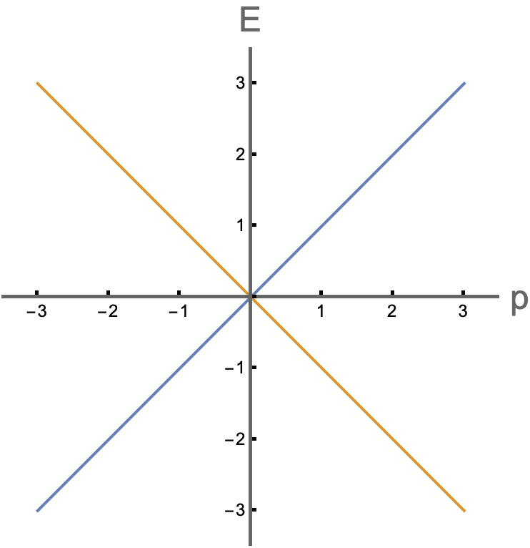
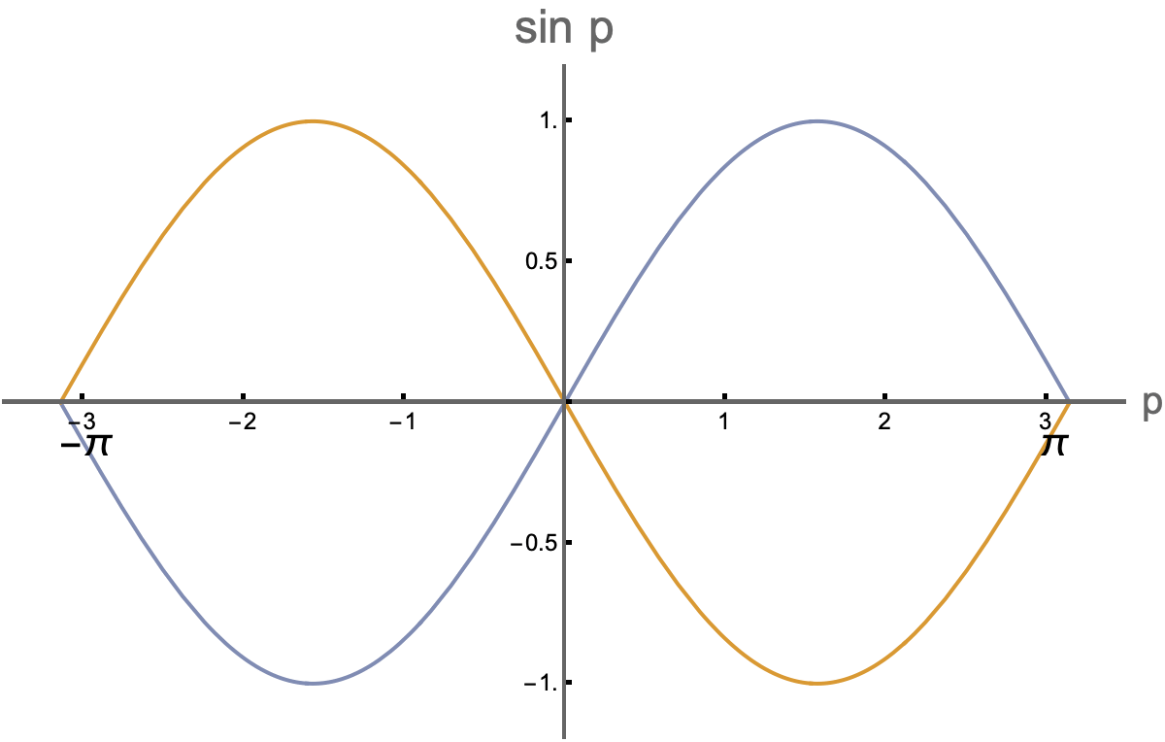
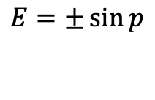

Chiral lattice Gauge Theories? NO-GO!
手征格点规范场论？山穷水尽
Nilsen-Ninomiya NO-GO theorem (1981): Cannot formulate Dirac fermion with exact chiral symmetry without an unwanted doubling of all fermion species.
Positive chirality
Negative chirality
Doublers
Continuum
Lattice in space with continous time
$$E=±p$$
$$E=±\sin{p}$$

Slide 10
Chiral lattice Gauge Theories? Ways Out…
手征格点规范场论？柳暗花明
Possible paths to a chiral lattice gauge theory
  Symmetric mass generation, started from 1986 revived since 2011 due to Fidkowski and Kitaev
  Symmetry disentanglers, proposed in 2026 in Thorngren, Preskill, Fidkowski, arXiv:2601.04304.
  Domain Wall, vector fermions proposed by Kaplan in 1992, chiral fermions in 2024
  …
Simulated in 1+1D using tensor networks (DMRG) to avoid sign problem, arXiv:2202.12355
No simulation yet
Abundant application in LQCD with vector fermions by Lagrangian method.
NO Hamiltonian method explored even for vector fermions

Slide 11
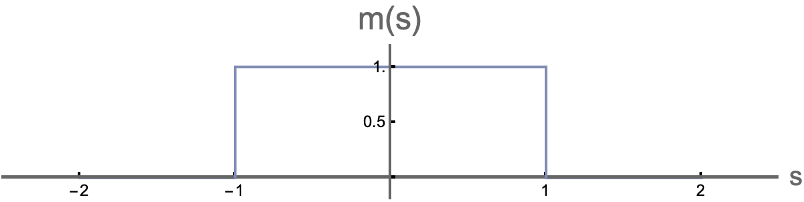










Domain Wall Fermion
畴壁费米子
n + 1-D fermions with mass defects $⟷$ Topological protected chiral modes on n-D defects
$$H=−iγ^{i}∂_{i}+m\left(s\right)+\frac{w}{2}Δ$$
$$E$$
$$E$$
L
L
R
$$m$$
$$−m$$
$$m$$
$$−m$$
$$p$$
$$J$$
Kaplan, Phys. Lett. B. (1992)
Kaplan, Sen, Phys.Rev.Lett . 132 (2024) 14, 141604

Slide 12


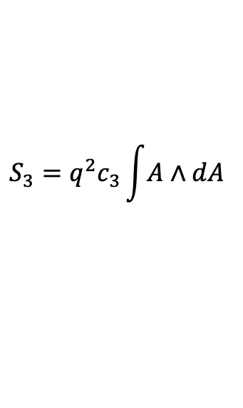


Callan-Harvey Effect
Callan-Havey效应
The anomaly of the boundary theory is provided by anomaly inflow from the bulk, like Quantum Hall.
After integrating out bulk contribution, there is an effective Chern-Simons action, e.g., for $U(1)$ gauge theory in 2+1D
Chern-Simons current provides the anomaly inflow
What Callan-Harvey missed: UV physics could make current jump
Chern-Simons Current
$$S_{3}=q^{2}c_{3}\int{A}∧dA$$
$$∇_{t}j_{t}+∇_{x}j_{x}=−∇_{s}j_{s}=qc_{3}F_{xt}$$
Extra dimension $s$
$$2π{ c}_{3}∈π_{2}\left(T^{2}\right)=ℤ$$
Chiral fermions with correct anomaly forms

Slide 13
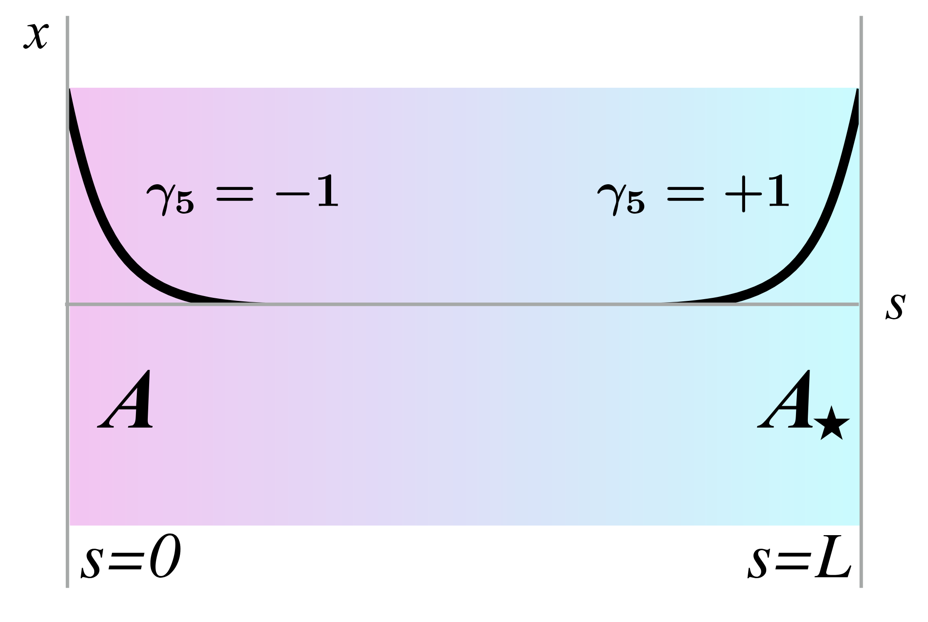
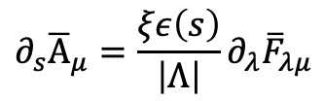
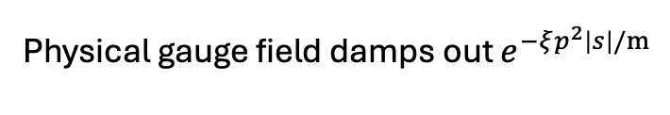

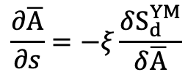


Gauge Field Flow
规范场流
We use gauge field flow to extend our gauge field from the defects to the bulk.
Gradient Flow
Annealing flow(Equation of motion flow)
$$\frac{∂\overline{A}}{∂s}=−ξ\frac{δS_{d}^{YM}}{δ\overline{A}}$$
$$∂_{s}{\overline{A}}_{μ}=\frac{ξε\left(s\right)}{\left|Λ\right|}∂_{λ}{\overline{F}}_{λμ}$$
On a slab
$$∂_{s}^{2}{\overline{A}}_{μ}+∂_{ν}\left(∂_{ν}{\overline{A}}_{μ}−∂_{μ}{\overline{A}}_{ν}\right)=0.$$
$$δS_{d+1}^{YM}=0$$
$$A_{s}=0$$
Anti-instanton
Instanton
Physical gauge field damps out $e^{−ξp^{2}\left|s\right|/m}$
Omitting many caveats
Grabowska, Kaplan, Phys. Rev. D. 94, 114504 (2016)
Kaplan, Sen, arXiv:2412.02024

Slide 14
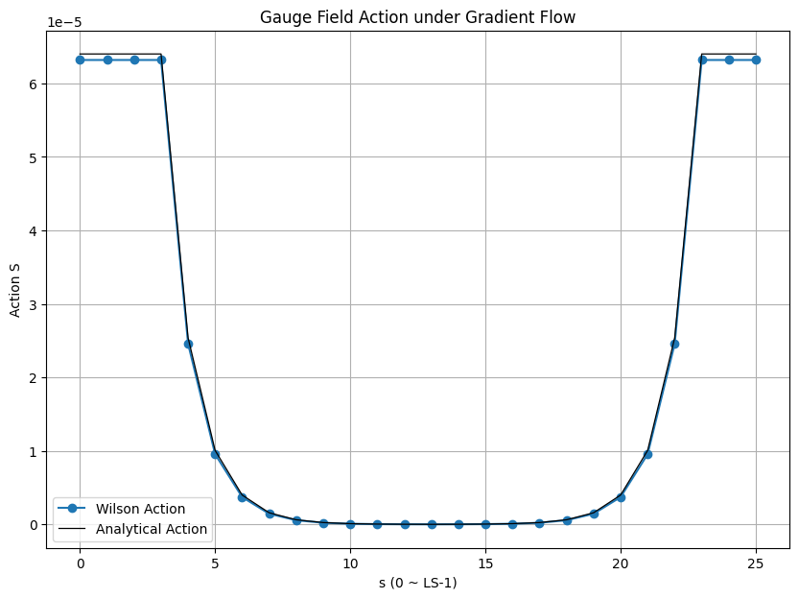

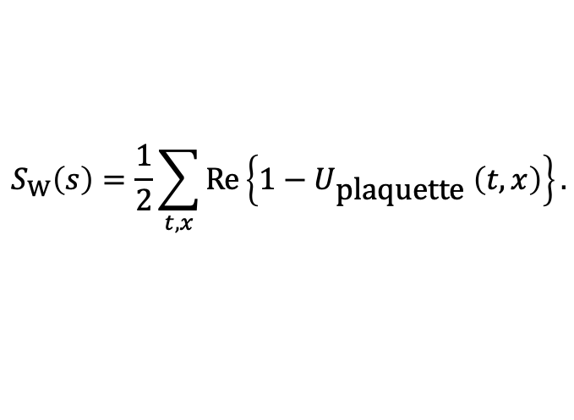

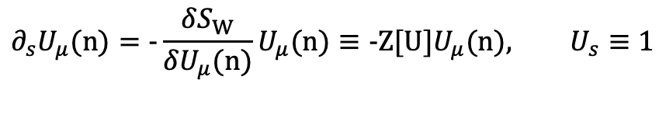


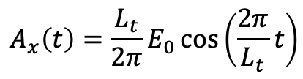
Gradient Flow on Lattice
格点上的梯度流
In 2+1D, with a Wilson action
comes a ‘Wilson flow’ into the extra dimension as
The Euler scheme for numerical calculation of the ‘Wilson flow’ equation
For $U(1)$ field, the scheme only converge when $εξ<\frac{1}{2}$.
Set Boundary as
In continuum, we expect the flow to bulk as
$$S_{W}\left(s\right)=\frac{1}{2}\sum_{t,x}{\operatorname{Re}\left\{1−U_{\text{plaquette} }\left(t,x\right)\right\}}.$$
$$∂_{s}U_{μ}(n)=−\frac{δS_{W}}{δU_{μ}(n)}U_{μ}(n)≡−Z[U]U_{μ}(n), U_{s}≡1$$
$$U_{μ}\left(n+ε\hat{s}\right)=e^{−εξZ\left[U\right]}U_{μ}\left(n\right)$$
$$A_{x}\left(t\right)=\frac{L_{t}}{2π}E_{0}\cos\left(\frac{2π}{L_{t}}t\right)$$
$${×e}^{−ξ{\left(\frac{2π}{L_{t}}\right)}^{2}∆s}$$
Lüscher, Commun. Math. Phys. 93, 899–919 (2010)
$$ξ=3, ε=1/7$$

Slide 15
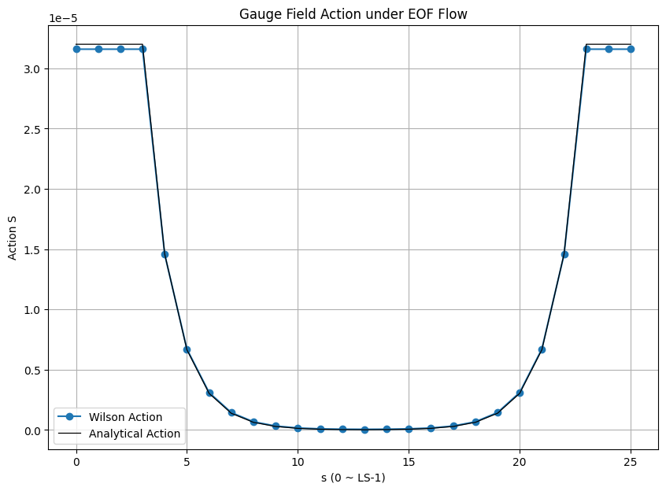
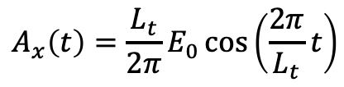
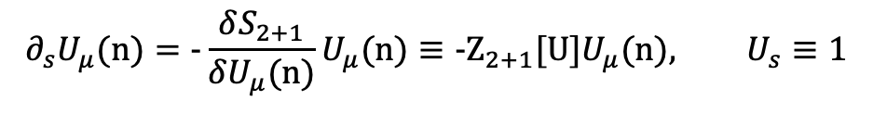




Equation of Motion Flow on Lattice
格点上的运动方程流
We solve for Equation of Motion Flow by a gradient flow in an imaginary flow direction $τ$
On lattice
Only converging to some minimum point.
Set the boundary as
In continuum, we expect
$$∂_{i}{\overline{F}}_{iμ}=0$$
$$∂_{τ}{\overline{A}}_{μ}=ξ∂_{i}{\overline{F}}_{iμ}$$
$$∂_{s}U_{μ}(n)=−\frac{δS_{2+1}}{δU_{μ}(n)}U_{μ}(n)≡−Z_{2+1}[U]U_{μ}(n), U_{s}≡1$$
$$A_{x}\left(t\right)=\frac{L_{t}}{2π}E_{0}\cos\left(\frac{2π}{L_{t}}t\right)$$
$${×e}^{−ξ\left(\frac{2π}{L_{t}}\right)∆s}$$

Slide 16
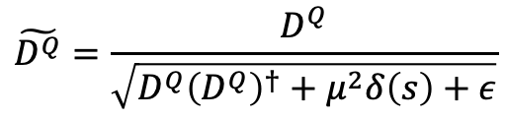
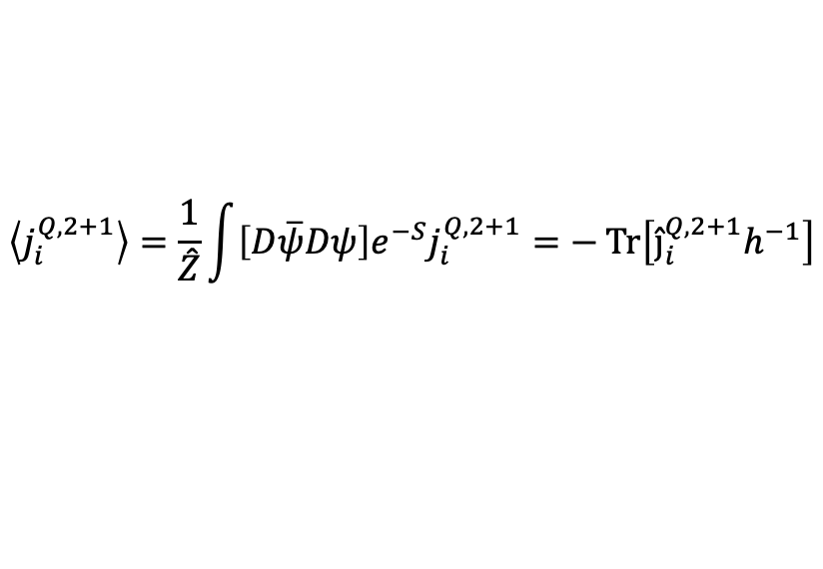
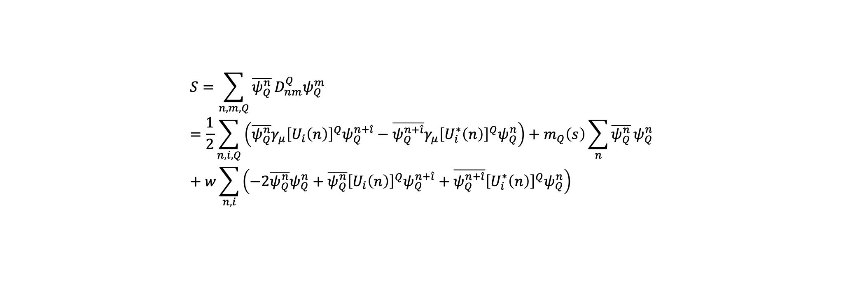

Lattice Construction
格点构造
A lattice of size $L_{t}×L_{x}×L_{s}$ with $Q=3,4,5,0$ fermions coupled to a background gauge field
$$S=\sum_{n,m,Q}{\overline{ψ_{Q}^{n}}}D_{nm}^{Q}ψ_{Q}^{m}=\frac{1}{2}\sum_{n,i,Q}{\left(\overline{ψ_{Q}^{n}}γ_{μ}{\left[U_{i}\left(n\right)\right]}^{Q}ψ_{Q}^{n+\hat{i}}−\overline{ψ_{Q}^{n+\hat{i}}}γ_{μ}{\left[U_{i}^{∗}\left(n\right)\right]}^{Q}ψ_{Q}^{n}\right)}+m_{Q}\left(s\right)\sum_{n}{\overline{ψ_{Q}^{n}}}ψ_{Q}^{n}+w\sum_{n,i}{\left(−2\overline{ψ_{Q}^{n}}ψ_{Q}^{n}+\overline{ψ_{Q}^{n}}{\left[U_{i}\left(n\right)\right]}^{Q}ψ_{Q}^{n+\hat{i}}+\overline{ψ_{Q}^{n+\hat{i}}}{\left[U_{i}^{∗}\left(n\right)\right]}^{Q}ψ_{Q}^{n}\right)}$$
If with dynamic gauge field
$$\tilde{D^{Q}}=\frac{D^{Q}}{\sqrt{D^{Q}{\left(D^{Q}\right)}^{†}+μ^{2}δ\left(s\right)+ε}}$$
Might be the first step to a Hamiltonian method
$$j_{i}^{Q,2+1}=\frac{1}{2}\left[\overline{ψ_{Q}^{n}}γ_{i}{\left[U_{i}\left(n\right)\right]}^{Q}ψ_{Q}^{n+\hat{i}}+\overline{ψ_{Q}^{n+\hat{i}}}γ_{i}{\left[U_{i}^{∗}\left(n\right)\right]}^{Q}ψ_{Q}^{n}\right]+w\left[\overline{ψ_{Q}^{n}}{\left[U_{i}\left(n\right)\right]}^{Q}ψ_{Q}^{n+\hat{i}}−\overline{ψ_{Q}^{n+\hat{i}}}{\left[U_{i}^{∗}\left(n\right)\right]}^{Q}ψ_{Q}^{n}\right]$$
$$\left\langle j_{i}^{Q,2+1}\right\rangle =\frac{1}{\hat{Z}}\int{\left[D\overline{ψ}Dψ\right]e^{−S}j_{i}^{Q,2+1}}=−\operatorname{Tr}\left[{{\hat{j}}_{i}^{Q,2+1}h}^{−1}\right]$$

Slide 17
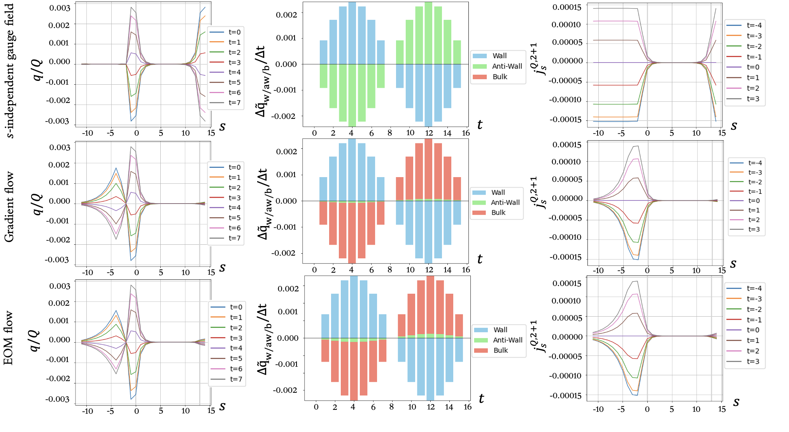
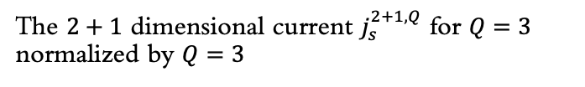
On a Slab Domain Wall
板形畴壁
Current density and charges
Plot of rate of change of total charge on wall, anti-wall and bulk
The $2+1$ dimensional current $j_{s}^{2+1,Q}$ for $Q=3$ normalized by $Q=3$
Charge per unit length in $s$ as a function of $s$

Slide 18
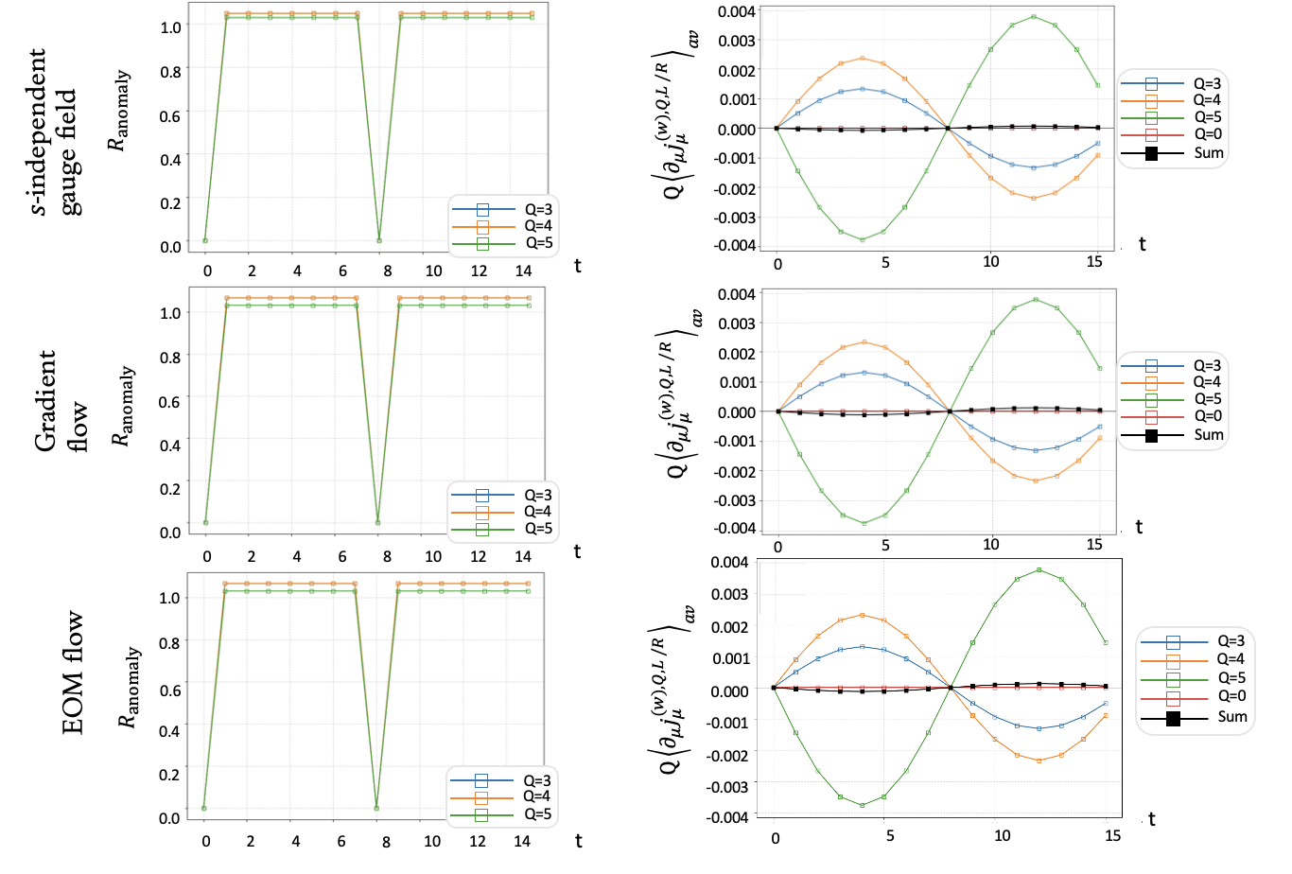


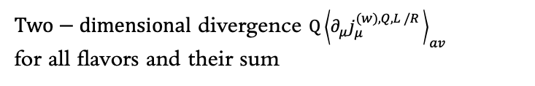
On a Slab Domain Wall
板形畴壁
$$R_{\text{Anomaly} }\left(t\right)≡±\left(QE_{\text{eff}}\left(t\right)/2π\right)/{\left\langle ∂_{μ}j_{μ}^{\left(w\right),Q,L}\left(t\right)\right\rangle }_{\text{av}}$$
Anomalies
$Two−dimensional$ divergence $Q{\left\langle ∂_{μ}j_{μ}^{(w),Q,L /R }\right\rangle }_{av}$
for all flavors and their sum
$$Plot of the anomaly ratio$$

Slide 19
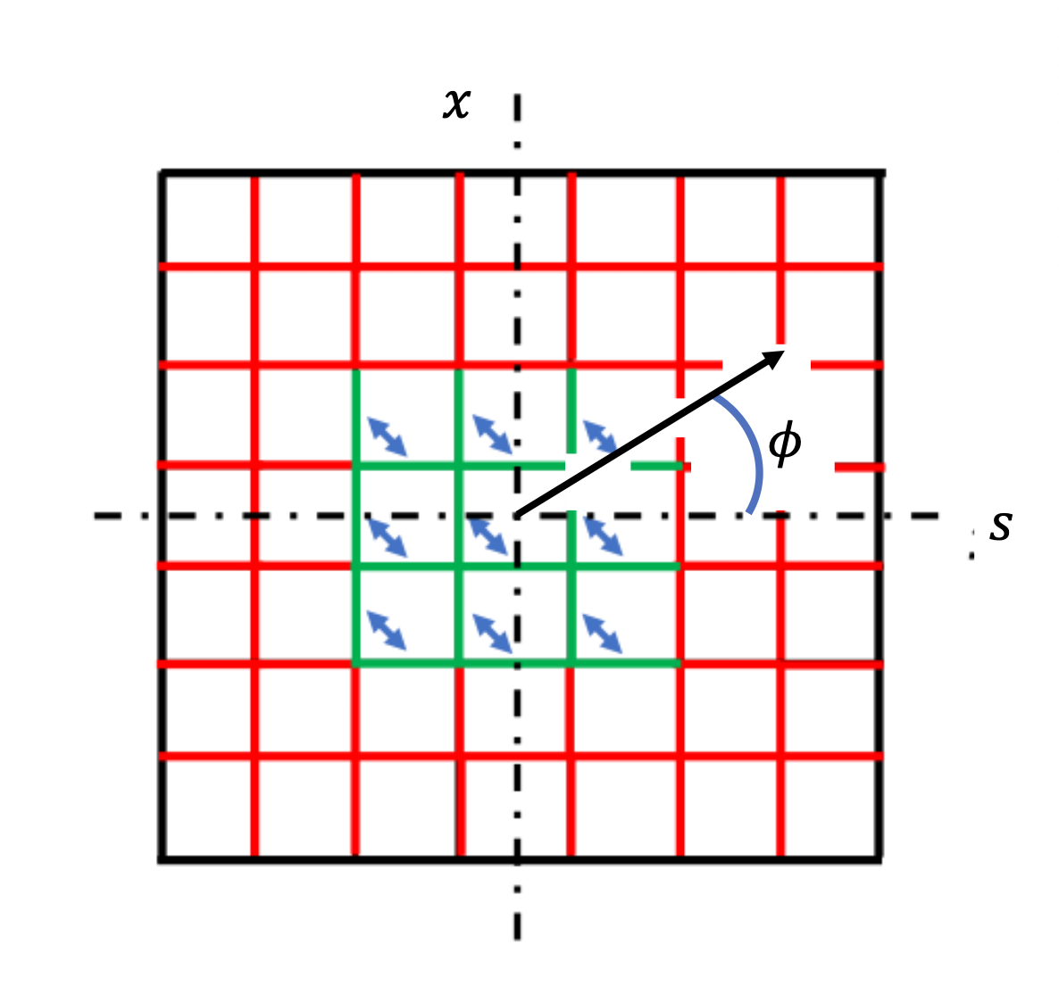
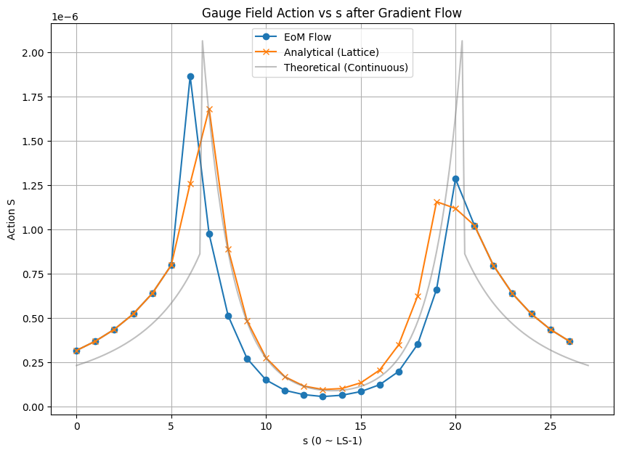

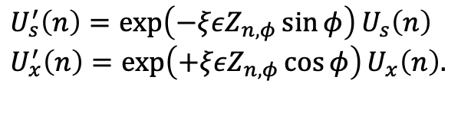
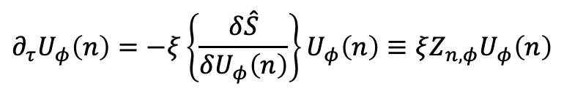

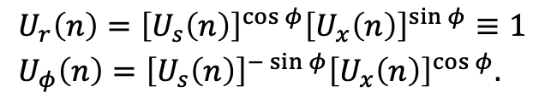
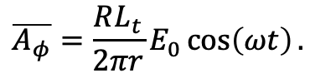
Equation of Motion Flow on Lattice
格点上的运动方程流
We want solve the Equation of Motion Flow in a cylindrical way on a square lattice.
Set the boundary condition as
In continuum, there will be
$$\begin{aligned}&U_{r}\left(n\right)={\left[U_{s}\left(n\right)\right]}^{\cos{φ}}{\left[U_{x}\left(n\right)\right]}^{\sin{φ}}≡1 \\ &U_{φ}\left(n\right)={\left[U_{s}\left(n\right)\right]}^{−\sin{φ}}{\left[U_{x}\left(n\right)\right]}^{\cos{φ}}.\end{aligned}$$
$$∂_{τ}U_{φ}\left(n\right)=−ξ\left\{\frac{δ\hat{S}}{δU_{φ}\left(n\right)}\right\}U_{φ}\left(n\right)≡ξZ_{n,φ}U_{φ}\left(n\right)$$
$$U_{s}^{′}\left(n\right)=\exp\left(−ξεZ_{n,φ}\sin{φ}\right)U_{s}\left(n\right) \\ U_{x}^{′}\left(n\right)=\exp\left(+ξεZ_{n,φ}\cos{φ}\right)U_{x}\left(n\right).$$
$$Z_{n,φ} =(−\sin{φ}Z_{n,s}+\cos{φ}Z_{n,x})$$
$$\overline{A_{φ}}=\frac{RL_{t}}{2πr}E_{0}\cos\left(ωt\right).$$
$$×I_{1}\left(2π/L_{t}r\right)$$

Slide 20
On a Disk Domain Wall
盘形畴壁
Gauge Field and Electromagnetic field
Numerical
Analytical

Slide 21
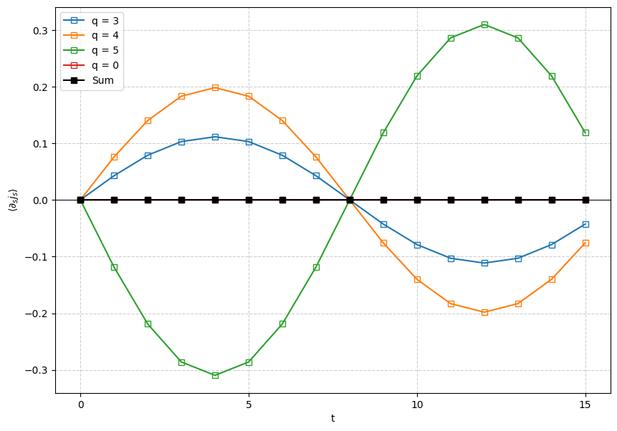
On a Disk Domain Wall
Anomaly Cancellation
盘形畴壁
currents
Charges

Slide 22

Conclusion & Outlook
总结
For a slab domain wall 3-4-5-0 system, we use Gradient Flow and Equation of Motion Flow to decouple mirror fermions
For a disk domain wall 3-4-5-0 system, , we use Equation of Motion Flow to gauge the bulk.
A Hamiltonian Method? On quantum circuits?
Higher dimension?
Instantons under flow?
CP problem and $η’$ mass?
Chiral Gauge Theory

Slide 23
Thank you for your attention!
Jinlong Dang

