Slide 1

Study of $γγ→γψ(2S)$ at BelleII

Slide 2
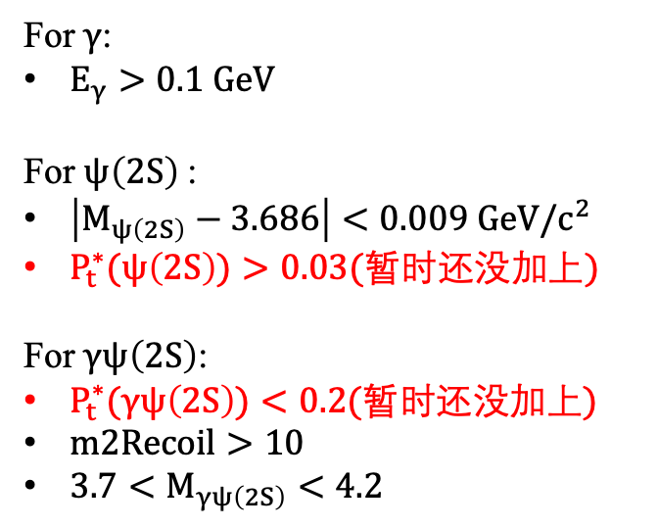
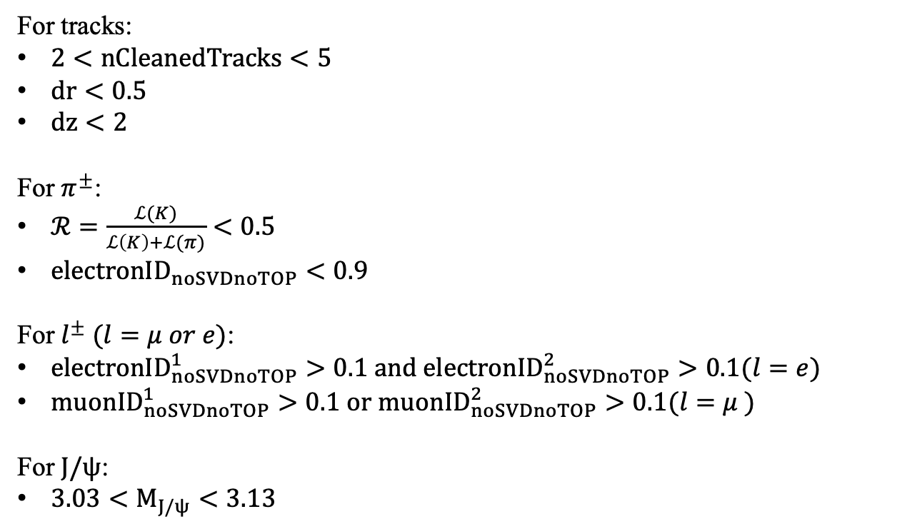
Event Selection
For tracks:
$2<nCleanedTracks<5$
$dr<0.5$
$dz<2$
For $π^{±}$:
$ℛ=\frac{ℒ(K)}{ℒ\left(K\right)+ℒ(π)}<0.5$
${electronID}_{noSVDnoTOP}<0.9$
For $l^{±} (l=μ or e)$:
${electronID}_{noSVDnoTOP}^{1}>0.1 and {electronID}_{noSVDnoTOP}^{2}>0.1(l=e)$
${muonID}_{noSVDnoTOP}^{1}>0.1 or {muonID}_{noSVDnoTOP}^{2}>0.1(l=μ )$
For $J/ψ$:
$3.03<M_{J/ψ}<3.13$
For $γ$:
$E_{γ}>0.1 GeV$
For $ψ\left(2S\right)$:
$\left|M_{ψ\left(2S\right)}−3.686\right|<0.009 GeV/c^{2}$
$P_{t}^{∗}(ψ\left(2S\right))>0.03(暂时还没加上)$
For $γψ\left(2S\right)$:
$P_{t}^{∗}(γψ\left(2S\right))<0.2(暂时还没加上)$
$m2Recoil>10$
$3.7<M_{γψ\left(2S\right)}<4.2$

Slide 3
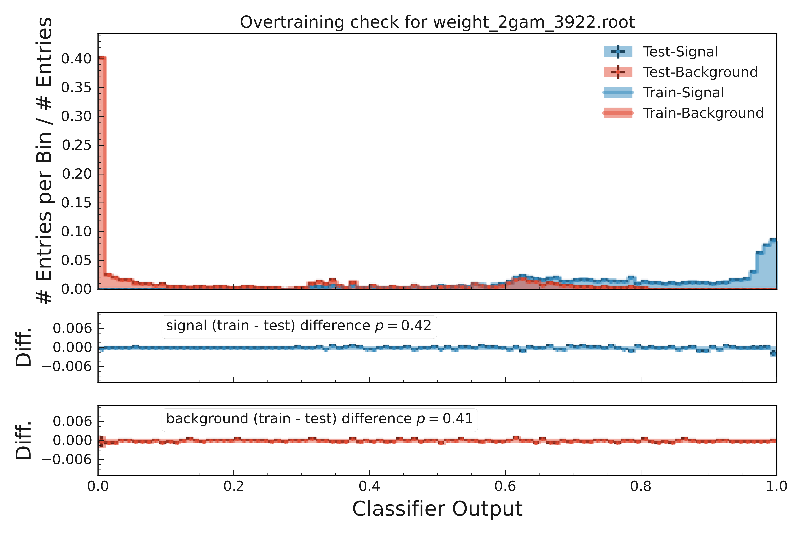
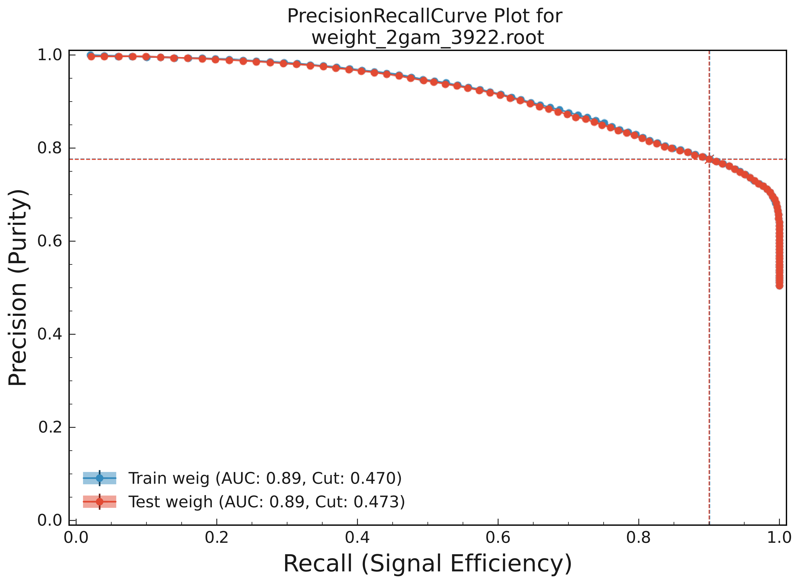
重新训练MVA
训练所用参数：
fastbdt_options.m_nTrees = 600
fastbdt_options.m_nLevels = 2
fastbdt_options.m_nCuts = 13
fastbdt_options.m_shrinkage = 0.10

Slide 4
Data-MC 一致性检查（MC仅指isr）
1.还没加 psi(2S)和gamma psi(2S)横动量的selection，其他条件都加了
2.其他条件保留与belle的分析一致(详细见第二页)
3.除了下面展示的分布，也检查了各track的dr和dz，没有发现明显的data-MC的差异
4.Jpsi、psi(2S)、 gamma psi(2S)的不变质量谱分布有点奇怪，data和MC有一定差异
5.MVA（仅由psi(2S)和gamma psi(2S)横动量训练得到）在靠近0那端也有一定差异
isr模拟的不好(用的是官方产生MC15样本)还是data需要修正(run1的4S+4S offres) ？

Slide 5
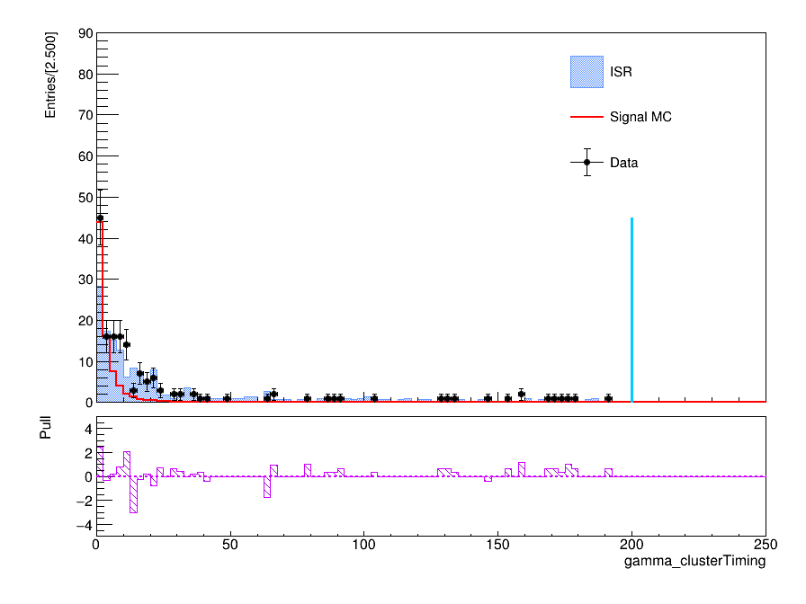
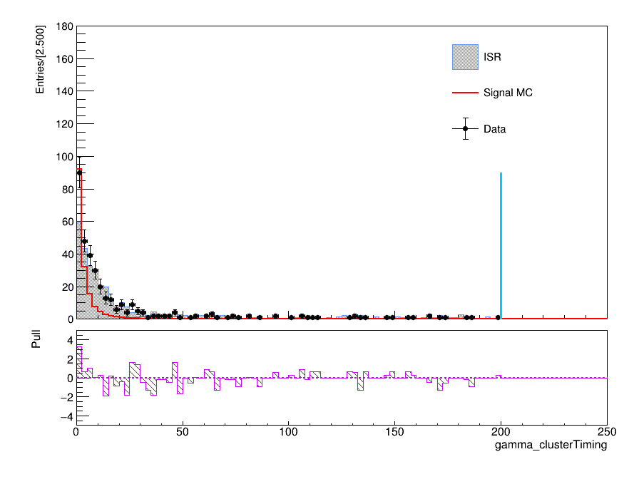
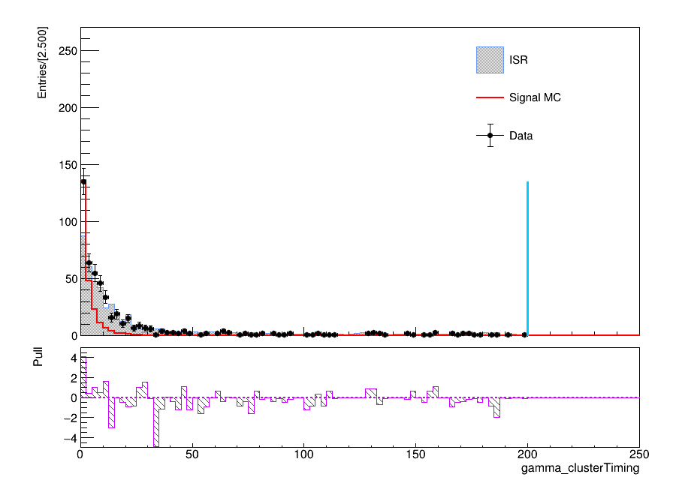
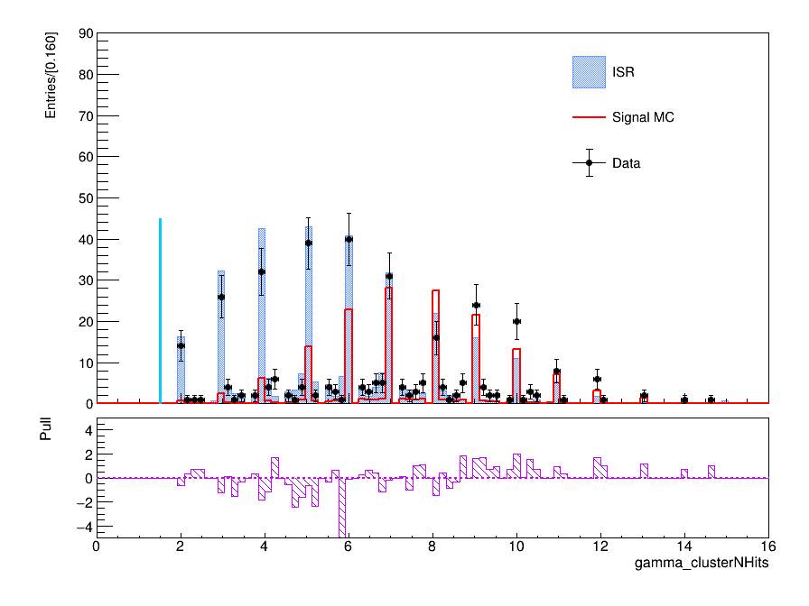
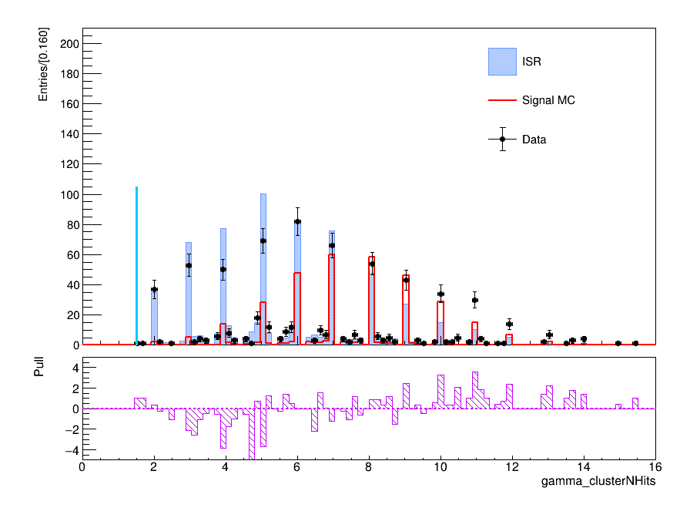
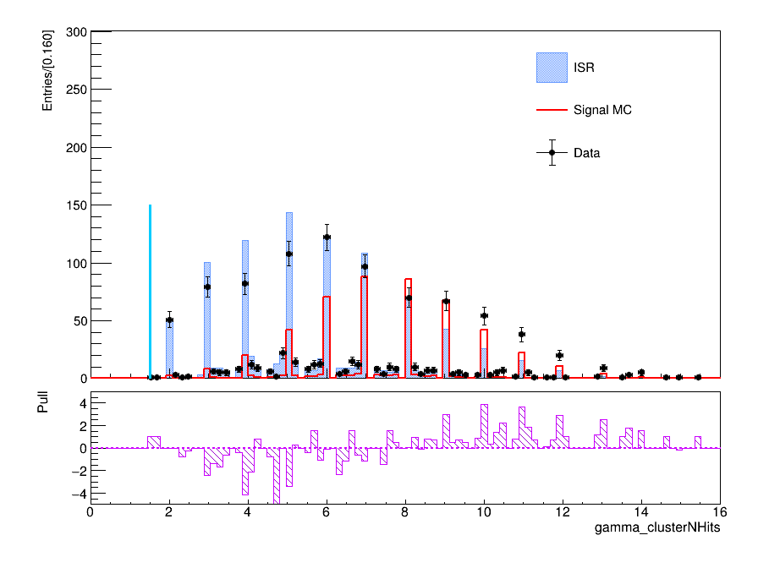
Data-MC agreement
ee mode
mumu mode
both mode
ee mode
mumu mode
both mode

Slide 6
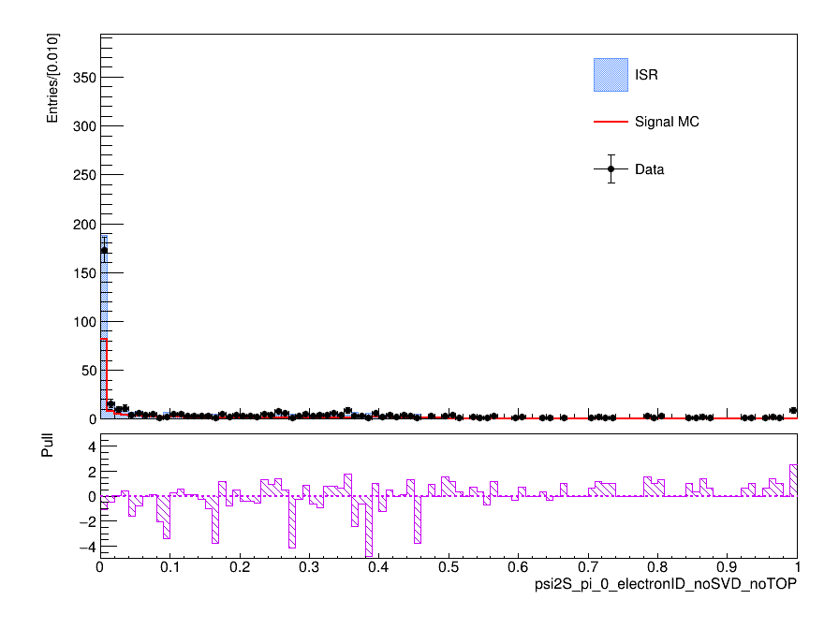
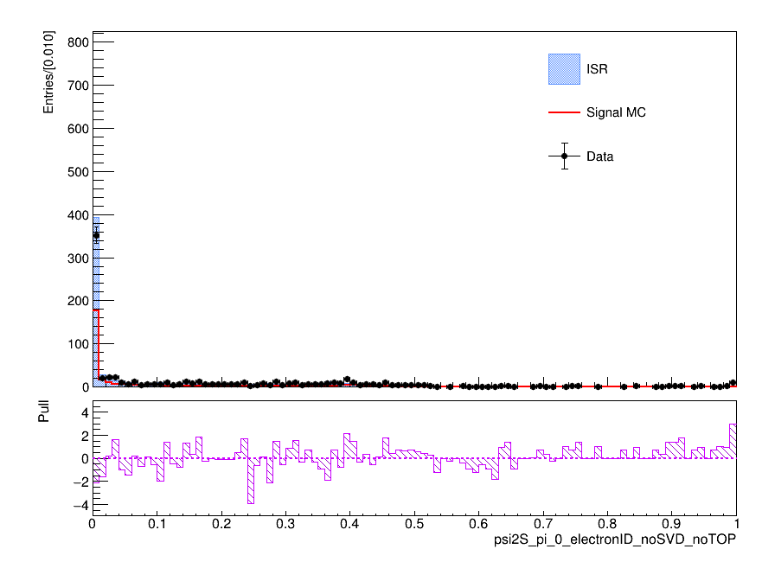
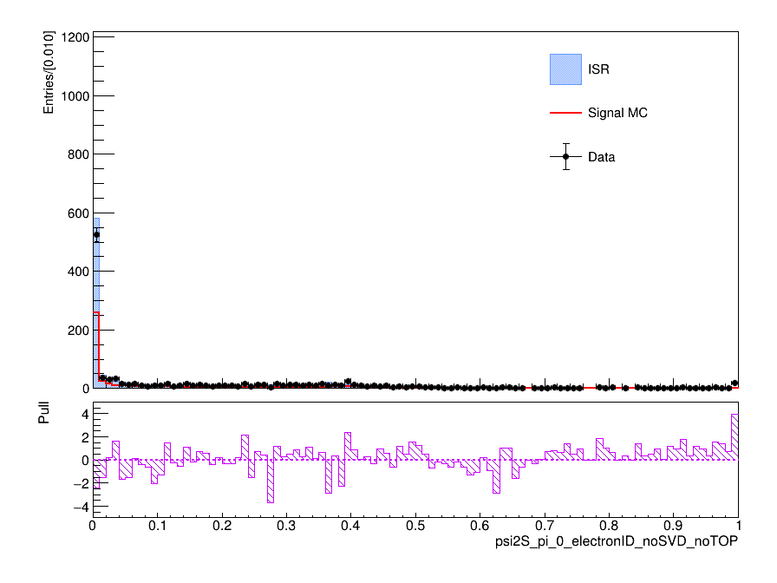
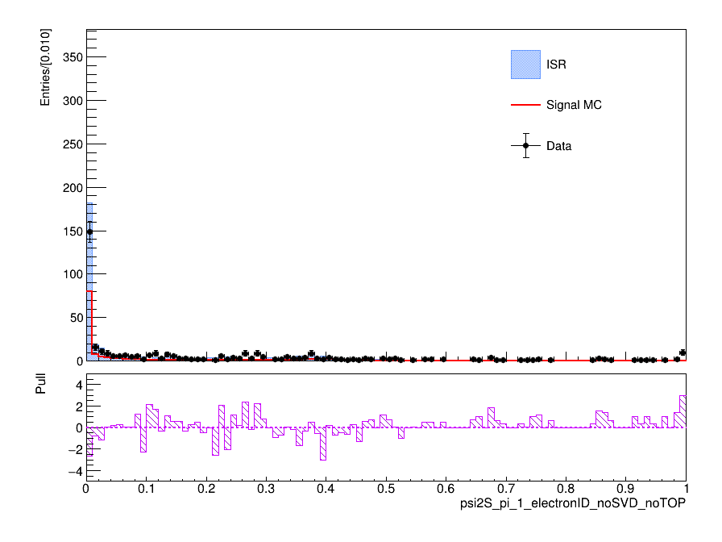
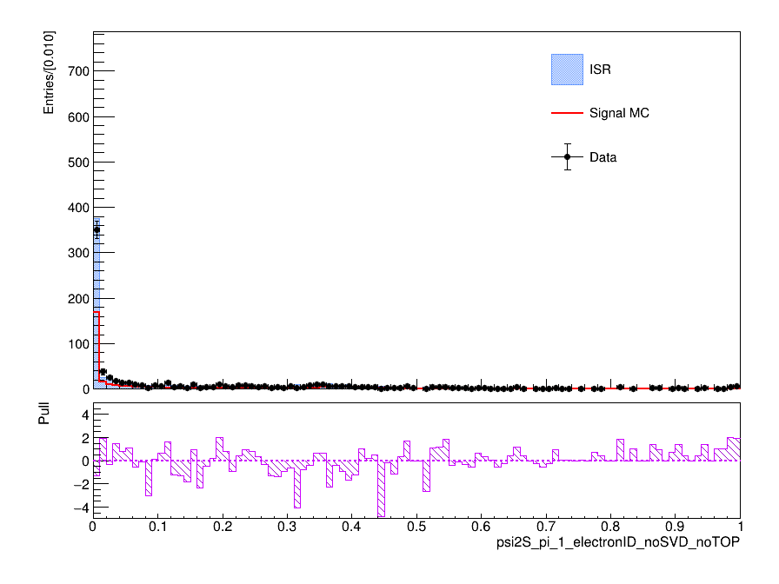
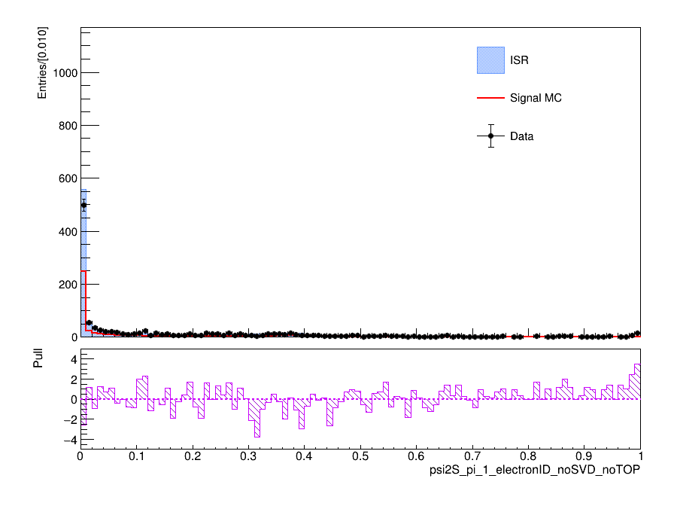
Data-MC agreement
ee mode
mumu mode
both mode
ee mode
mumu mode
both mode

Slide 7
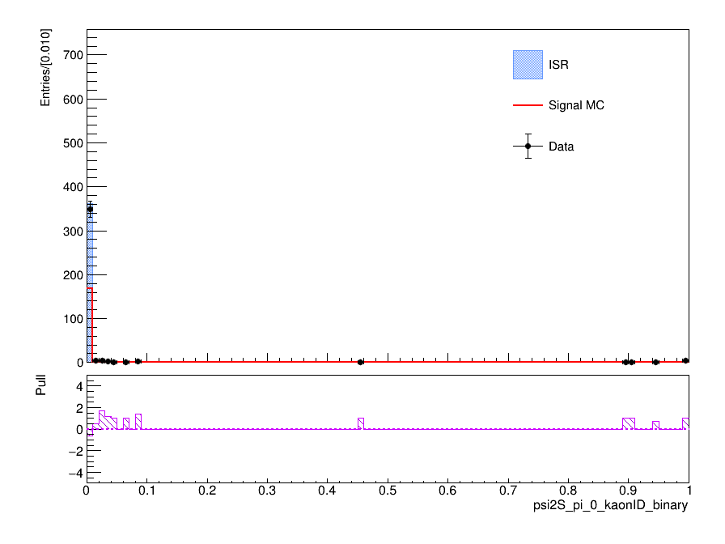
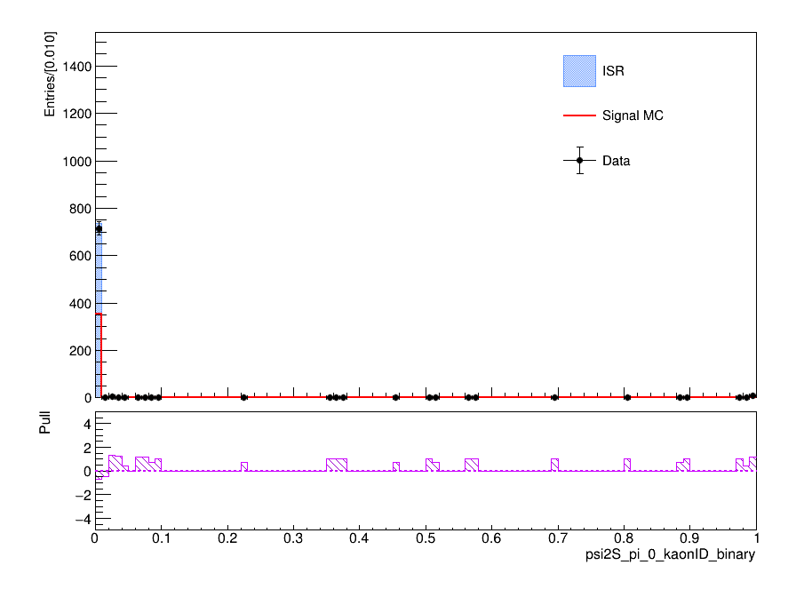
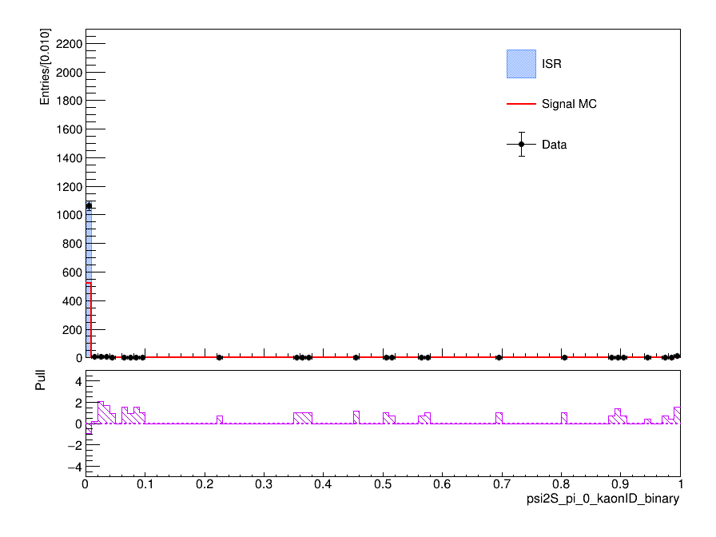
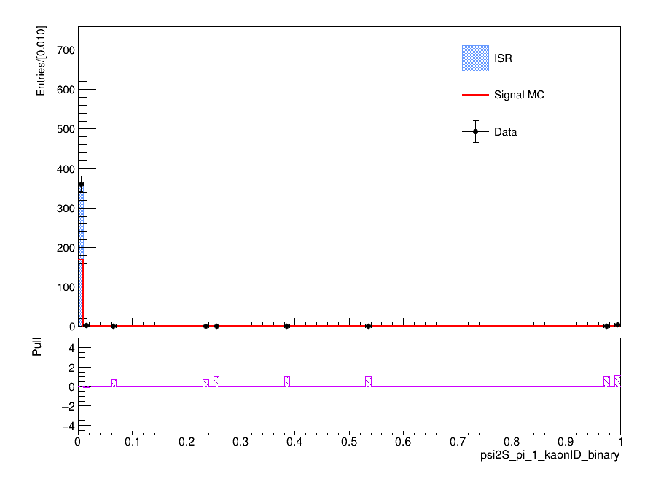
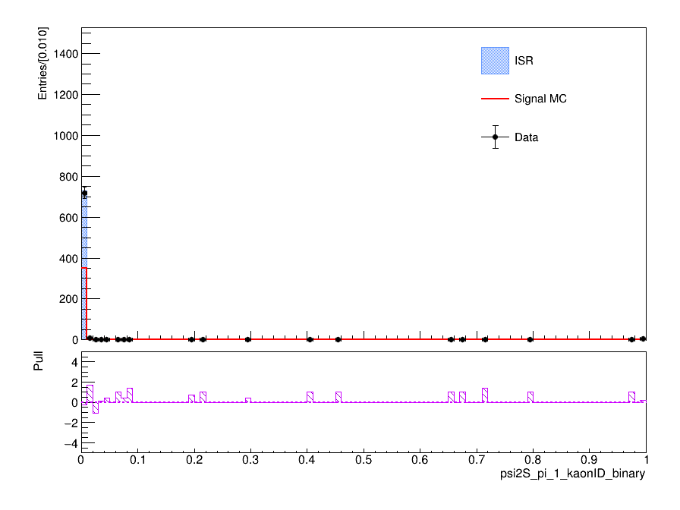
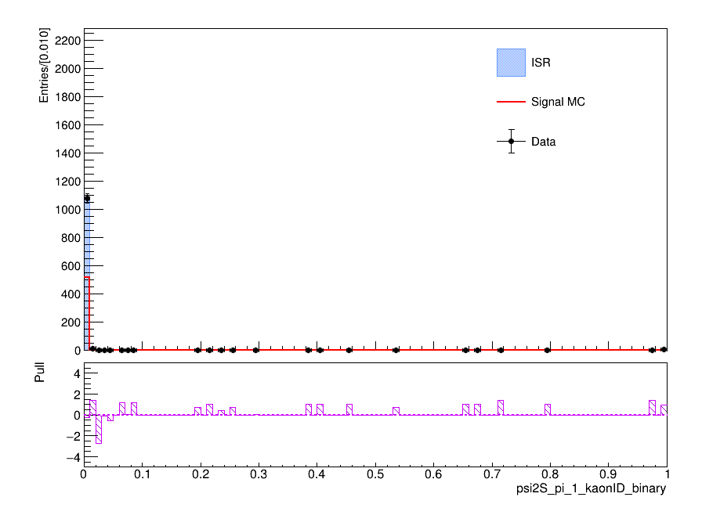
Data-MC agreement
ee mode
mumu mode
both mode
ee mode
mumu mode
both mode

Slide 8
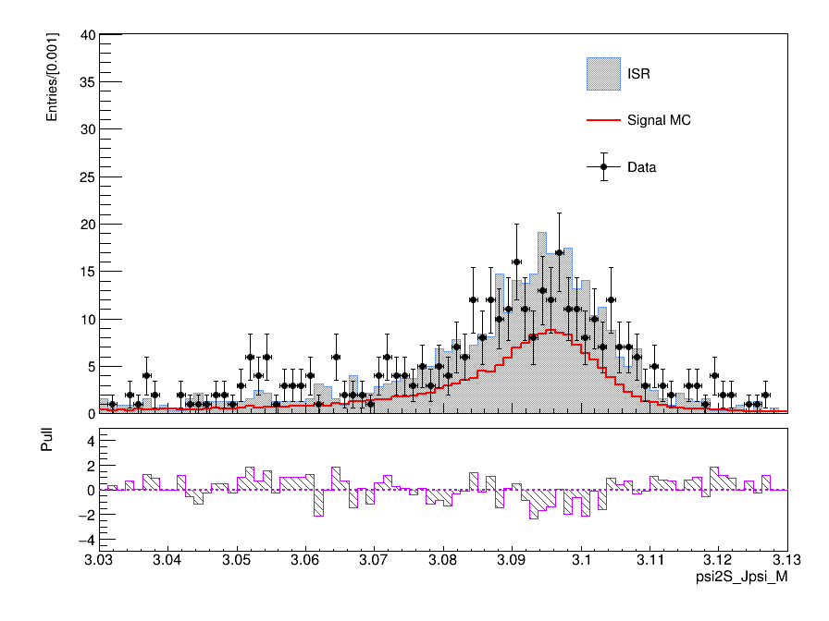


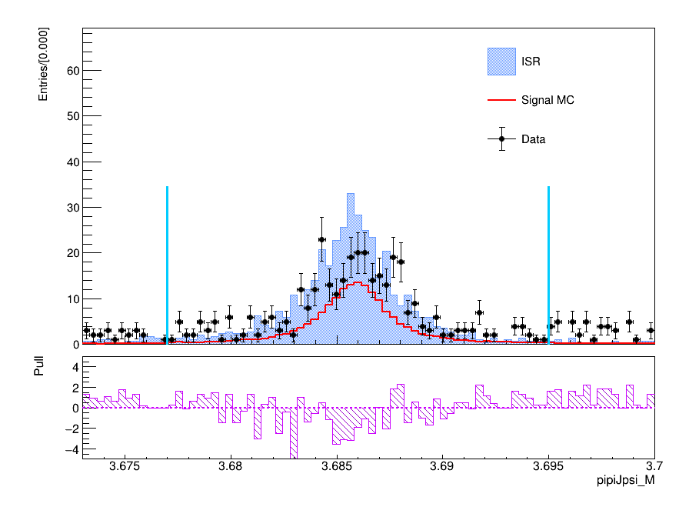
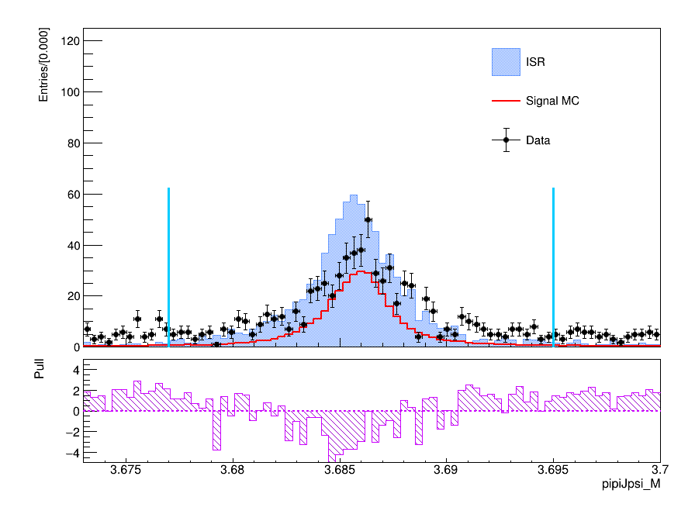
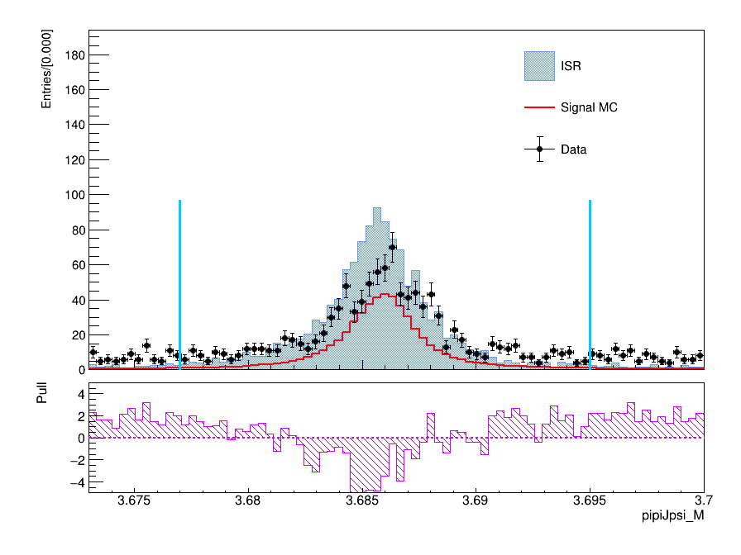
Data-MC agreement
ee mode
mumu mode
both mode
ee mode
mumu mode
both mode

Slide 9
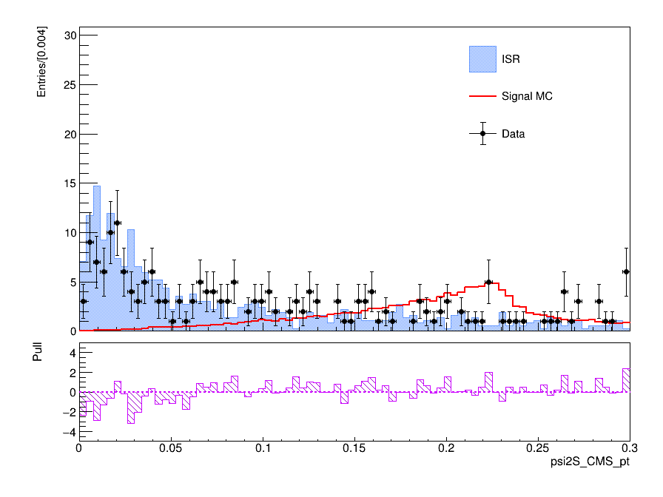
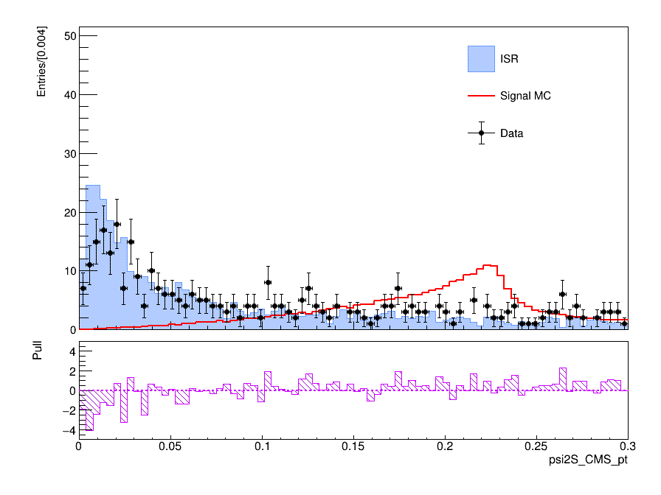
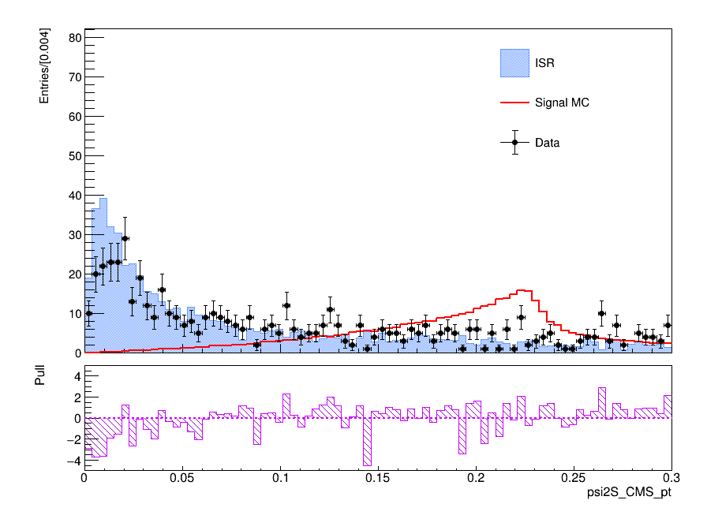
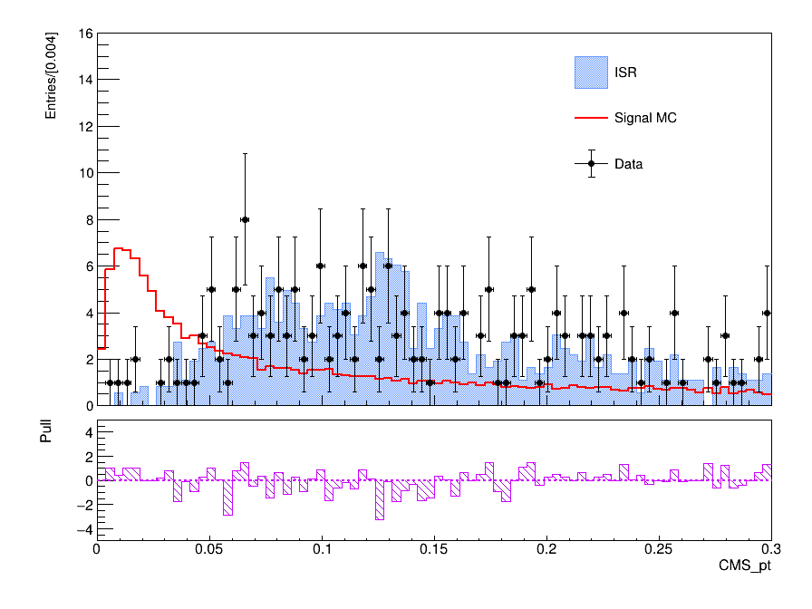
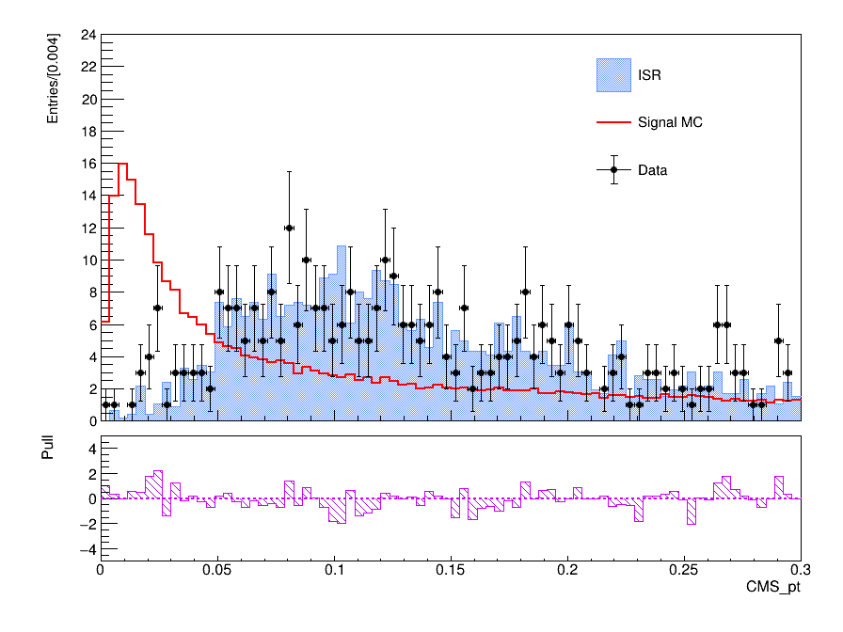
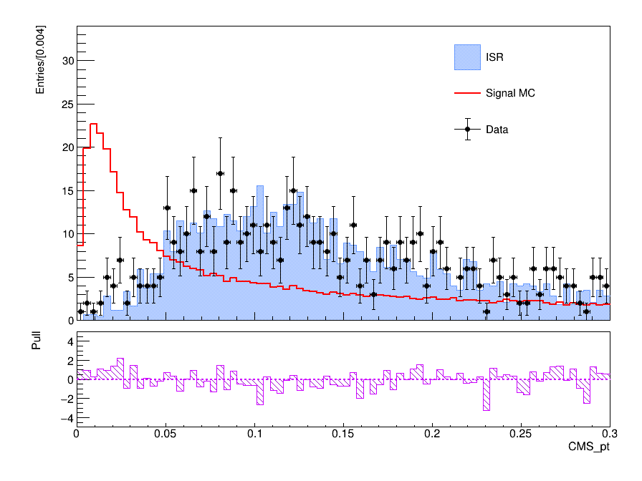
Data-MC agreement
ee mode
mumu mode
both mode
ee mode
mumu mode
both mode

Slide 10
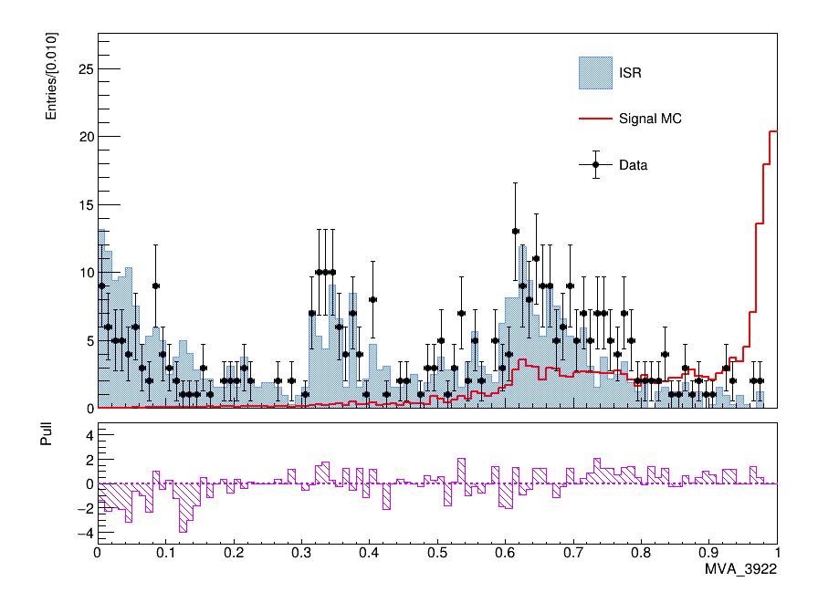
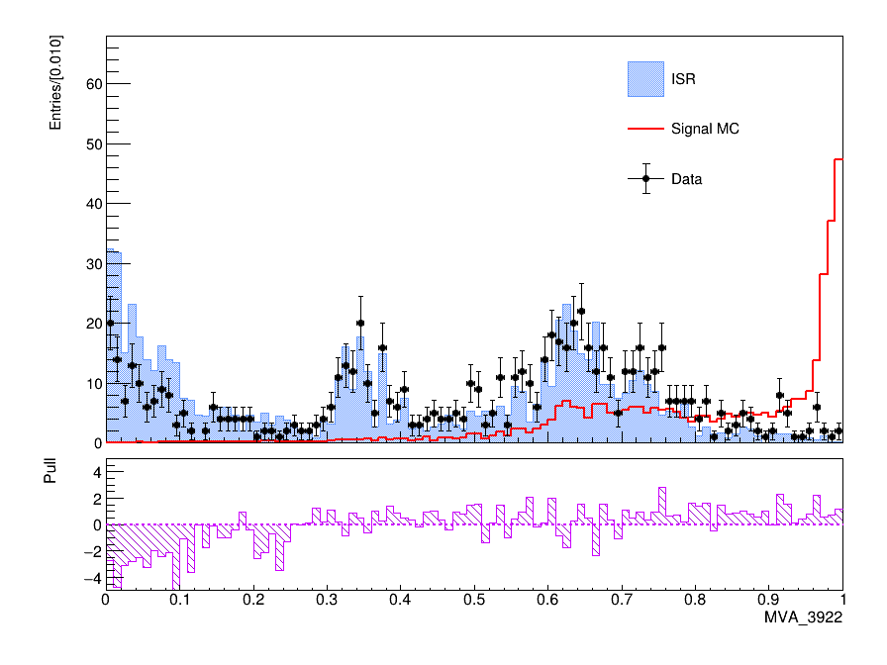
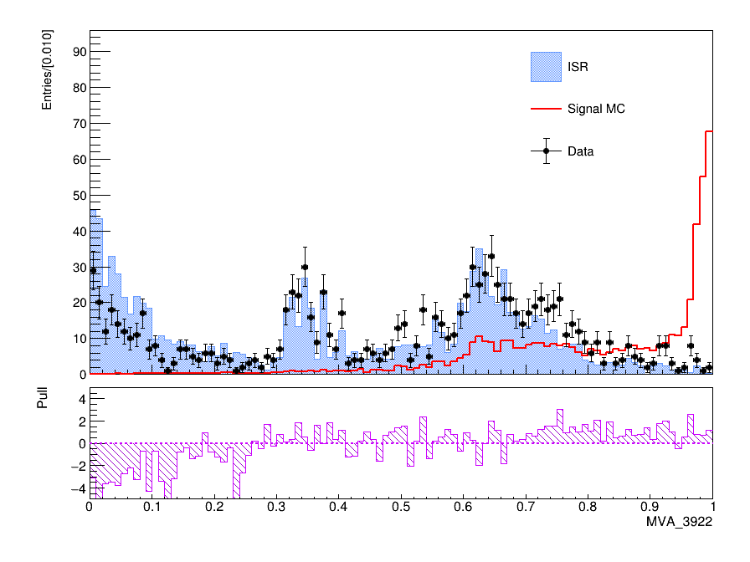
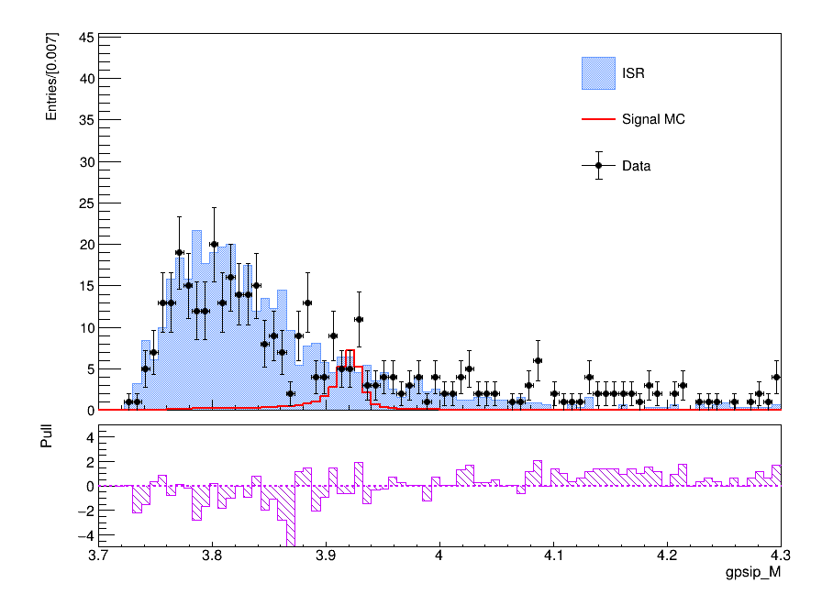
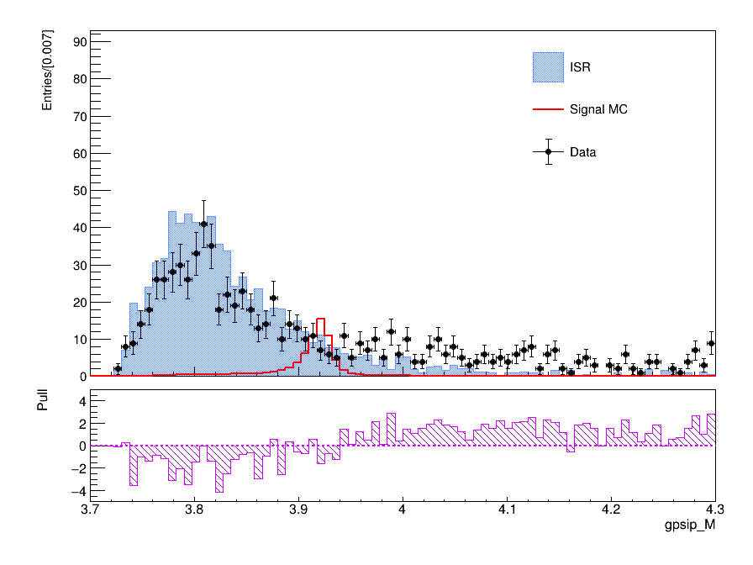
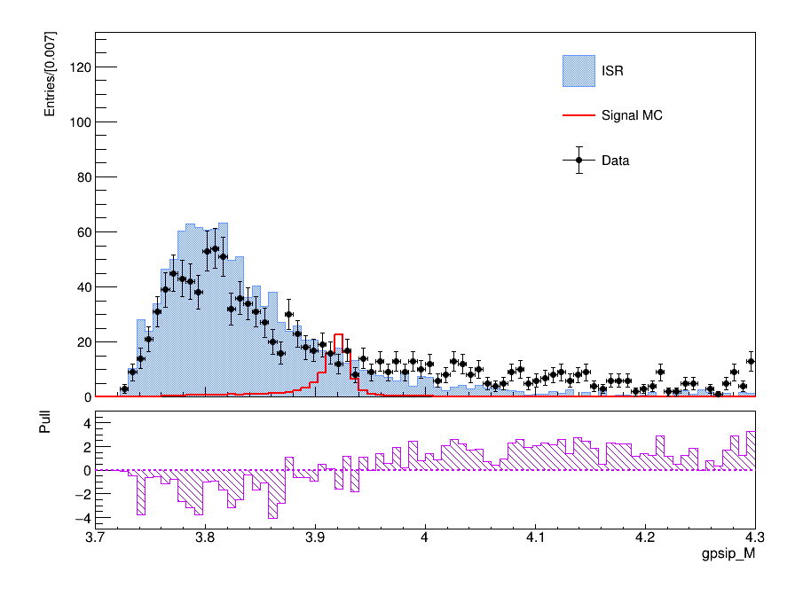
Data-MC agreement
ee mode
mumu mode
both mode
ee mode
mumu mode
both mode

Slide 11
FOM优化
1.重点优化gamma_E,m2Recoil,以及psi(2S)和gamma psi(2S)横动量，其他选择条件暂时保持与belle一致
2.前两个变量通过ponzi-FOM优化(a取3)
3.后面两个横动量用MVA来优化再分别投影

Slide 12
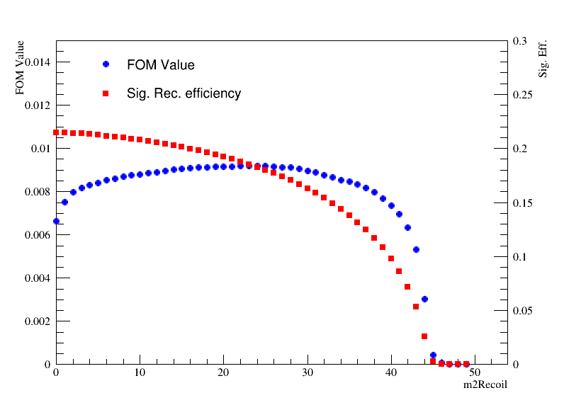
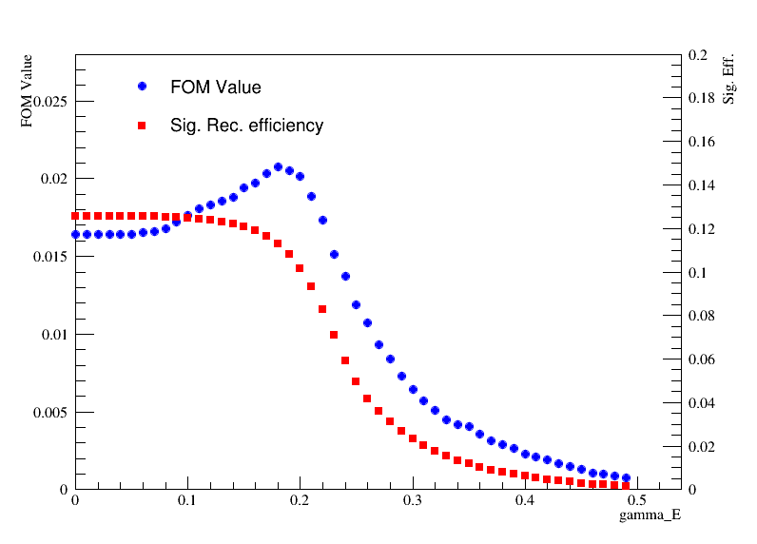
m2Recoil>10
Gamma_E > 0.15

Slide 13
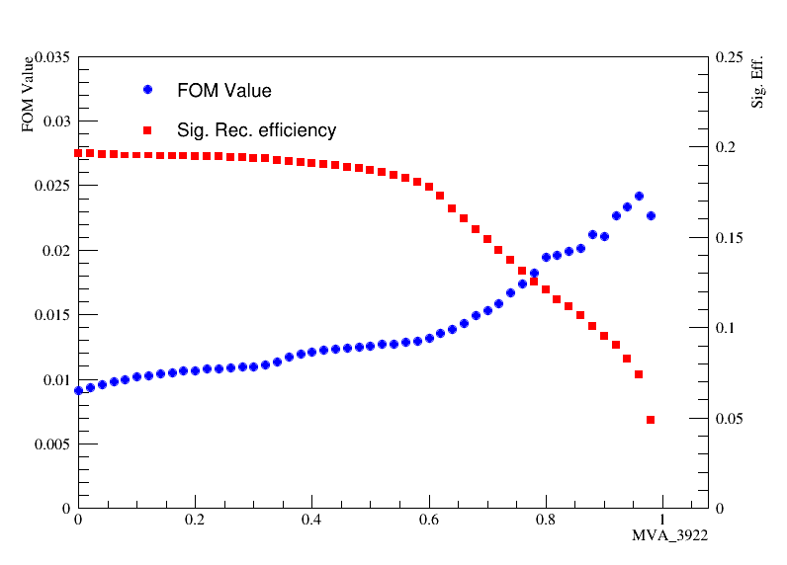
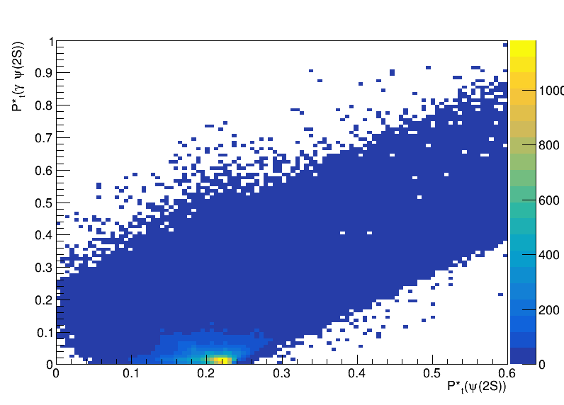
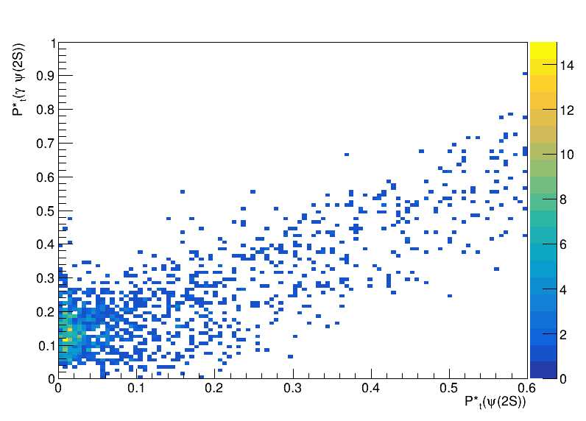
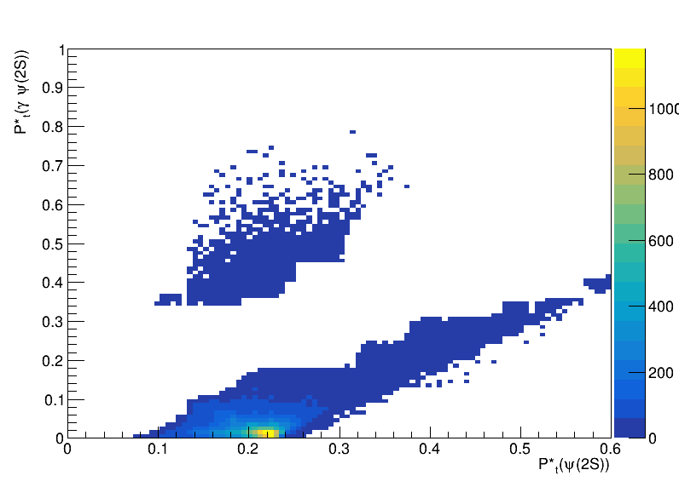
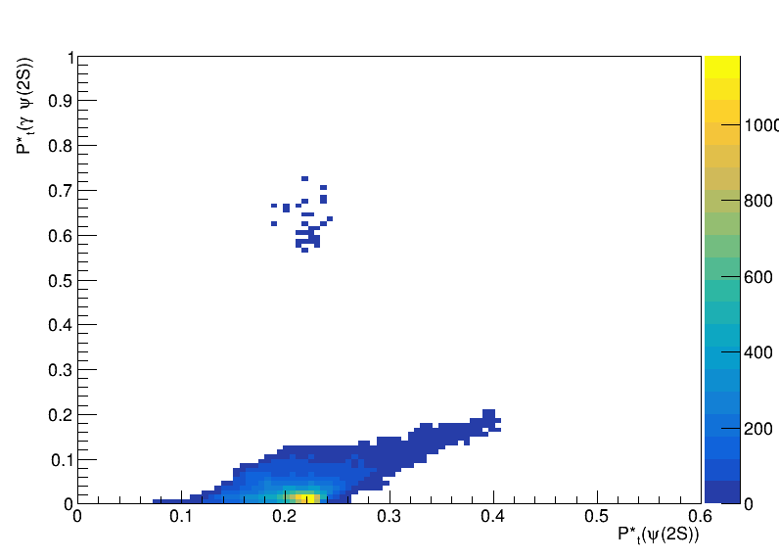
MVA_3922>0.80?
MVA_3922>0.80
MVA_3922>0.90

Slide 14
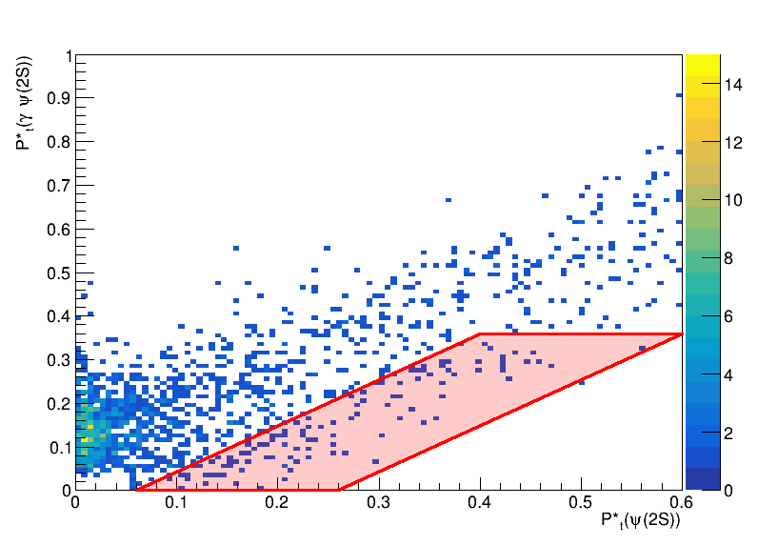
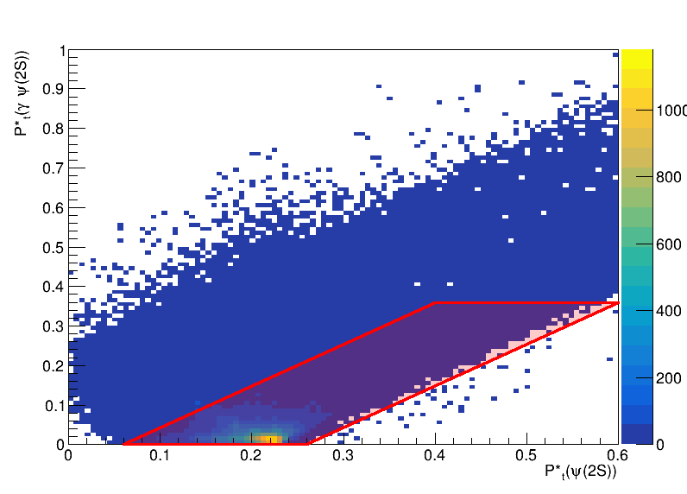
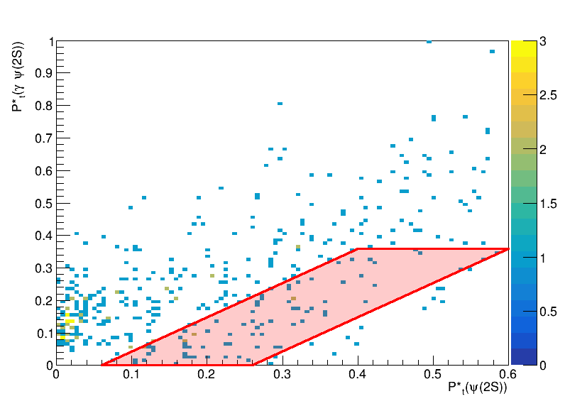
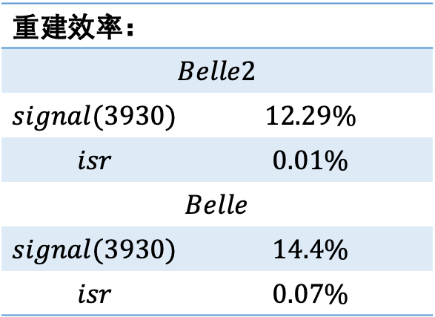
重建效率：
$$Belle2$$
$$signal(3930)$$ | $$12.29\%$$
$$isr$$ | $$0.01\%$$
$$Belle$$
$$signal(3930)$$ | $$14.4\%$$
$$isr$$ | $$0.07\%$$

Slide 15

Study of $γγ→γψ(2S)$ at Belle

Slide 16
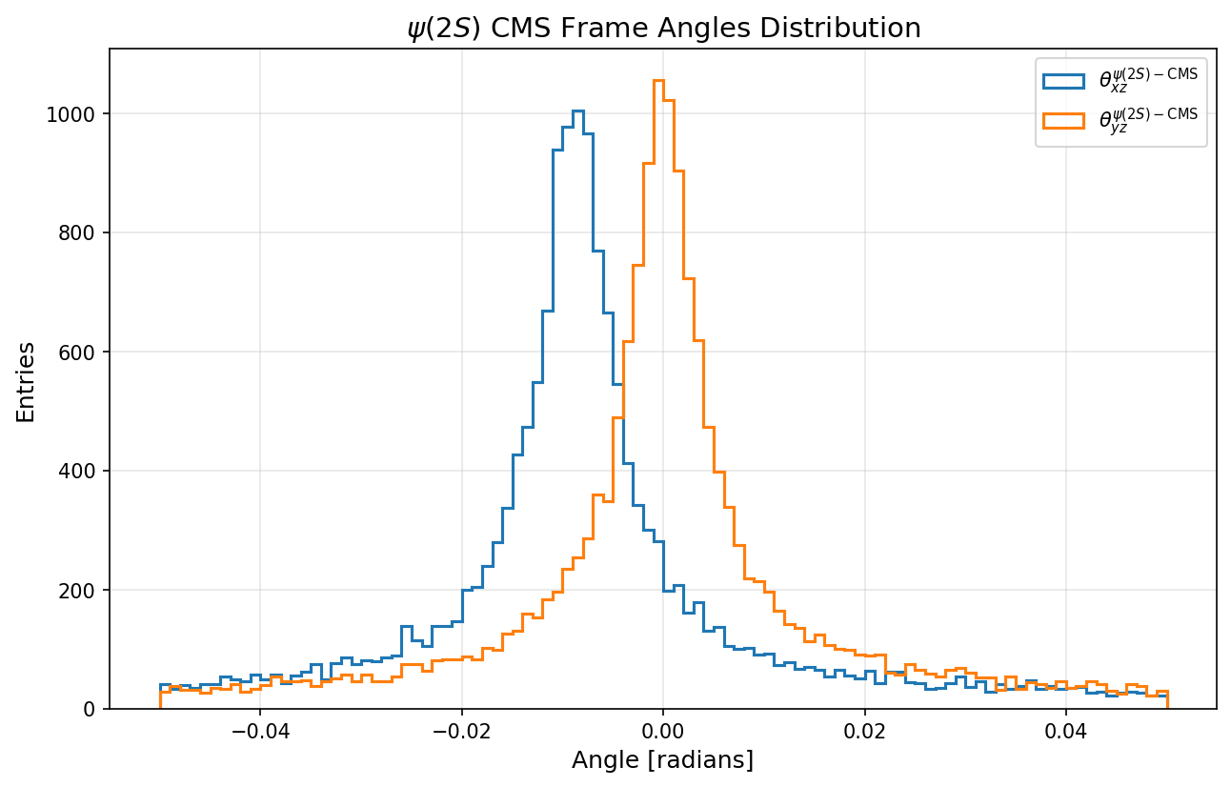



Angle check
Before rotation
ISR MC
ISR MC
Sig(3930) MC
Sig(3930) MC

Slide 17



Angle check
Before rotation
ISR MC
ISR MC
Sig(3930) MC
Sig(3930) MC

Slide 18




Before rotation
after rotation
Sig(3930) MC
Sig(3930) MC
ISR MC
ISR MC

Slide 19




Number of charged tracks
ee mode
mumu mode
both mode
Previous belle:

Slide 20




Particle Identification
Jpsi->ll (eID)
Jpsi->ll (muID)
pi_kaonID (ee mode)
pi_kaonID (mumu mode)
pi_kaonID (both mode)

Slide 21







$J/ψ$ $signals$
Figures of Jpsi sideband to be done…
ee mode
mumu mode
both mode

Slide 22



$ψ(2S)$ $signals$
ee mode
mumu mode
both mode

