Slide 1
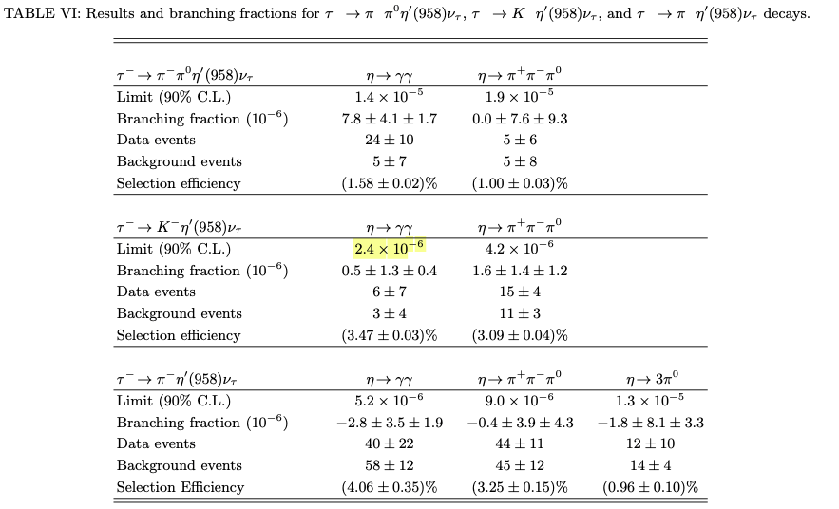
Study of high-multiplicity three-prong and five-prong τ decays at BABAR
Integrated luminosity:
424/fb(10.58GeV) 44/fb(10.54GeV)
Tau pair:
430 million tau pairs

Slide 2
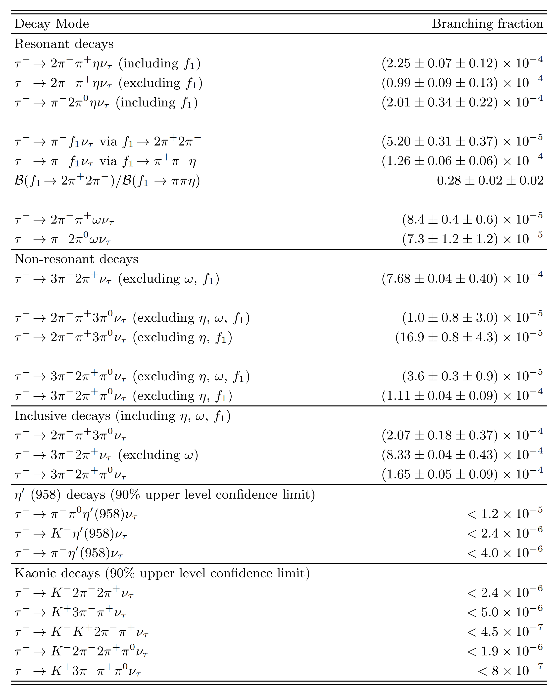

Slide 3
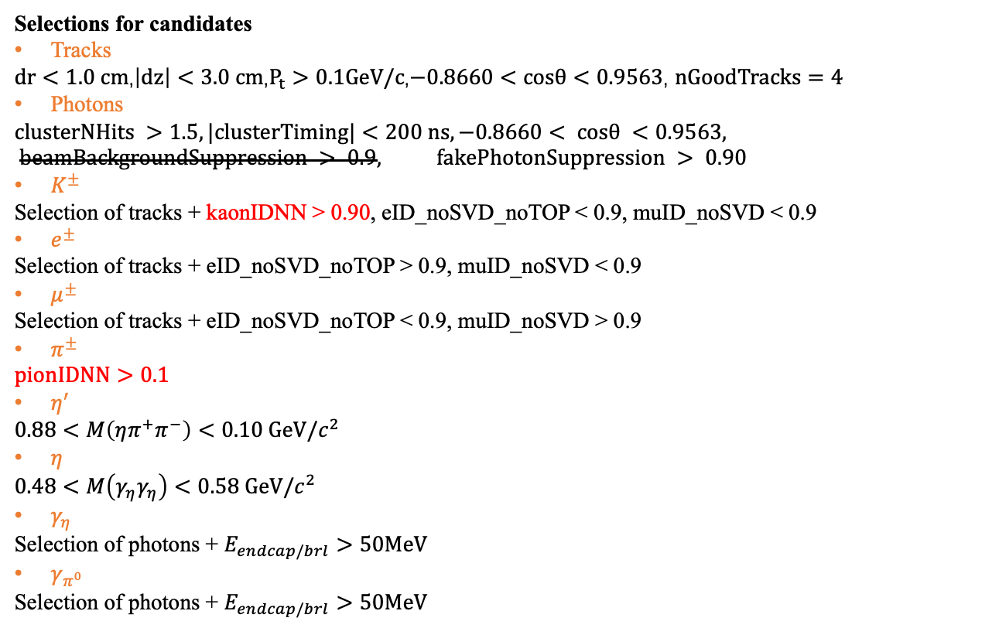
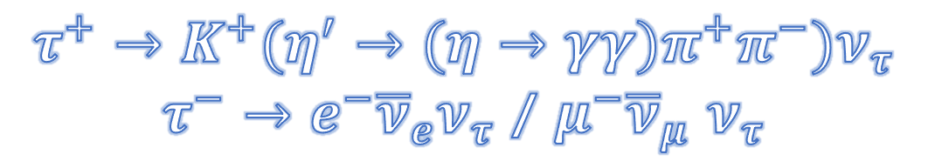
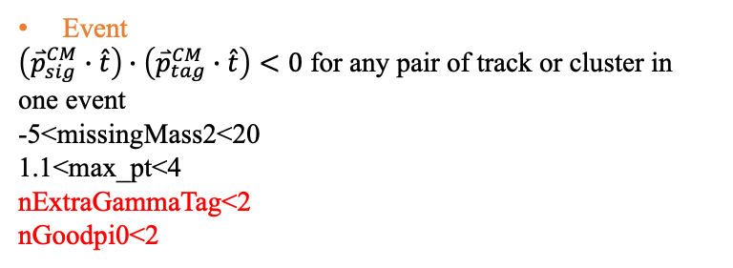
$$τ^{+}→K^{+}(η^{′}→(η→γγ)π^{+}π^{−})ν_{τ}$$
$τ^{−}→e^{−}{\overline{ν}}_{e}ν_{τ}$ / $μ^{−}{\overline{ν}}_{μ}$ $ν_{τ}$
Selections for candidates
Tracks
$dr<1.0 cm$,$\left|dz\right|<3.0 cm$,$P_{t}>0.1GeV/c$,$−0.8660<cosθ<0.9563$, $nGoodTracks=4$
Photons
$$clusterNHits >1.5, |clusterTiming|<200 ns, −0.8660< cosθ <0.9563, beamBackgroundSuppression > 0.9, fakePhotonSuppression > 0.90$$
$K^{±}$
Selection of tracks + kaonIDNN > 0.90, eID_noSVD_noTOP < 0.9, muID_noSVD < 0.9
$e^{±}$
Selection of tracks + eID_noSVD_noTOP > 0.9, muID_noSVD < 0.9
$μ^{±}$
Selection of tracks + eID_noSVD_noTOP < 0.9, muID_noSVD > 0.9
$π^{±}$
$$pionIDNN>0.1$$
$η^{′}$
$$0.88<M\left(ηπ^{+}π^{−}\right)<0.10 GeV/c^{2}$$
$η$
$$0.48<M\left(γ_{η}γ_{η}\right)<0.58 GeV/c^{2}$$
$γ_{η}$
Selection of photons + $E_{endcap/brl}>50MeV$
$γ_{π^{0}}$
Selection $\text{of} \text{photons}\text{ + }E_{endcap/brl}>50MeV$
Event
$\left({\overset{⃑}{p}}_{sig}^{CM}∙\hat{t}\right)∙\left({\overset{⃑}{p}}_{tag}^{CM}∙\hat{t}\right)<0$ for any pair of track or cluster in one event
-5<missingMass2<20
1.1<max_pt<4
nExtraGammaTag<2
nGoodpi0<2
Signal Reconstruction Efficiency:
e-mode: 6.94%
mu-mode: 6.76%

Slide 4
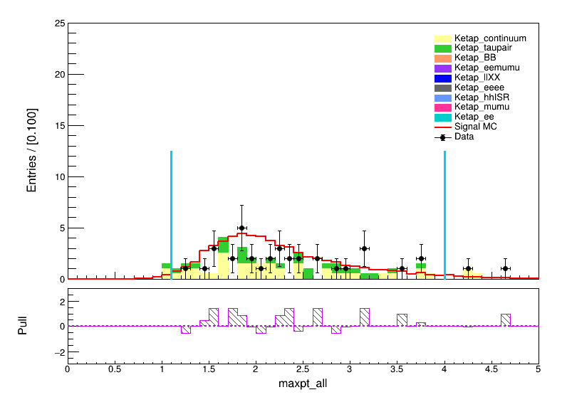
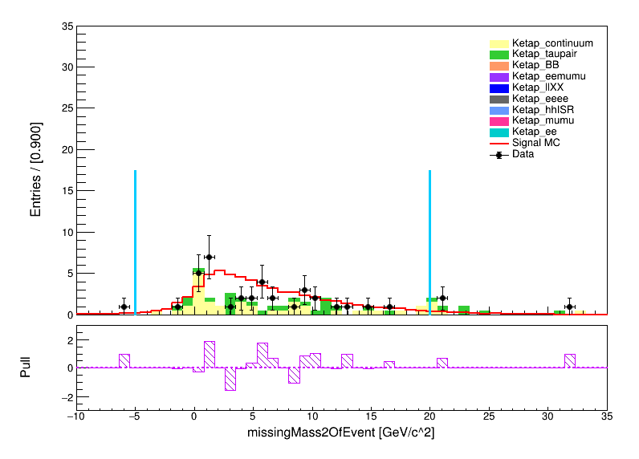
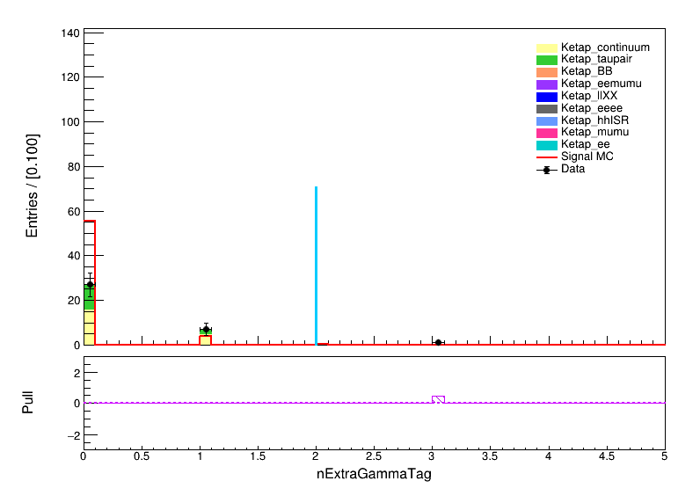
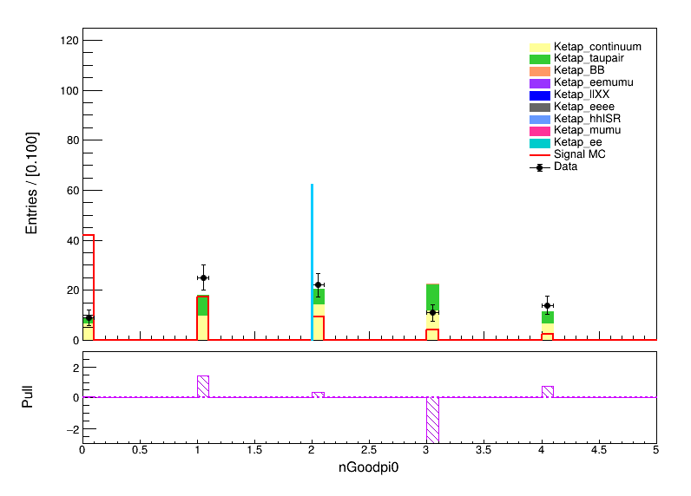

Slide 5
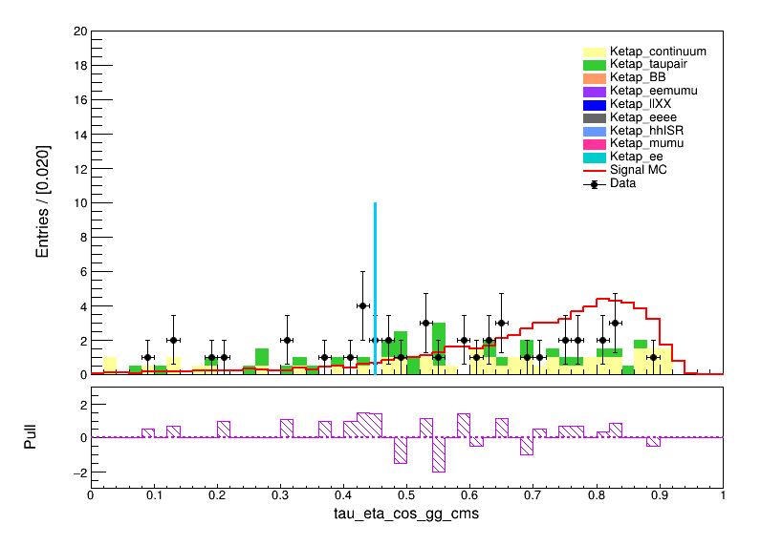
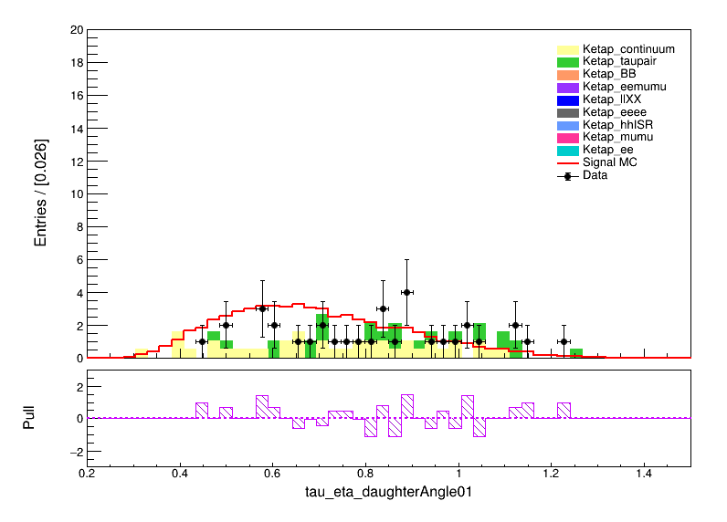
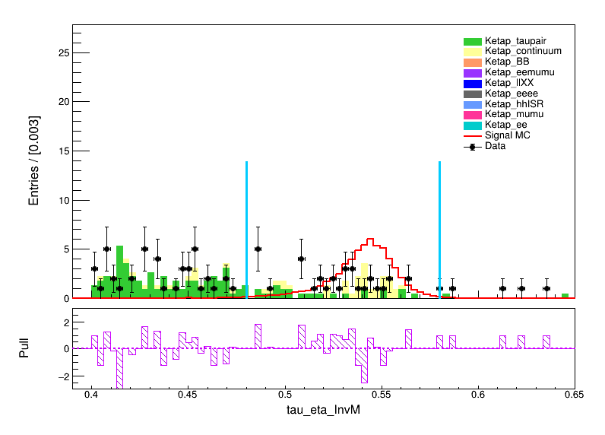
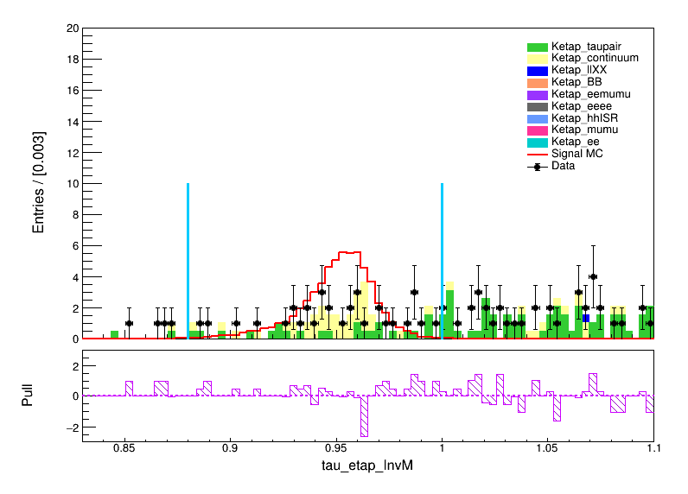

Slide 6
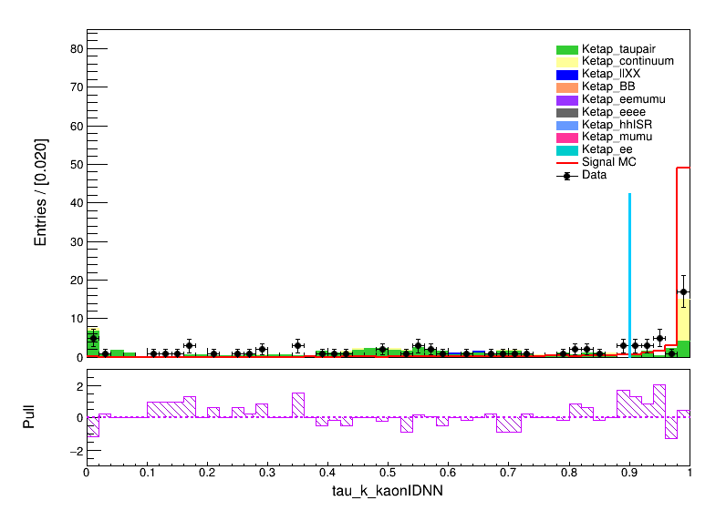
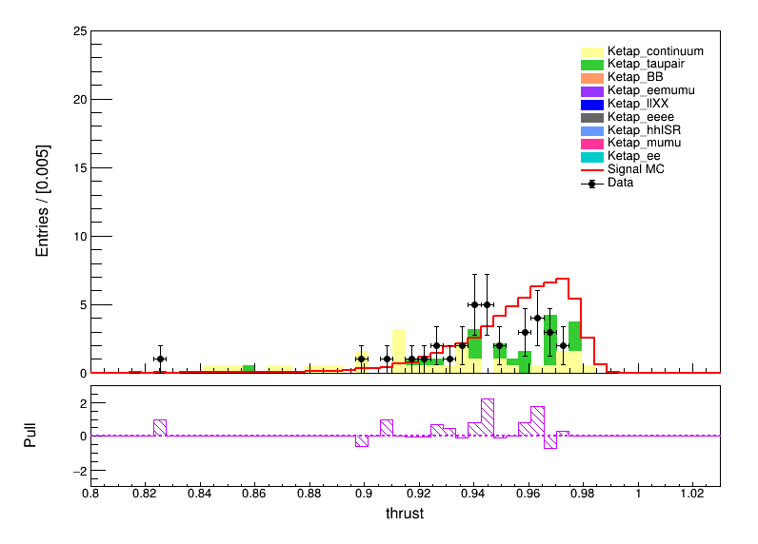
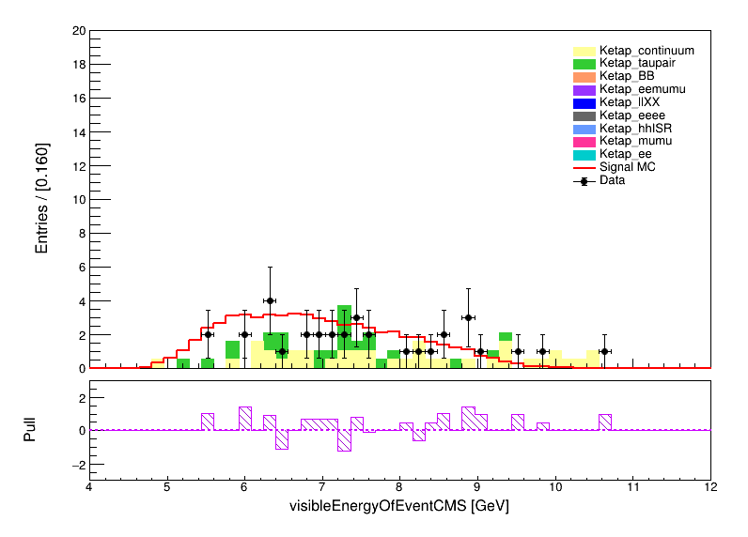
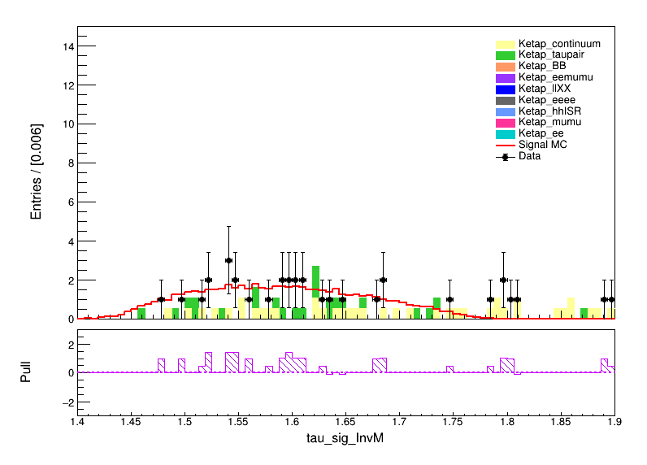

Slide 7
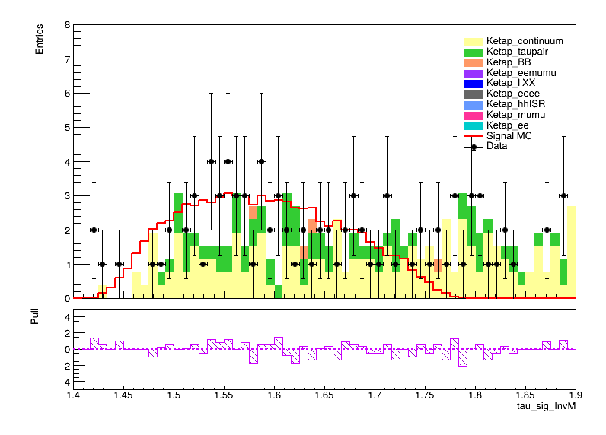
previous

