Slide 1


Nuclear uncertainties related to MeV gamma-ray astronomy
Bingshui Gao
Institute of Modern Physics,
Chinese Academy of Sciences
IHEP MeV Mission Workshop
Sep. 16-17, 2025, Beijing

Slide 2
γ lines from the Galaxy
γ-lines from a few nuclei have been observed, e.g. ⁶⁰Fe, ^{56,57}Co, ⁴⁴Ti, ²⁶Al…, which provides valuable information about the evolution of stars and the Galaxy.
Efforts from multiple fields are necessary to decipher such information, including stellar models, nuclear physics, etc.
More γ-lines and exciting science to be expected from next generation MeV missions!
2

Slide 3
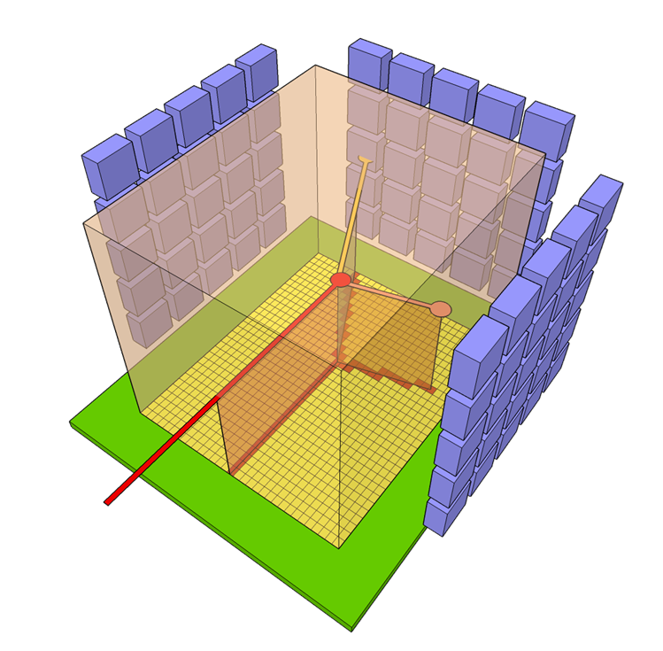
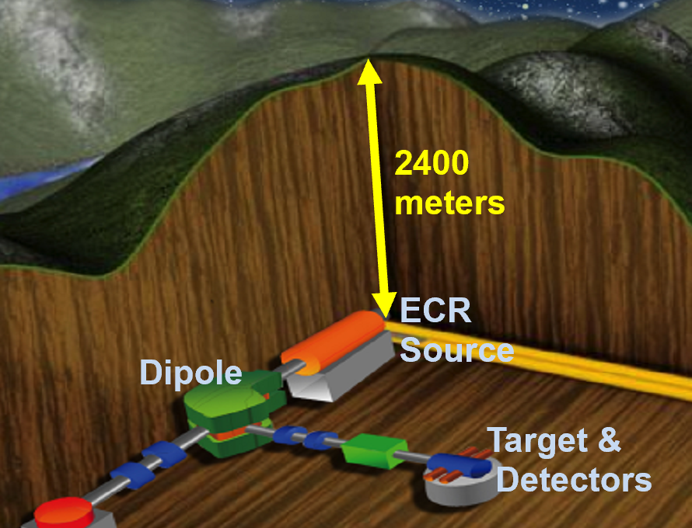
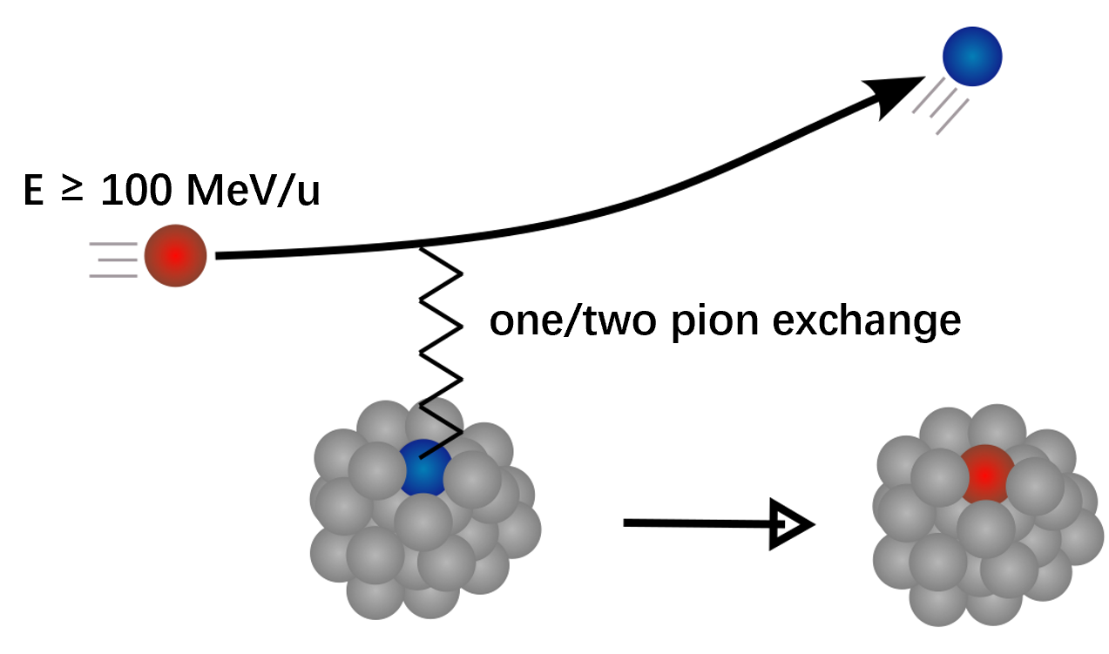
Technologies in Nuclear Physics
Nuclear physics enter the problem by providing reaction/decay rates to stellar evolution models
Time Projection Chamber (TPC)
Deep Underground Lab
Charge-exchange reaction
From Q.T. Li’s slide
3

Slide 4
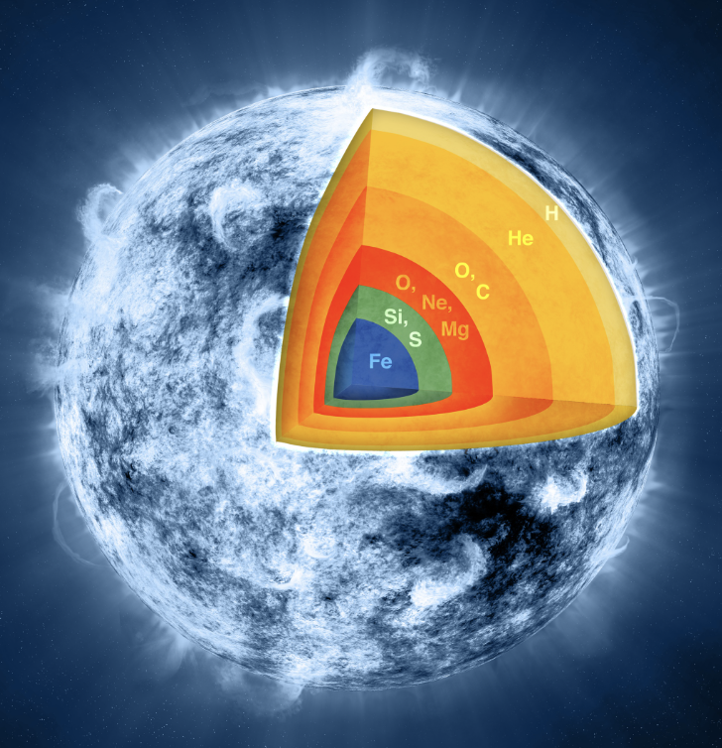
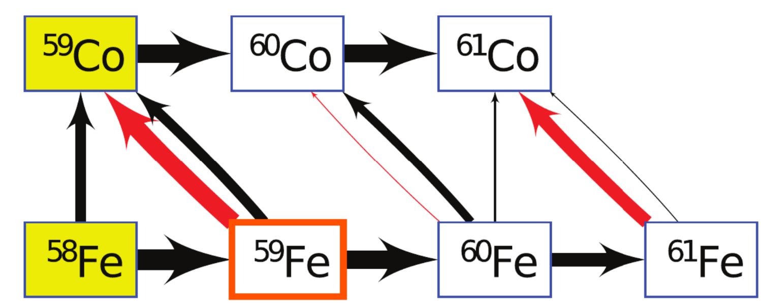
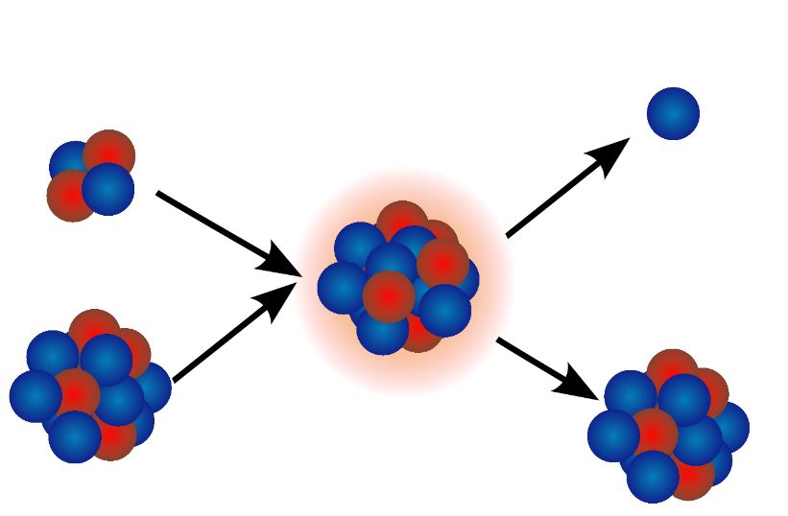
The case of ⁶⁰Fe
Reaction rates that matter locally and globally:
neutron
⁴He
²²Ne(α,n)²⁵Mg
¹²C(α,γ)¹⁶O
…
⁵⁹Fe(n,γ)⁶⁰Fe
⁵⁹Fe beta decay
⁶⁰Fe(n,γ)⁶¹Fe
²²Ne
²⁵Mg
4

Slide 5
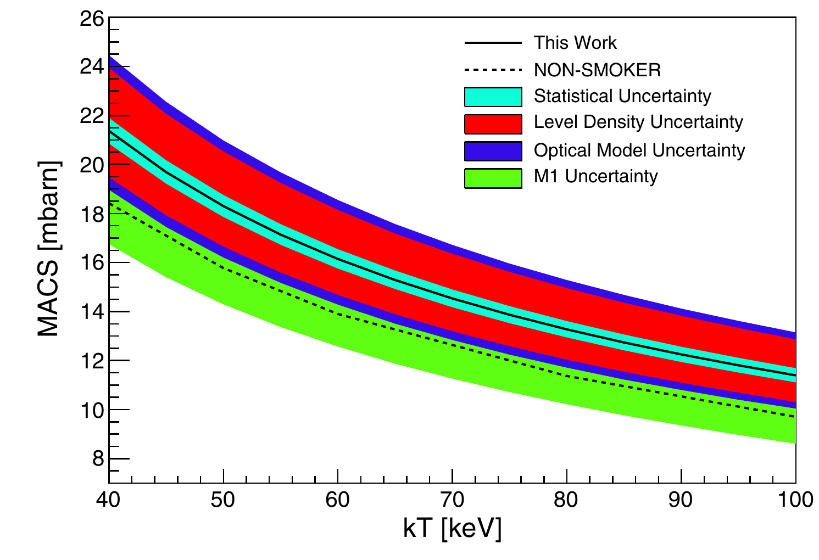
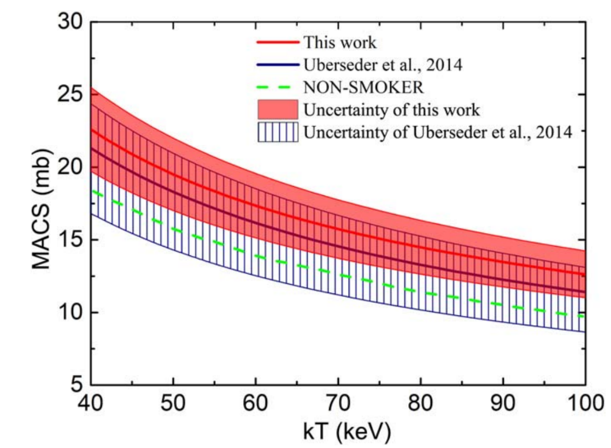
The case of ⁶⁰Fe
Reaction rates that matter locally and globally:
⁵⁹Fe(n,γ)⁶⁰Fe
⁵⁹Fe beta decay
⁶⁰Fe(n,γ)⁶¹Fe
[1]Uberseder et al., .PRL 112.211101(2014)
[2]Yan et al., ApJ 919.81 (2021)
5/23

Slide 6
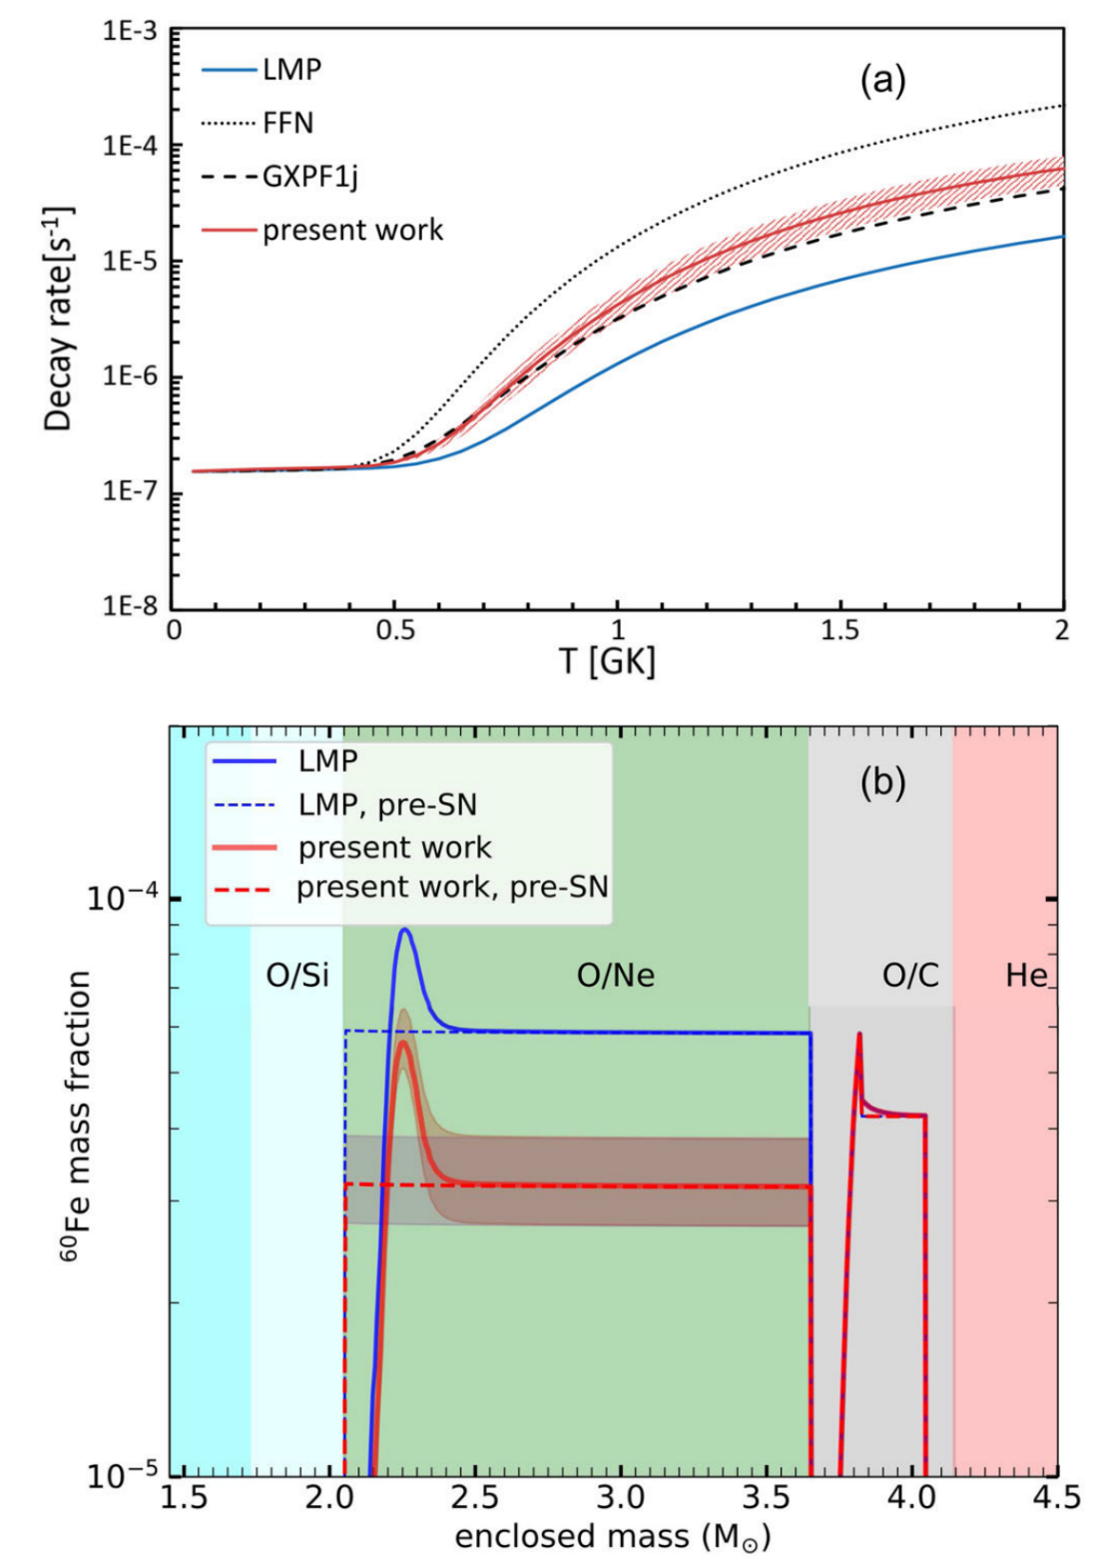
The case of ⁶⁰Fe
Reaction rates that matter locally and globally:
⁵⁹Fe(n,γ)⁶⁰Fe
⁵⁹Fe beta decay
⁶⁰Fe(n,γ)⁶¹Fe
[1] Gao et al., PRL 126.152701 (2021)
6

Slide 7
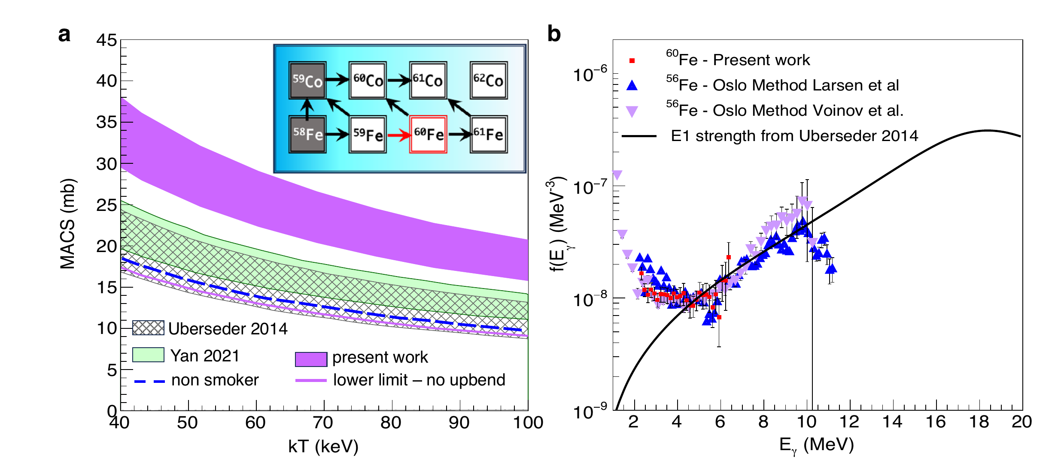
The case of ⁶⁰Fe
Reaction rates that matter locally and globally:
⁵⁹Fe(n,γ)⁶⁰Fe
⁵⁹Fe beta decay
⁶⁰Fe(n,γ)⁶¹Fe
Spyrou et al, .Nat. Comm. 15.9608 (2024)
7

Slide 8
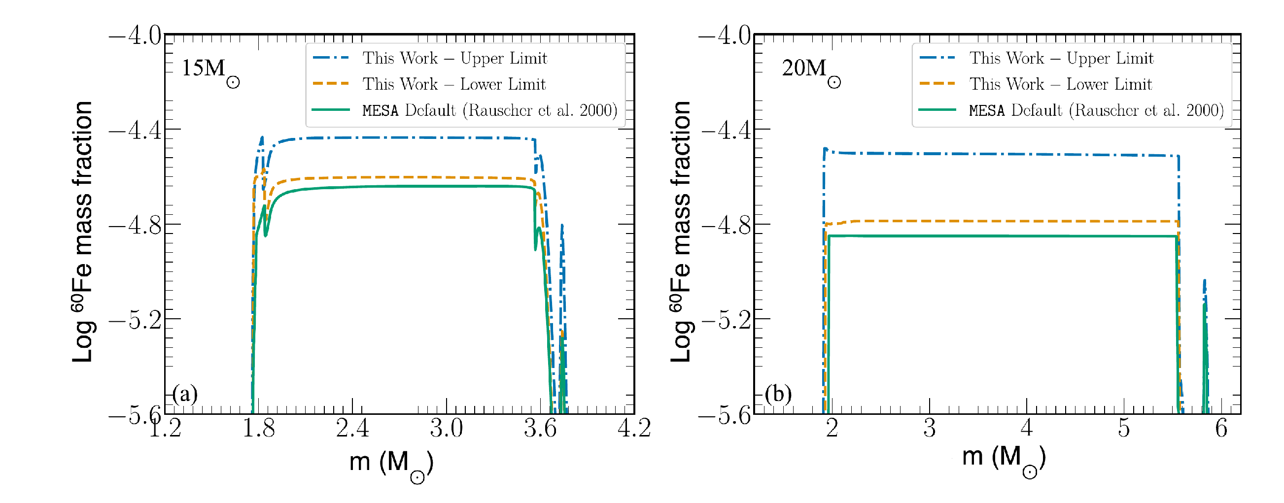
The case of ⁶⁰Fe
Reaction rates that matter locally and globally:
⁵⁹Fe(n,γ)⁶⁰Fe
⁵⁹Fe beta decay
⁶⁰Fe(n,γ)⁶¹Fe
Spyrou et al, .Nat. Comm. 15.9608 (2024)
7

Slide 9
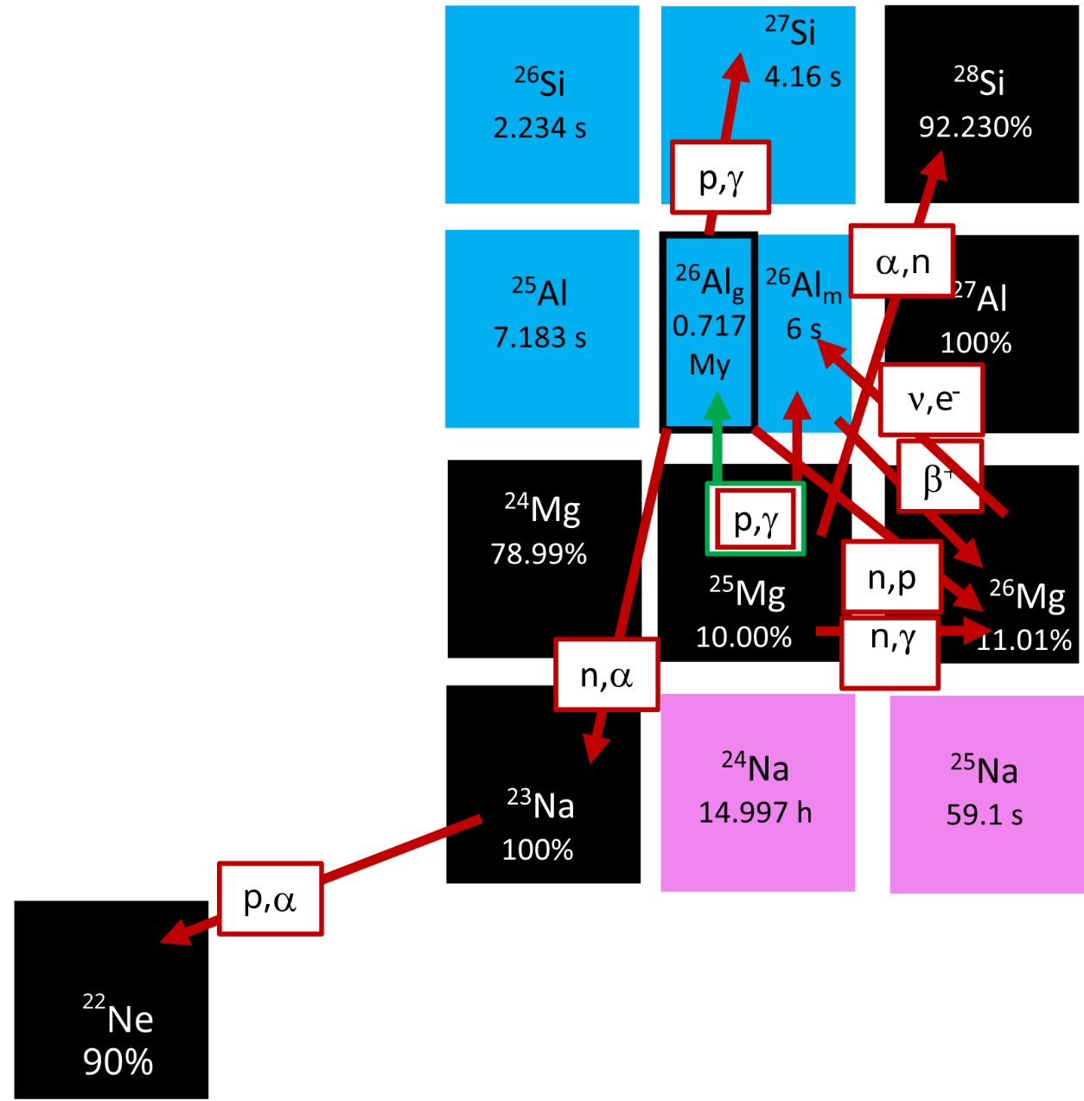
The case of ²⁶Al
Core H burning
²⁵Mg(p,γ) (Production channel)
²⁶Al(p,γ) (Destruction channel)
C-shell burning
²⁵Mg(p,γ) (Production channel)
²³Na(p,α) (Proton poison)
¹²C(¹²C,p) (Proton producer)
²⁶Al(n,p) (Destruction channel)
²⁶Al(n,α) (Destruction channel)
²⁵Mg(n,γ) (²⁵Mg poison)
²⁵Mg(α,n) (²⁵Mg poison)
Ne explosive burning
²⁶Mg(ν,e-) (Production channel)
…
8

Slide 10
The case of ²⁶Al
Core H burning
²⁵Mg(p,γ) (Production channel)
²⁶Al(p,γ) (Destruction channel)
C-shell burning
²⁵Mg(p,γ) (Production channel)
²³Na(p,α) (Proton poison)
¹²C(¹²C,p) (Proton producer)
²⁶Al(n,p) (Destruction channel)
²⁶Al(n,α) (Destruction channel)
²⁵Mg(n,γ) (²⁵Mg poison)
²⁵Mg(α,n) (²⁵Mg poison)
Ne explosive burning
²⁶Mg(ν,e-) (Production channel)
…
9

Slide 11
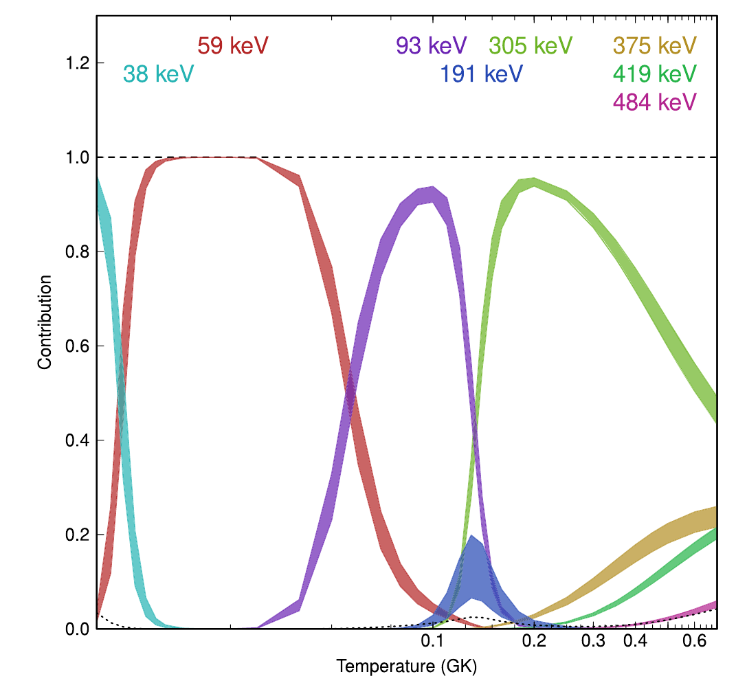
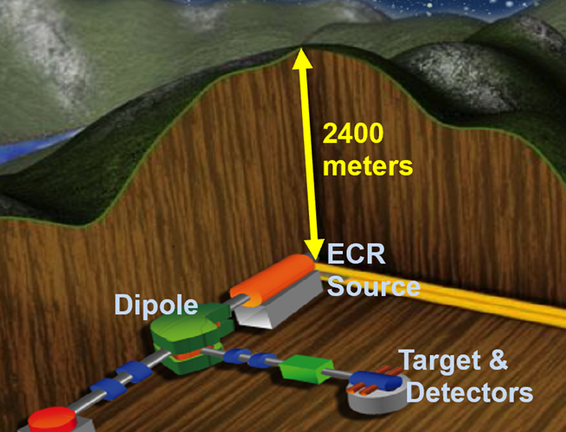
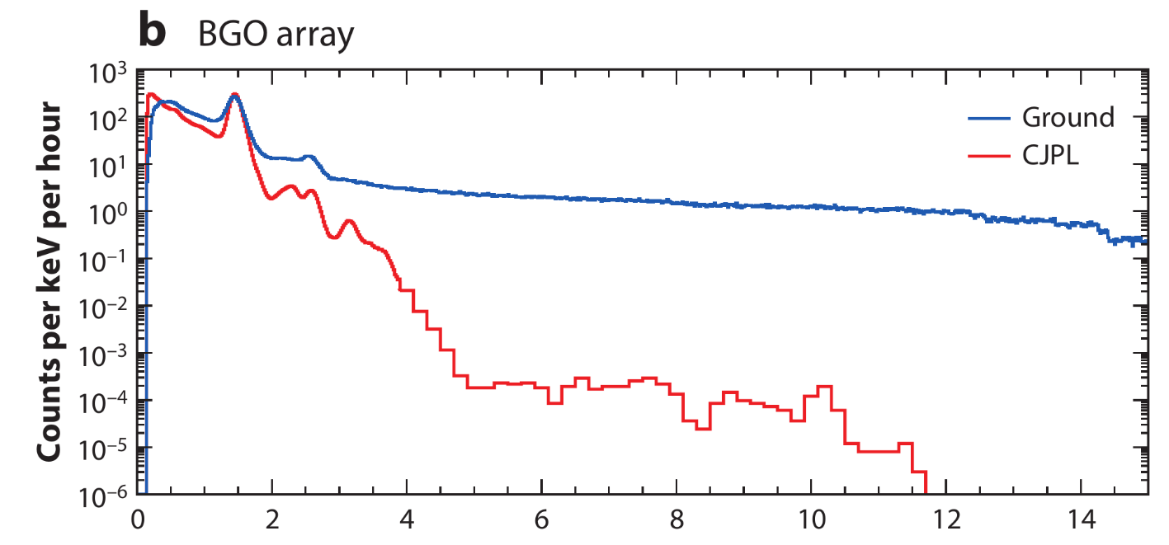
²⁵Mg(p,γ) cross section dominated by resonant states
The case of ²⁶Al
Liu et al., .NRAPS (2025)
Laird et al., .JPG 50.033002 (2024)
10

Slide 12
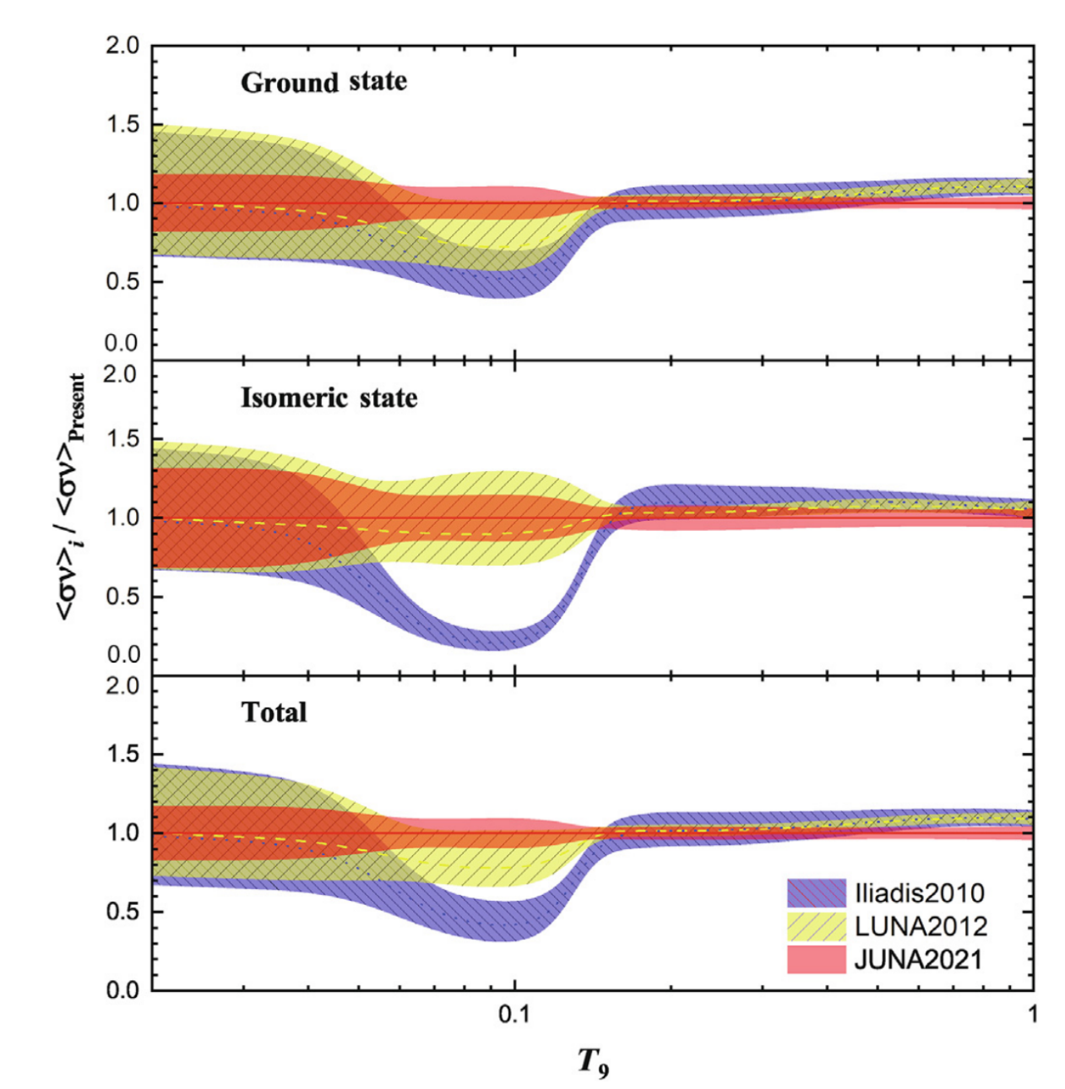
²⁵Mg(p,γ) cross section dominated by resonant states
The case of ²⁶Al
Su et al, .Sci.Bull. 67.125 (2022)
Laird et al., .JPG 50.033002 (2024)
11

Slide 13
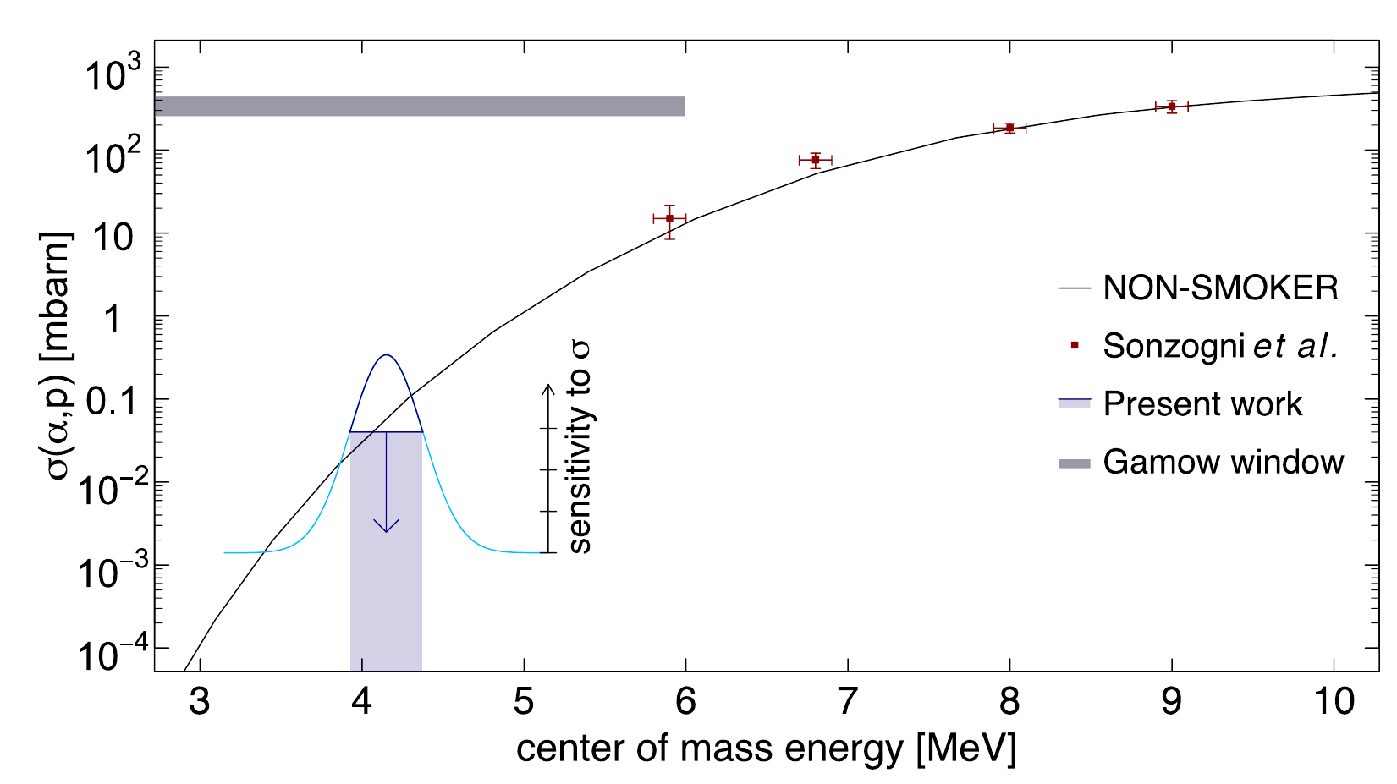
The case of ⁴⁴Ti
45V
46V
47V
(p,γ)
44Ti
(α,p)
(α,γ)
40Ca
α-rich freeze out
Margerin et al., PLB.731.358 (2014)
12

Slide 14
Thanks！

