Slide 1
MeV Observations of Pulsars
High energy emissions from pulsars
MeV observations of pulsars
Spectra, pulse profiles, polarization,
a possible population of ‘MeV Pulsars’
Hsiang-Kuang Chang
Institute of Astronomy, National Tsing Hua University (NTHU), Taiwan
MeV Workshop, IHEP, CAS, Beijing, Oct 16-17, 2025

Slide 2
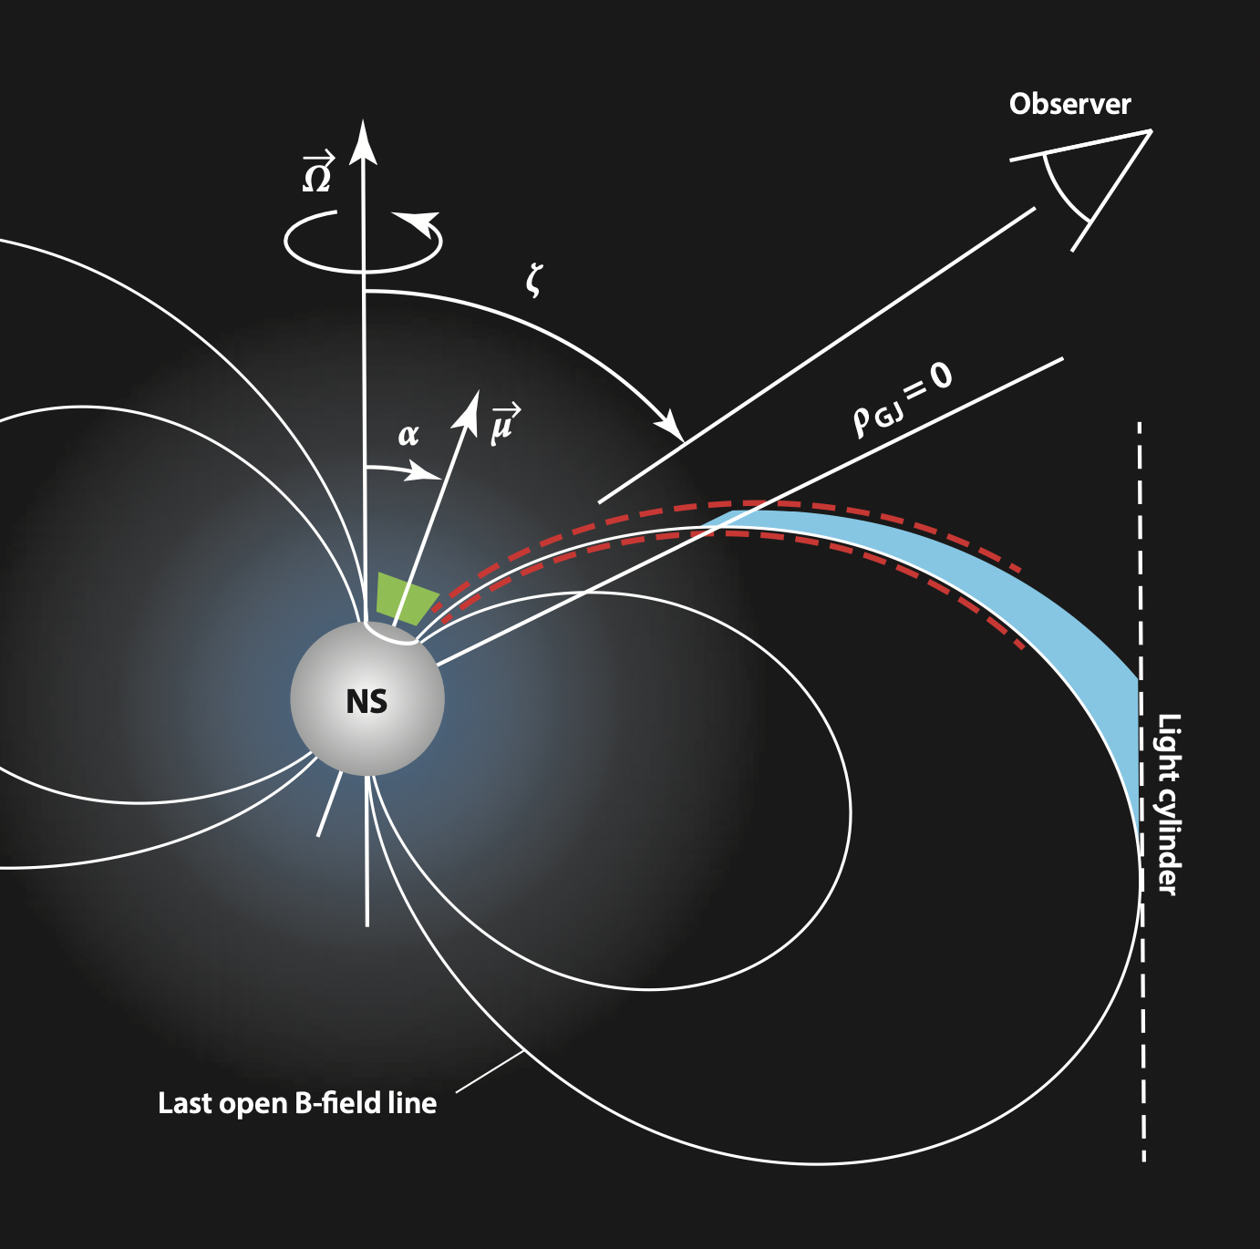
High energy emissions from pulsars
Pulsars are fast-rotating, strongly-magnetized neutron stars.
They are extensively observed in radio, X-ray and GeV gamma-ray bands.
Recent models for high energy emissions from pulsars and their polarization include, e.g.,
the striped-wind model (Petri 2015; Petri 2013),
the extended slot-gap and equatorial current-sheet model ( Harding+ 2021; Harding+ 2017) and
the non-stationary outer-gap model (Takata+ 2016; Takata+ 2007).
(Caraveo 2014, ARA&A, 52, 211)
The MeV band is relatively poorly explored. New observations, in particular with polarization measurements, may help to constrain/improve theoretical models.

Slide 3
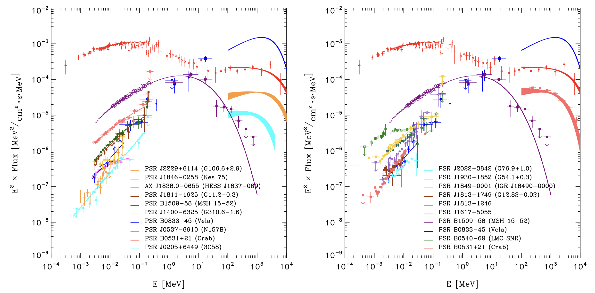
Only the Crab pulsar, the Vela pulsar and PSR B1509-58 are detected in the energy range of 0.2-5 MeV.
(Kuiper & Hermsen 2015: pulsars detected in 20 keV – 30 MeV)

Slide 4
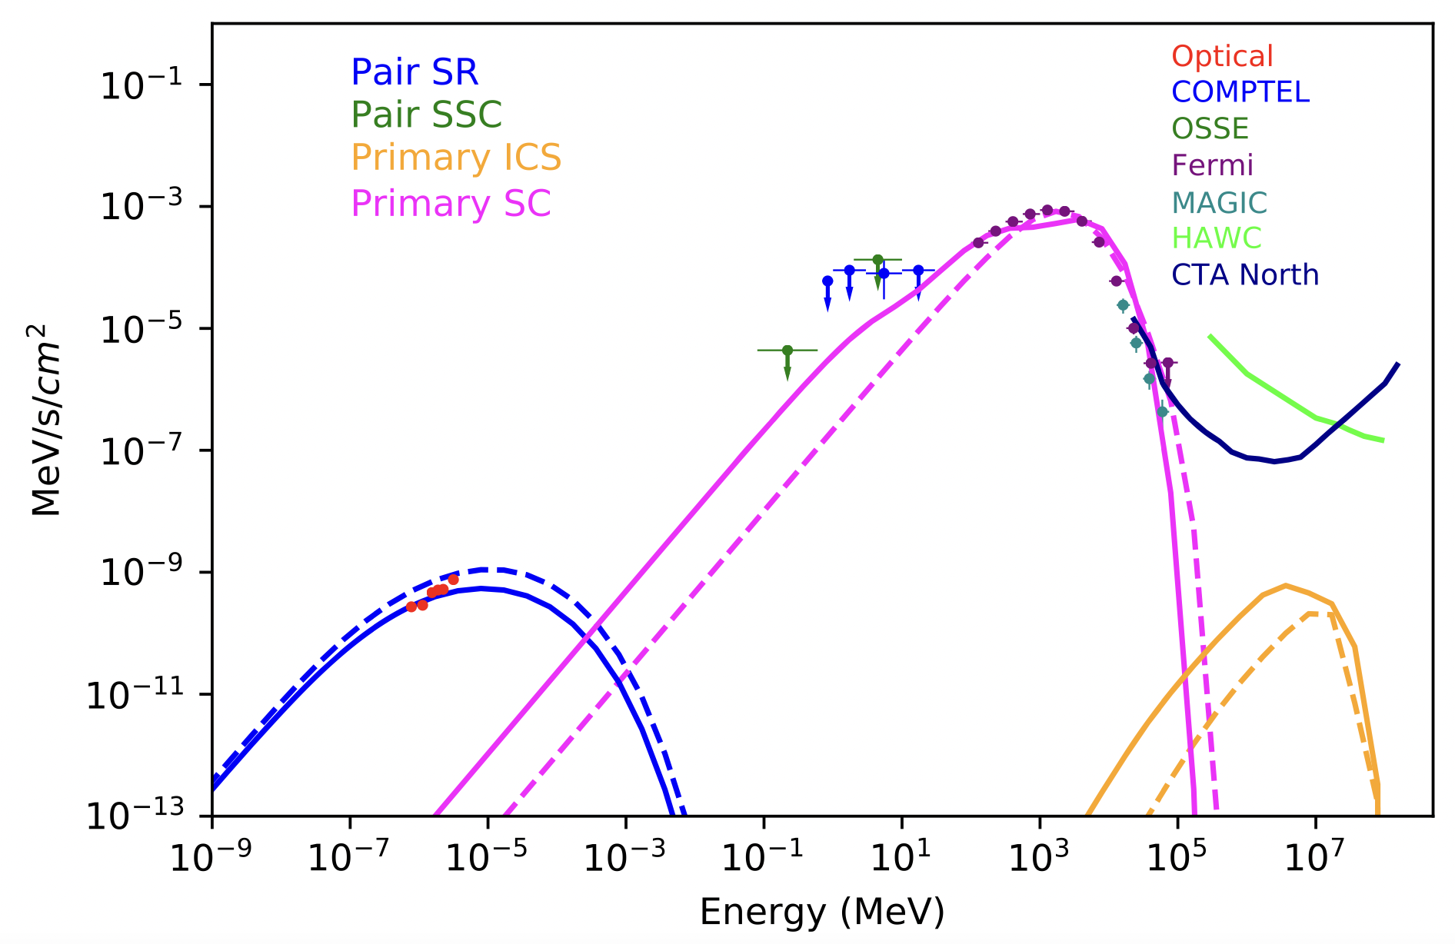
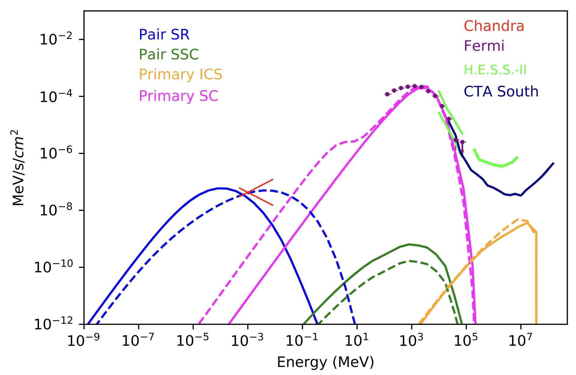
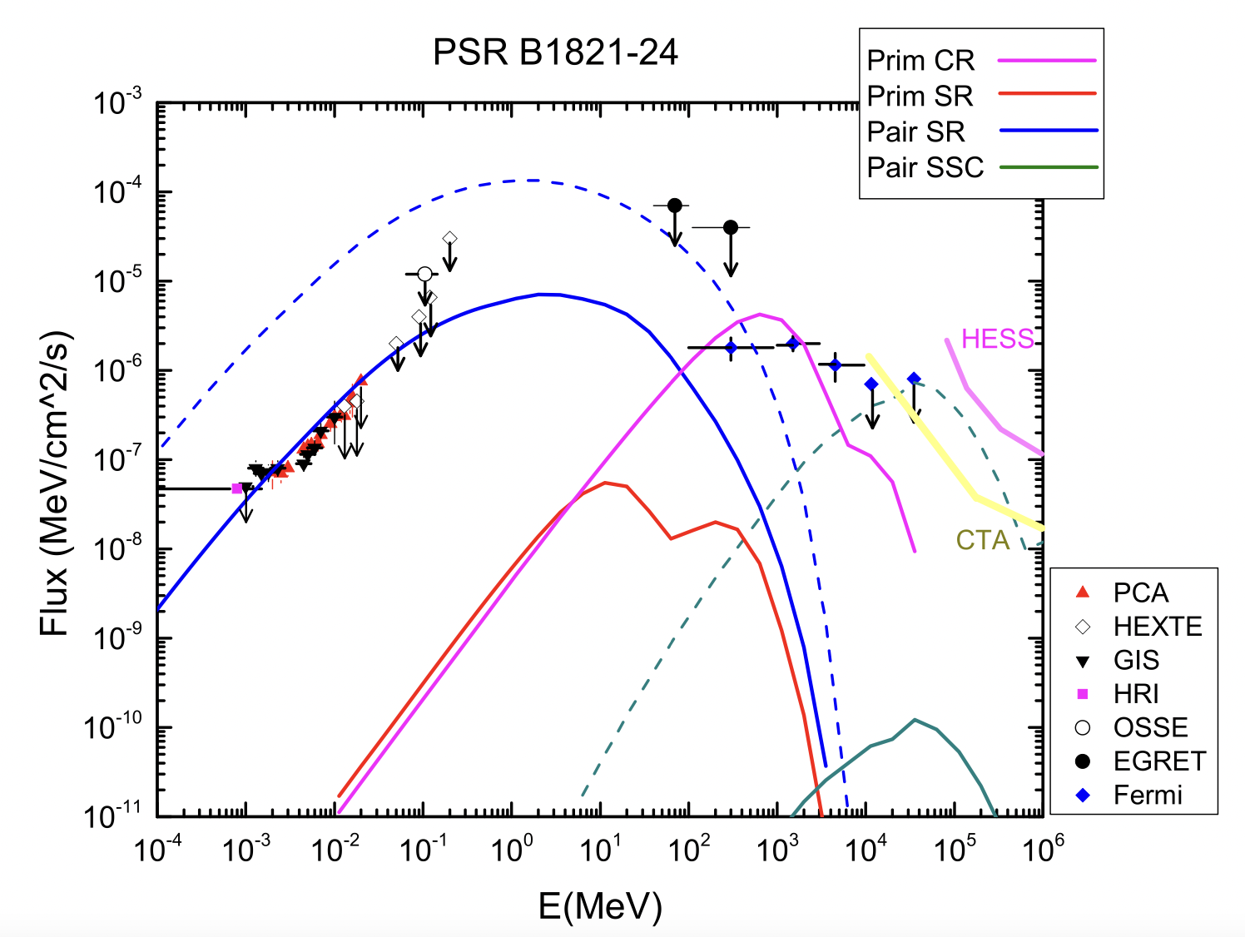
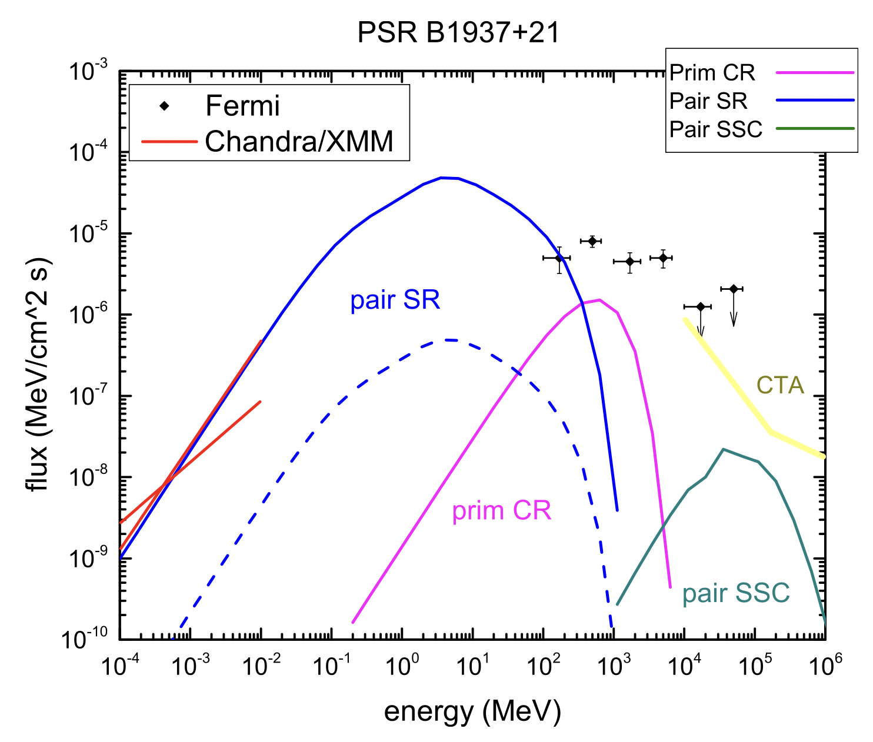
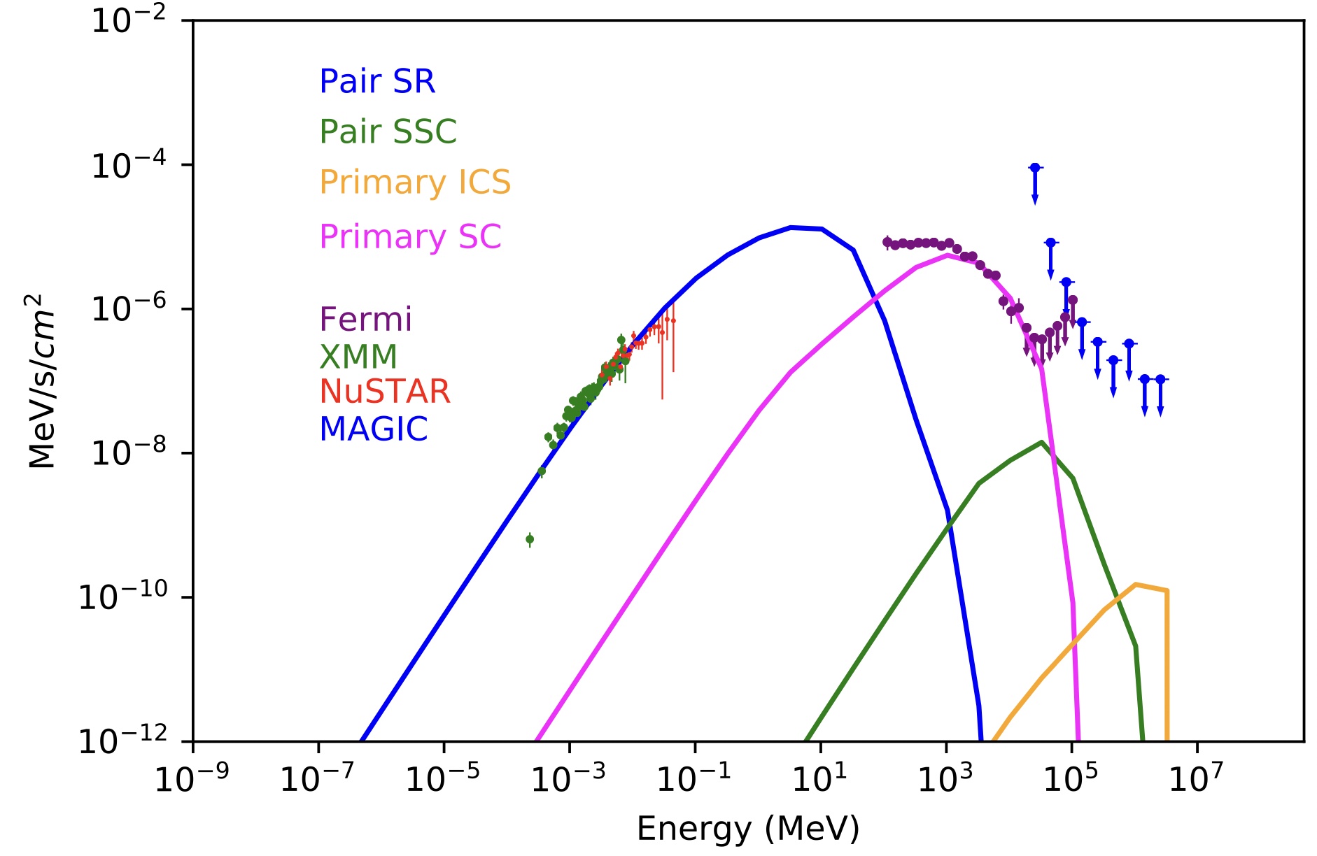
Geminga
PSR B1706-44
(Harding+ 2021)
(Harding+ 2021)
PSR J0218_4232
(Harding+ 2021)
(Harding+ 2015)
(Harding+ 2015)
More MeV detections may shed new light on pulsar models.

Slide 5
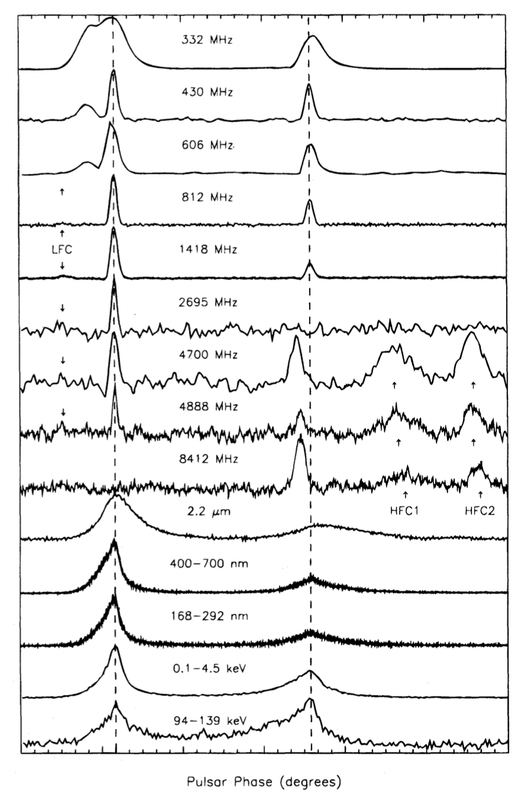
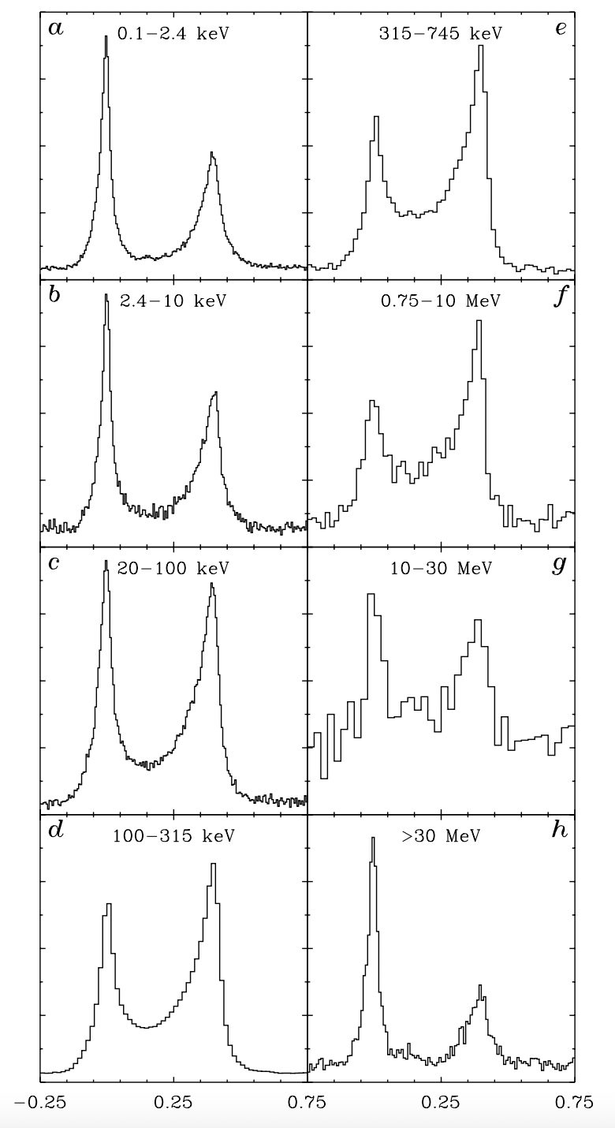
The Crab
Pulsar
(Left:
Moffett+
1996)
(Right:
Kuiper+
2001)

Slide 6
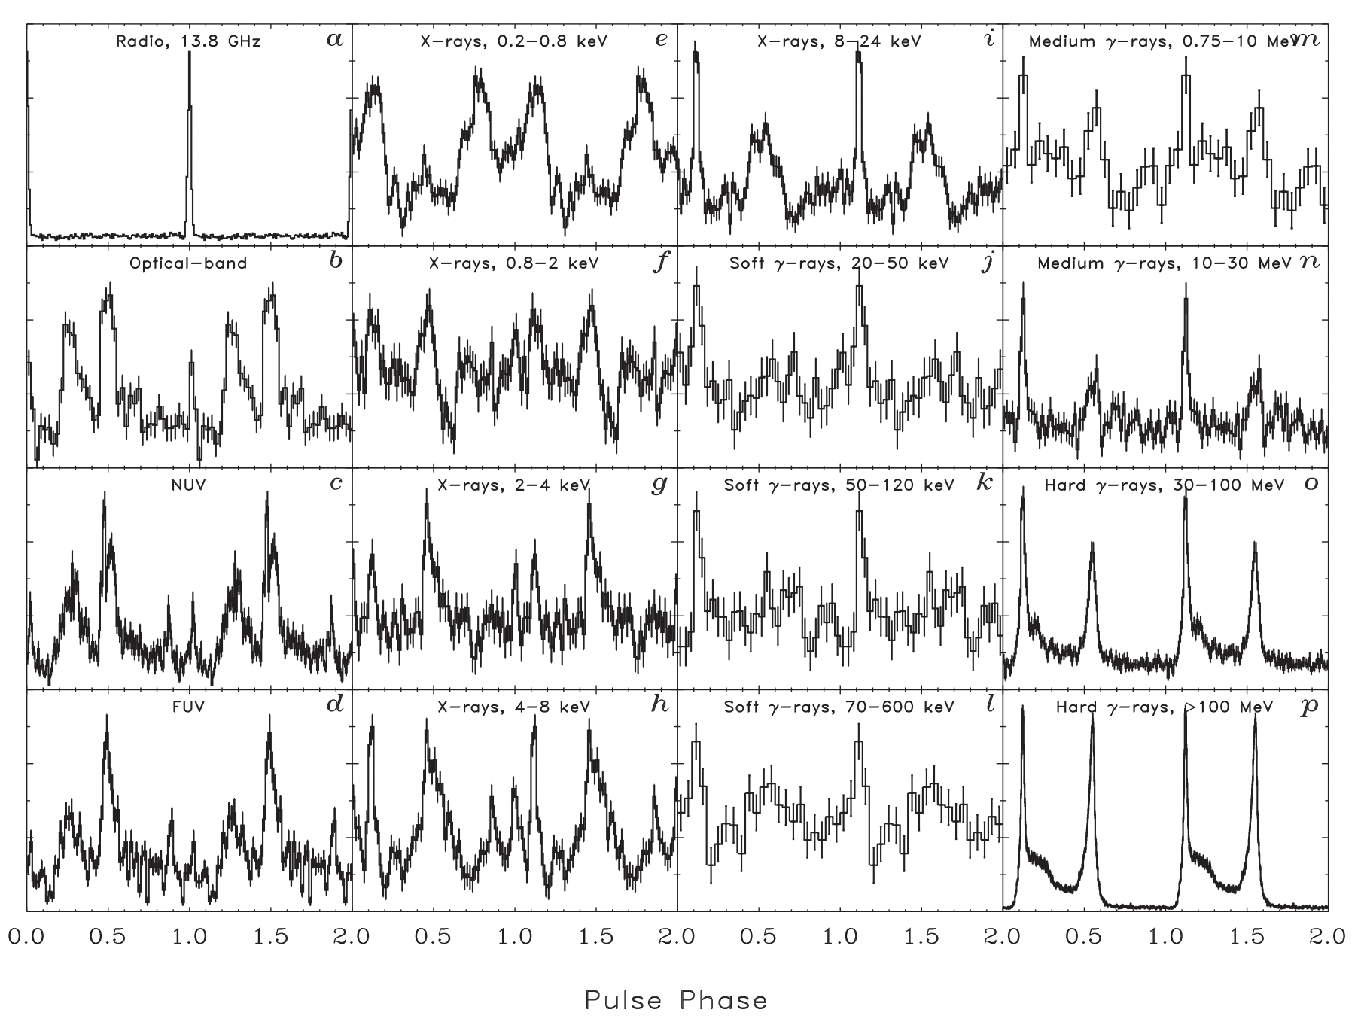
The Vela pulsar
(Kuiper+ 2015)

Slide 7
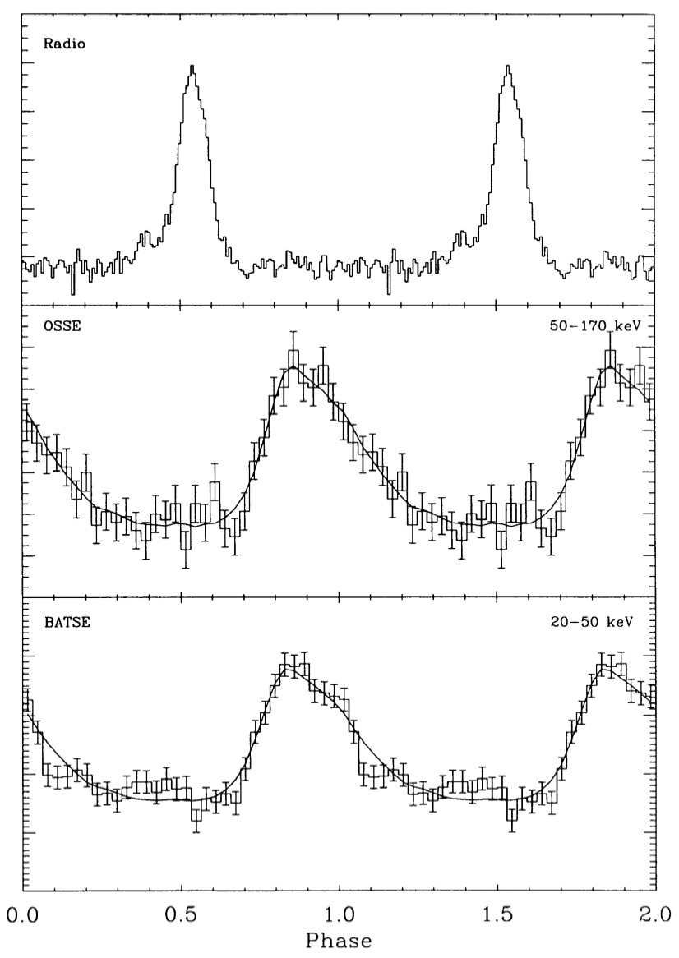
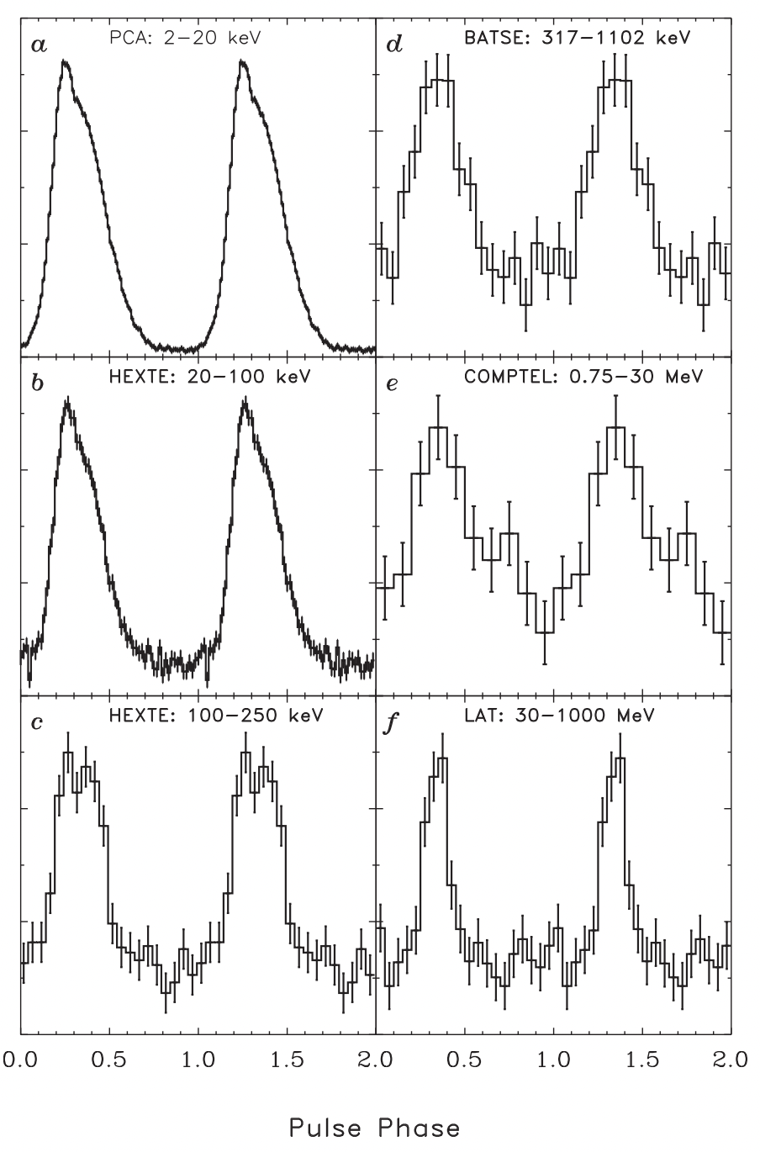
1.52 GHz+2.36 GHz
PSR B1509-58
(Ulmer+ 1993)
(Kuiper+ 2015)

Slide 8
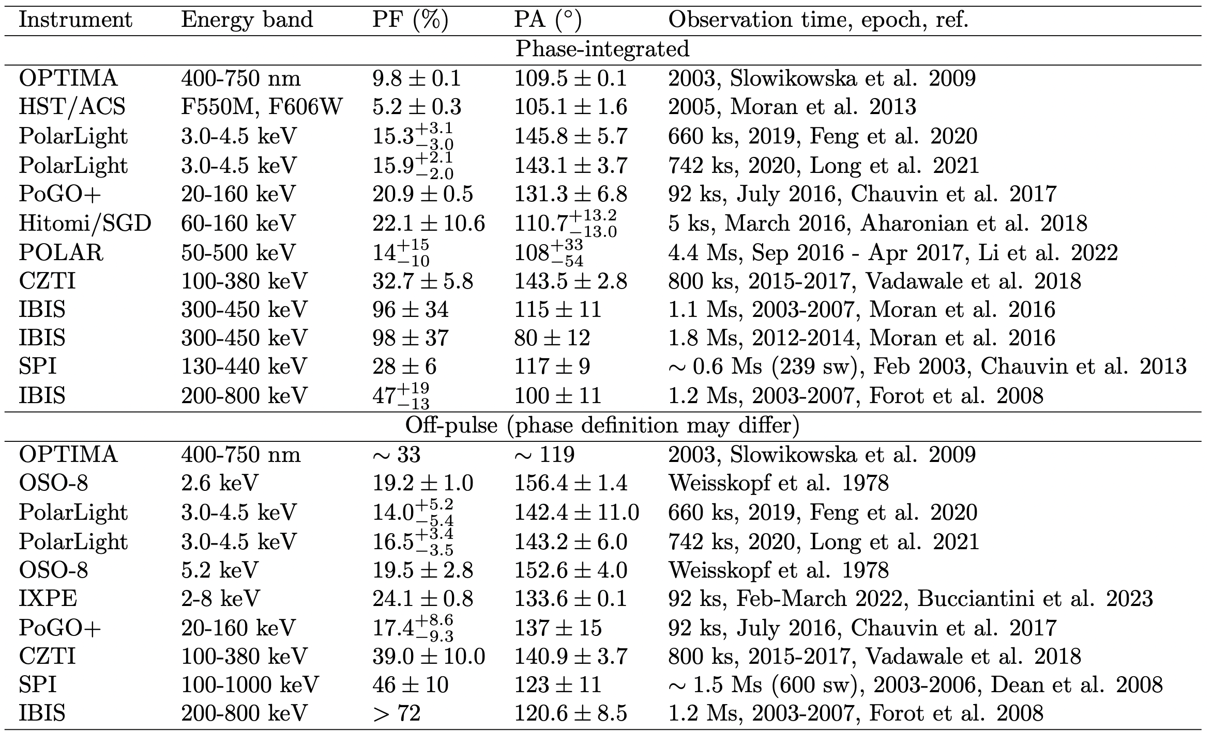
Crab’s polarization (phase-integrated and off-pulse)
# The phase-integrated PA change found in Moran et al. (2016) is not seen in other observations.
# The off-pulse PFs measured by SPI and IBIS are not consistent.

Slide 9
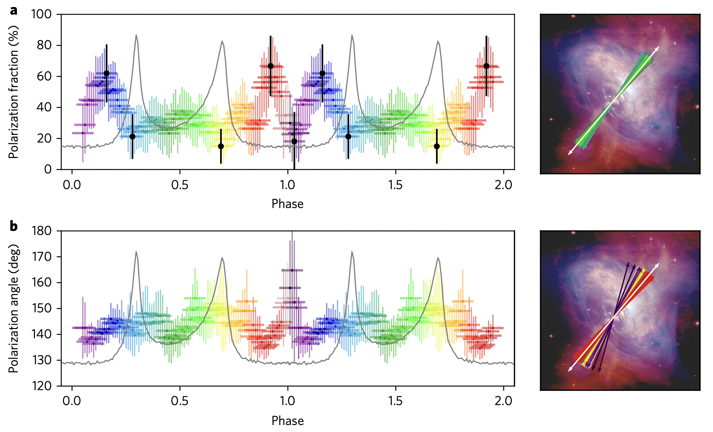
Crab’s polarization (CZTI; phase resolved)
The white arrow is the
off-pulse (0.82-1.18) PA 140.9º.
CZTI, 100-380 keV, 800 ks, 2015-2017 (Vadawale et al. 2018)

Slide 10
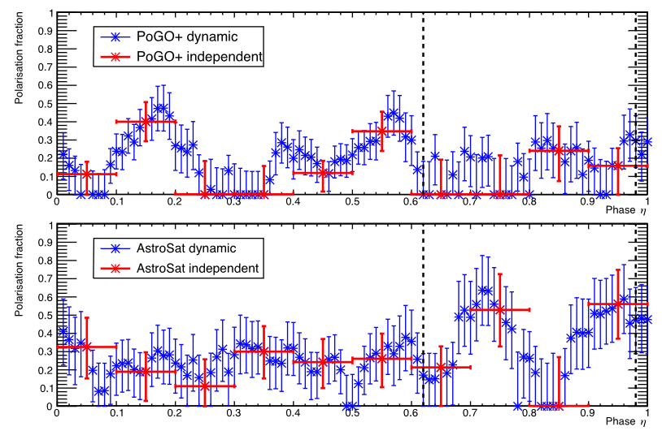
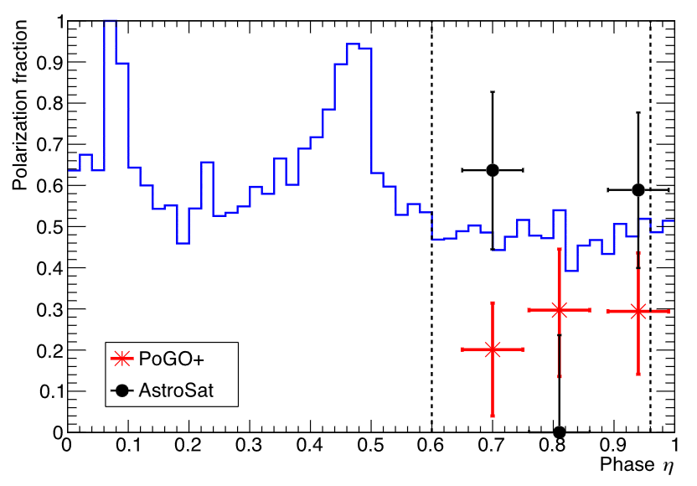
Crab’s polarization (PoGO+ vs AstroSat/CZTI)
This issue awaits new observations.
PoGO+ : 20-160 keV
CZTI : 100-380 keV
Chauvin et al. (2018)

Slide 11
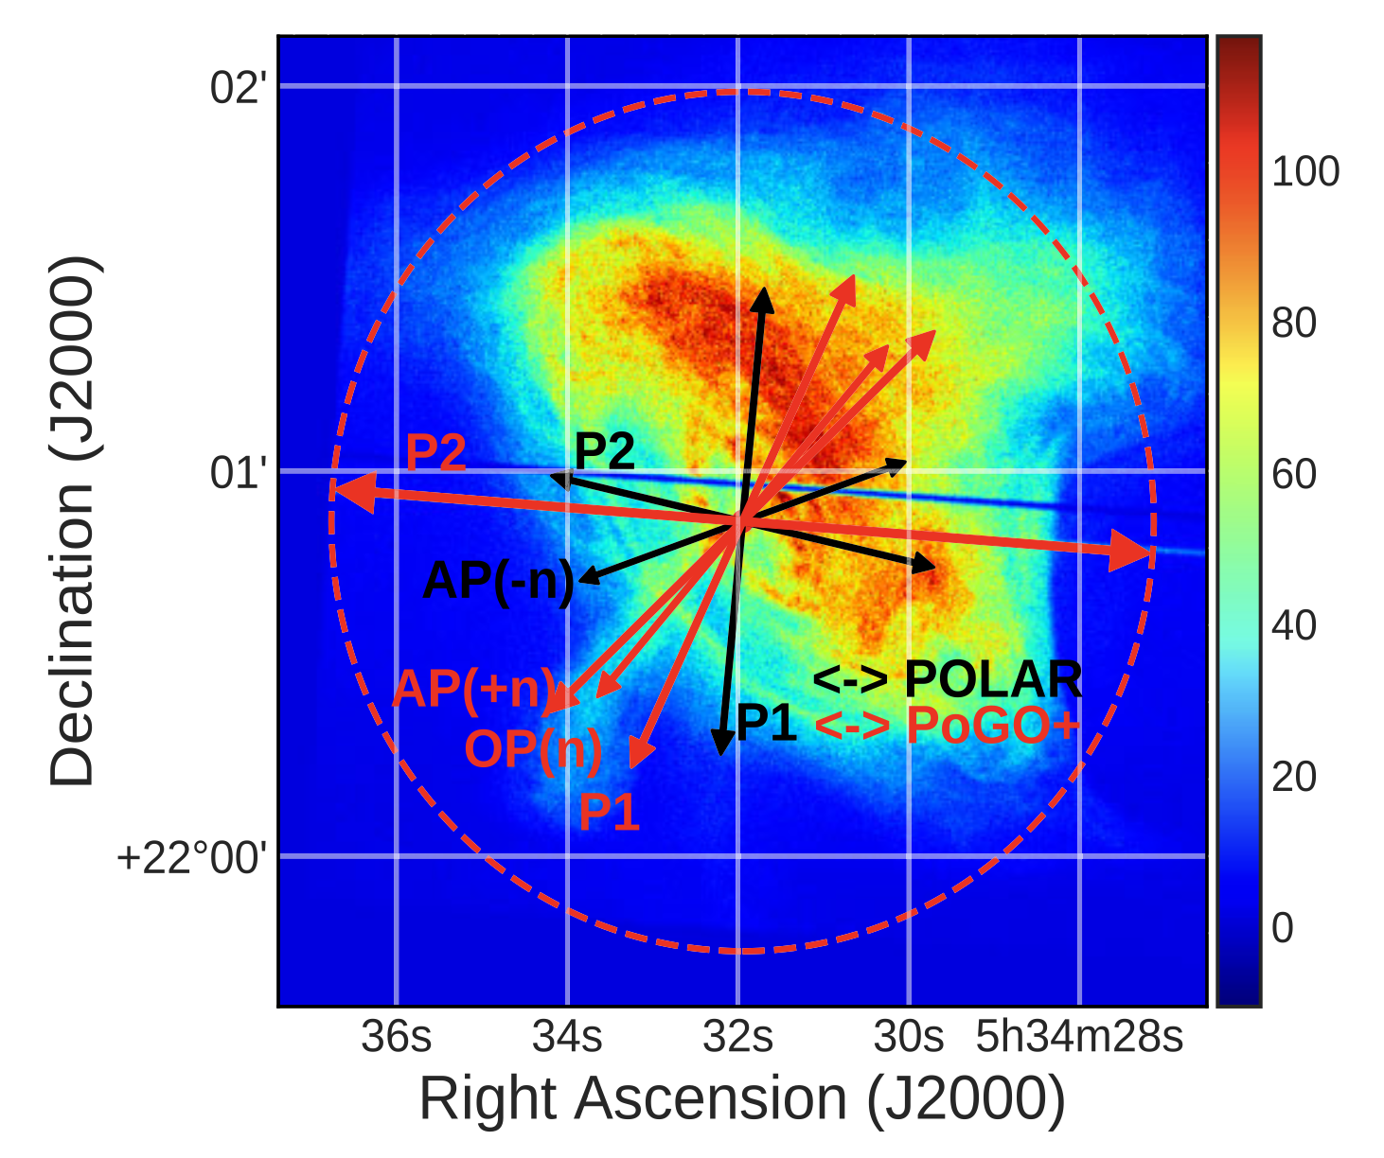
Crab’s polarization (POLAR and PoGO+ in peak phases)
POLAR, 50-500 keV, 4.4 Ms, 2016-2017 (Li+ 2022)
PoGO+, 20-160 keV, 92 ks, July 2016 (Chauvin+ 2017)
The red dashed circle represents 33.5% PD (of the PoGO+ P2, OP-subtracted).
(Li+ 2022)
The PD and PA of the two peaks and the bridge, as well as of the off-pulse phase, are currently not well determined.

Slide 12
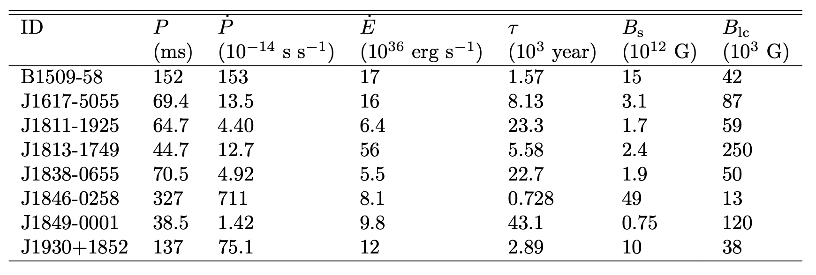
‘MeV Pulsars’:
There is a possible, distinct population of pulsars showing some common characteristics:
energy output peaking around MeV,
a single broad pulse in the hard X-ray band,
a single radio peak,
a large offset in phase between radio and X-ray pulse peaks.
Possible MeV pulsars
(Kuiper & Hermsen 2015; Kuiper+ 2018; Hare+ 2021; Gagnon+ 2024; Takata+ 2024)

Slide 18
Only the Crab pulsar, the Vela pulsar and PSR B1509-58 are detected in the energy range of 0.2-5 MeV.
(Kuiper & Hermsen 2015: pulsars detected in 20 keV – 30 MeV)

Slide 19
MeV Observations of Pulsars
High energy emissions from pulsars
MeV observations of pulsars
Spectra, pulse profiles, polarization,
a possible population of ‘MeV Pulsars’
Hsiang-Kuang Chang
Institute of Astronomy, National Tsing Hua University (NTHU), Taiwan
Looking forwards to a new era! Thanks!
MeV Workshop, IHEP, CAS, Beijing, Oct 16-17, 2025

Slide 20
References:
Aharonian F. et al., 2018, PASJ, 70, 113
Chauvin M., Roques J. P., Clark D. J., Jourdain E., 2013, ApJ, 769, 137 Chauvin M. et al., 2017, Sci. Rep., 7, 7816 Chauvin M. et al., 2018, MNRAS, 477, L45
Coti Zelati F. et al., 2020, MNRAS, 492, 1025
Dean A. J. et al., 2008, Sci, 321, 1183
Feng H. et al., 2020, Nature Astron., 4, 511
Forot M., Laurent P., Grenier I. A., Gouiffes C., Lebrun F., 2008, ApJL, 688, L29
Gagnon S. et al., 2024, ApJ, 968:67
Gelfand J. D. et al., 2019, BAAS, 51, id 513
Harding A., Kalapotharakos C., 2015, ApJ, 811, 63
Harding A., Kalapotharakos C., 2017, ApJ, 840, 73
Harding A., Venter C., Kalapotharakos C., 2021, ApJ, 923, 194
Hare J. et al., 2021, ApJ, 923, 249
Kuiper L. et al, 2001, A&A, 378, 918
Kuiper L, Hermsen W., 2015, MNRAS, 449, 3827
Kuiper L, Hermsen W., Dekker A., 2018, MNRAS, 475, 1238 Li H. et al., 2022, MNRAS, 512, 2827
Long X. et al, 2021, ApJL, 912: L28
Marchesi S. et al., 2024, ApJ, 964: 132
Mattana F. et al., 2011, ApJL, 743: L18
Moffett D.A., Hankins T.H., 1996, ApJ, 468, 779
Moran P. et al., 2013, MNRAS, 433, 2564 Moran P. et al., 2016, MNRAS, 456, 2974
Petri J., 2013, MNRAS, 434, 2636
Reynolds S. P. et al., 2017, SSRv, 207, 175 Slowikowska A., Kanbach G., Kramer M., Stefanescu A., 2009, MNRAS, 397, 103 Takata J., Chang H.-K., 2007, ApJ, 670, 677
Takata J. et al., 2024, ApJ, 965: 126
Ulmer M.P. et al. 1993, ApJ, 417, 738 Vadawale S. V. et al., 2018, Nature Astron., 2, 50
Weisskopf M. C., Silver E. H., Kestenbaum H. L., Long K. S., Novick R., 1978, ApJ, 220, L117
Xiao Y., Wu K., Fang J., 2024, arXiv:2408.06939

Slide 21
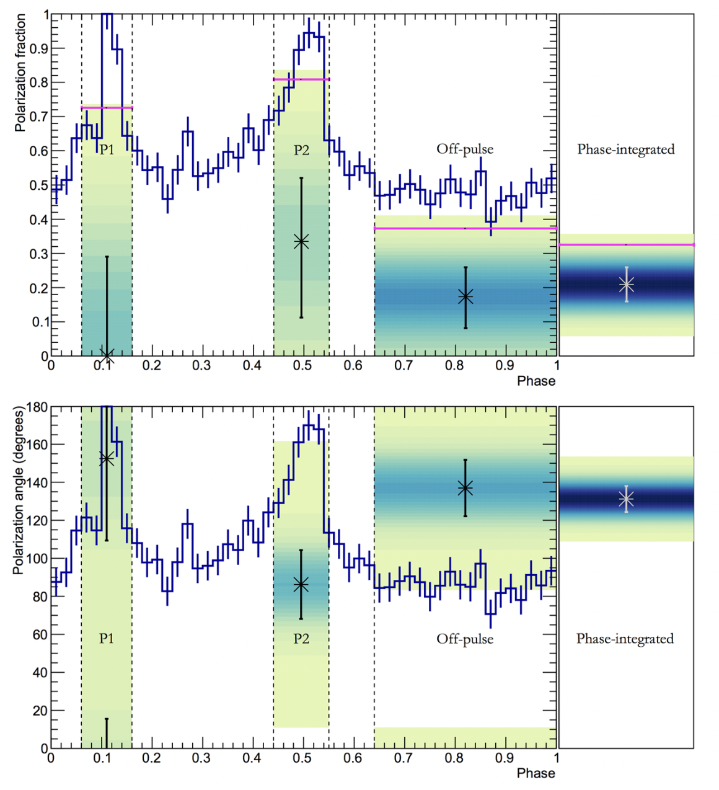
Crab’s polarization (PoGO+ in peak phases)
PoGO+, 20-160 keV, 92 ks, July 2016 (Chauvin et al. 2017)

