Slide 1
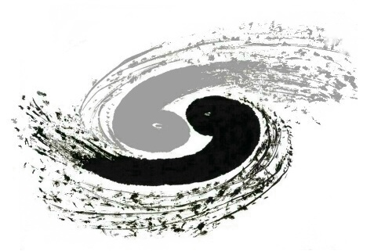

Flares from merged magnetars as a new population of MeV counterparts of GW
Institute of High Energy Physics, CAS
Shu-Xu Yi, Zhen Zhang, Xi-Lu Wang
present by Shu-xu Yi@ENGRAVE Webinar, 16th Sep. 2025
ApJ 2023, 955, 4Y

Slide 2
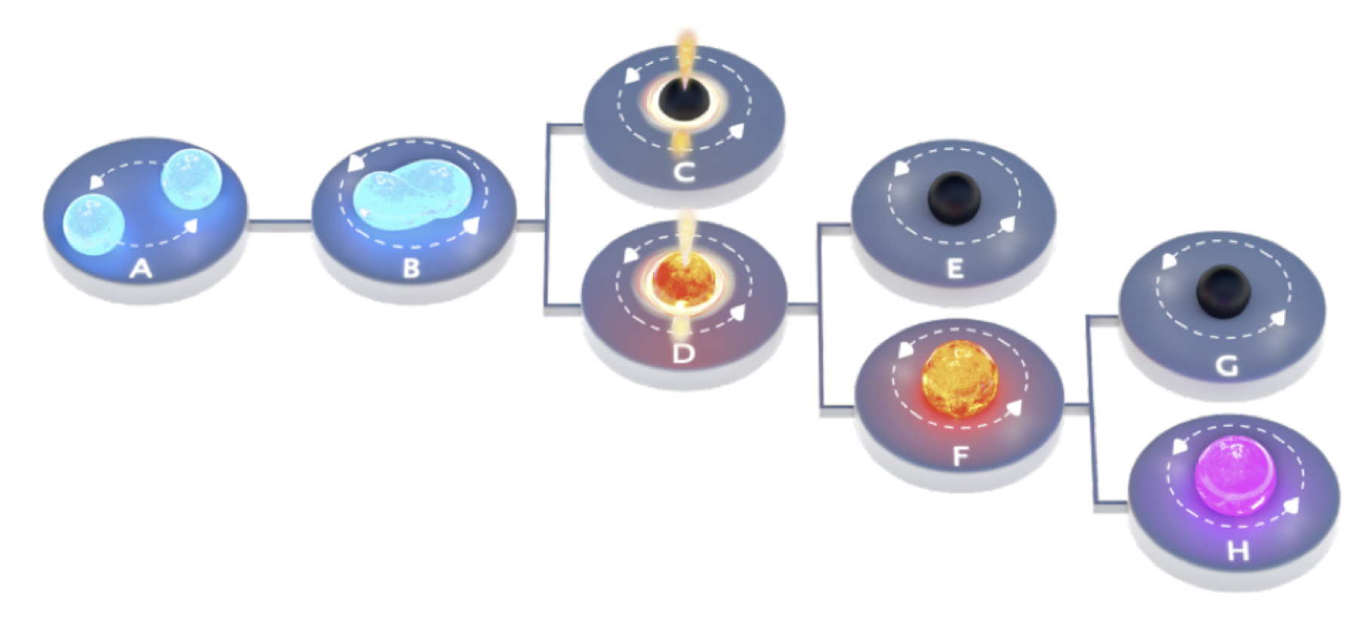
Remnant of binary neutron star mergers
~0.1 s
~hours
hypermassive
NS: P<1ms
supermassive
NS: P~1ms
magnetic field magnifying
long-lived-massive
magnetar
figure from S. Ascenzi et al. (2020)
Notes:
Let‘s start with some background. What is the outcome of a binary neutron star merger? There are many possibilities. When the mass of the merger product is large enough, it may immediately collapse into a black hole. Alternatively, due to the centrifugal force caused by rapid rotation, part of the gravity is balanced, so the product does not collapse immediately but forms a hypermassive neutron star. Here, hypermassive refers to a mass that clearly exceeds the theoretical limit of a static neutron star mass, or the TOV limit. Subsequently, the differentially rotating part of its spin is dissipated within milliseconds, resulting in uniform rotation. At this point, two different scenarios may occur: one is that there is no longer enough centrifugal force to support it, and the hypermassive magnetar collapses into a black hole. The other scenario is that the centrifugal force of uniform rotation is still sufficient, so it continues to exist as a magnetar. At this stage, due to magnetic dipole radiation braking, the spin rate will rapidly decrease, and it will quickly spindown within hours. Then two situations may arise: it collapses into a black hole during the spindown process, or it survives steadily. In the afterglow of gamma-ray bursts, there are evidences that,
the pulsar wind from such a stably surviving magnetar is a continuous energy injection sources. Our study focuses on such long live magnetars.

Slide 3
Magnetar flares
B~10¹⁴⁻¹⁵G
Soft-Gamma-ray Repeaters
Two scenarios:
Star quake：
crust quake triggers magnetic reconnection
magnetosphere reconfiguration:
sudden reconfiguration of magnetic field
triggers MHD instablities and reconnection.
Rate
Law of Self-Organized Critical (SOC)
Claim：
Such flares will also happen in merged magnetars
Much more frequent flares in new born merged magnetars
SGR
Flares
Giant
Flares
Super
Flare
10⁴¹
10⁴⁴
10⁴⁶
10⁴⁸
E (erg)
Notes:
Having discussed this special kind of magnetar, let‘s talk about general magnetar bursts. In our galaxy, there are many neutron stars with very strong magnetic fields, which we call magnetars. Their magnetic fields can reach 1e14-15, but typical neutron stars only have 1e12. These magnetars often exhibit flares in soft gamma rays, known as soft gamma-ray repeaters. The energy of each magnetar flare can span many orders of magnitude, from 1e41 to giant flares of 10e46. It is not very clear whether these different energy flares have the same physical origin. It is speculated that they may have the same physical origin but that the energy release follows a cascading power-law distribution, such as the power-law distribution predicted by self-organized criticality phenomena.
Two types of mechanisms have been proposed to explain magnetar bursts. One is that magnetar bursts are caused by starquakes in the crust of neutron stars, where the shaking of these plates drives magnetic field lines, ultimately leading to magnetic reconnection in the magnetosphere and triggering radiation. The other is that when accumulating magnetic stresses reach a critical value, the sudden reconfiguration in the magnetosphere,, leads to magnetic reconnection and ultimately a burst.
The starting point of our work is based on two propositions. 1. Such magnetar bursts will also occur in massive magnetars produced by binary neutron star mergers. This is not difficult for everyone to accept. 2. The second: The magnetar burst activity of newly formed merger magnetars is much more frequent than that of galactic magnetars. We will now explain this second claim.

Slide 4
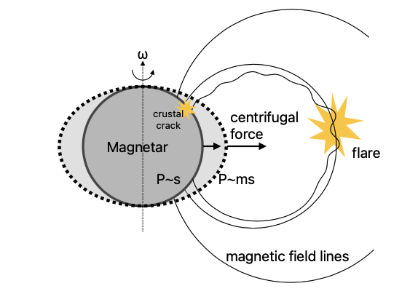










Star quake scenario
within a time interval $∆t:$
a crust element shift
$$≥$$
Active
fast spinning
phase (kid)
Calm
slow spinning
phase (adult)
Inactive
phase (adult)
Magnetic dipole braking of merged magnetar:
~10ms ~s
~day
~10⁵ year
Notes:
Let's first assume the framework of the starquake model. A newly born merger magnetar has a millisecond-level spin period, due to the large orbital angular momentum of its progenitor binary. At the same time, it has a very large magnetic field, which is amplified during its differentially rotating period through the dynamo effect. Therefore, its magnetic dipole braking is very large. A simple calculation shows that its spindown timescale is on the order of days, meaning that within one day, it will rapidly transition from millisecond spin to second-level spin. It can be imagined that the change in centrifugal force on the neutron star crust is also very rapid. (Pointing to the diagram) As shown in the schematic diagram, from a millisecond-spinning neutron star to a second-period neutron star, the centrifugal force decreases rapidly. We imagine that within a small time interval delta t, the change in centrifugal force at a local point on the crust will cause a displacement delta l. Kappa is equivalent to the elastic coefficient of a spring, or Young's modulus. Then the change in gravitational potential energy corresponding to this displacement is delta E. We assume that the release of this gravitational potential energy causes Delta N local crustal fracture events. Each fracture releases energy with a typical value Ecrack, so this Delta N can be related to the rate of change of centrifugal force. And the number of fractures per unit event under the starquake framework is equal to the rate of magnetar bursts. Therefore, the rate of magnetar bursts is related to the rate of change of centrifugal force. After some deductions, it can be found that the rate of magnetar bursts is inversely proportional to the fourth power of the magnetar's spin period. Therefore, for a merger magnetar, its burst rate in the first phase, that is, within 1 day of millisecond-level spin, is much greater than the subsequent long second-level spin phase.

Slide 5
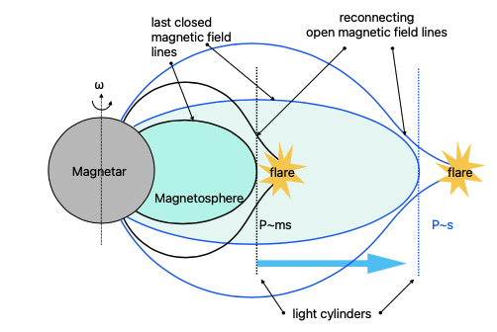







Magnetosphere reconfigure scenario
light cylinder
$$R_{LC}=Pc$$
Volume swept by expanding light cylinder within $∆t$
$$R_{B}∝1/P^{5}$$
$$≥$$
Active
fast spinning
phase (kid)
Calm
slow spinning
phase (adult)
Inactive
phase (adult)
~day
~10⁵ year
Notes:
For the framework of magnetospheric readjustment, we can have a similar discussion. For a rapidly spindown neutron star, the area in its magnetosphere that needs to be reconfigured quickly is near its light cylinder. The light cylinder is where the co-rotational speed of the magnetosphere equals the speed of light. It is also the boundary between open magnetic field lines and closed magnetic field lines. When a magnetar rapidly spindowns, the light cylinder also rapidly expands outward. During this process, open magnetic field lines become closed magnetic field lines, which will cause magnetic field readjustment and produce flares. We still consider the volume swept by the light cylinder within a delta t, which can be written like this. The magnetic energy contained in this volume is the magnetic energy density times this volume. We assume that this energy also becomes the flare released by the magnetar, so it will cause delta N flares, so delta N/delta t is the flare rate. Therefore, we can also relate the flare rate to the spin period of the neutron star. The conclusion is similar, that is, "The burst rate during the millisecond-level spin phase within 1 day is much greater than the subsequent long second-level spin phase."

Slide 6
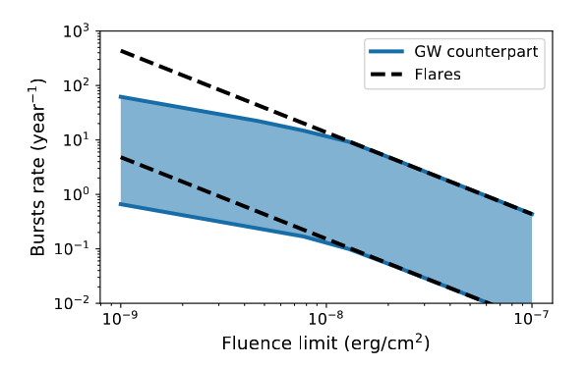
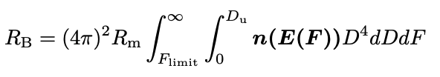



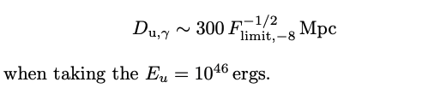

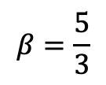
Burst rate from a population
$$R_{B,total}=R_{m}×N_{B}$$
With fluence and distance limit:
$$β=\frac{5}{3}$$
(Cheng et al. 2020)
Notes:
Okay, now we want to calculate the flare event rate from all merger magnetars in the nearby universe. This is simply the birth rate of merger magnetars multiplied by the average number of flares per magnetar. In reality, because the sensitivity of detectors is always limited, we also need to consider a flux or fluence threshold. So we also need to assume a distribution of burst energy. Here we assume it to be a power-law form, and the power index uses 5/3 from self-similar critical processes, which is also supported by real statistical literature. With these, we can simply derive the relationship between the detection rate and the fluence limit of th eGRB instrument. It is the black dashed line on the right side of the figure. Since there is some uncertainty in the parameters used here, such as the binary neutron star merger rate and the ratio of long lived magnetars out of the mergers, the corresponding detection rate is also uncertain, within this band. In addition, we want to ask, how many of these can be detected as electromagnetic counterparts to gravitational waves? For this, we need to limit the distance to within the detection range of gravitational wave detectors. This blue band is the detection rate curve with the sensitivity of gamma-ray burst detectors considering the gravitational wave detection distance limit. We see that the reduction in flux limit of GRB detection has two effects: one is that more bursts with lower intrinsic energy can be seen, and the other is that more distant magnetar bursts with larger intrinsic energy can be seen. These two points together cause the slope of this curve. However, when the threshold of the gamma-ray burst detector is less than a certain range, the detection range of the gravitational wave detector limits the distance range of the magnetars that can be seen, so the rising slope is only controlled by one factor, so the rise slows down.

Slide 7
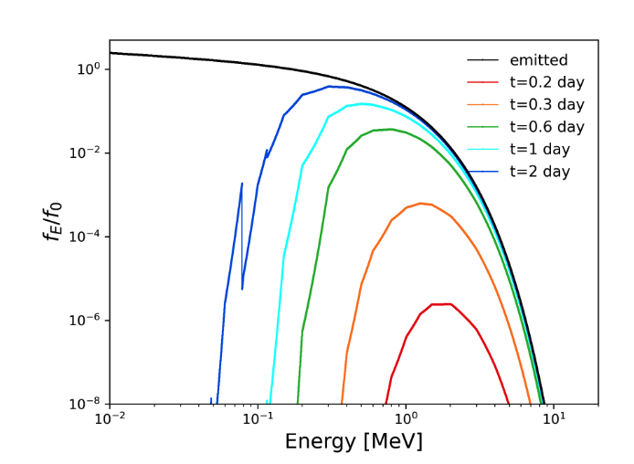
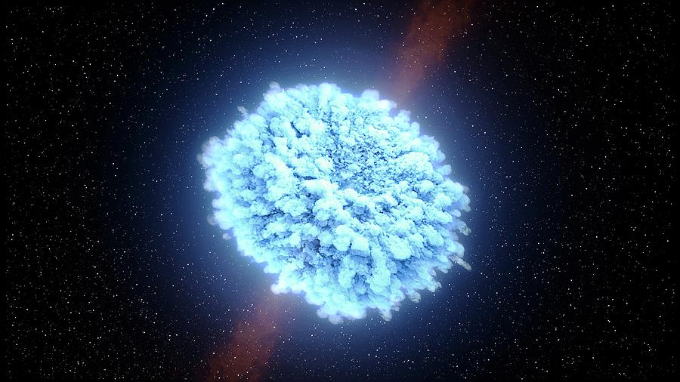
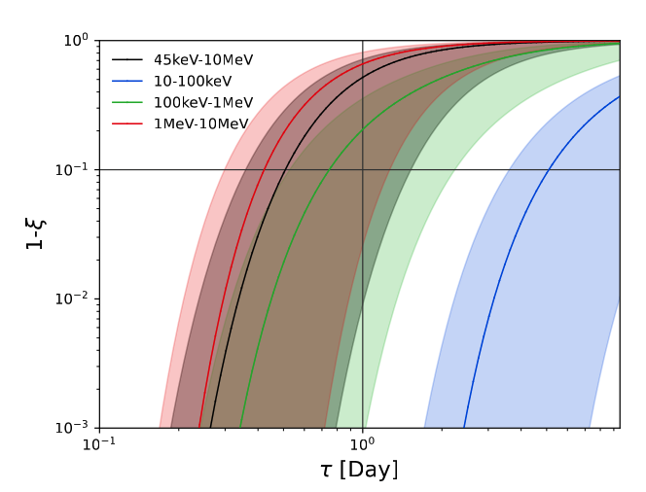
Considering absorption
Dense environment due to ejecta
large absorption!
optically thick in ~1 day
Notes:
Our discussion so far actually missed a very important thing: which is that we are now considering flares produced by magnetars newly born from the merger of binary neutron stars. Therefore, the absorption by circumstellar material must be taken into account. Especially since we know that a large amount of ejecta is produced after the merger of binary neutron stars, and this ejecta is optically thick for about a day, which is why the optical afterglow of the neutron star merger and kilonova optical signals are generally believed to appear about a day after the gravitational wave signal. For gamma rays, the absorption by these ejecta is also very significant, especially for keV photons. We used a code that calculates the absorption of ejecta from binary neutron star mergers to compute its effect on the absorption of a typical magnetar giant flare input spectrum. The result is this figure. From bottom to top, it shows the emission spectra 0.2 days, 0.3 days, 0.6 days, 1 day, and 2 days after the merger. As you can see, up to one day, the absorption for photons below 1 MeV is very strong. Therefore, we defined an absorption coefficient \epsilon, which is the ratio of the absorbed energy in the spectrum to the total energy. So here, 1-epsilon is the ratio of the emitted flare energy to the total energy. We see that if we use a detector operating in the 1 MeV to 10 MeV range, then basically after one day, these absorption effects become insignificant. Conversely, for a detector in the 10-100 keV range, we have to wait until after 10 days for the absorption effects to become insignificant. The uncertain shadow drawn here arises from the uncertainty in the total mass, velocity, composition, and so on, of the ejecta.

Slide 8
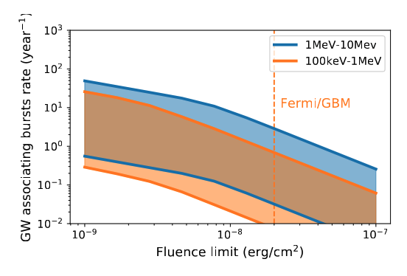
Rate taking absorption in to account
Summary
Lag ~ days after GW chirp
weak short GRB like
lower energy cut ~<100keV
spin modulation and significant spin-down
feature
Archival data:
Fermi/sGRBs catalogue: ~0.1-10 cases.
need careful spin-modulation search in weak bursts
Future:
MeV detectors @ 1e-8 erg/cm2
detect up to ~10 per year
Notes:
Taking into account the absorption coefficient mentioned above, we can revise our calculation of the event rate. The blue band corresponds to an MeV detector with a working range of 1 MeV to 10 MeV, and the yellow corresponds to a working range of 100 keV to 1 MeV, similar to the situation with Fermi/GBM. To summarize, if we want to observe magnetar bursts from magnetars produced by mergers, we should focus on gamma-ray transient signals occurring about a day after the gravitational wave event of a binary neutron star merger. The energy spectrum of this signal has a significant characteristic: it is truncated below 100 keV, which is due to the absorption by the circumstellar ejecta. At the same time, we may be able to see features of spin modulation and noticeable spin-down.
Based on our estimates, there may be some such bursts in the Fermi short gamma-ray burst catalog. In the future, with a new generation of detectors working in the MeV energy range, we might see about 100 such electromagnetic counterparts per year. Because these bursts are isotropic, the probability of them being detected as gravitational wave electromagnetic counterparts is greater than the typical gamma-ray burst afterglow radiation. They represent an excellent new scientific target for gamma-ray band gravitational wave electromagnetic counterparts.
考虑到上面的吸收系数之后，我们可以重新修正我们对事件率的计算。蓝色这个条带是对与MeV探测器，它的工作范围是1MeV-10MeV，黄色对应于工作范围在100keV-1MeV，类似于Fermi/GBM的情况。总结一下，我们如果想看到来自并合产生的磁星的磁星暴，我们应该关注双中子星并合引力波事件发生后大约一天的伽马射线暂现信号。这个信号的能谱有个显著的特点，就是100keV一下被截断，这是来自星周抛射物的吸收。与此同时，可能可以看到自转调制和明显的自转减慢的特征。
基于我们的估计，在FERMI 的短伽马暴的源表里，可能存在一些这样的暴发。未来，如果有了新一代的工作在MeV能区的探测器，或许可以看到大约一年100个这样的电磁对应体。因为这种暴发是各向同性的，所以它作为引力波电磁对应体被探测到的概率比一般说的伽马暴瞬时辐射还要大。是一种很好的新伽马射线波段的引力波电磁对应体科学目标。

