Slide 1
Brief Introduction to VLAST
Qiang Yuan
Purple Mountain Observatory, Chinese Academy of Sciences
MeV mission workshop, IHEP, Beijing, 2025-09-17

Slide 2
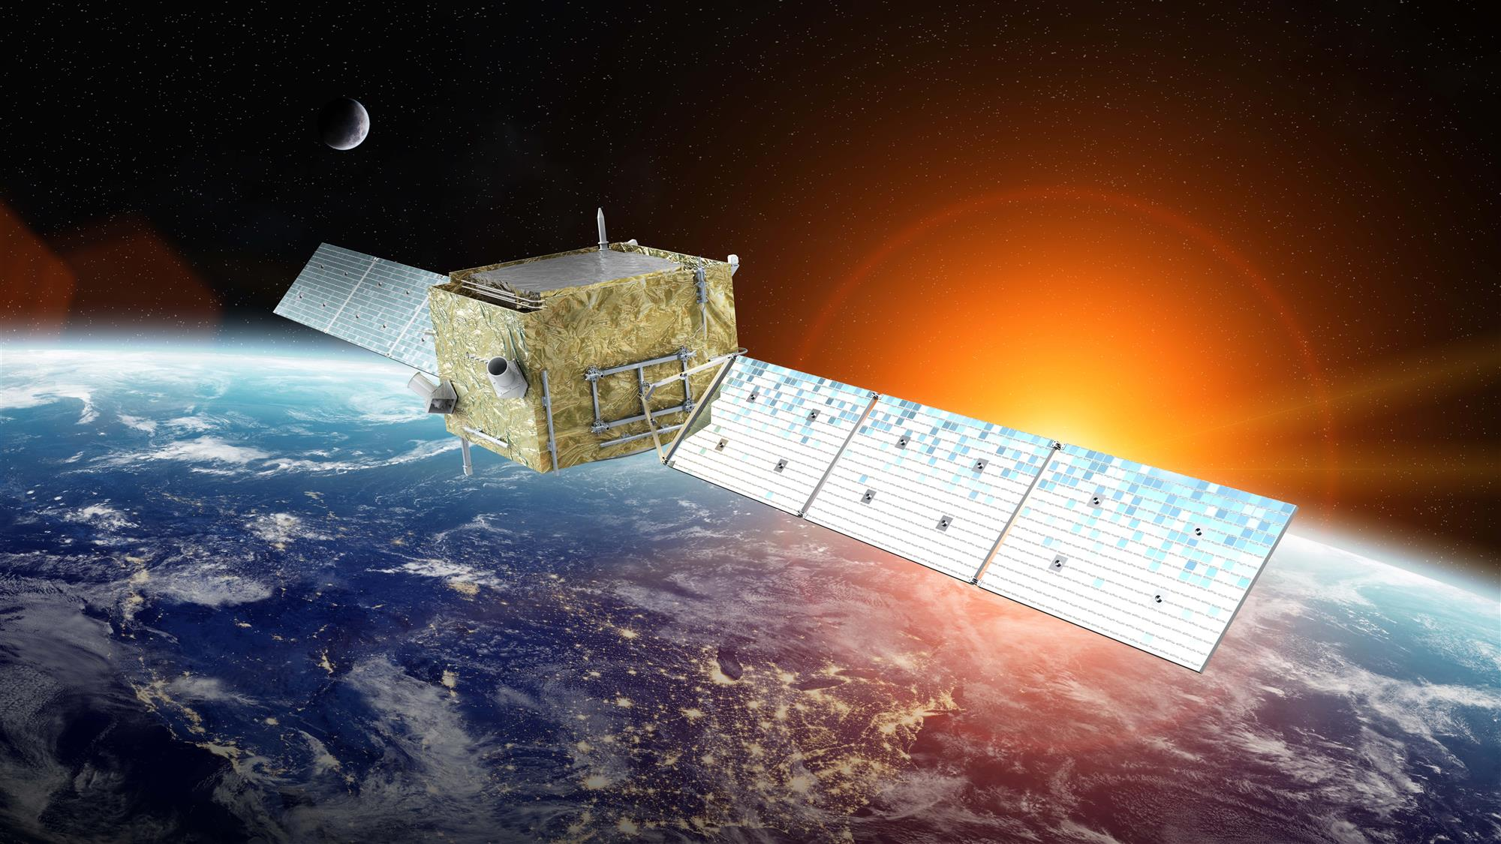
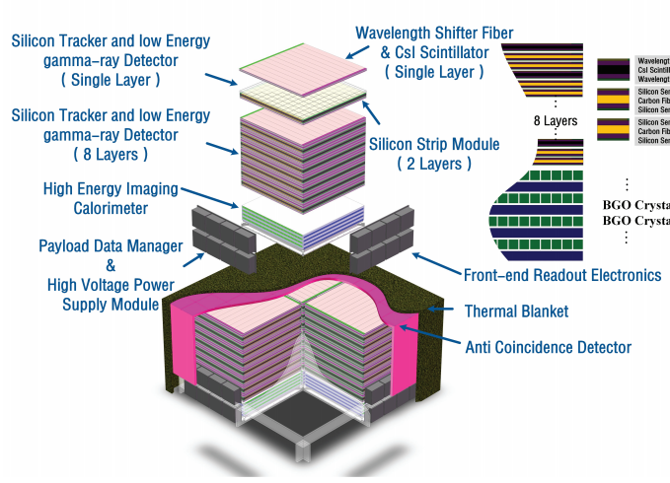
From DAMPE to VLAST
Dark Matter Particle Explorer
Particle (e+e-, nuclei) and γ detector
10 years in operation
0.3 m²sr; 1.5% E res.@10 GeV (for e/γ)
Very Large Area γ-ray Space Telescope
Large: ~10 m²sr
Wide: MeV - 10 TeV
Precise: ~1.5% E res.@10 GeV

Slide 3
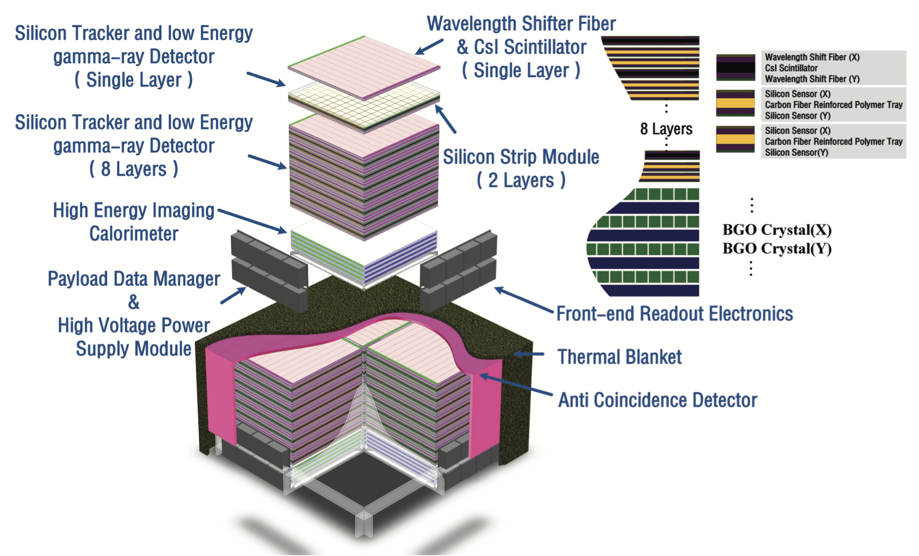
Design of detector
Three sub-detectors:
(a) Anti-coincidence detector: top and sides, to distinguish γ rays from charged particles
(b) Silicon tracker and low-E γ detector: to measure γ-ray trajectory (pair) and MeV photons (Compton)
(c) High-E imaging calorimeter: to measure energy of high-E γ rays

Slide 4
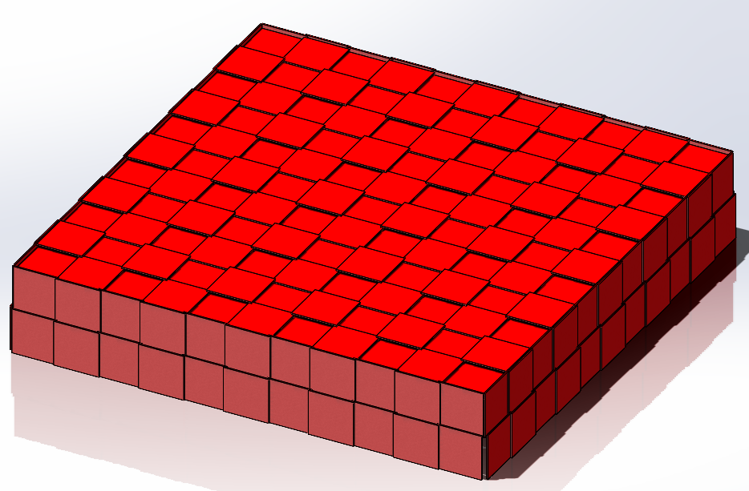
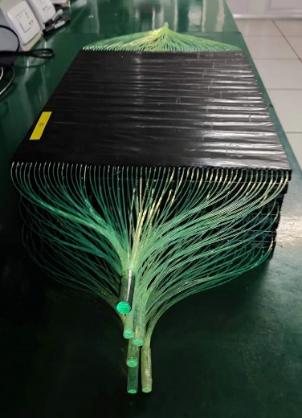
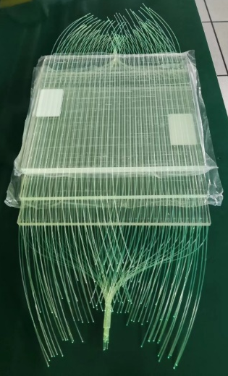
Anti-coincidence detector (ACD)
Main function
  Identify photons from charged particles
  Measure charge of light nuclei
Technical performance
  Dynamic range: Z=1~8
  Efficiency: >99.97%
  Event rate: >10 kHz/m²
  Size: 3100 mm×3100 mm (top), 3100 mm×600 mm (side)
  Unit: 300 mm×300 mm
Readout
  Wavelength shifting fiber
  PMT
反符合探测器结构图
反符合探测器探测单元预研

Slide 5
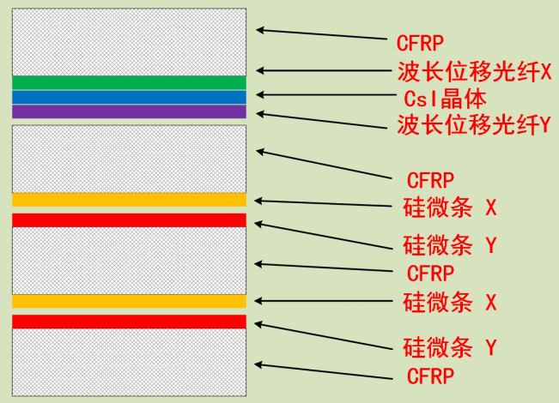
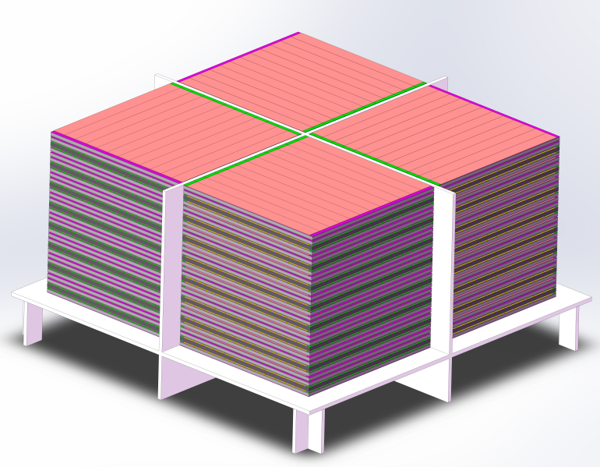
Silicon tracker and low-E γ detector (STED)
Main function
  Convert γ rays into e+e- pair and measure their trajectory
  Measure energy and direction of MeV photon
Technical performance
  8 super-layers, each with one CsI layer and two silicon strip layers (4 sub-layers)
  Size: 2800 mm×2800 mm
  4×4 array
  Angular resolution: 0.1°@50 GeV
Readout
  CsI: wavelength shifting fiber + SiPM
  Silicon tracker: front end ASIC hybrid
径迹及低能伽马探测器超层
Daylan et al. 2016
GC γ excess
整体布局图
（由2×2的探测阵列构成）

Slide 6
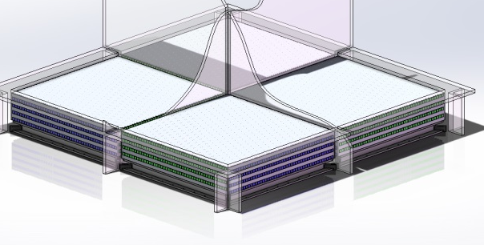
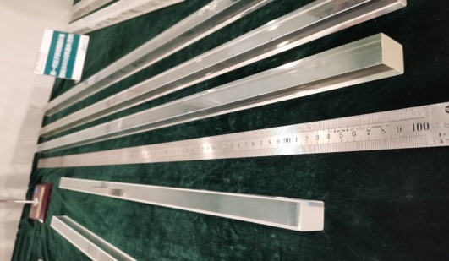
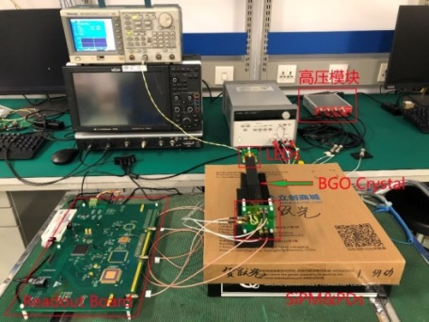
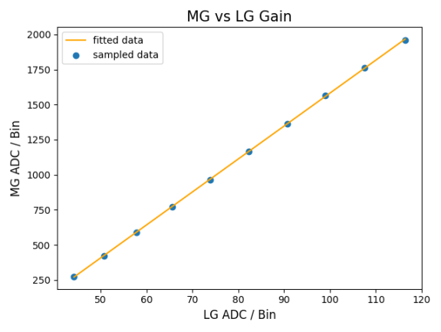
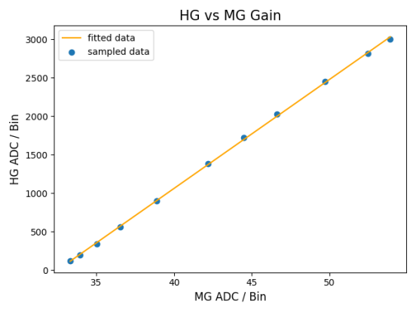
High energy imaging calorimeter (HEIC)
Main function
  Measure particle energy
  Distinguish e/γ from nuclei (protons)
  Trigger of events
Technical performance
  8 layers BGO crystals
  Size: 2400 mm×2400 mm
  4×4 array
  Energy resolution: 1.5%@10 GeV (e/γ)
  Dynamic range: 0.01 GeV - 20 TeV
  Proton rejection: 10⁴@50 GeV
Readout
  PMT
成像量能器结构图
读出电子学

Slide 7
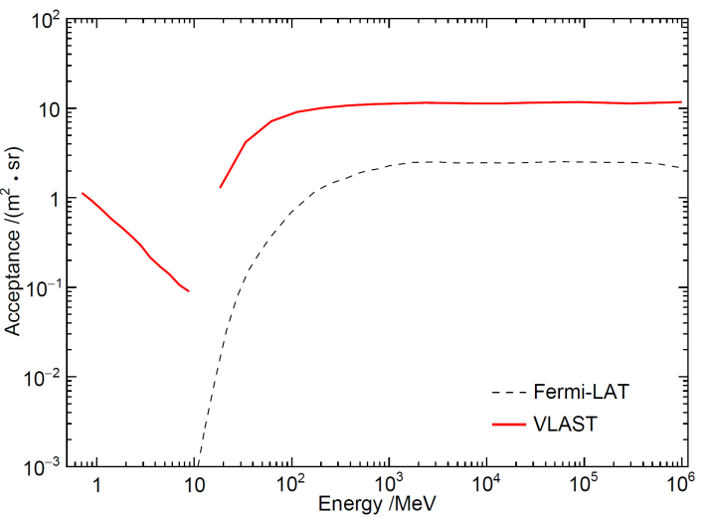
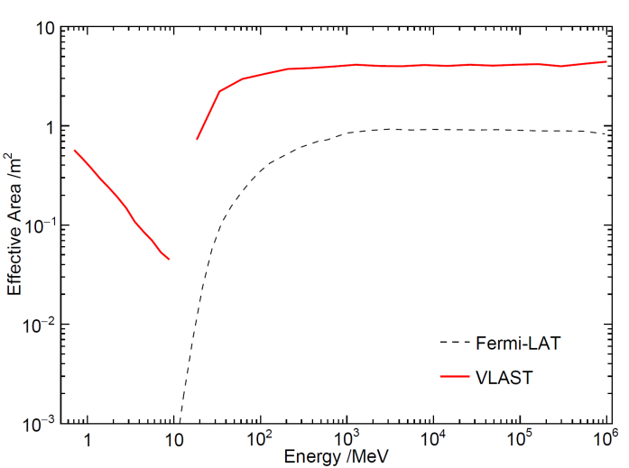
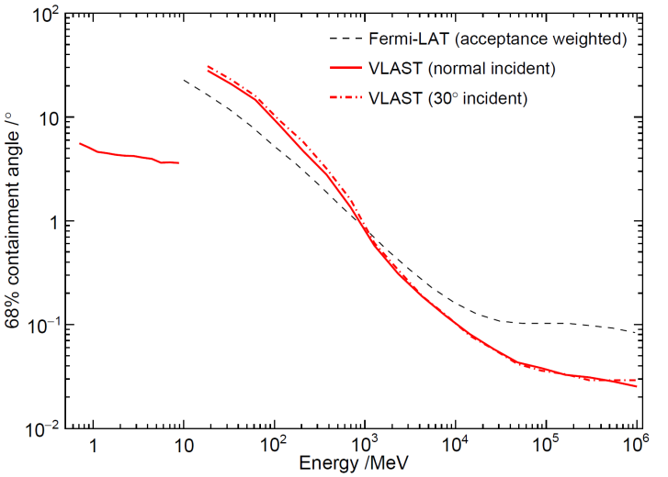
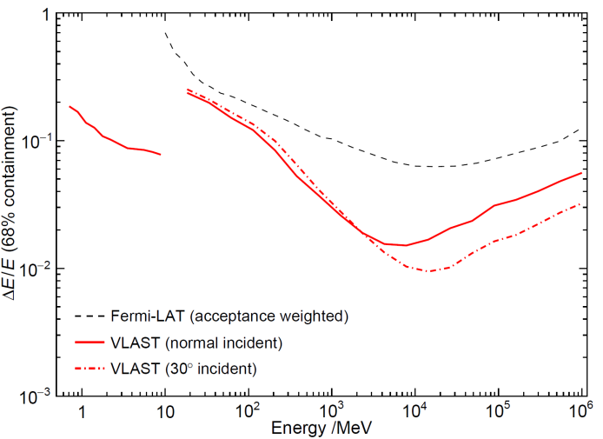
Expected performance
2407.16973
Acceptance Effective area Angular resolution Energy resolution
Facility | Acceptance (m² sr) | Energy range | Energy resolution (@10GeV) | Angular resolution (@50GeV)
Fermi-LAT | ~2 | 20 MeV-300 GeV | ~6.0% | ~ 0.10 deg
DAMPE | ~0.2 | 5 GeV-10 TeV | ~1.5% | ~ 0.10 deg
AMS-100 (concept) | ~30 | 0.1 GeV-10 TeV |  | ~ 0.03 deg
APT | ~20 | 1 MeV-10 TeV | ~20% | ~ 0.10 deg
HERD | ~2 | 0.5 GeV-10 TeV | ~1.5%
VLAST | ~10 | 1 MeV-10 TeV | ~1.5% | ~0.10 deg

Slide 8
Scientific goals
Fundamental physics
1) Indirect detection of WIMP/axion dark matter
2) Search for gamma-ray lines from superheavy elements
3) Test of Lorentz invariance violation
4) Gamma-ray pulsar timing array
Gamma-ray astronomy
1) Survey of the variable high-energy sky
2) Multi-messenger, multi-wavelength joint observations of transients
3) Probe of high-redshift universe, detection of the gamma-ray horizon
Cosmic ray physics
1) Cosmic ray spectral measurements in a very wide energy band
2) pion bump of gamma-ray sources

Slide 9
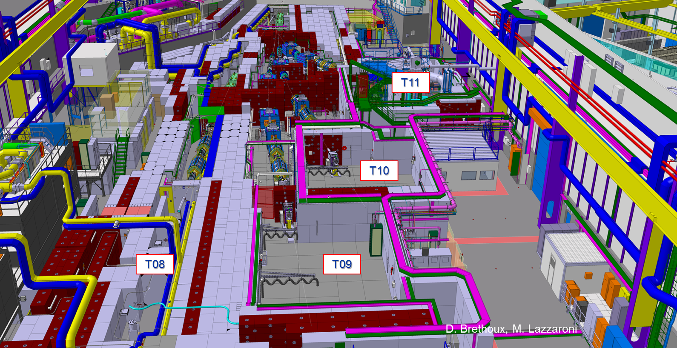
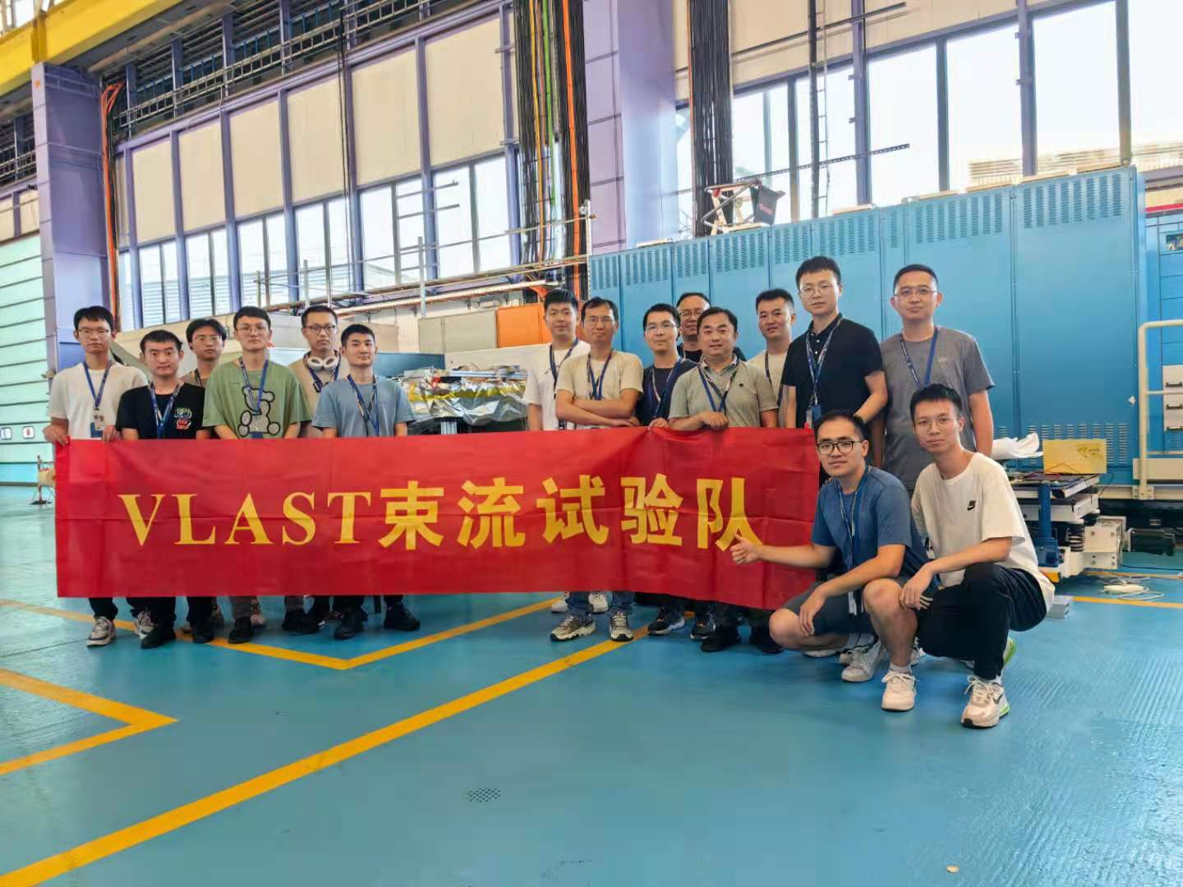
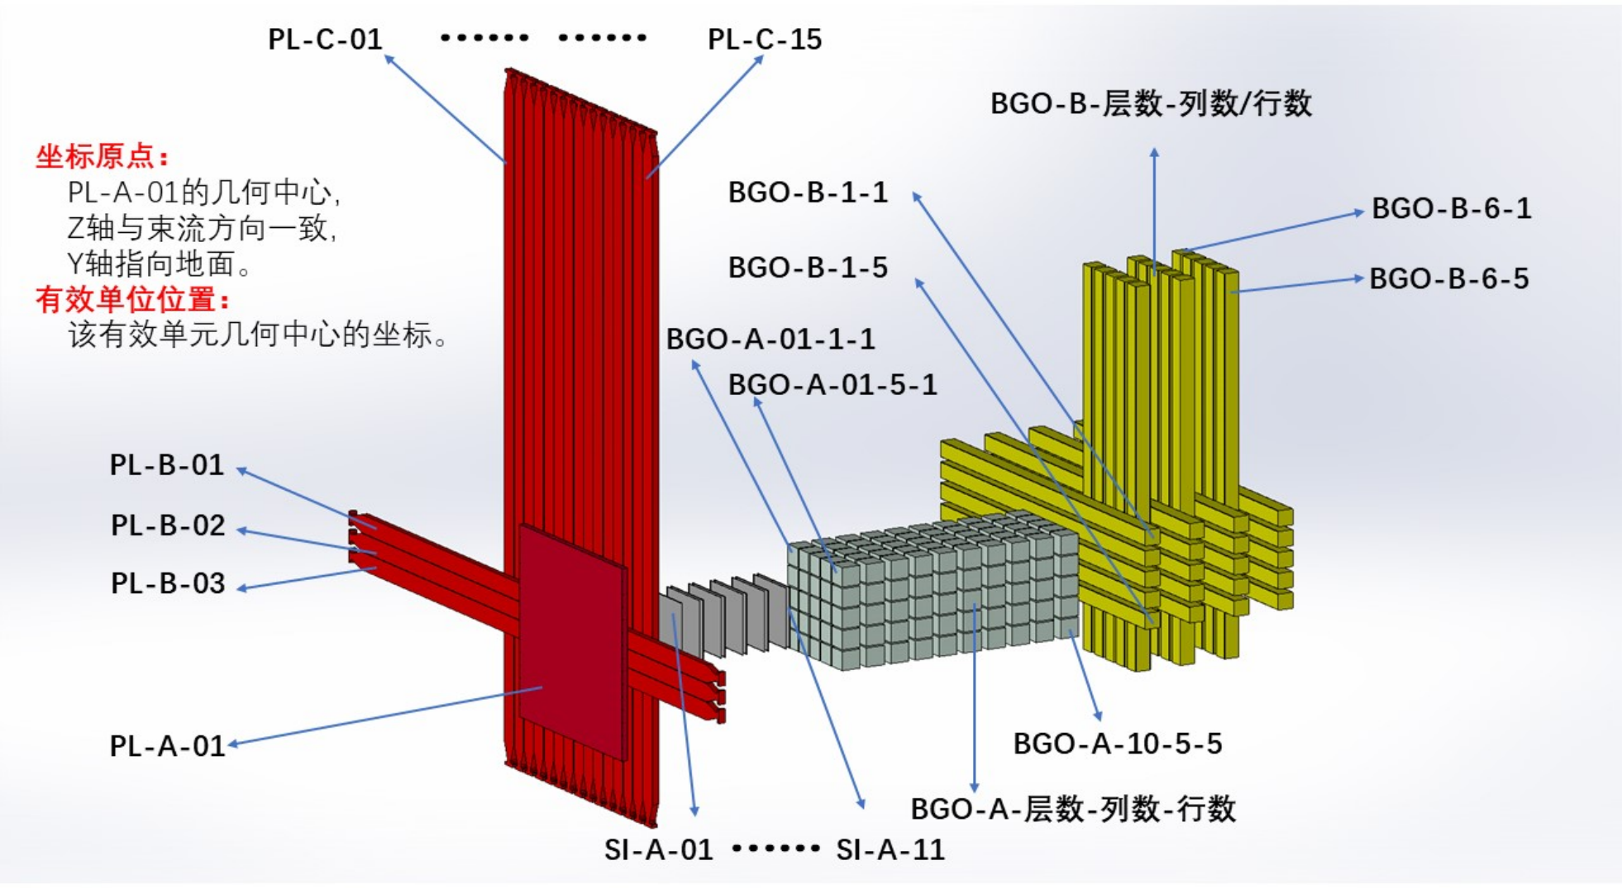
Beam tests of prototype at CERN
Beam Test at CERN：
  2023: Week37, PS-T9 (e-)
  2023: Week40, SPS-H8 (ion)
  2024: Week20, SPS-H2 (e-/p)
  2024: Week21, PS-T9 (γ)
  status for prototype：
  ACD (pile + long strip)
  STED (Silicon + CsI)
  HEIC (3D pixel + long bar)
A pathfinder (1% VLAST) will be launched in 2026!

