Slide 1
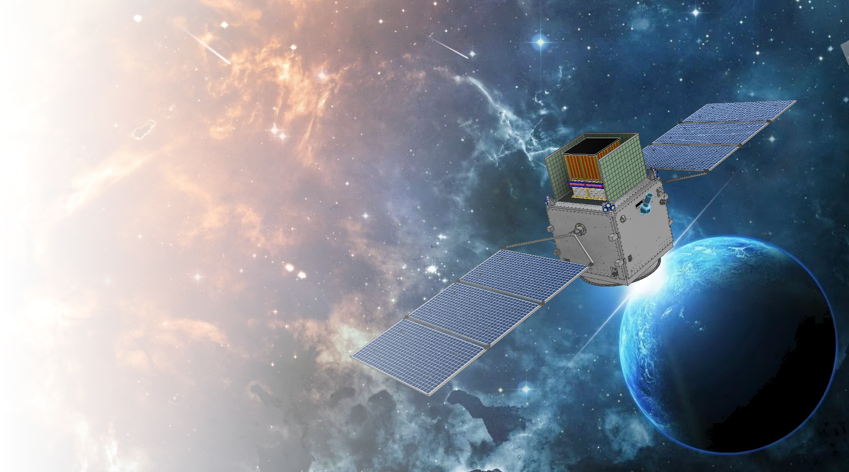

MeV Gamma-Ray Observatory
Wenxi Peng
pengwx@ihep.ac.cn
MeVGRO team
Institute of High Energy Physics, CAS
2025.04.02

Slide 2
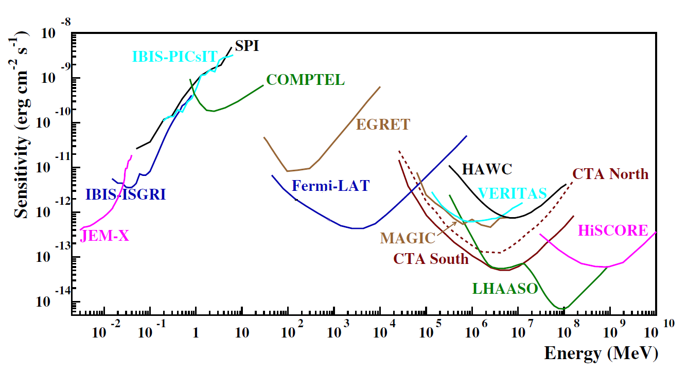
MeV Gamma Ray – An important window in multi-messenger observation
COSI, MASS, GECCO, MeGaT, AdEPT, SMILE, AMEGO, eAstrogam, MeVGRO，VLAST
MeV band (0.2-100MeV): sensitivity gap—"MeV Gap"
Many multi-messenger sources’ peak radiation power is expected to be in the MeV band: GRBs, blazars, pulsars …
MeV band is the region of gamma-ray nuclear lines, providing a unique and direct probe of the nuclear process in the universe

Slide 3
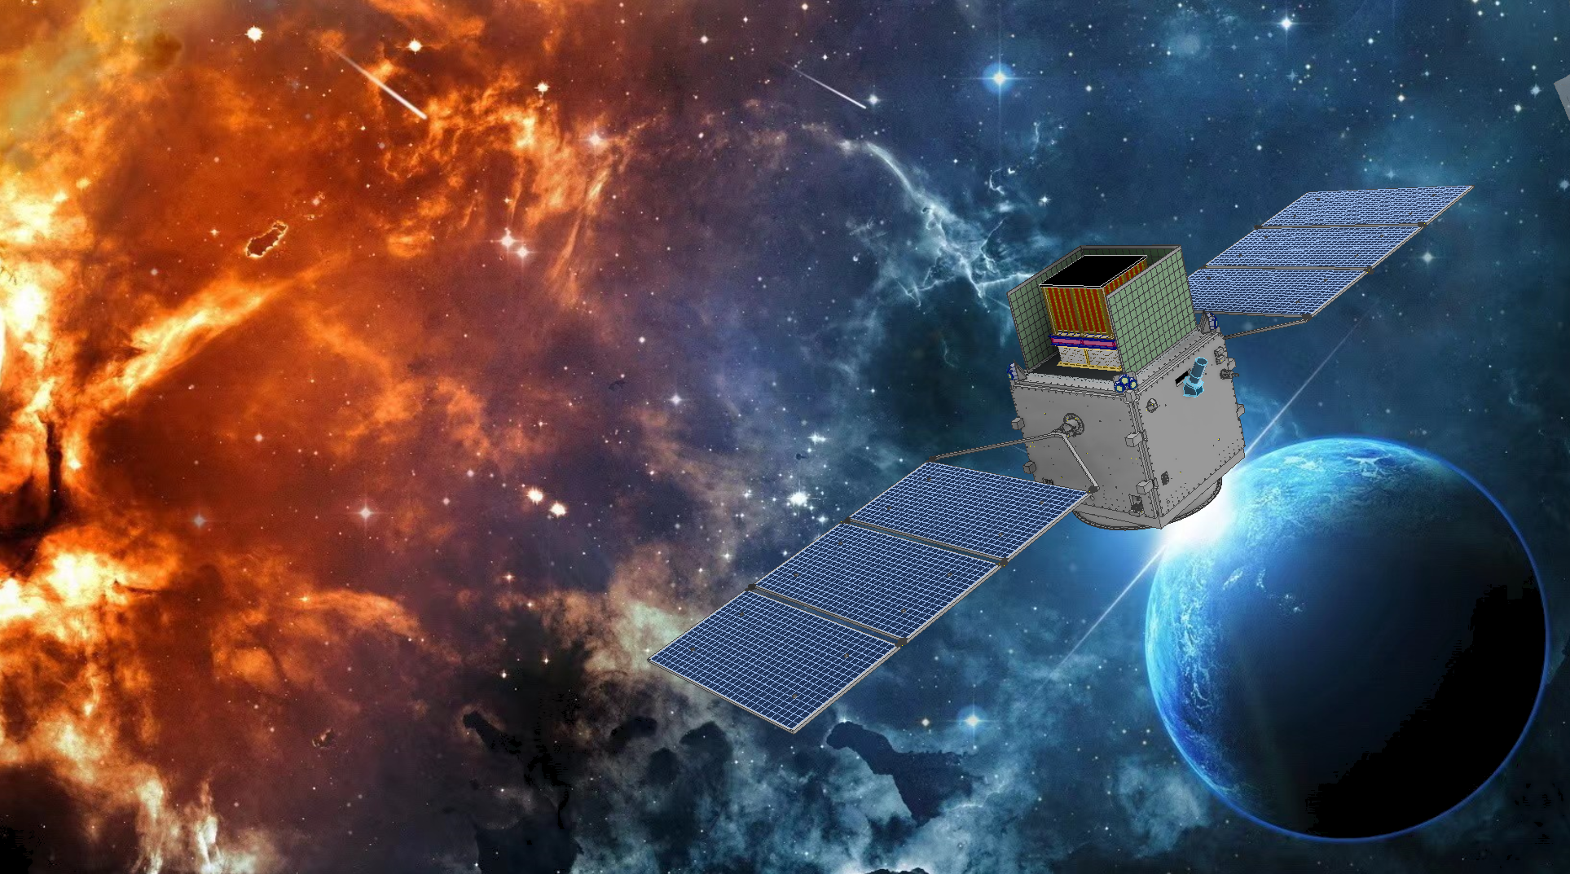

MeVGRO（女娲 NvWa）
(MeV Gamma-Ray Observatory)
Aim to observe 0.3~3MeV(100MeV) gamma-rays
-Energy : nuclear lines and continuum
-Imaging
-Timing
-Polarization(difficult)
MeV Gap
Proposed by IHEP to Chinese Academy of Sciences (CAS) in 2017.
Concept research funded by CAS (~2020)
Prototype development funded by NFSC and CNSA (~2024)
Proposed to CAS as a candidate mission for Intensive Study in 2022
Collaboration: THU, PMO, BUAA, Microsat, CAST …
goddess of Sky-patching
Sensitivity is expected to be improved by 1~2 orders of magnitude

Slide 4
MeVGRO Science
——probe the cosmic nuclear process and elemental evolution, explore the origin of cosmic rays, and the radiation mechanisms of extreme astrophysical events.
Core objectives
other objectives
Supernova Explosion Mechanisms
Heavy-element Formation and Evolution
Cosmic-ray Origin
New MeV sources: radiation mechanism
Diffusive MeV Background Emission
Transient source
Notes:
要讲清楚科学问题是什么，怎么解决，

Slide 5
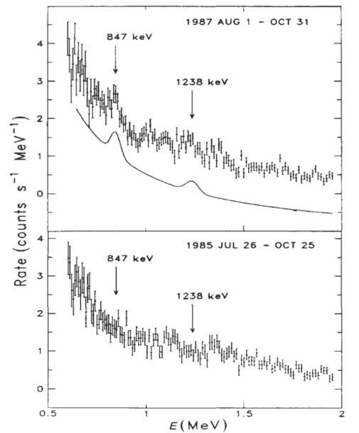
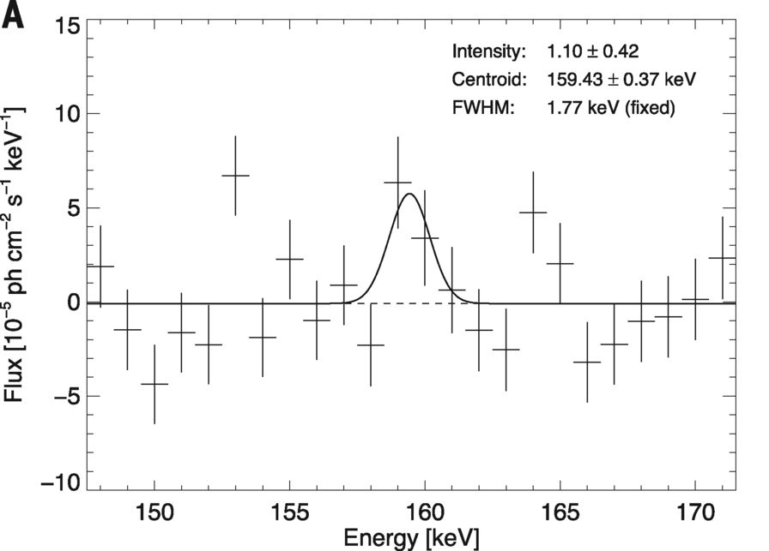
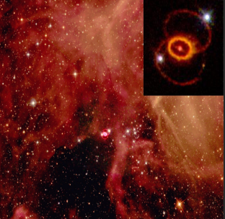
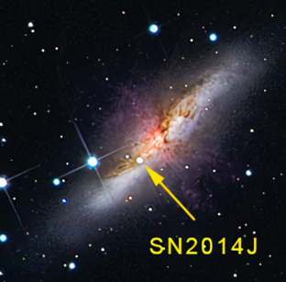
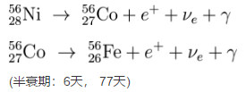
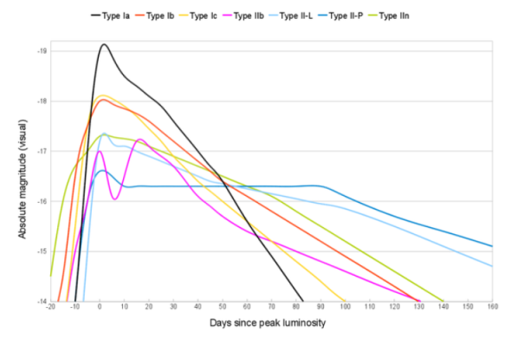
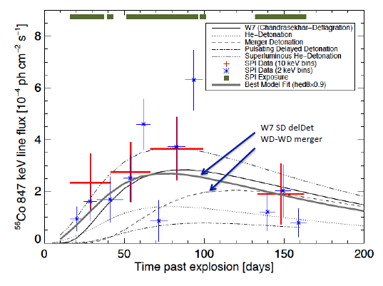
Supernova Explosion Mechanisms
Current Supernova (SN) observations:
Core-collapse (CCSNe)：SN1987A
Type Ia SN (SNIa)：SN2014J
Problems：only two samples，large error bars
——SNs: different types, different mass, metallicity of progenitor,
explosion mechanisms and surrounding environment will have different
light curve evolution.
SNIa: SN2014J
Matz et al. 1988
⁵⁶Ni decay chains power the light curves of SN →
⁵⁶Ni mass and distribution determines the light curve features
Diehl et al. 2014
CCSN: SN1987A
SNIa: SN2014J

Slide 6
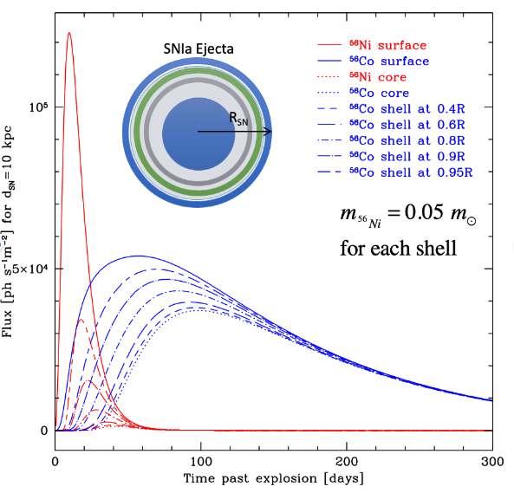
Supernova Explosion Mechanisms
The unique advantage of MeV gamma rays：
Directly detect the nuclear lines from the decays of radioisotopes ⁵⁶Ni，⁵⁶Co，⁴⁴Ti especially at early time, to constrain the progenitors and explosion models of SN
PRELIMINARY
MeVGRO Goals：
1) SNIa: MeVGRO can find SNIa in dusty starburst galaxies; detect ~1-2 SNIa/year out to a distance of 30 Mpc (~10 gamma-ray SNIa samples in 5 years); precisely measure ⁵⁶Ni mass for nearby SNIa – critical to determine optical light curve and test the standard candle model in cosmology
2) CCSN: ⁵⁶Ni and ⁵⁶Co lines detections from nearby galaxies
3) SN remnants: ⁴⁴Ti detections, search for unknow SNRs
PRELIMINARY
MeVGRO
~ 1-2 events/yr

Slide 7
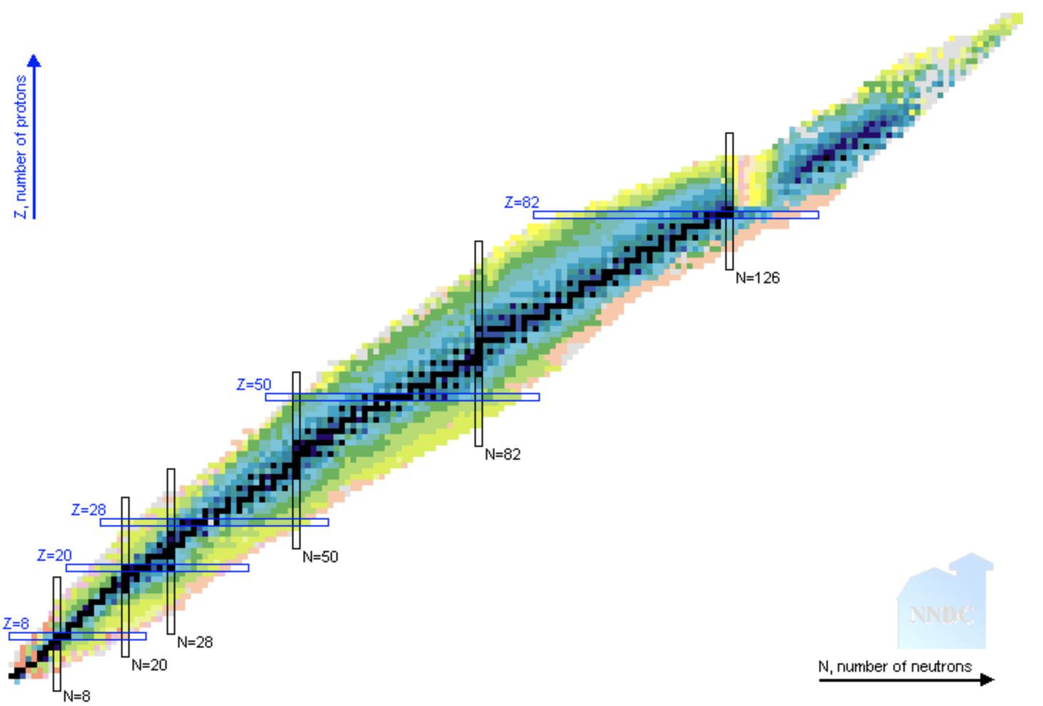
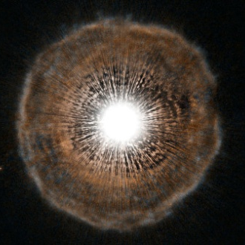
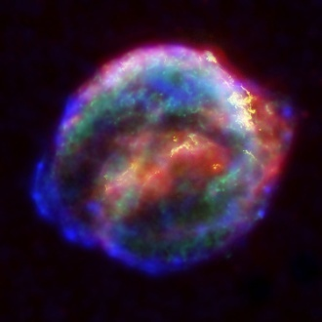
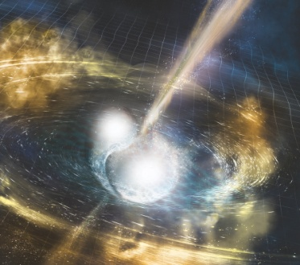
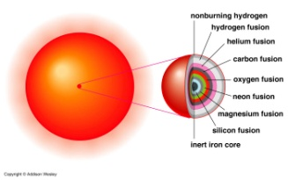
Heavy-element Formation and Evolution
Heavy elements:
the nucleosynthesis and origins has been a mystery for decades
Main processes—extreme environment:
1) Explosive nucleosynthesis -- SN
2) proton capture process (p process)--SNe;
3) neutron capture process:
s process (slow neutron capture)—AGB stars;
r process (rapid neutron capture) – neutron star mergers, SN …
Heavy element nucleosynthesis---extreme astrophysical events---multi-messenger sources: gamma rays, neutrinos, cosmic rays, etc
Asymptotic giant branch stars
uranium, thorium
gold,platinum
r process
supernovae
Credit: ESA/Hubble, NASA and H. Olofsson
europium
s process
Credit: NASA/ESA/JHU/R.Sankrit & W.Blair
Credit: NSF/LIGO/Sonoma State University/A. Simonnet
p process
neutron star mergers
iron group
Chart of Nuclides
Black squares：stable nuclei
Colored squares：unstable nuclei (radioactive isotopes) --- lighter/redder color, shorter half-lives
White region：No experimental data
Stellar fusion

Slide 8
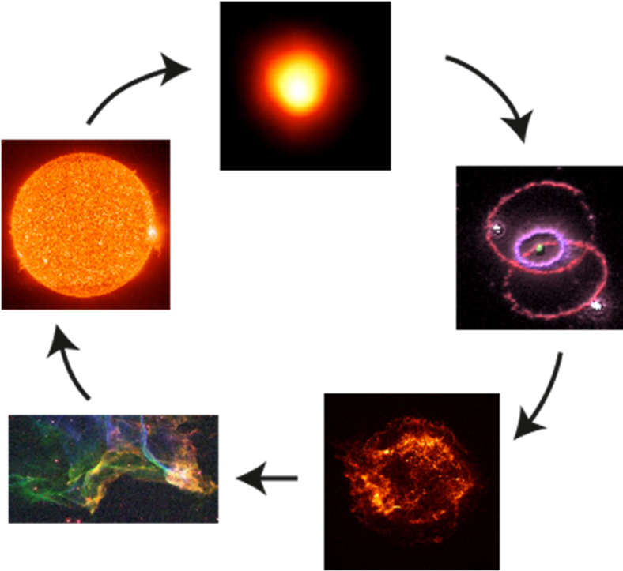
Heavy-element Formation and Evolution
Current research status：
In the nuclear astrophysics area, there is a long-time lack of gamma-ray nuclear line observations, the current research work about the relevant mechanisms still remain in the stage of theory and ground nuclear physics experiments (FRIB, FAIR, JUNA…)
MeV lines is the unique probe:
Abundant radioisotopes are formed during the heavy-element nucleosynthesis, and the MeV gamma-ray lines will be emitted directly from the decays of these isotopes
MeVGRO:
Provide a unique and direct probe of the individual nucleosynthesis sites (like SN, kilonova, nova, etc), to explore the nucleosynthesis and chemical evolution of heavy elements in the universe.

Slide 9
Heavy-element Formation and Evolution
Gamma-ray nuclear lines
Individual nucleosynthesis sites:
  Supernovae—: ⁵⁶Ni, ⁵⁶Co, ⁴⁴Sc…
  Novae: ⁷Be, ²²Na
  Neutron star mergers (KN): r process isotopes like ¹²⁵Sn…
  SN/KN remnants: ⁴⁴Ti, ⁶⁰Fe, ²⁶Al, ¹⁸²Hf…
Diffusive emission：
  511keV positron annihilation: multiple sources
  ⁶⁰Fe and ²⁶Al in Milky Way and nearby galaxies: stellar evolution, galaxy dynamics

Slide 10
MeV gamma-ray line detection and neutron star mergers（NSM）
Heavy-element Formation and Evolution
See L. Li's talk
Neutron star mergers（GW170817）: the only one confirmed r-process nucleosynthesis site by observations；
Many open questions still exist：What’s the exact contribution of NSM to the heavy elements in the universe? Are gold and heavier actinides are also synthesized in NSM?
MeV gamma line detections: NSM up to ~3Mpc；r-process radioisotopes in our Galaxy
PRELIMINARY
The gamma-ray spectra from a NSM at ~1 Mpc with different r-process elements synthesized

Slide 11
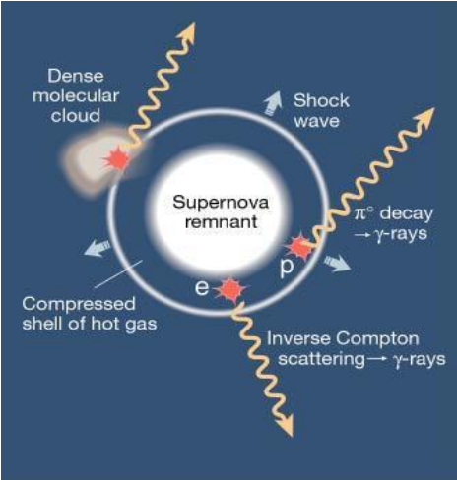
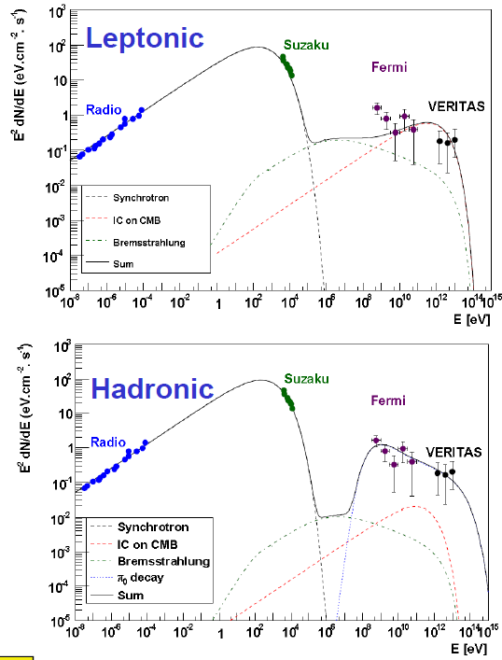
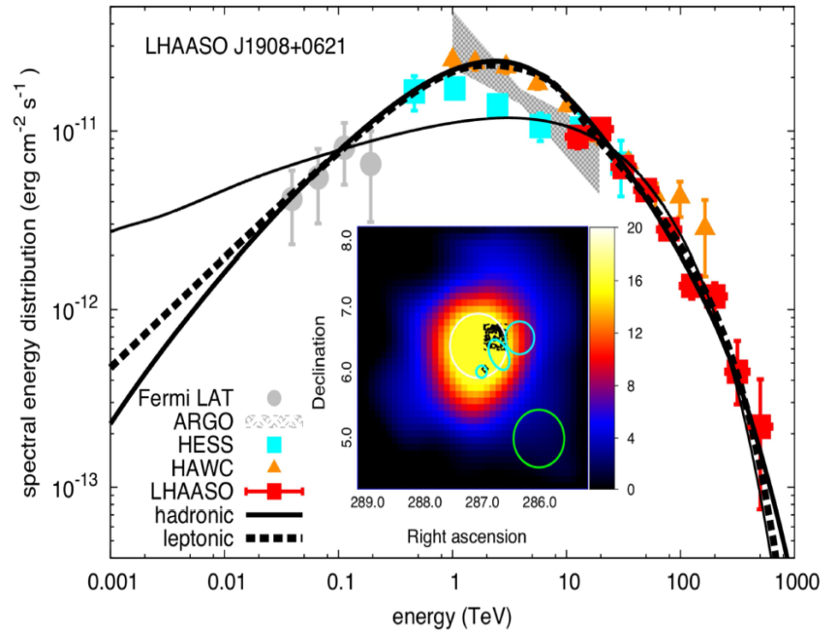
Cosmic-ray origin
Current data from X-ray and TeV gamma-ray can not decide which model is dominating→
MeV observation is crucial !
Trace the CRs acceleration sites, Identify the particle species
Possible source: SNRs, blazars/AGN jet, SN, starburst region…
Two models for gamma-ray emissions:
Hadron model: p-p interaction, p+p->π⁰->γγ (‘Pion Bump’ drop at <~100MeV), and proton-synchron radiation(10¹⁶eV in 10¹⁰G magnetic field; MeV polarization measurement); accompanied by neutrino emissions p+p-> π±-> ν: blazar TXS 0506+056 (Fermi-LAT/ IceCube)
Lepton model: interactions between electron and surrounding environment--- synchrotron radiation , inverse Compton scattering, bremsstrahlung
Fermi-LAT：Tycho

Slide 12
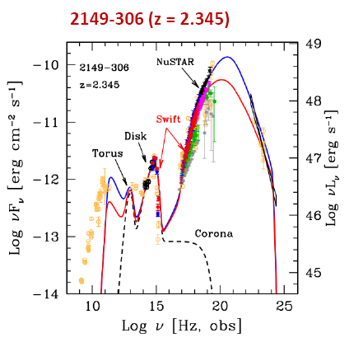
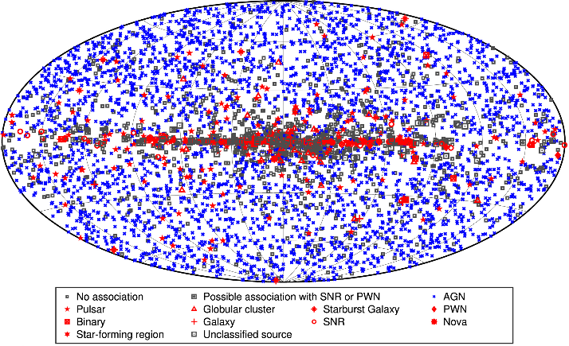
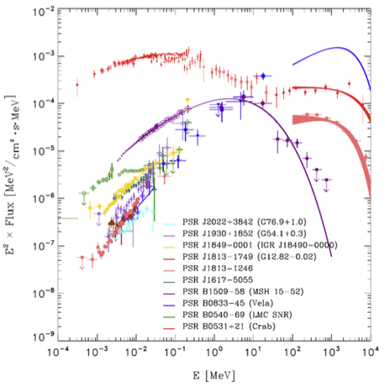
MeV Radiation and Compact Objects
Compact objects： Pulsar, Magnetar, Gamma-ray binaries, Micro-quasar, Blazar
MeV band contains key energy feature
1)Radiation and particle acceleration mechanism：lepton/hadron models
2)central engine to drive the Jet, relativistic outflow
3)the structure evolution of extreme magnetic field (polarization)
MeVGRO is expected to detect/identify several hundreds of new sources and high-energy transients with improved sensitivity
Pulsar radiation mechanism
Blazars
Fermi-LAT 4FGL-DR2
~5000 sources，~1/3 unidentified

Slide 13
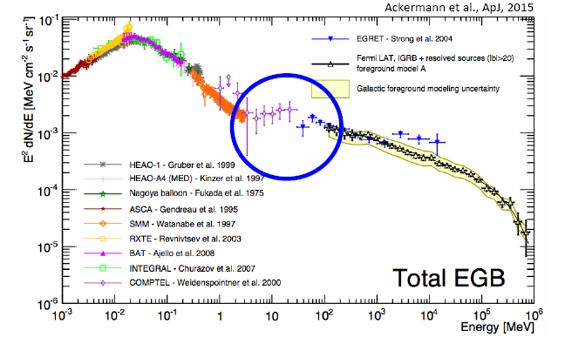
Diffusive MeV Background Emission
Galactic Background (GB)：
511keV origin
Fermi-Bubble
Galactic center emission
Dark matter WIMP?
Extragalactic Background (EGB):
the biggest uncertainty occur in 1-100 MeV band
Possible sources：
  SN
  Blazars/AGN
  Star-forming galaxies
  Dark matter—Hawking radiation from primordial blackhole (Ray et al. 2021, Coogan et al. 2021)

Slide 14
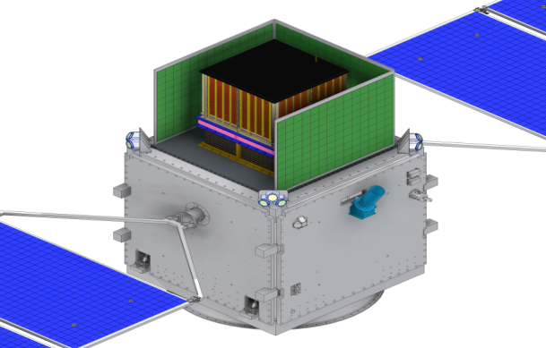
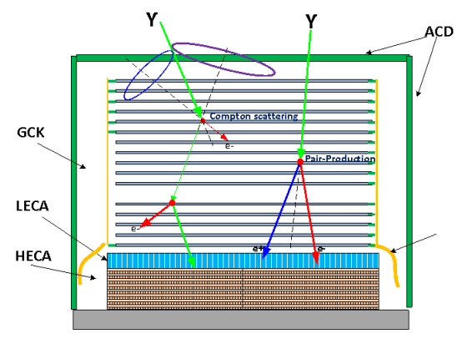
MeVGRO payloads
Gamma-ray converter tracker(GCK)
Low Energy Calorimeter(LECA)
3D CZT (2 layer)
Anti-concident Detector (ACD)
PSD+MAPMT, Veto for charge particles
50 layers DSSD
Converter and tracker
Precise energy measure, Compton camera
Cosmic burst monitor(CBM)
LaBr3+SiPM array
High Energy Calorimeter(HECA)
Scintillators(GAGG, CeBr3 or new materiall)
Absorber, high energy measure
Notes:
Cerium bromine(CeBr3)
Cerium-doped Gadolinium Aluminum Gallium Garnet(GAGG)

Slide 15
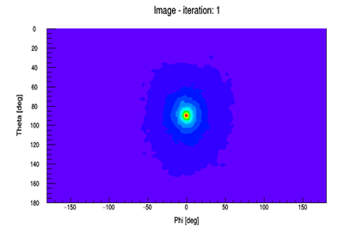
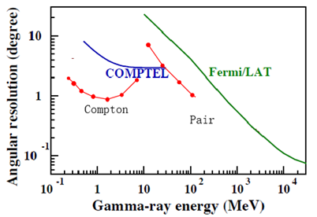
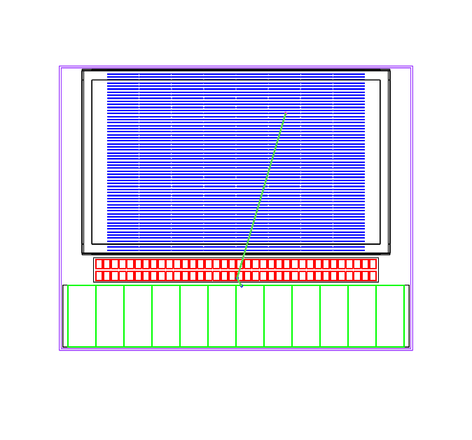
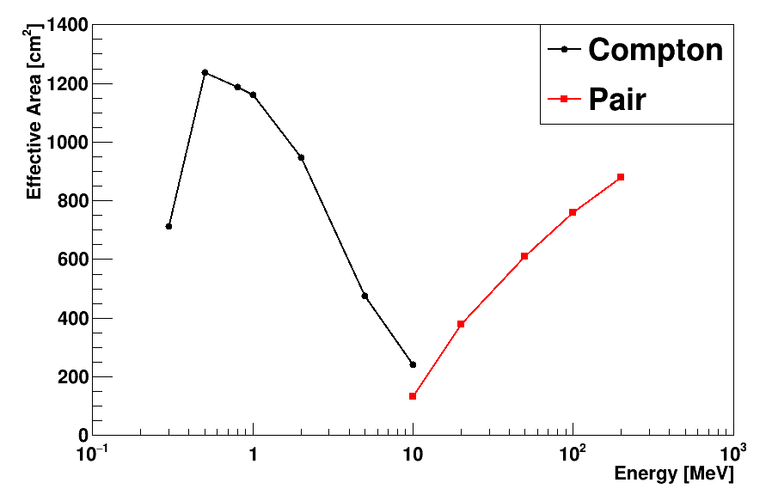
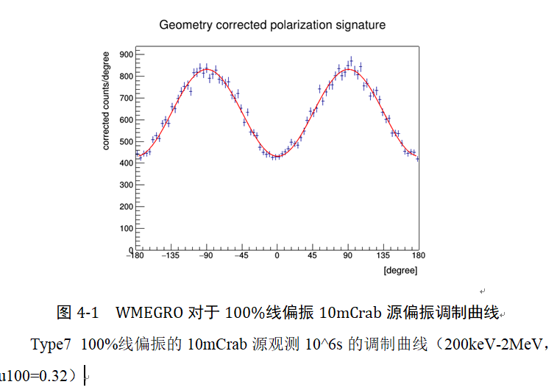
MeVGRO expected performance by simulation

Slide 16
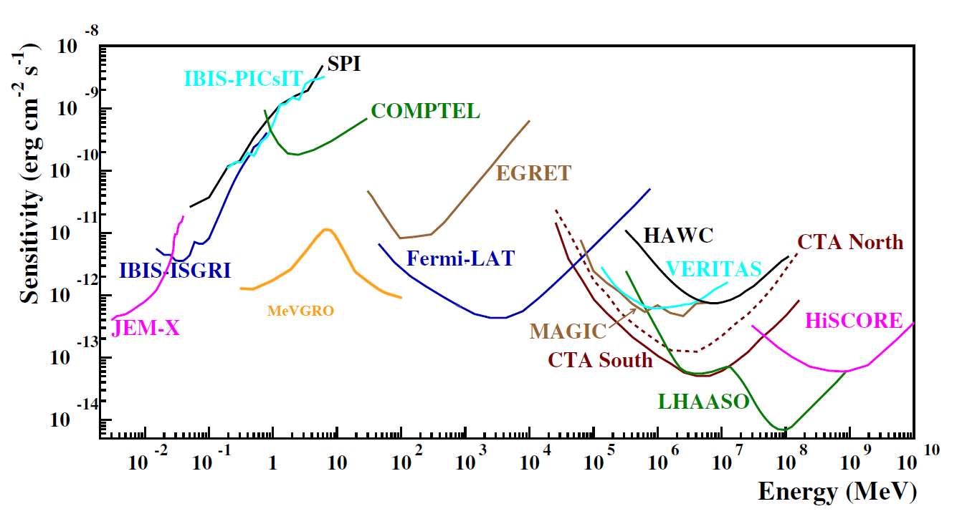
MeVGRO expected performance by simulation
 | Performance
Energy range | 0.3~3MeV(100MeV) (8keV~3MeV for CBM)
FOV | 3.6 sr (±65°), Imaging
Angular resolution | ~2°@1MeV, 100MeV (FWHM)
Effective area | ~1000cm²@1MeV，100MeV （3σ）
Energy resolution | <1%@662keV( by CZT)
Continuum Sensitivity | ~2.0E-12 erg/cm²/s@1MeV,100MeV (5yrs survey)
Lines sensitivity | ~2.48E-06 ph/cm²/s@0.511MeV ~9.56 E-7 ph/cm²/s@1.8MeV (5yrs survey)
MDP（polarization） | <15% (<2MeV) (10mCrab, 5yrs survey)
Energy (keV) | SPI (ph/cm²/s) | COSI (ph/cm²/s) | MeVGRO (ph/cm²/s)
511 | 5E-4 | 7.9E-6 | 2.48 E-6
1809 | 1E-4 | 1.70E-6 | 9.56 E-7

Slide 17
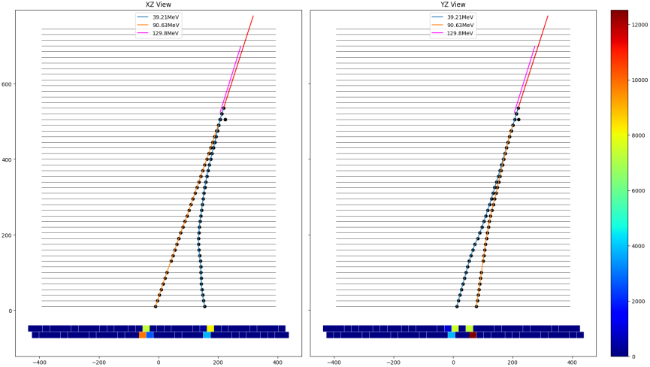
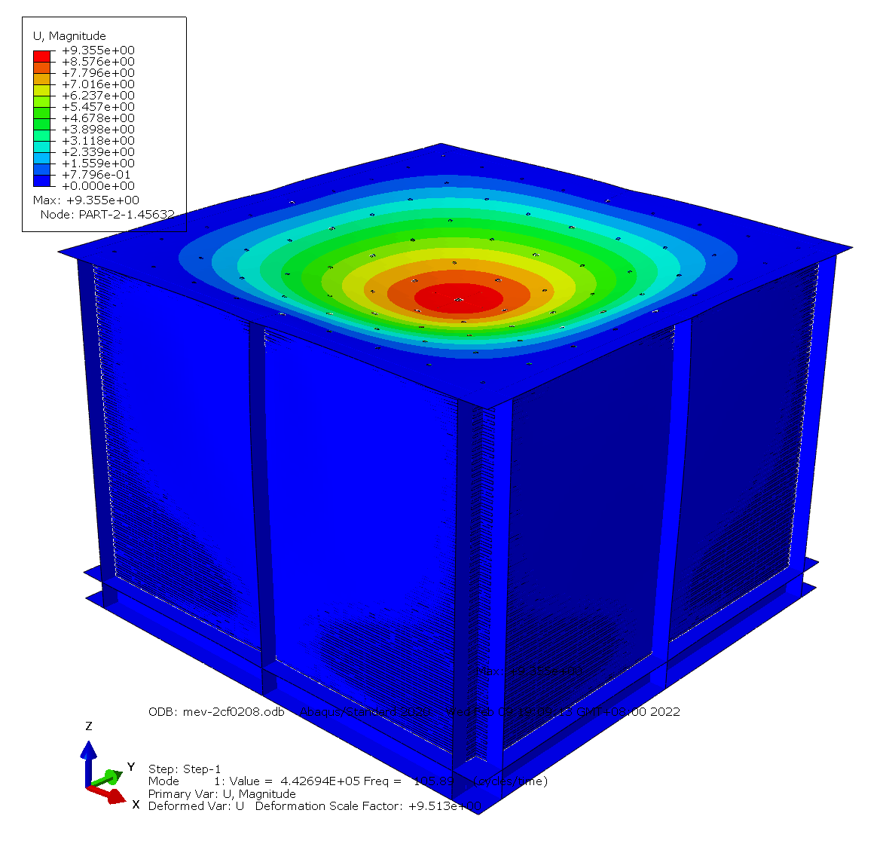
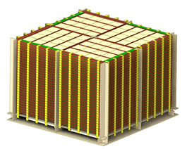
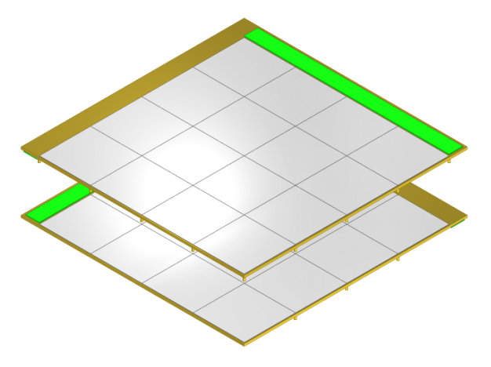
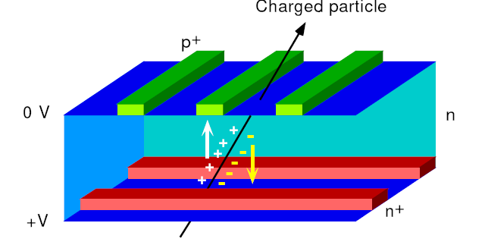
GCK (Gamma-ray Converter tracKer)
Multi-layers of double-sided Silicon strip detectors
Converter for Compton scattering and pair production
no passive material!
Particle Tracking
Energy measurement for high energy gamma-ray(>30MeV)
GCK
ECAL
Parameters | value
Energy range | 25keV~1MeV
Position resolution | X,Y≤0.5mm@662keV
Silicon tthickness | ≥ 500um
Layers | ≥50
Area | 80cm*80cm
thickness=30mm, Radiation length=0.32, Compton scattering cross-section~43%@1MeV

Slide 18
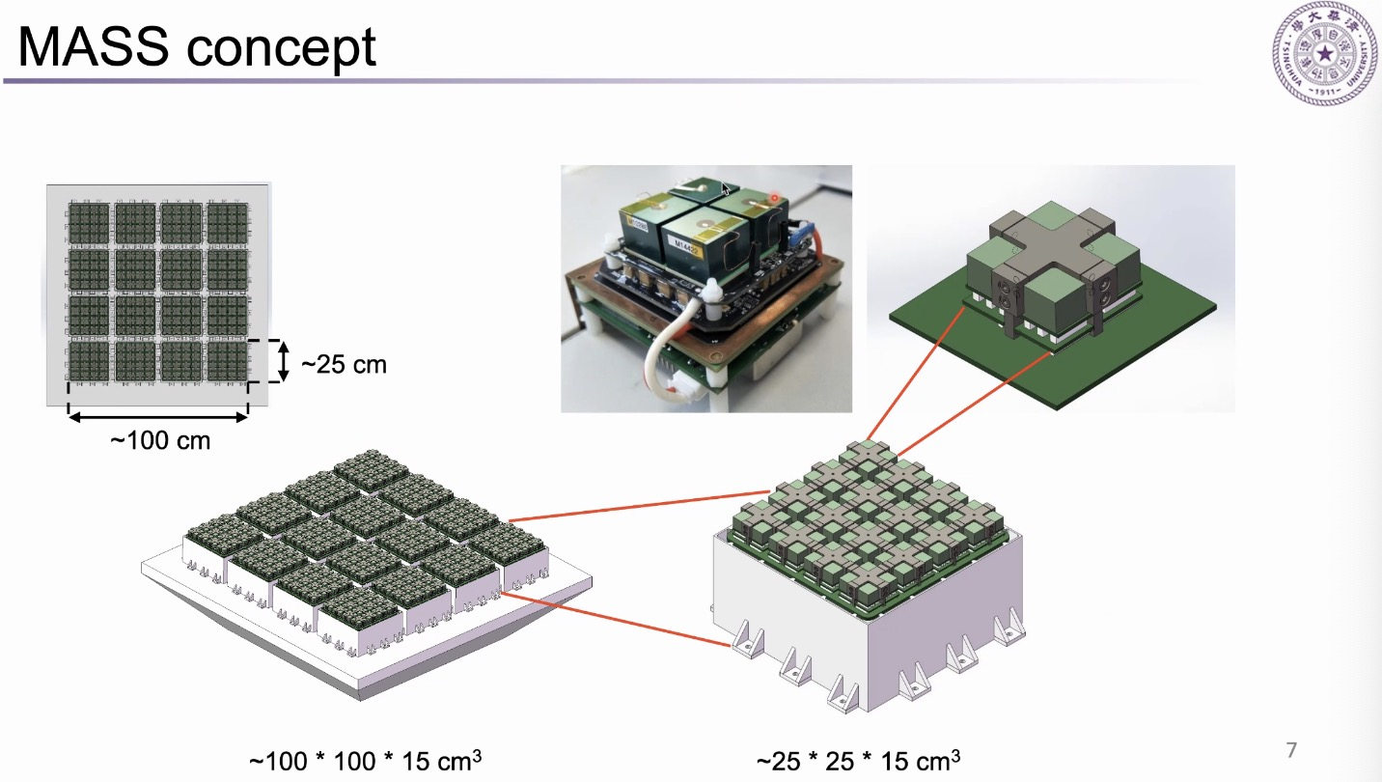
LECA (Low Energy CAlorimeter)
Two-layers of 3D CdZnTe detectors (3D pixel or 3D VFG CZT)
Room temperature with high energy resolution, comparable with HpGe！
Independent Compton camera
Low energy calorimeter worked for GCK.
Parameters | value
Energy range | 50keV~3MeV（100MeV）
Energy resolution | <1%@662keV
Position resolution | X,Y,Z≤2mm@662keV
Thickness | 1.5cm/layer
Layers | 2
Area | 100cm*100cm

Slide 19
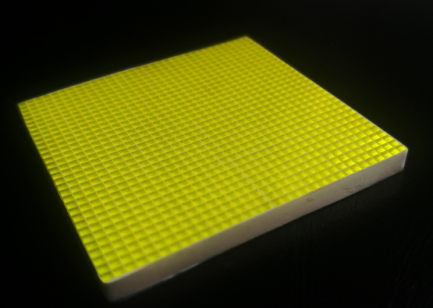
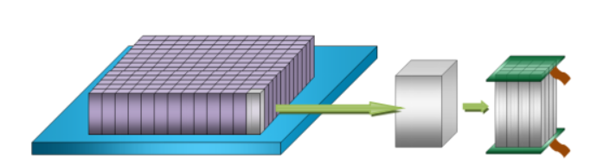
HECA (High Energy CAlorimeter)
Several-layers of Scintillator detectors
(GAGG, CeBr3 or new material with high energy resolution)
Absorber for gamma-rays penetrating the LECA (92% @2MeV)
Dual-end readout by SiPM arrays to achieve 3D position sensitivity.
Parameters | value
Energy range | 50keV~3MeV（100MeV）
Energy resolution | <10%@662keV
Position resolution | X,Y,Z≤5mm@662keV
Thickness | 4 cm/layer
Layers | >4
Area | 100cm*100cm

Slide 20
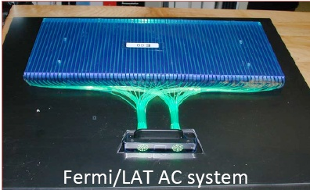
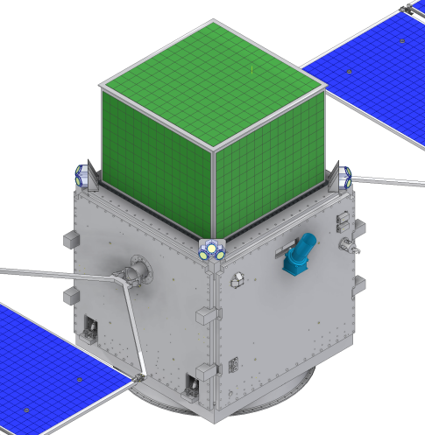
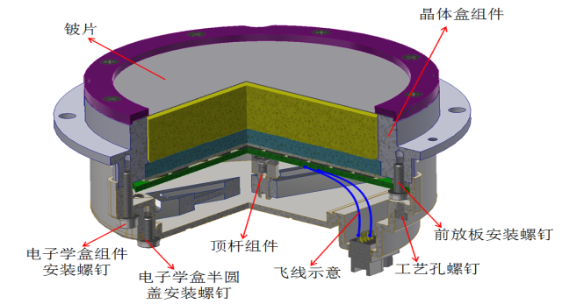
ACD(Anti-coincident Detector)
Plastic scintillator pad+ WLSF+MAPMT
Veto efficiency >99.9%
Trigger delay<100ns
CBM(Cosmic- Burst Monitor)
LaBr3+SiPM(SDD)(GECAM)
 | Performance
Energy range | 8keV～3MeV
Efficiency | >40 cm²
Dead time | <5 μs
Energy resolution | < 18%@59.5 keV

Slide 21
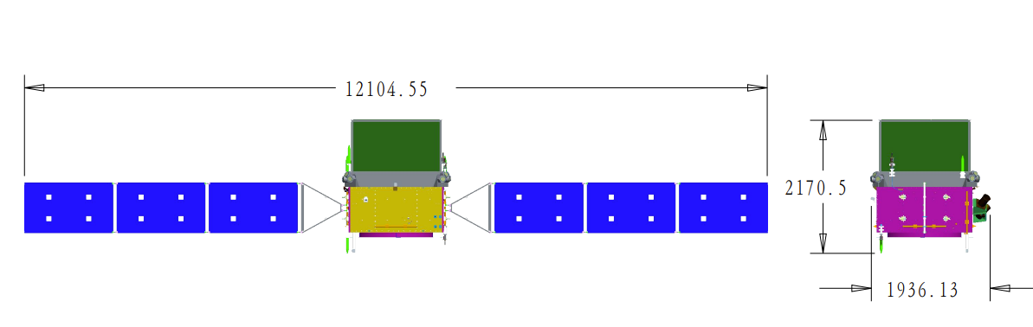
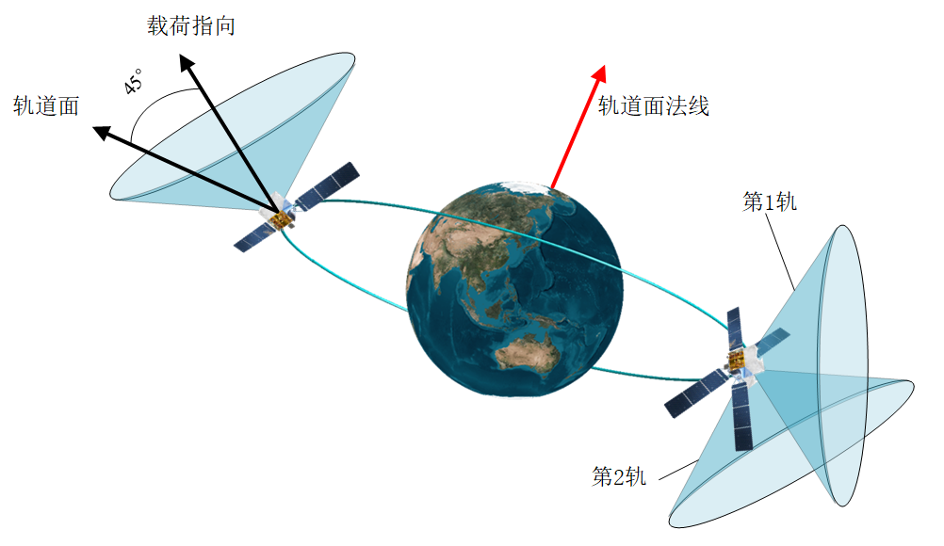
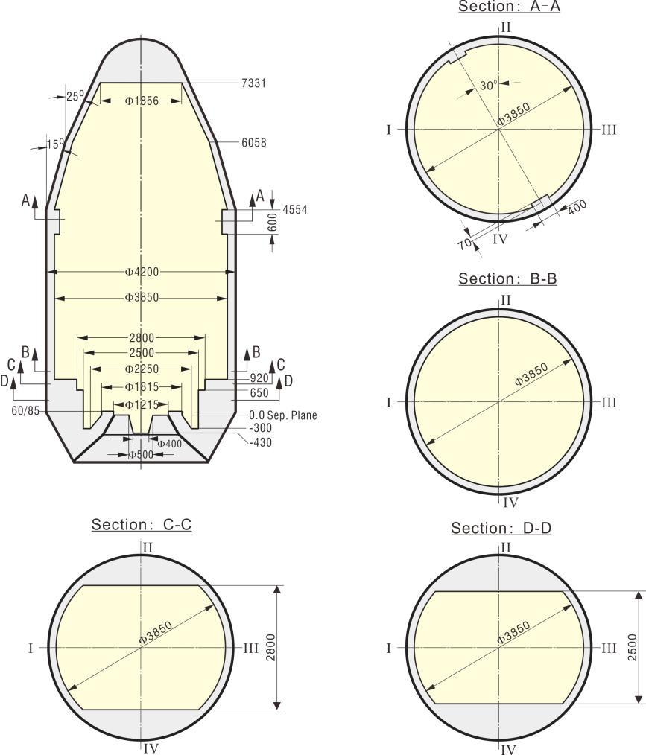
MeVGRO mission
Orbit | 550km in 2.5°inclination angle
Total Mass | 2200kg
Total power consumption | 2kW
Overall size | 1.5*1.5*1.5m
Observing mode | Scanning Survey (~7times/day) Pointing, TOO
Data downlink | ~20GB/day
Lifetime | 5 yrs
Launch vehicle | CZ-8

Slide 22
MeVGRO Hardware team
Payload | Team
GCK | IHEP | DSSD+VATA460 readout | Domestic DSSD&ASIC | Gong Ke, Qiao rui
 | PMO |  | DSSD assembly | Ma Tao, Zhang Yongqiang
LECA(CZT) | THU | Domestic ASIC &Electronics |  | Zeng Ming
 | IHEP | Domestic 3D-CZT |  | Jiang Weichun, Du Yuanyuan
HECA(Scintillator) | BUAA.. |  |  | Sun Baohua
ACD

Slide 23
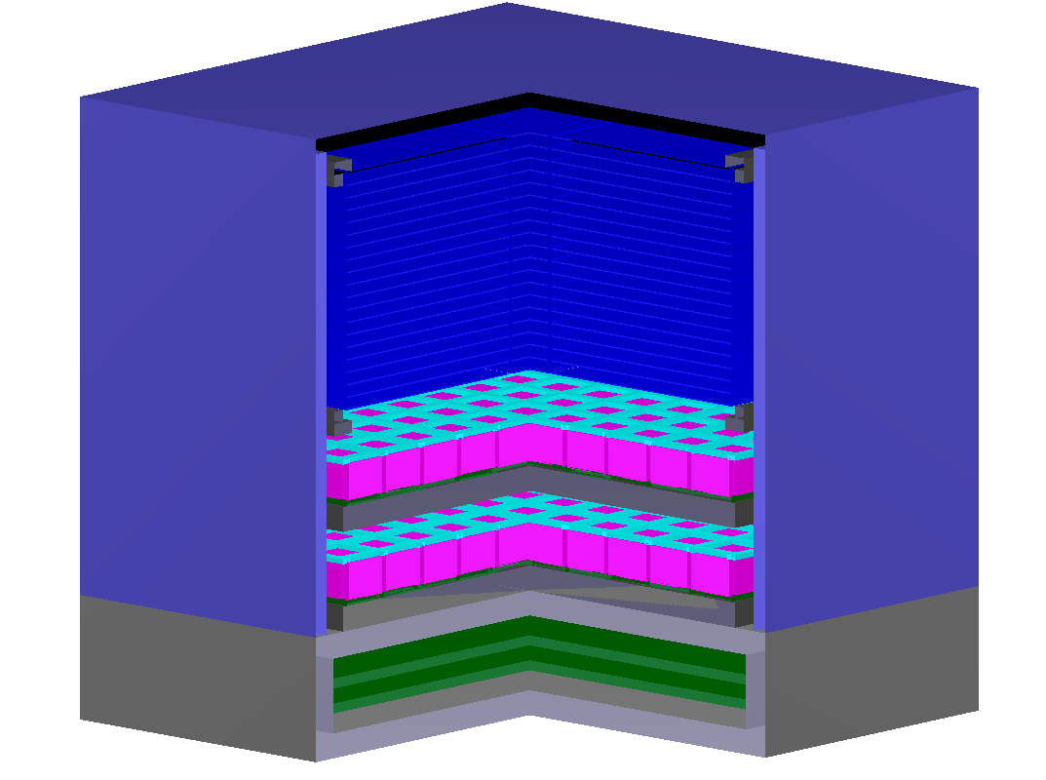
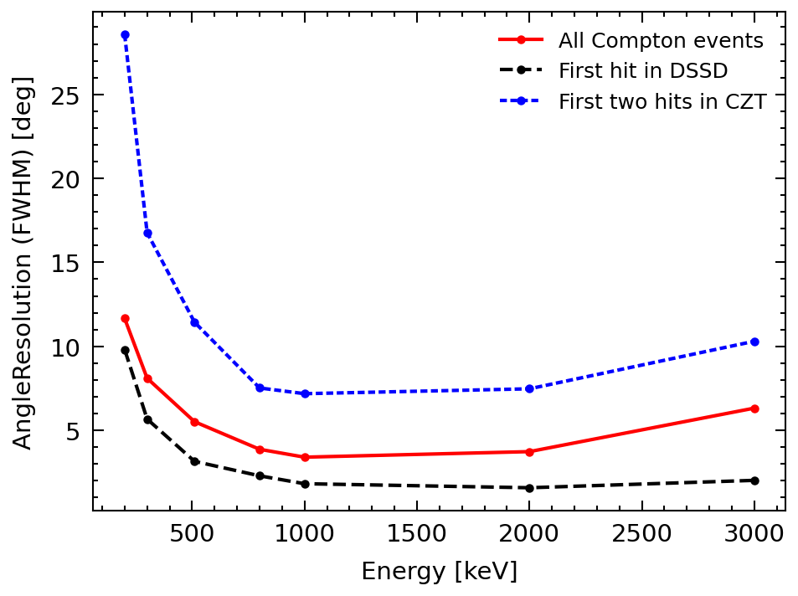
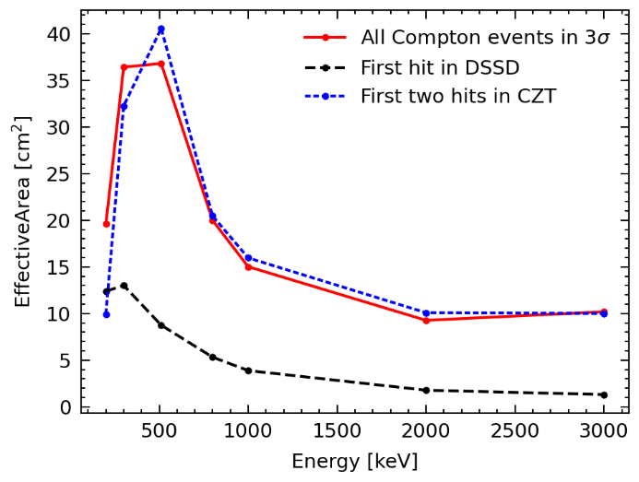
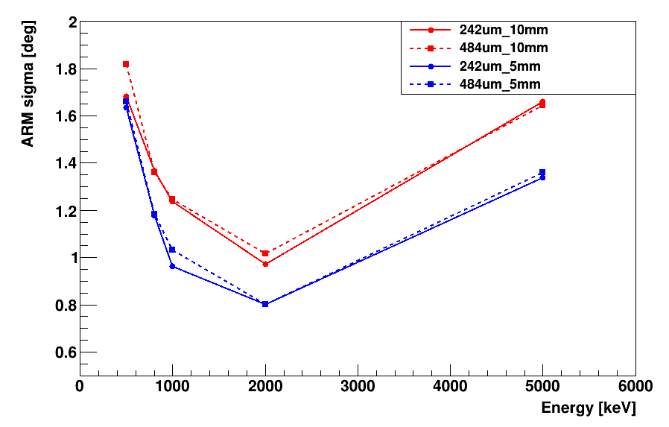
MeVGRO Prototype
GCK: 2*2 DSSD （20cm*20cm）
10layers
LECA: 1 layers (8*8) CZT
HECA: 1 layers scintillator array

Slide 24
Thanks!

