Slide 1
CZT Detectors for MeV Astronomy
Ming Zeng, Xutao Zheng, Hao Chang, Jiahuan Zhu
Tsinghua University
MeV Mission Workshop @IHEP: Preparing Next-Generation Astrophysics in the MeV Window 2025-09-17

Slide 2
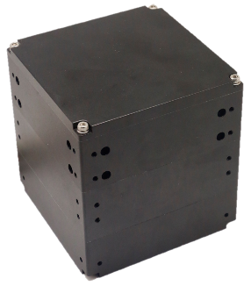
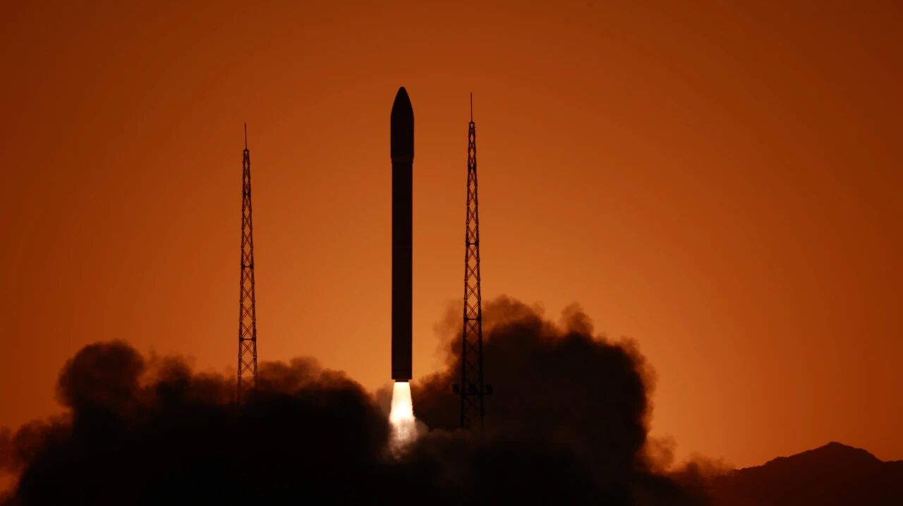
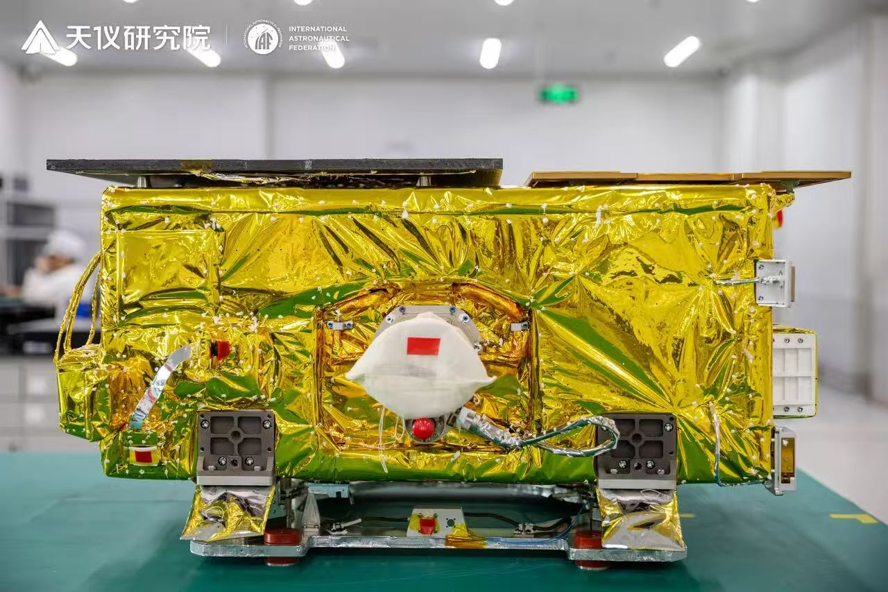
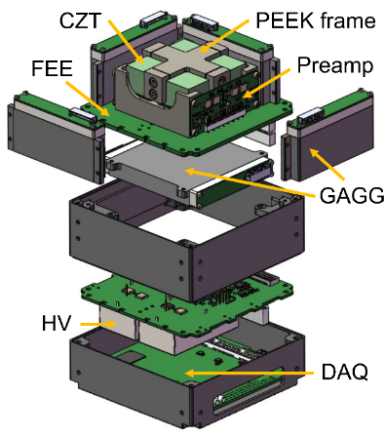
News about MASS-Cube
MASS-Cube
The first MASS-Cube payload was launched on Sep. 5th, 2025
Equipped with 4 pixelated CZT detectors, 2×2×1.5 cm³ each
Now on debugging and testing
Demonstrate pixelated CZT in space, increase Technology Readiness Level to TRL 6 - 7
Act as the pathfinder for MASS, MeVGRO, and also other CZT missions

Slide 3
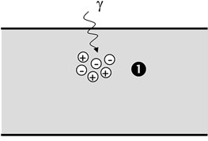
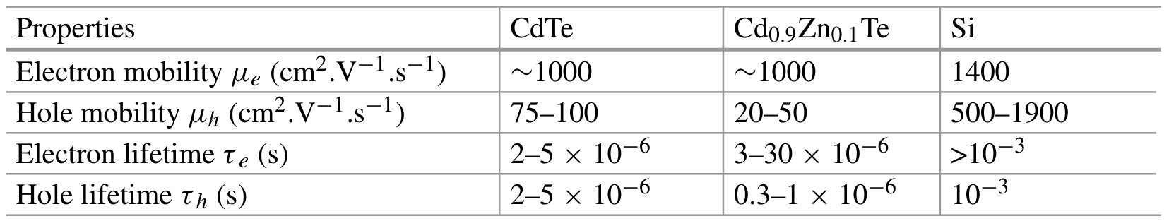
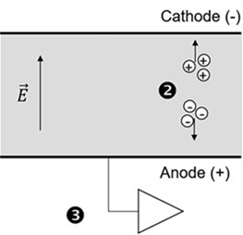
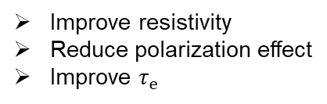
The room temperature semiconductor: CdZnTe
Transport properties at 300K (A. Meuris et al. 2023)
CZT
Improve resistivity
Reduce polarization effect
Improve $τ_{e}$
Severe hole capture
Single-polarity charge sensing technique, e.g. Frisch grid, coplanar, pixelated anode
Depth sensing technique and charge loss correction
~ kV/cm
CZT
Electron capture
3D CZT

Slide 4
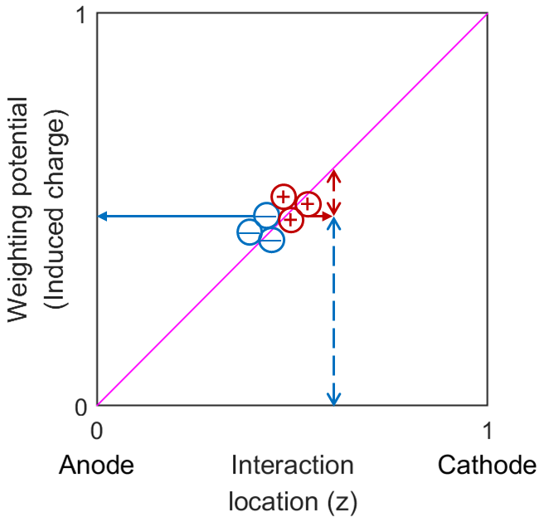
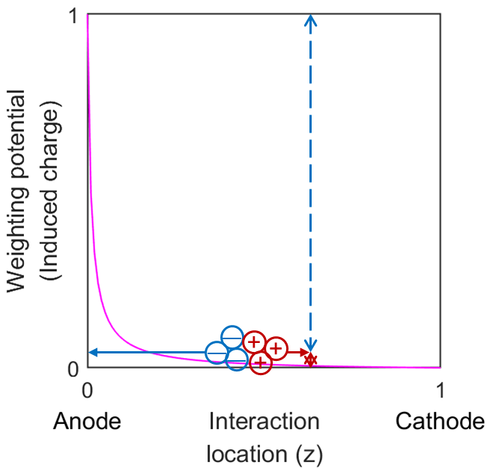




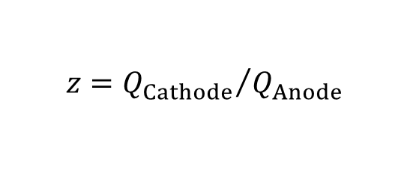


Readout and event reconstruction
Planar cathode
-HV
Waveform (Q_{Cathode}, t₀)
$$Q_{Cathode}=Ne∙z$$
$$Q_{Holes}$$
Planar cathode
$$Q_{Electrons}$$
CZT
Pixelated anode
XY position, Q_{Anode}, t
$$z={Q_{Cathode}}/{Q_{Anode}}$$
Pixelated anode
The anode pixel provides the x and y positions
The z position is derived from the cathode/anode charge ratio and/or the drift time
$$Q_{Anode} ≈Ne$$
$$Q_{Electrons}$$
$$Q_{Holes}$$
The "Small-Pixel Effect" governed by the Shockley-Ramo theorem.

Slide 5
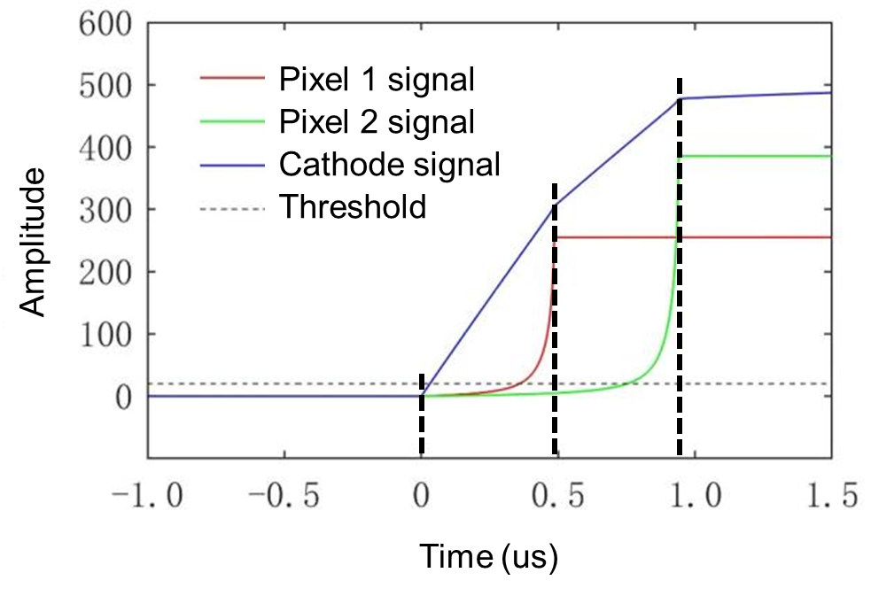
Readout and event reconstruction
-HV
Waveform (Q_{Cathode}, t₀)
Planar cathode
CZT
Pixelated anode
XY position, Q_{Anode}, t
The anode pixel provides the x and y positions
The z position is derived from the cathode/anode charge ratio and/or the drift time
Drift time
Depth reconstruction and depth correction of charge loss are the keys to achieve excellent energy resolution

Slide 6
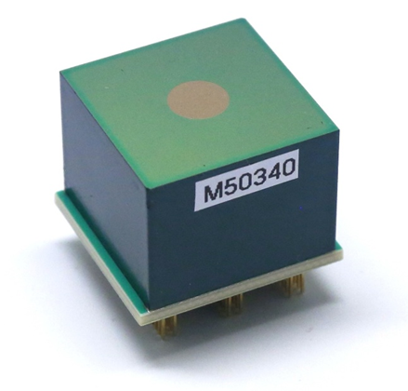
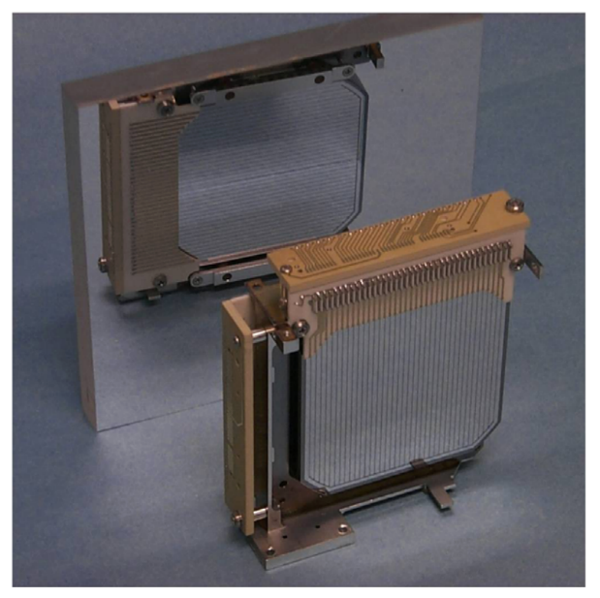
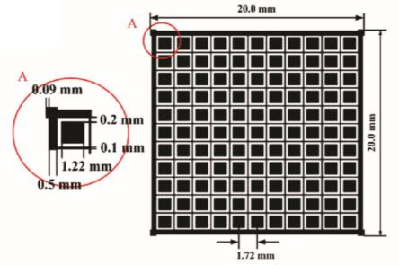
3D position sensitive pixelated CZT detectors
2 cm
Planar cathode
Compared with double-sided strip HPGe
1.5 cm
1.5 cm
Pixelated anode + Grid
Orthogonal strips
8 cm
CZT unit from Redlen
2×2×1.5 cm³
4 cm available
11×11 pixels
Pixel pitch = 1.72 mm
Comparable position resolution
Comparable energy resolution
Needs cryocooler / cryostat
Competing technology pathways, that both long-term supported by the DoE.
Notes:
CZT: XY 1.72mm, Z ~ 0.6mm, 0.6% ~ 1% @662 keV
HPGe: XY 1.162mm or 2mm, Z ~ 0.5mm, 0.8% @662 keV

Slide 7
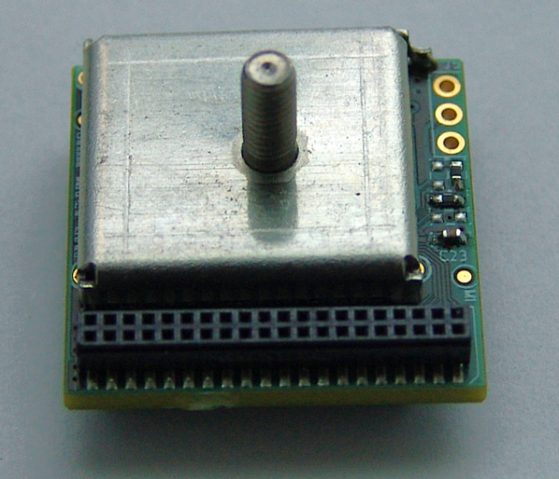
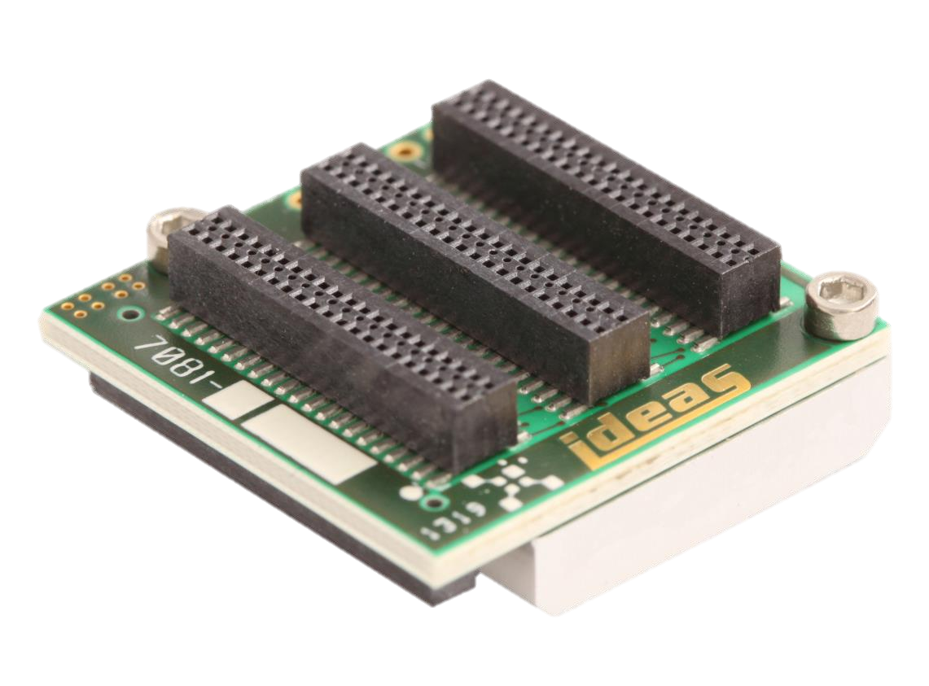
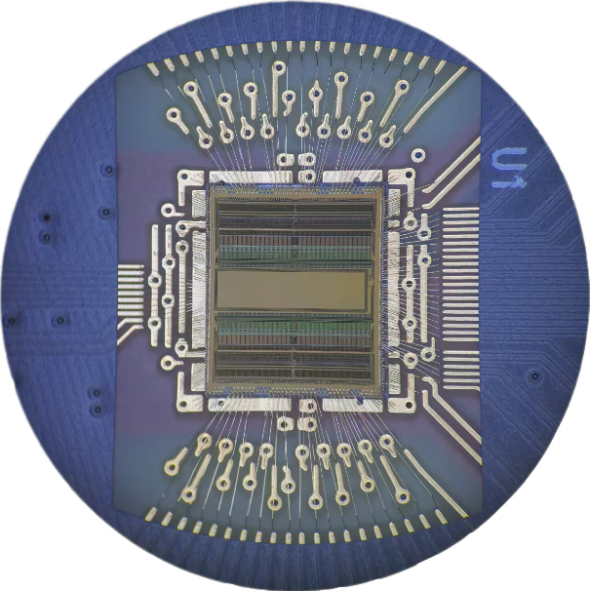
Readout ASICs for pixelated CZT
VAS_UM2.3/TAT4 (obsolete)
IDEAS, Norway
Analog readout
+
Analog output
||
Amplitude & trigger time
for each pixel
GDS-10 (in production)
IDEAS, Norway
Waveform sampling
QingTai (under development)
Microparity, China
Analog readout
+
Integrated ADC/TDC
||
Fully digital output

Slide 8
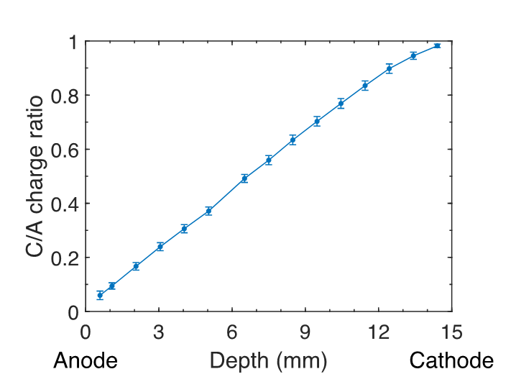
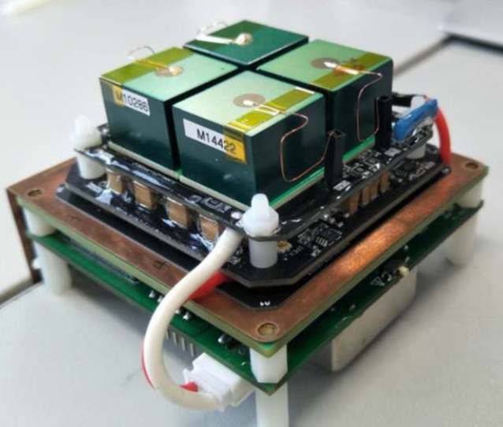
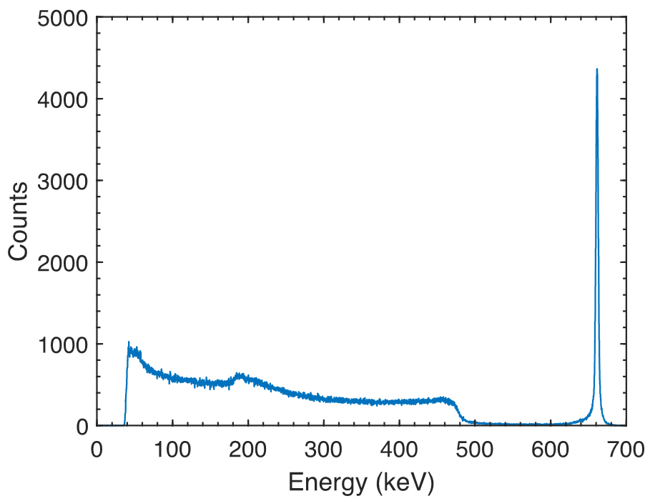
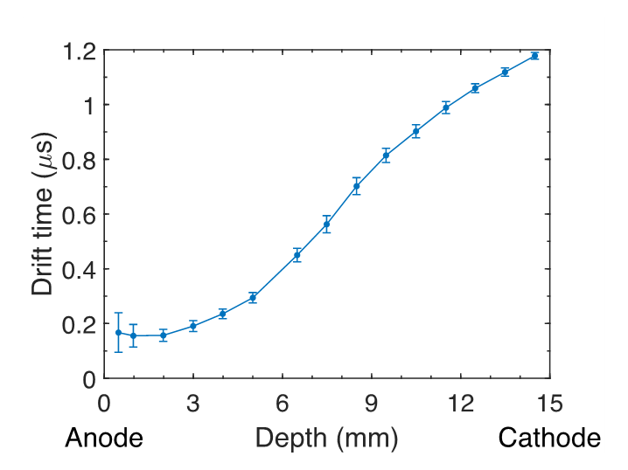
Performance
FWHM ~ 0.6% @662 keV
Hand-hold Compton camera prototype
(Yang et al. 2020)
Depth resolution (FWHM) ~0.6 mm →

Slide 9
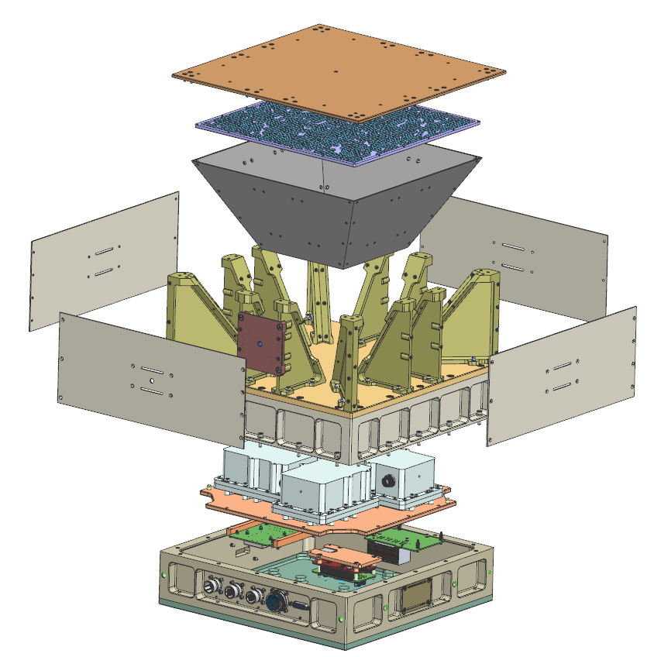
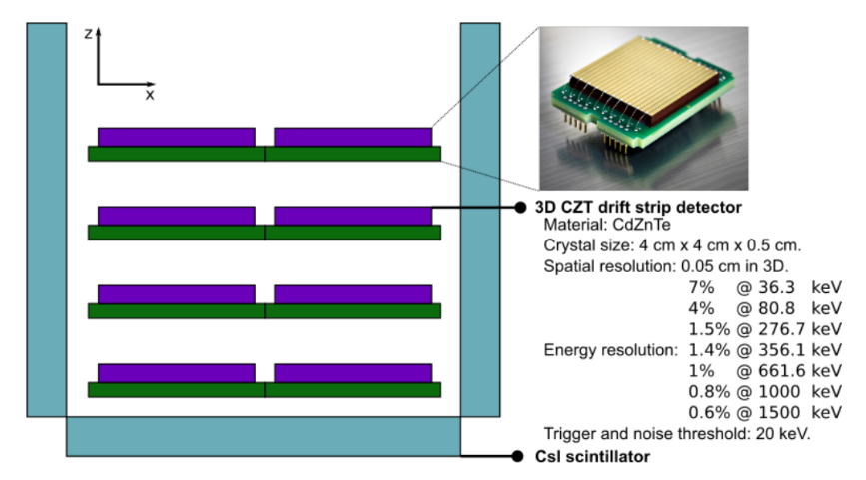
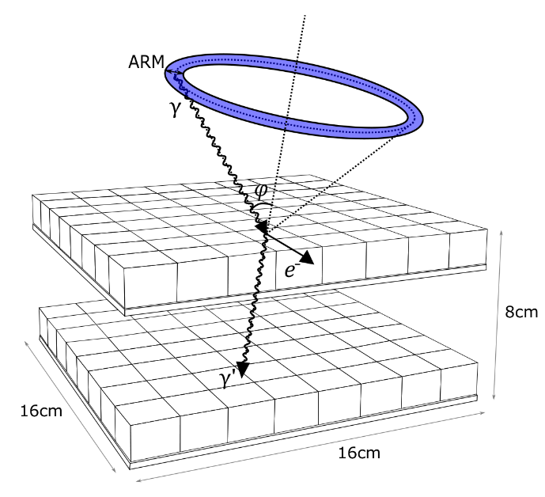
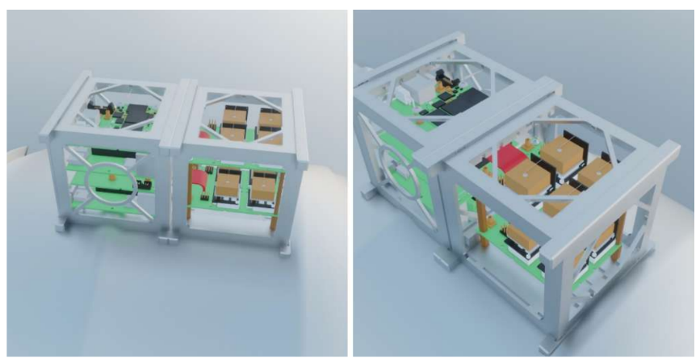
Compton telescope proposals based on (entirely) CZT
TERI
Pixelated CZT (+ Coded Mask)
Pixel pitch 1.72 mm
1.3% (FWHM) @662 keV
Launched to ISS on 2025.04.21
DTU CubeSat proposal
(Owe et al. 2024)
TERI (Shy et al. 2024)
MeVCube
Pixelated CZT
Pixel pitch 2.45 mm
2.8% (FWHM) @662 keV
6U CubeSat concept
HKU CubeSat proposal
(Kuijper et al. 2024)
MeVCube concept design
(Lucchetta et al. 2022)

Slide 10
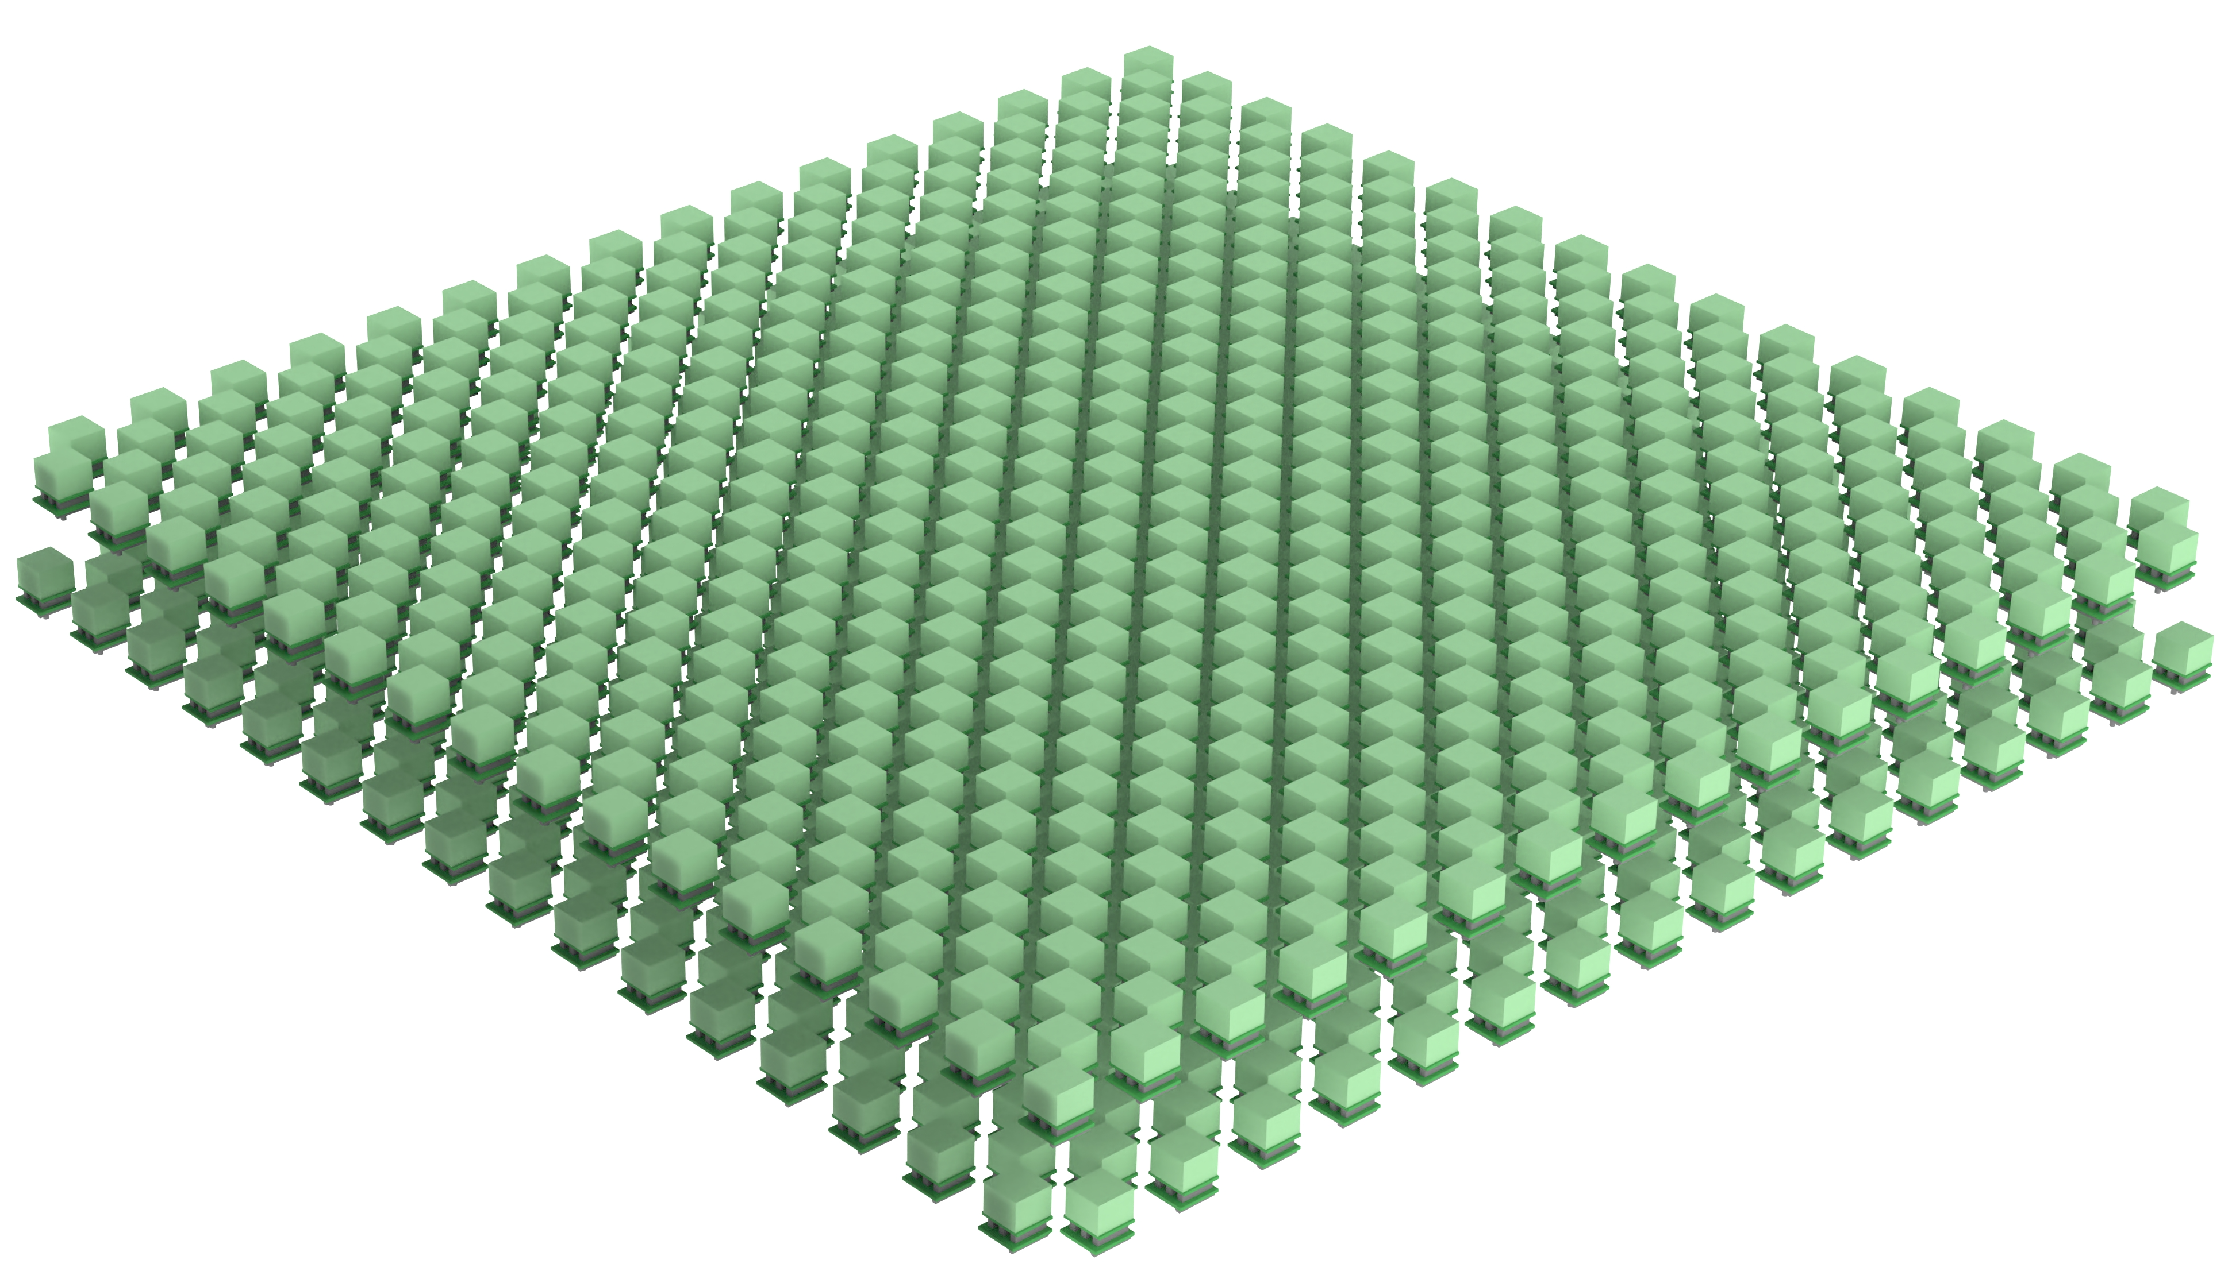
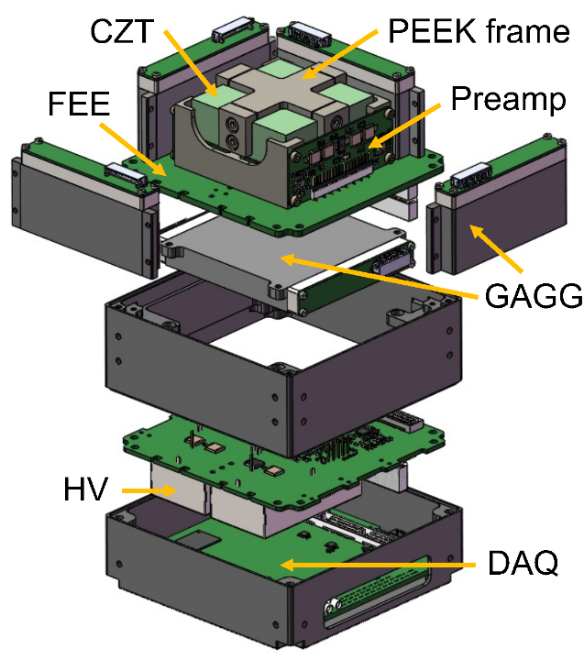
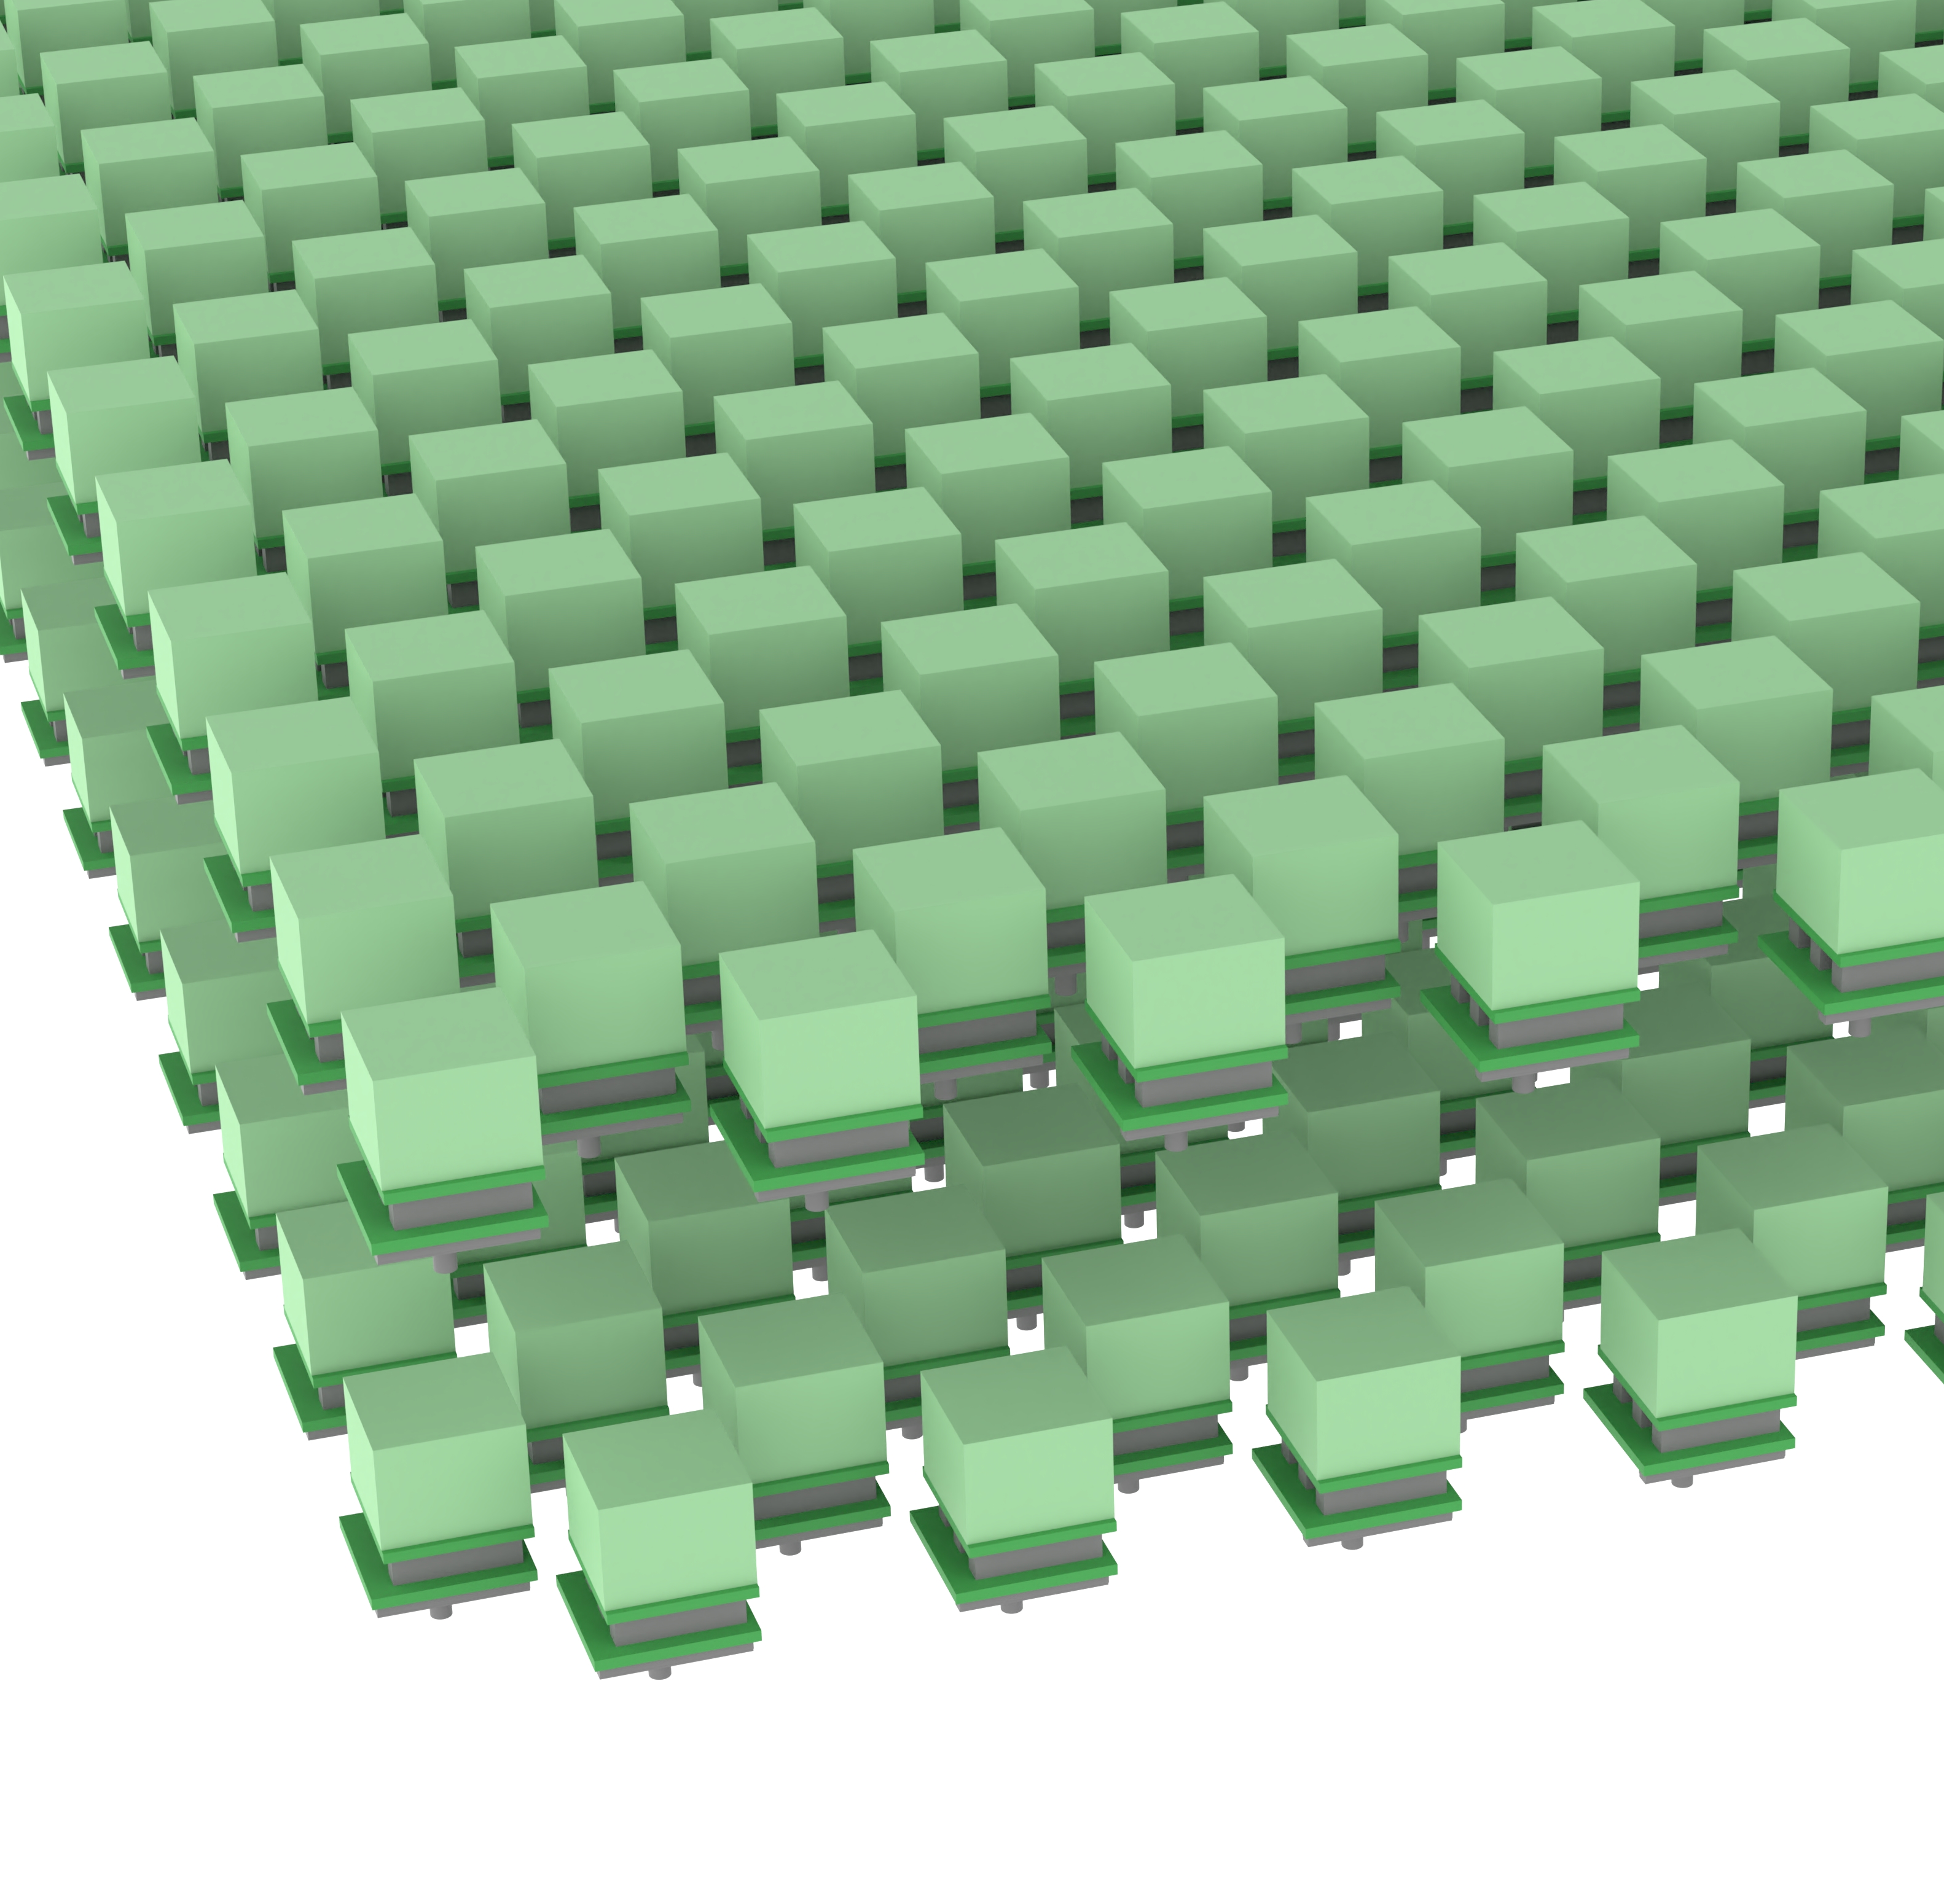
The MASS mission concept
32×16×2 = 1024 CZT Units (4096 cm²)
See https://doi.org/10.1007/s10686-024-09920-4
MASS-Cube
CubeSat pathfinder, also CubeSat constellation mission
Double layer chessboard layout, maximum effective area while improve ARM

Slide 11
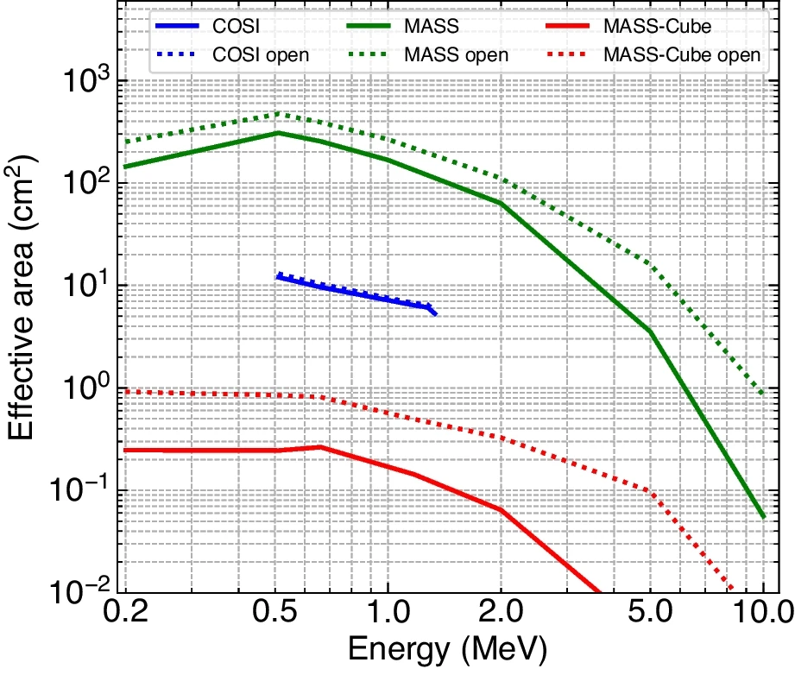
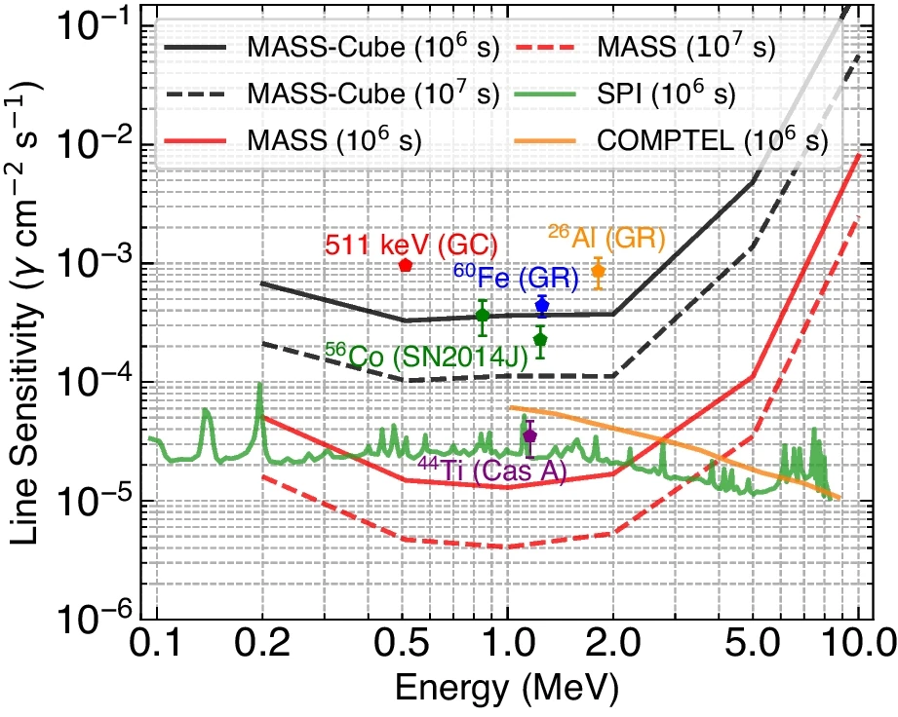
Expected performance — MASS & single MASS-Cube
20 – 50 times
Solid & Dashed:
Energy within ±2𝜎；Compton scattering angle 0–180◦；
Solid only First two interactions ≥ 5 mm, and any two interactions ≥ 0.3 cm.

Slide 12
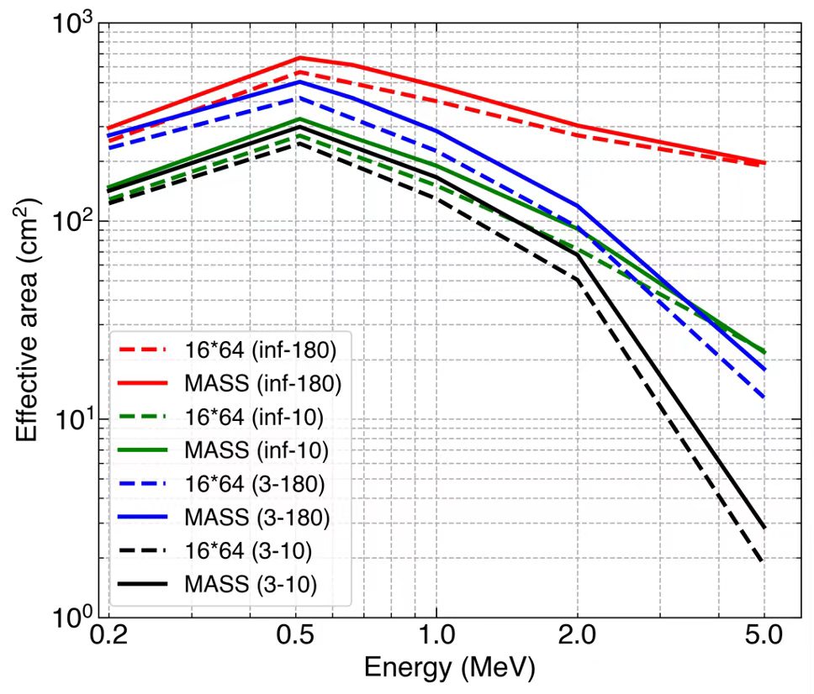
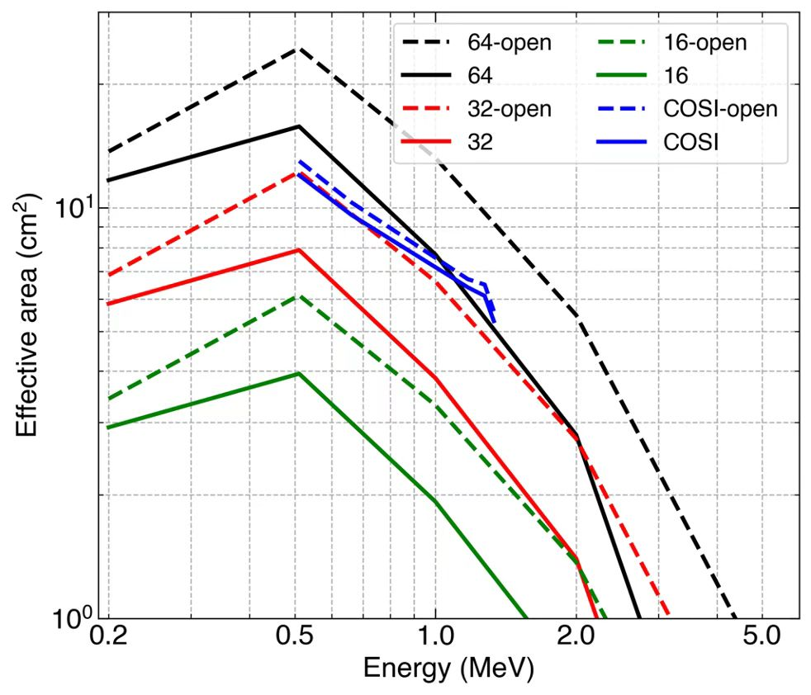
Expected performance — MASS-Cube constellation
Left: MASS vs 16 MASS-Cube, each with 64 CZT units (total 16*64=1024)
Right: Single MASS-Cube with different number of CZT units

Slide 13
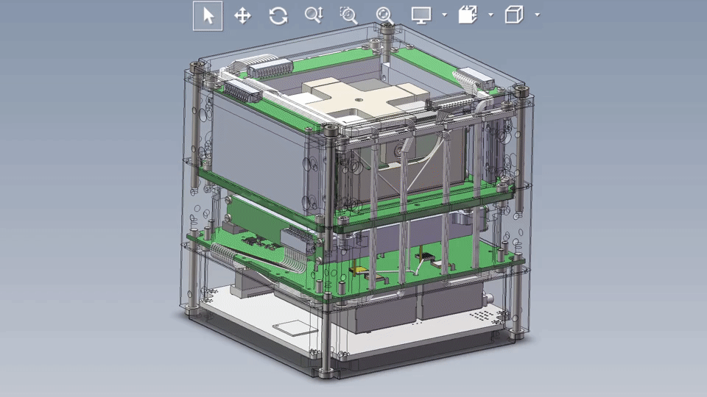
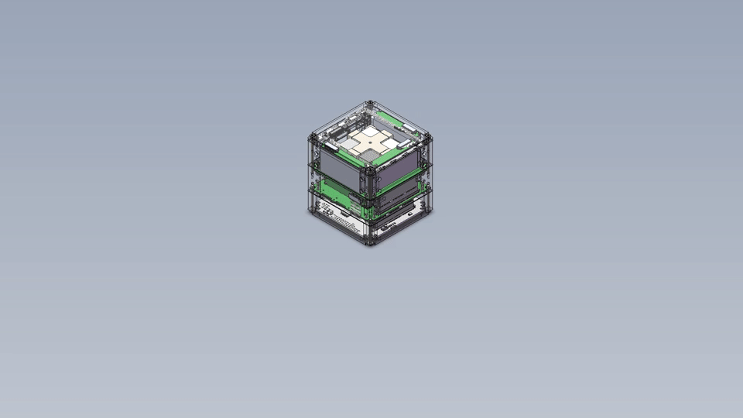
Hardware design of MASS-Cube
CubeSat platform compatibility
Size: 9.4×9.4×11 cm³ ( ~ 1.1U)
Weight: ~ 1.7 kg
Power: ~ 14 W
Pixelated CZT detector
2×2 CZT array, 16 cm²
Depth resolution (σ) <1 mm
Energy resolution <1% @662 keV
Dead time ~ 160 μs
Anti-coincidence detector
8 mm GAGG + SiPM
4 sides and bottom
To verify in-orbit background, the GAGG ACD was not installed on the first MASS-Cube payload

Slide 14
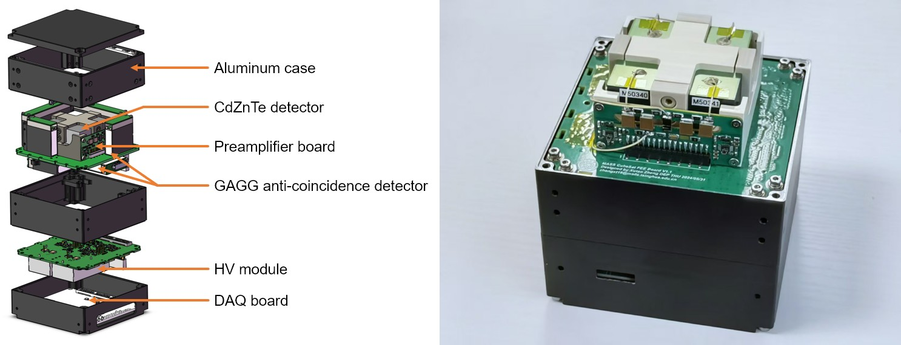
Hardware design of MASS-Cube

Slide 15
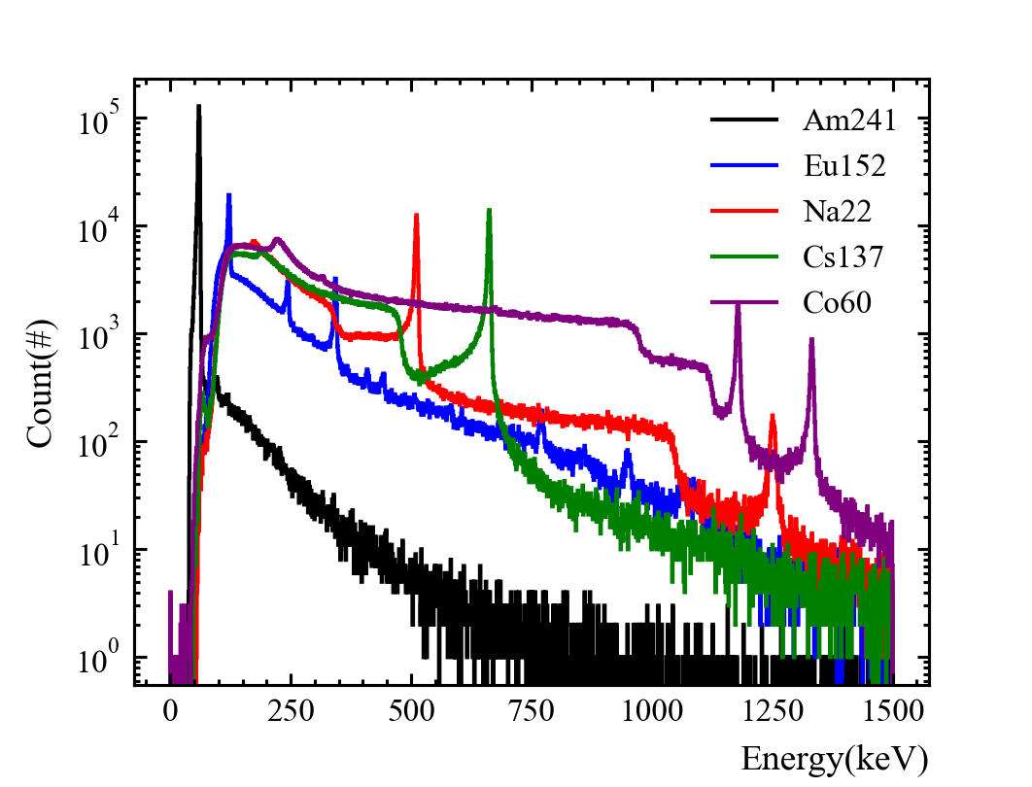
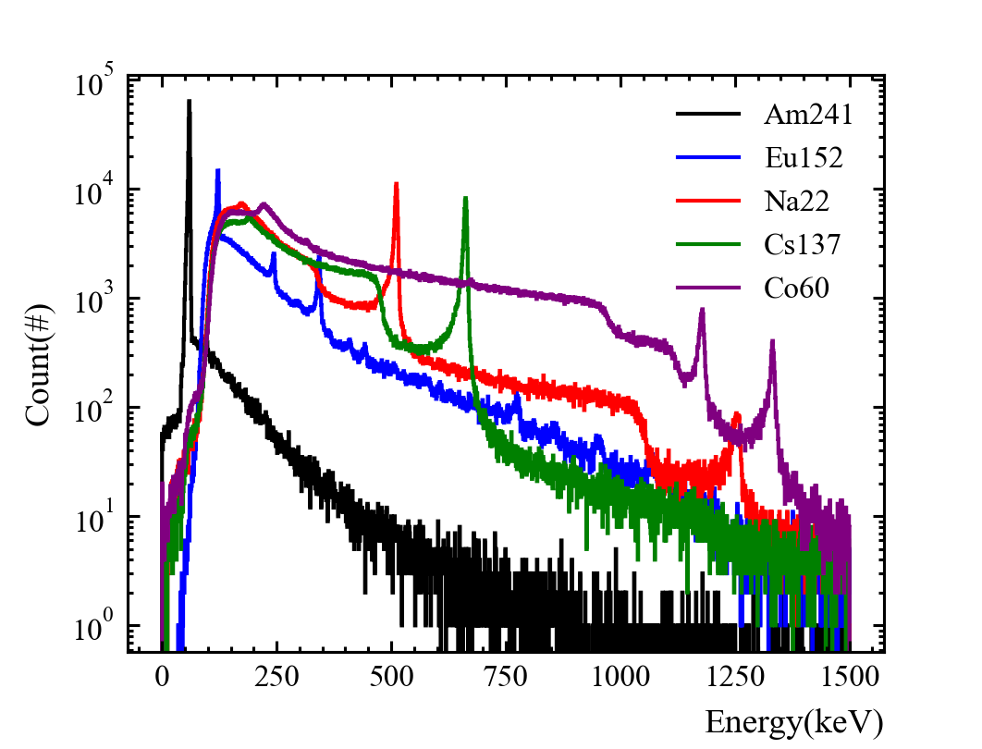
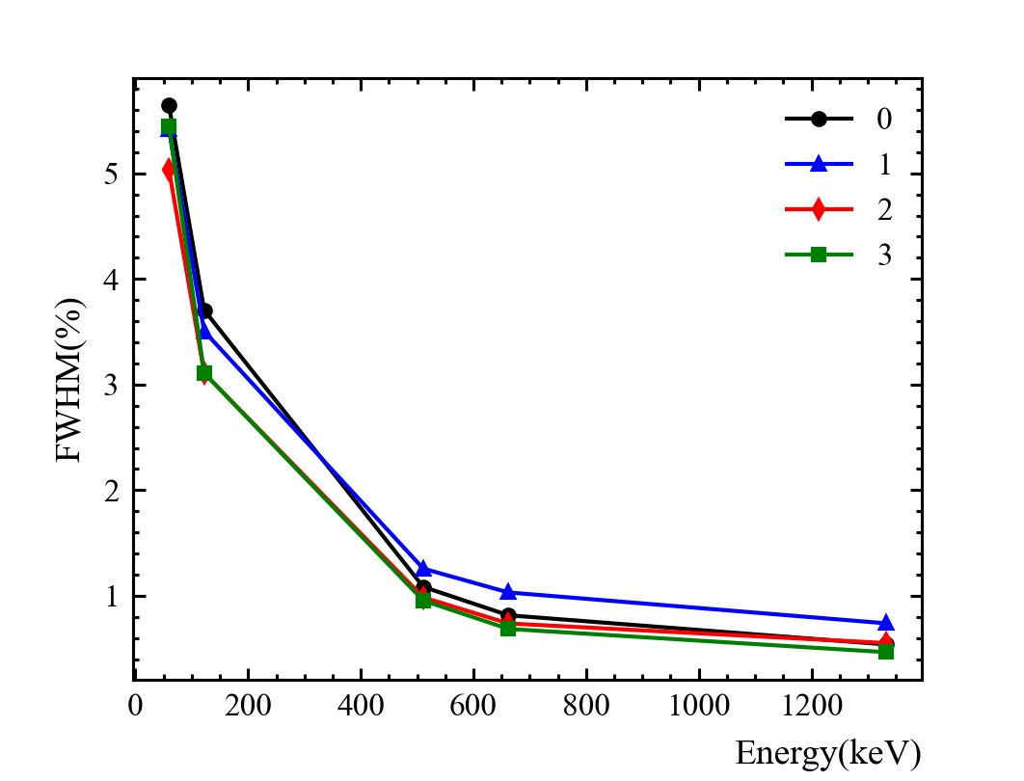
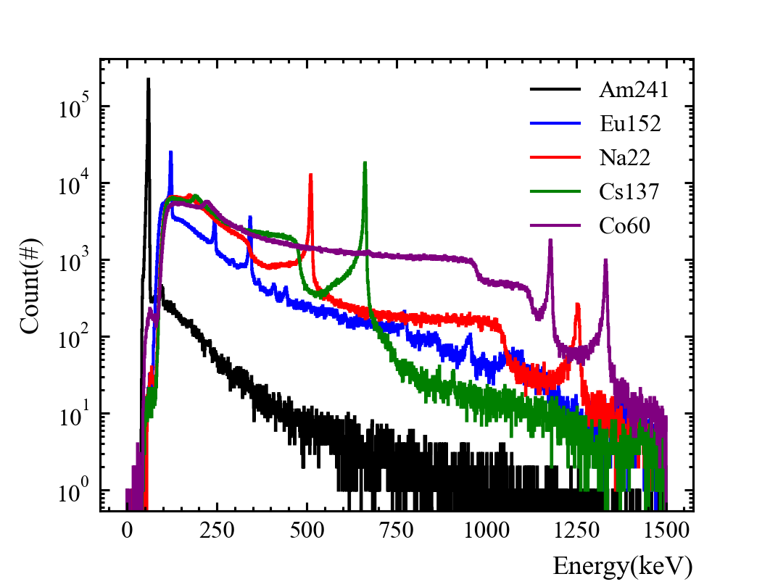
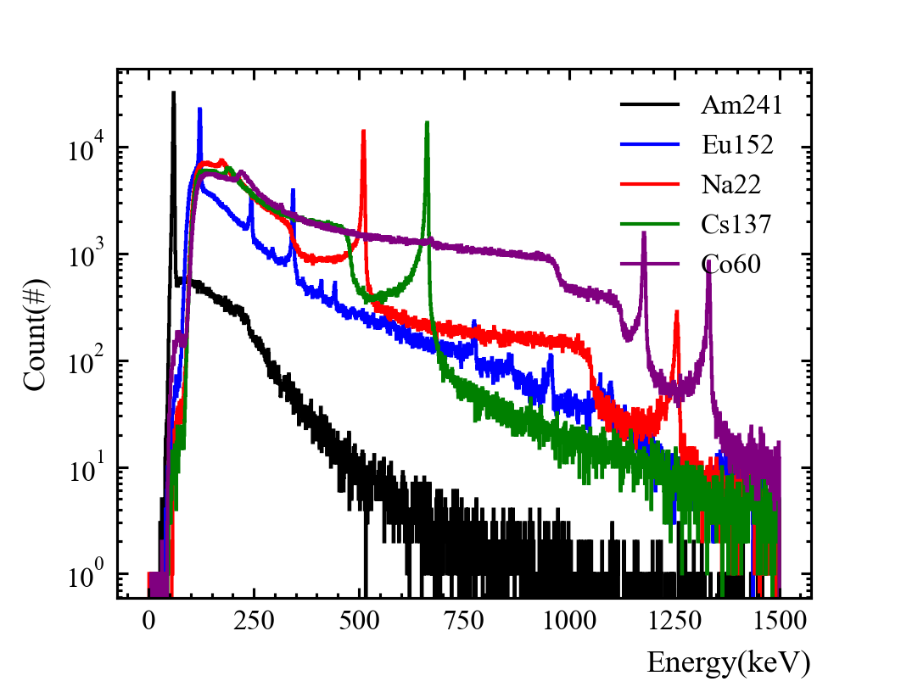
Spectrum performance
Energy resolution (FWHM) at different energy
Energy (keV) | CH0 | CH1 | CH2 | CH3
59.5 | 5.64% | 5.41% | 5.04% | 5.44%
122 | 3.70% | 3.50% | 3.11% | 3.11%
511 | 1.08% | 1.26% | 0.98% | 0.95%
662 | 0.82% | 1.03% | 0.74% | 0.69%
1332 | 0.54% | 0.74% | 0.55% | 0.47%

Slide 16
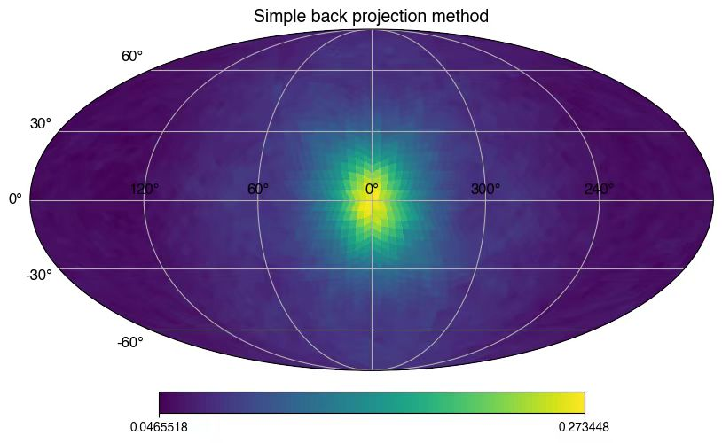
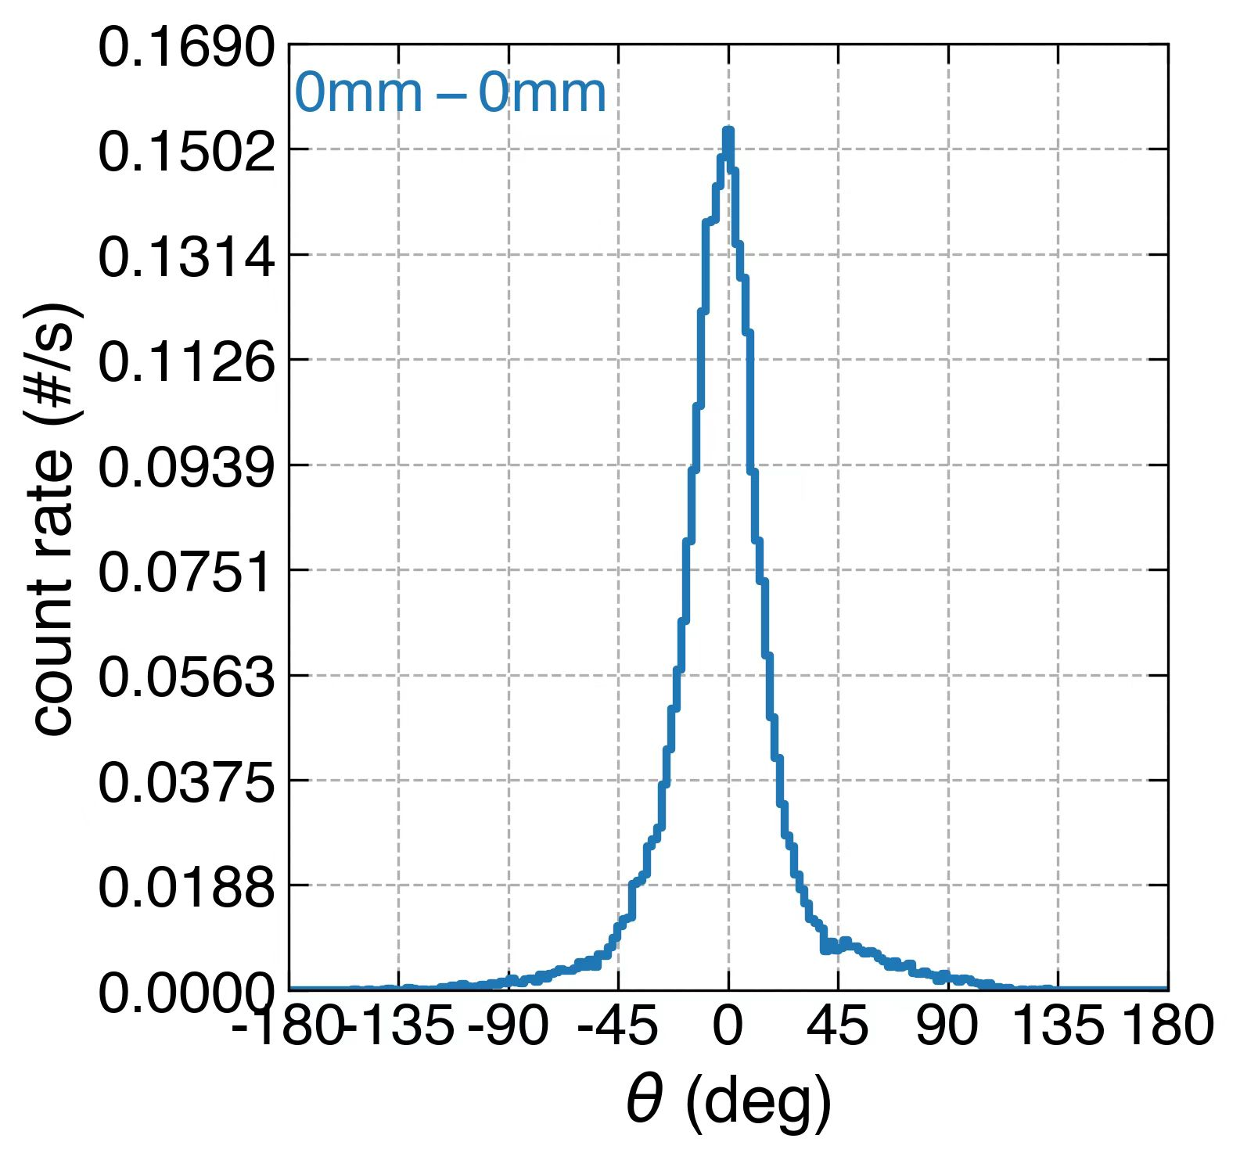
Imaging performance
(Without event filter)

Slide 17
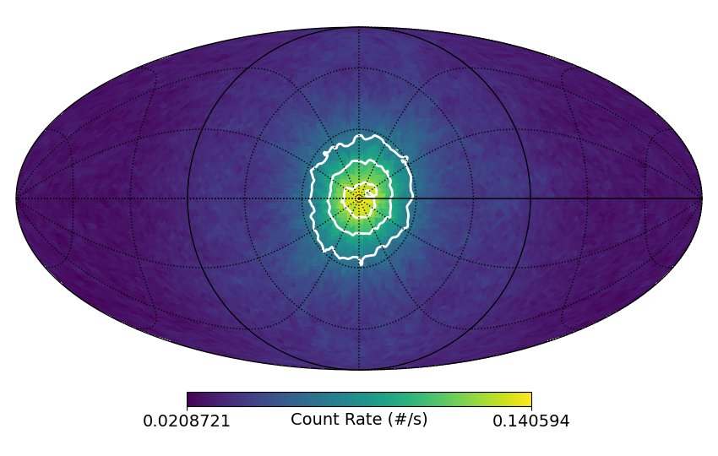
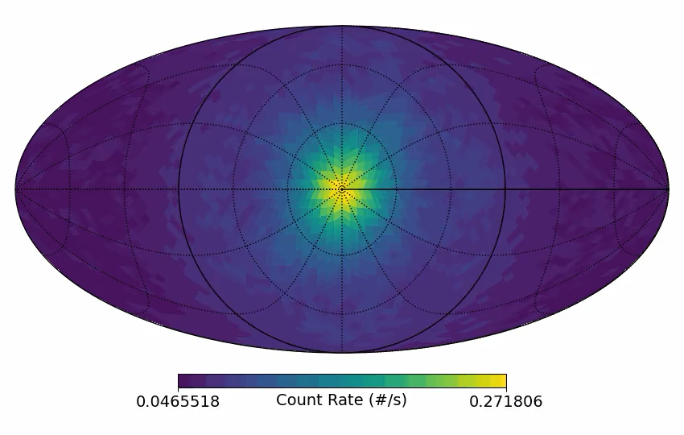
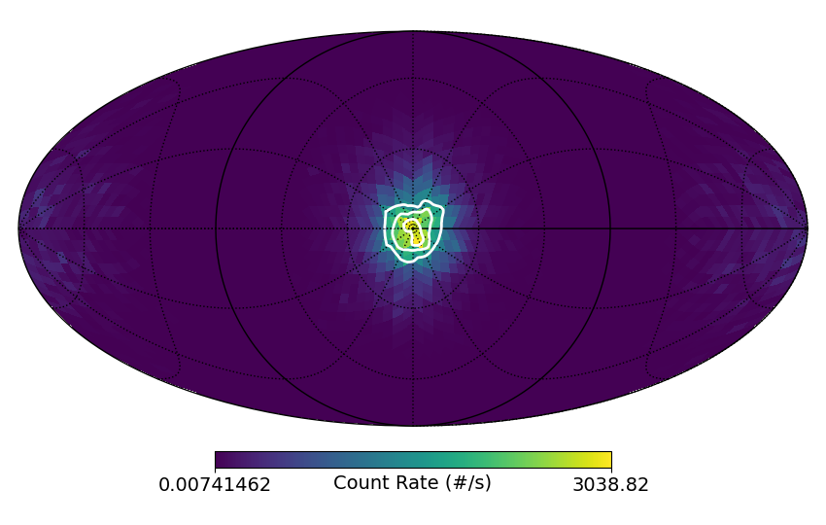
Imaging performance
before
after
511 keV, point source, on-axis
List-mode MLEM, improve imaging results

Slide 18
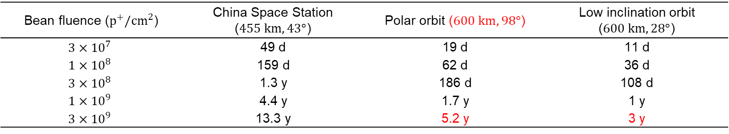
Radiation damage of CZT — irradiation experiment
Proton irradiation experiment setup:
Two 2×2×1 cm³ CZT units were irradiated
During irradiation:
Crystal 1: 1333 V @1 cm HV applied
(= 2000 V @1.5 cm)
Crystal 2: no HV applied
Spectrum test with Na-22 between each irradiation
Beam setting:
Proton energy: 100 MeV
Beam fluence range: 3×10⁷ ~ 3×10⁹ p / cm²
Beam non-uniformity: < 10%
Proton fluence and equivalent on-orbit time for various orbits
Bean fluence ($p^{+}/cm^{2}$) | China Space Station ($455 km,43°$) | Polar orbit ($600 km,98°$) | Low inclination orbit ($600 km,28°$)
$$3×{10}^{7}$$ | 49 d | 19 d | 11 d
$$1×{10}^{8}$$ | 159 d | 62 d | 36 d
$$3×{10}^{8}$$ | 1.3 y | 186 d | 108 d
$$1×{10}^{9}$$ | 4.4 y | 1.7 y | 1 y
$$3×{10}^{9}$$ | 13.3 y | 5.2 y | 3 y

Slide 19
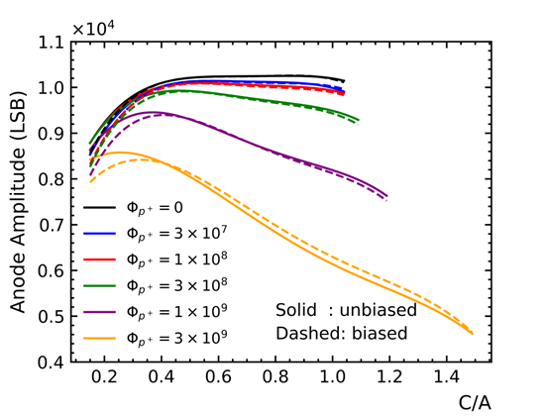
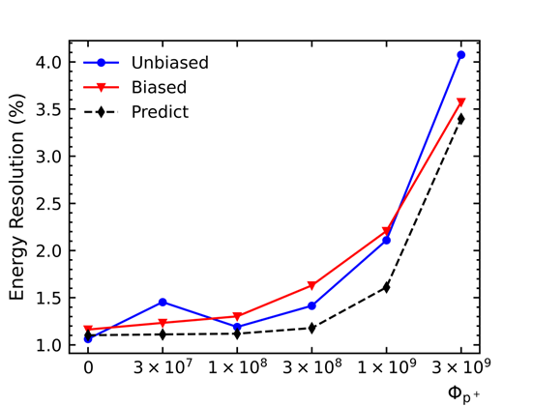
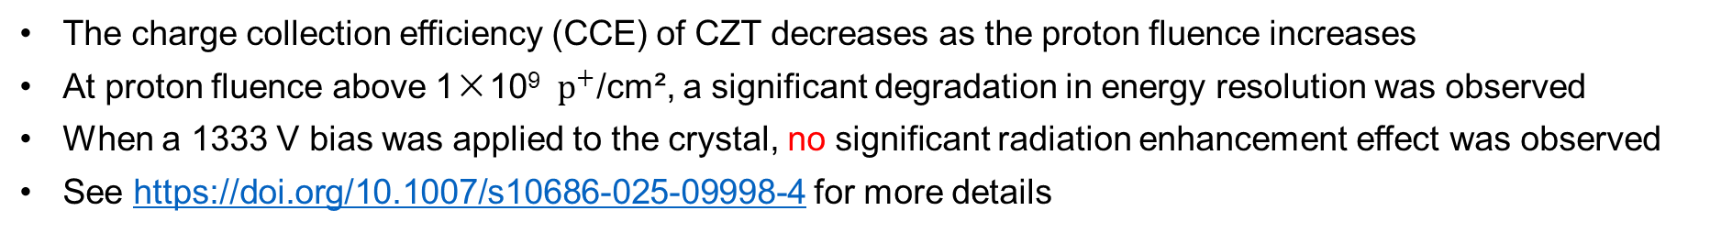
Radiation damage of CZT — results
Signal Amplitude Depth Distribution at Various Proton Fluences
Energy Resolution at Various Proton Fluences
The charge collection efficiency (CCE) of CZT decreases as the proton fluence increases
At proton fluence above 1×10⁹ ${ p}^{+}$/cm², a significant degradation in energy resolution was observed
When a 1333 V bias was applied to the crystal, no significant radiation enhancement effect was observed
See https://doi.org/10.1007/s10686-025-09998-4 for more details

Slide 20
Conclusion
We proposed the MASS medium-satellite mission and the MASS-Cube micro-/nano-satellite constellation concept based on pixelated CZT
With years of effort, the first MASS-Cube has been launched to demonstrate pixelated CZT in space
Preliminary testing in progress
CZT is a room-temperature alternative for HPGe, good for modular design or constellation mission
The design of MASS-Cube could be either the standard unit of a larger mission, or the payload component of a constellation

Slide 21
Open questions
Improvement of readout and event reconstruction methods for pixelated CZT (depth reconstruction, charge loss correction, XY sub-pixel resolution…)
Mass production of a large number of high quality CZTs and readout ASICs
Calibration method for a large number of pixelated CZTs (totally >100k pixels or >1M voxels)
Radiation damage, annealing, and in-orbit calibration of CZTs (mission lifetime)
Detector material improvement, e.g. Cd_{0.9}Zn_{0.1}Te_{0.9}Se_{0.1}?
Potential to do polarimetry?
…
CZT technique for MeV space missions still challenge!

Slide 22
Thanks!

Slide 23







Research progress of CZT detectors developed for MeVGRO in IHEP
1）Domestic pixel CZT detector (Imdetek) + ASIC chip (IHEP)
CZT detector
22*22*15mm³
121 pixel
Imdetek
CPRE 10-32
32 channels
IHEP

Slide 24






Prototype test results
Linear response
ASIC Chip and FFE
FWHM <2.0% @ 662keV(before 3D correction).

Slide 25







2）Frisch-grid CZT
size: 5×5×20mm³
CFG CZT anode readout with discrete component circuit
I-V

Slide 26

Simulated ARM
1 MeV On-axis ARM

