Slide 1
Gamma-ray Converter tracKer on MeVGRO
Gong Ke
IHEP& PMO team

Slide 2
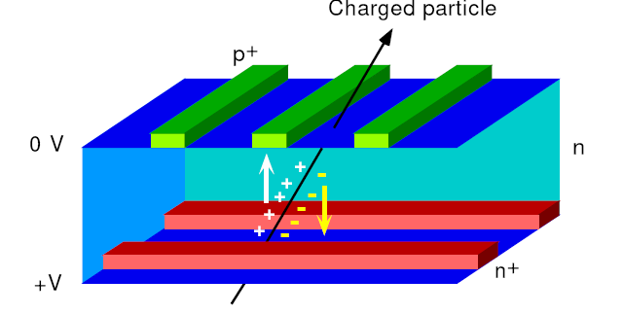
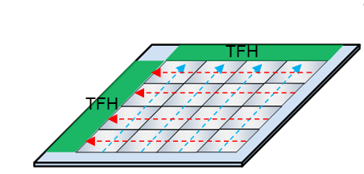
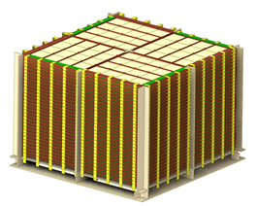
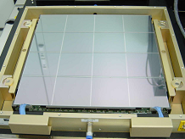
Gamma-ray Converter tracKer on MeVGRO
GCK consists of multi-layers of double-sided Silicon strip detectors
Converter for Compton scattering and pair production
no passive material!
Particle Tracking
Parameters | value
Energy range | 25keV~1MeV (47fC)
Position resolution | X,Y≤500um
Silicon Thickness | 500um
Layers | 50
Area | 80cm*80cm/tower
thickness=30mm, Radiation length=0.32, Compton scattering cross-section~43%@1MeV
Notes:
Challenge: light but rigid supporting structure, double sided connection of DSSD

Slide 3
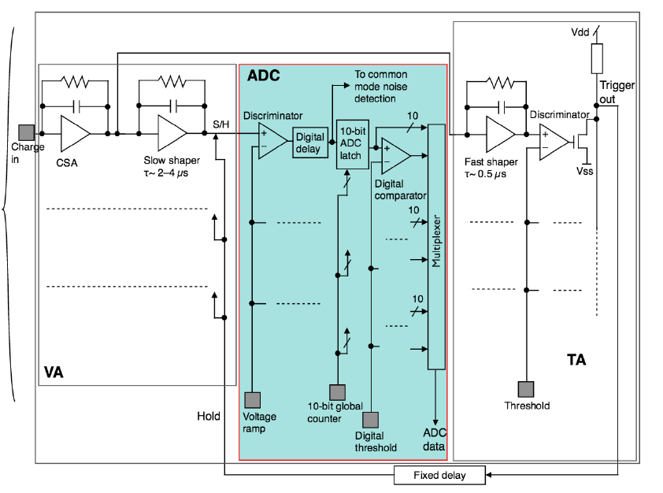
VATA460
Channels | 32
Input Charrge | ±95 fC
Shaping time | 2 μs
Noise (ENC) | 179e- (0pF)
Trigger threshold | tunable
Trigger out | 32 Or
Signal output | serial digital signal
DAC cal | gain calibration
Power consumpton | 0.38mW /ch (wo ADC) or 0.58mW/ch(ADC)
Total power consumption for VATA460 in GCK: 178W
Daisy chain readout

Slide 4
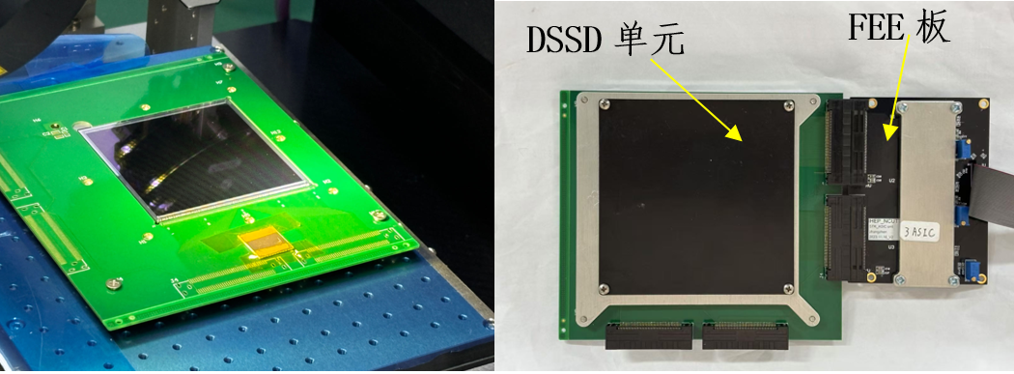
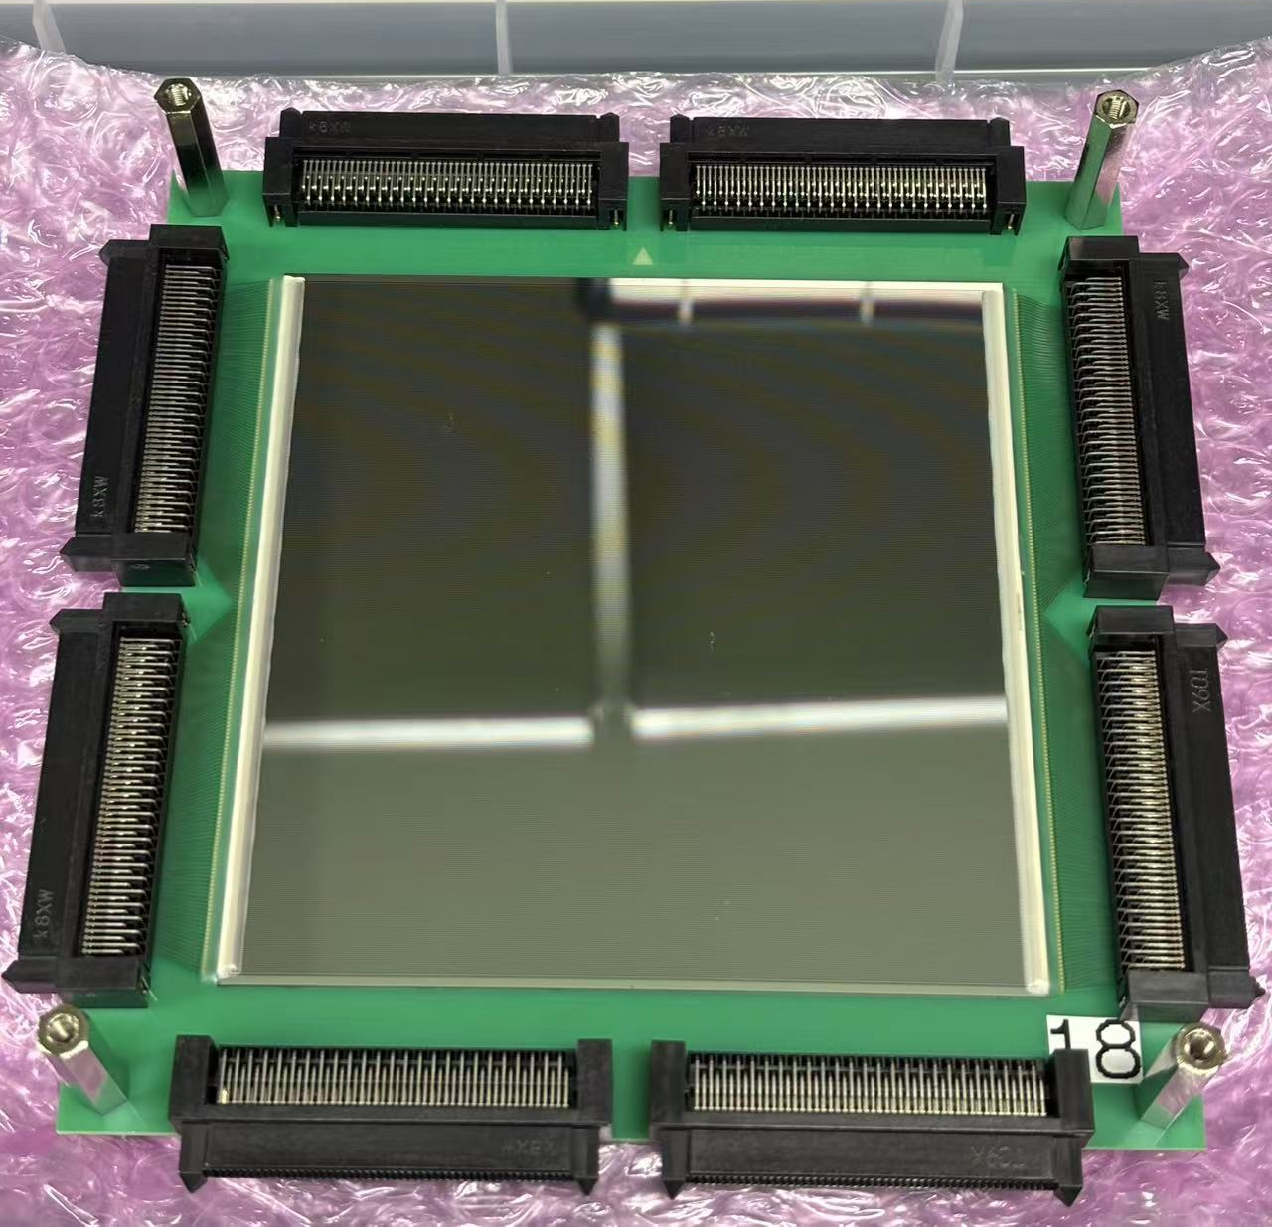
GCK prototype development
DSSD sensors
two types, customized from Micron and Hamamatsu
 | Micron | Hamamatsu
Readout coupling | AC | AC
Readout side | Double | Double
Chip size | 67mm x 67mm | 98mm x 98mm
Active Area | 64mm x 64mm | 95mm x 95mm
Thickness | 500um | 500um
Number of Strips | 128 | 384
Number of Readout Strips | 128 | 192
Strip Pitch | 498um | 247um
Readout Pitch | 498um | 494 um
Strip Width | 298um | 107um
Full depletion voltage | ~100V | <100V
Leakage current at full depletion | <2000nA | <1000nA
Breakdown Voltage | 300V | 300V
Max. count of bad channels | <=8 | <=8
Bias resistance (AC type) | 40M-ohms | 40M-ohms
Coupling capacitance (AC type) | 300pF | 1200pF
Micron
Hamamatsu

Slide 5
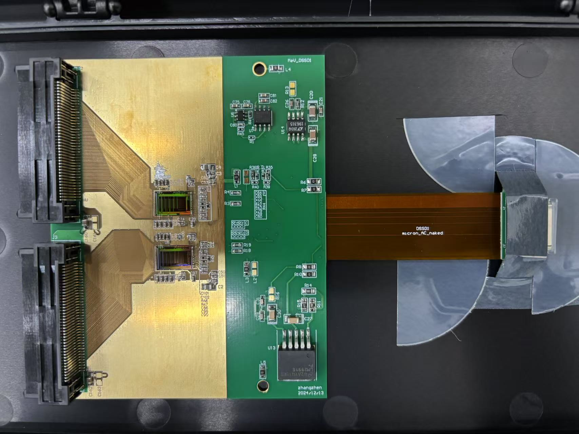
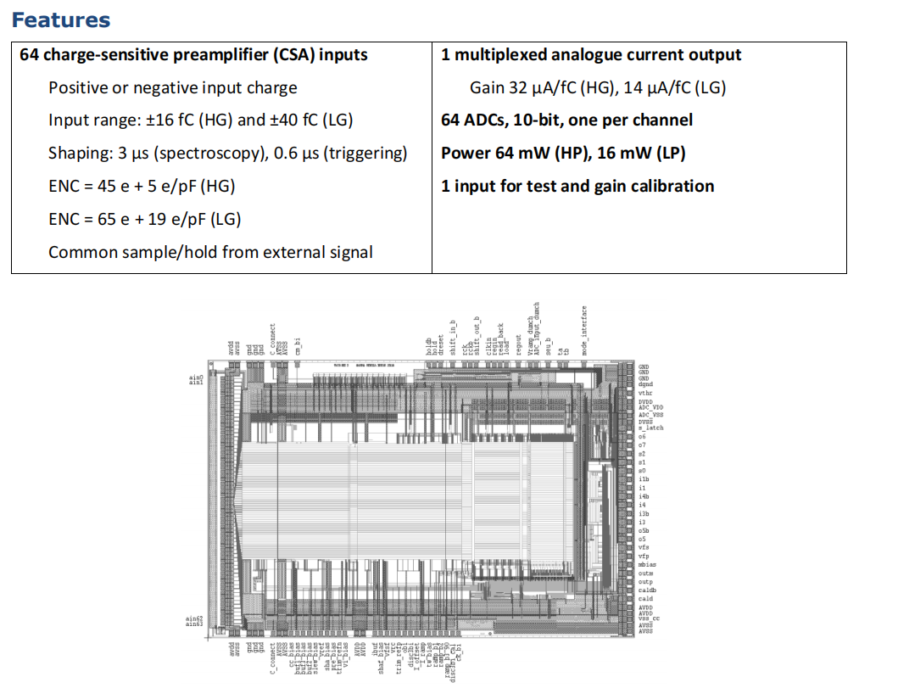
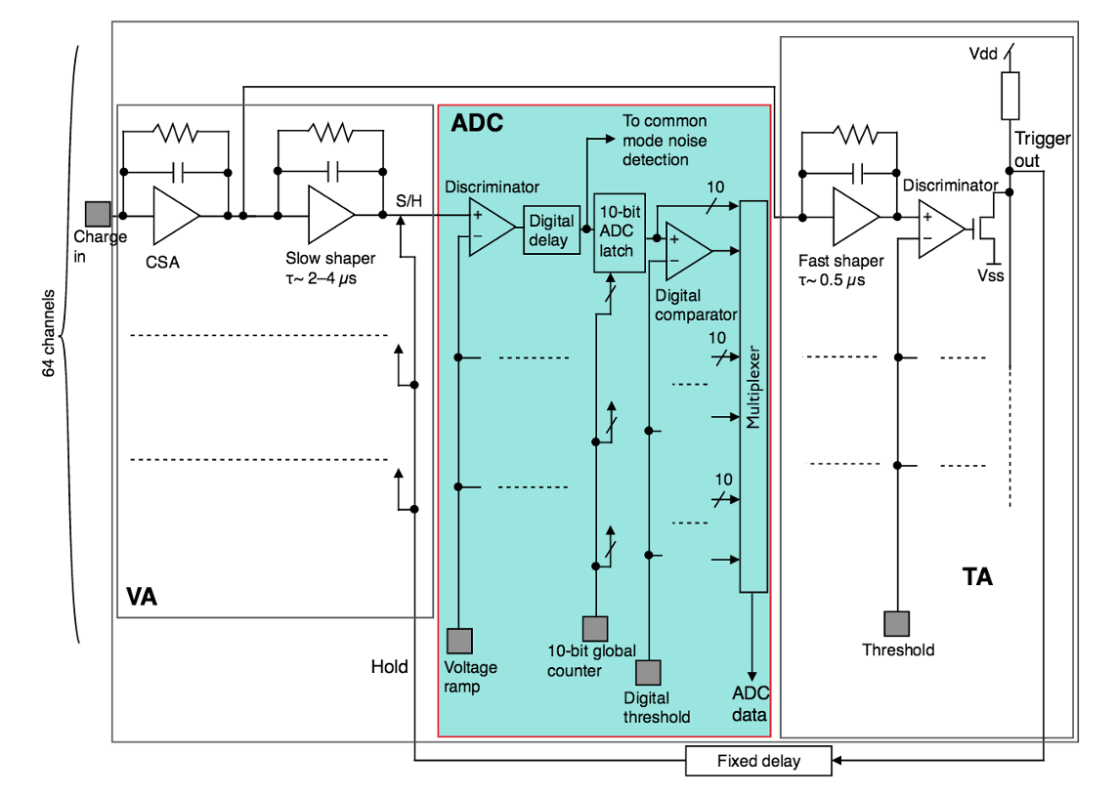
GCK prototype V1.0
Tracker Front-end Electronics(TFE)
ASIC chip: VATA450.3 (±40fC)
(mainly developed for HERD STK)

Slide 6
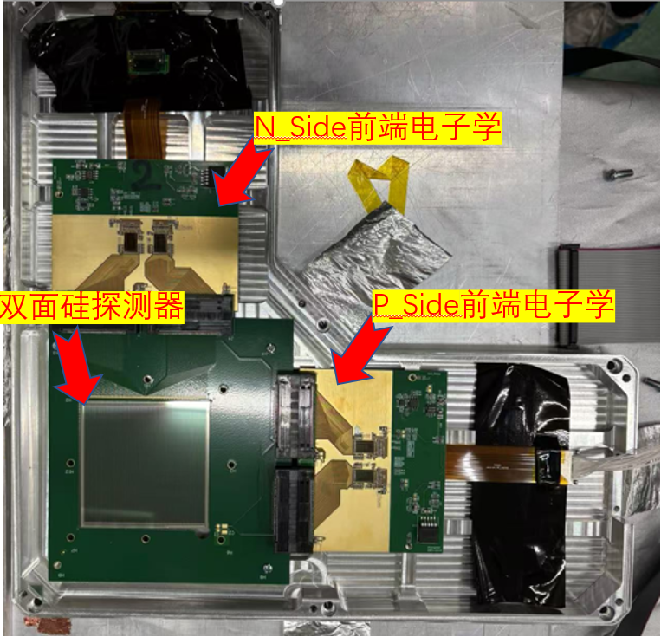
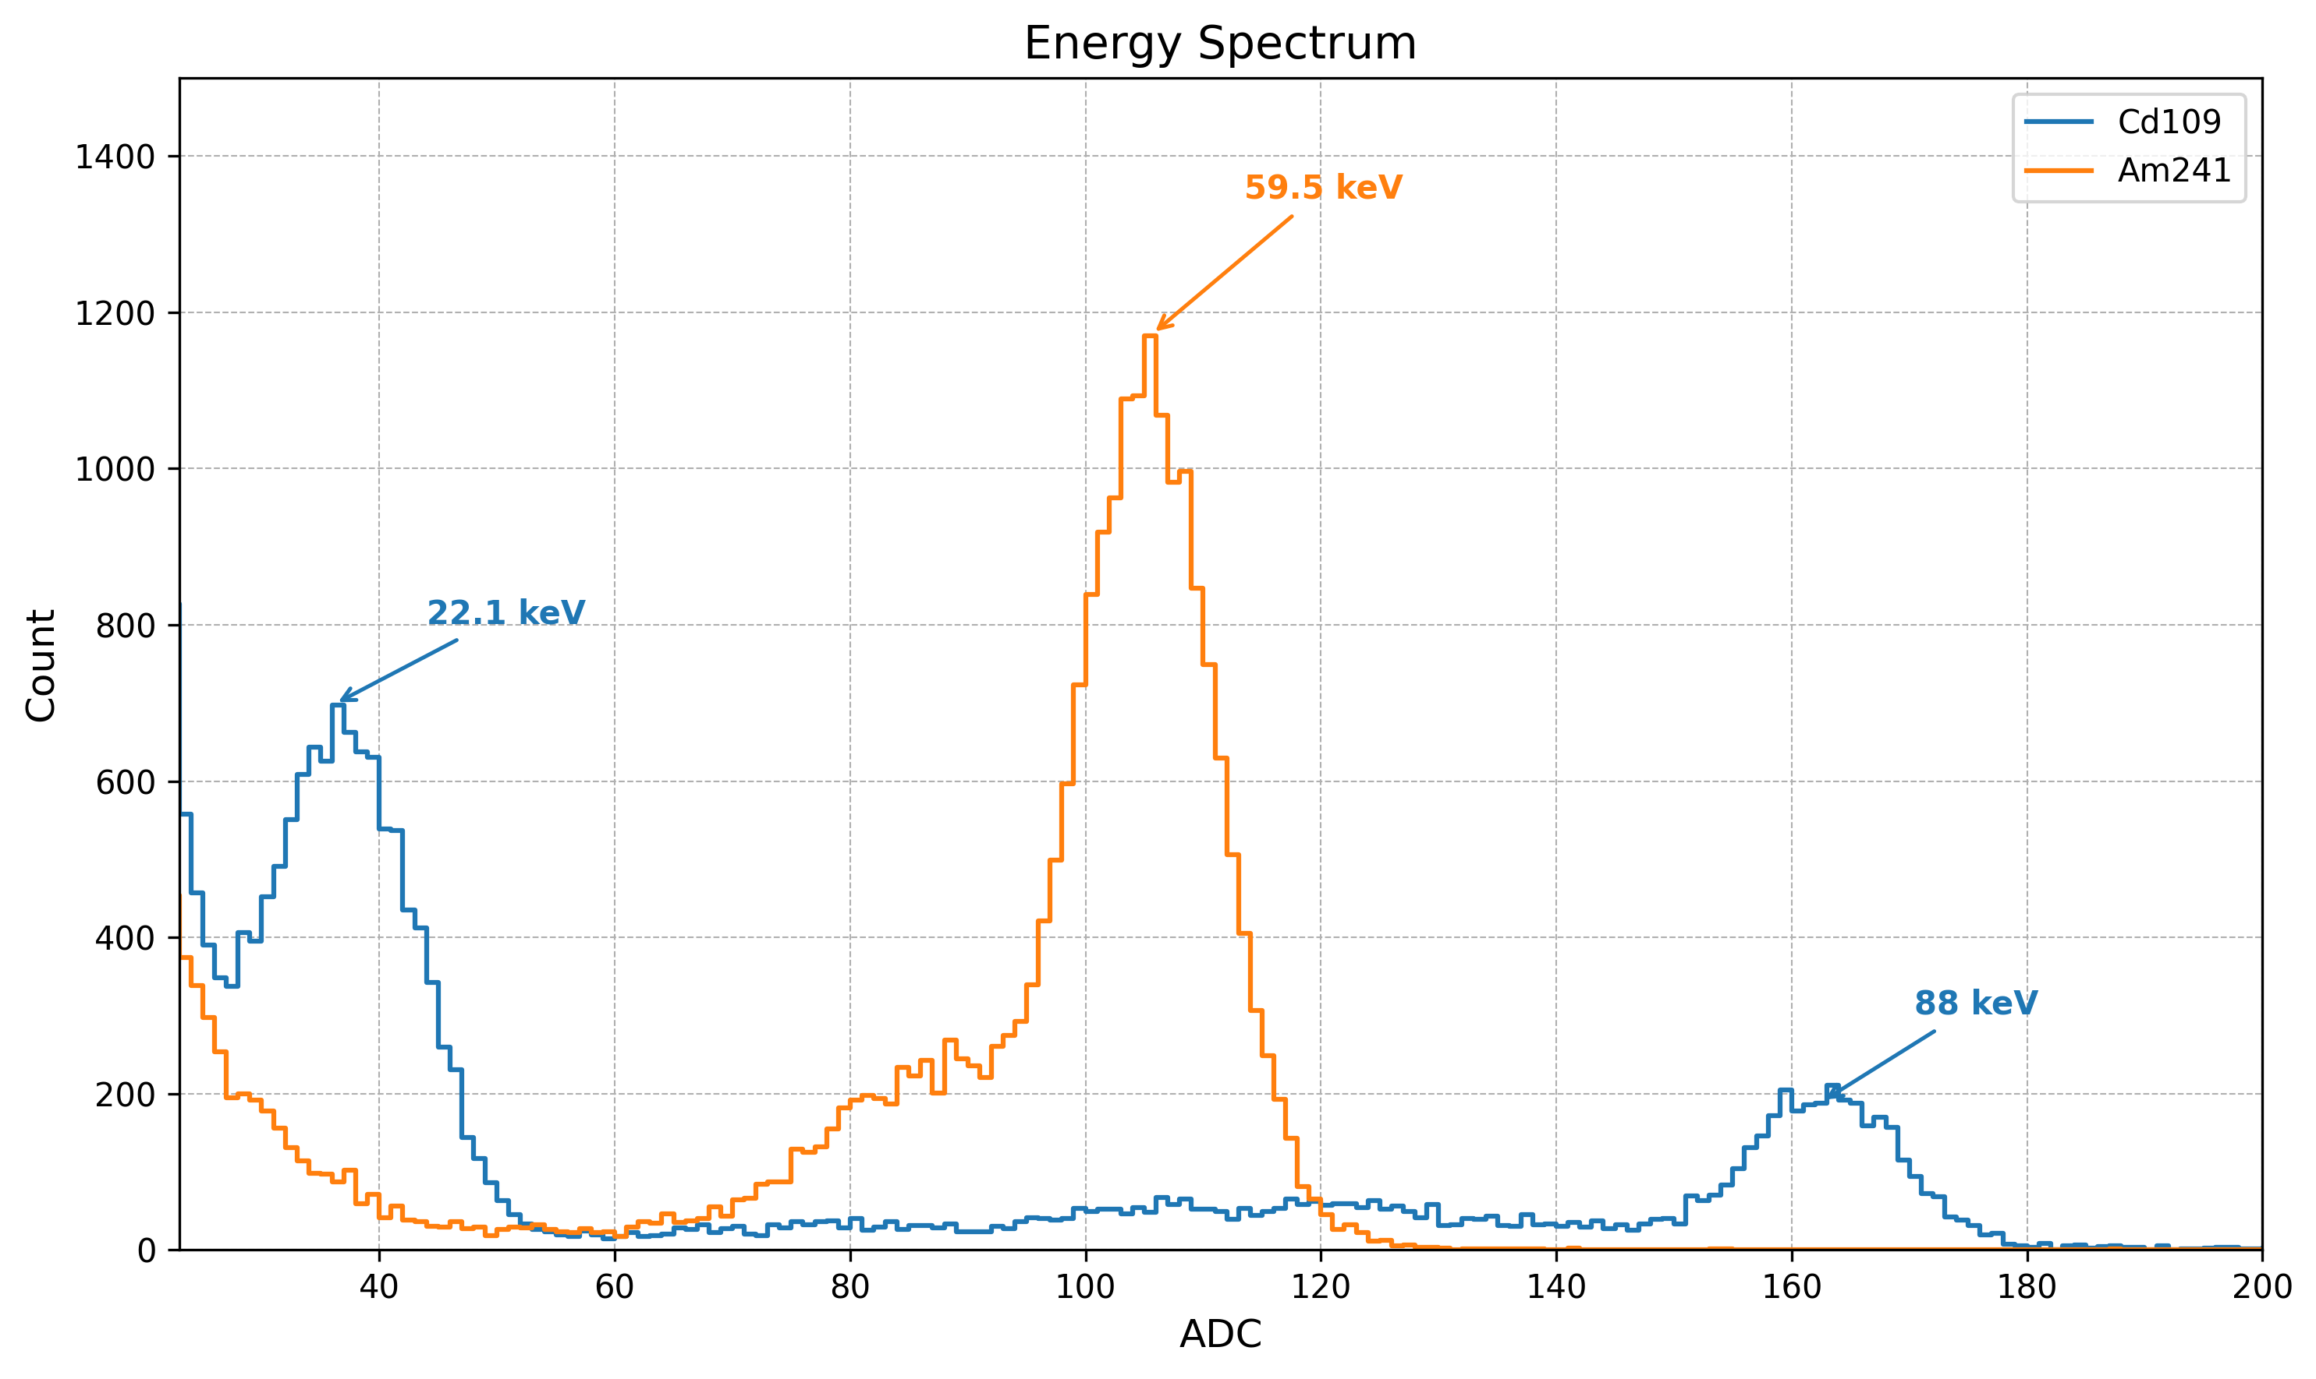
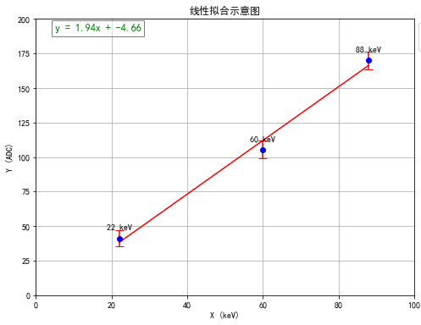
GCK prototype V1.0
Radioactive source test
Radioactive source (²⁴¹Am, ¹⁰⁹Cd) testing in self-trig mode
Micron DSSD (AC) + FEE board

Slide 7
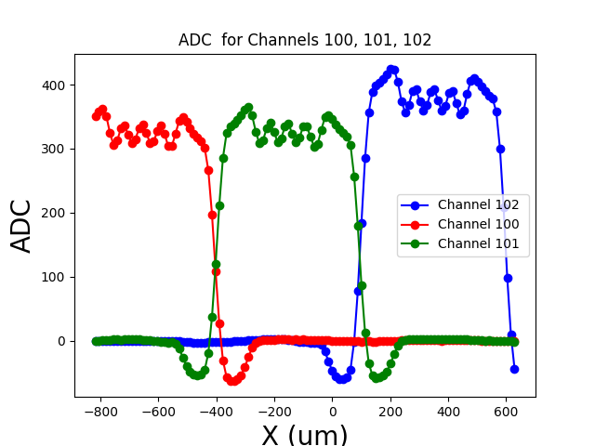
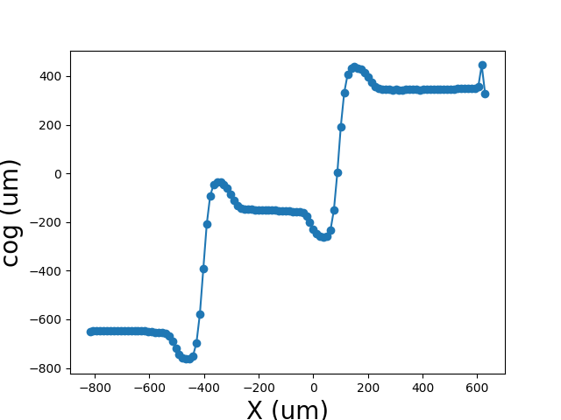
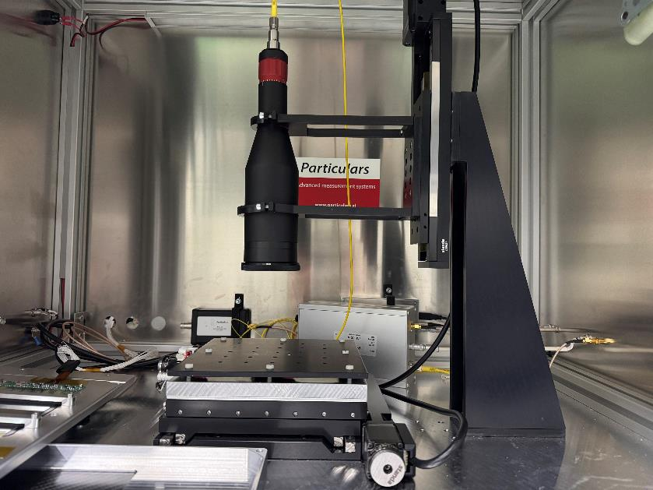
GCK prototype V1.0
Position resolution test
ps pulsed laser (Φ 6μm) + XY precision displacement stage
position resolution: 173.7 um (1 sigma)
ADC values for three channels VS scan position X in the laser scanning test
Reconstructed center of gravity VS
scan position X

Slide 8
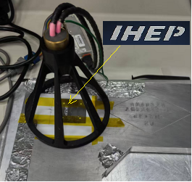
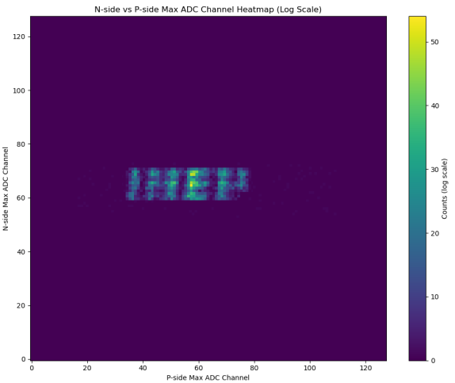
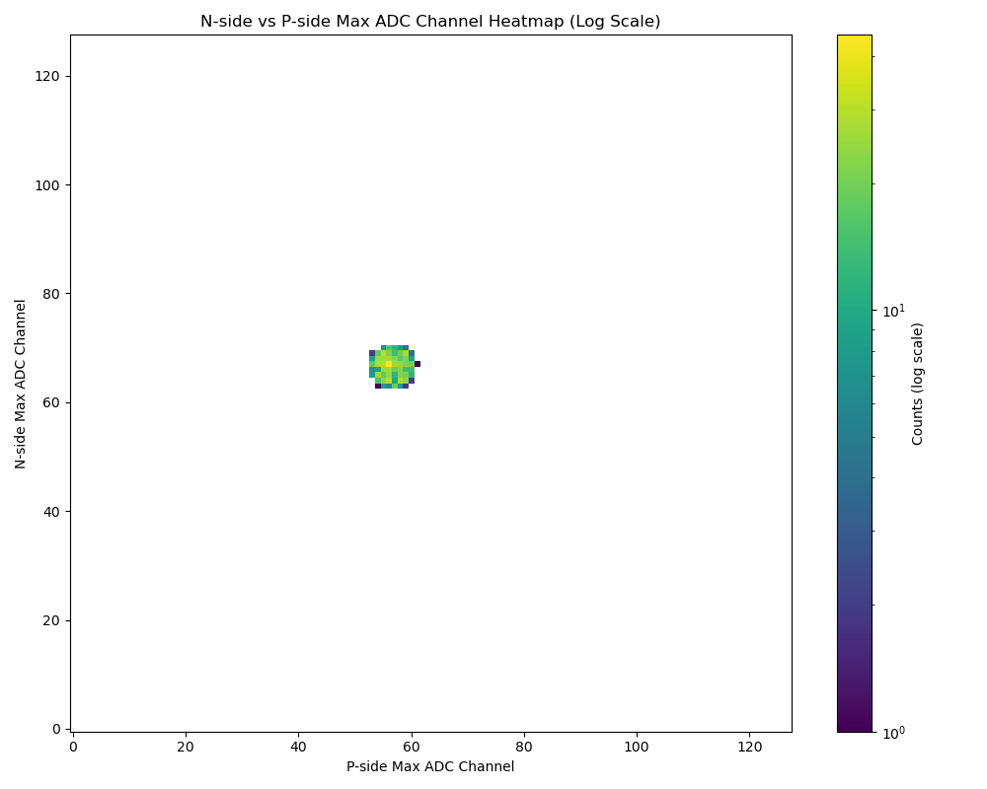
X-ray tube(40KV) imaging
GCK prototype V1.0
Tungsten mask
Pin hole with Ф=3.5mm

Slide 9
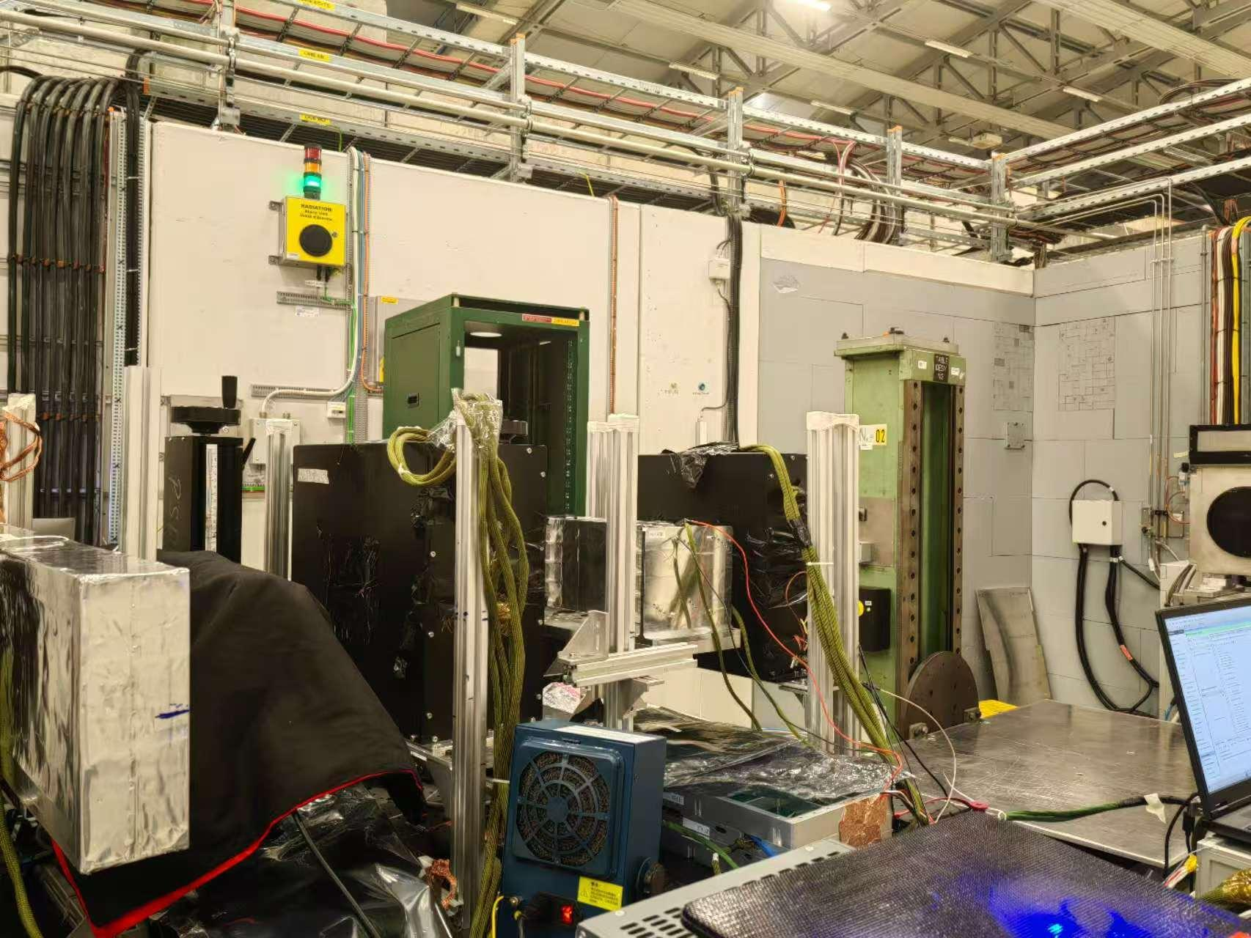
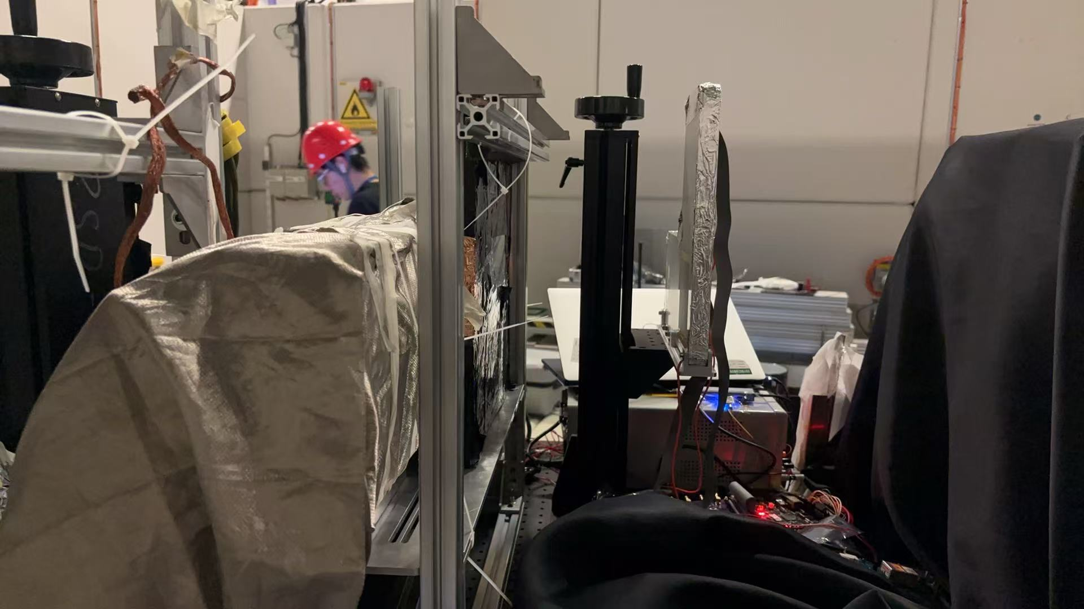
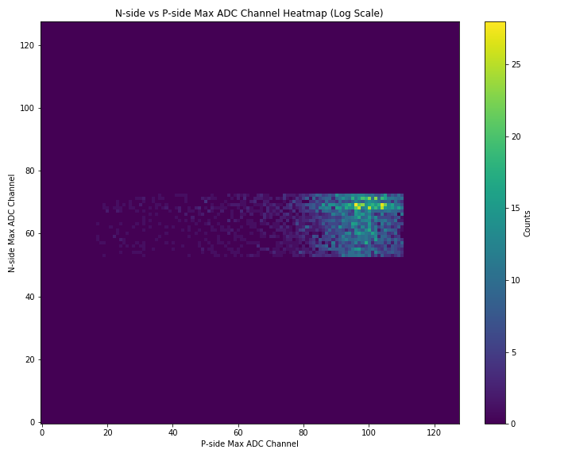
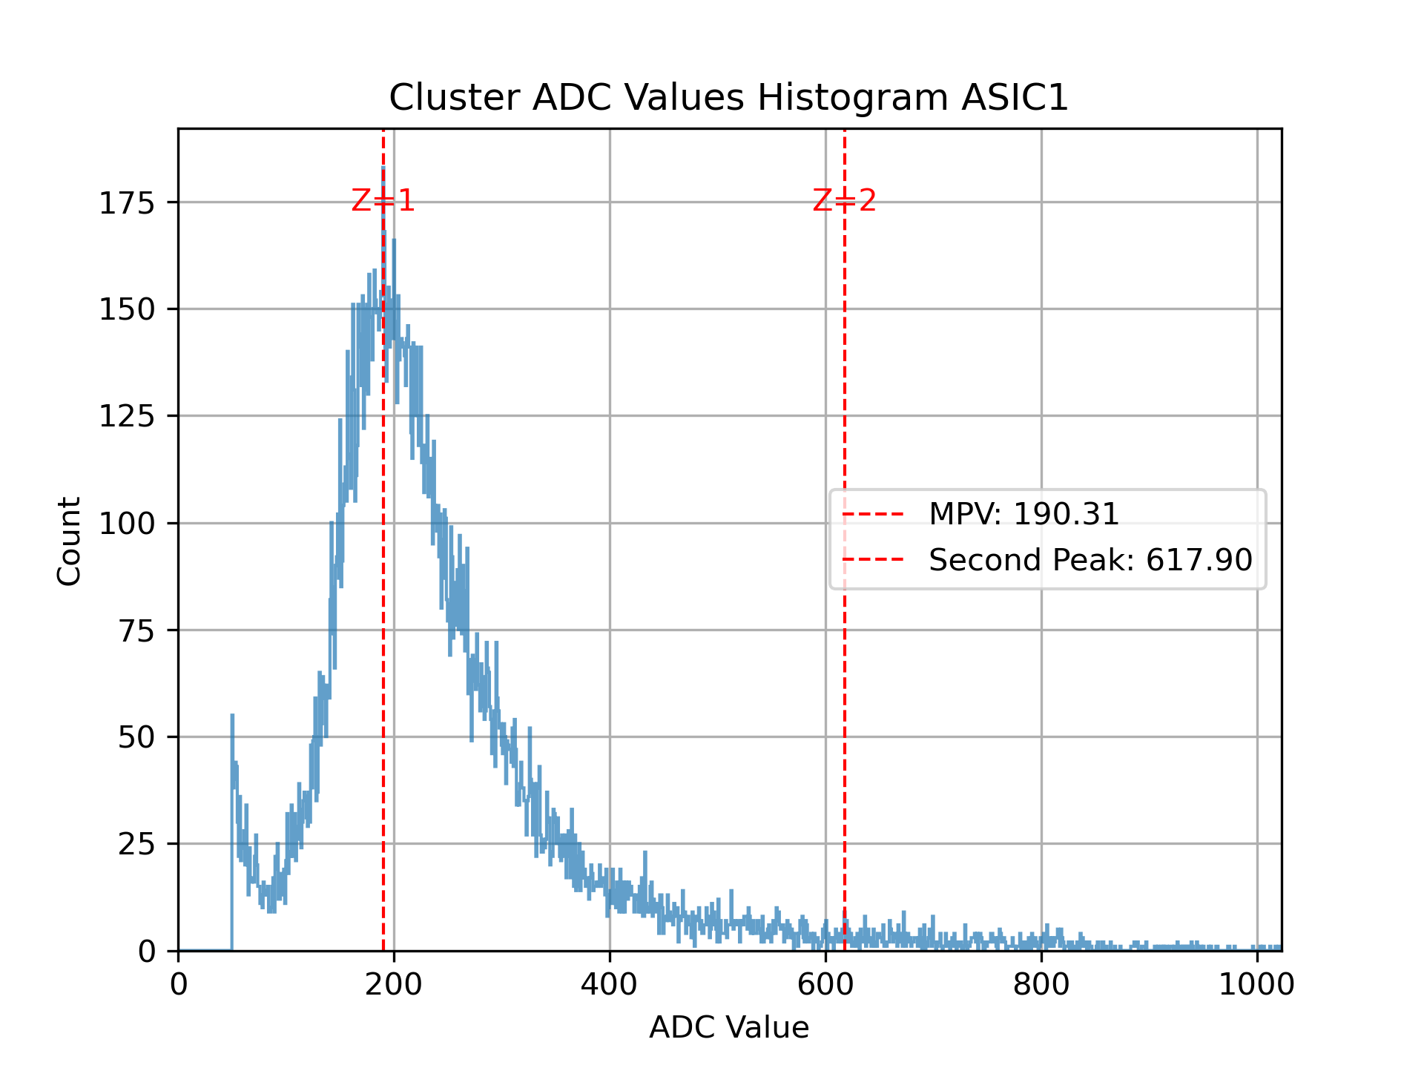
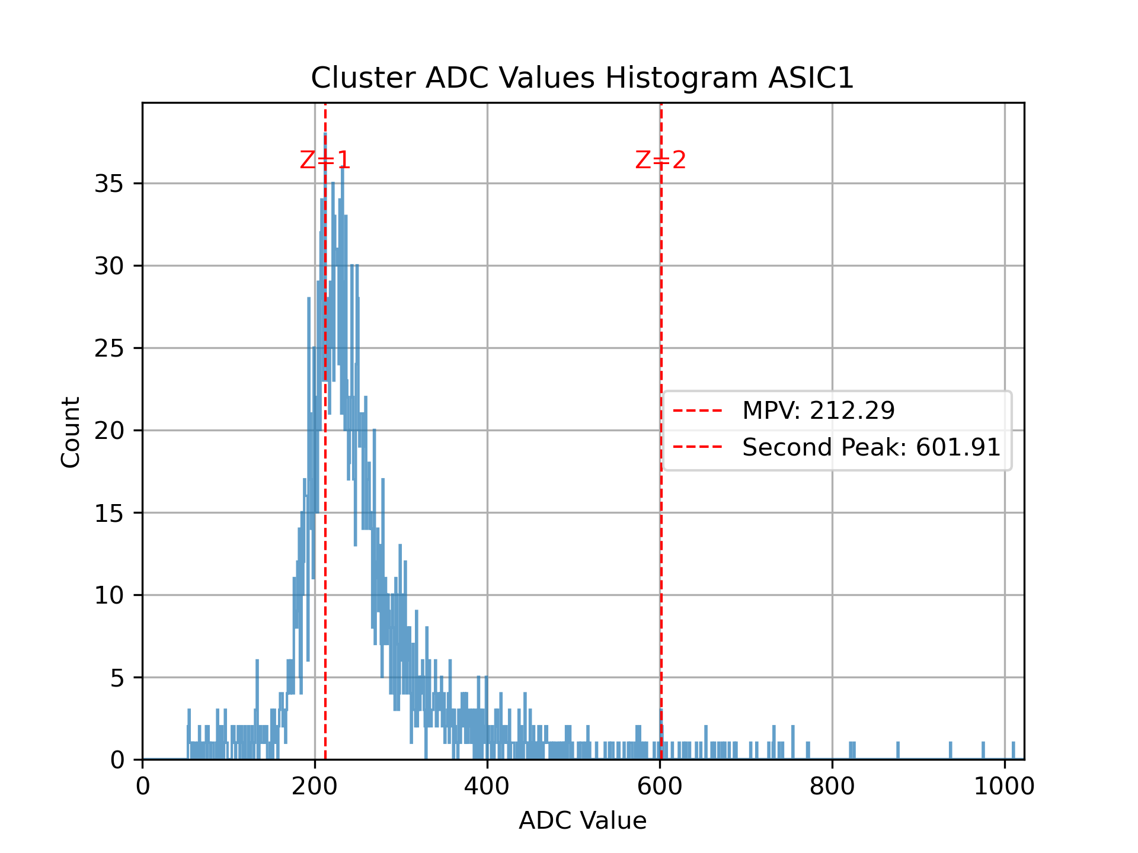
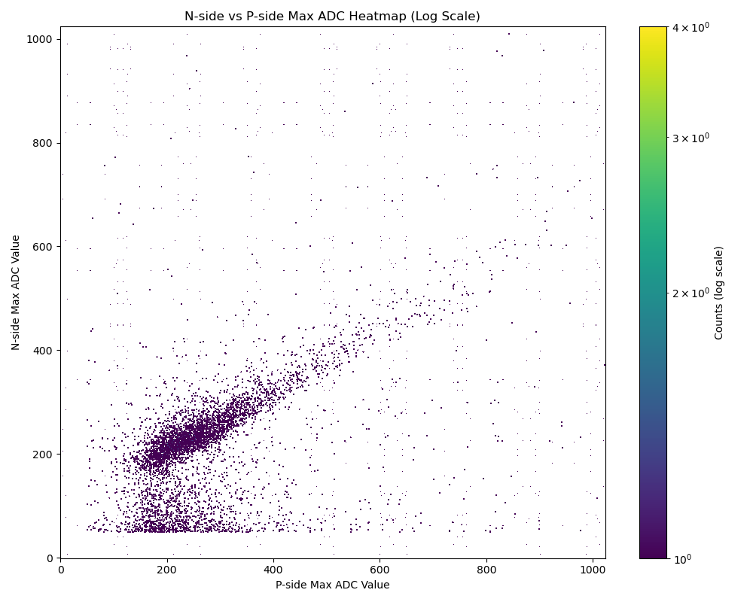
Beam test at PS/CERN in August,2025
particles: e-, proton, π, μ
energy: ~10GeV
GCK prototype
Beam direction
p-side
n-side
n-side
p-side

Slide 10
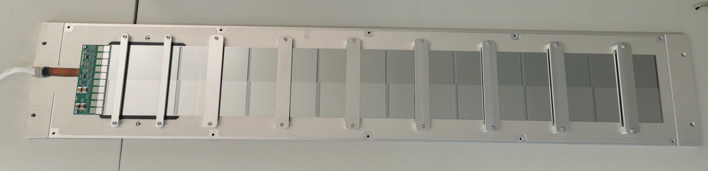
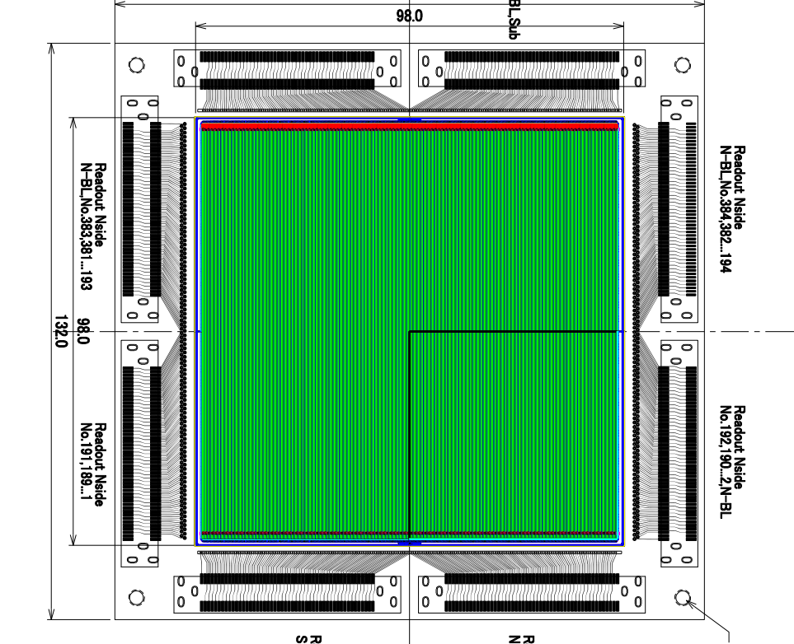
Collaboration with PMO
Assembly of DSSD arrays
long term collaboration from DAMPE to HERD mission.
Develop the GCK prototype V2.0 with HPK DSSD
Co-fund to customize the HPK chips.

