Slide 1
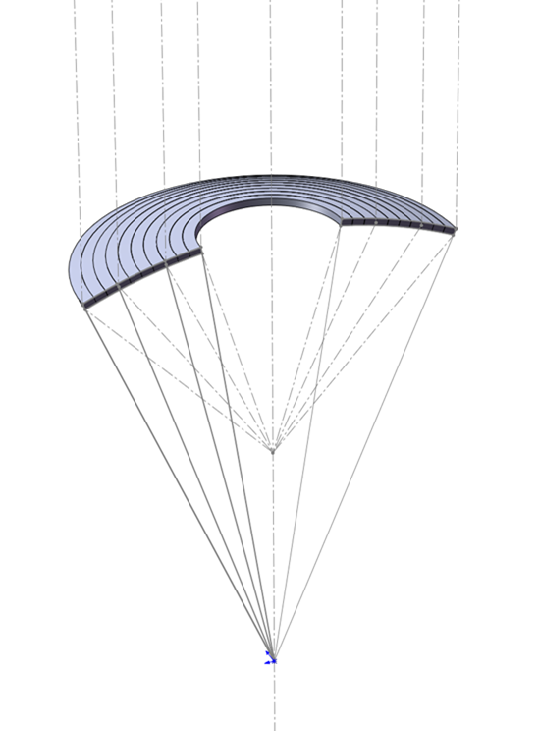
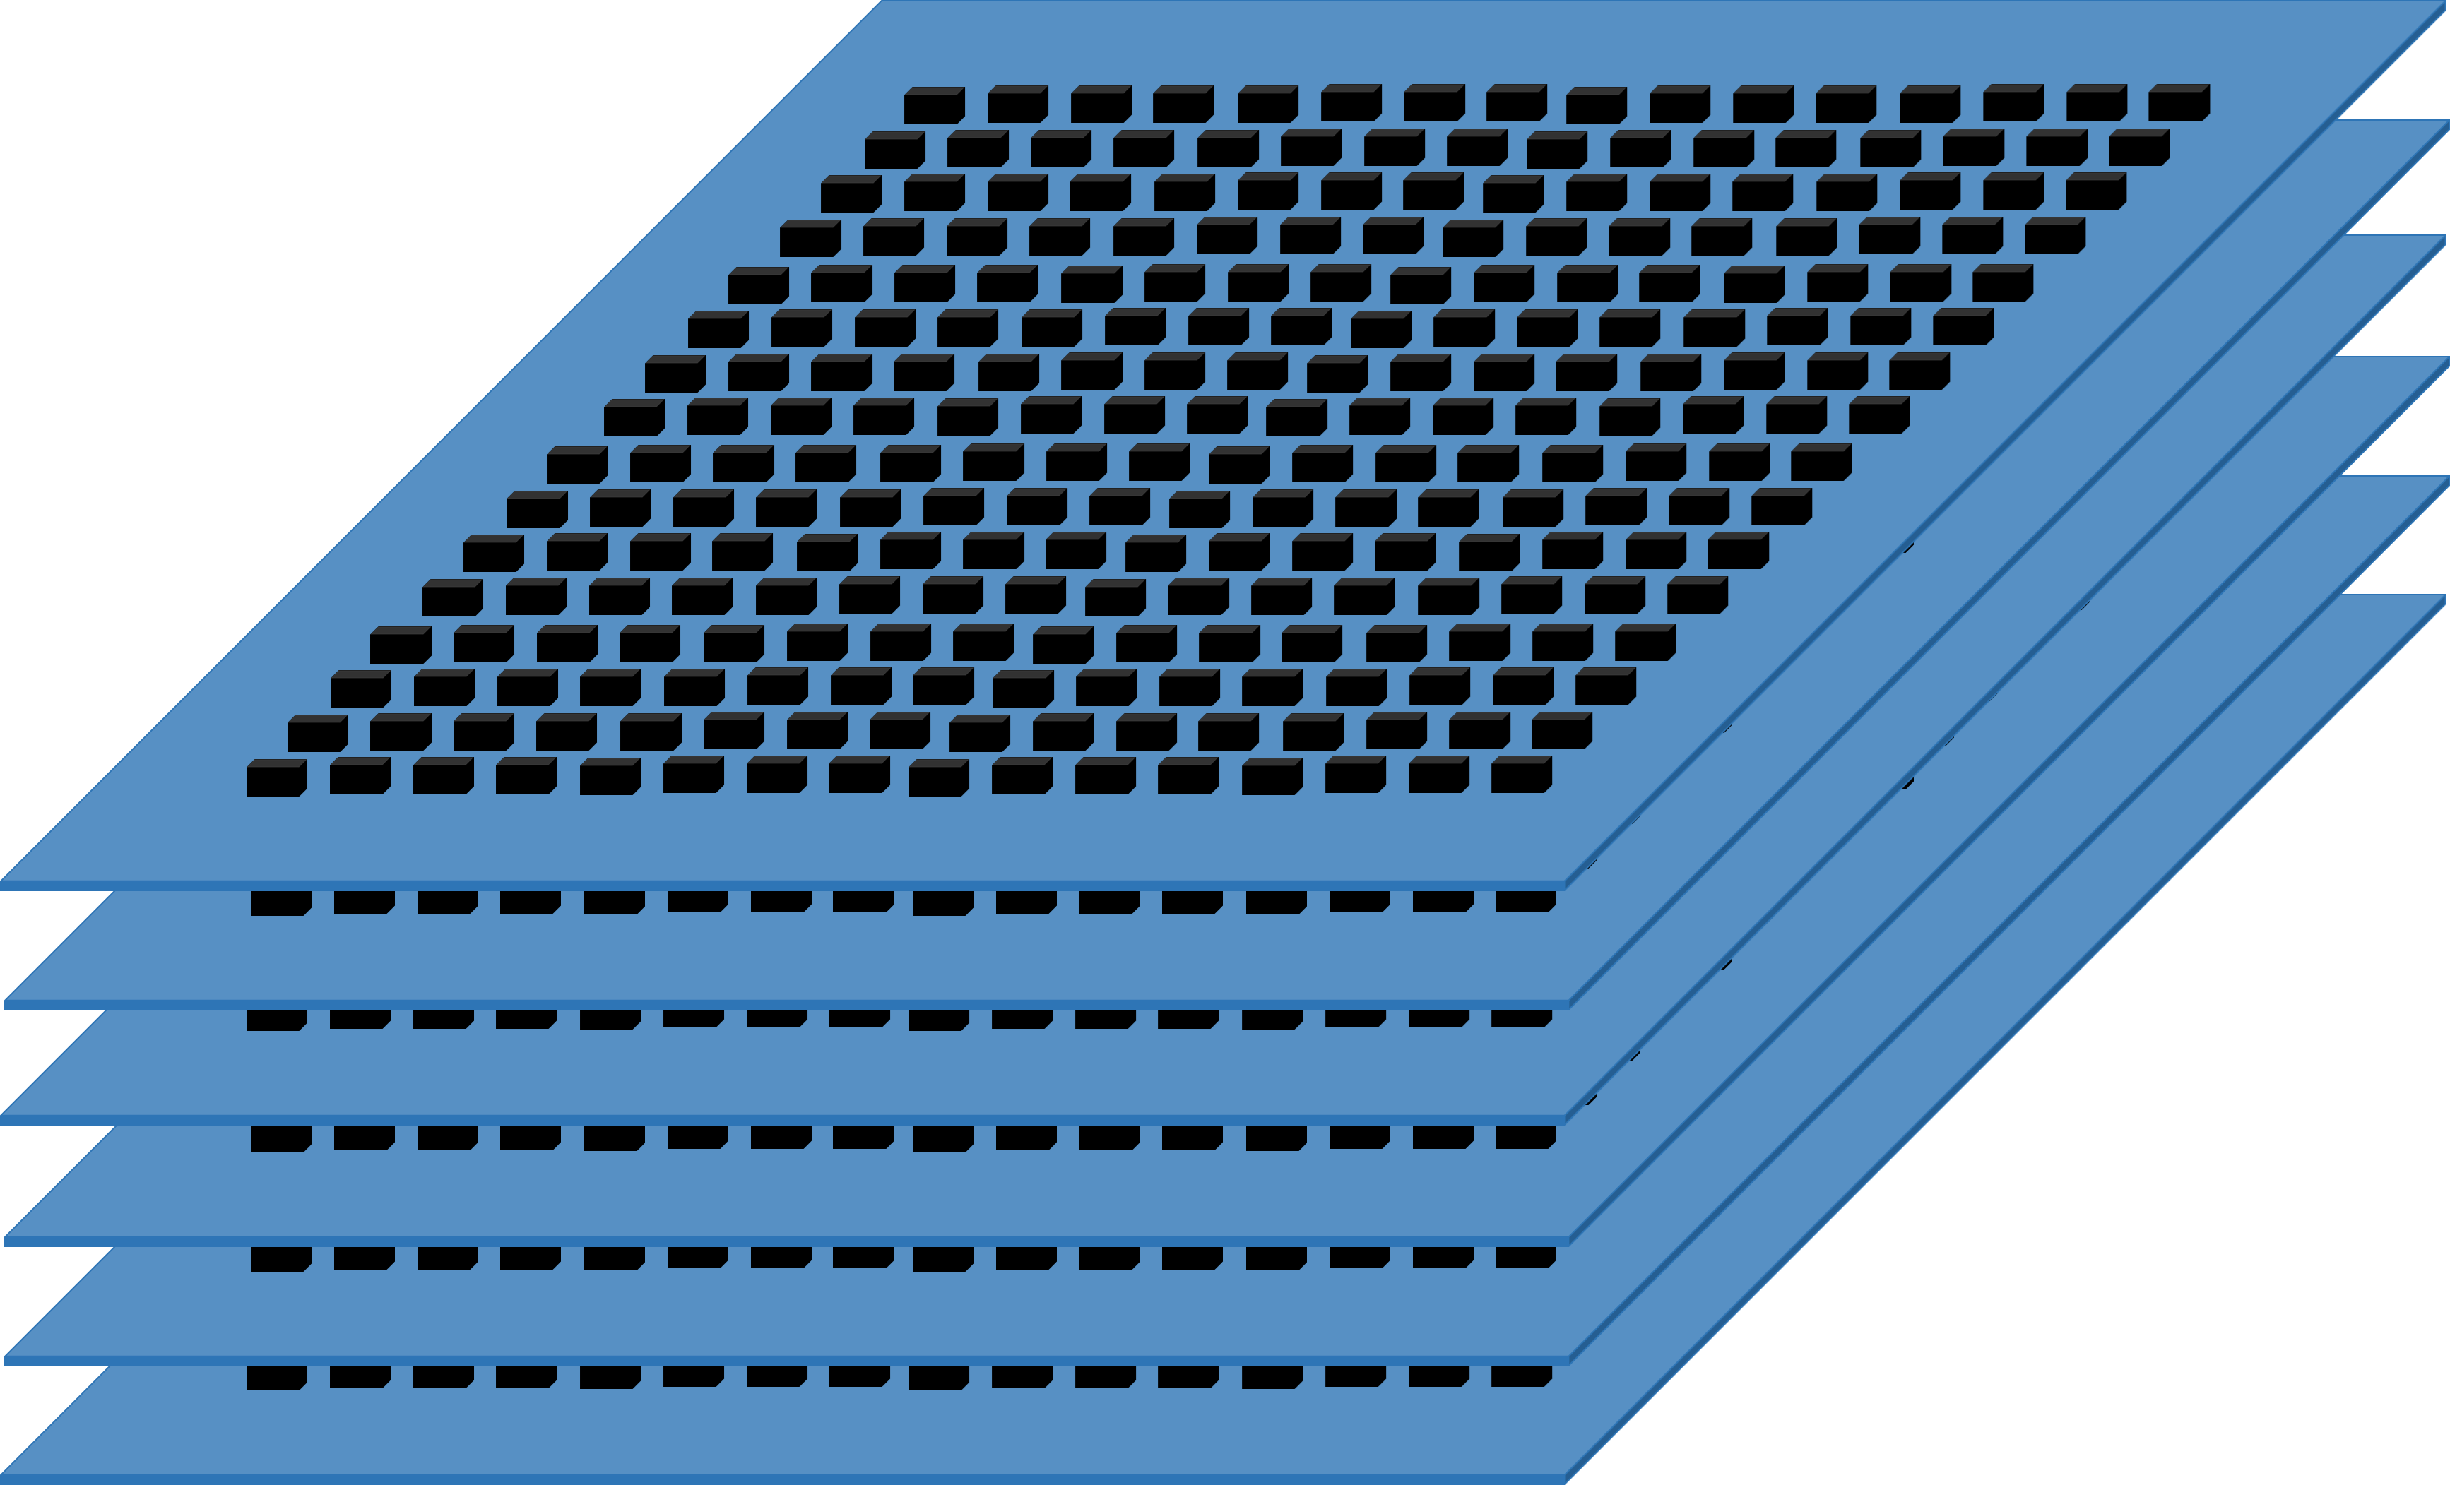
TES detectors development for PAIRS
Yifei Zhang
Institute of High Energy Physics,
Chinese Academy of Science,
2025-9-16
Notes:
A brief report.
Good morning everyone, my name is Yifei Zhang. I will stand for our group to introduce the topic. It is about a highly sensitive, high-resolution focusing telescope for 511 keV (five thousand and eleven thousand electron-volts) photon detection.

Slide 2
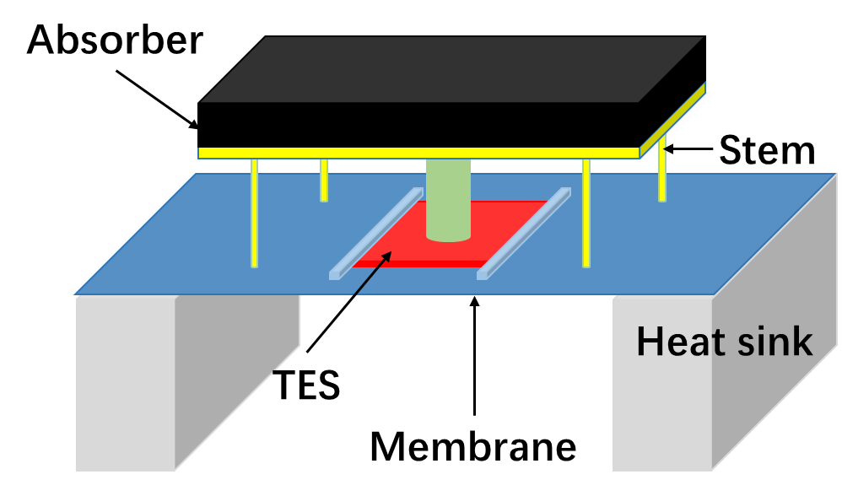
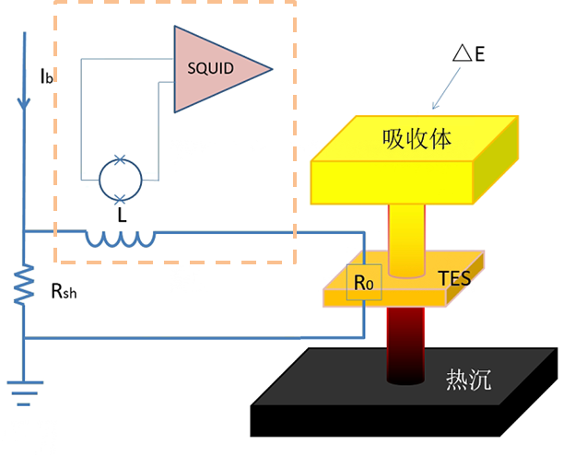
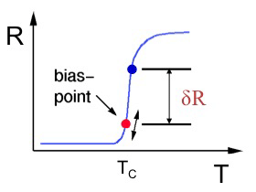

TES Structure and Principle
Transition edge sensor (TES)
Absorber: to absorb photon and convert its energy to temperature rise.
TES film: to detect the temperature rise of the absorber
Under voltage biased, the TES current will be changed and detected by SQUID
Heat sink: to release the photon energy and recover the TES detector
Membrane: to support the film and the absorber, to control the rate of heat loss to ensure that the temperature of the TES is consistent with that of the absorber
$$δI$$

Slide 3
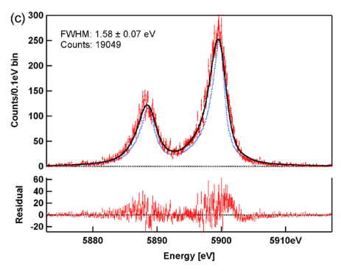
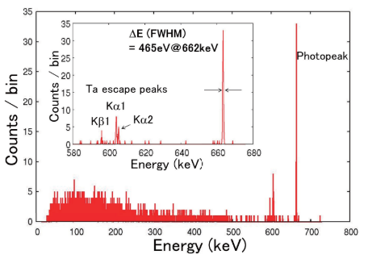

Excellent Resolution
A very promising choice for PAIRS
1.6 eV @ 5.9 keV (SDD ~120 eV @ 5.9 keV)
465 eV @ 662 keV (HPGe ~2.2 keV @ 662 keV)
$$ΔE∝\sqrt{4k_{B}T_{0}^{2}C}$$
Smith, 2012
Ohno, 2017
Notes:
Its energy resolution is two orders of magnitude better than that of semiconductors

Slide 4
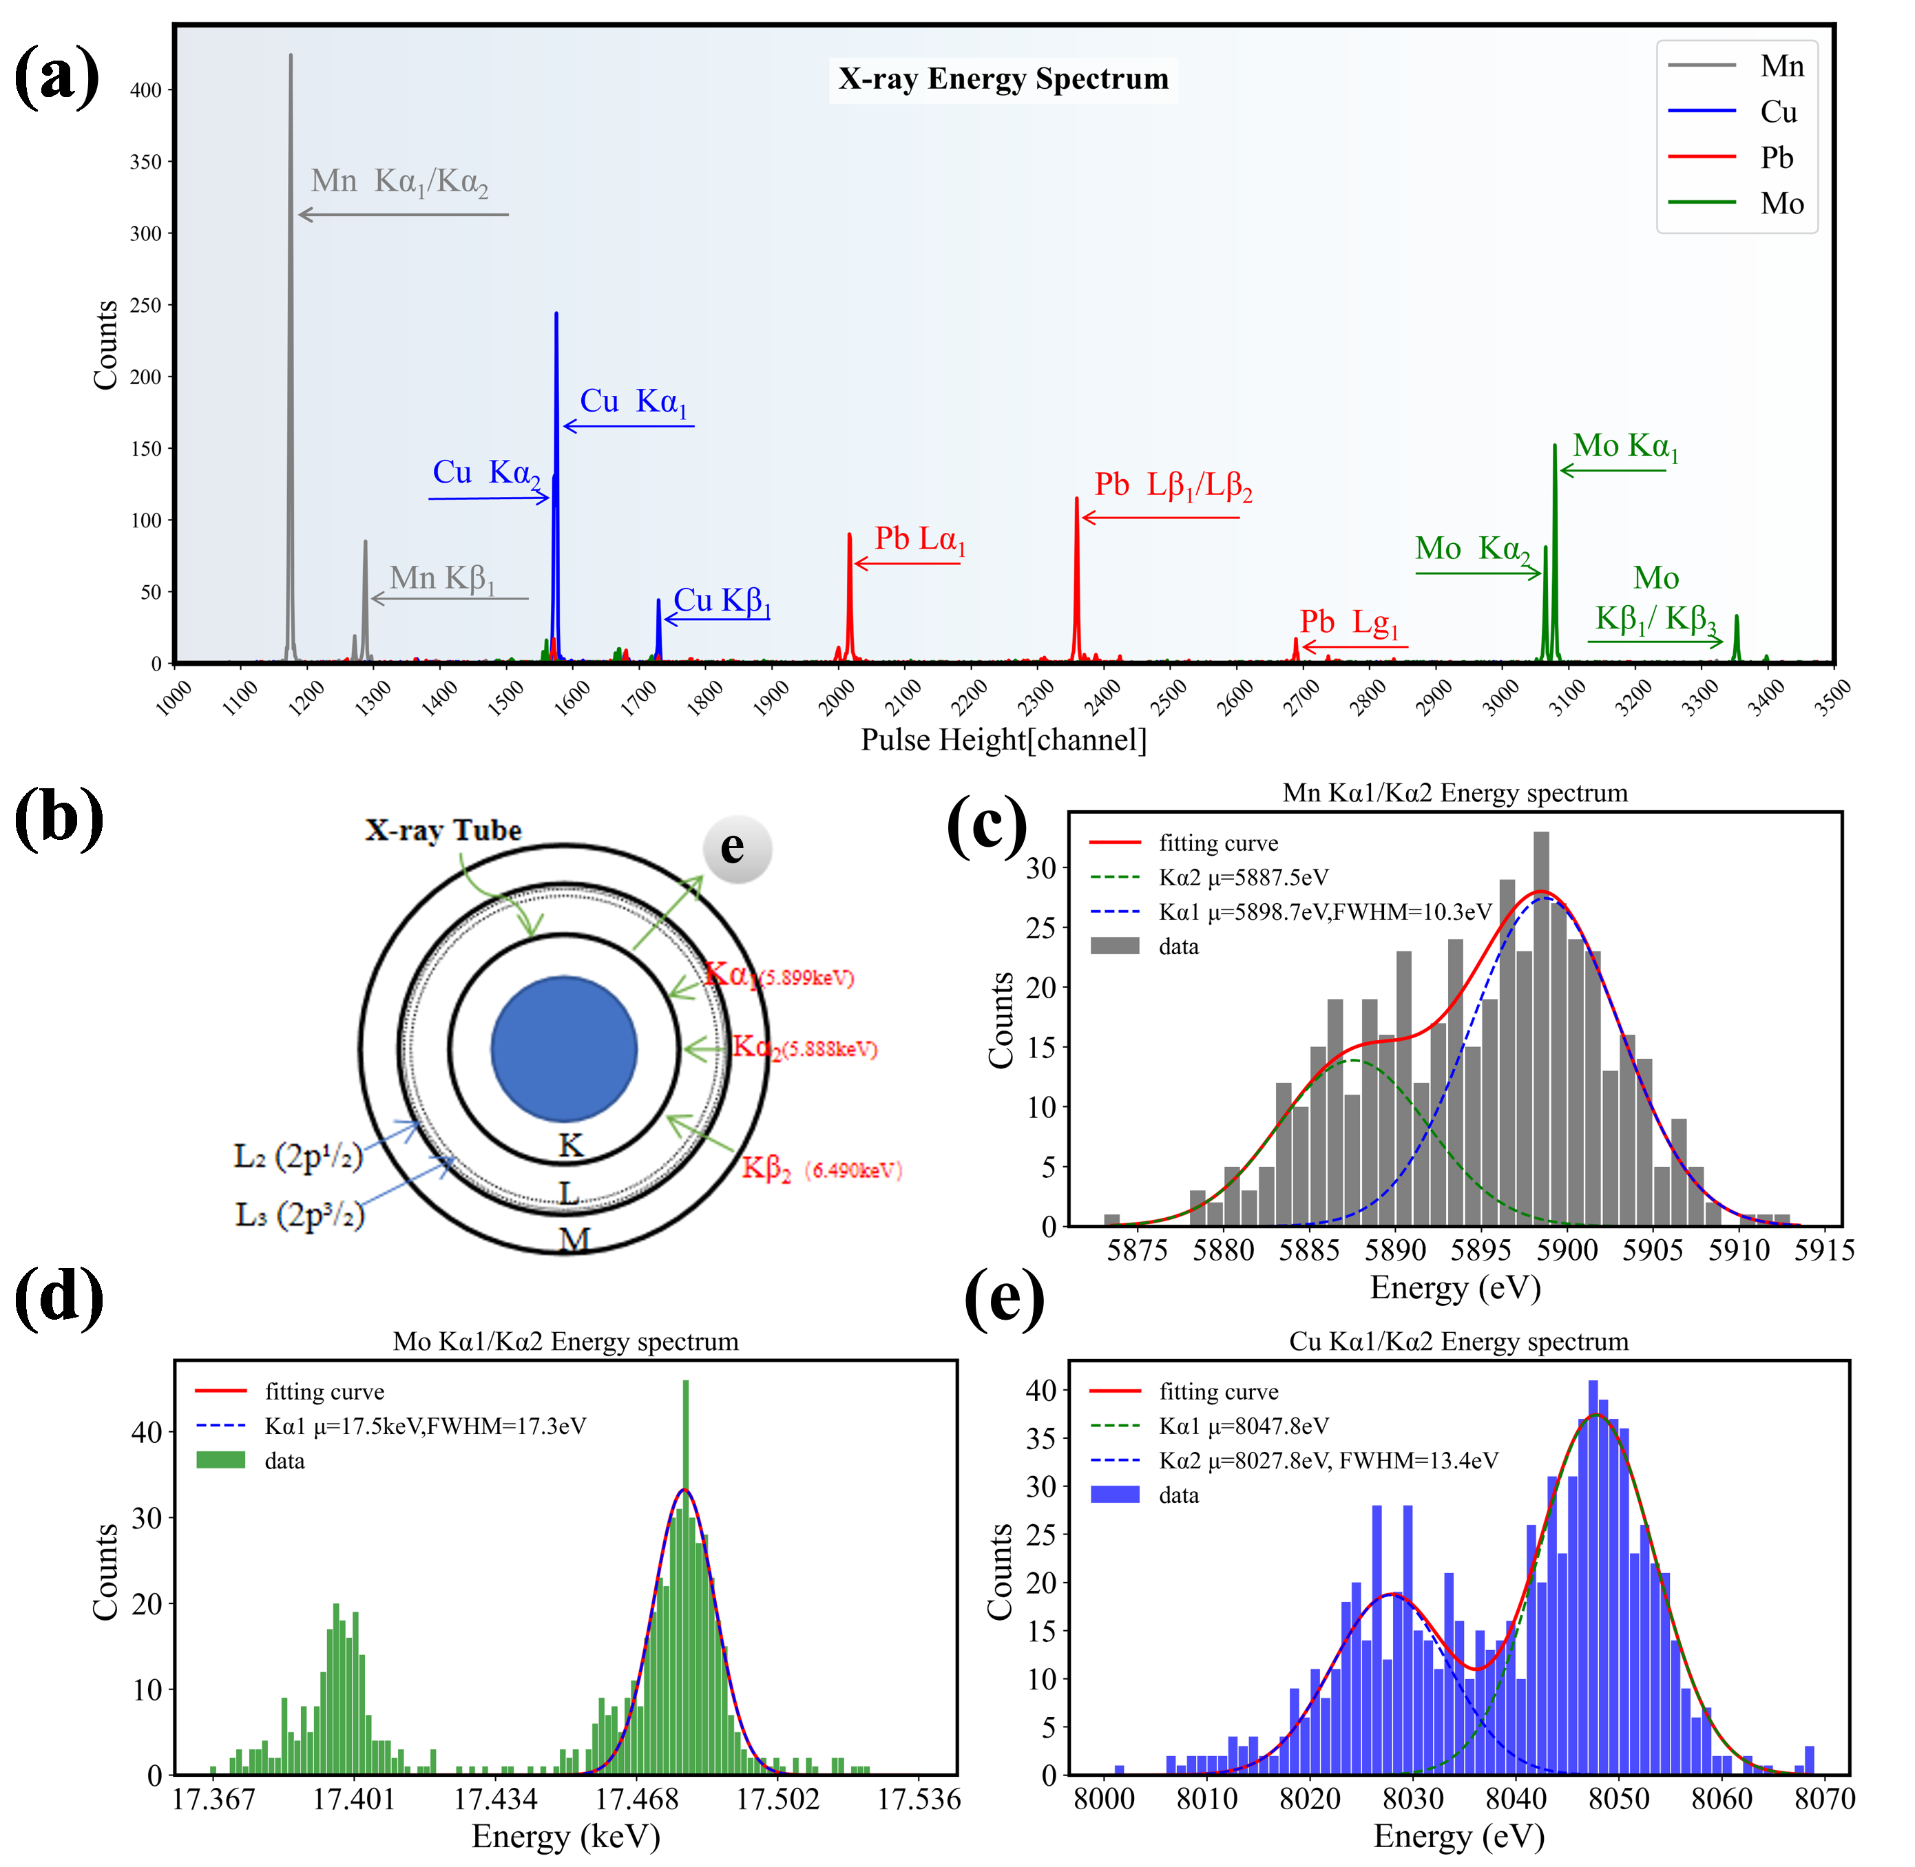
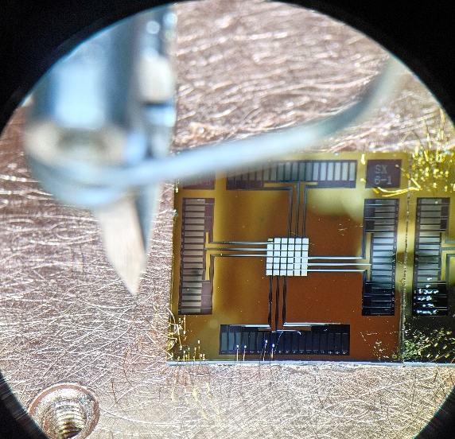
TES Development in Lab
2018-2020, TES fabrication technique exploration
2021, Finished 1st version X-ray TES
2022.3, 2nd version, 27 eV @ 5.9 keV
2023.4, 3rd version, 11 eV @ 5.9 keV
2024.4, 3rd version, 28 eV @ 17.48 keV
2025.8 4th version, 17 eV @ 17.48 keV
6×6 array
For X-ray detection
Notes:
It means that the energy resolution reaches one thousandth. Molybdenum, copper, maganese. We have mastered the preparation technology of TES detectors

Slide 5
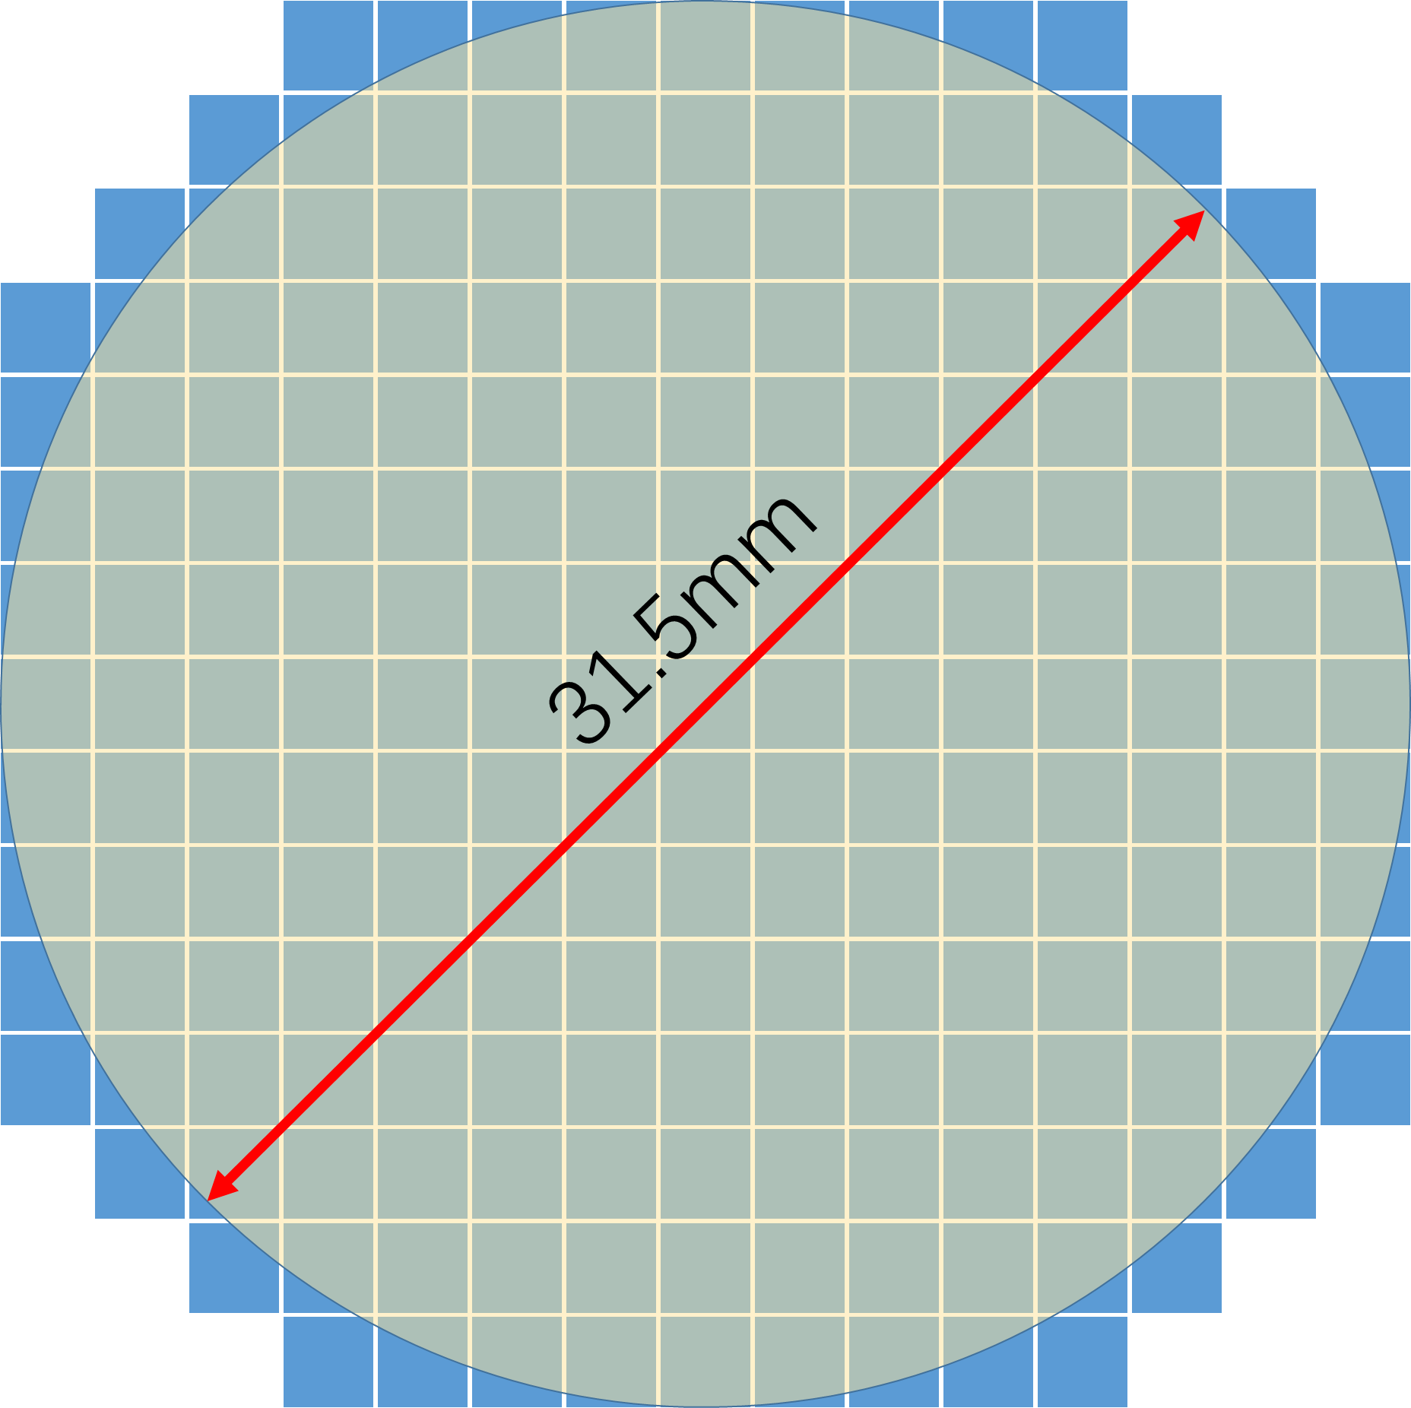
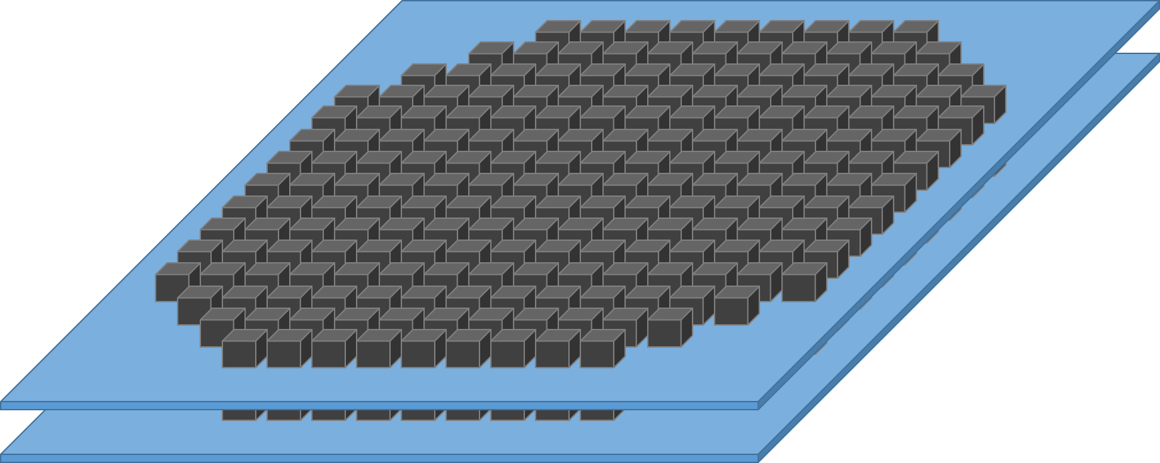
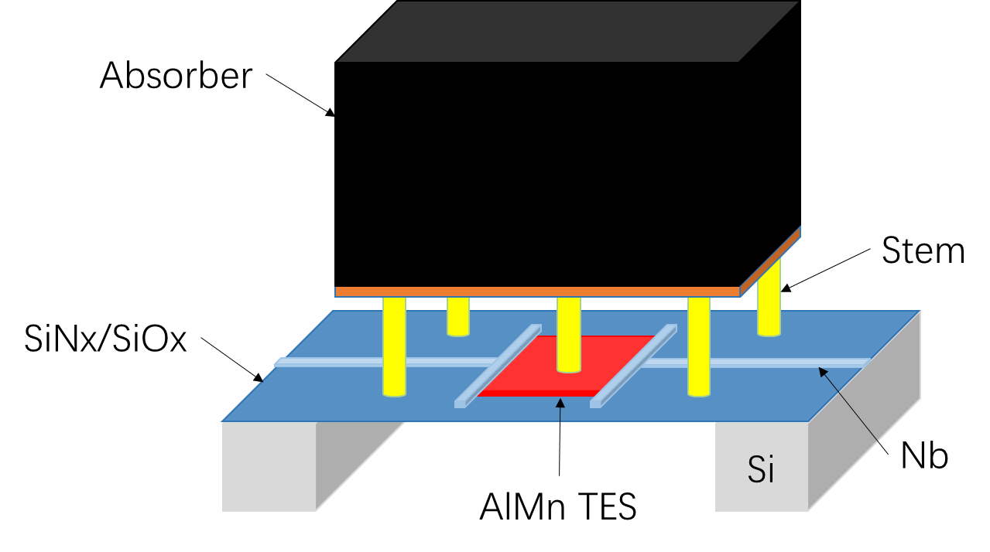
TES Primary Design for PAIRS
Detectors: AlMn alloy TES, 2 layers, 201 pixels per layer
Absorber: Ta, Pb, Bi metal or alloy will be used
Absorber size: 2 mm × 2 mm × 2 mm
Effective area: 8.0 cm²
Energy resolution: ≤ 0.5keV @ 511 keV
Energy range: 450 - 550 keV
Total detection efficiency: ~50% @ 511 keV
Working temperature: ~100 mK
Notes:
TES array adopts the stack design. Preliminarily, it has 2 layers, and each layer contains 201 pixels, total 402 pixels. Ta (tantalum), Pb (lead, or plumbum) and Bi (bismuth) metal or alloy have been reported to as the material of absorber. Currently Ta is the first choice. AlMn alloy TES is used and its critical temperature is around 100 mK for most X/gamma application. Pixel resolution need to be less than 230 eV, considering the reduction by TDM SQUID.

Slide 6
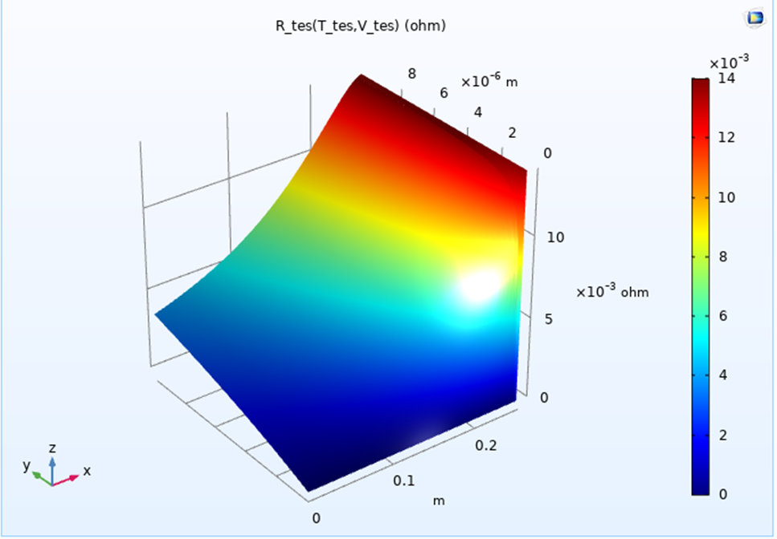
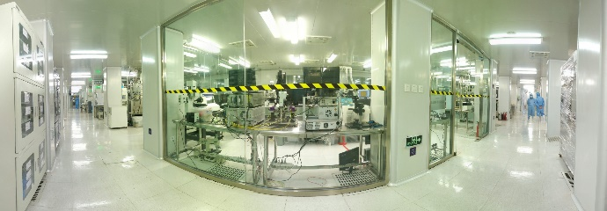
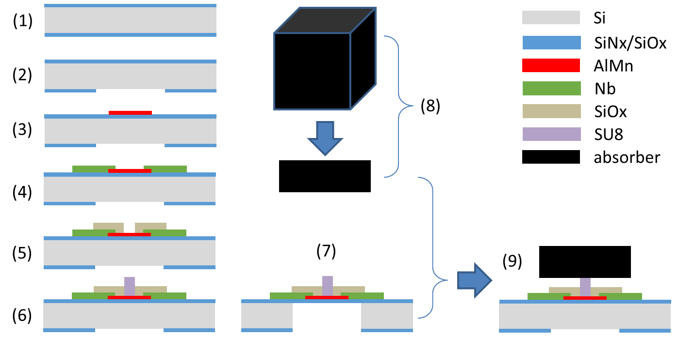
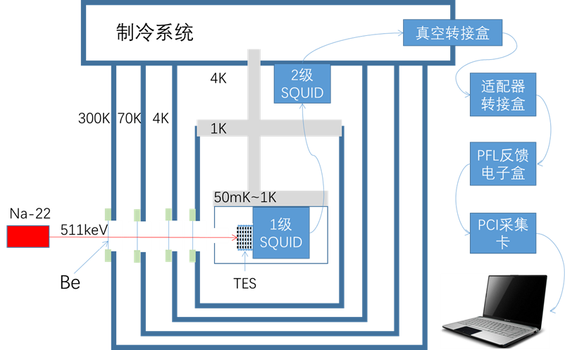

Development
Development route
Simulation and design
Pixel fabrication
Pixel test
Alignment and assembly
Big array
Small array fabrication
Notes:
We will develop the TES array by ourselves. First step is making simulation and design, second fabricating pixel TES on the micro and nano processing platform. Third testing pixel by radioactive isotope. When the characteristics of TES reach the energy resolution required, we will then focus more on the array fabrication, alignment and assembly until we get the final TES array.

Slide 7
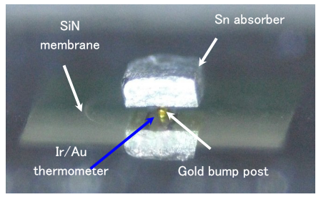
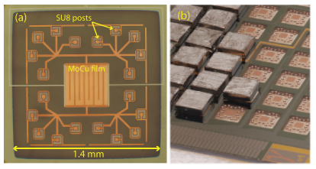
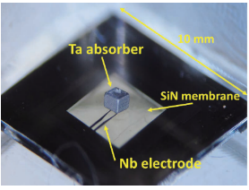
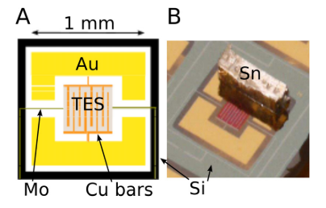
Challenge
Processing and fixation of absorbers？
Absorber:
200μm×200μm
×2-5μm
Absorber：
2000μm×2000μm
×2000μm
Commonly used size in X-ray detection
PAIRS
Reported design
Notes:
need to be addressed. Provide useful help.

Slide 8
Plans
1, Pixel resolution:
< 0.5 keV
@ 511 keV
1, Total resolution:
< 0.5 keV
@ 511 keV
1, Pixel resolution:
< 2 keV
@ 511 keV
Waiting for launch
2026
2027
2028
2029
Notes:
This simply show a plan for the main technique development. The TES detector will get through. in 2026, and we hope the main parameters will reach our goal.in 2029.
Next year, the year after, in 2028

Slide 9
Thank you for your attention！

