Slide 1
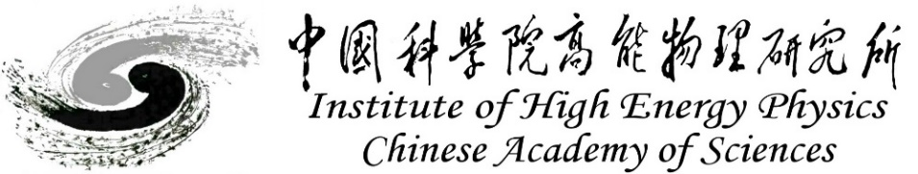

Energy and Time Readout ASIC
for CZT and Si Detector
Wang Ke, Wang Na, Liu Xiaohua, Li Xiaohui, Cai Jiale, Liao Haolong
Beijing, 17 September 2025
Notes:
Good morning everyone. I am Liao haolong from IHEP. It is my pleasure to present a kind of energy-time readout ASIC for CZT and Si detectors.

Slide 2

Outline
Introduction to CPRE
CPRE-64 chip
Application of CPRE-32 chip
Summary and conclusions
Notes:
My presentation will be structured as follows:

Slide 3
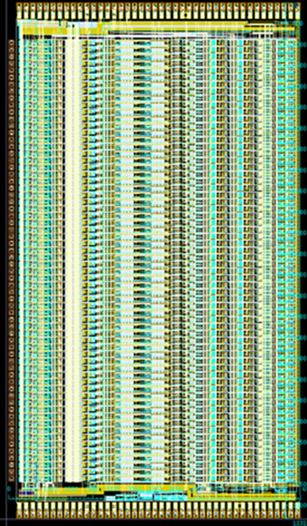
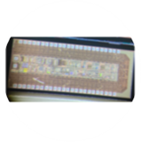
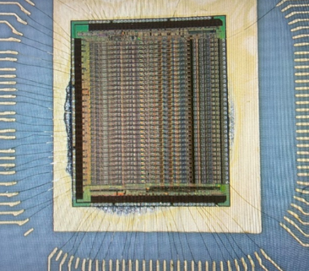
1.1 Introduction
CPRE (Charge Pulse Readout Electronics)
Readout chips designed for the energy and time readout of semiconductor detectors,
such as CZT and Si
Key Features:
Selectable signal polarity on a channel-by-channel basis
Independently selectable gain, peaking time, threshold
Two signal paths
—peak detector and hold for slow path, sample and hold for fast path
Programable readout selection
Differential analog output
Wire chips as daisy chain
CPRE-64
CPRE-32
CPRE-1CH
Notes:
Let me begin with a brief introduction to our chip, Charge Pulse Readout Electronics, witch we called CPRE .Its key features include

Slide 4
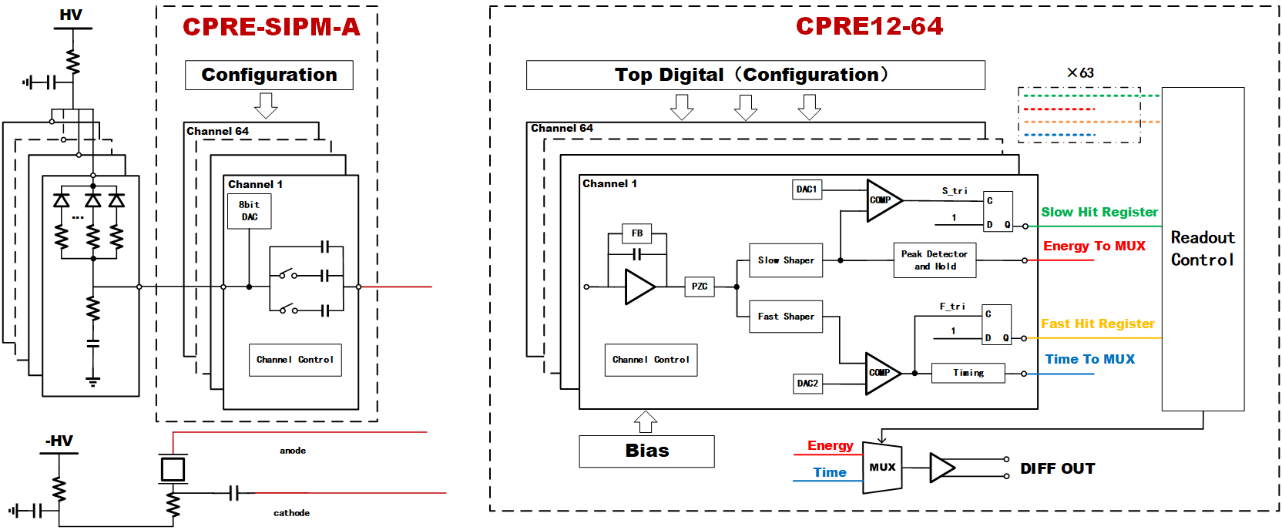
1.2 Introduction
For SiPM
For CZT or Si
Notes:
The main chip is capable of directly reading out signals from semiconductor detectors. When coupled with an additional chip, it can also capable of Silicon Photomultipliers .

Slide 5
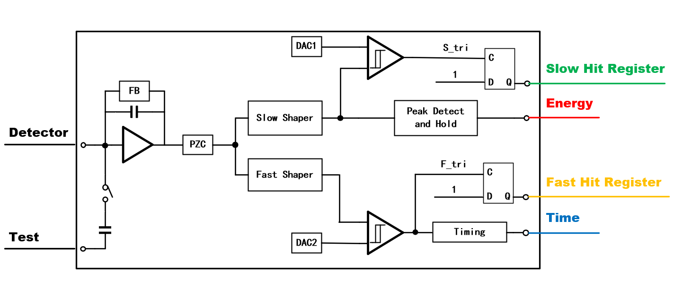
1.3 Architecture of the Analog Channel
Baseline Selectable
Gain
Peaking Time
Time Constant
CSA Gain
On/Off
Threshold
Notes:
Each analog channel is offering configurable options including test signal injection, gain and time constant of the charge-sensitive amplifier (CSA), baseline selection, gain and peaking time of the shaping amplifier, and trigger threshold levels.

Slide 6
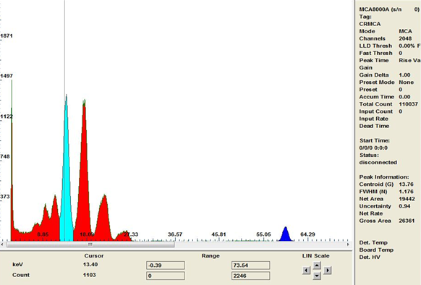
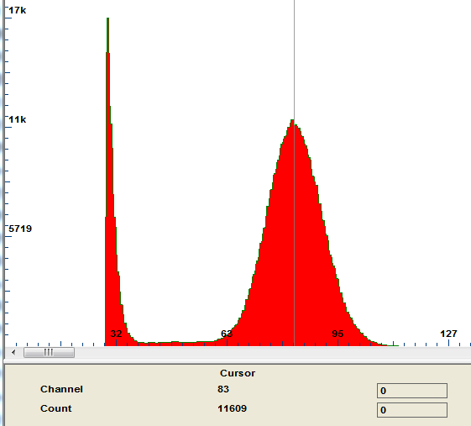
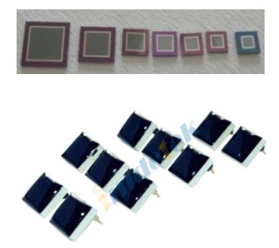
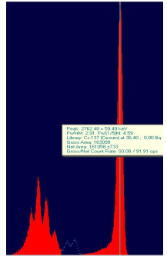
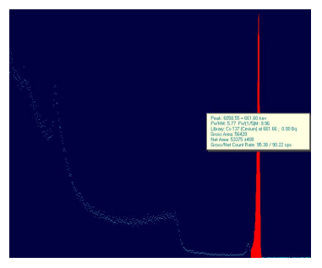
1.4 Measured Spectra
Si-PIN
Fe 5.9keV FWHM:1.42keV
Am241 13.76keV FWHM:1.176KeV
CZT
Am241 59.5keV FWHM:2.91keV
Cs137 661.6keV FWHM:5.77keV
Notes:
Some Measured Spectra are illustrated in the figure below, demonstrate capability in processing both polarity of signals.

Slide 7
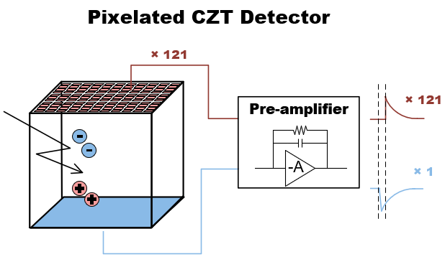
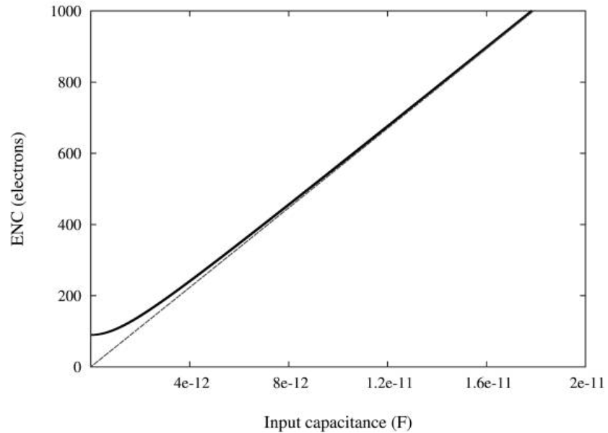
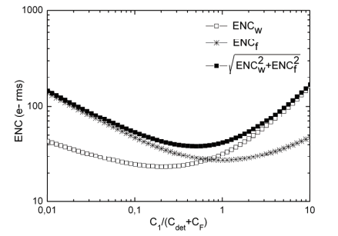
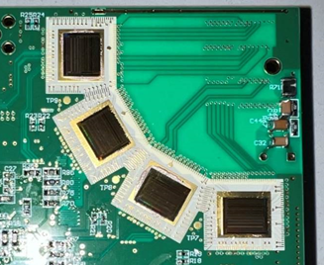
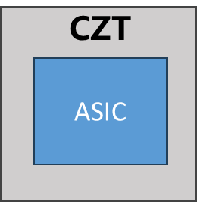
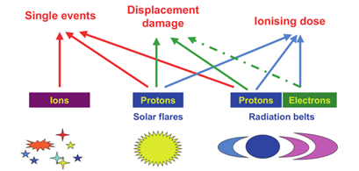
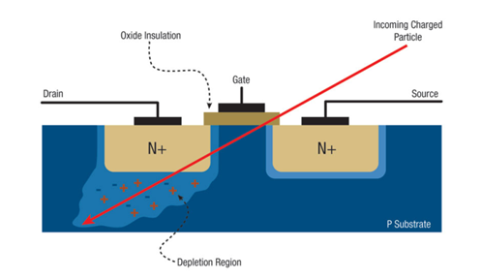
2.1 CPRE-64 : Motivation
Number of Channels
Noise Performance
Improve noise performance
Noise optimization of cathode channel
Radiation Hardening
4 * CPRE-32
Back to back
Notes:
The CPRE64, developed primarily to meet new system requirements. Key motivation include: a higher channel count to enable back-to-back placement; improved noise performance, and specific optimization for CZT cathode readout; and radiation hardening for tolerance to space radiation environments.

Slide 8
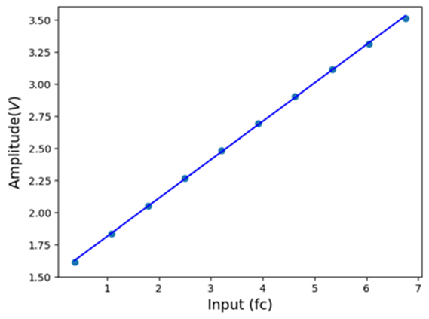
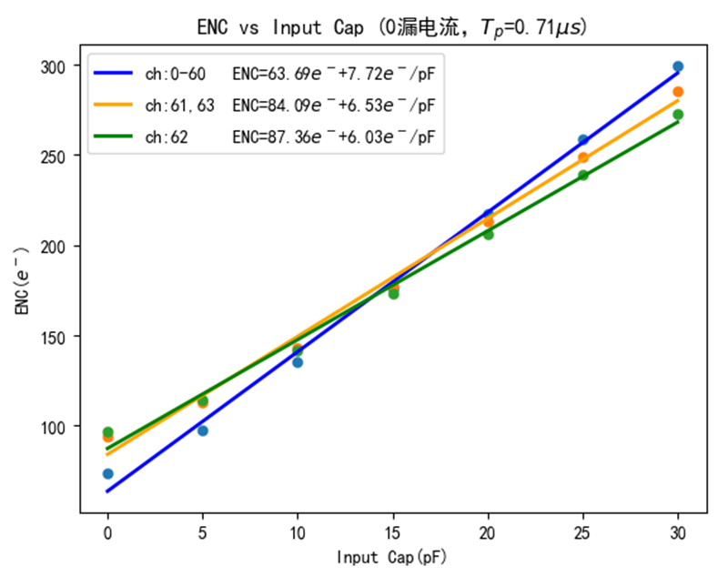
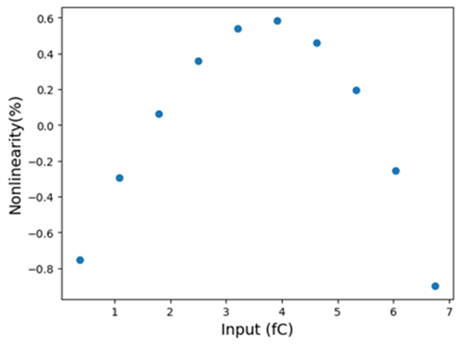
2.2 Electrical Characteristics Simulation Result
ENC
Linearity
CPRE-32
CPRE-64
ch0-60: 64e⁻+8e⁻/pF
ch61,63: 84e⁻+6.5e⁻/pF
ch62: 88e⁻+6e⁻/pF
80e⁻+13.2e⁻/pF
cathode optimized
Notes:
The CPRE64 chip has completed tape-out, and testing is pending. here are preliminary simulation results of its electronic characteristics.
ENC simulations indicate a significant noise reduction compared to the previous generation. The cathode channel shows a lower noise slope for the large capacitance of CZT cathodes.
Linearity simulations also indicate nonlinearity of about 1%.

Slide 9
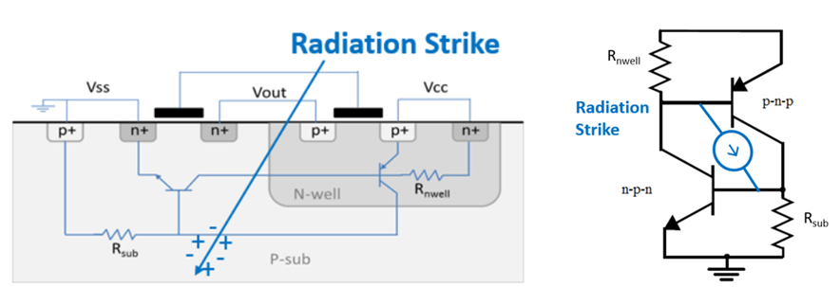
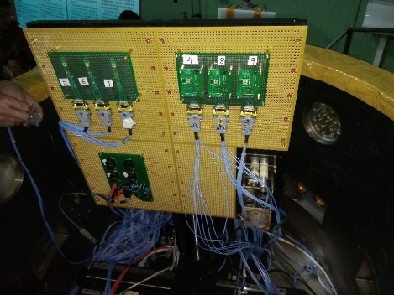
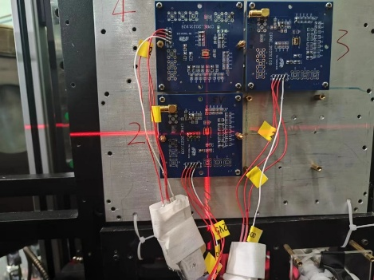
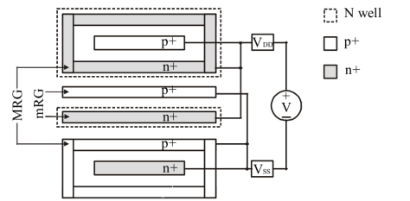
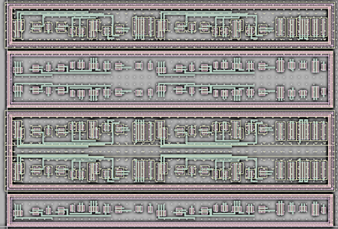
2.3 SEL Hardness
Heavy Ions Test of CPRE-1CH
SEL Hardening at Layout Level
Ion | Energy (MeV) | LET (MeV.cm²/mg)
⁷⁴Ge^{11,20+} | 208 | 37.7
¹²⁷I^{15,25+} | 283 | 56.7
SEL immune to 56.7MeV·cm²/mg
(limited by facilities)
Dual guard rings
Notes:
In space radiation environments, Single-Event Latch-up (SEL) can cause fatal hard errors. To mitigate SEL, dual guard rings were incorporated into the layout, which is one of the most reliable hardening techniques. The effectiveness of this approach was validated in a smaller-scale test chip, which demonstrated complete immunity to SEL during testing.

Slide 10
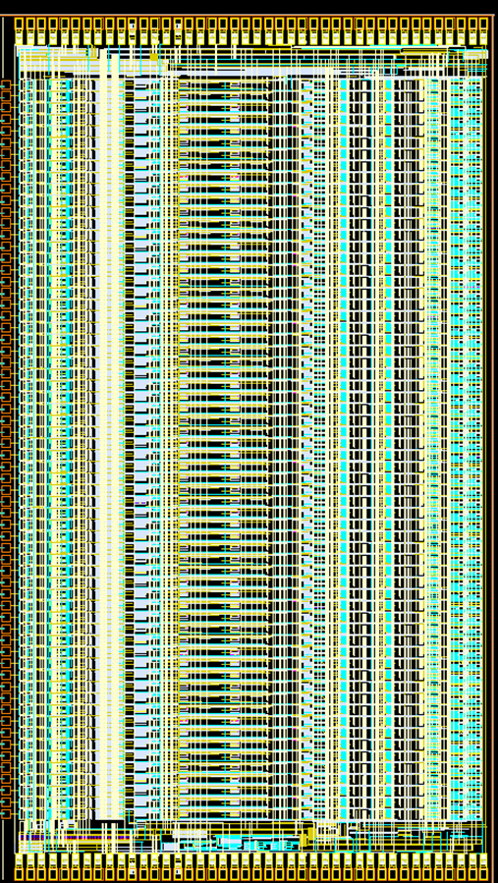
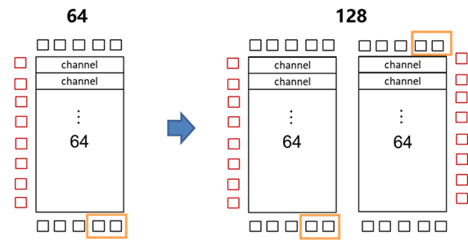
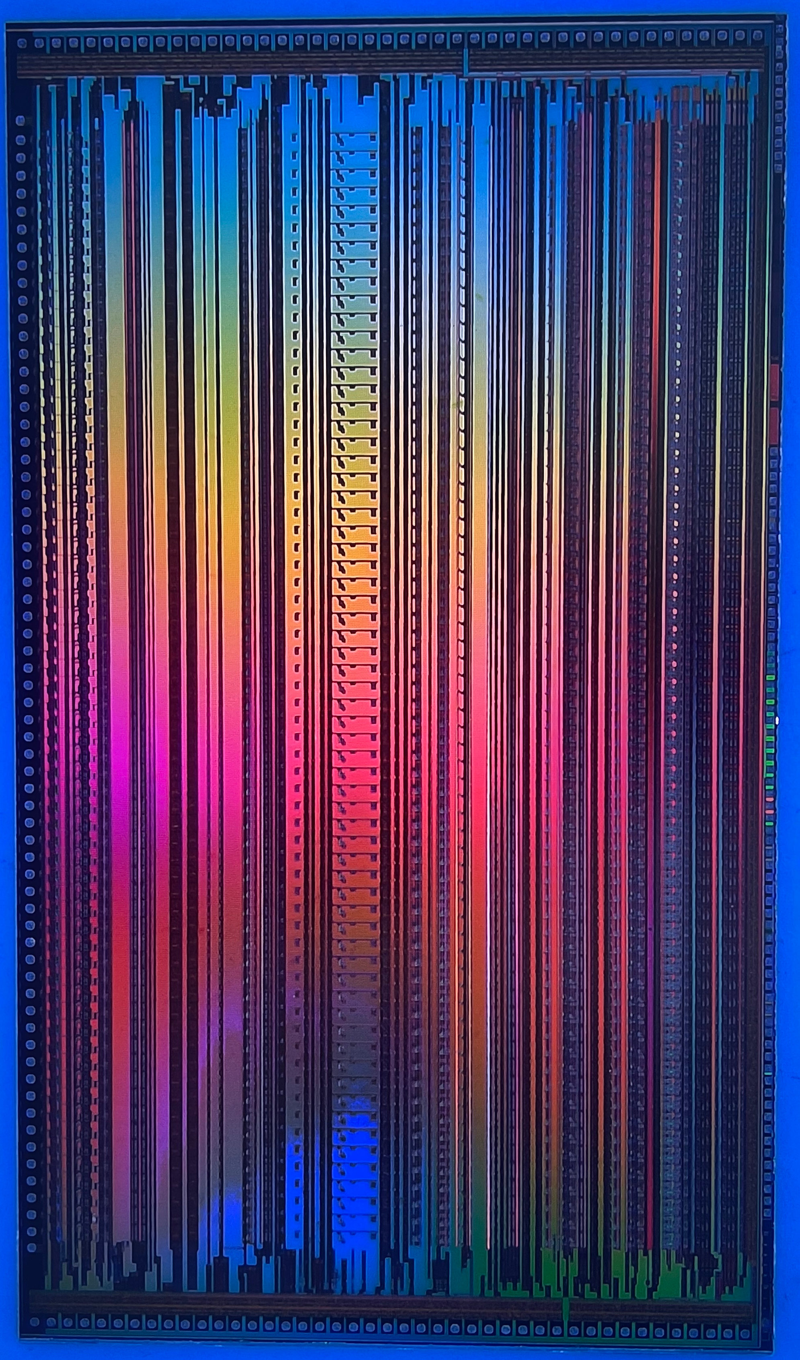
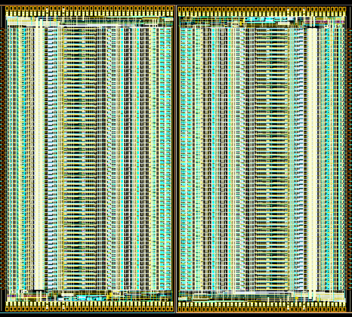
2.4 Layout
Digital
61 Channel
3 Channel (cathode optimized)
BIAS
Buffer
Pads on only three sides
Expansion to 128 channels with minimal area loss
7mm*12.4mm
Notes:
The chip layout and a micrograph are shown here. The die area is 7 × 12.4 mm.

Slide 11
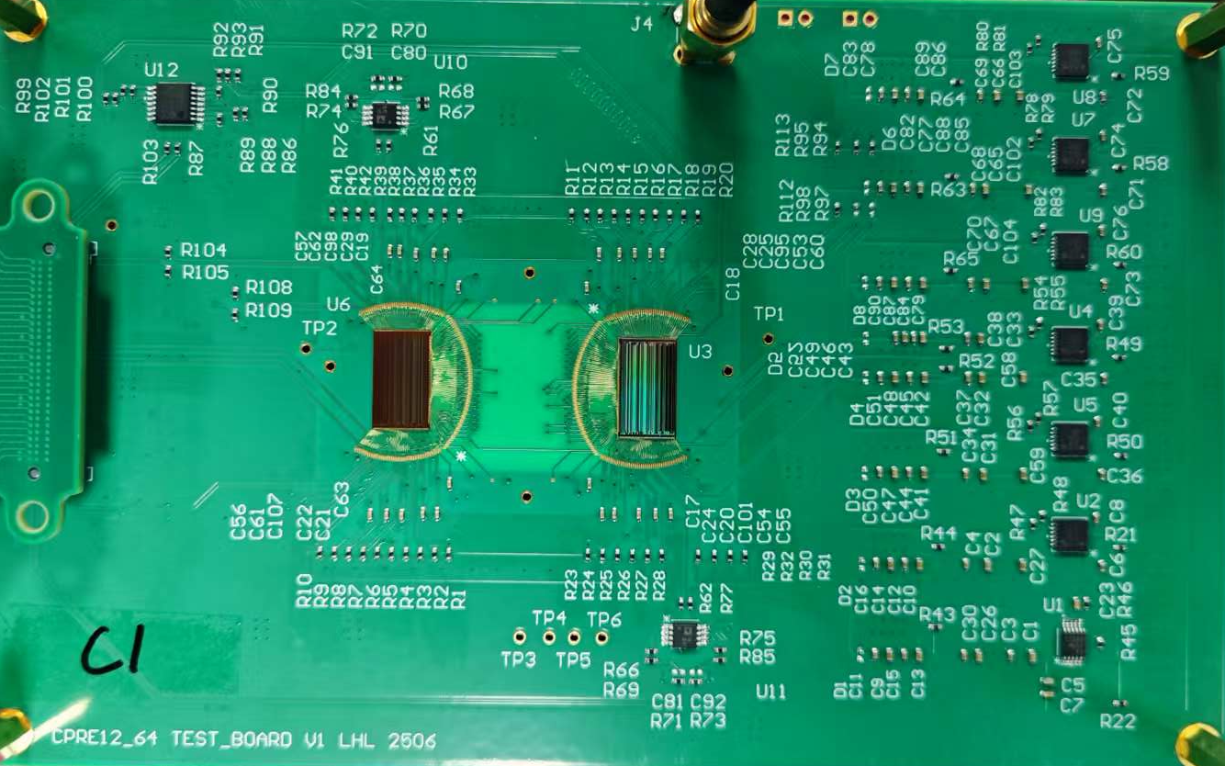
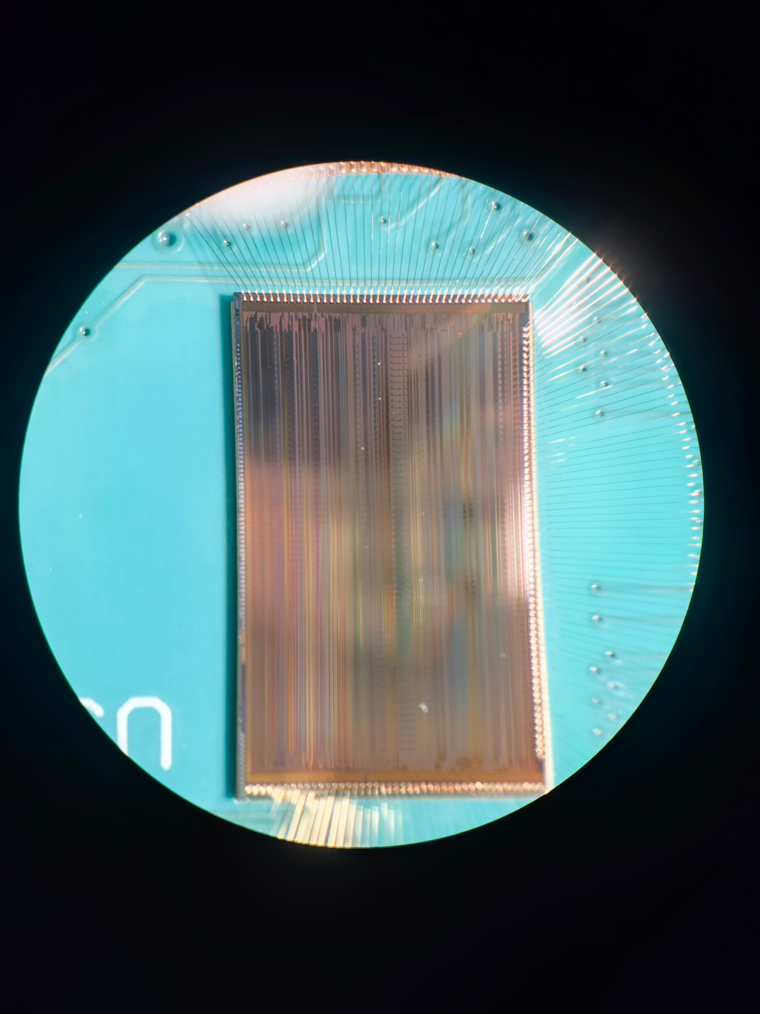
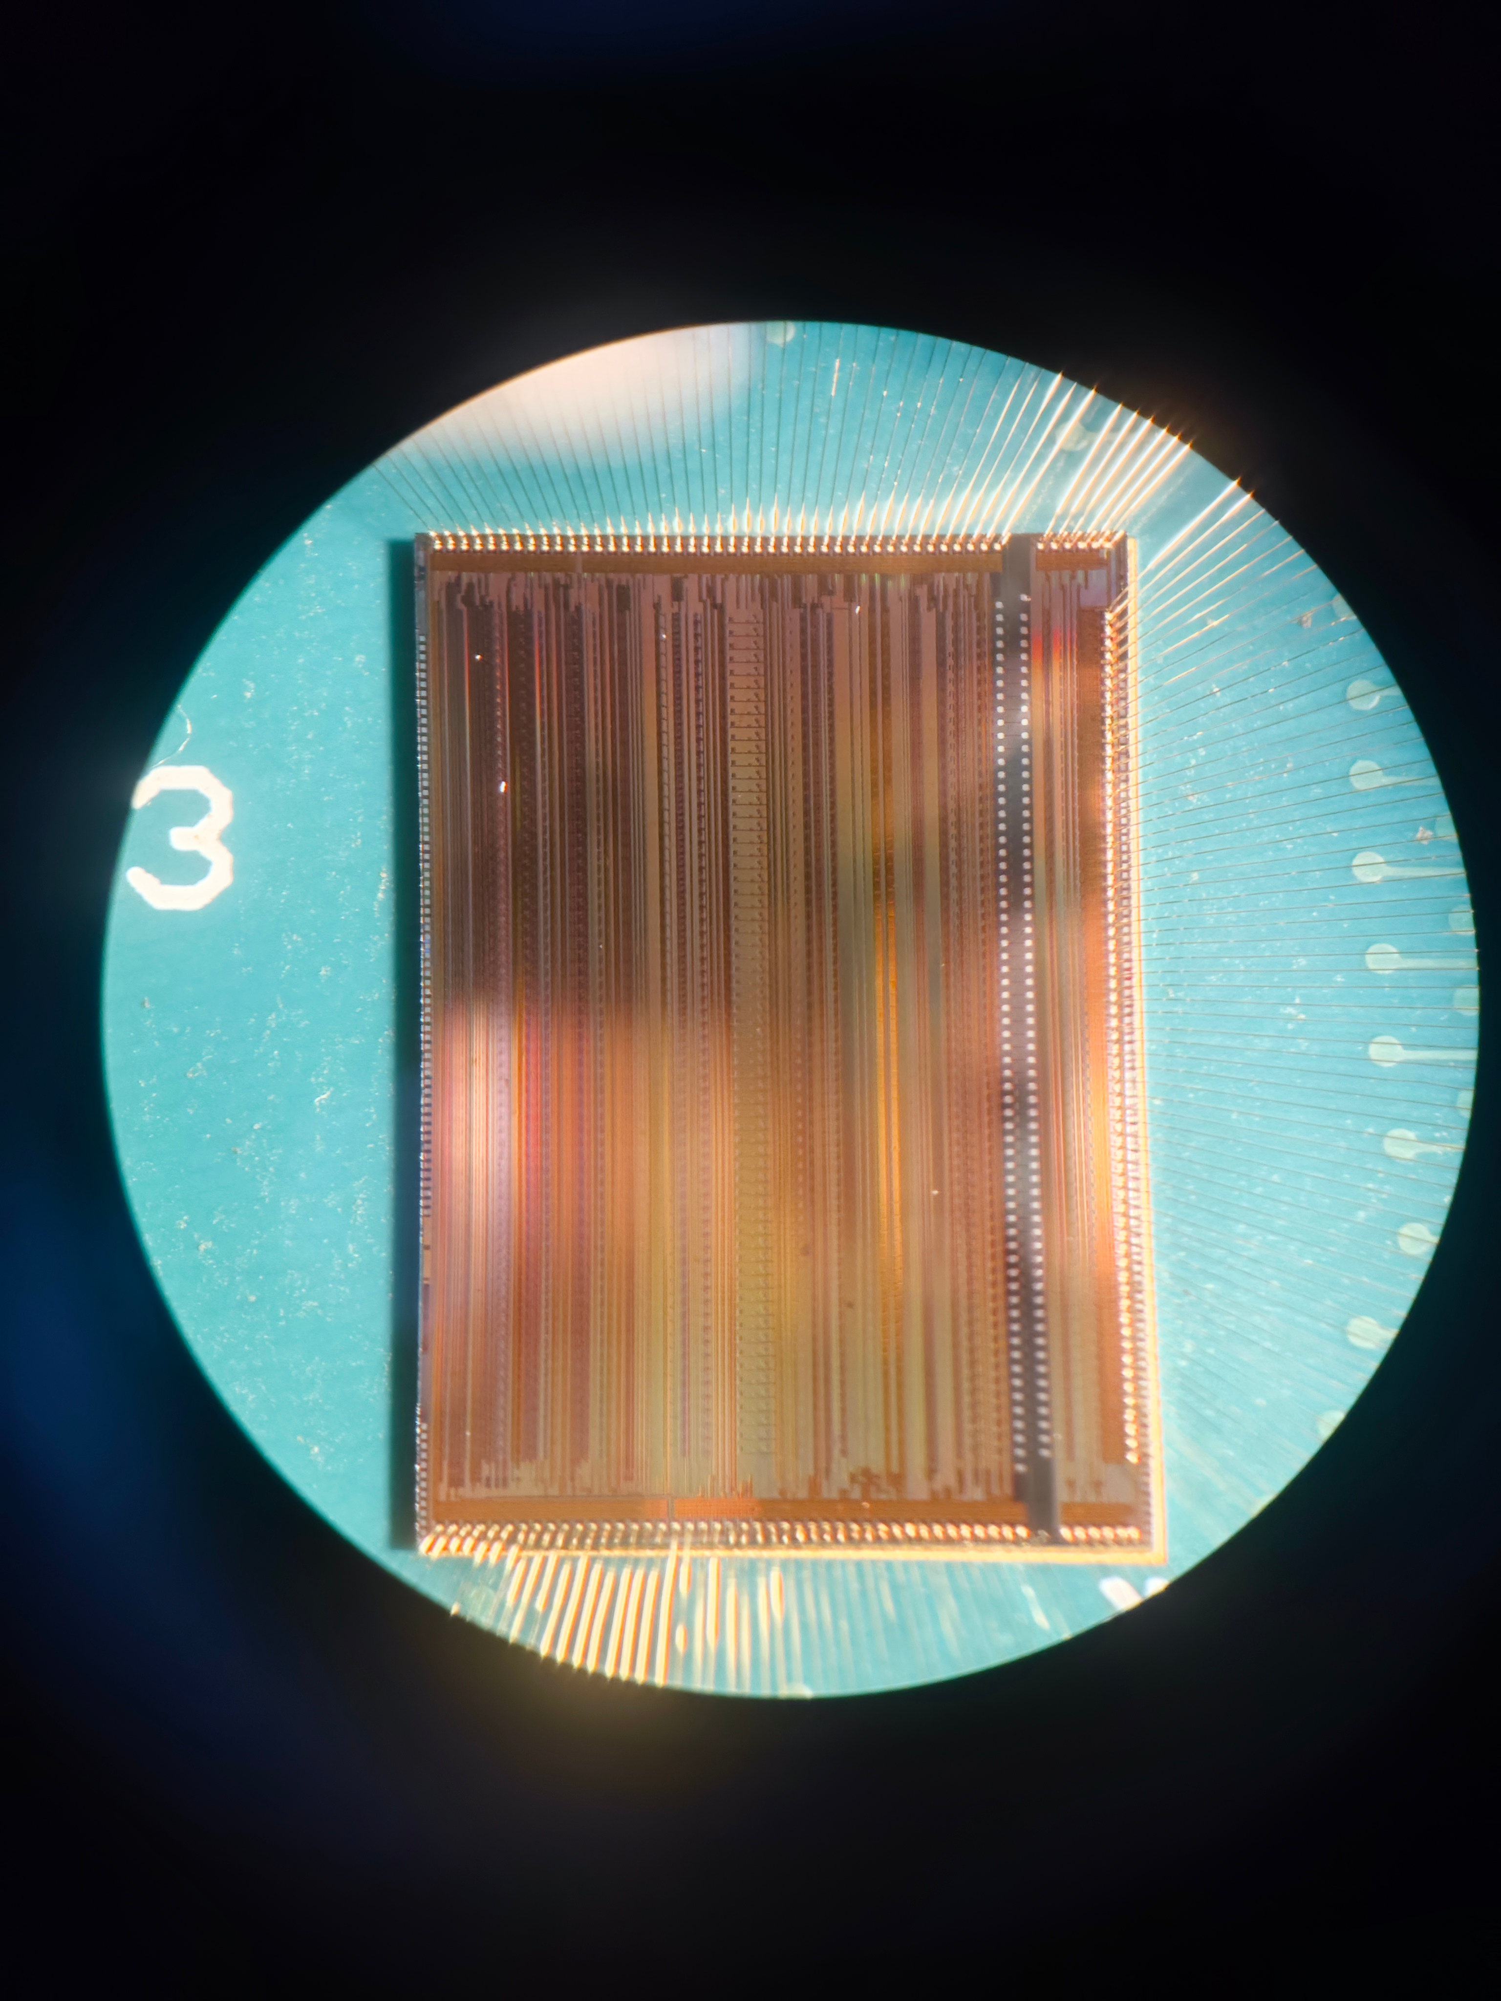
2.5 Test Board
Test Board
COB
Notes:
The chip was just assembled using Chip-On-Board (COB) packaging and has been shipped back to IHEP yesterday. testing is scheduled to commence shortly.

Slide 12
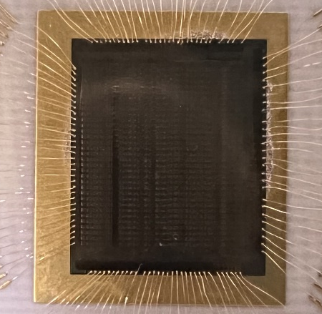
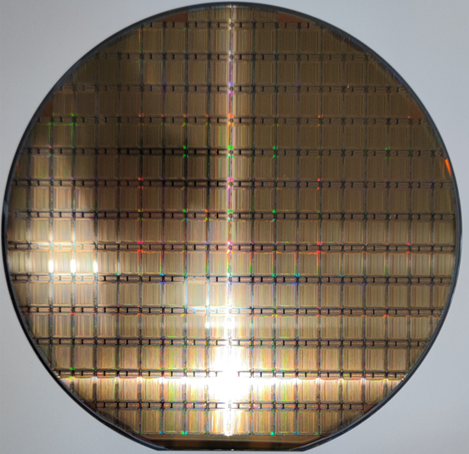
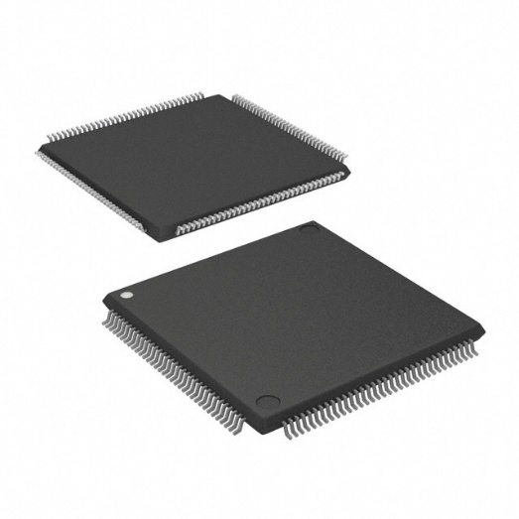
3.1 CPRE-32 : 32-channel Chip
Parameter | Characteristics
Size of DIE | 7100 × 8500 μm²
Number of pins | 123
Number of channels | 32
Polarity | Positive and negative optional
Time resolution | About 10 ns
Power consumption | 5 mW/channel
Counting rate | 100 k/s
Working temperature | −20~80 °C
CPRE-32 die
TQFP-144
Notes:
For potential applications, we can refer to introduce the application of CPRE-32. Its key specifications are summarized in the table below.

Slide 13
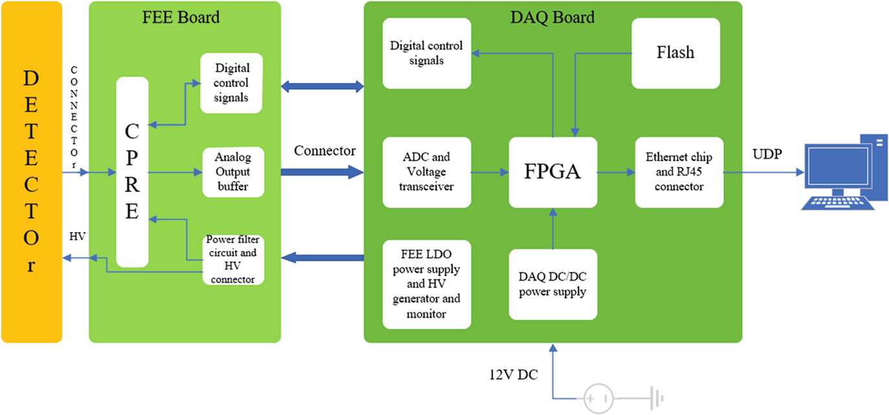
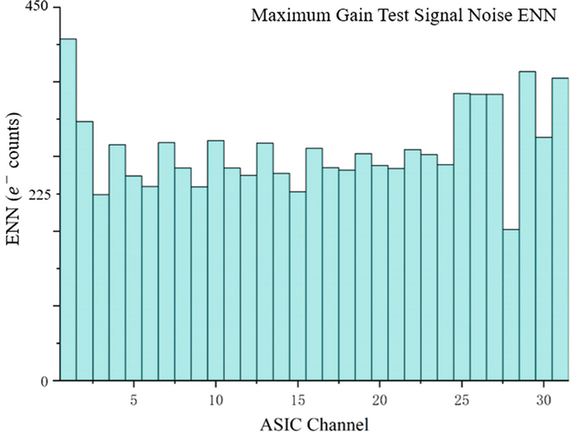
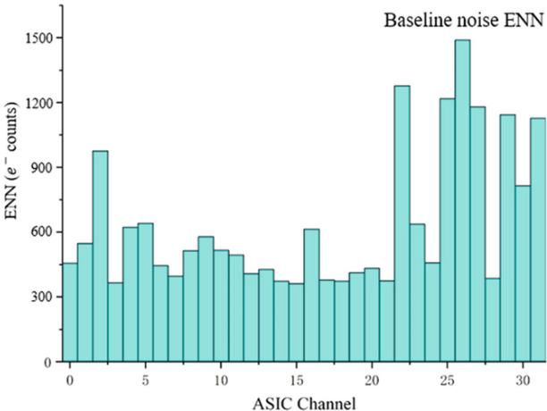
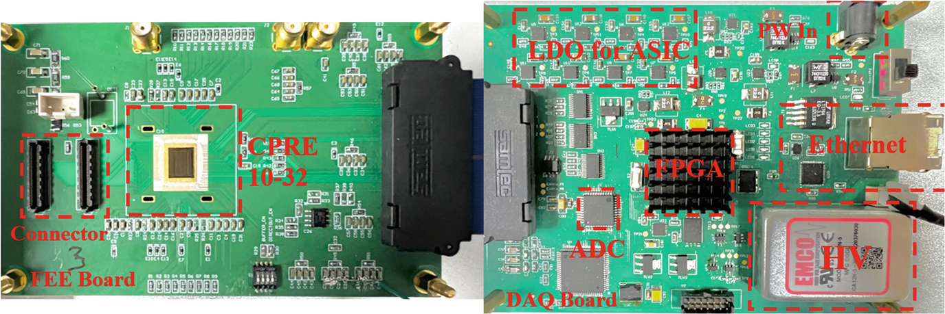
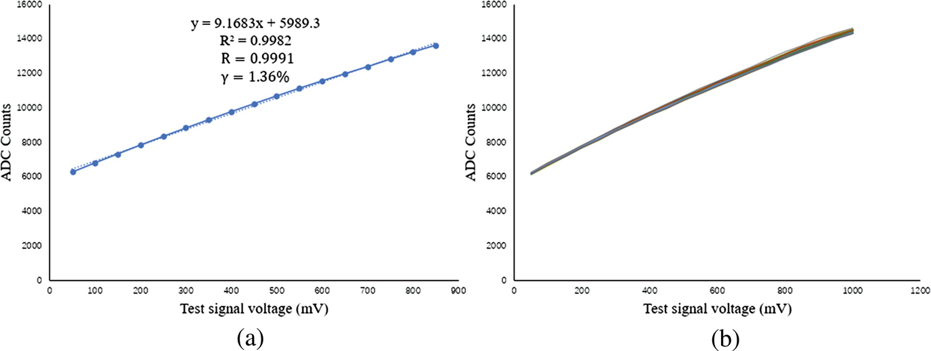
3.2 Characterization of CPRE-32
ENC~225e⁻
without detector
connected to detector
CPRE-32 Evaluation System
Chen Tianze, Li Xiaohui (IHEP)
Notes:
A electronic test system was developed. Measured performance are shown. For ENC, including PCB parasitic capacitance, showed an electronic noise of approximately 225 electrons. And a nonlinearity of about 1.36%.

Slide 14
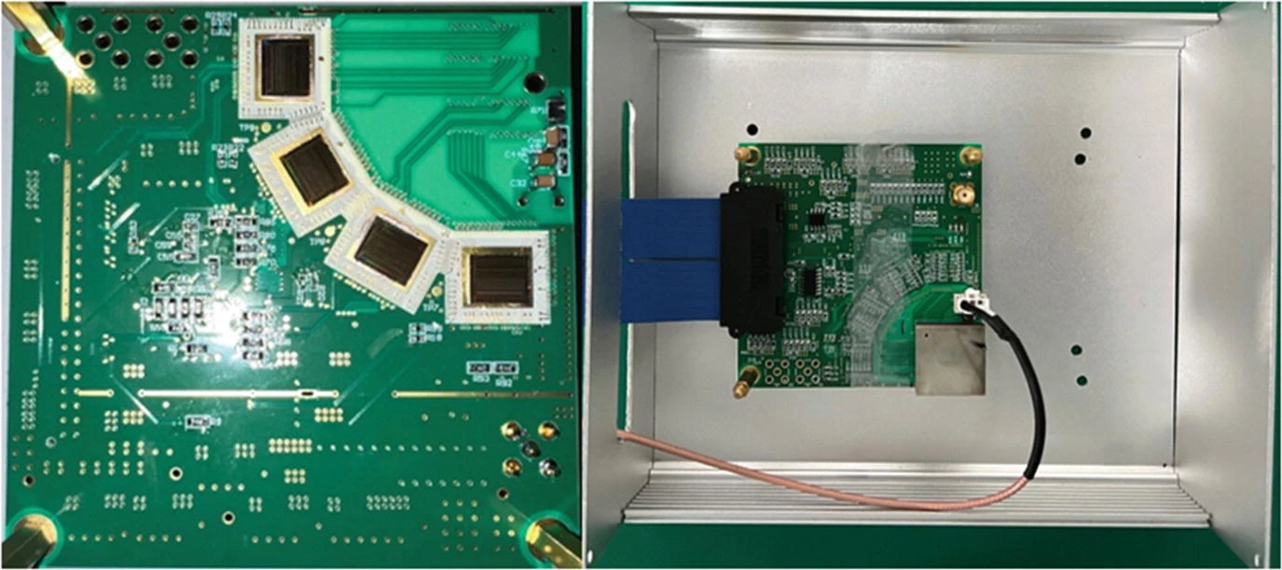
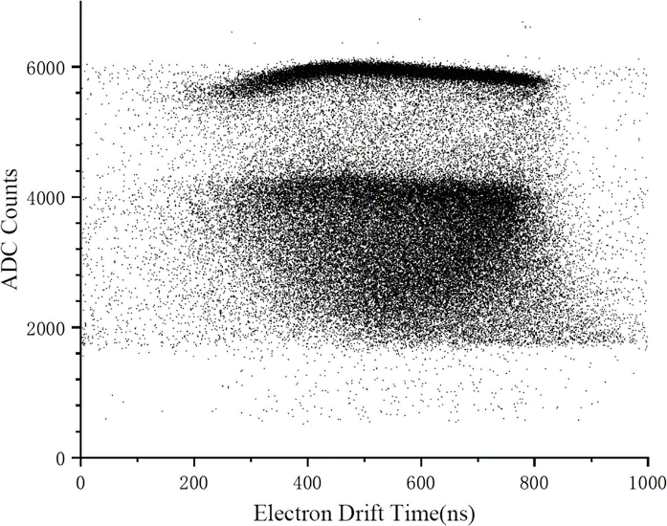
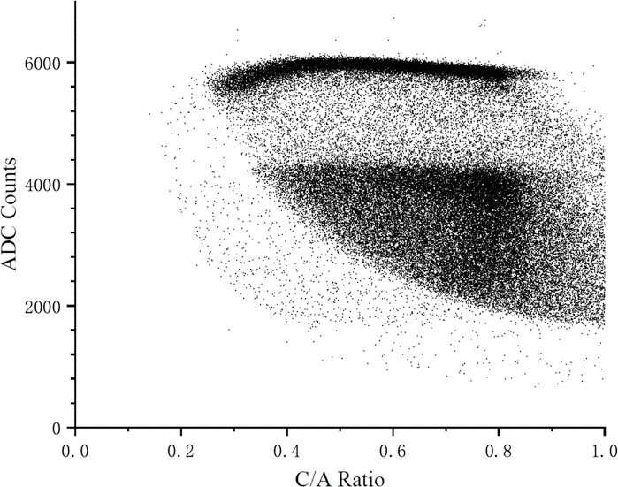
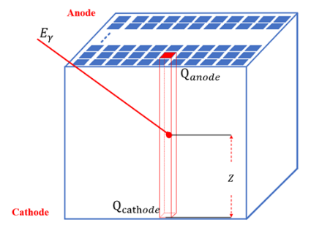
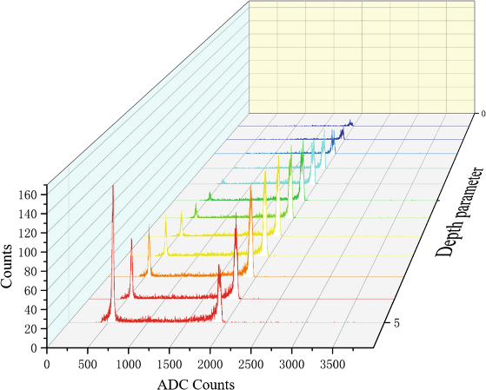
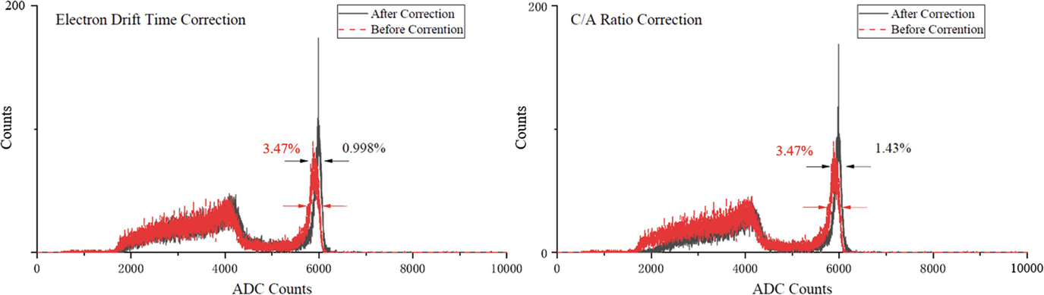
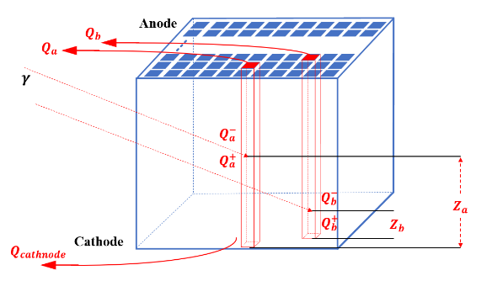
3.3 Readout Electronic for 3D-CZT Based CPRE-32
Single Pixel Spectrum
Chen Tianze, Li Xiaohui (IHEP)
0.998% @ 662 keV
after depth correction, single pixle
^{(22*22*5mm3 CZT,EV)}
Depth Correction
Notes:
A readout system based on four chips was developed. It successfully verified the chip's capability to read out signals from both anodes and cathodes. Two depth correction techniques were applied for spectroscopic correction.

Slide 15
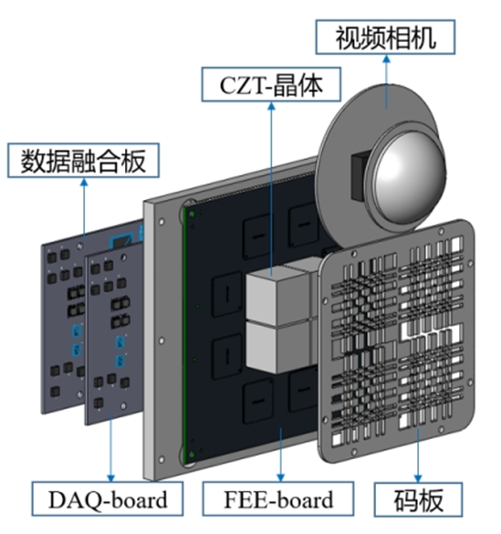
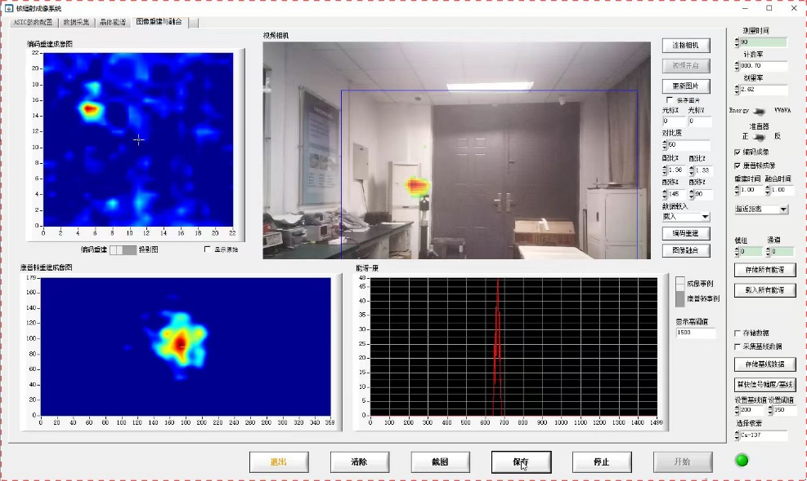




3.4 Application : Compton Camera
Overall Spectrum
Hybrid coded-aperture and Compton camera
1.3% @ 662 keV
^{after depth correction,}
Cumulative Spectrum (121 pixle) (22*22*15mm3 CZT, imdetek)
Li Xiaohui, Cai Jiale, Li Xiaoxuan (IHEP)
Notes:
Integrated into a Compton imaging system with a 15mm crystal, the system achieved an energy resolution of 1.3% for the summed spectrum of 121 pixels. The final imaging result is shown in the figure on the right.

Slide 16




3.5 Application : SPECT
Overall Spectrum
Reconstruction Image
1.86% @ 662 keV
^{without depth correction,}
Cumulative Spectrum (121 pixle) (22*22*5mm3 CZT, imdetek)
Cai Jiale, Li Xiaohui (IHEP)
Notes:
When deployed in a SPECT imaging system with an uncorrected 5mm crystal, an energy resolution of 1.86% was achieved for the summed spectrum of 121 pixels. The final imaging result is shown in the figure on the right.It is capable of imaging a 1mm radiation source.

Slide 17
4. Summary and Conclusions
Design of CPRE-64
  —improve the number of channels and noise performance
  —SEL Hardening at Layout Level
  —under testing
Characterization and Application of CPRE-32
  —work properly connecting the 3D-CZT detector
  —in service on several equipment
Notes:
In conclusion. Thank you for your attention.

