Slide 1



Pion Fake Rate in Muon Detector
Xiaolong Wang
Fudan University
Sep. 23rd, 2025

Slide 2
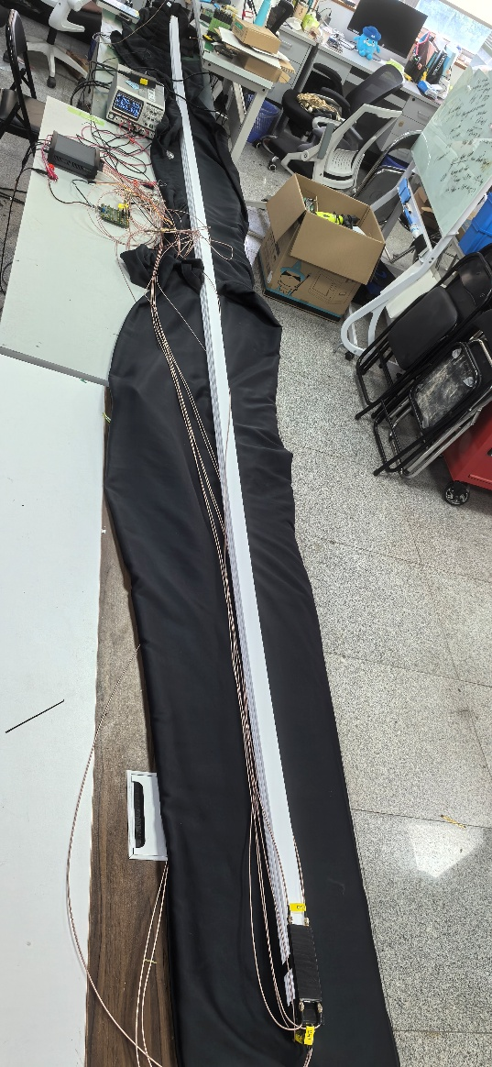
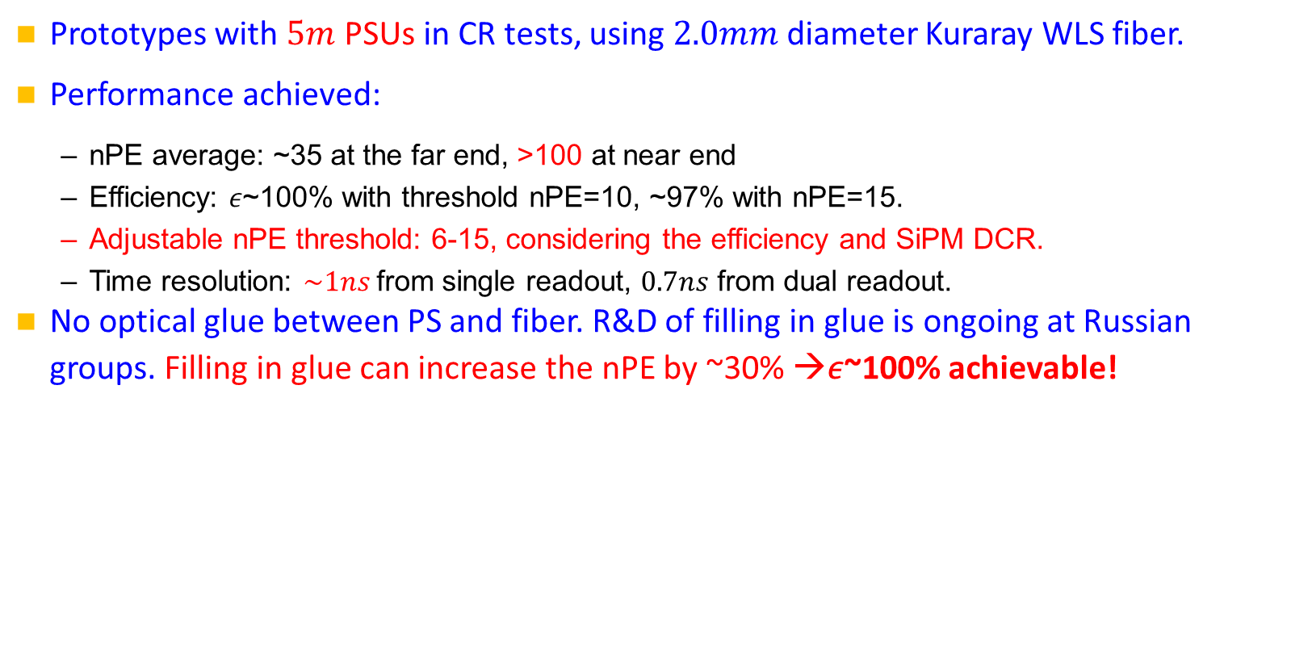
Performance of full size PSU prototype
Prototypes with $5m$ PSUs in CR tests, using $2.0mm$ diameter Kuraray WLS fiber.
Performance achieved:
  nPE average: ~35 at the far end, >100 at near end
  Efficiency: 𝜖~100% with threshold nPE=10, ~97% with nPE=15.
  Adjustable nPE threshold: 6-15, considering the efficiency and SiPM DCR.
  Time resolution: $\sim 1ns$from single readout, $0.7ns$ from dual readout.
No optical glue between PS and fiber. R&D of filling in glue is ongoing at Russian groups. Filling in glue can increase the nPE by ~30% →𝜖~100% achievable!
5m PSU prototypes under CR tests.
Fig. 9.12

Slide 3

Simulation: deposited energy and hit
Simulations show clear and distinct muon and pion events.
Deposited energy $E_{dep}\sim 1.8 MeV$ for muon hits in the muon detector.
According to nPE from R&D, $E_{dep}>0.5 MeV$ is required for a hit in a single PSU.
Two hits from the two PSU layers in one module combine the 2D-hit for $xyz$ .
Require $≥3$ layers of 2D-hits for the muID.
However, a fraction of pions remains! 8% of pions with 30 GeV/c momentum.
Muon event
Pion event
MIP
Fig. 9.13

Slide 4
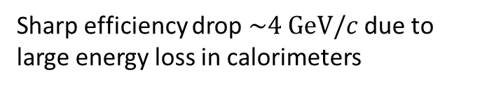
Performance: standalone muID (new)
$$ε=98\%$$
Excellent efficiency in most of areas, except the 10cm gaps in the endcaps.
Only 0.35% area has 𝜖<50%, agrees with the geometry calculation.
𝜖=98% including the dead zones of 10cm gaps.
Efficiency drop ~4 GeV/c due to the large energy loss in cals: ~2.4 GeV.
$$ε=95\%$$
New
New
New
Fig. 9.15
New
$$μ^{−} @ 10 GeV/c$$
$$μ^{+} @ 10 GeV/c$$
Sharp efficiency drop $\sim 4 GeV/c$ due to large energy loss in calorimeters

Slide 5
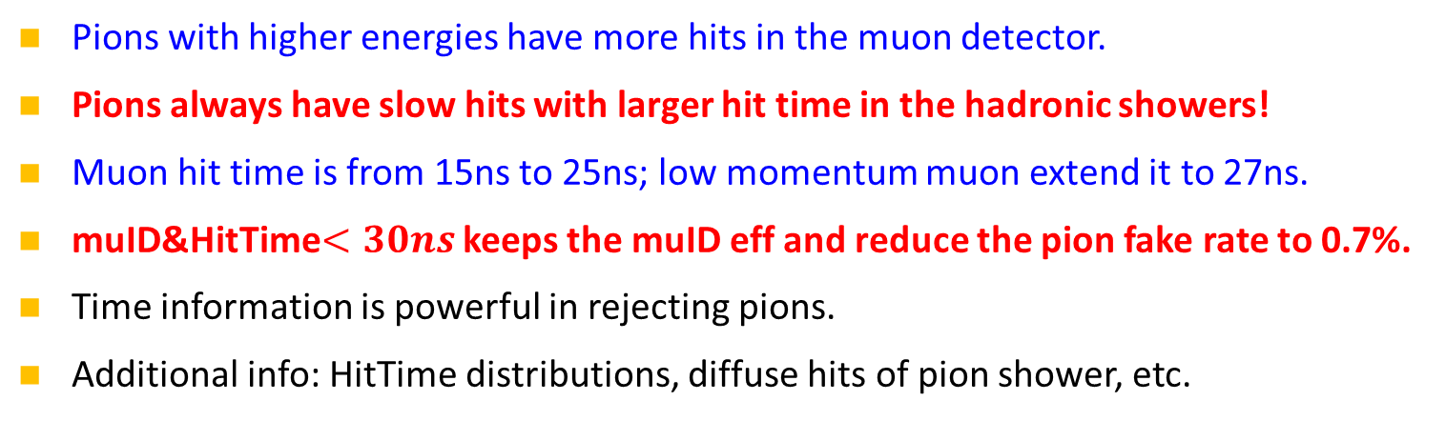
Performance: standalone pion fake rate
Pions with higher energies have more hits in the muon detector.
Pions always have slow hits with larger hit time in the hadronic showers!
Muon hit time is from 15ns to 25ns; low momentum muon extend it to 27ns.
muID&HitTime$<30ns$ keeps the muID eff and reduce the pion fake rate to 0.7%.
Time information is powerful in rejecting pions.
Additional info: HitTime distributions, diffuse hits of pion shower, etc.
muID&HitTime>30ns
New
New
Each sample has $2×{10}^{5}$ events.

