Slide 1
Stereo crystal ECAL for CEPC
Lianyou Shan, Han Wang, Chaochen Yuan,
Huaqiao Zhang, Xiao Zhao, Shengsen Sun(IHEP, Beijing)
Lei Guo, Yang Liu (SYSU)

Slide 2
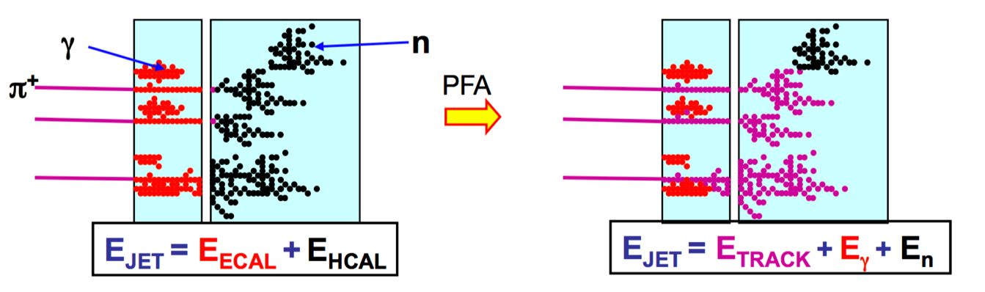
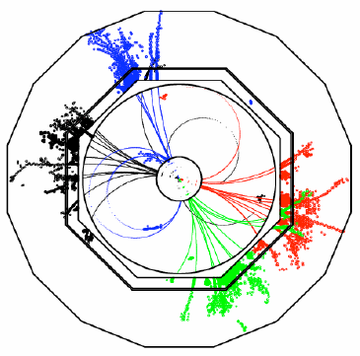
Requirement of a CEPC PFA calorimeter
CEPC Physics requirements
Precision measurements with Higgs and Z/W
Jet energy resolution (dEjet/Ejet- 3~4%)
PFA based Calorimeter (CEPC)
Good Shower separation
Small Moliere radius (Dense detector)
High lateral granularity (~Moliere radius)
Good Energy resolution
Critical in some special process
Sophisticate algorithm
Multi-million channels(energy and timing)
Multi-Dimensional information
Overlap removal

Slide 3
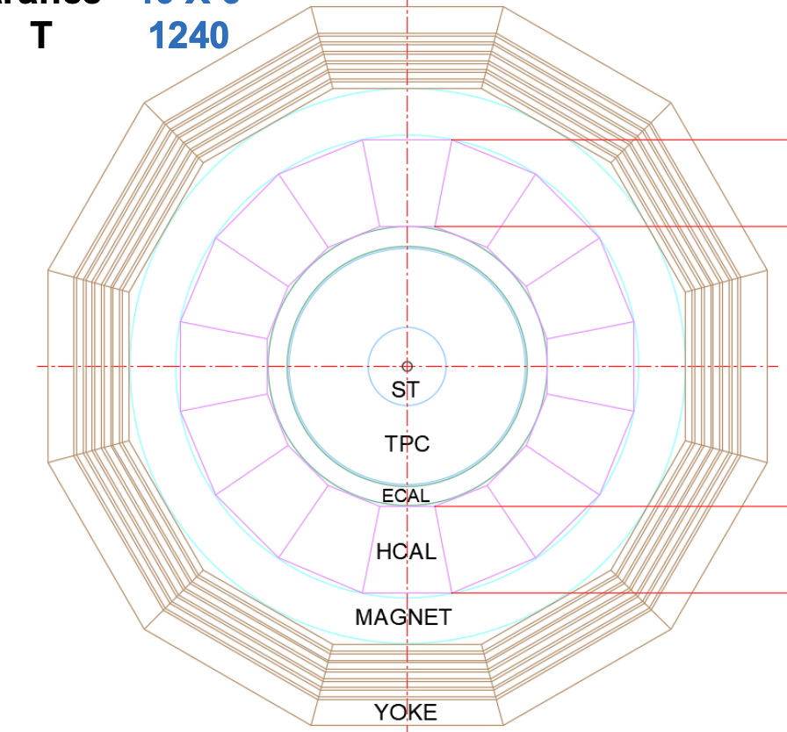
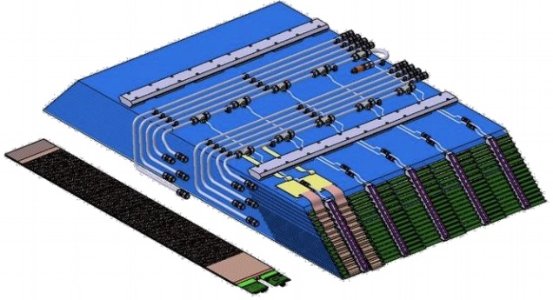
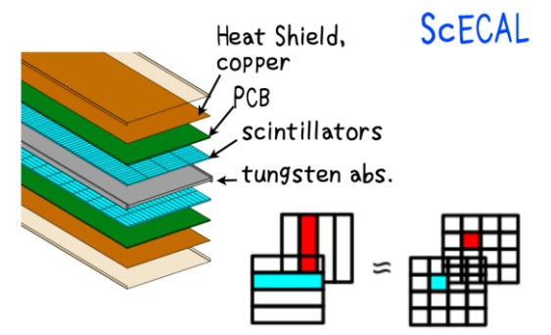
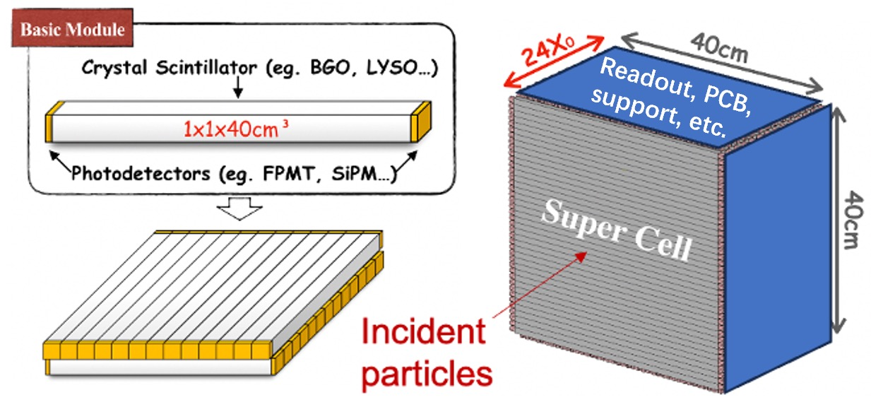
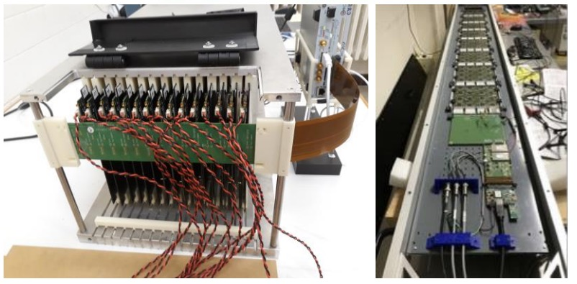
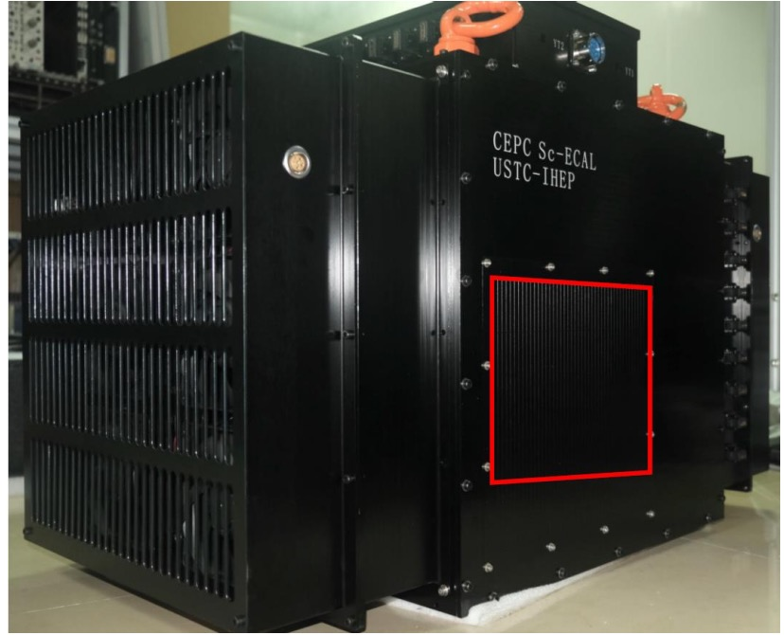
Available options for CEPC ECal
Silicon tungsten ECal
Scintillator sampling ECal
Dual readout calorimeter
Homogenous Crystal ECal: long bar, Stereo
SiW ECal
Sc ECal
Long bar Crystal ECal
Stereo Crystal ECal: Try to get 3D shower with 2D readout in simplified way

Slide 4
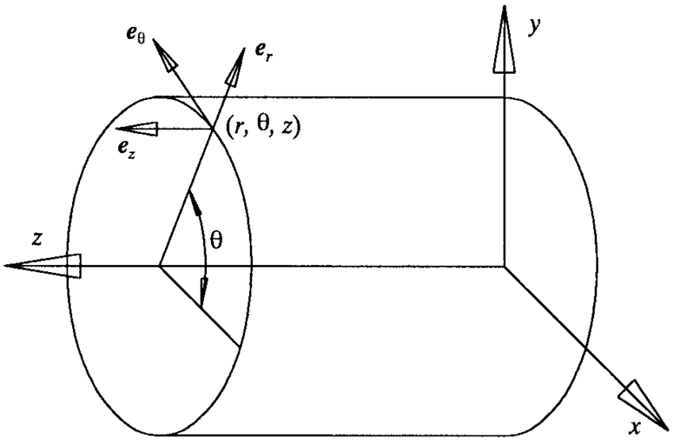
Stereo Crystal Electromagnetic Calorimeter: Basic idea
Traditional Crystal Ecal （CMS/BES…):
Crystal long bar pointing to interaction point (IP)
Slight twist to avoid escape of particles
Stereo Crystal ECal:
Crystal long bar not pointing to IP
Angle between Crystal long bar and det. radius is 𝛼
-90 <= 𝛼 <= 90 degrees
𝛼 = 0; pointing to Z axis ➔ traditional
𝛼 != 0: obtain sampling on R
Number of sampling can be optimized
Single-end readout on the outer surface w.r.t. IP
Form circular structure with trapezoid crystal without gap
Cylindrical coordinate
Sampling 1
Sampling 2
readout
Sampling 3
Sampling 4

Slide 5
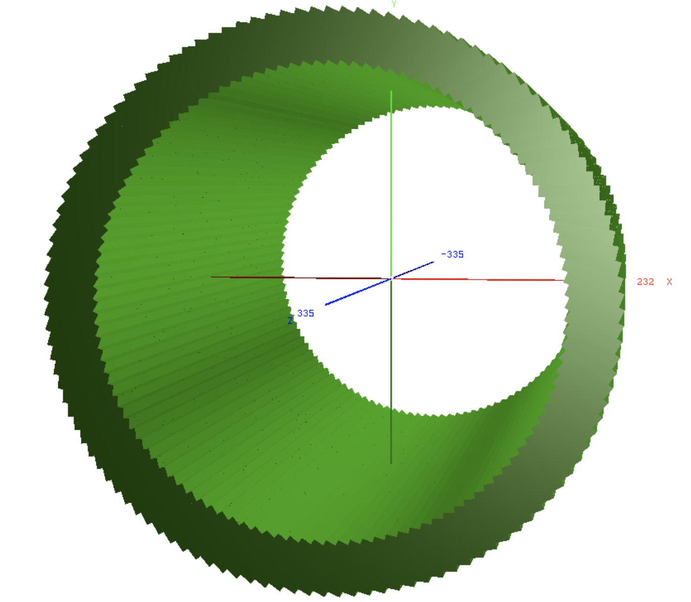
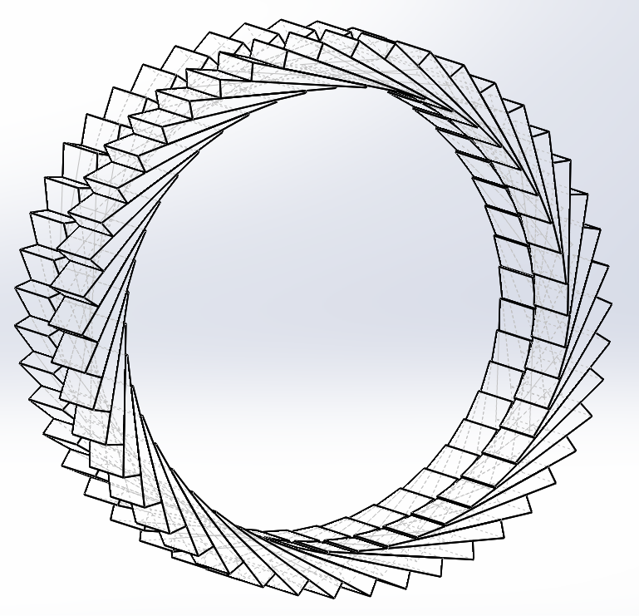
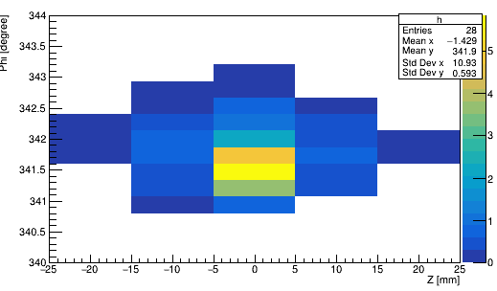
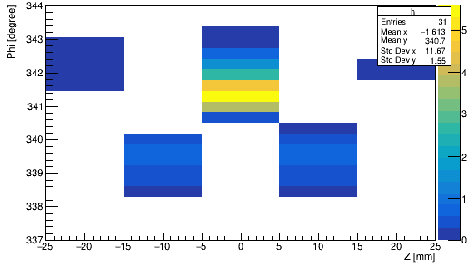
Stereo Crystal Electromagnetic Calorimeter: Design
To improve the 3D position resolution
Pointing angle of even layers alone Z: 𝛼
Pointing angle of odd layers alone Z： 𝛼’= -𝛼
Even layer
Odd layer
Not proportional to real angle/size
Traditional Crystal Ecal
SCEcal
Left eye
Right eye

Slide 6
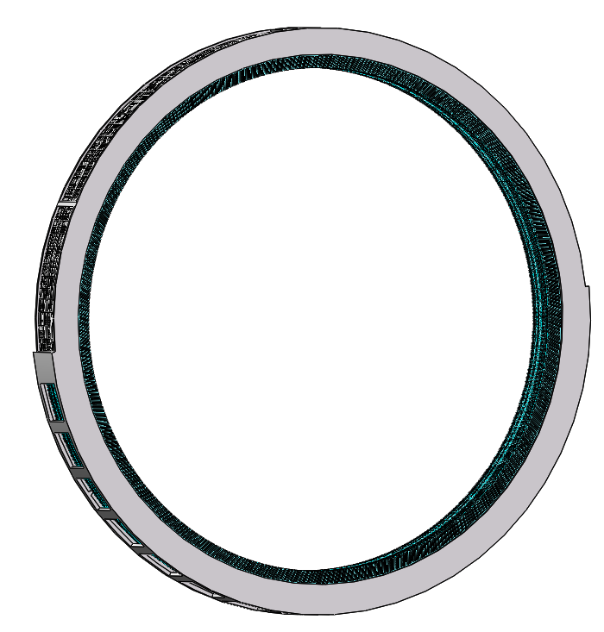
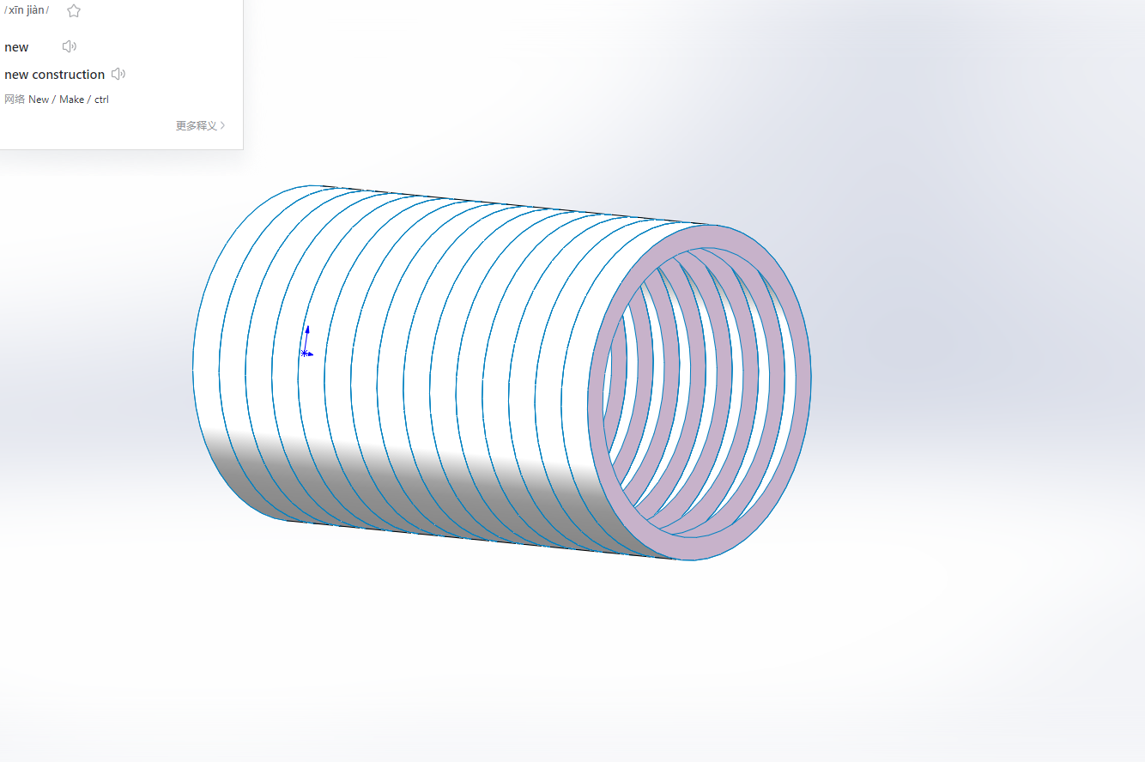
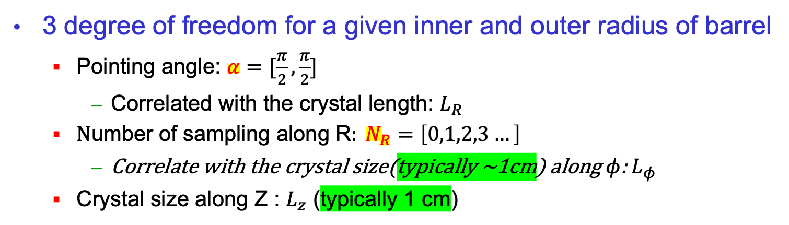
Analytical optimization of SCECal geometry
3 degree of freedom for a given inner and outer radius of barrel
Pointing angle: $α=[\frac{π}{2},\frac{π}{2}]$
Correlated with the crystal length: $L_{R}$
$\text{N}\text{umber} \text{of} \text{sampling} \text{along} \text{R}: N_{R}=\left[0,1,2,3…\right]$
Correlate with the crystal size(typically ~1cm) along $φ$: $L_{φ}$
Crystal size along Z : $L_{z}$ (typically 1 cm)
Only one freedom left, $α$ or longitudinal sampling $N_{R}$
Even layer
Odd layer
Readout at outer surface
One trapezoid shape
Form stereo structure
Form a super layer of 30 cm thick along Z
Super layer form the full barrel

Slide 7
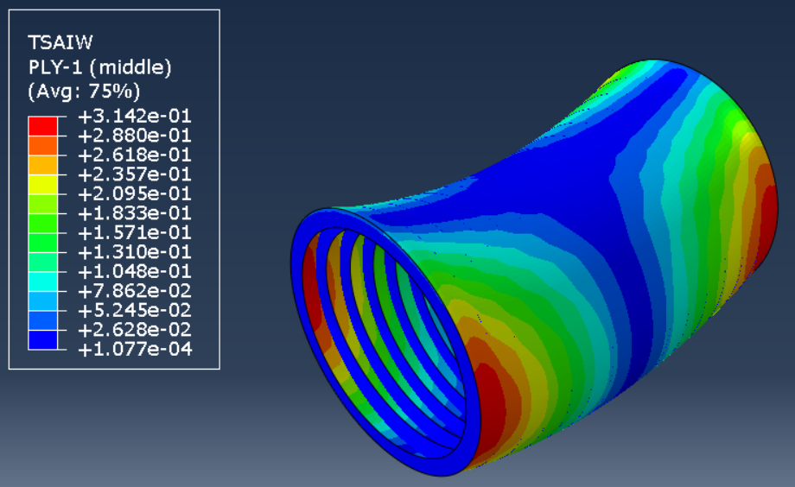
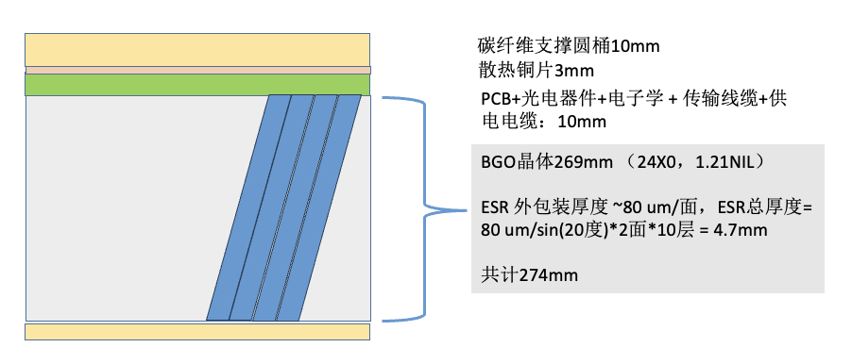
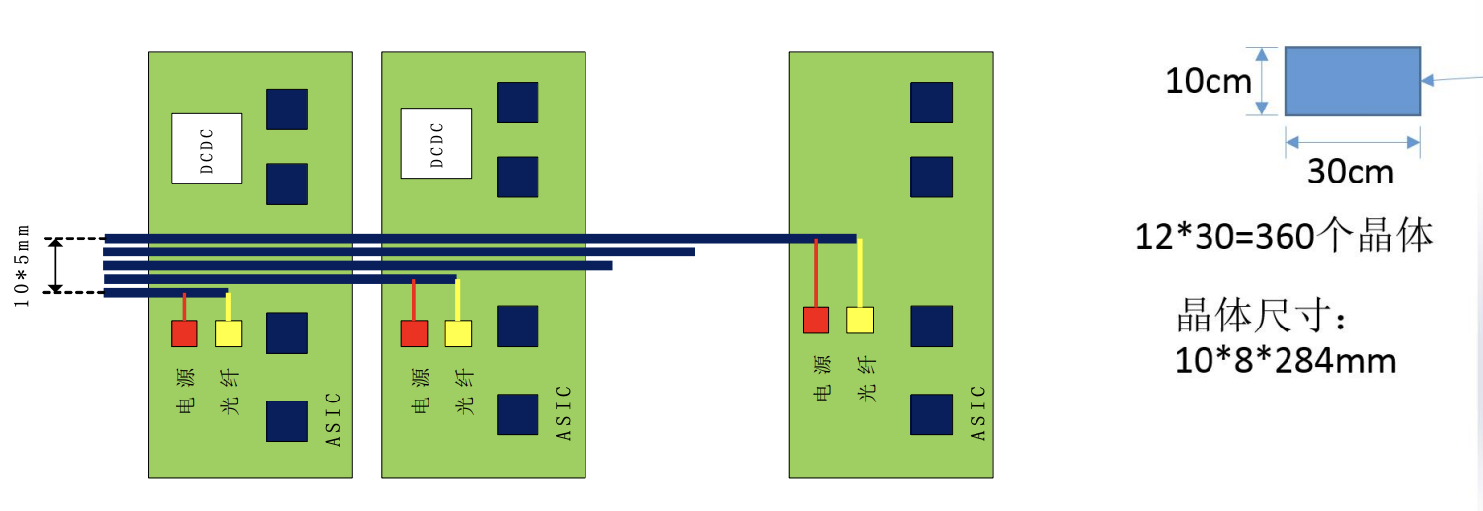
Demo for Mechanics and cooling
TSAIW值为0.3
Shaojing Hou
Z
phi
Jingfan Chang

Slide 8
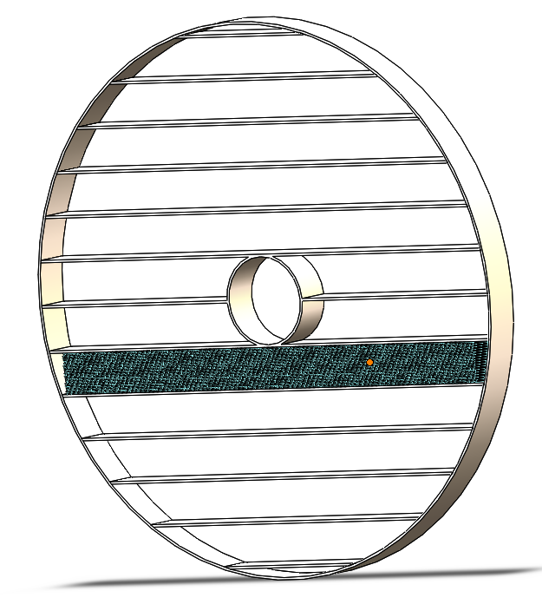
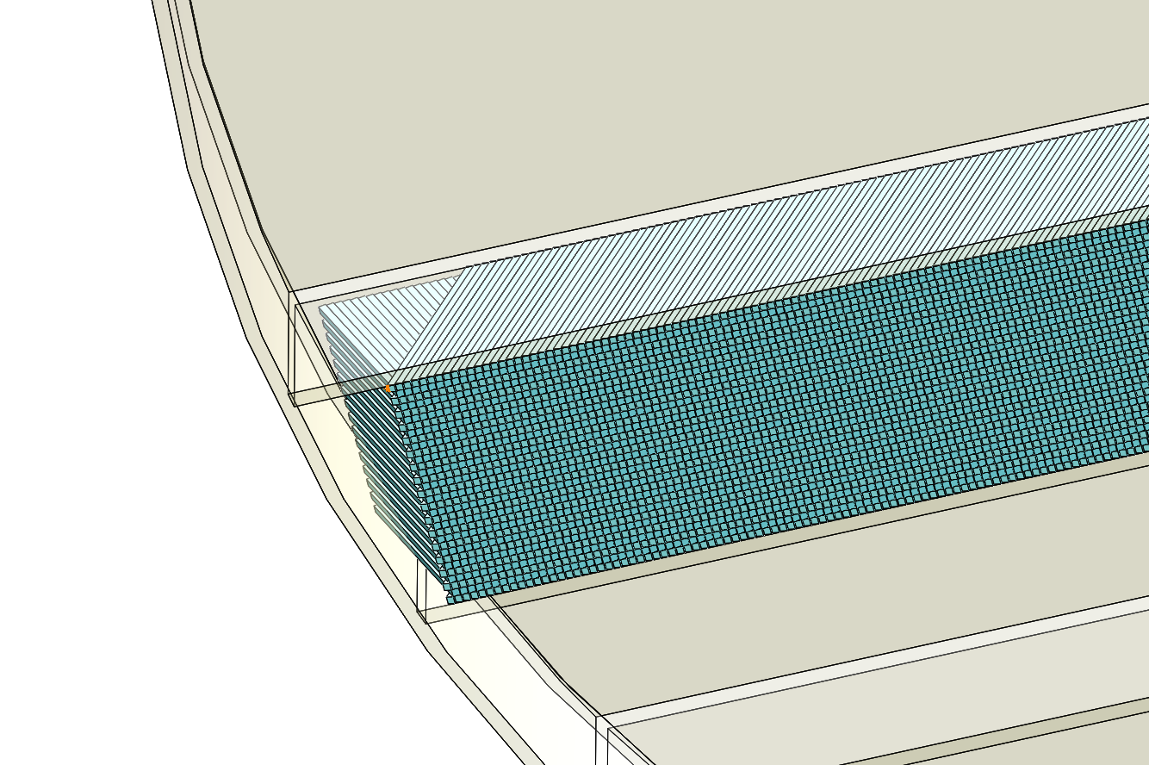
Design of Endcap SCECal
Shelf like structure
Each Super layer consistent of 30 layers of crystals
Crystal pointing angle w.r.t. Z axis（beam）
One variant of crystal shape: Parallelagon
Even layers: 𝛼; Odd layers: -𝛼
Readout electronics at outer Z w.r.t. IP
Super layer

Slide 9
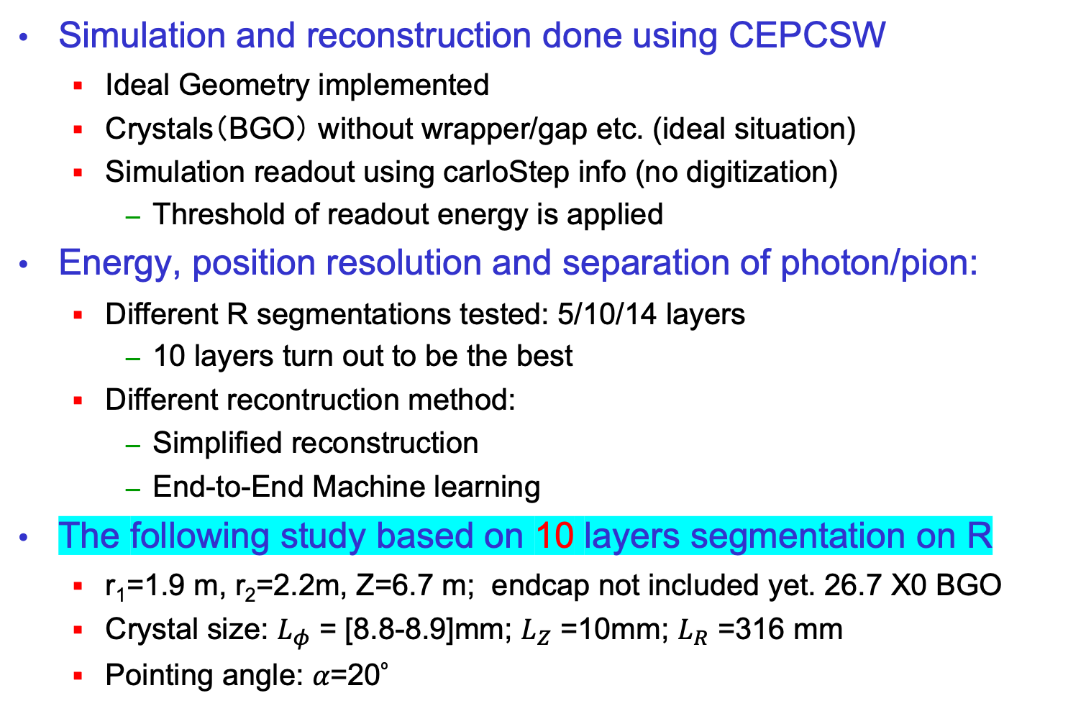
SCECal simulation using BGO crystal
Simulation and reconstruction done using CEPCSW
Ideal Geometry implemented
Crystals（BGO） without wrapper/gap etc. (ideal situation)
Simulation readout using carloStep info (no digitization)
Threshold of readout energy is applied
Energy, position resolution and separation of photon/pion:
Different R segmentations tested: 5/10/14 layers
10 layers turn out to be the best
Different recontruction method:
Simplified reconstruction
End-to-End Machine learning
The following study based on 10 layers segmentation on R
r₁=1.9 m, r₂=2.2m, Z=6.7 m; endcap not included yet. 26.7 X0 BGO
Crystal size: $L_{φ}$ = [8.8-8.9]mm; $L_{Z}$ =10mm; $L_{R}$ =316 mm
Pointing angle: 𝛼=20º

Slide 10

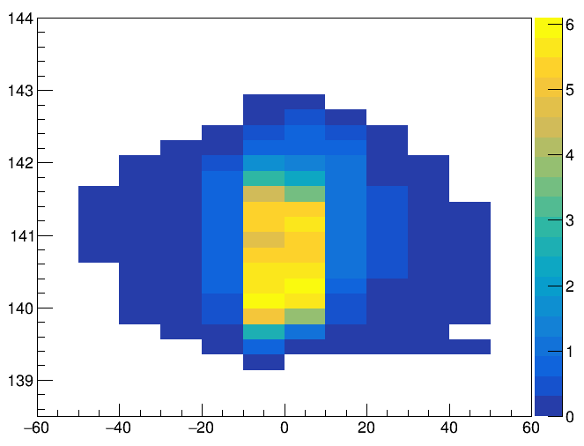
Simplified Reco method for isolated particle
Find a 2D Cluster, energy is the sum of crystals about 2 MeV
Hit (red points): The cross point of two nearby cluster crystal
Geometric center of hit define its z, phi, R
Assign hit energy as sum of the two crossed crystals
Renormalize the total energy to the Energy of 2D cluster
Cluster Phi/Z/R: energy weighted phi/Z/R of all hits
2D cluster
R [mm]
3D hits projection

Slide 11
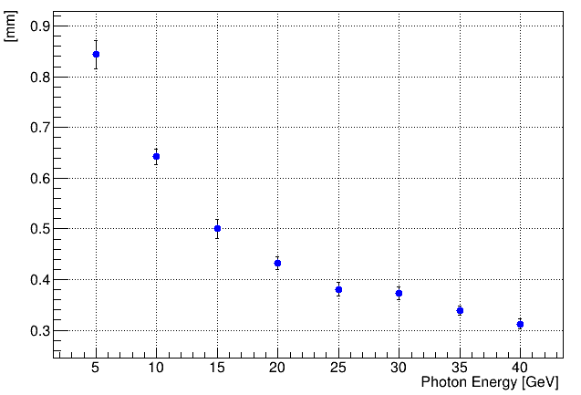
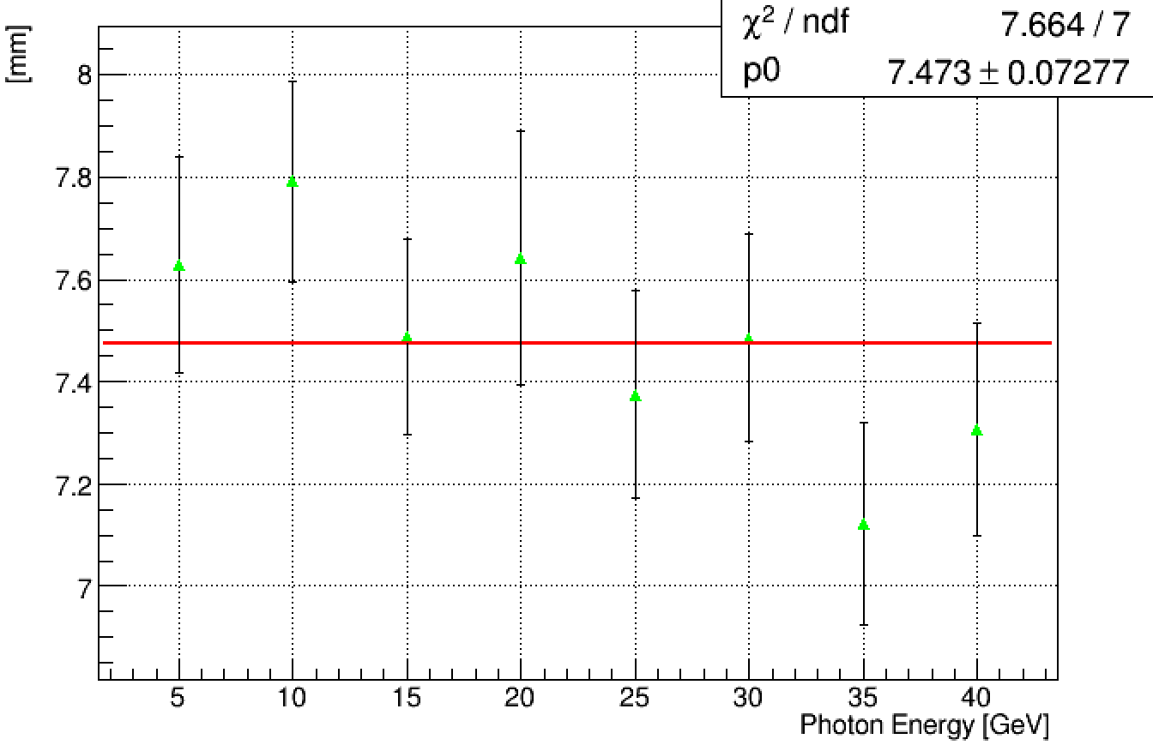
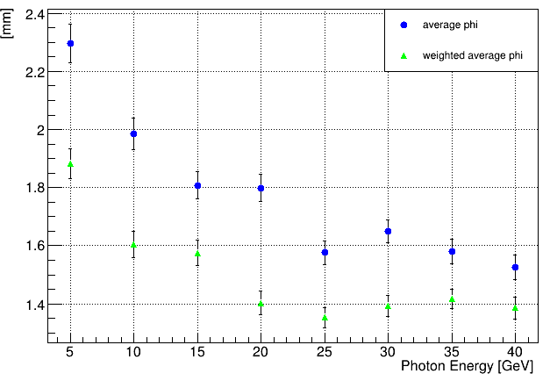
Performance of 3D positioning resolution
Particle gun used: check resolutions as function of γ energy
For 5GeV γ, phi: 0~360°, theta: 90°
Z resolution ~ 0.84 mm; Phi resolution ~ 1.9 mm
R resolution ~ 7.6 mm;
Z resolution
R resolution
Phi resolution
Gain resolution along R ☺
Good Z/phi resolution

Slide 12
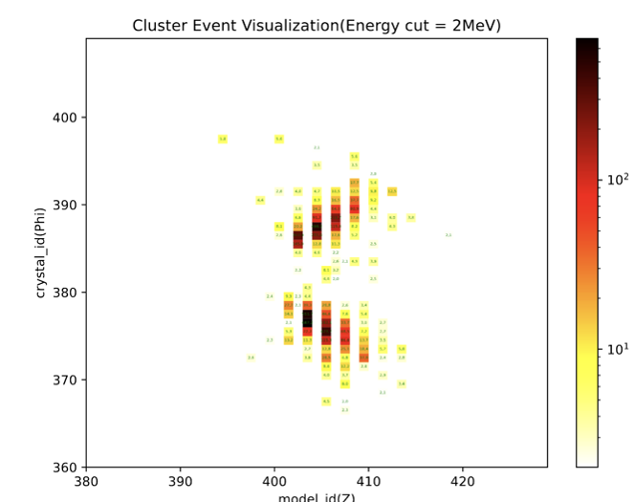
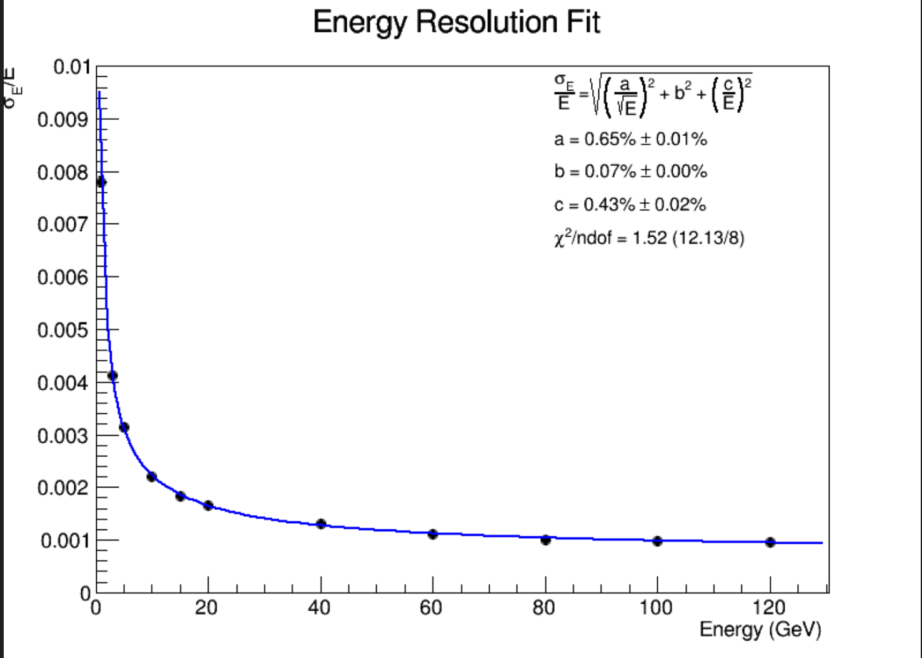
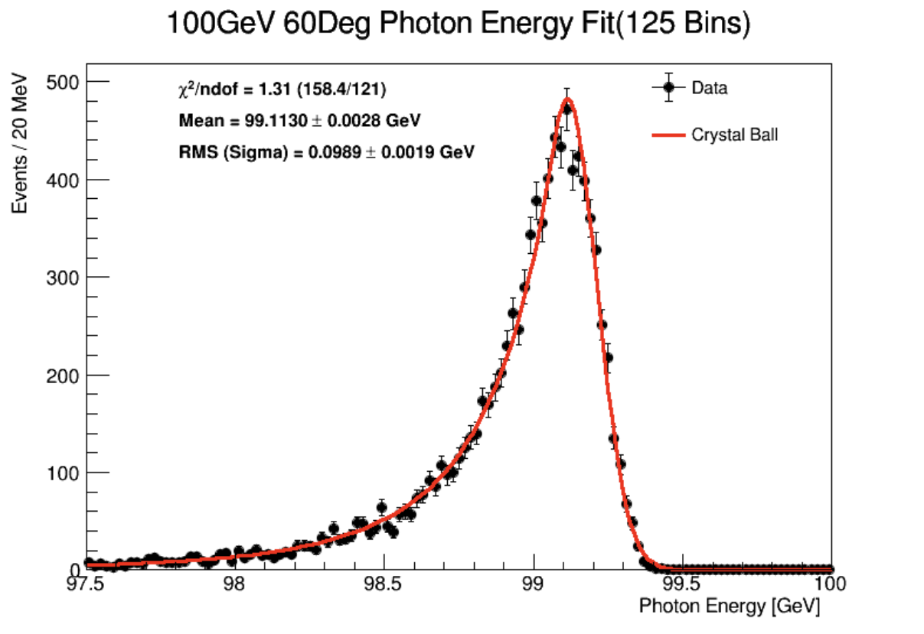

Closer look at Photon cluster/energy reconstruction
Typical photon shower in the home-made clustering algorithm
$\frac{σ}{E}=\frac{a}{\sqrt{E}}⨁b⨁\frac{c}{E}$
a=0.65%

Slide 13
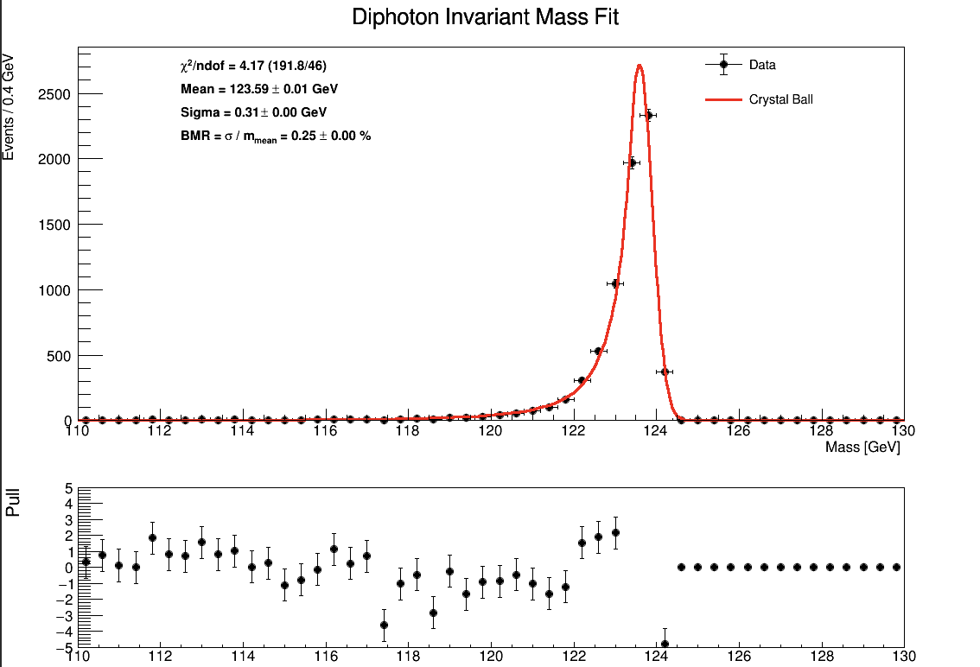
Boson mass resolution in H→ γγ
H→ γγ mass resolution use clustering algorithm
BMR = 0.25%

Slide 14
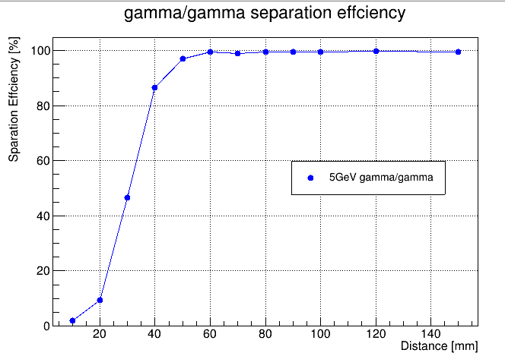
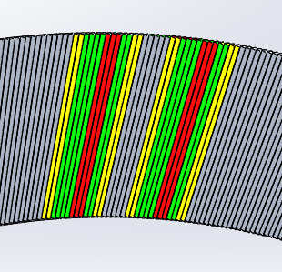
Separation between two 5 GeV photons
Two 5 GeV photons, vary distance along phi between them
Success reconstruction: 2 neutral particles, 3.3GeV<Eγ<6.6GeV for each photon
Threshold: 2MeV
two γ from IP

Slide 15
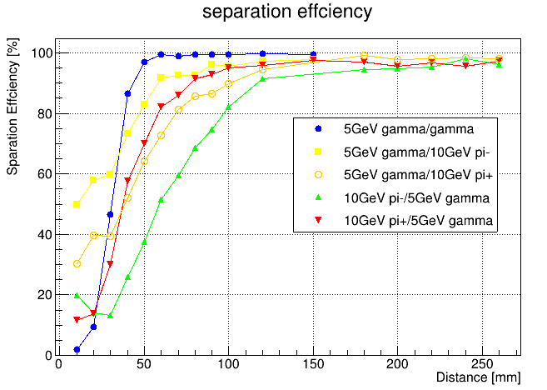
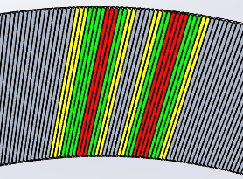
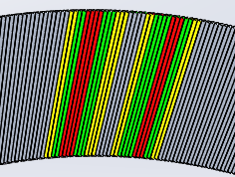
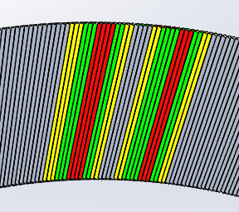
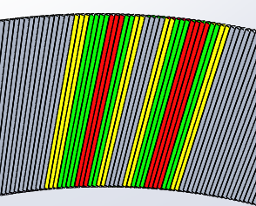
Separation between γ/π
5 GeV γ/10GeV π, vary distance along phi between them
Success reconstruction: 3.3GeV<E_{γ}<6.6GeV
Different π/γ separation power: pointing angle / magnetic field
γ
π+
π+
γ
Threshold: 2MeV
π-
γ
γ
π-

Slide 16
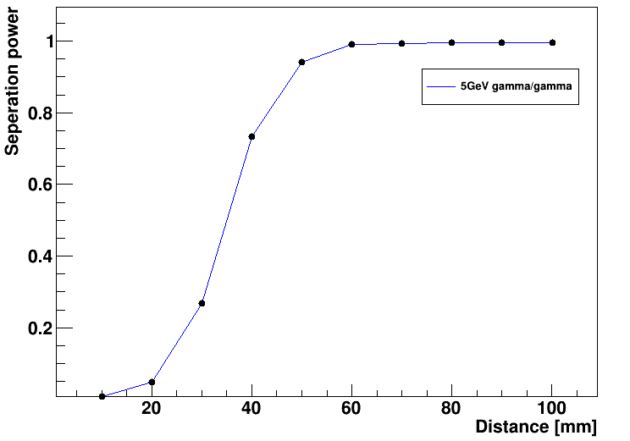
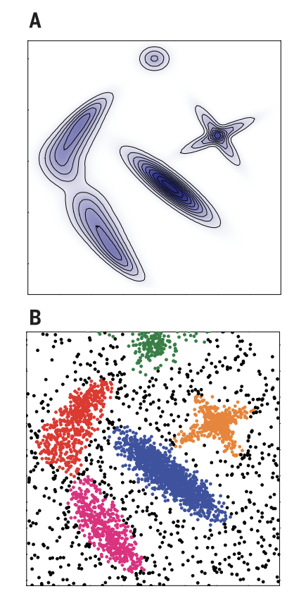
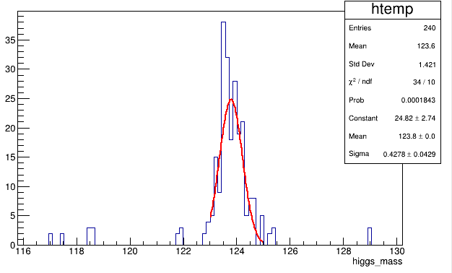

γ/γ performance using CLUE algorithm
CLUE (CLUstering of Energy):
Input parameters to determine cluster seeds, outliers and follower hits
the cut-off distance in the calculation of local energy density (dc);
the minimum density to promote a hit as a seed or the maximum density to demote a hit as an outlier (ρc);
the maximum distance for a hit to be linked to a nearest higher point (δo);
the minimum distance for a local high density hit to be promoted as a seed (δc).
Current CMS HGCal reco. alg.
γ/γ separation
even dc :1 rho: 2 delta_c: 2 delta_o:3
odd dc :1 rho: 0.2 delta_c: 2 delta_o: 2
Separate the raw data into odd and even modules
higgs->$γγ$
CLUE clustering algorithm
science.1242072
BMR: 0.35%
Merge odd/even sub-Clusters
[1] https://cds.cern.ch/record/2802590/files/CR2022_027.pdf
Consistent with simplified method, further tunning possible

Slide 17
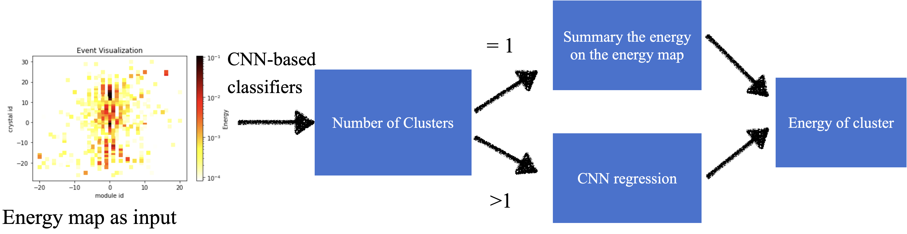
Particle separation using ML
CMS reconstruction of merged photons paper
PRD 108，052002（2023）
End-to-End method is used
2 steps, one for classification, one for energy regression(max 2 obj. now)
More complex NN is under investigation
Regression of 2D energy hit map of individual particle
Regression of 3D energy hit map of individual particle
Clustering
PID
Jet energy
With information from tracker and helps of PFA
Calor only

Slide 18
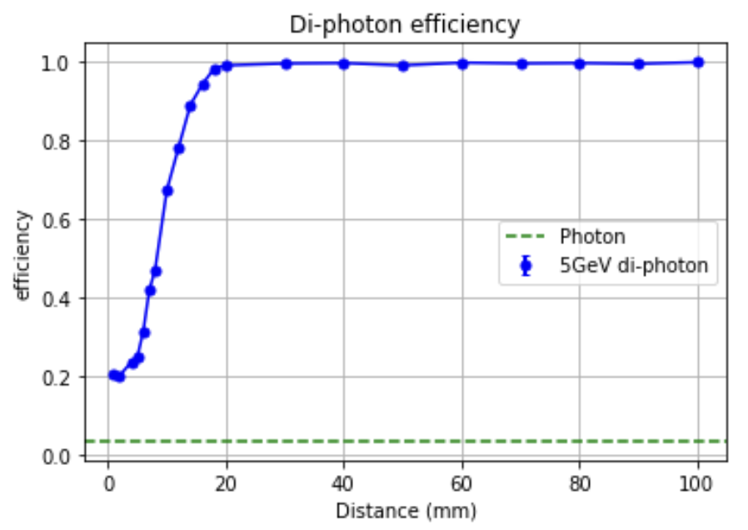

Separation between two 5 GeV photons: ML regression
Trained with 2 γ with energy(0-10] GeV and distances varis
Significant improvement than simple clustering
100% eff. After 20 mm distance
100% eff when 2 γ distance >20 mm
2 γ have diff. shower start
Longitudinal separation, 1->2, conversion
Prob. of 1 γ reco as 2 γs (1->2)

Slide 19
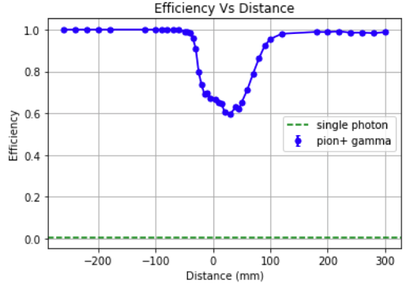
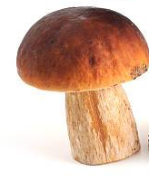
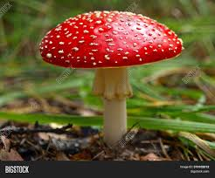
Separation between γ/π: Calor only ML
Trained with a sample of 1-10GeV γ, 2-20GeV π +, distance @calorimeter variated around 20 mm
Applied to separate 5 GeV photon and 10 GeV π +
~100% efficiency when > 100 mm distance
γ+π
π only
γ only

Slide 20
Reconstruct of jets: event display
Clear V-Parten seen in the 2D energy map (1 crystal ➔ 1 pixel)
Jet energy map
jet

Slide 21
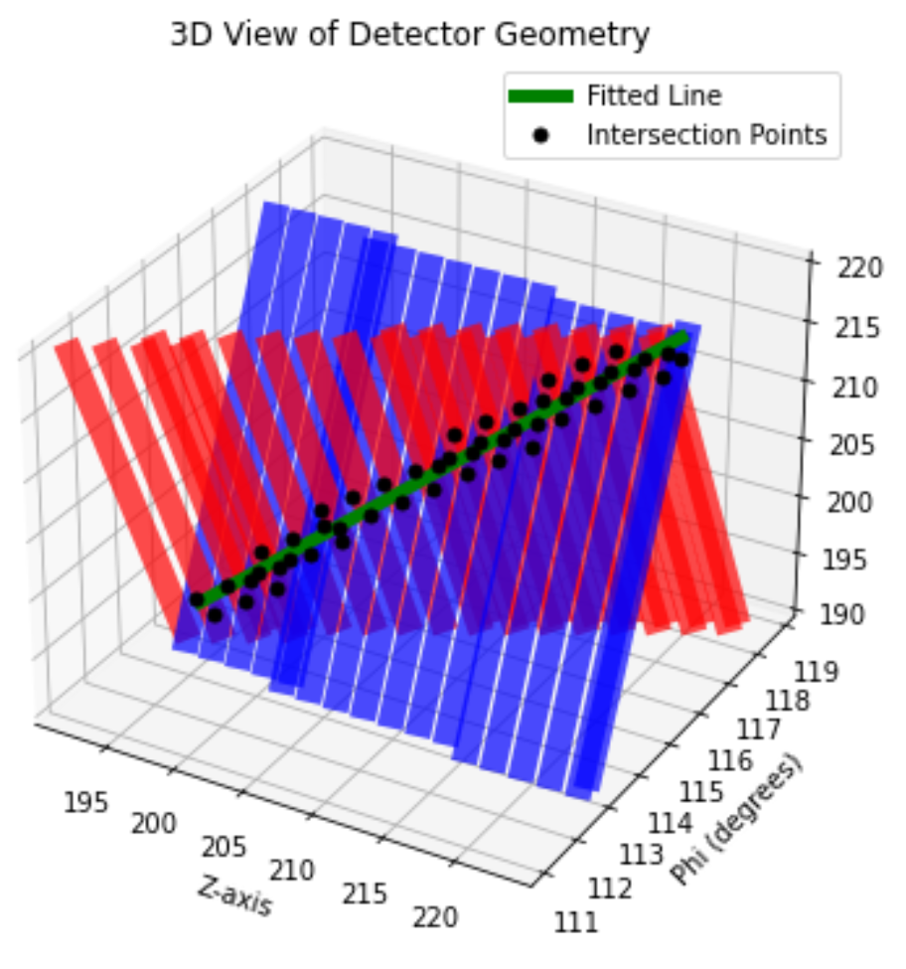
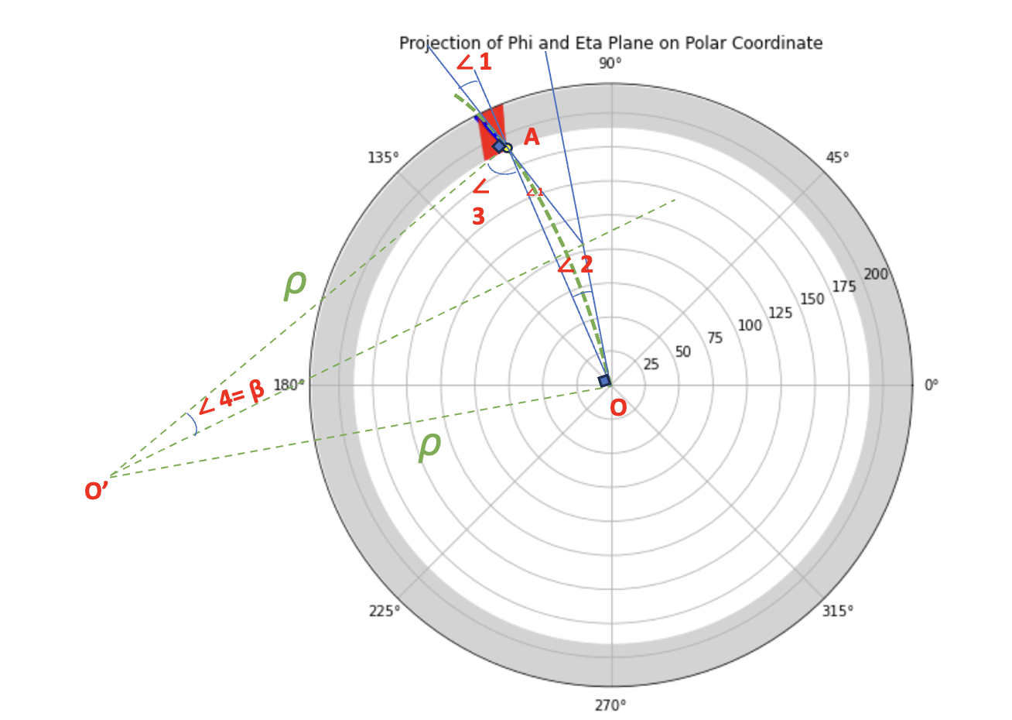
1st try: Reconstruction of charged muons in Stereo ECal
Fit the intersection of the two adjacent layers
Obtained Pt consistent with truth
Encouraging, Still way to do full jet reco.
Θ=45°
∠1=∠4=β
Could help on Charge particle cluster matching
Pt=0.855/sin(β)
P_initial / GeV | β° | Pt-recon/ GeV | Pt-truth/ GeV | Relative Diff.
2 | 37.21 | 1.41 | 1.41 | -0.02%
4 | 17.65 | 2.82 | 2.83 | -0.31%
5 | 14.00 | 3.53 | 3.54 | -0.06%
6 | 11.64 | 4.24 | 4.24 | -0.10%
8 | 8.78 | 5.60 | 5.66 | -1.01%
10 | 6.99 | 7.03 | 7.07 | -0.63%

Slide 22
Summary
A new configuration of Homogenous Crystal Ecal is presented
Long crystal bar with 2D readout at outer end of ECal
Use stereo structure to obtain measurement on the 3rd dimension
Only one free parameter: easy to optimize
Only one variant of crystal, very uniform in phi, Z, and R
minimal dead regions, minimal ghost hits,
Friendly to cooling, radiation shielding …
Working principle is demonstrated with preliminary simulation
Good energy resolution on EM objects including H→ γγ
Good separation between γ/γ and γ/π with Machine learning
100% eff. @ 20 mm for γ/γ and @100mm for γ/π
PFA/ML jet boson mass resolution study is ongoing
Optimization of crystal/readout
Starting from existing CEPC crystal Ecal R&D: BGO+SiPM
Further optimization to consider the large signal size

Slide 23
Backup

Slide 24
Ghost hits
Confusion of red hit with yellow ones
Happens only in small phi/R range
R-range: 0-30CM
Phi-range: -4.5 cm - +4.5 cm (10 layer)
Large probability have hits in middle shower depth, small chance to have hits in small or large shower depth
Big energy deposited in middle shower depth hit, small in inner/outer depth
If ghost hits happens
largest change of phi: ~4.5 cm,
Largest change of R: ~15cm
Ghost hit happens within this Parallelogram area
R
Phi
Phi range
Ghost hit in Z*phi plane: 1cm * 9cm
Ghost hit in R*phi plane: 30cm * 9cm
SCEcal unit ghost hits area： ～32/2*32/2*sin（2*𝛼） =160cm2；
Long bar Ecal unit ghost hits area： 40*40 = 1600 cm²

Slide 25
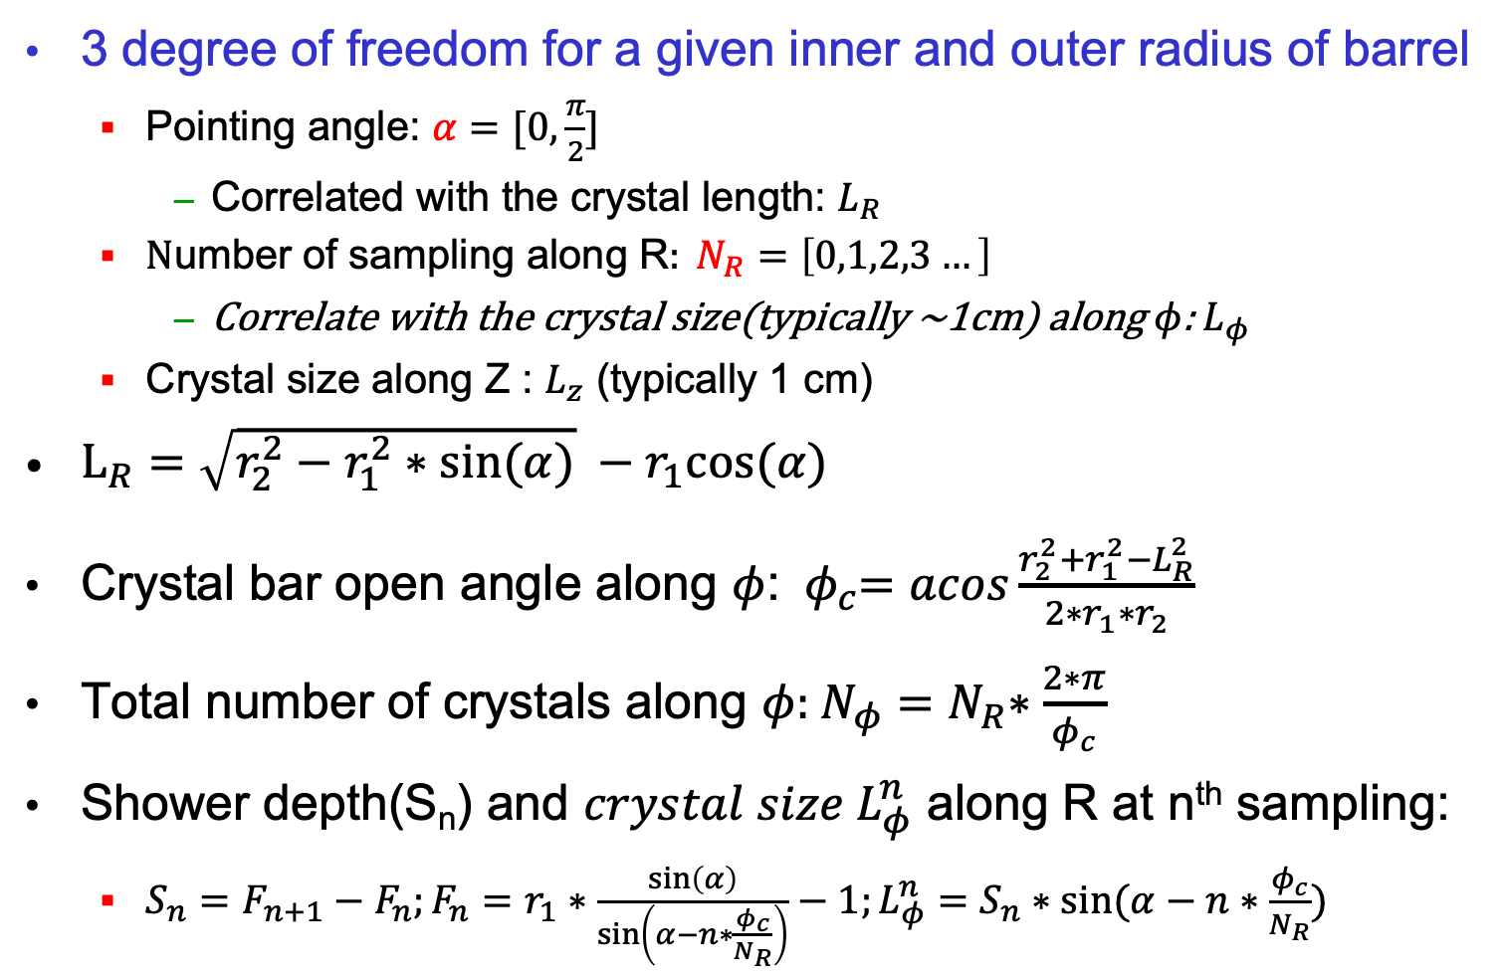
Analytical formular for SCECal geometry
3 degree of freedom for a given inner and outer radius of barrel
Pointing angle: $α=[0,\frac{π}{2}]$
Correlated with the crystal length: $L_{R}$
$\text{N}\text{umber} \text{of} \text{sampling} \text{along} \text{R}: N_{R}=\left[0,1,2,3…\right]$
Correlate with the crystal size(typically ~1cm) along $φ$: $L_{φ}$
Crystal size along Z : $L_{z}$ (typically 1 cm)
$L_{R}=\sqrt{r_{2}^{2}−r_{1}^{2}∗sin⁡(α)} −r_{1}cos⁡(α)$
Crystal bar open angle along $φ$: ${ φ}_{c}=acos\frac{r_{2}^{2}+r_{1}^{2}−L_{R}^{2}}{2∗r_{1}∗r_{2}}$
Total number of crystals along $φ:{ N_{φ}=N}_{R}∗\frac{2∗π}{φ_{c}}$
Shower depth(S_{n}) and ${crystal size L}_{φ}^{n}$ along R at n^{th} sampling:
$S_{n}=F_{n+1}−F_{n};F_{n}=r_{1}∗\frac{\sin\left(α\right)}{\sin\left(α−n∗\frac{φ_{c}}{N_{R}}\right)}−1;L_{φ}^{n}=S_{n}∗sin⁡(α−n∗\frac{φ_{c}}{N_{R}})$

Slide 26
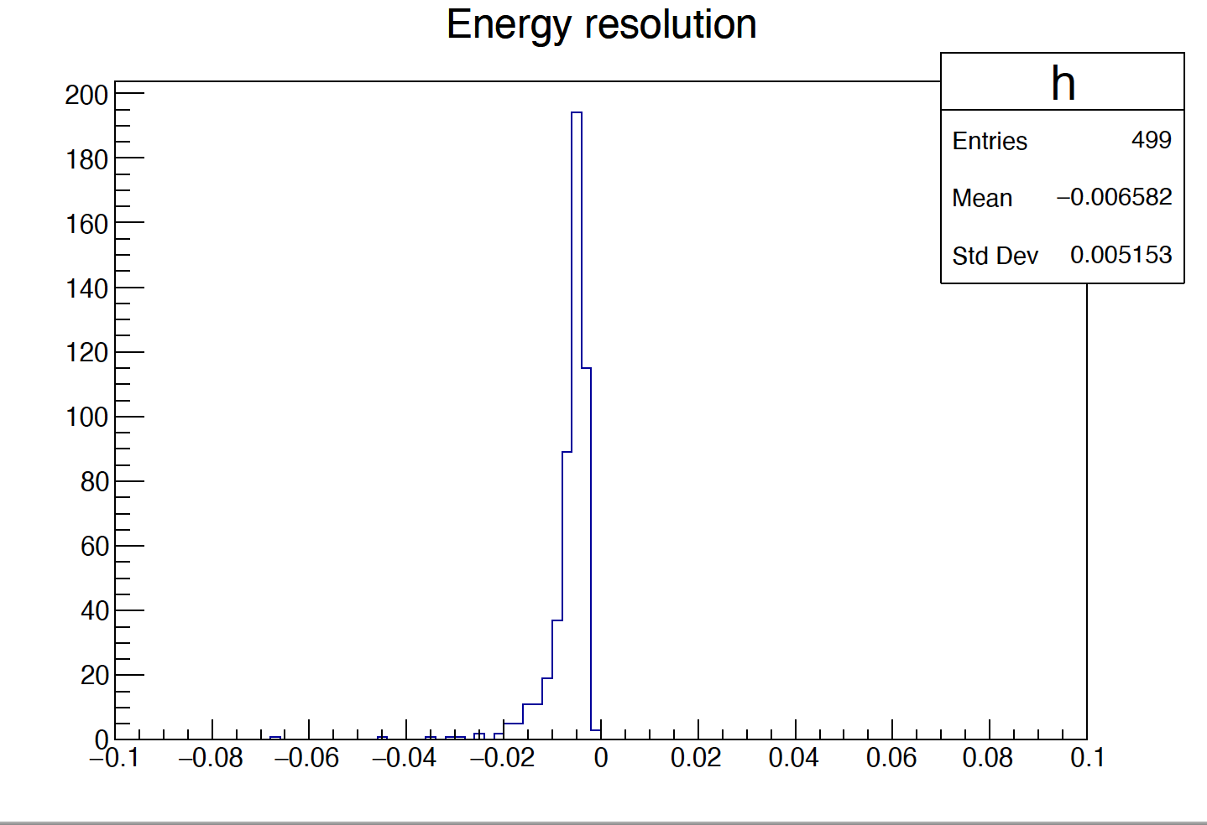
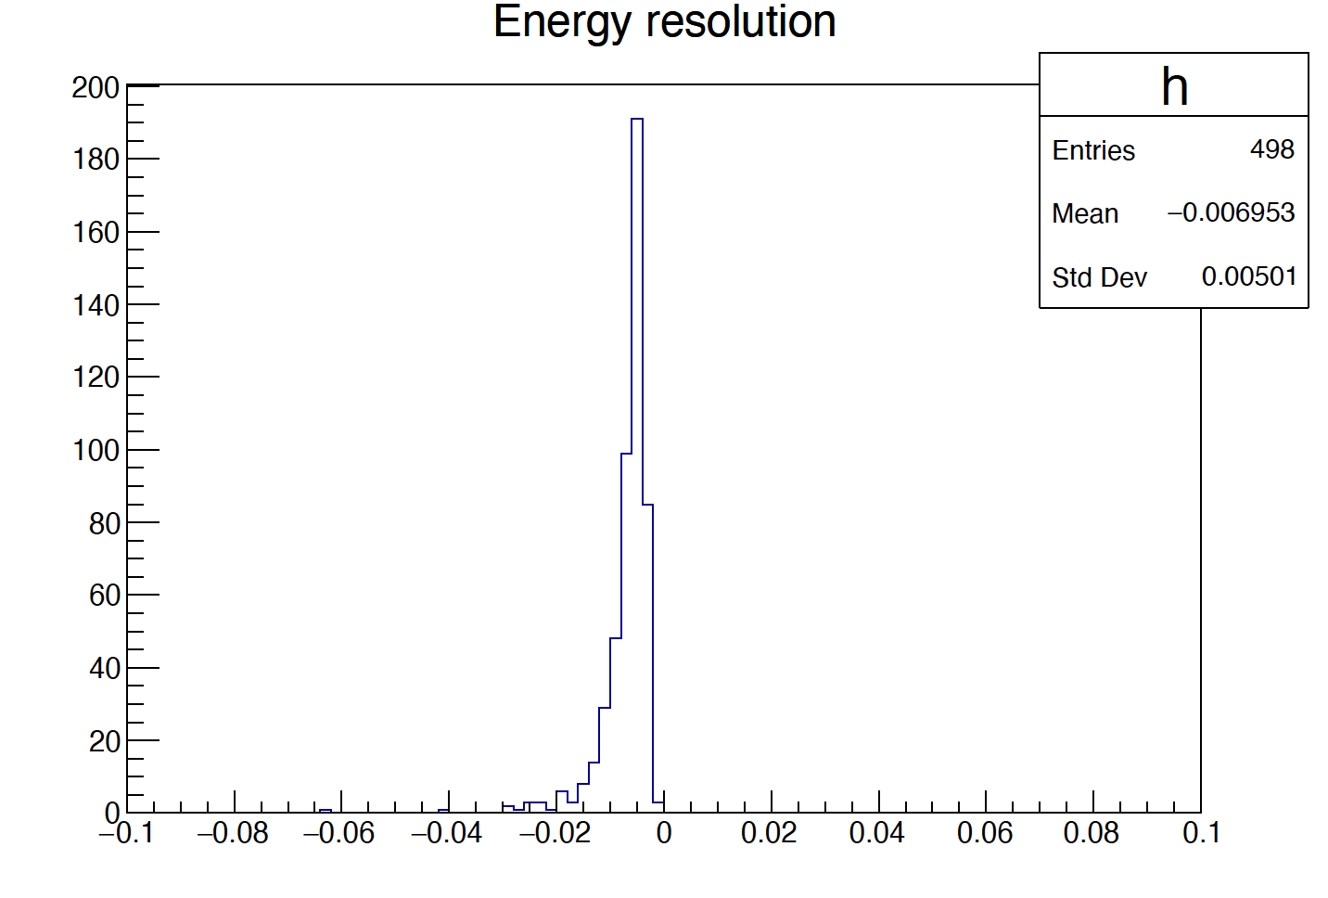

Configuration of 5/10/14 layers along R
Taget: change layers along R, keep similar Z/phi segmentation
5 layers: 𝛼=10º; crystal size: [9]*10*304 mm³, n = 1309 * 671;
10 layers: 𝛼=20º; crystal size: [8.8-8.9]*10*316 mm³, n = 1276 * 671
14 layers: 𝛼=30º; crystal size: [9.1-9.4]*10*339 mm³, n = 1141 * 671
Simulated 30 GeV photon pointing at theta = 90, phi = [0-360]
Simpler clustering algorithm with threshold of 1 MeV
Energy/Z resolution do not change for different layers along R
5 layer
10 layer
14 layer
E std. dev. ~0.5%@30GeV

Slide 27


Boson mass resolution in H→ γγ
Sample: ZH->2neutrinos + γγ at 240 GeV
Energy, position reconstruction and separation using simplified reconstruction method described above
Crystal energy threshold: 2 MeV/50MeV
BMR = 0.33%
BMR = 1.3%
Very optimistic simulation
Threshold: 2MeV
Very optimistic simulation
Threshold: 50MeV
Good BMR，more realistic simulation will give more reliable results

Slide 28




Event display for shower seperation
Two 5 GeV photon, 66 mm distance
Two 5 GeV photon, 165 mm distance
5 GeV photon and 10 GeV pi-, 66mm
5 GeV photon and 10 GeV pi-, 195mm

Slide 29


Simplified Reco method for 2 particle separation
Cluster splitting
For each layer (along Z): Find two locations with maximum energy deposition and separate them by the min. value between them
Merge clusters in individual layers use layer matching alg.
Criteria on delta phi according to its point angle direction
Z
Two 5GeV γ
γ₁
γ₂
Phi

Slide 30

Stereo ECal: muon momentum reconstruction
Origin info：
Single 5GeV μ
Θ=45°
Φ=100°
Geometric info：
∠1=∠4=β
OA=1.9 m
ρ=1.9/2sin(β)
Particles move in a magnetic field
P=mv=RBq
Pt=0.3ZBρ
Z=1 for charge
B=3 T for magnetic field
Pt for GeV/c
ρ for m
→ Pt=0.855/sin(β)
∠ 1
A
∠ 3
∠ 1
ρ
∠ 2
∠ 4= β
O
ρ
O’

Slide 31
Strategy
The fitted plot is as follows, with the green line being made by fitting the intersection of each of the two adjacent layers (odd/even)
Take the φ that fits the first intersection in the lower left corner
The deviation Angle β is obtained by differentiating the φ_ fitted with the φ_ initial
The β Angle is added to the Pt calculation formula and compared with truth

Slide 32
Results
Single 5GeV μ
Θ=45°
Φ=100°
Energy threshold 2MeV
Five cases were examined and the results are as follows: （Keep to two significant decimal places）
event | Pt-recon/ GeV | Pt-truth/ GeV | Uncert.
0 | 3.53 | 3.54 | -0.06%
1 | 3.51 | 3.54 | -0.78%
2 | 3.53 | 3.54 | -0.02%
3 | 3.53 | 3.54 | -0.11%
4 | 3.54 | 3.54 | 0.02%
3.77%
-2.95%

