Slide 1
VTX Track Resolution with Beam background Overlay
Zizi Kang , Bo Liu , Zhijun Liang

Slide 2
Background events : types and timings
背景类型 | 时间参数 | 模式类型 | 物理意义
Pair(Pair production) | -2770 | 固定时间窗口 | 事件间隔 2770ns
BGB(Beam-Gas Bremsstrahlung) | 4145.41 | 采样模式（速率） | 每秒发生 4145.41 次（Hz）
BGC(Beam-Gas Coulomb) | 87781.62 | 采样模式（速率） | 每秒发生 87781.62 次（Hz）
BTH(Beam-Thermal Photon) | 357.20 | 采样模式（速率） | 每秒发生 357.20 次（Hz）
TSC(Touschek Scattering) | 103.77 | 采样模式（速率） | 每秒发生 103.77 次（Hz）
updated:/cefs/higgs/shihy/tools/CEPCSW_TDR258S/CEPCSW/Test/Higgs/Pair_250829(真实外磁场）

Slide 3
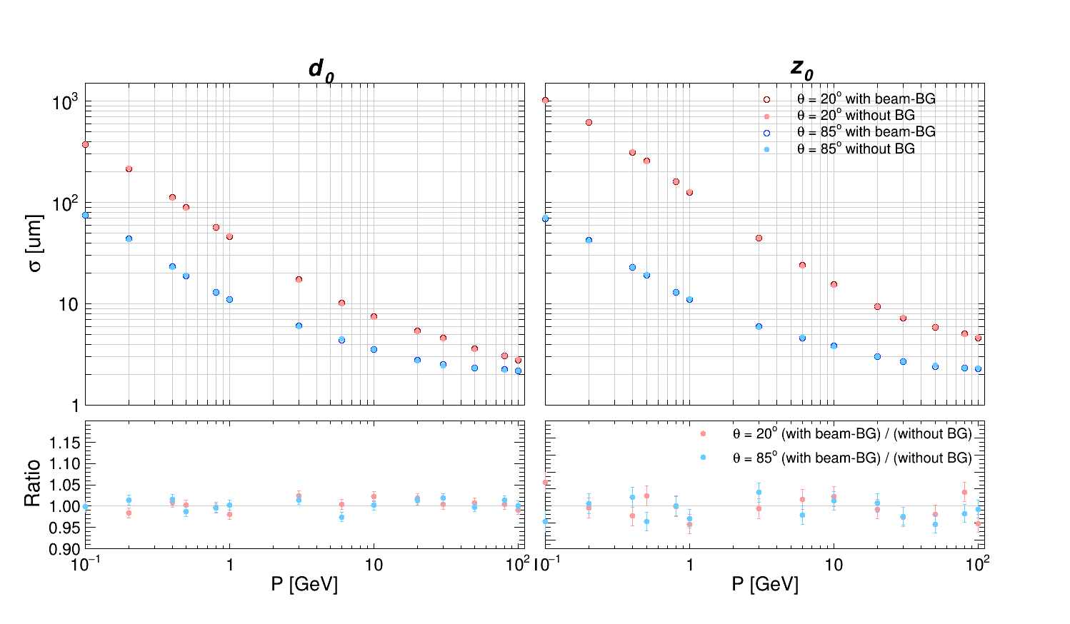
d₀and z₀Resolution : With vs. Without Background
Key Metrics:
d₀: Transverse impact parameter resolution.
z₀: Longitudinal impact parameter resolution.
Entries : 10000
InnerSolenoid
There is no noticeable degradation in the resolution of d₀and z₀at polar angles of 85°and 20°across the momentum range from 0.1 to 100 GeV.

Slide 4
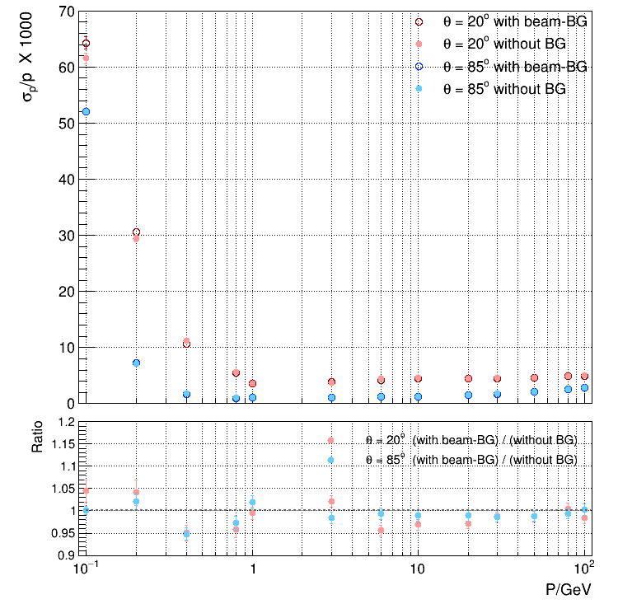
Momentum Resolution
InnerSolenoid with beam-BG
The momentum resolution with beam background is slightly better.
The momentum resolution is better at 85° than at 20°.

Slide 5
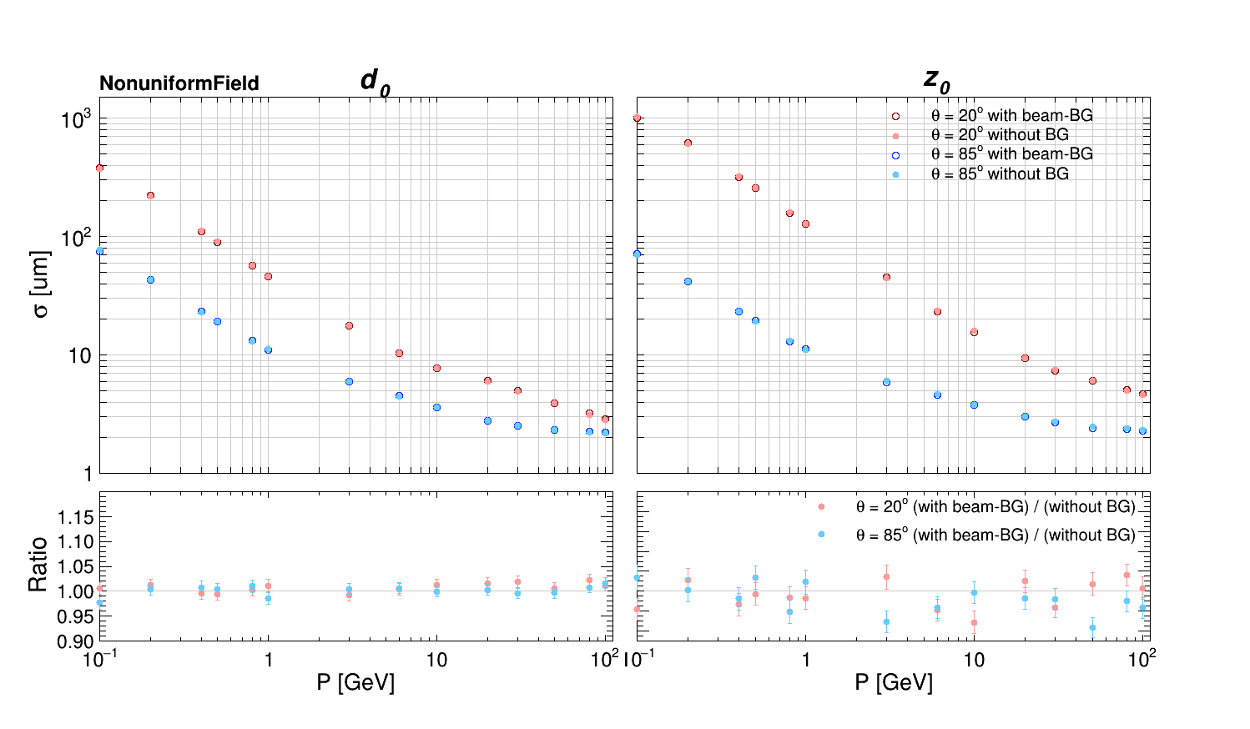
d₀and z₀Resolution : With vs. Without Background
geometry_option = "TDR_o1_v01/TDR_o1_v01-onlyTracker-NonuniformField.xml"
For Z₀ , the resolution with background mixing is slightly better than that without background.

Slide 6
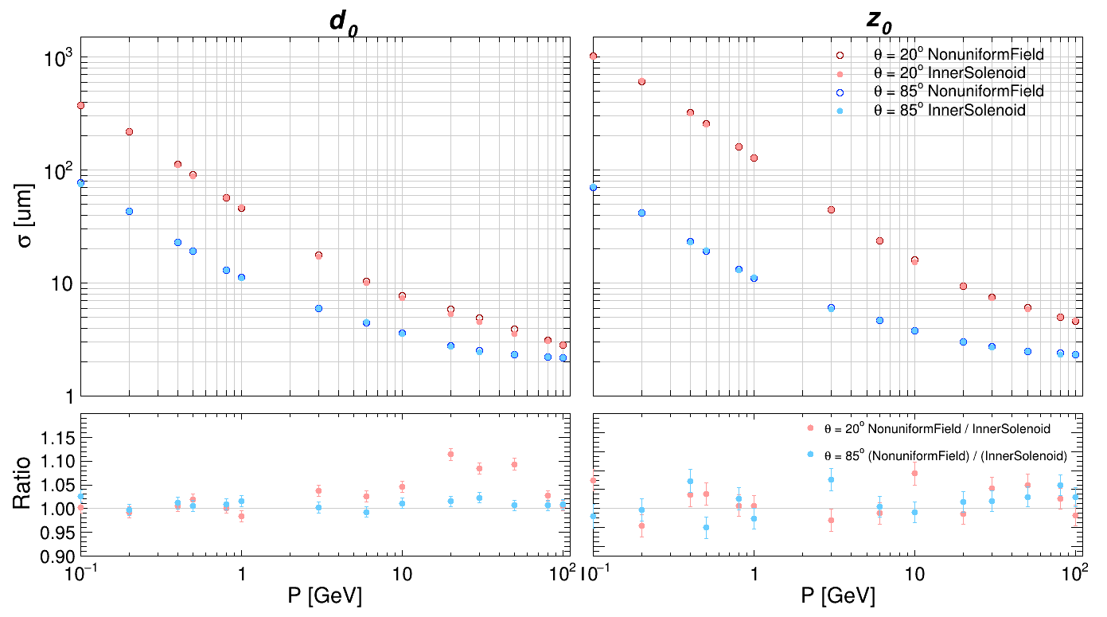
d₀and z₀Resolution : NonuniformField vs. InnerSolenoid nobkg
The resolution is relatively worse under the NonuniformField condition.

Slide 7
fit data
角度（°） | P（GeV/c） | 重建动量拟合均值（GeV/c） | bias（GeV/c）
20 | 0.1 | 0.146427 ± 0.000103 | 0.046427
85 | 0.1 | 0.142411 ± 0.000035 | 0.042411
20 | 0.2 | 0.225861 ± 0.000092 | 0.025861
85 | 0.2 | 0.226288 ± 0.000018 | 0.026288
20 | 0.4 | 0.413333 ± 0.000057 | 0.013333
85 | 0.4 | 0.413724 ± 0.000008 | 0.013724
20 | 0.8 | 0.805256 ± 0.000058 | 0.005256
85 | 0.8 | 0.806932 ± 0.000009 | 0.006932
20 | 1 | 1.005009 ± 0.000040 | 0.005009
85 | 1 | 1.005563 ± 0.000013 | 0.005563
20 | 3 | 3.001589 ± 0.000125 | 0.001589
85 | 3 | 3.001969 ± 0.000036 | 0.001969
20 | 6 | 6.001047 ± 0.000273 | 0.001047
85 | 6 | 6.000983 ± 0.000077 | 0.000983
20 | 10 | 10.000491 ± 0.000481 | 0.000491
85 | 10 | 10.000803 ± 0.000133 | 0.000803
20 | 20 | 20.001535 ± 0.000955 | 0.001535
85 | 20 | 20.000739 ± 0.000318 | 0.000739
20 | 30 | 30.002518 ± 0.001451 | 0.002518
85 | 30 | 30.000337 ± 0.000553 | 0.000337
20 | 50 | 49.998438 ± 0.002479 | -0.001562
85 | 50 | 49.999347 ± 0.001099 | -0.000653
20 | 80 | 80.002208 ± 0.004277 | 0.002208
85 | 80 | 79.995466 ± 0.002147 | -0.004534
20 | 100 | 100.002435 ± 0.005376 | 0.002435
85 | 100 | 99.994112 ± 0.003227 | -0.005888

Slide 8
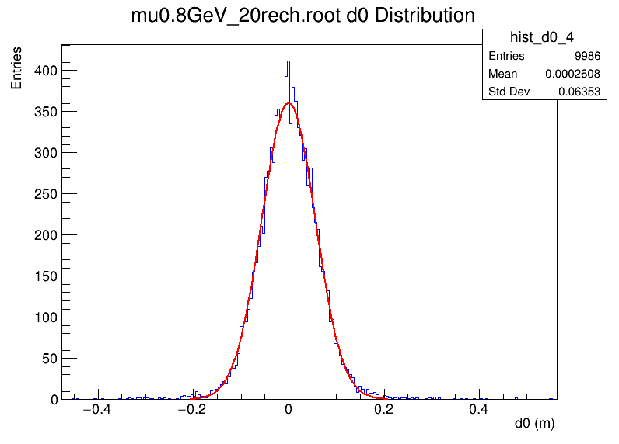
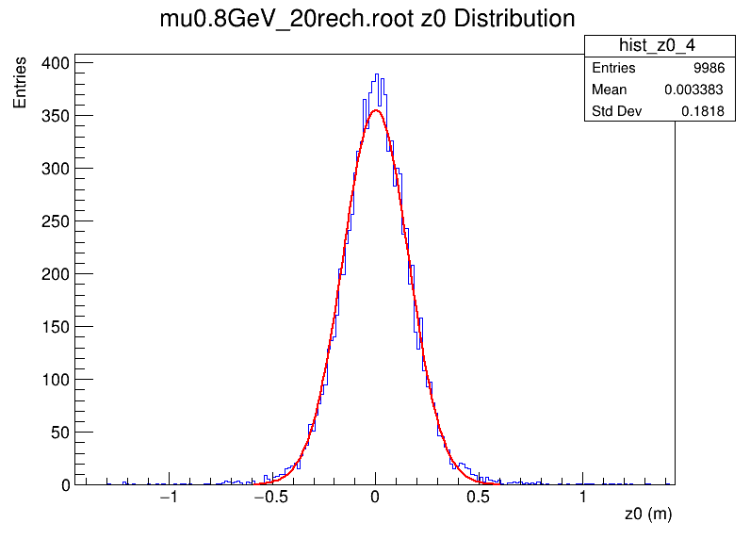
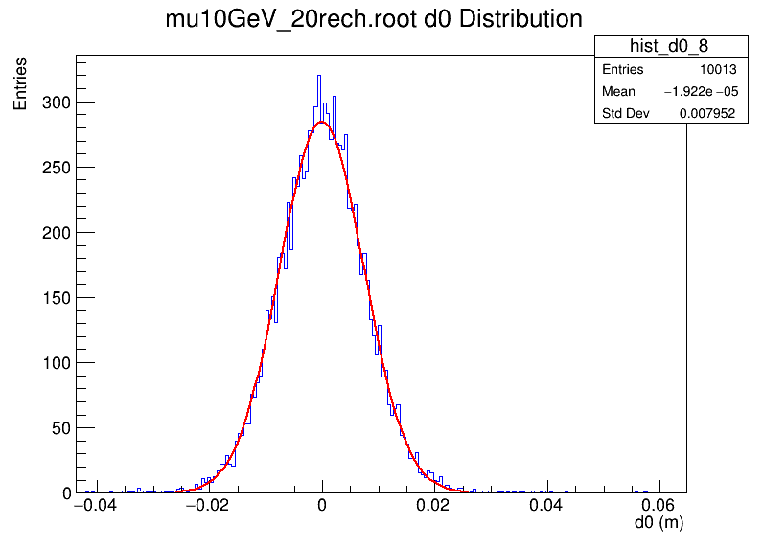
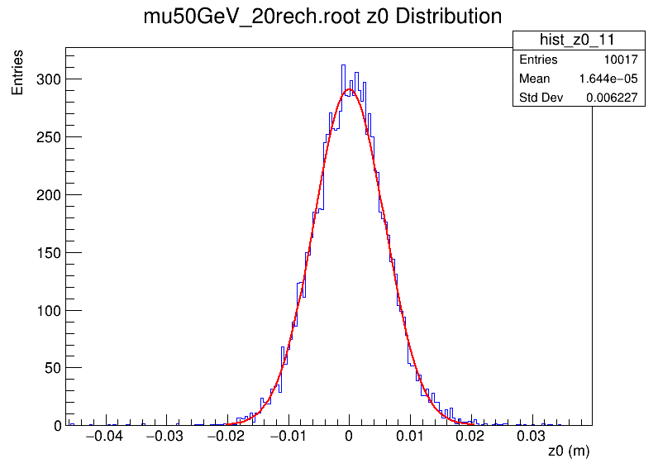
Backup
with beam-BG (Pair Production :250829)

Slide 9
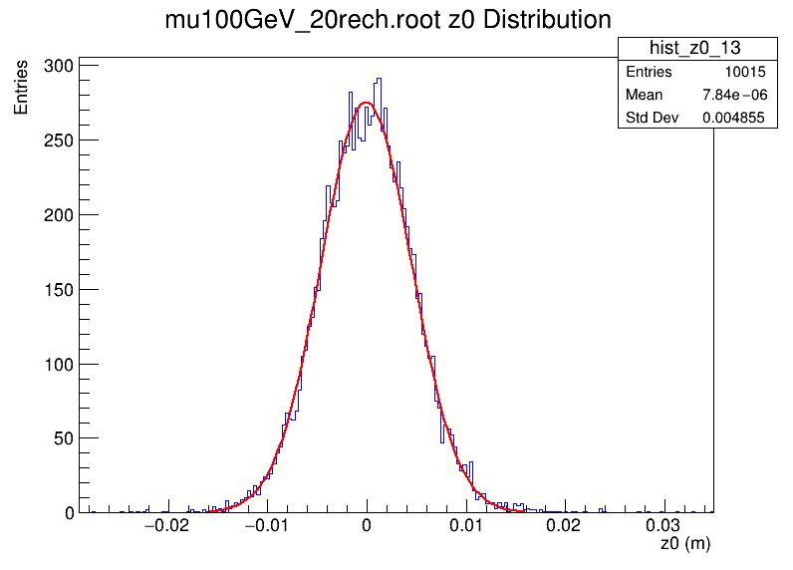
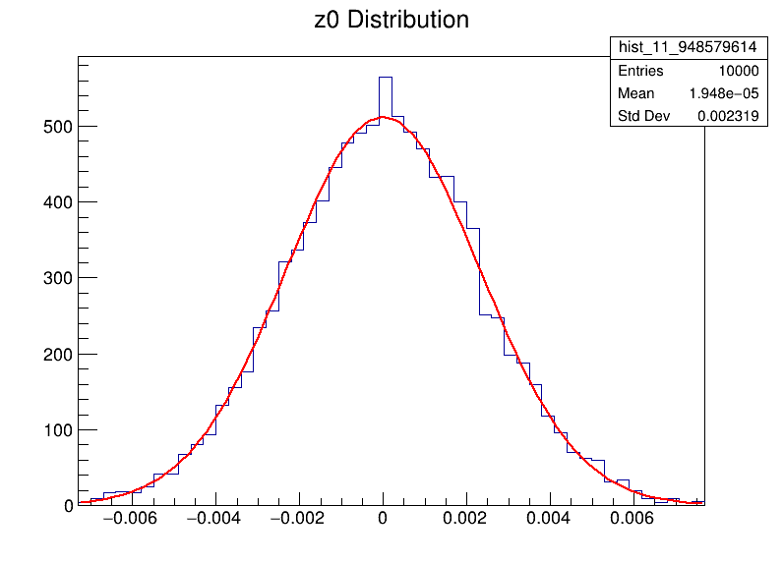
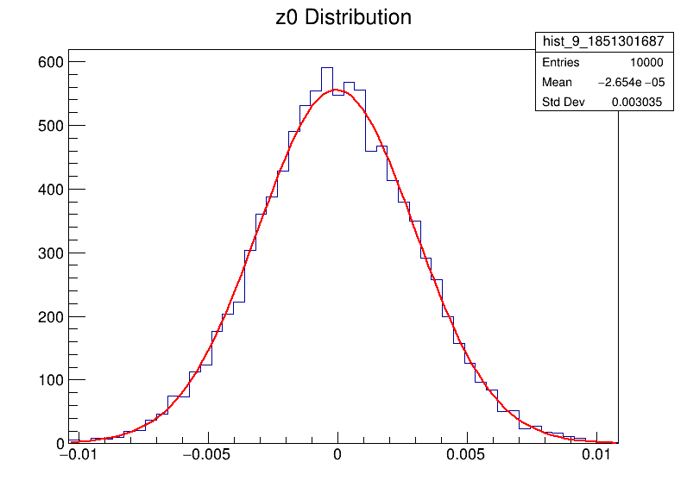
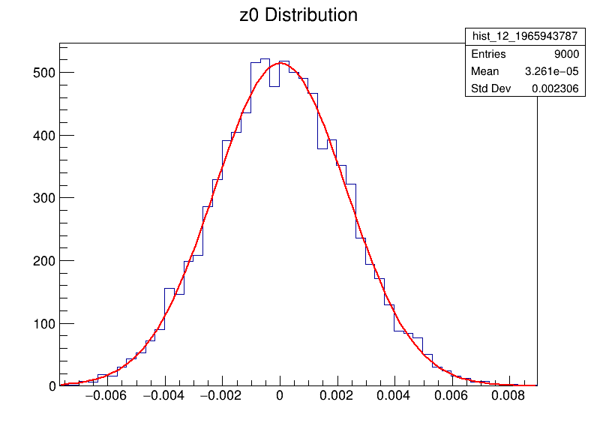
Backup
with beam-BG (Pair Production :250829)
80GeV_85
20GeV_85
100GeV_85

Slide 10
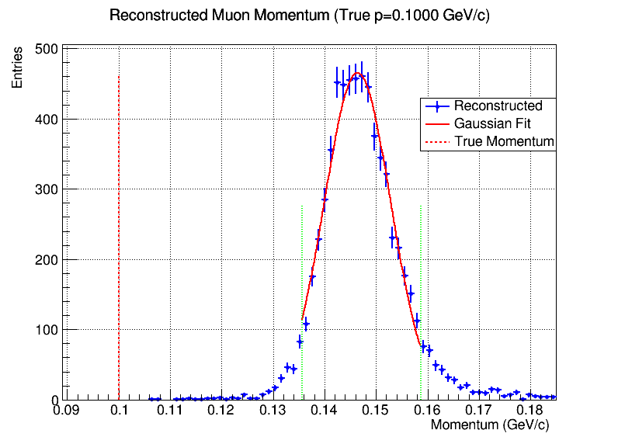
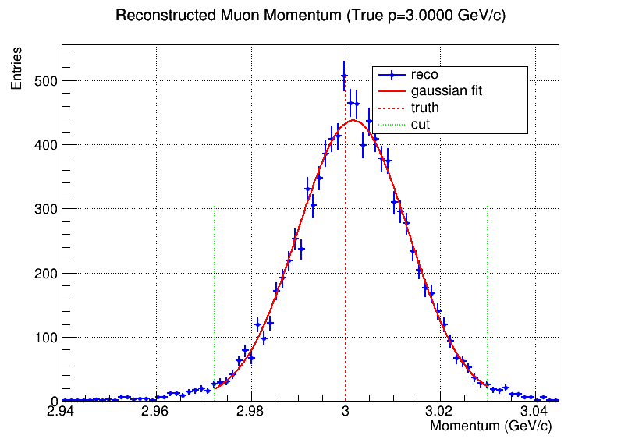
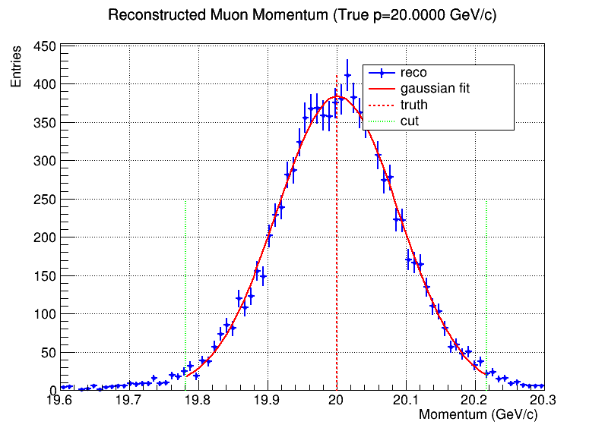
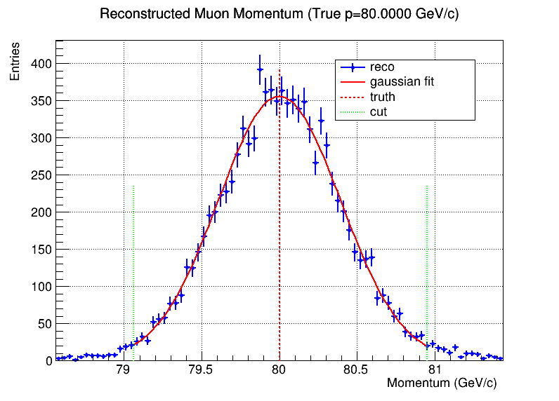
Backup
with beam-BG (Pair Production :250829) 20°

Slide 11
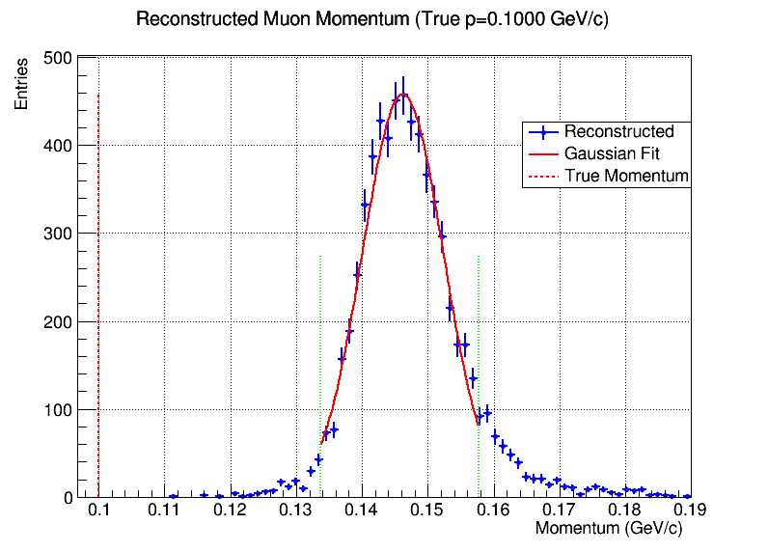
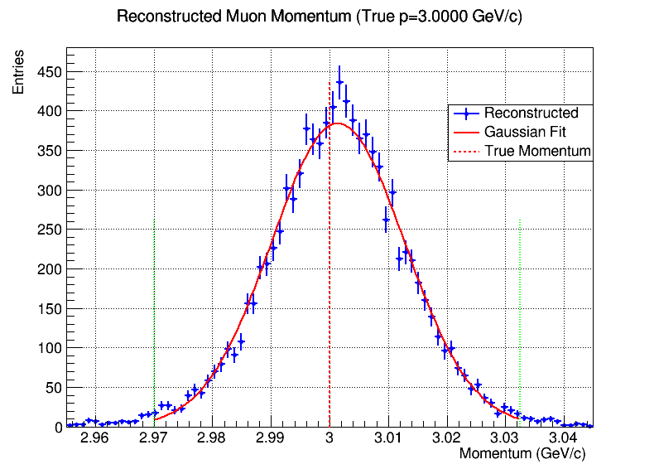
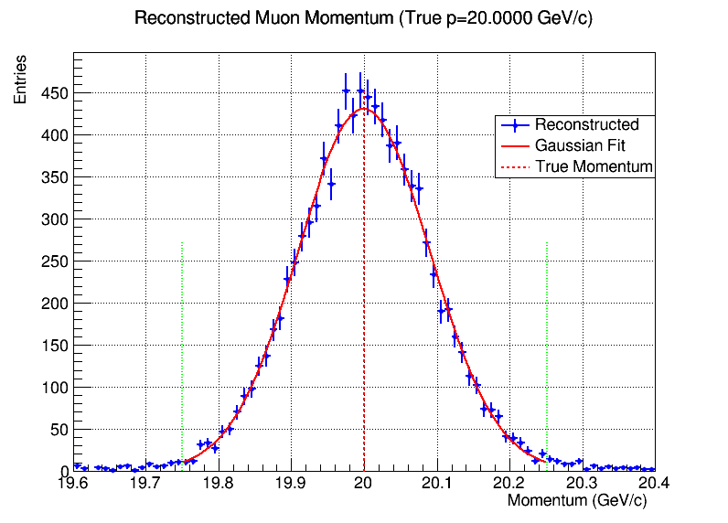
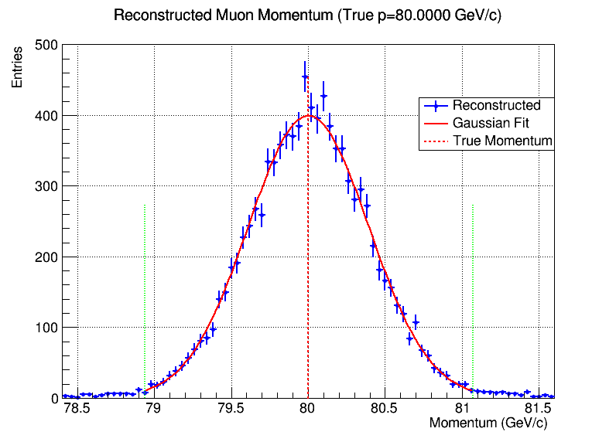
Backup
without BG 20°

