Slide 1
CEPC Ref-TDR author collection
请尽量在9月28日前完成， 10月7号是正式截止
  尊敬的高能物理学界同仁，您好！
  在国内国际同行专家的共同努力、及国内国外众多单位的支持下，CEPC项目组近期已完成了技术设计报告（TDR），撰写已接近尾声并计划于年底发表，目前项目组正在广泛收集TDR作者名单，高能物理分会受CEPC项目组委托邀请高能物理学界的专家学者作为共同作者参与CEPC TDR的发表。相关个人和单位信息收集请见附件邀请信及相关链接。您的参与不仅对CEPC TDR的发表具有重要意义，也对推动CEPC项目预研、以及推动我国高能物理事业蓬勃发展具有重要作用！
  顺致冬祺！
  赵强（代表高能物理分会秘书处）
  ------
  也可直接访问以下相关链接：
  1）The latest version of CEPC Detector Reference TDR draft:
  https://docs.ihep.ac.cn/link/AAE3245A0F543040E587B2B90B1B1A2783
  2）TDR Authorship Collection page (deadline Sep 28th )
  https://indico.ihep.ac.cn/event/27252/registrations/

Slide 2
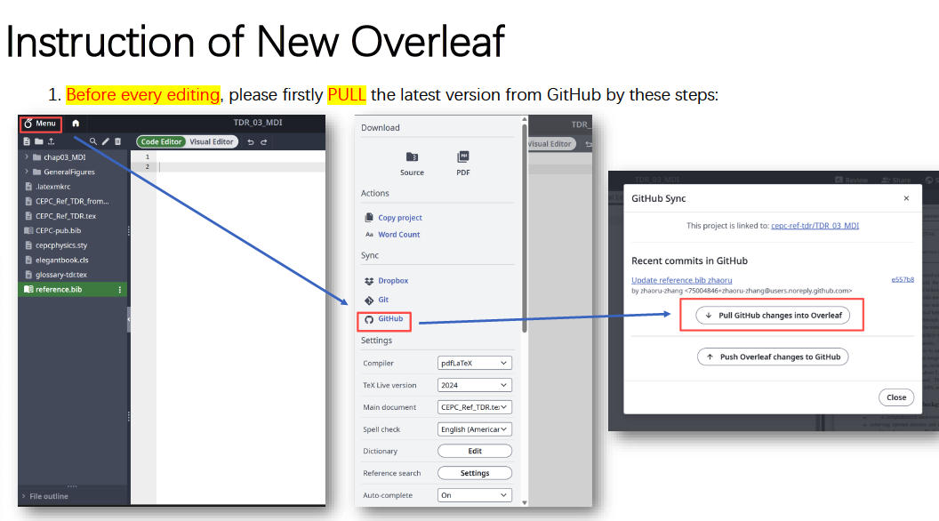
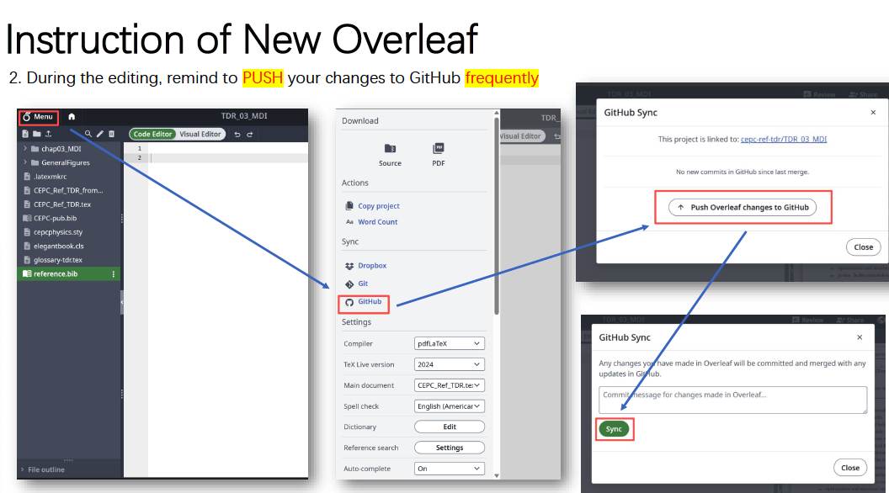
New Overleaf for Ref-TDR editoring
Please switch to new Overleaf website for TDR editing
https://www.overleaf.com/project/68cc26ccacaeefdf185cd80e

Slide 3
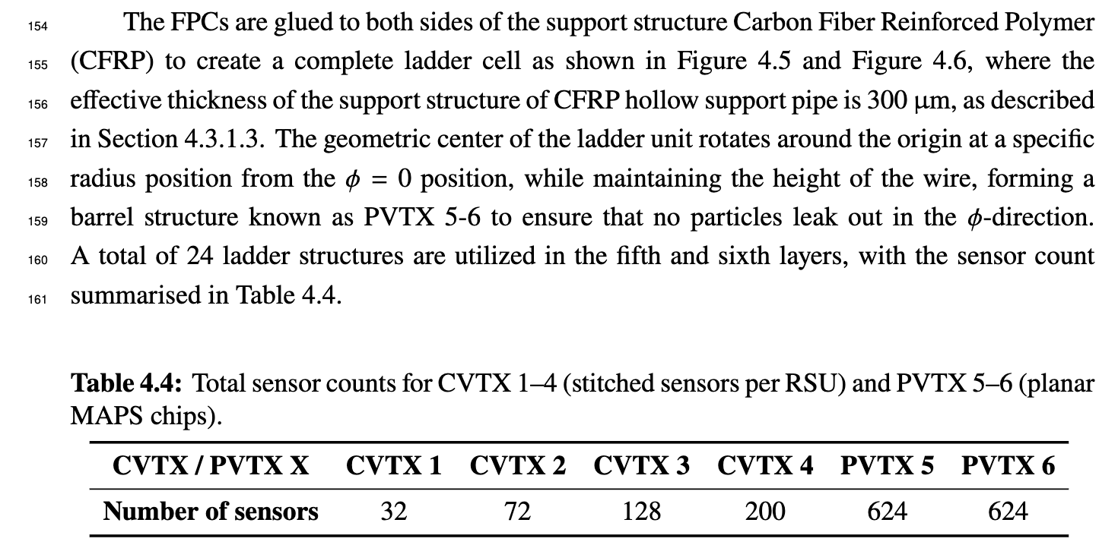
Comments from Yanyan Gao
L2381-2395: a bit hard to follow the numbers around, with RSU, module, sensor mixed up. Do we have a highlight table shows the number of RSUs or pixel sensors in each layer?

Slide 4
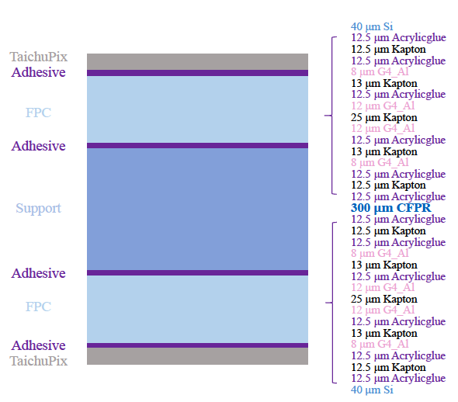
Comments from Yanyan Gao
L2406: FPC is just mentioned without a brief intro in the text, e.g. multi-layer with Al as the conductor, total thickness etc.
  We added linked to Figure 4.6

Slide 5
Comments from Yanyan Gao
L2524: how do we test and calibrate without individual TDAC?
  “Every pixel can be tested and calibrated individually, combining charge injection scans and threshold scans.“ which refers to the process of performing signal scanning for each pixel using the charge injection structure within the pixel to obtain the voltage threshold. Subsequently, the threshold charge for the pixel is determined by combining the simulated or tested results of the charge-to-voltage conversion ratio. To avoid misunderstanding, the original text has been revised.
Table 4.10: LRB power density is 485 mW/cm^2, a factor of 12 larger than the RSU (38 mW/cm^2). Does this create heat hot spot?

Slide 6
Comments from Yanyan Gao
Section 4.4: i don't follow the details of this laser calibration. Does this produce a sensor by sensor movement and what is the precision?
  It produce sensor by sensor, precision is about um level
Section 4.5.2: how many wafers were produced for TaichuPix, what is the approximate yield?
  12 wafers, 70-80% yield

Slide 7
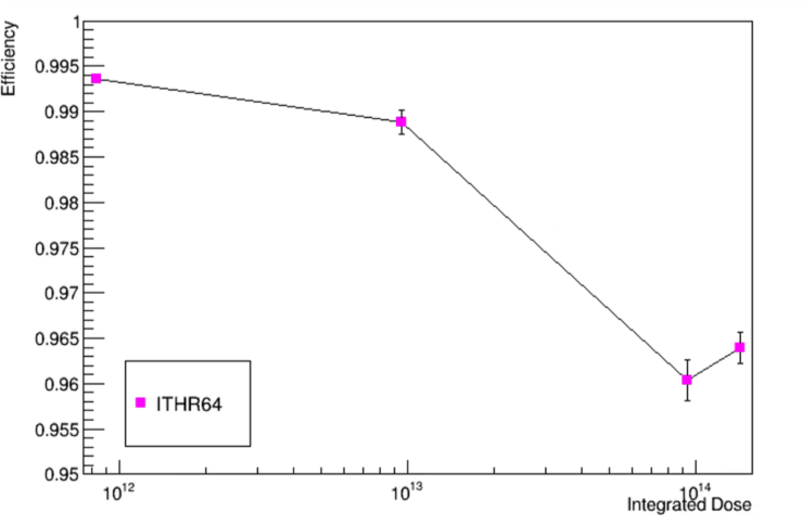
Comments from Yanyan Gao
Radiation tolerance as 2E14 is not exactly trivial, however not much discussion is devoted into this. Are there plans for detailed irradiation? All the performance so far is based on non-irradiated TaiChu Pix.
  Proton Irradiation tests up to 2E14 has been performed

Slide 8
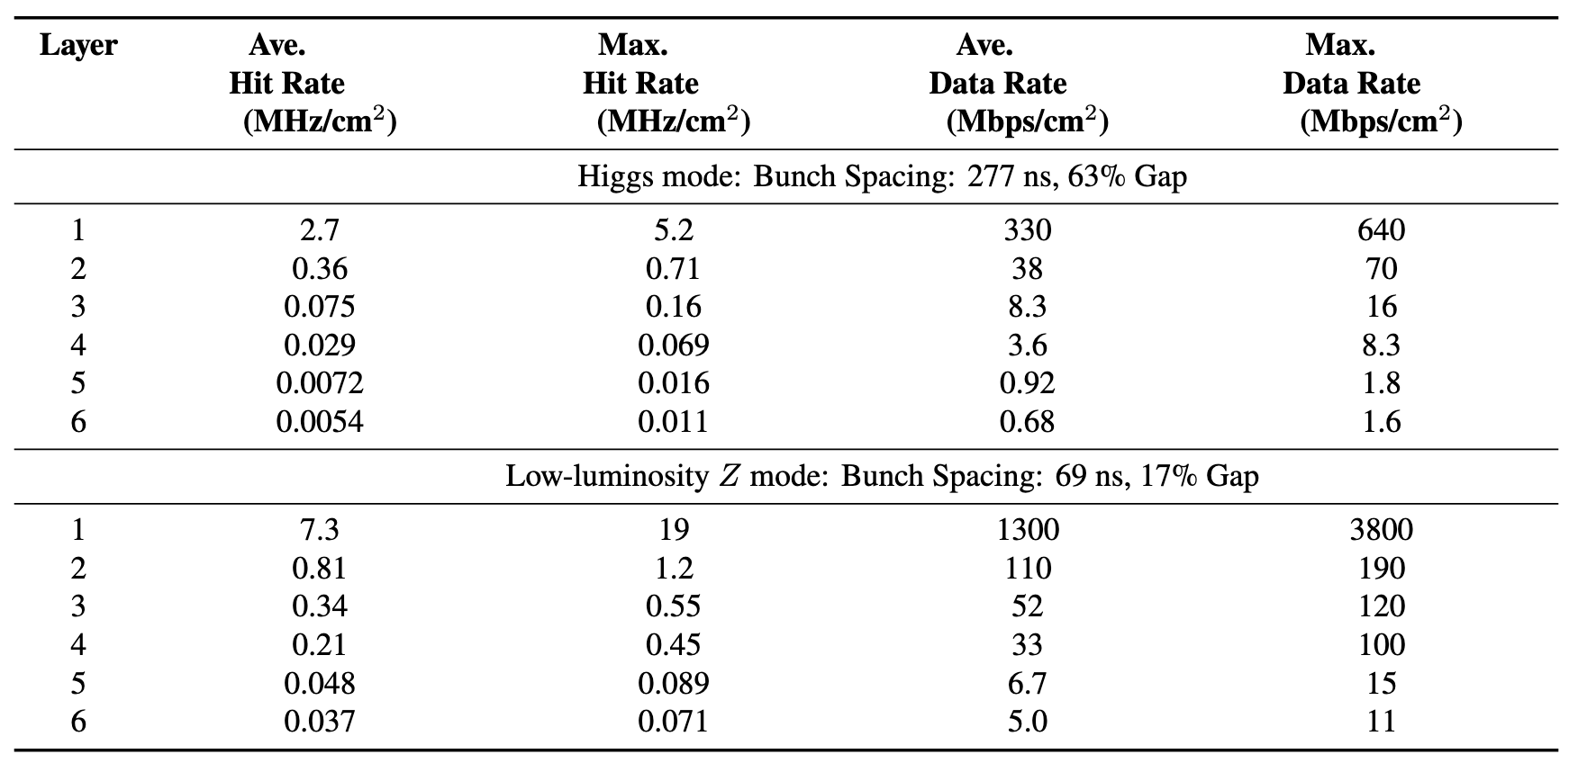
Remaining item for Ref-TDR
Background estimation will be updated
  single beam + pair production ?
Performance section need update ?

Slide 9
Introduction: vertex detector
Next CEPC day in Oct 16 morning: https://indico.ihep.ac.cn/event/27408/
  Development plan (merging Taichu and Jadepix) ,
    Review Taichu and Jadepix development (重要指标，异同），各自研发历程
      空间分辨
      高本底
    Plan for the future （MOST3, stitching )，提一下华力
    CEPC 最终指标是不是要3微米？
      目前ref-TDR， 25*25微米
      d0~3微米, z0 变差 , D0, Z0 ， 3微米 （16*16微米），功耗，散热
      （16*40微米）
      不同半径 11mm, 12mm, 13mm
    MOST3 (3微米, 指标）
      第一步，双面PCB的束流测试（一面Taichu，一面Jadepix）
      第二步，流片工程批（一半面积是Taichu，一半是Jadepix）
      第三步：65/55nm流片
    define new name of the chip

