Slide 1
Group meeting
2025/9/26

Slide 2
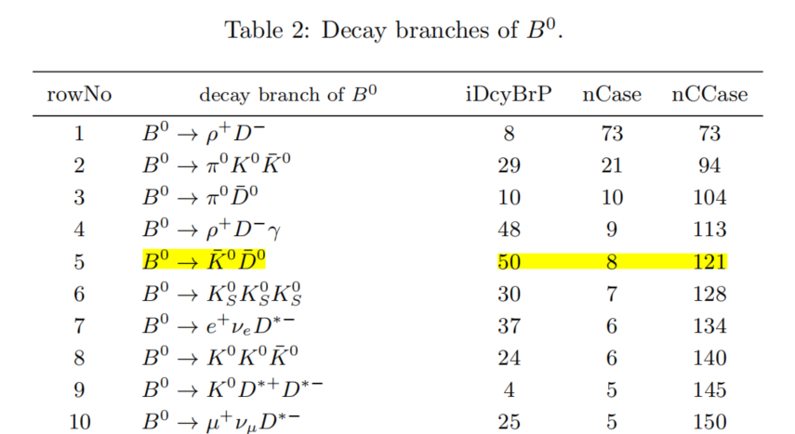
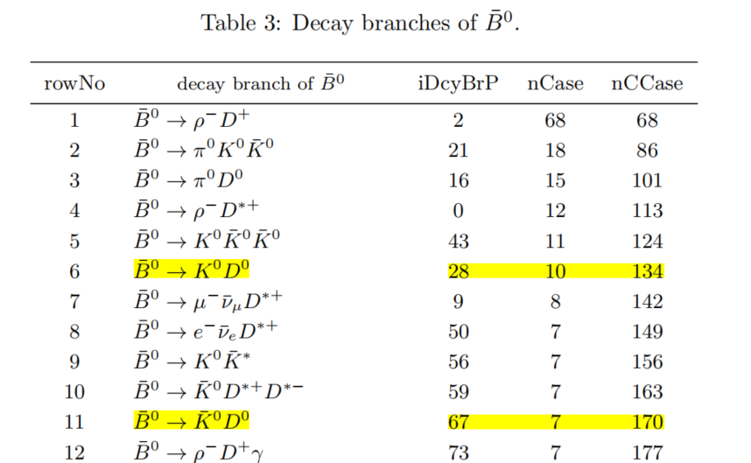
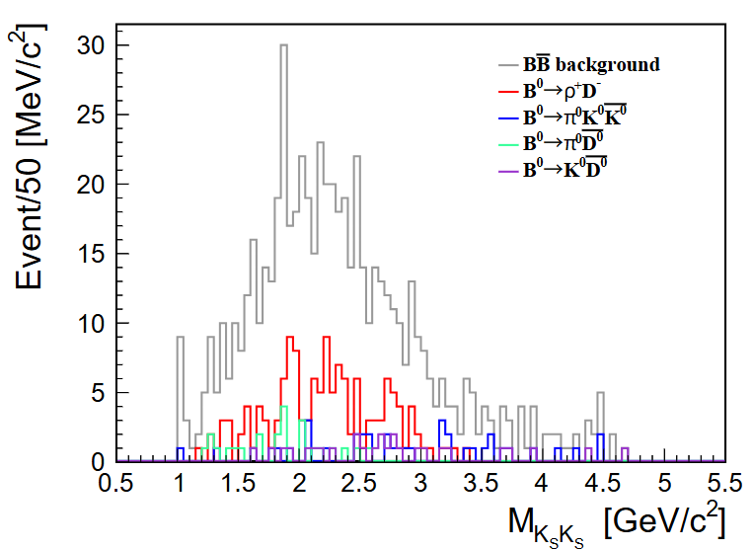
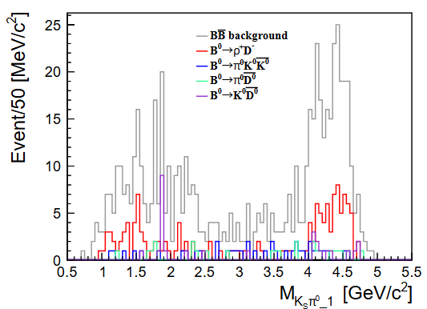
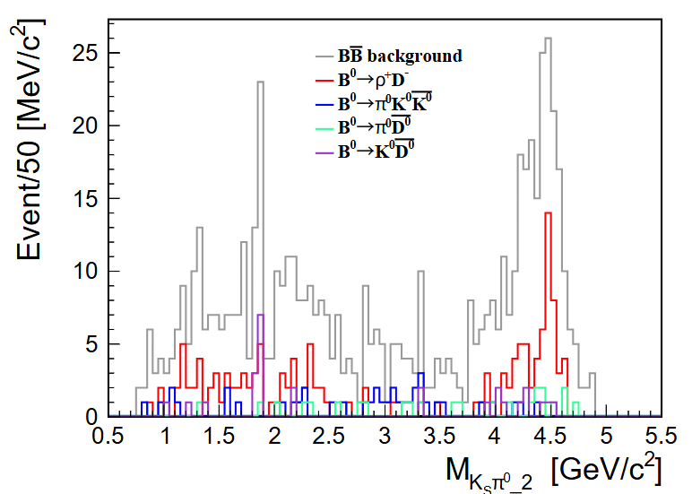

$B\overline{B}$ Background
Topology analysis
plots with no CSMVA cut
no peak
peak around $D^{0}$ mass

Slide 3
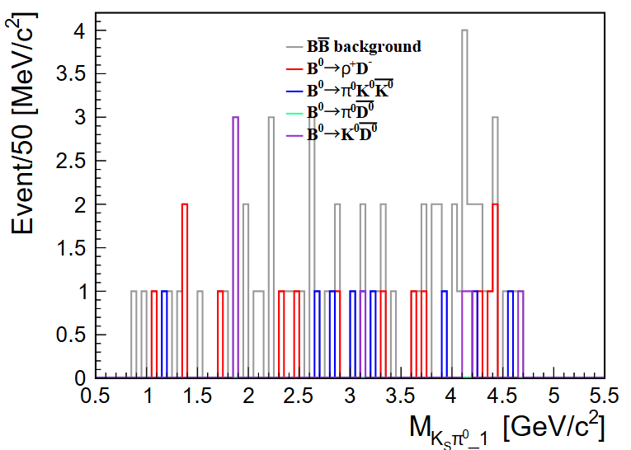
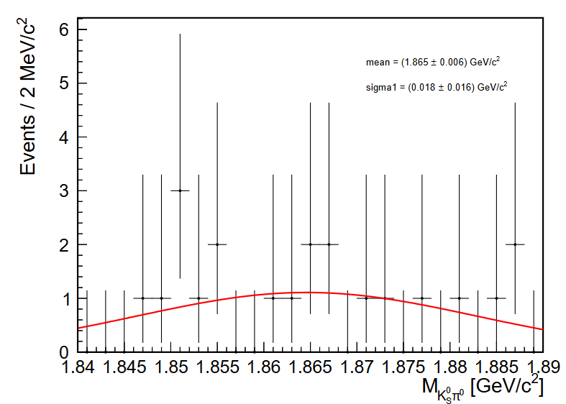
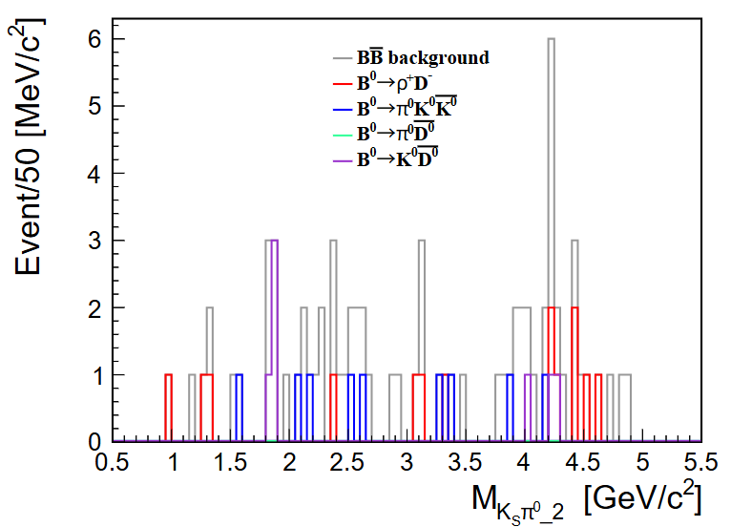
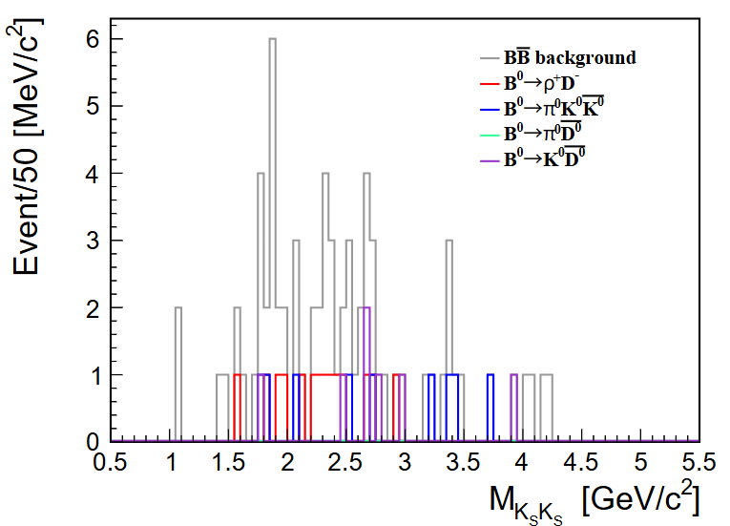

$B\overline{B}$ Background
plots with CSMVA cut
can not fit the peak
before : 616
after : 73
charm veto[Babar]:
$1.815<m(π^{0}K_{S}^{0})<1.899 GeV/c^{2}$
BBbkg
  entries: 73→68
signal eff
  entries: 287276→282278
  eff:14.36%→14.11%

Slide 4
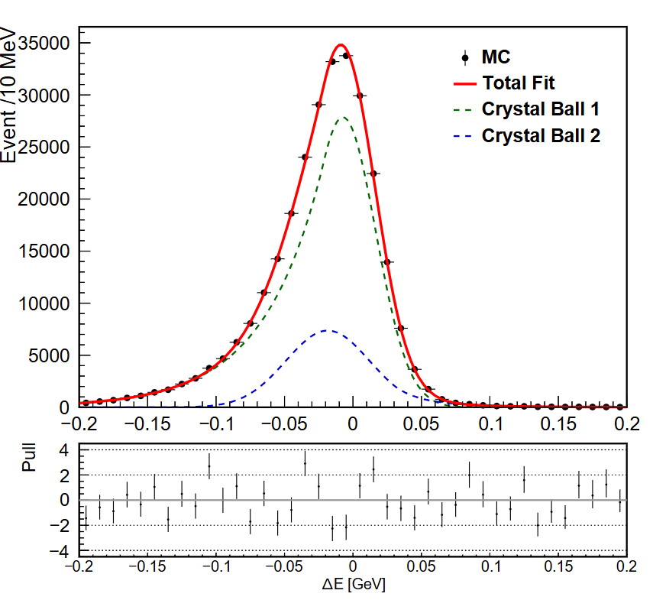
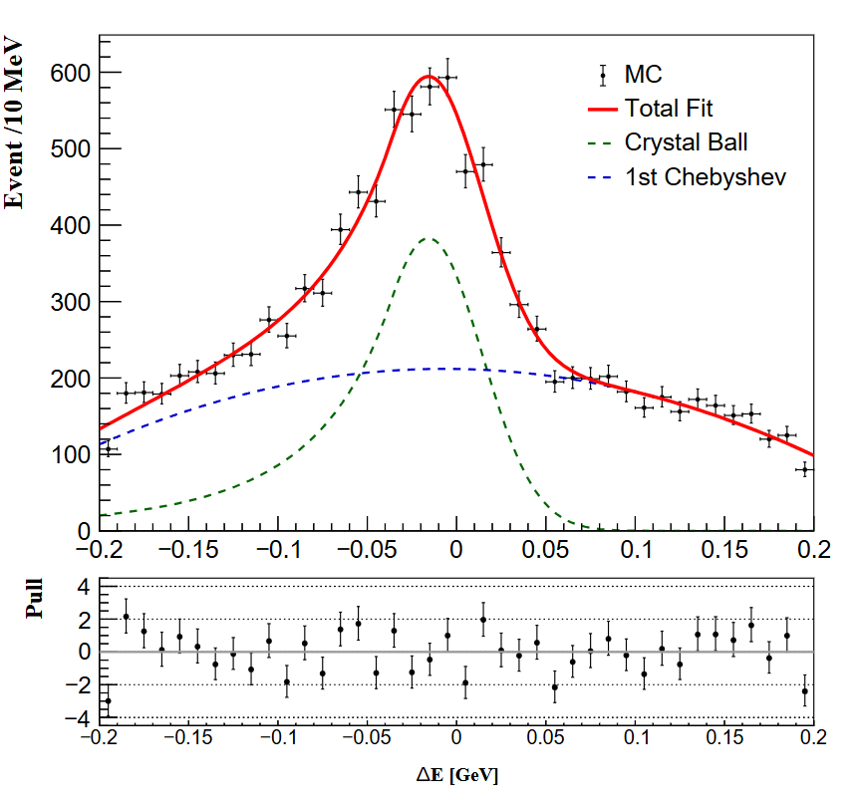
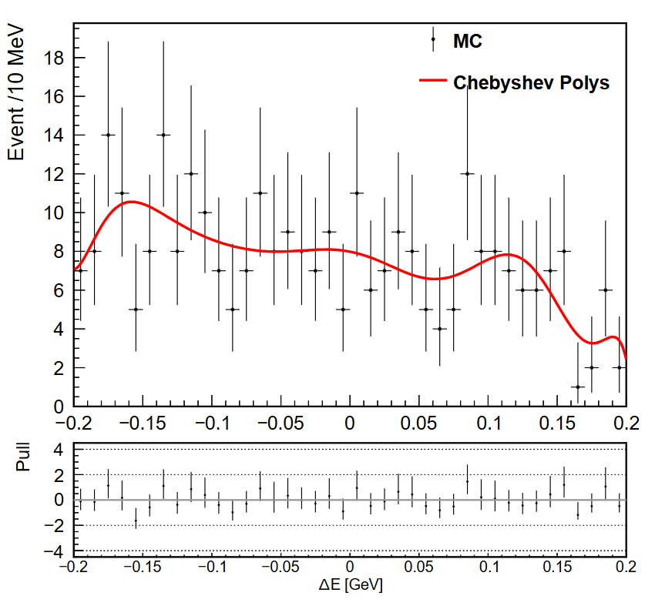
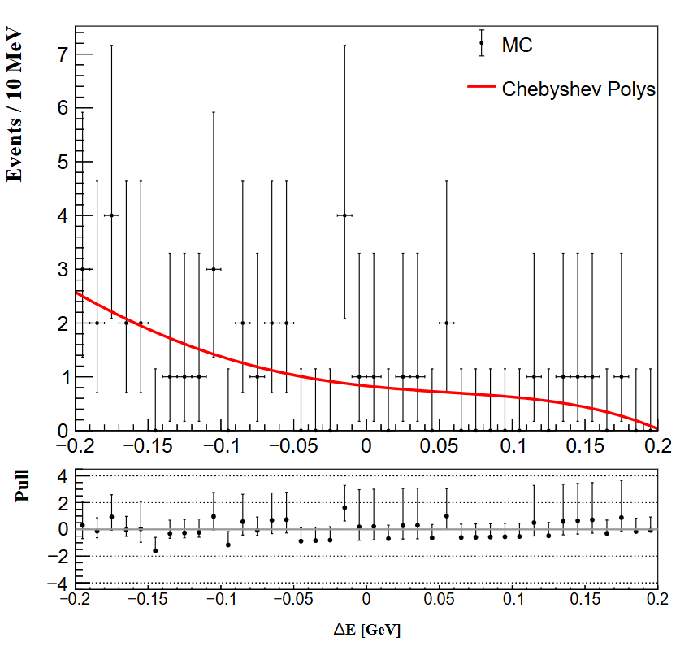
ToyMC study
1000 samples

Slide 5


ToyMC study
1000 samples
pull = ${(x_{fit}−x)}/σ$

Slide 6
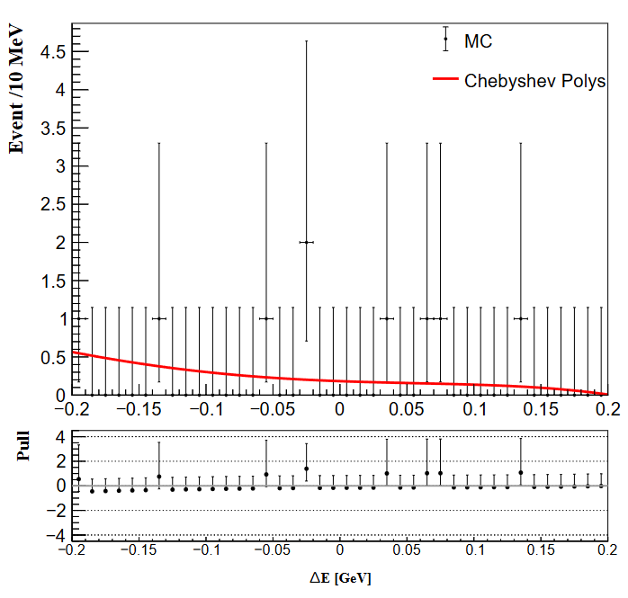
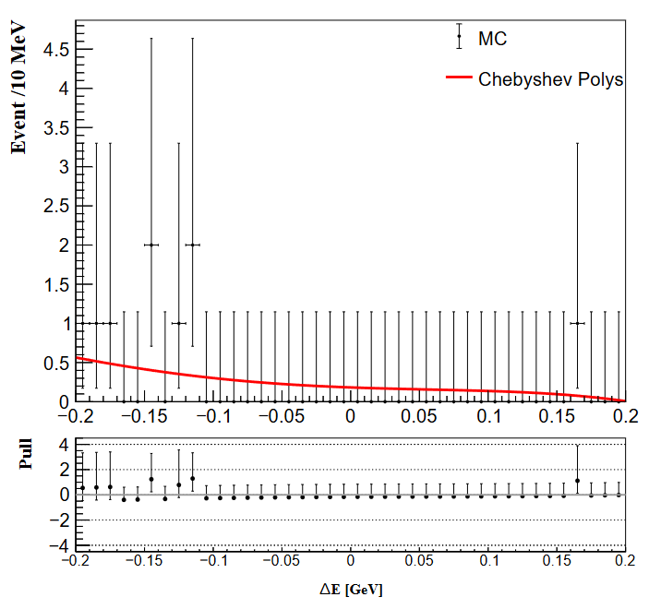
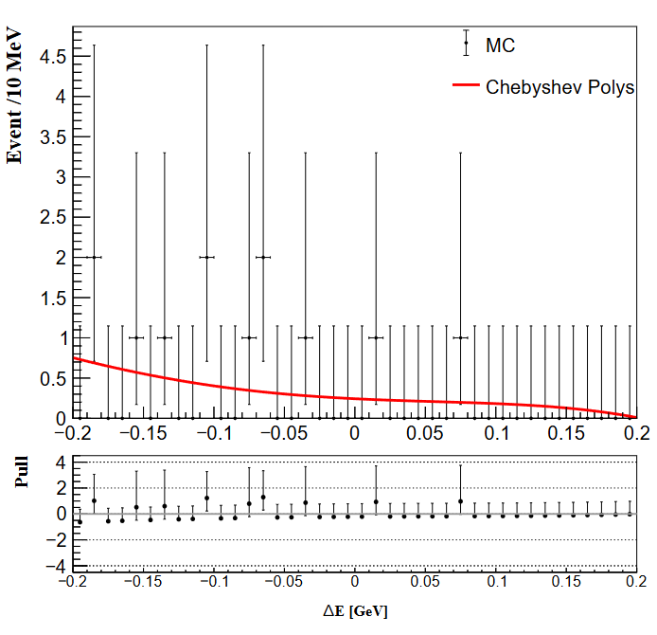
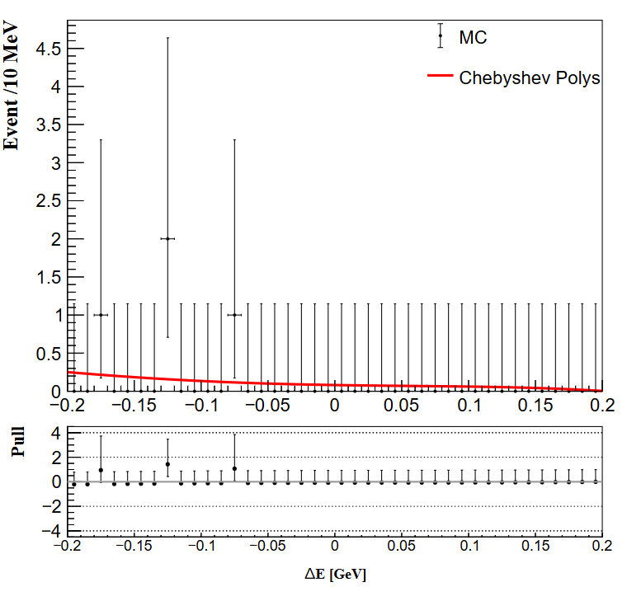
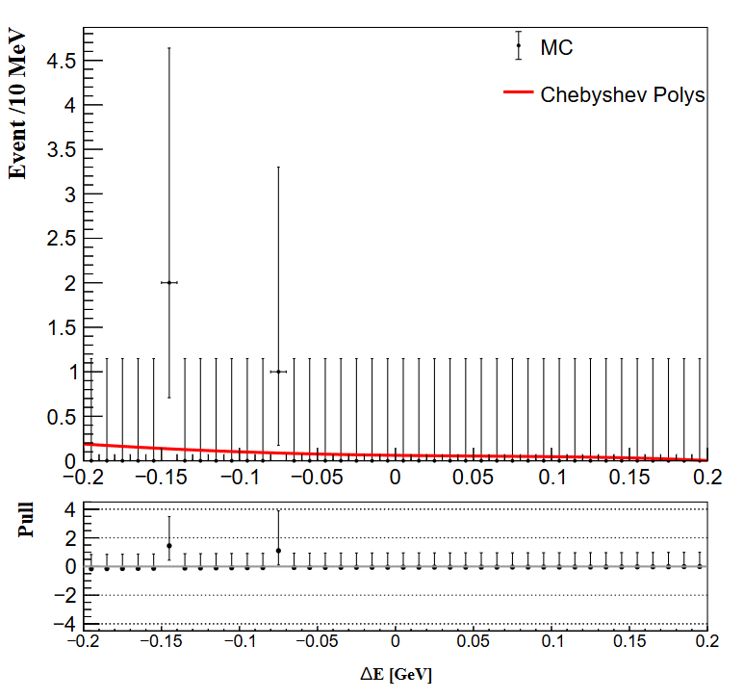
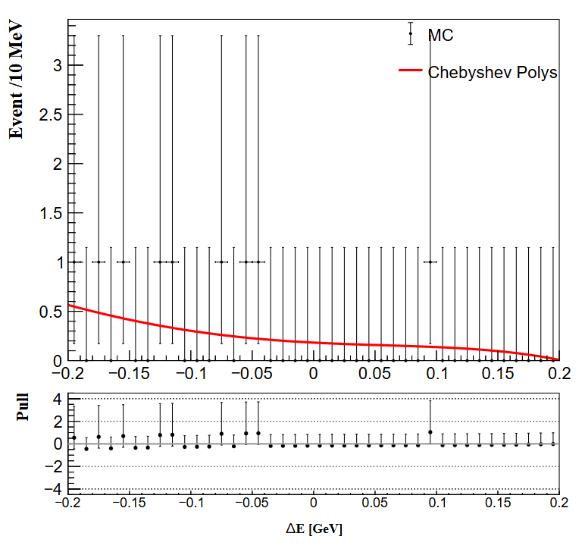
ToyMC study
BBbar toymc samples exam

Slide 7
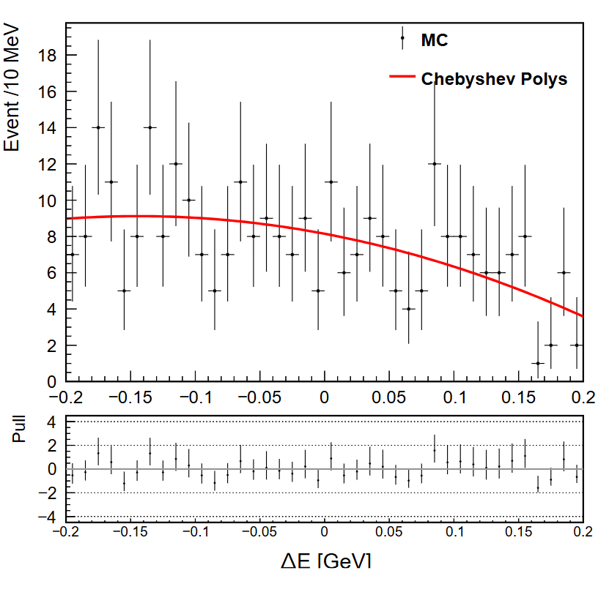
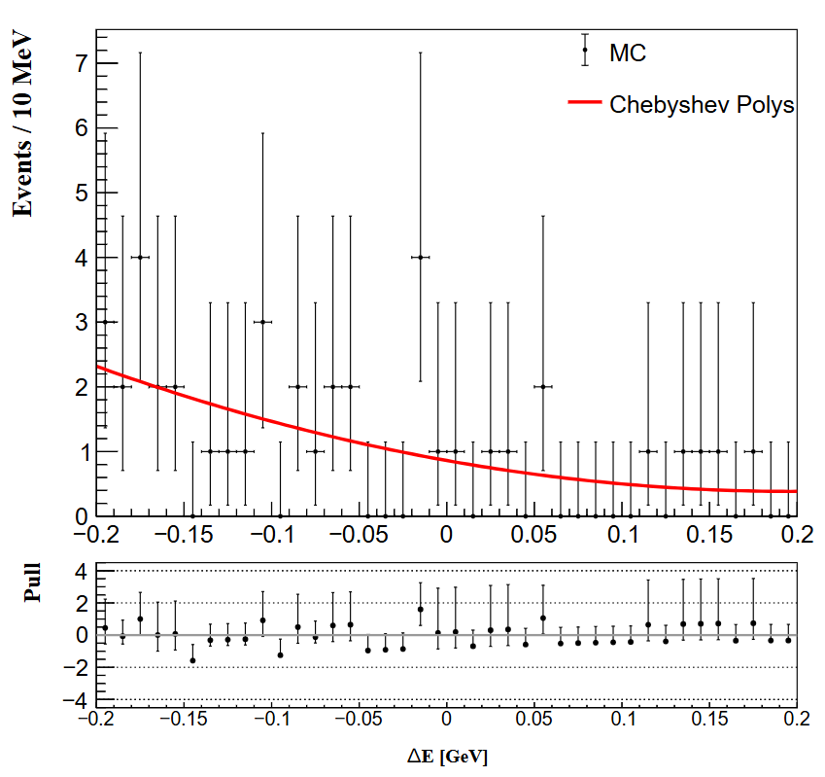
ToyMC study
New PDF ： lower order Chebyshev Polys for qqbar and BBbar

Slide 8


ToyMC study
Using different number of bins
45 40 25
55 55 22

Slide 9
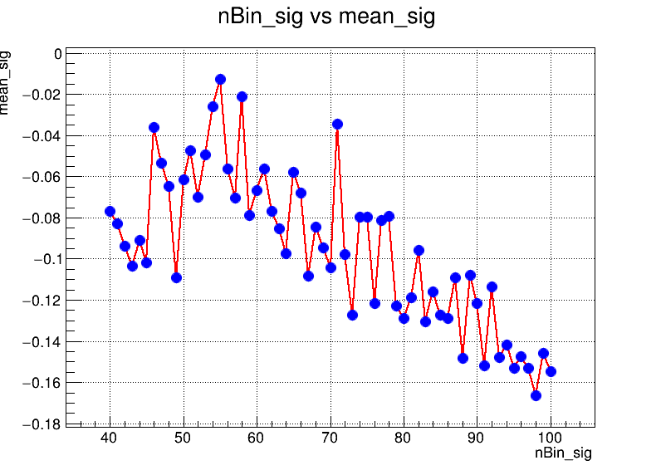
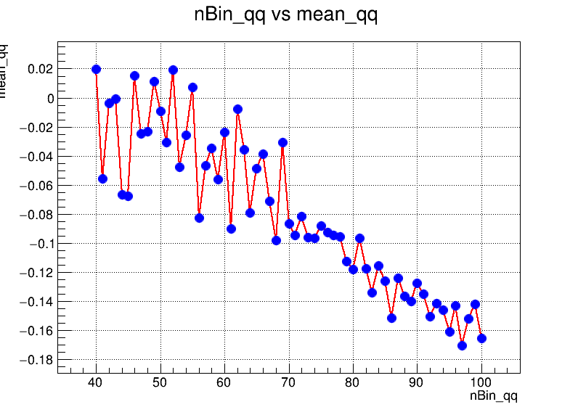
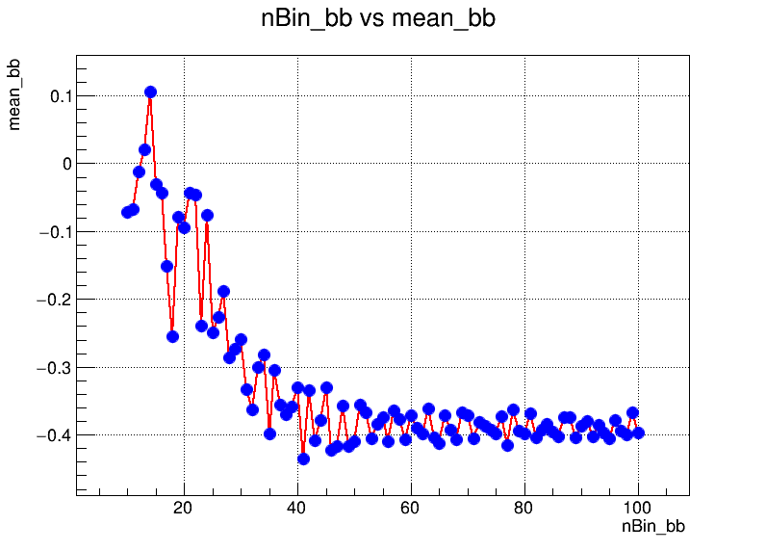
ToyMC study
Test number of bins vs means of fit results

