Slide 1
二氧化碳冷却问题
"ITK Recommendations
With respect to cooling, the TDR should provide more detailed information about the thermal studies, in particular the origin and justification of the sensor thermal requirements, and should better quantify the motivation for considering CO₂ cooling. As the text currently acknowledges the sufficiency of the water-based solution, a clearer quantitative comparison of the two approaches would help to assess whether parallel R&D is needed
The “Future Plans” subsection of the TDR should include a much more detailed schedule for the testing, redesigning, and manufacturing of the COFFEE ASIC family. This would provide a way to track progress and ensure that critical milestones for the ITK baseline are met in a timely manner."

Slide 2
为何选择蒸发式CO₂冷却？
超高传热效率 → 传热系数高于单相 → 沸腾换热
低流量 & 紧凑设计 → 质量流量（ṁ）低 → 管道直径更小 → 材料成本与体积减少
全域均匀冷却 → 管道温度近乎恒定（仅受微小压差Δp影响） → 长距离管线仍保持稳定，避免因热应力引起的sensor变形和破裂
为何选择CO₂？
抗辐射性极强 → 传统制冷剂易被电离辐射破坏，CO₂稳定性卓越
高压 & 小管径 → 高压流体 → 温降（温度滑移）极小 → 适用于微型化系统
环保无毒 → 零臭氧层破坏（ODP=0） → 比CFC制冷剂更可持续

Slide 3
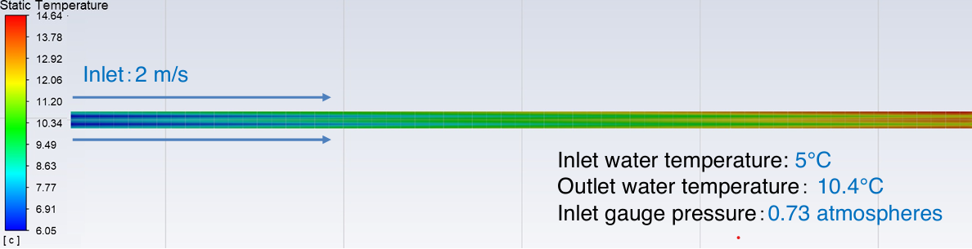
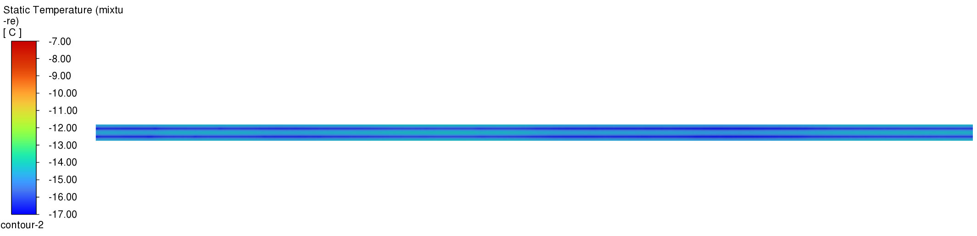
Comparison of water cooling and CO2 two-phase flow cooling of OTK (5680mm) under 5mm pipe diameters
Max：14.64℃
Min：6.05℃
(39g/s)
Simulation result of water cooling for the OTK stave
Max：-13.76℃
Min：-16.87℃
Inlet CO₂：10.5g/s； 2MPa；-19.503℃
Outlet vapor quality: 0.3
Simulation result of co₂ cooling for the OTK stave

Slide 4
热负载均匀性问题
"***** OTK Recommendations *****
Similarly to the case of the ITK, the OTK section of the TDR would benefit from the inclusion of more detailed information about the thermal simulations, in particular the assumptions underlying the sensor thermal requirements. This would help clarify the design margins of the cooling system and provide a stronger justification for pursuing alternatives such as CO₂ cooling in parallel with the water-based baseline.
The heat dissipation is very inhomogeneously distributed (dominated at the place of the LATRIC). It is not clear to us if it was taken into account with all the implications to the mechanics/services.
In addition, the “Future Plans” section should present a more explicit and detailed schedule for the development, testing, redesign, and validation of the LATRIC ASIC family, to reach the final multi-channel version, as well as the other auxiliary chips required for both the front-end and back-end electronics chain."

Slide 5
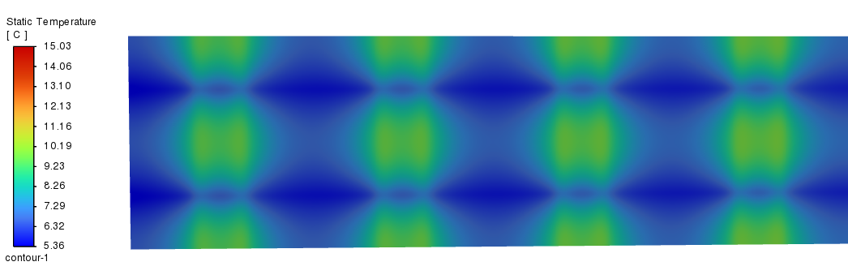
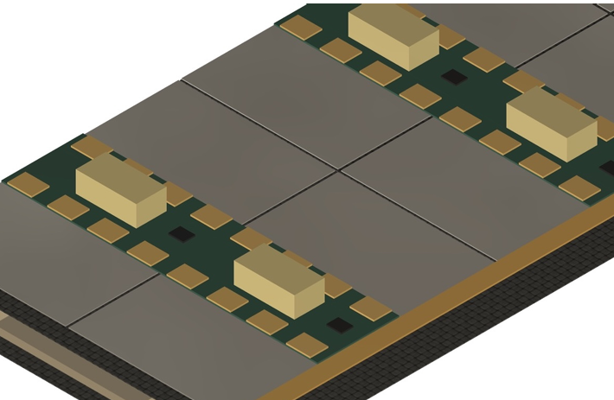
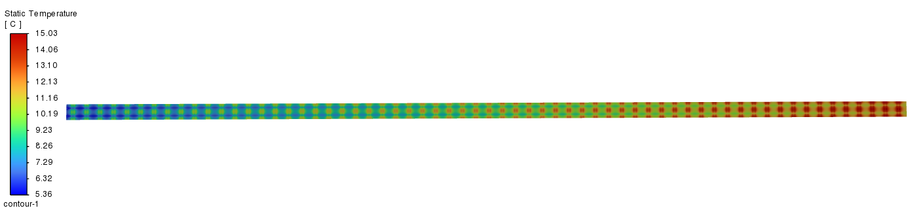
300mw/cm2 （sensor）
2450mw/cm2（asic）
考虑了碳板（背面0.5mm，正面0.3mm），sensor（0.3mm），导热胶（0.1mm），pcb板（0.5mm）对水平温度均匀性的贡献

Slide 6
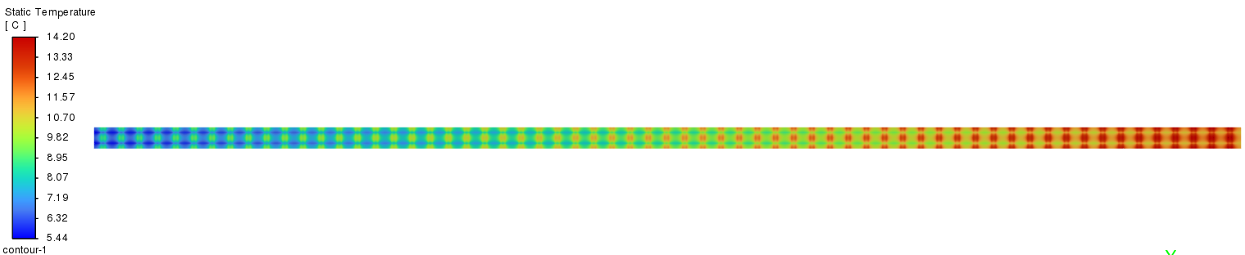
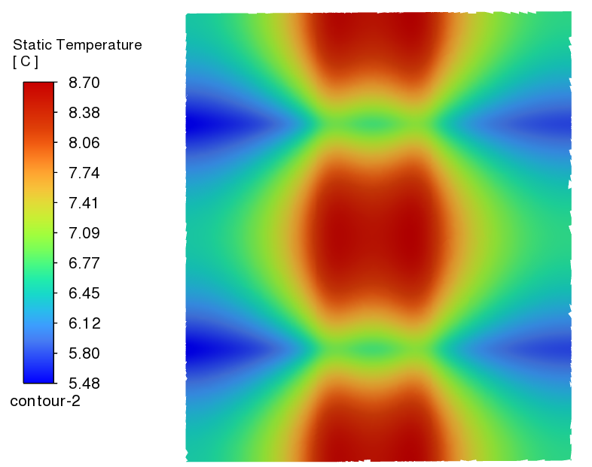
使用tdr里描述的高导热Carbon fiber plate
单块sensor温差在3℃-4℃

