Slide 1

轻标量介子$a_{0}$(1710)/$a_{0}$(1817)的理论研究
王 恩 郑州大学
2025年第17期味物理讲座
2025年10月16日

Slide 2
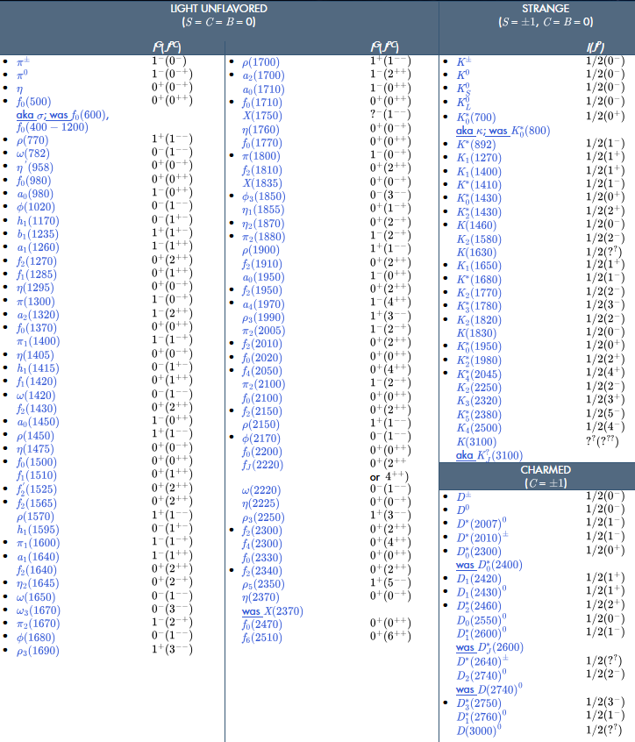
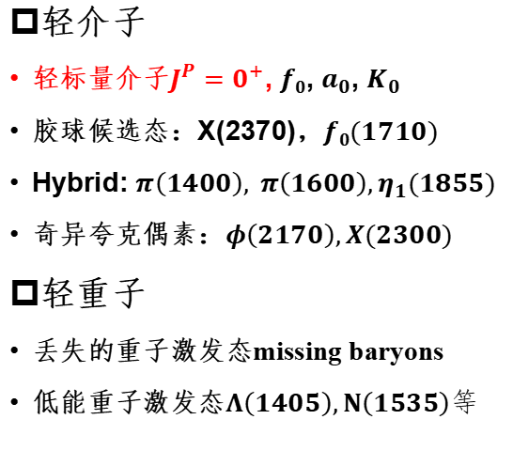
轻强子谱
轻介子
轻标量介子${J^{P}=0}^{+}$, $f0$, $a_{0}$, $K_{0}$
胶球候选态：X(2370)，$f0(1710)$
Hybrid: $π\left(1400\right), π\left(1600\right),η_{1}(1855)$
奇异夸克偶素：$φ\left(2170\right),X(2300)$
轻重子
丢失的重子激发态missing baryons
低能重子激发态$Λ\left(1405\right),N\left(1535\right)等$

Slide 3
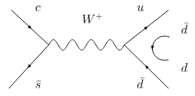
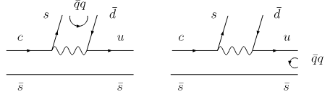
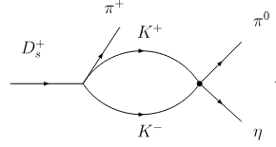

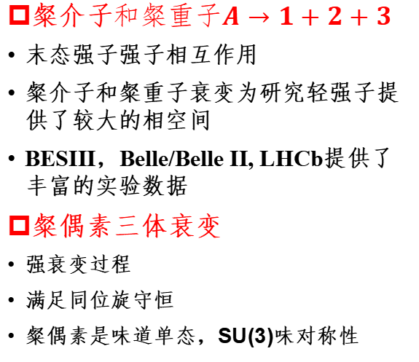

粲强子的多体衰变过程
粲介子$和粲重子A→1+2+3$
末态强子强子相互作用
粲介子和粲重子衰变为研究轻强子提供了较大的相空间
BESIII，Belle/Belle II, LHCb提供了丰富的实验数据
粲偶素三体衰变
强衰变过程
满足同位旋守恒
粲偶素是味道单态，SU(3)味对称性
$D_{s}^{+}→π^{+}π^{0}$ <$1.2∗{10}^{−4}$
$D_{s}^{+}→a_{0}{\left(980\right)}^{+/0}π^{0/+}$ $(2.1±0.4)\%$
$a_{0}$(980) can be dynamically generated from KK¯ final-state interactions in coupled channels
PLB803 (2020) 135279

Slide 4
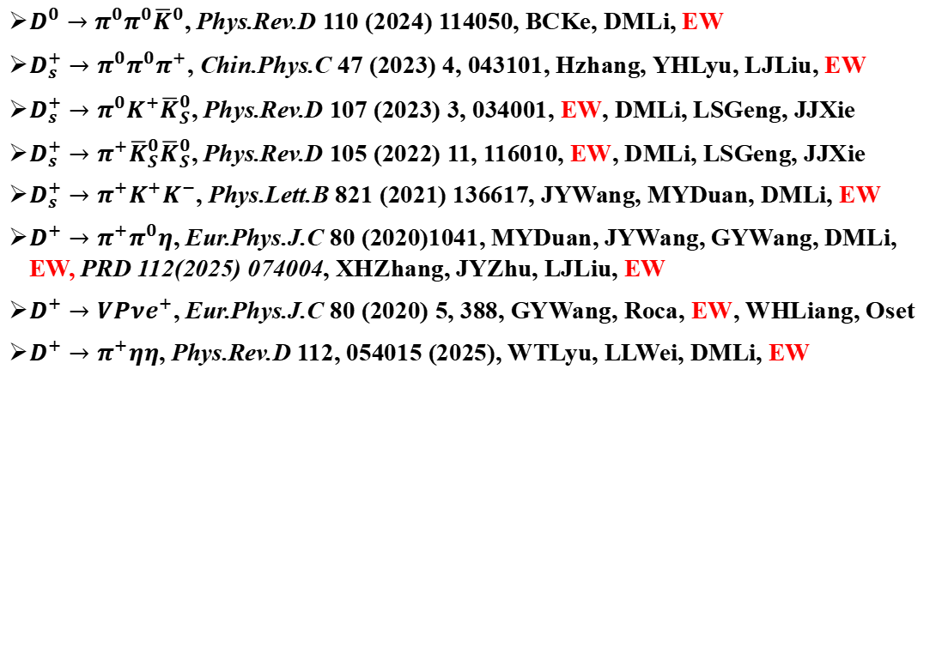
粲介子多体衰变
$D^{0}→π^{0}π^{0}{\overline{K}}^{0}$, Phys.Rev.D 110 (2024) 114050, BCKe, DMLi, EW
$D_{s}^{+}→π^{0}π^{0}π^{+}$, Chin.Phys.C 47 (2023) 4, 043101, Hzhang, YHLyu, LJLiu, EW
$D_{s}^{+}→π^{0}K^{+}{\overline{K}}_{S}^{0}$, Phys.Rev.D 107 (2023) 3, 034001, EW, DMLi, LSGeng, JJXie
$D_{s}^{+}→π^{+}{\overline{K}}_{S}^{0}{\overline{K}}_{S}^{0}$, Phys.Rev.D 105 (2022) 11, 116010, EW, DMLi, LSGeng, JJXie
$D_{s}^{+}→π^{+}K^{+}K^{−}$, Phys.Lett.B 821 (2021) 136617, JYWang, MYDuan, DMLi, EW
$D^{+}→π^{+}π^{0}η$, Eur.Phys.J.C 80 (2020)1041, MYDuan, JYWang, GYWang, DMLi, EW, PRD 112(2025) 074004, XHZhang, JYZhu, LJLiu, EW
$D^{+}→VPνe^{+}$, Eur.Phys.J.C 80 (2020) 5, 388, GYWang, Roca, EW, WHLiang, Oset
$D^{+}→π^{+}ηη$, Phys.Rev.D 112, 054015 (2025), WTLyu, LLWei, DMLi, EW

Slide 5
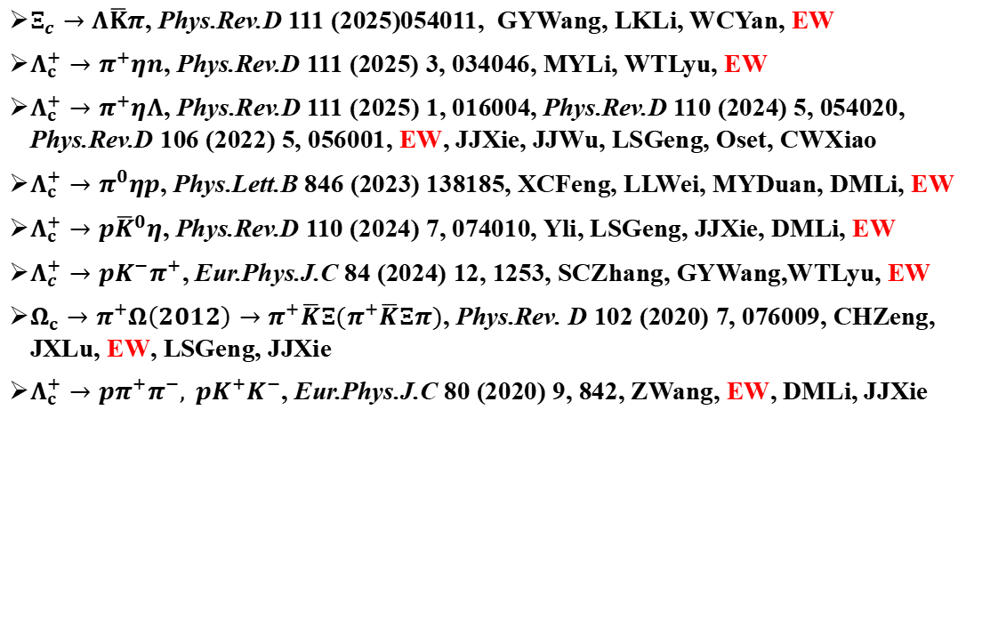
粲重子多体衰变
$Ξ_{c}→Λ\overline{K}π$, Phys.Rev.D 111 (2025)054011, GYWang, LKLi, WCYan, EW
$Λ_{c}^{+}→π^{+}ηn$, Phys.Rev.D 111 (2025) 3, 034046, MYLi, WTLyu, EW
$Λ_{c}^{+}→π^{+}ηΛ$, Phys.Rev.D 111 (2025) 1, 016004, Phys.Rev.D 110 (2024) 5, 054020, Phys.Rev.D 106 (2022) 5, 056001, EW, JJXie, JJWu, LSGeng, Oset, CWXiao
$Λ_{c}^{+}→π^{0}ηp$, Phys.Lett.B 846 (2023) 138185, XCFeng, LLWei, MYDuan, DMLi, EW
$Λ_{c}^{+}→p{\overline{K}}^{0}η$, Phys.Rev.D 110 (2024) 7, 074010, Yli, LSGeng, JJXie, DMLi, EW
$Λ_{c}^{+}→pK^{−}π^{+}$, Eur.Phys.J.C 84 (2024) 12, 1253, SCZhang, GYWang,WTLyu, EW
$Ω_{c}→π^{+}Ω\left(2012\right)→π^{+}\overline{K}Ξ(π^{+}\overline{K}Ξπ)$, Phys.Rev. D 102 (2020) 7, 076009, CHZeng, JXLu, EW, LSGeng, JJXie
$Λ_{c}^{+}→pπ^{+}π^{−}, pK^{+}K^{−}$, Eur.Phys.J.C 80 (2020) 9, 842, ZWang, EW, DMLi, JJXie

Slide 6
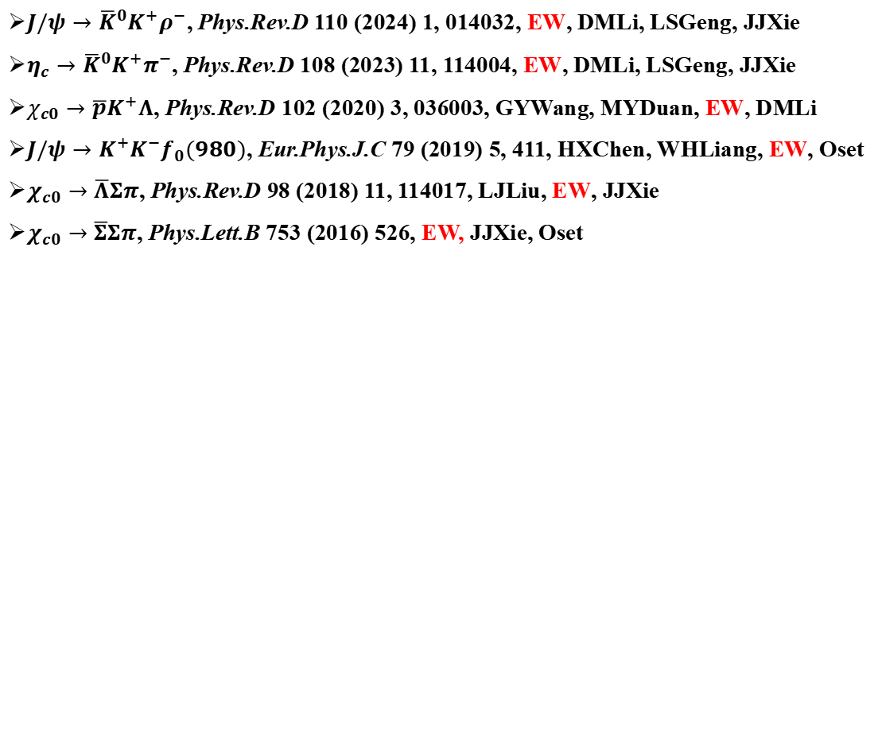
粲偶素多体衰变
$J/ψ→{\overline{K}}^{0}K^{+}ρ^{−}$, Phys.Rev.D 110 (2024) 1, 014032, EW, DMLi, LSGeng, JJXie
$η_{c}→{\overline{K}}^{0}K^{+}π^{−}$, Phys.Rev.D 108 (2023) 11, 114004, EW, DMLi, LSGeng, JJXie
$χ_{c0}→\overline{p}K^{+}Λ$, Phys.Rev.D 102 (2020) 3, 036003, GYWang, MYDuan, EW, DMLi
$J/ψ→K^{+}K^{−}f_{0}(980)$, Eur.Phys.J.C 79 (2019) 5, 411, HXChen, WHLiang, EW, Oset
$χ_{c0}→\overline{Λ}Σπ$, Phys.Rev.D 98 (2018) 11, 114017, LJLiu, EW, JJXie
$χ_{c0}→\overline{Σ}Σπ$, Phys.Lett.B 753 (2016) 526, EW, JJXie, Oset

Slide 7
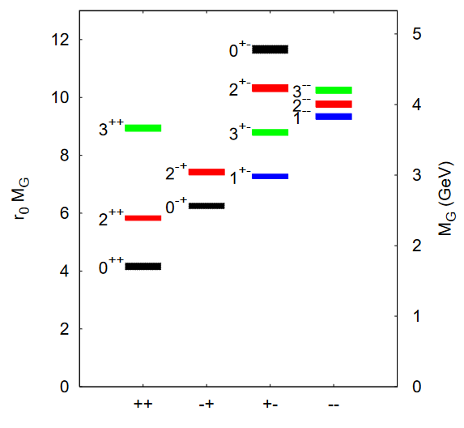
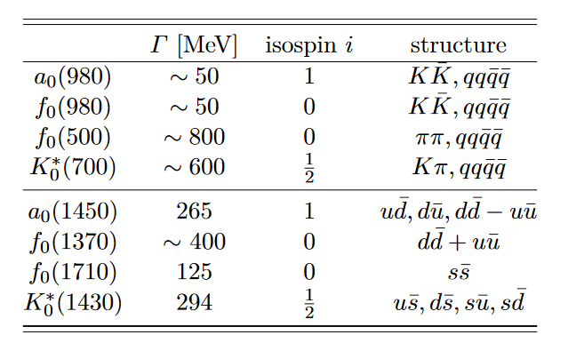

Scalar mesons
Masses puzzle: $a_{0}(980)/f_{0}(980)$, $K(700)$, $f_{0}\left(500\right)$
$a_{0}(980)/f_{0}(980)$: $q\overline{q}$, tetraquark, hadronic molecules
$f_{0}\left(1370\right), f_{0}\left(1500\right), f_{0}(1710)$
$f_{0}(1710)$: glueball,$s\overline{s}, K^{∗}{\overline{K}}^{∗}$
Y. Chen，PRD73(2006)014516
PDG: Tentative classification

Slide 8
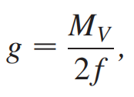
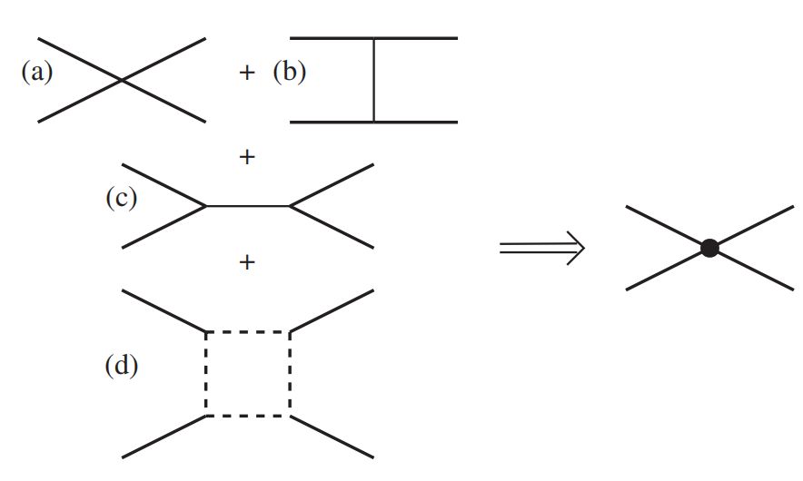
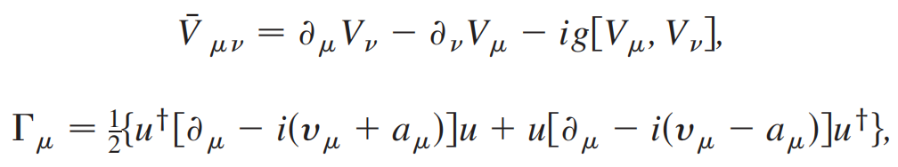
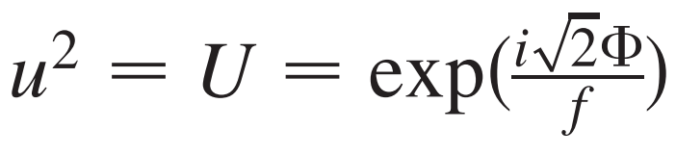
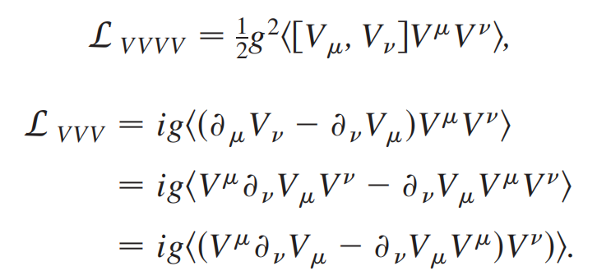
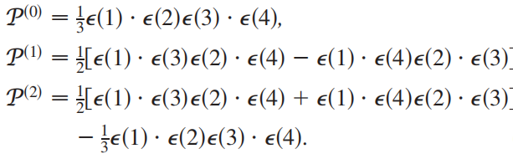
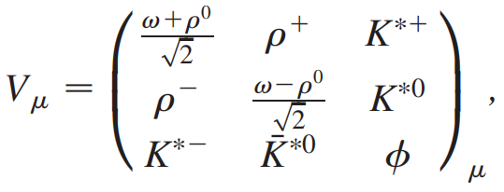

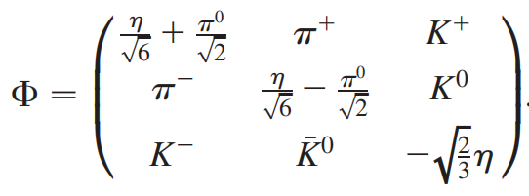
VV interaction from hidden-gauge lagrangians
The hidden-gauge Lagrangian Geng-Oset, PRD79(2009)074009

Slide 9
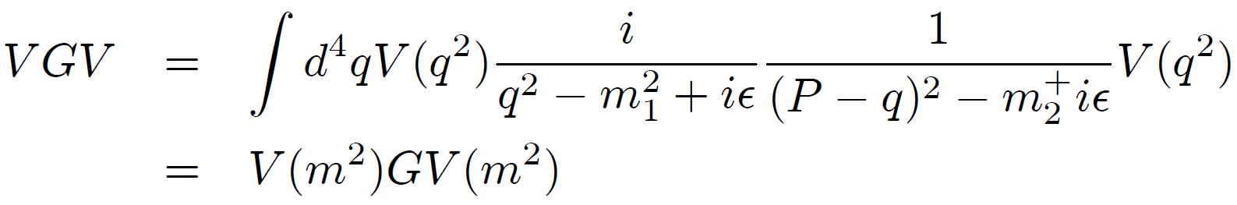
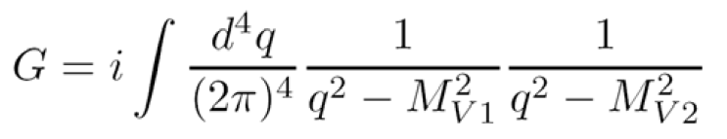
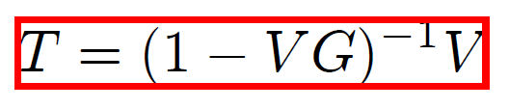
Bethe-Salpeter equation
Transition amplitude T
On-shell factorization
V + VGV + VGVGV + … = T

Slide 10
Free parameter
Loop function
Subtraction constants in dimensional regularization (DR)
cutoff values in cutoff method
Since we work with hadronic phenomena, one often uses a cutoff value of about 1 GeV to guide calculations in DR method.

Slide 11
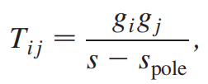
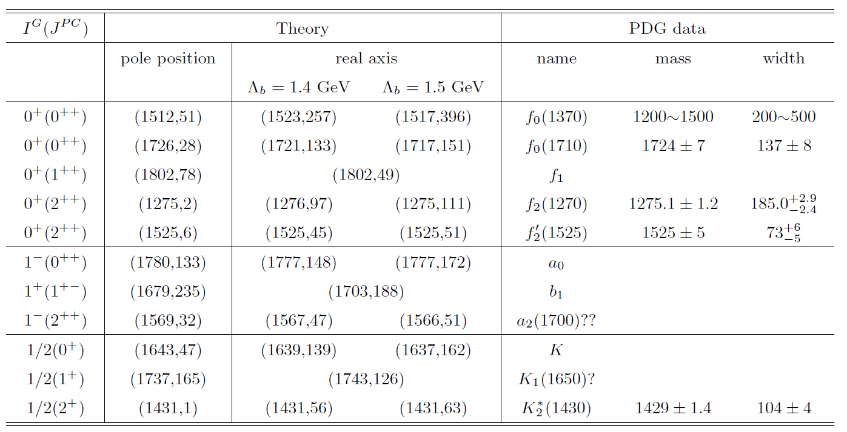
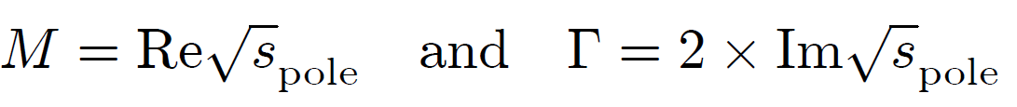
Dynamically generated state
To identify resonances, one goes to the complex plane to look for poles.
Around the pole position, the amplitude can be approximated by
Max[|T|²]
Max[|T|²]2
$$Γ$$
M

Slide 12
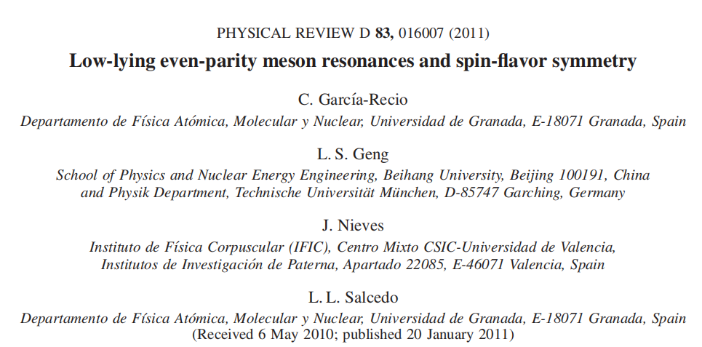
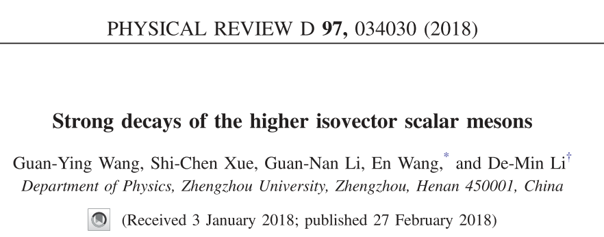
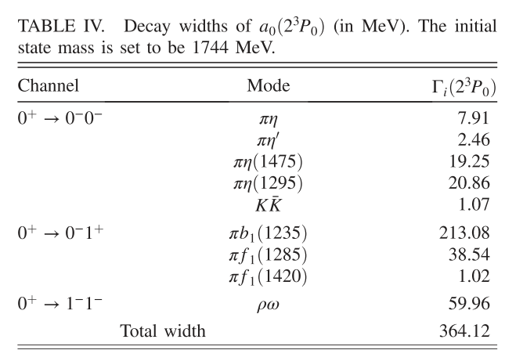
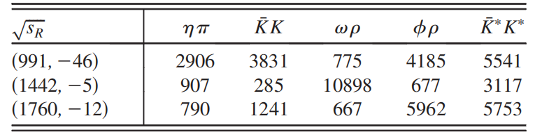
Other predictions for a₀(1710)

Slide 13
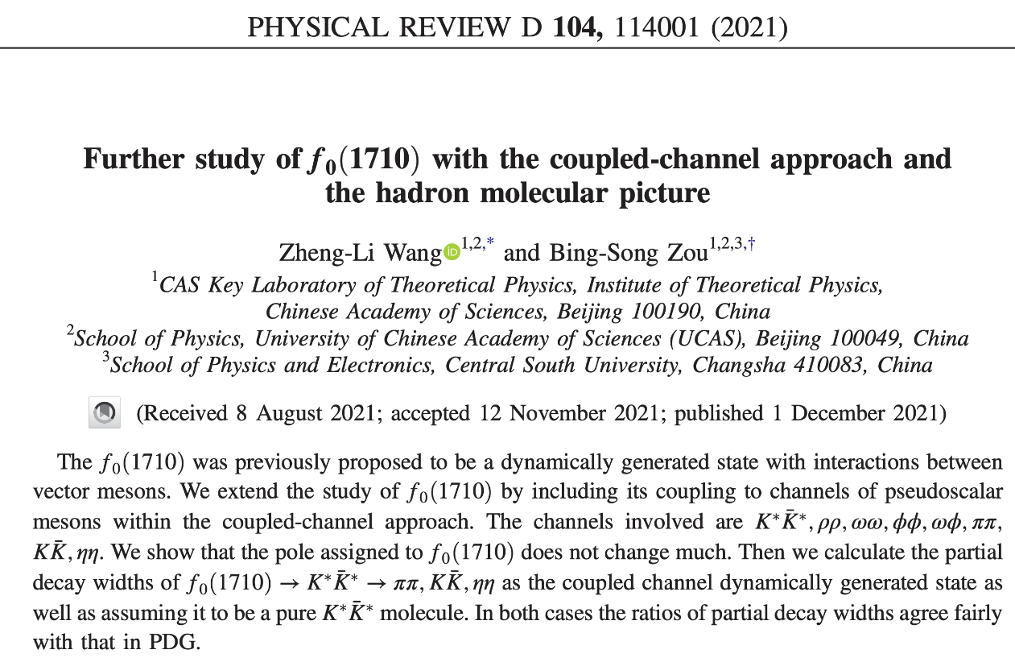
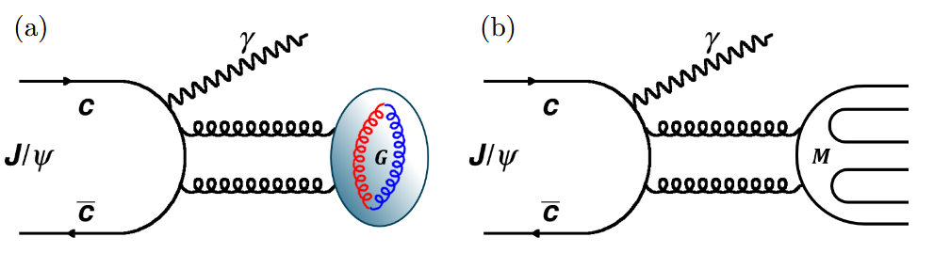


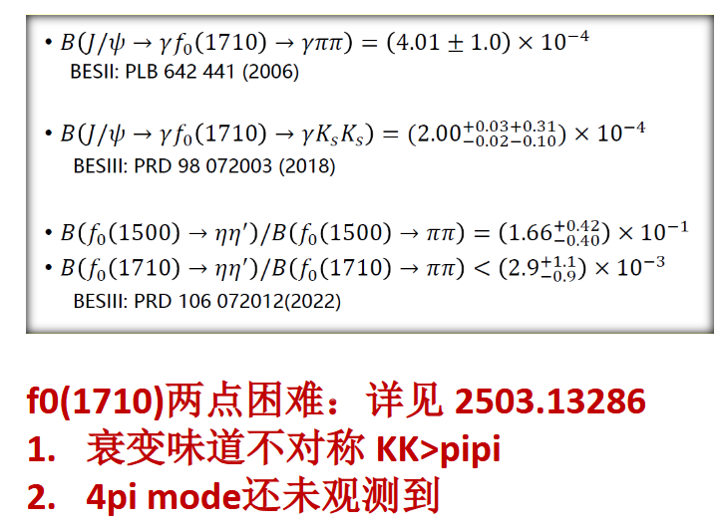

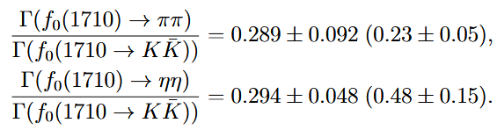


Other predictions for a₀(1710)
$f_{0}\left(1710\right)$
$K^{∗}{\overline{K}}^{∗}$ molecule
isovector partner $a_{0}(1710)$
glueball
金山老师报告：
第七届粒子物理天问论坛
https://indico.ihep.ac.cn/event/26398/timetable/#20250919
寻找$f_{0}$(1710)的同位旋伴随态$a_{0}$(1710)对于确定$f_{0}$(1710)是分子态还是胶球候选态，理解$a_{0}(1710)/f_{0}(1710)mixing，$以及构建轻标量介子谱至关重要！

Slide 14
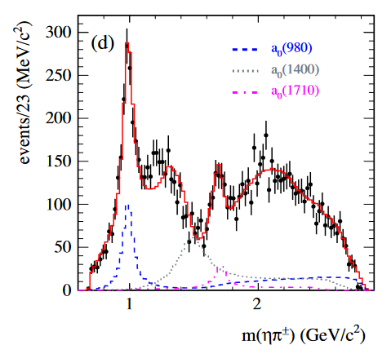
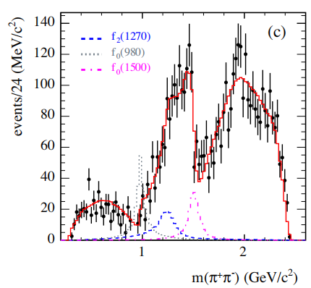
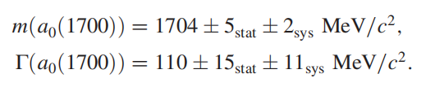
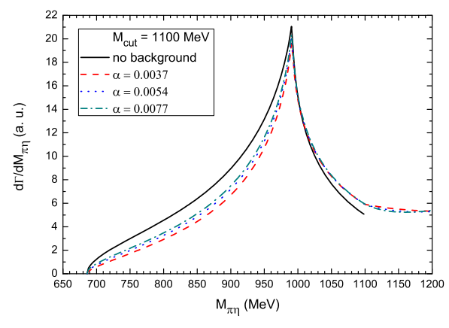
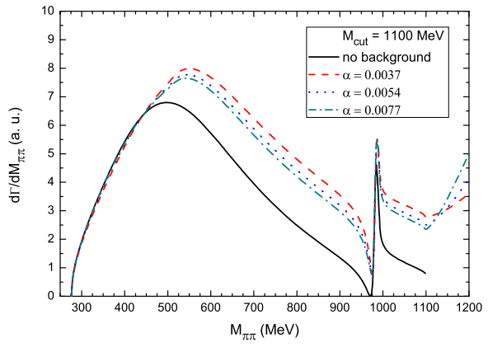

$$a_{0}(1710)$$
BaBar: $η_{c}→ηπ^{+}π^{−}$
BaBar: PRD104(2021)072002
Liang-Xie-Oset PLB766 (2017) 59

Slide 15
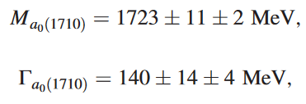
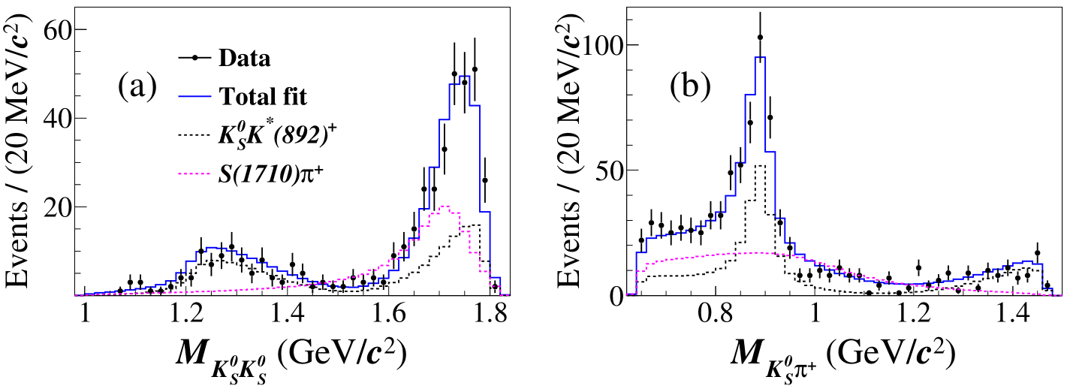
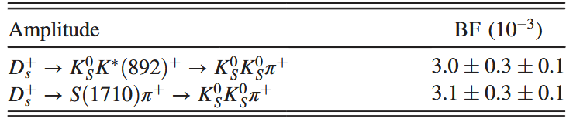
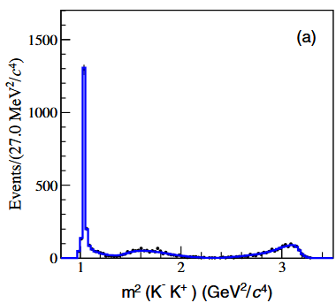
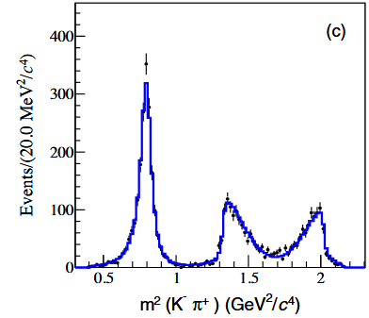
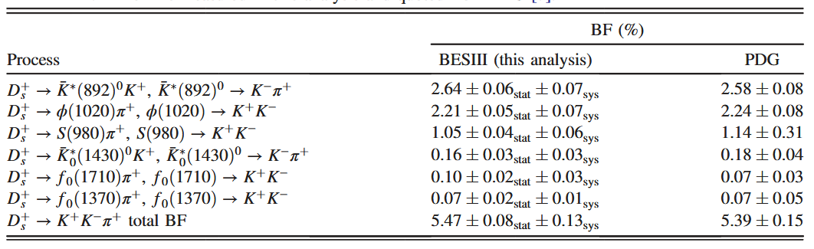


BESIII measurements
$D_{s}^{+}→{K_{s}^{0}K_{s}^{0}π}^{+}$
BESIII: PRD105(2022)L051103
BESIII:
PRD104, 012016 (2021)
$$D_{s}^{+}→{K^{+}K^{−}π}^{+}$$

Slide 16
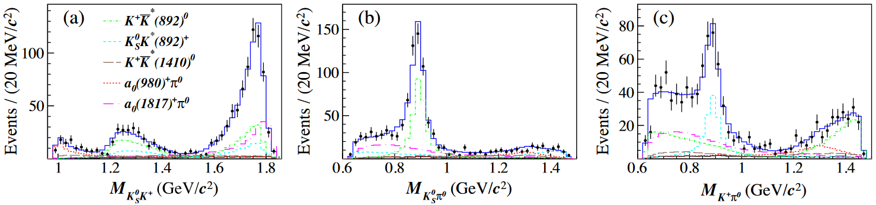

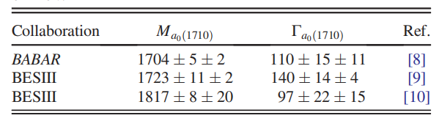


BESIII measurements
$D_{s}^{+}→K_{S}^{0}K^{+}π^{0}$
BESIII: PRL129, 182001
$$D_{s}^{+}→{K_{s}^{0}K_{s}^{0}π}^{+}$$
Too close to the boundary region!!!

Slide 17




VV interactions

Slide 18








$$a_{0}(1817)$$
$a_{0}\left(1817\right)\& X\left(1812\right)(J/ψ→γφω)$
BESIII: PRL96 (2006) 162002
BESIII: PRD87(2013)032008
D.Guo, PRD105(2022)114014
Martinze, PLB719(2013) 388
$$f_{0}\left(1710\right)→φω$$
$a_{0}\left(1817\right):$isospin-onepartner of the X(1812)?
Regge approach: qqbar, 2504.13698

Slide 19




Other studies
Molecule explanation
Z.Y. Wang, Y.W. Peng, J.Y Yi, W.C. Luo, C. W. Xiao, PRD107 (2023) 1116018
Oset-Dai-Geng, EPJC82 (2022) 225,Sci.Bull. 68 (2023) 243
Peng,Liang,Xiong,Xiao, PRD110 (2024) 036013
Oset, Dai, Geng, Sci.Bull. 68 (2023) 243-246
Tetraquark in MIT model
N.N. Achasov, Phys.Rev.D 108 (2023) 3, 036018
Search for $a_{0}(1710/1817)$
Abreu-Wang-Oset, Eur.Phys.J.C 83 (2023) 3, 243
EW-JJXie-LSGeng-DMLi, PRD108(2023)114004
Xiao-Yun Wang,Hui-Fang Zhou, Xiang Liu, Phys.Rev.D 108 (2023) 3, 034015
EW-JJXie-LSGeng-DMLi, Phys.Rev.D 110 (2024) 1, 014032, $J/ψ→{\overline{K}}^{0}K^{+}ρ^{−}$,
WHLiang/Jsong, ZYYang, Oset, 2412.20399 ,PRD111 (2025) 094047, $D_{s}^{+}→ρω$
XHZhang, EW, $D^{+}→π^{+}π^{0}η$, PRD 112, 074004 (2025)
$η_{c}→{\overline{K}}^{0}K^{+}π^{−}$

Slide 20





Mechanism of the $D_{s}^{+}→K_{S}^{0}K_{S}^{0}π^{+}$
Weakly decay

Slide 21





Mechanism of the $D_{s}^{+}→K_{S}^{0}K_{S}^{0}π^{+}$
Hadronization

Slide 22






Mechanism of the $D_{s}^{+}→K_{S}^{0}K_{S}^{0}π^{+}$
Final state interaction
[13] L. S. Geng and E. Oset, Phys. Rev. D 79, 074009 (2009)
[15] L. S. Geng, E. Oset, R. Molina, and D. Nicmorus, Proc. Sci. EFT09 (2009) 040 [arXiv:0905.0419].
[18] Z. L. Wang and B. S. Zou, Phys. Rev. D 104, 114001 (2021).

Slide 23





Mechanism of the $D_{s}^{+}→K_{S}^{0}K_{S}^{0}π^{+}$
G function

Slide 24






Mechanism of the $D_{s}^{+}→K_{S}^{0}K_{S}^{0}π^{+}$
The contribution of $K^{∗}(892)$

Slide 25





Results
Phys.Rev.D 105 (2022) 11, 116010
$D_{s}^{+}→K_{S}^{0}K_{S}^{0}π^{+}$
$a_{0}(1710)$ is dynamically generated from the $K^{∗}{\overline{K}}^{∗}$ interaction.
$K^{∗}$ also plays an important role around the peak of the $a_{0}$(1710) state.

Slide 26


Results
Phys.Rev.D 105 (2022) 11, 116010
$D_{s}^{+}→K_{S}^{0}K_{S}^{0}π^{+}$

Slide 27






Results
Phys.Rev.D 105 (2022) 11, 116010
$D_{s}^{+}→K^{+}K^{−}π^{+}$
BESIII: PRD104(2021)012016
$D_{s}^{+}→K_{s}^{0}K_{s}^{0}π^{+}$
Only consider $a_{0}$(1710),
No contribution from $a_{0}\left(980\right),$ $f_{0}(980)$.
${D_{s}^{+}→K}^{+}K^{−}π^{+}$
No contribution from $a_{0}$(1710), $f_{0}(1710)$.
$f_{0}$(980) dominant contribution
The mechanism for ${D_{s}^{+}→K_{s}^{0}K_{s}^{0}π^{+}/K}^{+}K^{−}π^{+}$ are different
PLB821 (2021) 136617
$$f_{0}(980)$$

Slide 28





Results
$D_{s}^{+}→K_{S}^{0}K^{+}π^{0}$
Phys.Rev.D 107 (2023) 3, 034001
$$D_{s}^{+}→K^{+}K^{−}π^{+}$$
Isospin$of K_{S}^{0}K^{+}$ is I=1, no $a_{0}/f_{0}$ mixing.
$a_{0}(1710)$ and $K^{∗}$ give the contributions around the peak of the $a_{0}$(1710) state.

Slide 29






Results
$$D_{s}^{+}→K_{S}^{0}K_{S}^{0}π^{+}$$
$D_{s}^{+}→K_{S}^{0}K^{+}π^{0}$
Phys.Rev.D 107 (2023) 3, 034001
The mechanism of $D_{s}^{+}→K_{S}^{0}K^{+}π^{0}$ and $D_{s}^{+}→K_{S}^{0}K_{S}^{0}π^{+}$ are same, and different with the one of $D_{s}^{+}→K^{+}K^{−}π^{+}$.
The mixing of $a_{0}(1710)$ and $f_{0}(1710)$ should be important.
The precise mass of the $a_{0}(1710)$ need to be determined.

Slide 30










$a_{0}\left(1710\right)$ in $η_{c}→ KKπ$
Phys.Rev.D 108 (2023) 11, 114004
$η_{c}→ K^{+}{\overline{K}}^{0}π^{−}$
BESIII: PRD100(2019)012003
PRD100(2019)114011
PLB797(2019)134831

Slide 31







Phys.Rev.D 108 (2023) 11, 114004
K₀(1430)

Slide 32



Results
Phys.Rev.D 108 (2023) 11, 114004
${\overline{K}}_{s}^{0}K^{±}$ invariant mass distribution
BABAR: PRD 93(2016)012005

Slide 33




Phys.Rev.D 108 (2023) 11, 114004
$η_{c}→K^{+}K^{−}π^{0}$
Belle: PRD89(2014)112004

Slide 34



Results
Phys.Rev.D 108 (2023) 11, 114004
$K^{±}π^{−}$ invariant mass distribution

Slide 35





LHCb: PRD108, 032010 (2023)

Slide 36








$a_{0}\left(1710\right)$ in $J/ψ→{{\overline{K}}^{0}K^{+}ρ}^{−}$
Phys.Rev.D 110 (2024) 1, 014032
Reaction mechanism
PRD79(2009)074009

Slide 37











$a_{0}\left(1710\right)$ in $J/ψ→{{\overline{K}}^{0}K^{+}ρ}^{−}$
Phys.Rev.D 110 (2024) 1, 014032
$K_{1}\left(1270\right)\& a_{0}(980)$
PLB821(2021)136617
PRD75(2007)014017

Slide 38







Results
Phys.Rev.D 110 (2024) 1, 014032
STCF) (STCF
BESIII
STCF per year
BABAR: PRD95(2017)092005
Front. Phys. 19, 14701 (2024).

Slide 39

Summary
The width of $a_{0}\left(1710/1817\right)$ is smaller than the one of $a_{0}(2^{3}P_{0})$ with in 3P0 model.
Our results are in good agreement with the BESIII measurements, which supports the $K^{∗}{\overline{K}}^{∗}$ molecule of $a_{0}\left(1710/1817\right)$.
The $a_{0}\left(1710/1817\right)$ mass and width are crucial to understand its internal structure, and their mixing.
$η_{c}→ K^{+}{\overline{K}}^{0}π^{−}$ and $J/ψ→{{\overline{K}}^{0}K^{+}ρ}^{−}$ could be used to determine the mass and width of $a_{0}\left(1710/1817\right)$
Thank you very much!

Slide 40
VV interaction from hidden-gauge lagrangians
Tree level transition amplitudes
Four vectors contact
t(u)-channel vector exchange
S-channel vector exchange
Box diagram
Most important! Provide attraction!
Basically p-wave, neglected!
Provides decays to two pseudoscalars;
Contributes only to spin 0 and 2;
Real part small, only imaginary part considered!

Slide 41



${D_{s}^{+}→K_{s}^{0}K_{s}^{0}π^{+}/K}^{+}K^{−}π^{+}$

