Slide 1
Group Meeting
王仕元
2025.10.14

Slide 2
Para_BEPC | Lattice | old | new
old | BEPCII_ele_v509vy571.sad | 4.83341 hours | 4.76053 hours
old | BEPCII.sad | 4.92597 hours | 4.9573 hours
old | BEPCII_pos_v509vy571.sad | 4.44359 hours | 4.44359 hours
old | BEPCII_e1.sad | 5.34721 hours | 5.32273 hours
Data from "Beam Background Simulation and Experiment at BEPCII." | BEPCII_ele_v509vy571.sad | 26.4817 hours | 26.3127 hours
~ | BEPCII.sad | 26.6603 hours | 27.0018 hours
~ | BEPCII_pos_v509vy571.sad | 24.3208 hours | 24.3208 hours
~ | BEPCII_e1.sad | 29.5136 hours | 29.1398 hours
old：p=LINE[“POSITION”,”INJ”]
new：p=LINE["POSITION","R4LSM"]

Slide 3
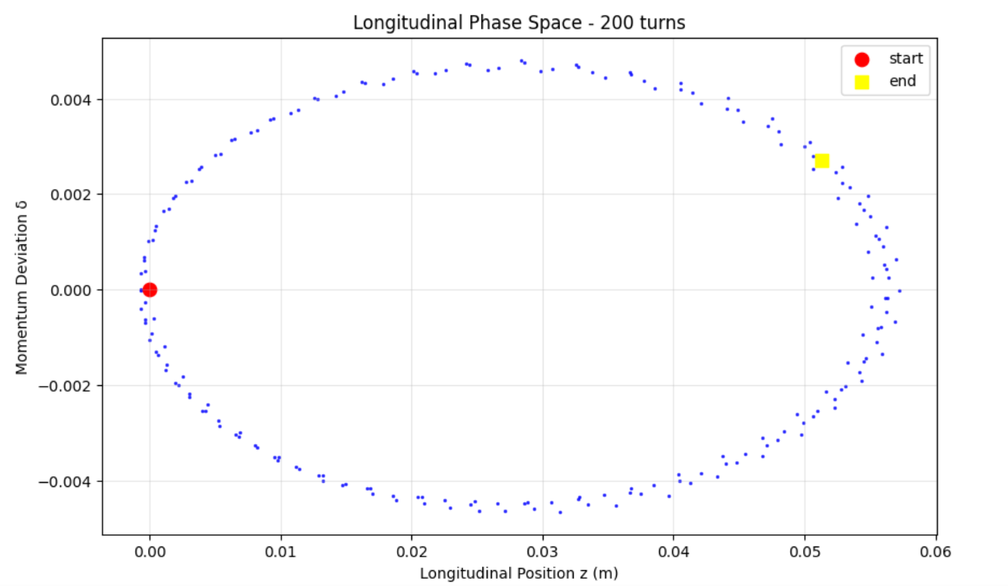
Accelerator Physics Emulation System （APES）
It is a new beam dynamics software developed to meet the special requirements of CEPC.
APES is built with a Python core and uses C/C++/CUDA for GPU acceleration to maximize parallel performance.
Longitudinal Phase Space Plot

