Slide 1
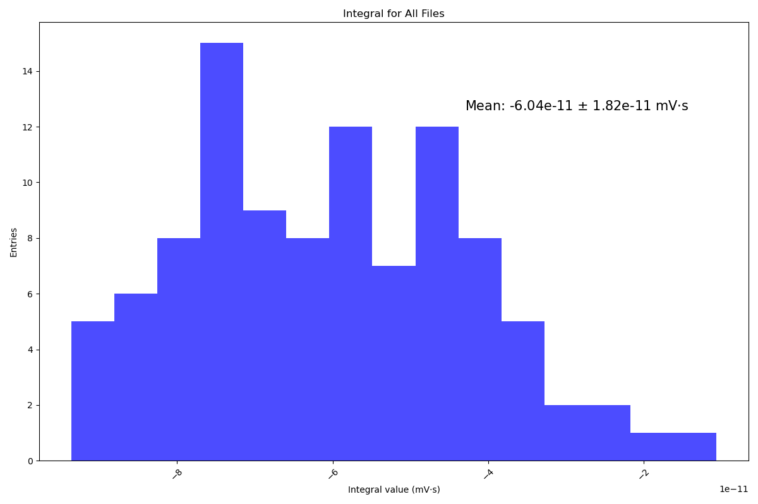
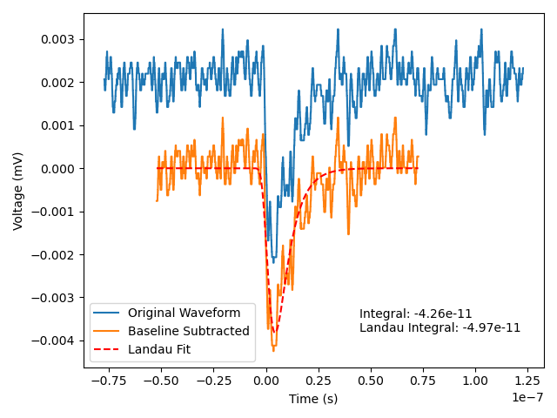
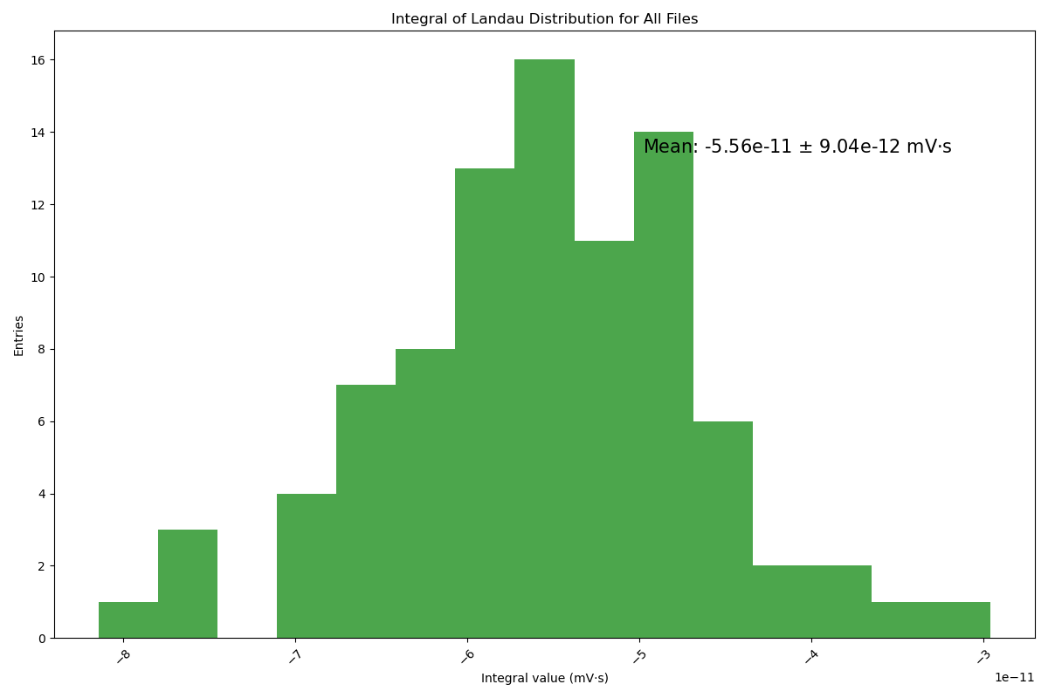
Intergrat of single photo signal
Pick a range of signal
Intergrat with subtracted waveform
Intergrat with landau fit function
Measured 100 single photon events
Int_mean_sp = 5.56e-11 mV*s
Intergrat with subtracted waveform
Intergrat with landau fit function

Slide 2
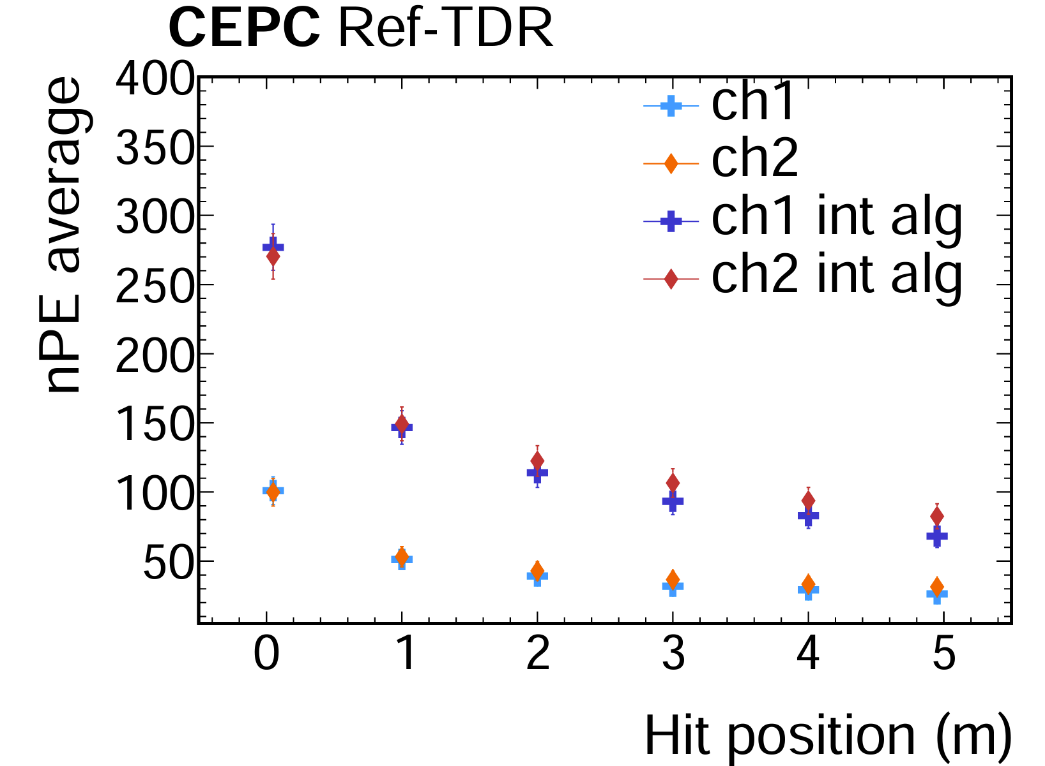
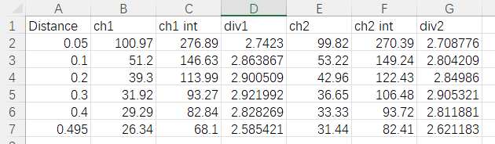
Integral algorithm result

