Slide 1
组会
2025/10/13

Slide 2
工作列表
APD+PPD方案chicane2束流整形——高阶色散抑制
APD+PPD方案CSR
束线2 Bunch Compressor CSR抑制
CSR理论

Slide 3
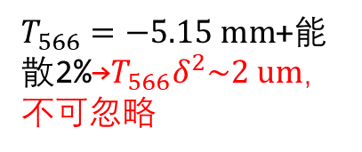
初始能谱偏高能+无chirp+高斯分布流强，CSR on
initial
chicane1(S)
APD
chicane2(C)
PPD
$T_{566}=−5.15 mm$+能散2%→$T_{566}δ^{2}\sim 2 um$，不可忽略
1.0%
1.4%
2.0%
2.0%
0.52%
切片能散0.34%

Slide 4
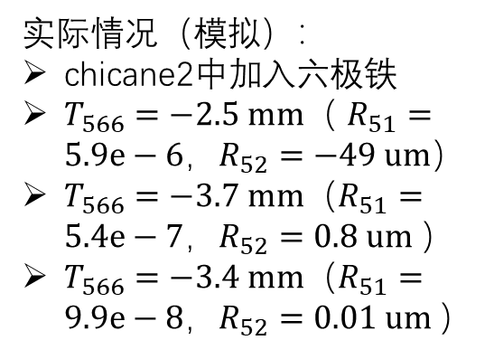
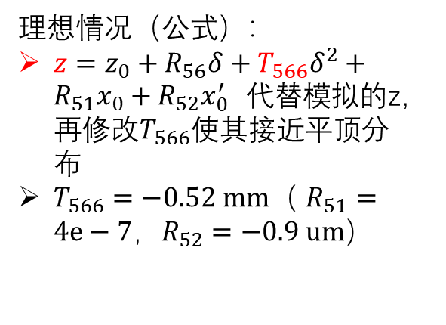
公式计算与模拟对比
理想情况（公式）：
$z=z_{0}+R_{56}δ+T_{566}δ^{2}+R_{51}x_{0}+R_{52}x_{0}^{′}$代替模拟的z，再修改$T_{566}$使其接近平顶分布
$T_{566}=−0.52 mm$（ $R_{51}=4e−7，R_{52}=−0.9 um$）
切片能散0.38%
切片能散0.59%
切片能散0.42%
实际情况（模拟）：
chicane2中加入六极铁
$T_{566}=−2.5 mm$（ $R_{51}=5.9e−6，R_{52}=−49 um$）
$T_{566}=−3.7 mm$（$R_{51}=5.4e−7，R_{52}=0.8 um$）
$T_{566}=−3.4 mm$（$R_{51}=9.9e−8，R_{52}=0.01 um$）
0.39%
0.66%
0.58%

Slide 5
初始能谱偏高能+负chirp，CSR on
initial
chicane1(S)
APD
chicane2(C)
Chicane2(C) w/ sextupole
0.94%

Slide 6
初始能谱偏高能+无chirp+平顶分布，CSR on
initial
chicane1(S)
APD
chicane2(C)
Chicane2(C) w/ sextupole
0.93%
2.0%

Slide 7
初始能谱偏高能+正chirp，CSR on
initial
chicane1(S)
APD
chicane2(C)
Chicane2(C) w/ sextupole

Slide 8



初始能谱平顶+负chirp+平顶分布，CSR off
$$T_{566}=0.515 mm$$
$$T_{566}=−0.515 mm$$
1.4%
$$T_{566}=−5.15 mm$$

Slide 9
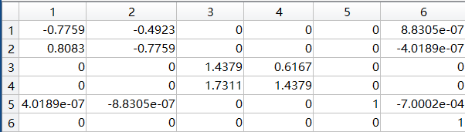
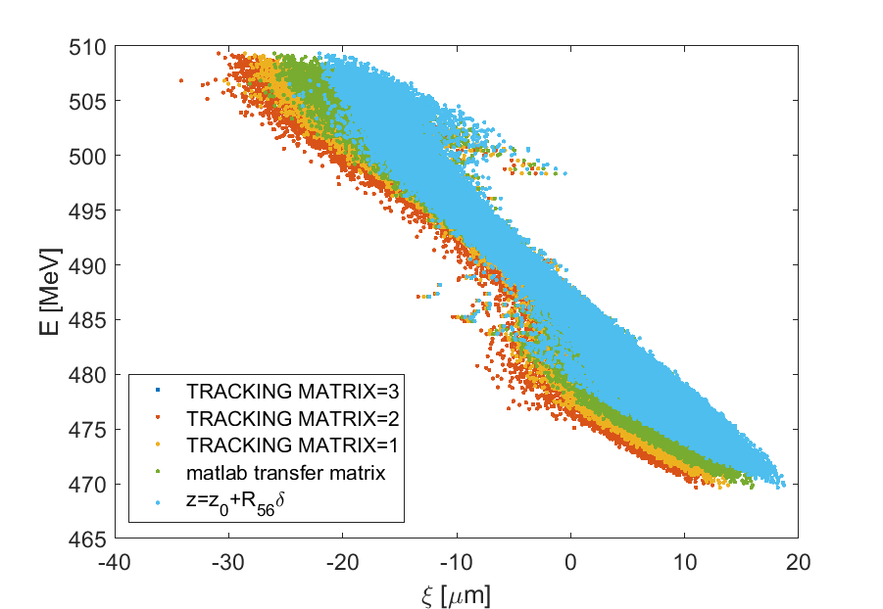
束流纵向分布：传输矩阵与模拟（不同阶）对比
考虑一阶传输矩阵对不同能量粒子的变化后的计算结果（浅蓝色）更接近elegant一阶模拟（黄色）
Elegant 输出的一阶传输矩阵（高阶项均为0）
Matlab计算的传输矩阵（针对参考粒子）

Slide 10
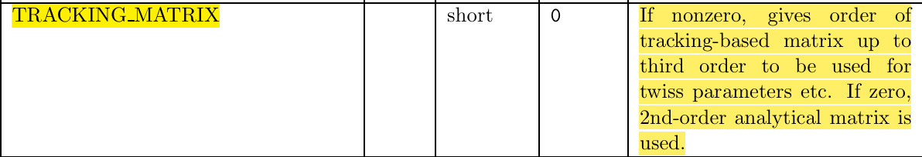
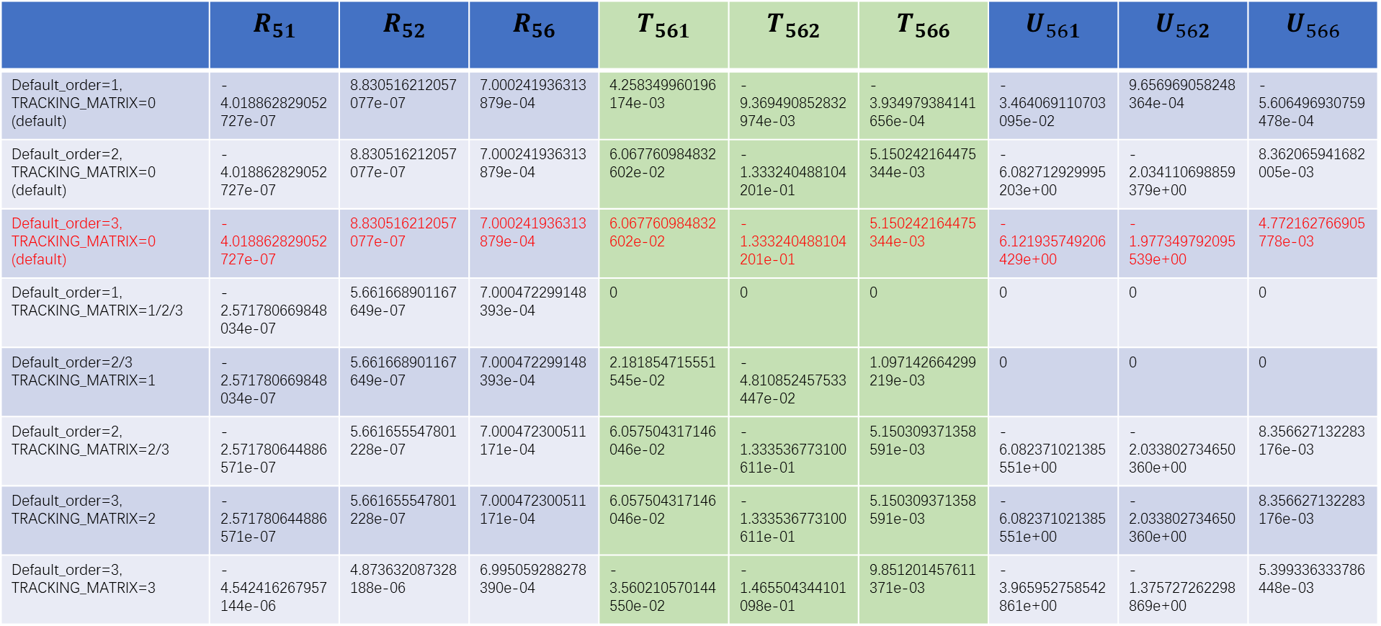
elegant：不同阶输出的纵向色散对比
 | $$R_{51}$$ | $$R_{52}$$ | $$R_{56}$$ | $$T_{561}$$ | $$T_{562}$$ | $$T_{566}$$ | $$U_{561}$$ | $$U_{562}$$ | $$U_{566}$$
Default_order=1, TRACKING_MATRIX=0 (default) | -4.018862829052727e-07 | 8.830516212057077e-07 | 7.000241936313879e-04 | 4.258349960196174e-03 | -9.369490852832974e-03 | -3.934979384141656e-04 | -3.464069110703095e-02 | 9.656969058248364e-04 | -5.606496930759478e-04
Default_order=2, TRACKING_MATRIX=0 (default) | -4.018862829052727e-07 | 8.830516212057077e-07 | 7.000241936313879e-04 | 6.067760984832602e-02 | -1.333240488104201e-01 | 5.150242164475344e-03 | -6.082712929995203e+00 | -2.034110698859379e+00 | 8.362065941682005e-03
Default_order=3, TRACKING_MATRIX=0 (default) | -4.018862829052727e-07 | 8.830516212057077e-07 | 7.000241936313879e-04 | 6.067760984832602e-02 | -1.333240488104201e-01 | 5.150242164475344e-03 | -6.121935749206429e+00 | -1.977349792095539e+00 | 4.772162766905778e-03
Default_order=1, TRACKING_MATRIX=1/2/3 | -2.571780669848034e-07 | 5.661668901167649e-07 | 7.000472299148393e-04 | 0 | 0 | 0 | 0 | 0 | 0
Default_order=2/3 TRACKING_MATRIX=1 | -2.571780669848034e-07 | 5.661668901167649e-07 | 7.000472299148393e-04 | 2.181854715551545e-02 | -4.810852457533447e-02 | 1.097142664299219e-03 | 0 | 0 | 0
Default_order=2, TRACKING_MATRIX=2/3 | -2.571780644886571e-07 | 5.661655547801228e-07 | 7.000472300511171e-04 | 6.057504317146046e-02 | -1.333536773100611e-01 | 5.150309371358591e-03 | -6.082371021385551e+00 | -2.033802734650360e+00 | 8.356627132283176e-03
Default_order=3, TRACKING_MATRIX=2 | -2.571780644886571e-07 | 5.661655547801228e-07 | 7.000472300511171e-04 | 6.057504317146046e-02 | -1.333536773100611e-01 | 5.150309371358591e-03 | -6.082371021385551e+00 | -2.033802734650360e+00 | 8.356627132283176e-03
Default_order=3, TRACKING_MATRIX=3 | -4.542416267957144e-06 | 4.873632087328188e-06 | 6.995059288278390e-04 | -3.560210570144550e-02 | -1.465504344101098e-01 | 9.851201457611371e-03 | -3.965952758542861e+00 | -1.375727262298869e+00 | 5.399336333786448e-03

Slide 11
初始能谱偏高能2+无chirp+高斯分布，CSR on
1.2%
2.0%
0.6%

Slide 12
初始能谱平顶+正chirp+平顶分布，CSR off
3.1%

