Slide 1



Study of charmless $B→VV$decays at LHCb
Xingyu Tong
Peking University
CLHCP 2025, XINXIANG
Nov 1st , 2025

Slide 2
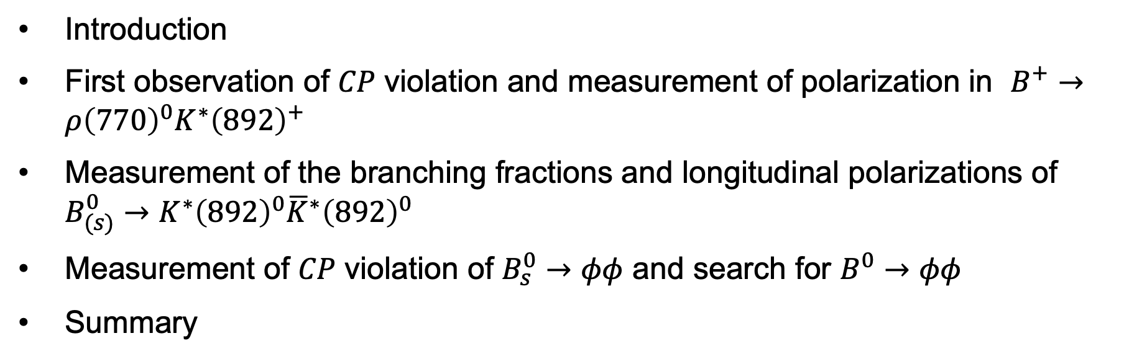
Introduction
First observation of 𝐶𝑃 violation and measurement of polarization in $B_{ }^{+}→ρ{\left(770\right)}^{0}K^{∗}{\left(892\right)}^{+}$
Measurement of the branching fractions and longitudinal polarizations of $B_{(s)}^{0}→K^{∗}{\left(892\right)}^{0}{\overline{K}}^{∗}{\left(892\right)}^{0}$
Measurement of 𝐶𝑃 violation of $B_{s}^{0}→φφ$ and search for $B_{ }^{0}→φφ$
Summary

Slide 3
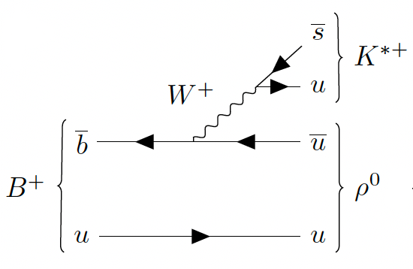
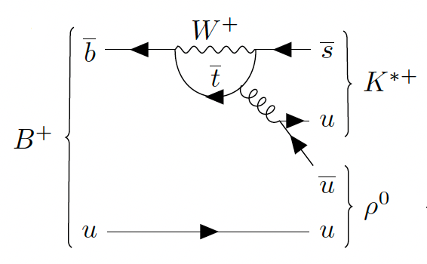
Introduction on charmless $B→VV$ decays
Charmless B decays:
  Tree level: Cabibbo suppressed
  Loop level: similar amplitudes as tree level
  Interference between them gives rise to direct CP violation
Vector resonances: additional CP violating observables

Slide 4
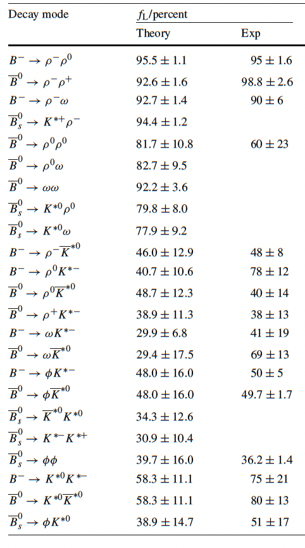
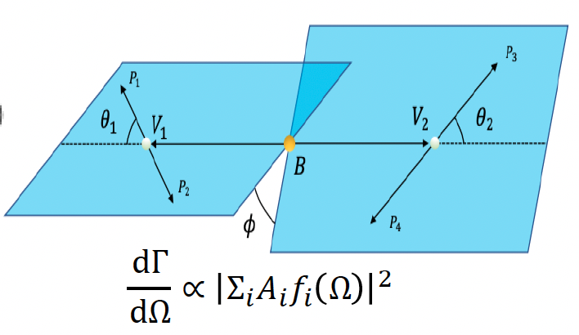

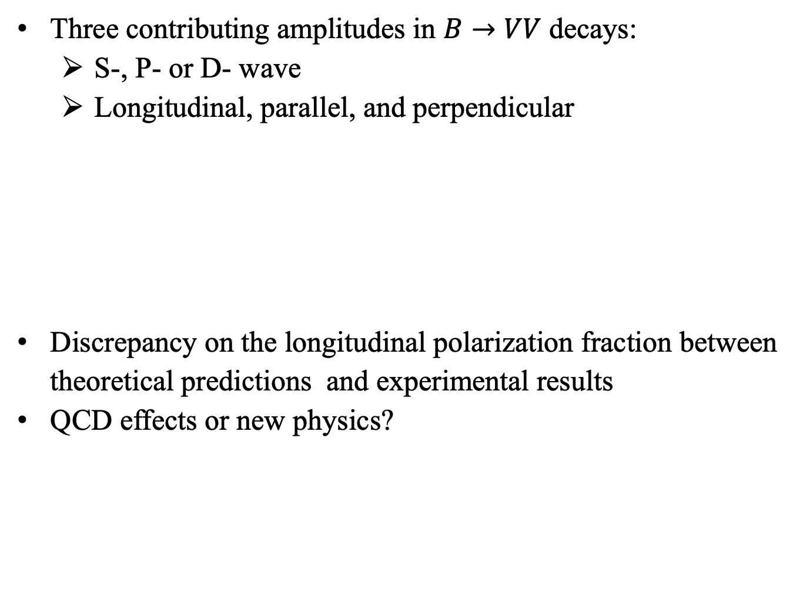
Polarization puzzle
Three contributing amplitudes in $B→VV$ decays:
  S-, P- or D- wave
  Longitudinal, parallel, and perpendicular
Discrepancy on the longitudinal polarization fraction between theoretical predictions and experimental results
QCD effects or new physics?
[Eur.Phys.J.C77(2017)333]

Slide 5
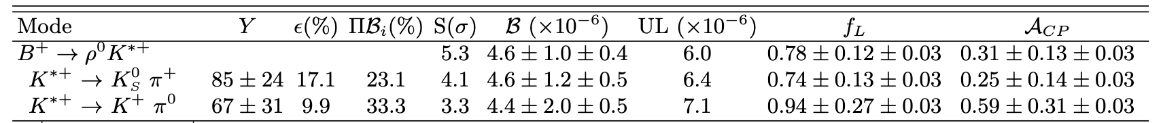

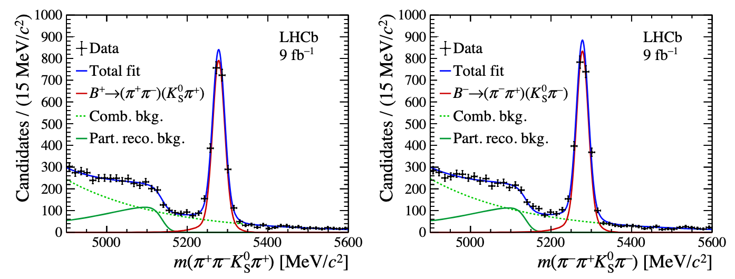

Study of $B_{ }^{+}→ρ{\left(770\right)}^{0}K^{∗}{\left(892\right)}^{+}$
Observed and measured by BaBar
Study of $B_{ }^{+}→ρ{\left(770\right)}^{0}K^{∗}{\left(892\right)}^{+}$decay with LHCb run1+2 data
Submitted to PRL
Larger statistics(>2000 signal for each B+ and B-)
[Phys.Rev.D83(2011)051101]
 | [arXiv:2508.13563]

Slide 6
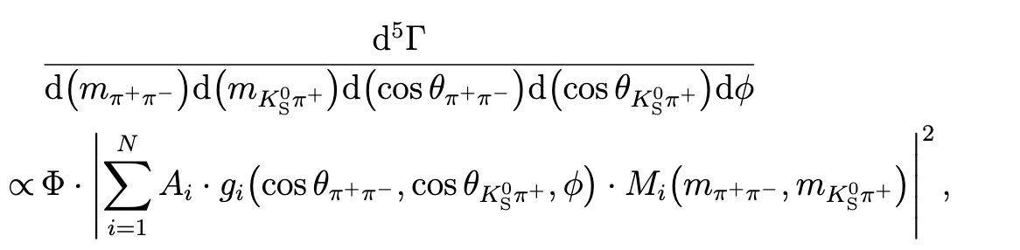
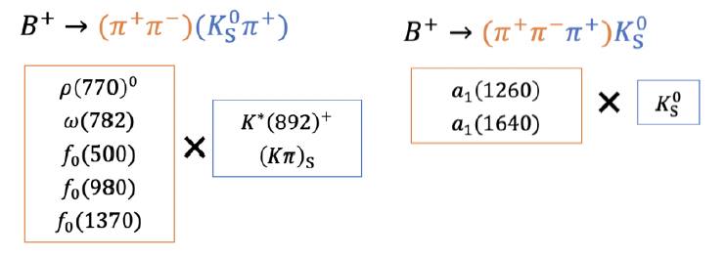
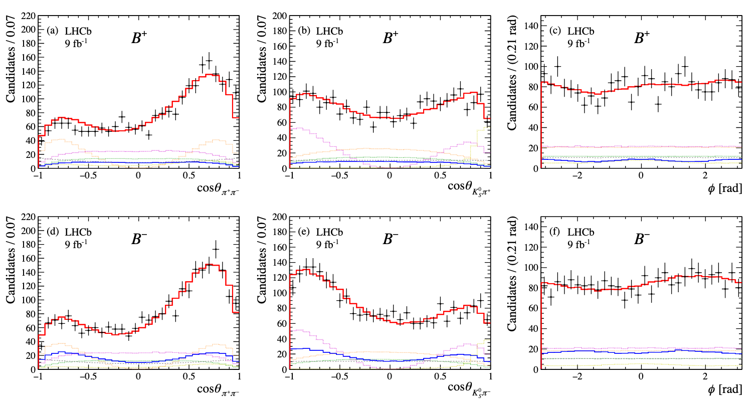
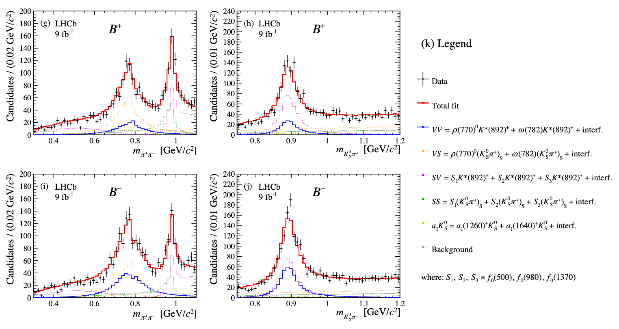
Amplitude analysis of $B_{ }^{+}→ρ{\left(770\right)}^{0}K^{∗}{\left(892\right)}^{+}$
Amplitude analysis: 5D c-fit
Resonances considered:

Slide 7
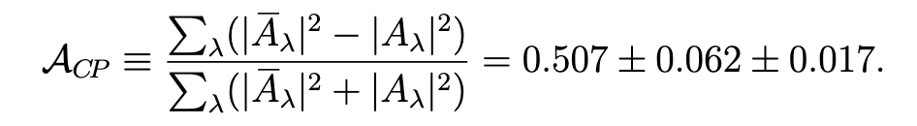
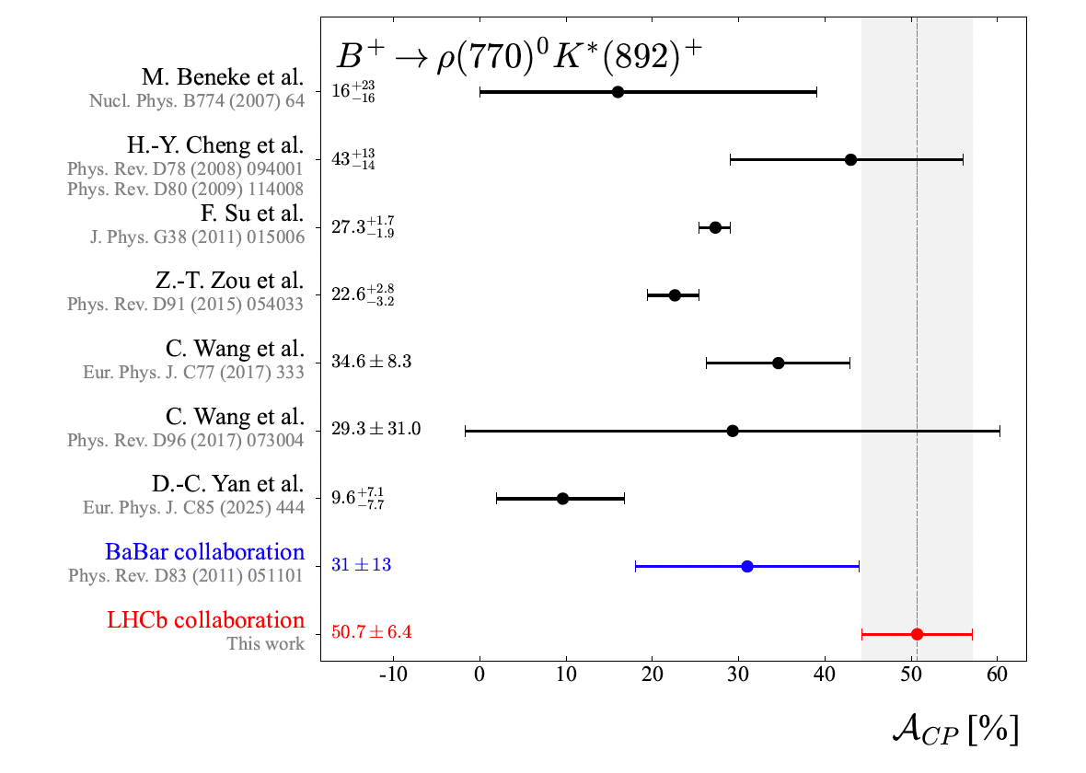
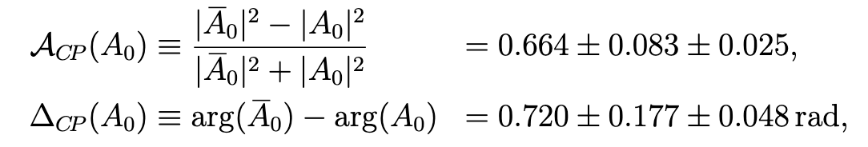
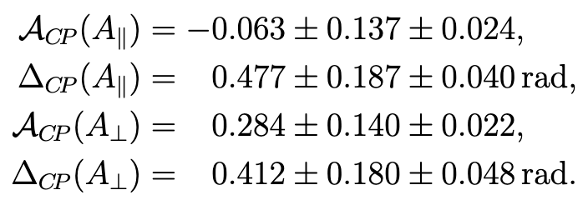
CPV in $B_{ }^{+}→ρ{\left(770\right)}^{0}K^{∗}{\left(892\right)}^{+}$
Direct 𝐶𝑃 asymmetry:
Significance of direct 𝐶𝑃 violation: >9𝜎
  First observation of 𝐶𝑃 violation in this channel !
𝐶𝑃 asymmetry for each component:

Slide 8
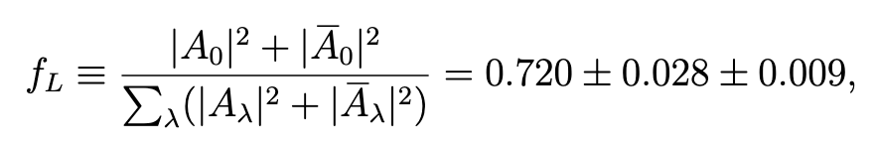
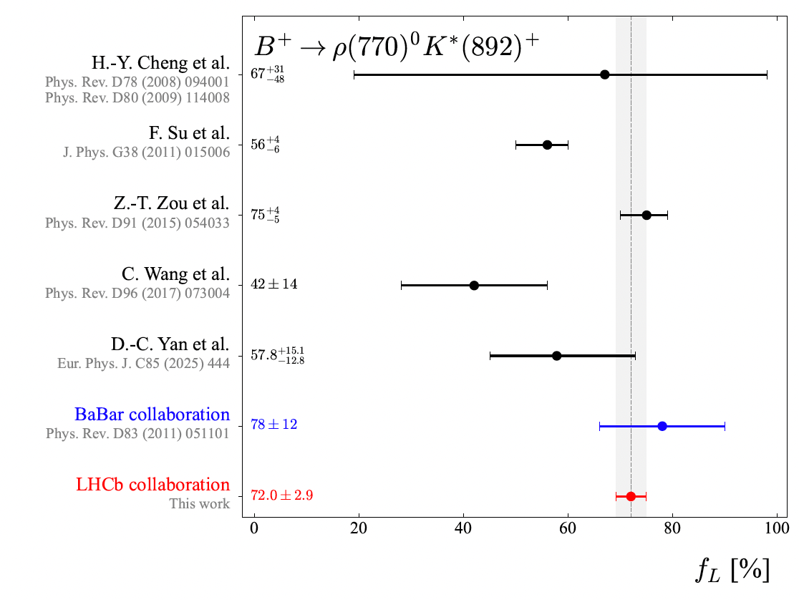
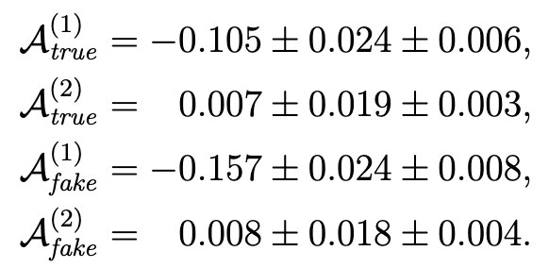
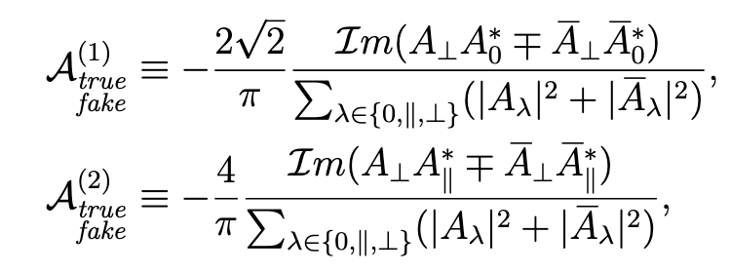

TPA and polarization in $B_{ }^{+}→ρ{\left(770\right)}^{0}K^{∗}{\left(892\right)}^{+}$
Longitudinal polarization fractions:
  Charge-specific:
  Averaged:
  Most precise measurement of $f_{L}$
  Consistent with Babar results
TPA measurements

Slide 9
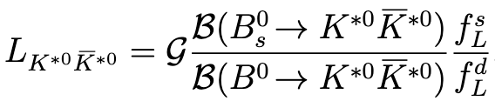


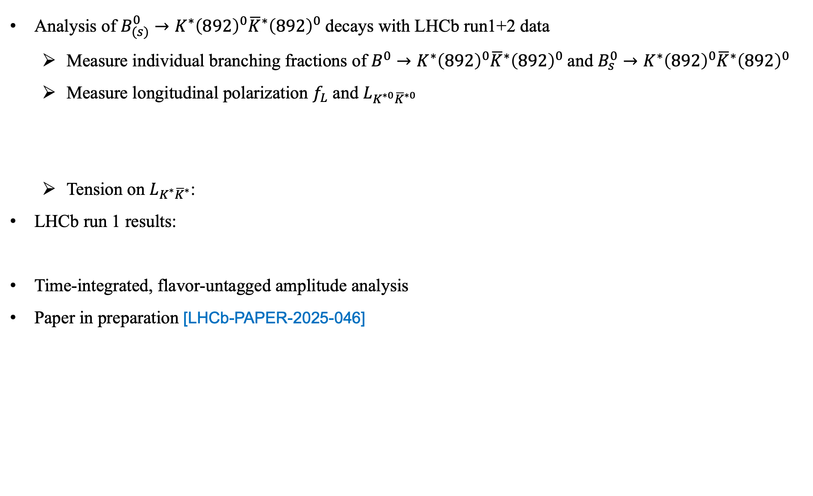

Study of $B_{(s)}^{0}→K^{∗}{\left(892\right)}^{0}{\overline{K}}^{∗}{\left(892\right)}^{0}$
Analysis of $B_{(s)}^{0}→K^{∗}{\left(892\right)}^{0}{\overline{K}}^{∗}{\left(892\right)}^{0}$decays with LHCb run1+2 data
  Measure individual branching fractions of $B_{ }^{0}→K^{∗}{\left(892\right)}^{0}{\overline{K}}^{∗}{\left(892\right)}^{0}$and $B_{s}^{0}→K^{∗}{\left(892\right)}^{0}{\overline{K}}^{∗}{\left(892\right)}^{0}$
  Measure longitudinal polarization $f_{L}$ and $L_{K^{∗0}{\overline{K}}^{∗0}}$
  Tension on $L_{K^{∗}{\overline{K}}^{∗}}$:
LHCb run 1 results:
Time-integrated, flavor-untagged amplitude analysis
Paper in preparation [LHCb-PAPER-2025-046]
[JHEP04(2021)066]
$$f_{L}^{s}=0.240 ± 0.031 ± 0.025 \\ f_{L}^{d}=0.724 ± 0.051 ± 0.016 \\ L_{K^{∗0}{\overline{K}}^{∗0}}=3.48 ± 0.38$$
[JHEP07(2019)032]

Slide 10
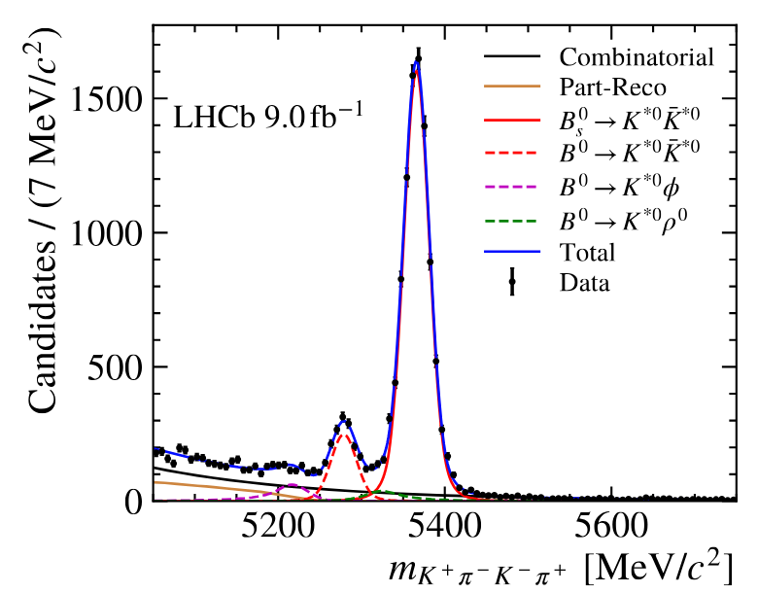
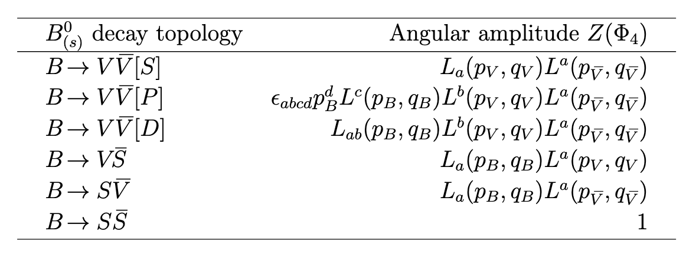

Amplitude analysis of $B_{(s)}^{0}→K^{∗}{\left(892\right)}^{0}{\overline{K}}^{∗}{\left(892\right)}^{0}$
Covariant tensor formalism rather than helicity formalism
  Set of four-momentum of final state particles, $Φ_{4}$, as the fit basis(instead of angles)
  Spin amplitudes are eigenstates of orbital angular momentum
  F: barrier factor; T: mass propagator; Z: angular amplitude
Backgrounds removed by sPlot
Preliminary

Slide 11
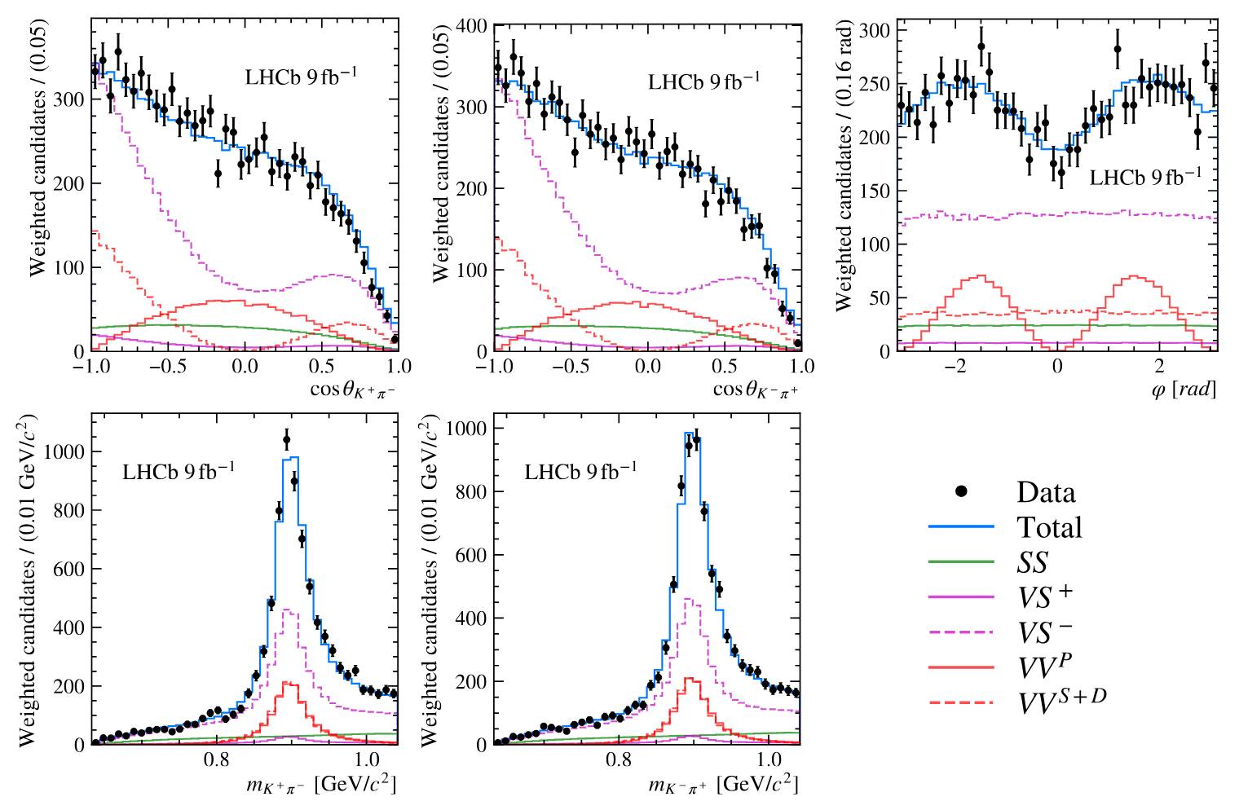
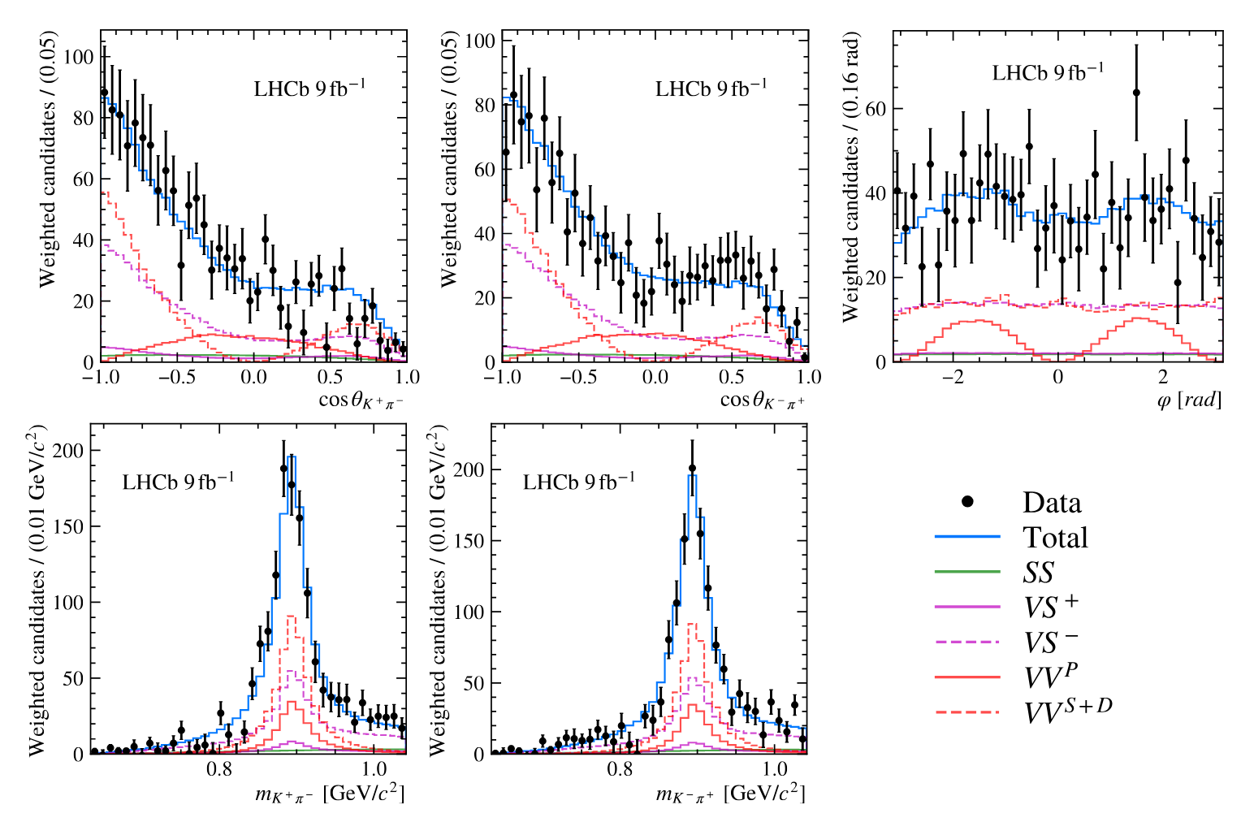
Amplitude analysis of $B_{(s)}^{0}→K^{∗}{\left(892\right)}^{0}{\overline{K}}^{∗}{\left(892\right)}^{0}$
Fit results in transversity basis:
$$B_{s}^{0}$$
$$B_{d}^{0}$$
Preliminary
Preliminary

Slide 12
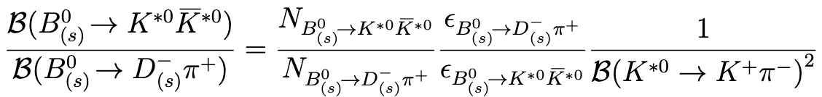
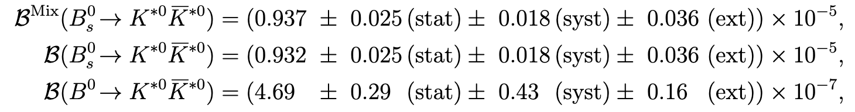

Branching fraction of $B_{(s)}^{0}→K^{∗}{\left(892\right)}^{0}{\overline{K}}^{∗}{\left(892\right)}^{0}$
Control channel: $B_{(s)}^{0}→D_{\left(s\right)}^{−}(→K^{+}K^{−}π^{−})π^{+}$
  $N_{B_{\left(s\right)}^{0}→K^{∗0}{\overline{K}}^{∗0}}$: from fit on $B_{\left(s\right)}^{0}$ mass and VV fraction in amplitude analysis
  $N_{B_{\left(s\right)}^{0}→D_{\left(s\right)}^{−}π+}$: from fit on $B_{\left(s\right)}^{0}$ mass
  $ε$: Efficiency estimated by MC
Results of vector-vector branching fractions
Preliminary

Slide 13
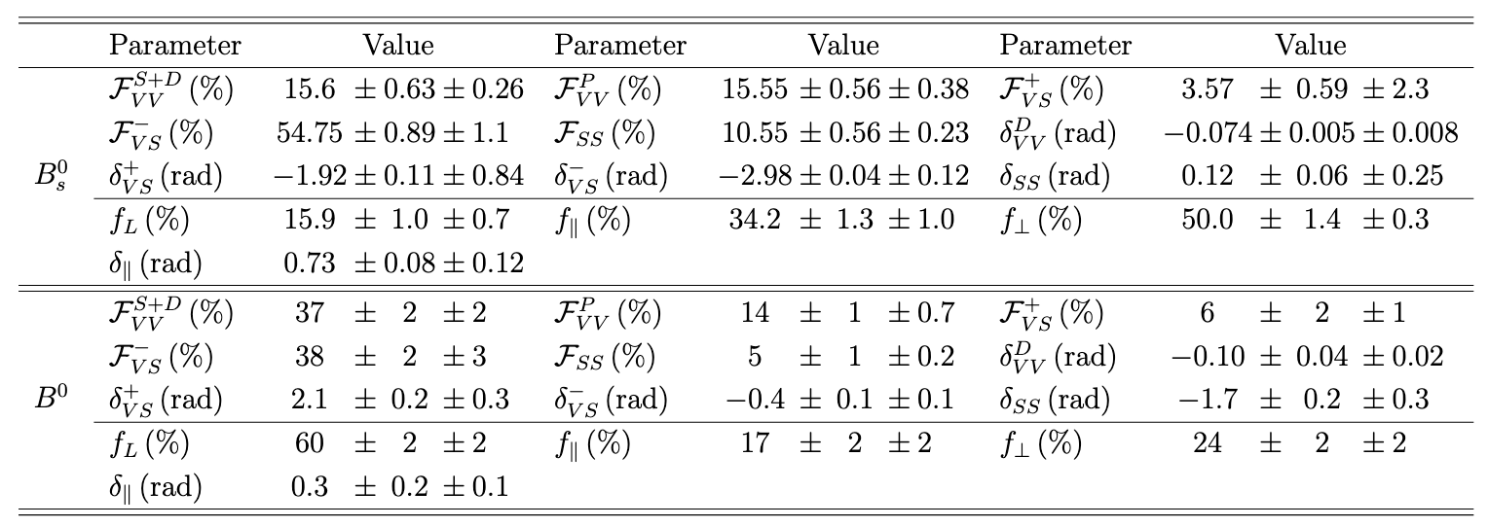


Polarization fraction of $B_{(s)}^{0}→K^{∗}{\left(892\right)}^{0}{\overline{K}}^{∗}{\left(892\right)}^{0}$
Fit fractions and phases:
Theory-motivated $L_{K^{∗0}{\overline{K}}^{∗0}}$observable
  Consistent with previous experimental results
  Latest SM prediction
  A $2.4\sim 3.5σ$tension between this results and the SM prediction
Preliminary
Preliminary
[arXiv:2506.12478]

Slide 14
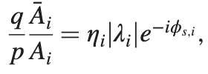
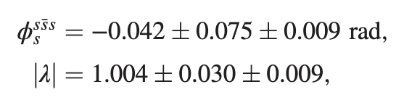
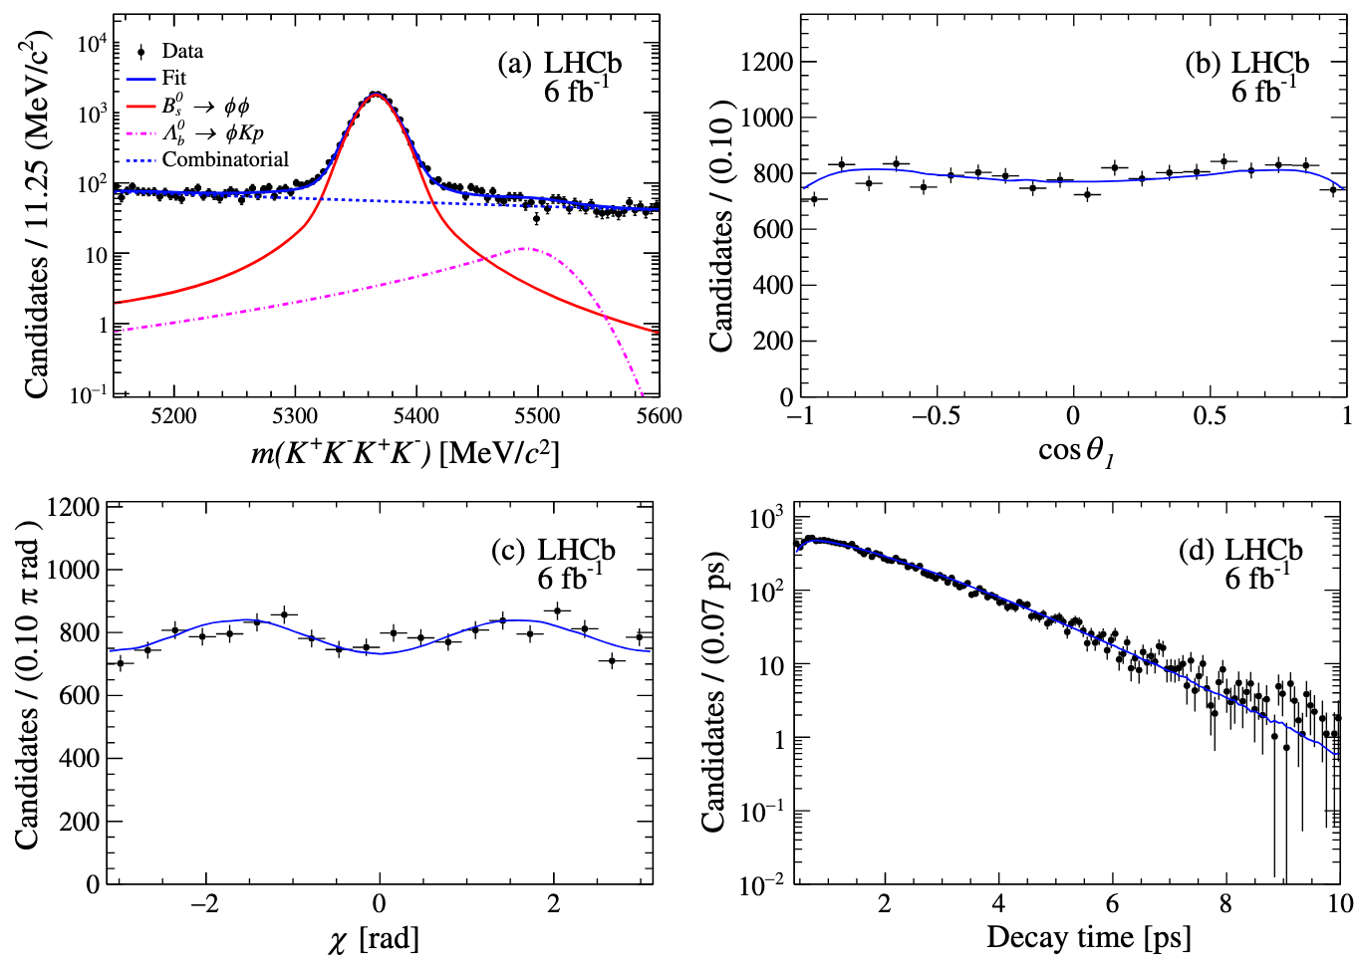
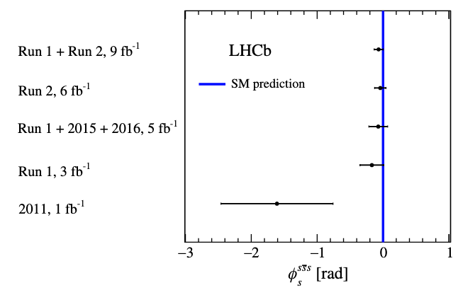

CPV in $B_{s}^{0}→φφ$
[Phys.Rev.Lett.131(2023)171802]
Time-dependent CP violation
Penguin-mediated decay
Precise measurement (LHCb run2 data)
Measurement of the the CP-violating parameter $|λ|$ and the phase $φ_{s}^{s\overline{s}s}$
Consistent with the SM prediction

Slide 15
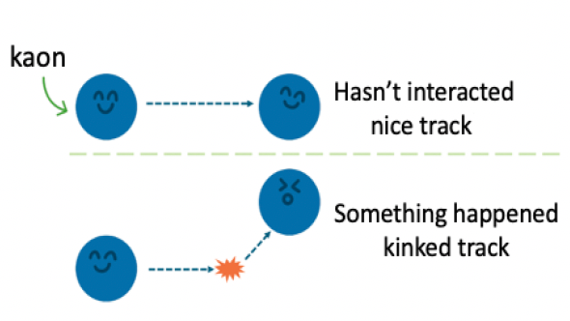
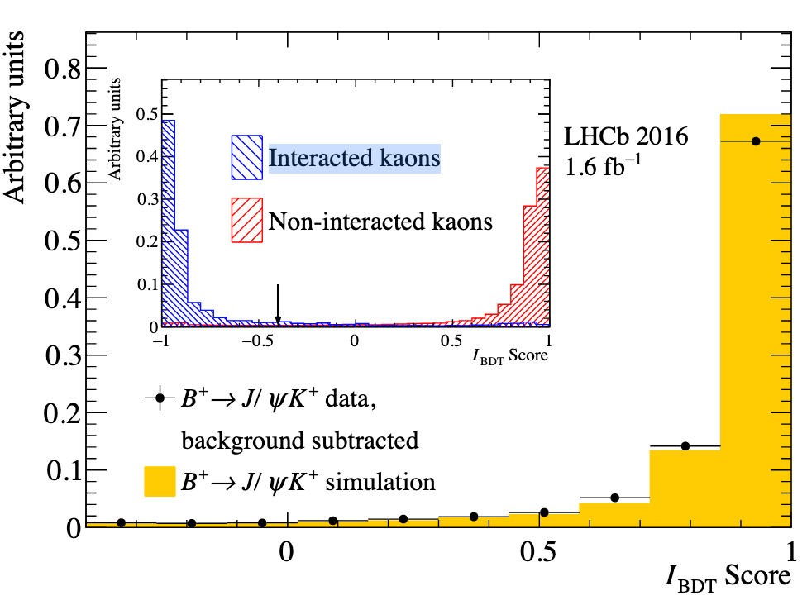
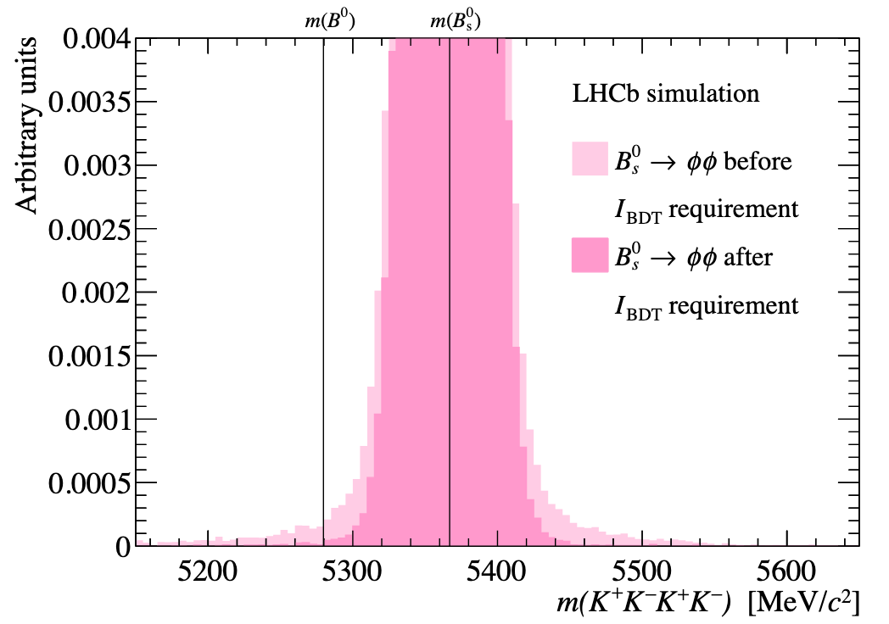

Search for $B_{ }^{0}→φφ$
$B_{ }^{0}→φφ$decay proceeds via a $b\overline{d}→s\overline{s}$ annihilation process
  At least one loop, Cabibbo suppressed, and Okubo–Zweig–Iizuka (OZI) suppressed
Not observed yet
Low branching fraction compared to $ℬ\left(B_{s}^{0}→φφ\right)=\left(1.84±0.14\right)×{10}^{−5}$
  Important to control the tail of the $B_{s}^{0}$ mass
  BDT classifier to suppress interacted kaons
[JHEP12(2019)155]

Slide 16
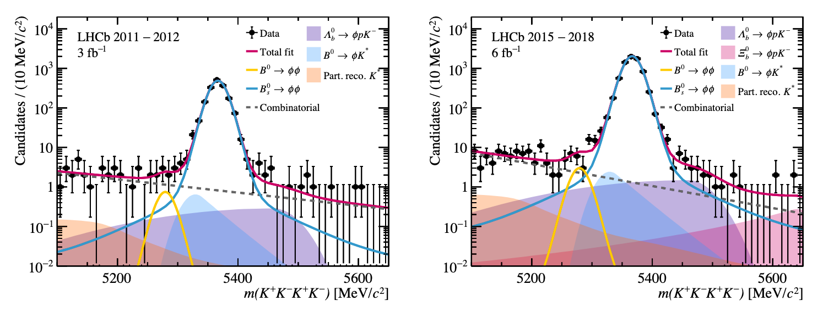
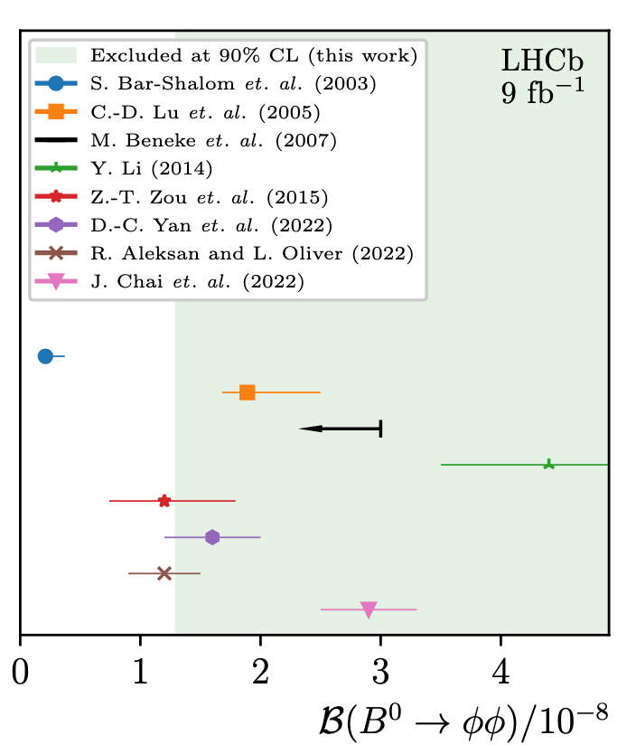
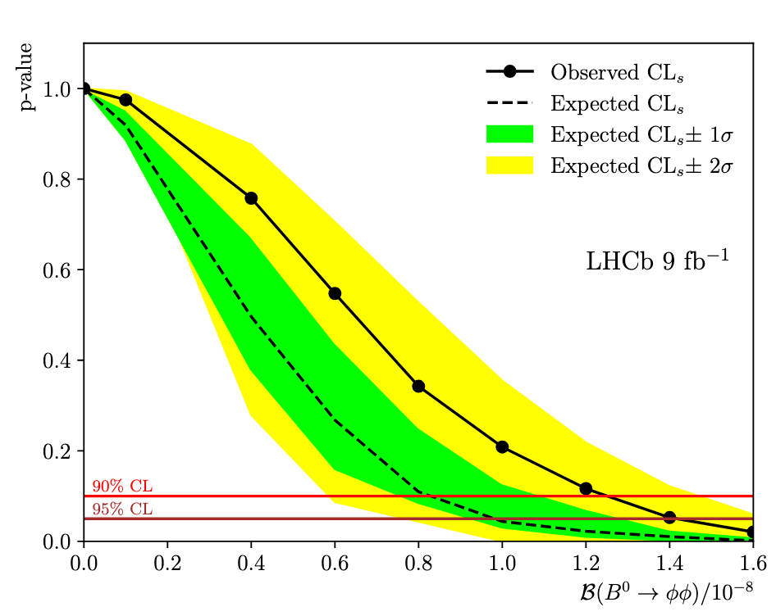
Search for $B_{ }^{0}→φφ$
Mass fits (run1 and run2):
  Consistent with the background-only hypothesis (1.9𝜎)
Upper limit:
  Improve the previous LHCb limit by a factor of two
Submitted to JHEP
[arXiv:2507.20945]

Slide 17
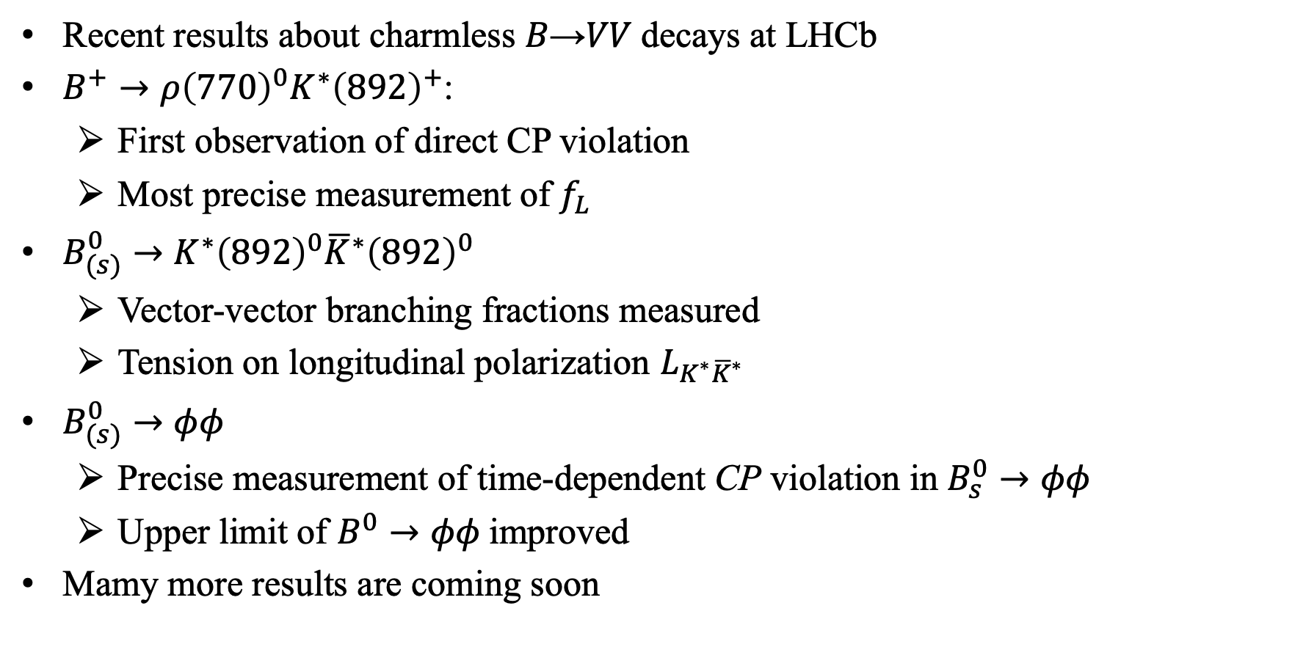
Summary
Recent results about charmless 𝐵→𝑉𝑉 decays at LHCb
$B_{ }^{+}→ρ{\left(770\right)}^{0}K^{∗}{\left(892\right)}^{+}$:
  First observation of direct CP violation
  Most precise measurement of $f_{L}$
$B_{(s)}^{0}→K^{∗}{\left(892\right)}^{0}{\overline{K}}^{∗}{\left(892\right)}^{0}$
  Vector-vector branching fractions measured
  Tension on longitudinal polarization $L_{K^{∗}{\overline{K}}^{∗}}$
$B_{(s)}^{0}→φφ$
  Precise measurement of time-dependent CP violation in $B_{s}^{0}→φφ$
  Upper limit of $B_{ }^{0}→φφ$improved
Mamy more results are coming soon

Slide 18
Thank you!

