Slide 1
Recent results on CP violation from the LHCb experiment
Wenbin Qian (钱文斌)
University of Chinese Academic of Sciences (中国科学院大学)
2025/10/30
CLHCP, 2025, Xinxiang
2025/10/30
UCAS, Wenbin Qian
1

Slide 2
Outline of the talk
Introduction
CKM angle measurements
CP violation measurements in baryon decays
Prospects and conclusion
See Kechen’s talk for CP violation in charmless B decays and in D decays
2025/10/30
UCAS, Wenbin Qian

Slide 3
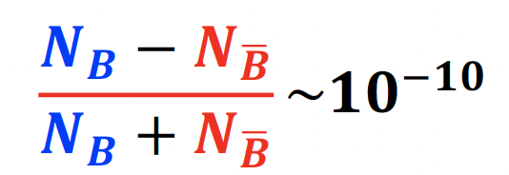


Why CP violation
SM model very successful;
Still an effective theory, many unexplained phenomena;
One standing-out quest: understanding matter and antimatter asymmetry in the Universe
Extra sources of CP violation needed
Higgs sector?
Neutrino sector? PMNS matrix
Quark sector?
Other places?
$≪{10}^{−17}$ predicted by CKM mechanism
All requires New physics
2025/10/30
UCAS Wenbin Qian
3

Slide 4
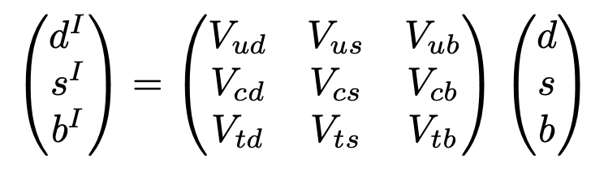







CP violation in SM
Complex phases in CKM matrix and PMNS matrix
CKM matrix：unitary matrix connecting interaction and mass eigenstates
Interaction eigenstates
Mass eigenstates
Matrix pattern very different？ Why？
Jarlskog invariant:
Related to mass hierarchy? Relation between Yukawa and CKM?
$$d$$
$$u$$
$$s$$
$$c$$
$J_{exp}$~ 3x10⁻⁵ < $J_{max}=1/6\sqrt{3}$~0.1
$$b$$
$$t$$
2025/10/30
UCAS Wenbin Qian
4

Slide 5
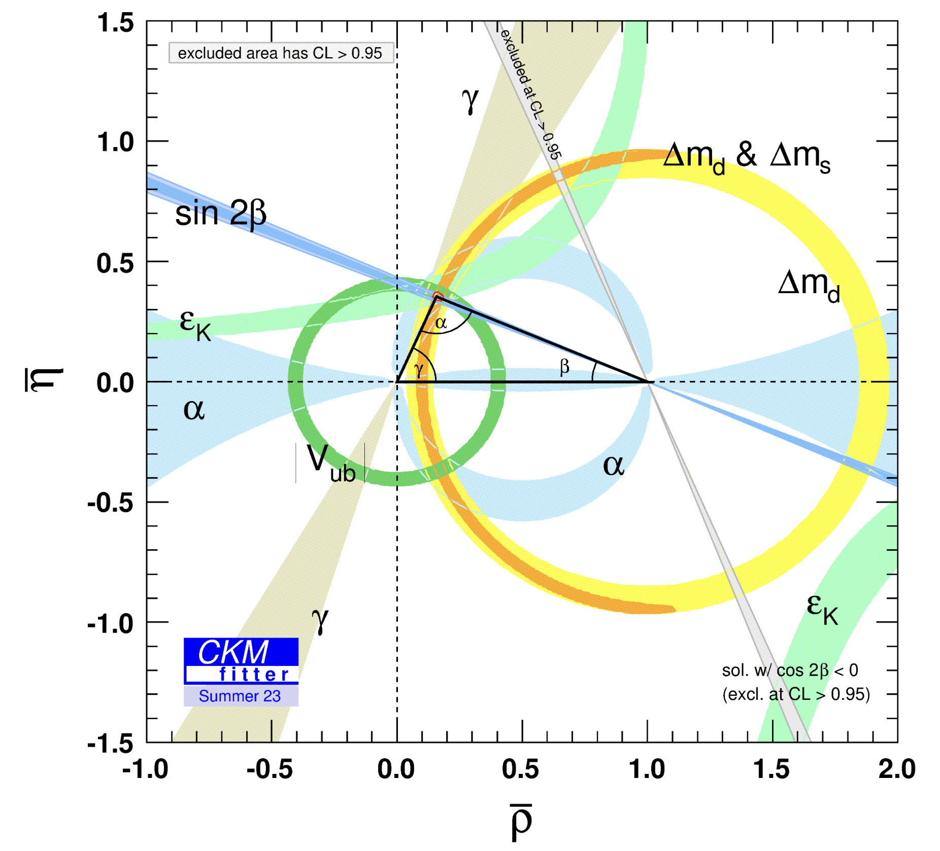
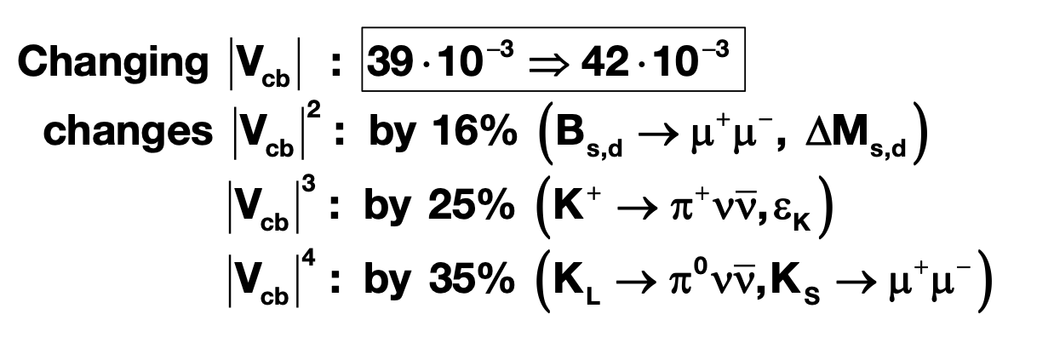

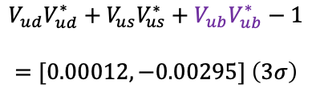


Precision measurements
Precision essential to find the footprint of NP
NP scale: $Λ$
Energy scale for SM: $v \sim 100$ GeV
Never have enough data, more for closure test of unitarity condition
Is current precision enough? No
Disaster for new physics searches if CKM elements not precise
$${10}^{−5}$$
$$V_{ud}V_{ud}^{∗}+V_{us}V_{us}^{∗}+V_{ub}V_{ub}^{∗}−1$$
$$=[0.00012,−0.00295] \left(3σ\right)$$
Cabbibo anomaly?
From A. Buras
2025/10/30
UCAS Wenbin Qian
5

Slide 6
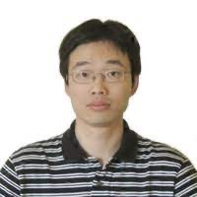
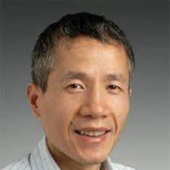
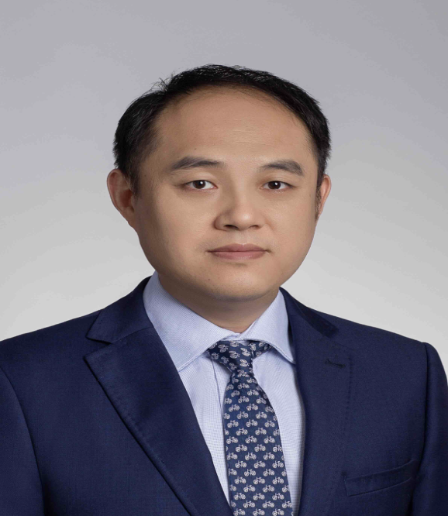
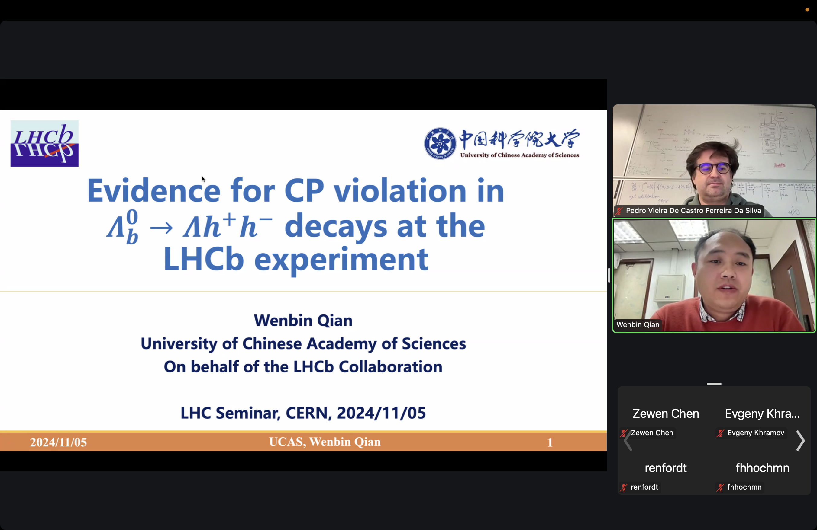

LHCb China in CP violation studies
From scattered studies to organized and grouped research (有组织科研)
UCAS
IHEP
Tsinghua + …
Peking U.
CCNU
LZU
HNU
2018-2025
Covering three main areas:
Precise measurements of CKM angles
CP violation in charmless b decays
Search for CP violation in baryon decays
LHC seminar on CP violation in baryon decays
Introduction talk in LHCb implication workshop
2025/10/30
UCAS Wenbin Qian
6

Slide 7
Outline of the talk
Introduction
CKM angle measurements
CP violation measurements in baryon decays
Prospects and conclusion
2025/10/30
UCAS, Wenbin Qian

Slide 8
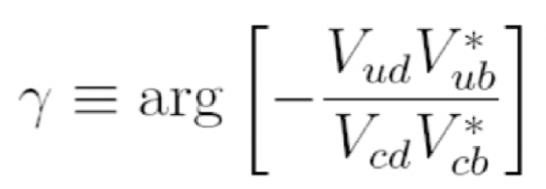
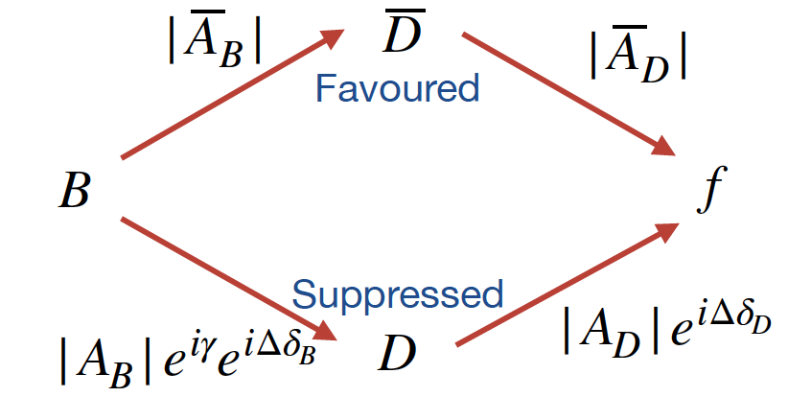
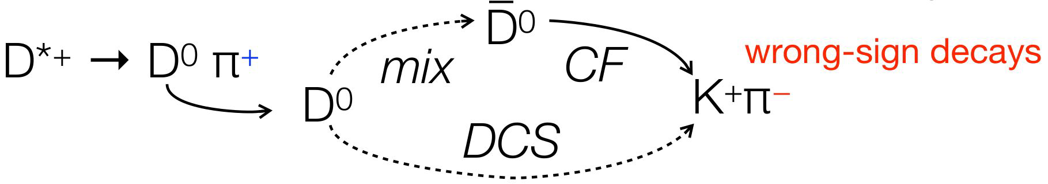



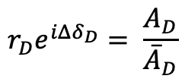







CKM angle $γ$
$b→c:$
$$\overline{A}\left(D\right):{\overline{D}}^{0}→f$$
$$r_{D}e^{iΔδ_{D}}= \frac{A_{D}}{{\overline{A}}_{D}}$$
$$A\left(D\right):D^{0}→f$$
$$D^{0}(\vec{p})$$
$b→u:$
$γ$ measurements
$$ψ\left(3770\right)$$
QC data
Charm mixing
$$\overline{D^{0}}(−\vec{p})$$
2025/10/30
UCAS Wenbin Qian
8

Slide 9
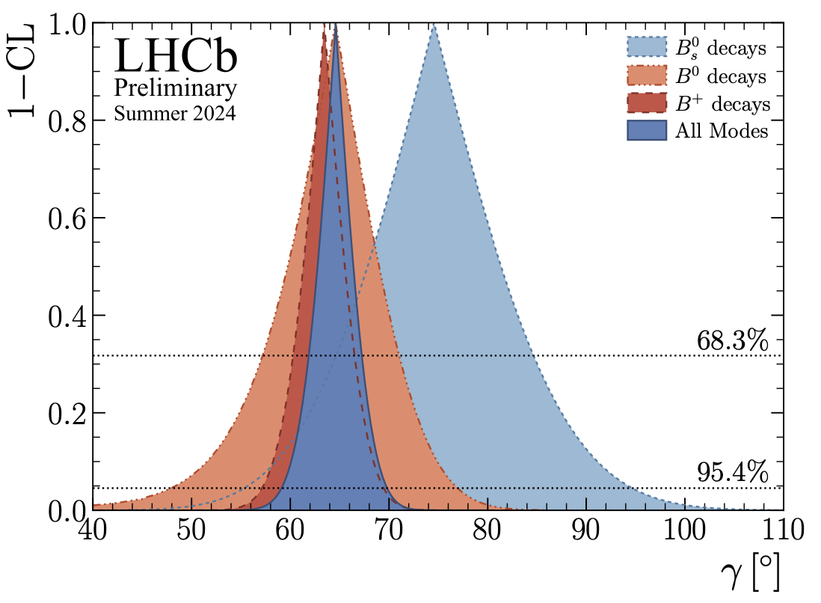

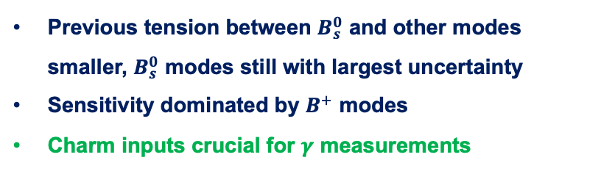


Global combination from LHCb
LHCb-CONF-2024-004
19 LHCb $B$ decay measurements + 11 $D$ decay measurements + 27 inputs from LHCb, HFLAV, BESIII and CLEO-c = 29 physics parameters of interest + additional nuisance parameters
$$γ={\left(64.6±2.8\right)}^{∘}$$
surpass LHCb design: $4^{∘}$
Previous tension between $B_{s}^{0}$ and other modes smaller, $B_{s}^{0}$ modes still with largest uncertainty
Sensitivity dominated by $B^{+}$ modes
Charm inputs crucial for $γ$ measurements
Advertisement: a new joint analysis between LHCb and BESIII may come out soon, stay tuned!
2025/10/30
UCAS Wenbin Qian
9

Slide 10
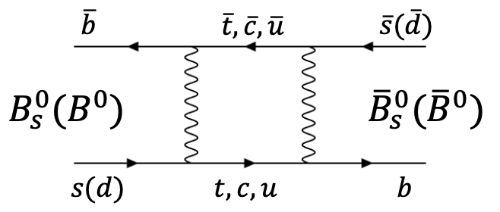
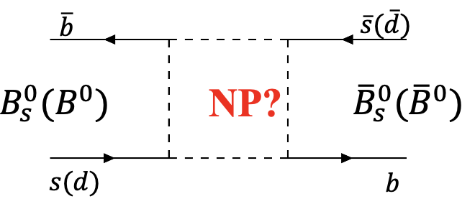
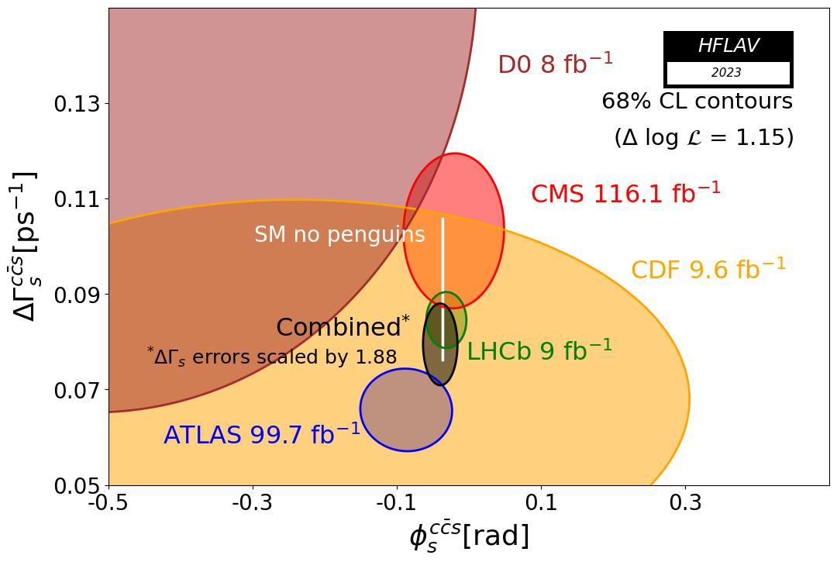
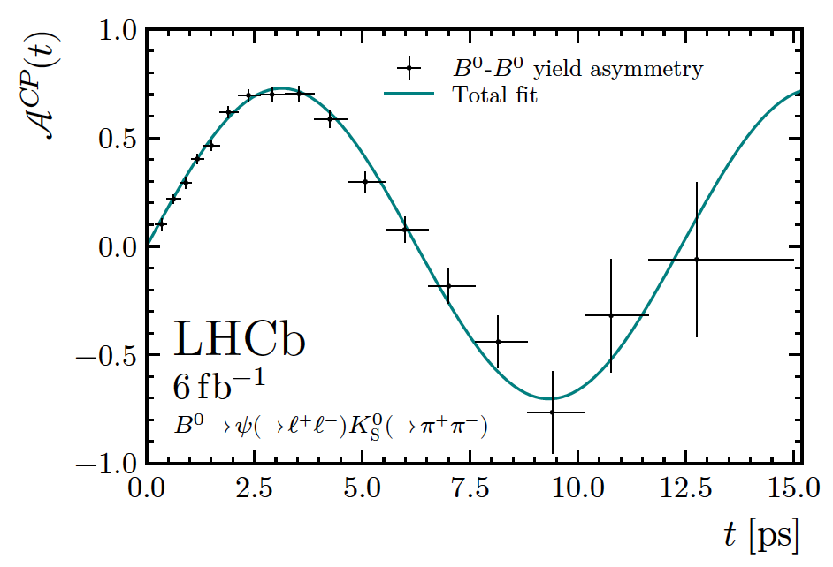
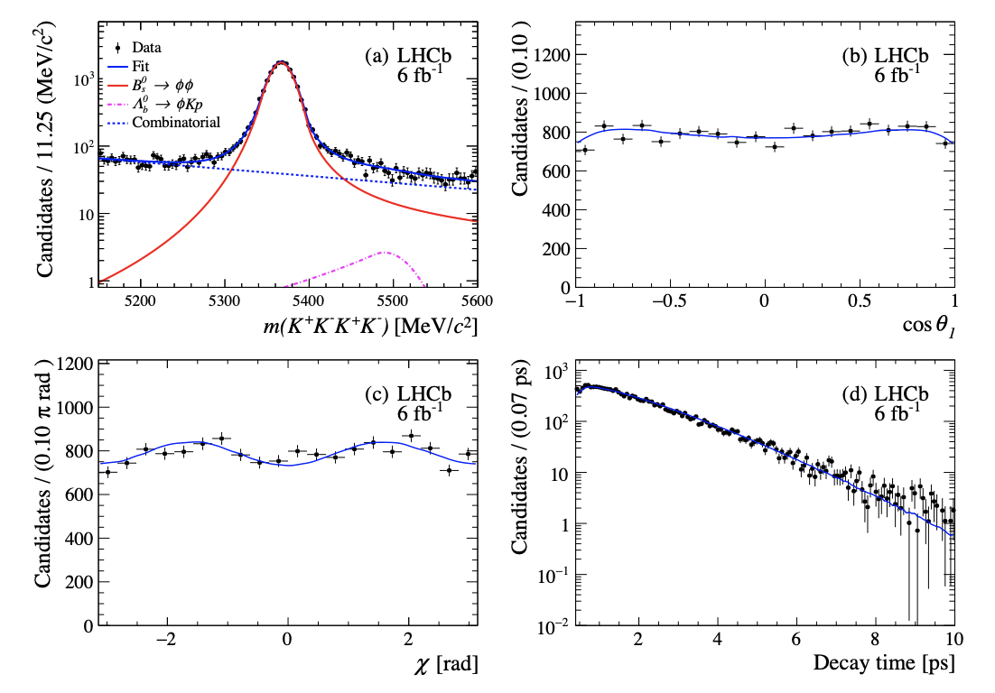



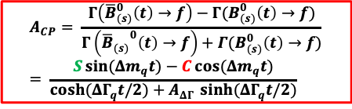

Time dependent measurements
TD measurement: Core program of B physics
$$A_{CP}= \frac{Γ\left({\overline{B}}_{(s)}^{0}\left(t\right)→f\right)−Γ(B_{(s)}^{0}\left(t\right)→f)}{Γ\left({{\overline{B}}_{(s)}}^{0}\left(t\right)→f\right)+Γ(B_{(s)}^{0}\left(t\right)→f)}= \frac{S\sin{(Δm_{q}t})−C\cos{(Δm_{q}t)}}{\cosh{(ΔΓ_{q}t/2)}+A_{ΔΓ }\sinh{(ΔΓ_{q}t/2)}}$$
$$φ_{s}=−0.039±0.022±0.006$$
$$S_{ψK_{S}^{0}}=0.717±0.013±0.008$$
$φ_{s}^{s\overline{s}s}=−0.042±0.075±0.009$ rad
Most precise search for NP in mixing
Most precise determination $sin2β$
Golden channel to search for NP
2025/10/30
UCAS Wenbin Qian
10

Slide 11
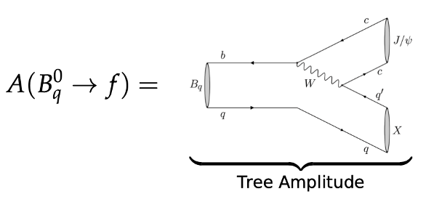
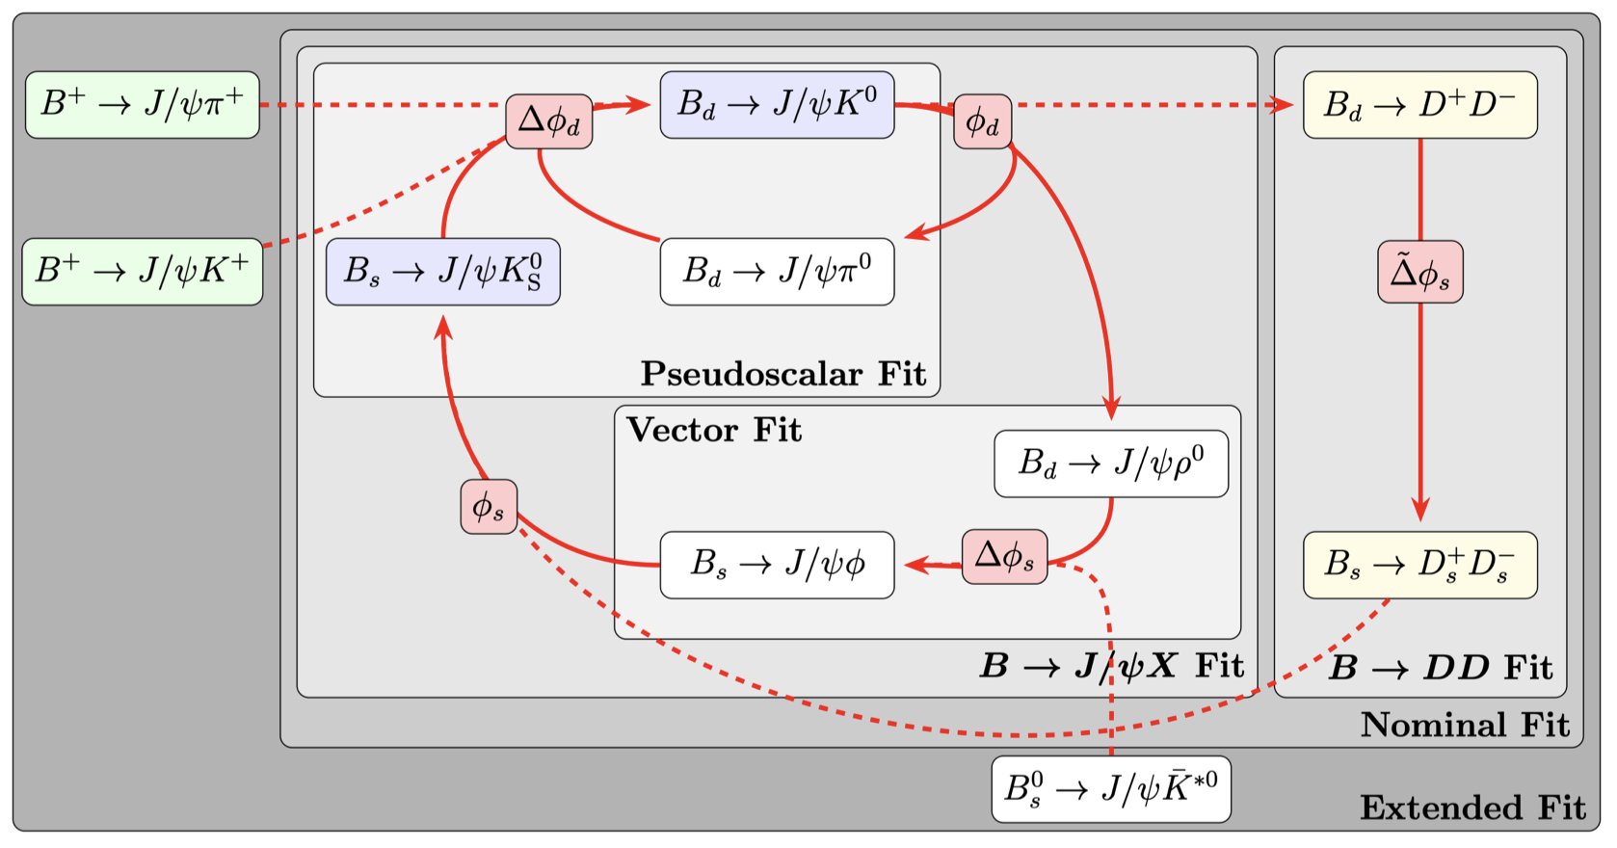
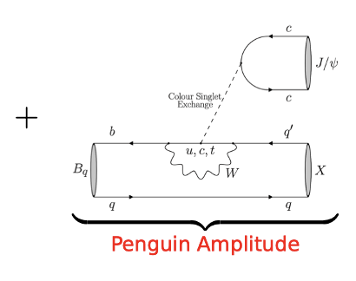

Penguin contribution
Two key elements to hunt for NP in box diagrams: precision + understanding penguin contributions
Methodology: Penguin enhanced channels + SU(3) assumption
arXiv:2505.06102
2025/10/30
UCAS Wenbin Qian
11

Slide 12
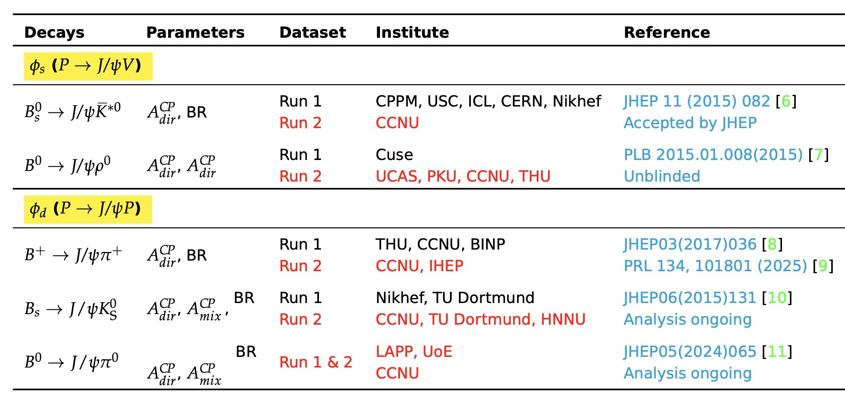


Contributions from LHCb China group
Courtesy of Jie Wu
2025/10/30
UCAS Wenbin Qian
12

Slide 13
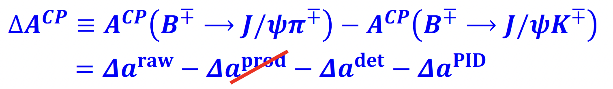
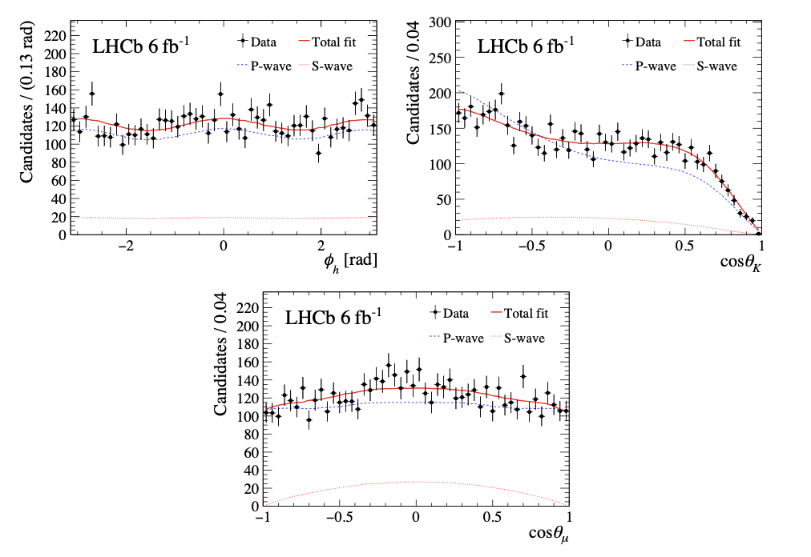

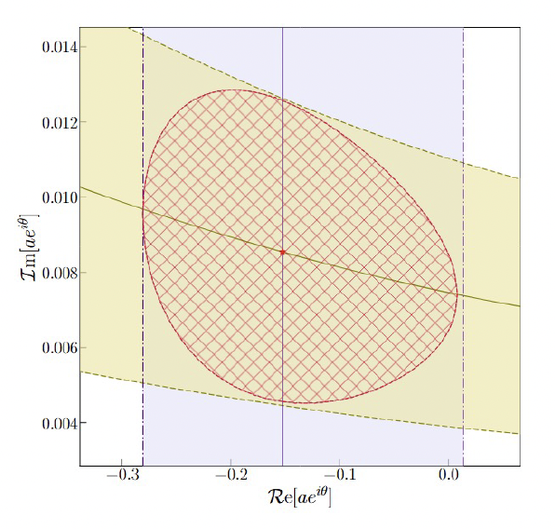
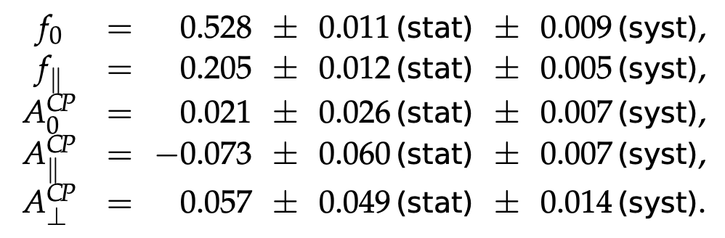
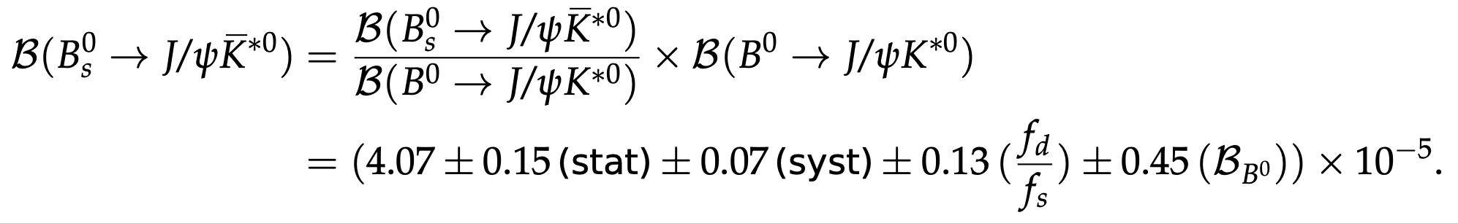



Fresh results
Branching fraction + CP violation for different CP eigenstates of $B_{s}^{0}→J/ψ{\overline{K}}^{∗0}$
Evidence of direct CP violation in $B^{+}→J/ψπ^{+}$
3.2$σ$ from 0
Branching fraction + CP violation ➜ constrain on penguin
2025/10/30
UCAS Wenbin Qian
13

Slide 14
Outline of the talk
Introduction
CKM angle measurements
CP violation measurements in baryon decays
Prospects and conclusion
2025/10/30
UCAS, Wenbin Qian

Slide 15
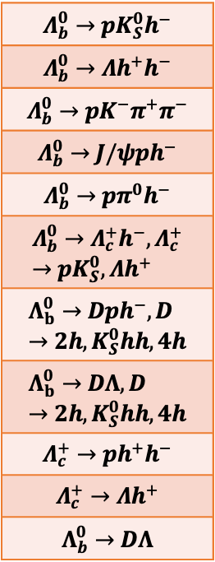
CP violation searches by LHCb China group
2016 | 2017 | 2018 | 2019 | 2020 | 2021 | 2022 | 2023 | 2024 | 2025
$$Λ_{b}^{0}→pK_{S}^{0}h^{−}$$
$$Λ_{b}^{0}→Λh^{+}h^{−}$$
$$Λ_{b}^{0}→pK^{−}π^{+}π^{−}$$
$$Λ_{b}^{0}→J/ψph^{−}$$
$$Λ_{b}^{0}→pπ^{0}h^{−}$$
$$Λ_{b}^{0}→Λ_{c}^{+}h^{−}, Λ_{c}^{+}→pK_{S}^{0}, Λh^{+}$$
$$Λ_{b}^{0}→Dph^{−}, D→2h, K_{S}^{0}hh, 4h$$
$$Λ_{b}^{0}→DΛ, D→2h, K_{S}^{0}hh, 4h$$
$$Λ_{c}^{+}→ph^{+}h^{−}$$
$$Λ_{c}^{+}→Λh^{+}$$
$$Λ_{b}^{0}→DΛ$$
CCNU
CCNU +UCAS
CCNU +UCAS +PKU
CCNU +UCAS
CCNU +UCAS +PKU
CCNU +UCAS +PKU + IHEP
UCAS + Tsinghua
Joint efforts from LHCb China
UCAS + PKU + WHU
UCAS
CCNU +UCAS +PKU
UCAS
9 years of studies
Covering all modes
UCAS
UCAS
UCAS + LZU
CCNU
CCNU +UCAS
2024/07/14
UCAS, Wenbin Qian
UCAS
15

Slide 16
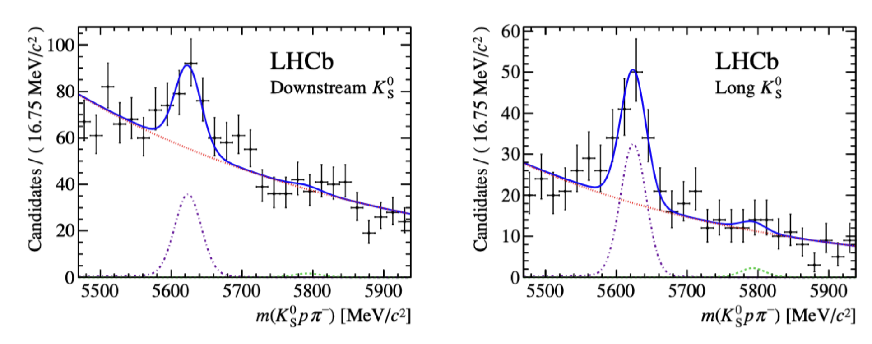
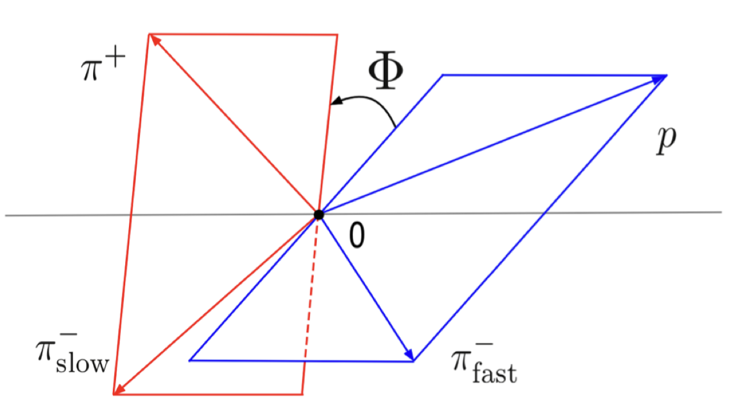
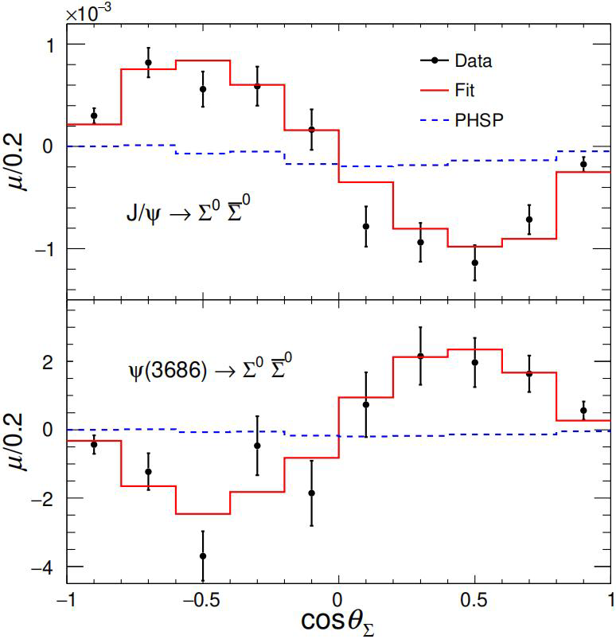
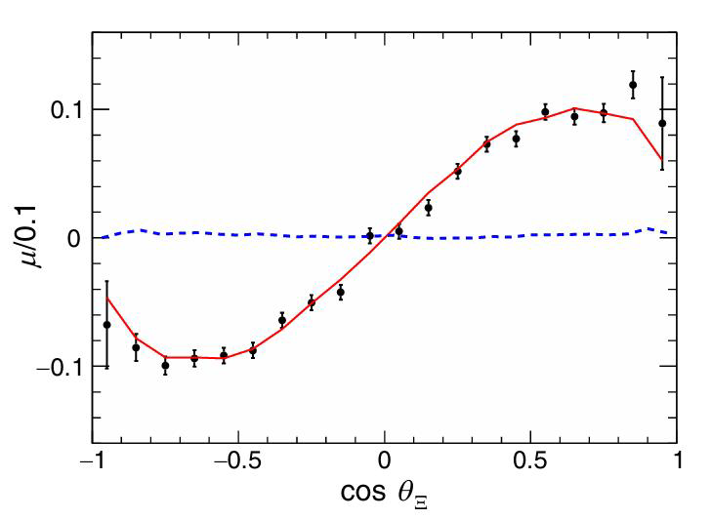




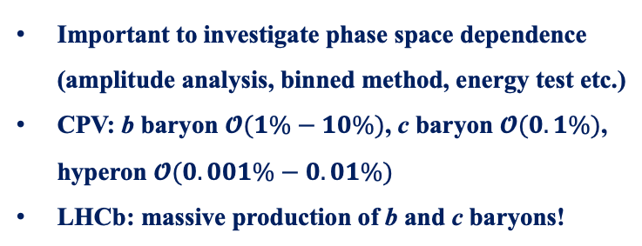
Methods to search for CP violation
JHEP04(2014)087
PRD108(2023)L011101
PRL133 (2024) 101902
Nature Phys.13(2017)391
Many methods have been explored to search for CP violation in baryon decays
Direct CP violation ($∝sin\left(Δδ_{ST}\right)sin(Δφ_{EW})$)
Triple-product asymmetry ($∝cos\left(Δδ_{ST}\right)sin(Δφ_{EW})$)
$$Λ_{b}^{0}→pK_{S}^{0}π^{−}$$
$$Λ_{b}^{0}→pπ^{+}π^{−}π^{+}$$
Decay parameters asymmetry
Important to investigate phase space dependence (amplitude analysis, binned method, energy test etc.)
CPV: b baryon $𝓞(1\%−10\%)$, c baryon $𝓞(0.1\%)$, hyperon $𝓞(0.001\%−0.01\%)$
LHCb: massive production of b and c baryons!
$J/ψ$ $→Ξ^{0}{\overline{Ξ}}^{0}, Ξ^{0}→Λπ^{0}$
2025/10/30
UCAS Wenbin Qian
16

Slide 17
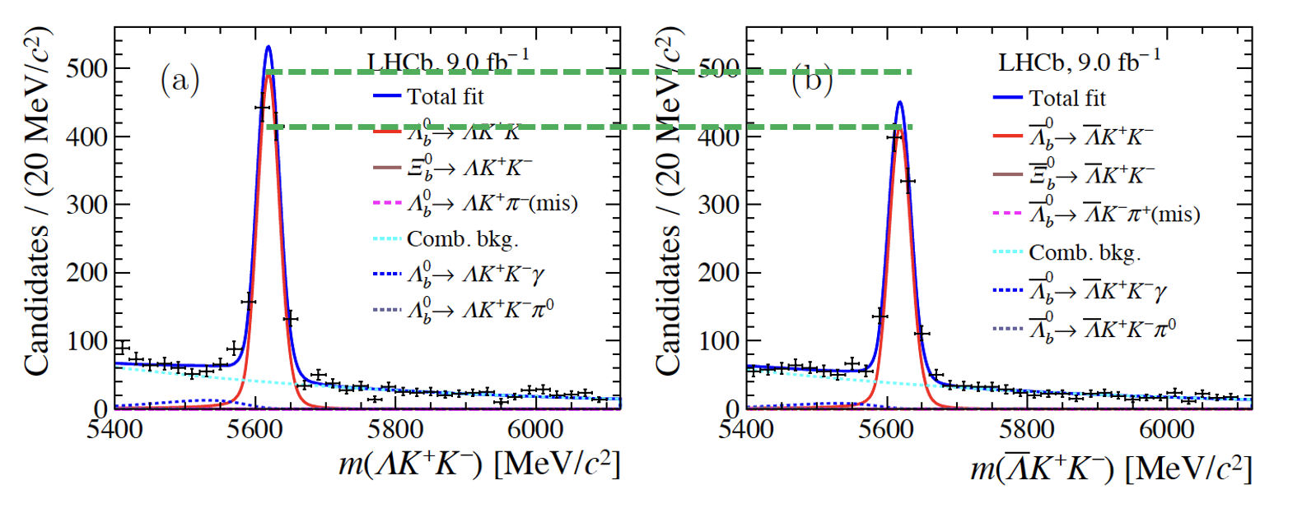


Evidence of CP violation
PRL 134 (2025) 101802
$$Λ_{b}^{0}→ΛK^{+}K^{−}$$
$$ΔA_{CP}=0.083±0.023±0.016$$
First evidence of CP violation, 3.1$σ$
Three body decays, need to know which resonance contributes
2025/10/30
UCAS, Wenbin Qian
17

Slide 18
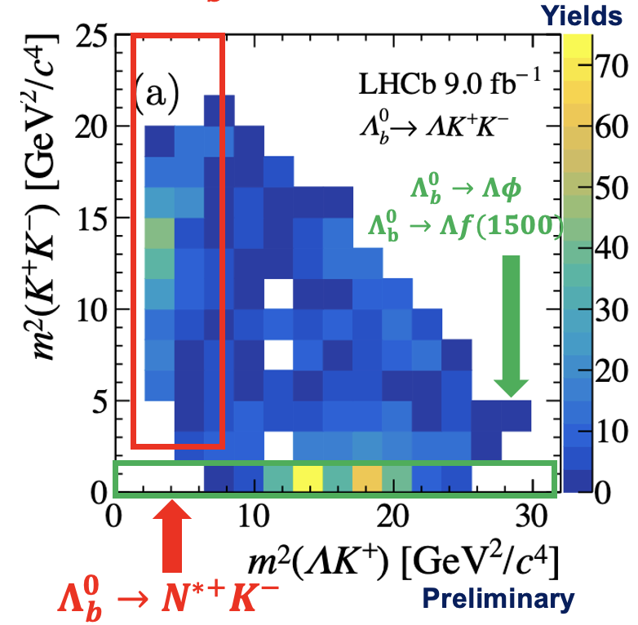
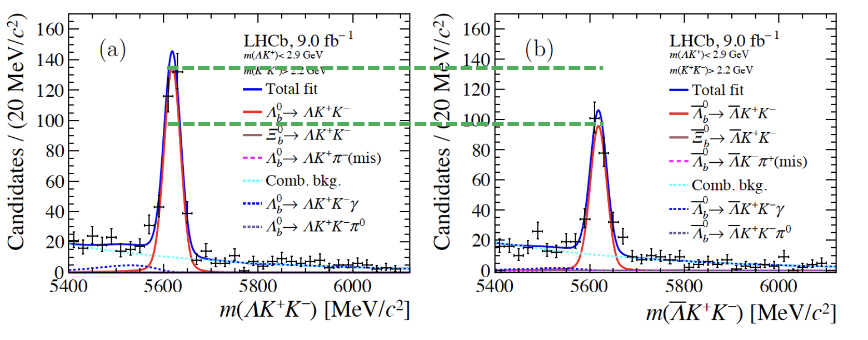




Looking into Dalitz plot ($Λ_{b}^{0}→ΛK^{+}K^{−}$)
PRL 134 (2025) 101802
Preliminary
$$ΔA_{CP}(N^{∗+}K^{−})=0.165±0.048±0.017$$
First evidence of CP violation in local resonant region, 3.2$σ$
$φ$region
Consistent with 0 within 2.5$σ$
PRD107 (2023) 053009
$$ΔA_{CP}(Λφ)=0.150±0.055±0.021$$
Predicted CPV (resonant), ~1.5%
2025/10/30
UCAS, Wenbin Qian
18

Slide 19
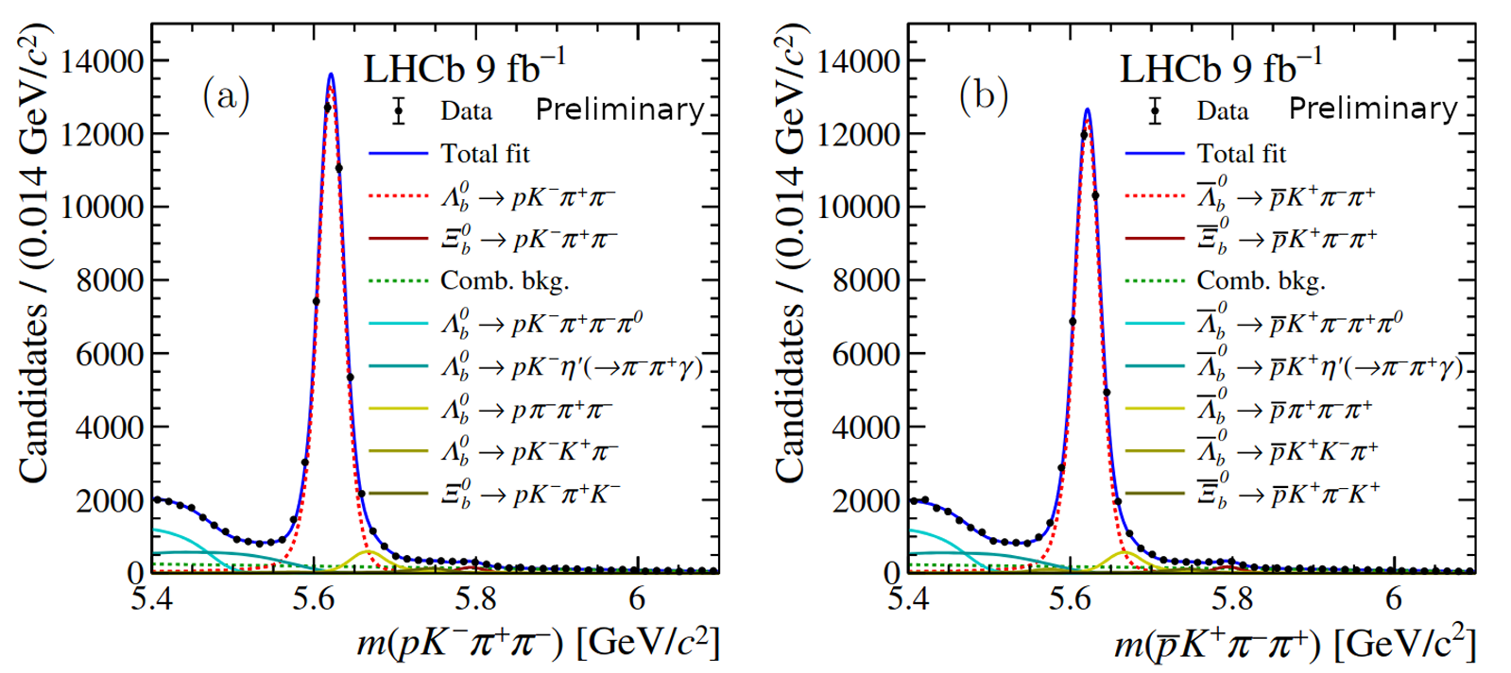
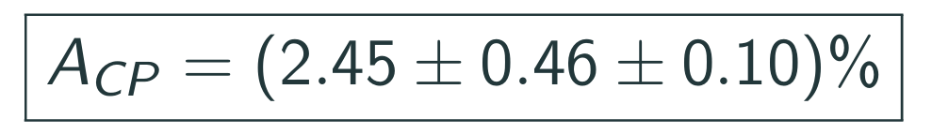

Observation of CP violation in baryon decays
Nature 643 (2025) 1223
See Xinchen’s talk for details
CP symmetry violated by more than 5$σ$
2025/10/30
UCAS, Wenbin Qian
19

Slide 20
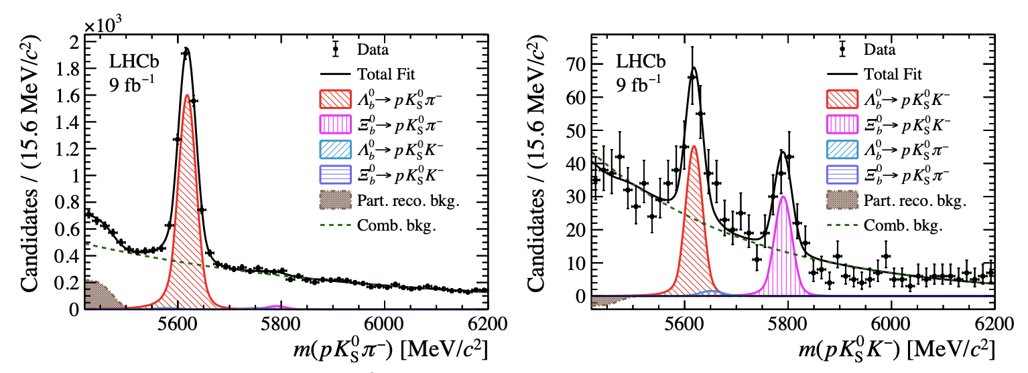
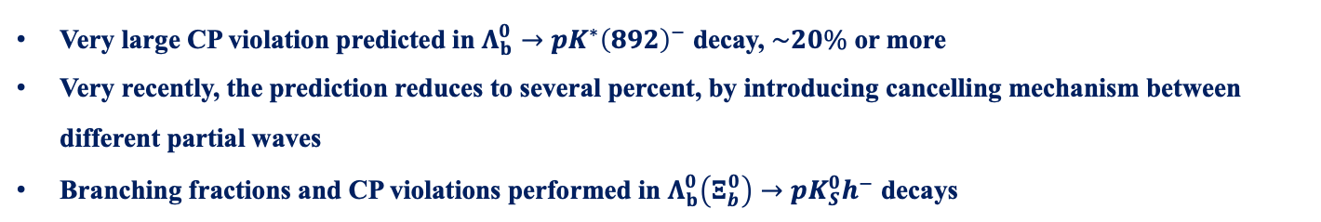



Unexpected small CP violation
arXiv:2508.17836
Very large CP violation predicted in $Λ_{b}^{0}→pK^{∗}{\left(892\right)}^{−}$ decay, $\sim 20\%$ or more
Very recently, the prediction reduces to several percent, by introducing cancelling mechanism between different partial waves
Branching fractions and CP violations performed in $Λ_{b}^{0}\left(Ξ_{b}^{0}\right)→pK_{S}^{0}h^{−}$ decays
~5000
$$\sim 130, 8.1σ$$
$$\sim 90, 8.0σ$$
$$1σ$$
See Zewen’s talk for details
2025/10/30
UCAS, Wenbin Qian
20

Slide 21
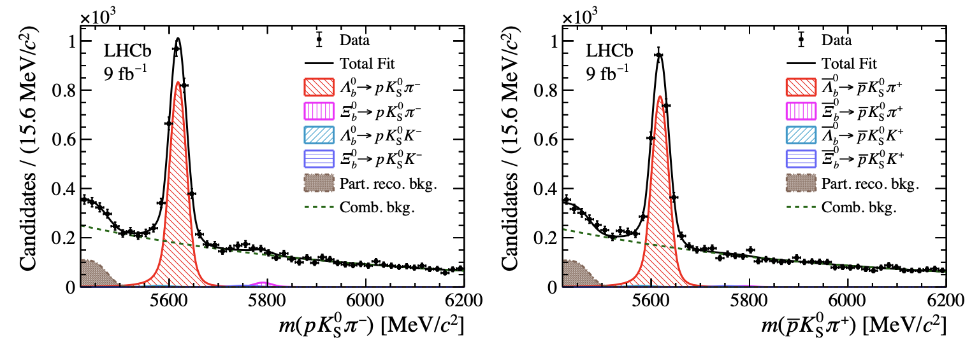
Unexpected small CP violation
arXiv:2508.17836
Very large CP violation predicted in $Λ_{b}^{0}→pK^{∗}{\left(892\right)}^{−}$ decay, $\sim 20\%$ or more
Very recently, the prediction reduces to several percent, by introducing cancelling mechanism between different partial waves
Branching fractions and CP violations performed in $Λ_{b}^{0}\left(Ξ_{b}^{0}\right)→pK_{S}^{0}h^{−}$ decays
$$A^{CP}\left(Λ_{b}^{0}→pK_{S}^{0}π^{−}\right)=\left(3.4±1.9±0.9\right)\%$$
See Zewen’s talk for details
2025/10/30
UCAS, Wenbin Qian
21

Slide 22
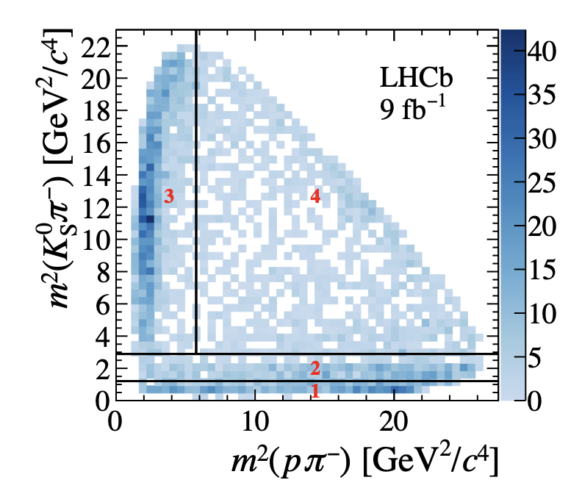
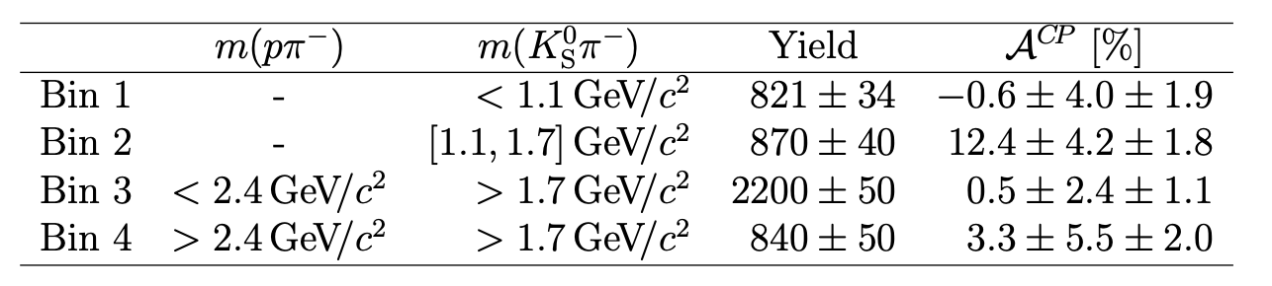
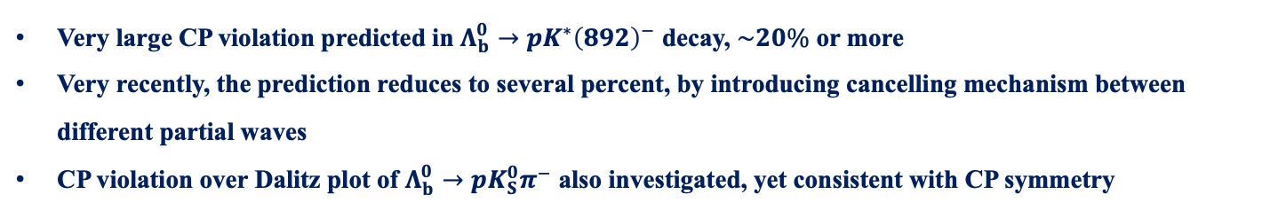
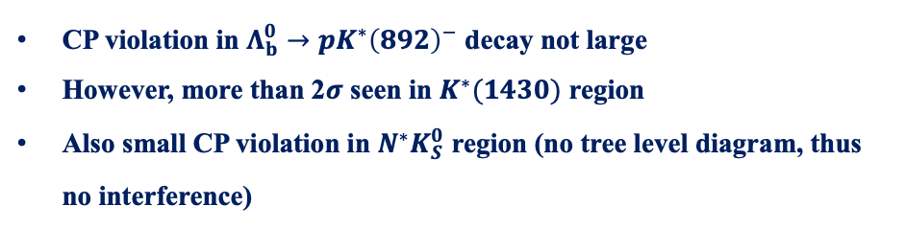
Unexpected small CP violation
arXiv:2508.17836
Very large CP violation predicted in $Λ_{b}^{0}→pK^{∗}{\left(892\right)}^{−}$ decay, $\sim 20\%$ or more
Very recently, the prediction reduces to several percent, by introducing cancelling mechanism between different partial waves
CP violation over Dalitz plot of $Λ_{b}^{0}→pK_{S}^{0}π^{−}$ also investigated, yet consistent with CP symmetry
CP violation in $Λ_{b}^{0}→pK^{∗}{\left(892\right)}^{−}$ decay not large
However, more than 2$σ$ seen in $K^{∗}(1430)$ region
Also small CP violation in $N^{∗}K_{S}^{0}$ region (no tree level diagram, thus no interference)
See Zewen’s talk for details
2025/10/30
UCAS, Wenbin Qian
22

Slide 23
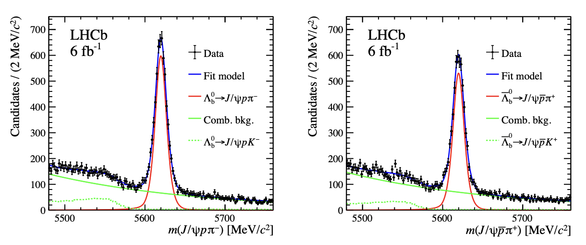

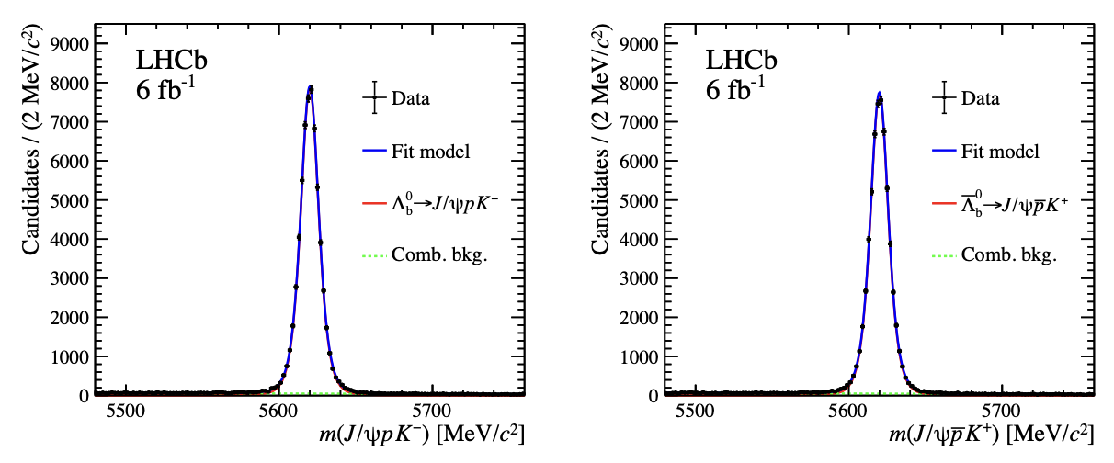





CP violation in $Λ_{b}^{0}→J/ψph$ decays
LHCb-PAPER-2025-021
$Λ_{b}^{0}→J/ψpπ^{−}$
A significance of 3.3$σ$, when combining with Run 1 result, it reaches 3.9$σ$
$Λ_{b}^{0}→J/ψpK^{−}$
CP violation seen in a channel where pentaquark is found!
See Xinchen’s talk for details
2025/10/30
UCAS, Wenbin Qian
23

Slide 24



Investigation over Dalitz plot
LHCb-PAPER-2025-021
$$A_{CP}$$
$$A_{TPA}$$
Some enhancement of CP violation in the region of pentaquark, however, not yet significant and also observed after unblinding
Stay tuned for more results with further data collected by LHCb
See Xinchen’s talk for details
2025/10/30
UCAS, Wenbin Qian
24

Slide 25










Decay parameter measurements
PRL 133 (2024) 261804
Several decay chains considered:
$$Λ_{b}^{0}→Λ_{c}^{+}{(→Λh^{+})h}^{−}, Λ→pπ^{−}$$
$$Λ_{b}^{0}→Λ_{c}^{+}{(→pK_{S}^{0})h}^{−}$$
$$α_{b}:Λ_{b}^{0}→Λ_{c}^{+}h^{−}$$
$$α_{c}:Λ_{c}^{+}→pK_{S}^{0}$$
$$α_{b}:Λ_{b}^{0}→Λ_{c}^{+}h^{−}$$
$$α_{c},β_{c},γ_{c}:Λ_{c}^{+}→Λh^{+}$$
$$α_{s}:Λ→pπ^{−}$$
2025/10/30
UCAS Wenbin Qian
25

Slide 26














Results of decay parameters
PRL 133 (2024) 261804
$$Λ_{b}^{0}→Λ_{c}^{+}(→pK_{S}^{0})h^{−}$$
$$Λ_{b}^{0}→Λ_{c}^{+}{\left(→Λh^{+}\right)π}^{−}$$
First determination of $α$ in $Λ_{b}^{0}→Λ_{c}^{+}h^{−}$ decays (precision $\sim 0.9\%$ for $Λ_{c}^{+}π^{−}$)
Most precise determinations of $α,(β,γ)$ in $Λ_{c}^{+}→pK_{S}^{0}$ (precision $\sim 1.4\%$) and $Λ_{c}^{+}→Λh^{+}$ decays
Confirmation of $α(Λ→pπ^{−})$ from BESIII (significantly higher than previous measurements)
Results consistent with no CP violation in both $A_{α}$ and $R_{β_{1}} (\text{precision} \sim 2\% \text{for} Λ_{c}^{+}π^{−})$
Pave the way for other decay parameter measurements (more sensitive)
$$Λ_{b}^{0}→Λ_{c}^{+}π^{−}$$
$$Λ_{c}^{+}→Λπ^{+}$$
$$Λ_{b}^{0}→Λ_{c}^{+}K^{−}$$
$$Λ_{c}^{+}→ΛK^{+}$$
$$Λ_{c}^{+}→Λπ^{+}$$
$$Λ_{c}^{+}→Λπ^{+}$$
$$Λ_{c}^{+}→ΛK^{+}$$
$$Λ_{c}^{+}→ΛK^{+}$$
$$Λ_{b}^{0}→Λ_{c}^{+}{\left(→Λh^{+}\right)π}^{−}$$
$$Λ_{b}^{0}→Λ_{c}^{+}{\left(→Λh^{+}\right)π}^{−}$$
2025/10/30
UCAS Wenbin Qian
26

Slide 27


CP violation in baryon decays
CP violation in baryon decays finally established after 61 years of its discovery
1956, Parity violation, Lee, Yang & Wu
1973, CP violation mechanism, Kobayashi & Maskawa
2025, CP violation in baryon decays,
LHCb collaboration
1957
2008
1980
1964, CP violation, Cronin & Fitch
2008
2001, CP violation in B decays, Babar & Belle collaborations
Next crucial question: Is it SM?
Measuring CKM angle $γ$ in baryon system essential
2024/11/05
UCAS, Wenbin Qian
27

Slide 28





Prospects and conclusion
1995
2023
2040?
2025/10/30
UCAS, Wenbin Qian

Slide 29
Thank you for your attention!
2025/10/30
UCAS Wenbin Qian
29

Slide 30

LHC: a new energy and luminosity frontier
Now 13.6 TeV
2025/10/30
UCAS, Wenbin Qian
30

Slide 31


The LHCb detector (Run 1+2)
2008 JINST 3 S08005
Designed for CP violation and heavy flavor studies
2025/10/30
UCAS Wenbin Qian
31

Slide 32

The LHCb status
Run 1:
2011 (7 TeV): 1 fb⁻¹
2012 (8 TeV): 2 fb⁻¹
Run 2:
2015-2018 (13 TeV): 6 fb⁻¹
Run 3:
2024 alone (13.6 TeV): 9.56 fb⁻¹
2025 (13.6 TeV): > 6.92 fb⁻¹
A new LHCb detector for Run 3 operates at $×5$ higher instantaneous luminosity
Similar performance, while efficiency for hadron final states increased by a factor of 2
2025/10/30
UCAS Wenbin Qian
32

Slide 33



Triple product asymmetry in $Λ_{b}^{0}→J/ψph$ decays
LHCb-PAPER-2025-021
Triple product asymmetry supposed to probe different types of CP violation than direct CP measurements
Very good in cancelling experimental effects, i.e. efficiencies, detection and production asymmetries
No global triple product asymmetry found
2025/10/30
UCAS, Wenbin Qian
33

