Slide 1


Study of rare decays at LHCb
河南师范大学
李可陈
2025/11/1
CLHCP2025，新乡
Notes:
亮亮图文旗舰店https://liangliangtuwen.tmall.com

Slide 2
CONTENTS
1.Study of (semi)leptonic FCNC decays
2. Study of hadronic FCNC decays
3.Searching for NP in VRD processes
4.Prospects and summary

Slide 3
1
FCNC decays and LFU

Slide 4
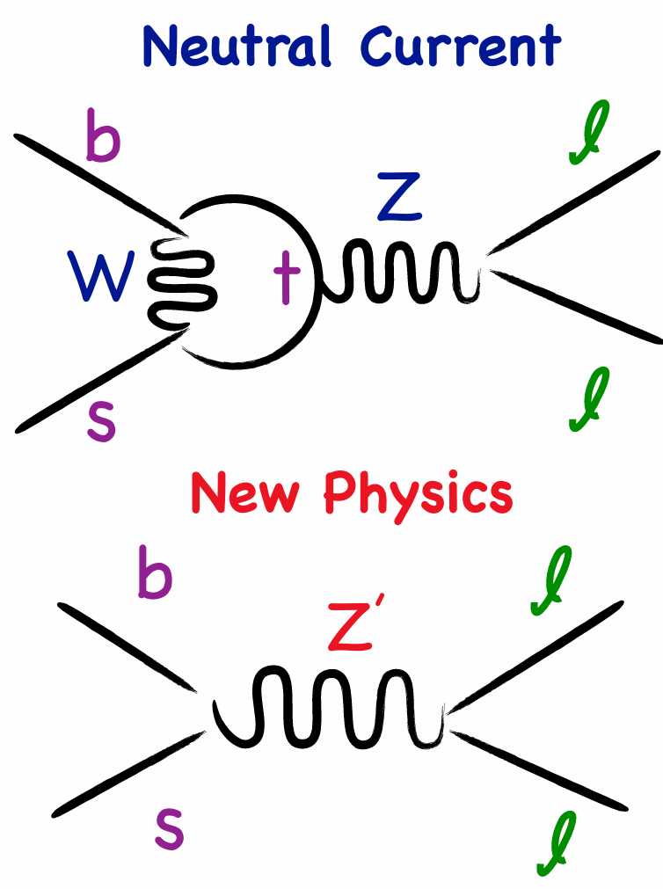
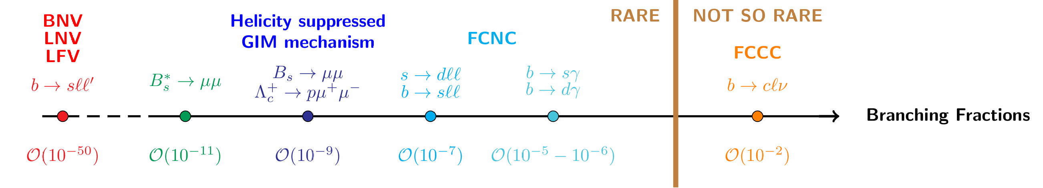
Study of b →sℓℓ transitions at LHCb
RESEARCH BACKGROUNDS
New Physics (NP) beyond SM ⇒ indirect searches: test SM predictions to look for deviations from new virtual particles
SM contribution is suppressed in rare decays ⇒ sensitive to explore NP
How would NP manifest?
Modification of the Branching Fraction
Modification of the Angular Distributions
New sources of CP Violation
How do we measure?
Head count
Head count & projection on angles
Head count ||{ projection on angles||
projection ondecay time}

Slide 5
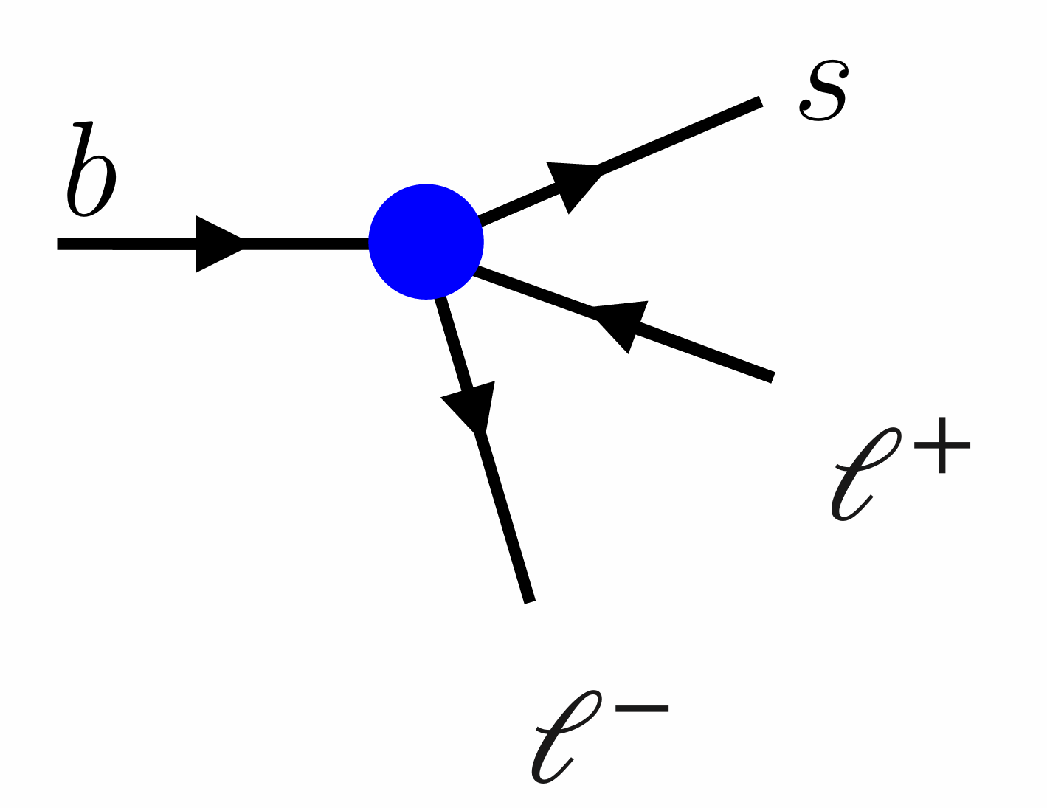
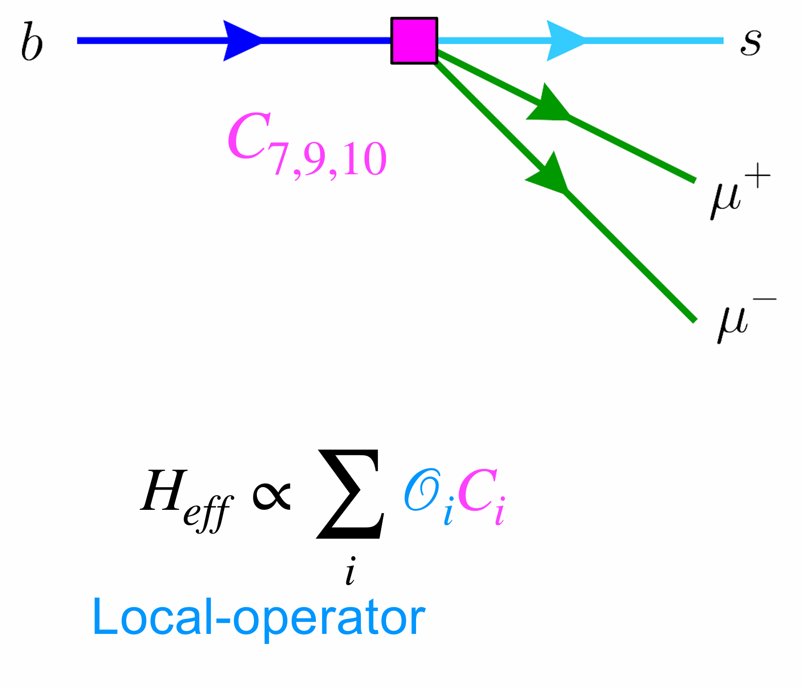
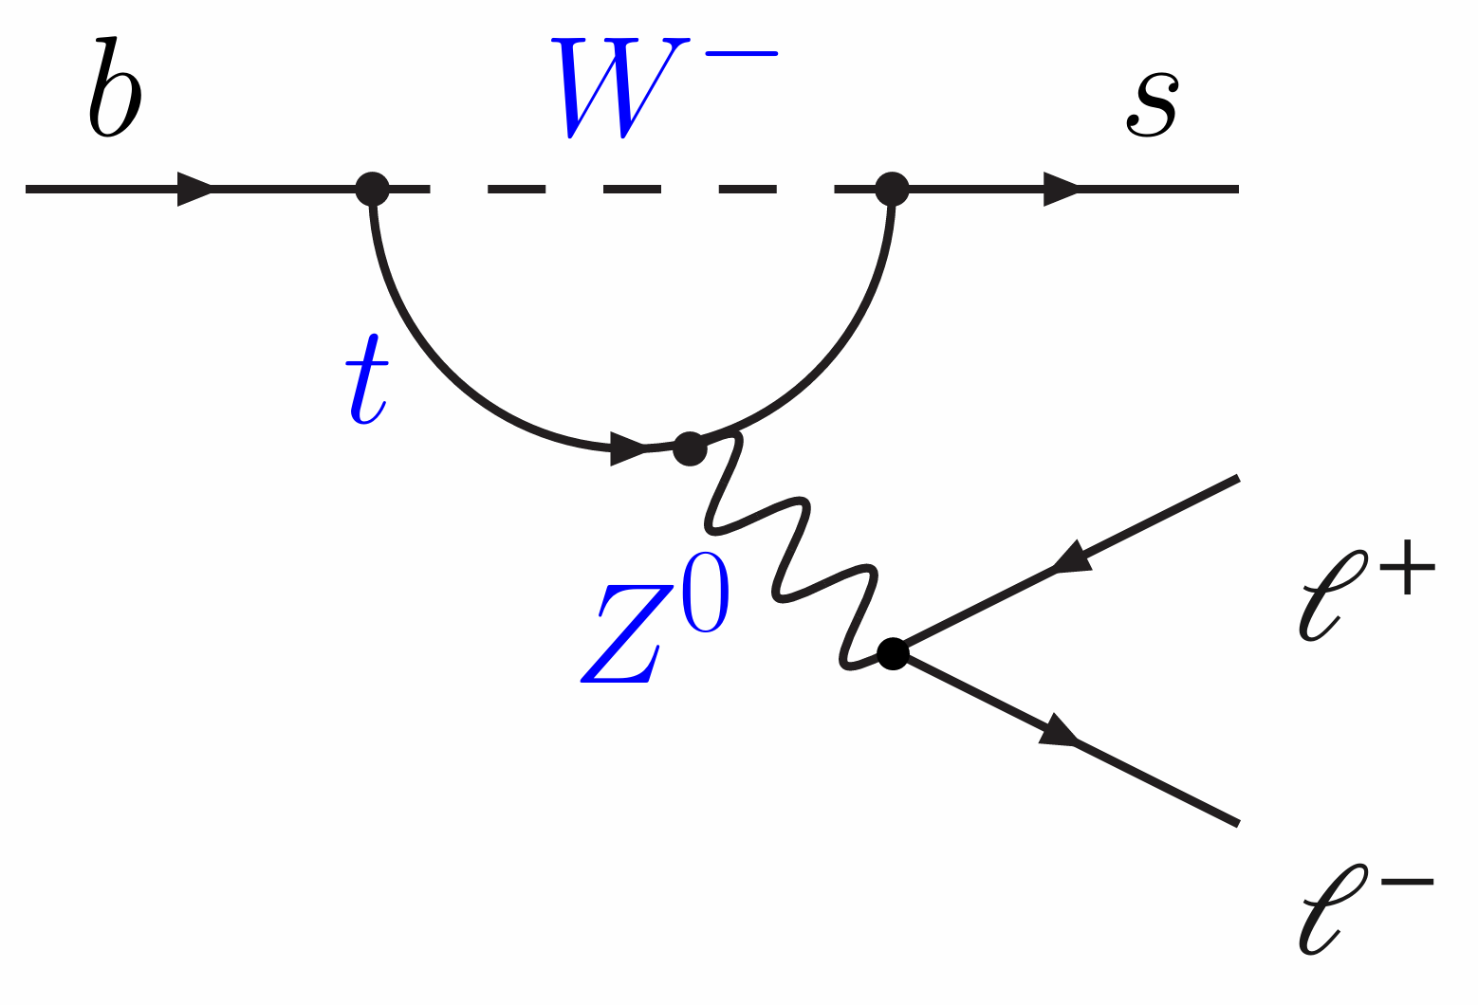
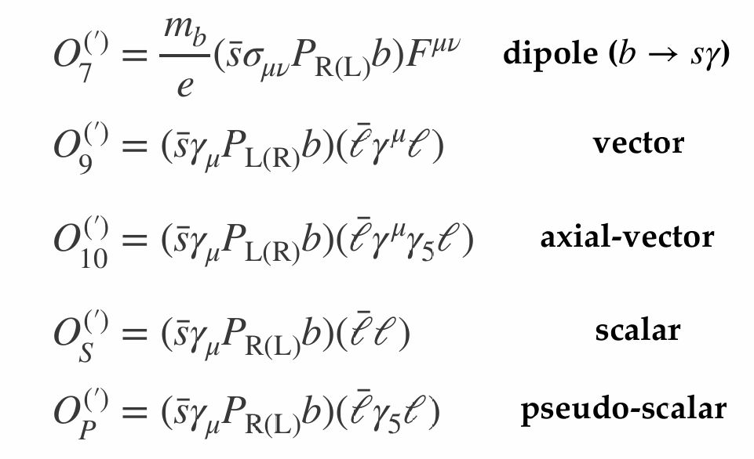
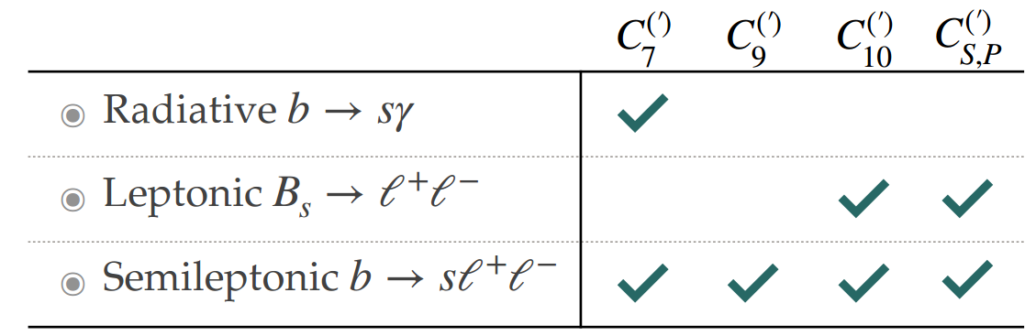
b →sℓℓ decays in theory
RESEARCH BACKGROUNDS
Electro weak penguin (EWP) decays decays in effective theory interpretation
Wilson coefficients are complex values (CPV)
SM is LFU but could be violated
in NP:
Ce ≠ C^{μ} ≠ C^{τ}

Slide 6
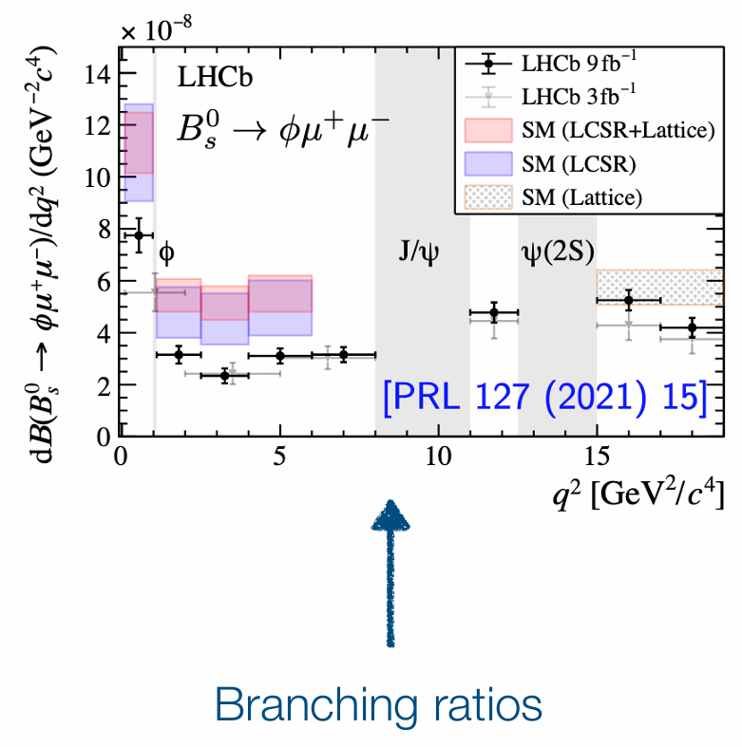
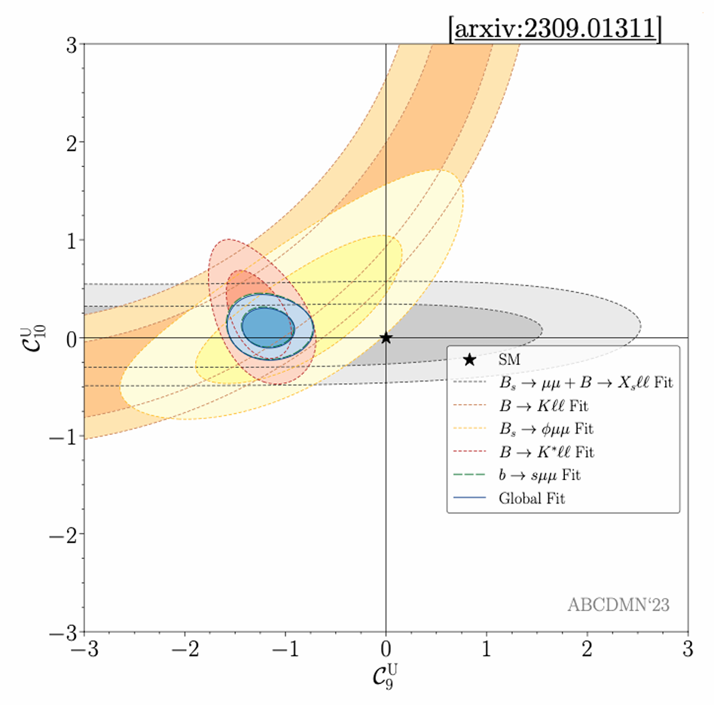
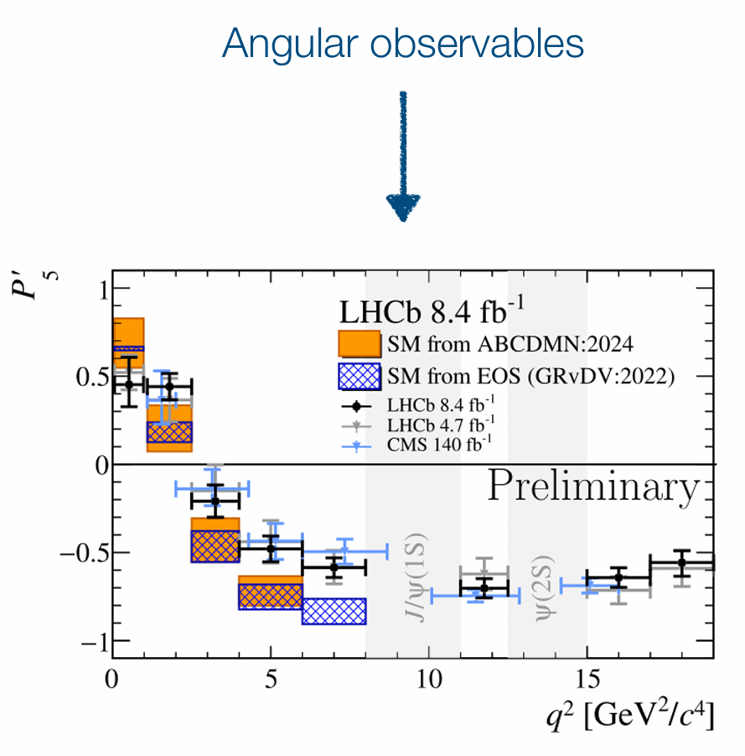
b→sℓℓ anomalies
RESEARCH BACKGROUNDS
Global fits to all these observables point
to a non-SM vector coupling (C9)

Slide 7
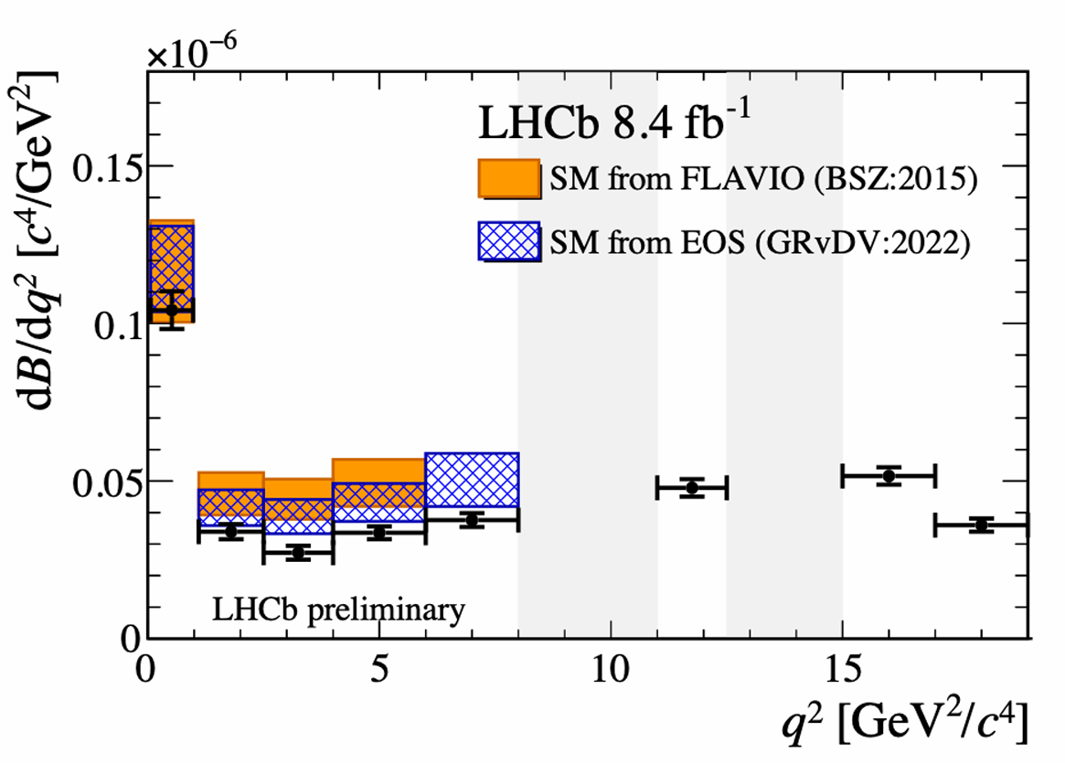
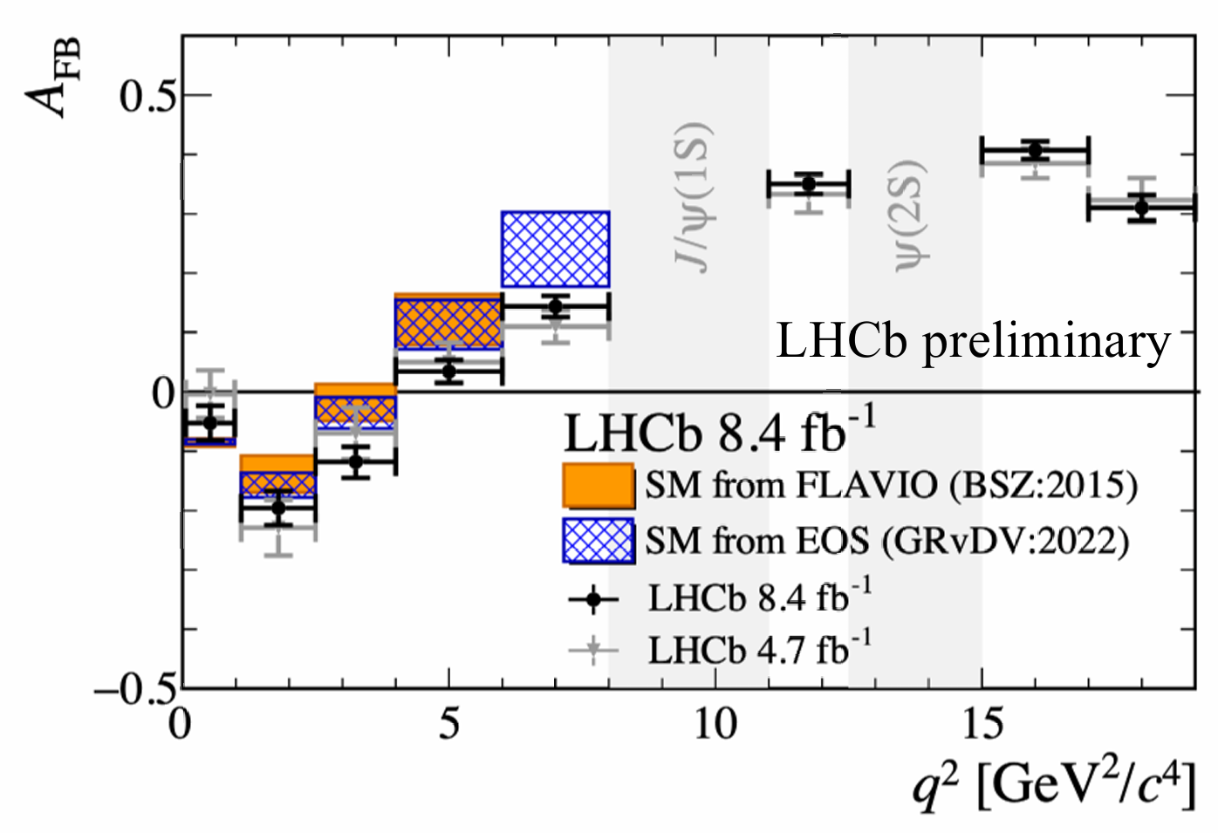

Latest news for $B^{0}→K^{∗0}μ^{+}μ^{−}$
RESEARCH BACKGROUNDS
A comprehensive analysis is re-performed to the LHCb Run1 +Run2 $B^{0}→K^{∗0}μ^{+}μ^{−}$ dataset
The anomaly remains with the increasing sensitivity.
Tensions of 2.5 (2.2) σ and 1.9 (1.7) σ in 2.5-4 and 4-6 GeV²

Slide 8
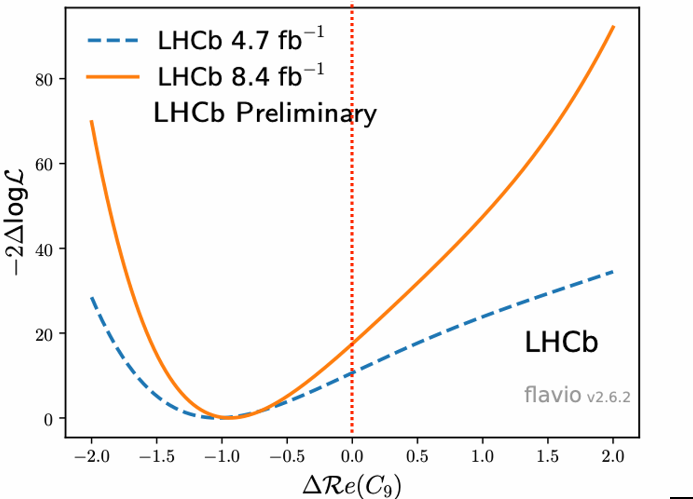
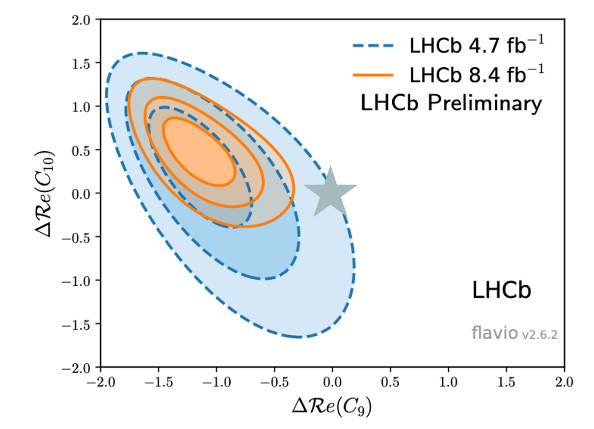
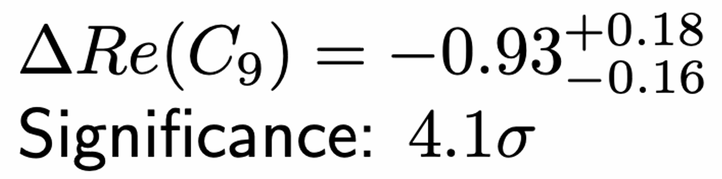
Latest news for $B^{0}→K^{∗0}μ^{+}μ^{−}$
RESEARCH BACKGROUNDS
As expected, deviation most pronounced in C

Slide 9
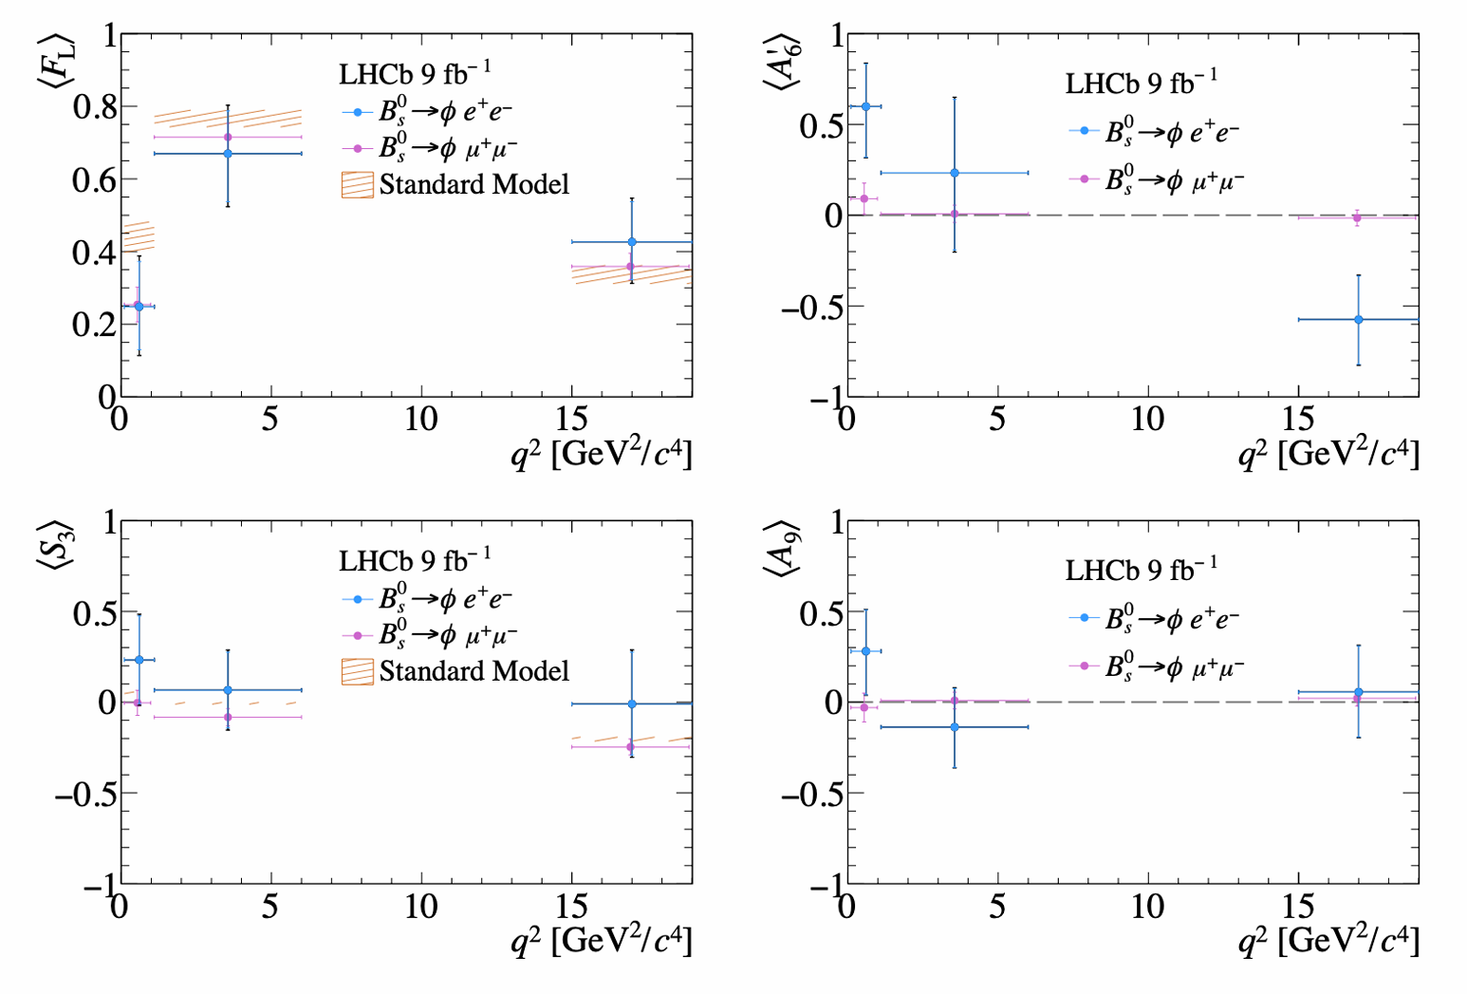
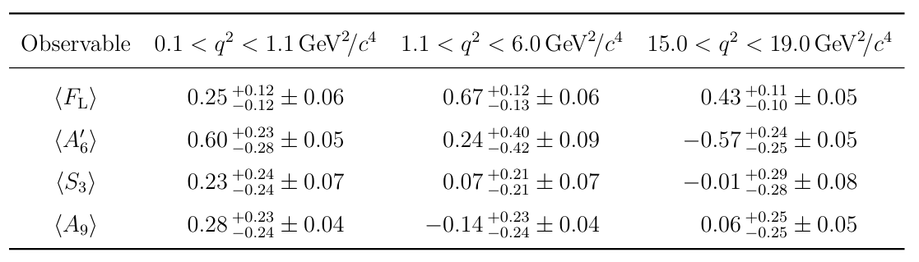
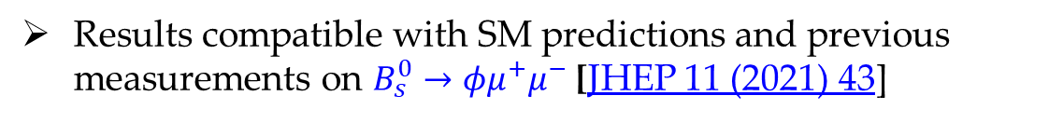
Angular analysis of $B_{s}^{0}→φe^{+}e^{−}$ decay
RESEARCH BACKGROUNDS
Angular analysis of similar decay mode in the low, central and high $q^{2}$ regions, to extract angular coefficients
Results compatible with SM predictions and previous measurements on $B_{s}^{0}→φμ^{+}μ^{−}$ [JHEP 11 (2021) 43]
Statistic limited， require more data for further improvement

Slide 10
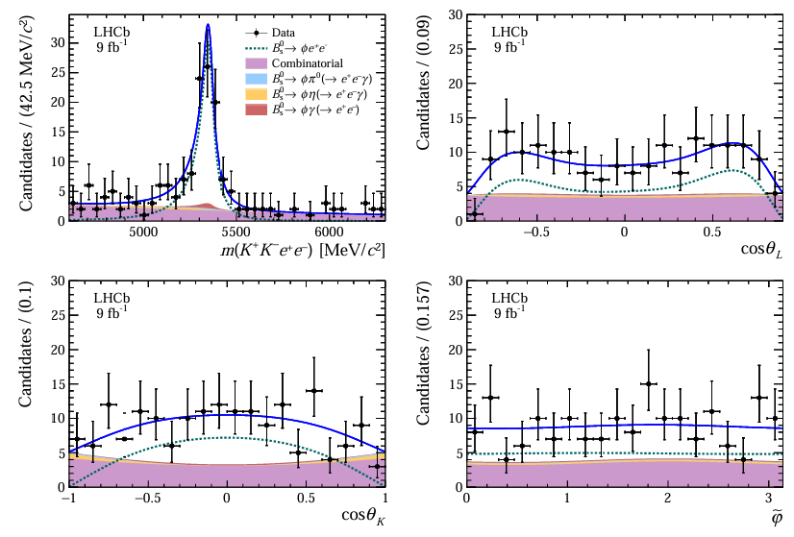
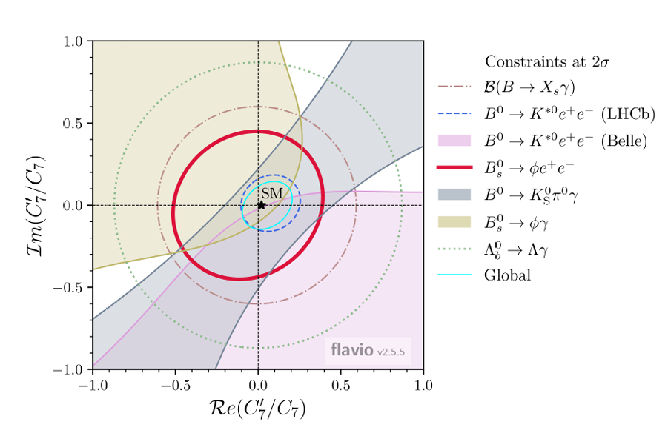
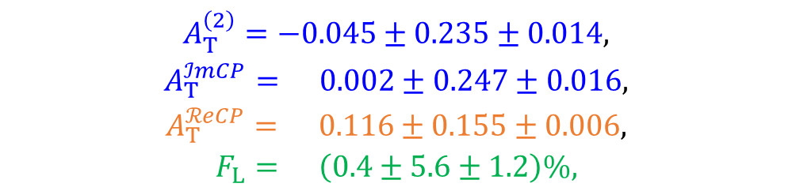
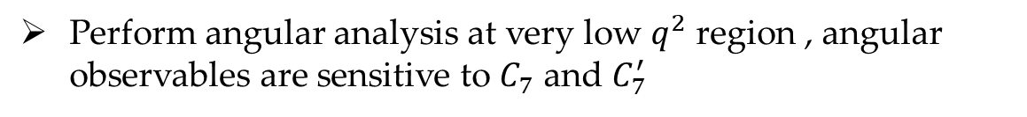
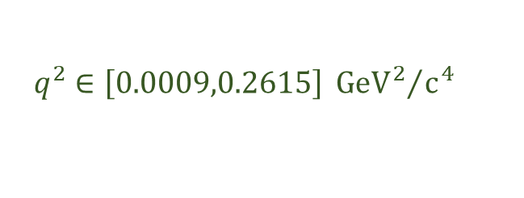
Photon polarisation constraints from $B_{s}^{0}→φe^{+}e^{−}$
RESEARCH BACKGROUNDS
Perform angular analysis at very low $q^{2}$ region , angular observables are sensitive to $C_{7}$ and $C_{7}^{′}$
$$q^{2}∈\left[0.0009,0.2615\right]{{ GeV}^{2}}/{c^{4}}$$
*First observation of $B_{s}^{0}→φe^{+}e^{−}$ decay
Consistent with the SM predictions
$$\begin{matrix}A_{T}^{\left(2\right)}=−0.045±0.235±0.014, \\ A_{T}^{ℐmCP}= 0.002±0.247±0.016, \\ A_{T}^{ℛeCP}= 0.116±0.155±0.006, \\ F_{L}= \left(0.4±5.6±1.2\right)\%,\end{matrix}$$
Sensitive to photon polarisation
Fwd-bkd asymmetry
[JHEP03(2025)047]
Longitudinal polarisation

Slide 11
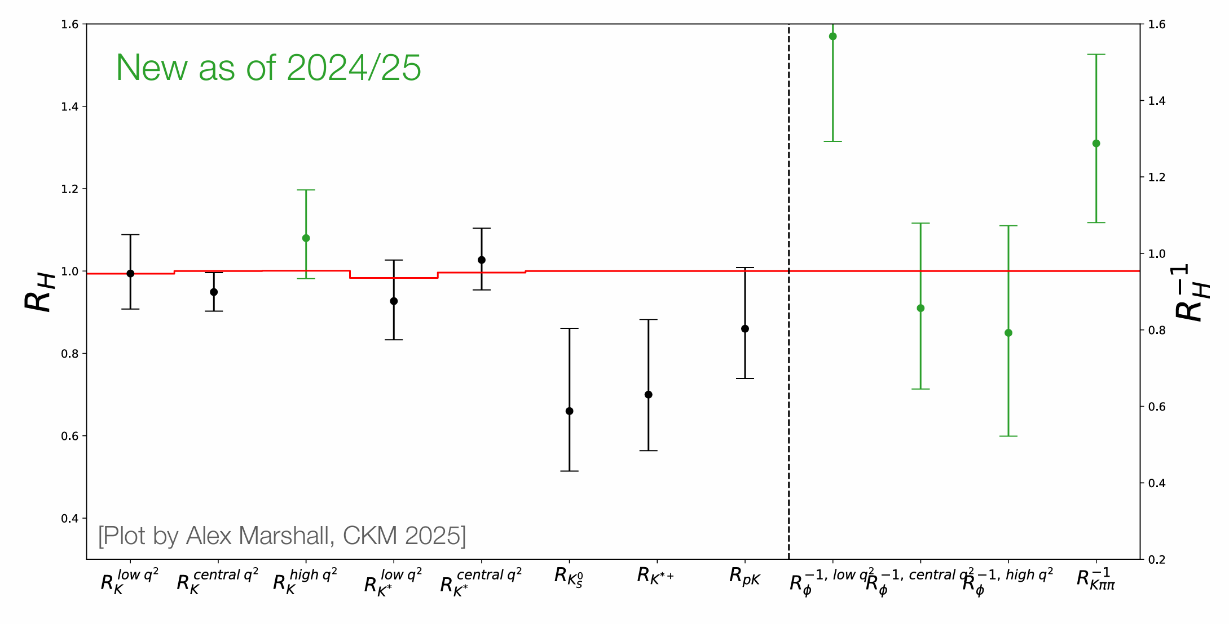
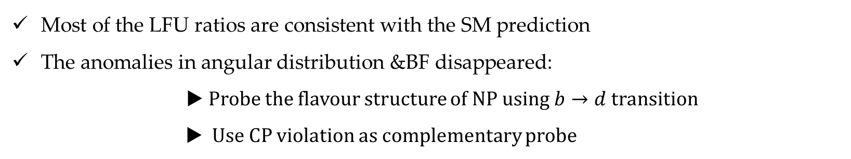
Status of measurement of R values
RESEARCH BACKGROUNDS
Most of the LFU ratios are consistent with the SM prediction
The anomalies in angular distribution &BF disappeared:
▶ Probe the flavour structure of NP using $b→d$ transition
▶ Use CP violation as complementary probe

Slide 12
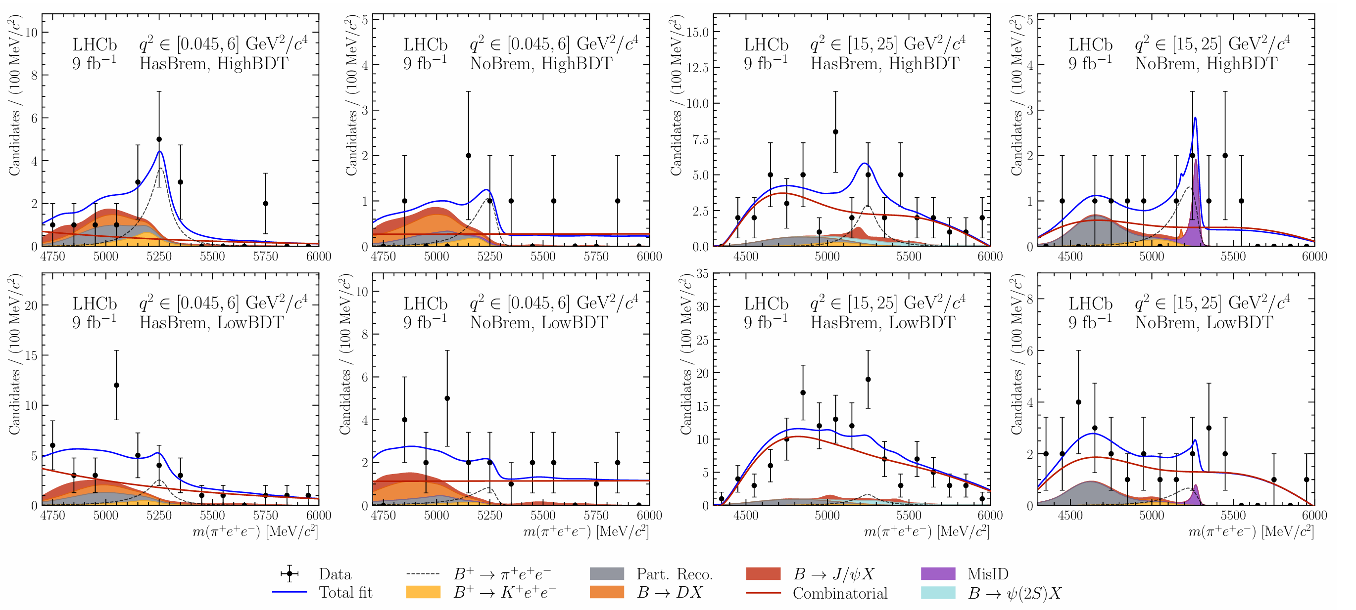
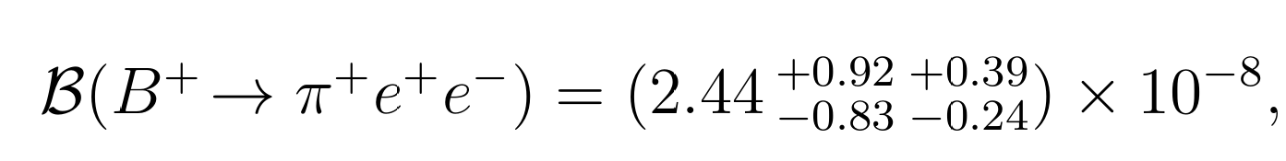
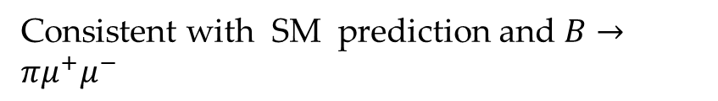

LFU in b→d ℓ⁺ ℓ– decays?
RESEARCH BACKGROUNDS
1. b→d ℓ⁺ ℓ– decays is further suppressed by |V_{td}/V_{ts}| , could serve as complementary probe for LFU searches.
JHEP12(2012)125
2. $B→πμ^{+}μ^{−}$decays was observed using LHCb Run1 dataset with 5.2 sigma significance.
3. No $b→de^{+}e^{−}$ decays observed, the best sensitivity comes from belle with Br < 5.4×10−8 @90%C.L.
First evidence of $B→πe^{+}e^{−}$decays using LHCb Run 1+Run 2 dataset.
Consistent with SM prediction and $B→πμ^{+}μ^{−}$

Slide 13
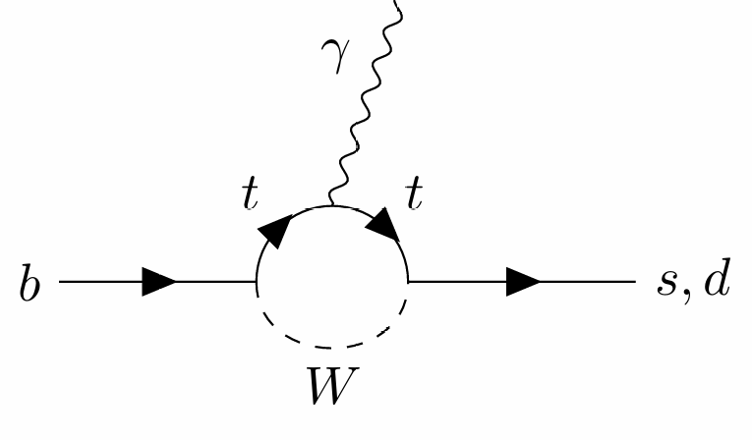

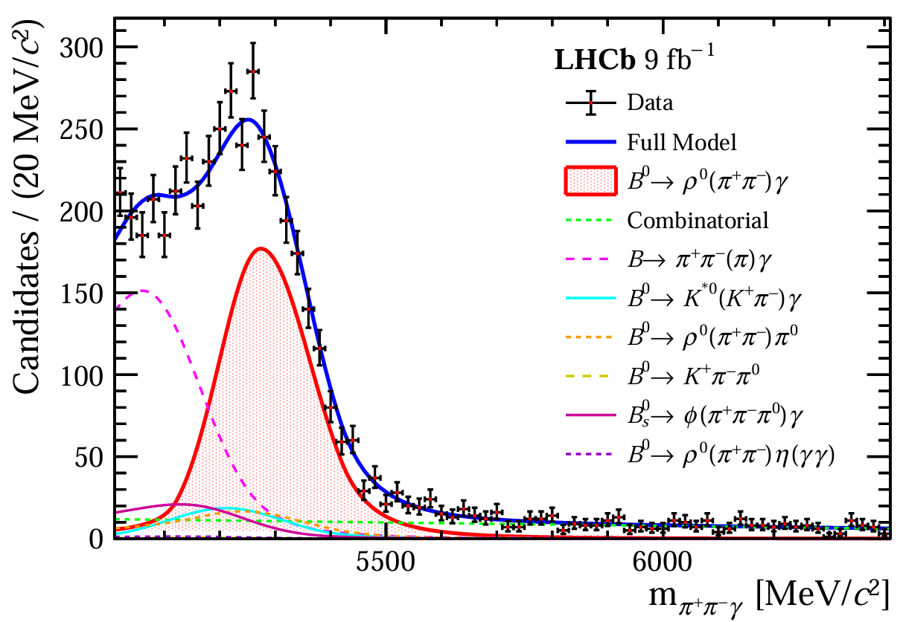

Probing NP in b->dγ
RESEARCH BACKGROUNDS
In analog to b→d ℓ⁺ ℓ– , $b→dγ$ transition could probe the NP
Recent combination in this decay gives
The analysis uses 9 fb-1 of full Run1 + RUn2 data set, and observed 2K signal yields

Slide 14
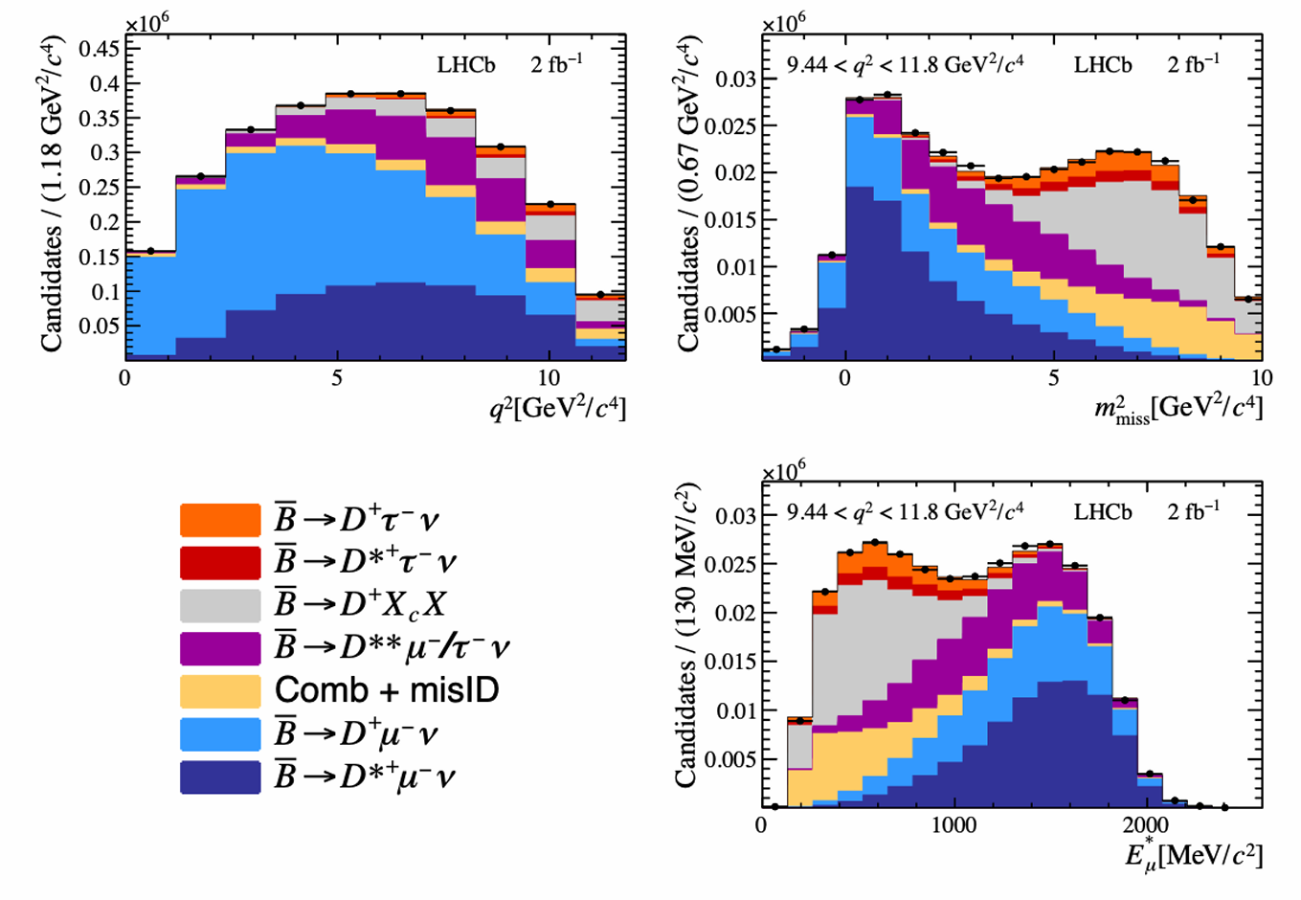
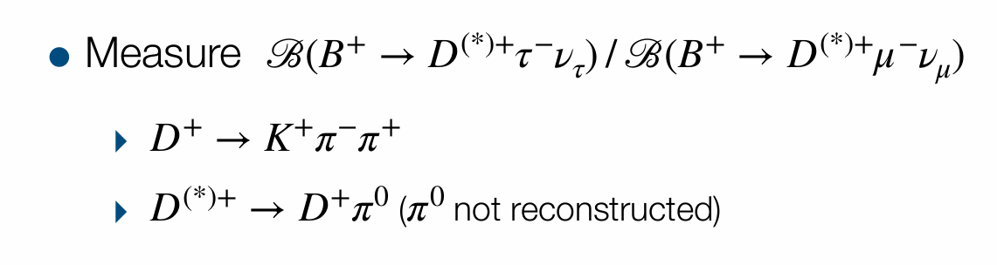
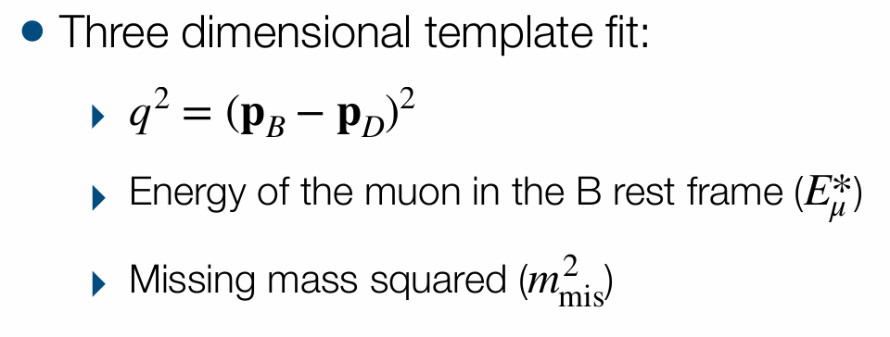
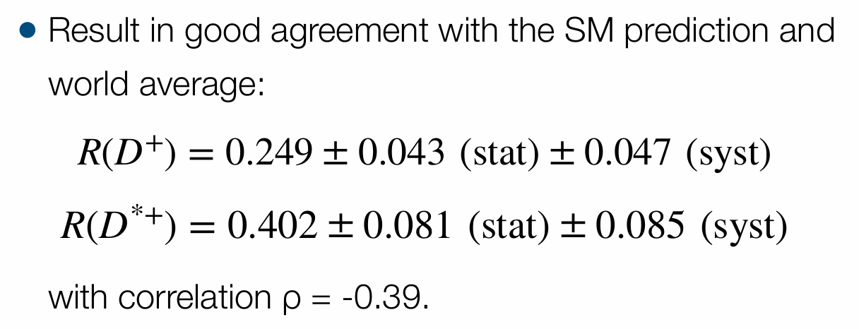
Search for NP in charged current decays
RESEARCH BACKGROUNDS
R(D+) and R(D*+) with muonic τ
PRL 134 (2025) 061801

Slide 15
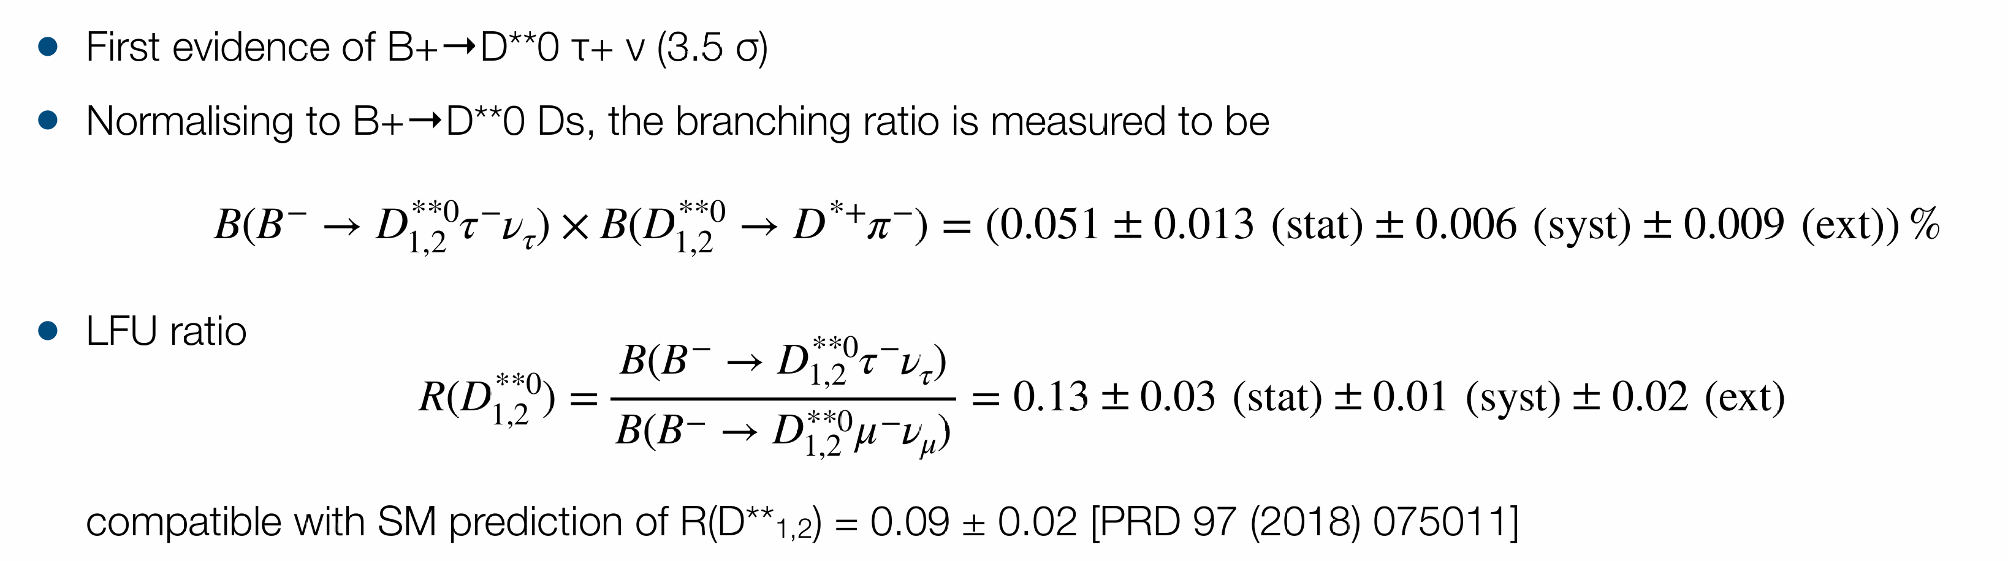
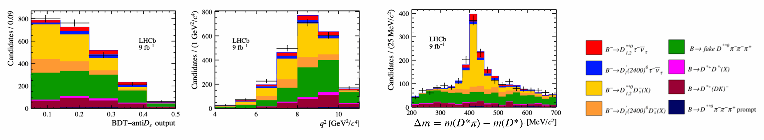
Search for NP in charged current decays
RESEARCH BACKGROUNDS

Slide 16
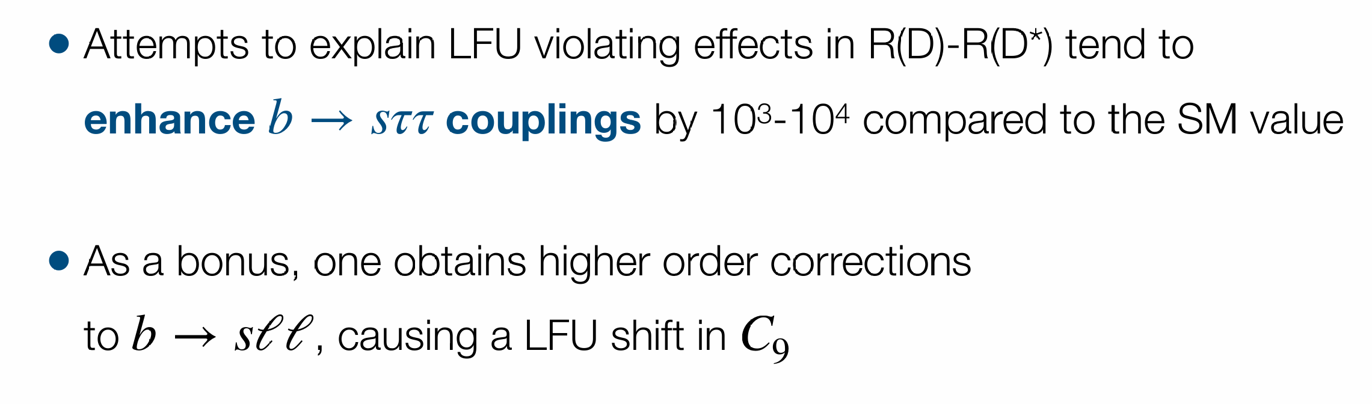
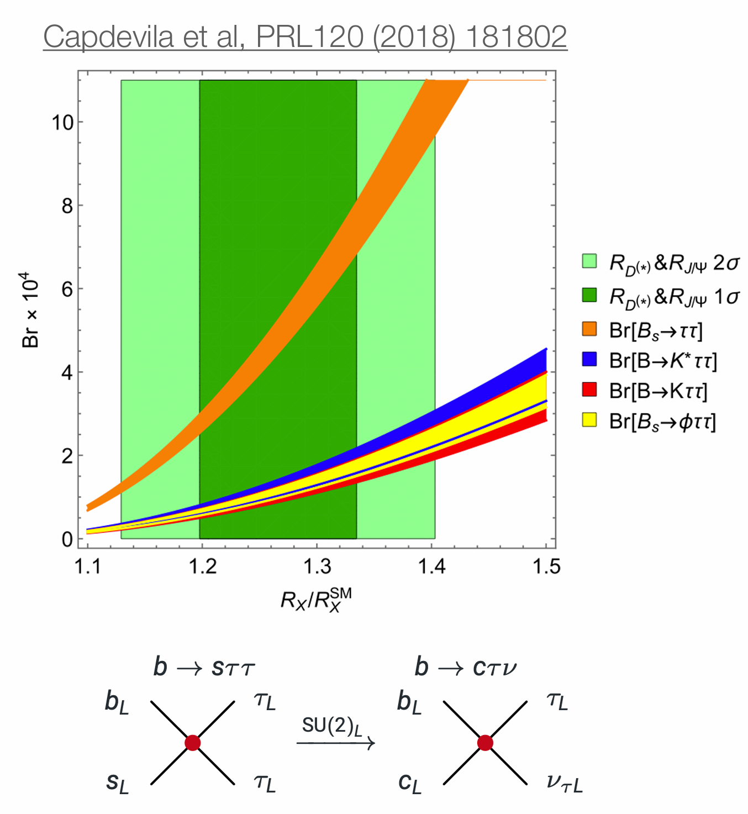
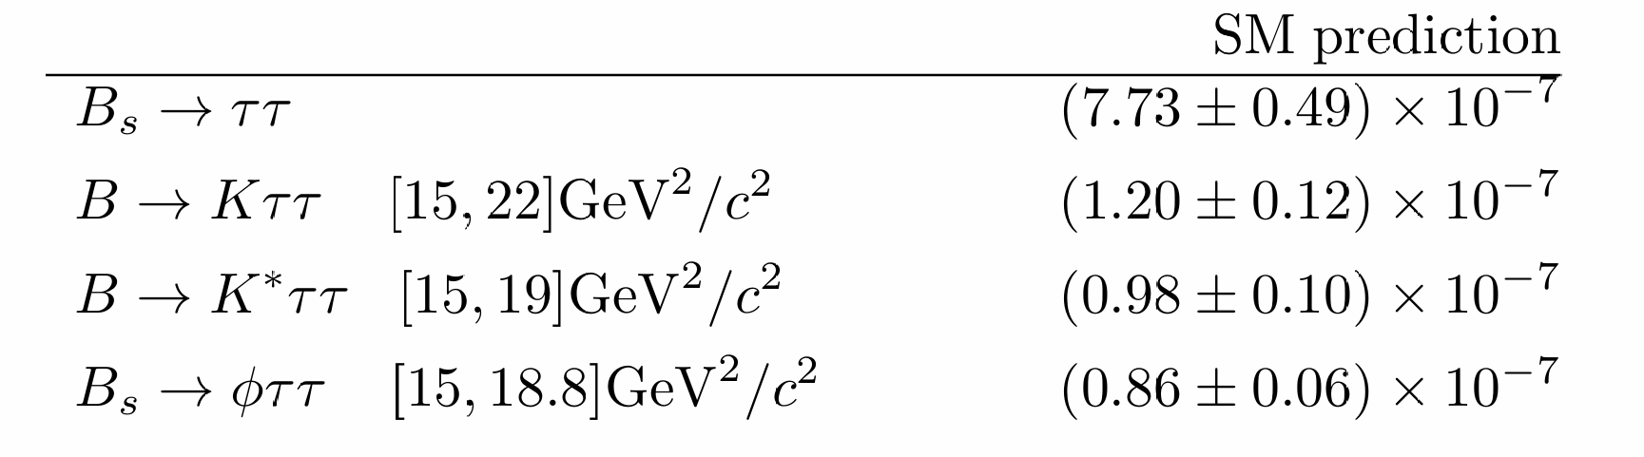
Connection between b→cℓν and b→s ℓ+ℓ– ?
RESEARCH BACKGROUNDS

Slide 17
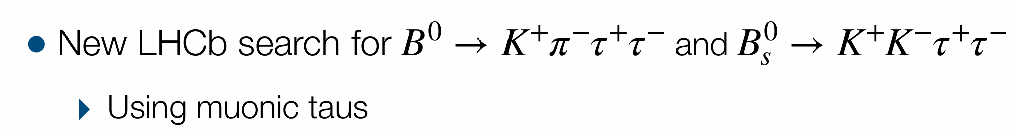
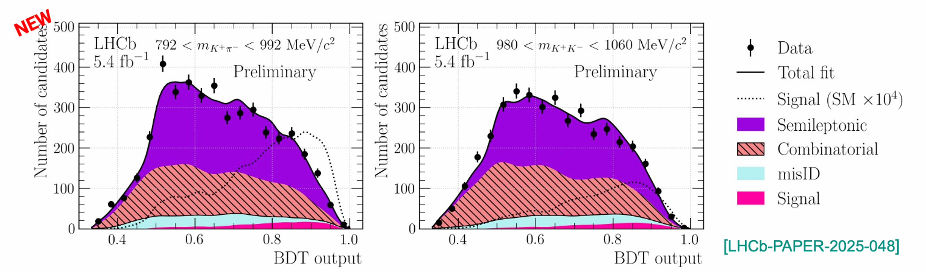
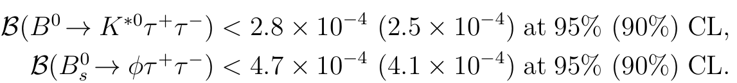
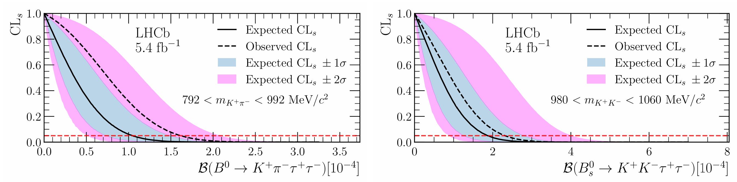
Search for b→s 𝜏⁺ 𝜏– decays
RESEARCH BACKGROUNDS
● No signal is observed, UL is
set as
● Improves by approx a factor ✖10
the recent best limit from Belle
[arxiv: 2504.10042]

Slide 18
2
Hadronic FCNC decays

Slide 19
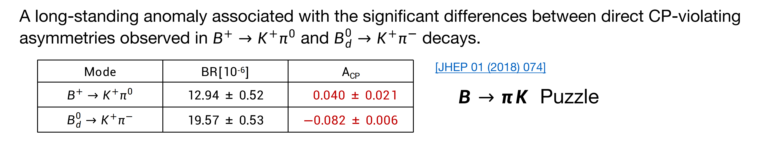
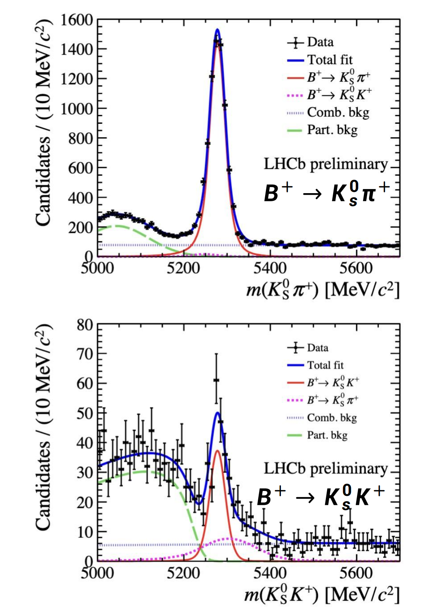
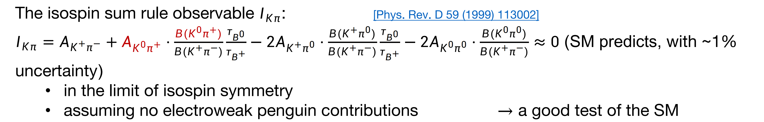
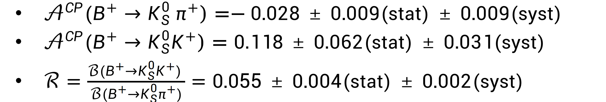

Study of decays $B→Kπ$
RESEARCH BACKGROUNDS

Slide 20

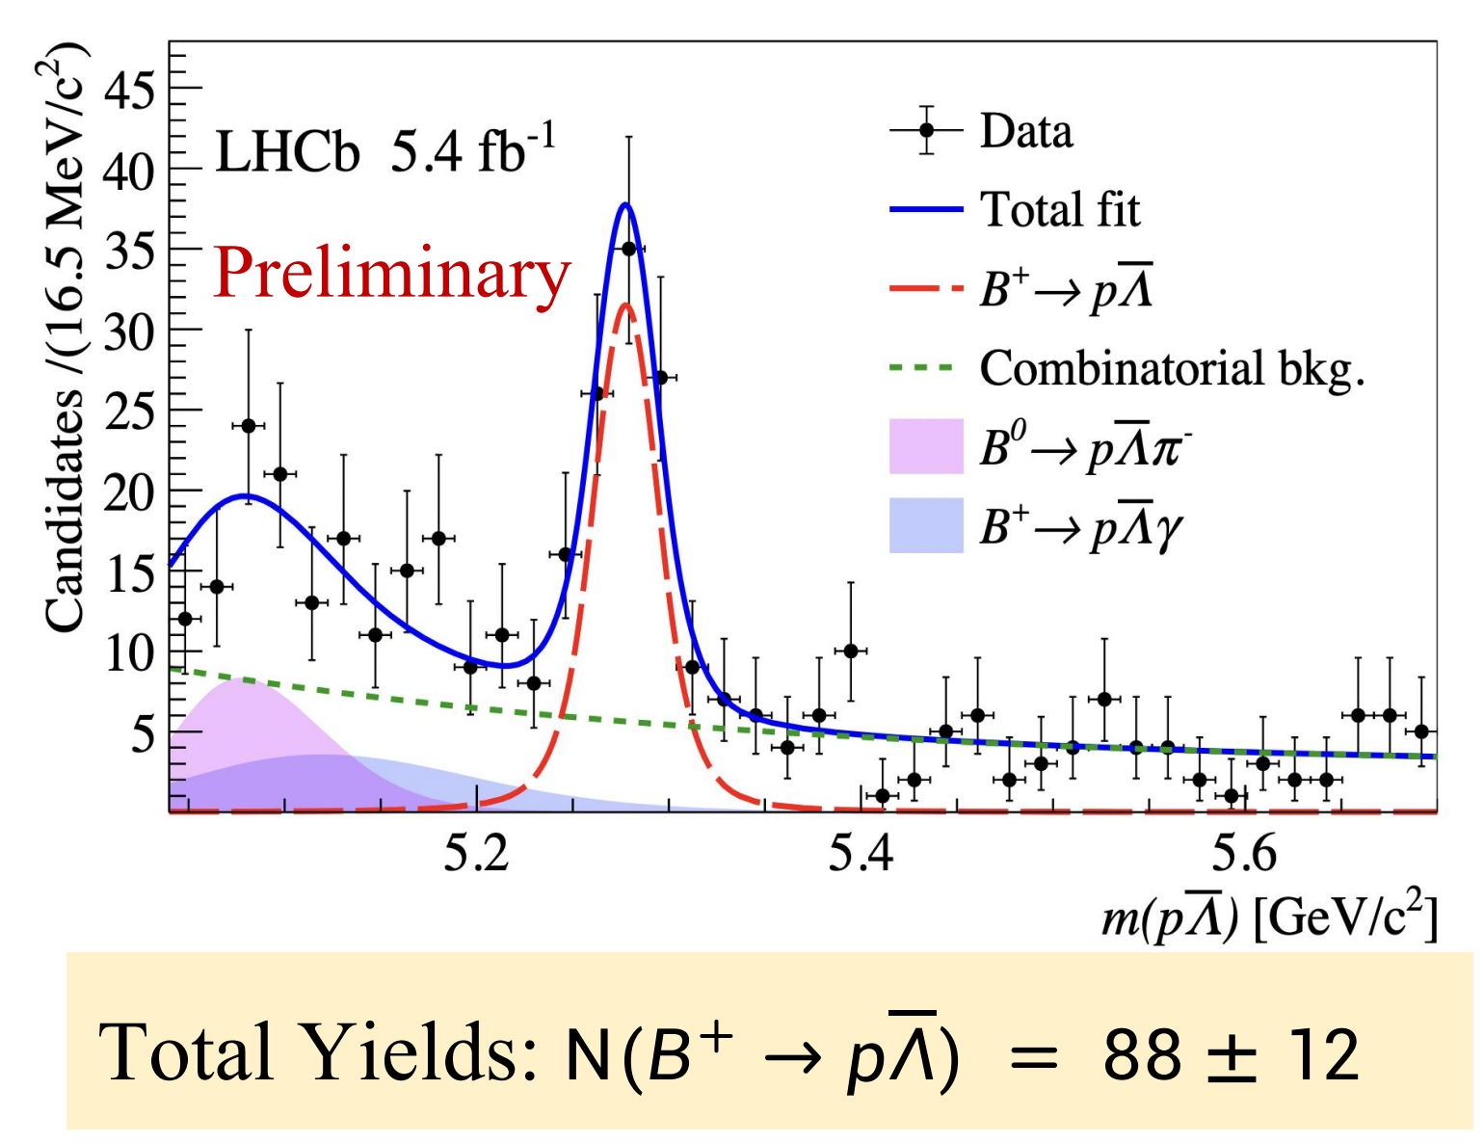
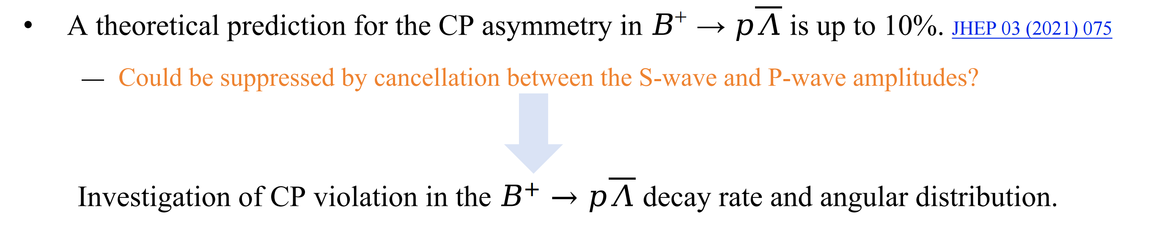
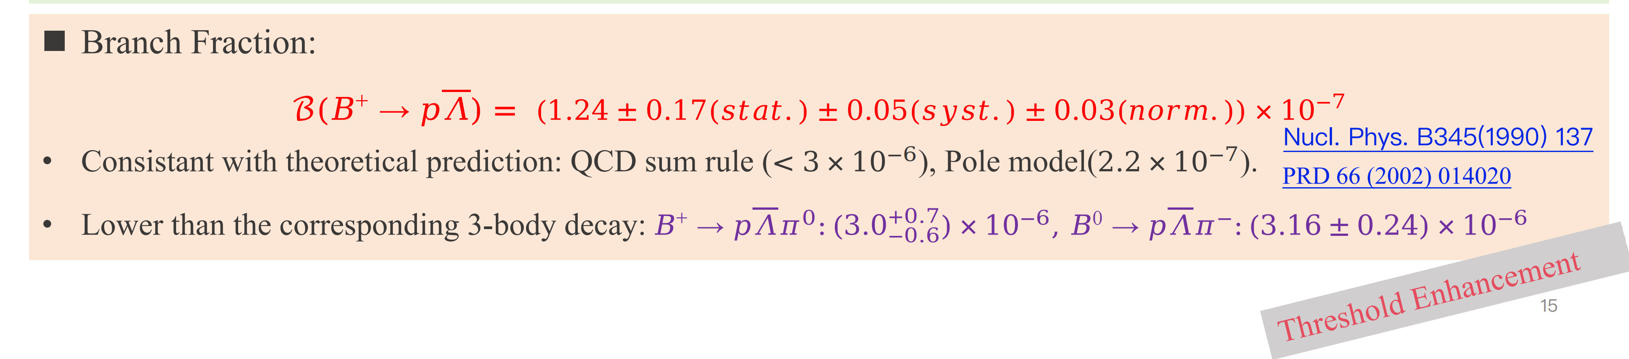

Study of decays $B→pΛ$
RESEARCH BACKGROUNDS

Slide 21




First observation of $B^{+}→Λp\overline{p}p$ decay
RESEARCH BACKGROUNDS

Slide 22
3
VR decays

Slide 23




Search for $Σ^{+}→pμ^{+}μ^{−}$ decays
RESEARCH BACKGROUNDS

Slide 24


Search for $Σ^{+}→pμ^{+}μ^{−}$ decays
RESEARCH BACKGROUNDS
Search for resonances in the dimuon invariant mass distribution
No evidence of resonant structures found
HyperCP anomaly excluded
Distribution compatible with SM prediction
THIS IS THE RAREST BARYON DECAY EVER OBSERVED

Slide 25



Search for $Λ_{c}^{+}→pμ^{+}μ^{−}$ decays
RESEARCH BACKGROUNDS

Slide 26




Search for $Λ_{c}^{+}→pμ^{+}μ^{−}$ decays
RESEARCH BACKGROUNDS

Slide 27


Search for $Λ_{c}^{+}→pμ^{+}μ^{−}$ decays
RESEARCH BACKGROUNDS

Slide 28


Search for $Λ_{c}^{+}→pμ^{+}μ^{−}$ decays
RESEARCH BACKGROUNDS

Slide 29









Search for LFV decays
RESEARCH BACKGROUNDS
Any observation of a charged LFV decay would provide clear evidence for physics beyond the SM
Phys. Rev. D110 (2024) 7
Search for rare decay $B_{s}^{0}→φμτ$
The first limit on this LFV decay
$$ℬ\left(B_{s}^{0}→φμ^{+}τ^{−}\right)<1.0×{10}^{−5}at 90\%CL,$$
$$ℬ\left(B_{s}^{0}→φμ^{+}τ^{−}\right)<1.1×{10}^{−5}at 95\%CL.$$
Search for rare decay $B^{0}→K^{∗0}τ^{±}e^{∓}$
https://arxiv.org/abs/2506.15347
Mass re-fitted including missing neutrino momentum and kinematic constraints
the most stringent upper limits placed on
$b → sτe$transitions

Slide 30



Search for LFV decays
RESEARCH BACKGROUNDS
LFV decay strongly suppressed in SM + 𝜈 oscillations: ℬ(𝜏→𝜇𝜇𝜇) ∼10 [Eur. Phys. J. C (2020) 80:506]
Observation of the decay a clear sign of new physics
Set upper limit on the BF
●constrain theories of physics beyond the SM
●including 𝑍 or leptoquarks, heavy neutrinos… [PRD 92, 054013, PRD 94, 115021], predicting ℬ(𝜏→𝜇𝜇𝜇) ∼𝒪(10⁻¹⁰ −10⁻⁷ )

Slide 31


Search for B meson 0νββ decay
RESEARCH BACKGROUNDS
• Standard Model thinks of neutrinos as Dirac particles
• Majorana nature of neutrinos can be tested with neutrinoless double beta decay (0νββ)
• B mesons can decay in the 0νββ mode
• Sensitivity to intermediate mass non-standard sterile neutrinos

Slide 32


Search for B meson 0νββ decay
RESEARCH BACKGROUNDS

Slide 33
4
Prospects & Conclusions

Slide 34


LHCb detector
RESEARCH BACKGROUNDS
General purpose detector specialized in beauty and charm hadrons
2<η<5
Single-arm forward designed to study the b and c hadrons in forward region
Excellent tracking, momentum resolution and particle identification.
Calorimeters
Hadron ID
Muon ID
Vertexing
Tracking
$δP/P≲$1% for $P<100GeV/c$
97% efficiency for $e/μ$ with 3% pion mis-ID
→ Precisely testing SM
→ Indirectly search for New Physics
Int.J.Mod.Phys.A 30 (2015) 07

Slide 35



Luminosity and publication
RESEARCH BACKGROUNDS
Running Condition
•Run 1: 2011+2012, 7, 8 TeV •Run 2: 2015-2018, 13 TeV
•Run 3: 2022-2025, 13.6 TeV
Run3 data taking ongoing!
๏ Run 1(2011+2012): 3 ${fb}^{−1}$+ Run 2 (2015-2018): 6 ${fb}^{−1}$
๏ 2024: 9.6 ${fb}^{−1}$
Publication in 2025，
- 13 paper submitted to arxiv
- 22 papers published on journal
This talk cannot cover all the recent results; you can refer to the publication page for a full list of LHCb publications
See LHCb ALCM statistics page

Slide 36



Prospects of LHCb physics
RESEARCH BACKGROUNDS
• Run 3 data-taking with Upgrade I LHCb detector ongoing
―×5 luminosity in pp wrt Run 2
―Expect to accumulate 23 ${fb}^{−1}$ data in Run3
• Phase II Upgrade for Run 5 proposed
―Huge increase in sample size expected - stay tuned

Slide 37





What could be expected after upgrades?
RESEARCH BACKGROUNDS
▶ More data than the expectation luminosity of Run 1 & 2 in 2024!
The gain maybe $\sim 2×$ due to removal of hardware trigger
e.g. Replacing TT → SCIFI allow to probe the invisible using SCIFI-only tracking

