Slide 1


Study of rare decays at LHCb
河南师范大学
李可陈
2025/10/31
CLHCP2025，新乡
Notes:
亮亮图文旗舰店https://liangliangtuwen.tmall.com

Slide 2
CONTENTS
1.Study of (semi)leptonic FCNC decays
2. Study of hadronic FCNC decays
3.Searching for NP in VRD processes
4.Prospects and summary

Slide 3
1
FCNC decays and LFU

Slide 4
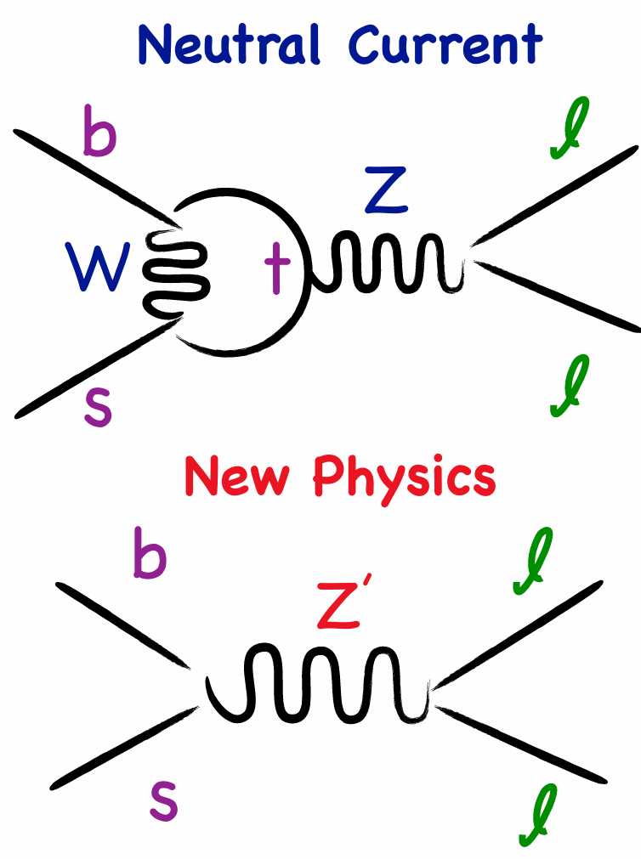
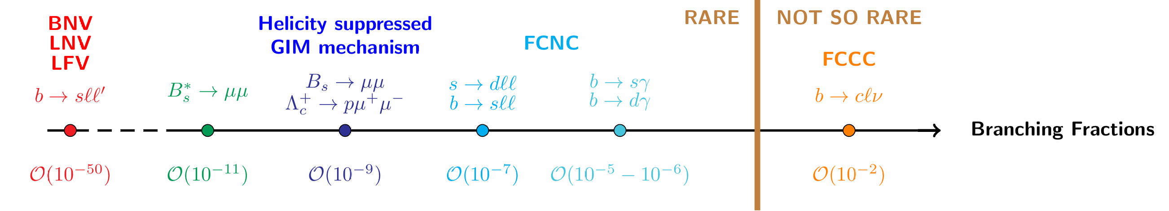
Study of b →sℓℓ transitions at LHCb
RESEARCH BACKGROUNDS
New Physics (NP) beyond SM ⇒ indirect searches: test SM predictions to look for deviations from new virtual particles
SM contribution is suppressed in rare decays ⇒ sensitive to explore NP
How would NP manifest?
Modification of the Branching Fraction
Modification of the Angular Distributions
New sources of CP Violation
How do we measure?
Head count
Head count & projection on angles
Head count ||{ projection on angles||
projection ondecay time}

Slide 5
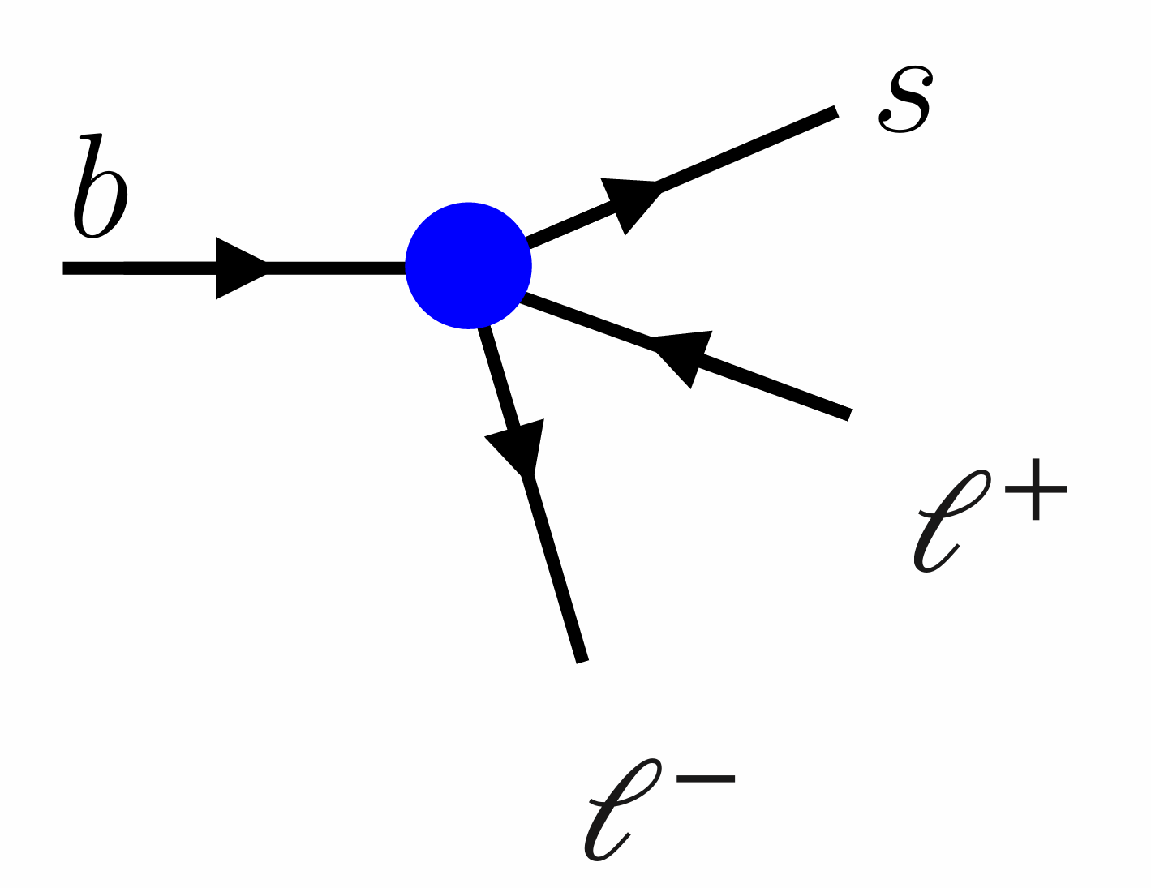
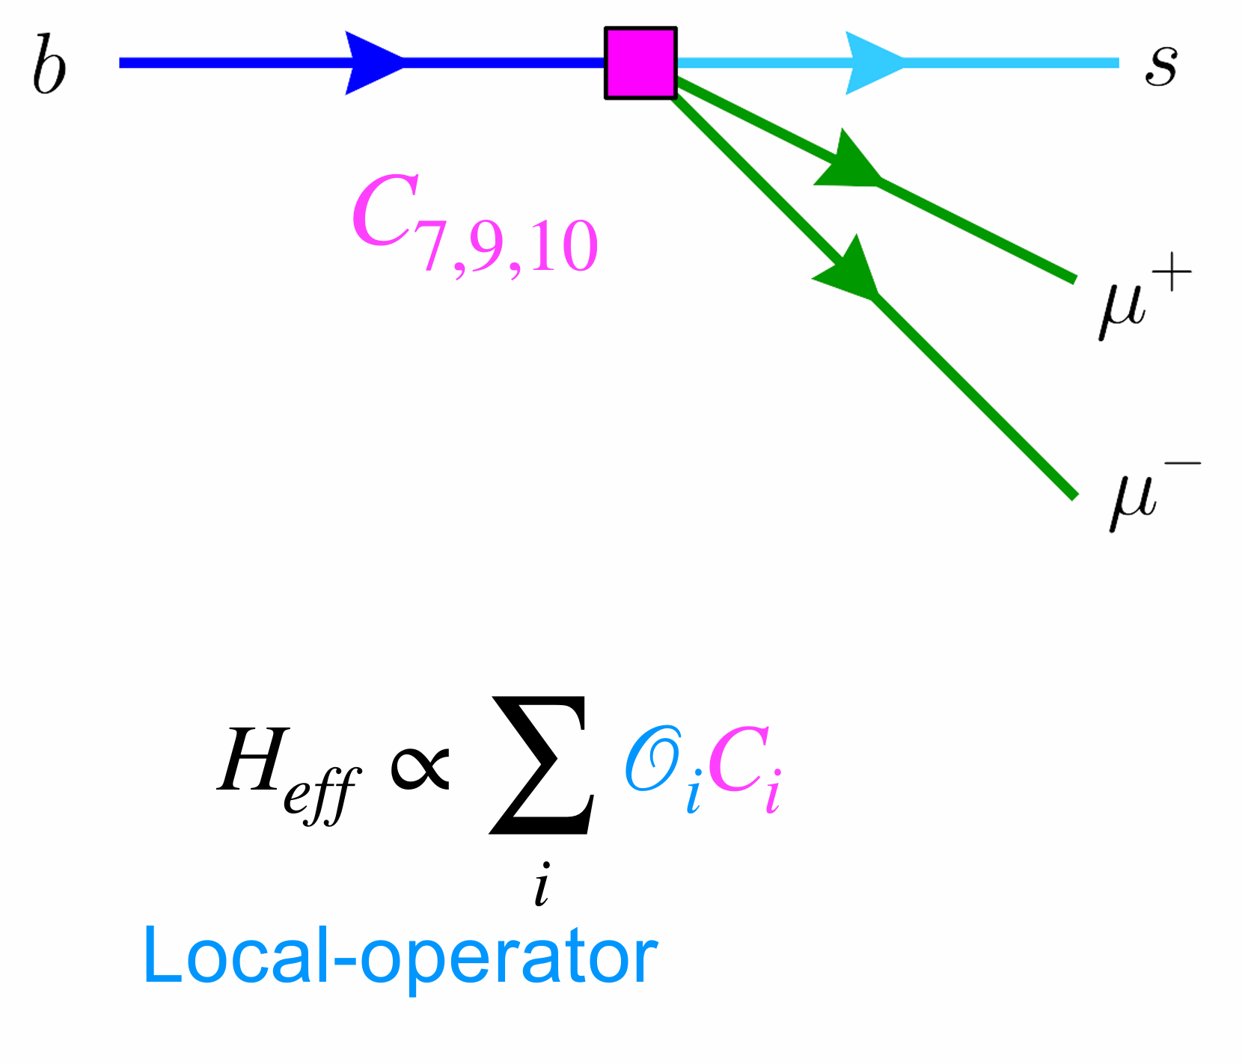
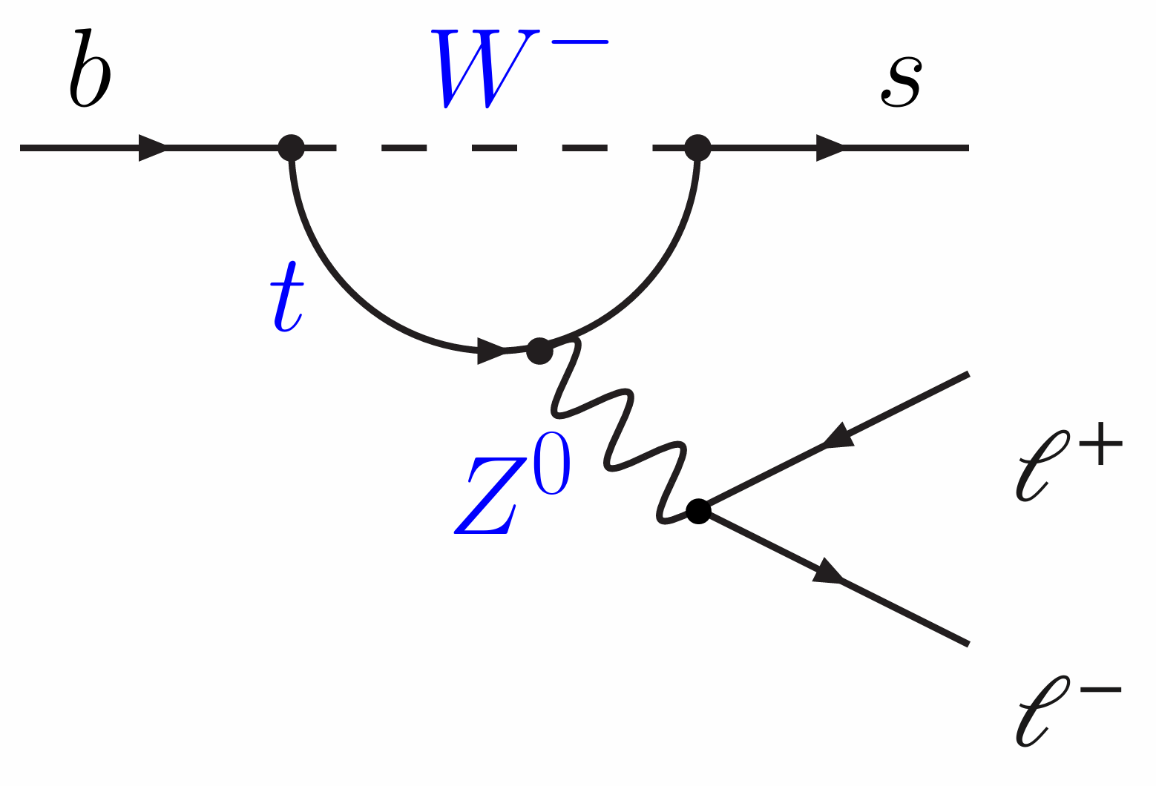
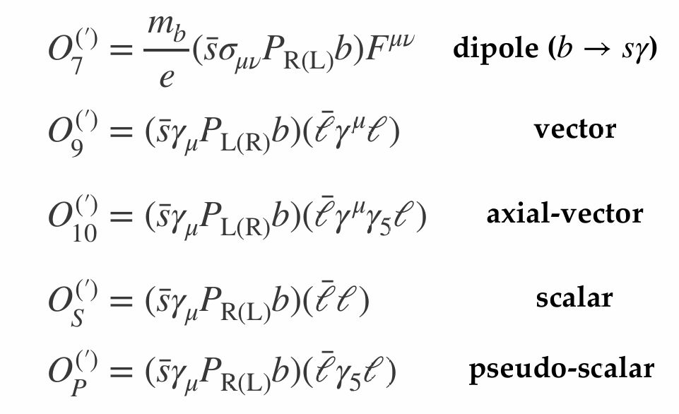
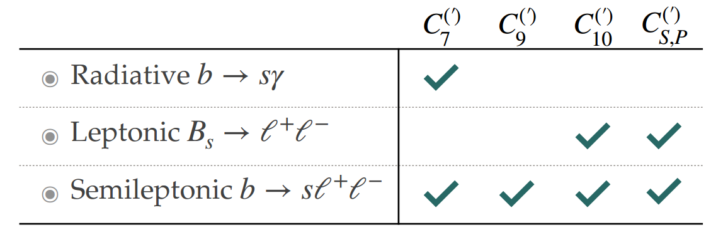
b →sℓℓ decays in theory
RESEARCH BACKGROUNDS
Electro weak penguin (EWP) decays decays in effective theory interpretation
Wilson coefficients are complex values (CPV)
SM is LFU but could be violated
in NP:
Ce ≠ C^{μ} ≠ C^{τ}

Slide 6
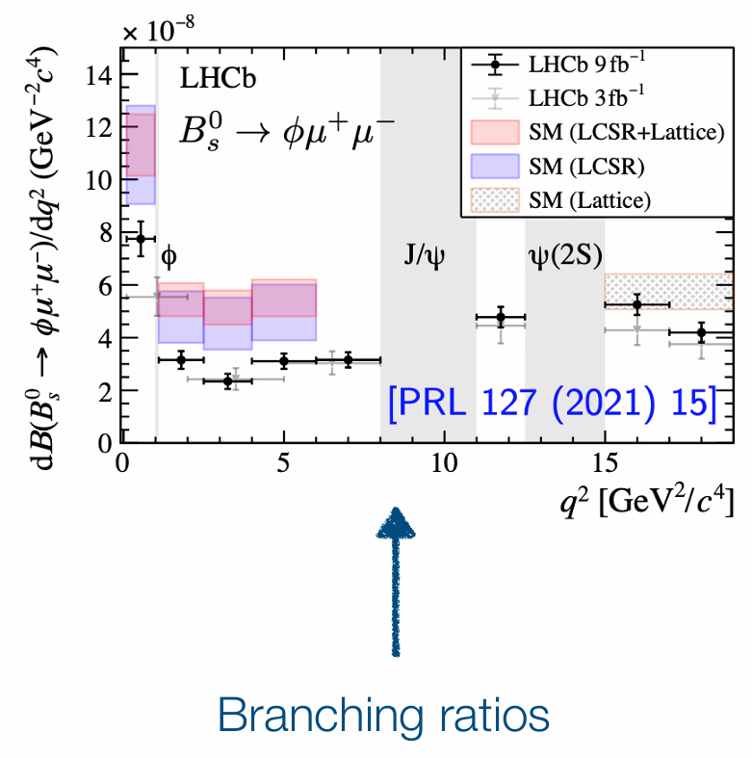
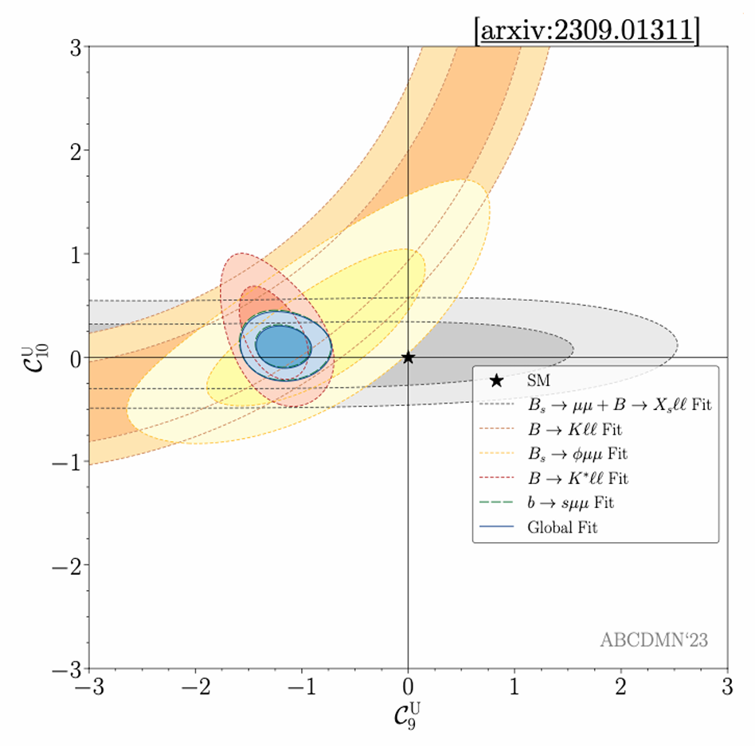
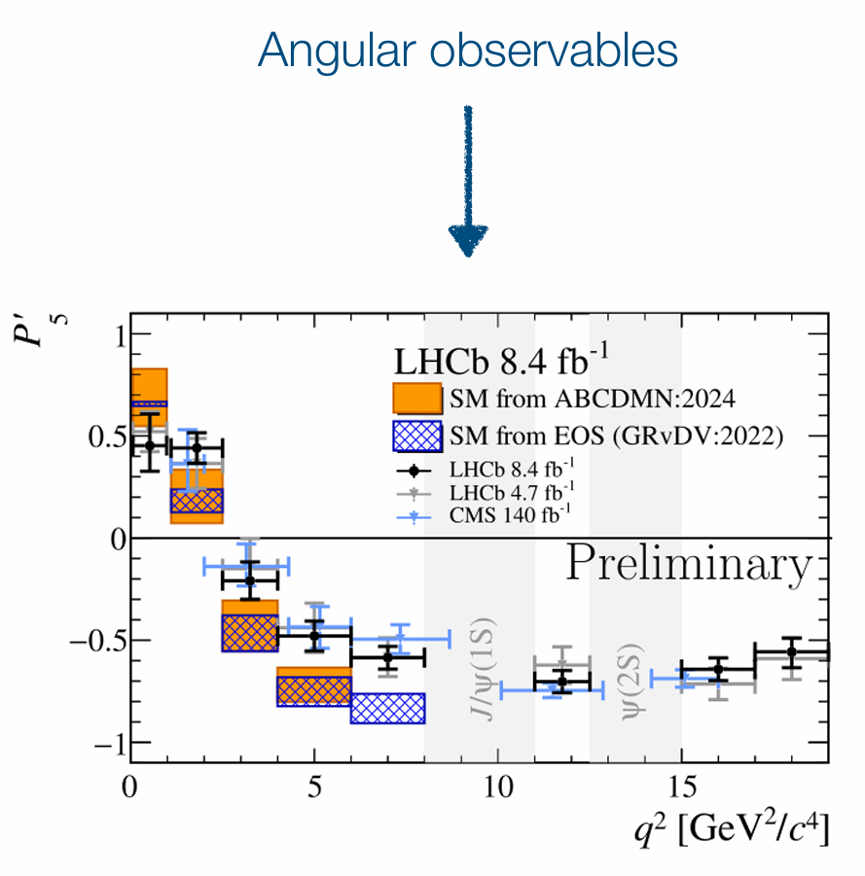
b→sℓℓ anomalies
RESEARCH BACKGROUNDS
Global fits to all these observables point
to a non-SM vector coupling (C9)

Slide 7
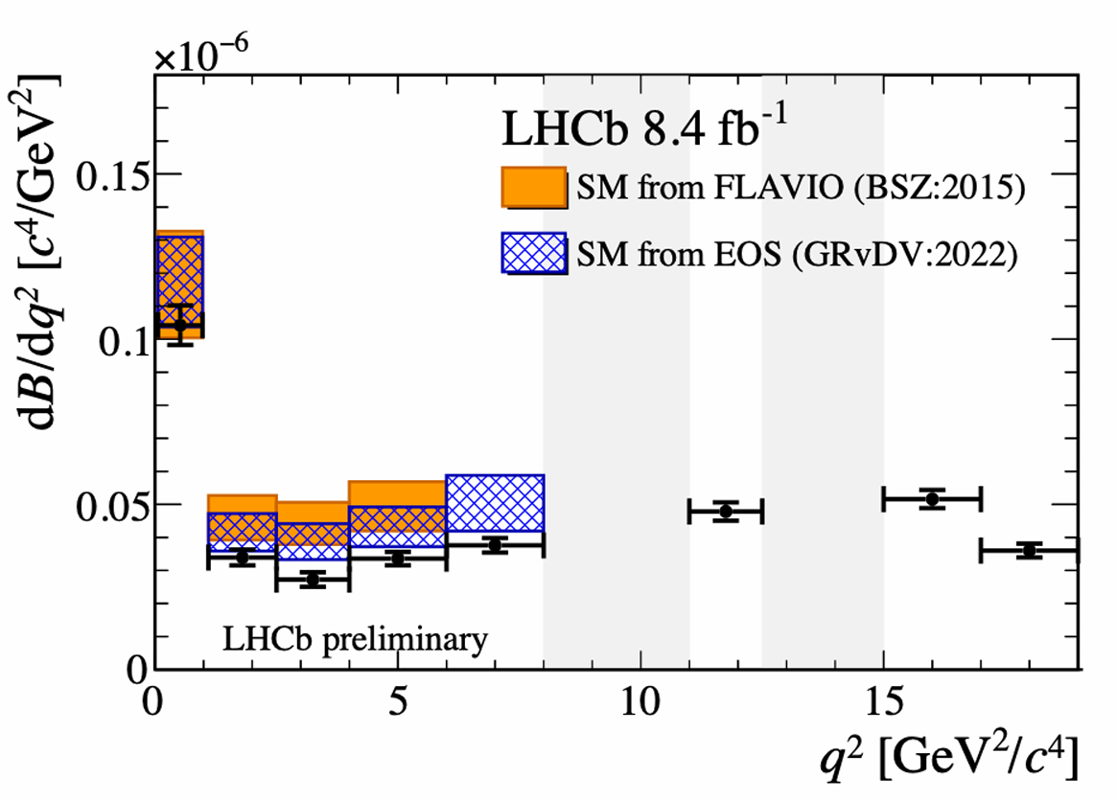
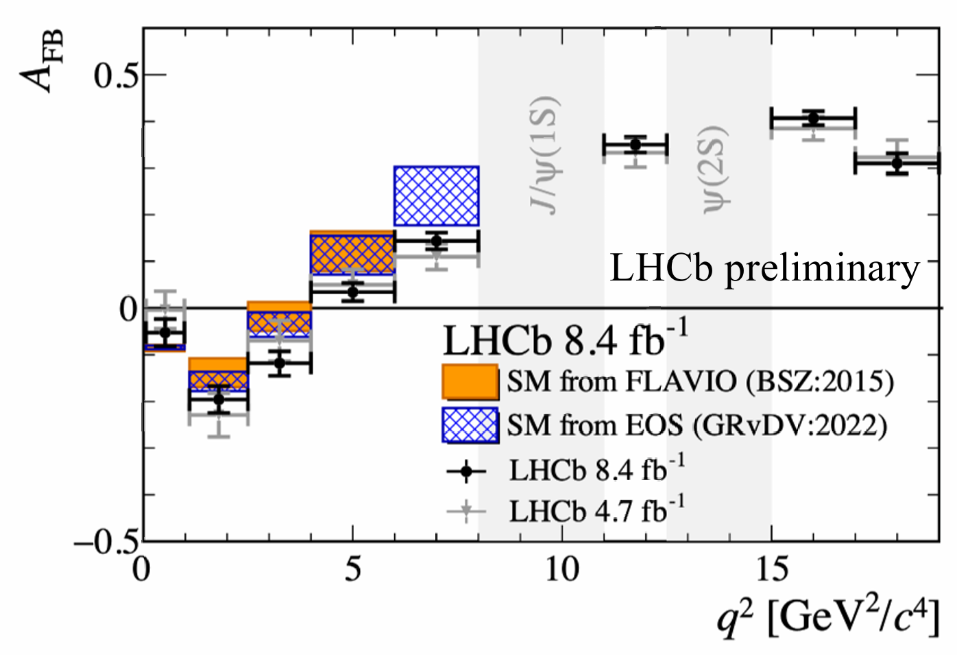

Latest news for $B^{0}→K^{∗0}μ^{+}μ^{−}$
RESEARCH BACKGROUNDS
A comprehensive analysis is re-performed to the LHCb Run1 +Run2 $B^{0}→K^{∗0}μ^{+}μ^{−}$ dataset
The anomaly remains with the increasing sensitivity.
Tensions of 2.5 (2.2) σ and 1.9 (1.7) σ in 2.5-4 and 4-6 GeV²

Slide 8
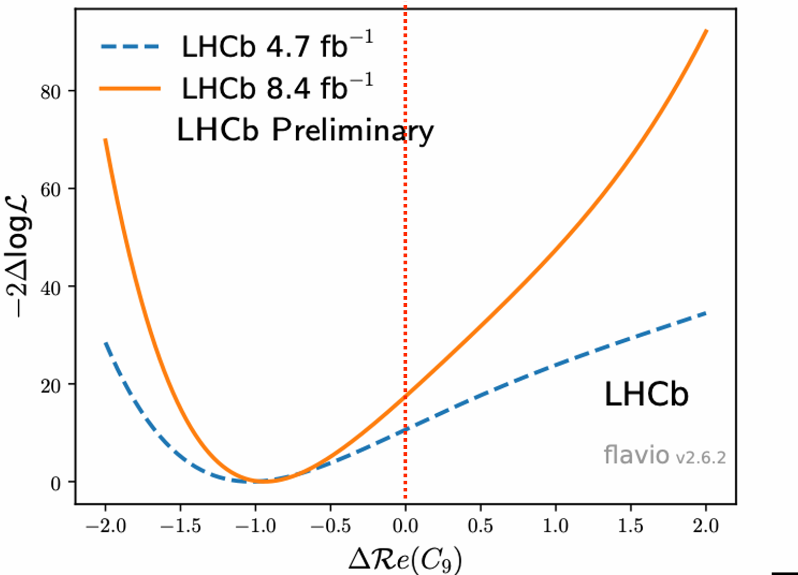
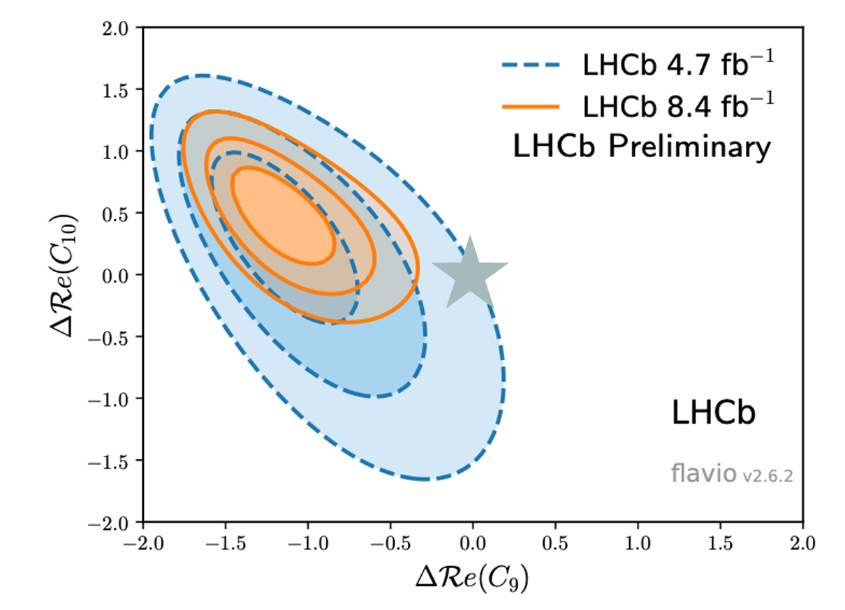
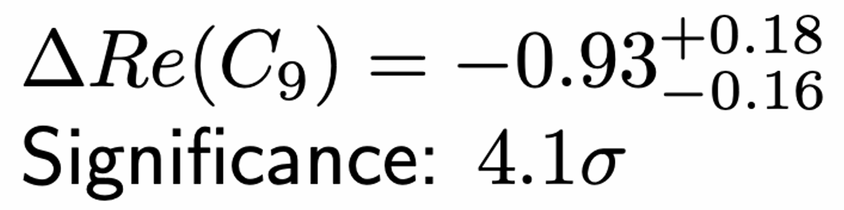
Latest news for $B^{0}→K^{∗0}μ^{+}μ^{−}$
RESEARCH BACKGROUNDS
As expected, deviation most pronounced in C

Slide 9
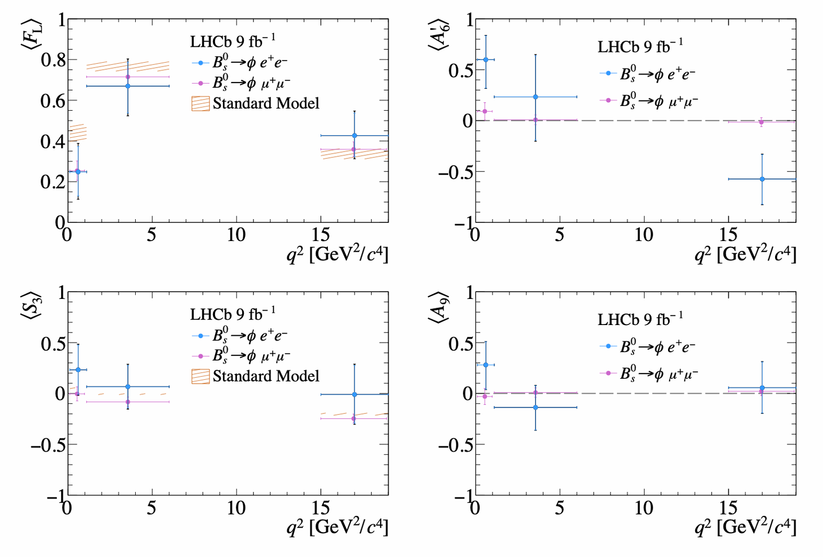
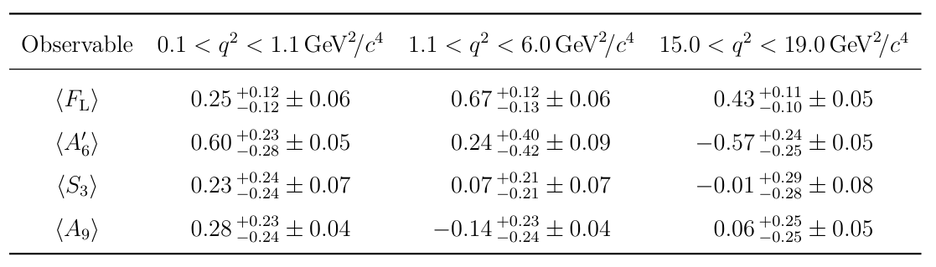
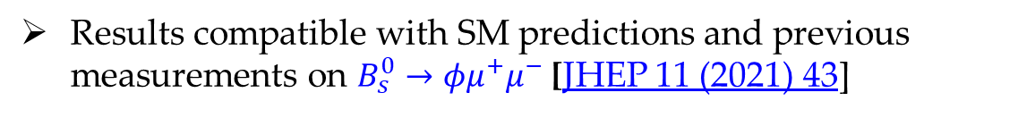
Angular analysis of $B_{s}^{0}→φe^{+}e^{−}$ decay
RESEARCH BACKGROUNDS
Angular analysis of similar decay mode in the low, central and high $q^{2}$ regions, to extract angular coefficients
Results compatible with SM predictions and previous measurements on $B_{s}^{0}→φμ^{+}μ^{−}$ [JHEP 11 (2021) 43]
Statistic limited， require more data for further improvement

Slide 10
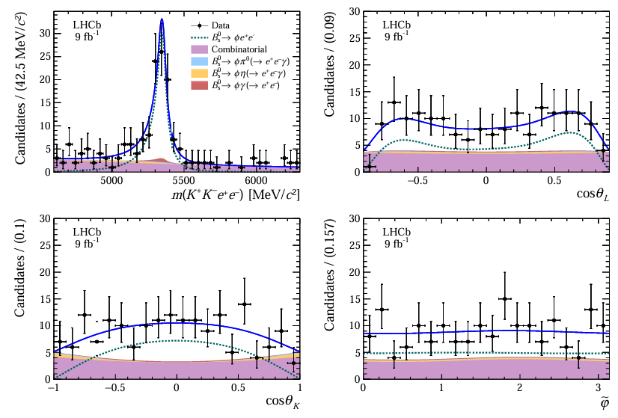
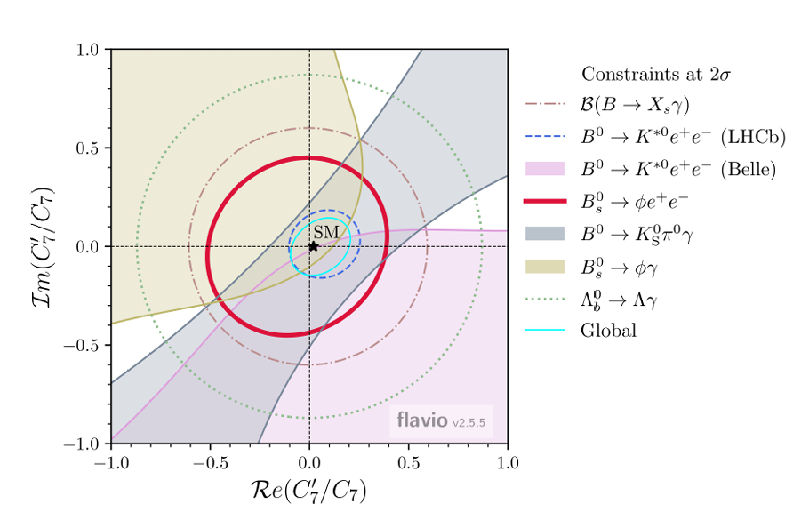
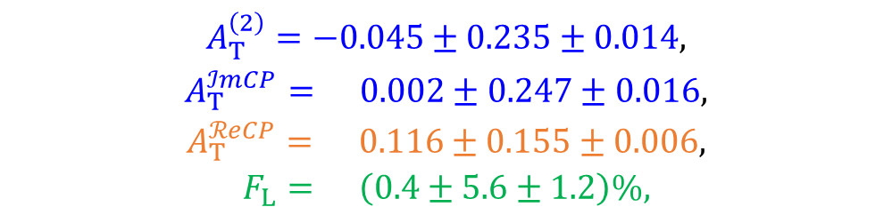
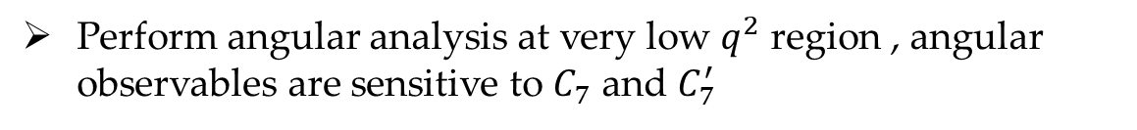
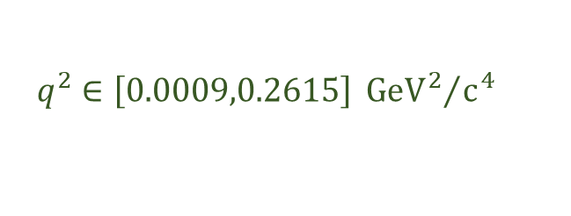
Photon polarisation constraints from $B_{s}^{0}→φe^{+}e^{−}$
RESEARCH BACKGROUNDS
Perform angular analysis at very low $q^{2}$ region , angular observables are sensitive to $C_{7}$ and $C_{7}^{′}$
$$q^{2}∈\left[0.0009,0.2615\right]{{ GeV}^{2}}/{c^{4}}$$
*First observation of $B_{s}^{0}→φe^{+}e^{−}$ decay
Consistent with the SM predictions
$$\begin{matrix}A_{T}^{\left(2\right)}=−0.045±0.235±0.014, \\ A_{T}^{ℐmCP}= 0.002±0.247±0.016, \\ A_{T}^{ℛeCP}= 0.116±0.155±0.006, \\ F_{L}= \left(0.4±5.6±1.2\right)\%,\end{matrix}$$
Sensitive to photon polarisation
Fwd-bkd asymmetry
[JHEP03(2025)047]
Longitudinal polarisation

Slide 11
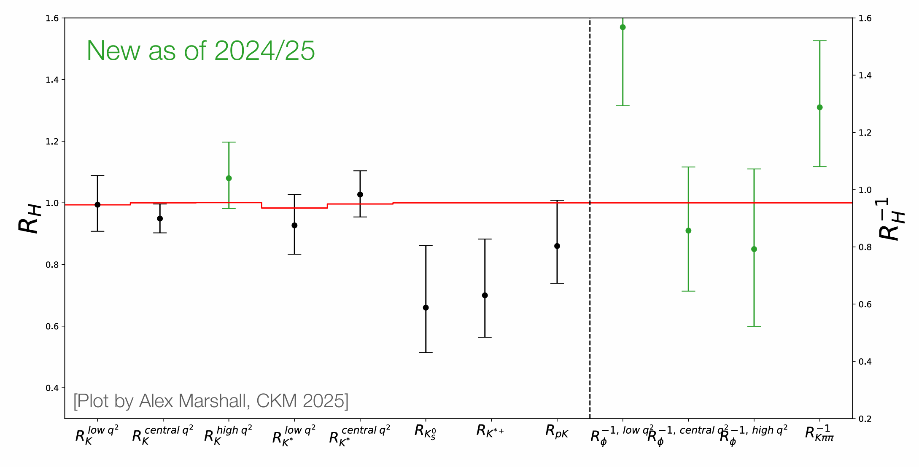
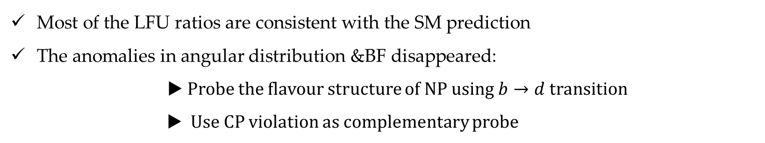
Status of measurement of R values
RESEARCH BACKGROUNDS
Most of the LFU ratios are consistent with the SM prediction
The anomalies in angular distribution &BF disappeared:
▶ Probe the flavour structure of NP using $b→d$ transition
▶ Use CP violation as complementary probe

Slide 12
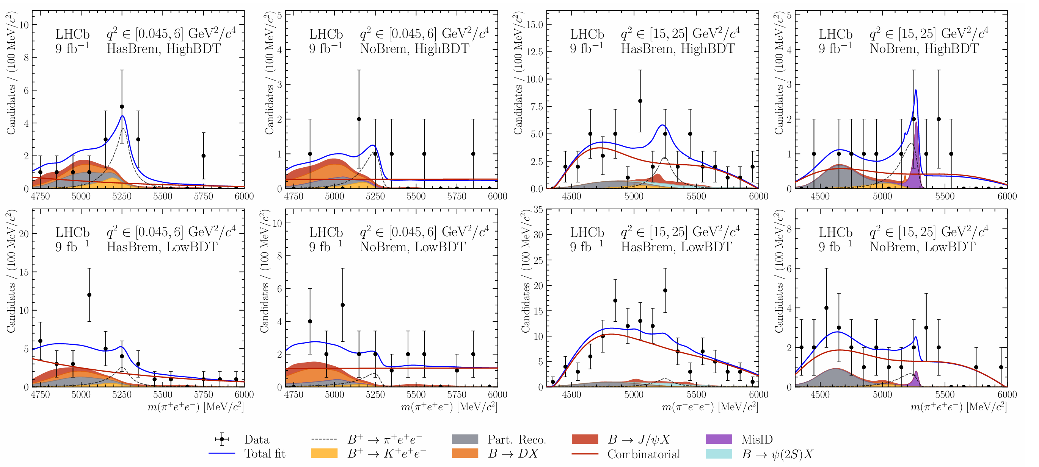
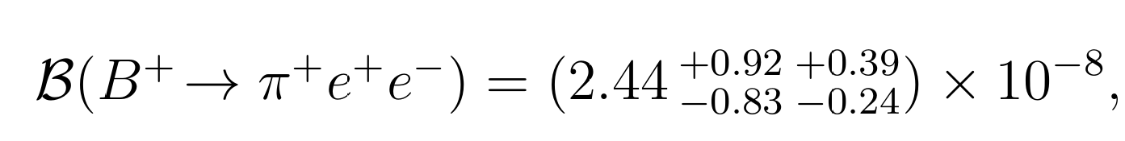
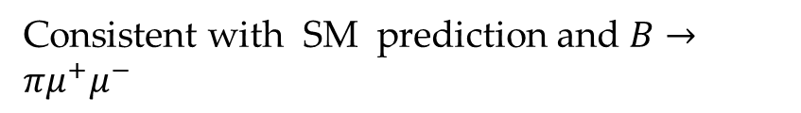

LFU in b→d ℓ⁺ ℓ– decays?
RESEARCH BACKGROUNDS
1. b→d ℓ⁺ ℓ– decays is further suppressed by |V_{td}/V_{ts}| , could serve as complementary probe for LFU searches.
JHEP12(2012)125
2. $B→πμ^{+}μ^{−}$decays was observed using LHCb Run1 dataset with 5.2 sigma significance.
3. No $b→de^{+}e^{−}$ decays observed, the best sensitivity comes from belle with Br < 5.4×10−8 @90%C.L.
First evidence of $B→πe^{+}e^{−}$decays using LHCb Run 1+Run 2 dataset.
Consistent with SM prediction and $B→πμ^{+}μ^{−}$

Slide 13
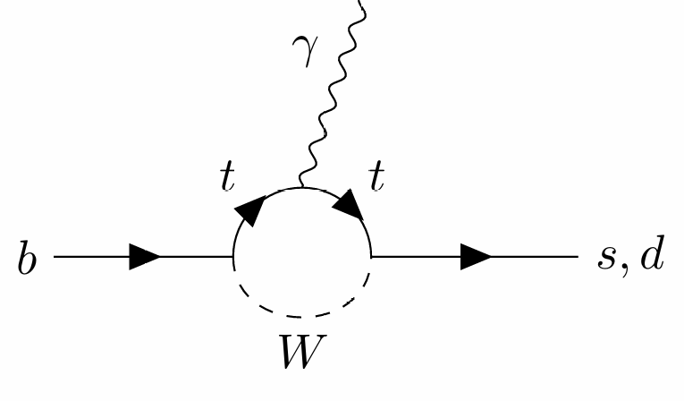


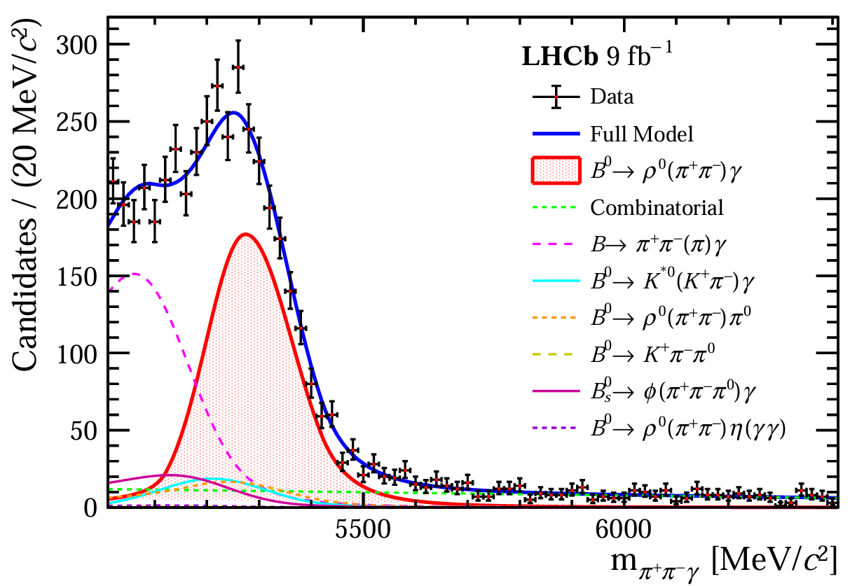

Probing NP in 𝑏→𝑑𝛾
RESEARCH BACKGROUNDS
In analog to b→d ℓ⁺ ℓ– , $b→dγ$ transition could probe the NP
Recent combination in this decay gives
The analysis uses 9 fb-1 of full Run1 + Run2 data set, and observed 2K signal yields
$$m(π^{+}π^{−})∈\left(630,920\right)MeV/c^{2}$$
Consistent with the current world average and the most precise to date
Amplitude analyses planned to constrain the resonant $ρ^{0}$and $K^{∗0}$contributions over wider $π^{+}π^{−}$ mass ranges

Slide 14
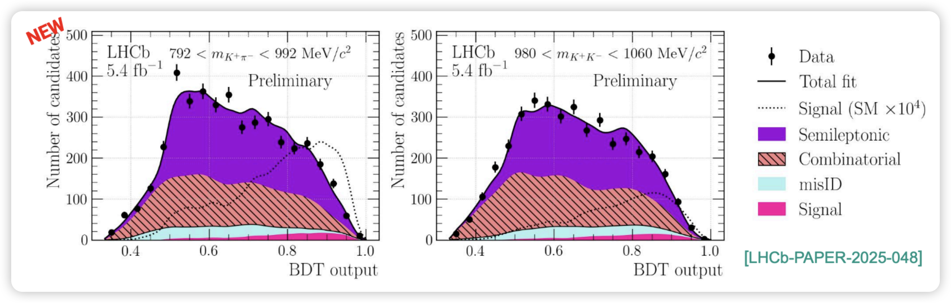
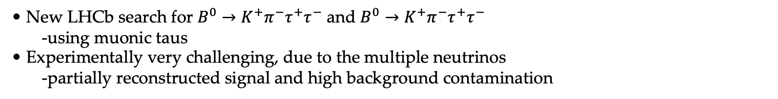
Searching for b
RESEARCH BACKGROUNDS
• New LHCb search for $B^{0}→K^{+}π^{−}τ^{+}τ^{−}$ and $B^{0}→K^{+}π^{−}τ^{+}τ^{−}$
-using muonic taus
• Experimentally very challenging, due to the multiple neutrinos
-partially reconstructed signal and high background contamination
No signal is observed

Slide 15
2
Hadronic FCNC decays

Slide 16
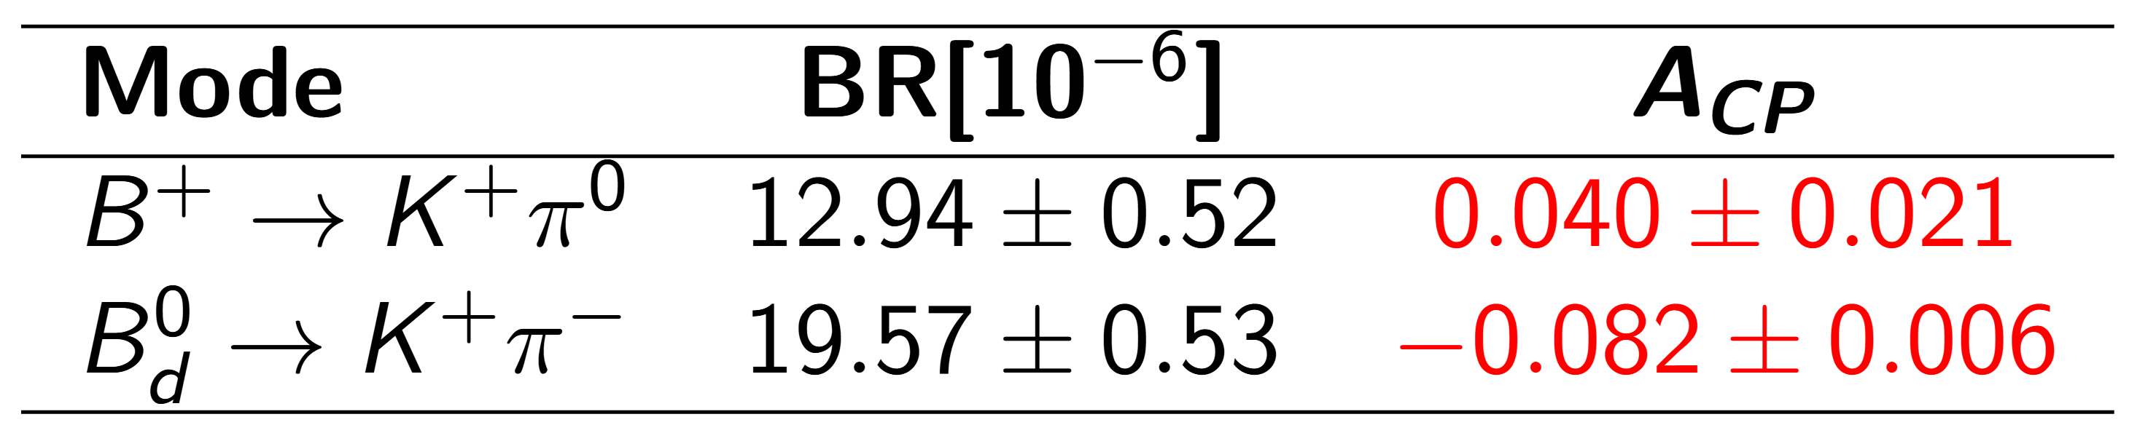
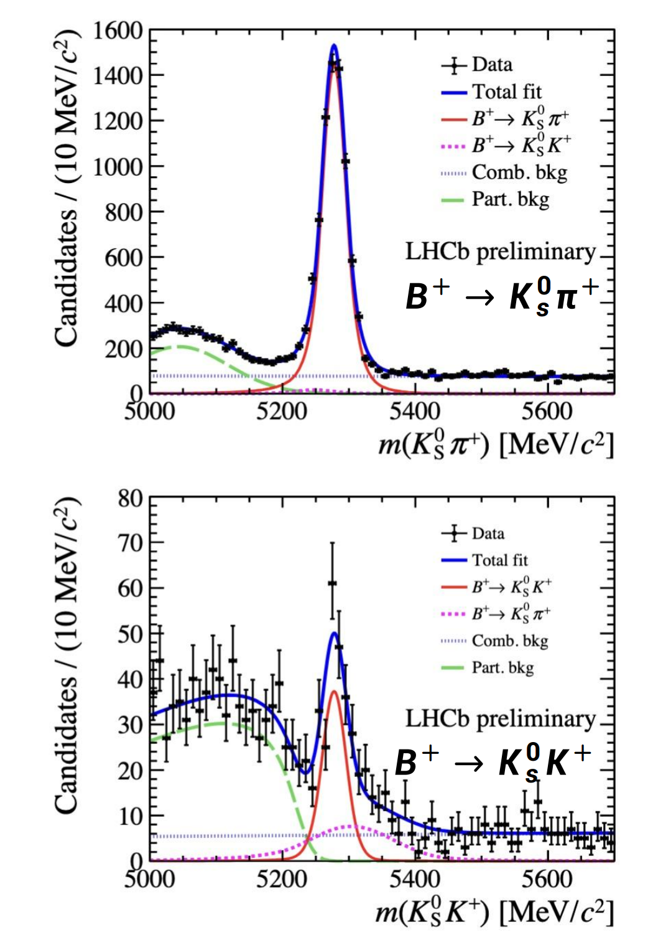
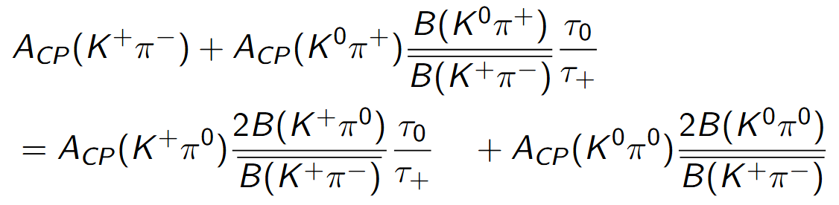
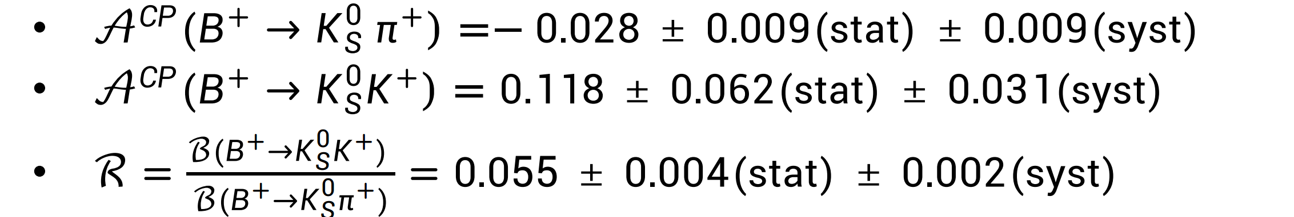

Study of decays $B→Kπ$
RESEARCH BACKGROUNDS
A long-standing anomaly associated with the significant differences between direct CP-violating
asymmetries observed in $B^{+}→K^{+}π^{0}$ decays.
[JHEP 01 (2018) 074]
In SM, the full isospin symmetry related to $B→Kπ$ decay reads:

Slide 17
Study of decays $B→Kπ$
RESEARCH BACKGROUNDS

Slide 18
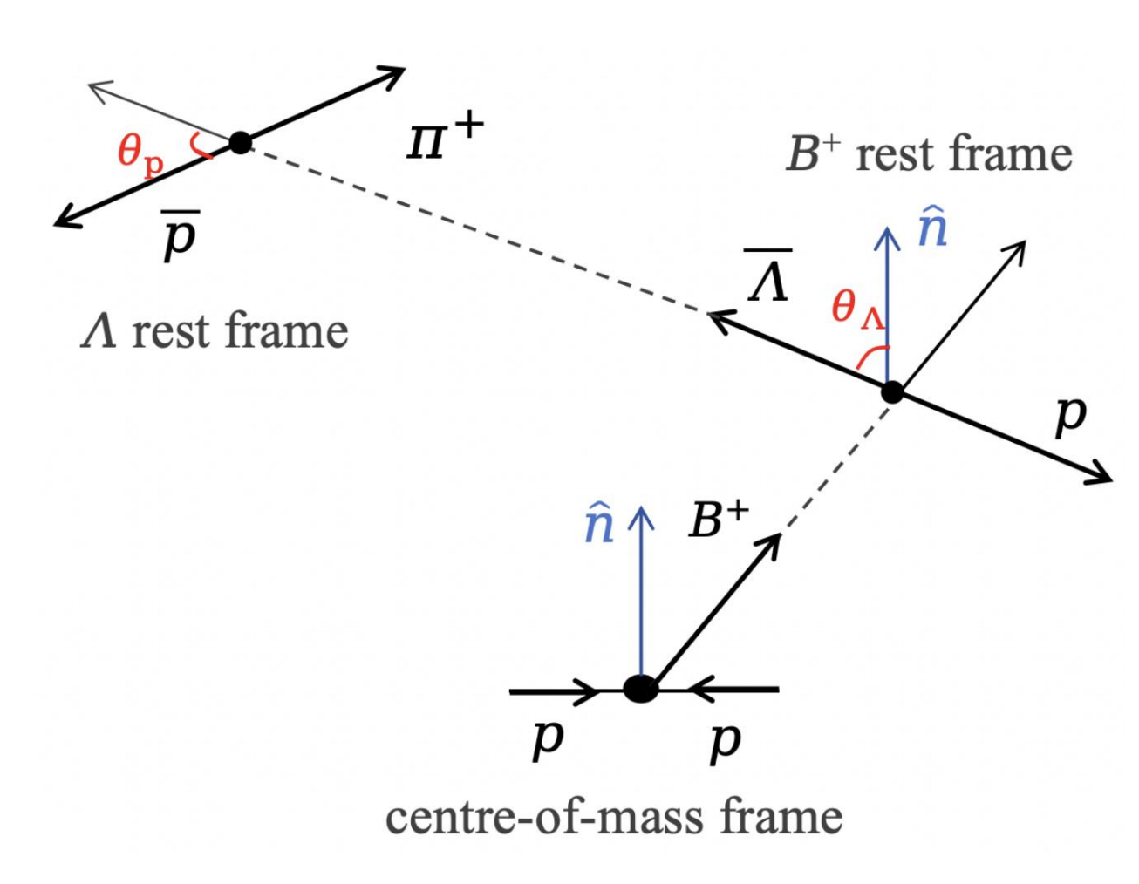
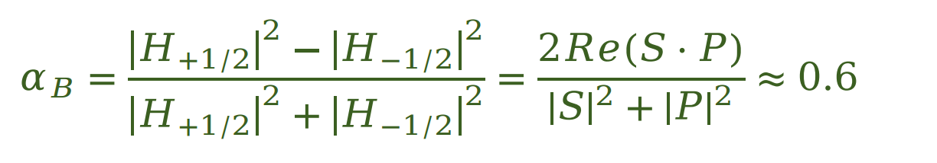
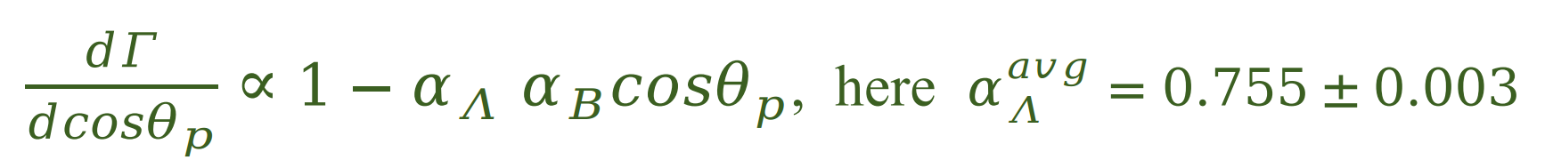
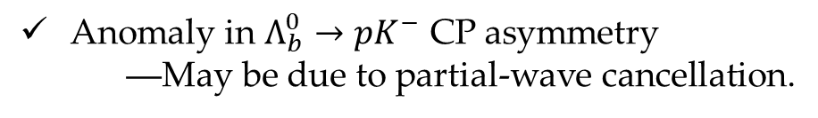

Study of decays $B^{+}→pΛ$
RESEARCH BACKGROUNDS
Anomaly in $Λ_{b}^{0}→pK^{−}$ CP asymmetry
―May be due to partial-wave cancellation.
PRL. 134290 (2025) 221801
A theoretical prediction for the CP asymmetry in $B^{+}→pΛ$
is up to 10%.[JHEP 03 (2021) 075]
―Could be suppressed by S-P wave cancellation?
Investigation of CP violation in the $B^{+}→pΛ$ decay rate and
angular distribution
[arxiv.2204.11058]

Slide 19
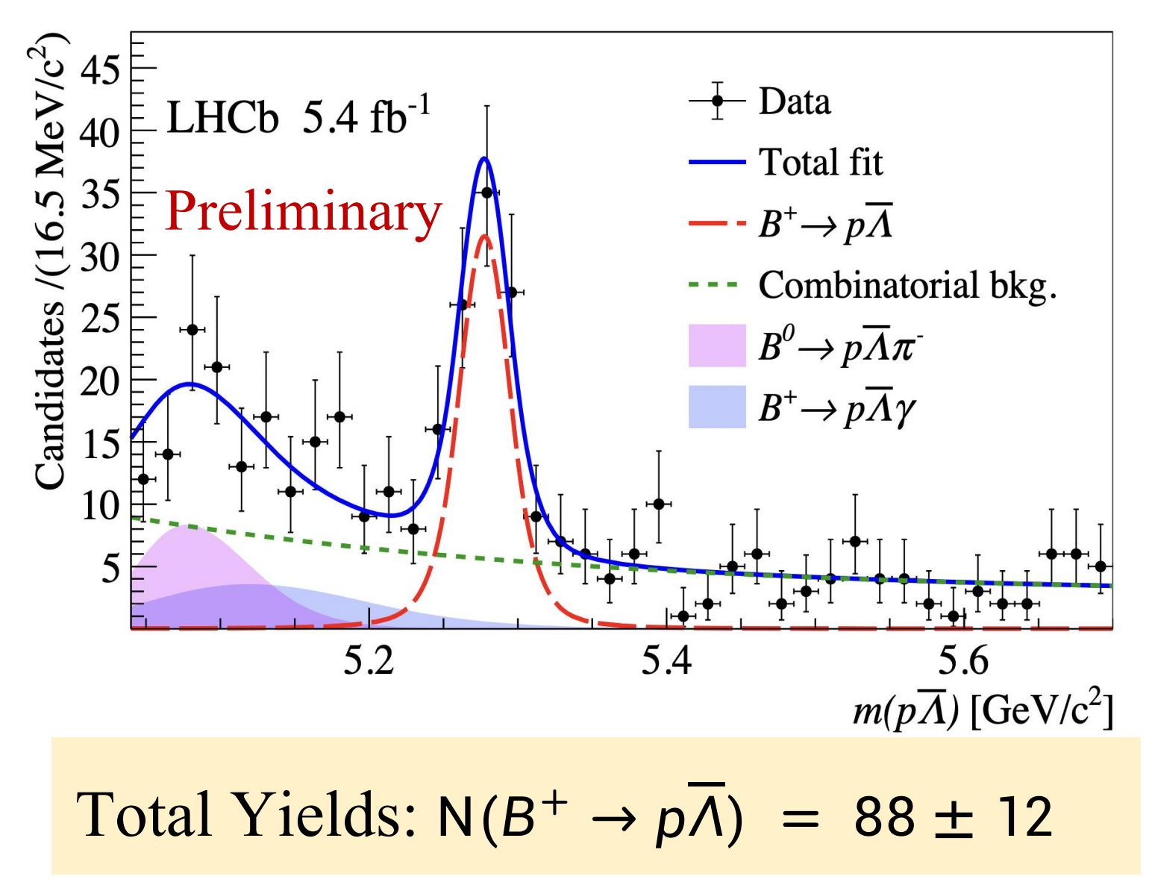
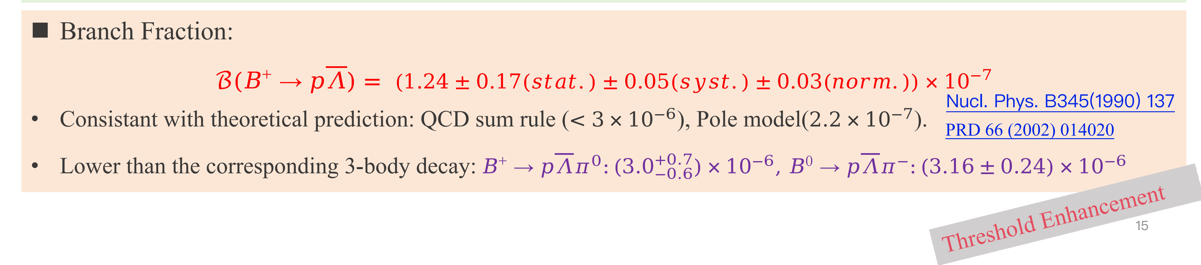
Study of decays $B→Kπ$
RESEARCH BACKGROUNDS

Slide 20
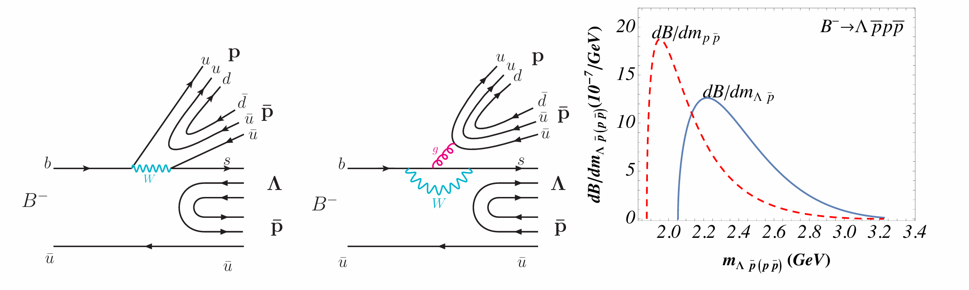

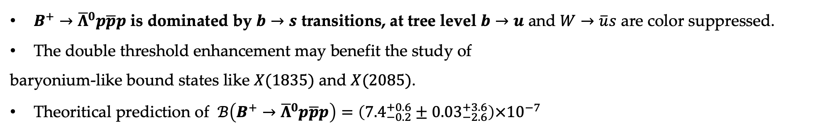
First observation of $B^{+}→{\overline{Λ}}^{0}p\overline{p}p$ decay
RESEARCH BACKGROUNDS
$B^{+}→{\overline{Λ}}^{0}p\overline{p}p$ is dominated by $b→s$ transitions, at tree level $b→u$ and $W→\overline{u}s$ are color suppressed.
The double threshold enhancement may benefit the study of
baryonium-like bound states like $X(1835)$ and $X(2085)$.
Theoritical prediction of $ℬ\left(B^{+}→{\overline{Λ}}^{0}p\overline{p}p\right)=\left({7.4}_{−0.2}^{+0.6}±{0.03}_{−2.6}^{+3.6}\right)×{10}^{−7}$
[PLB845(2023)138158]
PRL 88 (2003) 181803
arxiv.2508.16259

Slide 21
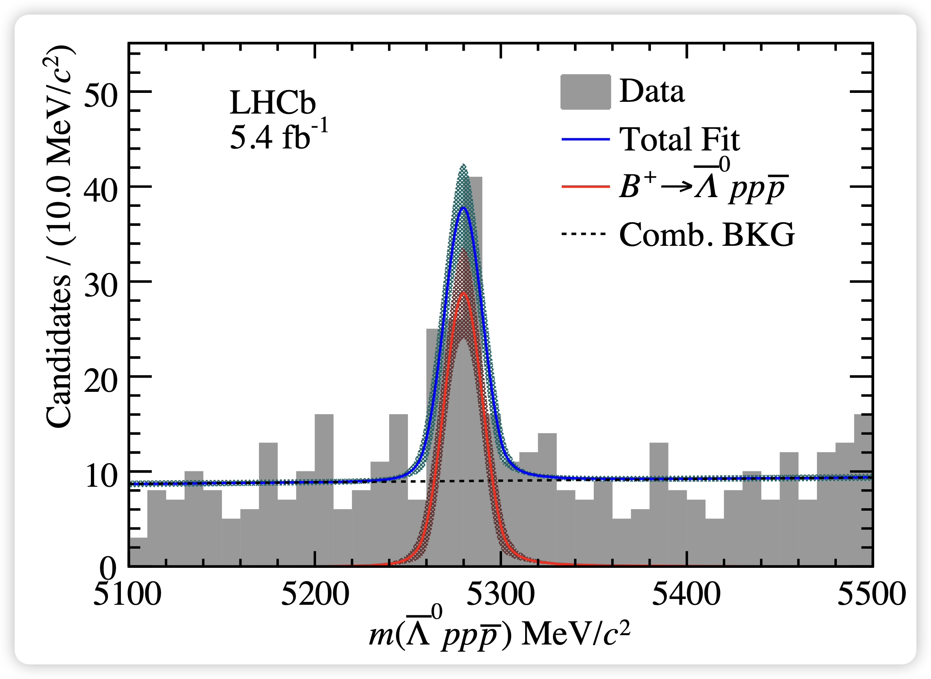
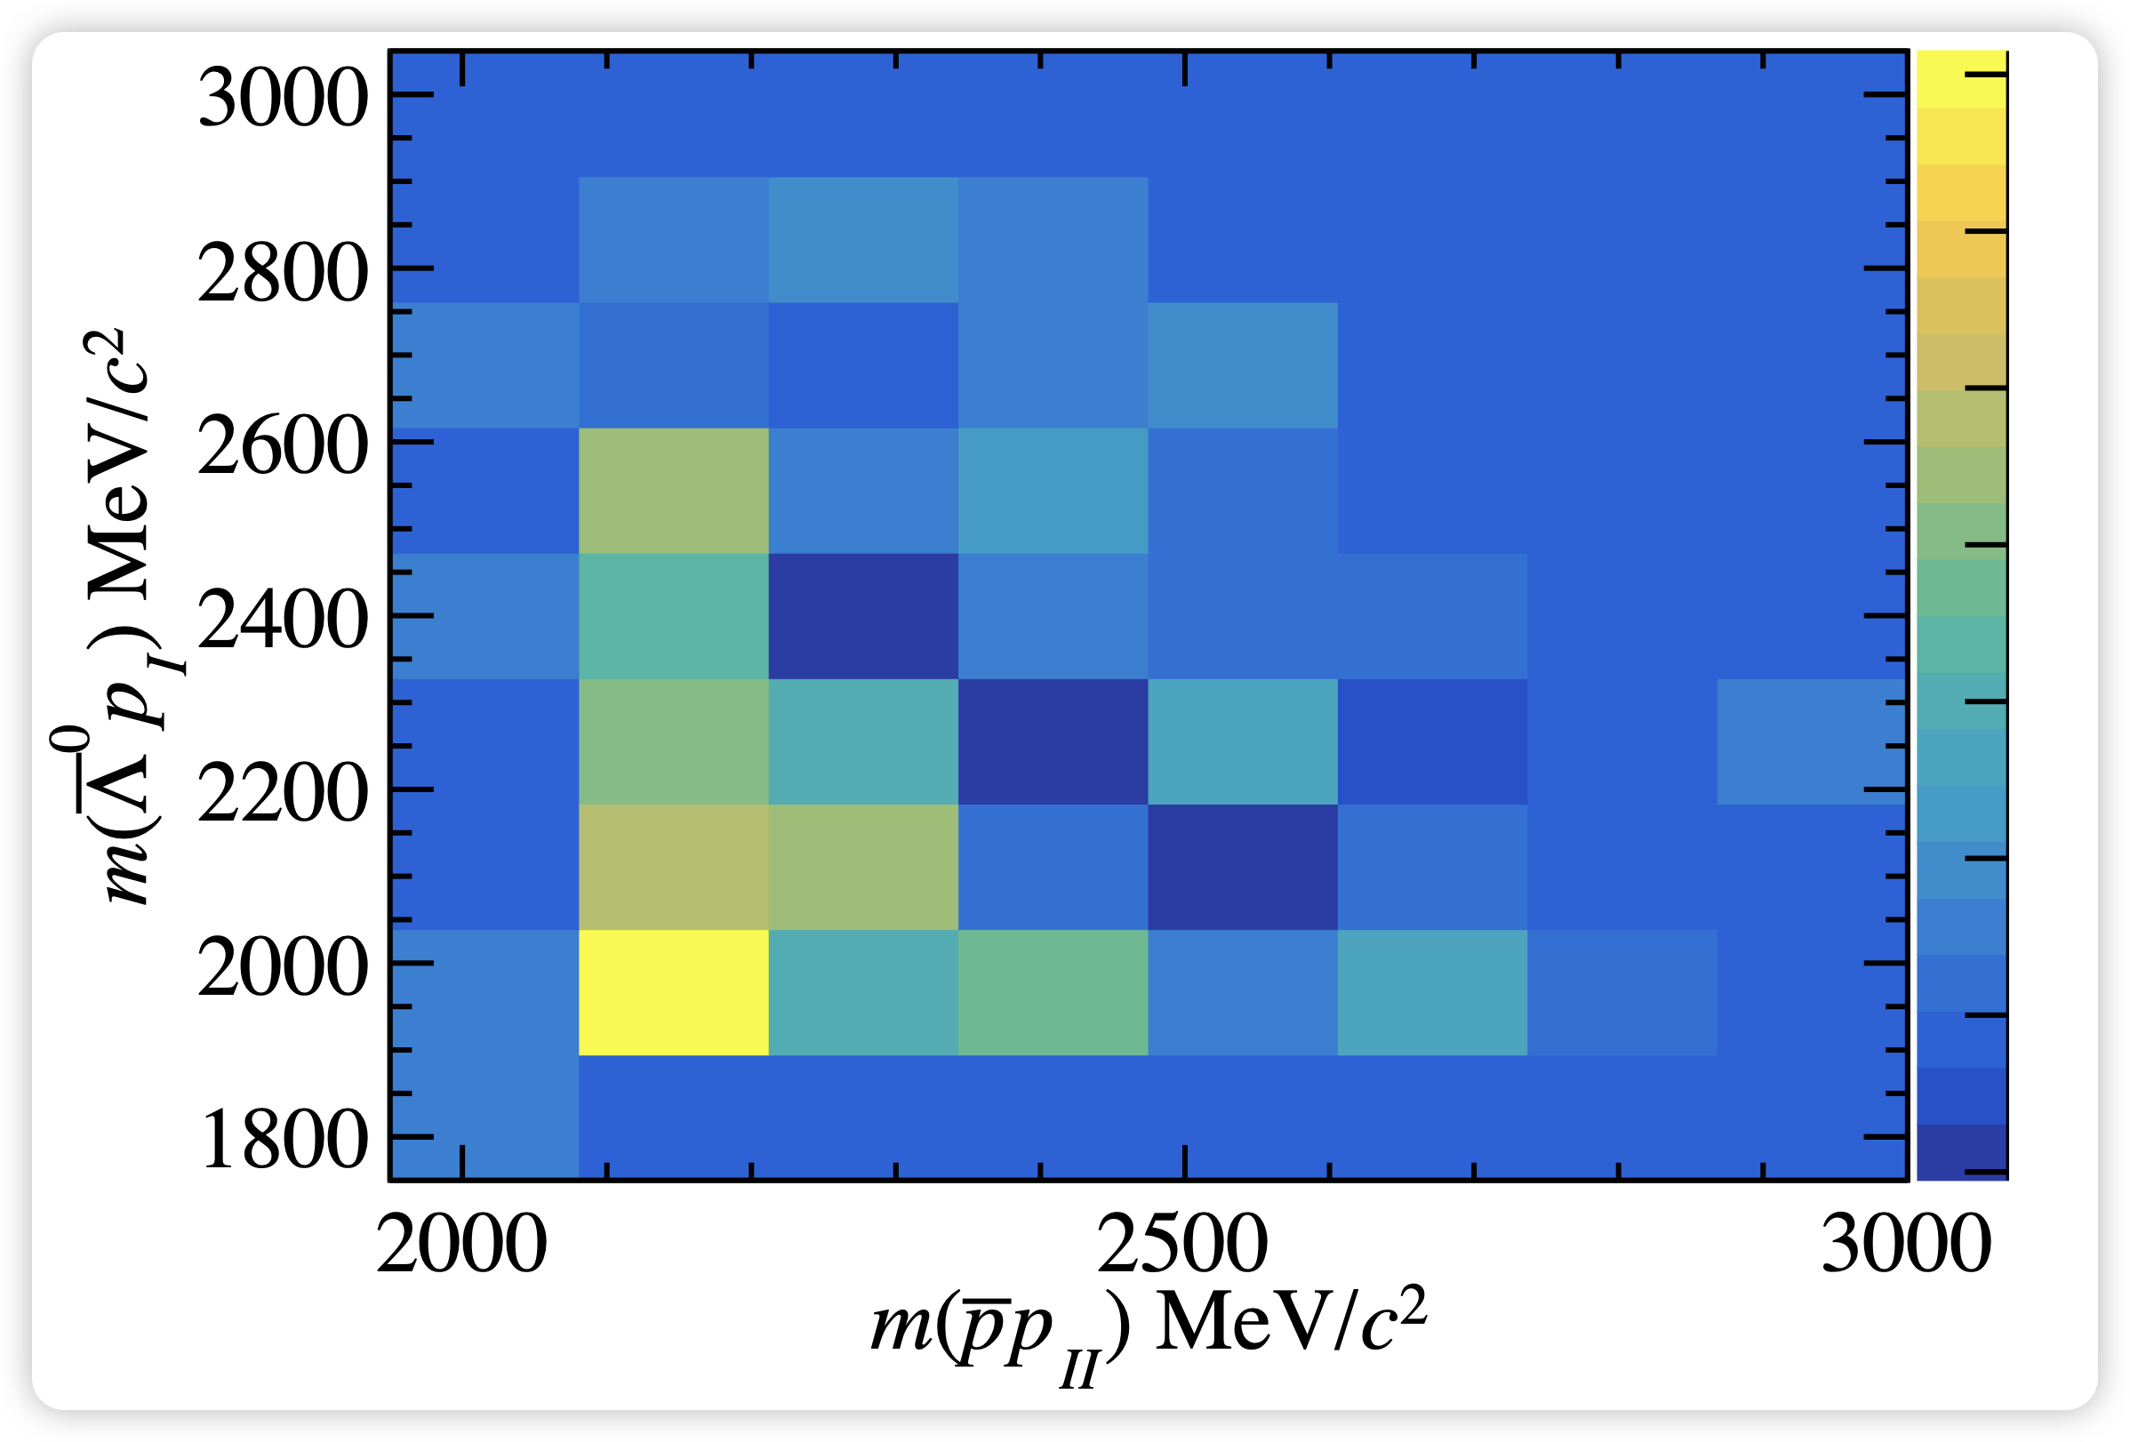

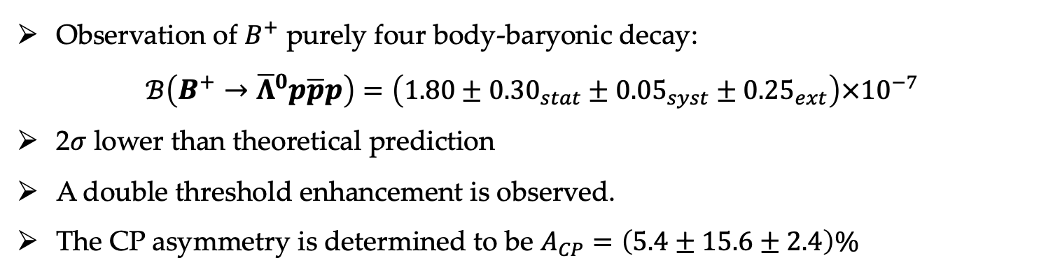
First observation of $B^{+}→{\overline{Λ}}^{0}p\overline{p}p$ decay
RESEARCH BACKGROUNDS
Observation of $B^{+}$ purely four body-baryonic decay:
$$ℬ\left(B^{+}→{\overline{Λ}}^{0}p\overline{p}p\right)=\left(1.80±{0.30}_{stat}±{0.05}_{syst}±{0.25}_{ext}\right)×{10}^{−7}$$
2$σ$ lower than theoretical prediction
A double threshold enhancement is observed.
The CP asymmetry is determined to be $A_{CP}=\left(5.4±15.6±2.4\right)\%$
arxiv.2508.16259
$$N\left(B^{+}→{\overline{Λ}}^{0}p\overline{p}p\right) = 78 ±12$$

Slide 22
3
VR decays

Slide 23
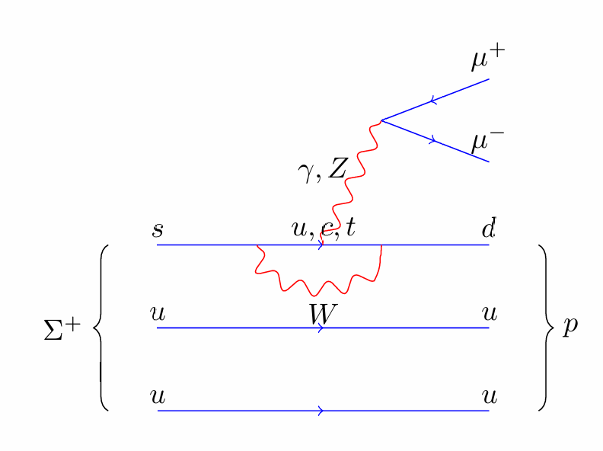
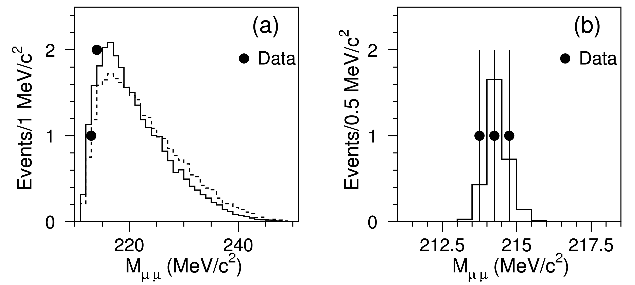
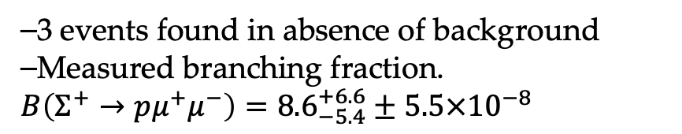


Search for $Σ^{+}→pμ^{+}μ^{−}$ decays
RESEARCH BACKGROUNDS
$Σ^{+}→pμ^{+}μ^{−}$ is a very rare decay mediated by $s→d$ transition
⎯Short-distance contribution(penguin/box diagrams) $B\sim 𝒪({10}^{−12})$
⎯Long-distance contributions (from the decay $Σ^{+}→ργ^{∗}$)
$1.28×{10}^{−8}<$ $B(Σ^{+}→pμ^{+}μ^{−}) < 7.8×{10}^{−8}$
[PRD72(2005) 074003]
[JHEP1810(2018)040]
[PRD111(2025)013003]
First evidence for $Σ^{+}→pμ^{+}μ^{−}$ decay was found by HyperCP (2005)
⎯3 events found in absence of background
⎯Measured branching fraction.
$B\left(Σ^{+}→pμ^{+}μ^{−}\right)={8.6}_{−5.4}^{+6.6}±5.5×{10}^{−8}$
PRL94(2005)021801
Evidence of $Σ^{+}→p{X^{0}(→μ}^{+}μ^{−})$ is also found with
$$m\left(X^{0}\right)=214.3±0.5MeV/c^{2}$$

Slide 24




Search for $Σ^{+}→pμ^{+}μ^{−}$ decays
RESEARCH BACKGROUNDS
Observe $Σ^{+}→pμ^{+}μ^{−}$decay using LHCb Run 2 data
$$N\left(Σ^{+}→pμ^{+}μ^{−}\right)=78±12$$
THIS IS THE RAREST BARYON DECAY EVER OBSERVED
Search for resonances in the dimuon invariant mass distribution , and no evidence of resonant structures found
HyperCP anomaly excluded
Distribution compatible with SM prediction

Slide 25



Search for $Λ_{c}^{+}→pμ^{+}μ^{−}$ decays
RESEARCH BACKGROUNDS
$Λ_{c}^{+}→pμ^{+}μ^{−}$ is a very rae FCNC + GIM mechanism
⎯Short-distance contribution(penguin/box diagrams) $B\sim 𝒪({10}^{−8})$
⎯Long-distance contributions $B\sim 𝒪({10}^{−8})$ from $Λ_{c}^{+}→pX(→μ^{+}μ^{−})$ where X=$η,ρ,ω,φ$
BSM contributions could enhance the expected BR, produce a non-zero forward-backward asymmetry or introduce additional sources of charge-parity (CP) asymmetry
Measure the BF of $Λ_{c}^{+}→pμ^{+}μ^{−}$ decay in 6 regions:
resonant($η,ρ,ω,φ$) and non-resonant(low-mass and high mass)
arxiv.2407.11474

Slide 26


Search for $Λ_{c}^{+}→pμ^{+}μ^{−}$ decays
RESEARCH BACKGROUNDS
Observe $Λ_{c}^{+}→pX(→μ^{+}μ^{−})$ decay for X=$ω,ρ,η$ with $>7σ$, $>5σ,$ $>3σ$ significance
arxiv.2407.11474

Slide 27


CP asymmetries in $Λ_{c}^{+}→pμ^{+}μ^{−}$ decays
RESEARCH BACKGROUNDS
arxiv.2502.04013

Slide 28









Search for LFV decays
RESEARCH BACKGROUNDS
Any observation of a charged LFV decay would provide clear evidence for physics beyond the SM
Phys. Rev. D110 (2024) 7
Search for rare decay $B_{s}^{0}→φμτ$
The first limit on this LFV decay
$$ℬ\left(B_{s}^{0}→φμ^{+}τ^{−}\right)<1.0×{10}^{−5}at 90\%CL,$$
$$ℬ\left(B_{s}^{0}→φμ^{+}τ^{−}\right)<1.1×{10}^{−5}at 95\%CL.$$
Search for rare decay $B^{0}→K^{∗0}τ^{±}e^{∓}$
Mass re-fitted including missing neutrino momentum and kinematic constraints
the most stringent upper limits placed on
$b → sτe$transitions
arxiv.2506.15347

Slide 29




Search for LFV decays
RESEARCH BACKGROUNDS
LFV decay strongly suppressed in SM + 𝜈 oscillations: ℬ(𝜏→𝜇𝜇𝜇) ∼${10}^{−55}$ [Eur. Phys. J. C (2020) 80:506]，Observation of this decay will be a clear sign of new physics
Set upper limit on the BF
●constrain theories of physics beyond the SM
●including 𝑍 or leptoquarks, heavy neutrinos…
[PRD 92, 054013, PRD 94, 115021], predicting ℬ(𝜏→𝜇𝜇𝜇) ∼𝒪(10⁻¹⁰ −10⁻⁷ )

Slide 30



Search for B meson 0νββ decay
RESEARCH BACKGROUNDS
• Standard Model thinks of neutrinos as Dirac particles
• Majorana nature of neutrinos can be tested with neutrinoless double $β$ decay (0νββ)
• B mesons can decay in the 0νββ mode
• Sensitivity to intermediate mass non-standard sterile neutrinos

Slide 31


Search for B meson 0νββ decay
RESEARCH BACKGROUNDS

Slide 32
4
Prospects & Conclusions

Slide 33


Luminosity
RESEARCH BACKGROUNDS
Running Condition
•Run 1: 2011+2012, 7, 8 TeV •Run 2: 2015-2018, 13 TeV
•Run 3: 2022-2026, 13.6 TeV
Run3 data taking ongoing!
๏ Run 1(2011+2012): 3 ${fb}^{−1}$+ Run 2 (2015-2018): 6 ${fb}^{−1}$
๏ 2024: 9.6 ${fb}^{−1}$
๏ 2025: 11.0 ${fb}^{−1}$ as of last week
A lot of data will contribute to
Physics!

Slide 34



Prospects of LHCb physics
RESEARCH BACKGROUNDS
• Run 3 data-taking with Upgrade I LHCb detector ongoing
―×5 luminosity in pp wrt Run 2
―Expect to accumulate 23 ${fb}^{−1}$ data in Run3
• Phase II Upgrade for Run 5 proposed
―Huge increase in sample size expected - stay tuned

Slide 35
Summary
RESEARCH BACKGROUNDS
๏ The LHCb experiment marked a new era for rare B decays
• Very large yields allowing more and more sophisticated analyses
• Persistent anomaly in decays under scrutiny
Run3 data from LHCb is beginning to be analysed.
❏ The volume of data in recorded so far in Run3 is massive.

Slide 36





What could be expected after upgrades?
RESEARCH BACKGROUNDS
▶ More data than the expectation luminosity of Run 1 & 2 in 2024!
The gain maybe $\sim 2×$ due to removal of hardware trigger
e.g. Replacing TT → SCIFI allow to probe the invisible using SCIFI-only tracking

Slide 37


Search for NP in charged current decays
RESEARCH BACKGROUNDS

Slide 38



Connection between b→cℓν and b→s ℓ+ℓ– ?
RESEARCH BACKGROUNDS

Slide 39




Search for b→s 𝜏⁺ 𝜏– decays
RESEARCH BACKGROUNDS
● No signal is observed, UL is
set as
● Improves by approx a factor ✖10
the recent best limit from Belle
[arxiv: 2504.10042]

