Slide 1
Weekly Report
Minghao Li 2025.10.21

Slide 2
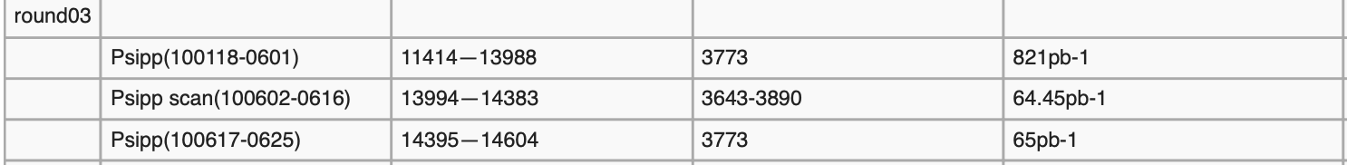

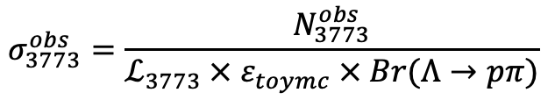
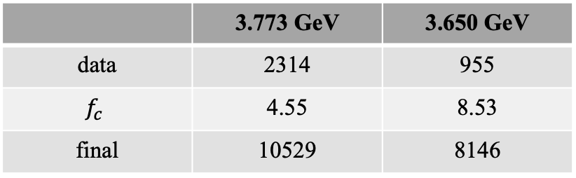
$$ψ\left(3686\right)→pK^{−}\overline{Λ}+c.c.$$
p12, L4: we can see your factor is 8.89, so the subtraction may introduce larger statistical error. so what about using the 3.77 GeV data?
 | 3.773 GeV | 3.650 GeV
data | 2314 | 955
$$f_{c}$$ | 4.55 | 8.53
final | 10529 | 8146
$$σ_{3773}^{obs}=\frac{N_{3773}^{obs}}{ℒ_{3773} × ε_{toymc} × Br(Λ→pπ)}$$
(1)
$$N_{bak}^{obs}=σ_{3773}^{obs} × ℒ_{3686}$$
(2)

Slide 3


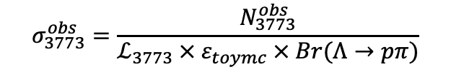

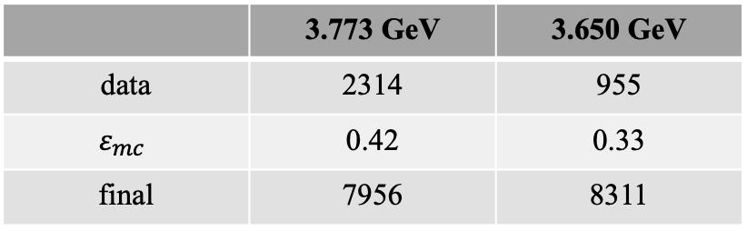

$$ψ\left(3686\right)→pK^{−}\overline{Λ}+c.c.$$
p12, L4: we can see your factor is 8.89, so the subtraction may introduce larger statistical error. so what about using the 3.77 GeV data?
$$σ_{3773}^{obs}=\frac{N_{3773}^{obs}}{ℒ_{3773} × ε_{toymc} × Br(Λ→pπ)}$$
(1)
$N_{bak}^{obs}=\frac{N_{3773}^{obs}}{ℒ_{3773} × ε_{3773mc}}× ℒ_{3686}$ $×$ $ε_{3686mc}$
$N_{bak}^{obs}=σ_{3773}^{obs} × ℒ_{3686}$ $×$ $ε_{toymc} × Br(Λ→pπ)$
(2)
 | 3.773 GeV | 3.650 GeV
data | 2314 | 955
$$ε_{mc}$$ | 0.42 | 0.33
final | 7956 | 8311
$ℒ_{3686}=3877 {pb}^{−1}$
$ℒ_{3773}=886 {pb}^{−1}$
$ℒ_{3650}=445.5 {pb}^{−1}$

Slide 4



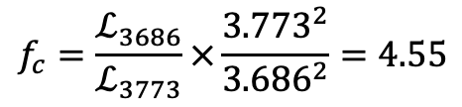
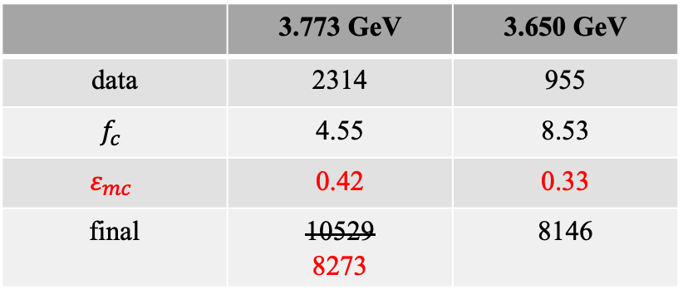
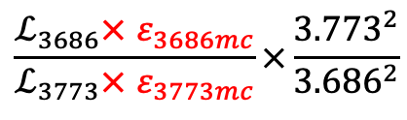
$$ψ\left(3686\right)→pK^{−}\overline{Λ}+c.c.$$
p12, L4: we can see your factor is 8.89, so the subtraction may introduce larger statistical error. so what about using the 3.77 GeV data?
$$f_{c}=\frac{ℒ_{3686}}{ℒ_{3773}}×\frac{{3.773}^{2}}{{3.686}^{2}}=4.55$$
$ℒ_{3686}=3877 {pb}^{−1}$
$ℒ_{3773}=886 {pb}^{−1}$
$ℒ_{3650}=445.5 {pb}^{−1}$
$$\frac{ℒ_{3686}× ε_{3686mc}}{ℒ_{3773}× ε_{3773mc}}×\frac{{3.773}^{2}}{{3.686}^{2}}$$
 | 3.773 GeV | 3.650 GeV
data | 2314 | 955
$$f_{c}$$ | 4.55 | 8.53
$$ε_{mc}$$ | 0.42 | 0.33
final | 10529 8273 | 8146

Slide 5
$$ψ\left(3686\right)→pK^{−}\overline{Λ}+c.c.$$
Next to do
Preparing Prof. Zhao's question and updated the memo.
Read articles to prepare for writing the draft.
Engaged in the BESIII shift at this week.
Discuss with Prof. Guo and carry out research on new physics.

